Slide 1
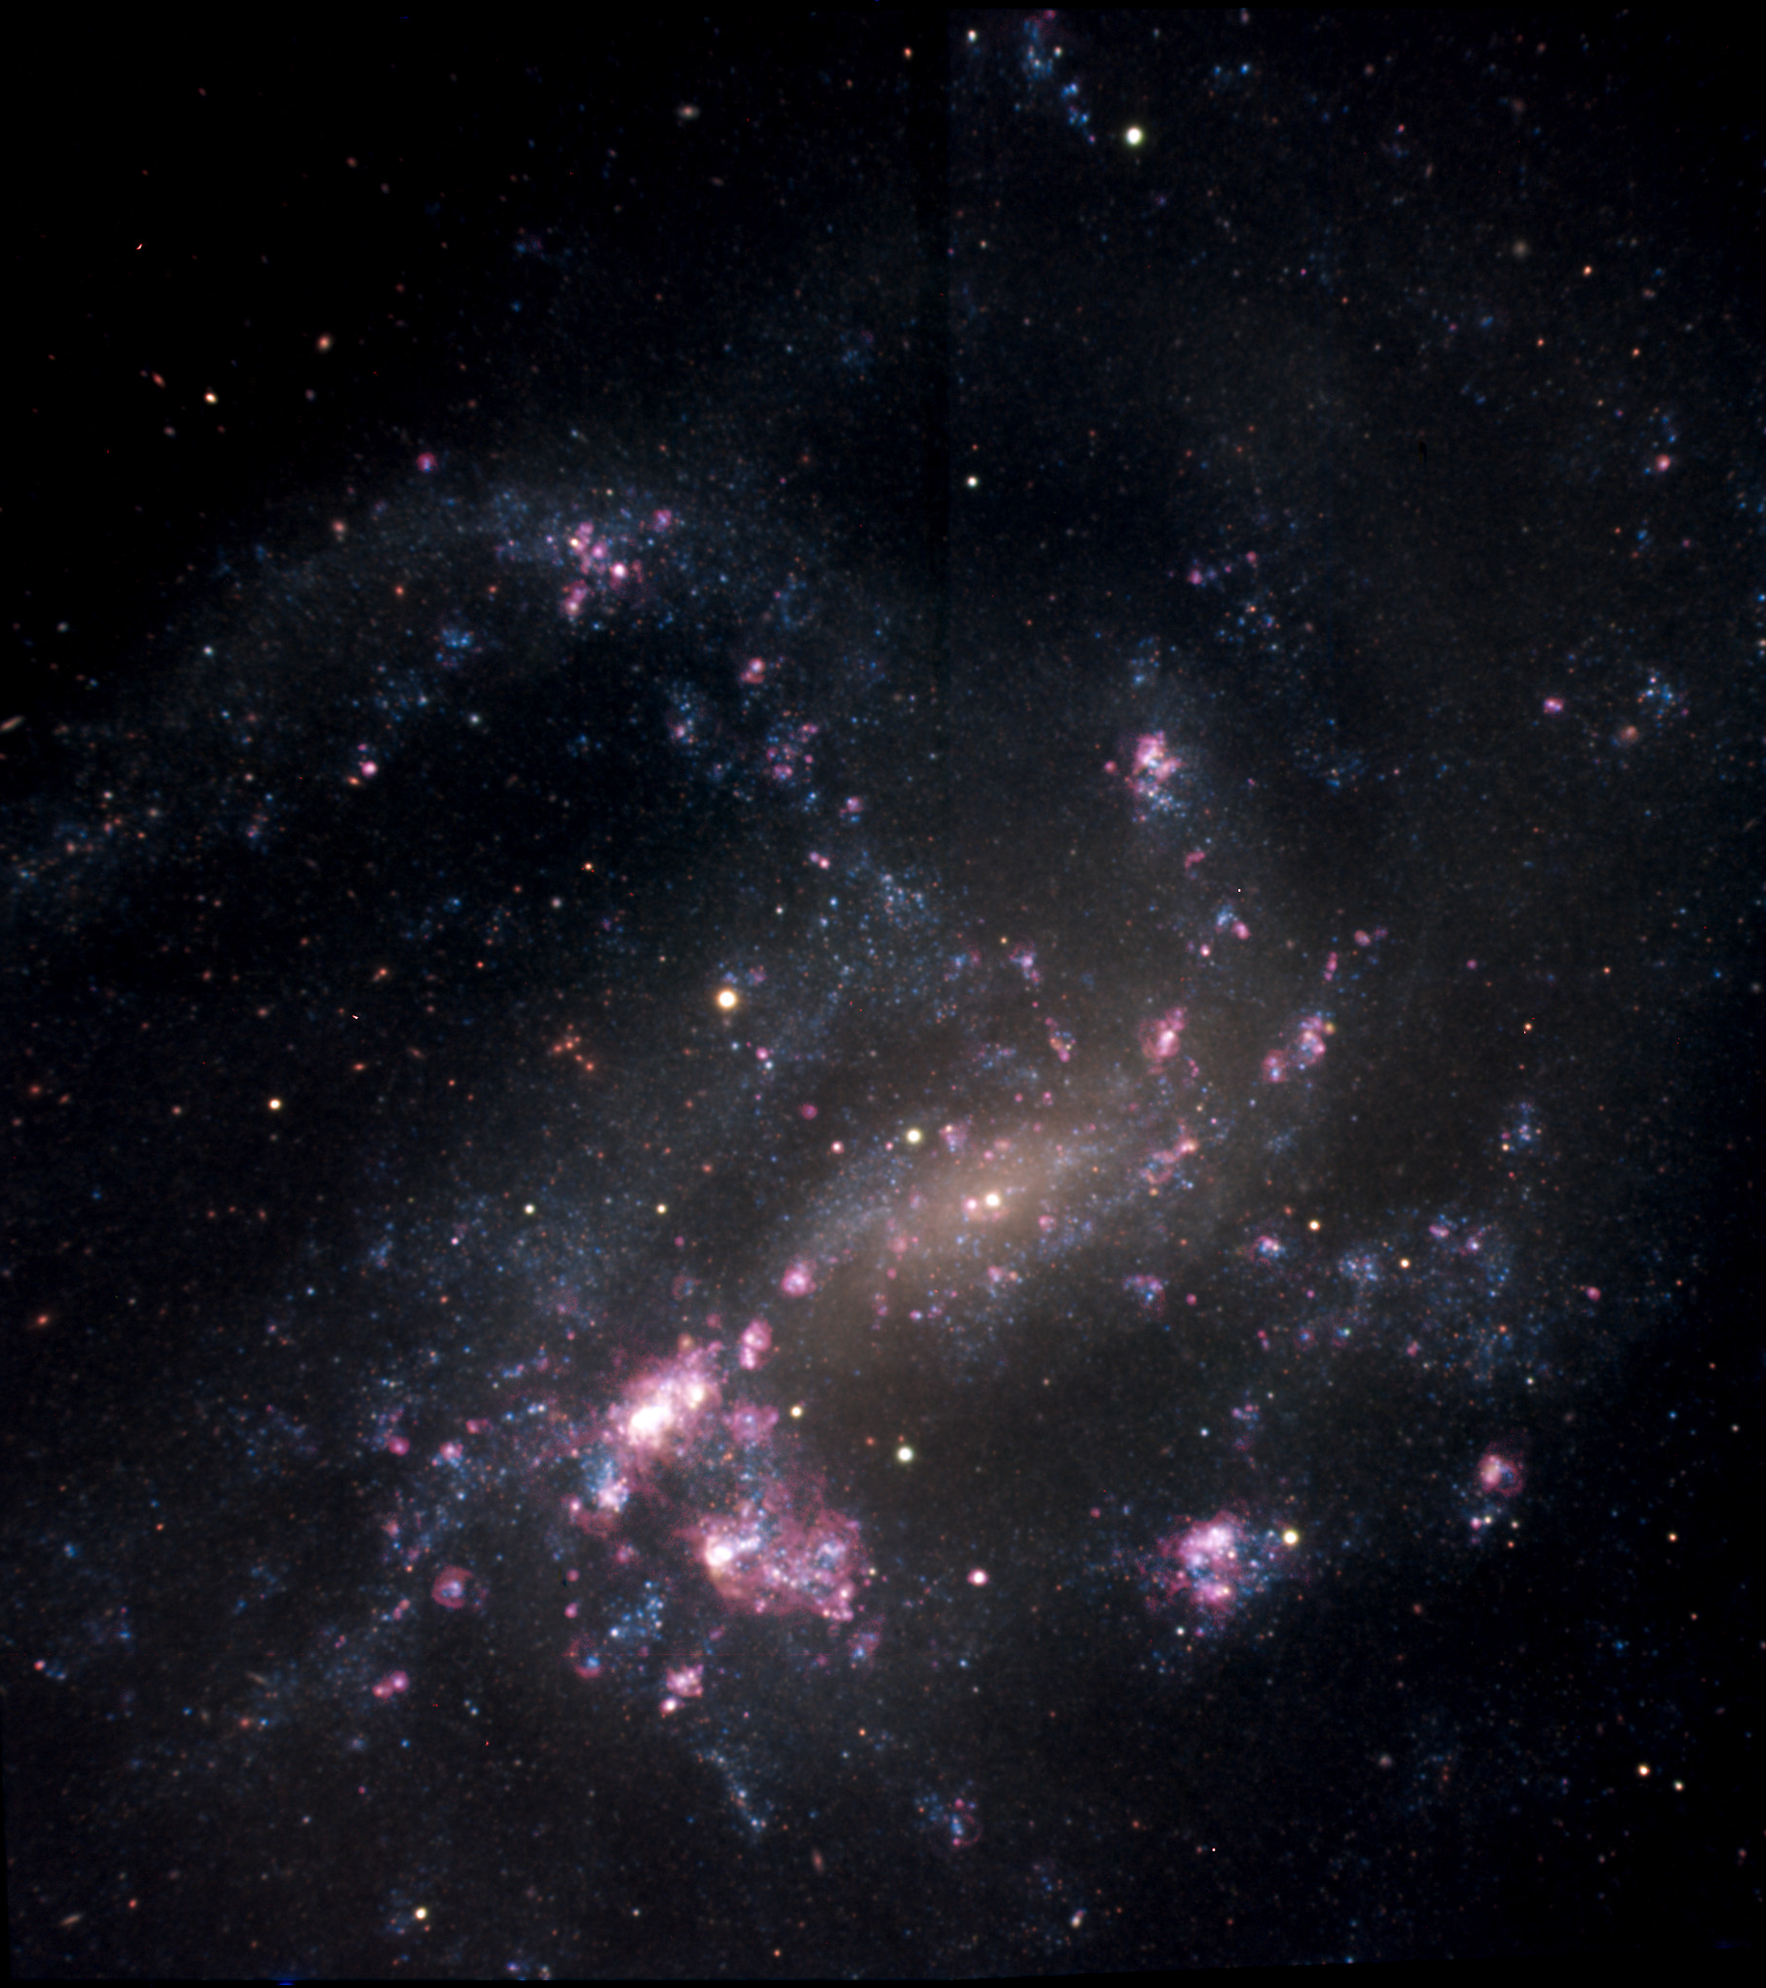
The HII Regions of NGC 4395 from the SIGNALS Survey
Mykola Posternak
Supervised by Carmelle Robert and Laurent Drissen

Slide 2
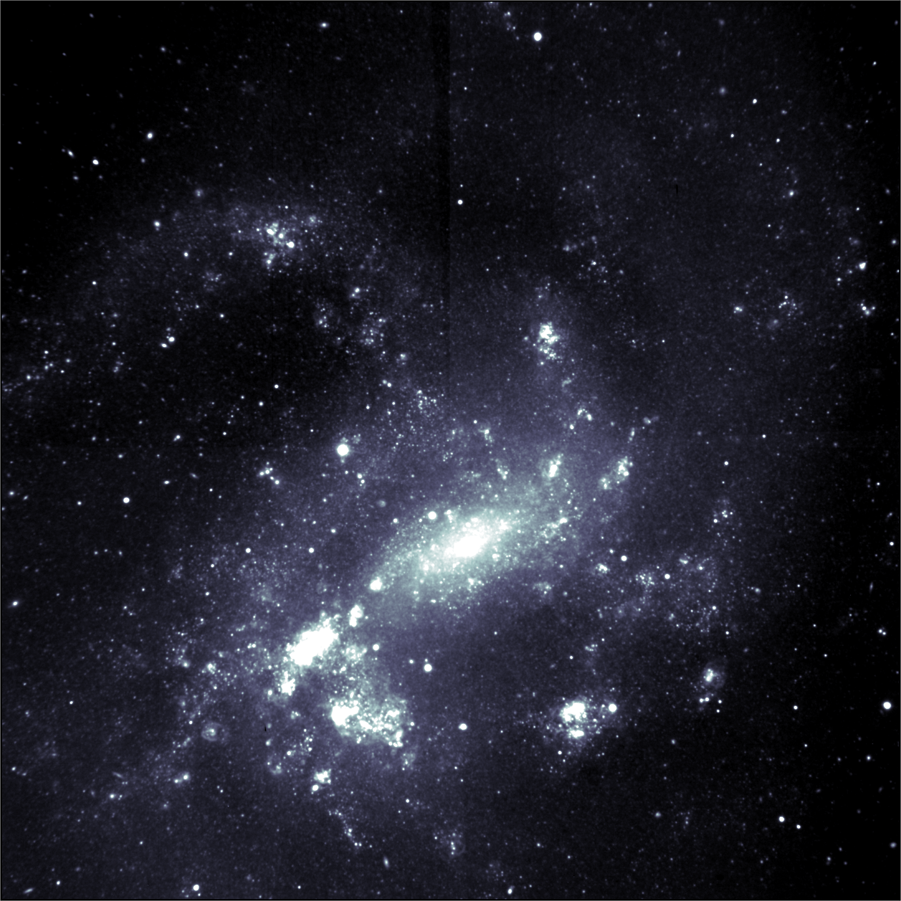
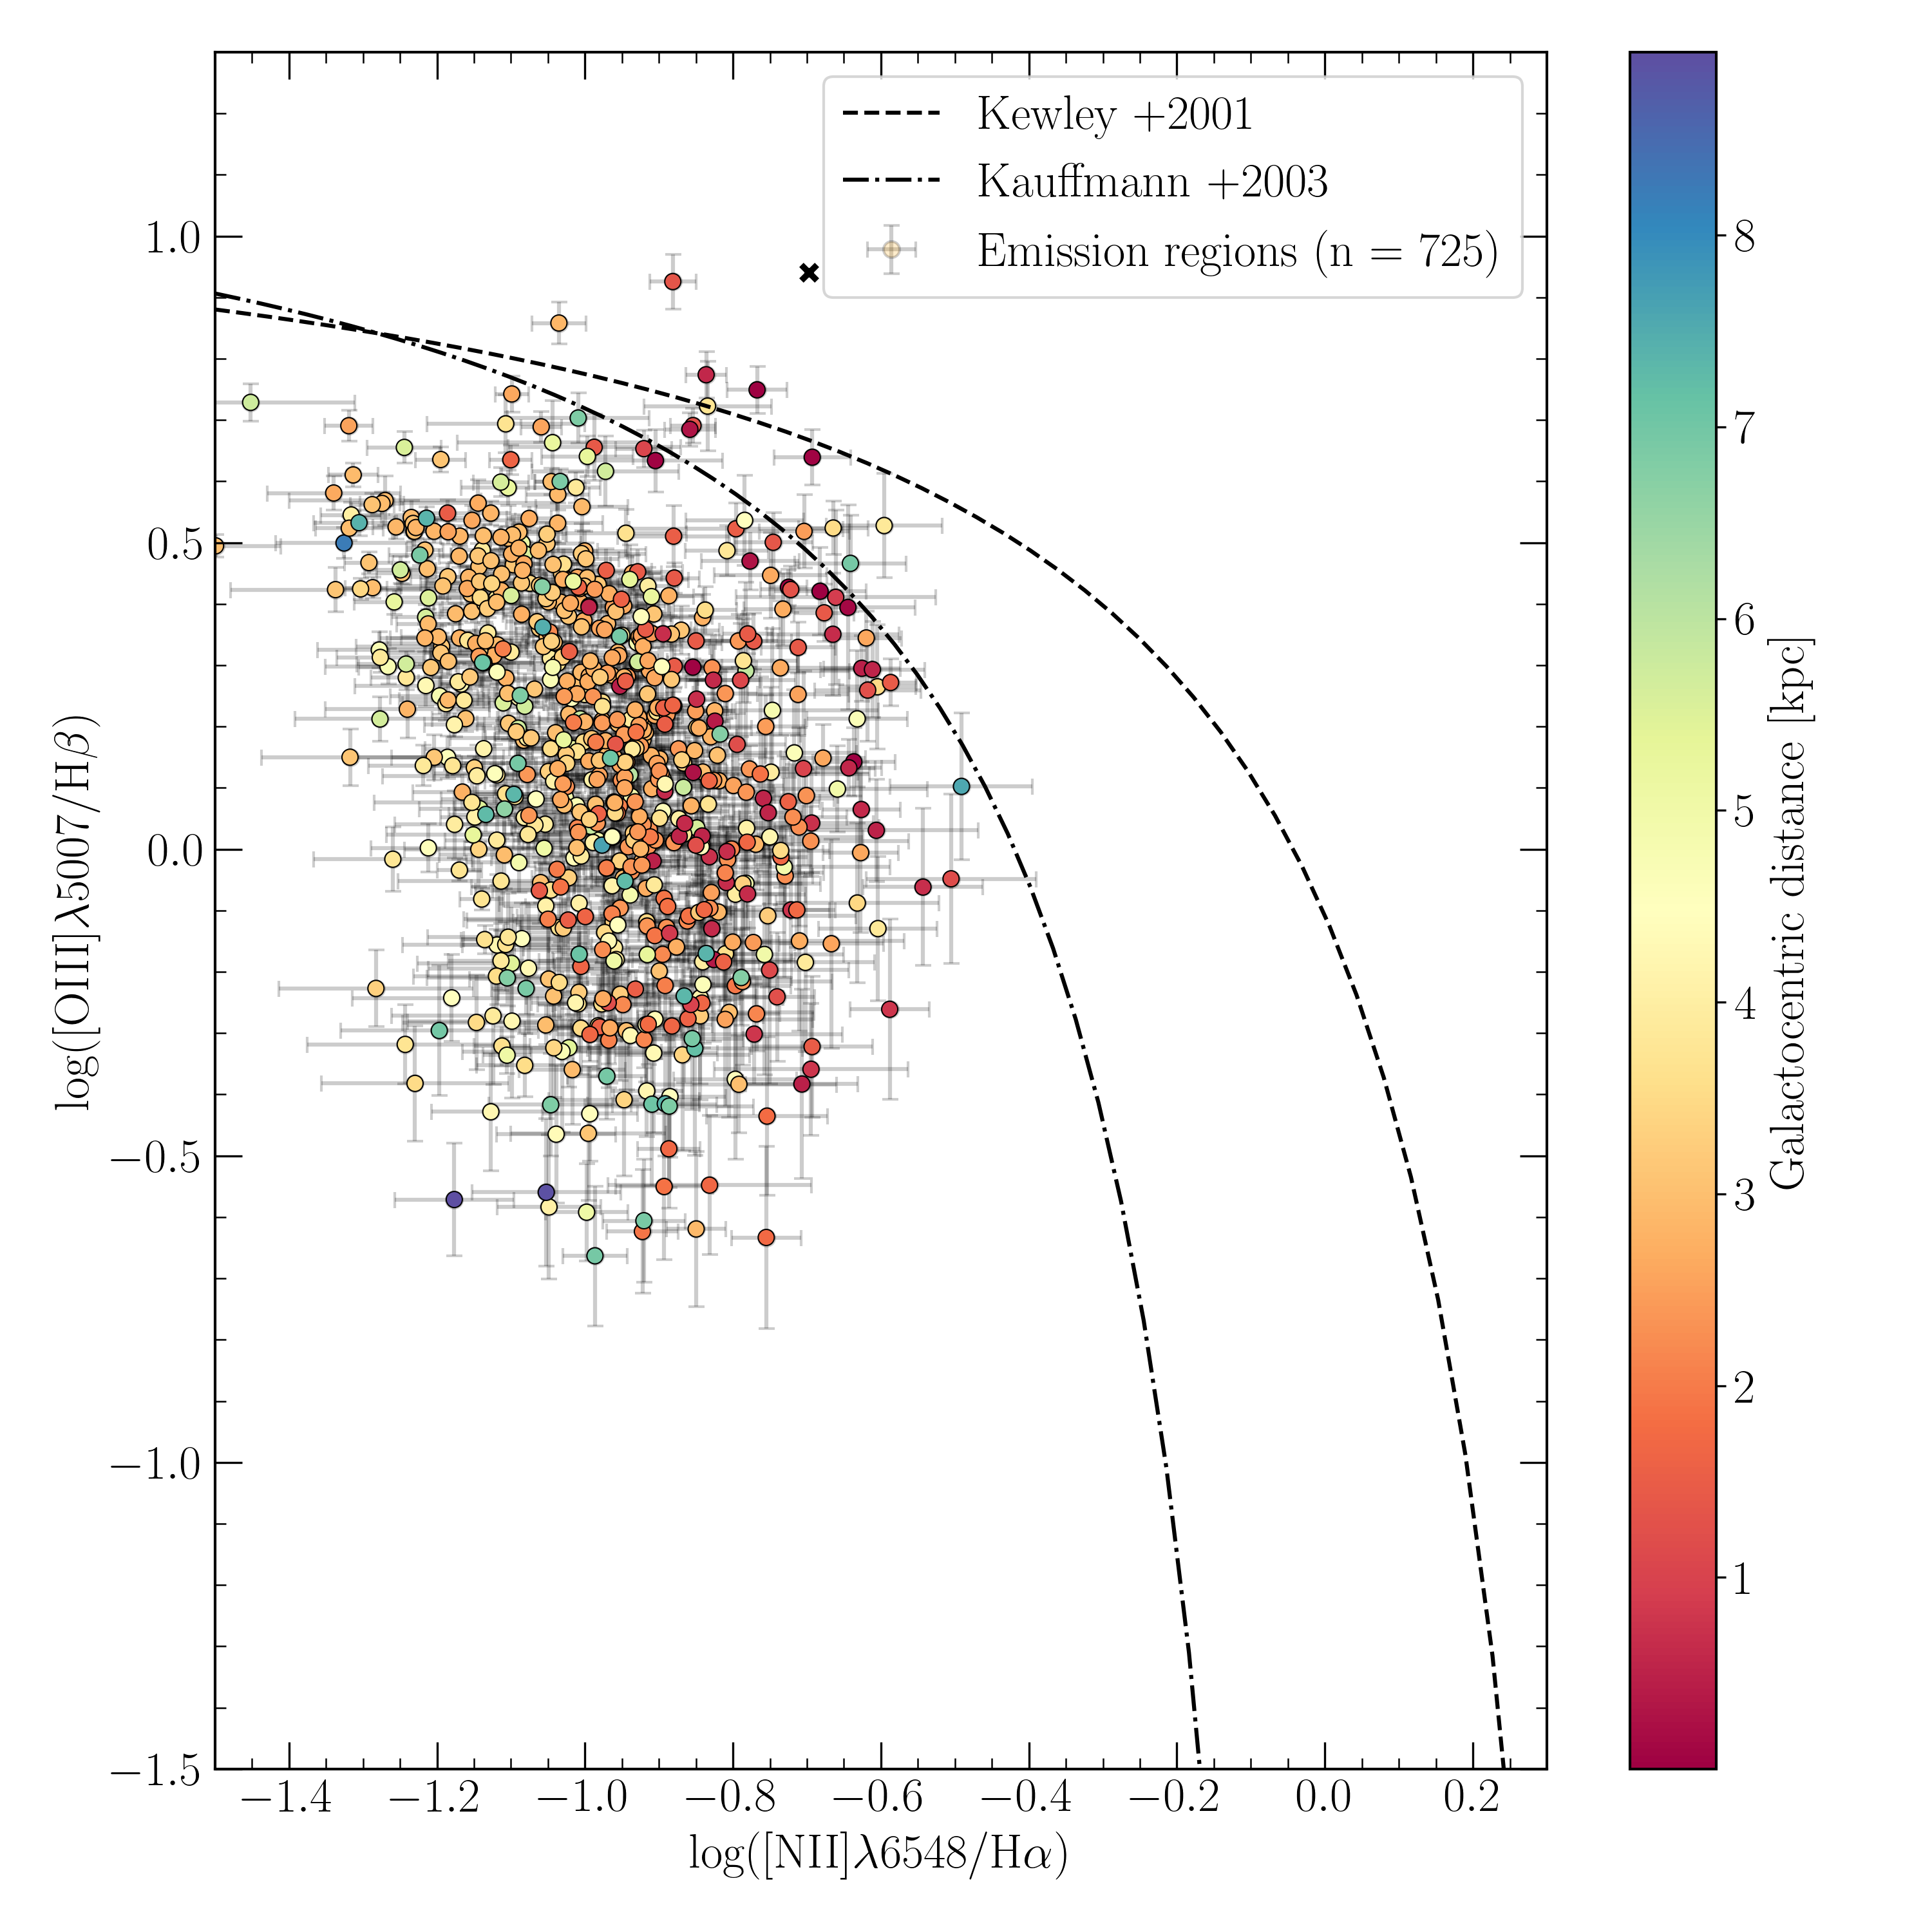
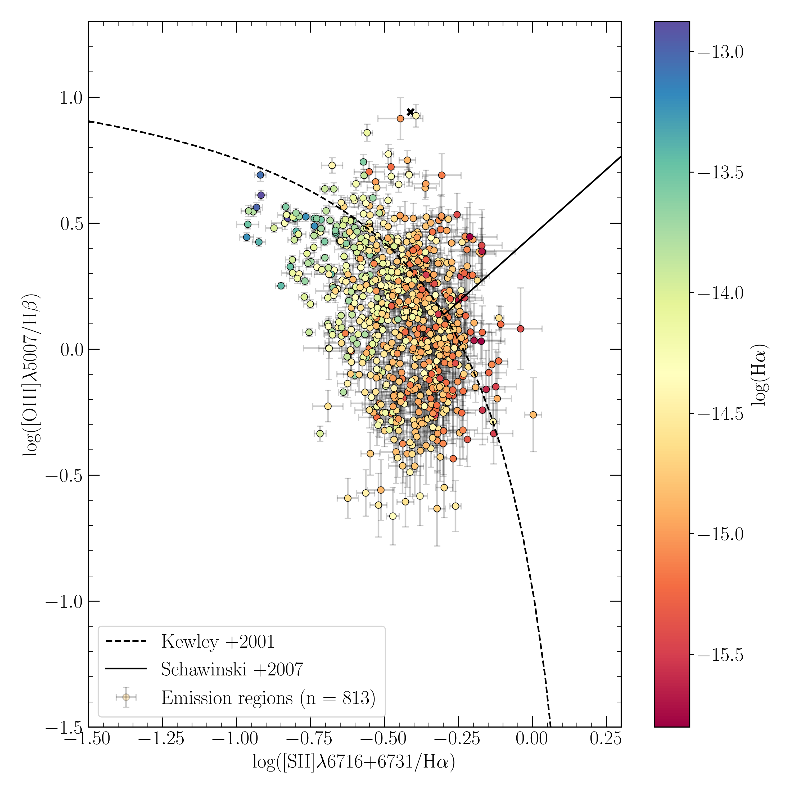
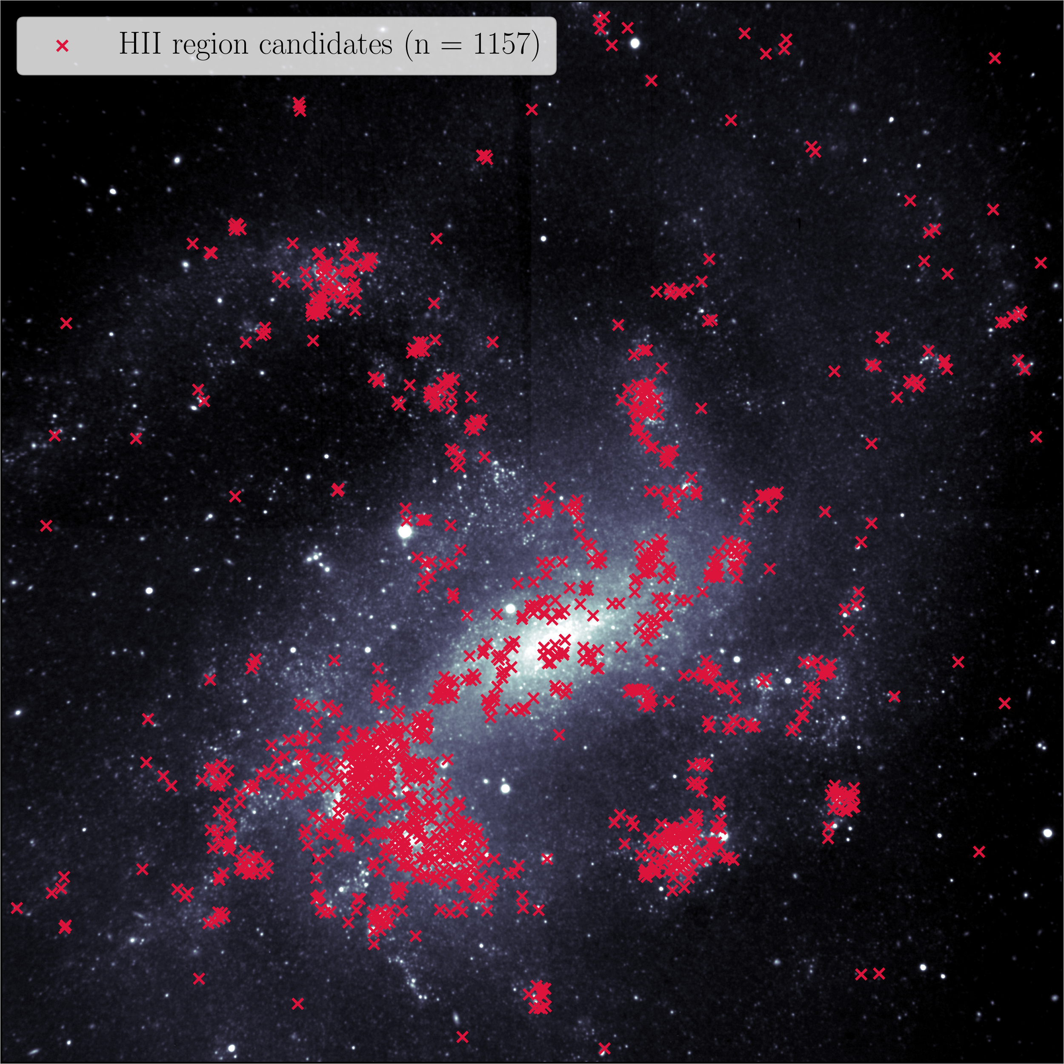
1157 HII region candidates
Measurement of the abundance and metallicity gradient
Definition of emission domain using Monte Carlo simulation
Calculation of star-formation rate
Construction of the HII region Hα luminosity function

