Slide 1
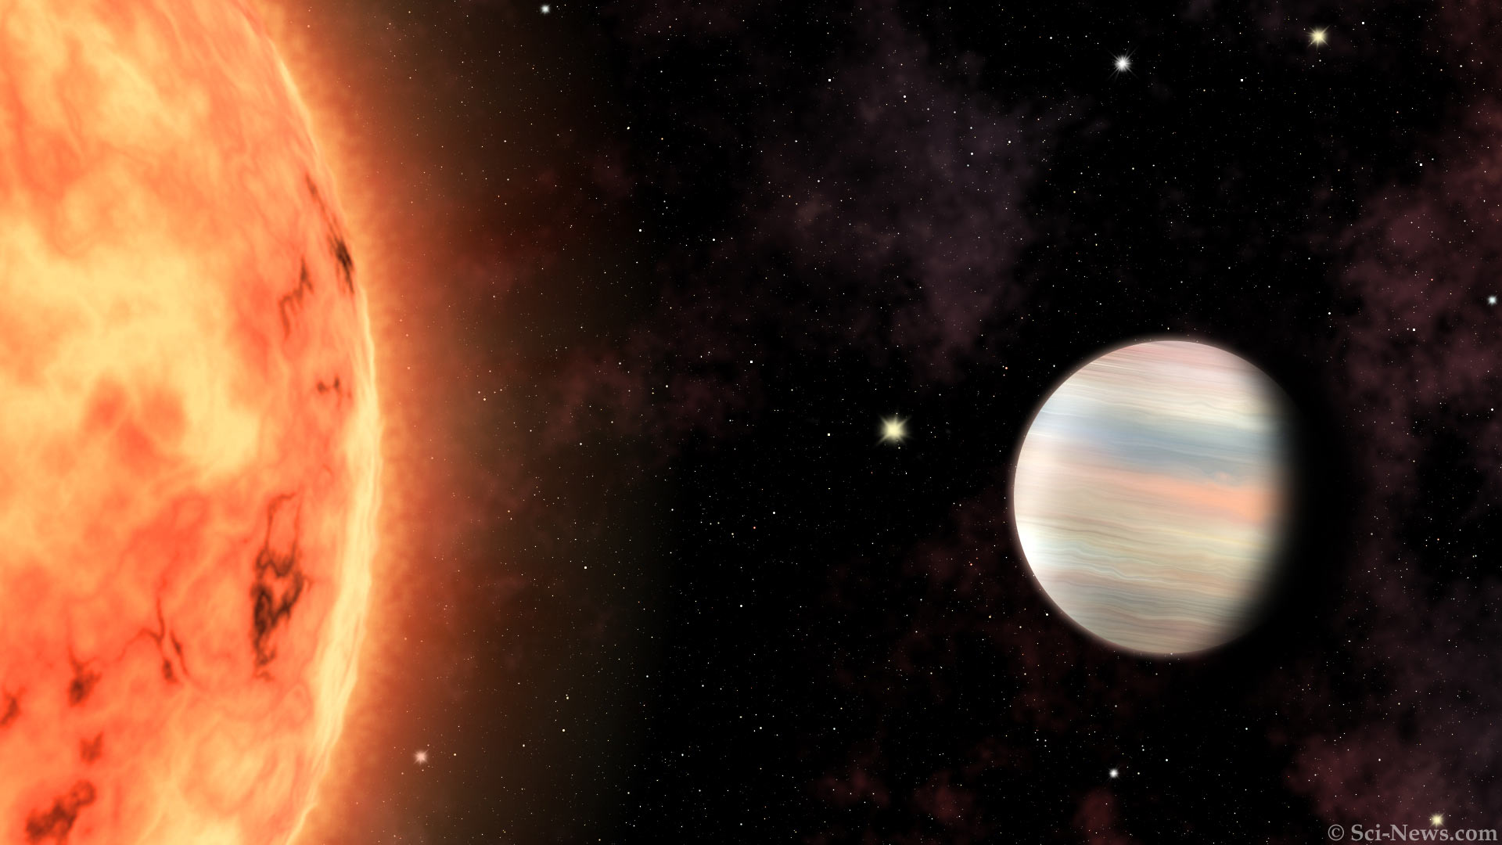

Bridging the gap between theory and observation
Interpreting the transmission signatures of the ultra-hot Jupiter WASP-121b with global circulation models and 3D radiative transfer
image credit:
sci-news.com
Joost P. Wardenier
Trottier Postdoctoral Fellow | iREx, Université de Montréal
joost.wardenier@umontreal.ca

Slide 2
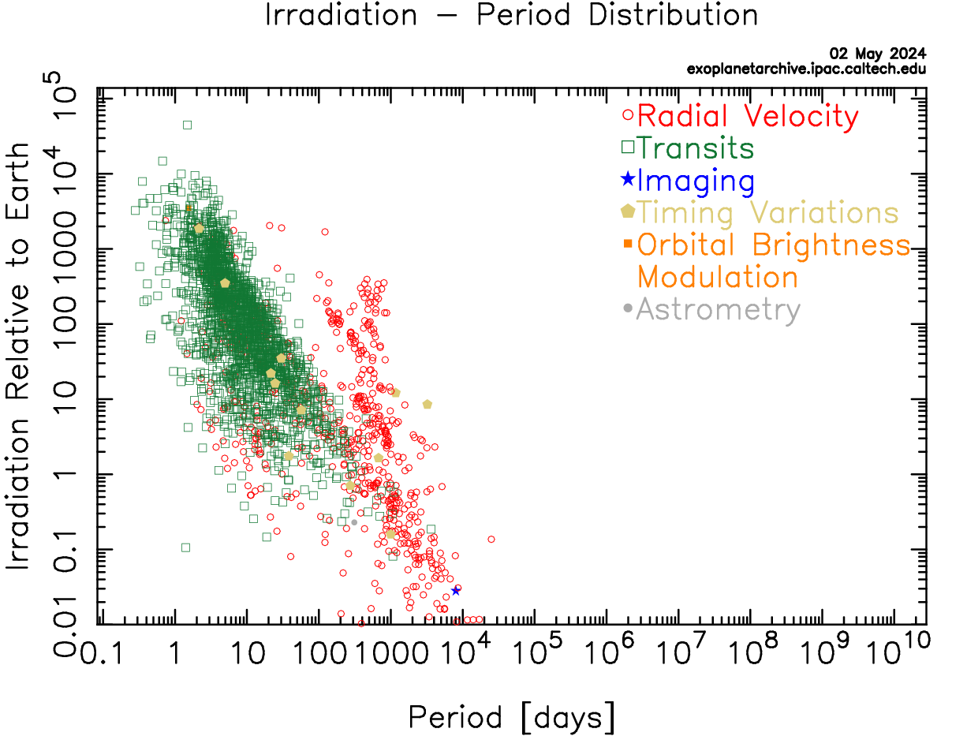

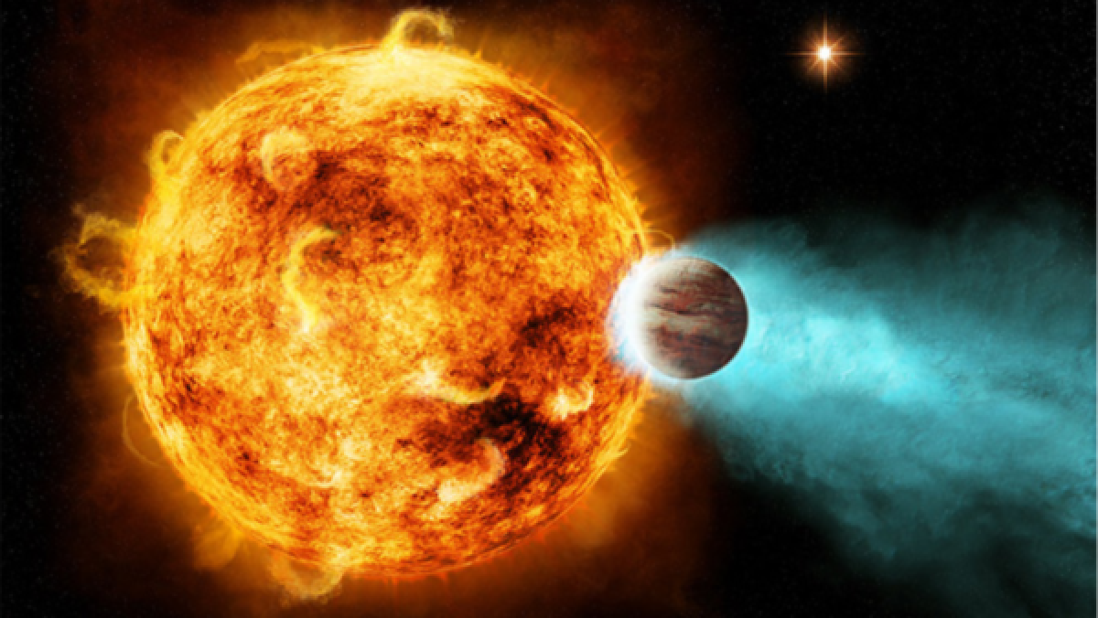
Ultra-hot ( ) Jupiters
🌶️🌶️🌶️
image credit: NASA
NASA Exoplanet Archive
CRAQ Meeting | 7 May 2024 | Joost P. Wardenier | joost.wardenier@umontreal.ca

Slide 3
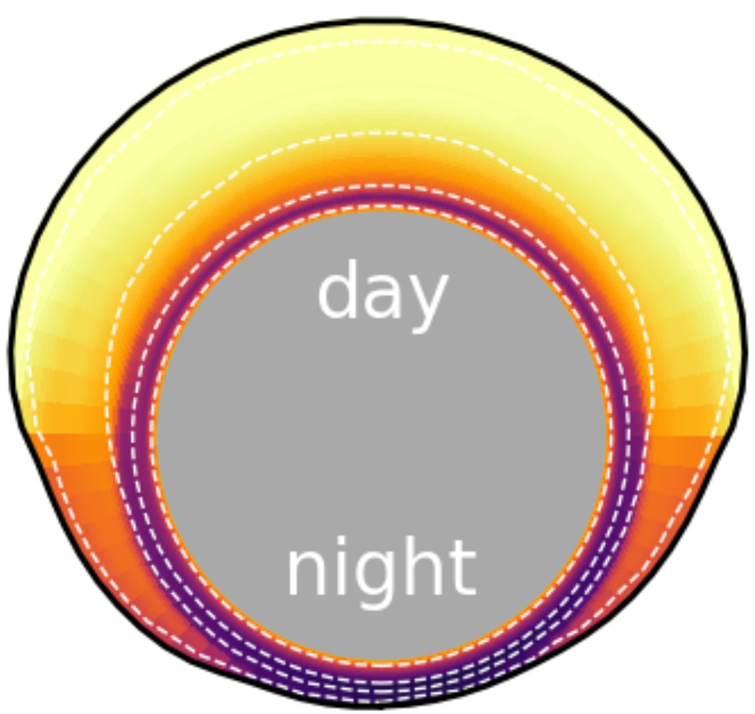

WASP-121b: an archetype ultra-hot Jupiter
Dayside temperature > 3000 K
Nightside temperature ~1000 K
~20 different atoms and molecules detected in the atmosphere
Orbital period of 1.3 days
Wind speeds of multiple km/s
Wardenier+ (in prep.)
CRAQ Meeting | 7 May 2024 | Joost P. Wardenier | joost.wardenier@umontreal.ca

Slide 4
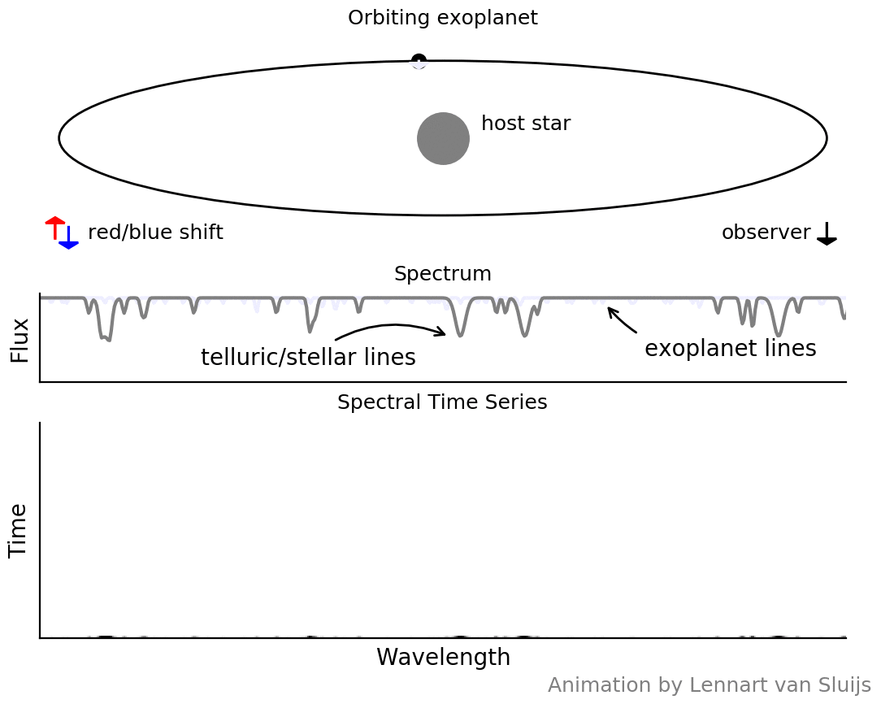
High-resolution spectroscopy of exoplanets
Doppler shifts due to orbital motion allow to separate the planet signal from stellar and telluric lines.
Each molecule has a unique spectral fingerprint.
We can measure the Doppler shifts of different molecules in the planet’s atmosphere.
CRAQ Meeting | 7 May 2024 | Joost P. Wardenier | joost.wardenier@umontreal.ca

Slide 5
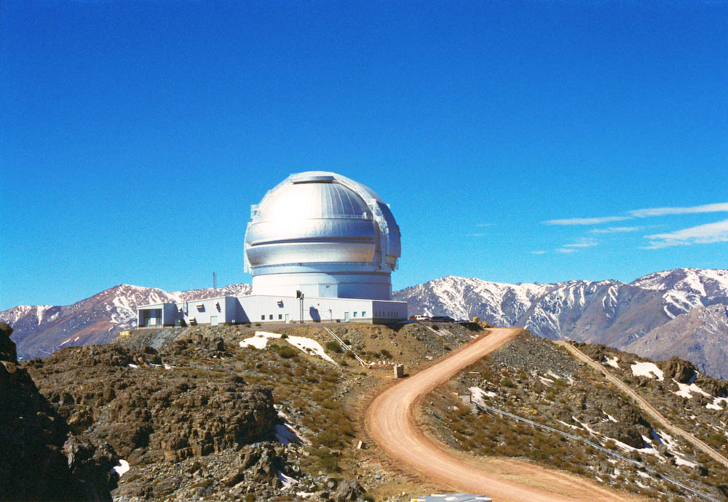
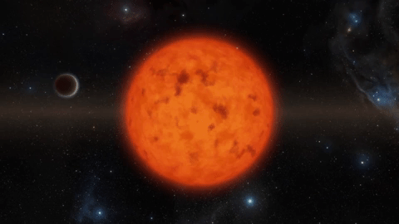
WASP-121b with Gemini-S/IGRINS
Gemini-S/IGRINS
(1.4 – 2.4 micron)
+
3 transit observations
CRAQ Meeting | 7 May 2024 | Joost P. Wardenier | joost.wardenier@umontreal.ca

Slide 6
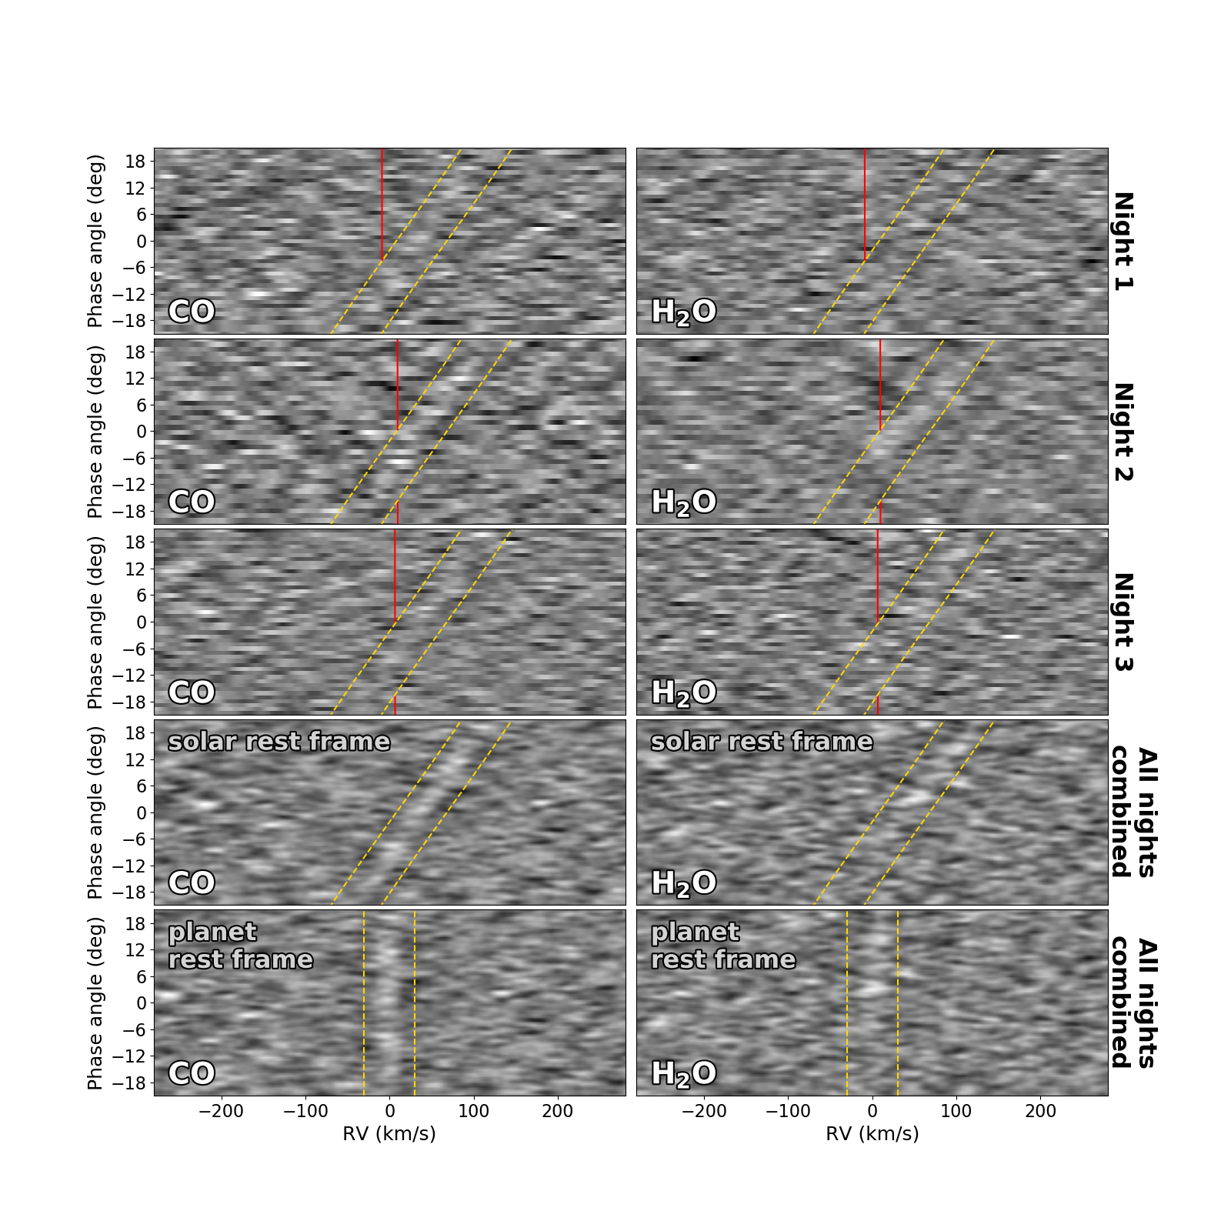
WASP-121b with Gemini-S/IGRINS
Gemini-S/IGRINS
(1.4 – 2.4 micron)
carbon monoxide
water
WASP-121b orbit
+
Phase angle (deg)
Doppler shift (km/s)
Doppler shift (km/s)
3 transit observations
Wardenier+ (in prep.)
CRAQ Meeting | 7 May 2024 | Joost P. Wardenier | joost.wardenier@umontreal.ca

Slide 7
WASP-121b with Gemini-S/IGRINS
carbon monoxide
water
increasing blueshift
increasing redshift
Wardenier+ (in prep.)
CRAQ Meeting | 7 May 2024 | Joost P. Wardenier | joost.wardenier@umontreal.ca

Slide 8
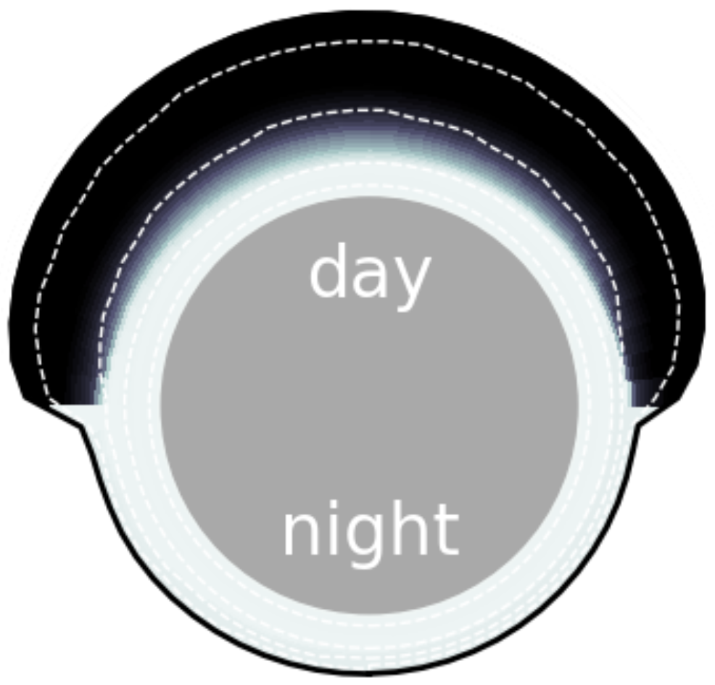
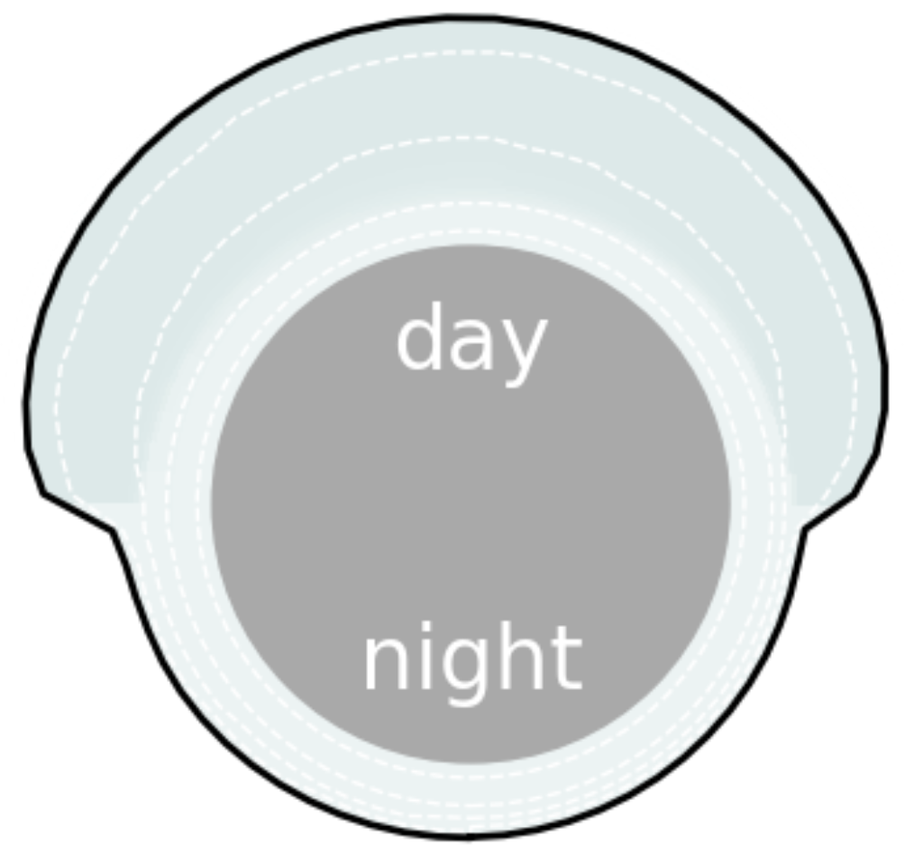

Water vs. CO in ultra-hot Jupiters
water distribution
CO distribution
evening limb
evening limb
morning limb
morning limb
CRAQ Meeting | 7 May 2024 | Joost P. Wardenier | joost.wardenier@umontreal.ca

Slide 9
Water vs. CO in ultra-hot Jupiters
water distribution
CO distribution
evening limb
evening limb
morning limb
morning limb
CRAQ Meeting | 7 May 2024 | Joost P. Wardenier | joost.wardenier@umontreal.ca

Slide 10
WASP-121b with Gemini-S/IGRINS
carbon monoxide
water
increasing blueshift
increasing redshift
Wardenier+ (in prep.)
CRAQ Meeting | 7 May 2024 | Joost P. Wardenier | joost.wardenier@umontreal.ca

Slide 11
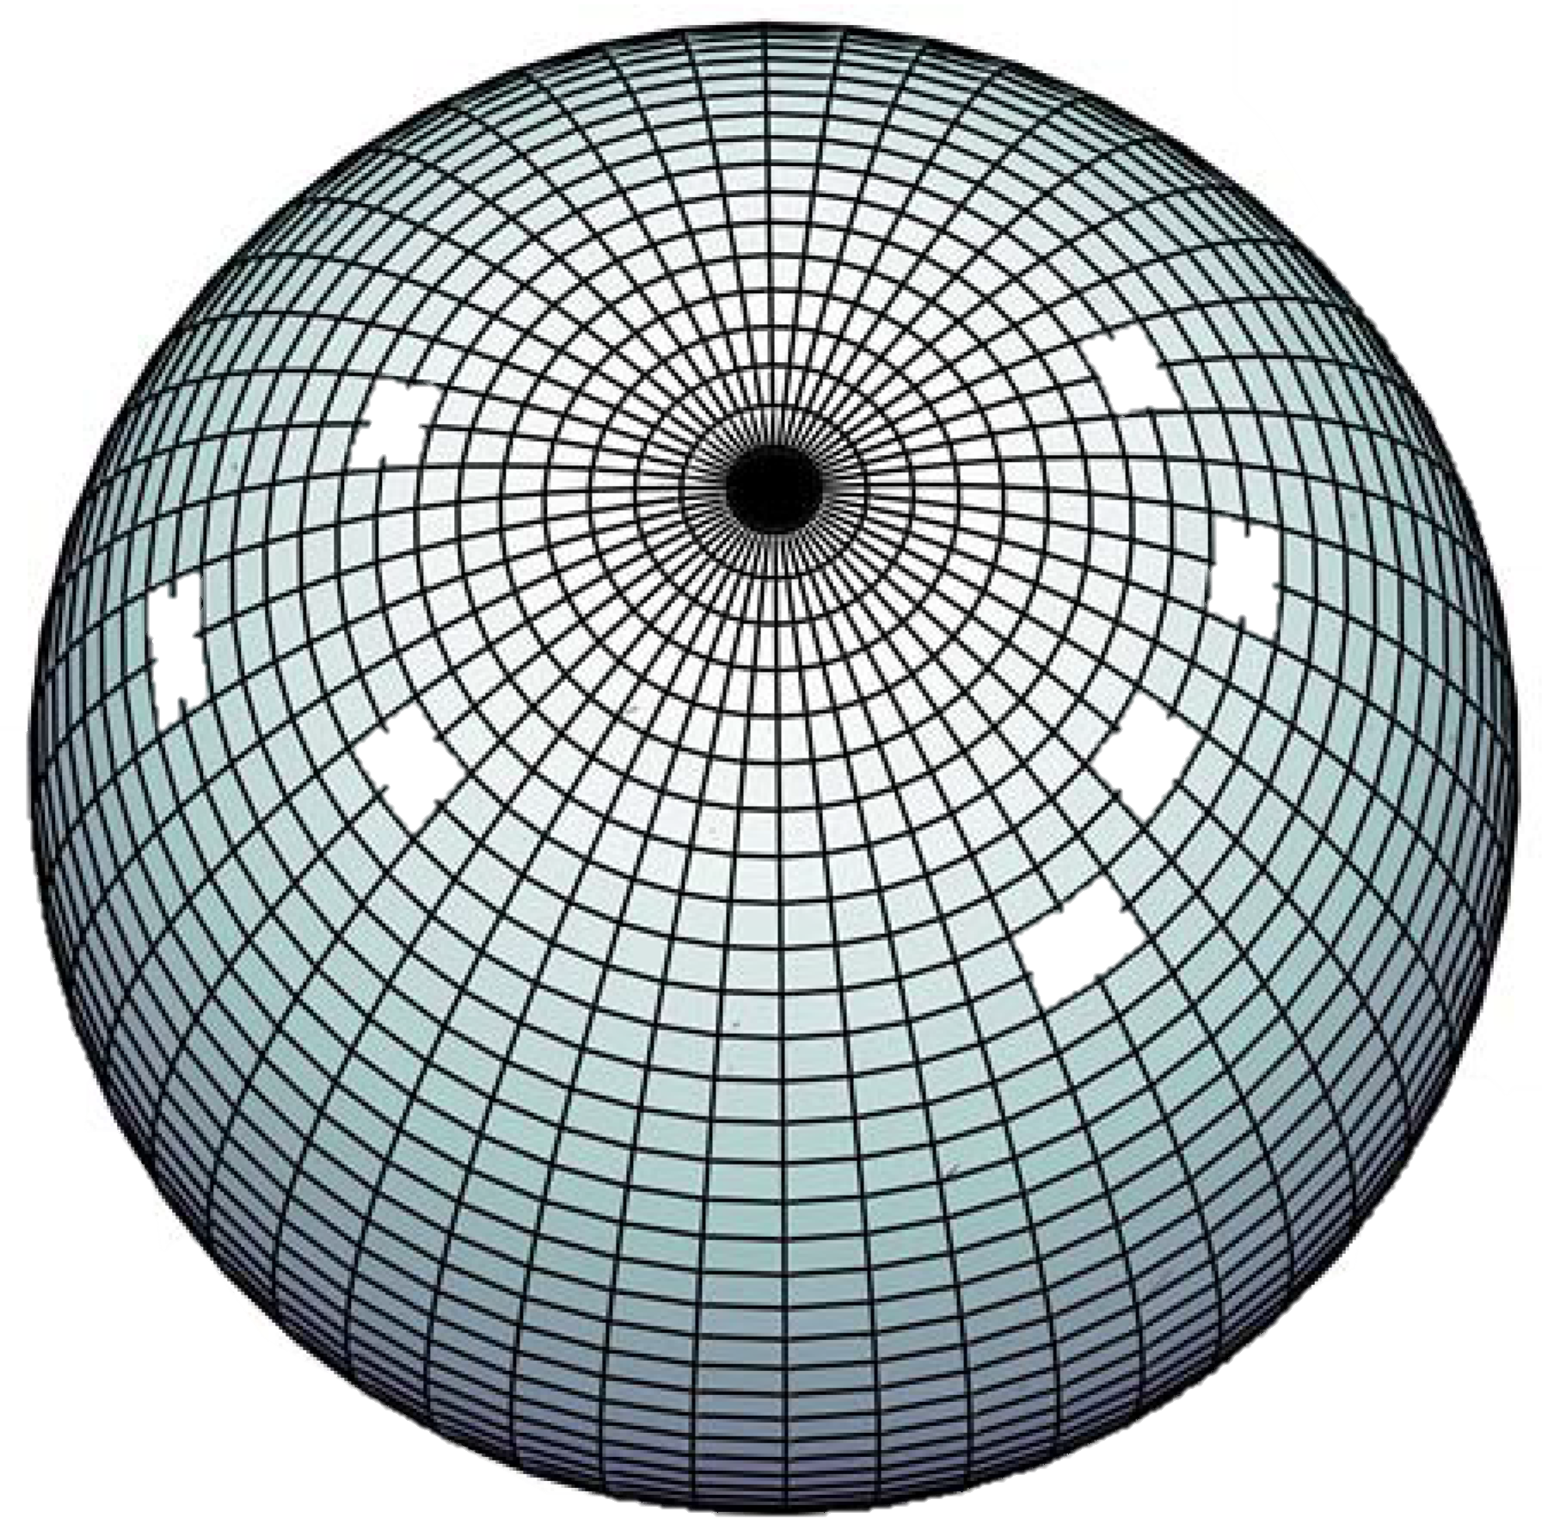


3D Monte-Carlo radiative transfer
x 10⁵
Global circulation model (SPARC/MITgcm)
Showman+ 2009
Lee+ 2017, 2019, 2022 Wardenier+ 2021, 2022
Monte-Carlo radiative transfer (gpu-CMCRT)
Transmission spectra
Measure Doppler shifts
Elsie Lee (Bern)
First frameworks of this kind by Fortney+ 2010 (low resolution) and Kempton & Rauscher 2012
CRAQ Meeting | 7 May 2024 | Joost P. Wardenier | joost.wardenier@umontreal.ca

Slide 12
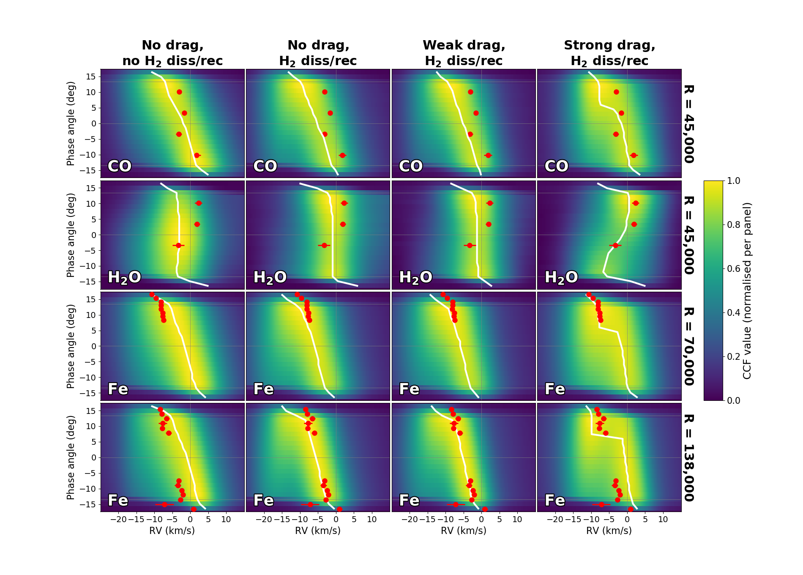
CO
IGRINS
H₂O
IGRINS
Fe (4-UT)
ESPRESSO
Fe (1-UT)
ESPRESSO
Fe data from Borsa+ (2021)
Wardenier+ (in prep.)
CRAQ Meeting | 7 May 2024 | Joost P. Wardenier | joost.wardenier@umontreal.ca

Slide 13
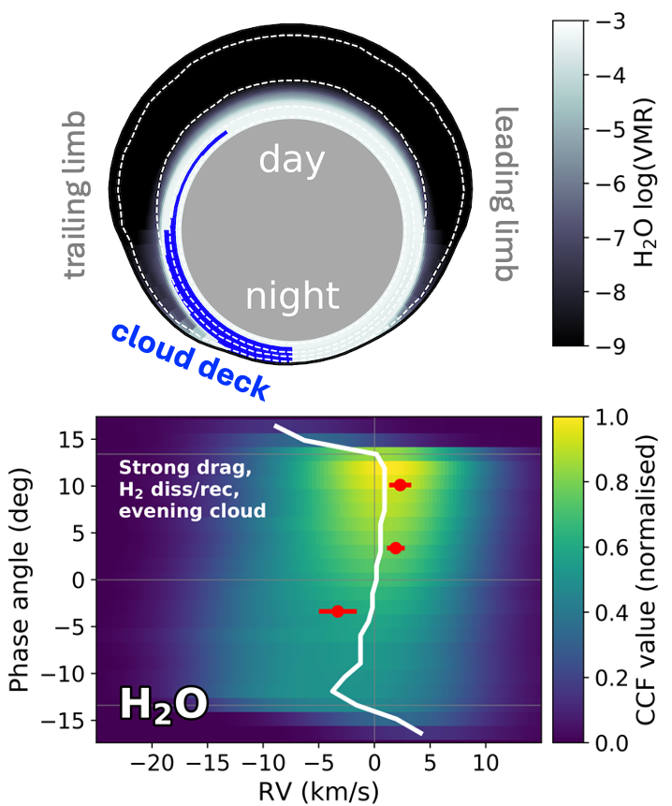
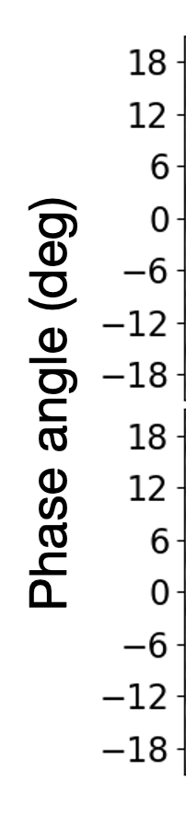
Asymmetric cloud deck on the nightside?
evening limb
morning limb
Wardenier+ (in prep.)
CRAQ Meeting | 7 May 2024 | Joost P. Wardenier | joost.wardenier@umontreal.ca

Slide 14
Summary and conclusions
IGRINS (R ~ 45,000) is capable of phase-resolving the absorption signals of water and CO in ultra-hot Jupiters.
The different Doppler shifts of water and CO reveal their unique spatial distribution across the atmosphere of WASP-121b.
The data are consistent with atmospheric drag. Low wind speeds are required to reproduce the redshift observed for water.
The muted water signal at the start of the observation could be indicative of clouds on the trailing (evening) limb of WASP-121b.
CRAQ Meeting | 7 May 2024 | Joost P. Wardenier | joost.wardenier@umontreal.ca

