Slide 1
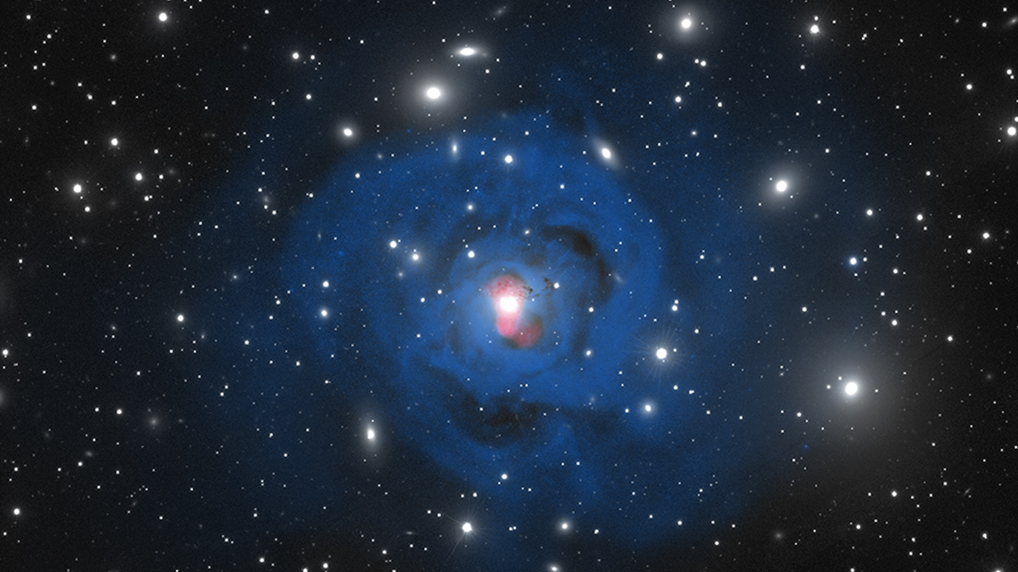



High Spectral Resolution Observations of the Filamentary Nebula Surrounding NGC 1275
Benjamin Vigneron,
PhD. Candidate,
Université de Montréal
Supervisor : Julie Hlavacek-Larrondo
Perseus cluster of galaxies. Credit: MLGM/JHL/NASA.

Slide 2
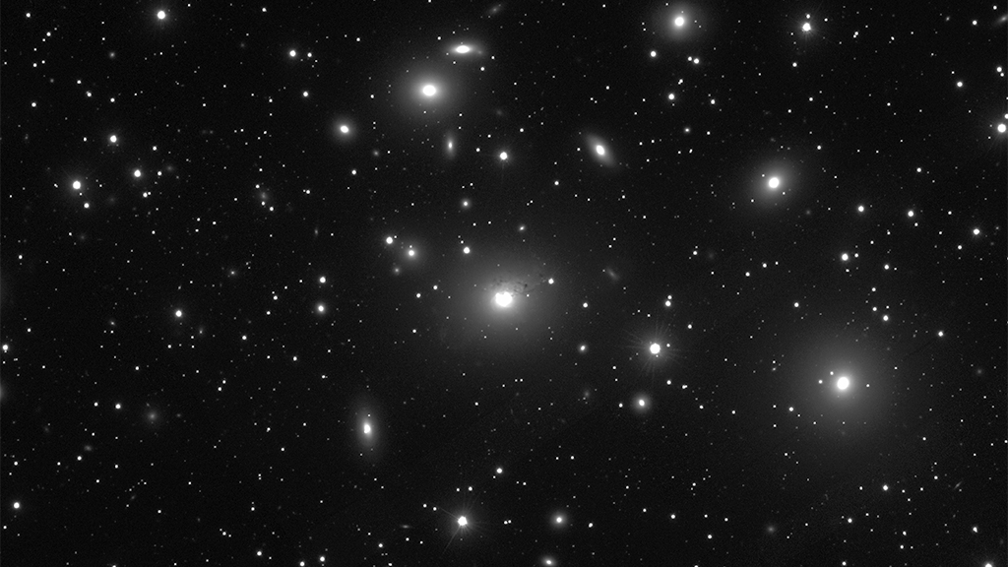
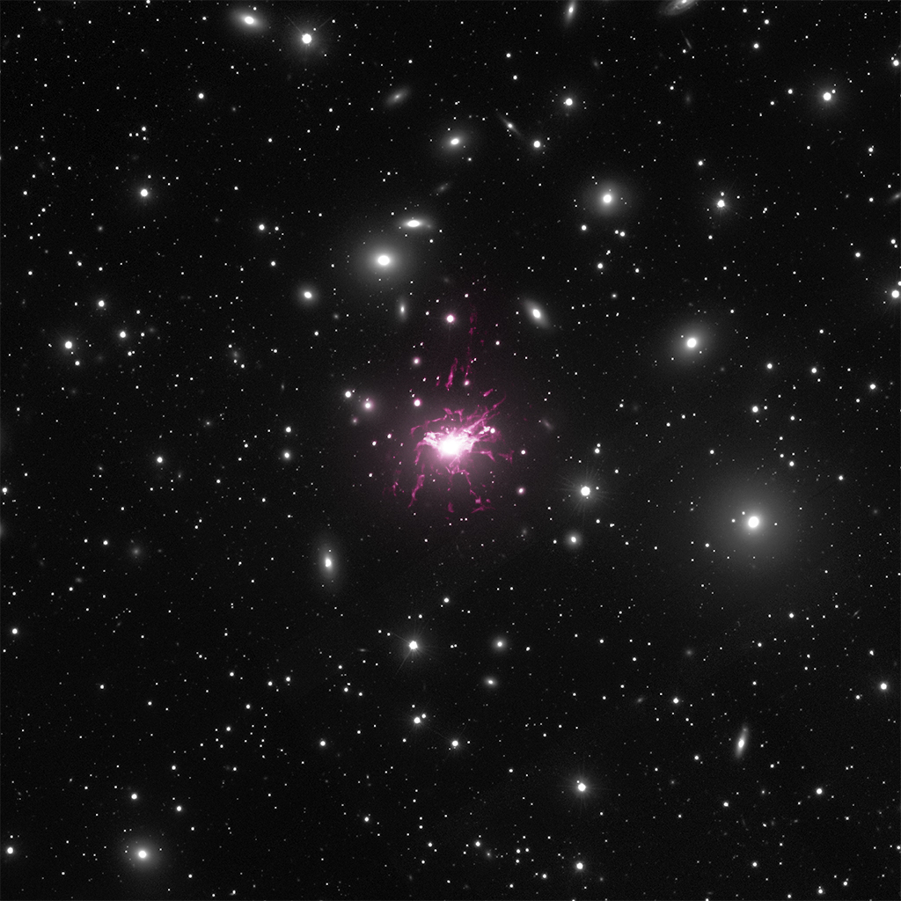
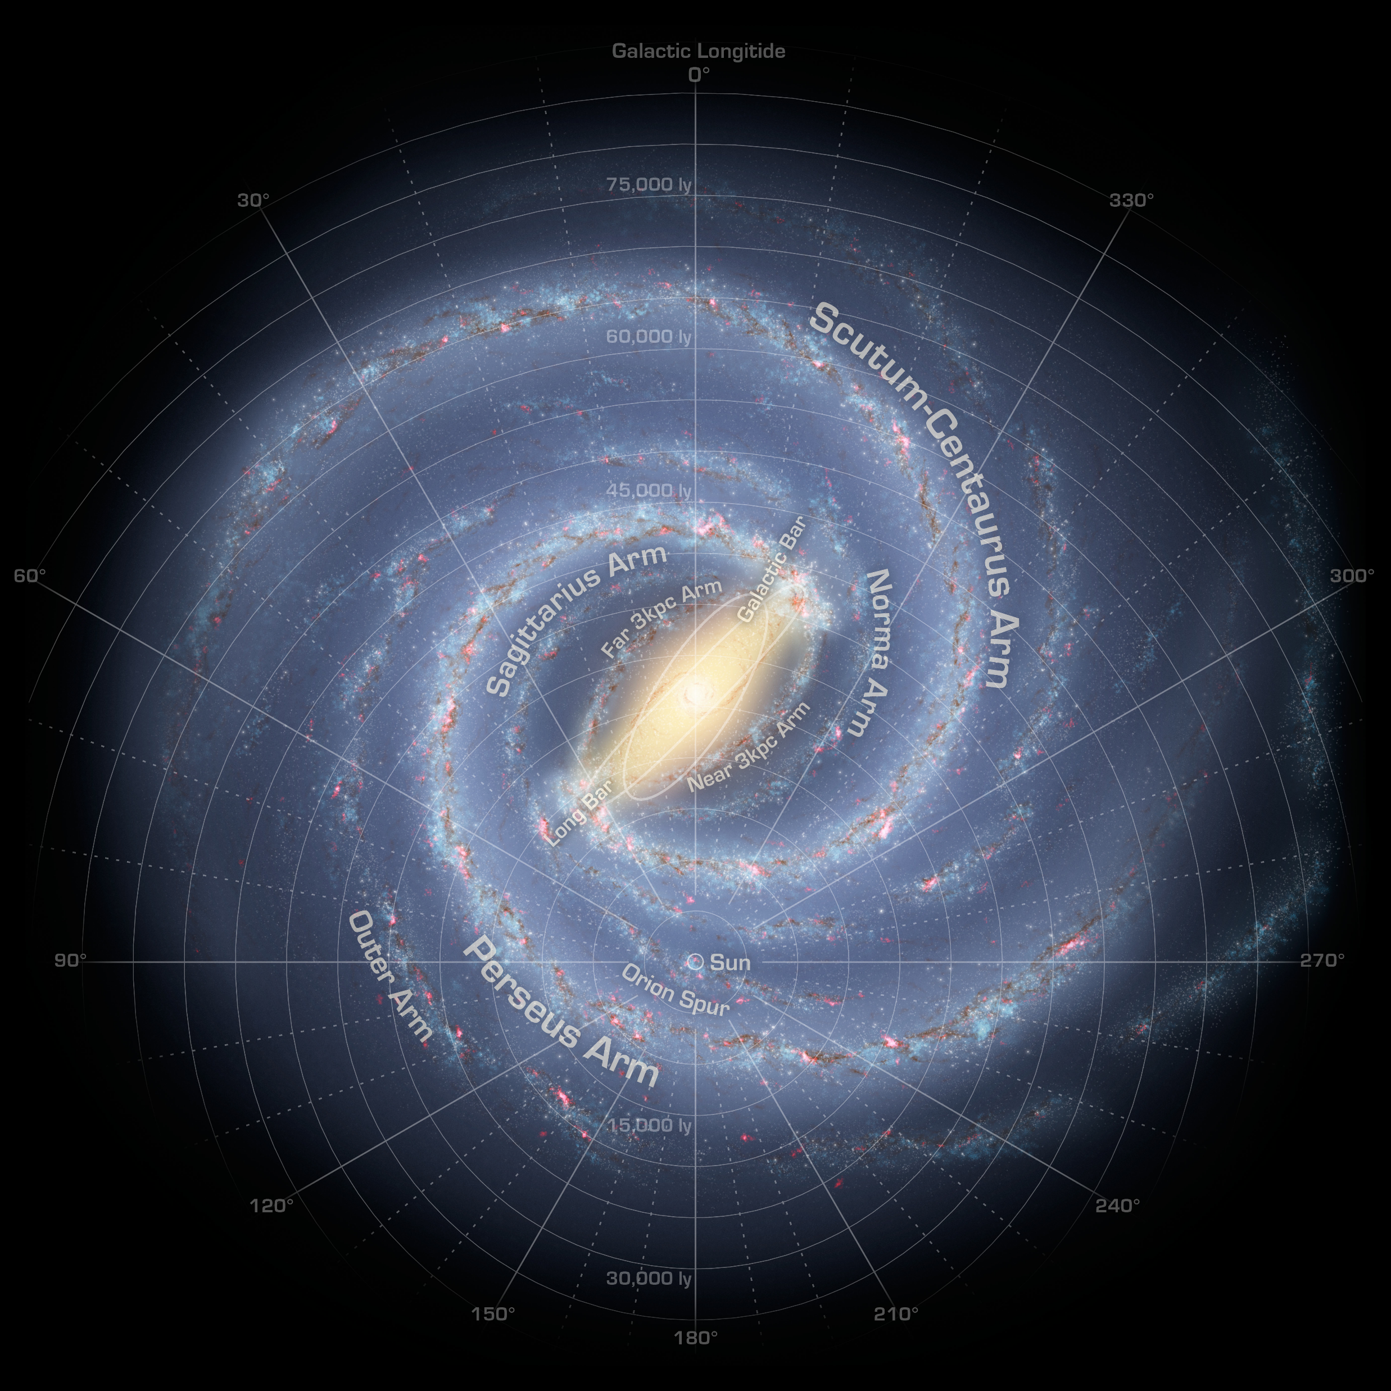
X-rays (Chandra)
Hα emission
at the redshift of
the central galaxy NGC 1275
Size of Milky Way
Radio
328 MHz
(VLA)
Brightest Cluster Galaxy
100 kpc
Perseus cluster of galaxies;
Credit: SDSS, CXC/IoA/ACFabian, NRAO/VLA/GBTaylor and MLGendron-M./JHlavacek-L.
Perseus cluster of galaxies;
Credit: SDSS, CXC/IoA/ACFabian.
Perseus cluster of galaxies;
Credit: SDSS, CXC/IoA/ACFabian, CFHT/Gendron-M.

Slide 3
What do we know ?

Slide 4
Structure of the Filaments
Thread-like structure : thin (60-70 pc wide; Fabian et al. 2008, 2016) and extended (diameters from 5 kpc to 100 kpc).
Most do NOT display stellar formation.
Extremely luminous in Hα with L_{Hα} = 10⁴⁰-10⁴² erg/s associated with temperatures of 10 000 K.
Multiphase structure : spatial correlations with cold molecular gas (T < 100 K) and soft X-ray gas (T > 100 000 K).
CO (2-1) Molecular gas emission (HERA)
Hα emission (WIYN)
Soft X-ray emission (Chandra) with superimposed Hα emission (WIYN)
Salomé et. al. 2006.
Fabian et. al. 2011.

Slide 5
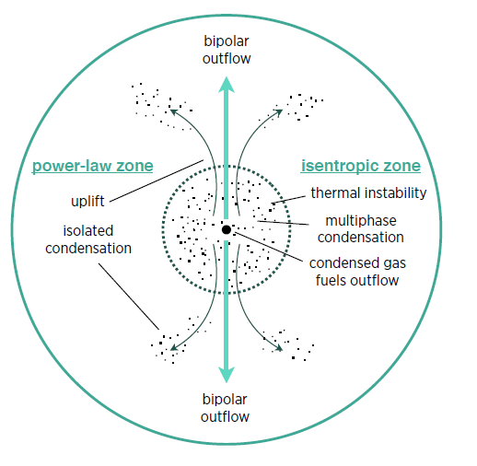
Origin of the Filaments
The morphology and depletion of metals in BCGs argues that they are being dragged out by the jets of the central black hole (e.g. work by Fabian and collaborators).
Another possibility for their origin is by precipitation-based cooling flows where clouds rain down because of thermal instabilities and produces outflows through uplift. (e.g. work by Voit and collaborators).
CO(2–1) emission (black) superimposed on the X-ray image (false colours, indicating intensity) with the radio contours (white).
CO(3-2) intensity map with X-ray cavities in dashed white contours
Voit et. al. 2015.
Russel et. al. 2016.

Slide 6
Why SITELLE ?

Slide 7
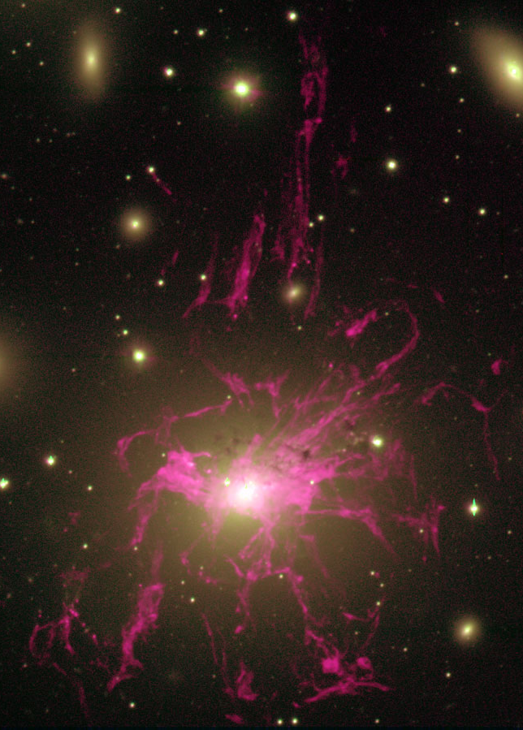
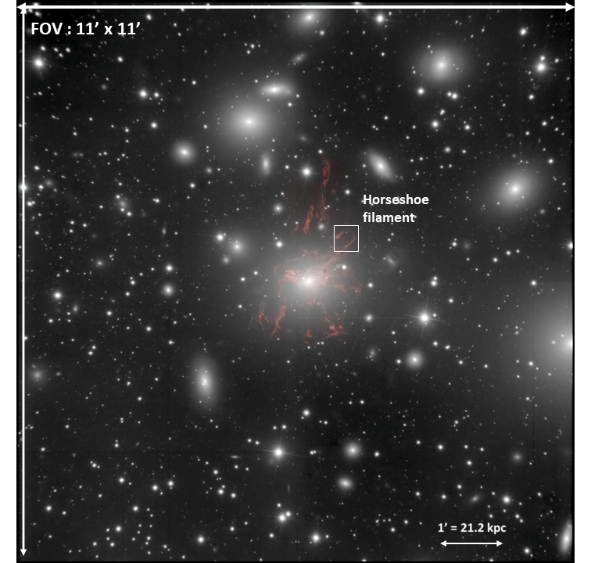
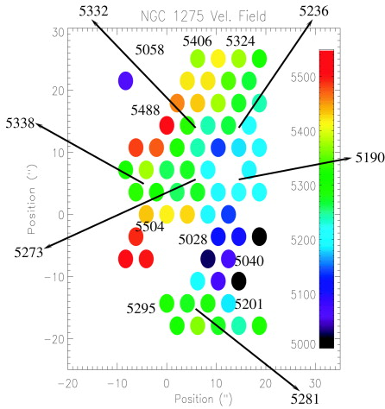
90 kpc
4.2 arcmin
SITELLE Field of View
NGC 1275 (Hα continuum)
11 arcmin x 11 arcmin
MUSE (VLT)
SINFONI
Hatch et al. 2006.
Conselice et al. 2001, see also Salomé’s work on CO observations of NGC 1275.

Slide 8
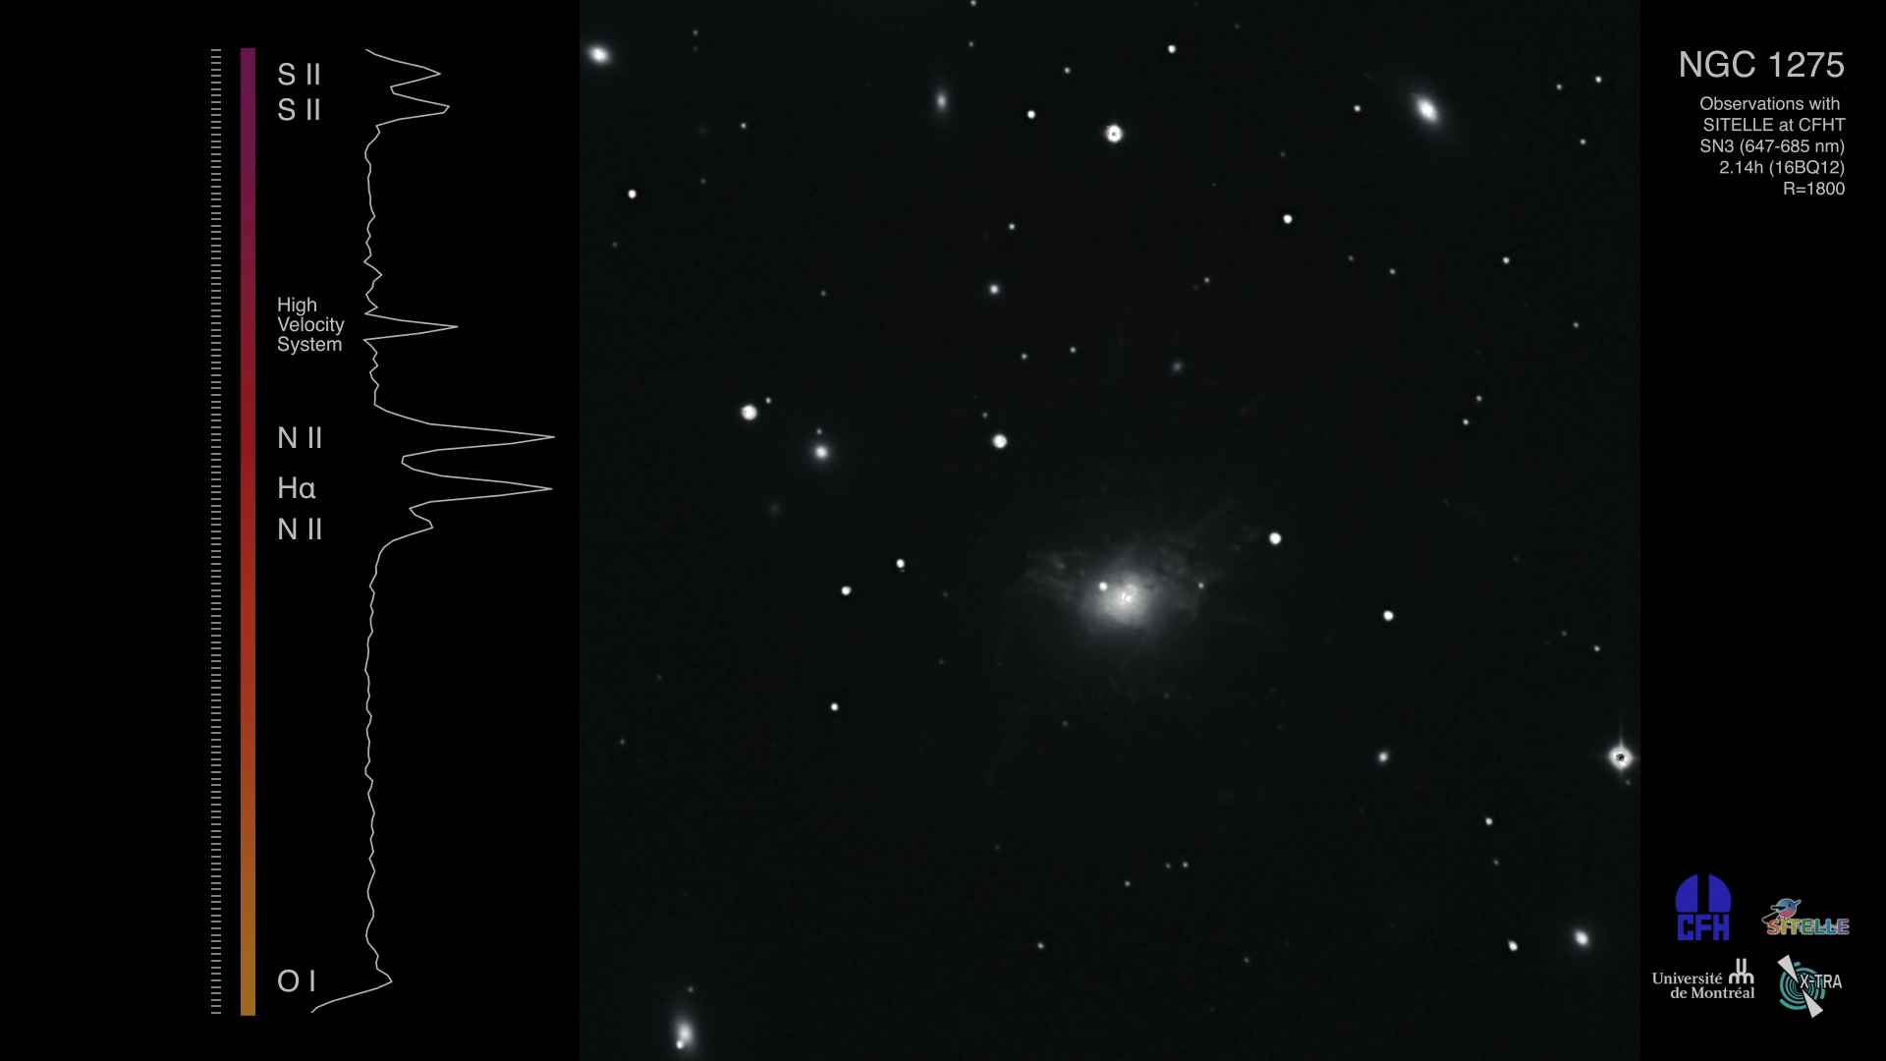
Credit: JHL/MLGM/ML.
Credit: JHL/MLGM/ML.
Credit: JHL/MLGM/ML.

Slide 9

Results
With LUCI
Special thanks to Carter Rhea and everyone involved in the LUCI Development Team.

Slide 10
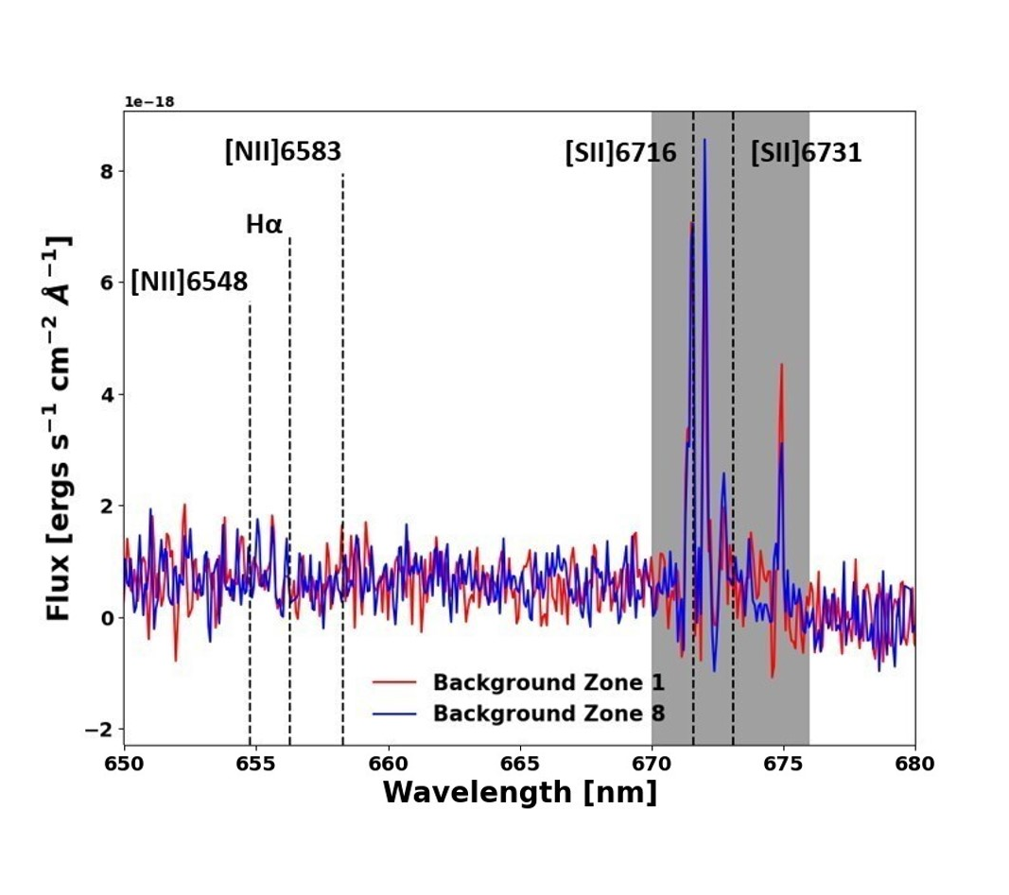
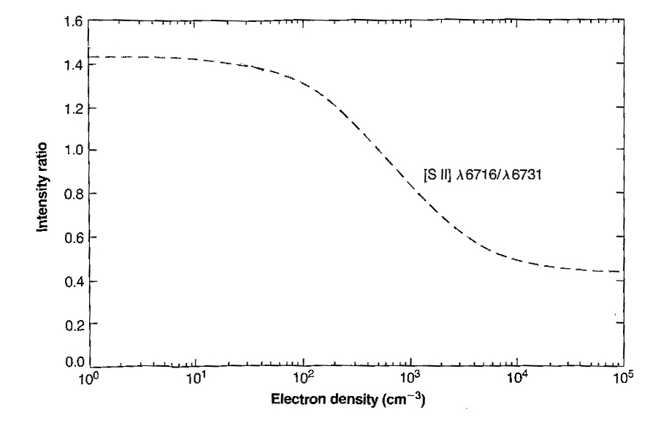
[SII] Ratio Measurement
The measurement of the electron density through the [SII] emission line ratio is highly constrained.
We need a precise detection of the emission lines which is further complicated by a strong background emission...
Shocks can influence the electron density relationship; this will be explored.
Osterbrock & Ferland, 1989

Slide 11

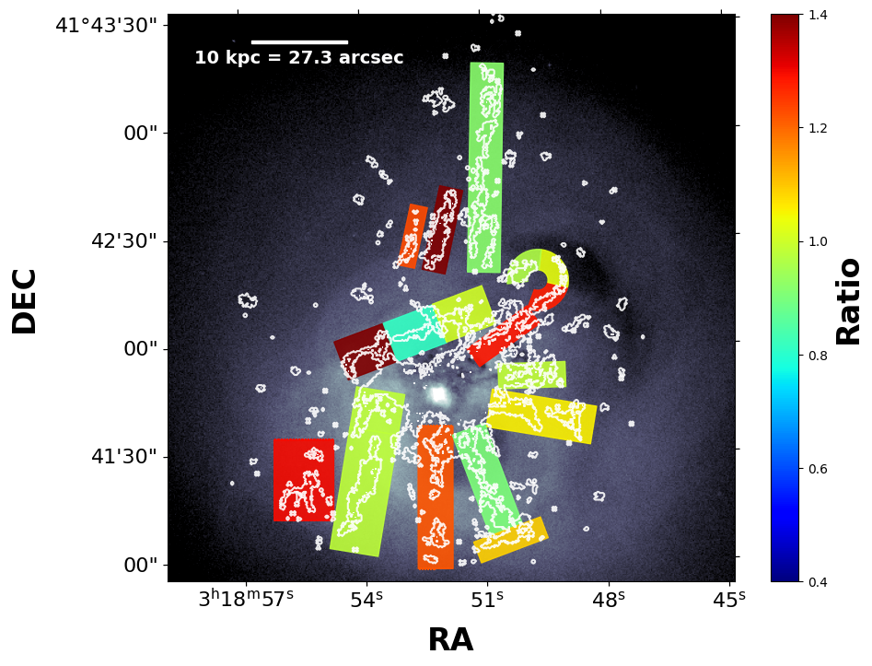
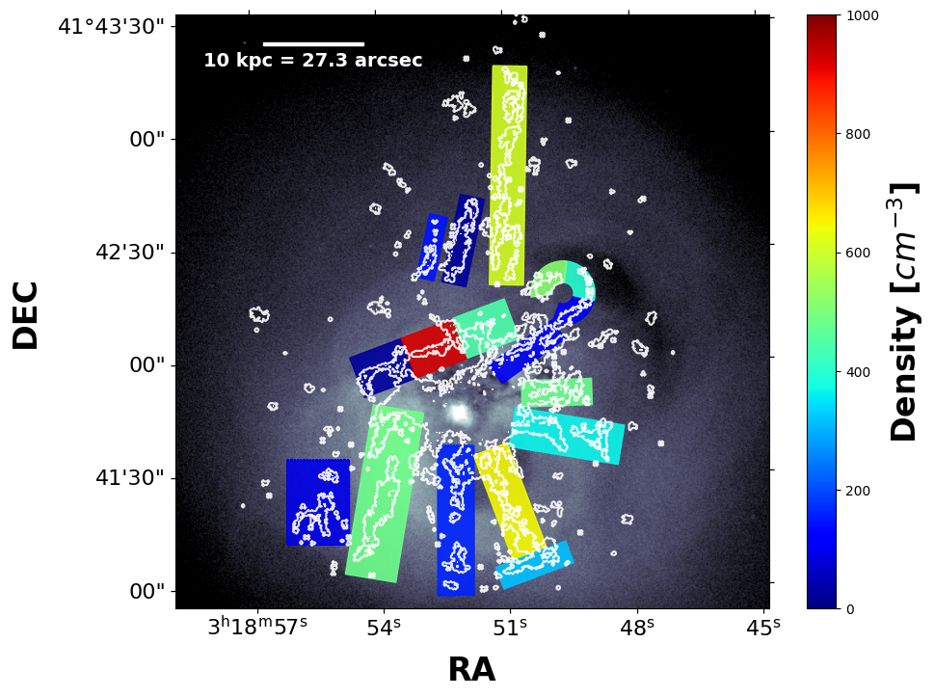
[SII] Ratio and Electron Density

Slide 12
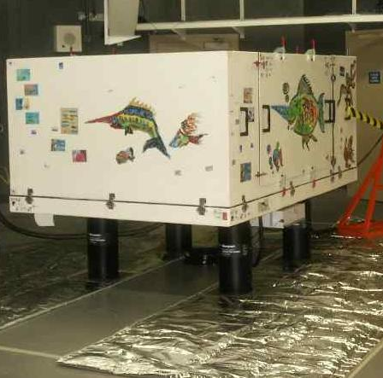
ESPaDOnS Observations of NGC 1275 Filaments
Some elements are still missing from the SITELLE observations even at high spectral resolution.
We can't resolve efficiently multiple velocity components of possibly overlapped filaments.
So why don't we go even further in terms of spectral resolution !
NGC 1275 filamentary nebula was observed with ESPaDOnS in 2015 but no analysis was carried out.
ESPaDOnS, CFHT Web Page

Slide 13
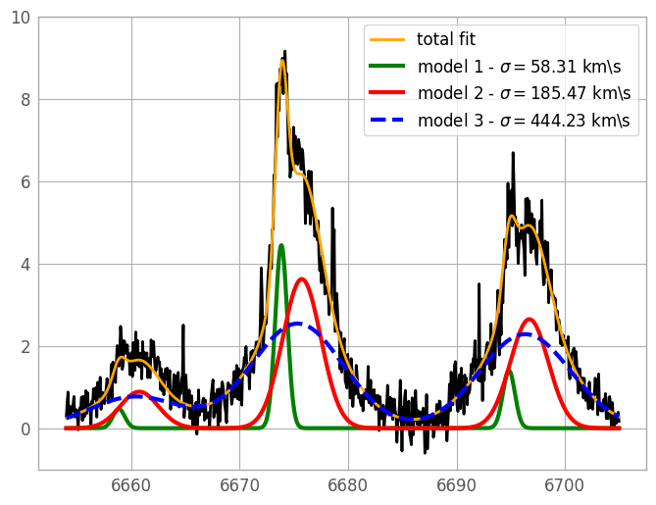
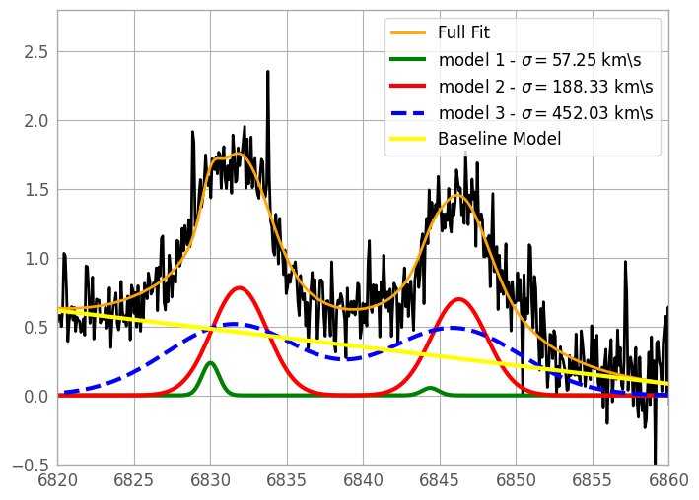
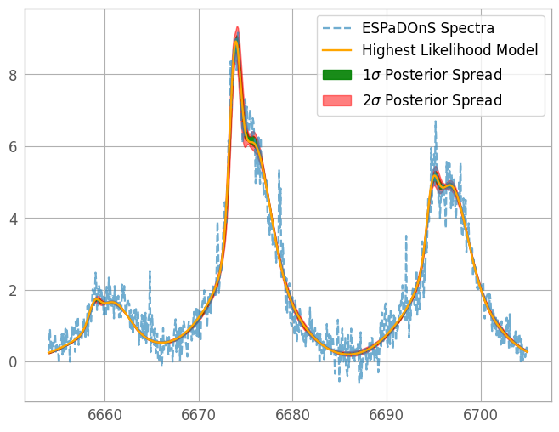
Multiple velocity components – Preliminary Results
Hα​
Hα​
[SII] 671.6
[NII] 658.3​
[NII] 658.3​
[SII] 673.1
[NII] 654.8​
[NII] 654.8​

Slide 14
TAKE-HOME POINTS
By studying the optical emission of such filamentary nebula surrounding brightest cluster galaxies, we can deepen our knowledge on the cooling that takes place in such environment from X-ray temperatures down to molecular gas temperatures.
Focusing our analysis on the [SII] emission line doublet across the filaments, we would be able to determine the electron density of the ionised gas by measuring their ratio.
Since the environment surrounding NGC 1275 is highly multiphase, we want to compare the electron density for the optical emission and the one derived from the permeating ICM emitting brightly in X-ray to determine if we are able to see any spatial correlation.
Soft X-ray emission (Chandra) with superimposed Hα emission (WIYN)
Finally, ESPaDOnS observations at extremely high-spectral resolution will allow us to study multiple velocity components as well as polarimetric data from the filamentary nebula surrounding NGC 1275.
Fabian et. al. 2011.

Slide 15
Thank you !
Benjamin Vigneron,
benjamin.vigneron@umontreal.ca
PhD. Candidate,
Université de Montréal
Link to Luci’s webpage : https://crhea93.github.io/LUCI/index.html
Supervisor : Julie Hlavacek-Larrondo
Perseus cluster of galaxies. Credit: MLGM/JHL/NASA.

Slide 16
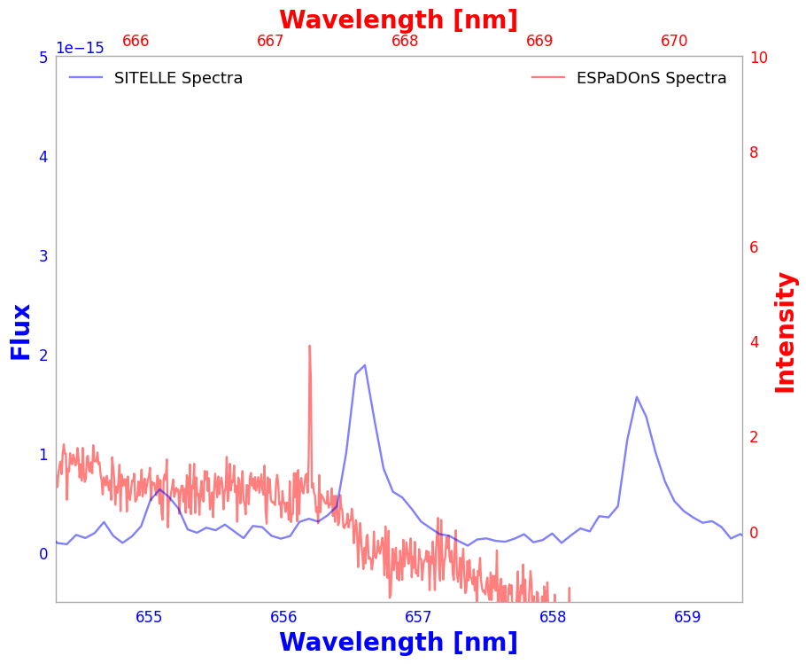
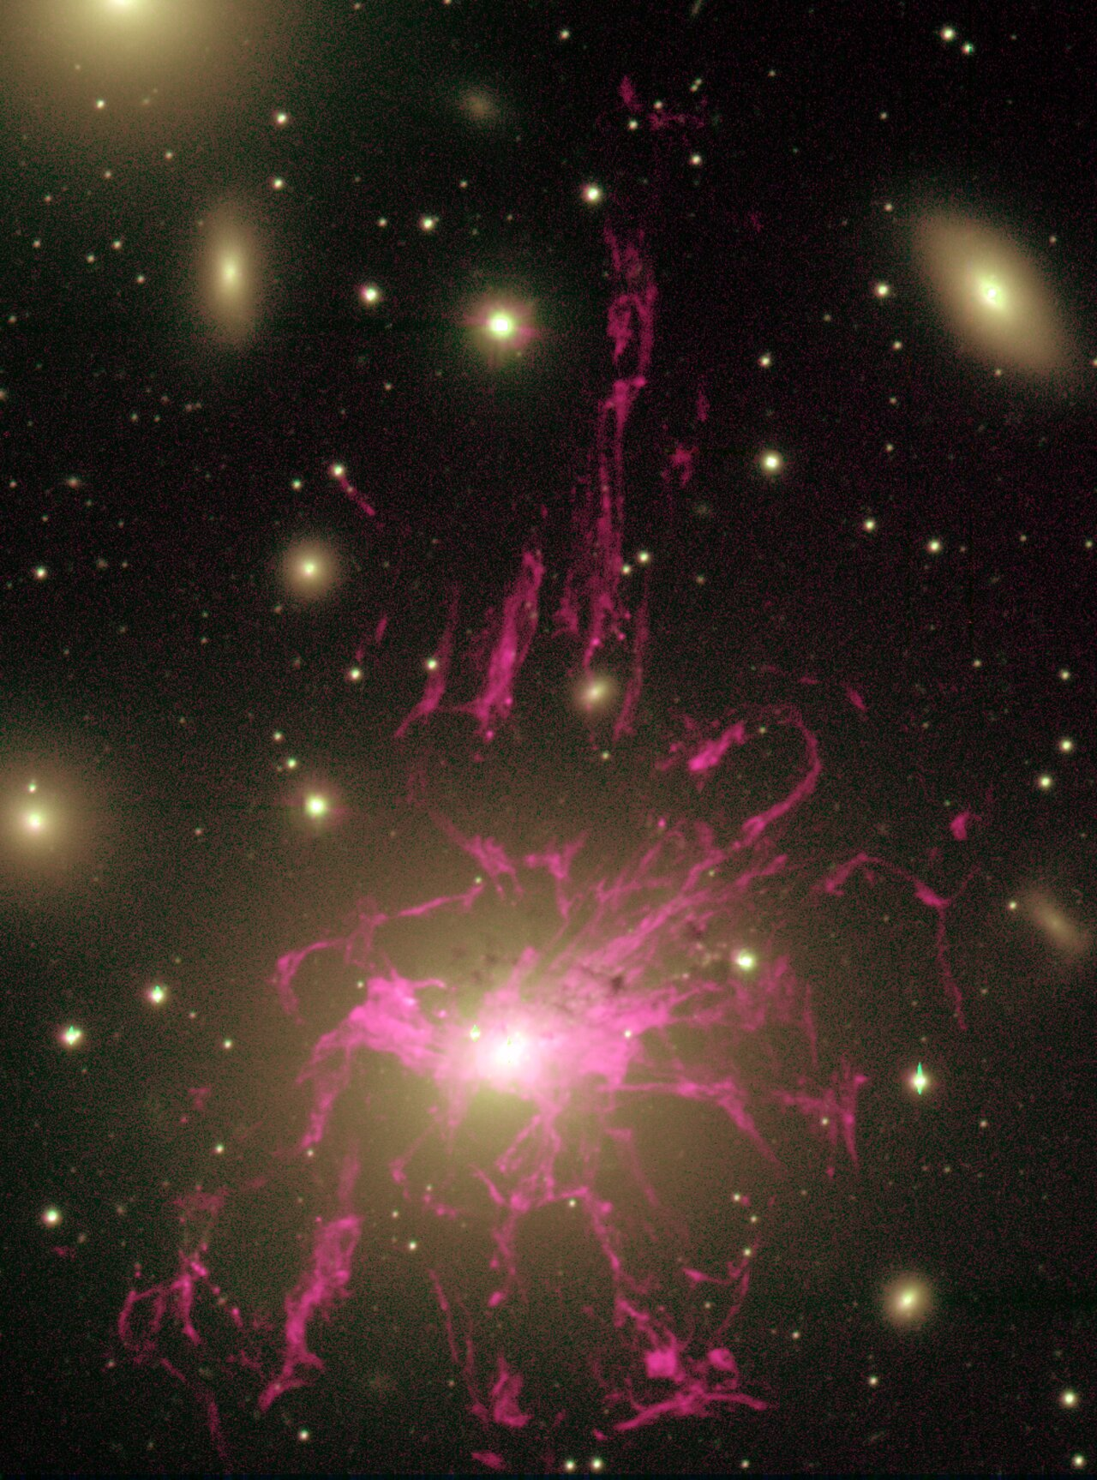
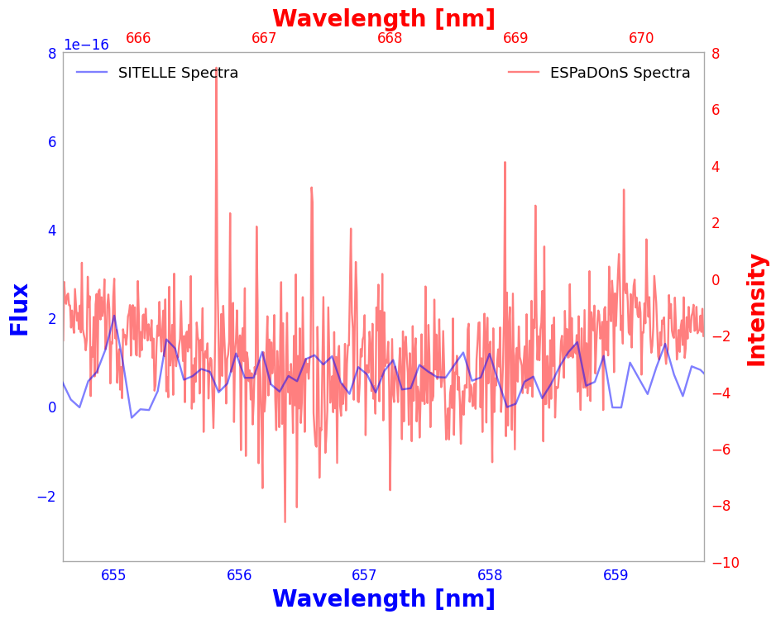
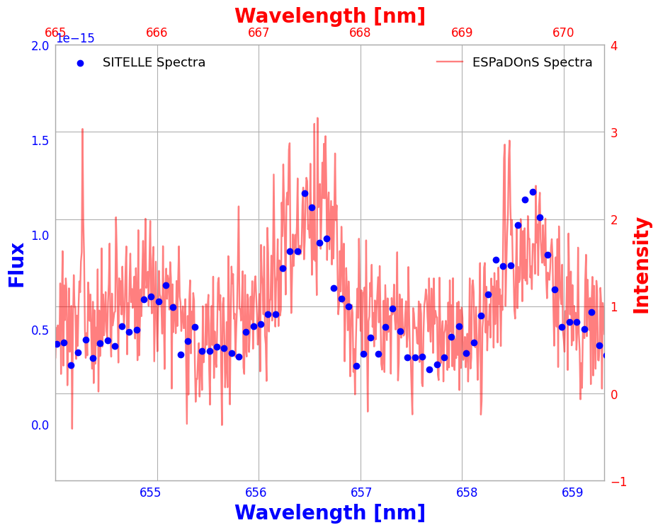
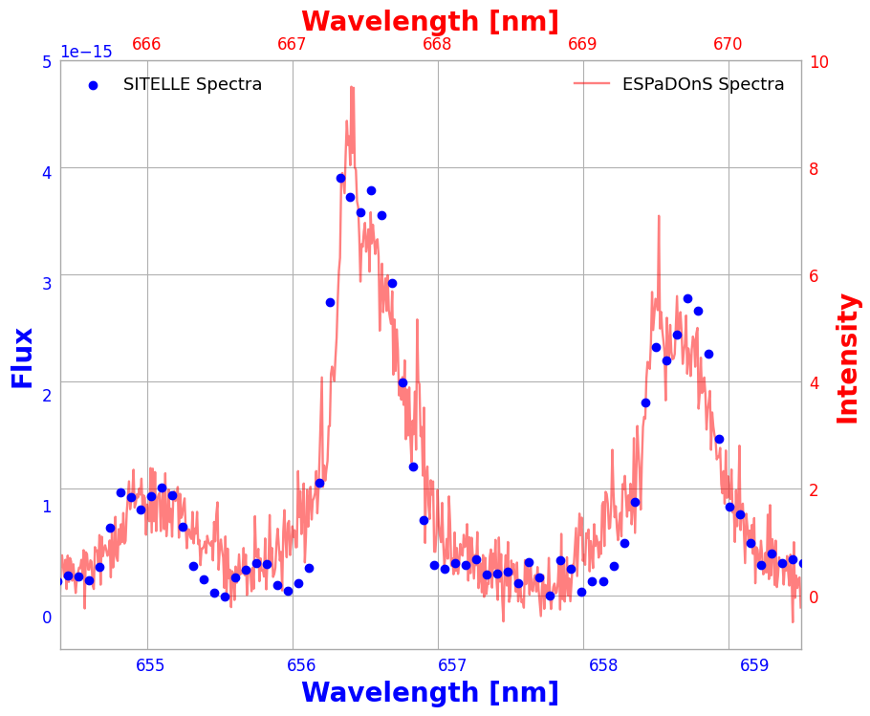
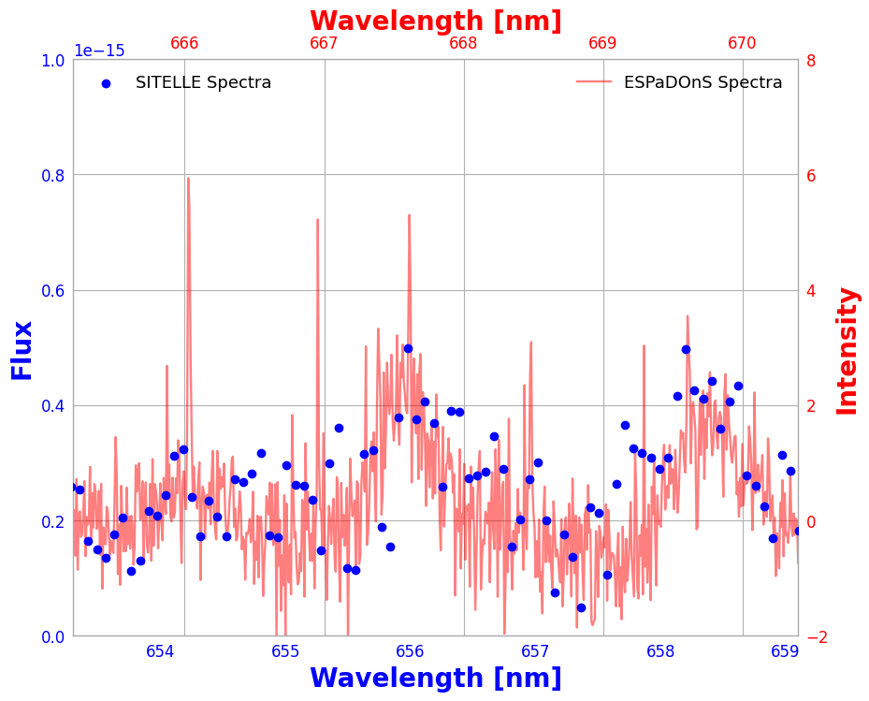

Slide 17
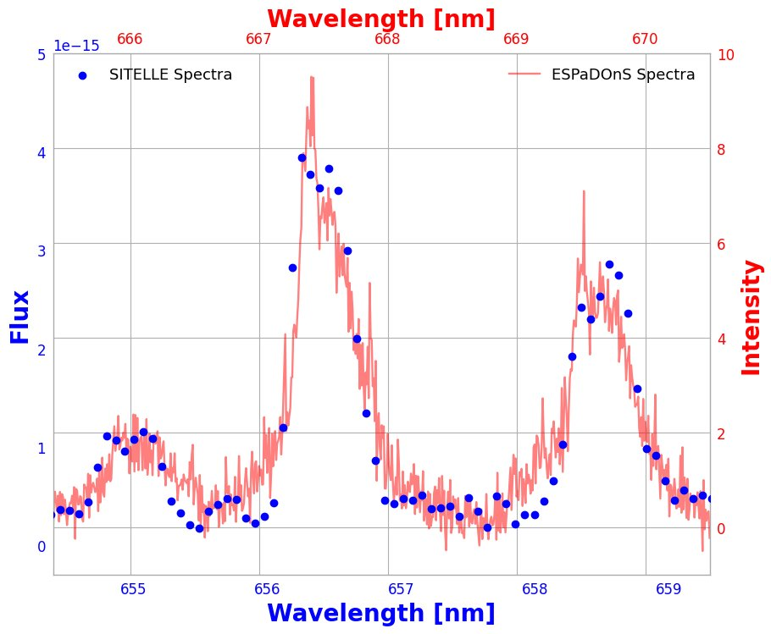
Hα​
[NII] 658.3​
[NII] 654.8​

Slide 18
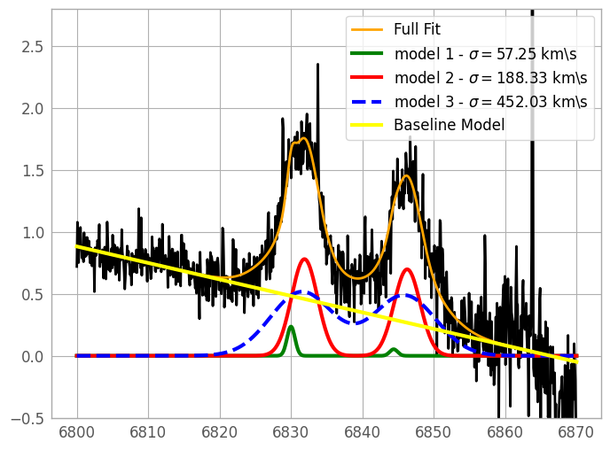
[SII] Emission Doublet – Multiple Components
[SII] 671.6​
[SII] 673.1​

Slide 19
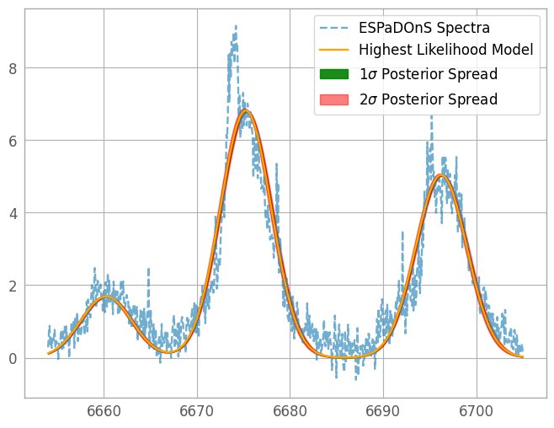
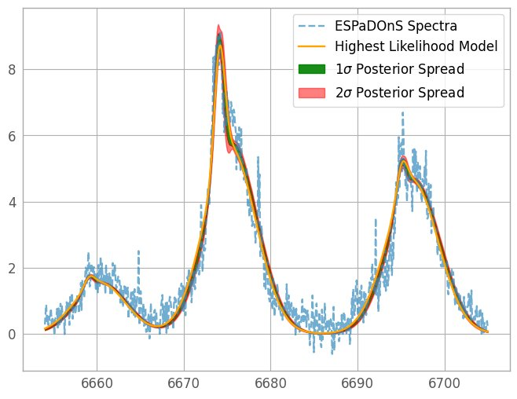
3 Components
2 Components
1 Component

Slide 20
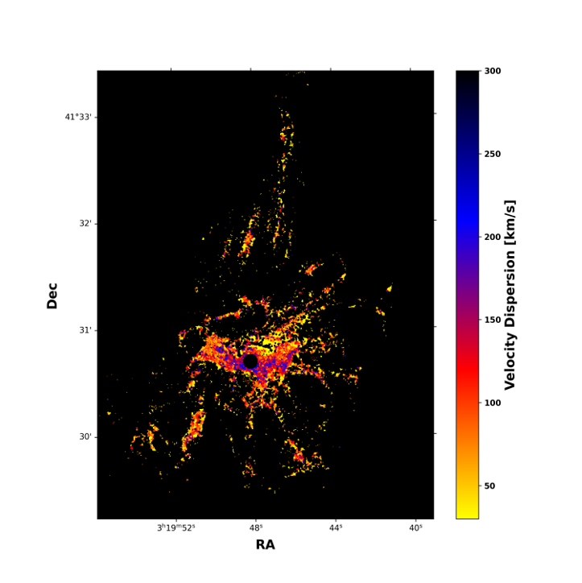
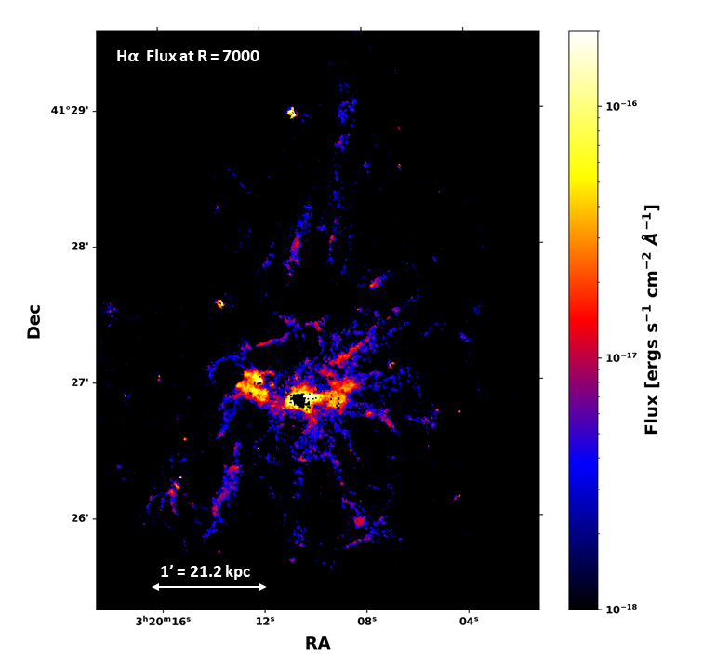
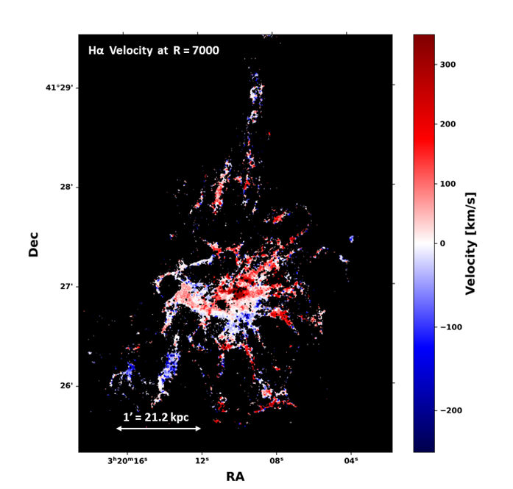
Flux, Velocity and Velocity Dispersion
Hα Velocity Dispersion at R = 7000
1' = 21.2 kpc

Slide 21
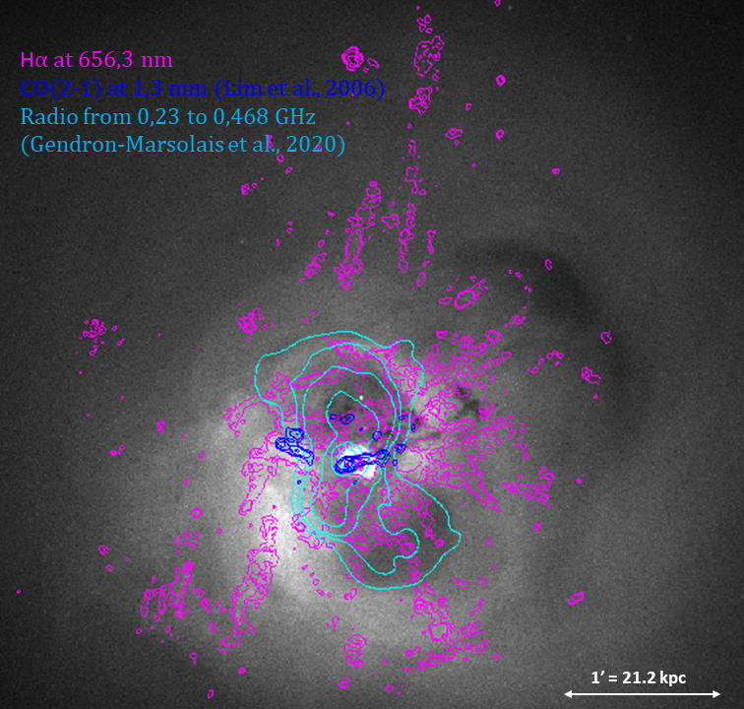
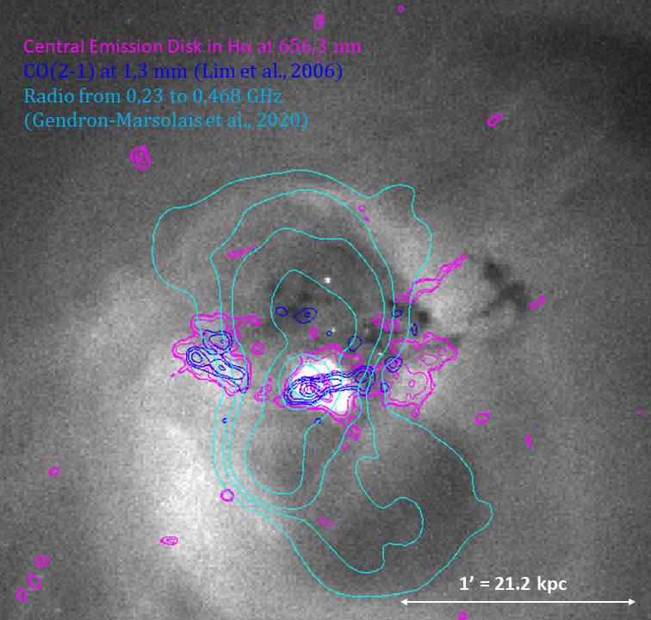
Spatial Correlation

Slide 22
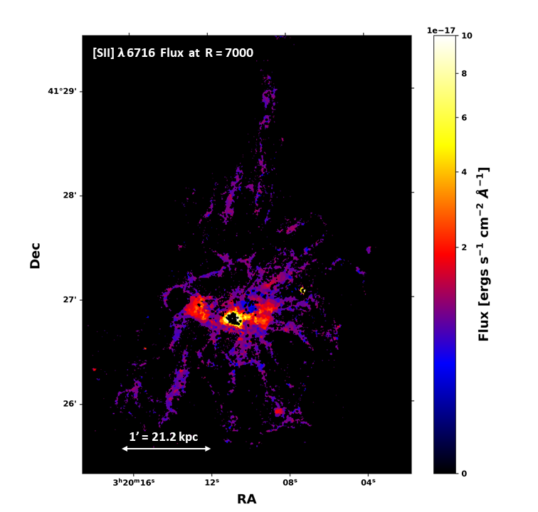

SII Emission

Slide 23
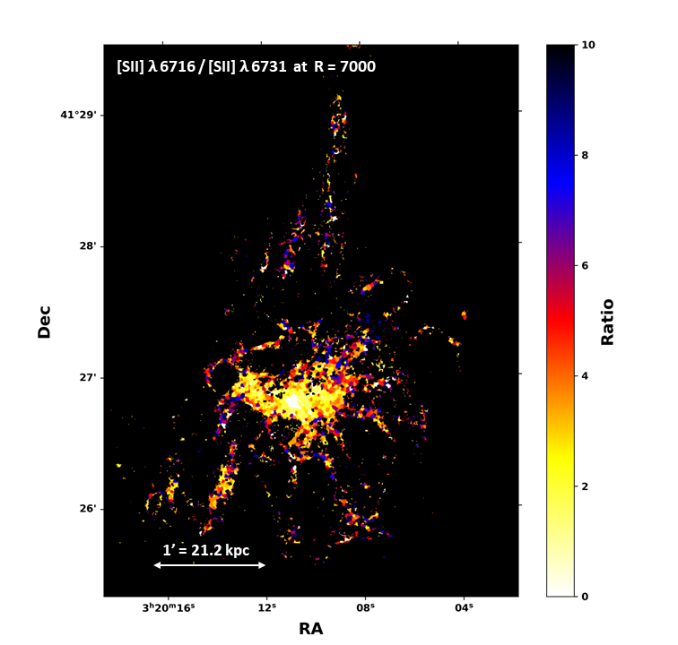
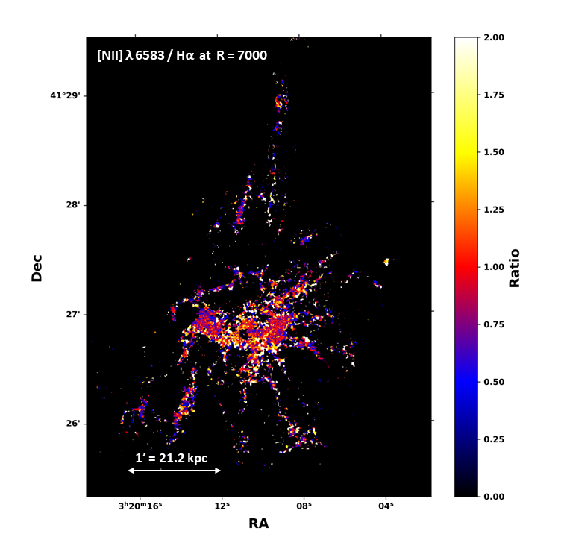
Line Ratios
The ratio SII λ 6716 / SII λ 6731 gives information on the density of the gas.
The lower the ratio, the denser the gas is in the region of interest.
As expected, the central region near the AGN has a higher density compared to the filaments.
The south-western filaments also seem to display a higher density compared to the other filaments.

