Slide 1
Abundances of heavy elements in neutron star mergers with SPARK
Nick Vieira
John Ruan & Daryl Haggard
PhD candidate
Trottier Space Institute @ McGill

Slide 2
Where does heavy metal come from?
Big Bang: H, He, Li
Nuclear burning, supernovae: up to ~ iron (Fe)
What about everything else?
Notes:
I want to start off with a very simple question: where does everything in the Universe come from?
We know that hydrogen, helium, and some lithium were produced in the Big Bang. Big Bang Nucleosynthesis is a very successful model aside from some tension between predictions and the observed abundance of lithium.
Aside from this, nuclear burning in the interiors of massive stars can generate some heavier elements. Beyond this, the explosions of massive stars can generate all of the elements in the iron group, up to, e.g., atomic number 30.
But what about everything else?

Slide 3
Where does heavy metal come from?
Big Bang: H, He, Li
Nuclear burning, supernovae: up to ~ iron (Fe)
What about everything else?
Notes:
I want to start off with a very simple question: where does everything in the Universe come from?
We know that hydrogen, helium, and some lithium were produced in the Big Bang. Big Bang Nucleosynthesis is a very successful model aside from some tension between predictions and the observed abundance of lithium.
Aside from this, nuclear burning in the interiors of massive stars can generate some heavier elements. Beyond this, the explosions of massive stars can generate all of the elements in the iron group, up to, e.g., atomic number 30.
But what about everything else?

Slide 4
Where does heavy metal come from?
Big Bang: H, He, Li
Nuclear burning, supernovae: up to ~ iron (Fe)
What about everything else?
Where can we find lots of neutrons?
Notes:
I want to start off with a very simple question: where does everything in the Universe come from?
We know that hydrogen, helium, and some lithium were produced in the Big Bang. Big Bang Nucleosynthesis is a very successful model aside from some tension between predictions and the observed abundance of lithium.
Aside from this, nuclear burning in the interiors of massive stars can generate some heavier elements. Beyond this, the explosions of massive stars can generate all of the elements in the iron group, up to, e.g., atomic number 30.
But what about everything else?

Slide 5
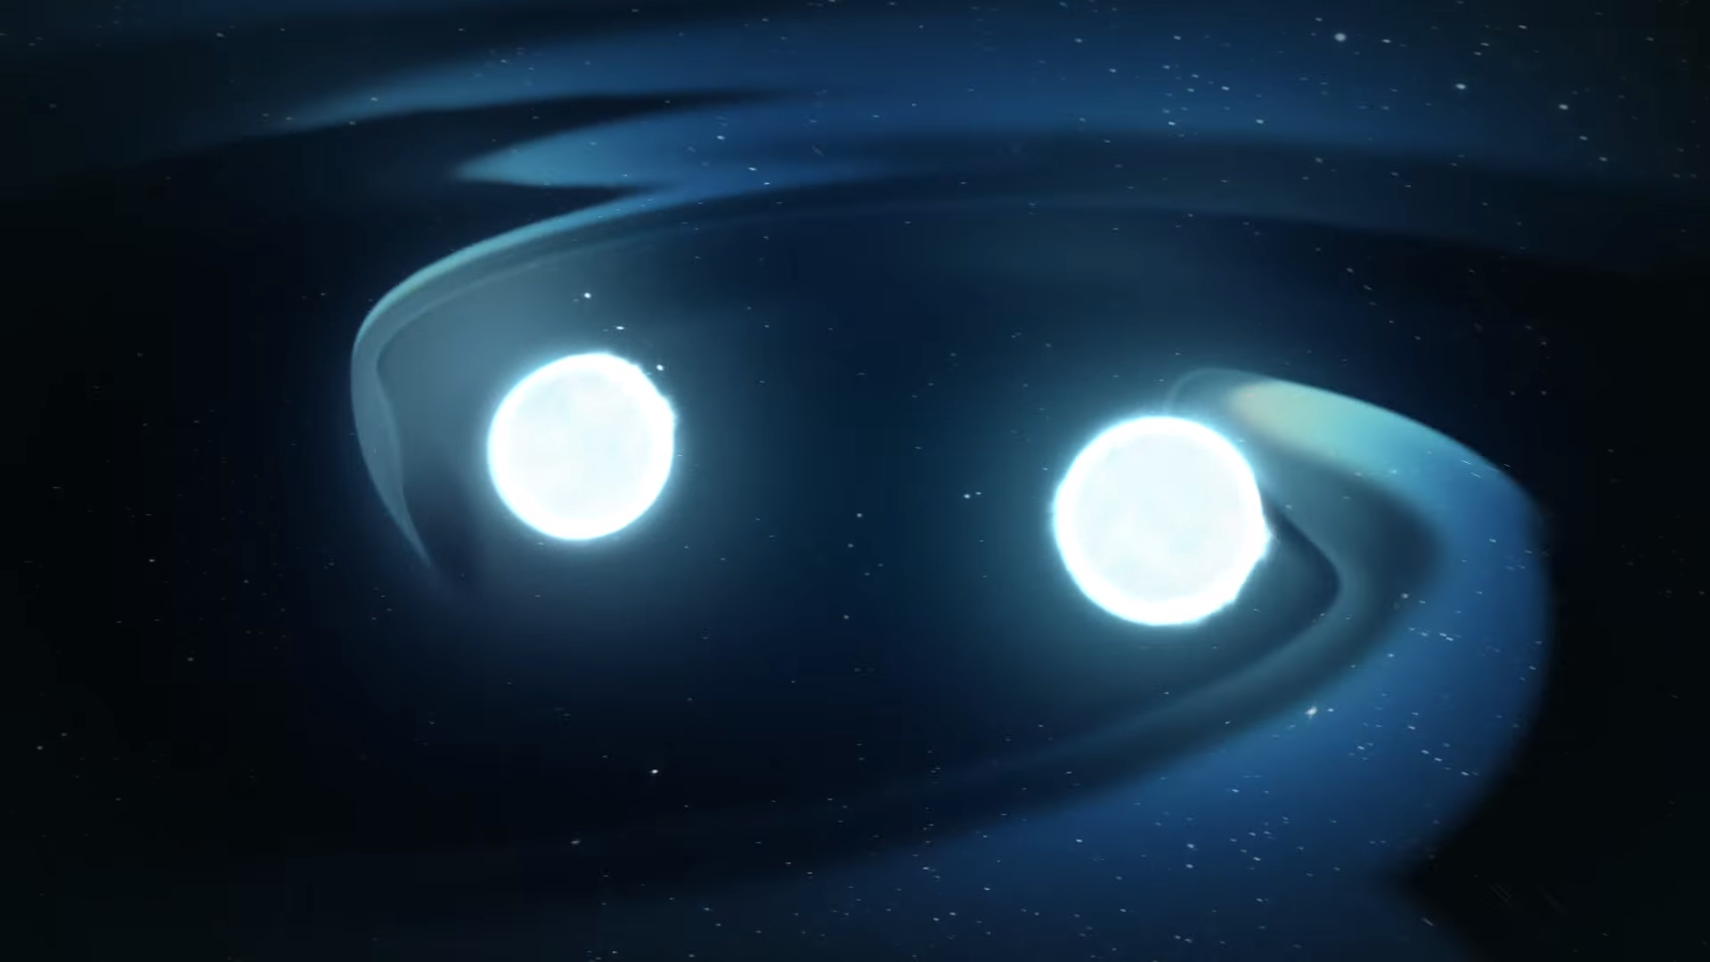
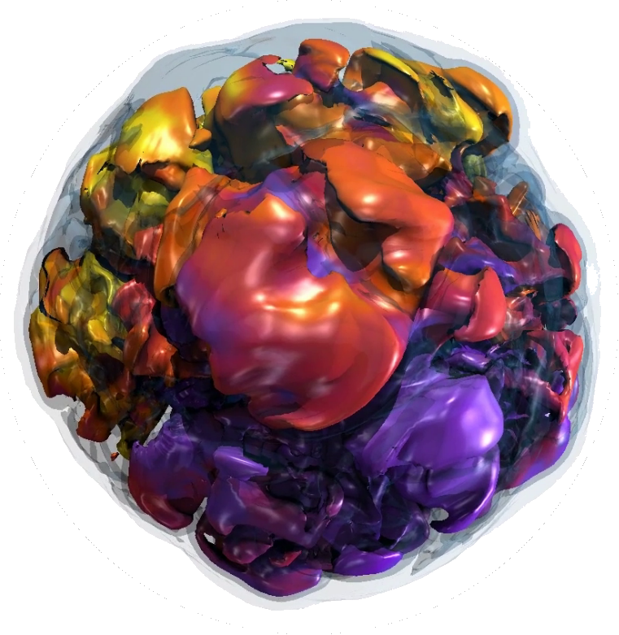
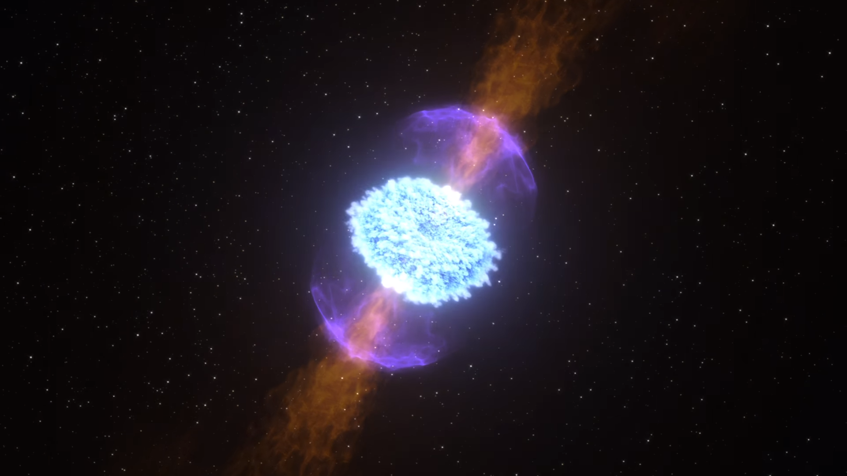
Where can we find large numbers of free neutrons?
neutron star + (neutron star / black hole) mergers
collapse of rapidly-rotating, highly-magnetized, massive stars
NASA Goddard
Burrows+19
Notes:
Indeed, it was recognized almost 70 years ago that you might find these large numbers of free neutrons in astrophysical settings. Many candidate sites have been proposed, but the two which are currently most favoured are the mergers of neutron stars with each other or with black holes, or, the collapse of rapidly-rotating, highly-magnetized, massive stars.
The reason these sites are favoured is that, in the ejecta produced by the catastrophic events, we find the conditions for something called rapid neutron capture, or the r-process.

Slide 6
Where can we find large numbers of free neutrons?
these mergers are a source of gravitational waves!
neutron star + (neutron star / black hole) mergers
collapse of rapidly-rotating, highly-magnetized, massive stars
NASA Goddard
Burrows+19
Notes:
Indeed, it was recognized almost 70 years ago that you might find these large numbers of free neutrons in astrophysical settings. Many candidate sites have been proposed, but the two which are currently most favoured are the mergers of neutron stars with each other or with black holes, or, the collapse of rapidly-rotating, highly-magnetized, massive stars.
The reason these sites are favoured is that, in the ejecta produced by the catastrophic events, we find the conditions for something called rapid neutron capture, or the r-process.

Slide 7
Where can we find large numbers of free neutrons?
these mergers are a source of gravitational waves!
they also shine across the electromagnetic spectrum
neutron star + (neutron star / black hole) mergers
collapse of rapidly-rotating, highly-magnetized, massive stars
NASA Goddard
Burrows+19
Notes:
Indeed, it was recognized almost 70 years ago that you might find these large numbers of free neutrons in astrophysical settings. Many candidate sites have been proposed, but the two which are currently most favoured are the mergers of neutron stars with each other or with black holes, or, the collapse of rapidly-rotating, highly-magnetized, massive stars.
The reason these sites are favoured is that, in the ejecta produced by the catastrophic events, we find the conditions for something called rapid neutron capture, or the r-process.

Slide 8
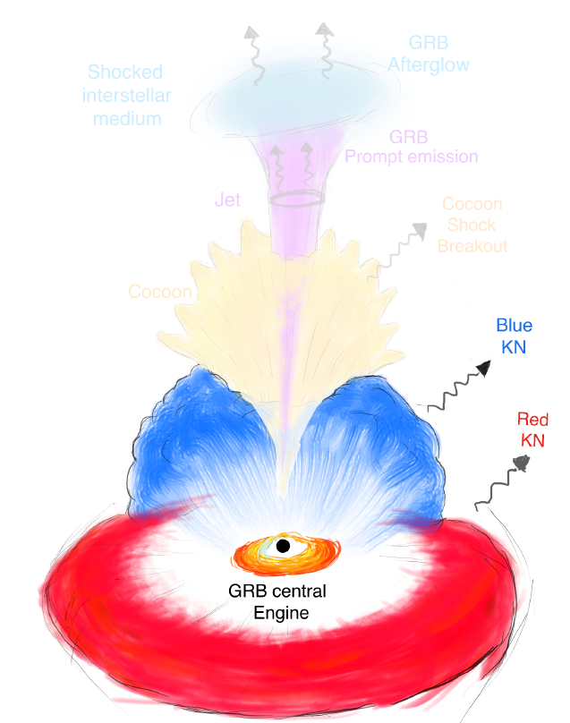
UV / optical / IR: Kilonovae
Neutron-rich ejecta → rapid neutron capture (r-process) to form radioactive isotopes of heavy elements
Elements decay, decay products thermalize → radioactively-powered transient
Ascenzi+21

Slide 9
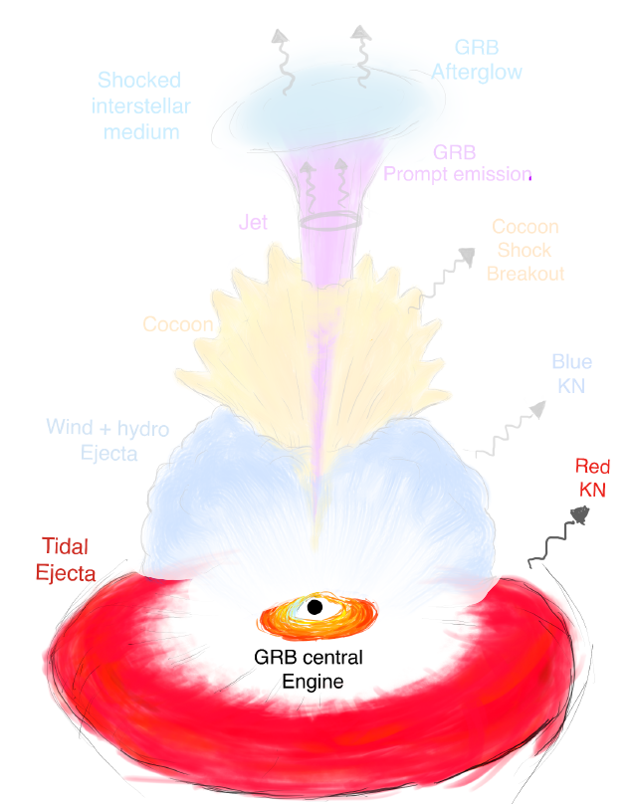
UV / optical / IR: Kilonovae
Tidal ejecta is dominated by heavier elements with large opacities in UV and optical → red(der) ejecta
Ascenzi+21

Slide 10
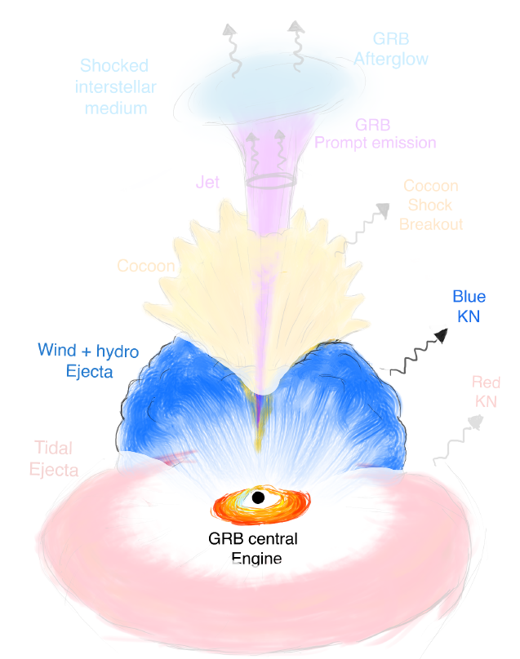
UV / optical / IR: Kilonovae
Disk wind is dominated by lighter elements with smaller overall opacities → blue(r) ejecta
Ascenzi+21

Slide 11
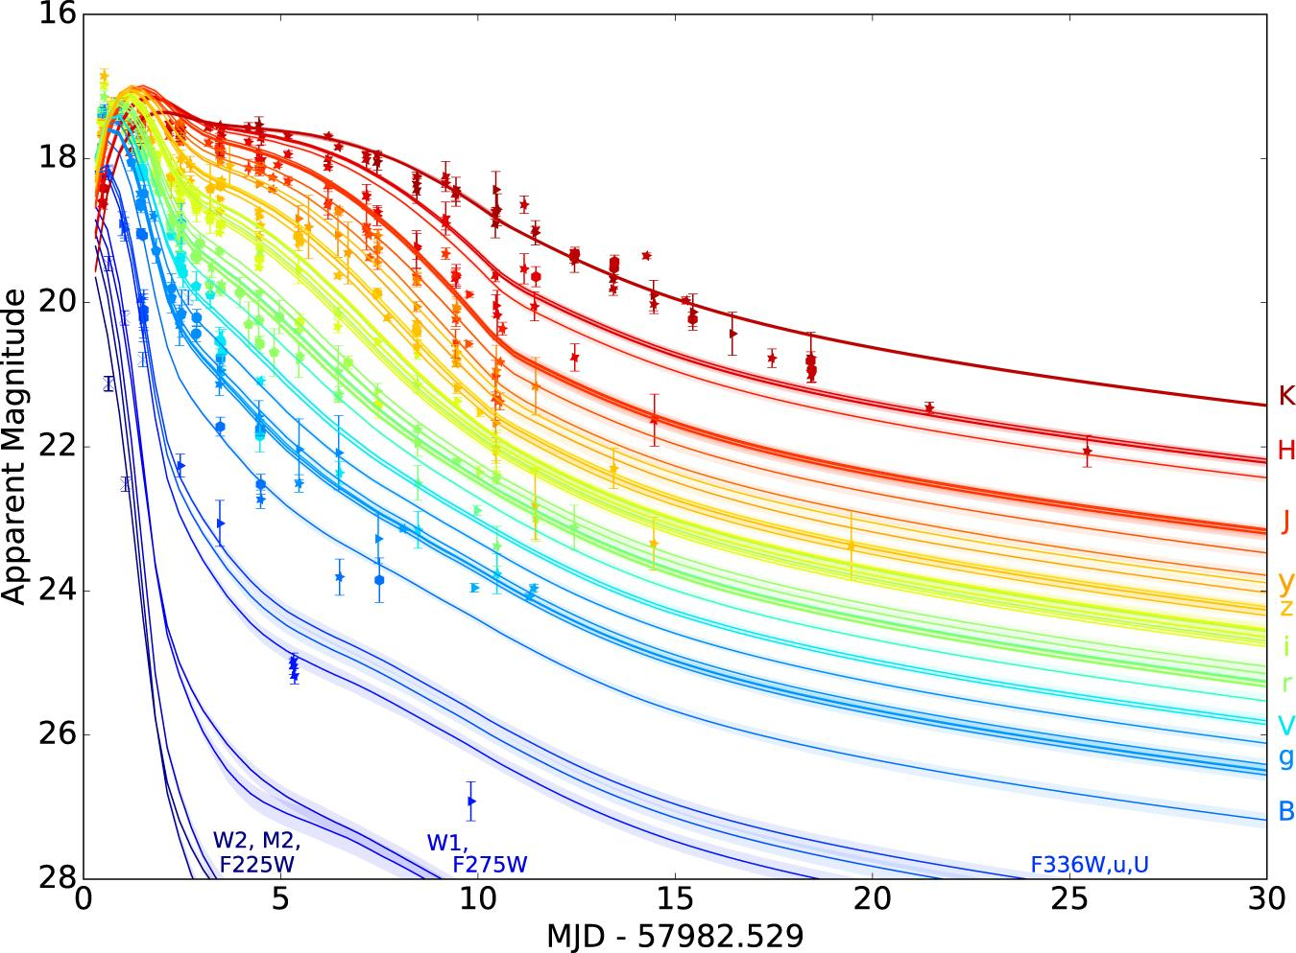
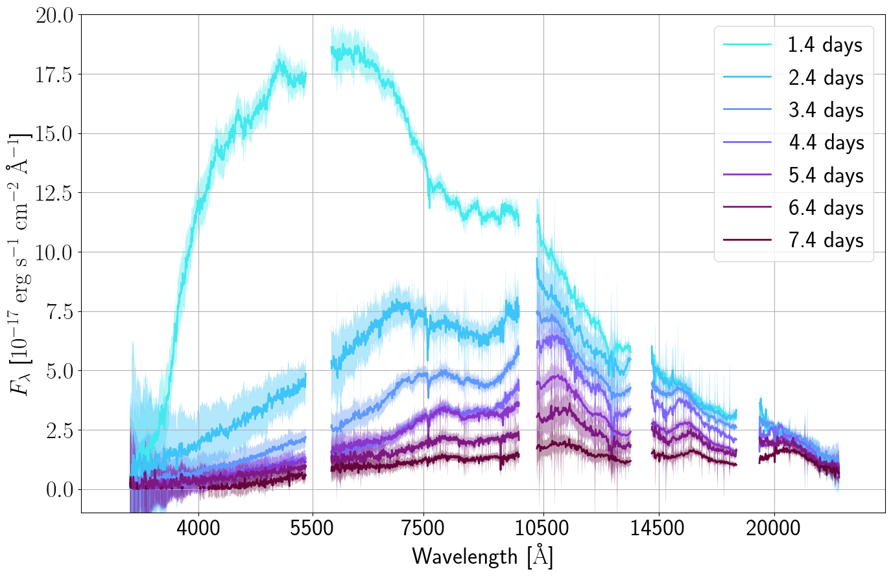
GW170817: first NS-NS merger, only gravitational wave + light detection to date
Villar+17
Data: Pian+17, Smartt+17

Slide 12
Can we infer the abundances of individual elements from the spectra of the GW170817 kilonova?
GW170817: first NS-NS merger, only gravitational wave + light detection to date
Villar+17
Data: Pian+17, Smartt+17
Notes:
VERSION 1 OF THIS TRANSITION

Slide 13
SPARK: Spectroscopic r-Process Abundance Retrieval for Kilonovae
Idea: Generate many synthetic spectra and compare them to observations → Fit for the r-process elemental abundance pattern of GW170817 (“spectral retrieval”)

Slide 14
Radiative transfer with TARDIS
1D Monte Carlo radiative transfer code for spectral synthesis
Radiation-matter interactions in a stratified medium under homologous expansion (supernovae, kilonovae)
Synthetic spectrum at a point in time
Elemental abundances are an input
https://tardis-sn.github.io/tardis/

Slide 15
SPARK: Spectroscopic r-Process Abundance Retrieval for Kilonovae
Problems:
many elements → high dimensionality if we naively fit for each abundance individually
simulations are computationally expensive
Idea: Generate many synthetic spectra and compare them to observations → Fit for the r-process elemental abundance pattern of GW170817 (“spectral retrieval”)

Slide 16
SPARK: Spectroscopic r-Process Abundance Retrieval for Kilonovae
Problems:
many elements → high dimensionality if we naively fit for each abundance individually
simulations are computationally expensive
parametrize abundances
Idea: Generate many synthetic spectra and compare them to observations → Fit for the r-process elemental abundance pattern of GW170817 (“spectral retrieval”)

Slide 17
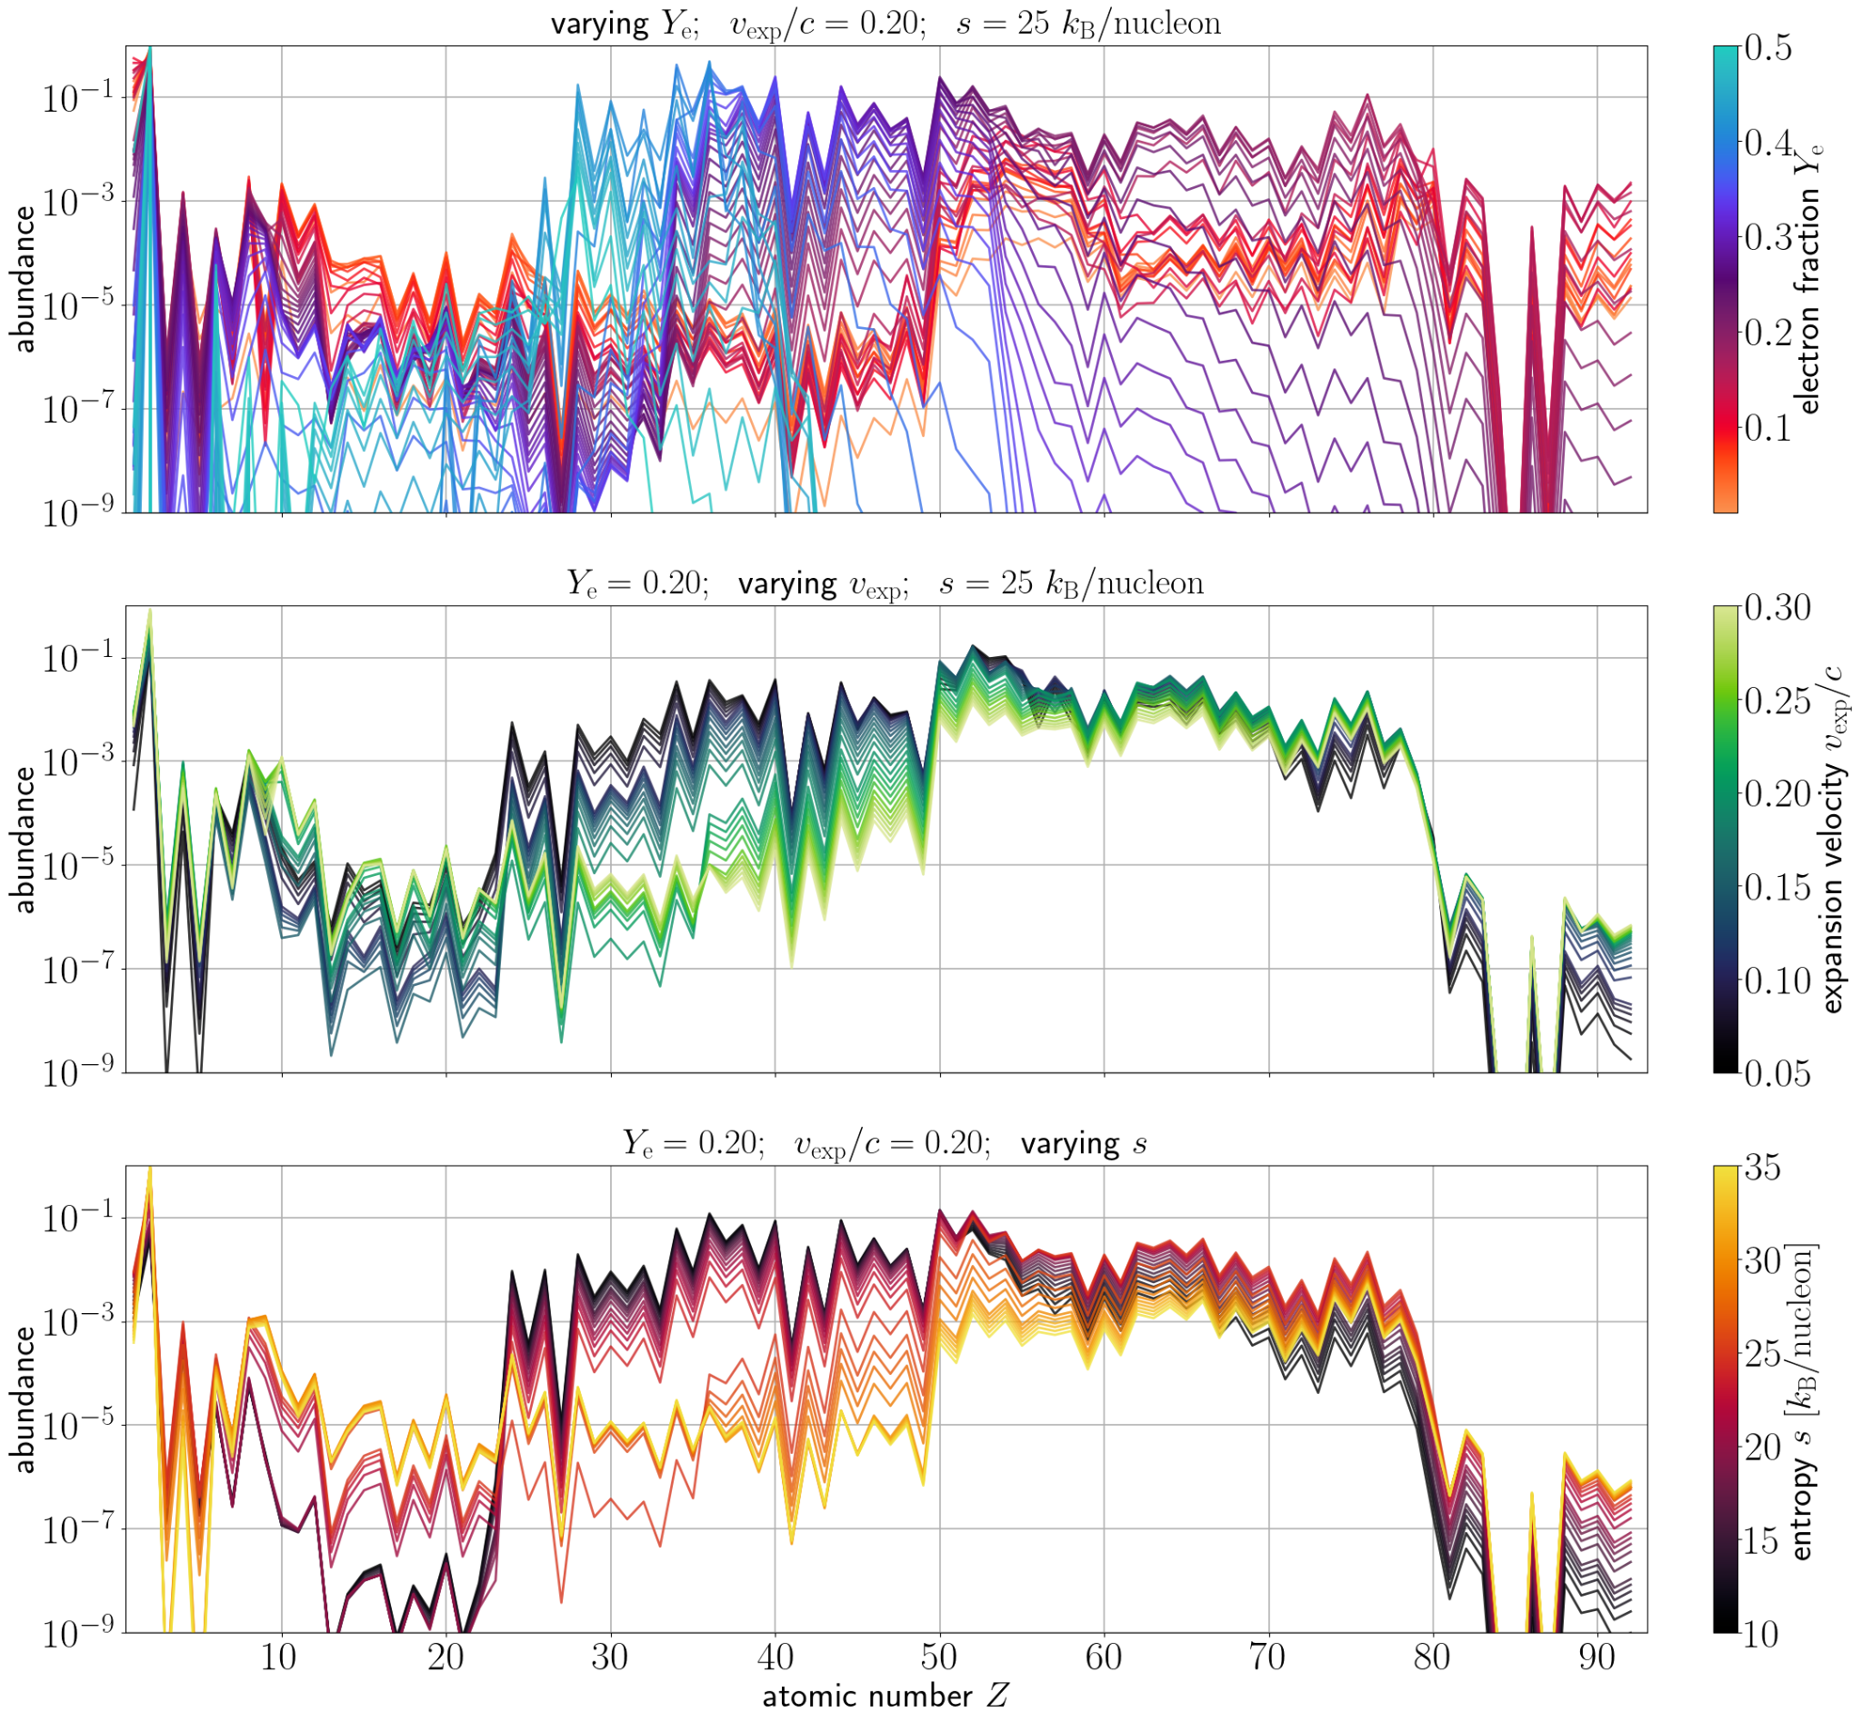
Parametrizing the abundances
Parametrize using electron fraction, expansion velocity, and entropy
Constrain fundamental conditions of the r-process
Vieira+23 (SPARK I)
Reaction network: Wanajo 18

Slide 18
SPARK: Spectroscopic r-Process Abundance Retrieval for Kilonovae
Problems:
many elements → high dimensionality if we naively fit for each abundance individually
simulations are computationally expensive
parametrize abundances
Idea: Generate many synthetic spectra and compare them to observations → Fit for the r-process elemental abundance pattern of GW170817 (“spectral retrieval”)

Slide 19
SPARK: Spectroscopic r-Process Abundance Retrieval for Kilonovae
Problems:
many elements → high dimensionality if we naively fit for each abundance individually
simulations are computationally expensive
parametrize abundances
active learning
Idea: Generate many synthetic spectra and compare them to observations → Fit for the r-process elemental abundance pattern of GW170817 (“spectral retrieval”)

Slide 20
Ambitions
Does the inferred abundance pattern evolve with time?

Slide 21
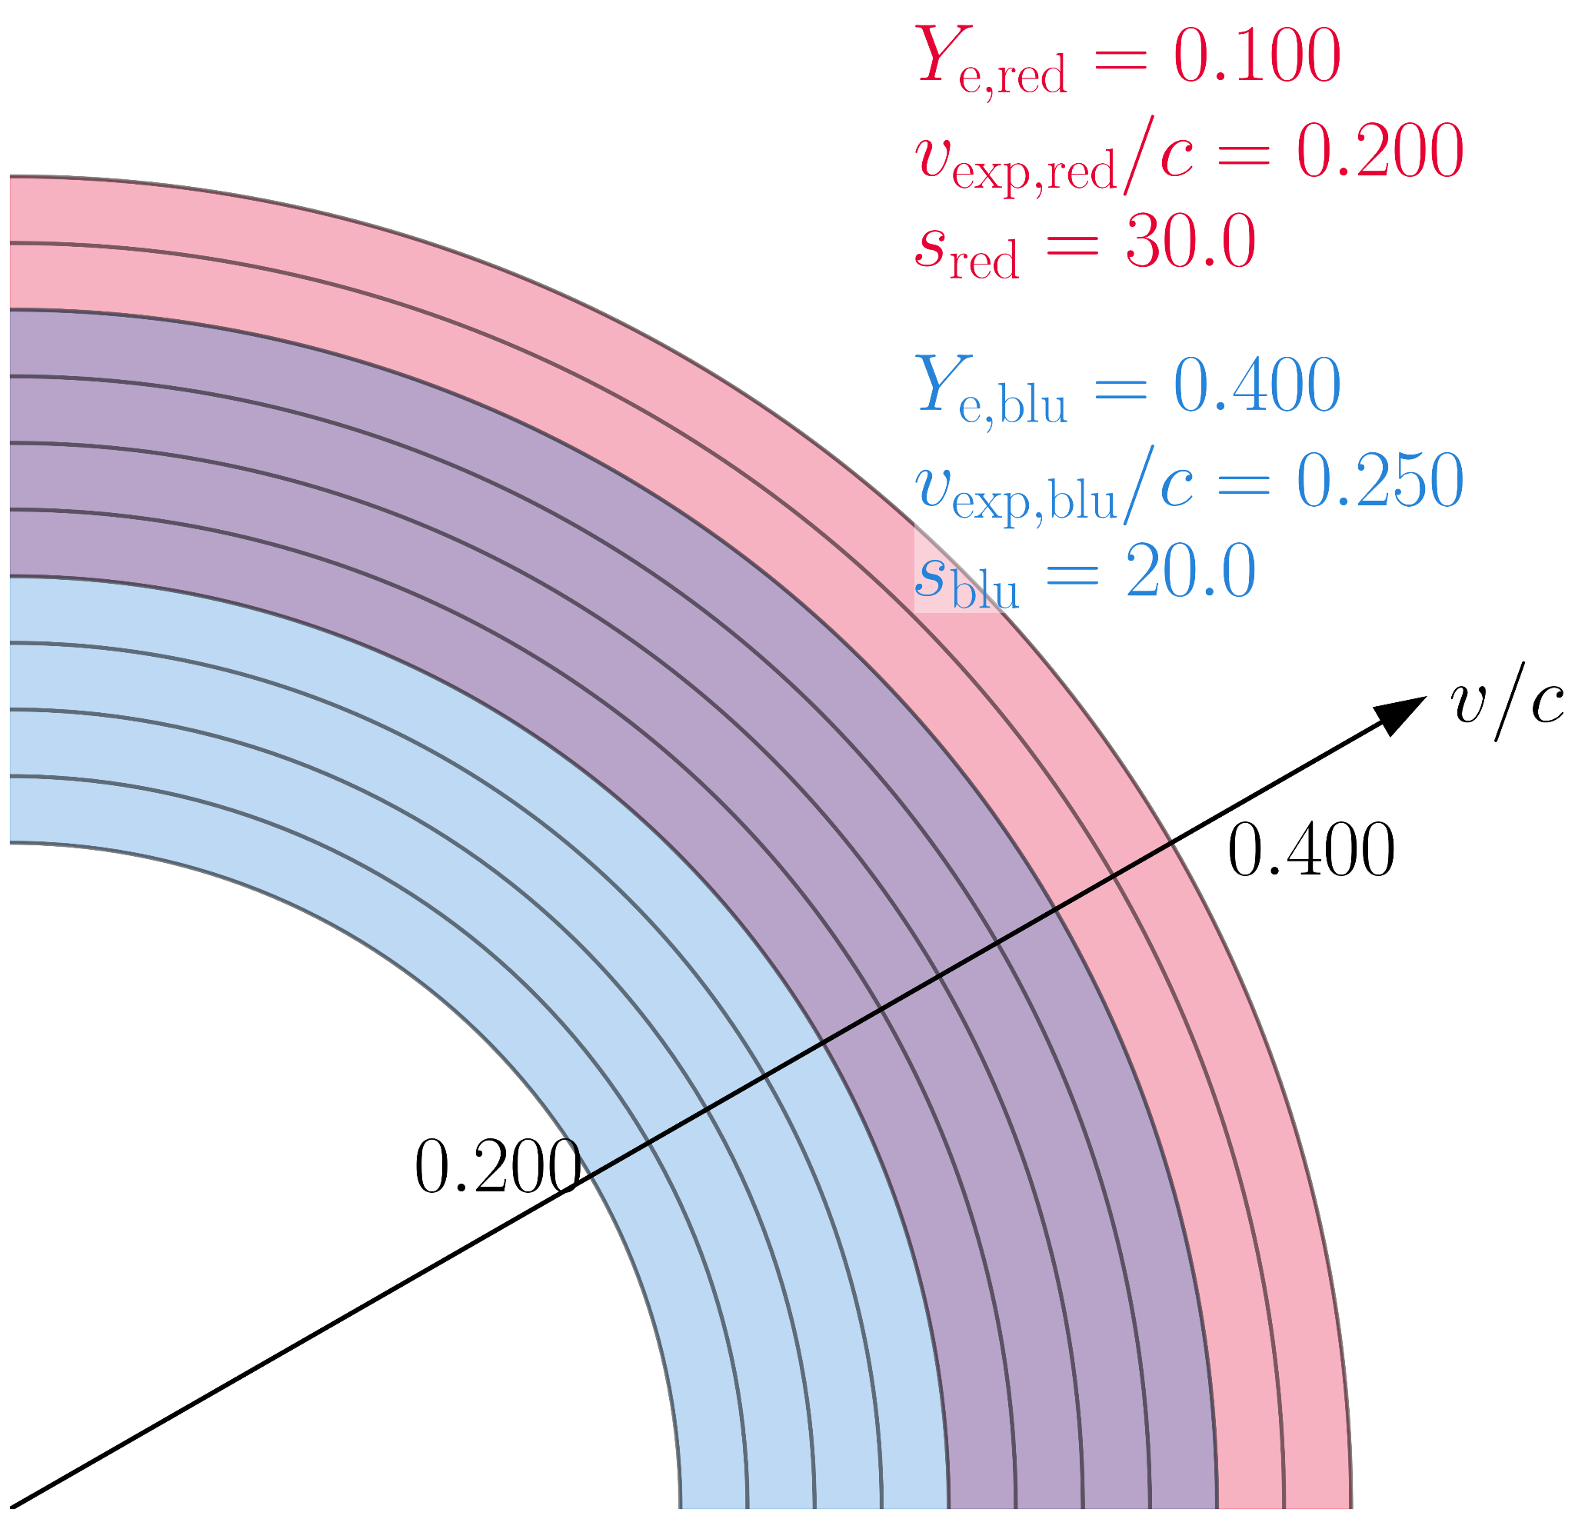
Ambitions
Do we need multi-component ejecta models to fit later epochs?

Slide 22
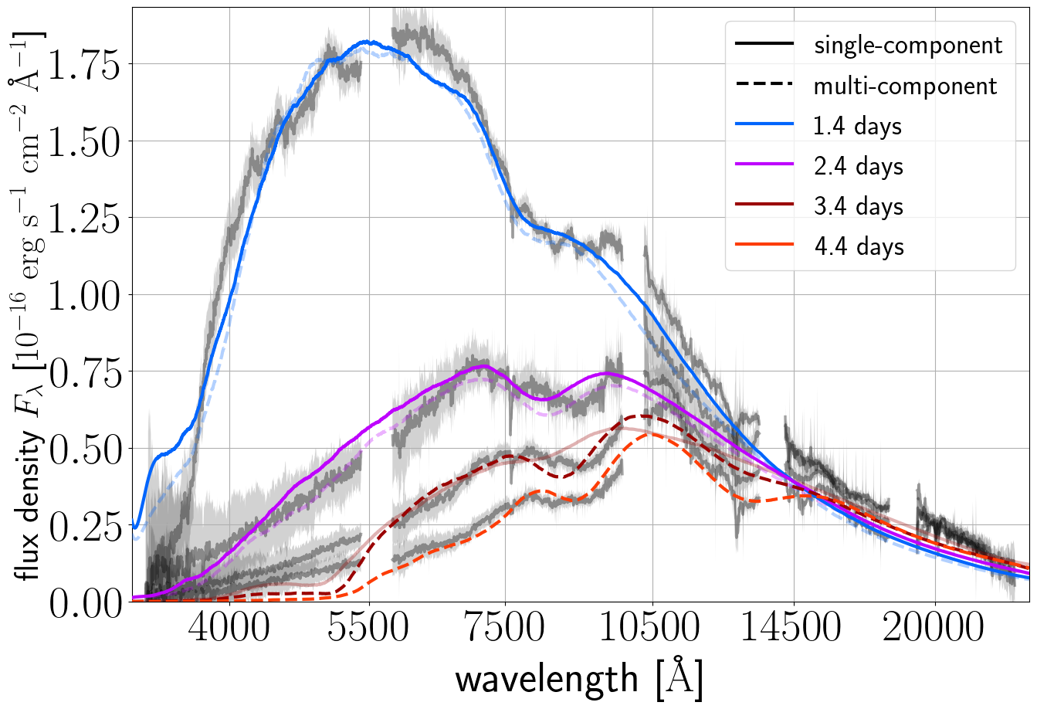
Favoured models
Vieira et al

Slide 23
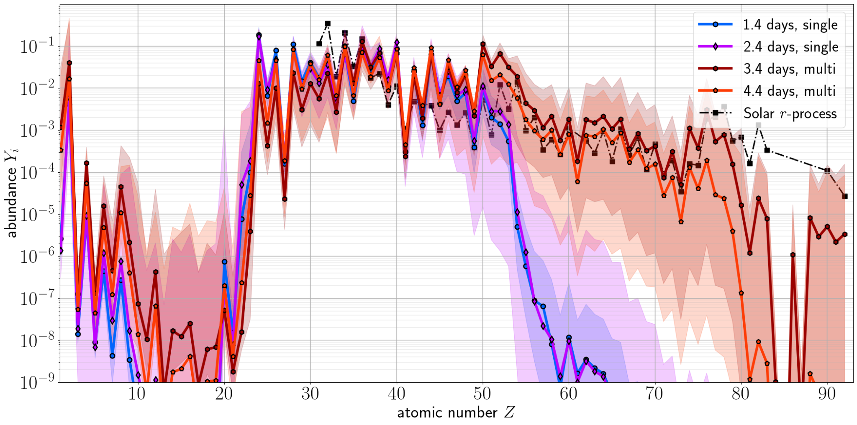
Abundances
Vieira et al
Solar r-process: Lodders 09 & Bisterzo+14

Slide 24
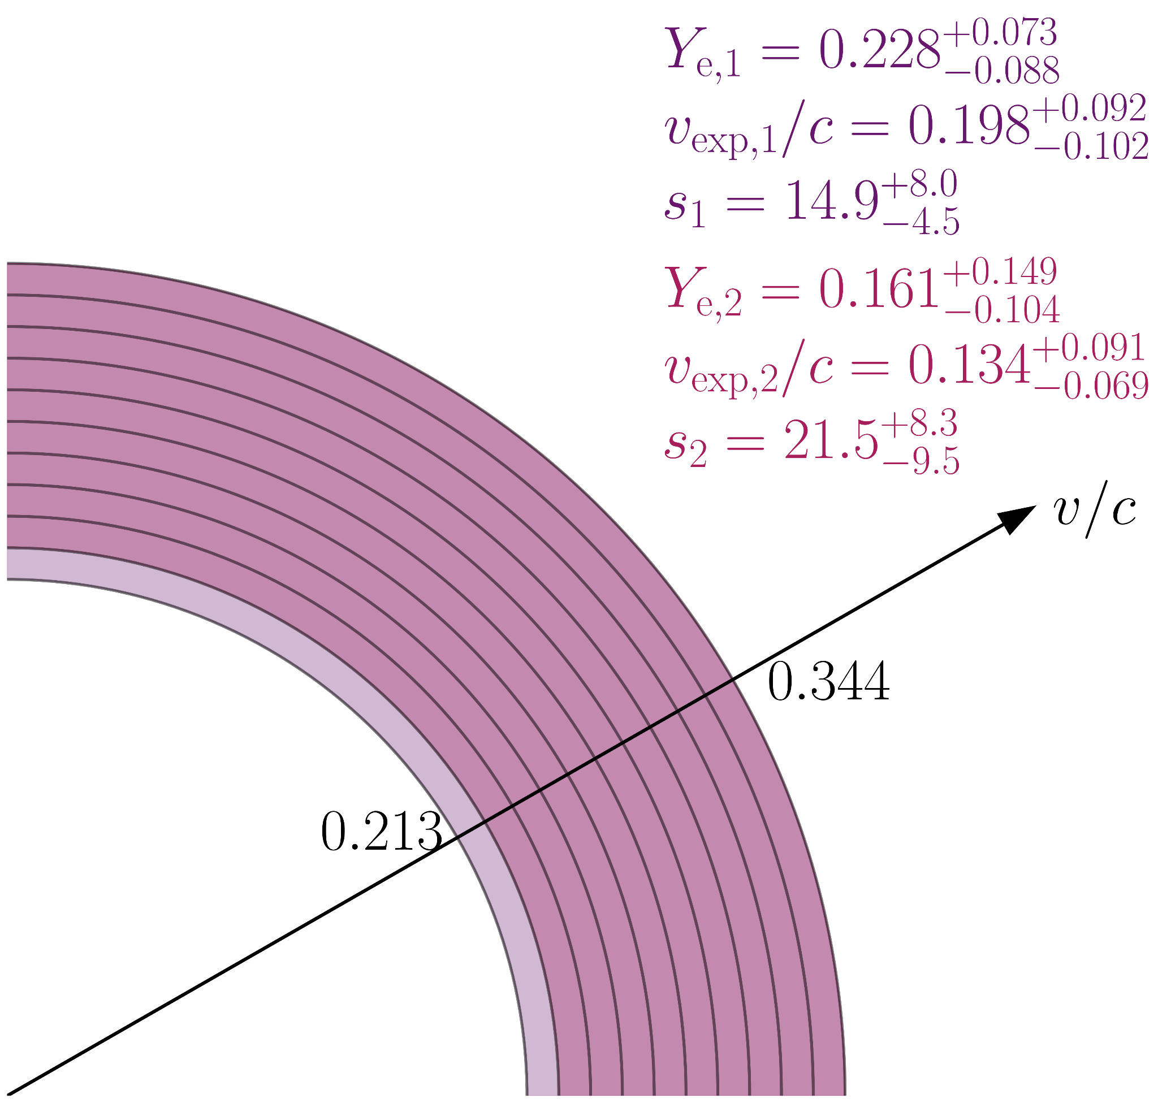
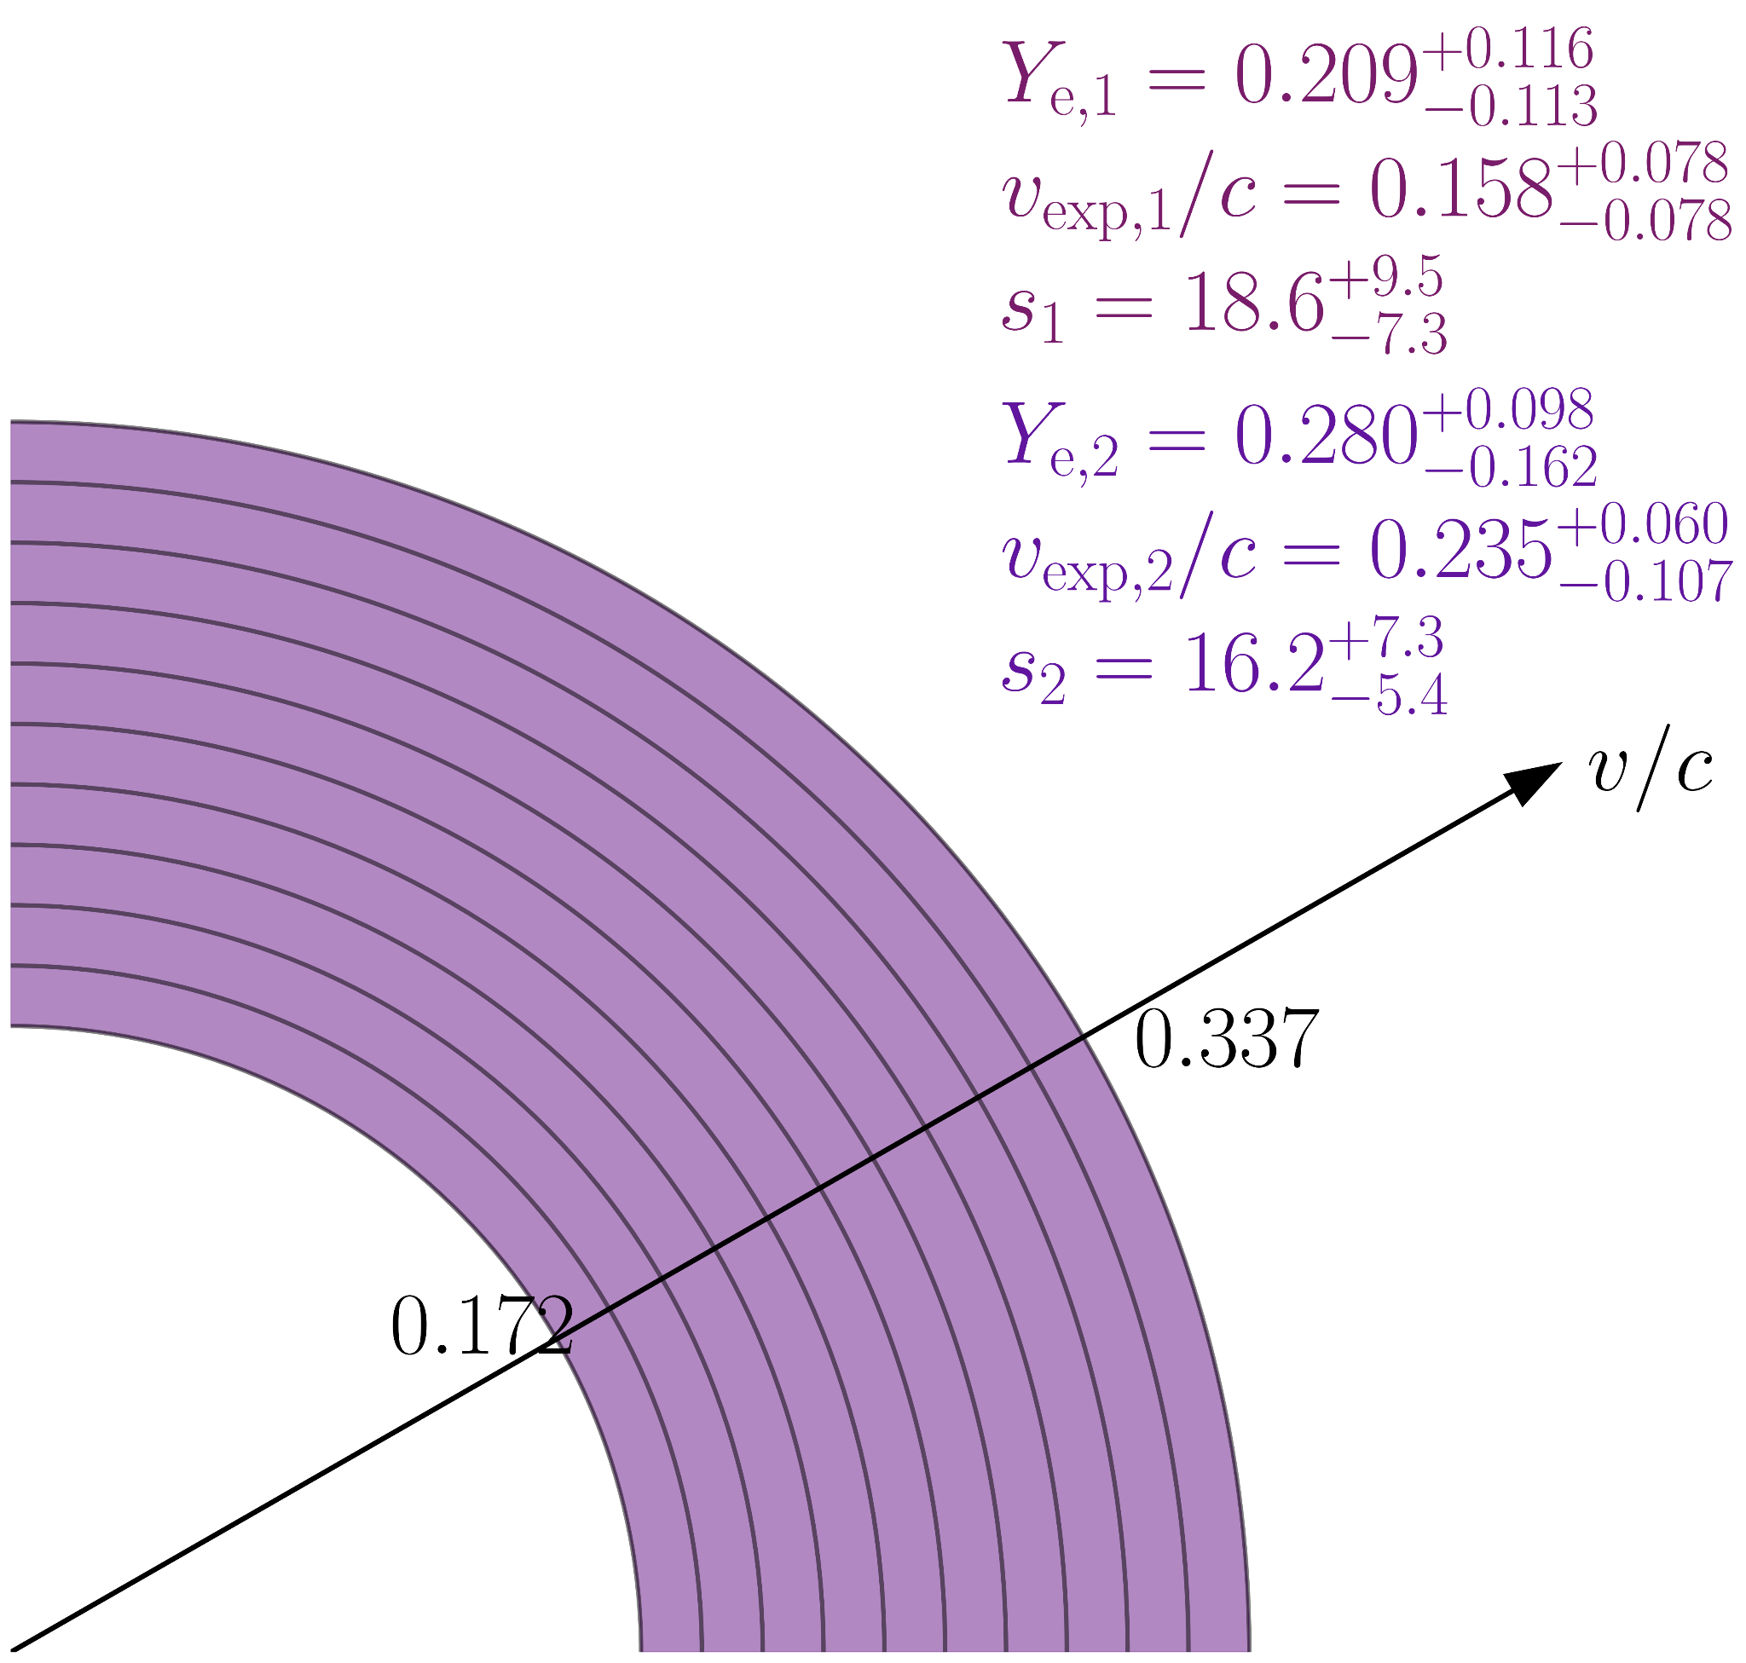
Multi-component ejecta geometries
3.4 days
4.4 days
Vieira et al

Slide 25
Multi-component ejecta geometries
3.4 days
4.4 days
genuinely multi-component!
~complete overlap; different compositions
~complete overlap; different compositions
Vieira et al

Slide 26
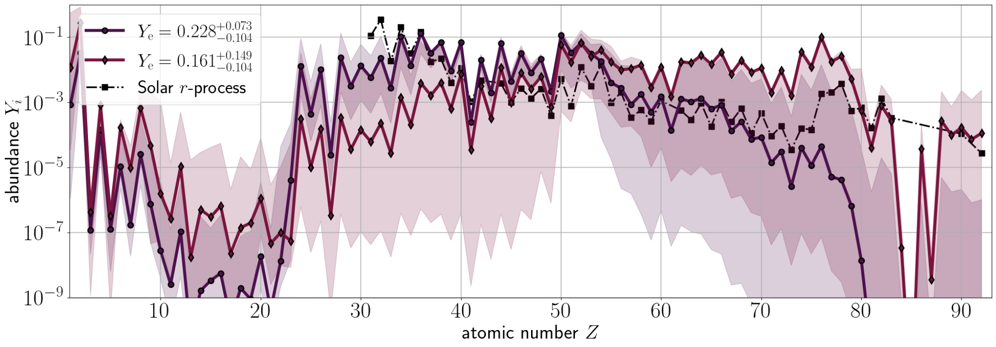
Compare components' abundances @ 3.4 days
Vieira+24 (SPARK II)
Solar r-process: Lodders 09 & Bisterzo+14

Slide 27
Compare components' abundances @ 3.4 days
more Sr
Vieira+24 (SPARK II)
Solar r-process: Lodders 09 & Bisterzo+14

Slide 28
Compare components' abundances @ 3.4 days
more lanthanides
Vieira+24 (SPARK II)
Solar r-process: Lodders 09 & Bisterzo+14

Slide 29
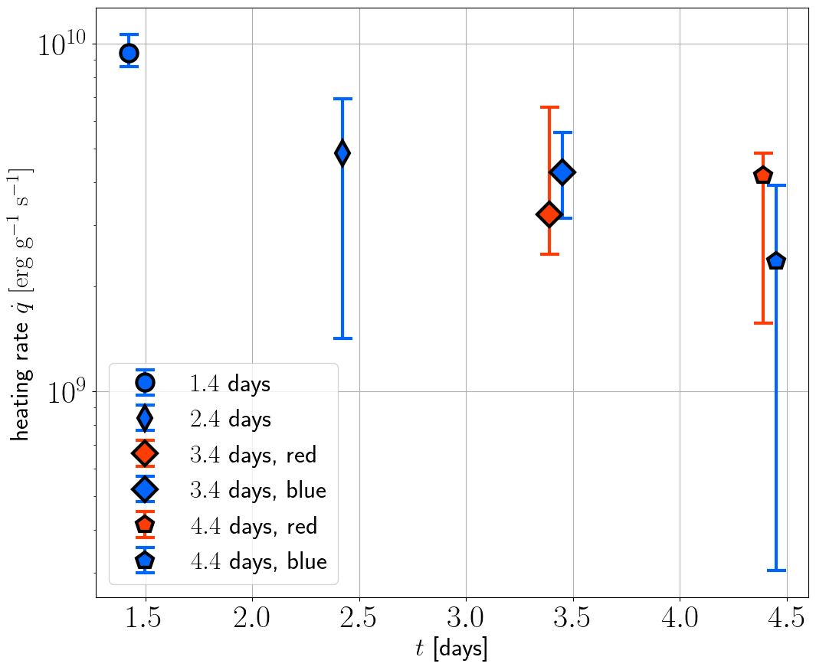
Conclusions & looking forward
We infer abundances of the GW17017 kilonova at 1.4, 2.4, 3.4, and 4.4 days post-merger
New lanthanide-rich red component emerges at 3.4 days, in addition to the blue component
Next steps:
We can also infer the heating rates; how do these drive light curves?
Are non-LTE effects relevant at later epochs?
What about new kilonovae?

Slide 30
EXTRA RESULTS FOLLOW

Slide 31
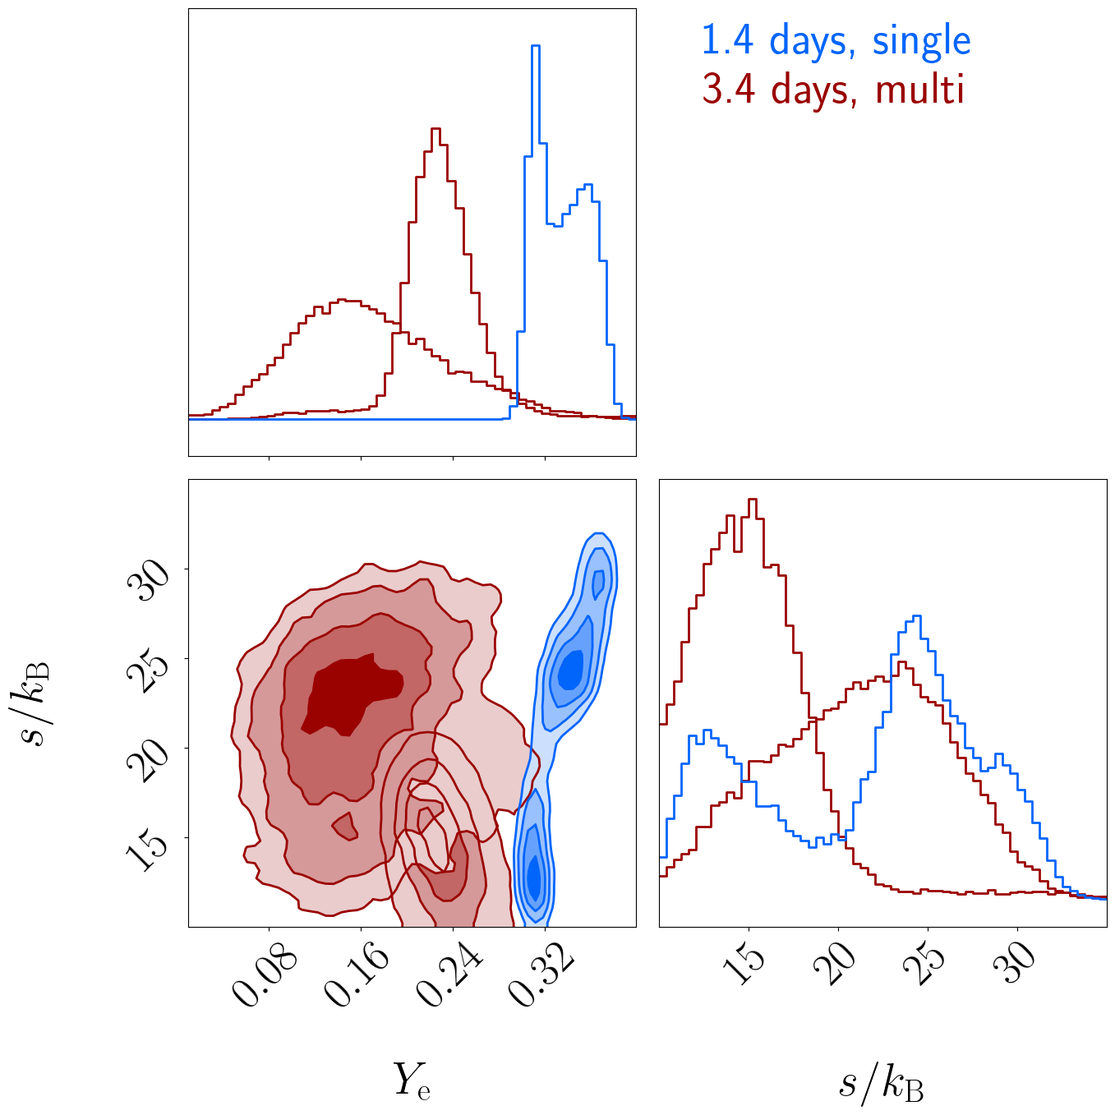
Posteriors for electron fraction and entropy
Vieira et al

Slide 32
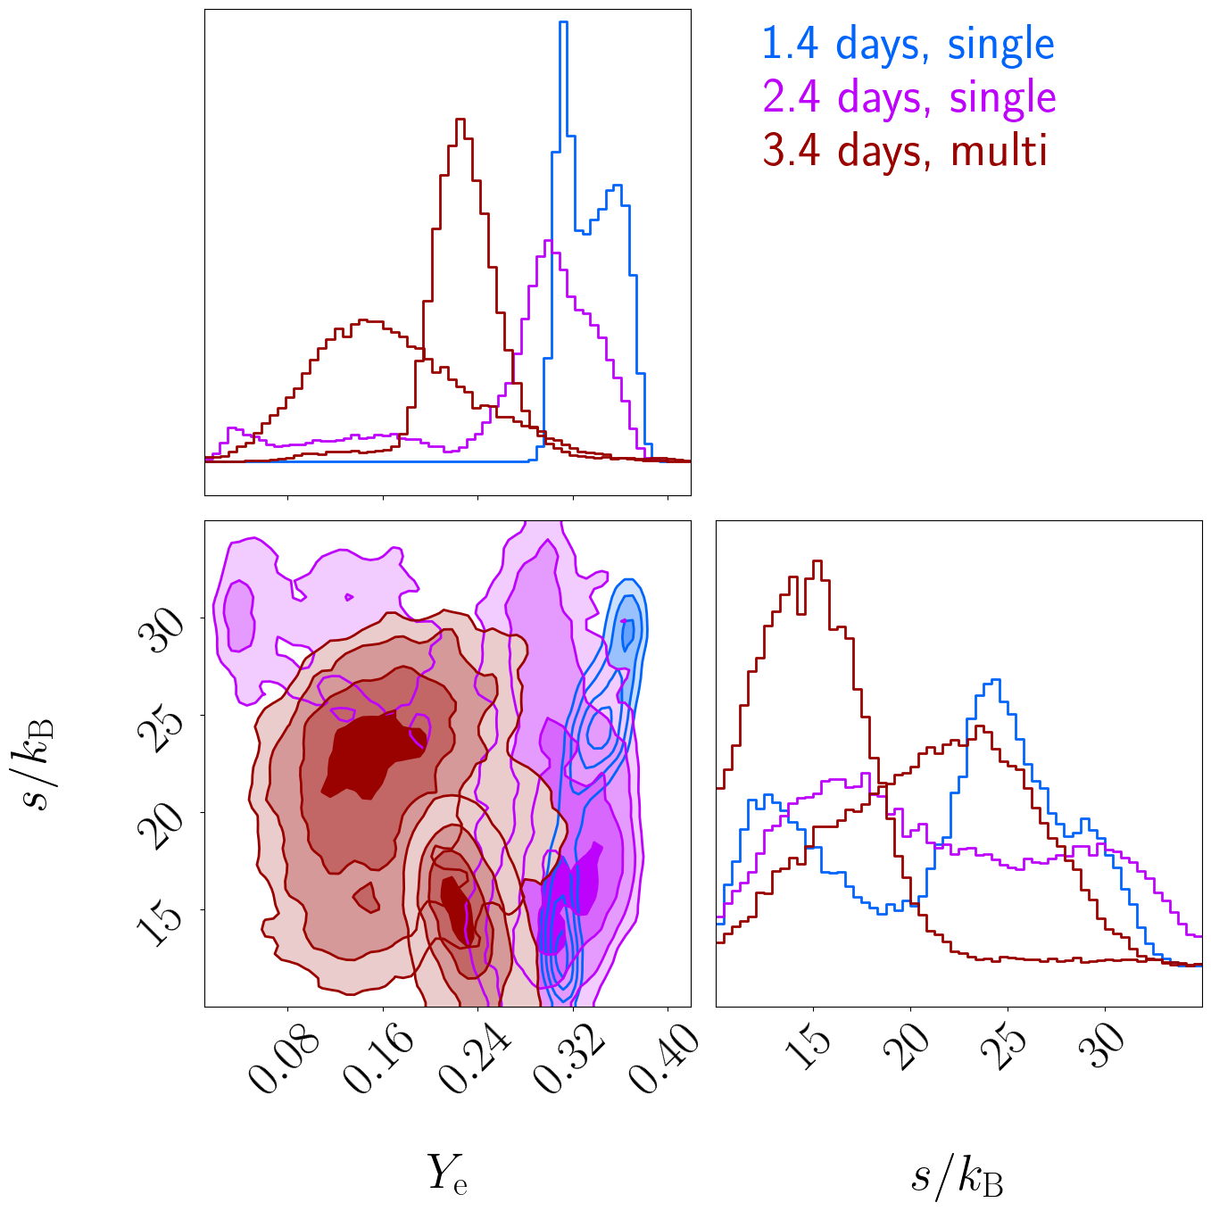
Posteriors for electron fraction and entropy
Vieira+24 (SPARK II)

Slide 33
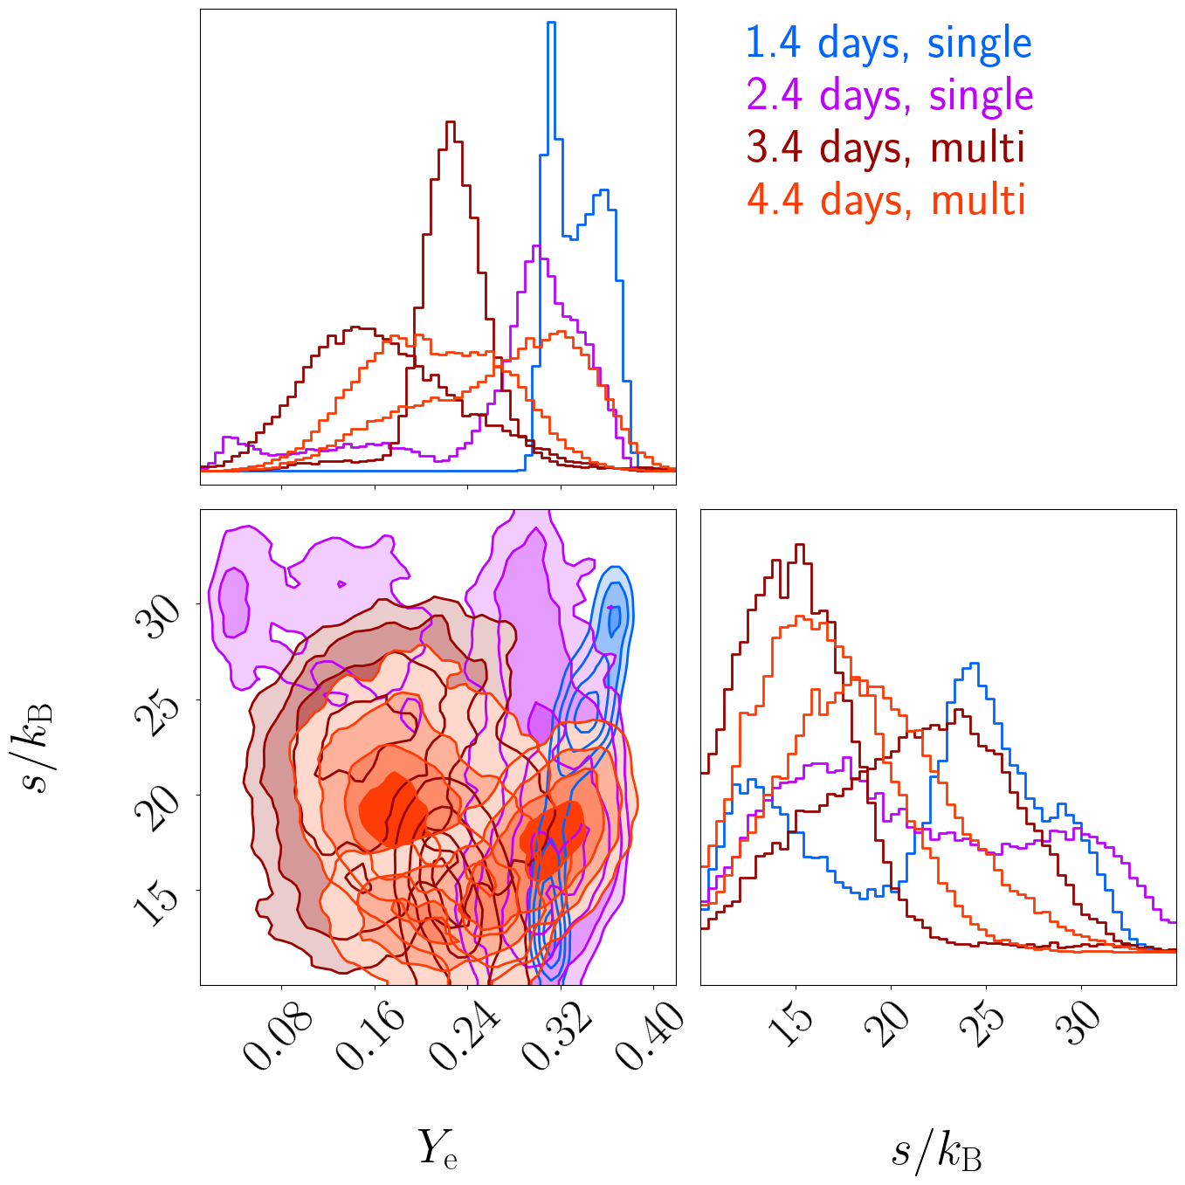
Posteriors for electron fraction and entropy
Vieira et al

Slide 34
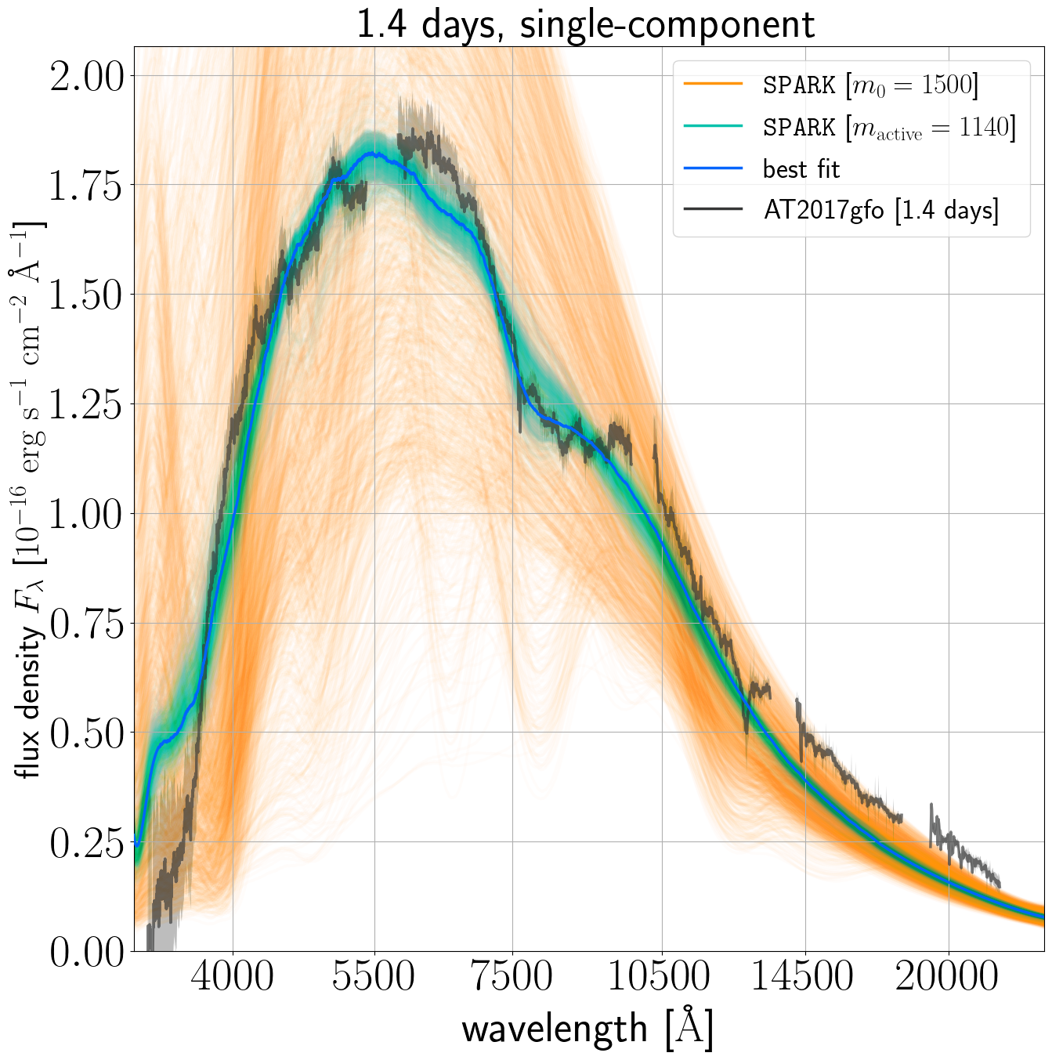
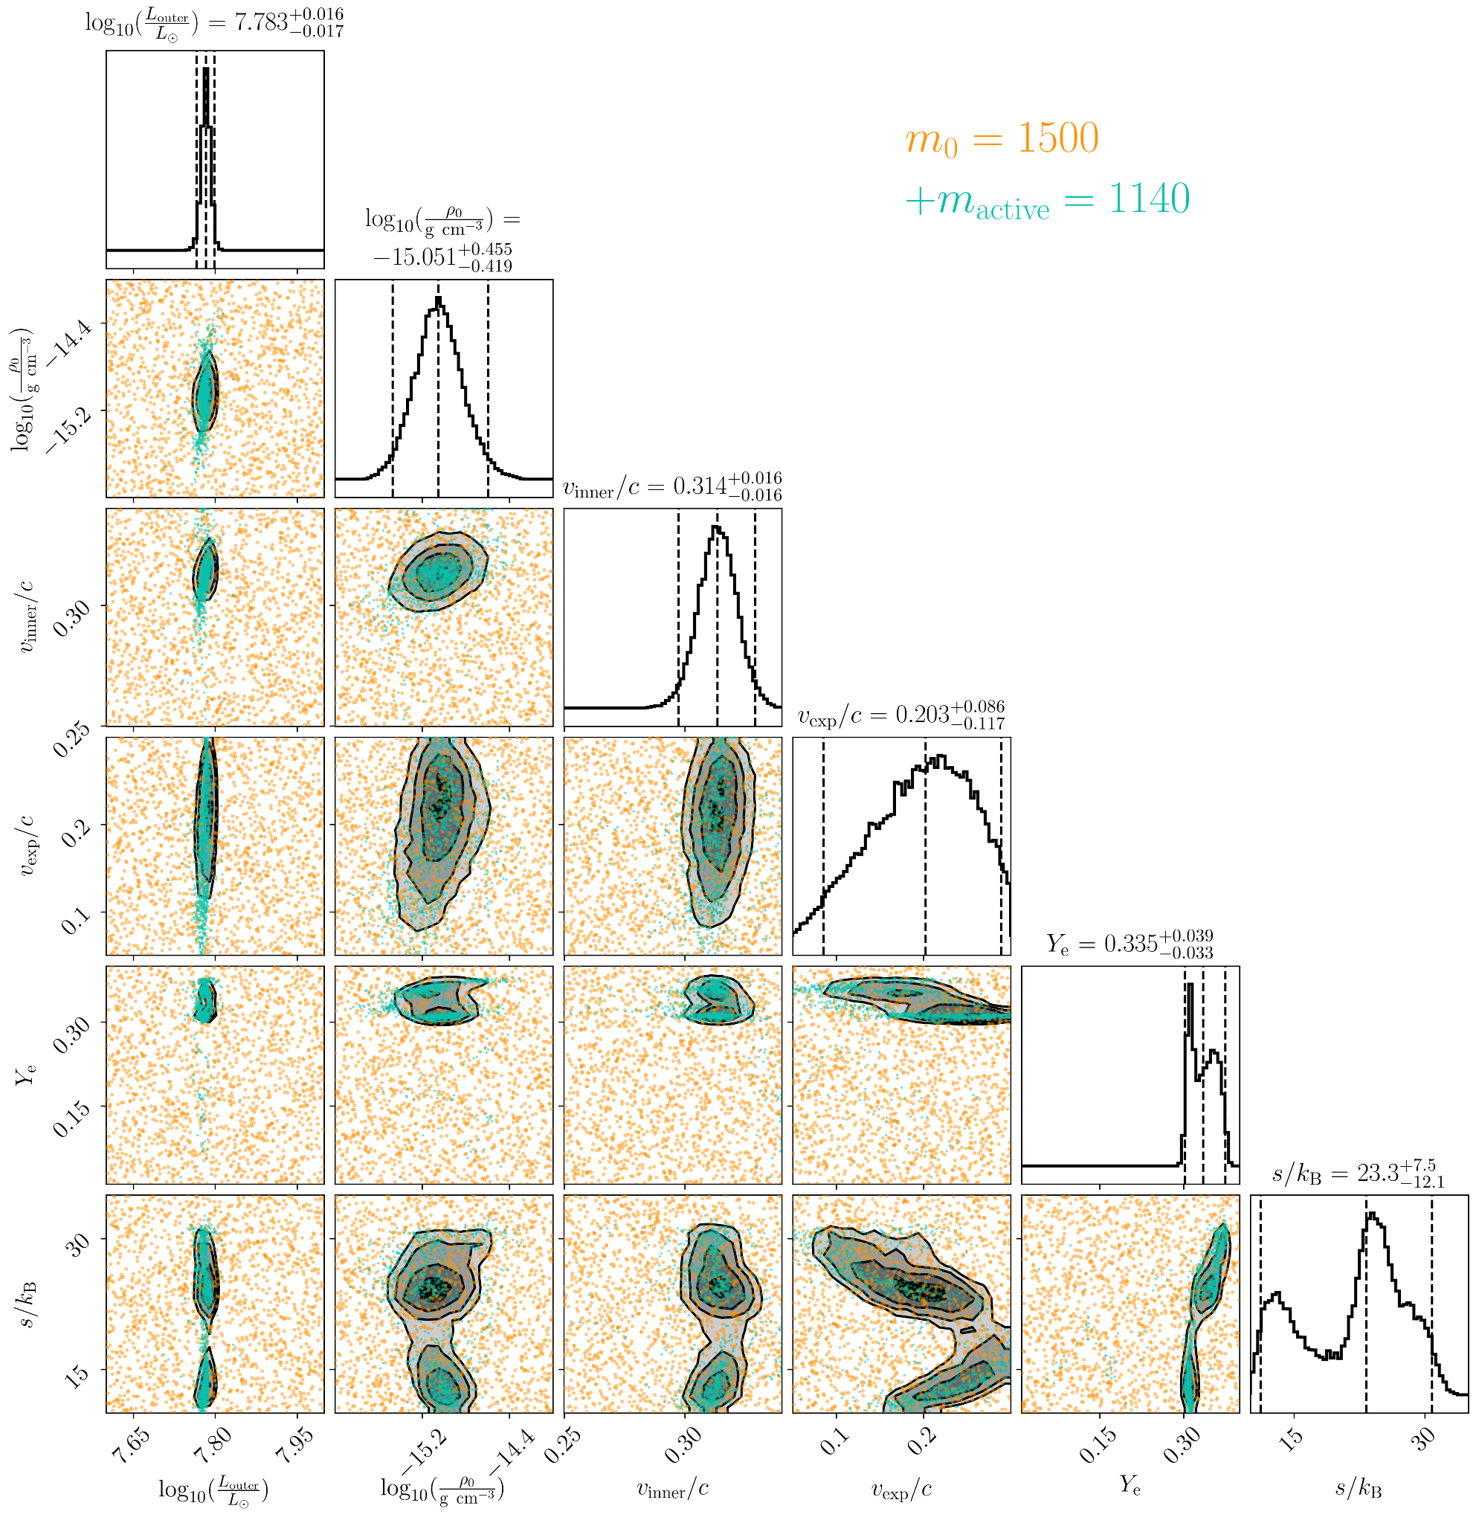
1.4 days, single-component
Vieira+24 (SPARK II)

Slide 35
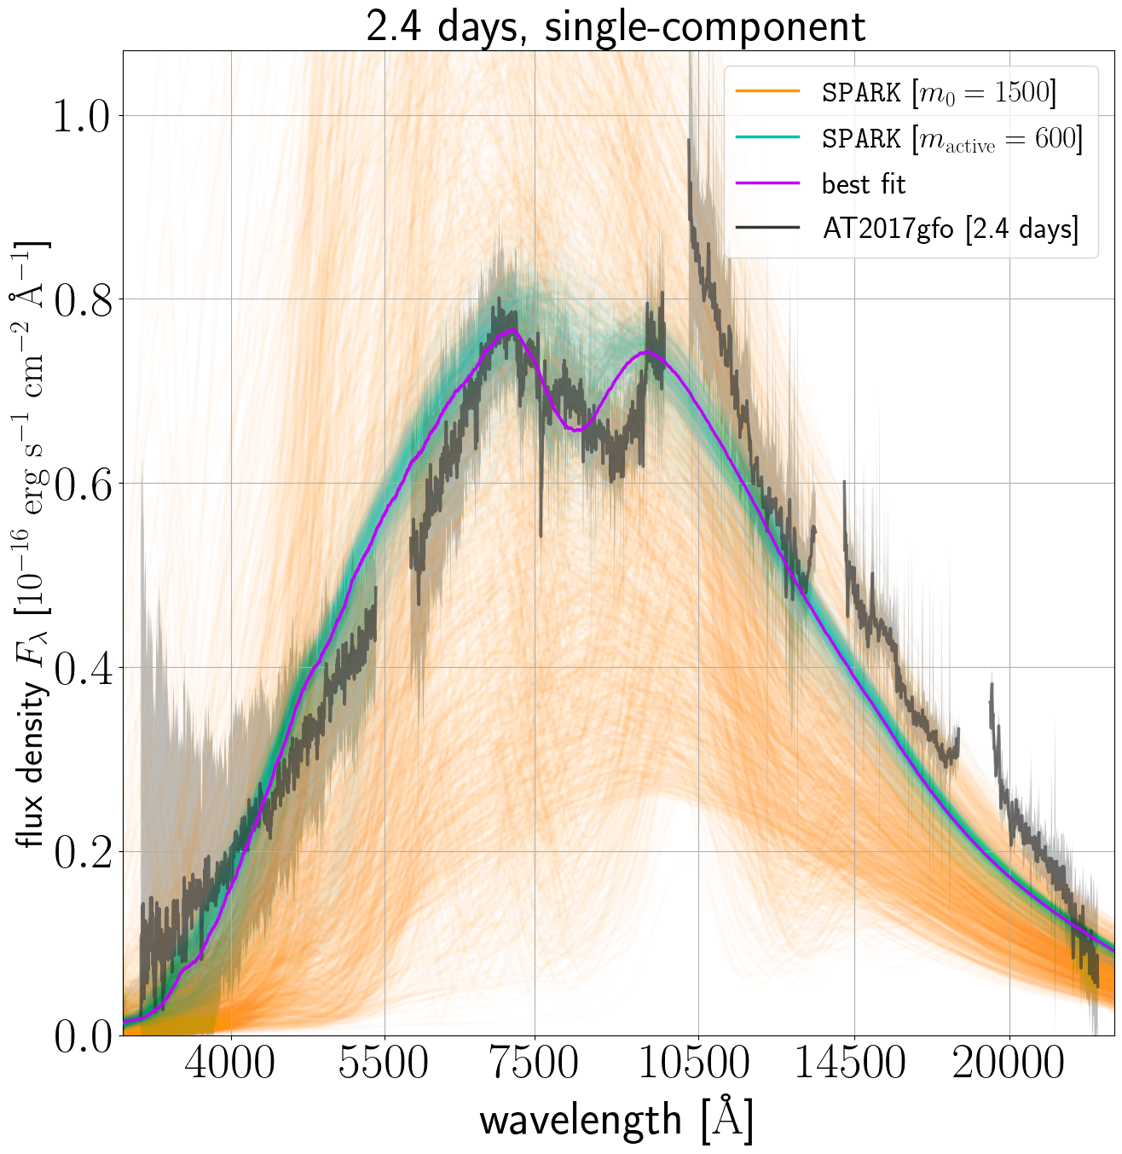
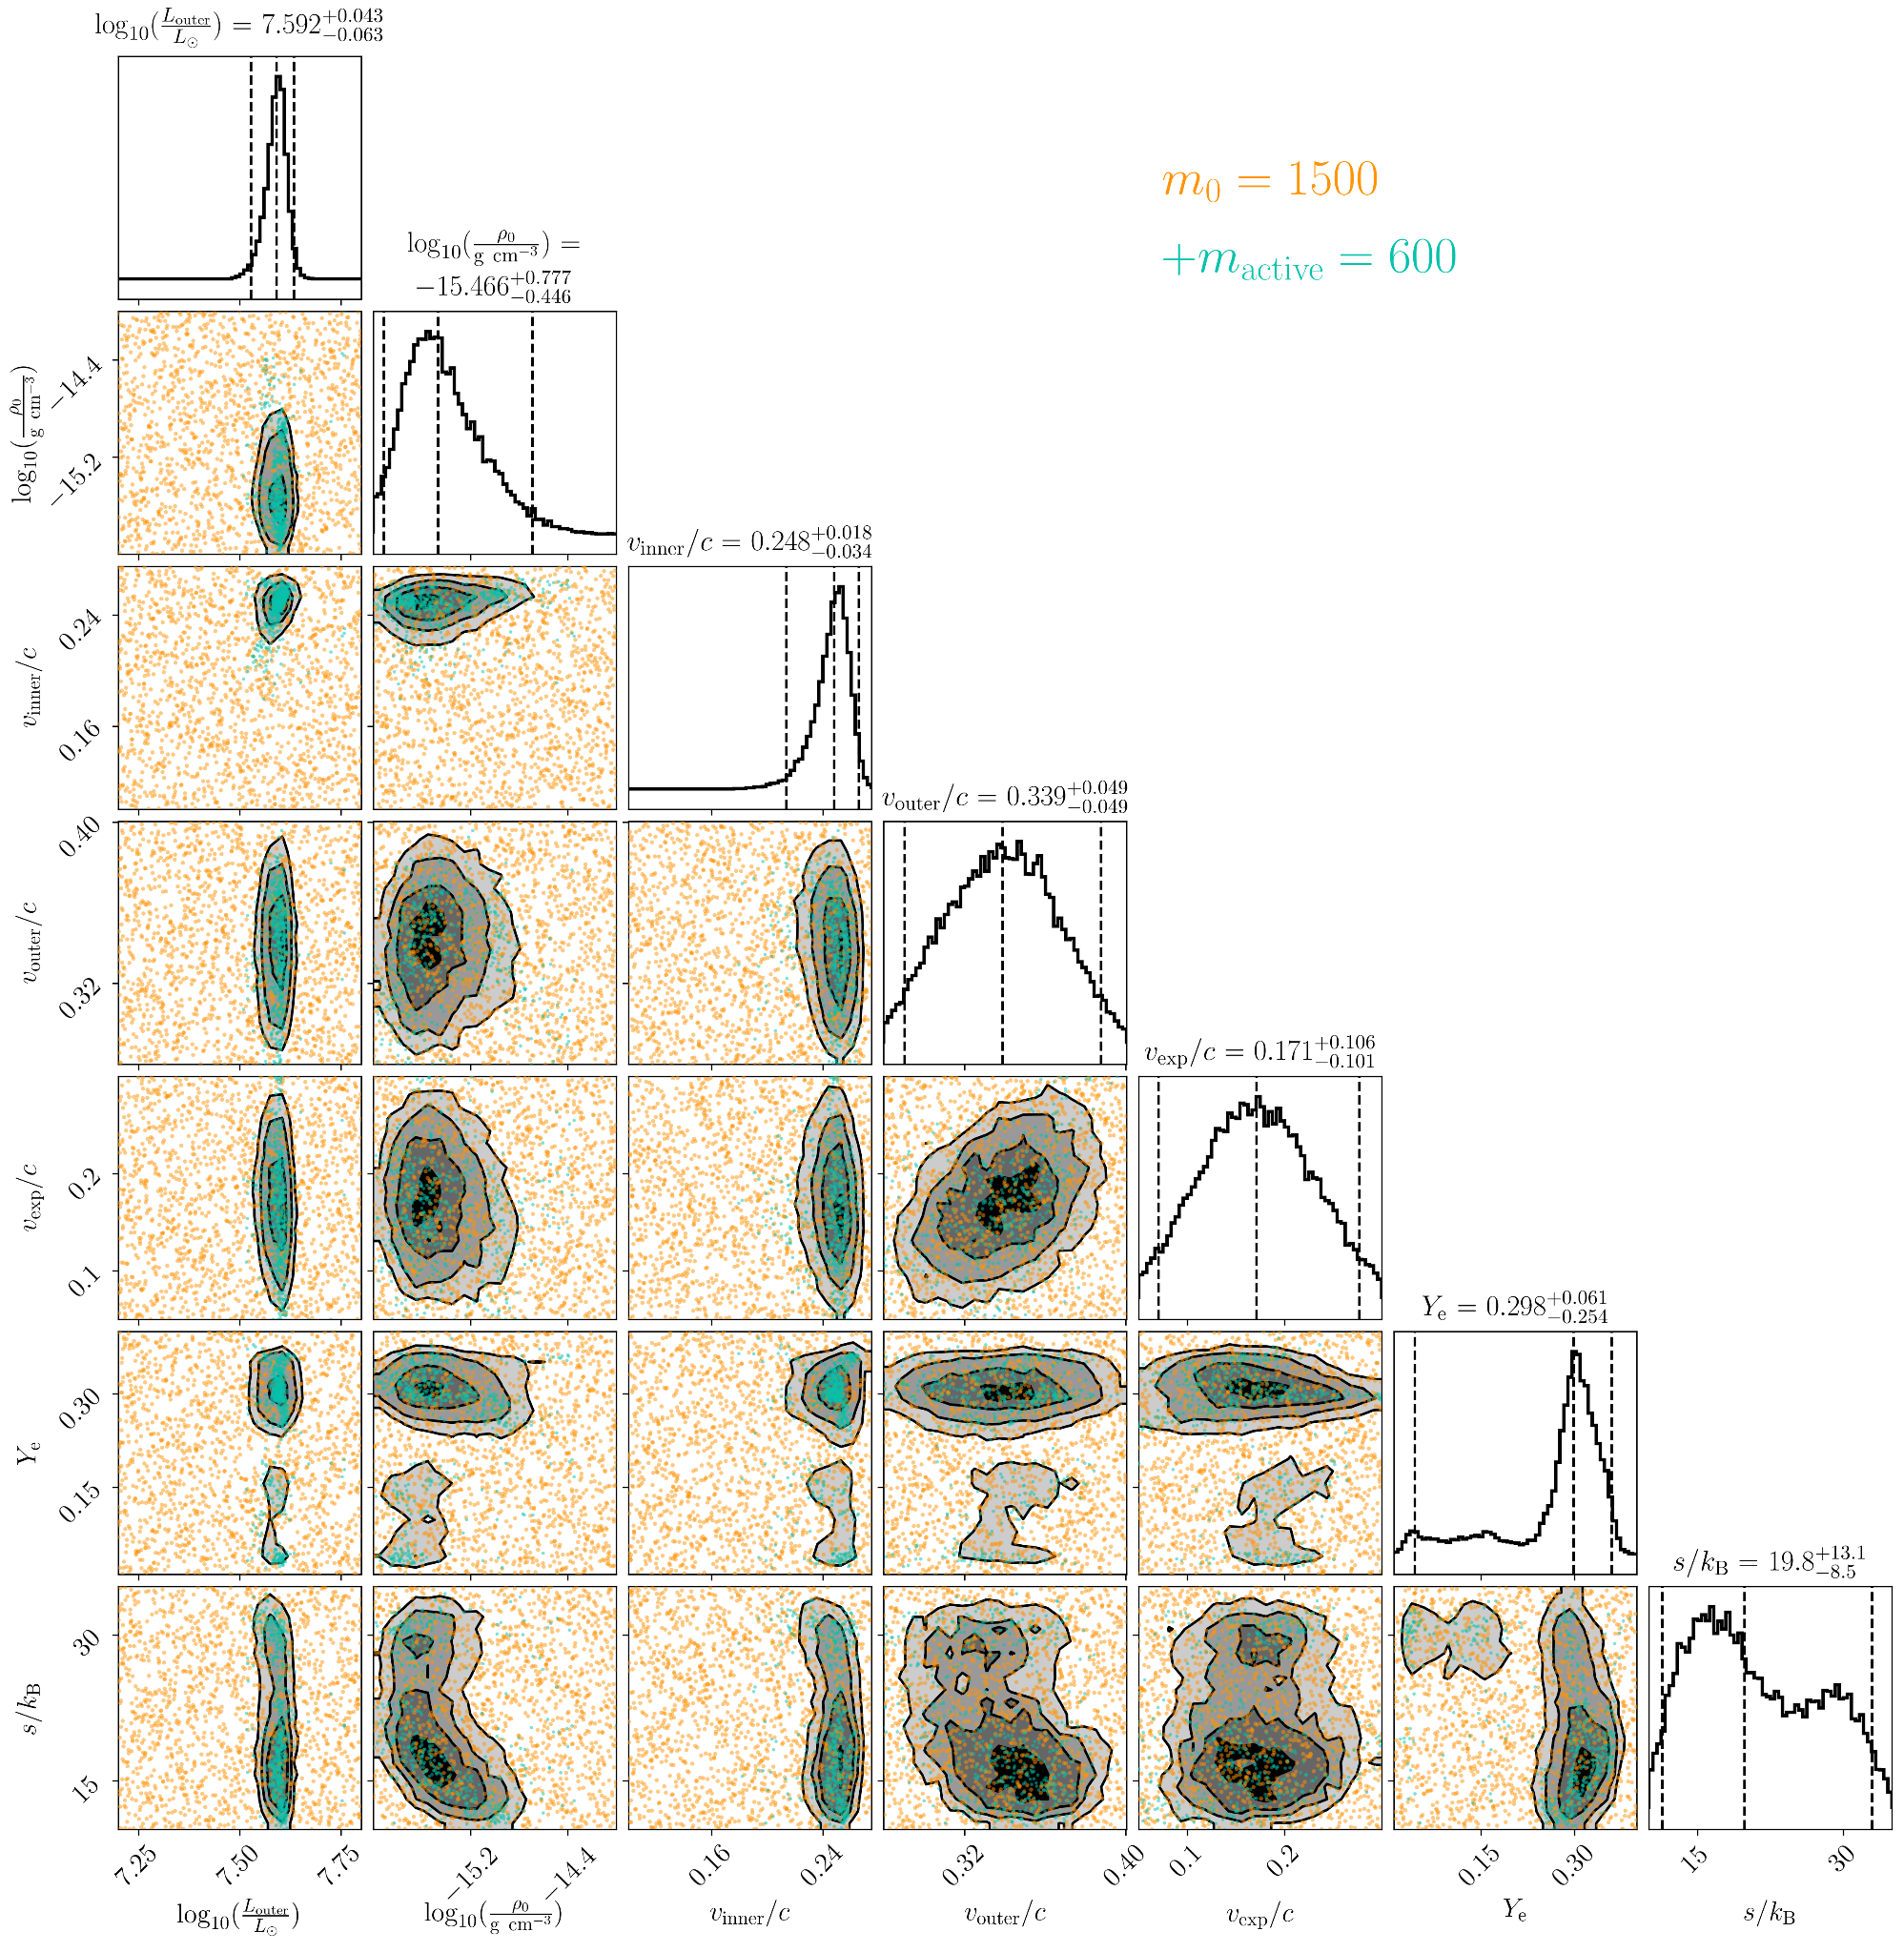
2.4 days, single-component
Vieira+24 (SPARK II)

Slide 36
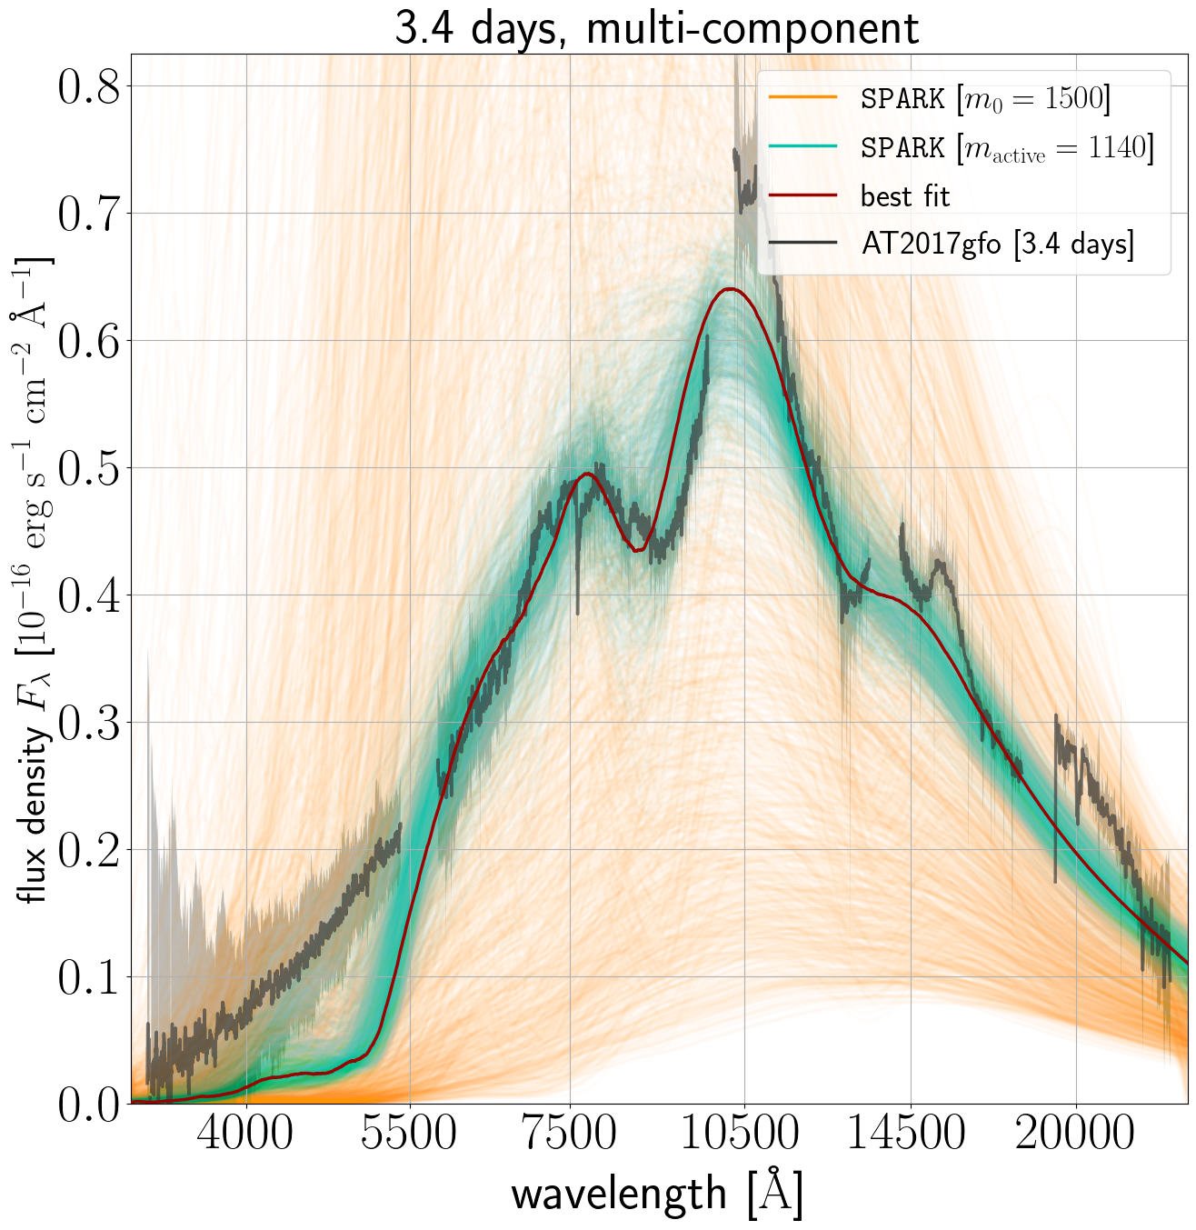
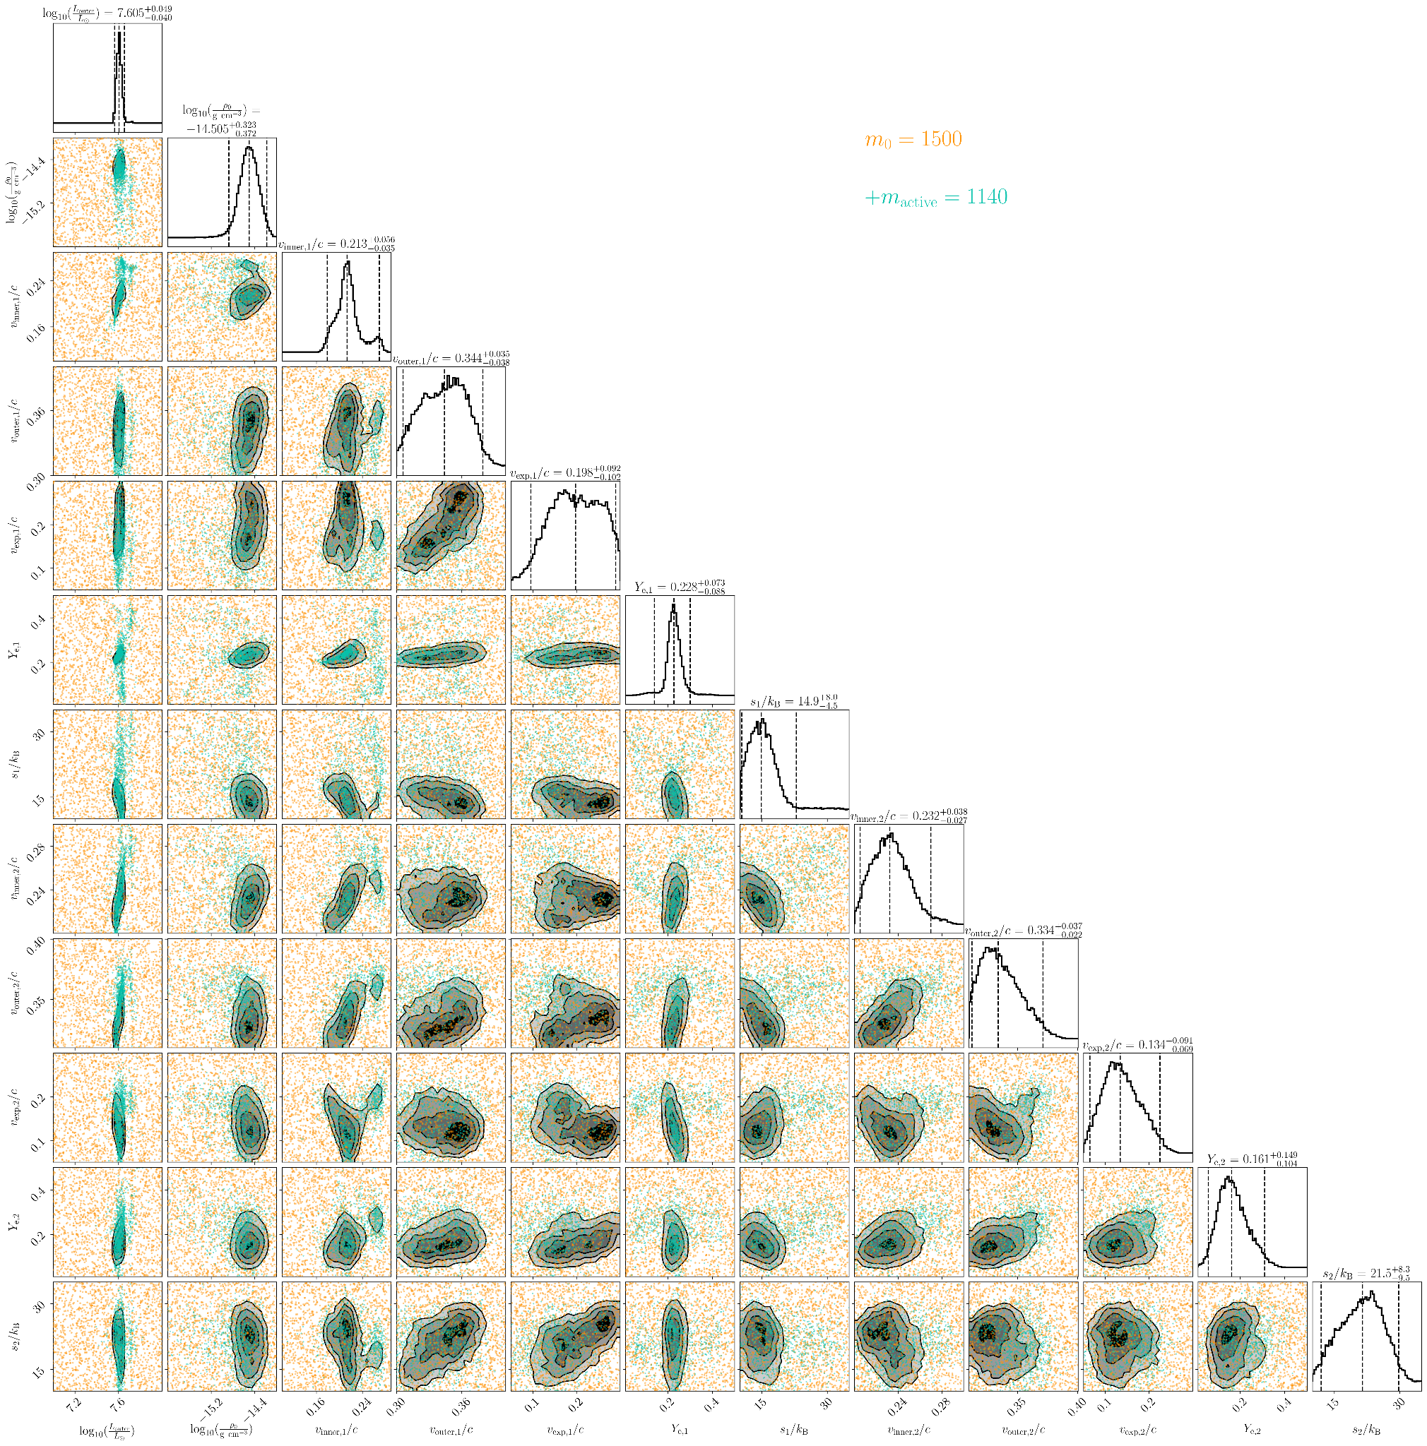
3.4 days, multi-component
Vieira+24 (SPARK II)

Slide 37
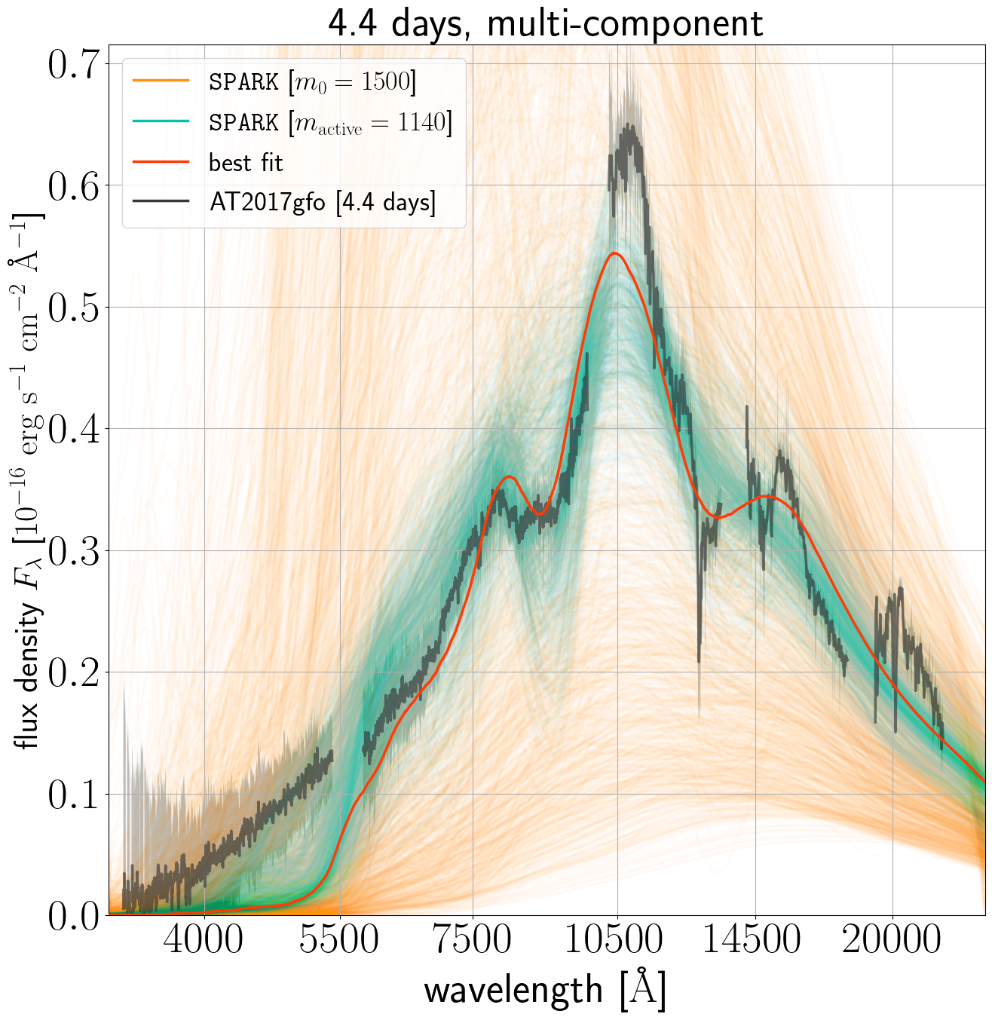
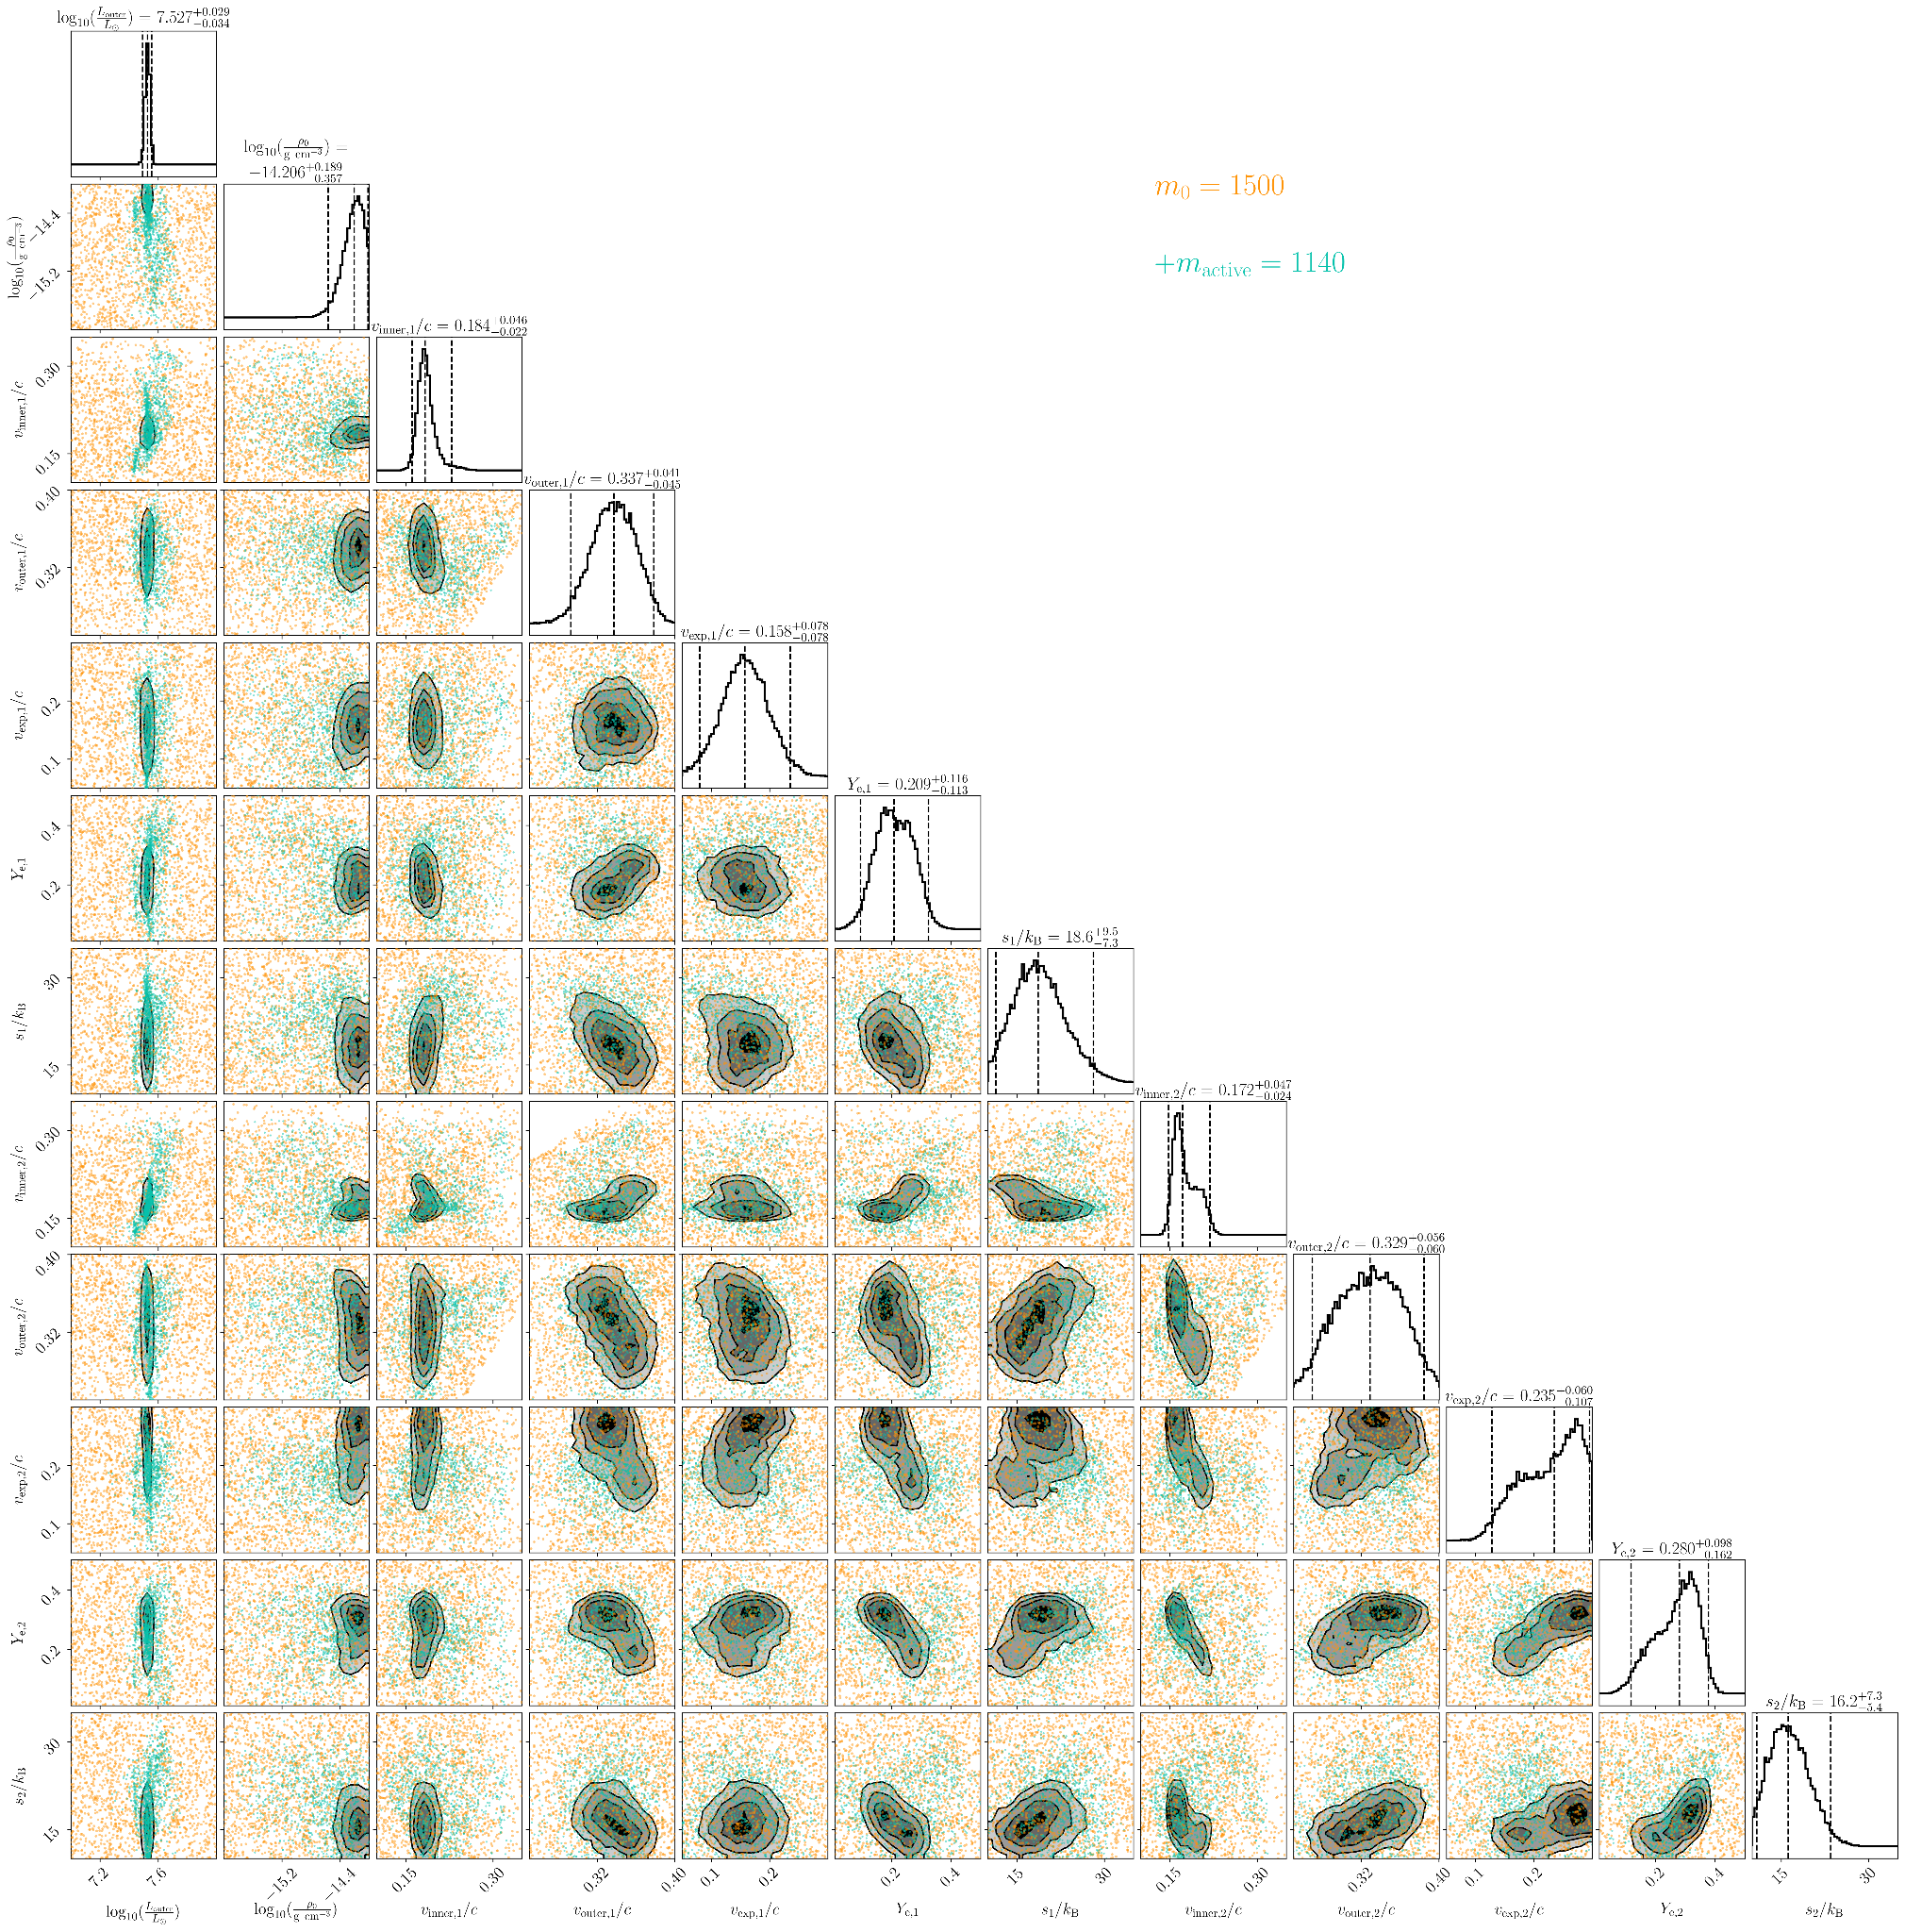
4.4 days, multi-component
Vieira et al

Slide 38
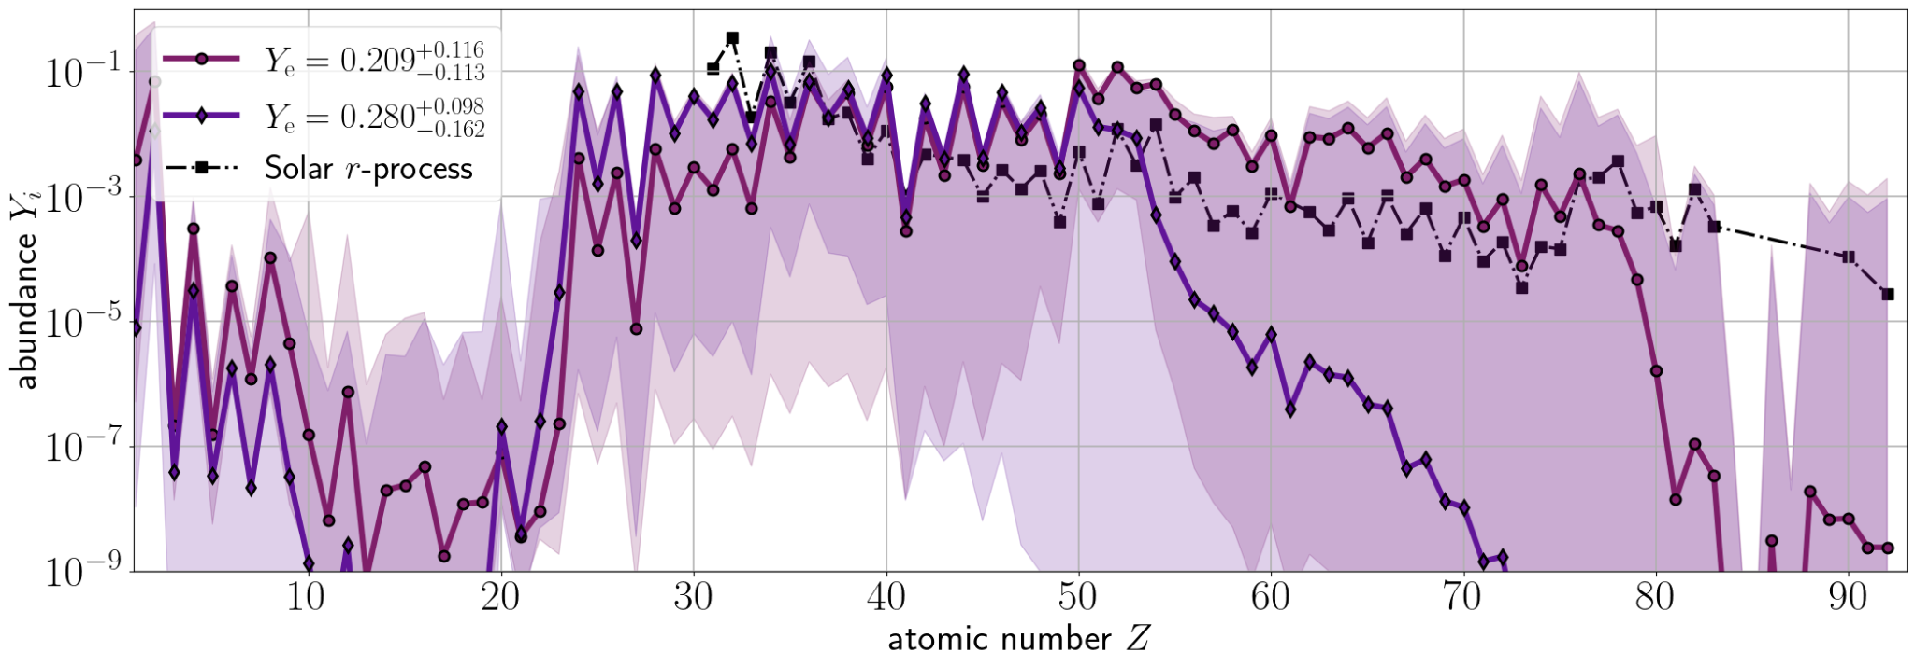
Compare components' abundances @ 4.4 days
Vieira et al
Solar r-process: Lodders 09 & Bisterzo+14

Slide 39
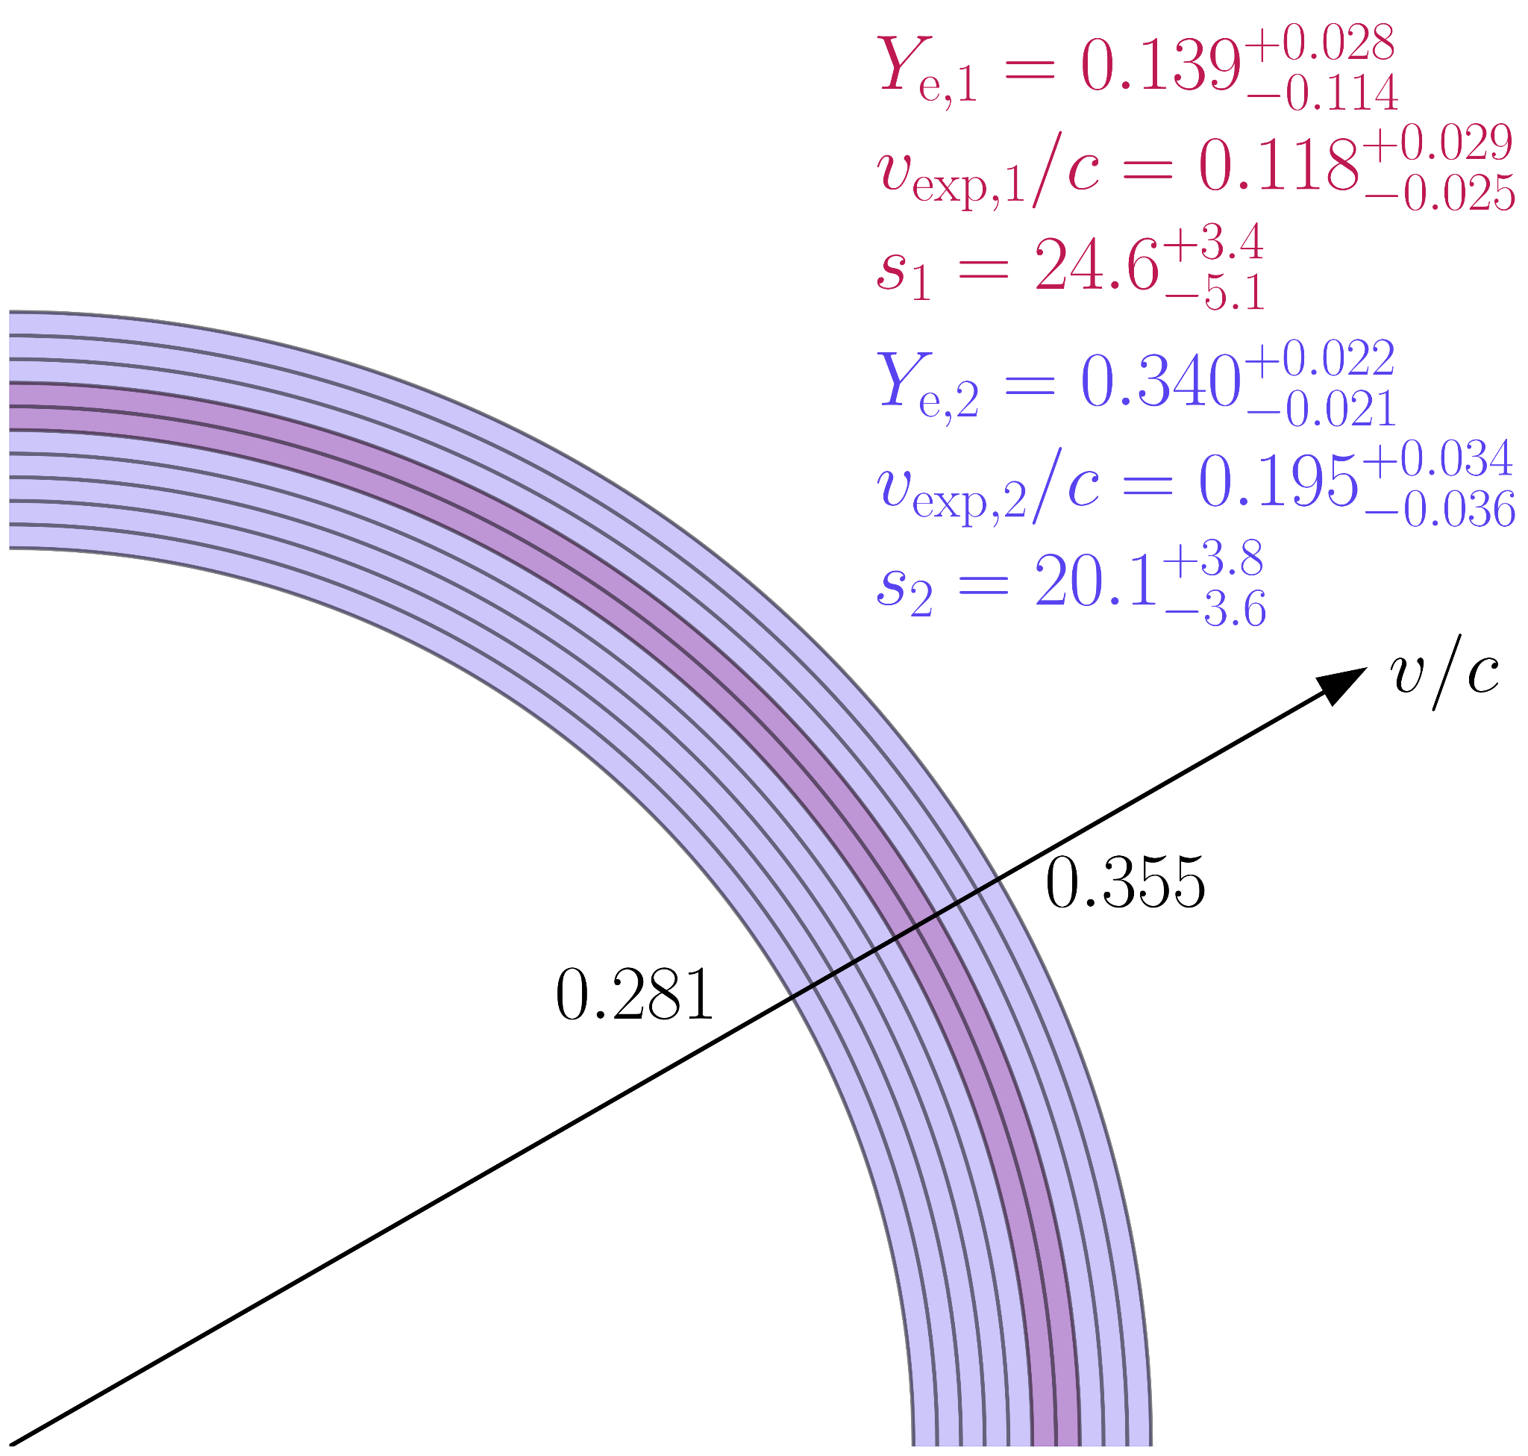
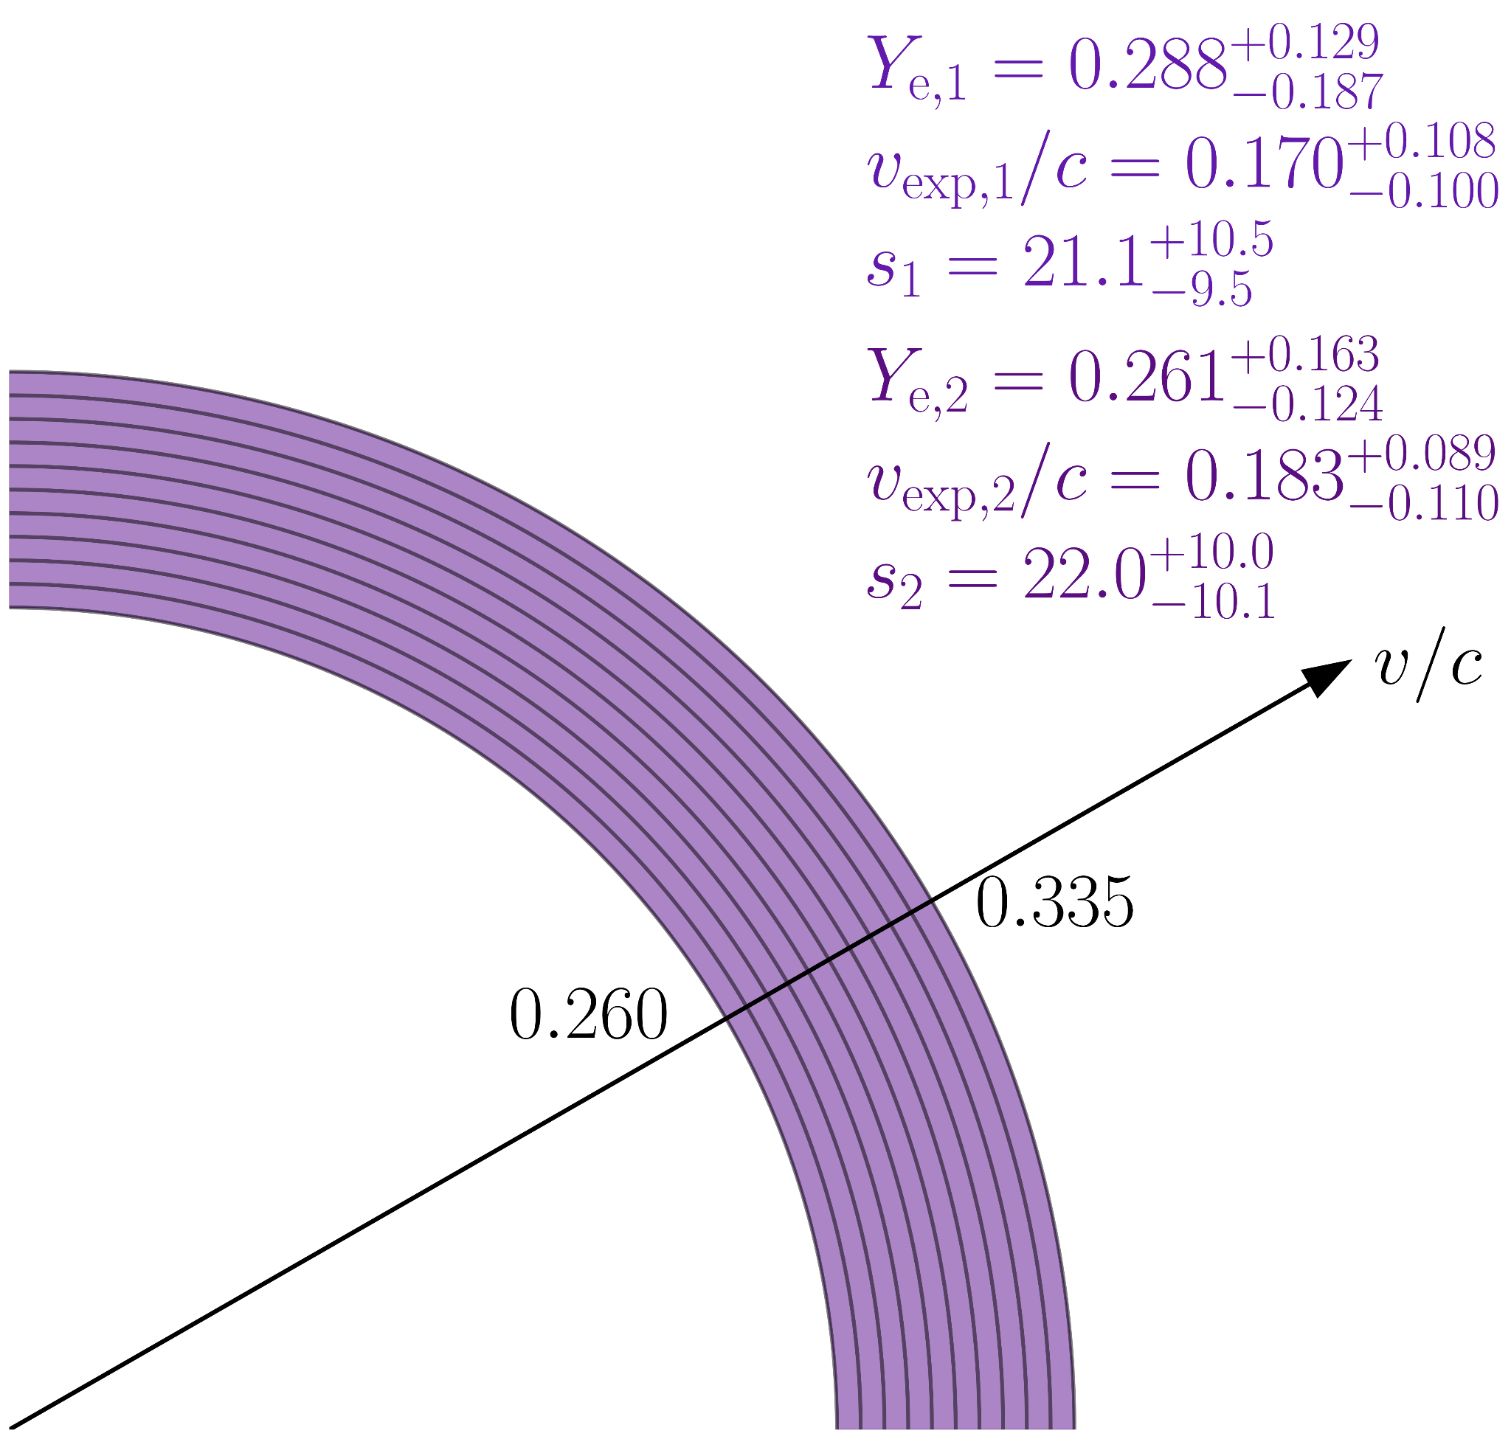
Multi-component ejecta geometries
1.4 days
2.4 days
Vieira+24 (SPARK II)

Slide 40
Multi-component ejecta geometries
1.4 days
2.4 days
effectively single-component
presence of red is negligible
complete overlap; similar compositions
Vieira+24 (SPARK II)

Slide 41
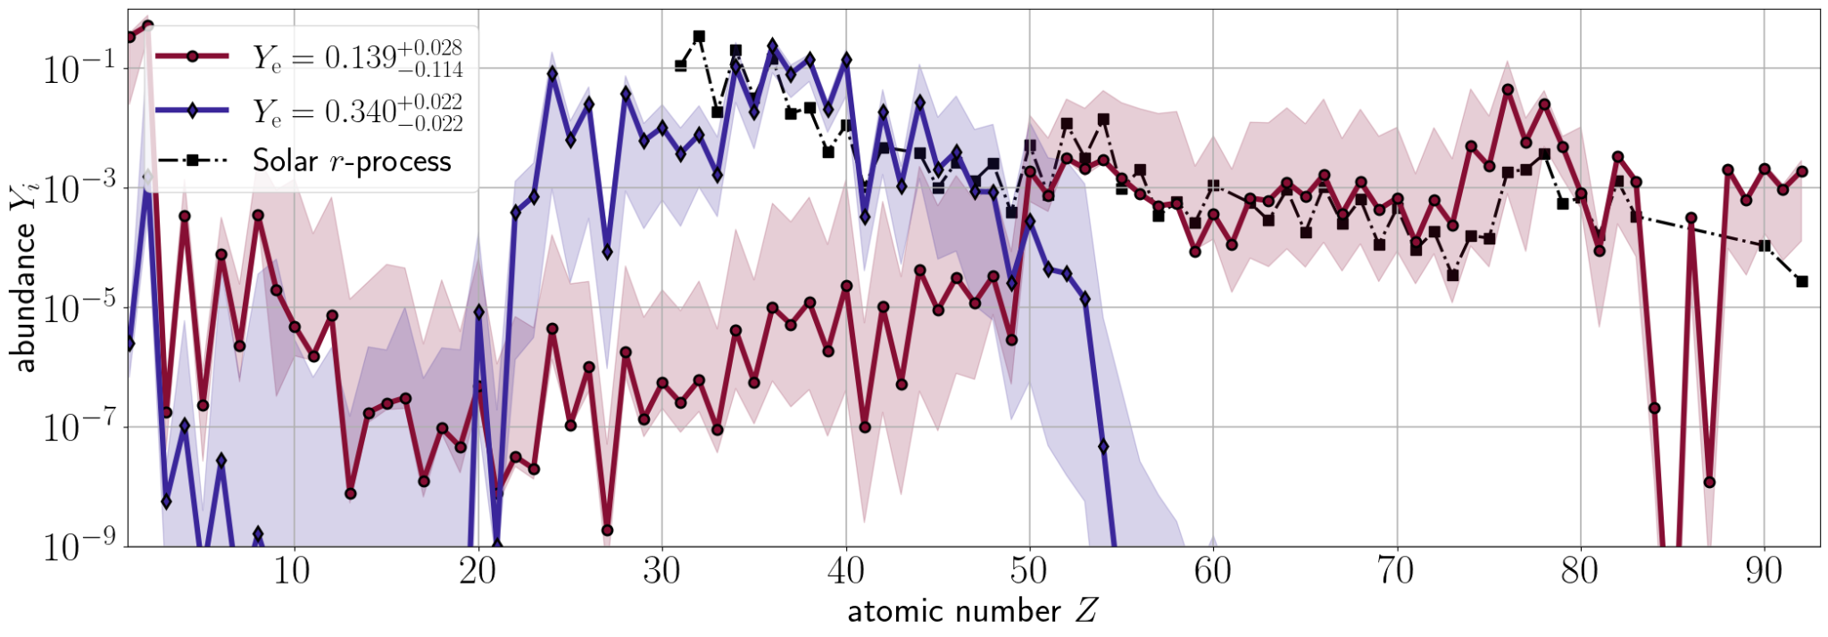
Compare components' abundances @ 1.4 days
Vieira+24 (SPARK II)
Solar r-process: Lodders 09 & Bisterzo+14

Slide 42
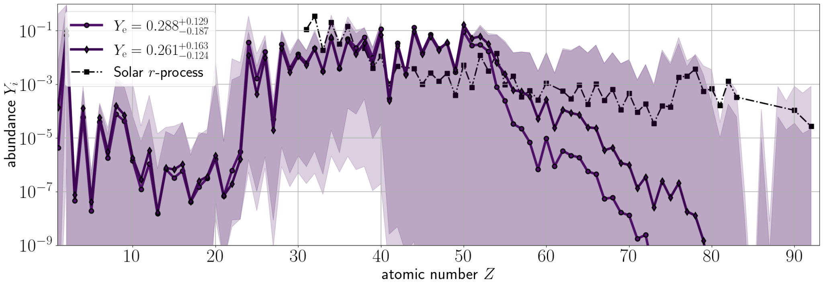
Compare components' abundances @ 2.4 days
Vieira+24 (SPARK II)
Solar r-process: Lodders 09 & Bisterzo+14

Slide 43
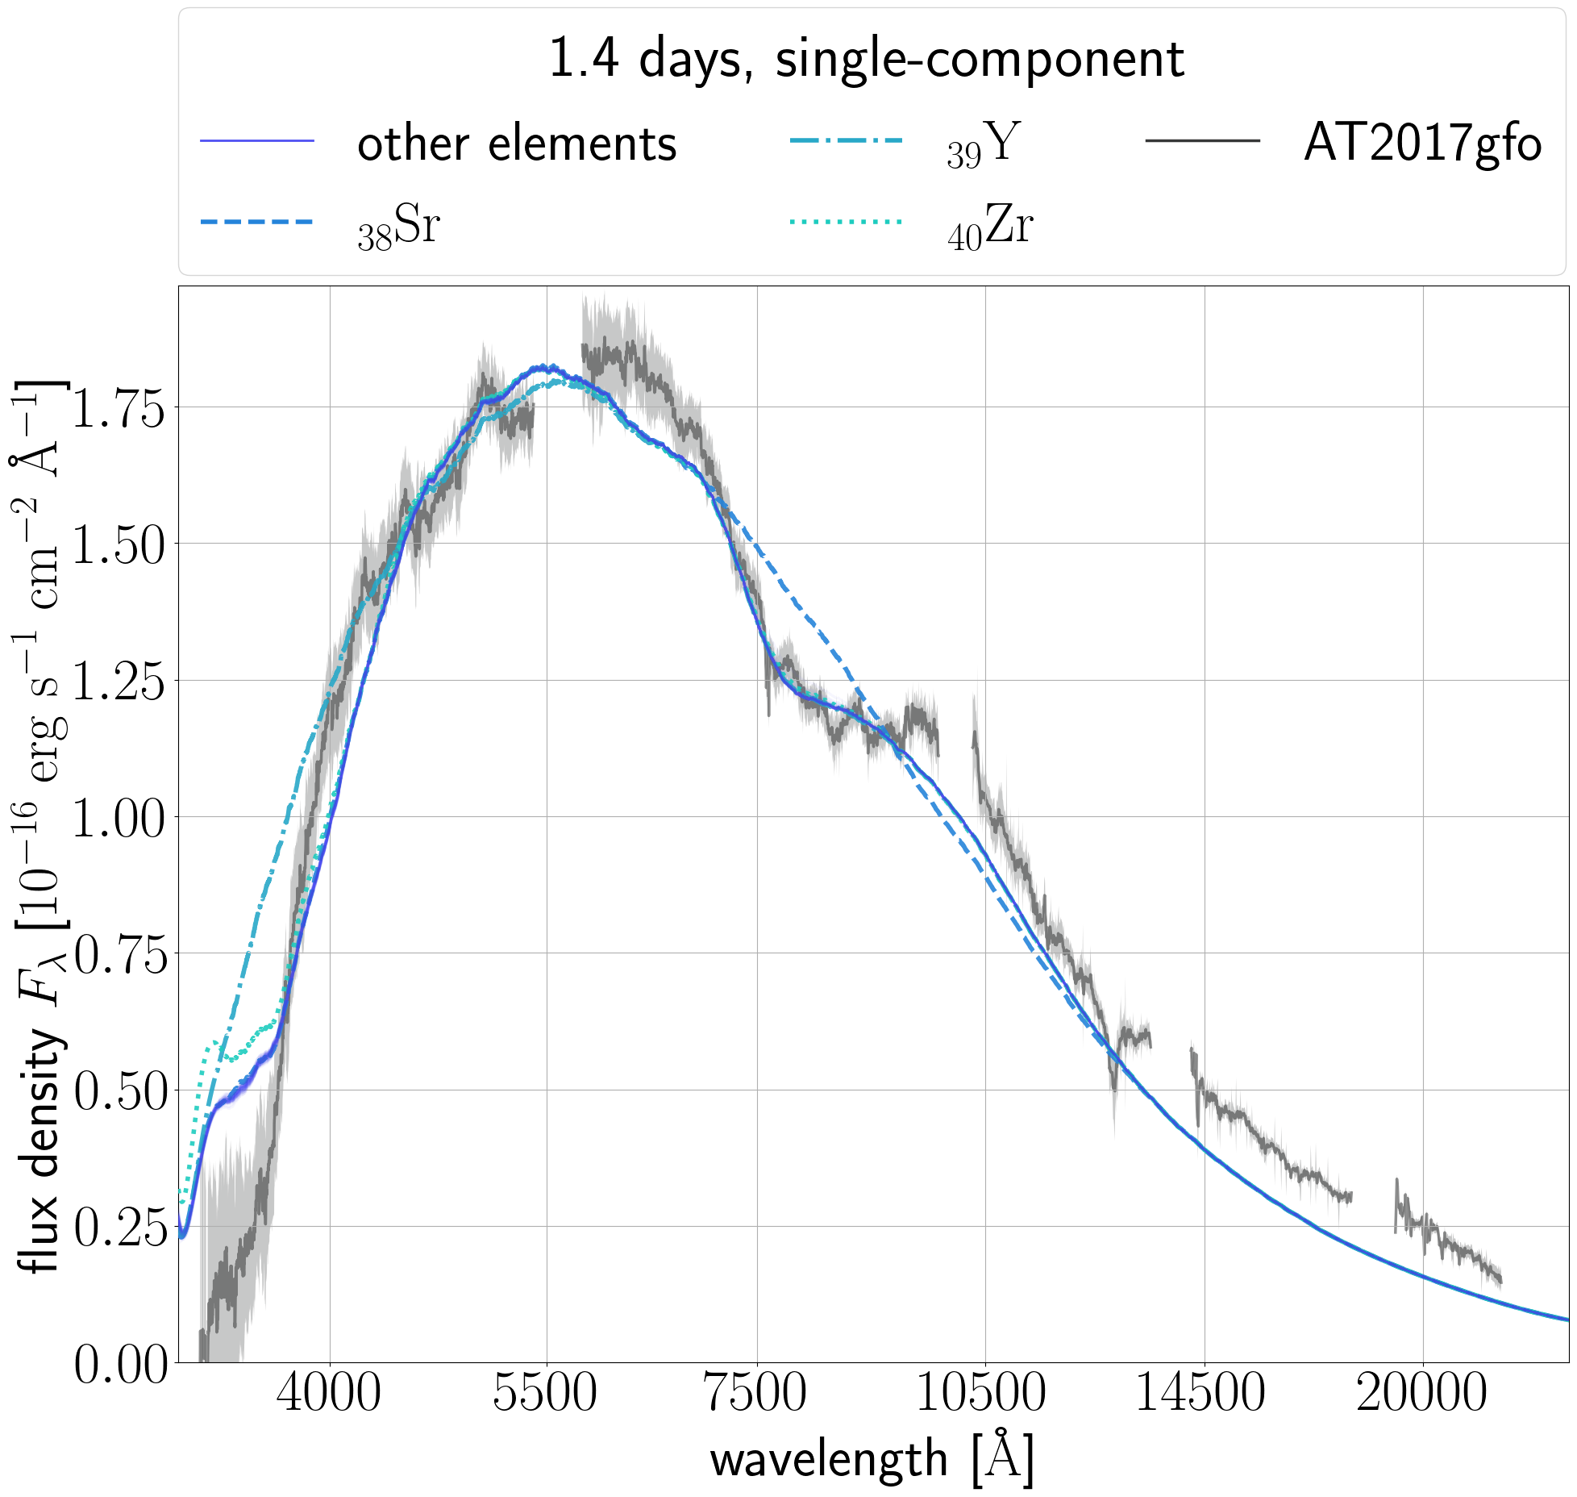
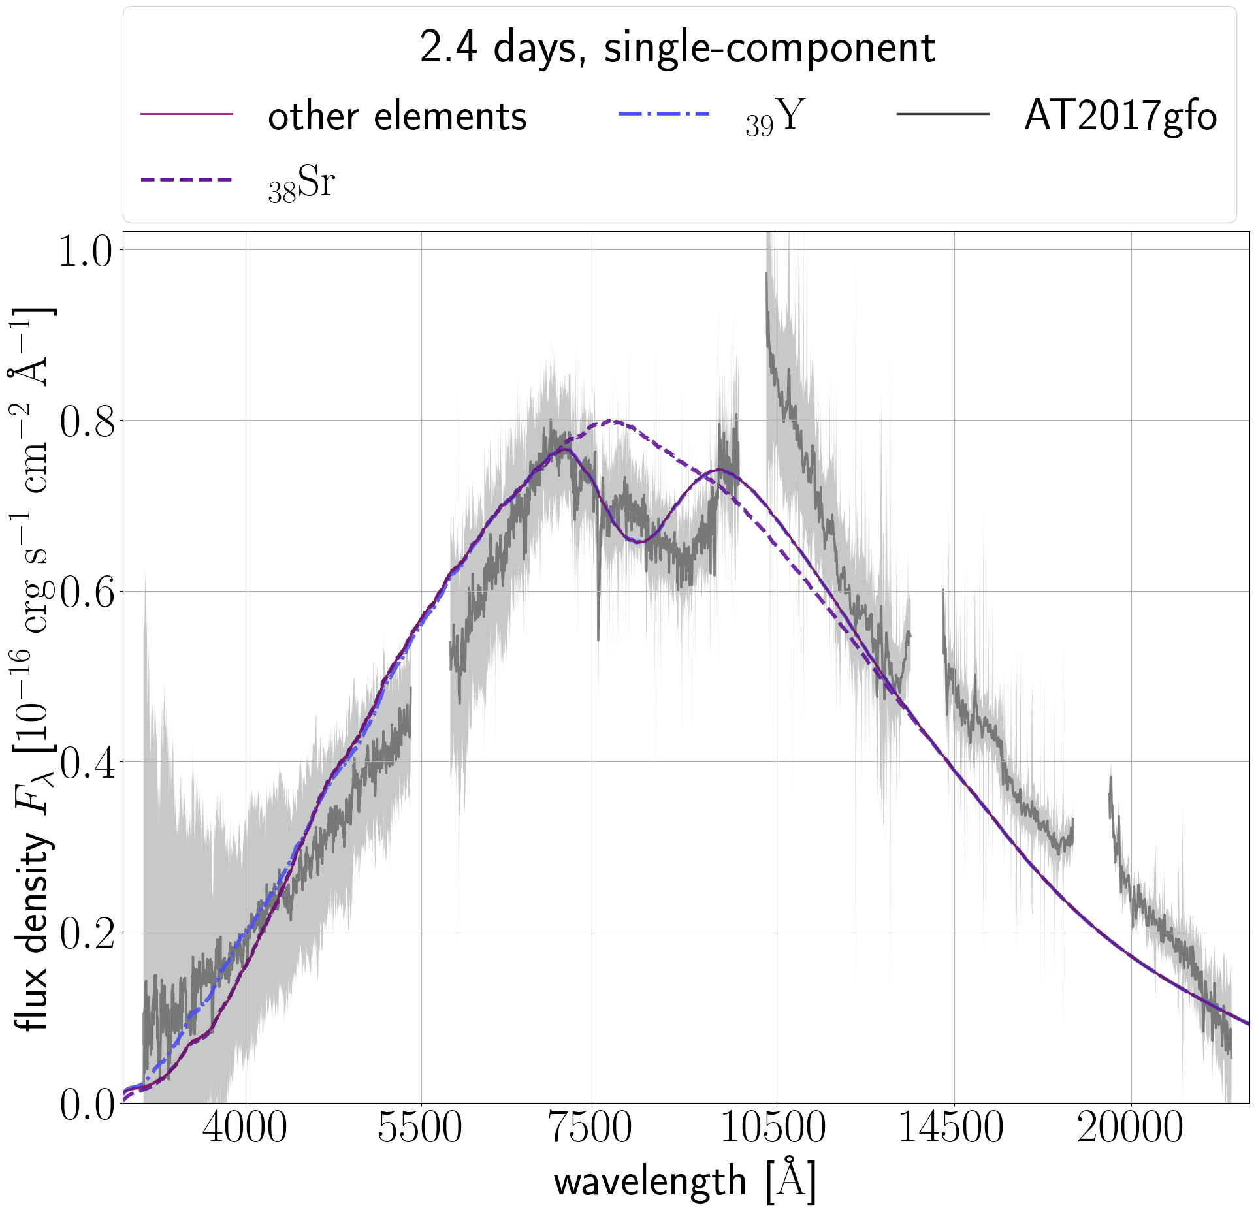
Leave-one-out for favoured models
single-component
single-component
Vieira+24 (SPARK II)

Slide 44
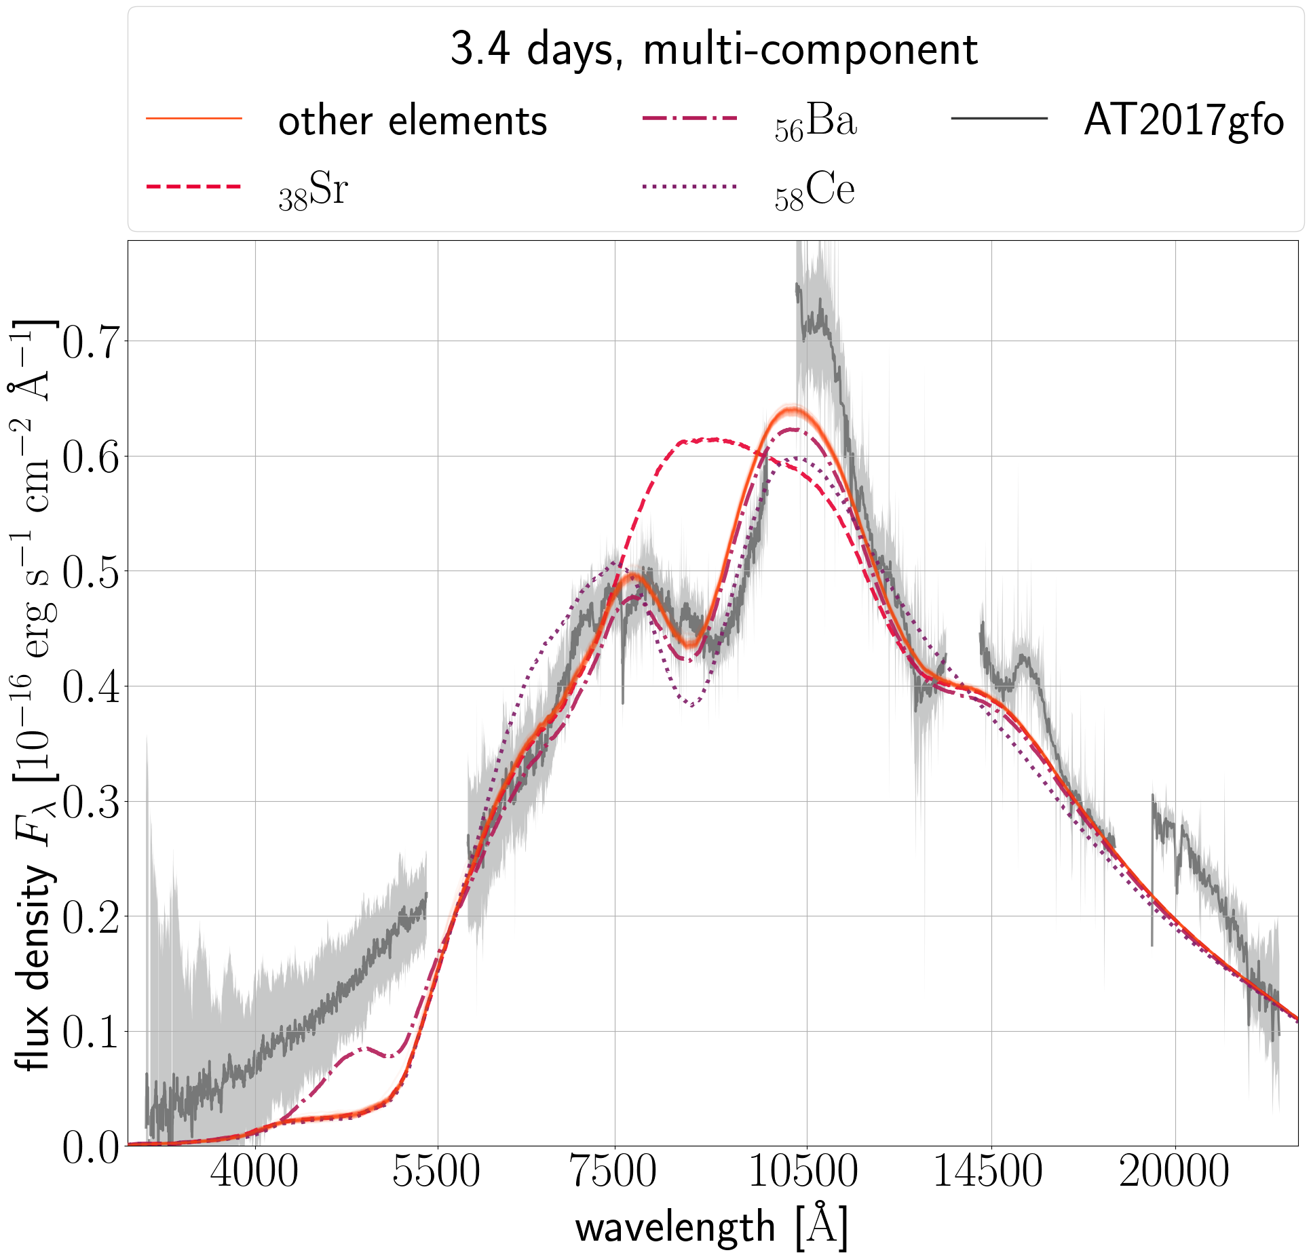
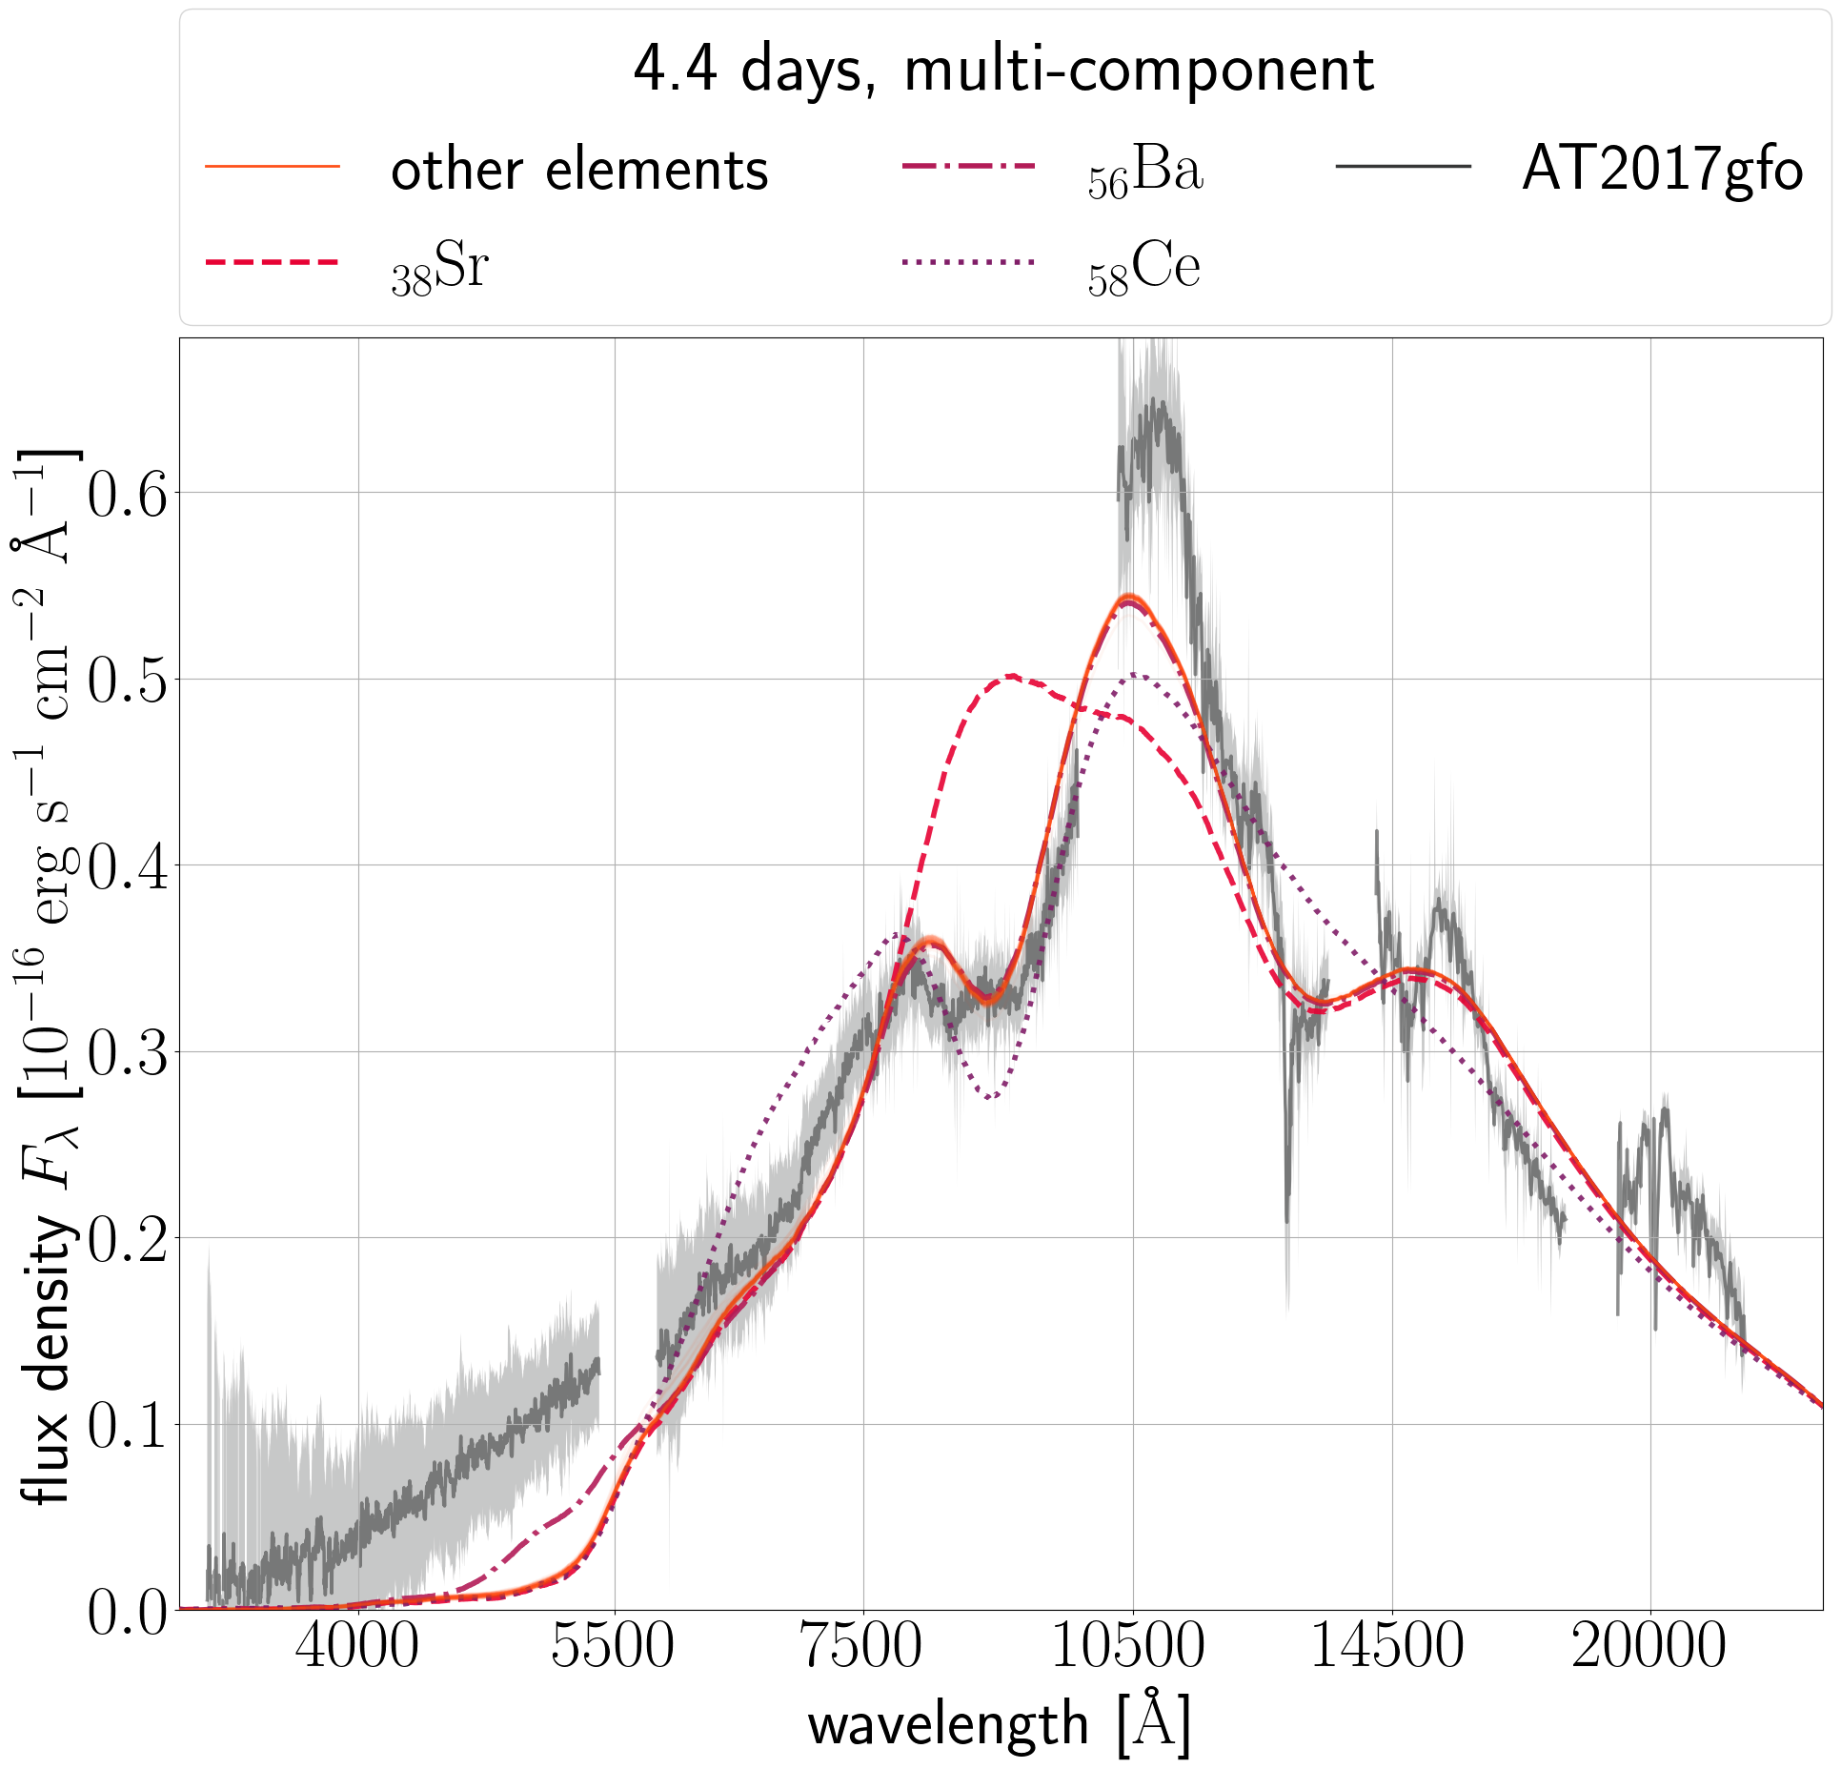
Leave-one-out for favoured models
multi-component
multi-component
Vieira+24 (SPARK II)

Slide 45
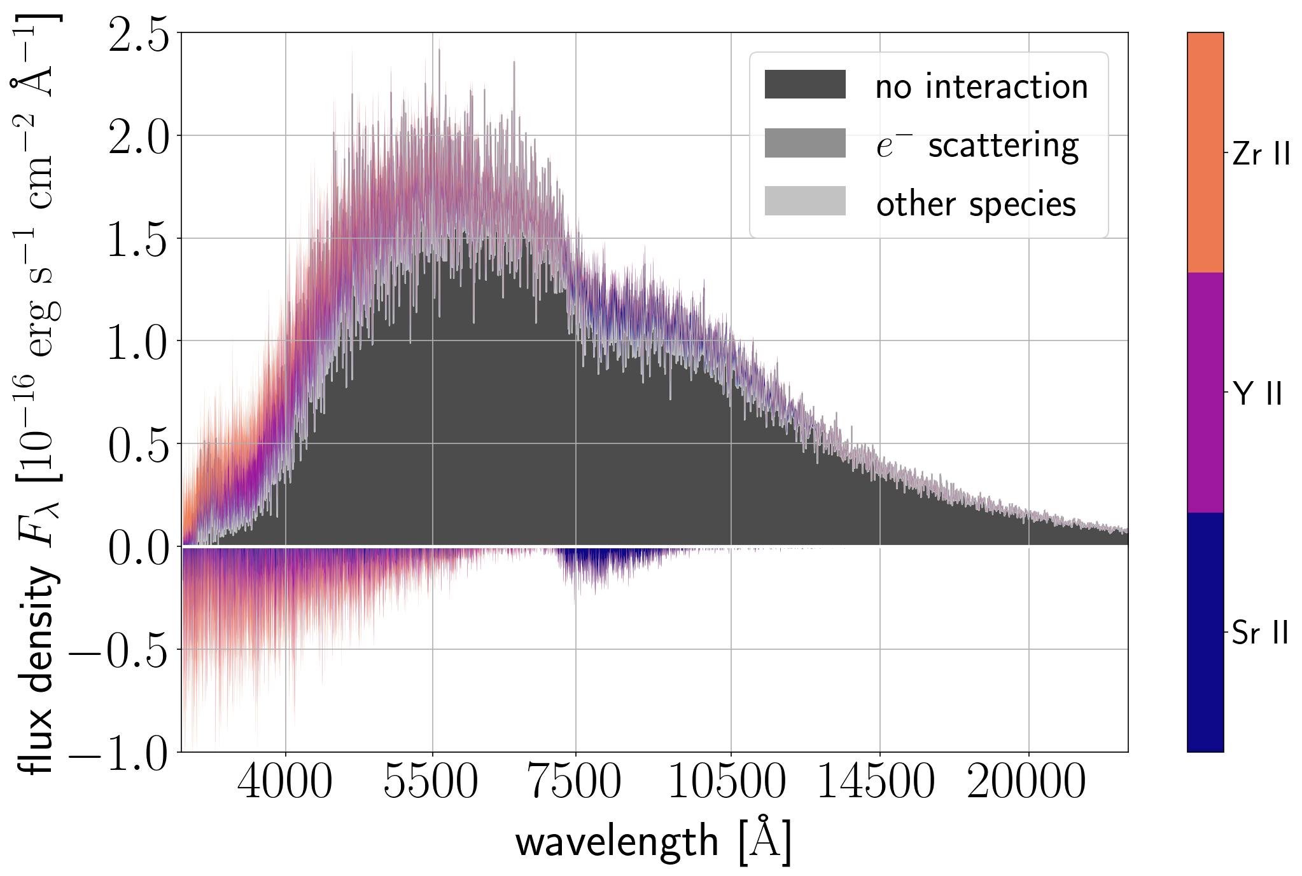
Spectral DECompositions @ 1.4 days, single-component
Sr II + Y II + Zr II responsible for 98.9% of all final matter-radiation interactions
Vieira+24 (SPARK II)

Slide 46
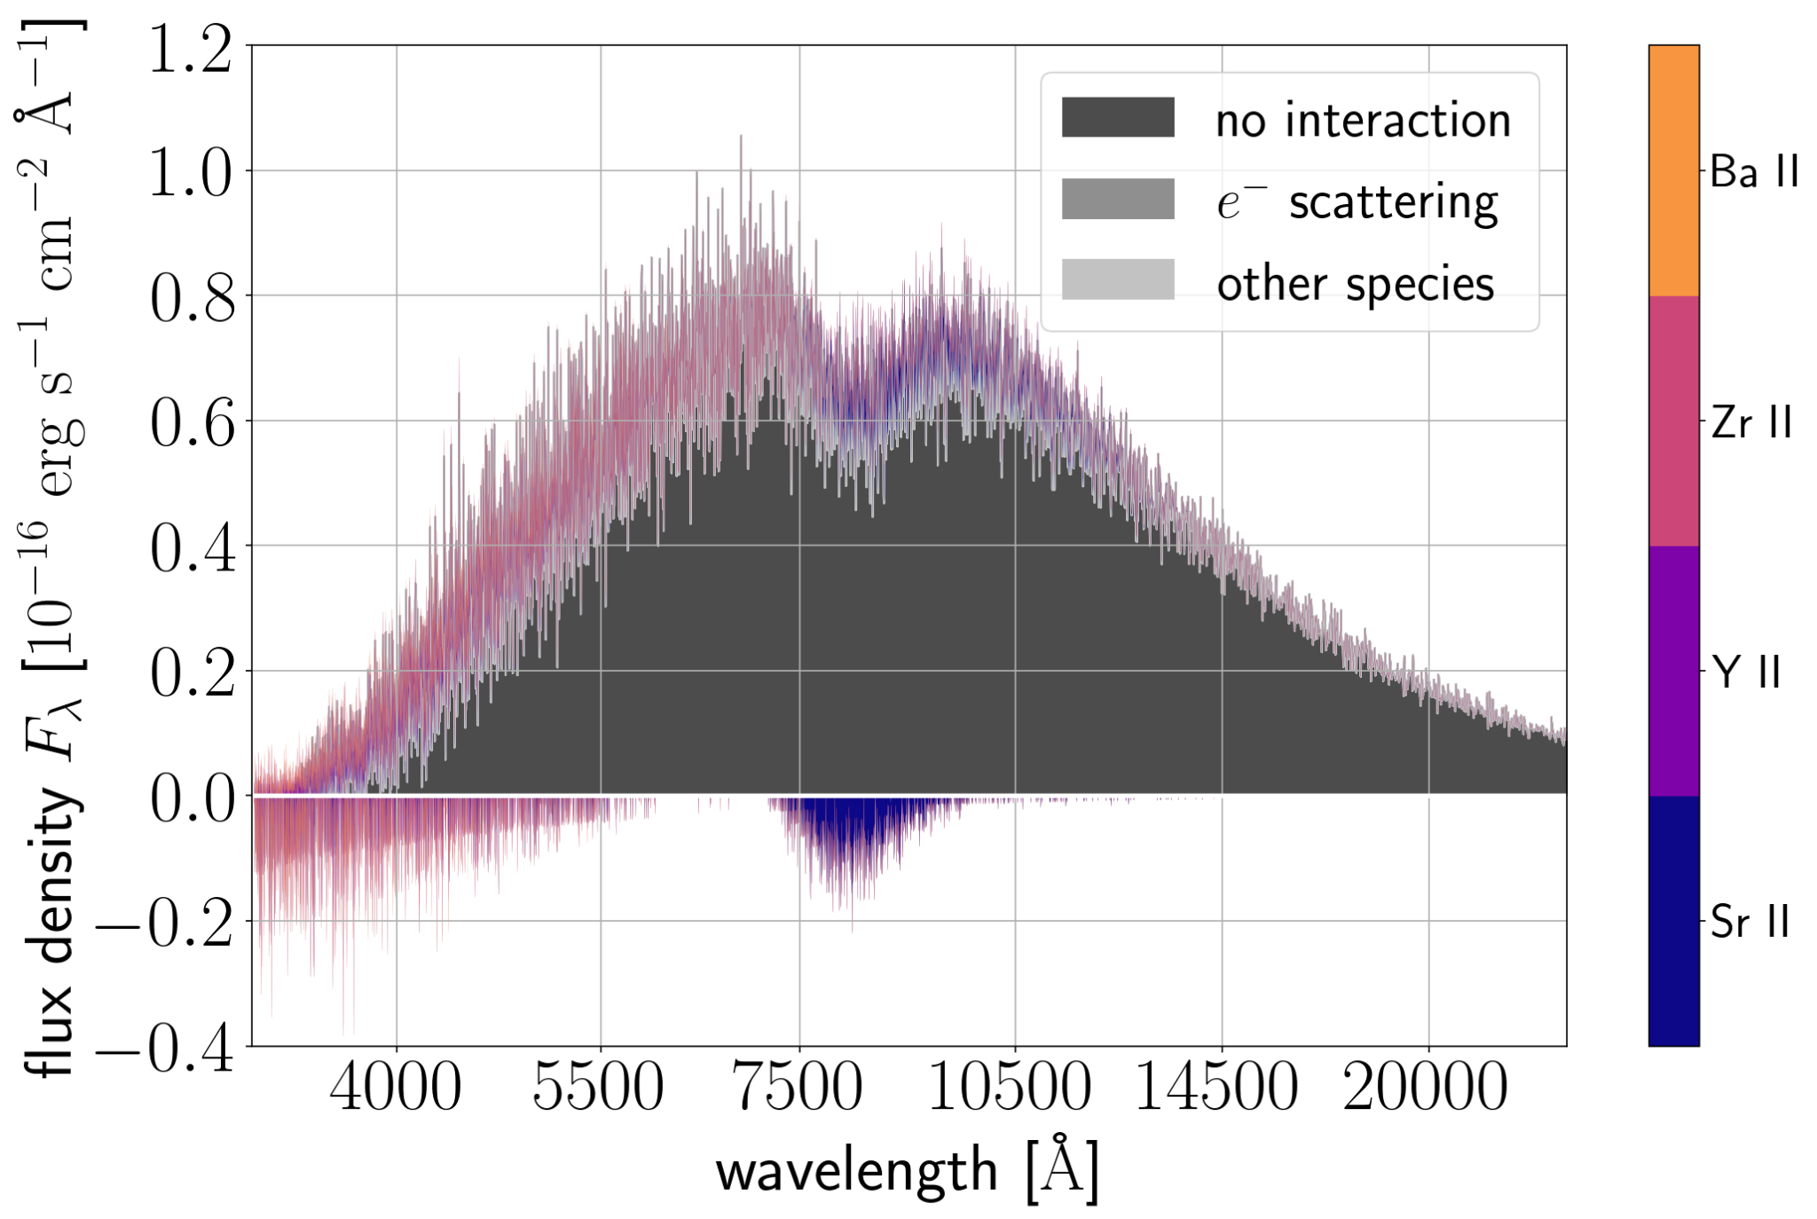
Spectral DECompositions @ 2.4 days, single-component
Sr II + Y II + Zr II remain important, a bit of Ba II emerges
Vieira+24 (SPARK II)

Slide 47
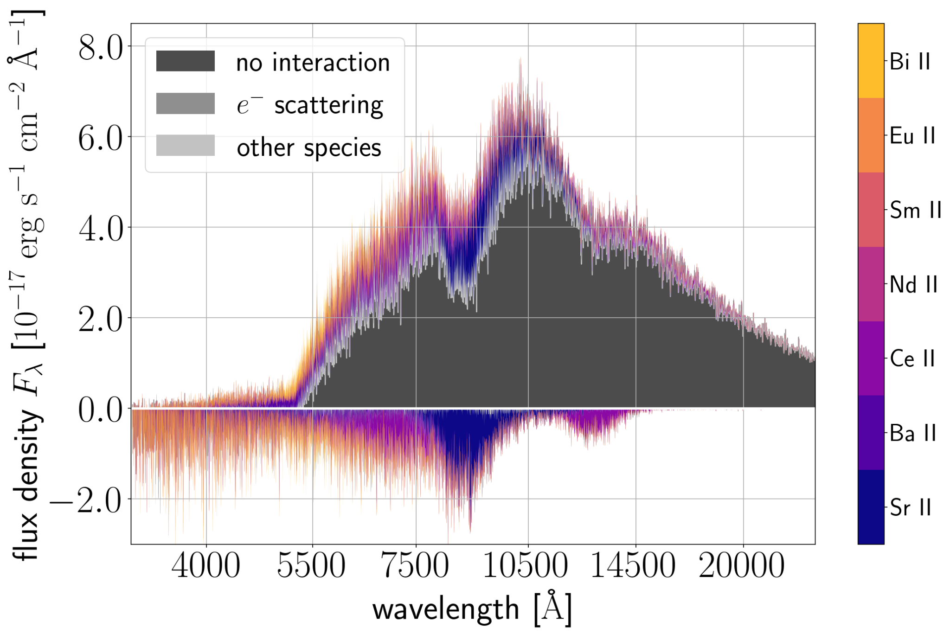
Spectral DECompositions @ 3.4 days, multi-component
Sr II remains important
Y II, Zr II are swamped out by a new ensemble of lanthanides: Ce II, Nd II, Sm II, Eu II
Ce II contributes 27.5% of absorption (compare to 30.3% from Sr II)
Vieira+24 (SPARK II)

Slide 48
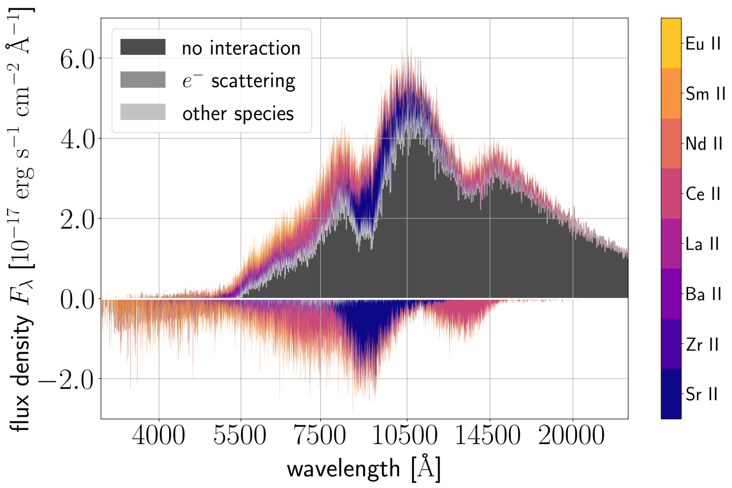
Spectral DECompositions @ 4.4 days, multi-component
Sr II remains important
Y II, Zr II are swamped out by a new ensemble of lanthanides: Ce II, La II, Nd II, Sm II, Eu II
Ce II contributes 36.6%% of absorption (compare to 31.0% from Sr II)
Vieira et al

Slide 49
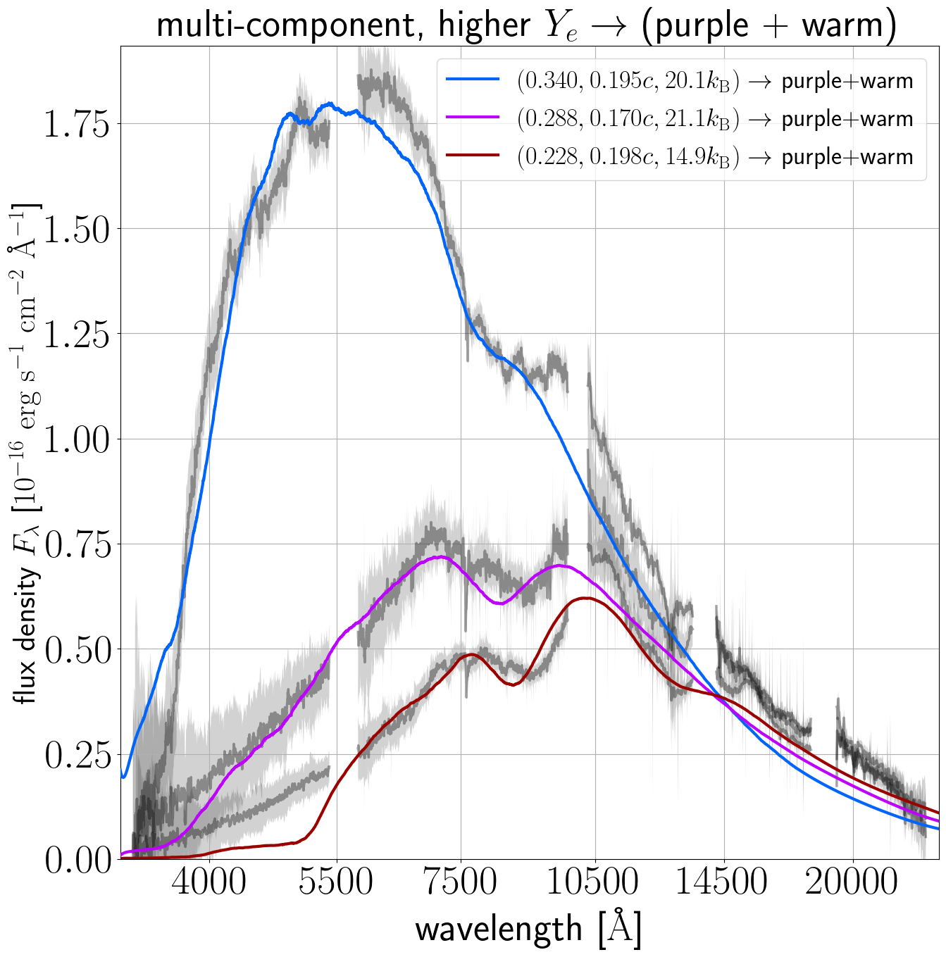
Replace the higher-electron fraction component of multi-component fit with the 1.4 day, single-component parameters
swap out the higher-electron fraction component’s (Y_{e,} v_{exp,} s) for that of the single-component, 1.4 day model
→ negligible impact!
Vieira+24 (SPARK II)

Slide 50
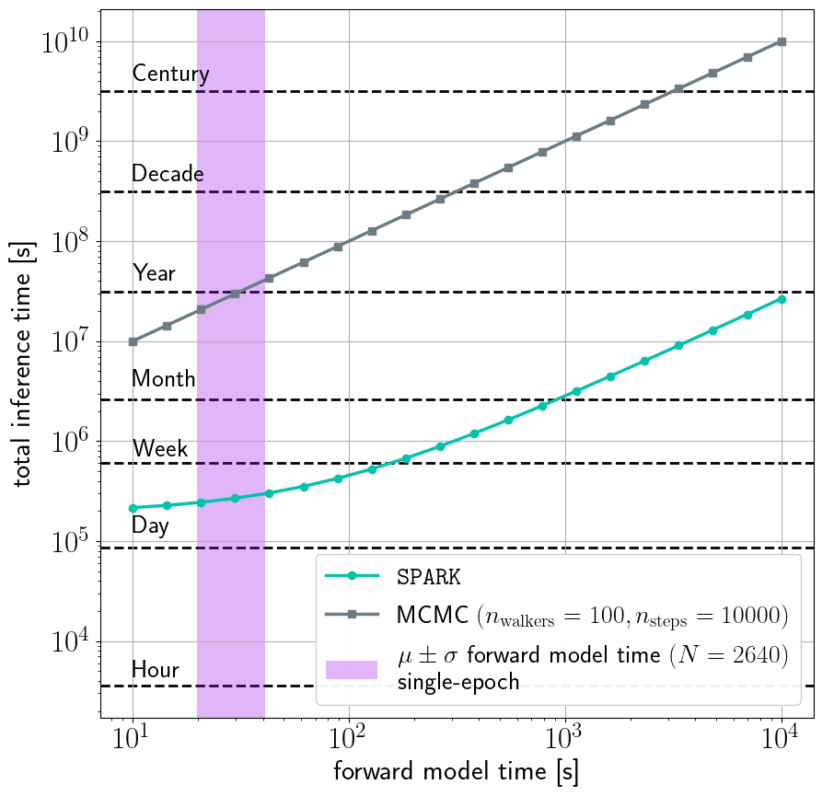
Inference is now computationally tractable
1.4 days, single-component
Purple band: forward model evaluation time
Typical MCMC would take a year
SPARK: less than a week!
Vieira+23 (SPARK I)

Slide 51
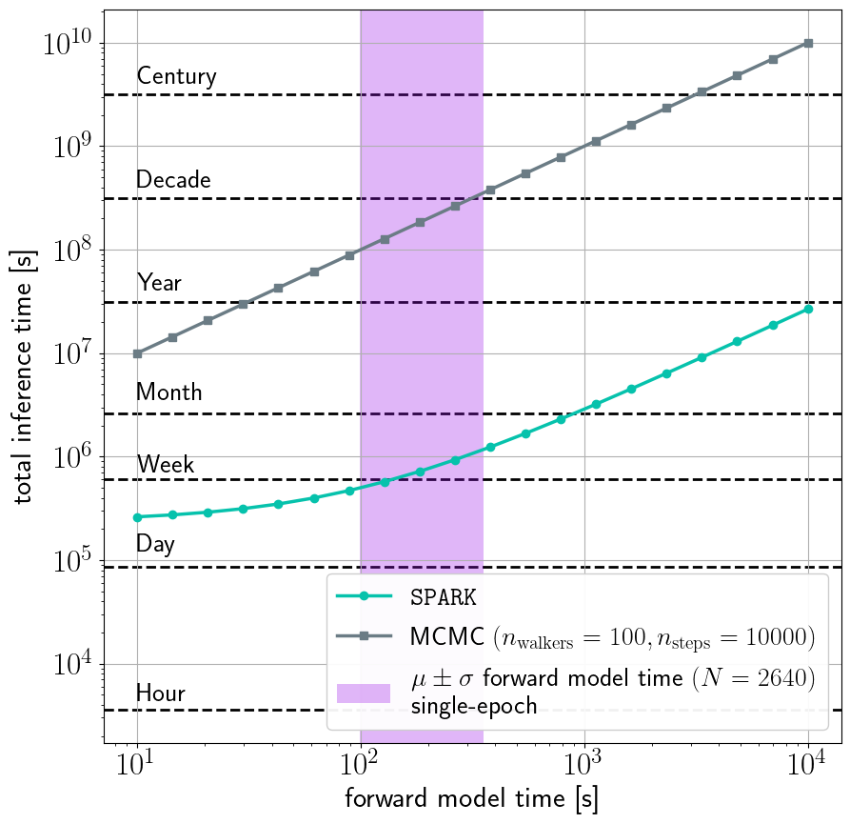
Inference is now computationally tractable
3.4 days, multi-component
As our model develops in complexity & dimensionality, the advantage of active learning becomes clearer!
Vieira et al

Slide 52
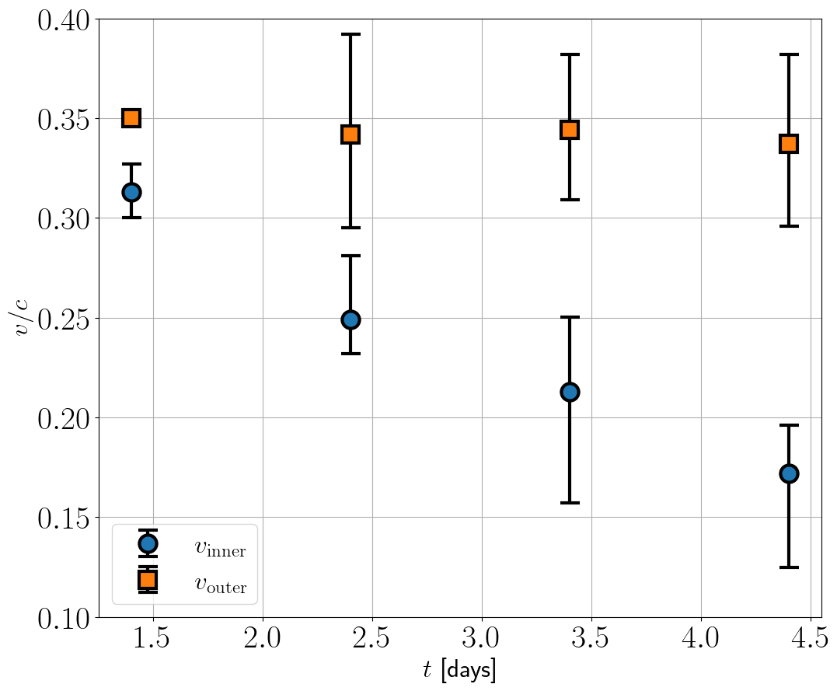
How do we interpret the emergence of a new component?
The inner boundary (photosphere) velocity decreases with time
The photosphere is receding into the ejecta, allowing us to see deeper into the ejecta over time
The blue strongly out-shone the red at earlier epochs
Vieira et al

Slide 53
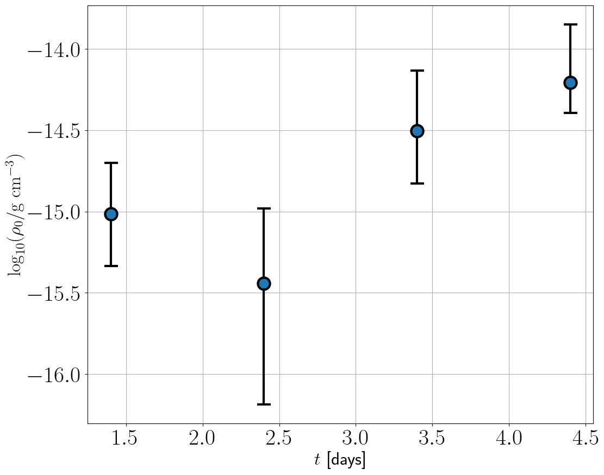
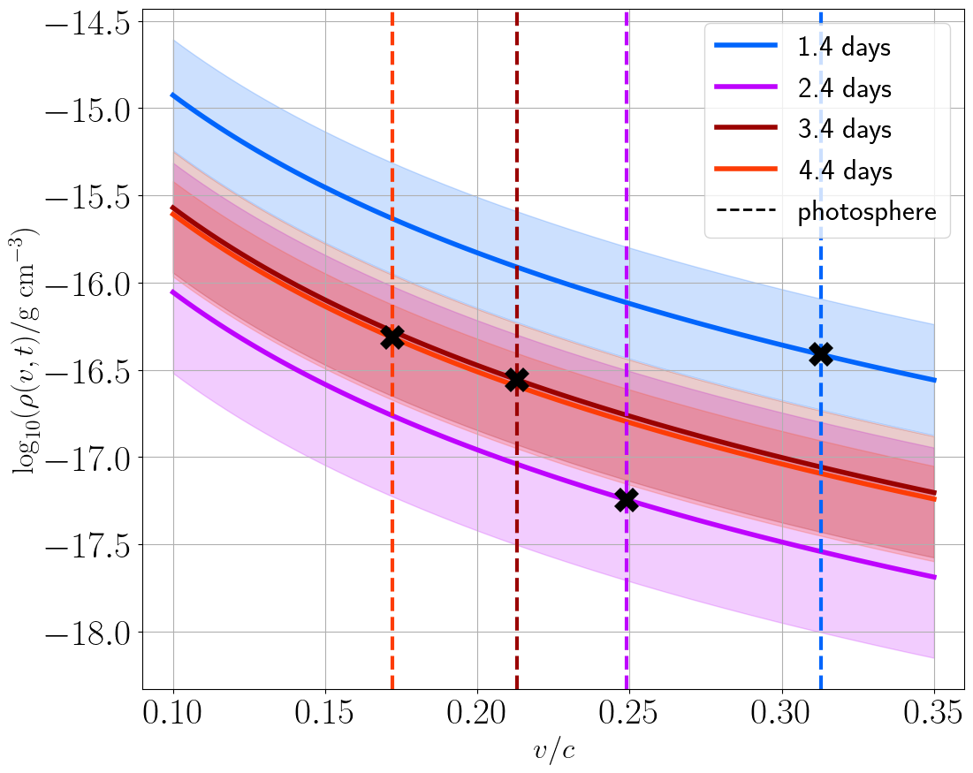
Density evolution (or lack thereof!)
Vieira et al

Slide 54
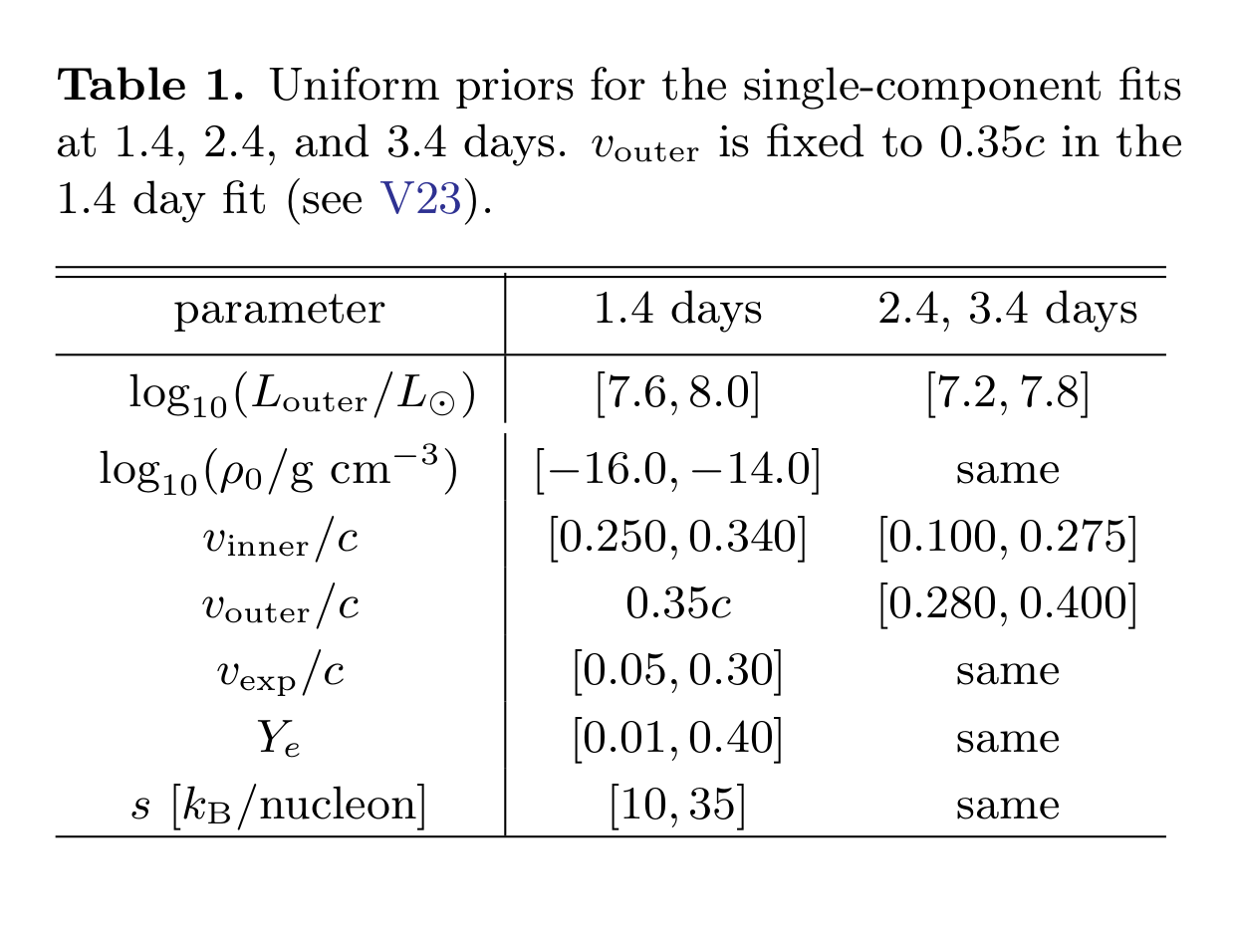
Single-component priors
Vieira+24 (SPARK II)

Slide 55
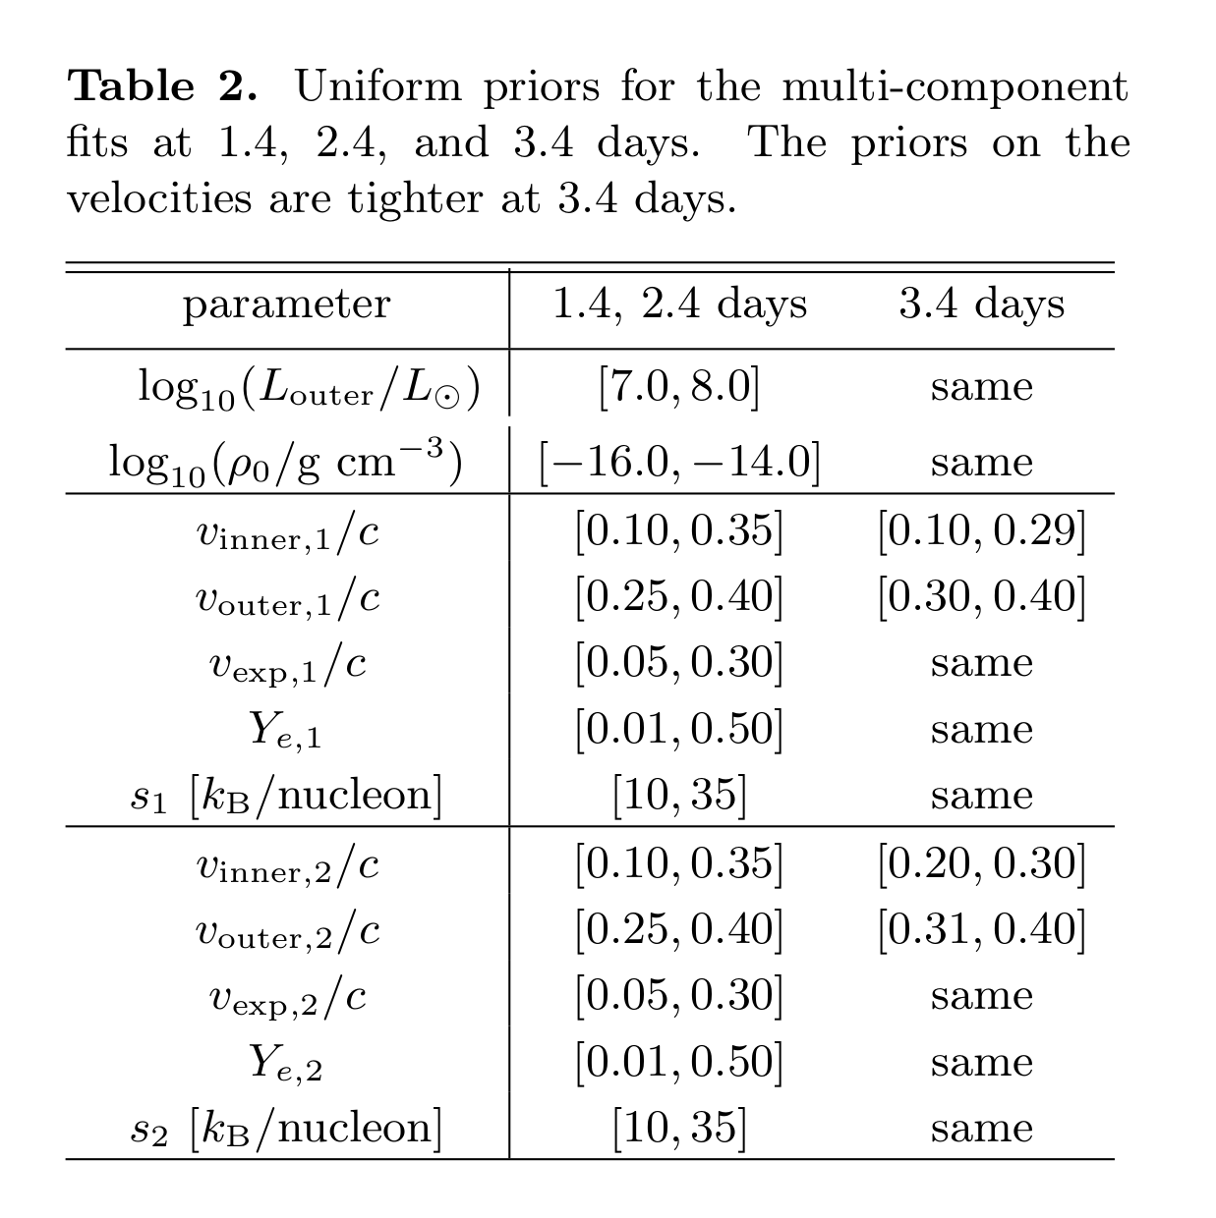
Multi-component priors
Vieira+24 (SPARK II)

Slide 56
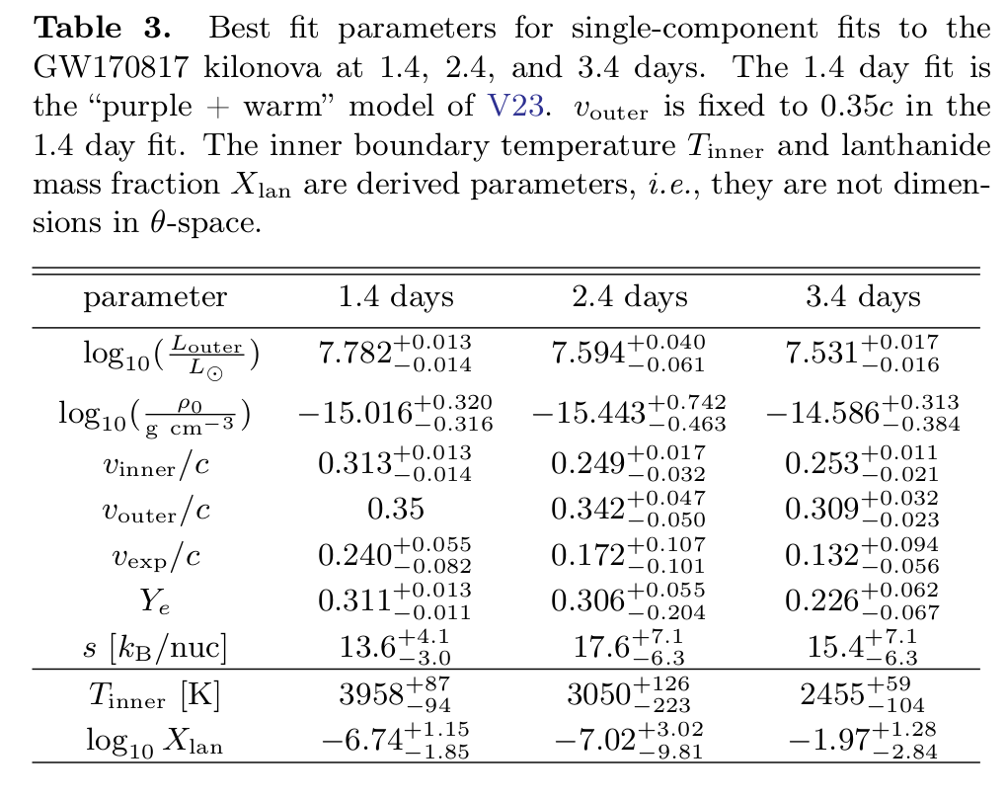
Single-component fits
Vieira+24 (SPARK II)

Slide 57
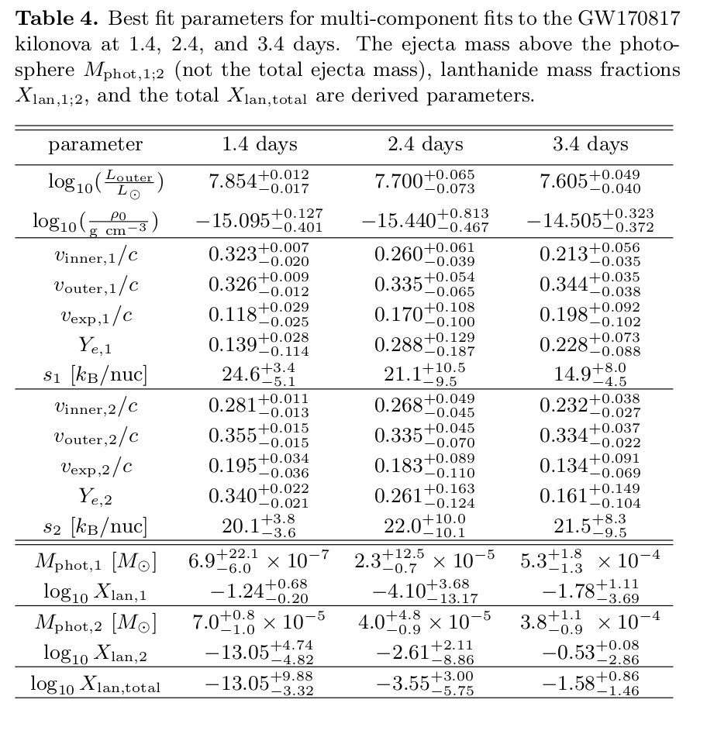
Multi-component fits
Vieira+24 (SPARK II)

Slide 58
Ce II lines from APOGEE survey?
Cunha+17

Slide 59
Preferred mode in 2.4 days, single-component
lower-entropy mode

Slide 60
Preferred mode in 3.4 days, single-component
higher density + mid electron fraction +
lower entropy
mode

Slide 61
Posterior convergence @ 1.4 days, single-component

Slide 62
Posterior convergence @ 2.4 days, single-component

Slide 63
Posterior convergence @ 3.4 days, single-component

Slide 64
Posterior convergence @ 1.4 days, multi-component

Slide 65
Posterior convergence @ 2.4 days, multi-component

Slide 66
Posterior convergence @ 3.4 days, multi-component

Slide 67
EXTRA SLIDES FOLLOW

Slide 68
Heavy metal
Stable isotopes of heavier elements have more neutrons than protons
NNDC, Brookhaven (NuDat 3: https://www.nndc.bnl.gov/nudat3/)
Notes:
Maybe we can get a clue by looking at which isotopes are stable for these heavier elements. What we see right away is that heavier elements have far more neutrons than protons. So, to synthesize these elements, we need an environment with a lot of free neutrons…

Slide 69
GW170817: first NS-NS merger, only gravitational wave + light detection to date
gravitational waves detected by both LIGO detectors, not Virgo
short gamma-ray burst: T + 3 seconds
kilonova: found at T + 11 hours
Kasliwal+2018

Slide 70
SPARK: Spectroscopic r-Process Abundance Retrieval for Kilonovae

Slide 71
SPARK: Spectroscopic r-Process Abundance Retrieval for Kilonovae

Slide 72
SPARK: Spectroscopic r-Process Abundance Retrieval for Kilonovae

Slide 73
SPARK: Spectroscopic r-Process Abundance Retrieval for Kilonovae
Notes:
Once we have obtained a good fit to the spectrum, we can then look at the corresponding abundances and associate features in our spectrum with specific elements

Slide 74
Gaussian Processes
GPs can approximate a function by conditioning on data and can provide uncertainties
In our case, we have some point and the function we care about is the posterior
Train our GP on pairs
Görtler+19
https://distill.pub/2019/visual-exploration-gaussian-processes/
Notes:
Why a Gaussian process? Well, GPs are a very powerful tool which can be used to approximate any function by conditioning them on data, or in the language of machine learning, training them on data
Importantly, a Gaussian process can also be used to provide an estimate of the uncertainty, which can be really powerful
This image here shows a 1D Gaussian process being conditioned on a few data points, and it’s from this really nice interactive visual exploration of GPs which I highly recommend you check out
In our case, we have some point which we’ll call theta, and the function we want to approximate is the posterior p of theta given some data X
So, we’re training our GP on pairs of theta and p

Slide 75
Bayesian Active Posterior Estimation (BAPE)
explore regions of high σ
exploit regions of high μ
Kandasamy+17

Slide 76
[r]apid neutron capture: the r-process
temperature ~ 10⁹ - 10¹⁰ K
density ~ 10¹² g cm⁻³
neutron capture timescale < beta-decay timescale
over t ~ 1 s (!), neutrons capture onto seed nuclei, synthesizing heavy elements
also require a neutron : seed ratio > 1
adapted from Ji+19
Notes:
This r-process requires pretty exceptional conditions: namely, temperatures in excess of 1 billion degrees Kelvin, and densities in excess of 10¹² g cm⁻³ . If we have a large number of free neutrons under these conditions, we enter the regime where the timescale for neutron capture is shorter than the timescale for radioactive beta decay.
In this regime, neutrons are repeatedly captured onto seed nuclei before the nuclei can undergo radioactive decay, and thus we can generate radioactive isotopes of very heavy elements
Importantly, this also requires a neutron to seed ratio much greater than 1---this is achieved by [...]
Here, we see an example of the r-process abundances in the Solar system, from a few different sources. The thinking is that some sort of catastrophic event which generates r-process elements happened nearby, introducing these elements to our Solar system. This abundance pattern is quite complex, and reflects a few things:
First of all, we see 3 peaks. These peaks happen to be near the magic numbers for nuclei, that is, where nuclides are most stable. So it’s not surprising that, after billions of years, these stable isotopes are what remained of some catastrophic event.
However, we also see sub-peaks. There are a few ideas for how these get formed, but one is that they are the result of repeated fission cycling. Basically, in the r-process, you generate very heavy nuclei and these almost immediately fission to create lighter elements. This cycling repeats over and over again, and so you get a pile-up of these lighter elements. We can see one such pile-up around here, for the lanthanides.

Slide 77
[r]apid neutron capture: the r-process
Lippuner+15
Notes:
This r-process requires pretty exceptional conditions: namely, temperatures in excess of 1 billion degrees Kelvin, and densities in excess of 10¹² g cm⁻³ . If we have a large number of free neutrons under these conditions, we enter the regime where the timescale for neutron capture is shorter than the timescale for radioactive beta decay.
In this regime, neutrons are repeatedly captured onto seed nuclei before the nuclei can undergo radioactive decay, and thus we can generate radioactive isotopes of very heavy elements
Importantly, this also requires a neutron to seed ratio much greater than 1---this is achieved by [...]
Here, we see an example of the r-process abundances in the Solar system, from a few different sources. The thinking is that some sort of catastrophic event which generates r-process elements happened nearby, introducing these elements to our Solar system. This abundance pattern is quite complex, and reflects a few things:
First of all, we see 3 peaks. These peaks happen to be near the magic numbers for nuclei, that is, where nuclides are most stable. So it’s not surprising that, after billions of years, these stable isotopes are what remained of some catastrophic event.
However, we also see sub-peaks. There are a few ideas for how these get formed, but one is that they are the result of repeated fission cycling. Basically, in the r-process, you generate very heavy nuclei and these almost immediately fission to create lighter elements. This cycling repeats over and over again, and so you get a pile-up of these lighter elements. We can see one such pile-up around here, for the lanthanides.

Slide 78
Fundamental tracer for neutron-richness: electron fraction
conservation of charge
equivalently, proton fraction
higher electron fraction → more protons, fewer neutrons
electron fraction ~ 0.01 - 0.45 required for r-process, less than 0.3 required to produce all peaks
Notes:
Now, the fundamental tracer for neutron richness when we discuss these nucleosynthesis events and abundance patterns is the electron fraction
This is a bit of a misnomer, or not a useful name, because it’s actually better understood as the ratio of protons to the ratio of all baryons. This means that, for a higher electron fraction, the ejecta is more proton-rich, and lacking in neutrons.
This parameter is very important in determining the abundance pattern of a given r-process event, and we usually need between 0.01 and 0.45 to get an r-process. To get a robust r-process which produces all of the peaks we saw in the previous slide, we need electron fractions closer to ~0.3.

Slide 79
Hot or cold? Slow or fast?
hot: large entropy, equilibrium between neutron capture and photodissociation
cold: small entropy, may drop out of equilibrium before synthesizing lanthanides and heavier
can transition from one regime to another via expansion cooling / radioactive heating
expansion timescale/velocity is also important!
adapted from Vassh+21
Notes:
However, there are other parameters which determine the abundances from some r-process event. One of these is the entropy of the ejecta.
For high entropy, the plasma is radiation-dominated, and we have an equilibrium between neutron captures and photodissociations of heavy nuclei. This photodissociation gives a continuous supply of seed nuclei for neutrons to capture onto, and so we can have a robust r-proces where we generate all of the peaks in the r-process abundance pattern. The entropy is strongly dependent on temperature in this regime, hence, we call this a “hot” entropy.
For a lower or “colder” entropy, in contrast, photodissociations are almost irrelevant and equilibrium is only maintained for a short time. This can then impede the synthesis of the heaviest elements, like the lanthanides.
In these two plots, we can see how these hot and cold entropies differ. The cold scenario generates more radioactive isotopes close to the neutron dripline, while the hot scenario generates more stable nuclei through repeated photodissociations and neutron captures. This then impacts the final abundances, which we see in the bottom plot.
Importantly, we can actually transition from one regime to another via, for example, expansion cooling or radioactive heating. This is one intuitive way to realize that the expansion timescale / velocity is also an important quantity.

Slide 80
Impact of nuclear physics uncertainties on abundances
the final abundances (as predicted by reaction networks) depend sensitively on nuclear physics:
nuclear mass model
beta-decay rates
neutron capture cross-sections
treatment of fission
Mendoza-Temis+15
Notes:
One final note is that these abundances are highly impacted by uncertainties in the nuclear physics
The abundances I showed just before are from reaction network calculations, where you write down the coupled differential equations for several thousand reactions, you set up some plasma with some temperature, density, entropy, and so on, and you say “go”.
The outcomes of these calculations are very sensitive to the nuclear physics employed. The four most important pieces of physics are:
which nuclear mass model you use
the accuracy of the beta-decay rates of different radioactive isotopes
the neutron capture cross-sections for different isotopes
and the treatment of fission
For example, here we’re seeing the outcomes of the same reaction network calculations, where the nuclear mass model has been varied. You can see that this impacts the location, width, and amplitude of some of the r-process peaks, for example.

Slide 81
Radioactive decay, thermalization, and r-process heating
radioactive decays:
𝜶, 𝛽, 𝛾-particles + fission fragments
power law heating → kilonova
thermalization
Barnes+16
Wanajo 18
Notes:
I want to clarify why this emission is in the UV, optical, and IR in the first place. The mechanism is the following:
In the r-process, you synthesize lots of radioactive isotopes. These freshly-synthesized isotopes undergo alpha, beta, and gamma decays, as well as fission.
These processes deposit energy into the surrounding ejecta. In a process called thermalization,

Slide 82
Impact of nuclear physics on heating, light curves
order of magnitude variations in heating rates and bolometric luminosities + large variations in slopes
Barnes+21
Notes:
I want to clarify why this emission is in the UV, optical, and IR in the first place. The mechanism is the following:
In the r-process, you synthesize lots of radioactive isotopes. These freshly-synthesized isotopes undergo alpha, beta, and gamma decays, as well as fission.
These processes deposit energy into the surrounding ejecta. In a process called thermalization,

Slide 83
Multi-component effects
Kawaguchi+20

Slide 84
Red versus blue in photometric modelling
Villar+17

Slide 85
Red versus blue in photometric modelling
more red than blue!
Villar+17

Slide 86
Red versus blue in photometric modelling
more red than blue!
Siegel 19 & (many) references therein

Slide 87
KilonovAE FIGURES

Slide 88
KilonovAE
generate kilonovae across parameter space
find clusters in some lower-dimensional latent space using an autoencoder (AE)
how do these clusters relate to physical parameters and spectral features?
Nicole Ford
Ford+24, ApJ, 961, 1, 119

Slide 89
KilonovAE
these clusters give an idea what a future representative sample of kilonovae might look like
Ford+24, ApJ, 961, 1, 119

Slide 90
Cluster 3 @ 1.4 days
strong Sr II absorption
Ford+24, ApJ, 961, 1, 119

Slide 91
Cluster 4 @ 3.4 days
strong Ce II absorption
Ford+24, ApJ, 961, 1, 119

