Slide 1
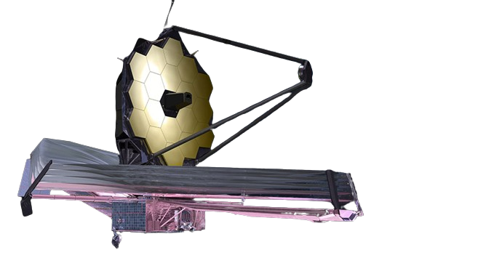
A First Look at the JWST Phase Curve of WASP-121b with NIRISS/SOSS
Jared Splinter
CRAQ Annual Meeting 2024
Supervisor: Nicolas Cowan

Slide 2
The Target:
WASP-121 b
Mass | 1.18 M_{Jupiter}
Radius | 1.186 R_{Jupiter}
Period | ~1.27 days
Tidally locked
(permanent day and nightside)
An Ultra-hot Jupiter
Dayside: ~3000 K
Nightside: <2200 K
Image Credit: NASA,ESA, G.Bacon (STScI)

Slide 3
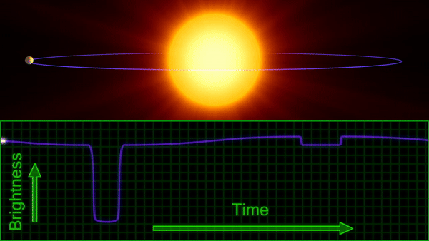
Exoplanet Phase Curves
Animation Credit: ExploreAstro

Slide 4
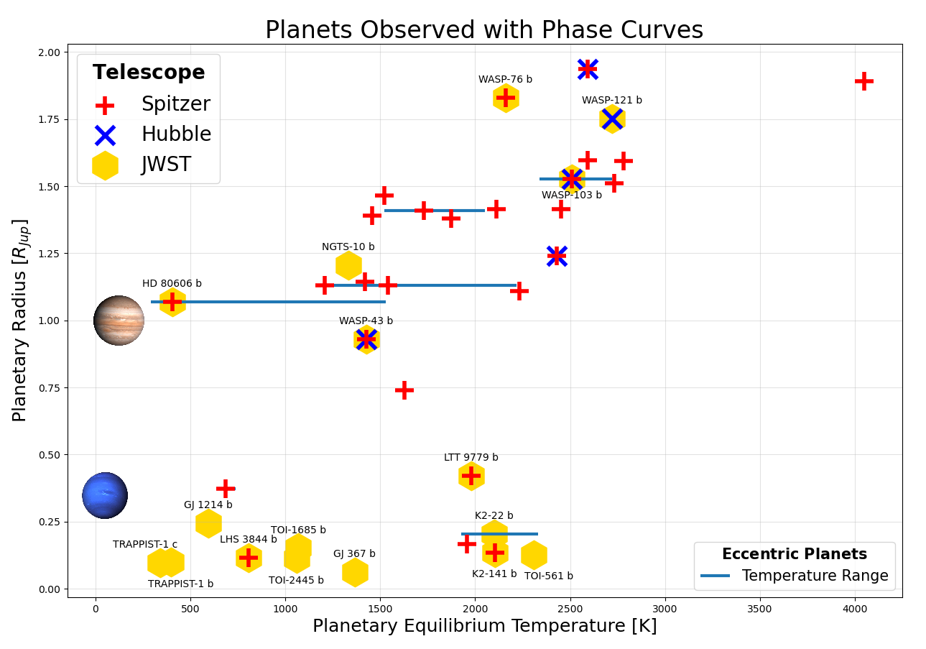
Previous Phase Curve Observations
Must be done with Space Telescopes
Most observations done with photometry (ex. Spitzer)
Handful of planets observed with spectroscopic phase curves
JWST Observations from Cycle 1, 2 & 3

Slide 5
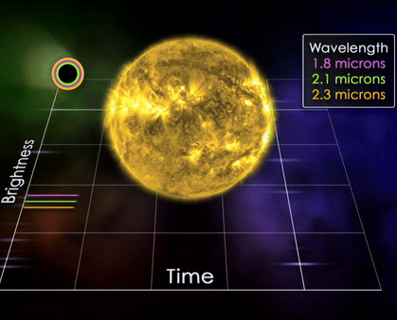
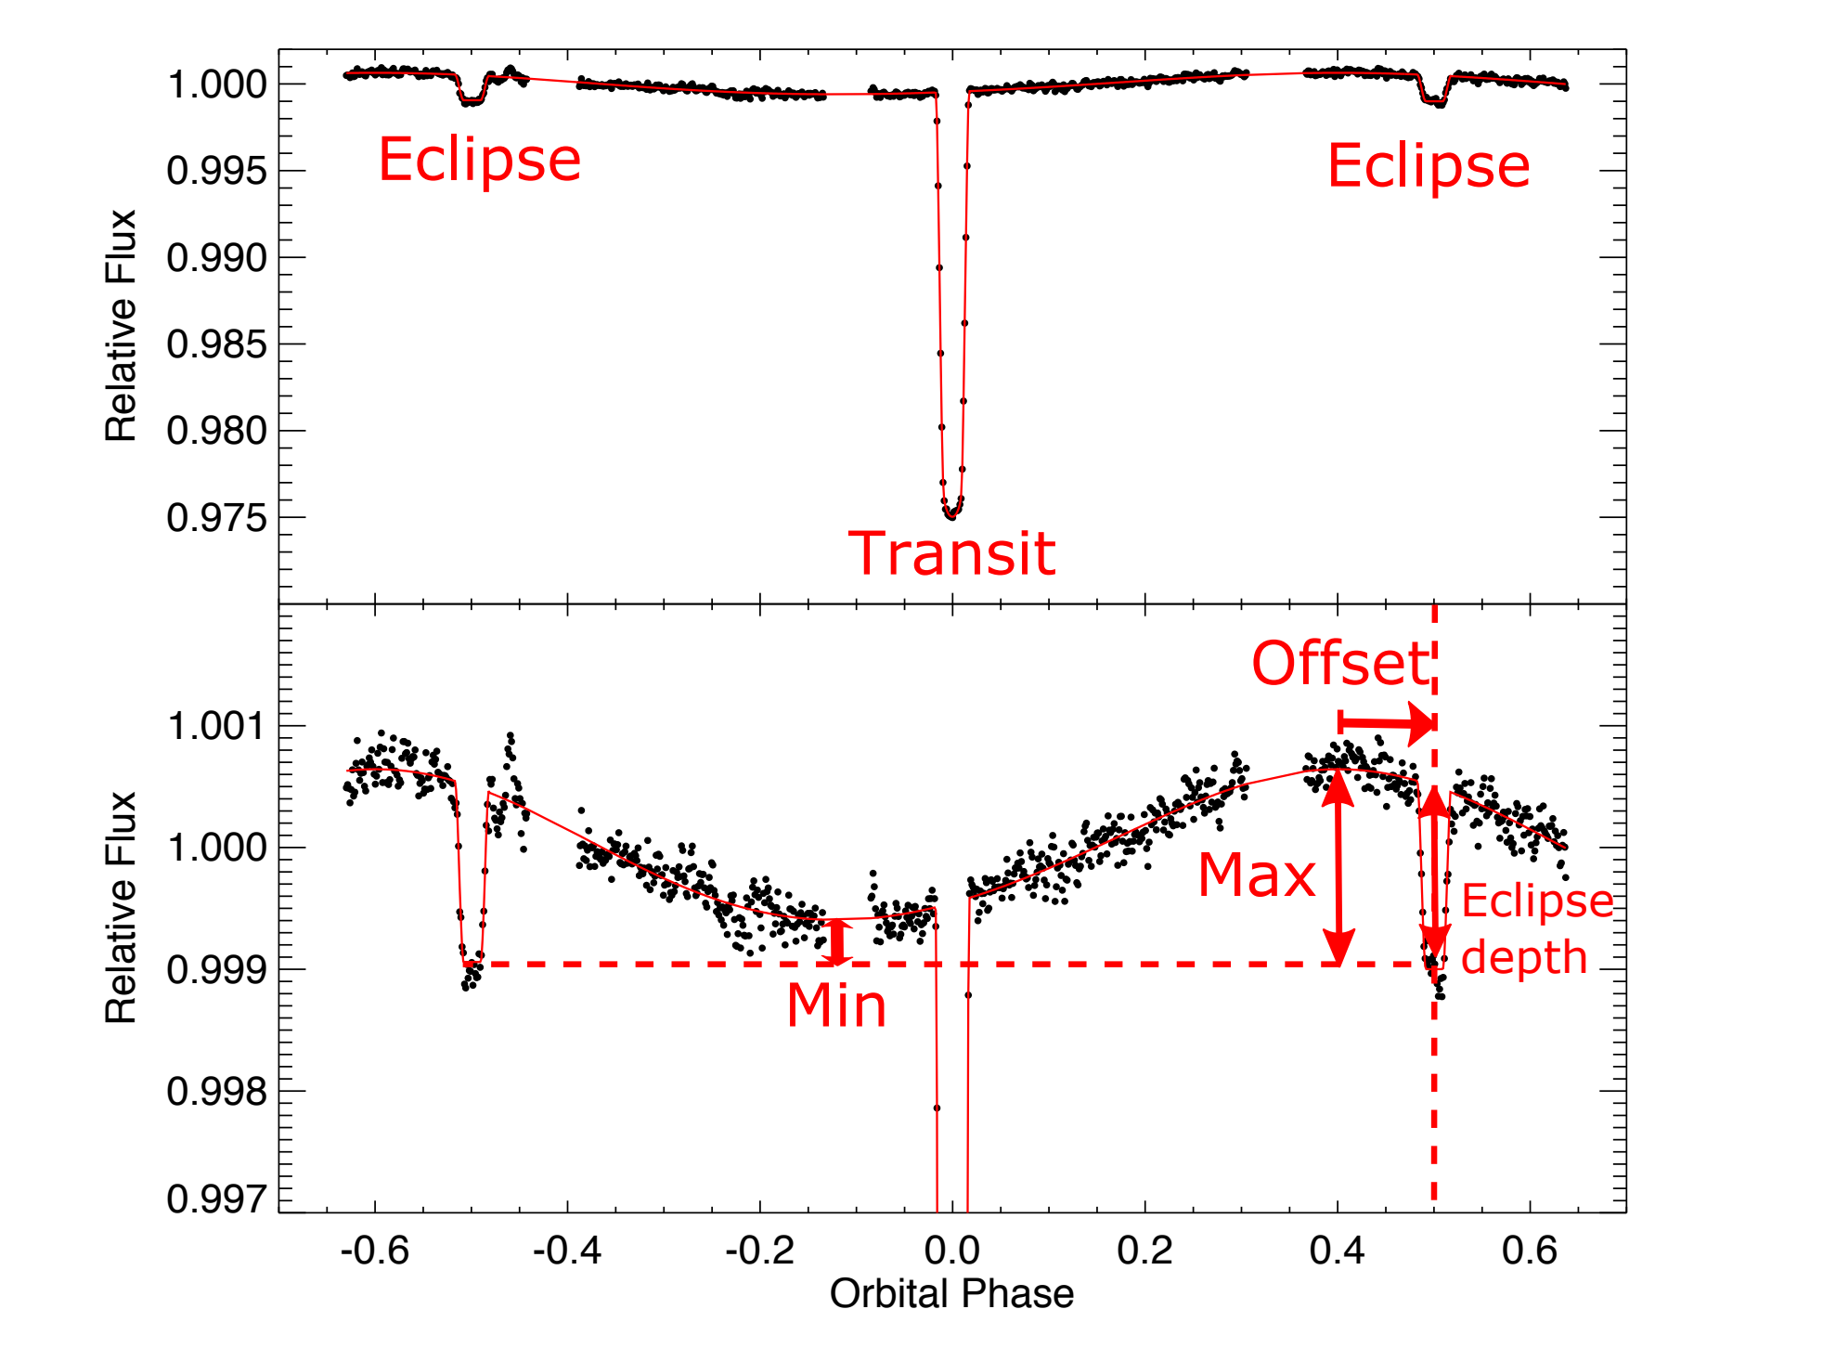
Spectroscopy vs Photometry
Spectroscopy only:
Spectroscopy & Photometry:
Image from: Parmentier, V., & Crossfield, I.J. (2018). Which makes use of phase curve from Knutson, H.A.(2012).
Credit: NASA

Slide 6
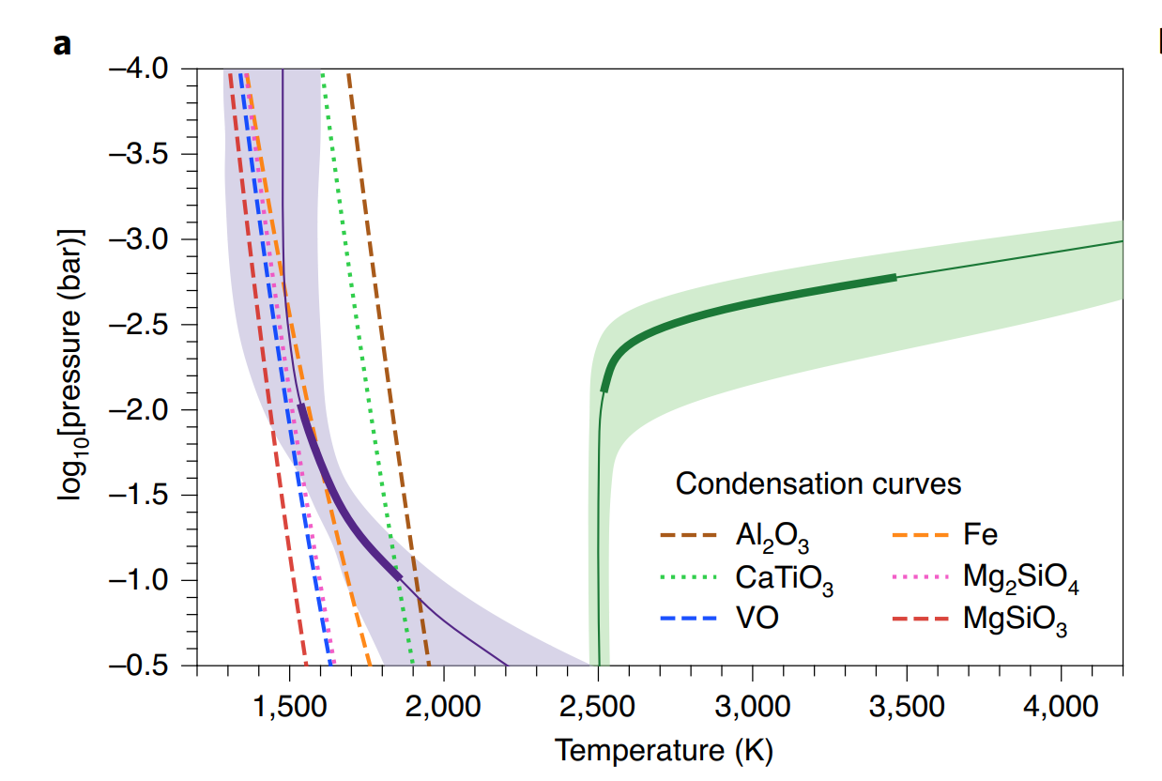
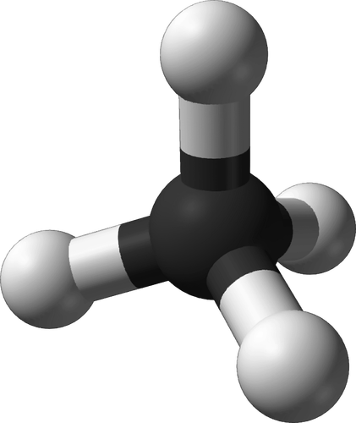
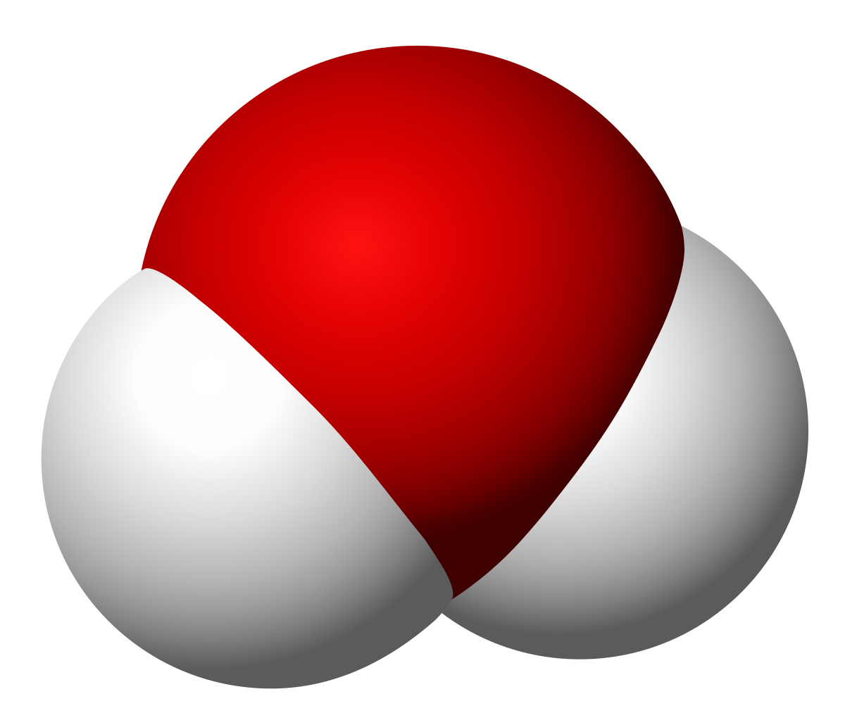
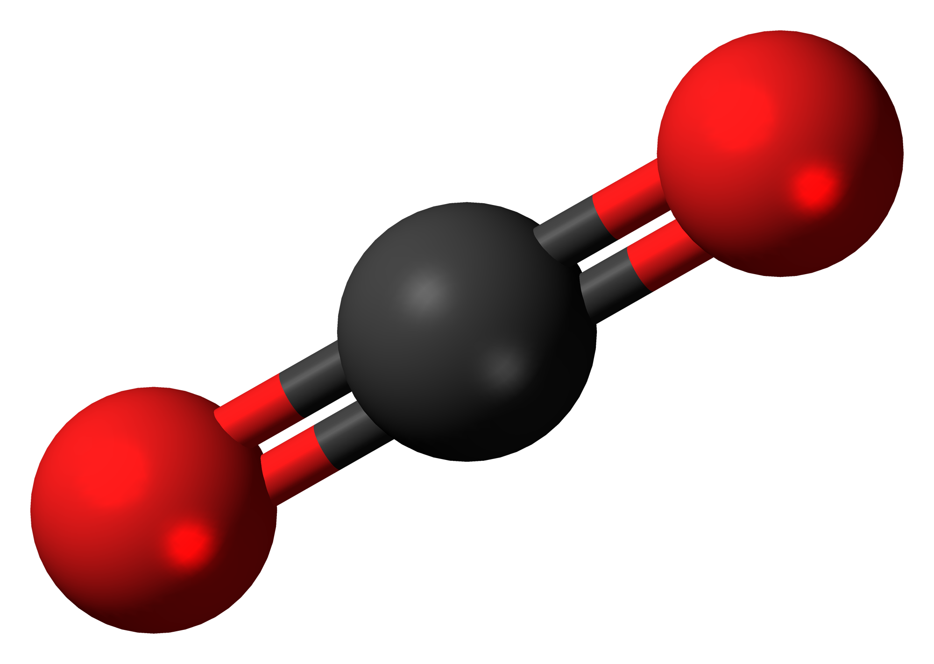
Spectroscopic Phase Curve
in Infrared
Higher Signal-to-noise
Better coverage of blackbody of the planet
Probe layers of atmosphere
Temperature-Pressure Profile
Better constrained
Molecular Composition/detection
Detect new molecules
Longitudinal abundance
Energy Balance/ Heat Transfer Models
Cloud map
Wind patterns
Water (H₂O)
Carbon Dioxide (CO₂)
Methane (CH₄)
Mikal-Evans, T. et al. (2022)
Notes:
Further insights are anticipated with the James Webb Space Telescope, which will enable higher signal-to-noise ratio spectroscopy across the broader 0.8–11μm wavelength range. This will provide fuller coverage of the H− opacity continuum and access to stronger H2O bands at longer wavelengths, breaking the degeneracy between the two species. Additional spectral features, such as the CO spectral band at 4.5μm, will provide further leverage for constraining the chemical composition, thermal structure and wind patterns of the atmosphere.

Slide 7
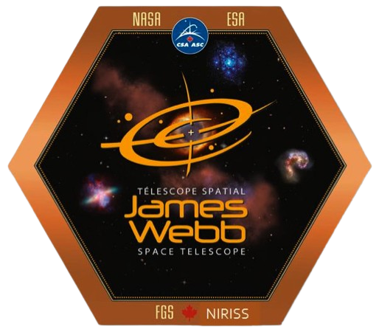
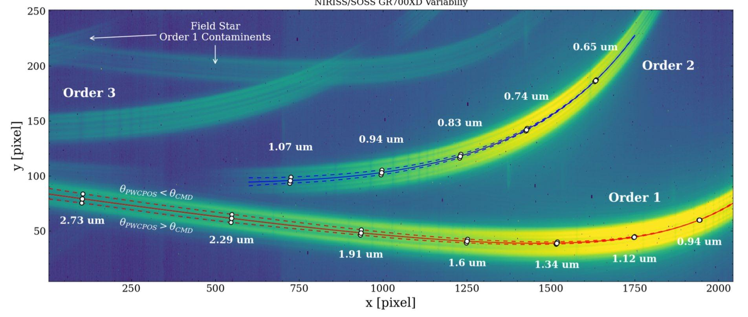
NIRISS/SOSS
Instrument: Near Infrared Imager and Slitless Spectrograph
Mode: Single Object Slitless Spectroscopy
Canadian Instrument onboard JWST
0.5 - 2.8 micron wavelength range
Multiple Spectral Orders (currently only use 1 and 2)
NIRISS logo
Example SOSS image:
Baines, T., Espinoza, N., Filippazzo, J., & Volk, K. (2023)

Slide 8
NIRISS/SOSS
Instrument: Near Infrared Imager and Slitless Spectrograph
Mode: Single Object Slitless Spectroscopy
Observation part of a Cycle 1 Guaranteed Time Observation (GTO):
Proposal ID: 1201; PI: David Lafreniere
NIRISS Exploration of the Atmospheric diversity of Transiting exoplanets (NEAT)
Canadian Instrument onboard JWST
0.5 - 2.8 micron wavelength range
Multiple Spectral Orders (currently only use 1 and 2)
NIRISS logo
Example SOSS image:
Baines, T., Espinoza, N., Filippazzo, J., & Volk, K. (2023)

Slide 9
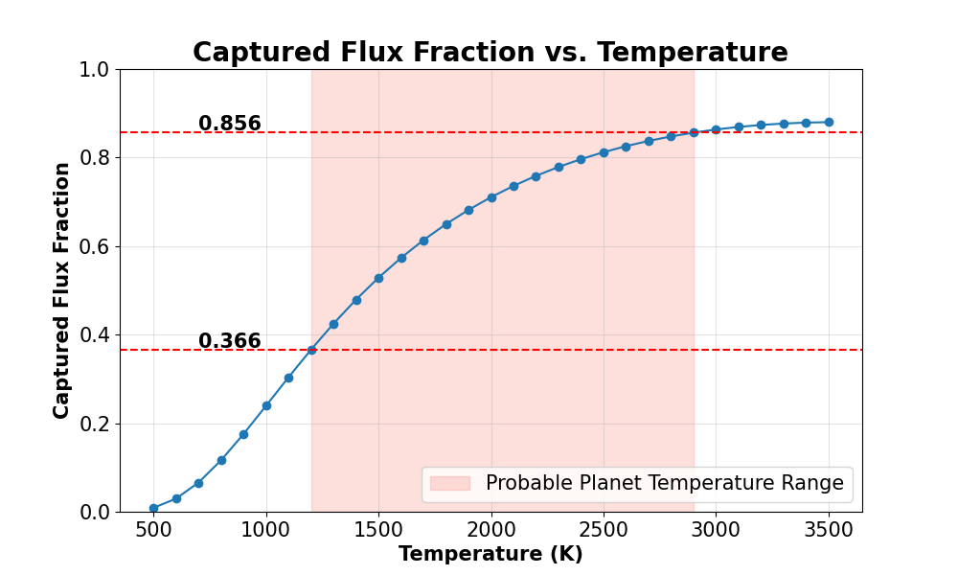
Captured Flux with NIRISS/SOSS
0.5 - 2.8 μm range will capture a large portion of the planet’s emitted flux
(Assuming the planet as a blackbody)

Slide 10
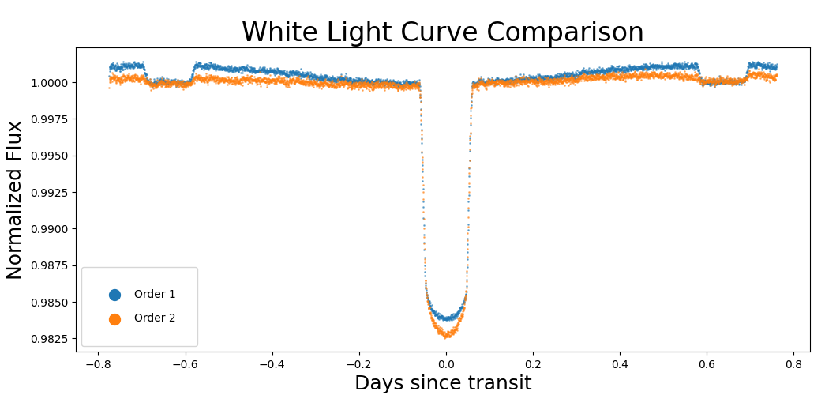
Results - White Light Curves
Order 1: (~0.84 - 2.83 micron)
Order 2: (~0.5 - 1.4 micron)
Reduction #1 done with supreme-spoon (now exoTEDRF) pipeline created by Michael Radica

Slide 11
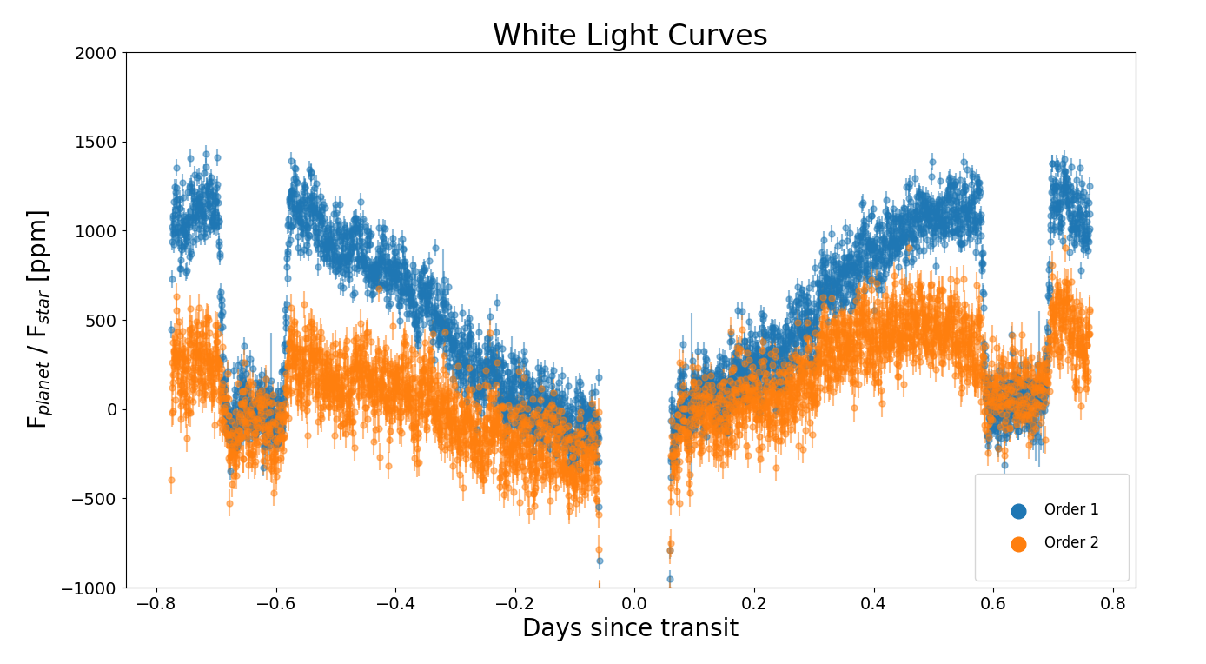
Results - White Light Curves
Order 1: (~0.84 - 2.83 micron)
Order 2: (~0.5 - 1.4 micron)

Slide 12
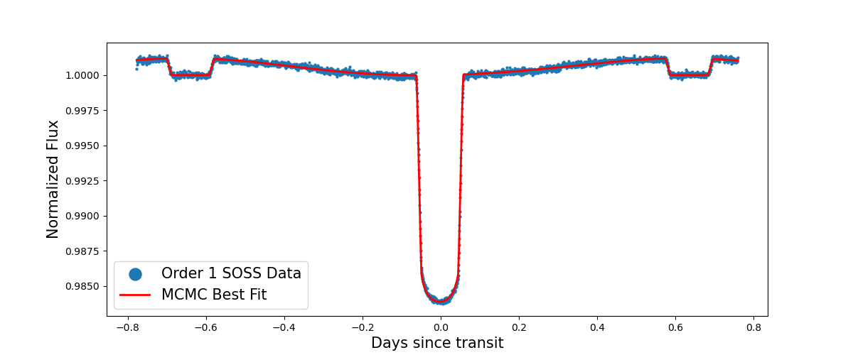
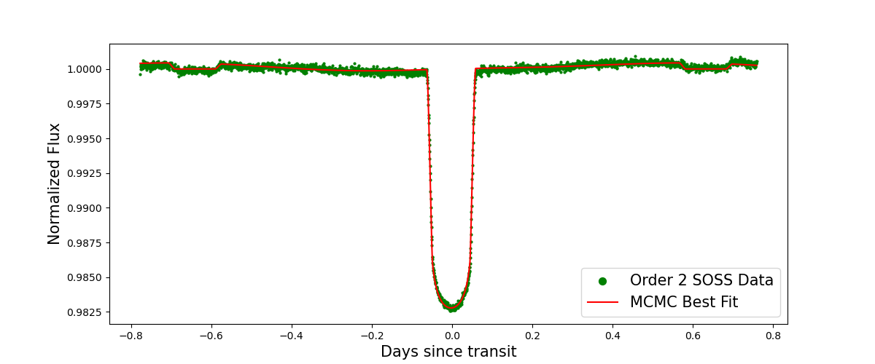
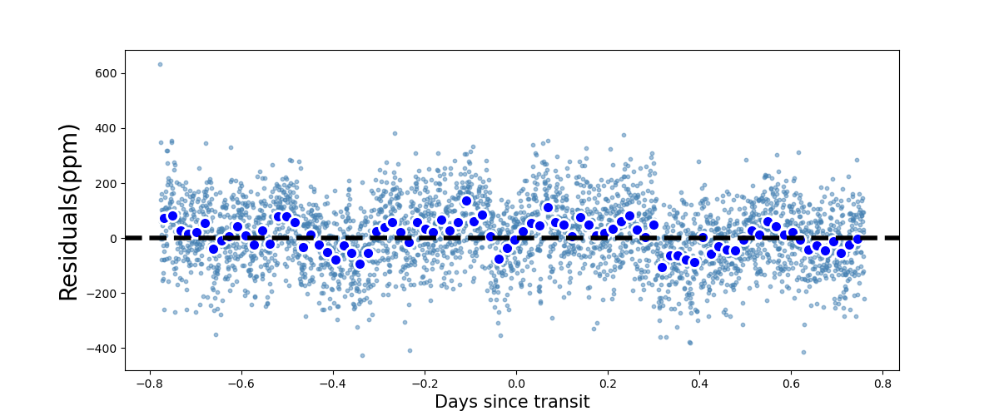
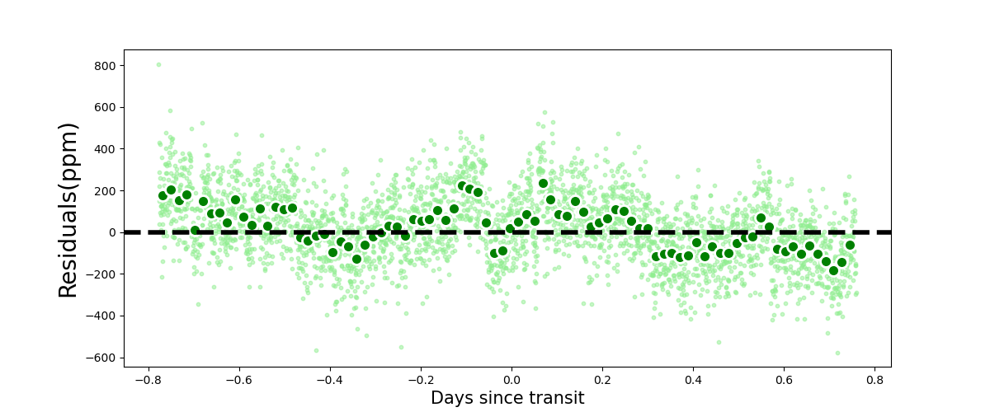
Results - MCMC Fits
Order 1: (~0.84 - 2.83 micron)
Order 2: (~0.5 - 1.4 micron)
Systematics uncorrected!

Slide 13
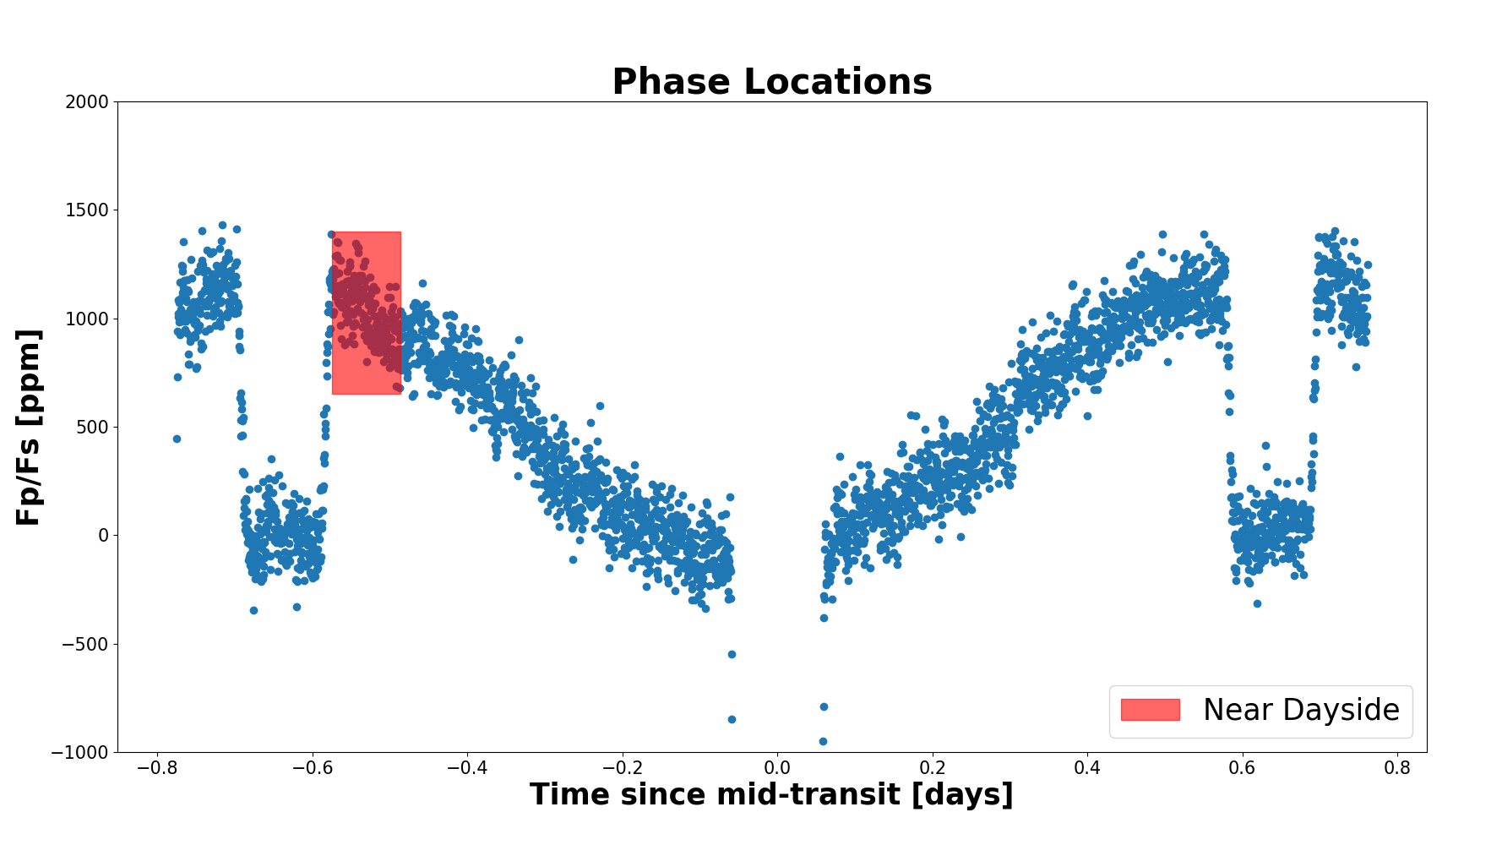
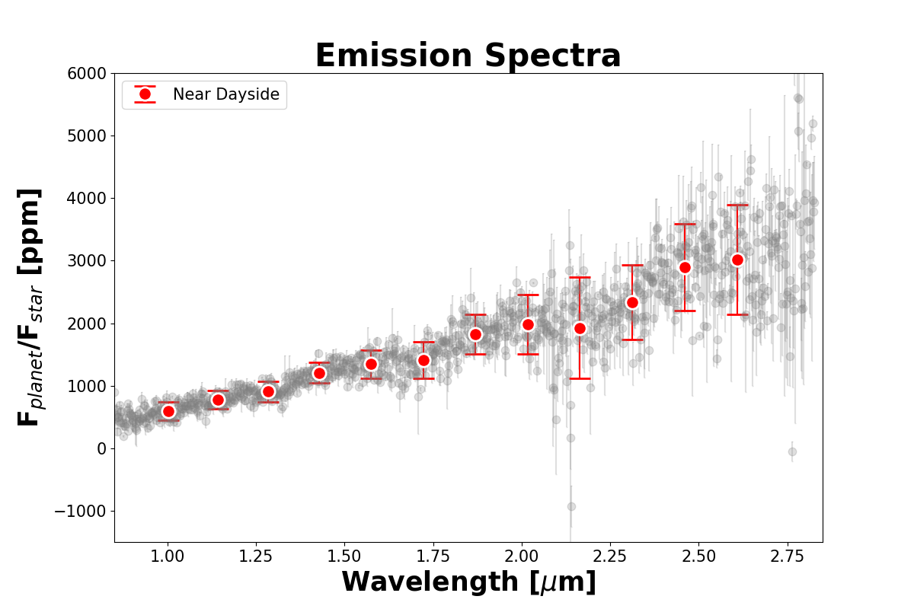
Emission Spectra
CO emission
CO₂ emission
H₂O emission
H- emission
Data from Order 1 (~0.84 - 2.83 μm)

Slide 14
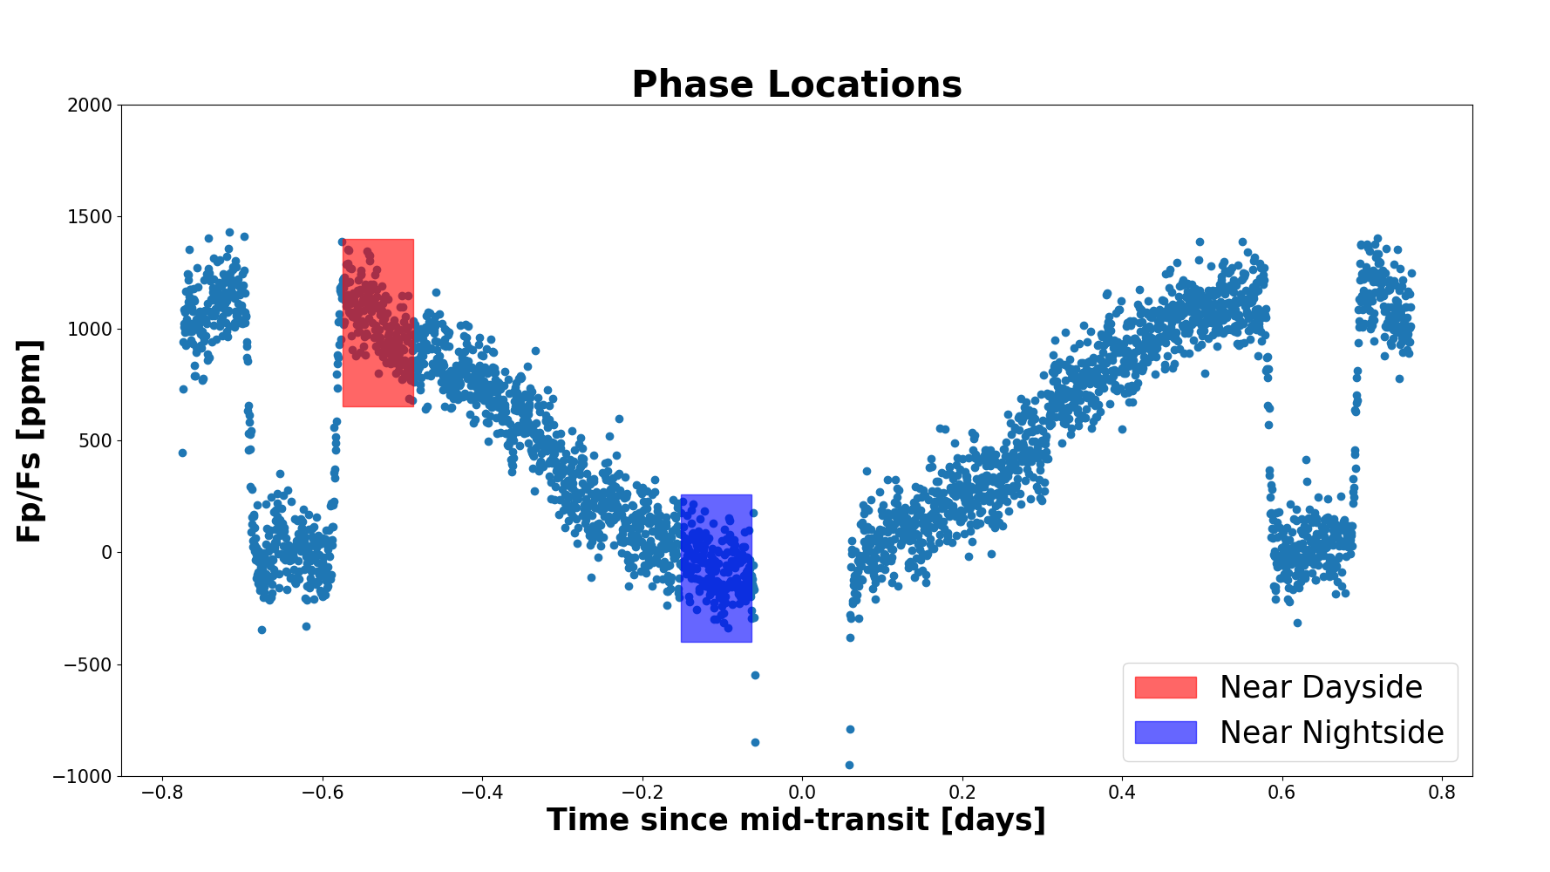
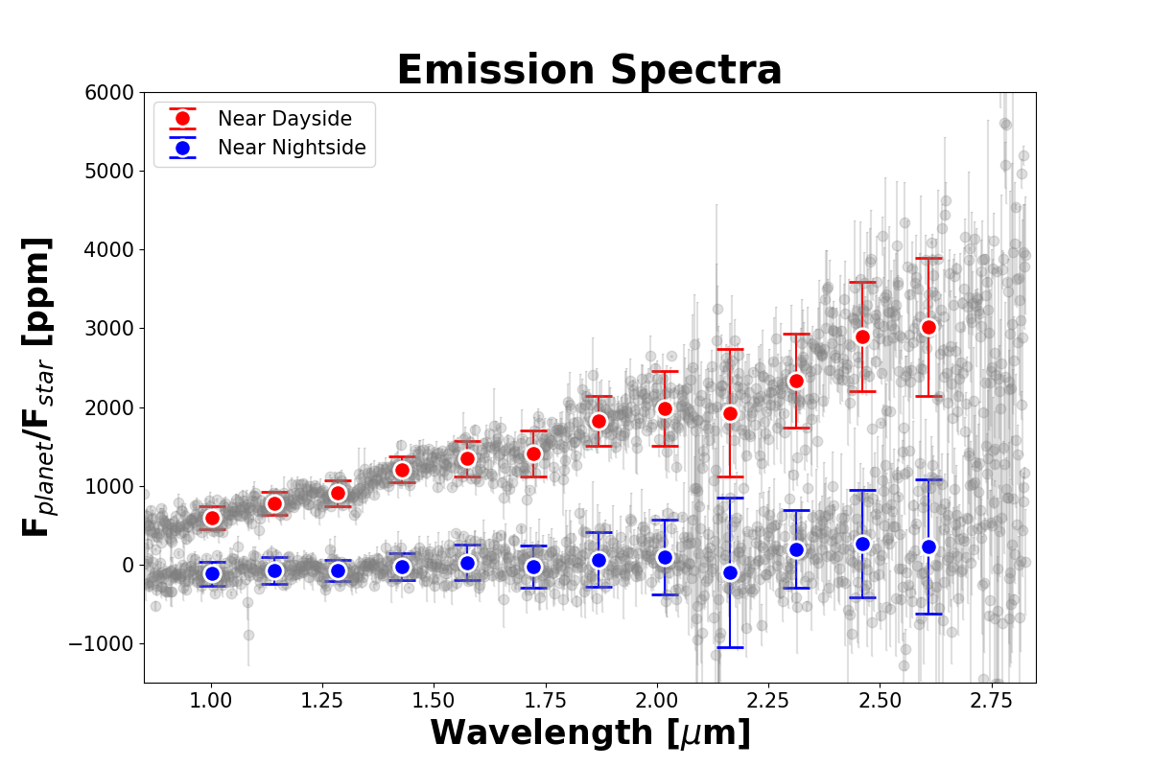
Emission Spectra
CO emission
CO₂ emission
H₂O emission
H- emission
Data from Order 1 (~0.84 - 2.83 μm)

Slide 15
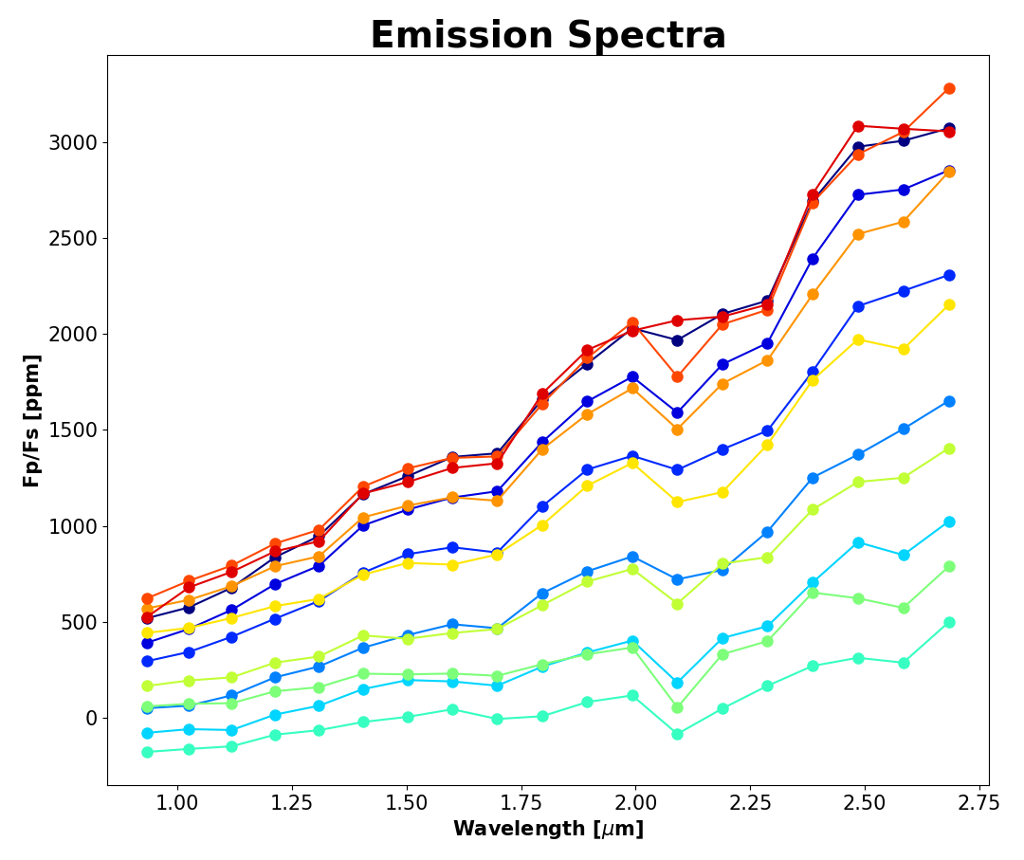
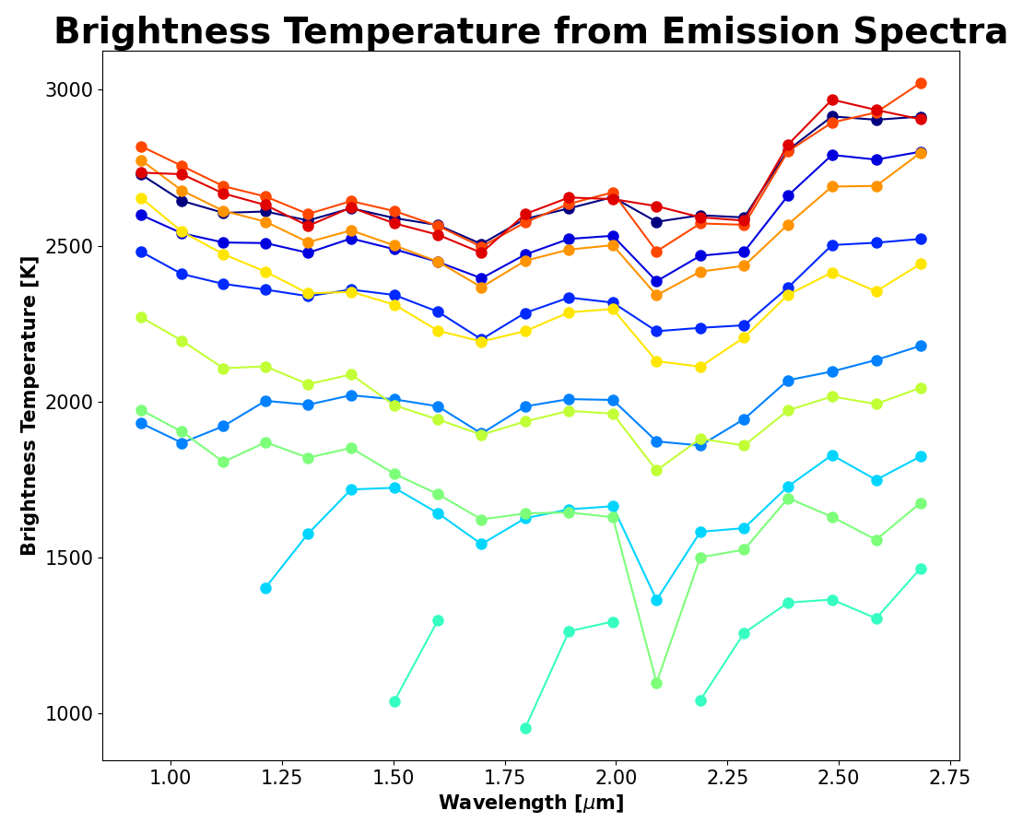
Spectra and Temperature across the Planet
Varying with Longitude
Data binned and error bars removed for clarity!
Data from Order 1 (~0.84 - 2.83 micron)

Slide 16
Energy Balance Model
Overlay simple Energy Balance Model of planet to find…

Slide 17
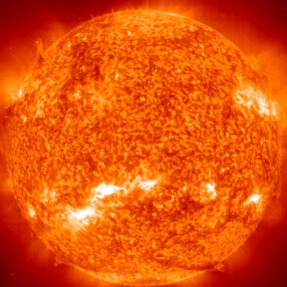
Energy Balance Model
Wind Speed
(How fast the heat recirculates to nightside)
Bond Albedo
(Amount of reflected Starlight)
“Top-Down” View
“Top-Down” View
Planet
Planet

Slide 18
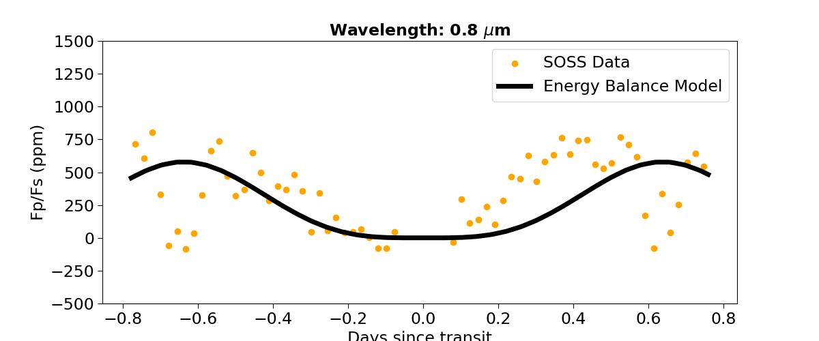
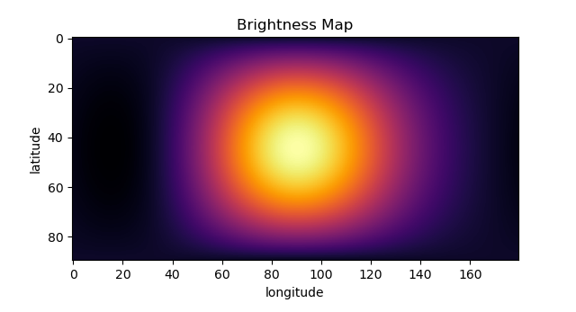
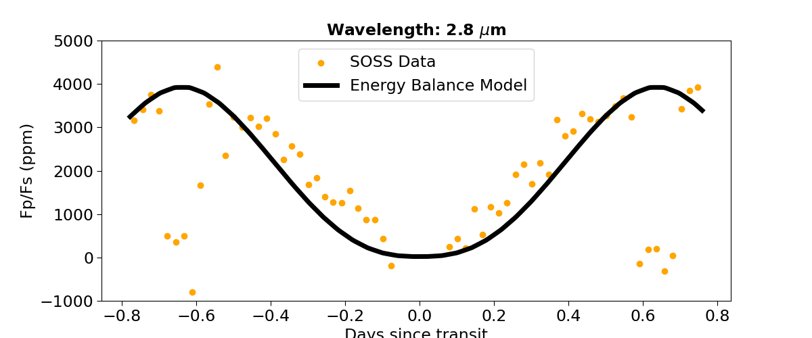
Zero Albedo, Low Wind Speed
0.8 Micron
2.8 Micron

Slide 19
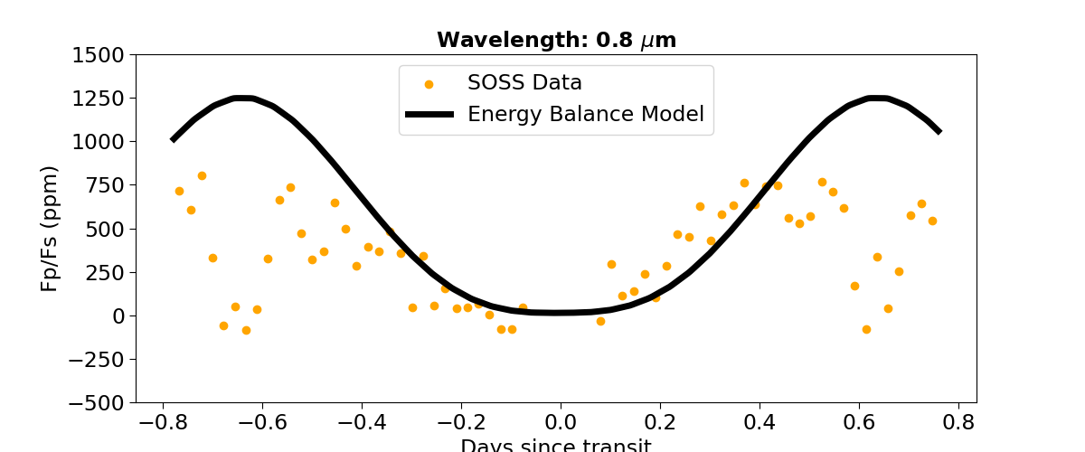
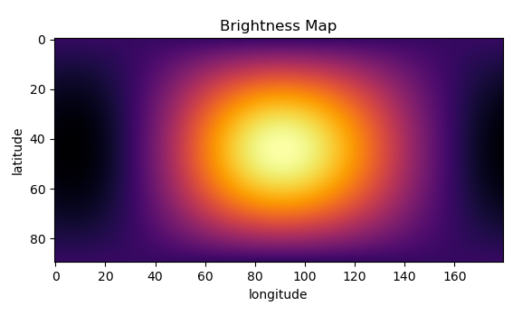
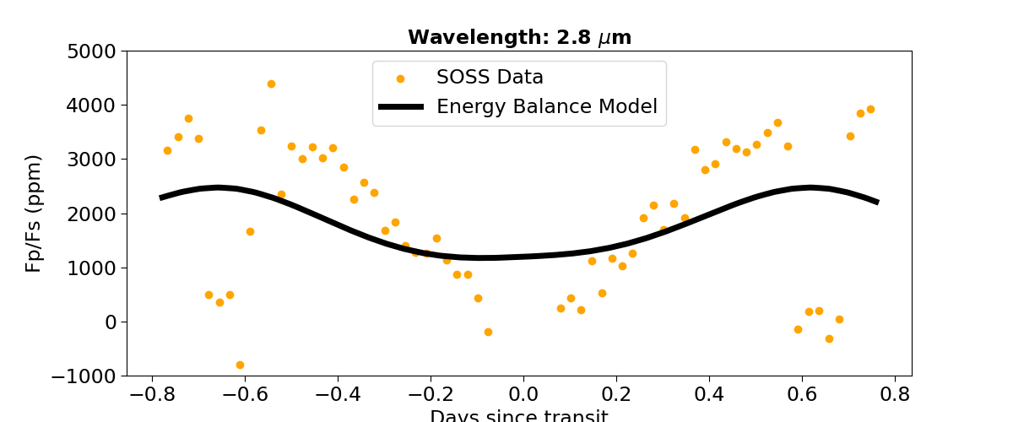
High Albedo, High Wind Speed
0.8 Micron
More reflected light at shorter wavelengths
2.8 Micron
Wind flattens lightcurve at longer wavelengths

Slide 20
High Albedo, High Wind Speed
0.8 Micron
More reflected light at shorter wavelengths
2.8 Micron
Wind flattens lightcurve at longer wavelengths

Slide 21
Future Work
Dayside and Nightside Brightness Temperature estimates:
Improve on Data Reduction (Raw image to spectra)
Reduction #2 underway!
Calculate Effective Temperature of planet by phase
Fit to Energy Balance Model
Spectral Retrieval on data to obtain molecular abundances
Fit Spectroscopic light curves
Order 1: (Estimating by max throughput λ ~= 1.2 μm)
T_{day}: 2836.82 K
T_{night}: 1475.83 K
Order 2: (Estimating by max throughput λ ~= 0.75 μm)
T_{day}: 2926.8 K
T_{night}: 1833.11 K
Suggests poor heat recirculation efficiency as expected for Ultra-hot Jupiters
heat recirculation efficiency ~ 0.1741
Bond Albedo ~ 0.08

Slide 22
Thanks for Listening!

Slide 23
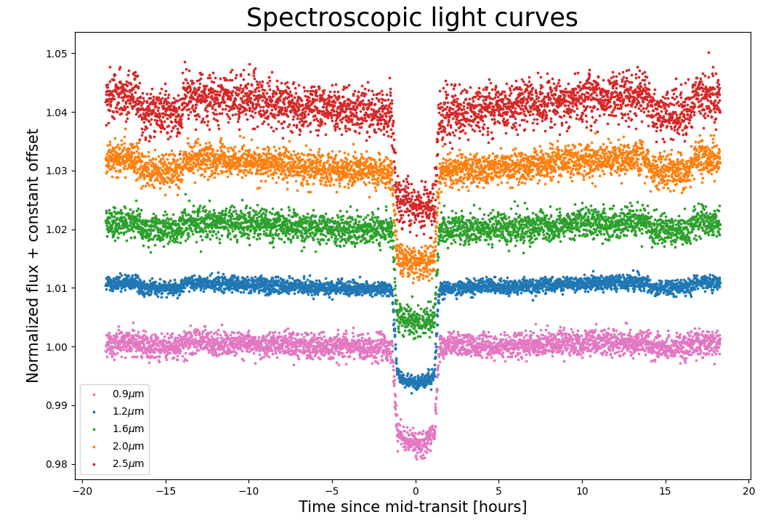
Spectroscopic Light curves

Slide 24
But first, let’s estimate some limits from Cowan & Agol 2011b
Assume T_{O} = 3320 K (from Mikal-Evans 2022)
Uniform day-side, T = 0 on nightside, equilibrium temp:
Tday = (½)^{¼} T_{O} = 2791.77 K
Perfect longitudinal transport, no latitudinal transport:
Tday = (8/3𝛑²)^{¼} T_{O} = 1465.78 K
Uniform temperature everywhere on planet:
T = (¼)^{¼} T_{O} = 2347.59 K

Slide 25
No Albedo, No circulation limit. Max possible day-side T_{eff} we could measure
T_{ϵ=0} = (⅔)^{¼} T_{O} = 2999.95 K
Then, blackbody peak would be at:
λ_{ϵ=0} = 2989 / T_{ϵ=0} μm
= 0.966 μm
Actual peak will be at slightly longer wavelengths than this but this is in coverage of NIRISS/SOSS!

