Slide 1
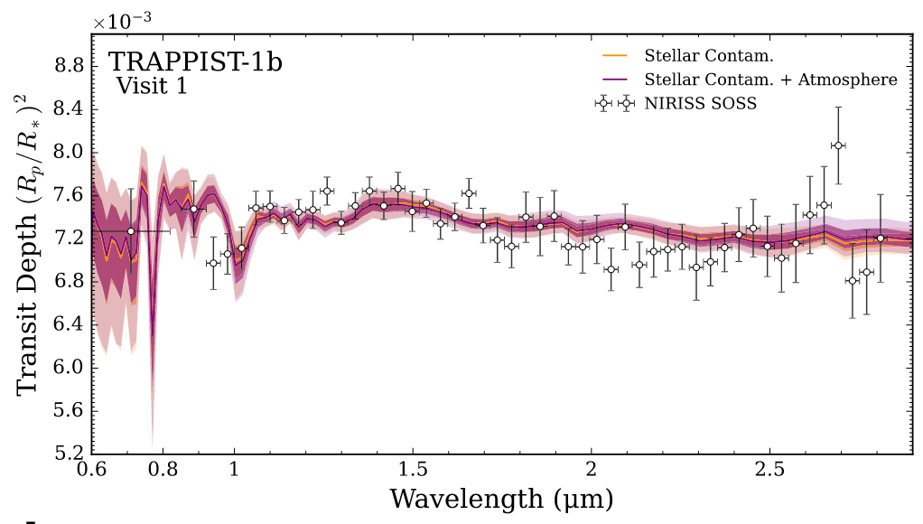
Beating the noise in JWST spectral data
Salma Salhi, Supervised by René Doyon and Laurence Perreault-Levasseur
Noise
Diffusion Model
Gaussian noise
Real images (JWST)
Generated images
Lim et al, 2023
Toy Model
Bayesian Inference
GOAL: get to the photon noise limit over all wavelengths
Scores from the noise model
Legin et al, 2023

