Slide 1
SITELLE Observations of NGC 1275
Carter Rhea

Slide 2
Overview
Introduction to the Perseus Cluster (Thanks Ben!)
Introduction to SITELLE data analysis with LUCI
Spectral analysis results
Diagnostic diagrams
Regions of interest
Conclusions

Slide 3
An Introduction to Luci
LUCI is a general purpose fitting pipeline built for SITELLE
The three primary quantities of interest are the amplitude of the line, the position of the line (often described as the velocity and quoted in km/s), and the broadening of the line (often described as the velocity dispersion).
The available fitting functions are as follows: ‘gaussian’, ‘sinc’, ‘sincgauss’
LUCI: A Python package for SITELLE spectral analysis
Research Notes of the AAS, Volume 5, Number 9
Arxiv: 2108.12428
Updates to LUCI: A New Fitting Paradigm Using Mixture Density Networks
Research Notes of the AAS, Volume 5, Number 12
Arxiv: 2111.12755
Velocity:
Broadening:

Slide 4
Initial Fit Parameters
A Machine-learning Approach to Integral Field Unit Spectroscopy Observations. I. H ii Region Kinematics
The Astrophysical Journal, Volume 901, Issue 2
Arxiv: 2008.08093
A Machine-learning Approach to Integral Field Unit Spectroscopy Observations. II. H II Region Line Ratios
The Astrophysical Journal, Volume 910, Issue 2
Arxiv: 2102.06230
A Machine-learning Approach to Integral Field Unit Spectroscopy Observations. III. Disentangling Multiple Component Emission
The Astrophysical Journal, Volume 923, Issue 2
Arxiv:2110.00569

Slide 5
Back to NGC 1275

Slide 6
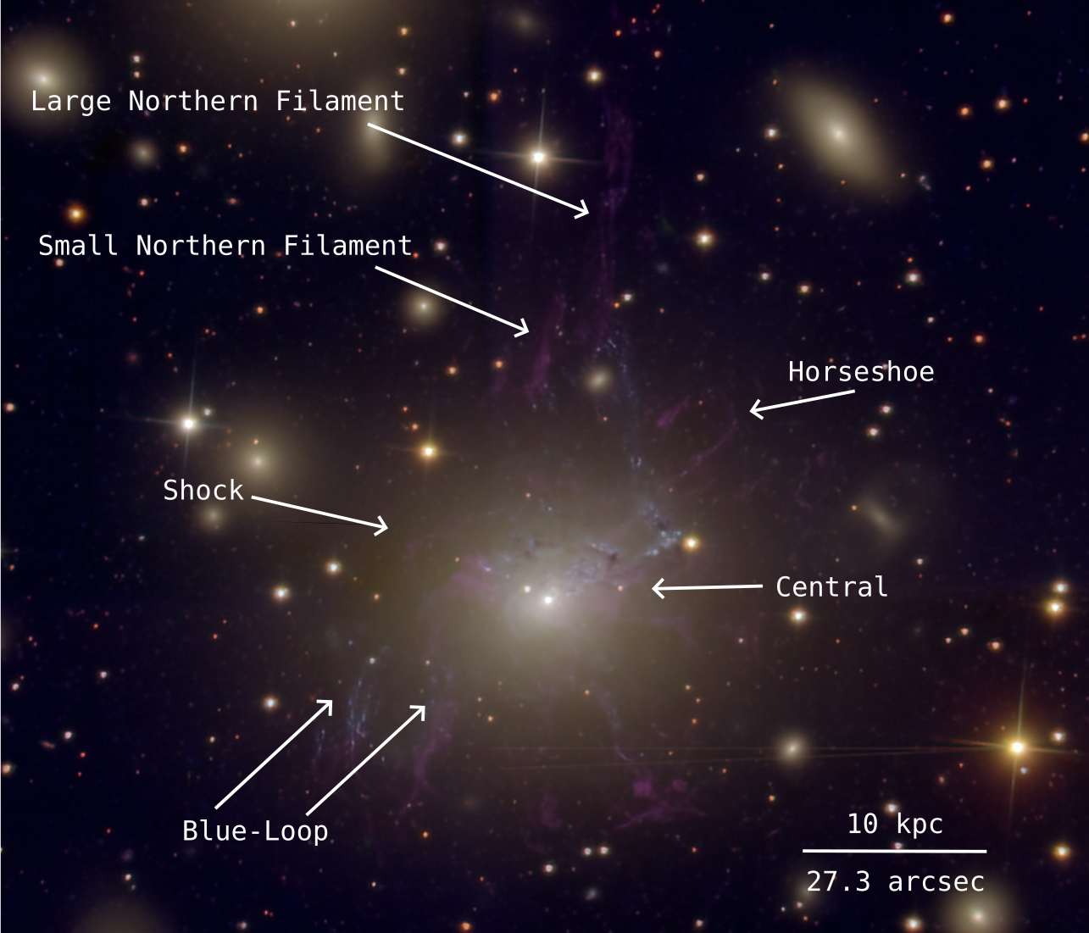
The Observations
Filter | Wavelength (nm) | Emission Lines
SN1 | 365-385 | [OII]3726/3729
SN2 | 480-520 | [OIII]4959/5007, Hβ
SN3 | 651-685 | [NII]6548/6583, H𝛼, [SII]6716/6731

Slide 7
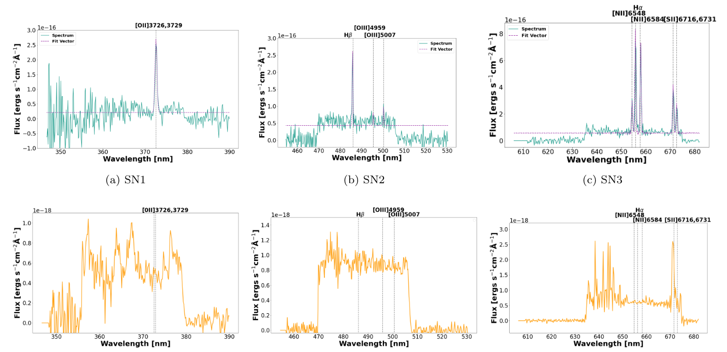
Example Spectra

Slide 8
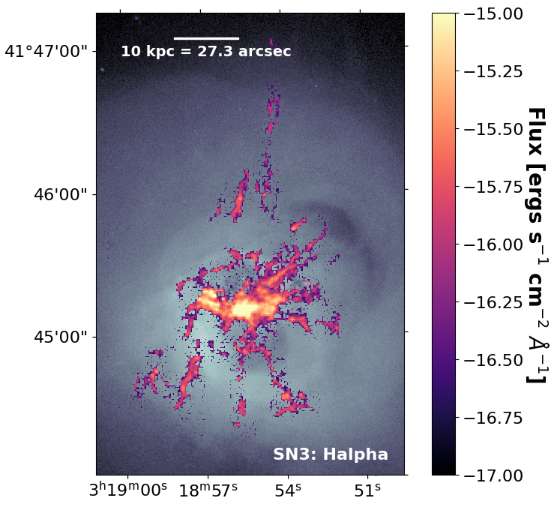
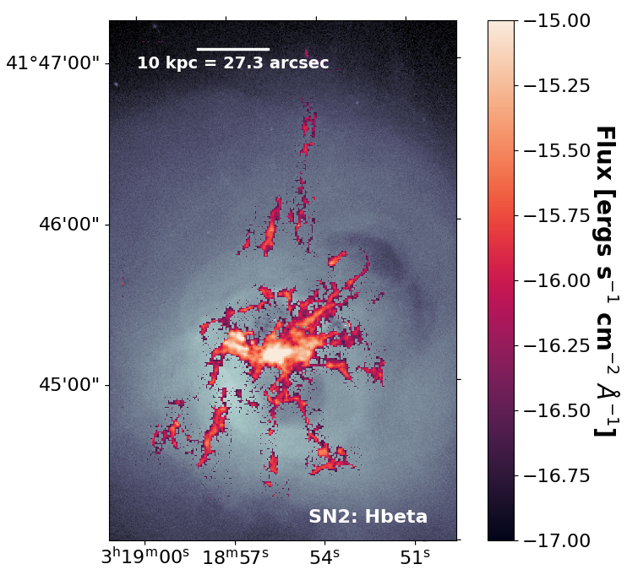
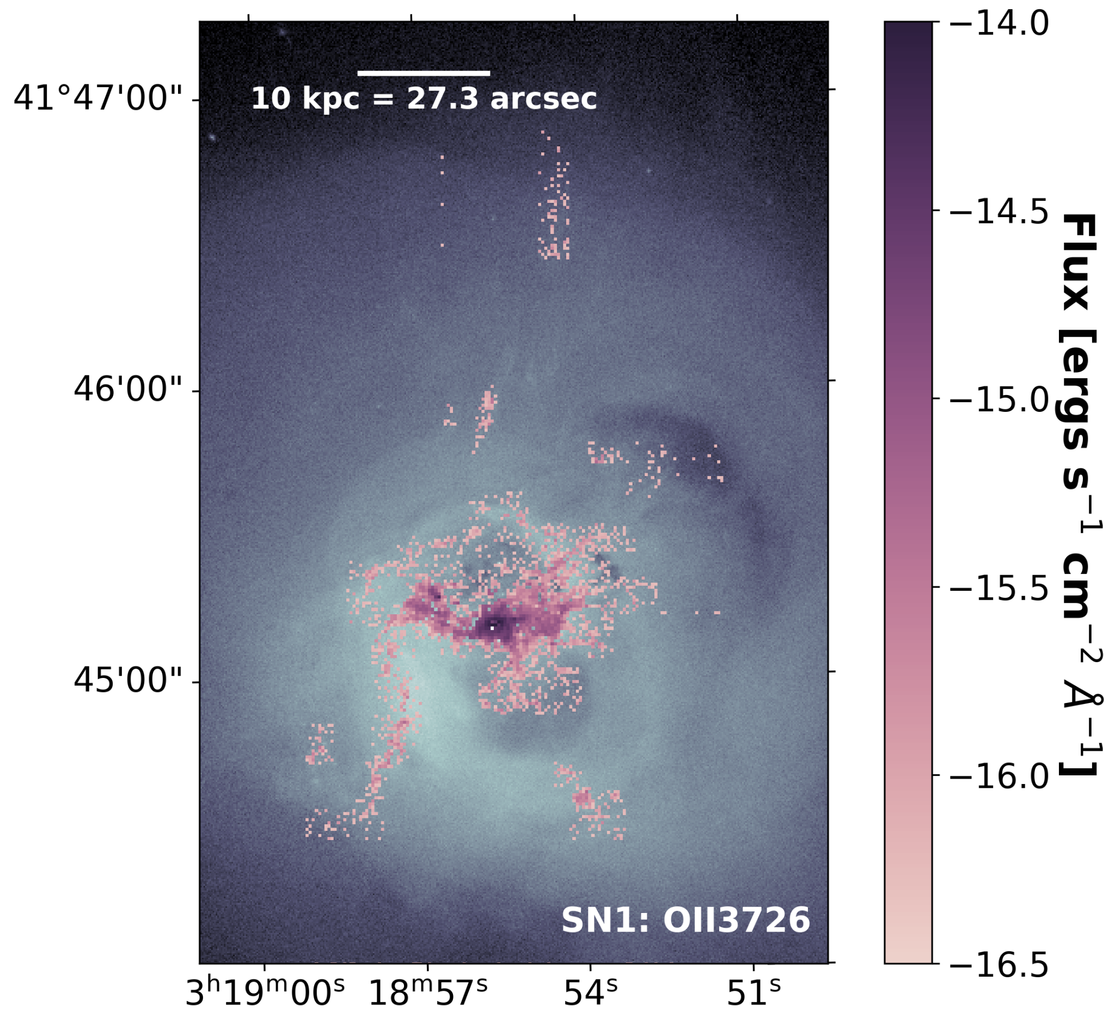
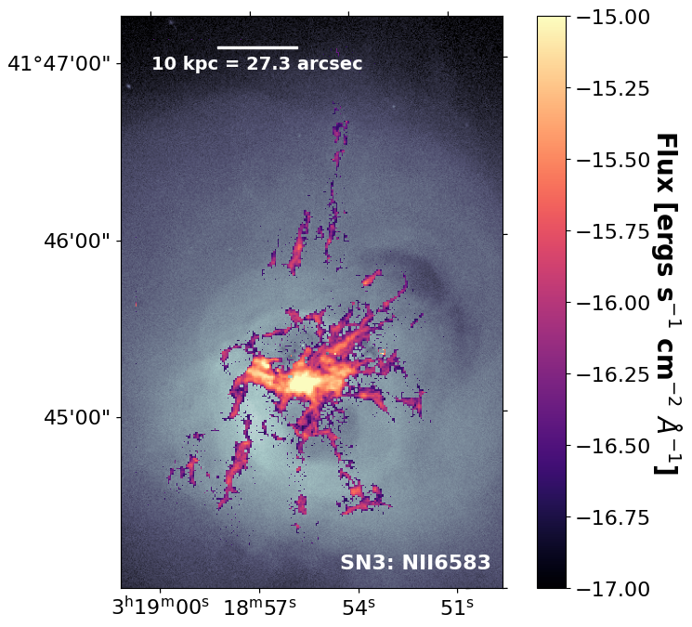
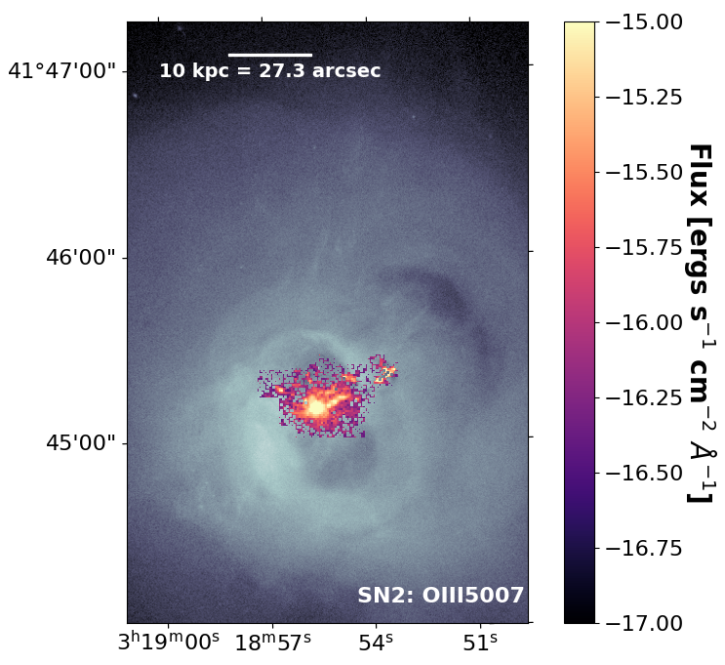
Flux Maps

Slide 9
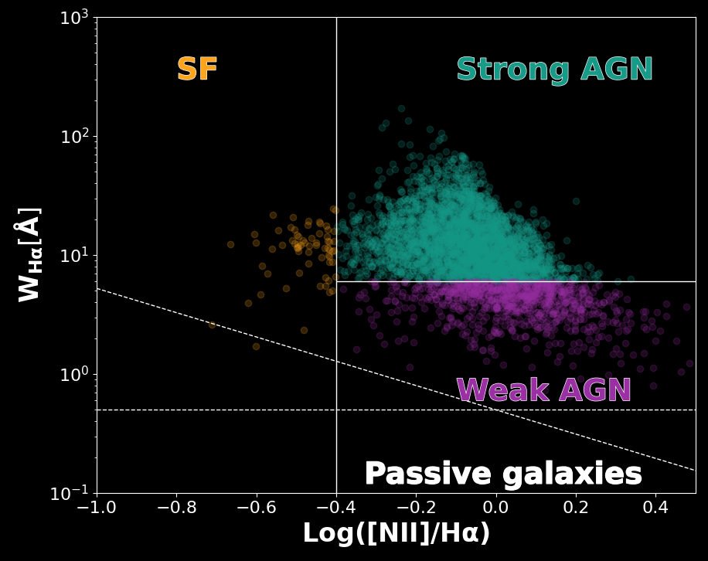
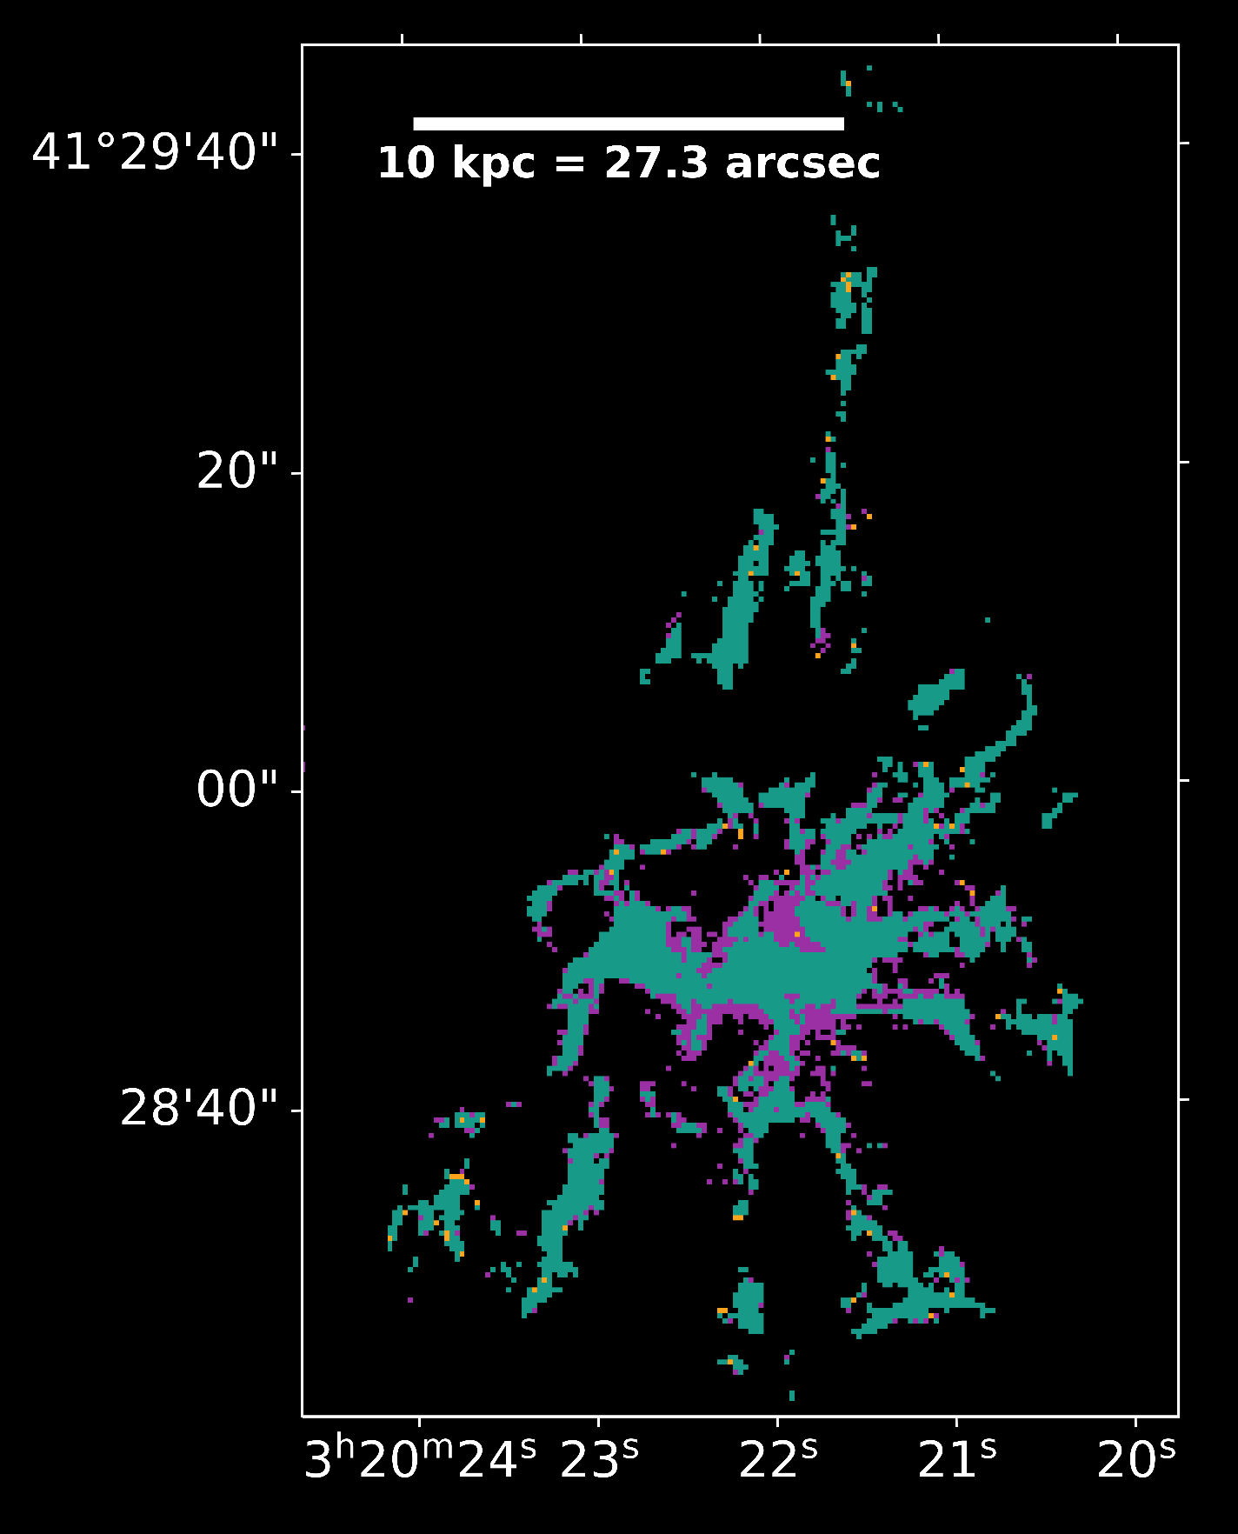
Diagnostic Diagrams

Slide 10
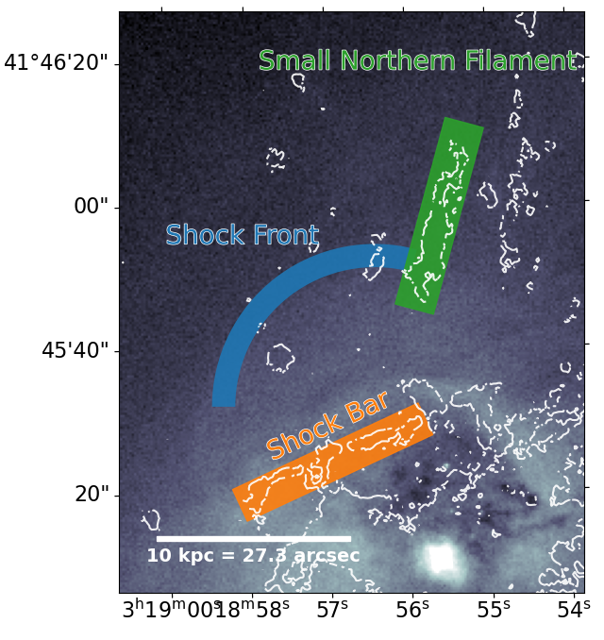
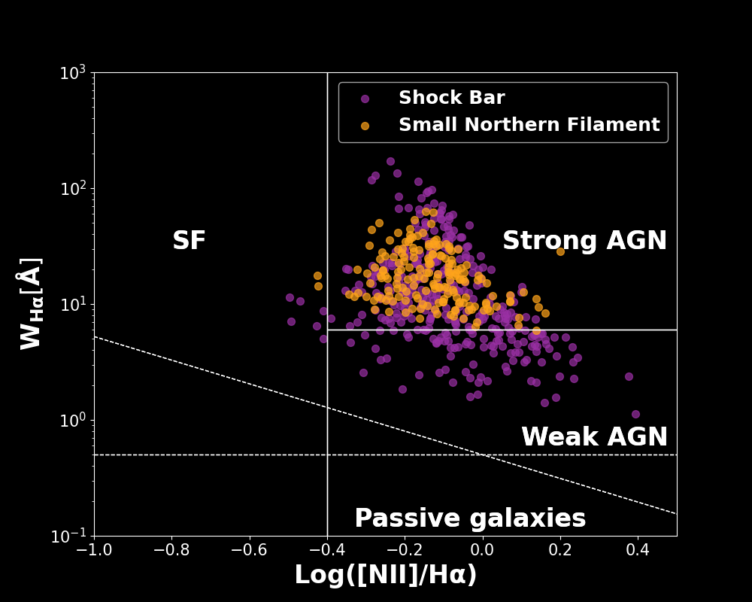
Shock Region

Slide 11
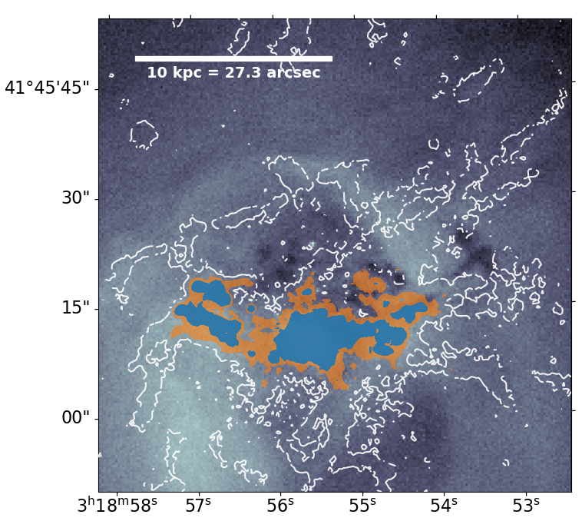
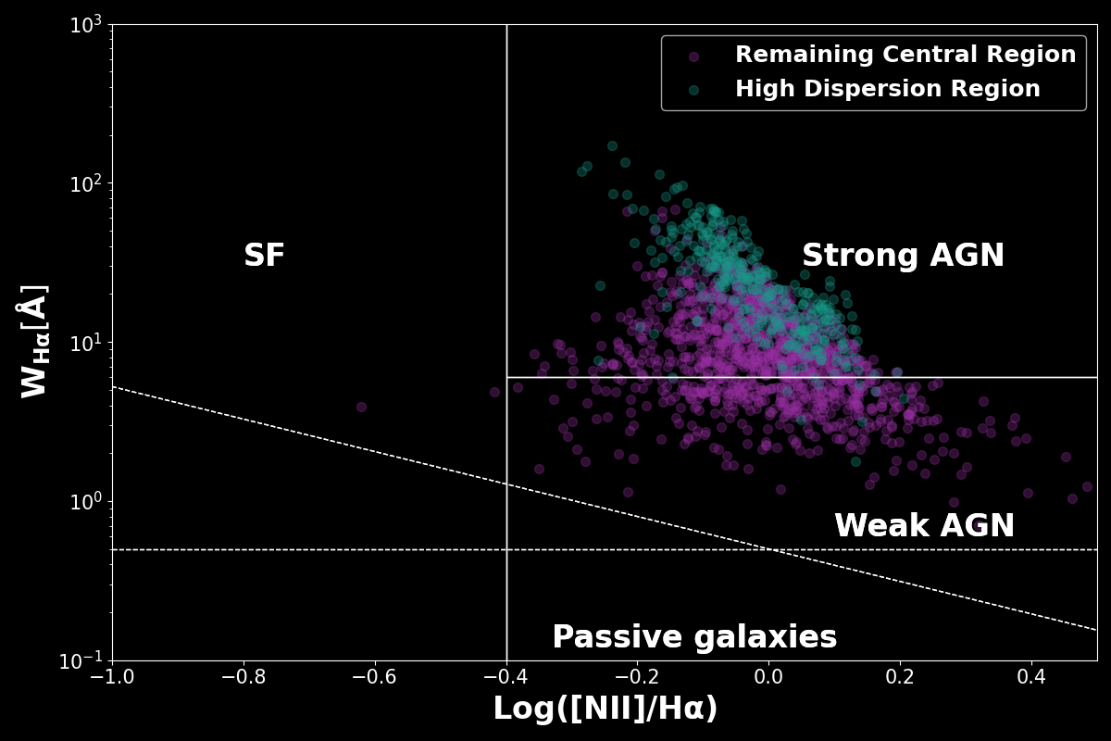
Central Region

Slide 12
Conclusions
There is not considerable star formation in the filaments
The central region is defined by two distinct regions
The shock in the ICM has affected the ionization of the nebula
Within each filament, the ionization appears homogeneous

