Slide 1
Turbulence inside of the Sh2-158 HII region
CRAQ Annual Meeting 2024
Maxime Royer Ph. D.
May 10 2024

Slide 2
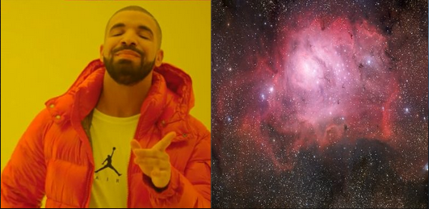
Exoplanets? Where we're going we don't need Exoplanets

Slide 3
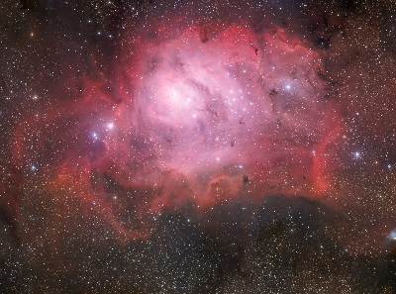
Exoplanets? Where we're going we don't need Exoplanets
Massive young hot stars
Ionized gas
Hot dust
Ionization front

Slide 4
Exoplanets? Where we're going we don't need Exoplanets
Density
Temperature
Cinematic
Small scale fluctuations

Slide 5
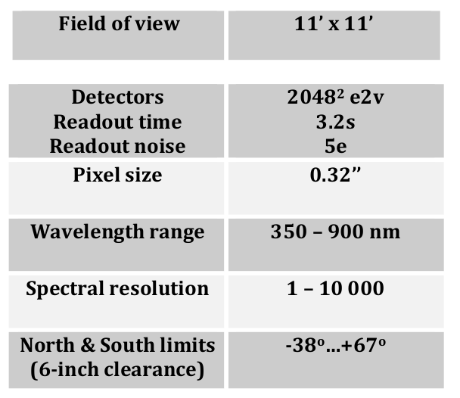
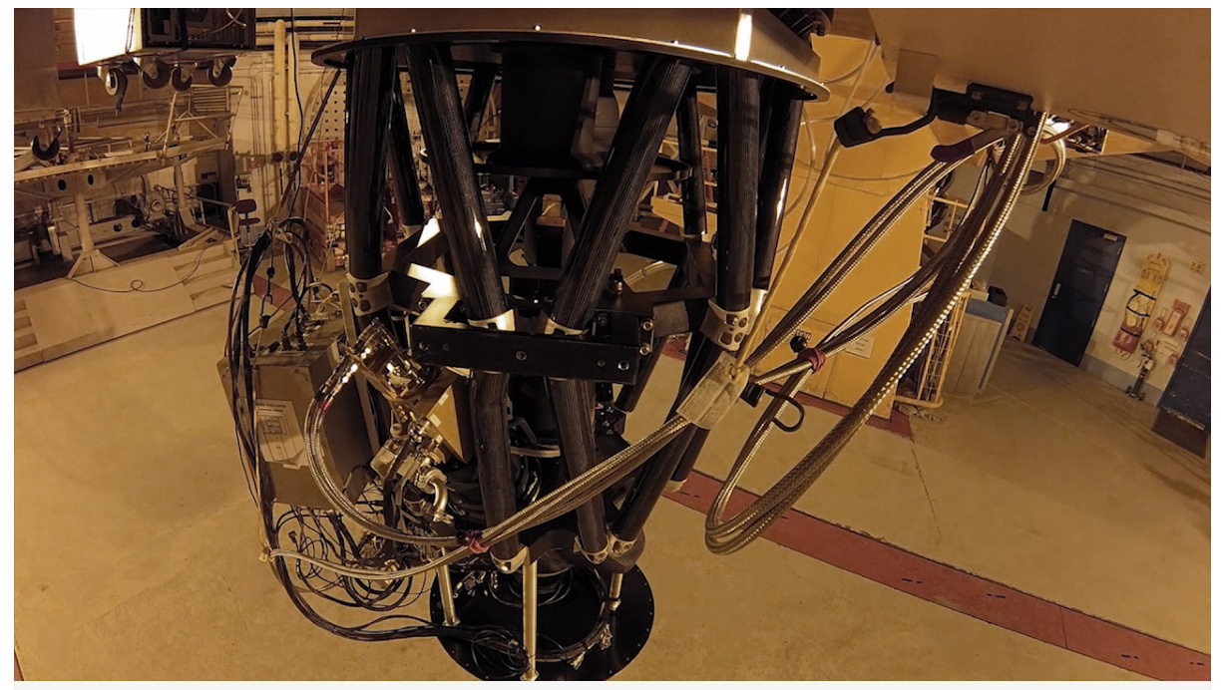
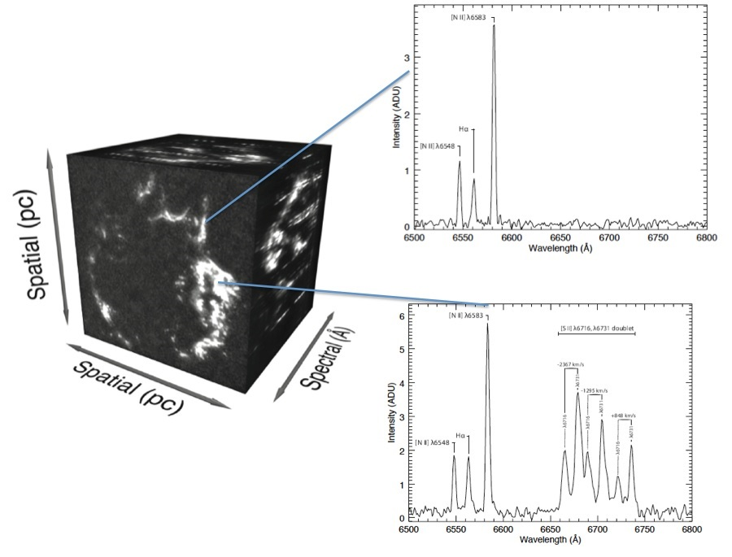
Nobody puts SITELLE in a corner!

Slide 6
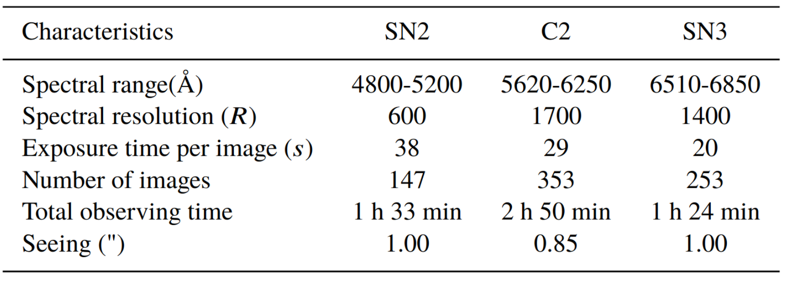
My precious... HII region!

Slide 7
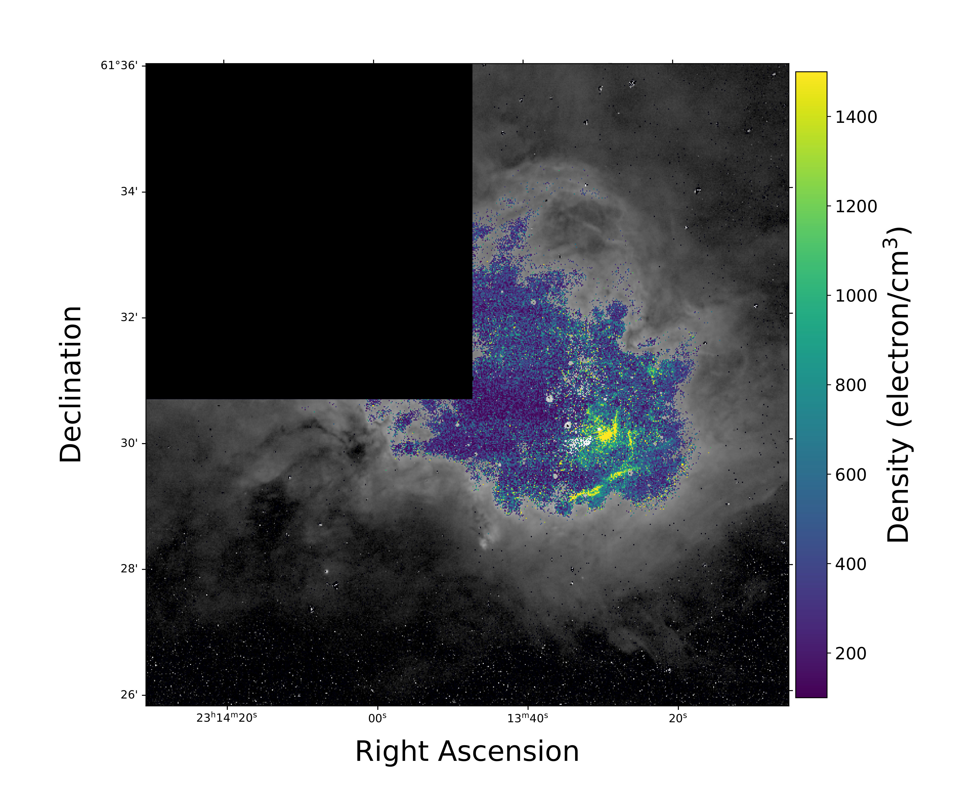
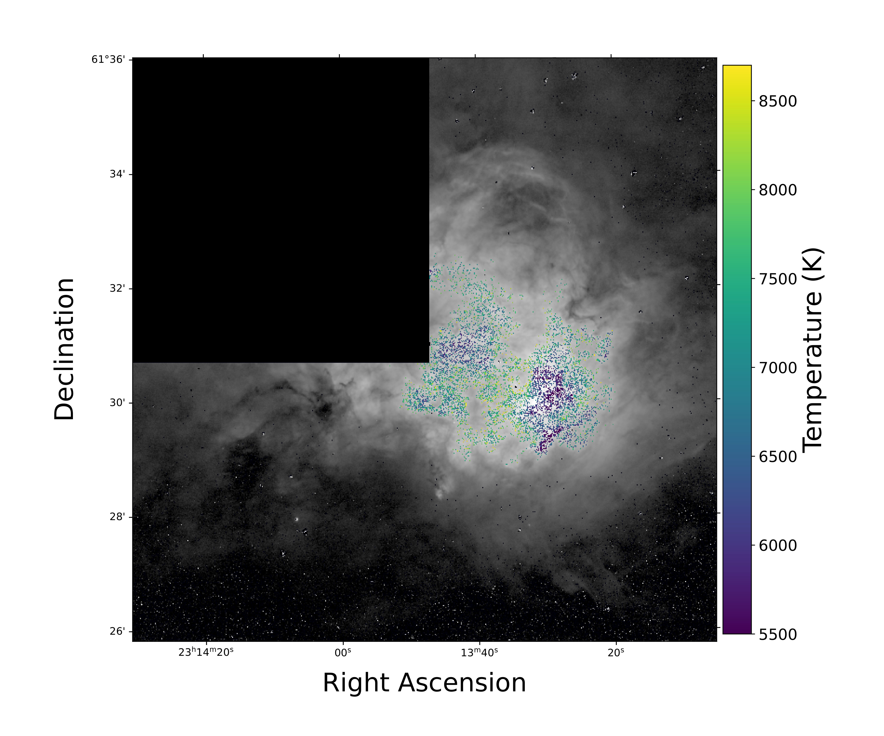
A HII region. Stirred, not shaken.

Slide 8
Why so pressure?

Slide 9
Did you ever hear the Tragedy of Darth Pressure the Wise?

Slide 10
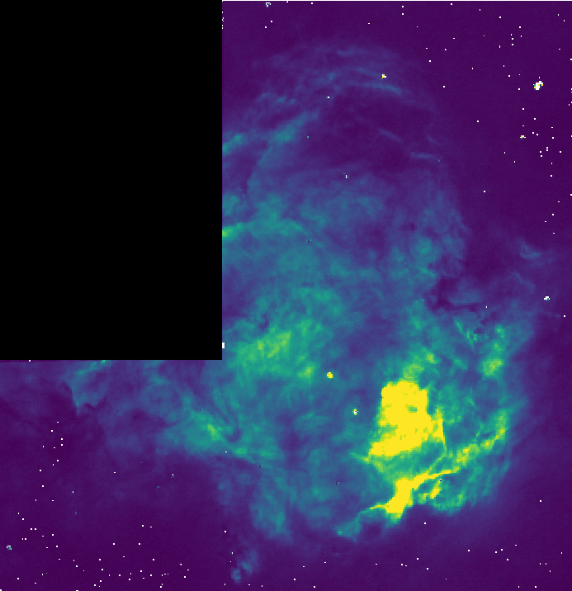
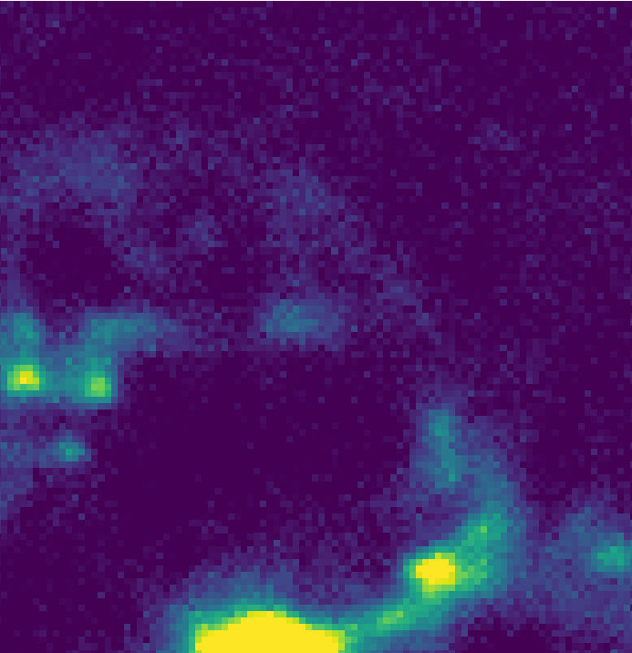
Surely you can't be turbulent?
Intern Mathieu Marquis

Slide 11
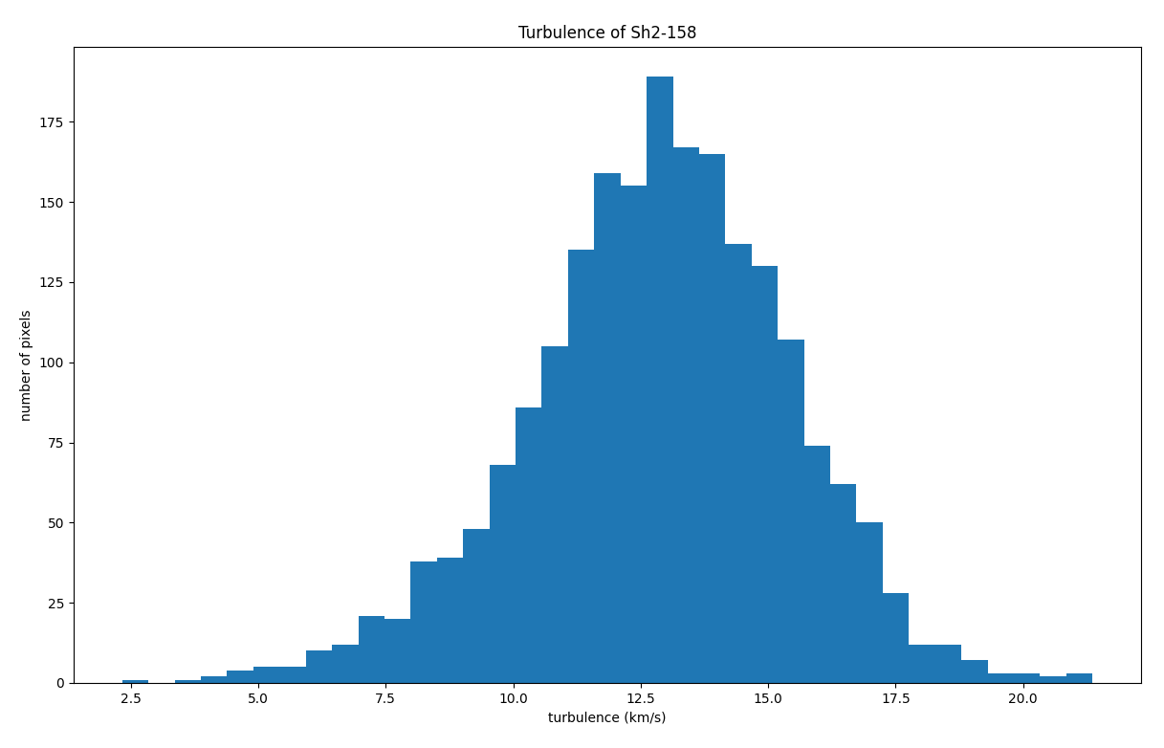
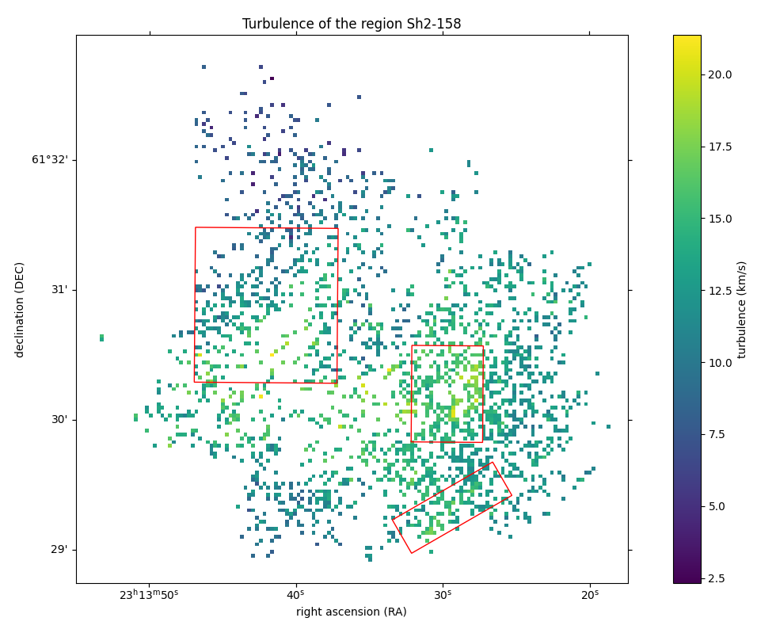
I am turbulent … and don't call me Shirley!
Full map turbulence13±1 km/s

Slide 12
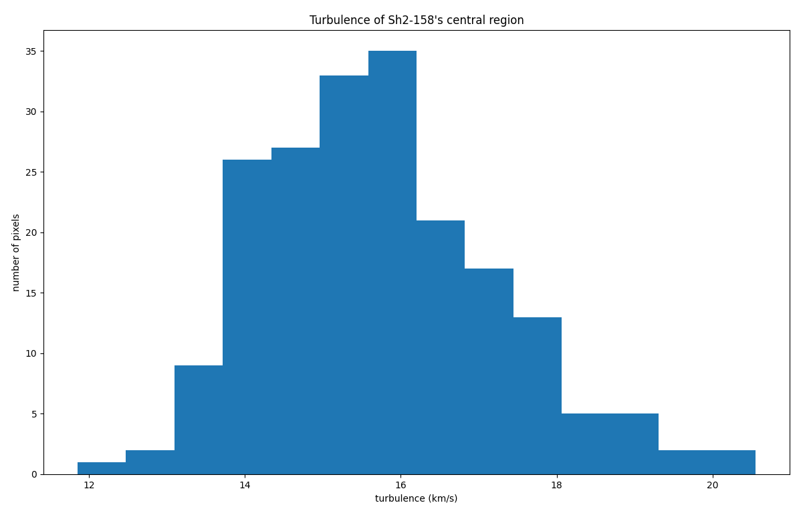
I am turbulent … and don't call me Shirley!
Central turbulence15.6±0.6 km/s

Slide 13
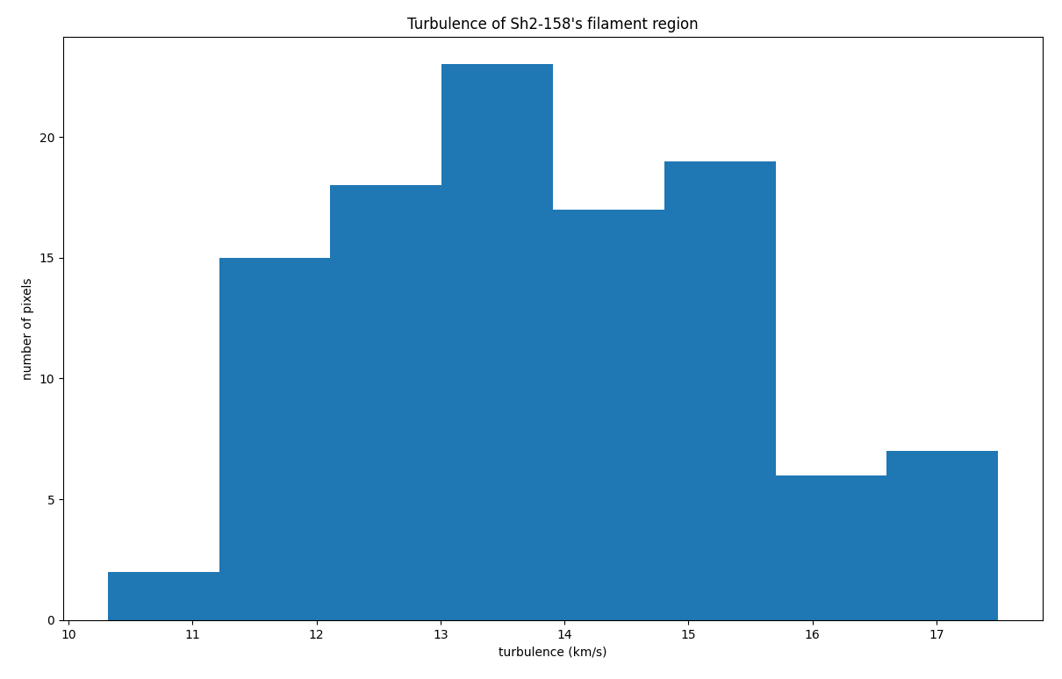
I am turbulent … and don't call me Shirley!
Filament turbulence13.6±0.6 km/s

Slide 14
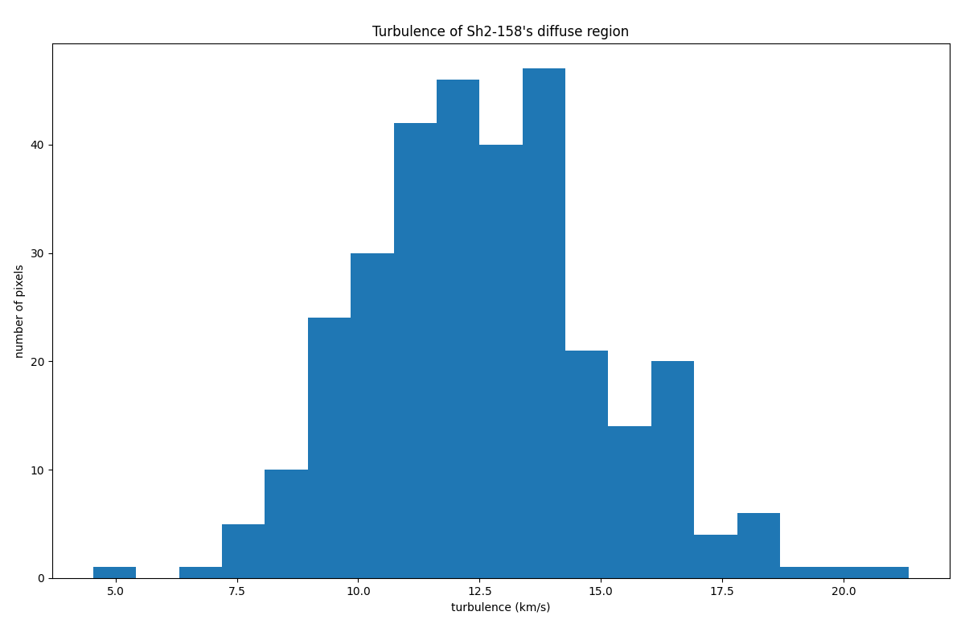
I am turbulent … and don't call me Shirley!
Diffuse turbulence12.5±0.7 km/s

Slide 15
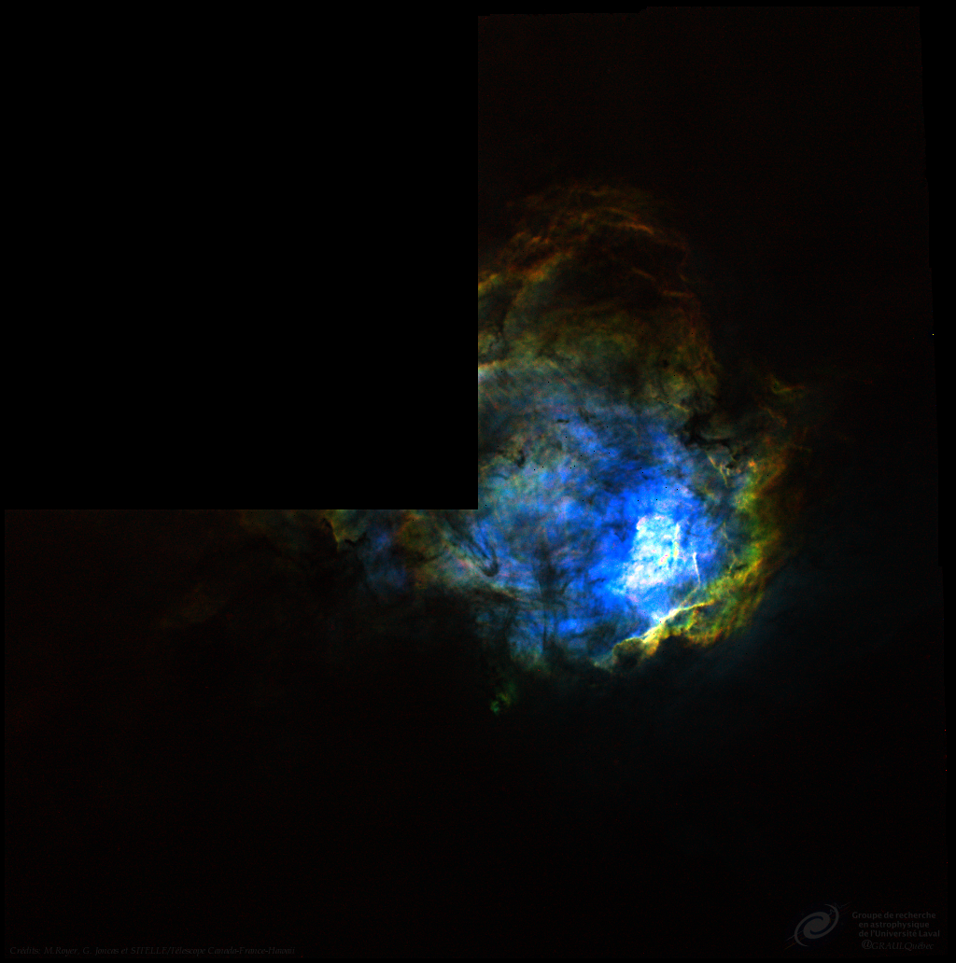
What is this? A HII region for ants?
Difference of median = 2 km/s
Max of interval = 4 km/s
Champagne model = 1 km/s/pc
4.6 pc
Face-On
Gradient+ turbulence
15.6 km/s
Edge-On
4pc
Pure turbulence
13.6 km/s
6.9 pc

Slide 16
Thank you Questions?
Maxime Royer Ph. D.
maxime.royer.2@ulaval.ca

