Slide 1
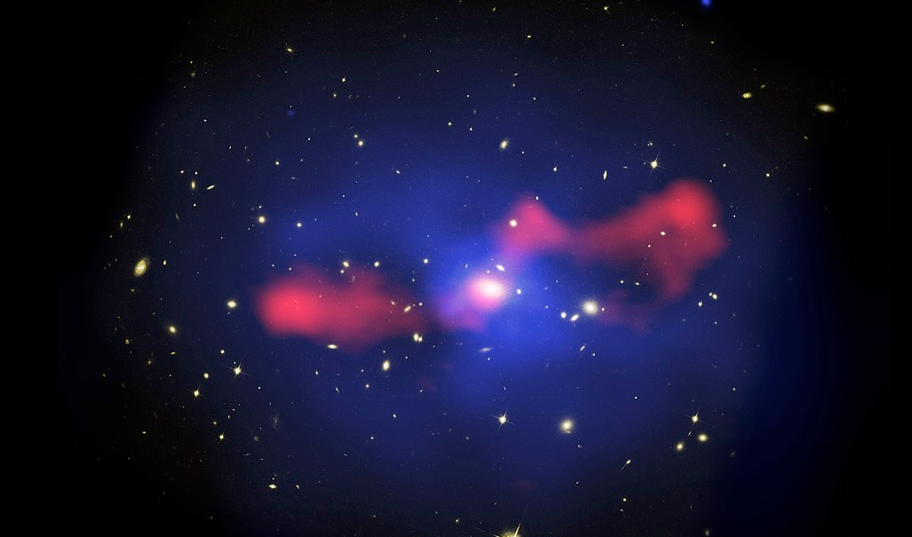
X-ray cavities from AGN feedback in massive clusters with TNG-Cluster
Marine Prunier
with Julie Hlavacek Larrondo (UdeM) and Annalisa Pillepich (MPIA)

Slide 2
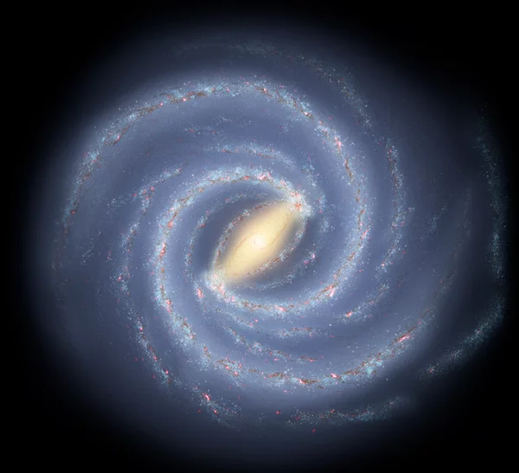
MW size
SMBH
100 kpc
MS 0735.6 7421

Slide 3
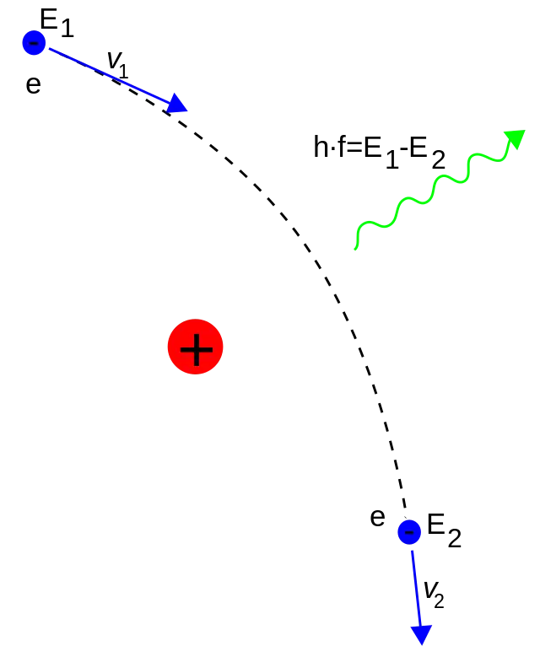
x-ray photon
proton
bremsstrahlung =
cooling
electron
SMBH
MS 0735.6 7421

Slide 4
SMBH
MS 0735.6 7421

Slide 5
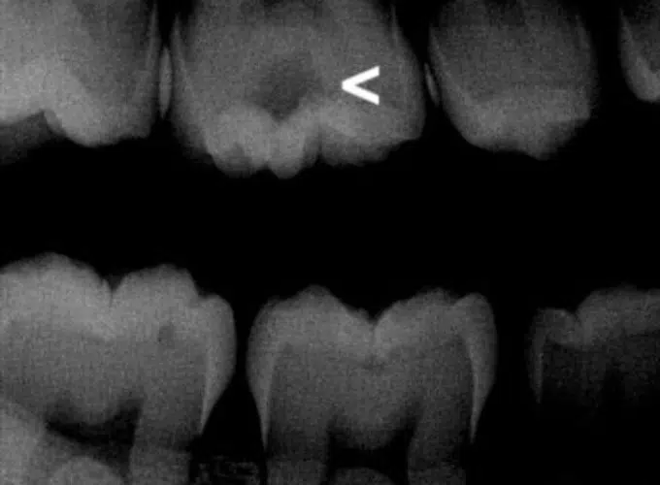
MS 0735.6 7421

Slide 6
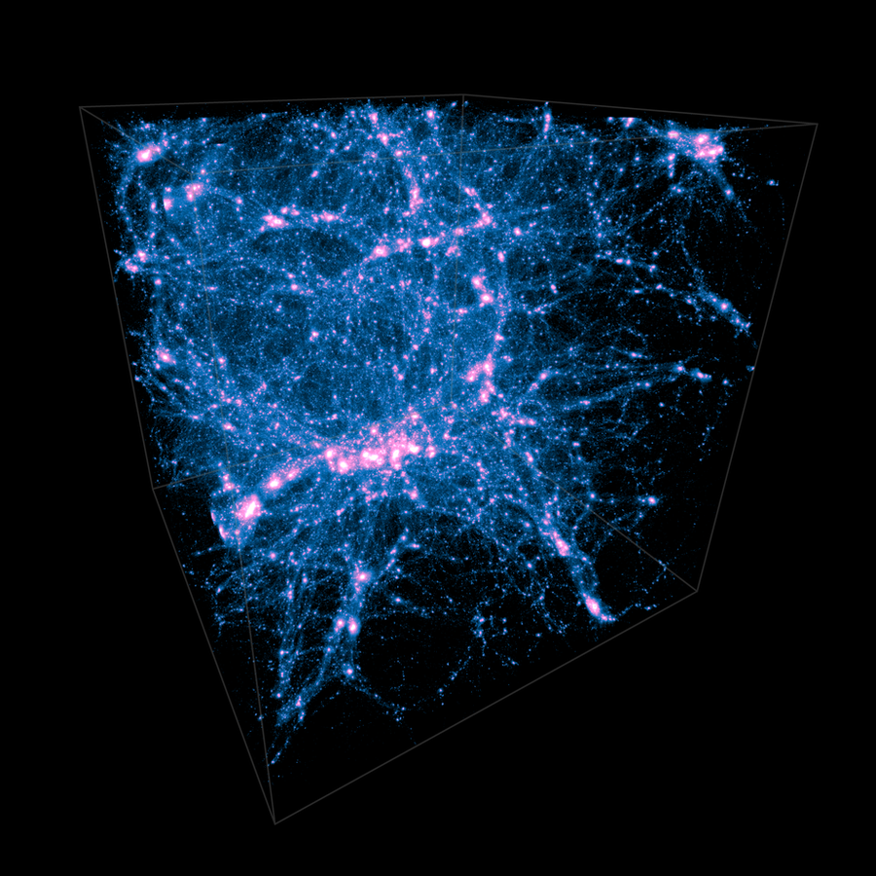
Illustris TNG-Cluster (2024)
1 Gpc

Slide 7
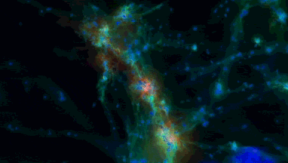
Illustris TNG-Cluster (2024)
1 Gpc

Slide 8
Does IllustrisTNG black holes feedback create X-ray cavities ?
Are they similar to the ones observed ?

Slide 9
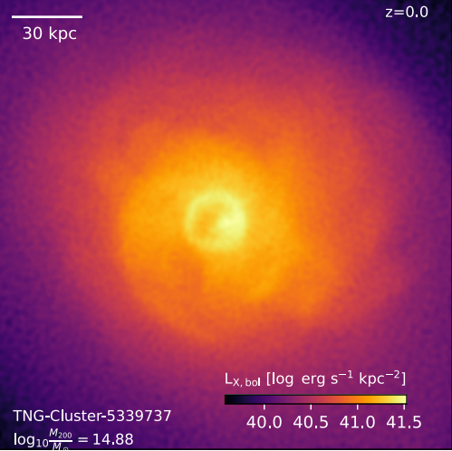
1 Gpc

Slide 10
kinetic injection
SMBH

Slide 11
cavity
shock fronts

Slide 12
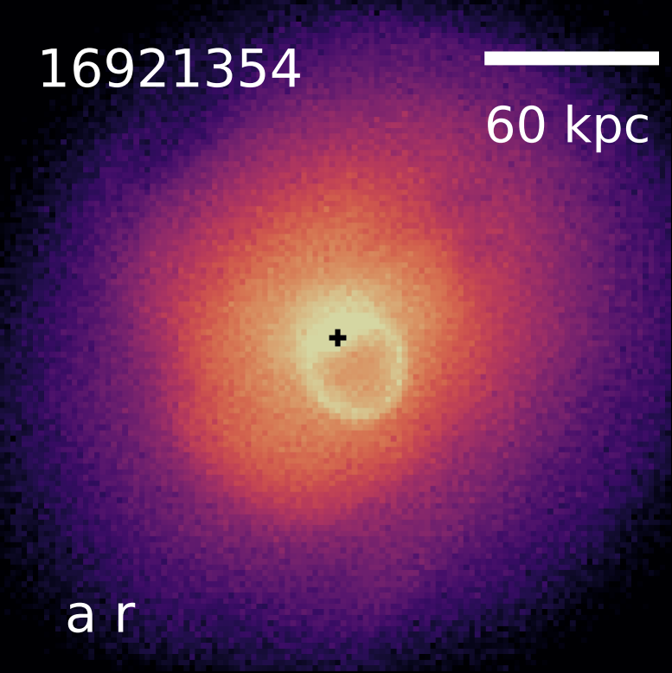
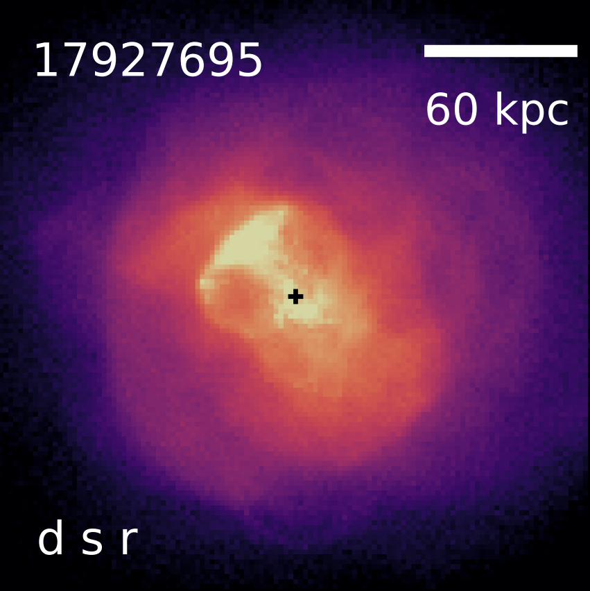
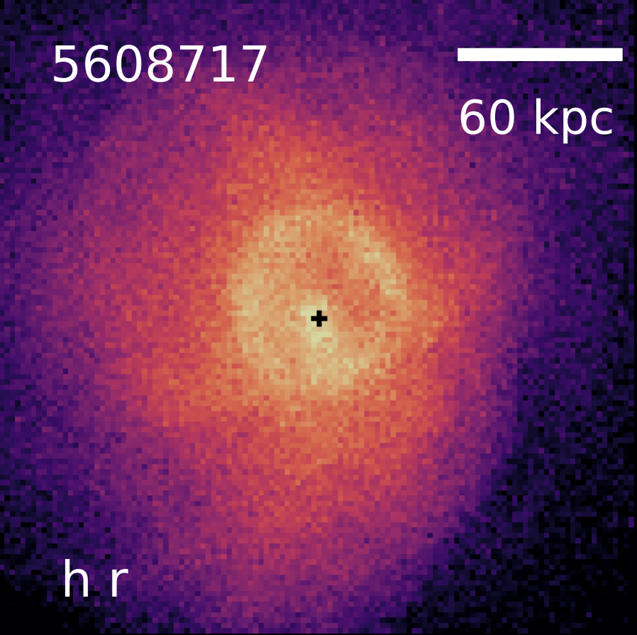
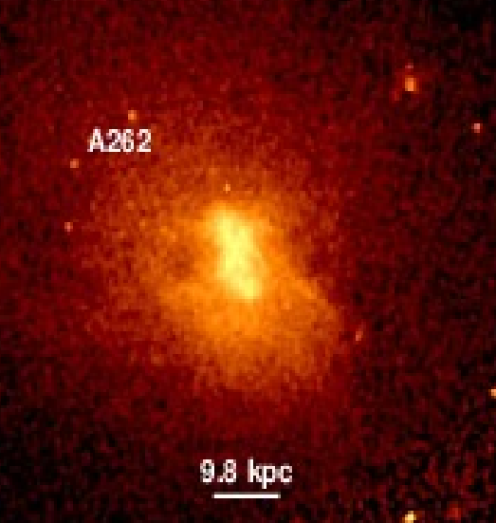
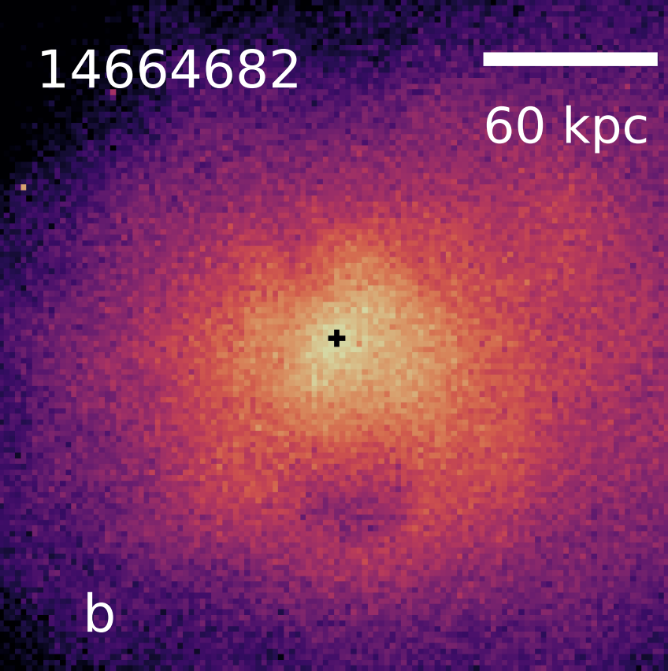
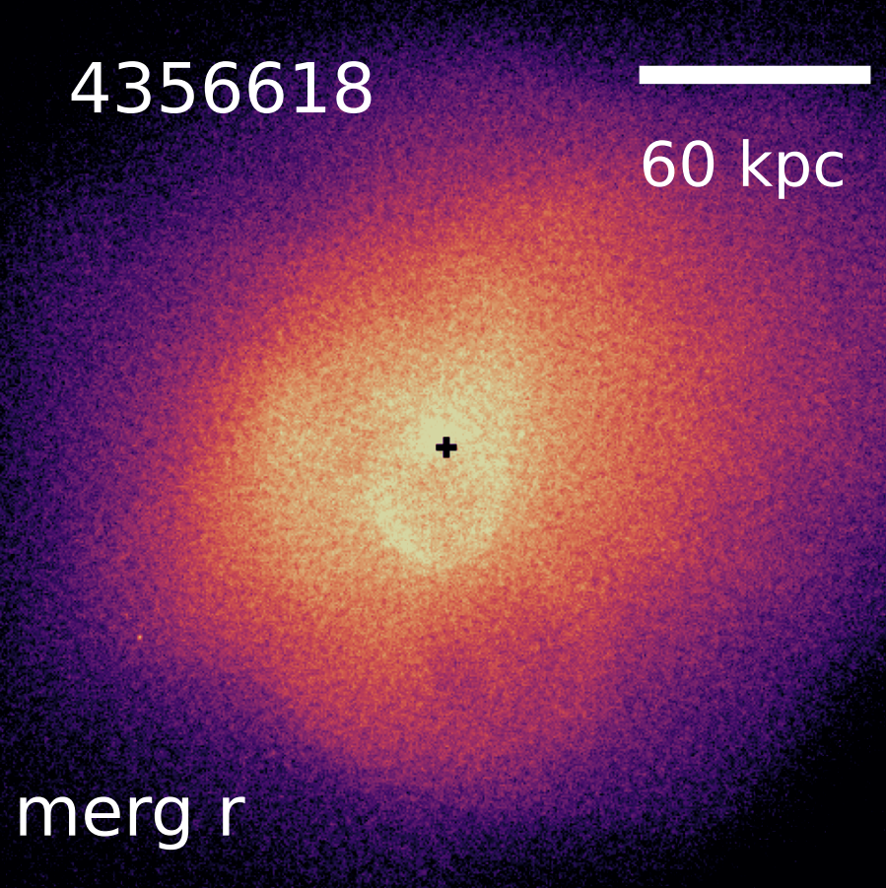
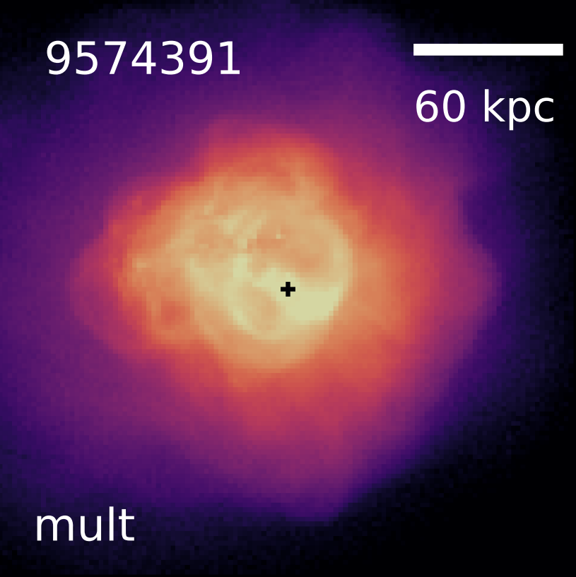
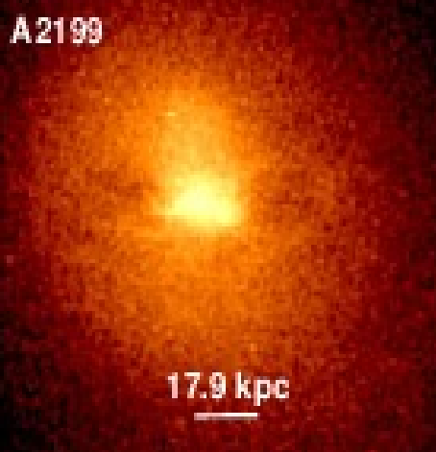
TNG-Cluster
Real Cavities

Slide 13
Does IllustrisTNG black holes feedback create X-ray cavities ?
Are they similar to the ones observed ?

Slide 14
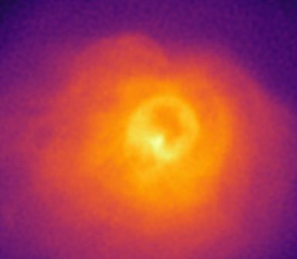
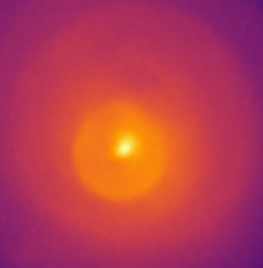
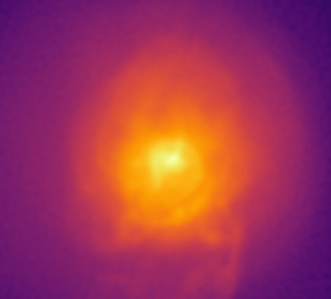
Observation:
Simulation:
105 TNG-Cluster analogs
35 clusters

Slide 15
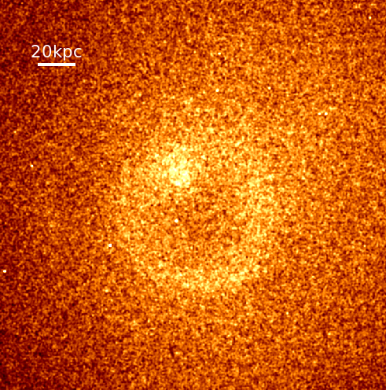
Observation:
Simulation:
Mock Observations:
105 TNG-Cluster analogs
105 mock x-ray images
35 clusters

Slide 16
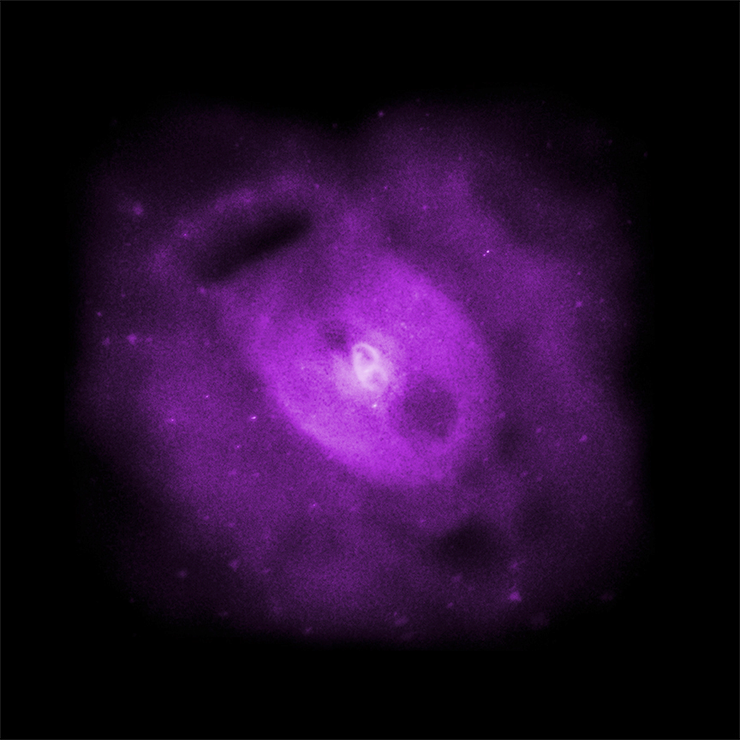
How to measure the size of X-ray cavities ?
by hand …
NGC 5813

Slide 17
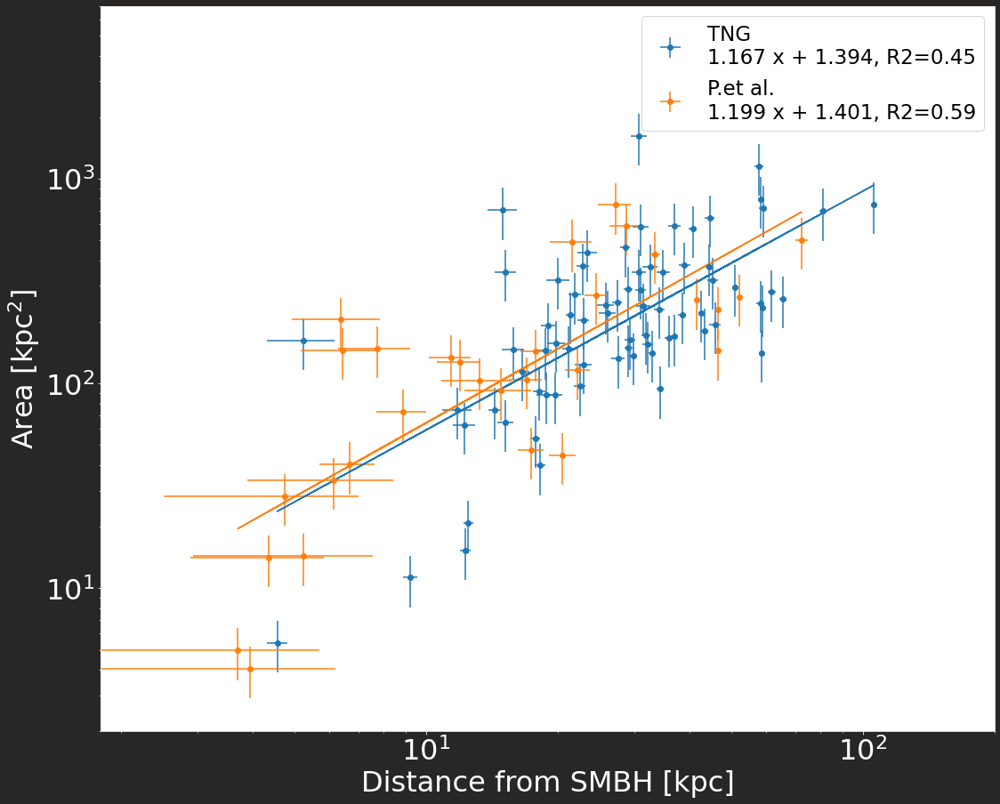

Slide 18
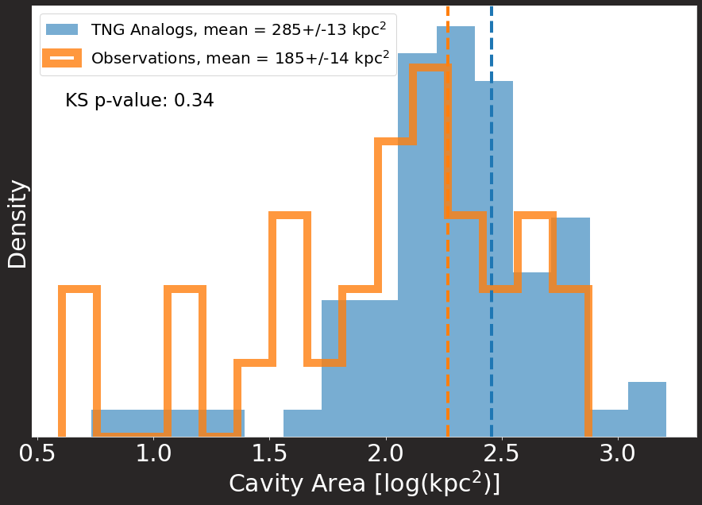
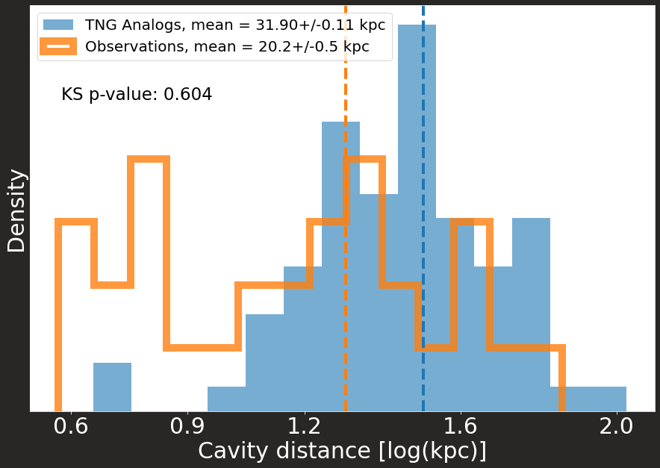

Slide 19
Does IllustrisTNG black holes feedback create X-ray cavities ?
Are they similar to the ones observed ?

Slide 20
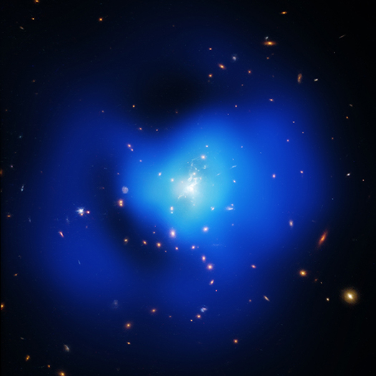

Slide 21
References
Recent review on X-ray Cavities
AGN Feedback in Groups and Clusters of Galaxies Hlavacek-Larrondo et al. (2022)
TNG-Cluster
Introducing TNG-Cluster: Nelson et al. (2023)
Radio relics Lee et al. (2023)
Hot CGM of massive cluster satellites Rohr et al. (2023)
X-ray kinematics of the core ICM in Perseus-like clusters Truong et al. (2023)
Cool-core and non-cool-core halos Lehle et al. (2023)
An Atlas of Gas Motions Ayromlou et al. (2023)

