Slide 1
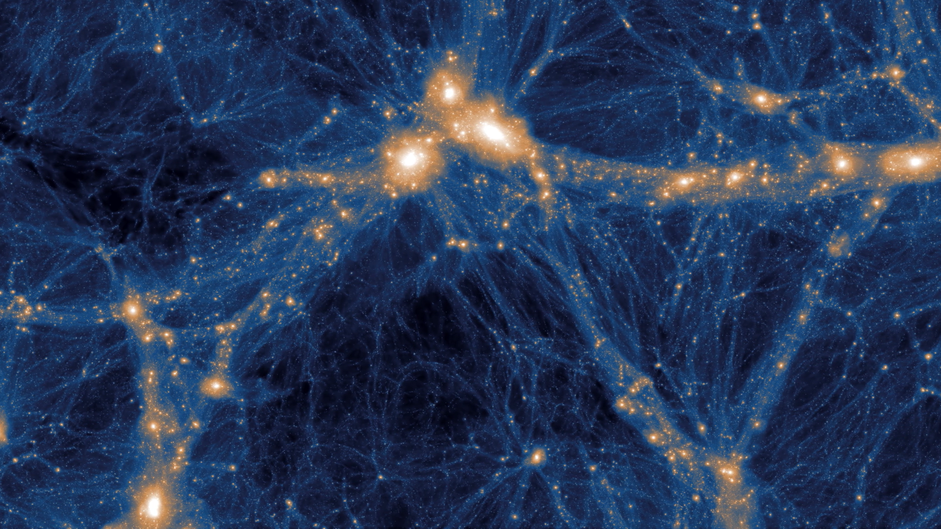
Uncovering Star Formation Histories with Diffusion
2023 The TNG Collaboration.
Sacha Perry-Fagant
Supervised by: Yashar Hezaveh, Laurence Perreault-Levasseur
CRAQ May 8th 2024

Slide 2
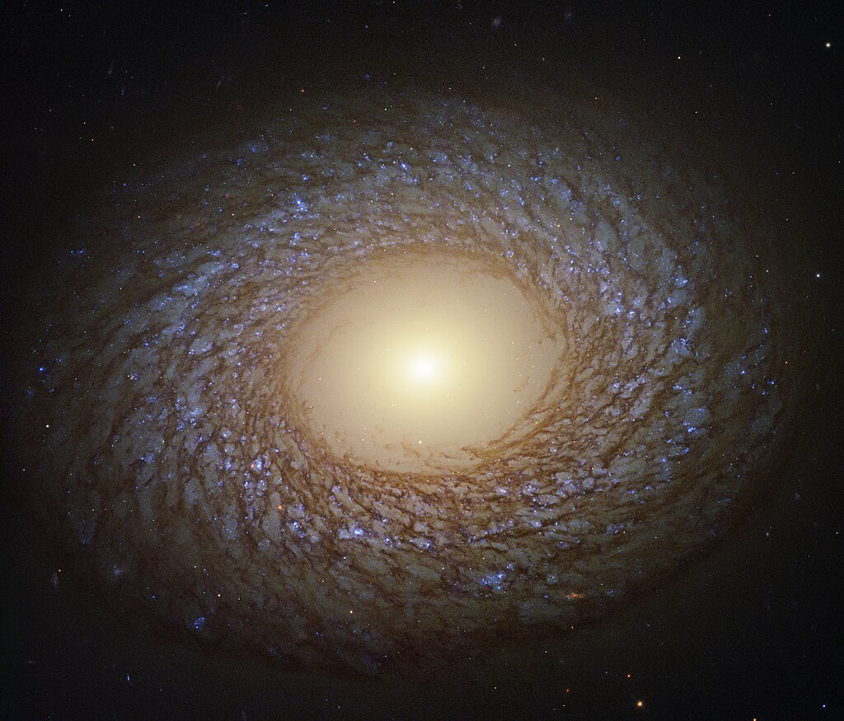
How did this happen?
NGC 2775 - ESA/Hubble & NASA, J. Lee and the PHANGS-HST Team

Slide 3
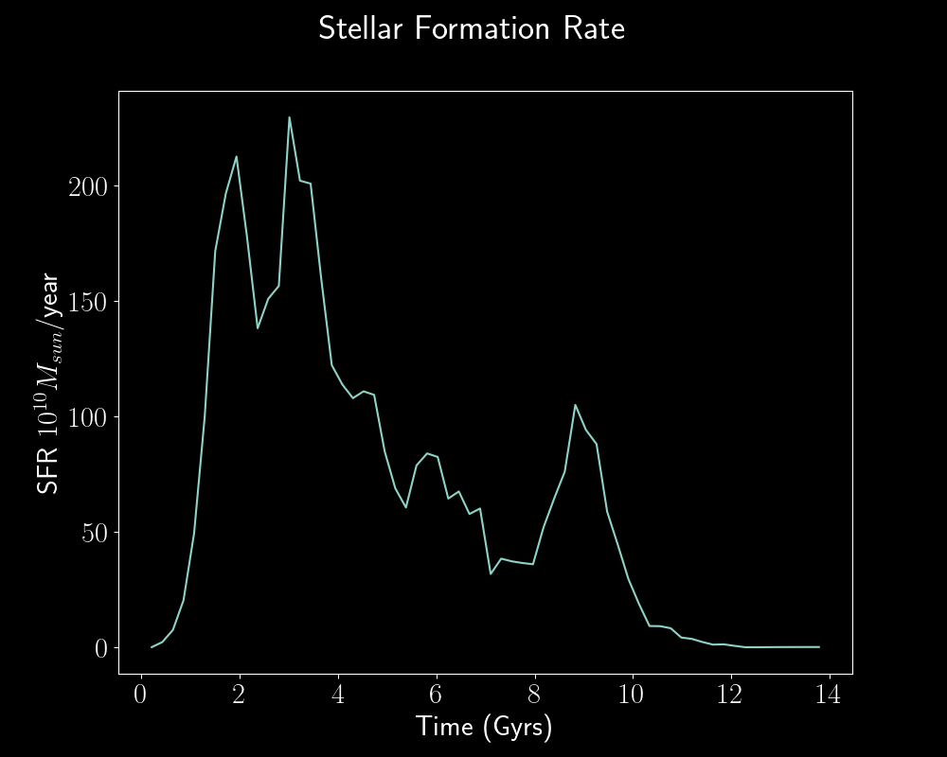
Star Formation Histories
Stellar mass created in a galaxy over time
Star formation rate (SFR) vs Time

Slide 4
Galaxy spectrum
Each star has
Mass
+ Metallicity
+ Age

Slide 5
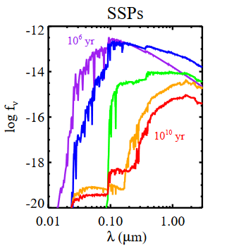
Galaxy spectrum
Each star has
Mass
+ Metallicity
+ Age
Use Single Stellar Populations (SSPs) to find spectrum

Slide 6
Galaxy spectrum
Each star has
Mass
+ Metallicity
+ Age
Use Single Stellar Populations (SSPs) to find spectrum
Combination of every star’s spectrum + dust ≈ observed spectrum

Slide 7
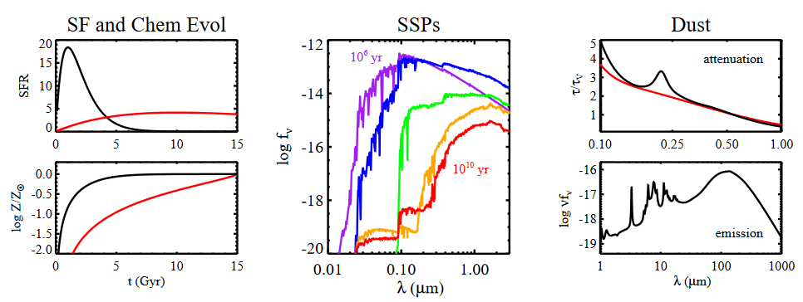
SFH to CSP
SSP + SFH + Metallicity + Dust
= Composite stellar population ≈ spectrum
Conroy, 2013

Slide 8
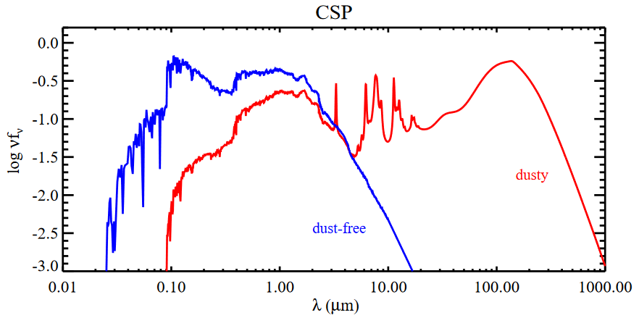
SFH to CSP
SSP + SFH + Metallicity + Dust
= Composite stellar population ≈ spectrum
Conroy, 2013

Slide 9
CSP to SFH?
SFH -> CSP: Straightforward
CSP -> SFH: ?
Conroy, 2013
Notes:
In doing this we’ll get a plot that looks like this
Then we can compare it to the original plot
This is of course great if we already have the SFH, but how do we know what SFH to feed the model?
What we can do

Slide 10
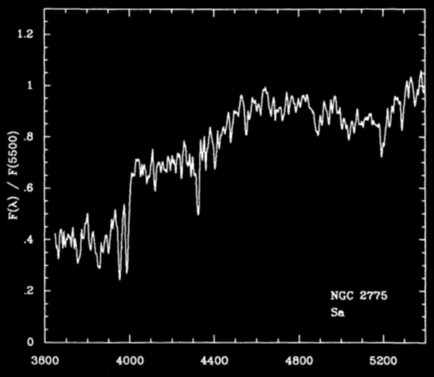
How to determine SFH?
Kennicutt 1992
NGC 2775 - ESA/Hubble & NASA, J. Lee and the PHANGS-HST Team

Slide 11
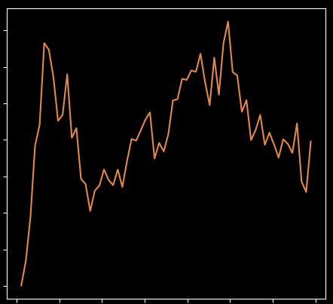
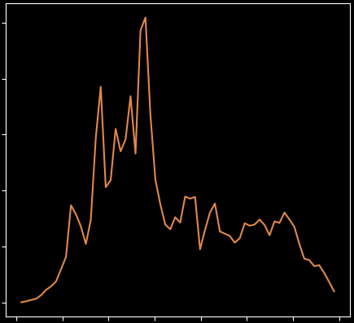
How to determine SFH?
?
?
Kennicutt 1992
Notes:
What kind of SFH could have resulted in this spectrum?
We basically have to work backwards. If we have a SFH then we can compute the expected spectrum and compare it to the real thing
Samples 26 and 18

Slide 12
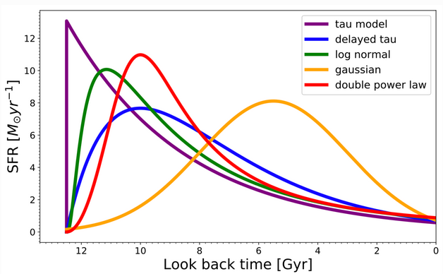
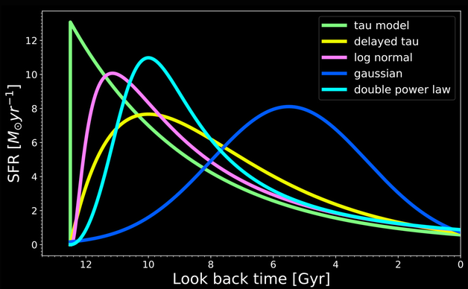
Parametric models
Pros
Quick and easy to compute
Cons
Biased
SED modeling. piXedfit 1.0 documentation

Slide 13
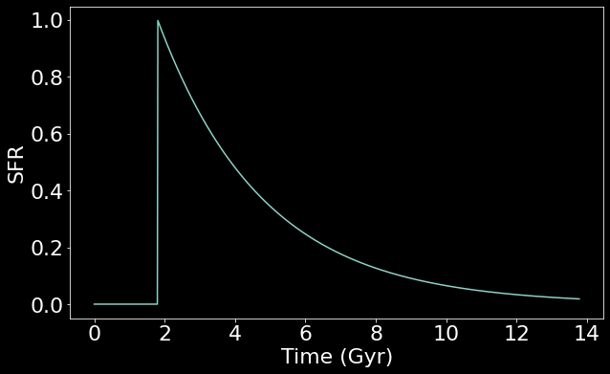
Parametric models
Exponentially declining SFHs (tau models)

Slide 14
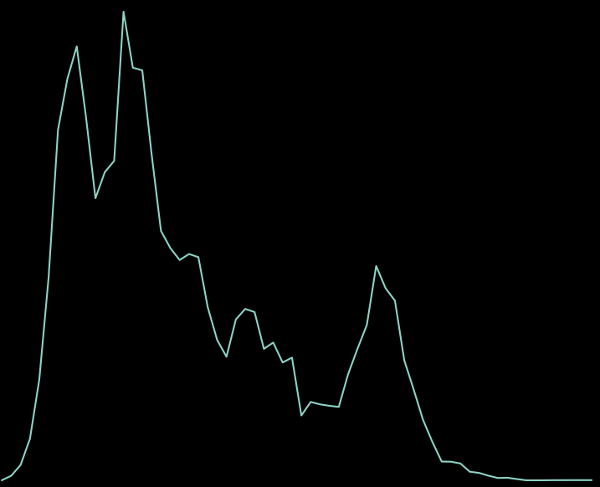
Parametric models
Exponentially declining SFHs (tau models)

Slide 15
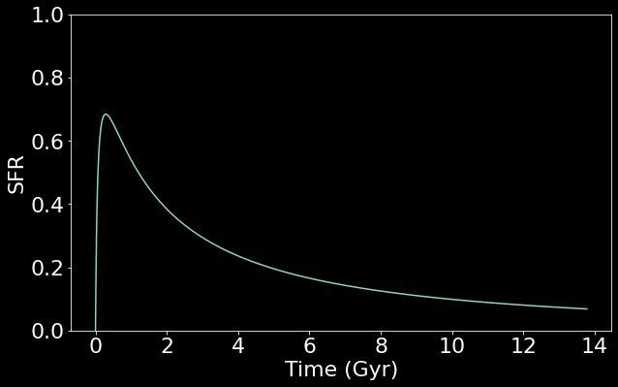
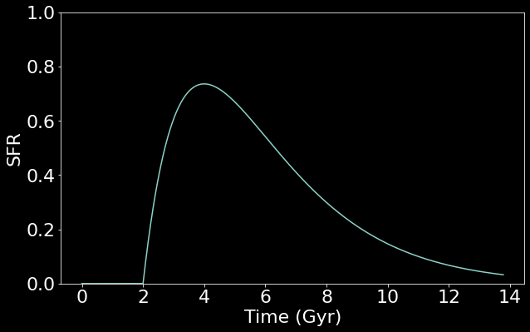
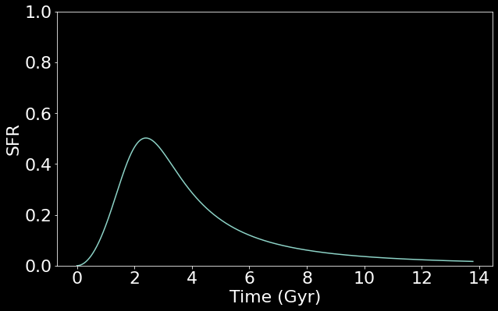
Exponentially declining SFHs (tau models)
Delayed Exponentially Declining
Lognormal
Double power-law (DPL)

Slide 16
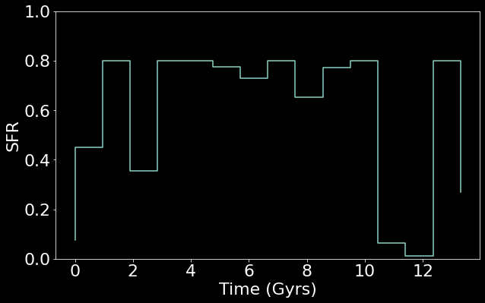
Non-Parametric models
N time bins with variable mass
More freedom
More difficult to fit
Prone to overfitting
Often require regularization

Slide 17
Diffusion Models

Slide 18
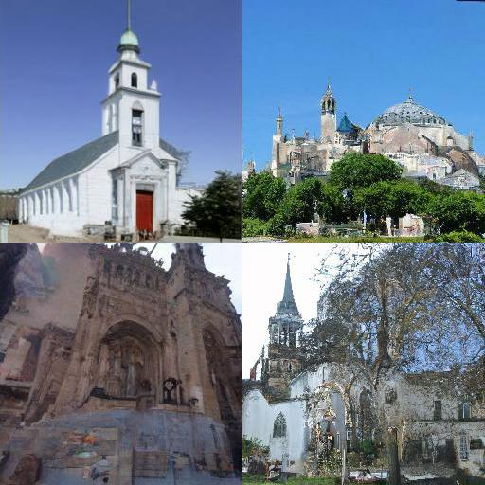
Diffusion Models
Generative machine learning model
Train on samples
Produces new samples from the distribution
Known for generating convincing images
Great for doing Bayesian posterior inference
We have f(x) and want to find x (f(x)=spectrum, x=SFH)
Song 2021

Slide 19
Generating Samples
The data we are interested in (ie – pictures of frogs) has an inherent probability distribution

Slide 20
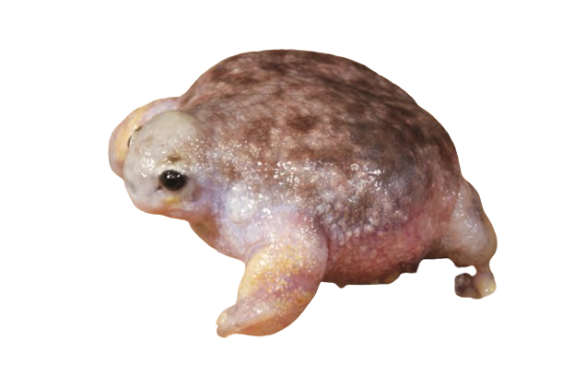
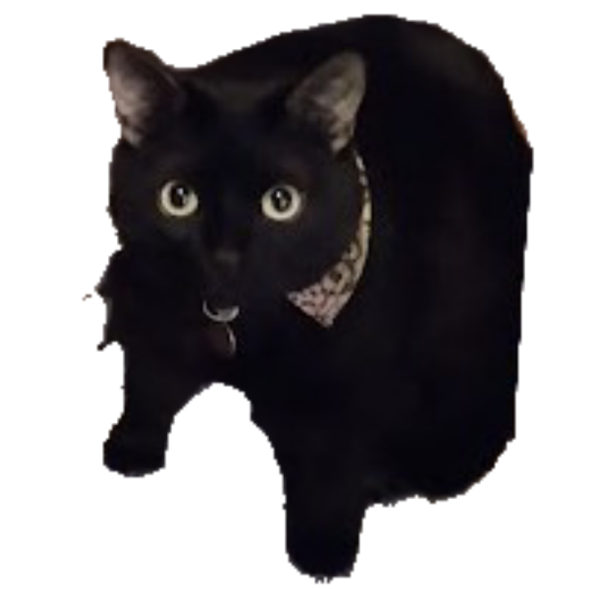
Generating Samples
The data we are interested in (ie – pictures of frogs) has an inherent probability distribution
Perfect world: we know $p\left(x\right)$
Can evaluate p(x) for sampling
p( )
p( )
>>

Slide 21
Sampling Higher Dimensional Data
Higher dimensional data
Images: each pixel is a dimension (256x256)
Histograms: each bin is a dimension
True distribution $p\left(x\right)=\frac{e^{−f\left(x\right)}}{Z}$
Integral over every possible image
$$Z=\int{}$$
$e^{−f\left( \right)}$dx

Slide 22
Sampling Higher Dimensional Data
Higher dimensional data
Images: each pixel is a dimension (256x256)
Histograms: each bin is a dimension
If p(x) is known:
Impossible to explore entire space when sampling
B+W images: 2^{256x256} possible samples

Slide 23
Score
Use score instead of p(x)
$∇_{x}\log{p\left(x\right)}=−∇_{x}f\left(x\right)$
No longer dependant on Z
Train model $s_{θ}\left(x\right)$ to approximate $∇_{x}\log{p\left(x\right)}$

Slide 24
Score
Use score instead of p(x)
$∇_{x}\log{p\left(x\right)}=−∇_{x}f\left(x\right)$
No longer dependant on Z
Train model $s_{θ}\left(x\right)$ to approximate $∇_{x}\log{p\left(x\right)}$
Sample space still too large to explore…

Slide 25
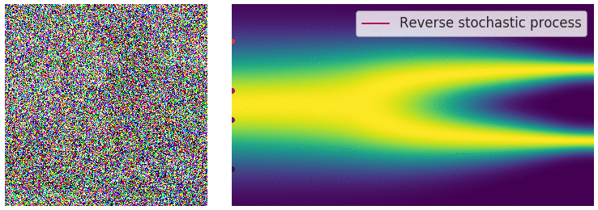
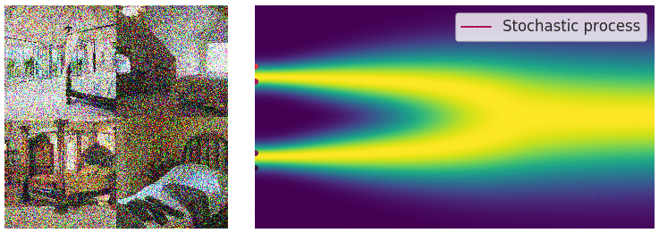
Sampling with Diffusion
Start with “noisy” in-distribution sample
Song 2021

Slide 26
Sampling with Diffusion
Start with “noisy” in-distribution sample
The score tells it in which direction to move to get better sample
$s_{θ}\left(x\right)≈∇_{x}\log{p\left(x\right)}$

Slide 27
Sampling with Diffusion
Start with “noisy” in-distribution sample
The score tells it in which direction to move to get better sample
$s_{θ}\left(x\right)≈∇_{x}\log{p\left(x\right)}$
Take large step towards better solution + large random step (x N)
Song 2021

Slide 28
Sampling with Diffusion
Start with “noisy” in-distribution sample
The score tells it in which direction to move to get better sample
$s_{θ}\left(x\right)≈∇_{x}\log{p\left(x\right)}$
Take large step towards better solution + large random step (x N)
Reduce step size + repeat
Song 2021

Slide 29
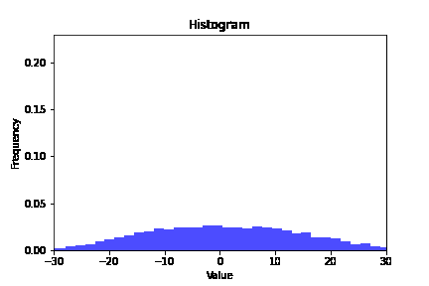
Sampling with Diffusion
Start with “noisy” in-distribution sample
The score tells it in which direction to move to get better sample
$s_{θ}\left(x\right)≈∇_{x}\log{p\left(x\right)}$
Take large step towards better solution + large random step (x N)
Repeat with smaller and smaller steps until sample is reached
$x_{t}=x_{t−1}+α_{t}s_{θ}\left(x\right)$+ $\sqrt{α_{t}}N(0,I)$ (simplified version)
Song 2021

Slide 30
SFH Diffusion

Slide 31
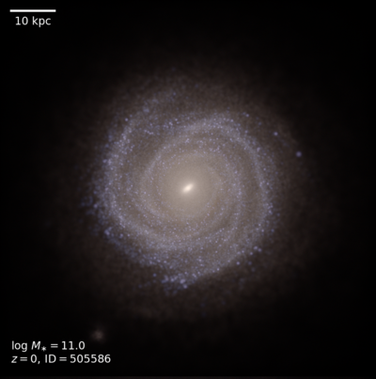
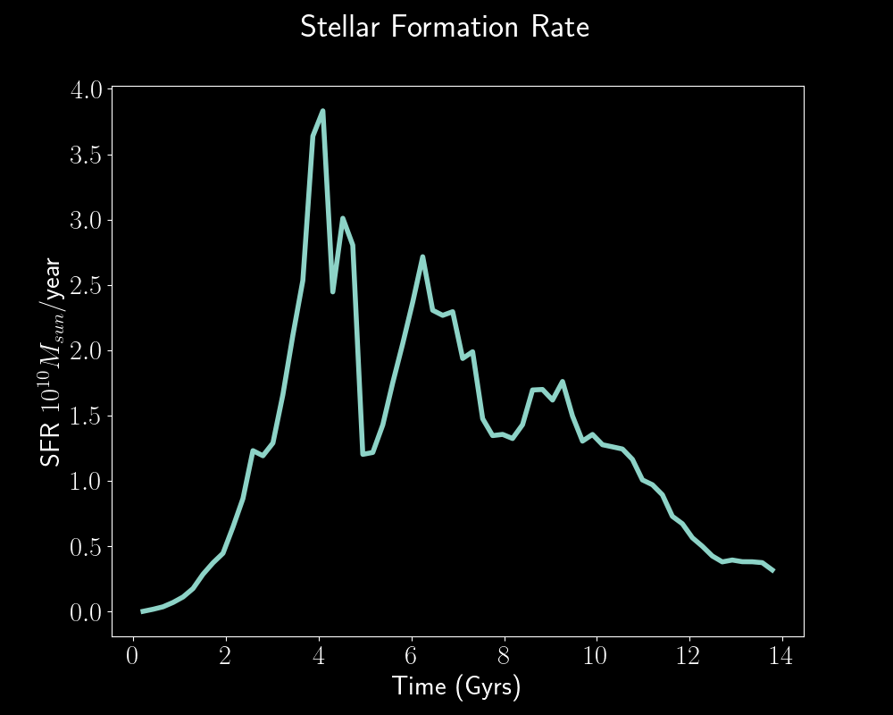
SFH Diffusion
TNG50 simulations
Initial mass
Creation time
SSPs depend on time + metallicity
Include metallicity
Joint Diffusion on SFH and metallicity history
Pillepich+ (2023)

Slide 32
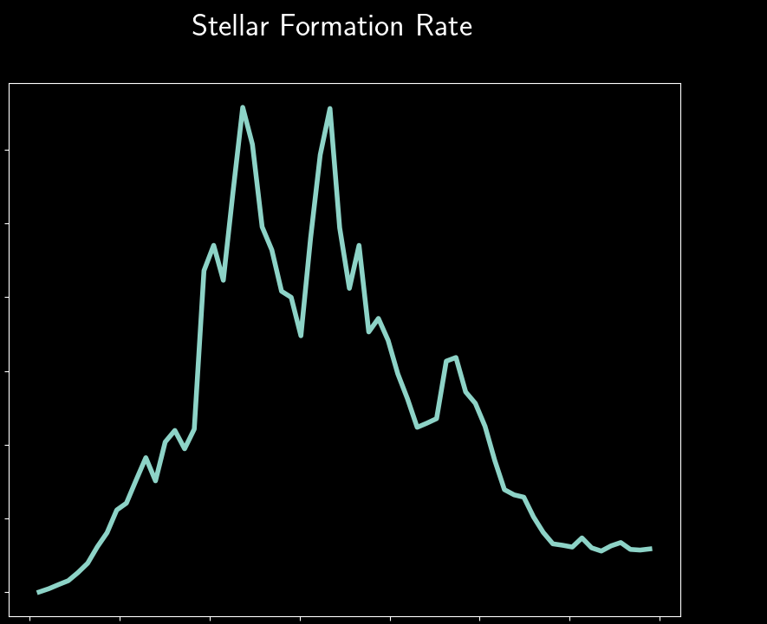
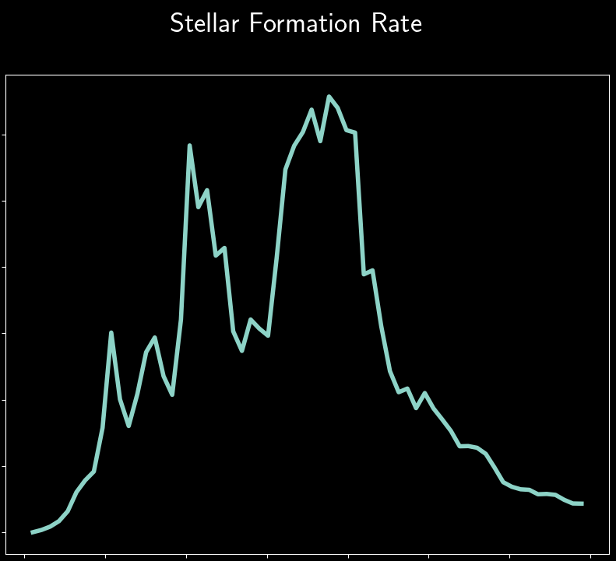
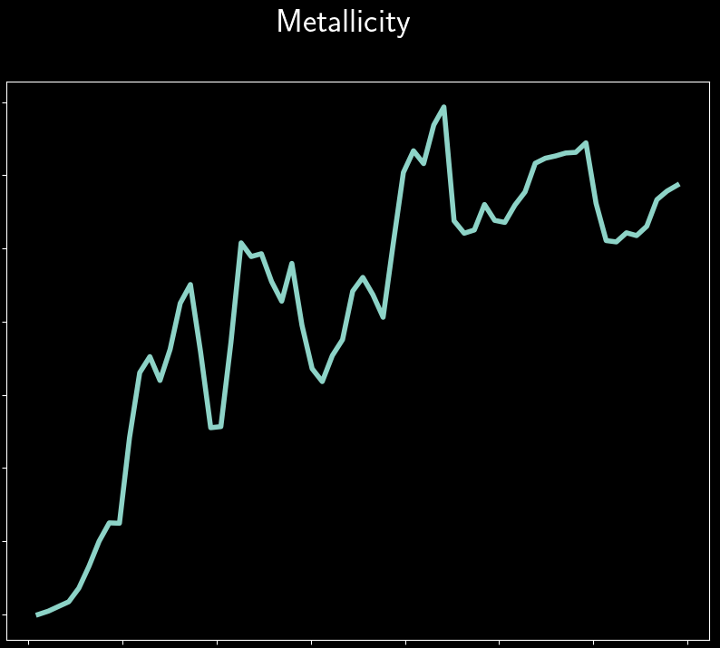
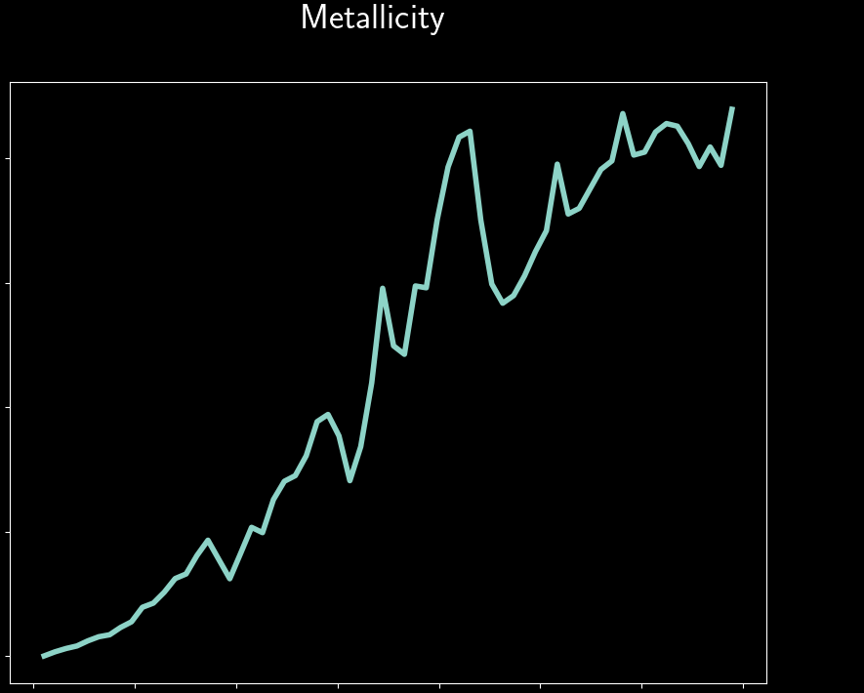
Samples
Training data

Slide 33
Posterior Sampling with Diffusion
Bayes’ Theorem:
$p\left(x | y\right)=\frac{p\left(y | x\right)p\left(x\right)}{p\left(y\right)}$
Given an observation $y$ and candidate sample $x$, we know how to compute $p\left(x | y\right)$
Replace $∇_{x}\log{p\left(x\right)}$ by
$$∇_{x}\log{p\left(x|y\right)}=∇_{x}\log{p\left(x\right)}+∇_{x}\log{p\left(y|x\right)}$$
$$=s_{θ}\left(x\right)+∇_{x}\log{p\left(y|x\right)}$$
when sampling.

Slide 34
$p\left(y|x\right)$ for SFHs
When trying to find the SFH of a real galaxy, we take our candidate SFH and apply our forward model:
We can calculate $p\left(y|x\right)$ by comparing the simulated spectrum to the observed spectrum. If they are similar then $p\left(y|x\right)→1$, if not, then $p\left(y|x\right)≪1$

Slide 35
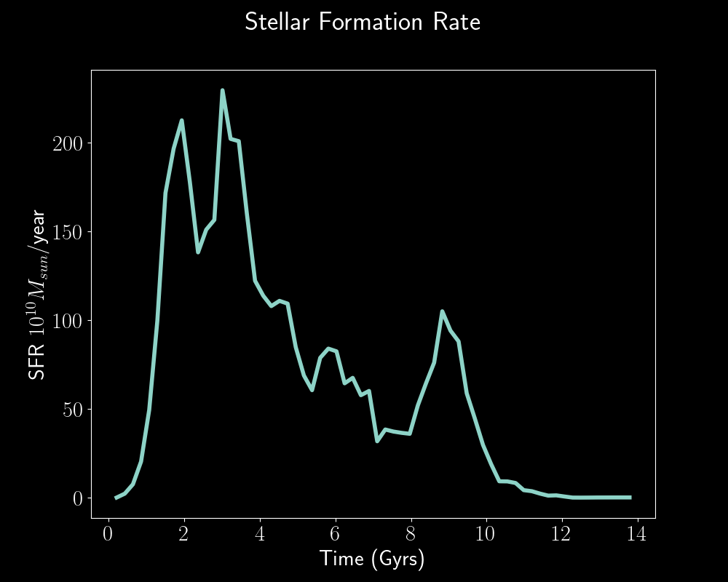
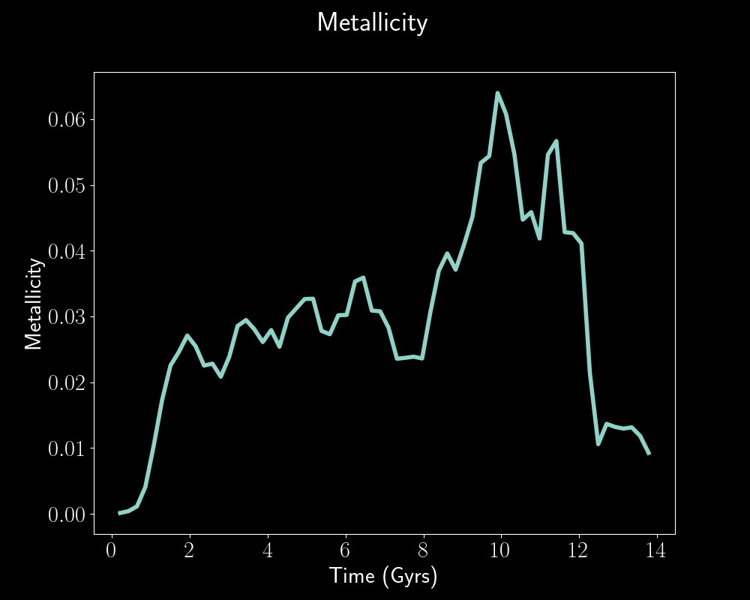
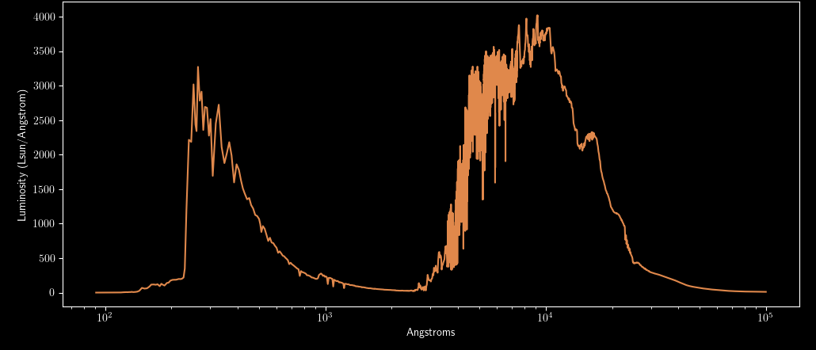

Slide 36
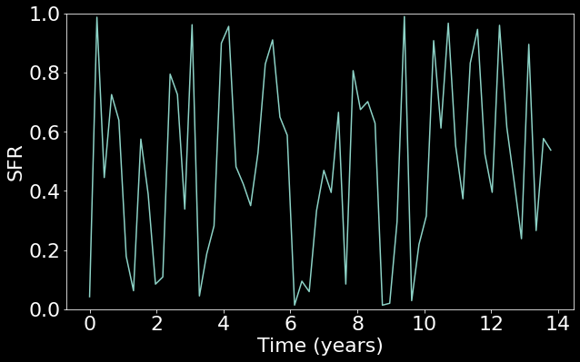
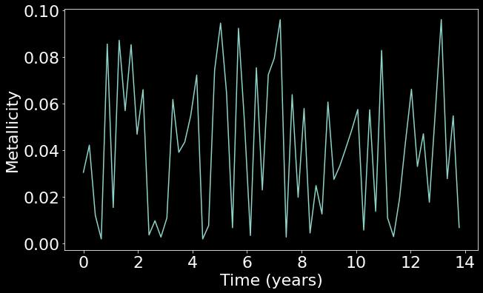
Likelihood p(y|x)
Model
p( | )
Data (mock spectrum)

Slide 37
Likelihood p(y|x)
Model
p( | )
Data (mock spectrum)

Slide 38
Likelihood p(y|x)
Model
Data (real spectrum)
p( | )
Kennicutt 1992
NGC 2775 - ESA/Hubble & NASA, J. Lee and the PHANGS-HST Team
Notes:
Ultimately, once the model is trained, it can be used with real galaxy data

Slide 39
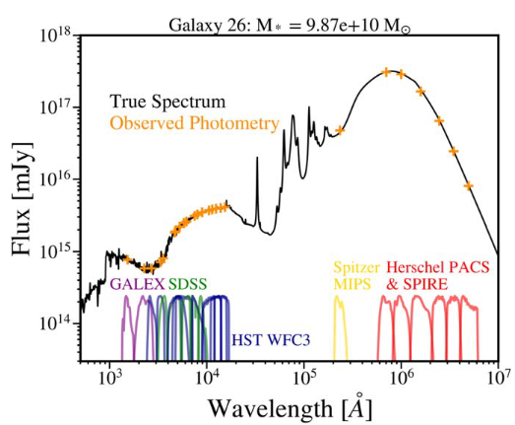
Next
Posterior inference
Photometric bins
How good are the posterior samples?
How close are posterior samples to training samples?
Are the SFHs physical?
Similar to parametric results?
Sidney Lower et al 2020 ApJ 904 33

Slide 40
Summary
SFHs vital to understand evolution of galaxies
Existing methods of finding galaxy SFHs are biased
Diffusion models are optimal for Bayesian posterior inference
We have no SFH data
use simulations!
inference on SFH and metallicity history
Diffusion + simulations => infer more realistic SFHs

Slide 41
References
Adam C. Carnall et al 2019 ApJ 873 44
Kennicutt, Robert C., Jr. 1992 ApJ 388 310
Conroy, Charlie. (2013 51. 10.1146/annurev-astro-082812-141017
Song, Yang, and Stefano Ermon. Advances in neural information processing systems 33 (2020): 12438-12448.
Nelson, D., Springel, V., Pillepich, A. et al. Comput. Astrophys. 6, 2 (2019)
Chung, Hyungjin, et al. arXiv:2209.14687 (2022).
Abdurro'uf et al 2021 ApJS 254 15
Sidney Lower et al 2020 ApJ 904 33

Slide 42
Questions?

