Slide 1
Rencontre annuelle du CRAQ
Jeudi 9 mai 2024
Des nouveaux mondes à découvrir,
au primaire et au secondaire
www.exoplanetesalecole.ca
New worlds to discover, in primary and secondary school
www.exoplanetsintheclassroom.ca
Des exoplanètes à l'école,
Des ressources éducatives bilingues pour les écoles canadiennes
Marie-Eve Naud, marie-eve.naud@umontreal.ca
Institut Trottier de recherche sur les exoplanètes (iREx), Université de Montréal
Also part of the team :
Nathalie Ouellette, Heidi White & Frédérique Baron, iREx, Observatoire du Mont-Mégantic
Julie Bolduc-Duval, Discover the Universe
Notes:
I am… from…
Pleased to talk to you about a projet we lead at iREx (UdeM), in close collab with many partners, notably the program Discover the Universe.
Many of the people involved in this project arr here, Nathalie ouellette and heidi white, working with me st UdeM, and julie from DU
We said exoplanetes in the classroom is
resources for educators (goal of the program, funded by the canadian province of quebec govt,
By educators for two reasons, first we are ourselcew educators (my background…) but also because a main feature of this project is we try tonwork much more closely with teachers while we were developing it. More on that later
Exoplanets in the Classroom - Resources for educators, by educators
Astrophysicists, science educators and teachers collaborated to create a wealth of educational resources presented in Des exoplanètes à l’école (Exoplanets in the Classroom). Activities, slide decks, short videos, biographies of Québécois and Canadian astrophysicists, an FAQ, a glossary, play cards and more, are all available for free on our website: www.exoplanetesalecole.ca (French only at the moment). They can be used by primary and secondary school teachers and kids to learn more about exoplanets and the search for life in the Universe.
During this talk, I’ll present the resources and how they were developed, in a process led by astrophysicists and science educators at the Trottier Institute for Research on Exoplanets at the Université de Montréal, in close collaboration with Discover the Universe and other educational partners, with funding from the Québec provincial government. More than a hundred teachers in Québec have been involved from the start of the project in 2021 up to the publication of the resources in March 2023. They participated in brainstorming sessions, helped test the resources in their classrooms, and were consulted on many occasions to ensure the resources were adapted to their realities and needs.
The reaction of the teachers is extremely positive : they told us the resources are easy to adopt and adapt, have significant connections with the Quebec school curriculum they must teach, and provide a novel way for them and their students to review mandatory topics and learn more about cutting-edge actual research topics and the scientists who make them.

Slide 2
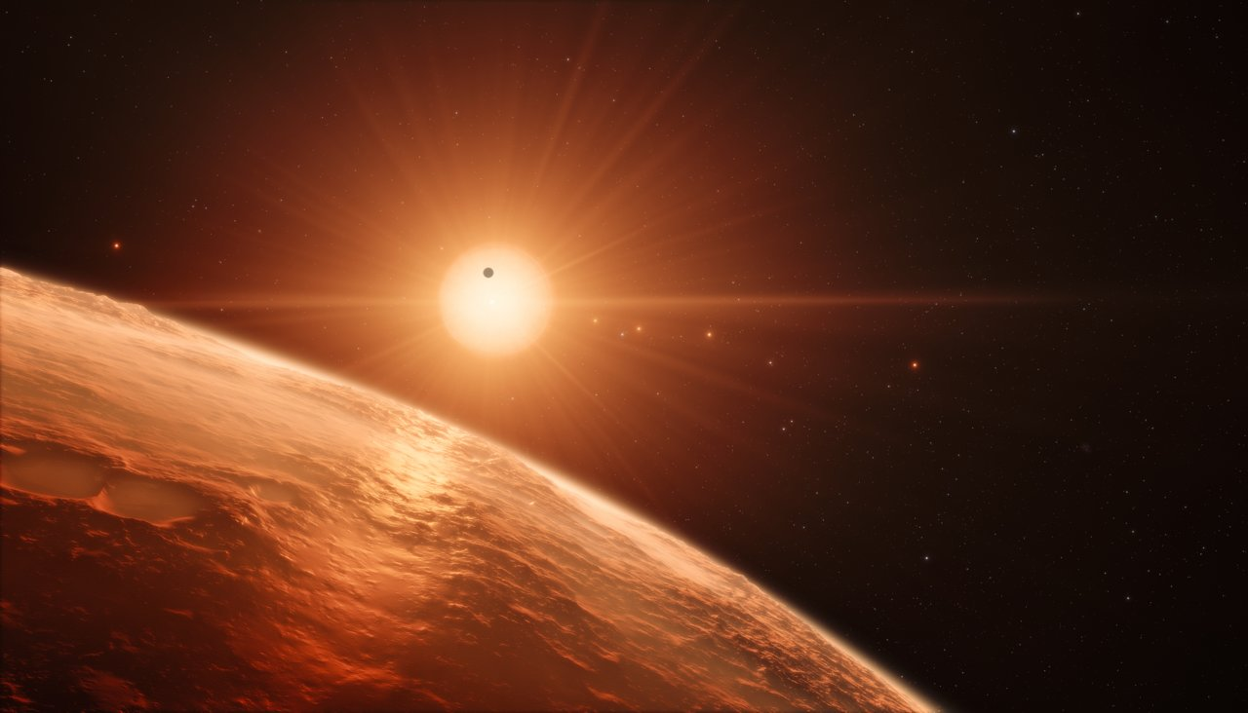
Exploring new worlds, searching for life
www.exoplanets.ca
@iRExoplanetes
@iExoplanets
/exoplanetes
/company/exoplanetes/
www.exoplanets.ca
ESO/M. Kornmesser
Notes:
iREx - Research institute + EPO hub
A lot of great scientists here, not well known by the public
A strong wish to share our passion and engage discussion with the public in general
Connect kids and teenagers with local scientists
And… in the work we already did with kids…

Slide 3
https://www.discovertheuniverse.ca/
Notes:
… and from what Julie from our partner Discover the Universe program, we knew that the topic of exoplanets and search for life elsewhere was very popular among kids and teenagers, and that it was generating a lot of curiosity and interest from kids and in fact, people of all ages.

Slide 4
THE PROJECT
Who?
+ dozens of Quebec school staff
What?
A website full of free resources
(in French, currently being translated to English)
About what?
The Solar System, exoplanets, looking for life in the Universe
Why?
Connect kids and teenagers with local scientists
Topics interesting to students and teachers, aligned with the school program
For whom?
Educational staff, primary and secondary schools
When?
Was developed over a
period of 〜3 years
(2020-2023)
www.exoplanetesalecole.ca www.exoplanetsintheclassroom.ca
Notes:
You can see a little more of the people and institutions involved b’here
People you know, and others collaborators, key people with excellent knowledge of the school system
What, About what
For whom
When
Why… (going to the other slides)
I need to say a little more about us, our research institute

Slide 5
INTRODUCTION WHAT WE WANTED
Compatible with remote learning
A Covid-19 project…!
Inter/Multidisciplinary
Connect exoplanets and astronomy with other sciences (geology, biology, chemistry, env. sci) & technology, but also French, English, math, arts, etc.
Sustainable development
Astronomer POV :
Earth = our planet ⇿ life
Collaborative nature of scientists' work
Up-to-date content, connected to the school curriculum
provide ways to teach differently, connecting to recent science breakthroughs
Showcase Quebec research and researchers
Present the research done locally and present diversified and accessible models of scientists
In collab. with and for ALL teachers
Boost their confidence
All can find something of interest, (knowledge/motivation level)
www.exoplanetesalecole.ca www.exoplanetsintheclassroom.ca
Notes:
In addition to those main objectives, we had other interests. We wanted our resources to be…
…
showcase … that I already said, but we wanted to Present a variety of relatable, local astronomers that offer a wider representation of what a scientist is, and also, as a far-term goal, to improve our the representation of some populations in astronomy and physics through early education.
For all… to that end

Slide 6
INTRODUCTION CREATION PROCESS
Sept 2020/Dec 2020 Project submitted to the provincial govt/Funding granted
Feb 2021 Start of the project
April 2021 Creation of the teaching community (Fb + mailing list)
April/May 2021 1st Workshops (5) with school staff : brainstorming (27)
June-Aug 2021 Creation of activities (primary + secondary)
Aug/Sept 2021 2nd Workshops (4) with school staff : feedback (8)
Oct 2021 Project presented to iREX scientists to get feedback
Nov 2021-May 2022 Test 4 primary activities with staff & classrooms (~30)
Summer 2022 3rd Workshops with secondary school staff : feedback (9)
Summer 2022 Recording of videos with scientists
Fall 2022/Winter 2023 Revision process
Fall 2022/Winter 2023 Pres. to school staff at conferences, webinars and CoP (>75)
Spring 2023 Publication and promotion of resources
2023/2024 Translation to English
www.exoplanetesalecole.ca www.exoplanetsintheclassroom.ca
Notes:
Our process involved a lot of interaction with the school personnel.
Originally, we planned on holding workshops with them to work during half days. That proved impossible because of the pandemic and also a severe lack of school personnel in Quebec schools.
We dabbled with many other ways of interacting with them : some of them were huge successes and some much less. But what is sure is we learned a lot.
Here are a few things we learned

Slide 7
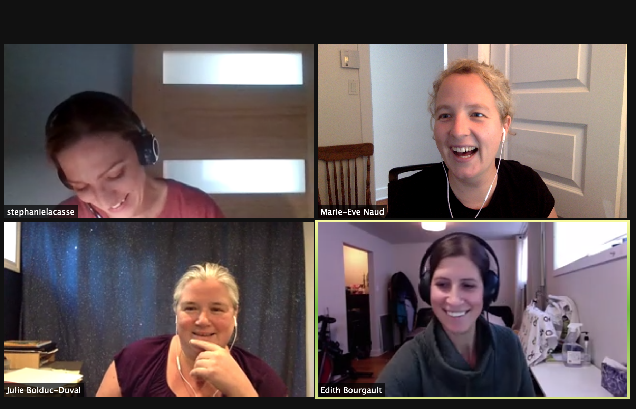
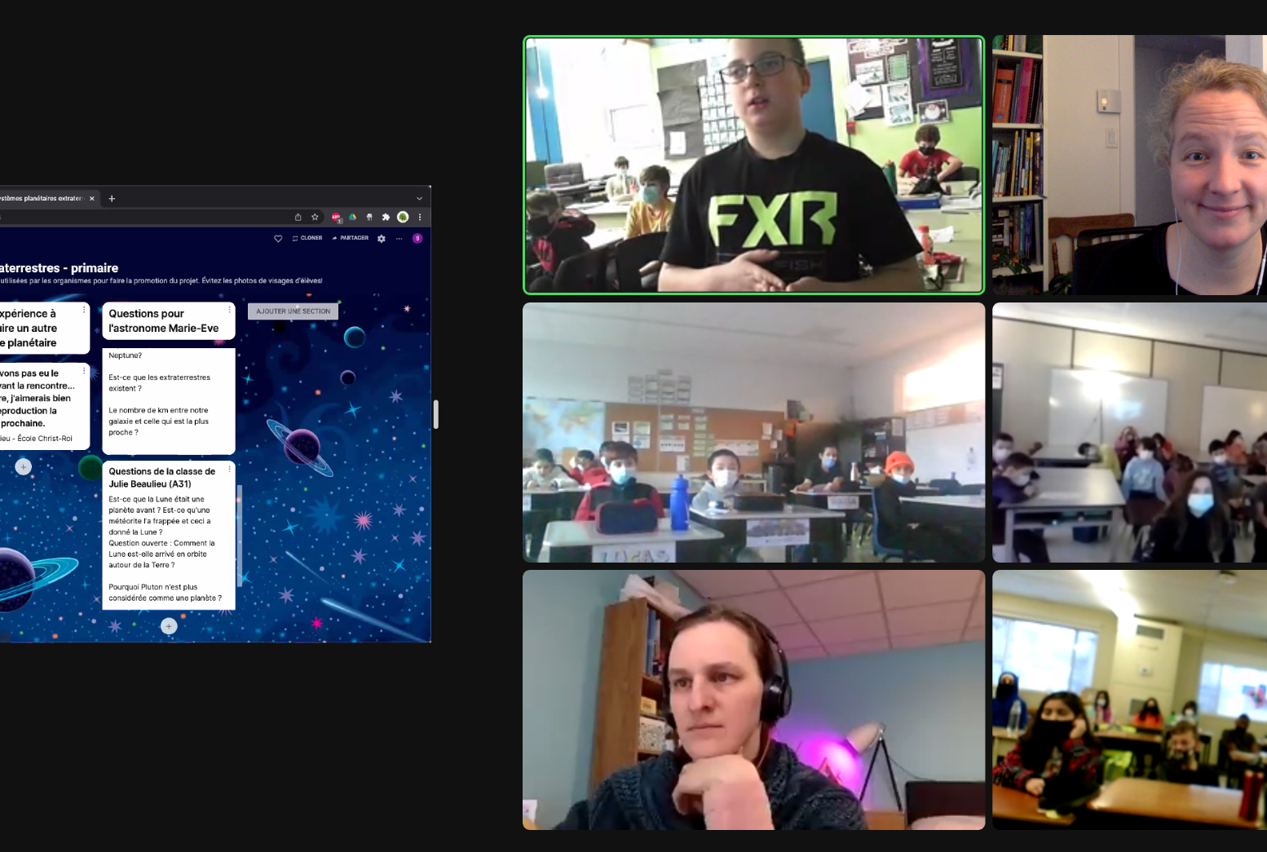
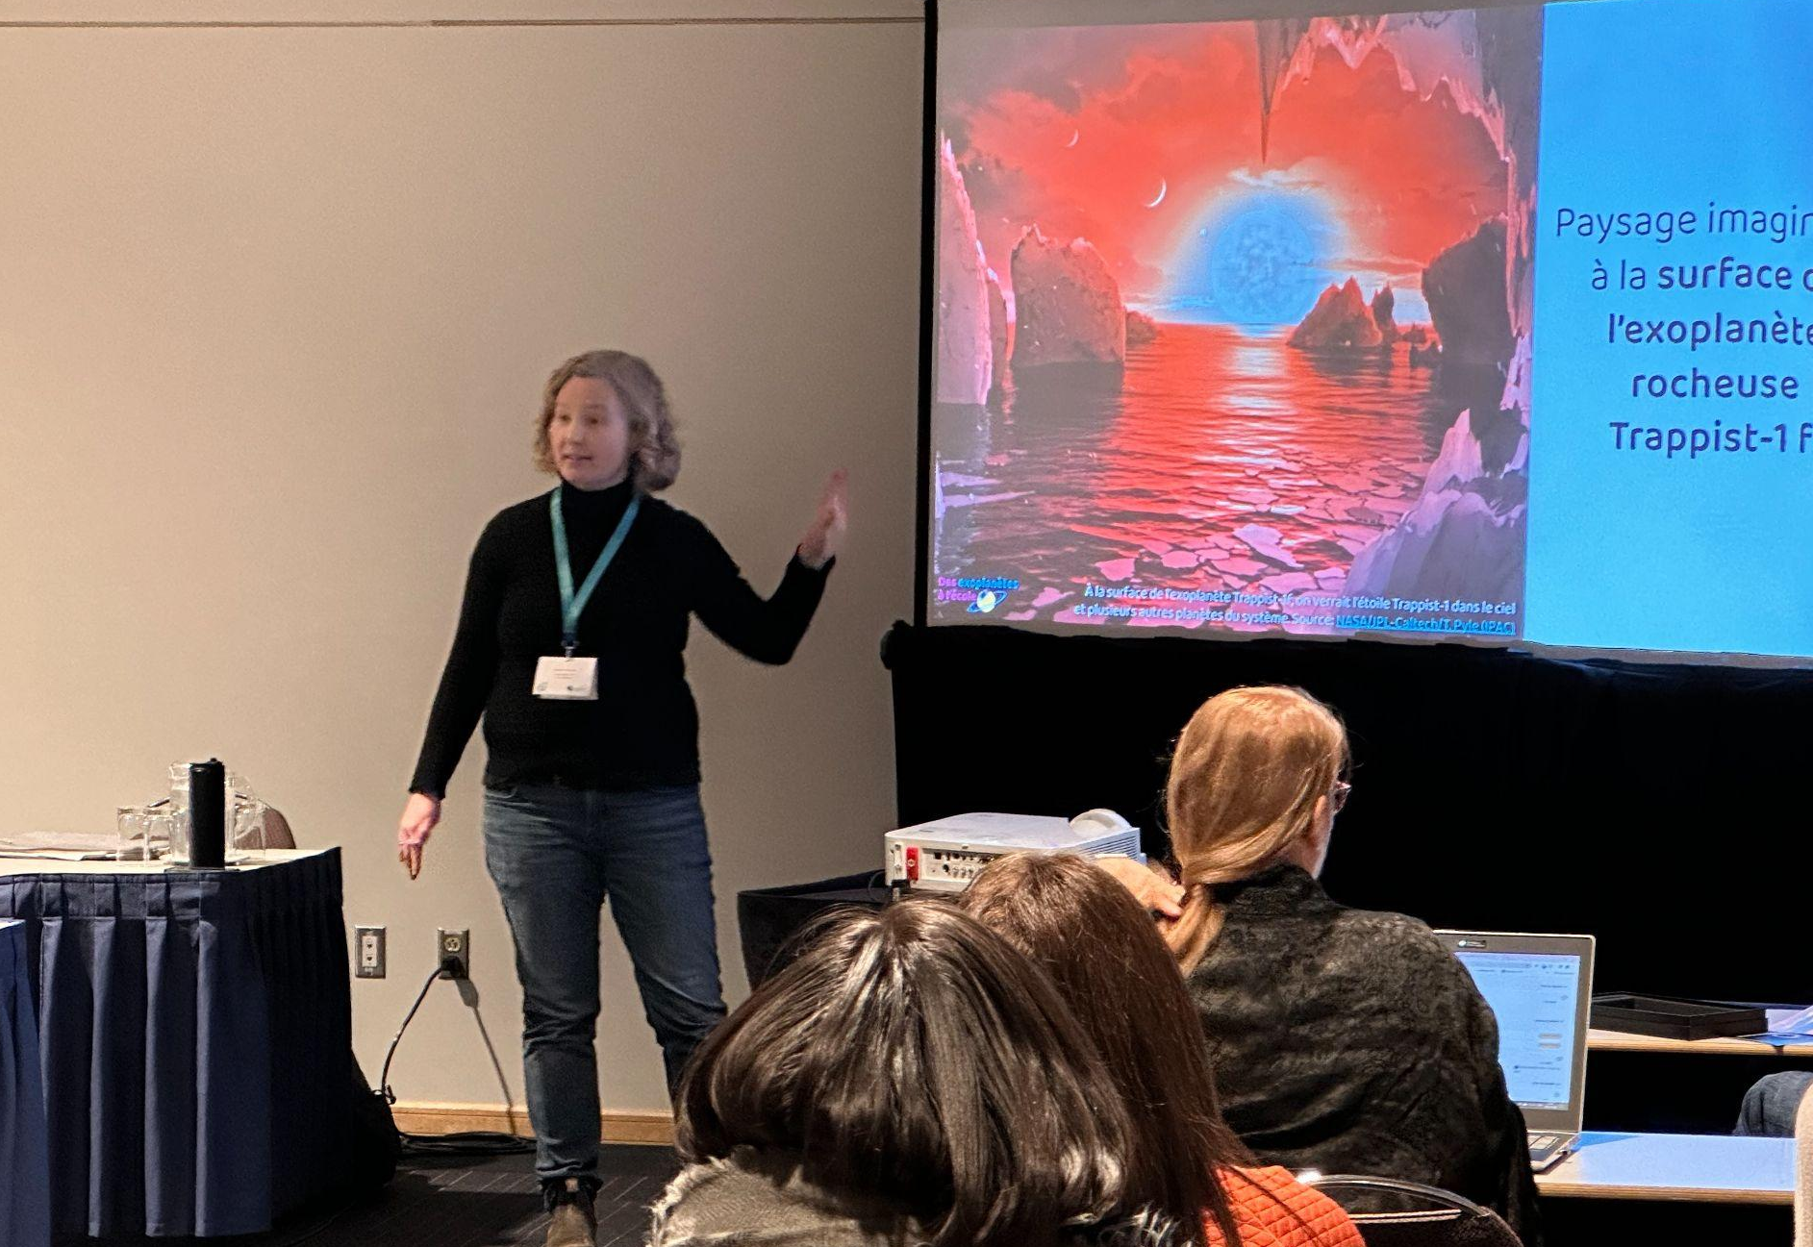
LESSONS LEARNED WHAT WORKED WELL?
Fauxel, pexels
www.exoplanetesalecole.ca www.exoplanetsintheclassroom.ca
Notes:
All remote interactions with school staff and scientists
Brainstorming workshops at the beginning
Workshops seven months in (check-up on activities)
Summer workshop with secondary school teachers in 2022
Session with iREx scientists
With both these last, we used the same process, which worked well :
Virtual meeting at the beginning large groups
Google Docs they reviewed on their own
One on one (or smaller groups) virtual meetings later
Remote presentations with primary school kids and classrooms
Collaboration with partners Discover the Universe and École en réseau to test activities on a large scale, supporting teachers as they do the activities
We realized training them in specific workshops was really hard, but training and supporting them as they do an activity with their classrooms was very efficient, with their busy schedules the many things they juggle at the same time. For primary school teachers, that format was really successful. For secondary school kids, it was still hard to get into classrooms at first. Teachers were not enrolling in large activities (could not attend presentations due to schedule constraints, were not in "that module" at the time we were offering the activity). We ended up going in secondary classrooms later, with material that was much better developed https://eer.qc.ca/activites-en-reseau/164460760528-a-laventure-dans-ton-systeme-planetaire.

Slide 8
LESSONS LEARNED NEEDS OF PRIMARY & SECONDARY TEACHERS
Primary | Secondary
Can take on activities that take a few periods to complete | Hardly have any time for "enrichment" activities, nothing above 60-75 min.
Like multidisciplinary activities (esp. French and Math) | Struggle to adopt multidisciplinary activities (not the same teacher, schedule constraints, etc.)
Appreciate turnkey activities where everything is included and carefully explained | Appreciate activities they can modify to make their own
Sometimes do not feel confident enough about teaching sciences | Have chosen science as their main topic, but often have a background in life sciences
Both :
Like to feature "real" scientists ( videos, live or presentations).
Like having resources from credible and local experts.
Are attached to their school program!
Appreciated being consulted (!).
Appreciate online, copyright-free activities and resources they don't have to create.
Notes:
Now, we learned a lot during this process
Some of the things we learned
Other : primary : can print stuff!
school program : some stick religiously to it (exoplanets aren't part of the program!), other are much more open to present other things and see the interest of topics like exoplanets to present things in the program (like the Solar system) originally. But most teachers we met stressed the importance of explicitely mentioning links to the program.

Slide 9
www.exoplanetesalecole.ca www.exoplanetsintheclassroom.ca

Slide 10
www.exoplanetesalecole.ca www.exoplanetsintheclassroom.ca

Slide 11
www.exoplanetesalecole.ca www.exoplanetsintheclassroom.ca

Slide 12
www.exoplanetesalecole.ca www.exoplanetsintheclassroom.ca

Slide 13
www.exoplanetesalecole.ca www.exoplanetsintheclassroom.ca

Slide 14
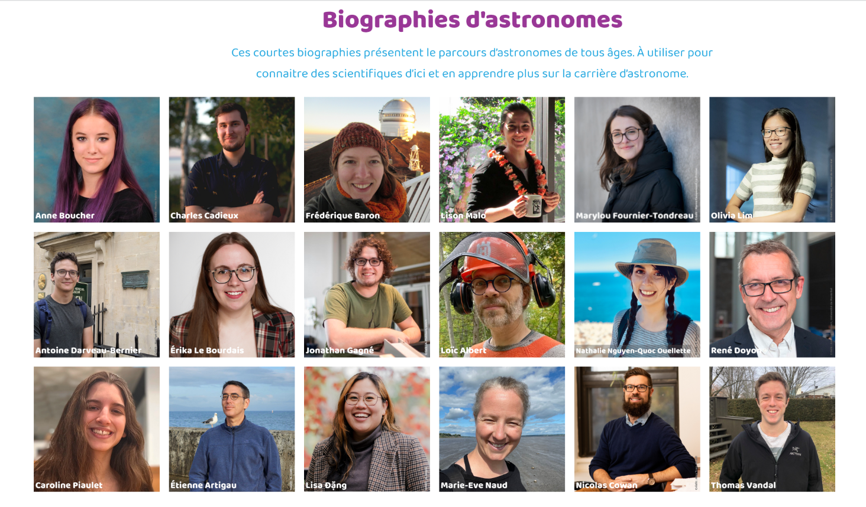
www.exoplanetesalecole.ca www.exoplanetsintheclassroom.ca

Slide 15
www.exoplanetesalecole.ca www.exoplanetsintheclassroom.ca

Slide 16
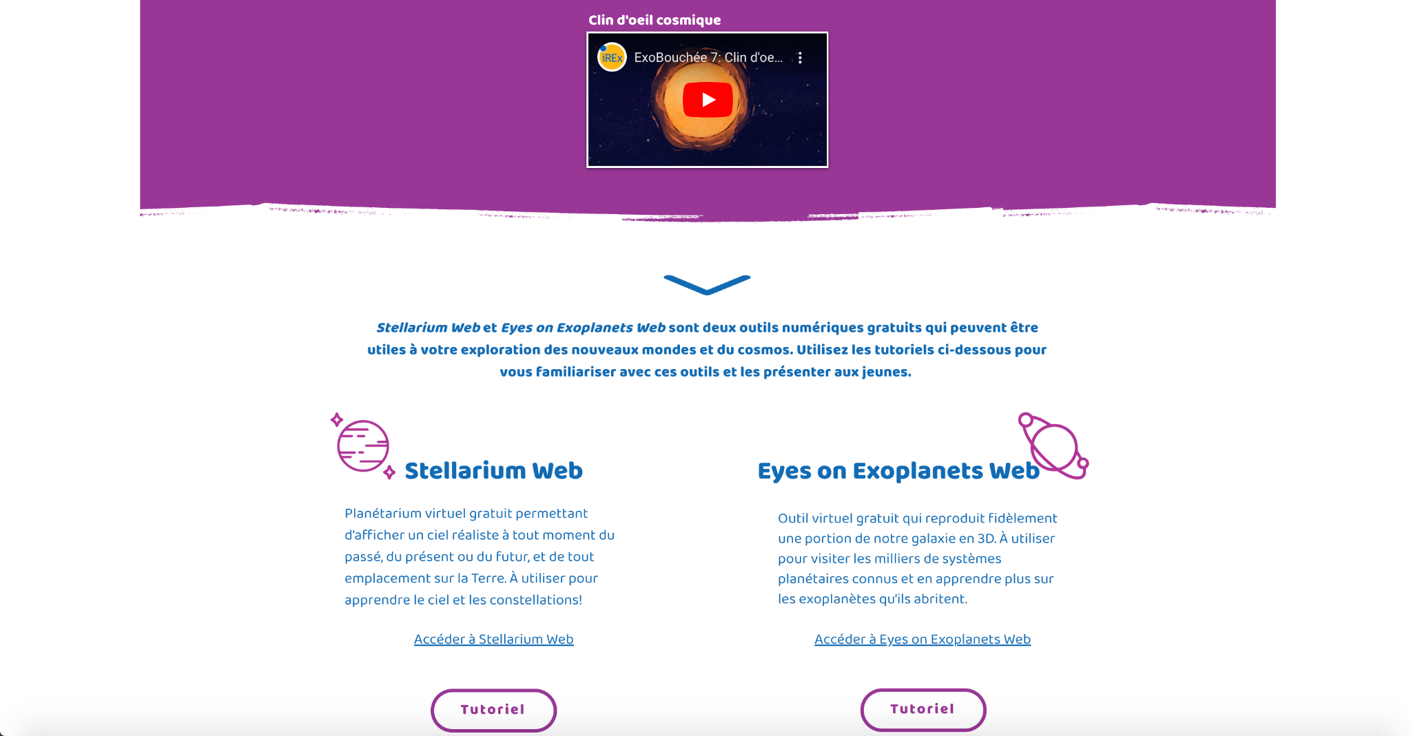
www.exoplanetesalecole.ca www.exoplanetsintheclassroom.ca

Slide 17
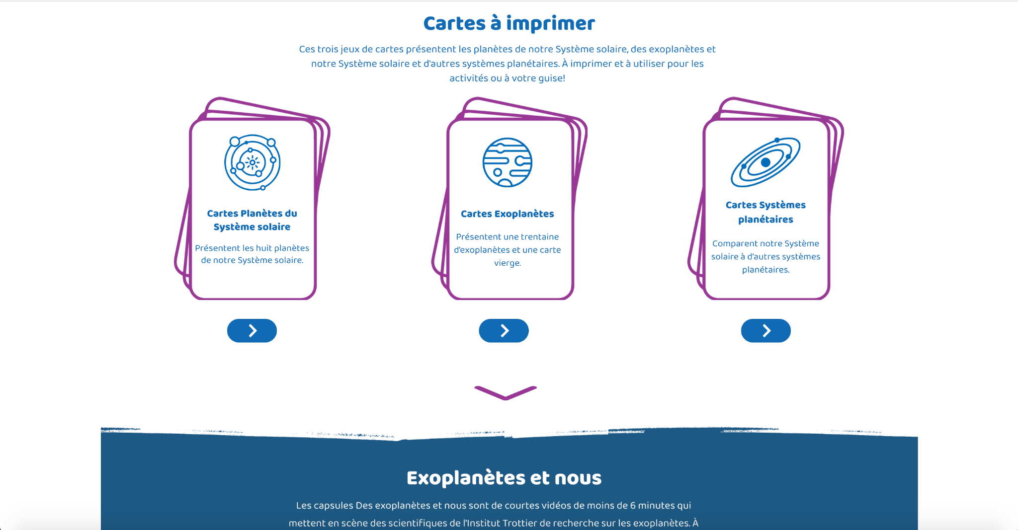
www.exoplanetesalecole.ca www.exoplanetsintheclassroom.ca

Slide 18
www.exoplanetesalecole.ca www.exoplanetsintheclassroom.ca

Slide 19
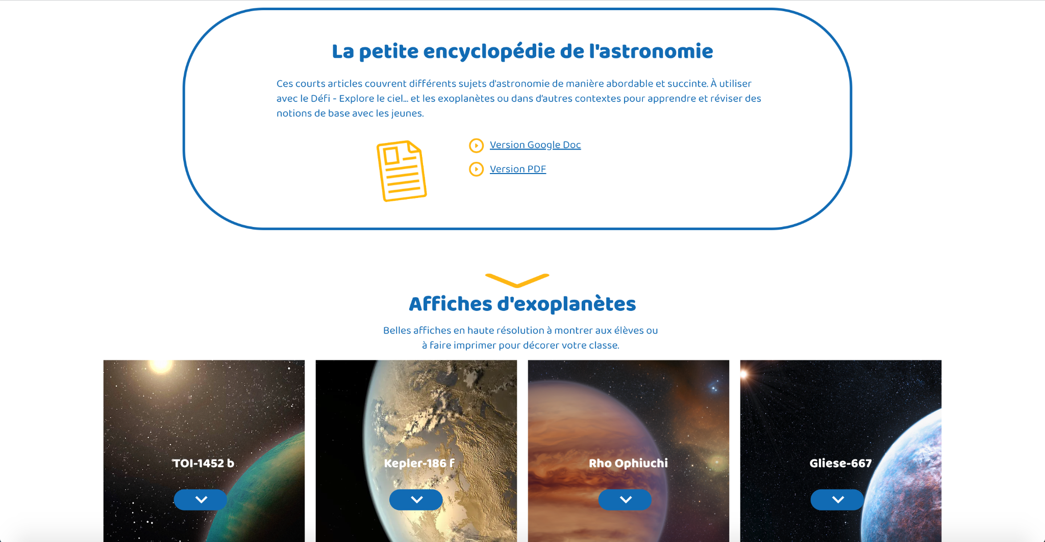
www.exoplanetesalecole.ca www.exoplanetsintheclassroom.ca

Slide 20
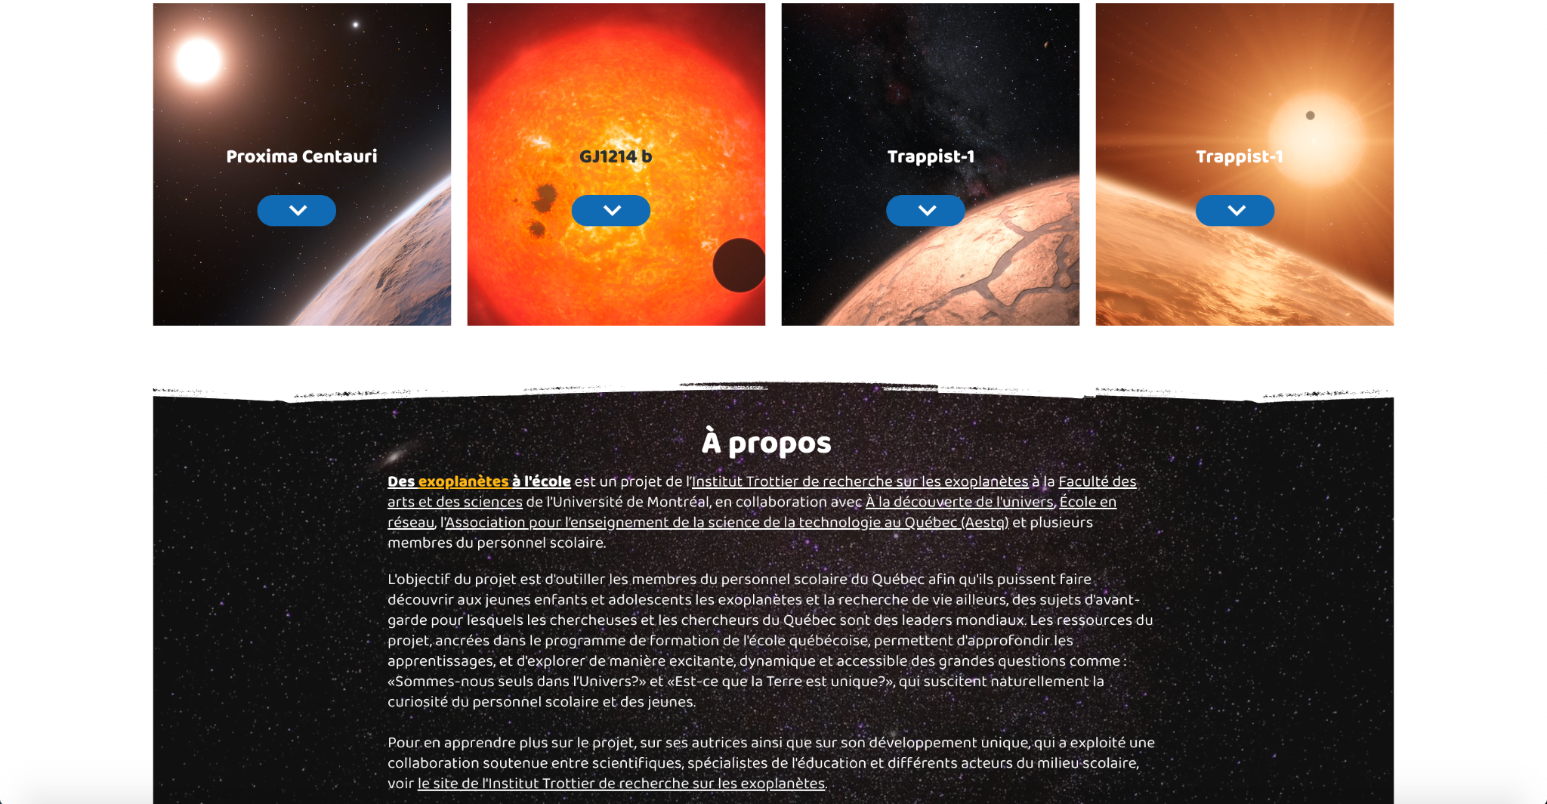
www.exoplanetesalecole.ca www.exoplanetsintheclassroom.ca

Slide 21
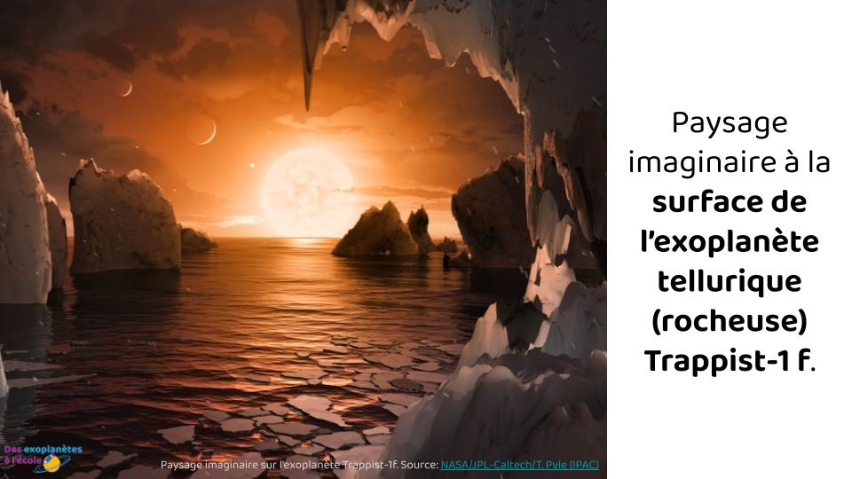
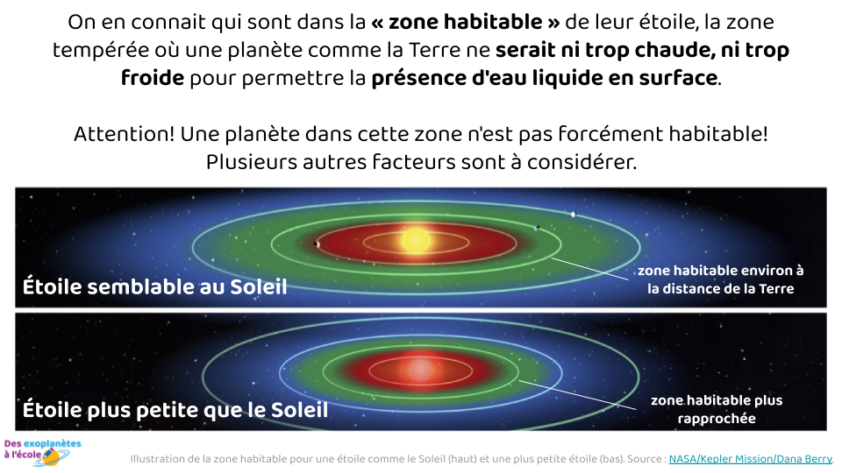
CLOSEUP ON THE RESOURCES SLIDE DECKS (20-25 slides 〜30-45 min)
The Solar System
Exoplanets
Travel to other worlds (artistic illustrations of exoplanets)
How to detect exoplanets
Life… here and elsewhere
www.exoplanetesalecole.ca www.exoplanetsintheclassroom.ca
Notes:
This is something that came to be when we prepared the activities for primary schools, mainly. We needed a support to present basic content before to let them work and slideshows came very handy.
When then realized the topics were often the same from one activity to the other, and that secondary school teachers were also interested to use them.

Slide 22
CLOSEUP ON THE RESOURCES ACTIVITIES FOR PRIMARY AND SECONDARY
www.exoplanetesalecole.ca www.exoplanetsintheclassroom.ca
Notes:
The activities are the core of the resources and also what we worked on first.
Discover the universe has many modules composed of activities that are all ready to deliver in classrooms, and we were inspired by that.
In the process working with teachers, we found out most of the work we did for primary schools after the brainstorming sessions were right on track. The teachers who evaluated them in the second round of workshops liked them a lot.
For the secondary school teachers, it proved a little more difficult. We learned a lot on their specific needs through this process. After the second round of workshops, we had to rethink a lot of what we did. We even wondered at some point if we would do activities at all. I'll come back to that later.

Slide 23
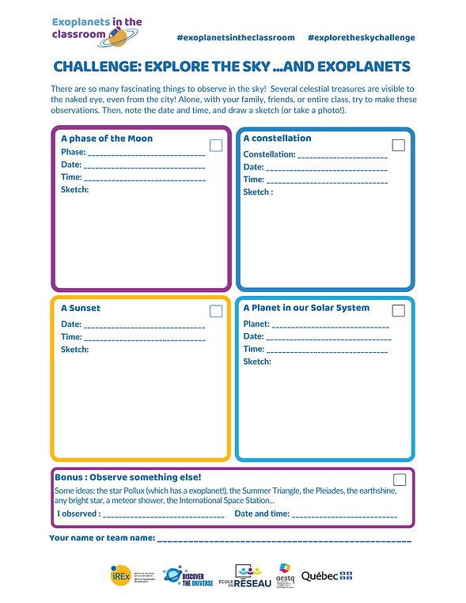
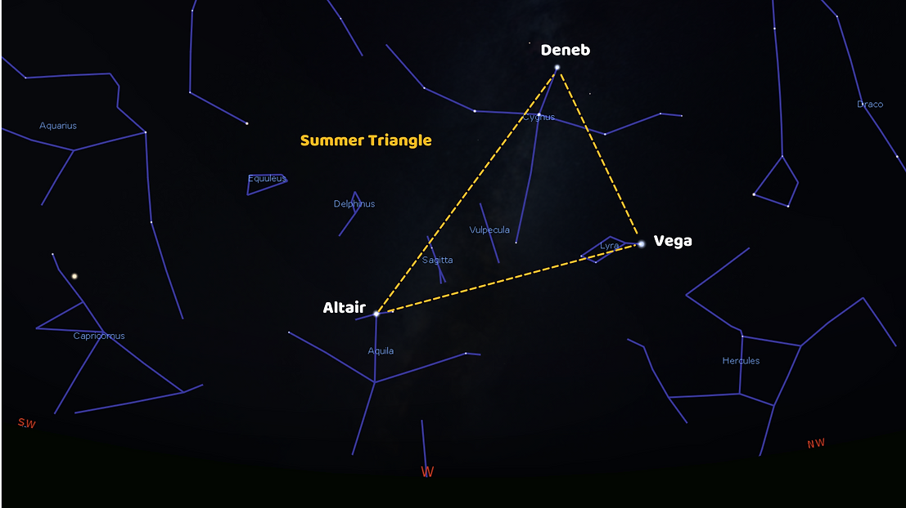
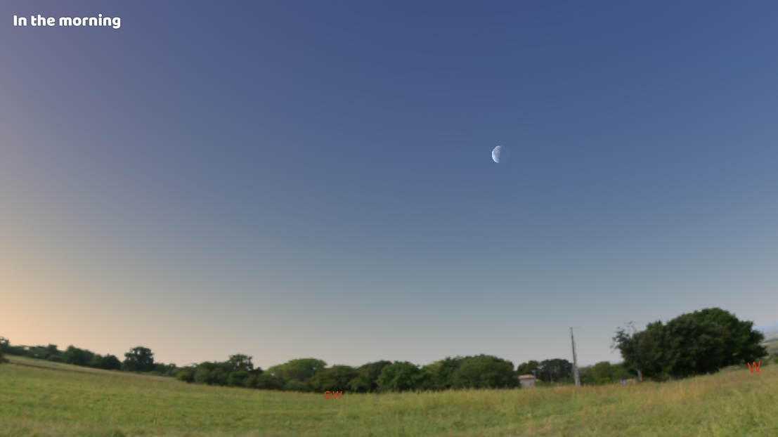
CLOSEUP ON THE RESOURCES ACTIVITIES FOR PRIMARY SCHOOL STUDENTS
Experience the great beauty of our sky, during the day or at night, for yourself!
Challenge takes place every year during the Holidays. Check Discover the Universe website around November!
www.exoplanetesalecole.ca www.exoplanetsintheclassroom.ca

Slide 24
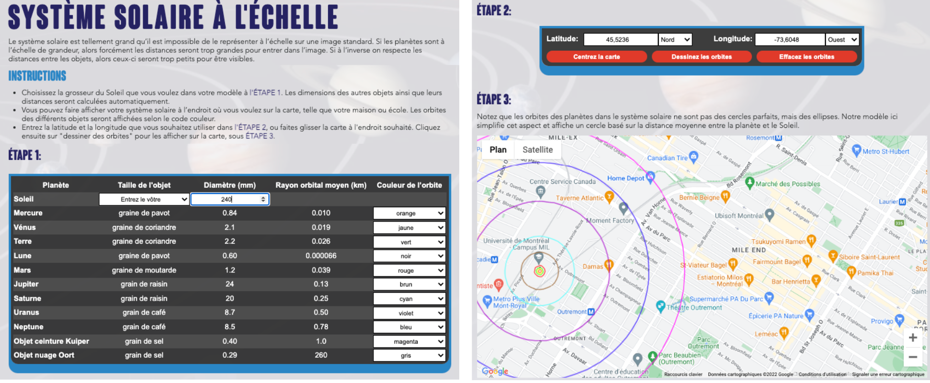
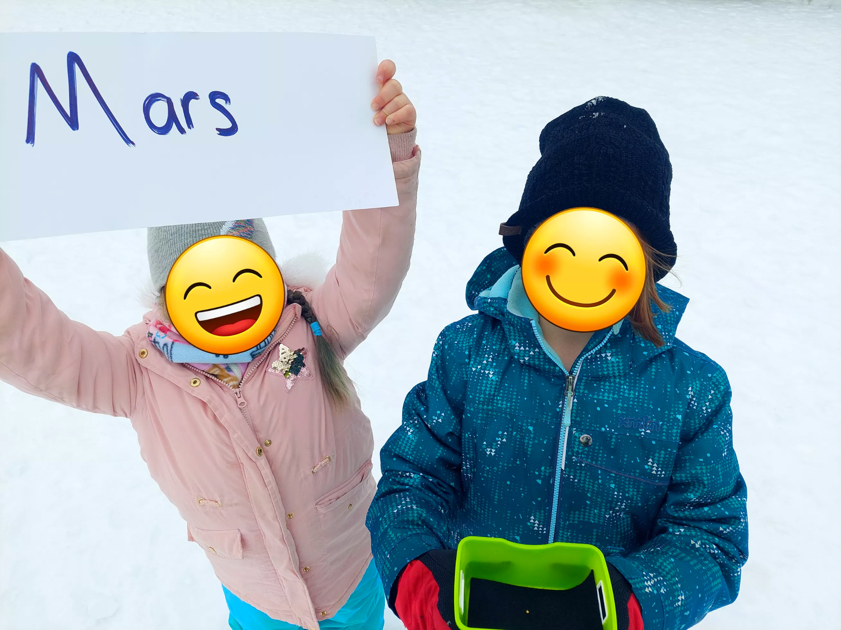
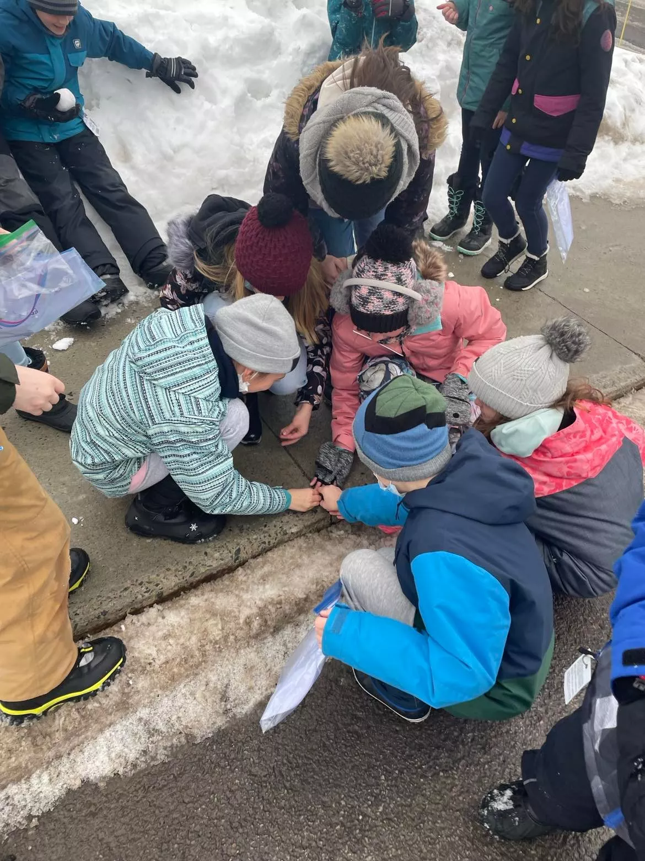
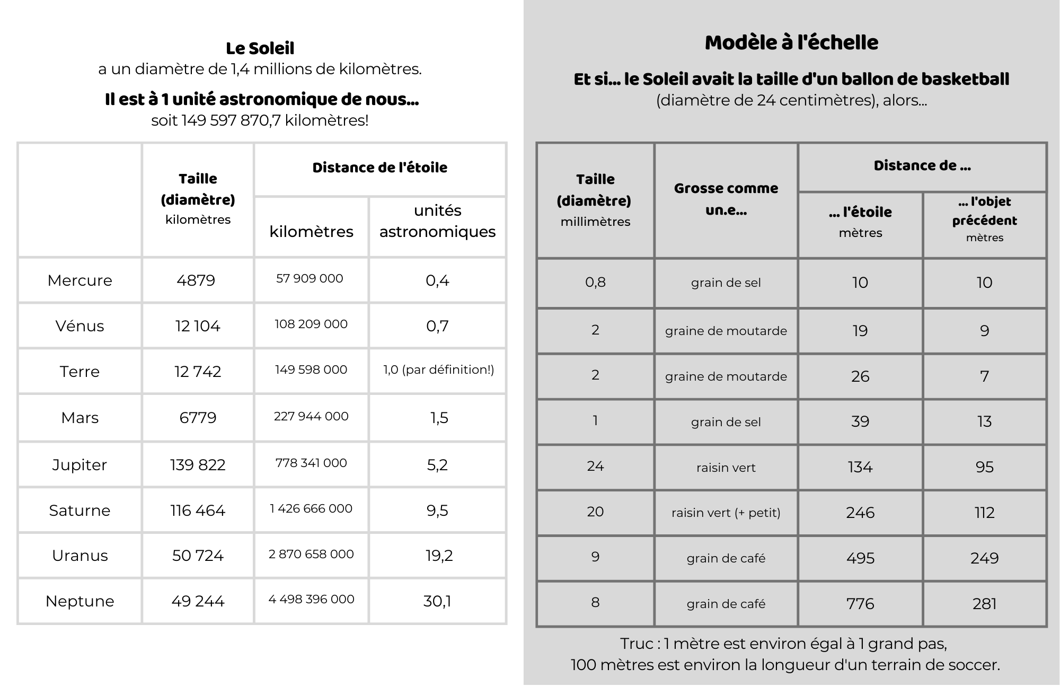
CLOSEUP ON THE RESOURCES ACTIVITIES FOR PRIMARY SCHOOL STUDENTS
Take a look at the interactive web tool Scale Model of Solar System,
as well as the Systèmes planétaires extraterrestres activity and the Cartes Systèmes planétaires at www.exoplanetesalecole.ca
Reproduce our Solar System, and other planetary systems, to scale in your neighbourhood!
www.exoplanetesalecole.ca www.exoplanetsintheclassroom.ca

Slide 25
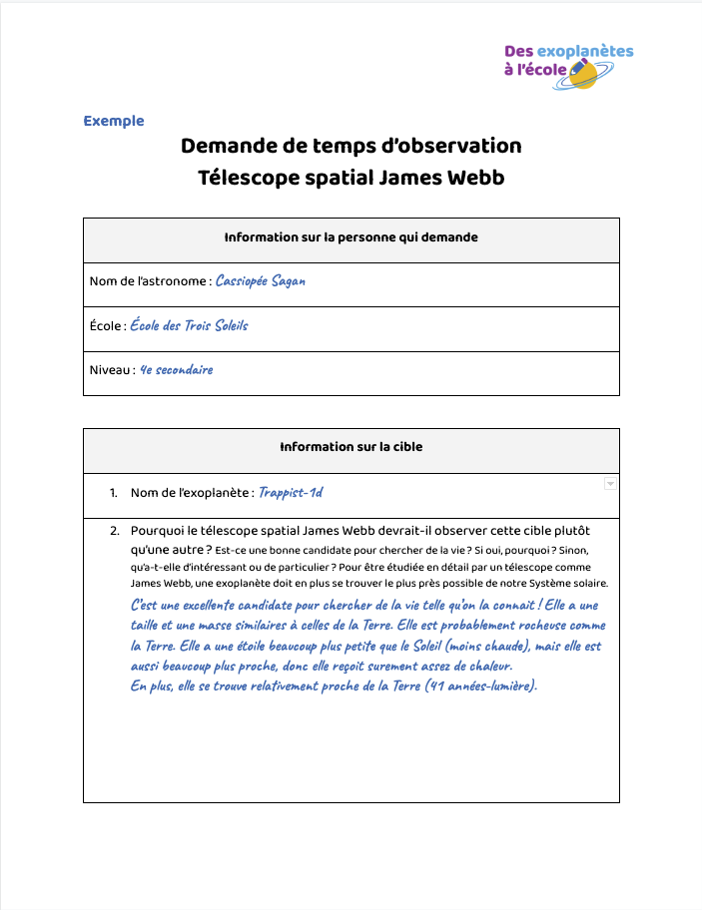
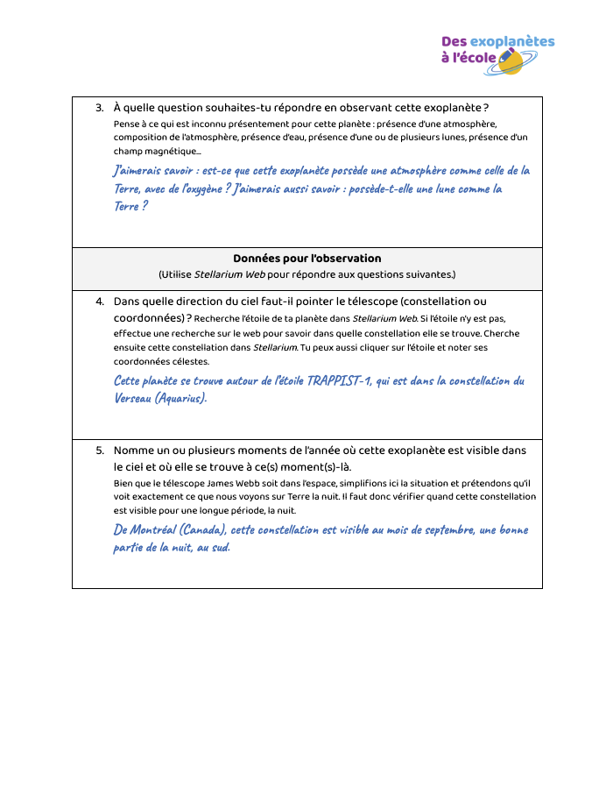
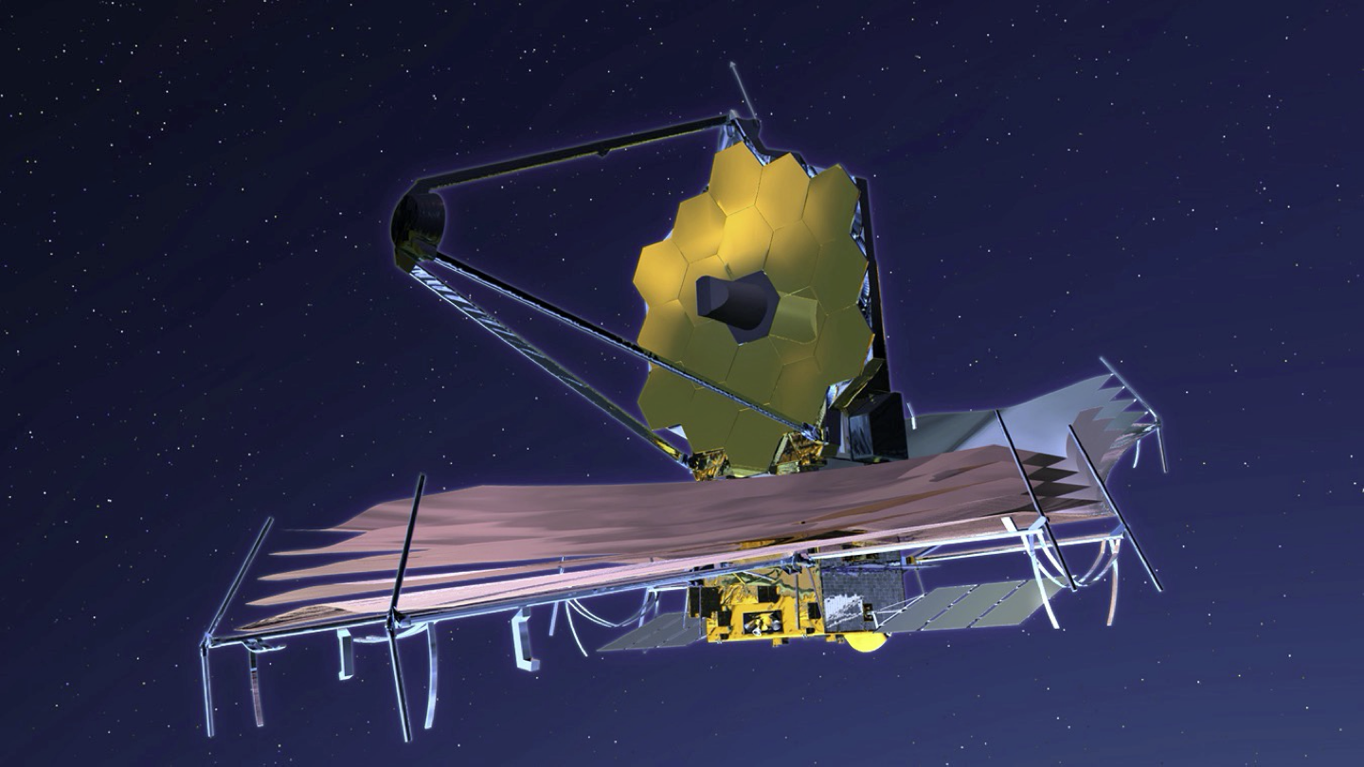
CLOSEUP ON THE RESOURCES ACTIVITIES FOR SECONDARY SCHOOL STUDENTS
Choose an exoplanet/other object you would like to observe and try to convince your peers that it is the best target for the Webb Telescope!
www.exoplanetesalecole.ca www.exoplanetsintheclassroom.ca

Slide 26
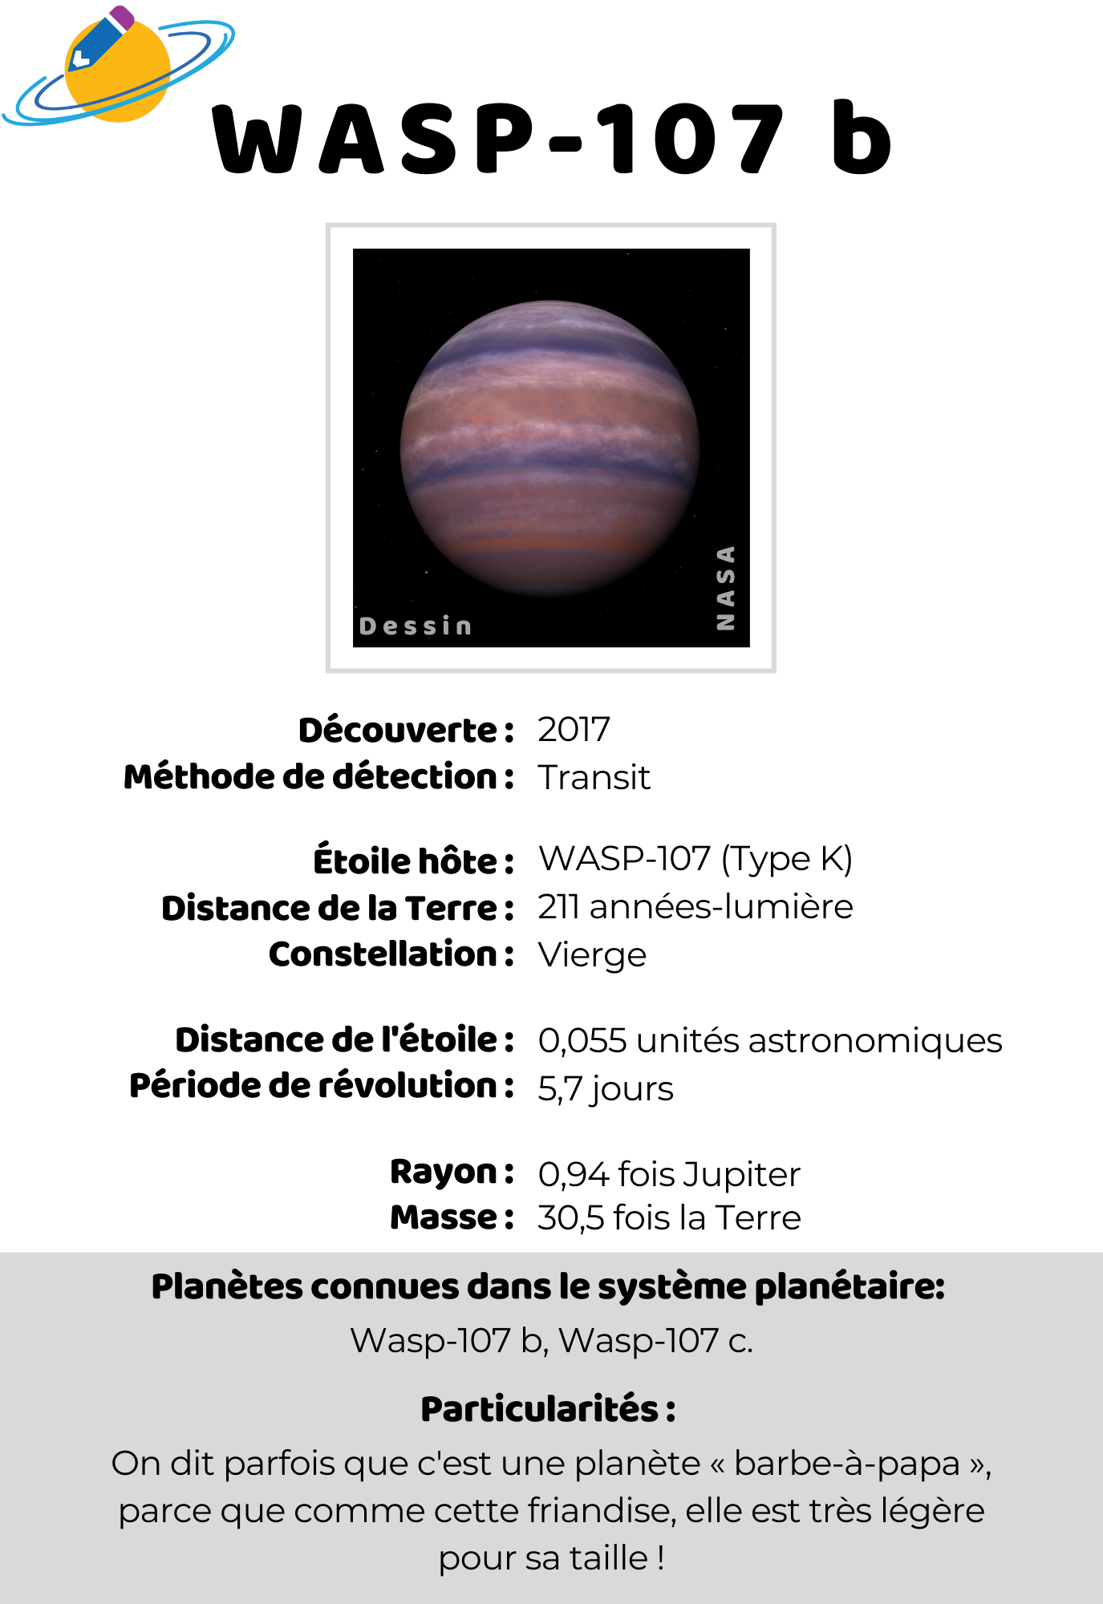
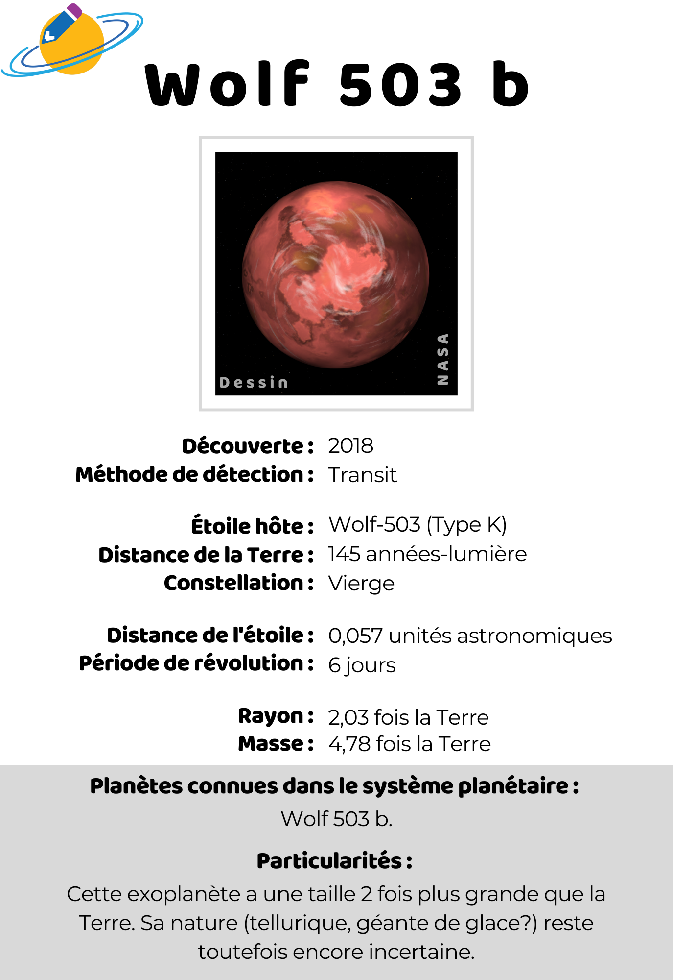
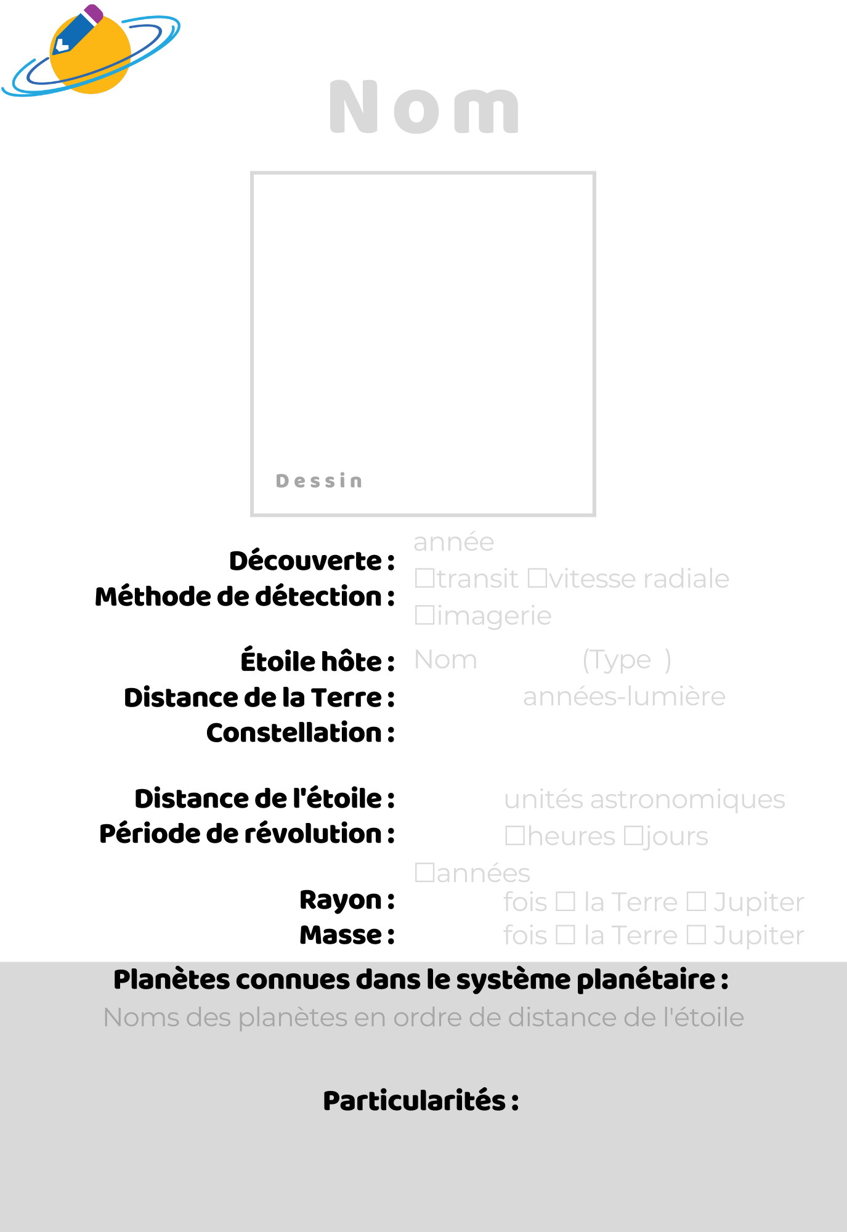
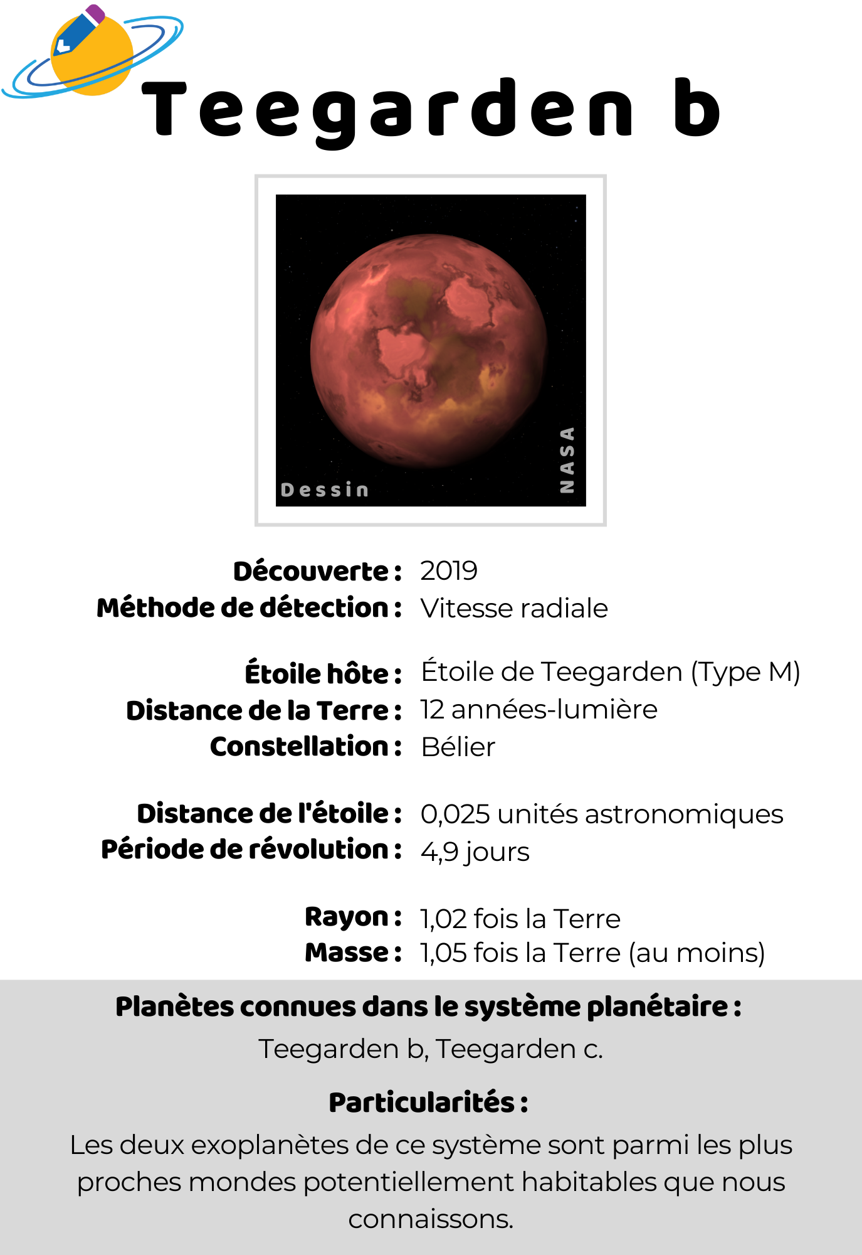
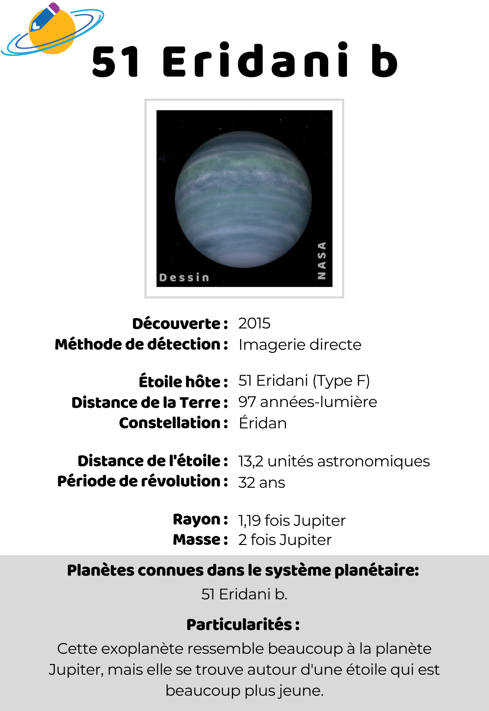
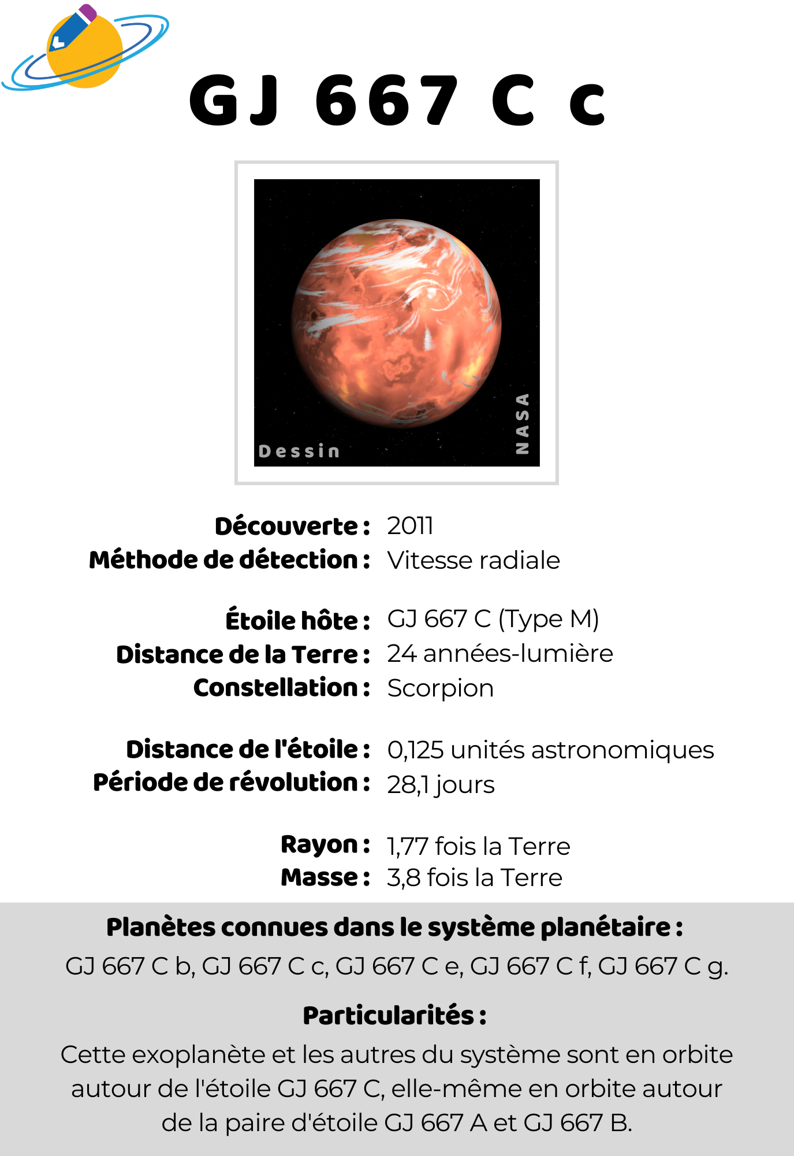
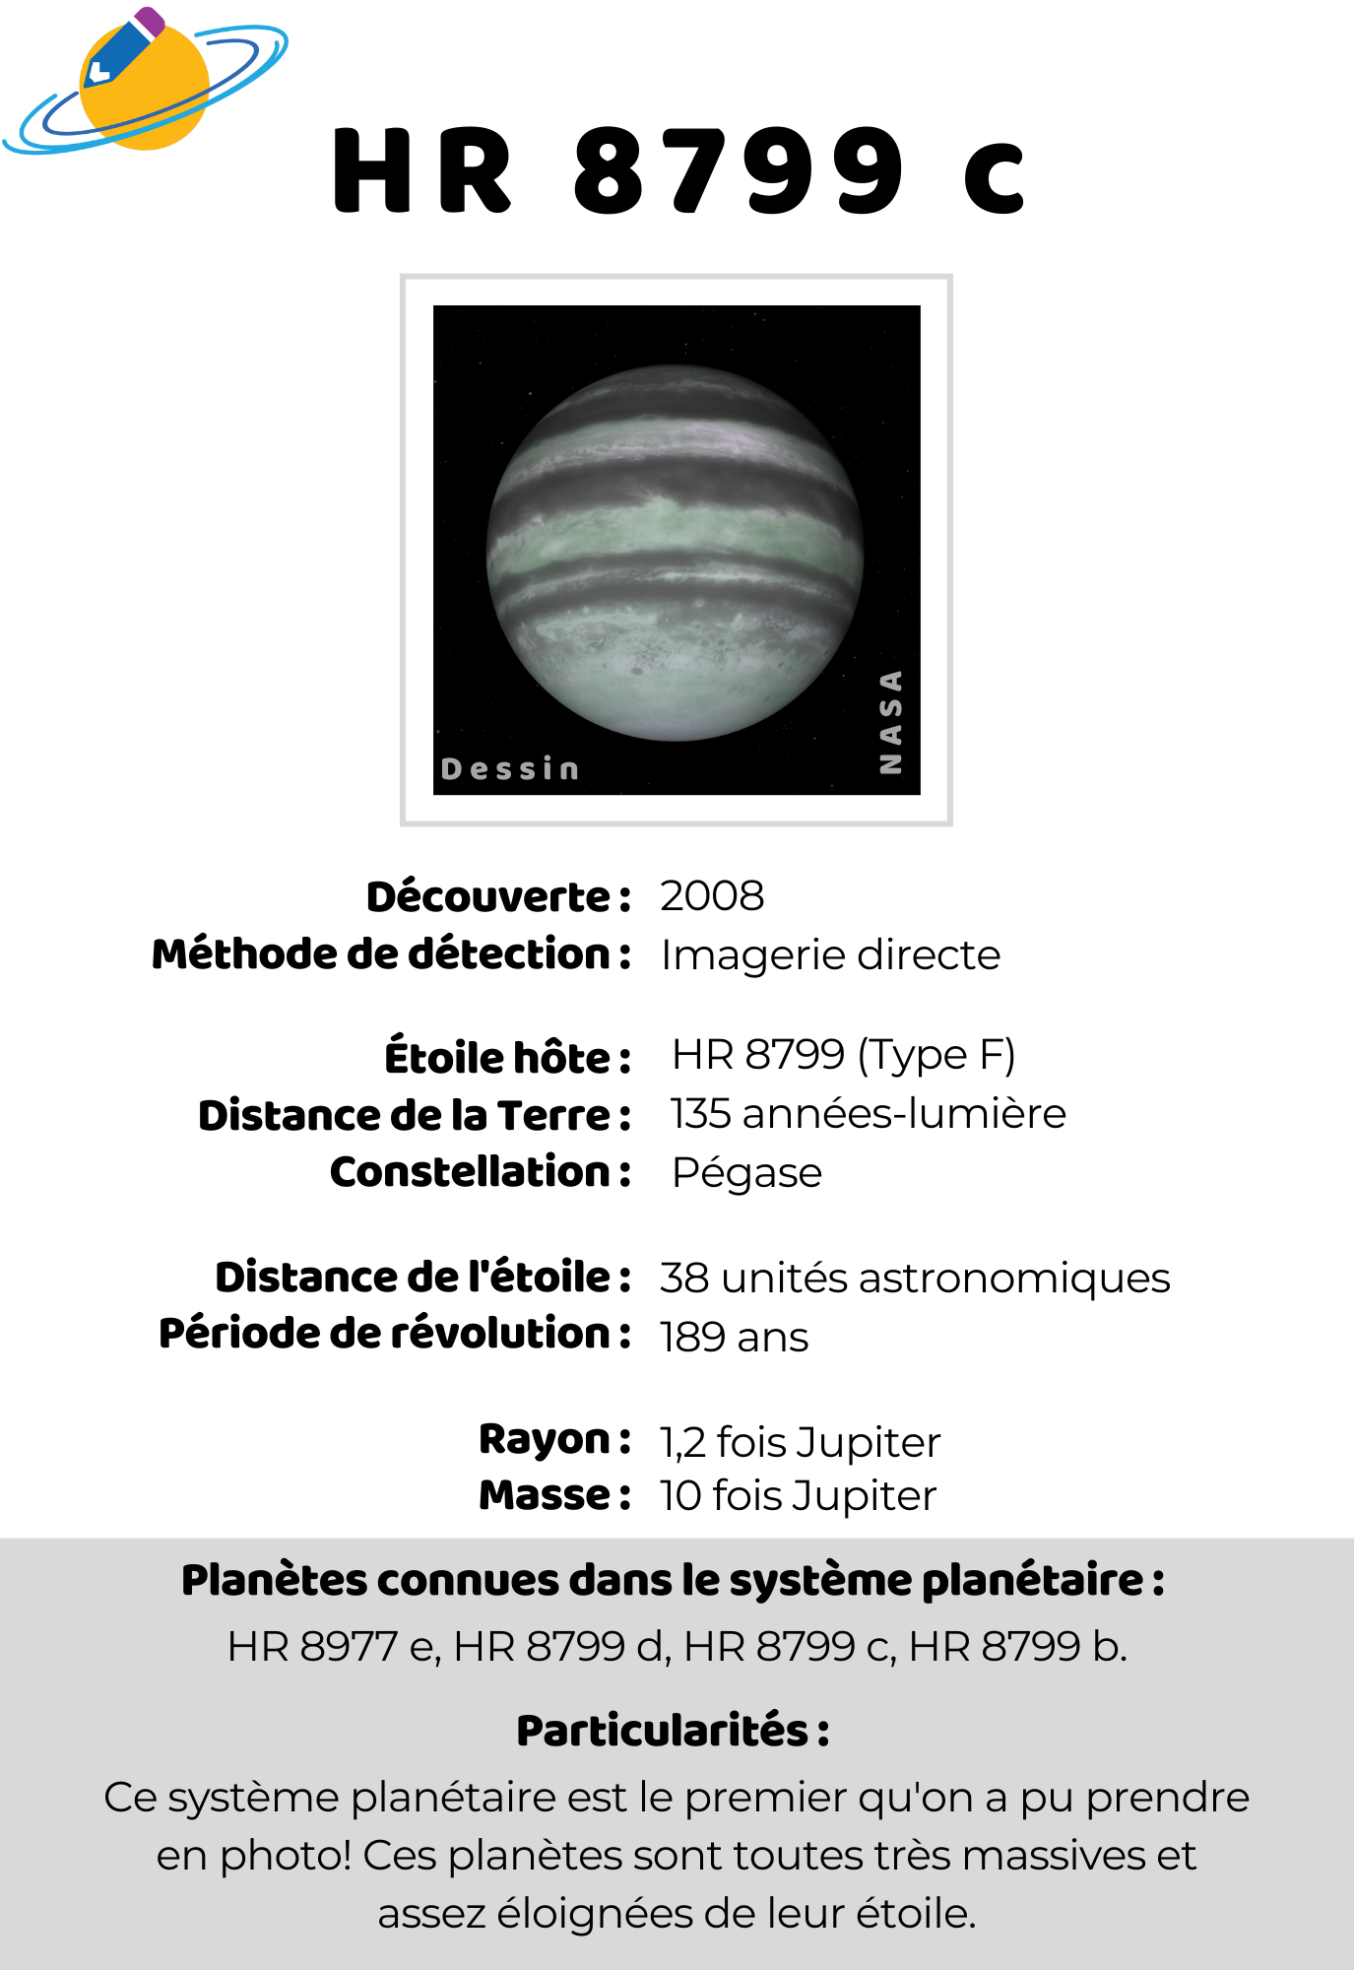
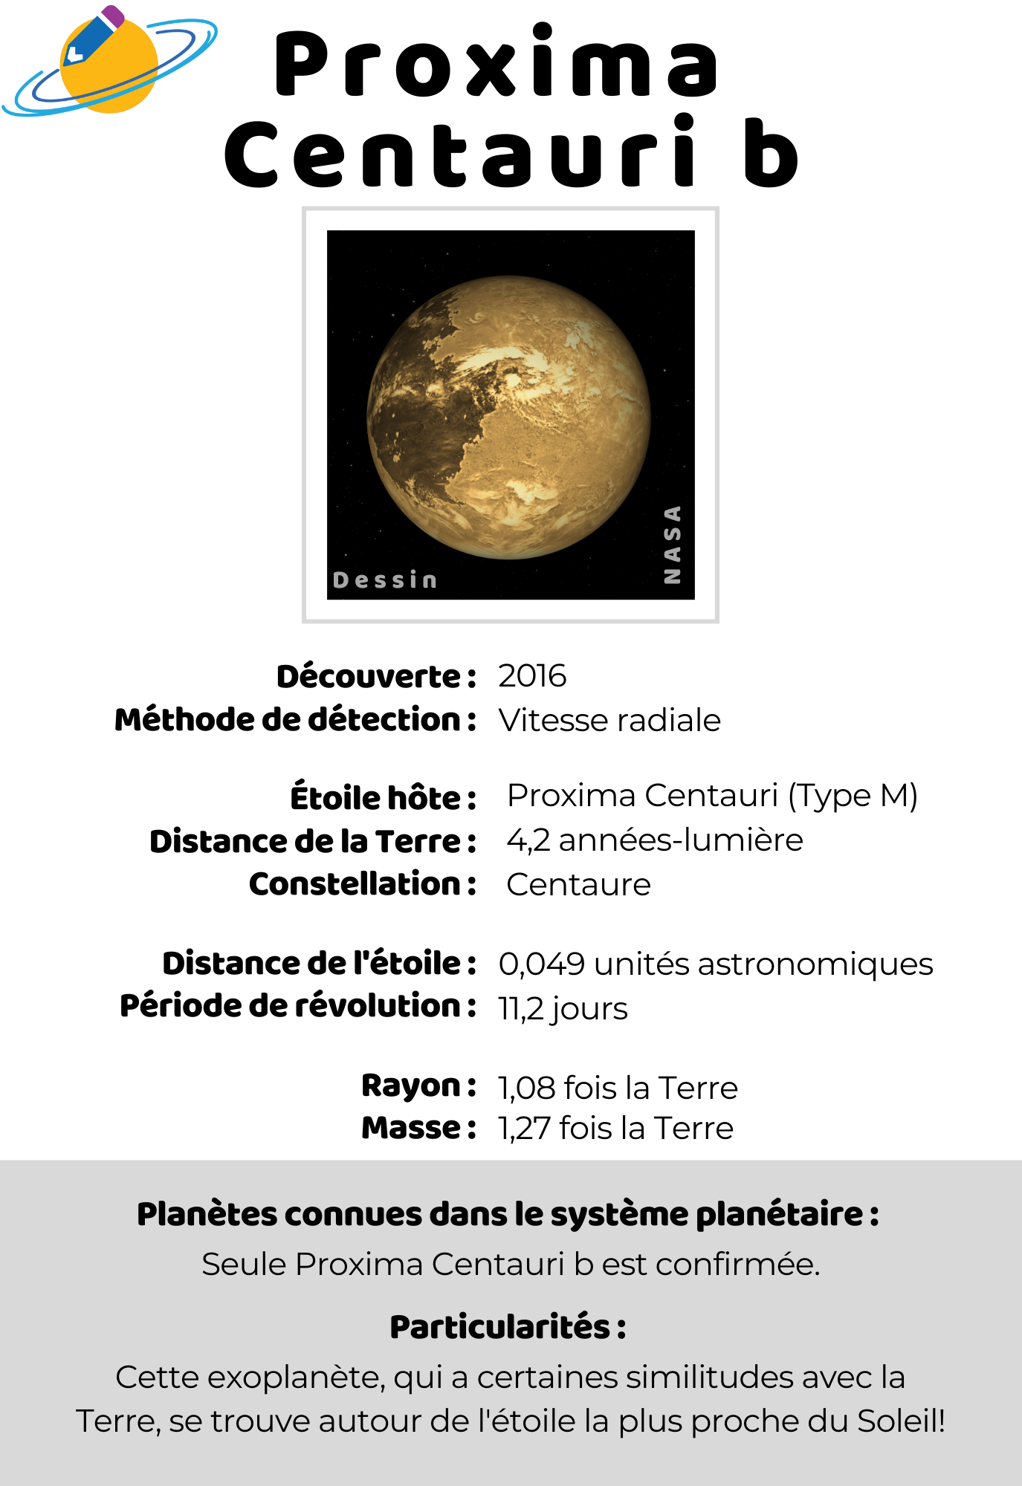
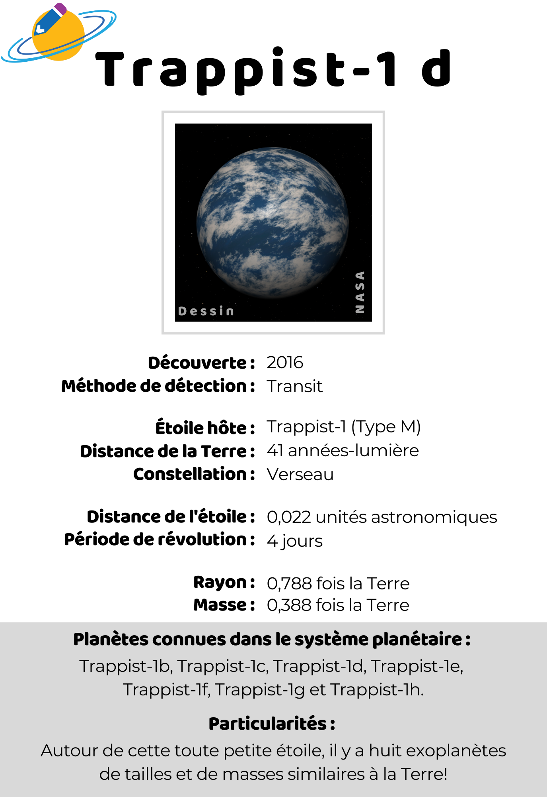
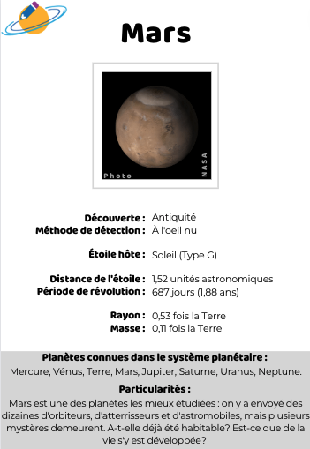
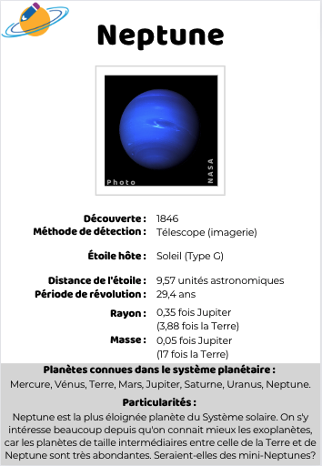
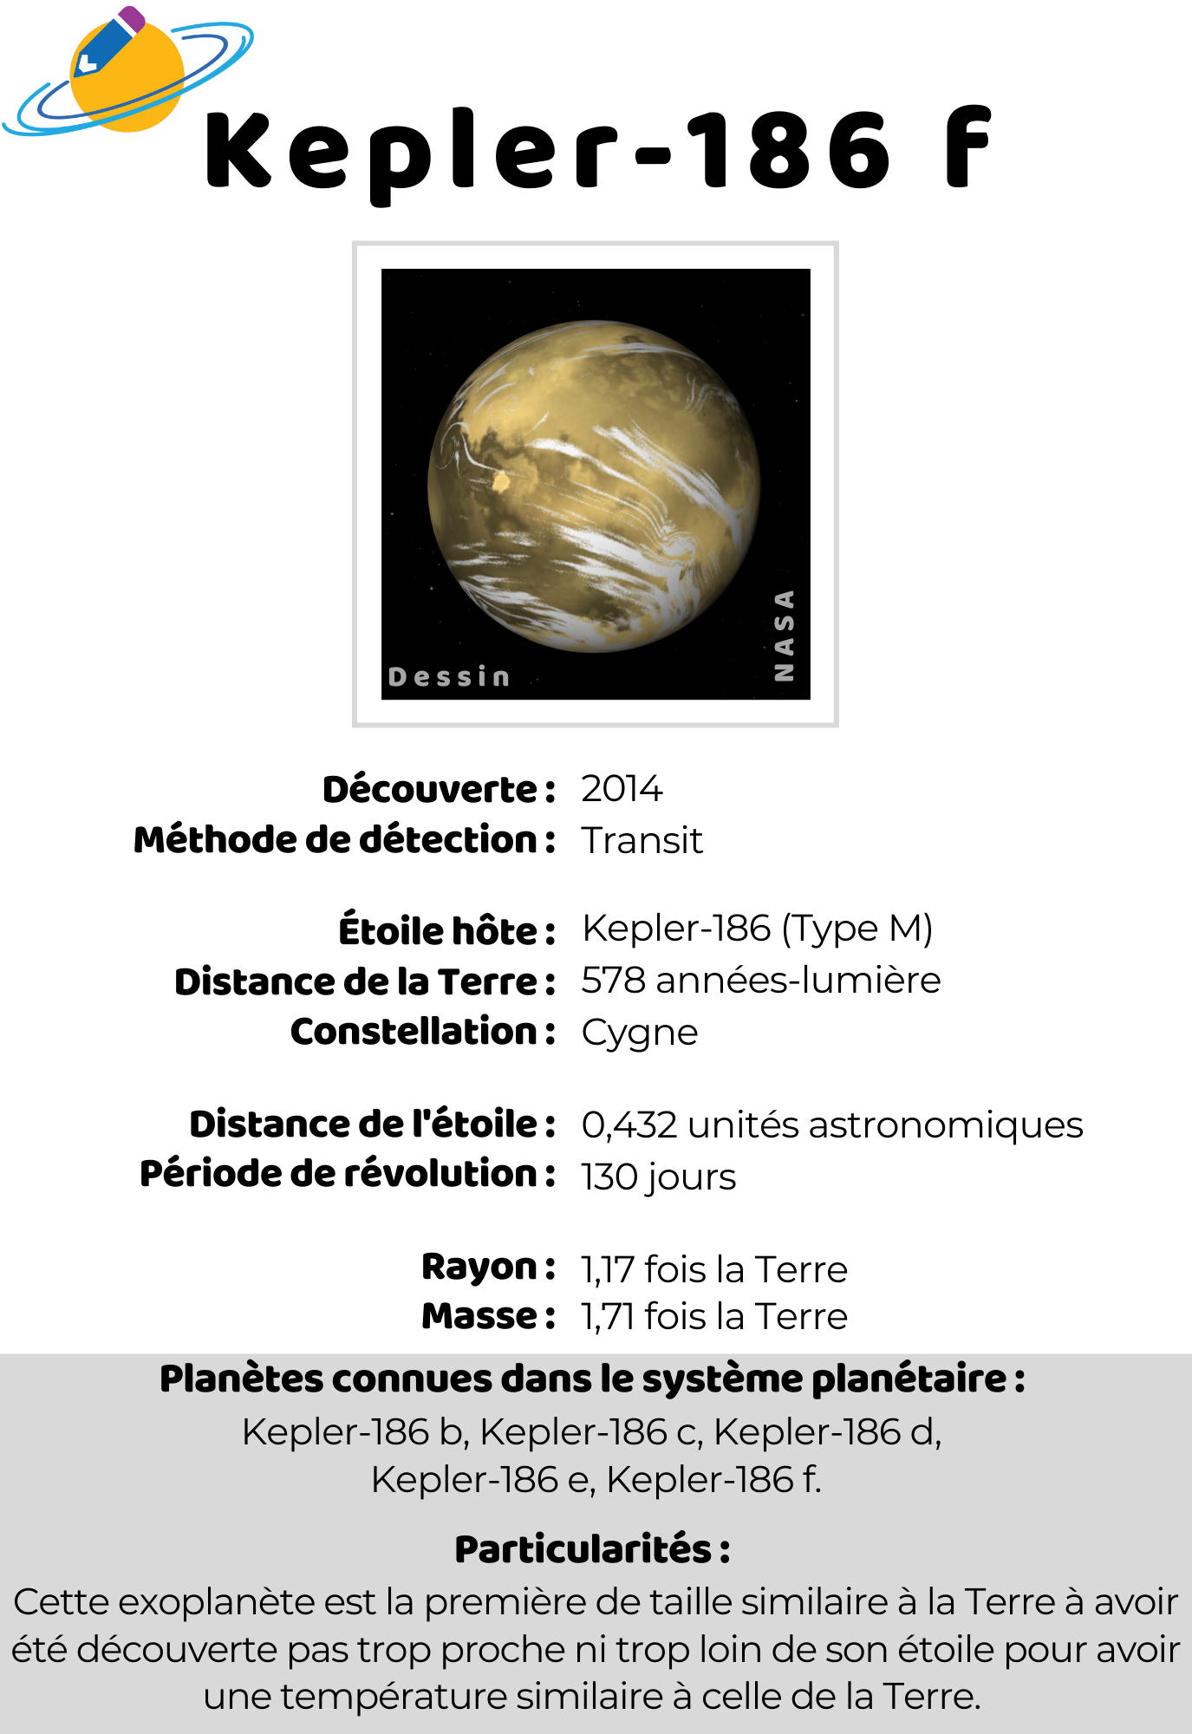
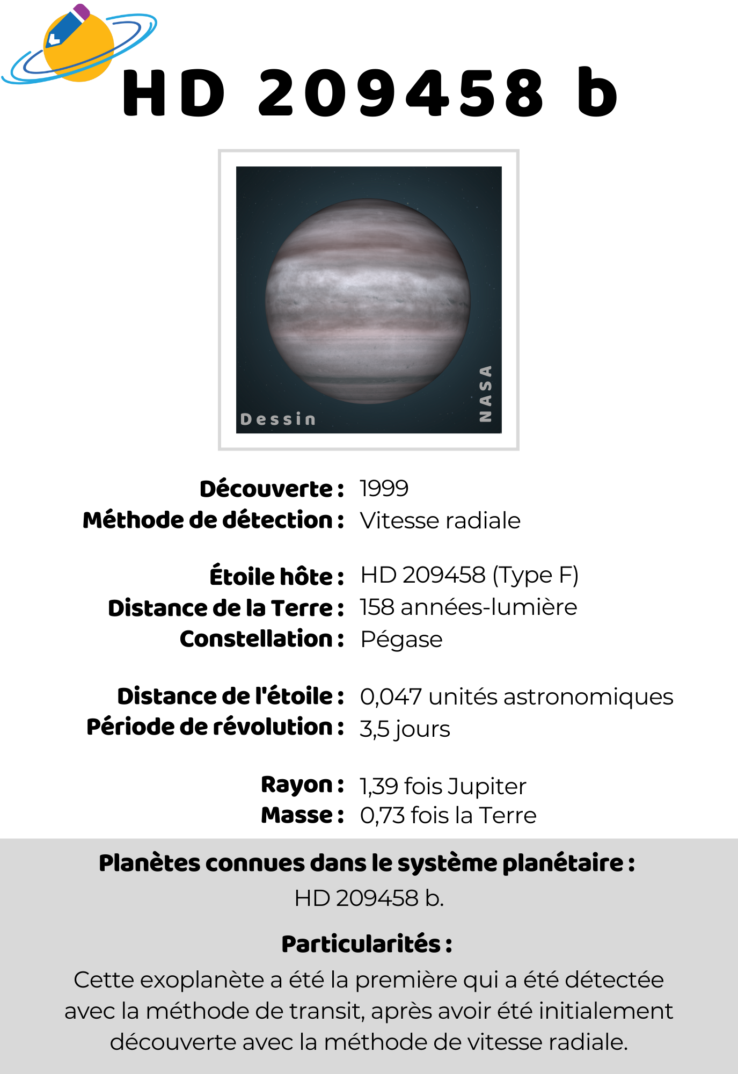
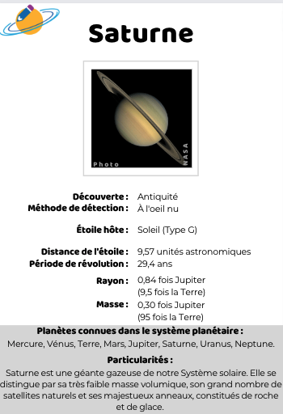
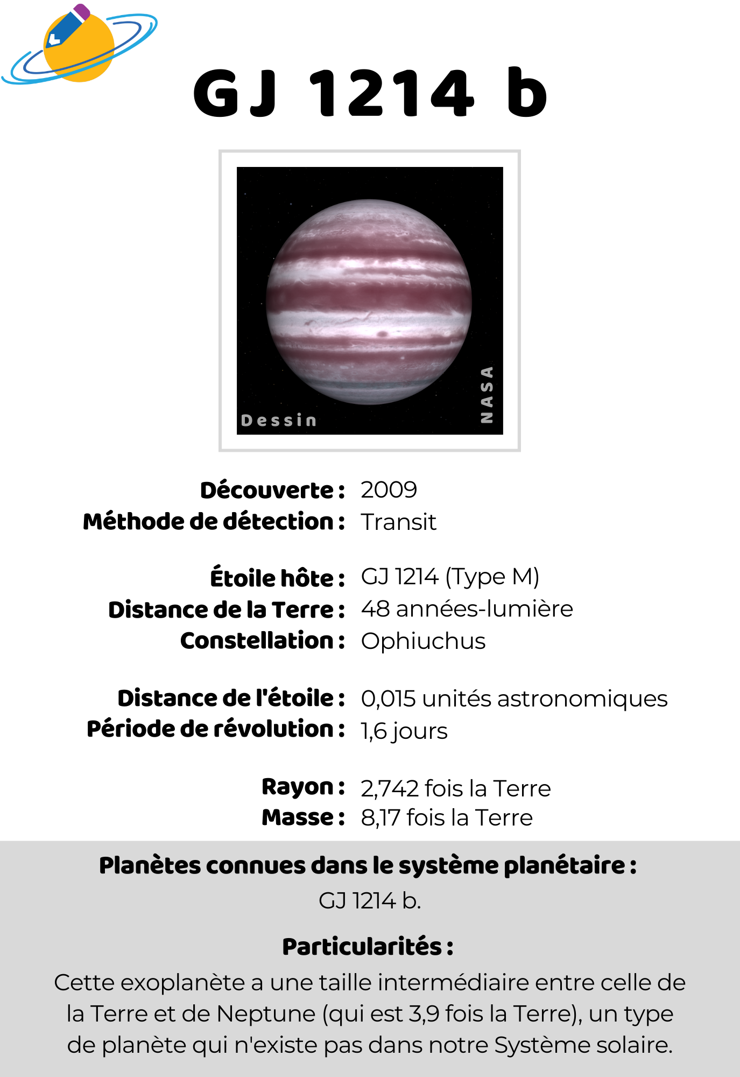
CLOSEUP ON THE RESOURCES EXOPLANETS CARD DECK TO PRINT
www.exoplanetesalecole.ca www.exoplanetsintheclassroom.ca
Notes:
Another resource I want to point out and that was really appreciated both by kids, teenagers and their teachers were these cards we made for one od the activity.
They present known exoplanets and some of their characteristics.
We ended up using them in many activities and in other contexts.

Slide 27
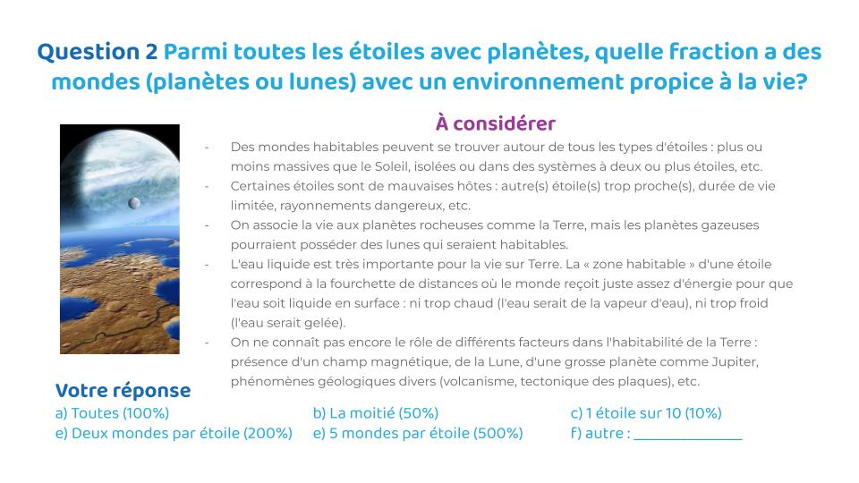
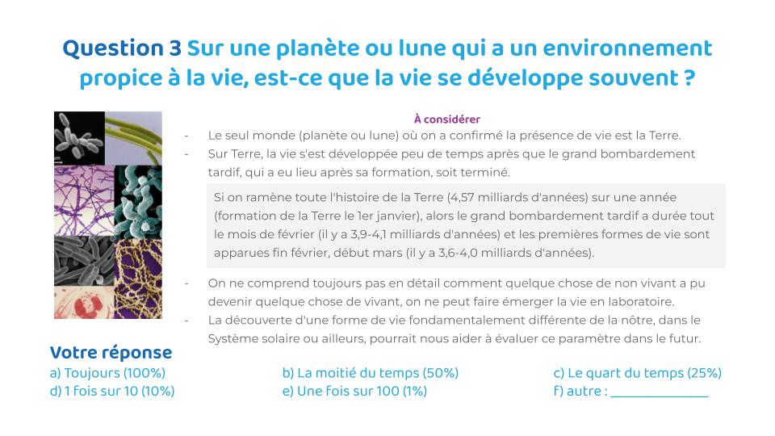
CLOSEUP ON THE RESOURCES ACTIVITIES FOR SECONDARY SCHOOL STUDENTS
Exploring all the factors to consider in the search for ET life.
www.exoplanetesalecole.ca www.exoplanetsintheclassroom.ca

Slide 28
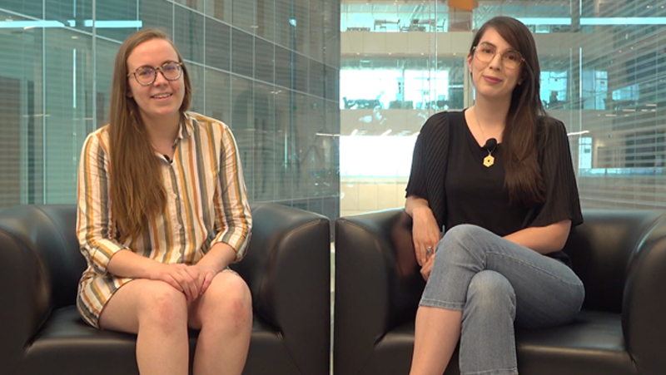
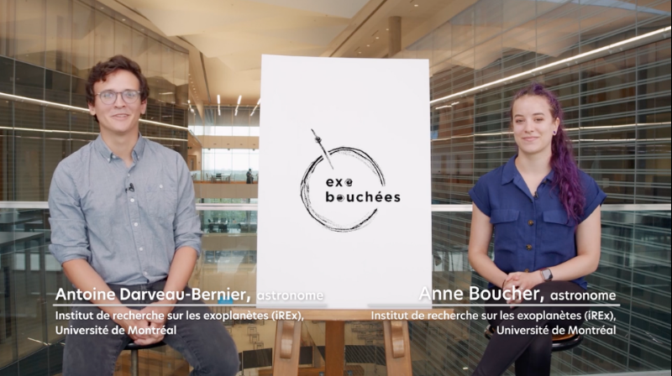
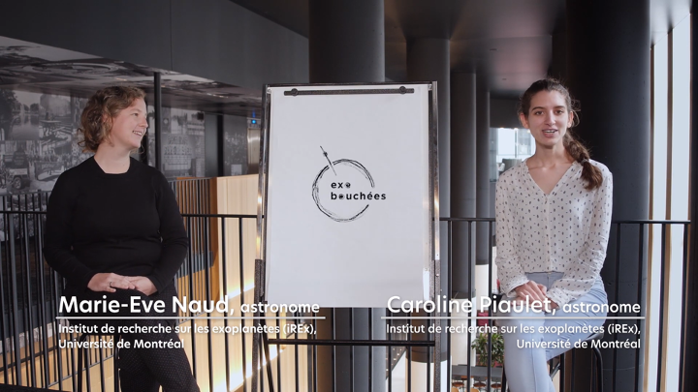
CLOSEUP ON THE RESOURCES VIDEOS FEATURING… YOU!
Check our YouTube playlist, bit.ly/yt_exoplanetes_ecole
www.exoplanetesalecole.ca www.exoplanetsintheclassroom.ca
Notes:
Other resources that were really popular were short videos we made with our own scientists. Some of them were already shot as part of another grant. Other, we did thanks to the summer intern we hired last summer, who has been working as a professional video producer before switching to astronomy.

Slide 29
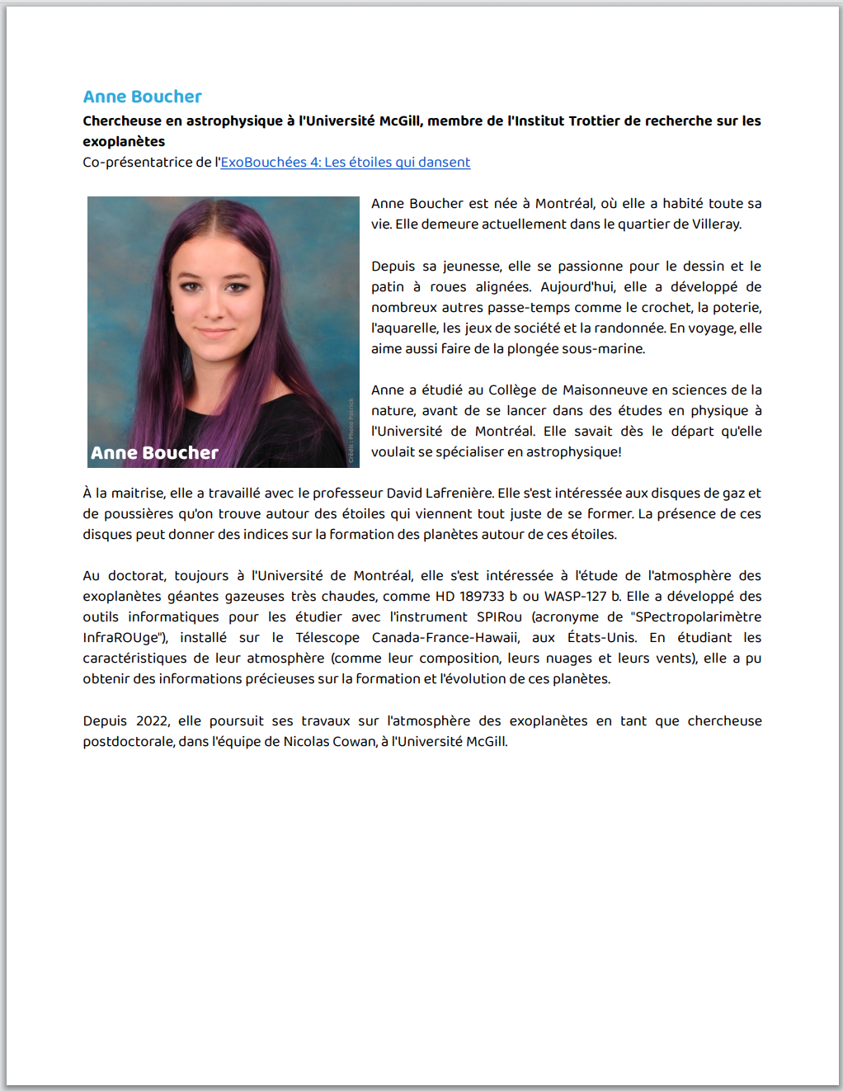
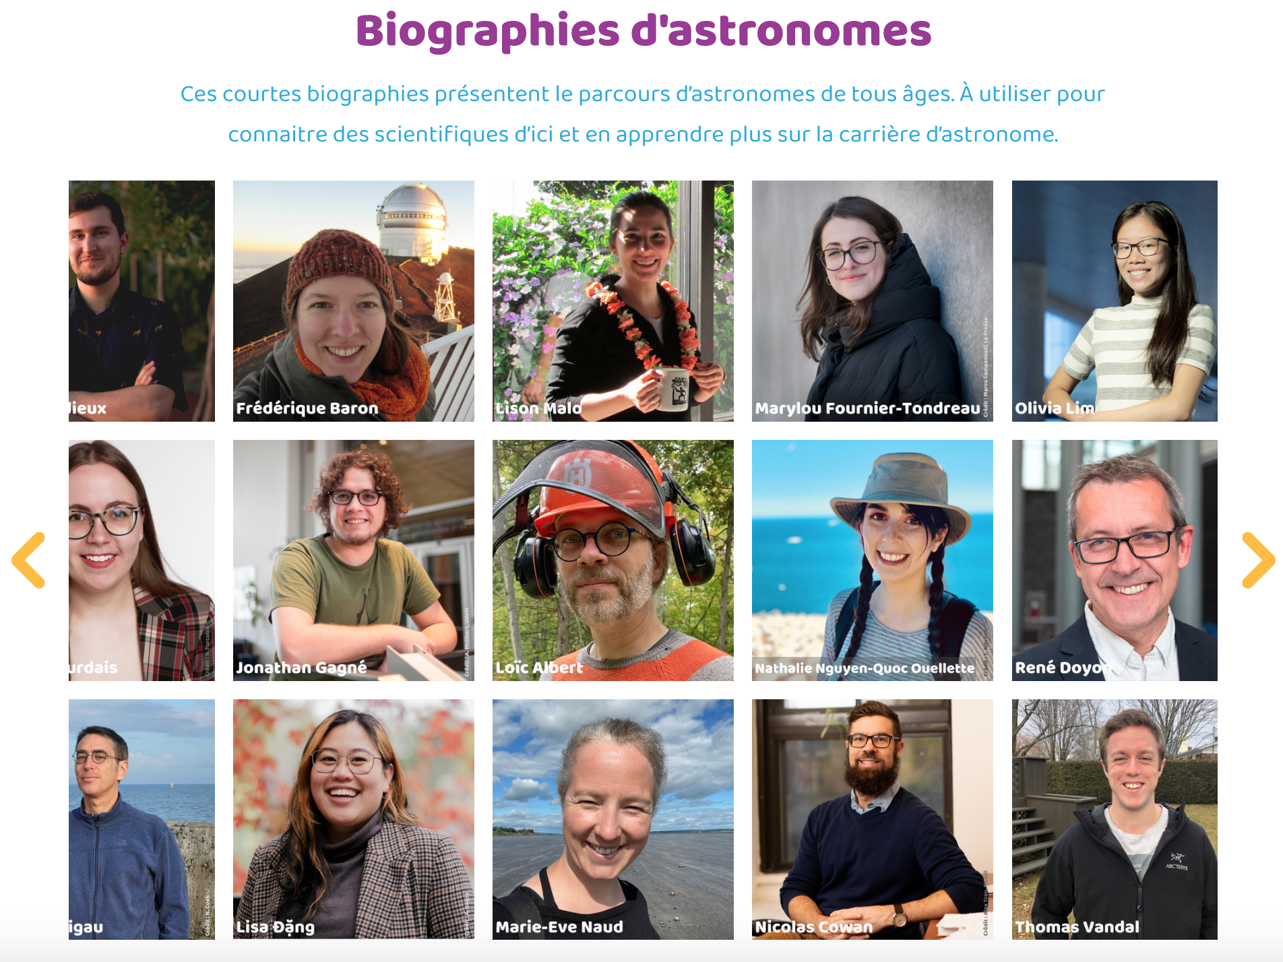
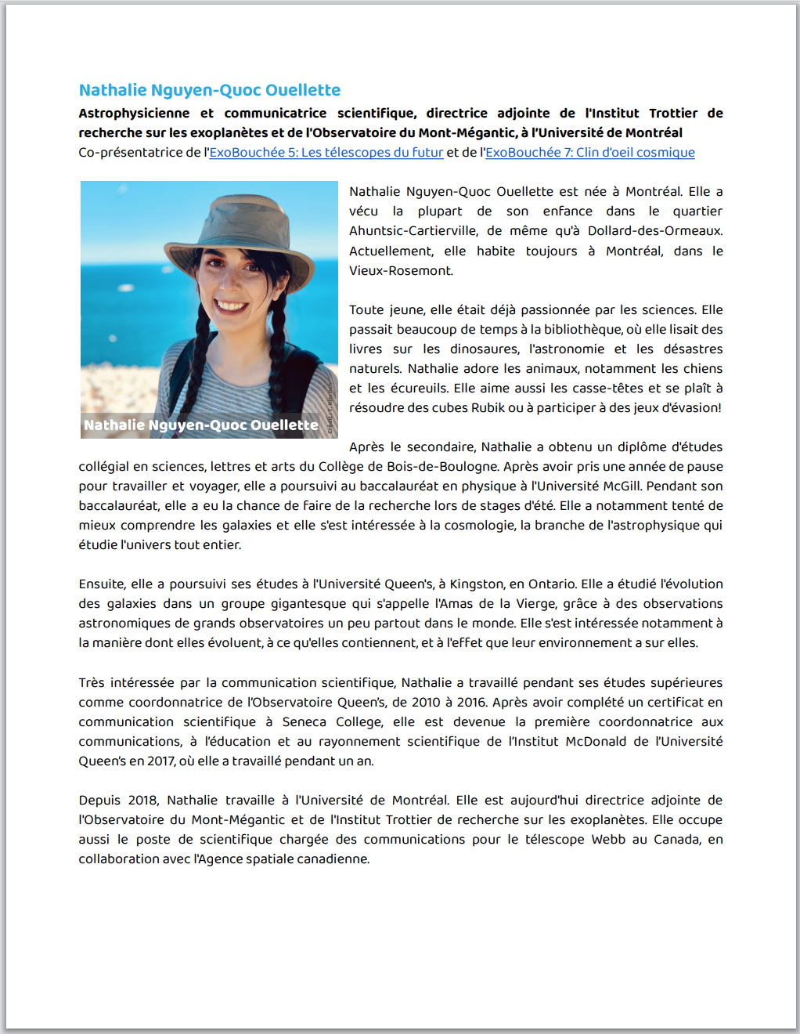
CLOSEUP ON THE RESOURCES PUBLIC-FRIENDLY BIOS
www.exoplanetesalecole.ca www.exoplanetsintheclassroom.ca
Notes:
We also wrote public friendly biographies of the scientists featured in videos to allow people to know them better. We inistited on showcasing not only their career path and reserch interest, but also their passions now and when they were kids and other details that makes them more relatable.

Slide 30
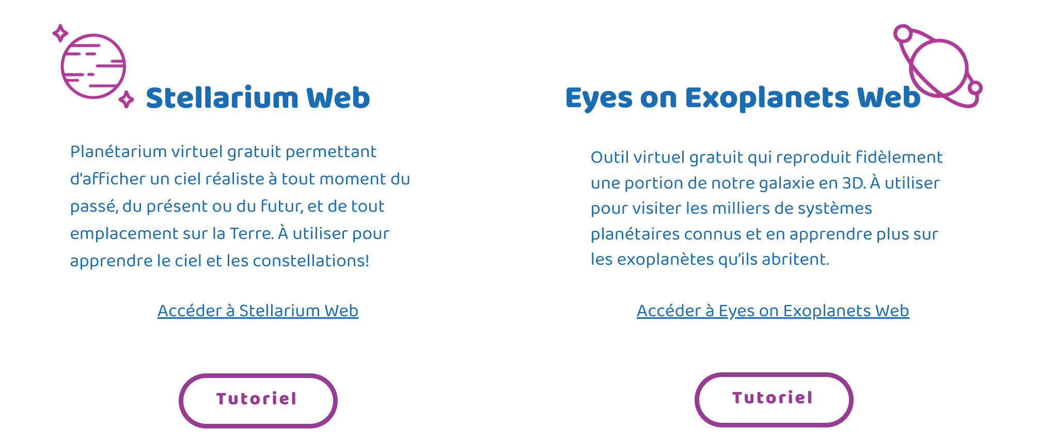
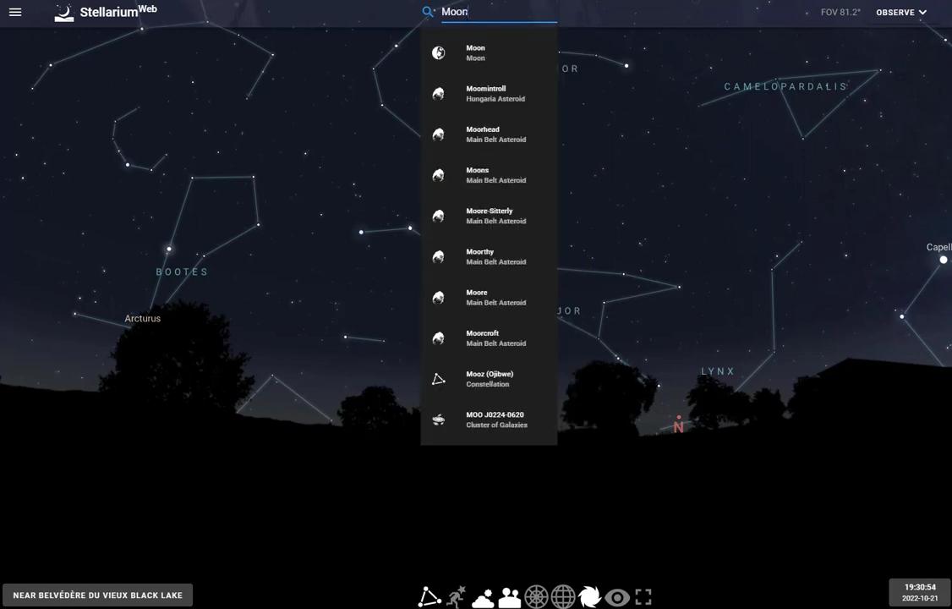
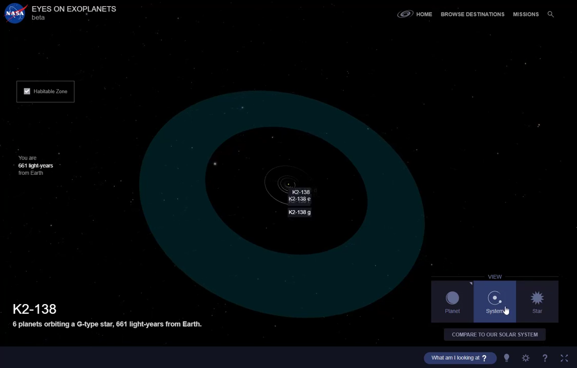

Slide 31
Des nouveaux mondes à découvrir,
au primaire et au secondaire
www.exoplanetesalecole.ca
New worlds to discover, in primary and secondary school
www.exoplanetsintheclassroom.ca
IN SUMMARY
Outstanding experience working in collaboration with school staff and partners that are in or close to the school system.
Created resources for the schools, but also for us! (career day, day camp, science fairs, etc.)
FOR YOU
Look at our resources on www.exoplanetesalecole.ca (in French).
Stay tuned for the English version www.exoplanetsintheclassroom.ca!
We look forward to discussing with you! Contact us! marie-eve.naud@umontreal.ca - How has interactions with (prim. and sec.) school staff gone for you? - Any ideas on how to get these resources to those who might need/use them?
www.exoplanetesalecole.ca www.exoplanetsintheclassroom.ca

Slide 32
Des nouveaux mondes à découvrir,
au primaire et au secondaire
www.exoplanetesalecole.ca
New worlds to discover, in primary and secondary school
www.exoplanetsintheclassroom.ca
Thanks!
Don't hesitate to reach out!
Marie-Eve Naud, PhD, marie-eve.naud@umontreal.ca
Trottier Institute for Research on Exoplanets, Université de Montréal
Co-presenters : Julie Bolduc-Duval, Nathalie Ouellette,
Heidi White, Frédérique Baron
Notes:
Exoplanets in the Classroom - Resources for educators, by educators
Astrophysicists, science educators and teachers collaborated to create a wealth of educational resources presented in Des exoplanètes à l’école (Exoplanets in the Classroom). Activities, slide decks, short videos, biographies of Québécois and Canadian astrophysicists, an FAQ, a glossary, play cards and more, are all available for free on our website: www.exoplanetesalecole.ca (French only at the moment). They can be used by primary and secondary school teachers and kids to learn more about exoplanets and the search for life in the Universe.
During this talk, I’ll present the resources and how they were developed, in a process led by astrophysicists and science educators at the Trottier Institute for Research on Exoplanets at the Université de Montréal, in close collaboration with Discover the Universe and other educational partners, with funding from the Québec provincial government. More than a hundred teachers in Québec have been involved from the start of the project in 2021 up to the publication of the resources in March 2023. They participated in brainstorming sessions, helped test the resources in their classrooms, and were consulted on many occasions to ensure the resources were adapted to their realities and needs.
The reaction of the teachers is extremely positive : they told us the resources are easy to adopt and adapt, have significant connections with the Quebec school curriculum they must teach, and provide a novel way for them and their students to review mandatory topics and learn more about cutting-edge actual research topics and the scientists who make them.

Slide 33
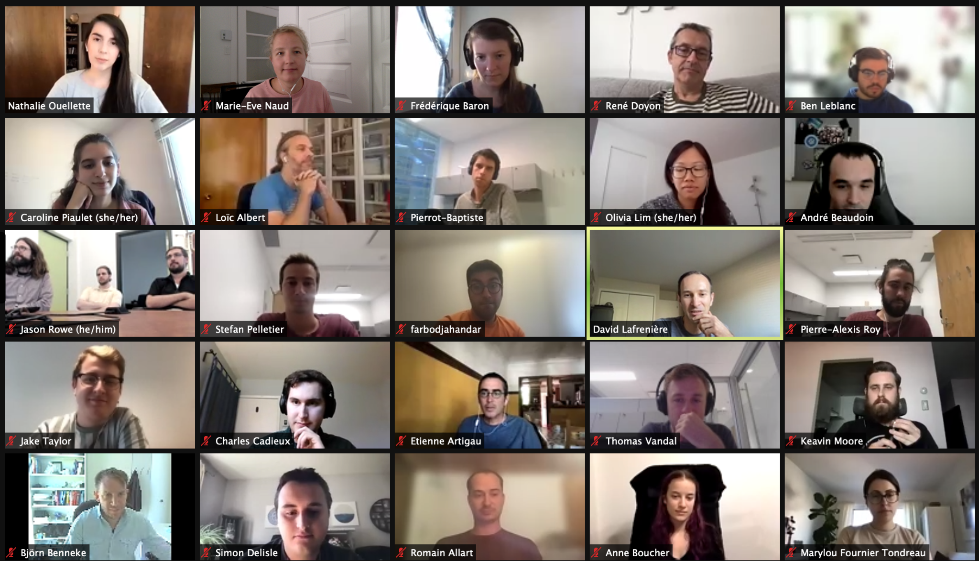
LESSONS LEARNED WHAT WORKED WELL?
All remote interactions with school staff and scientists
Brainstorming workshops at the beginning
Workshops seven months in (check-up on activities)
Summer workshop with secondary school teachers in 2022
Session with iREx scientists
www.exoplanetesalecole.ca www.exoplanetsintheclassroom.ca
Notes:
With both these last, we used the same process, which worked well :
Virtual meeting at the beginning large groups
Google Docs they reviewed on their own
One on one (or smaller groups) virtual meetings later

Slide 34
LESSONS LEARNED WHAT WERE THE CHALLENGES?
Getting teachers in in-person workshops
Fauxel, pexels
www.exoplanetesalecole.ca www.exoplanetsintheclassroom.ca

Slide 35
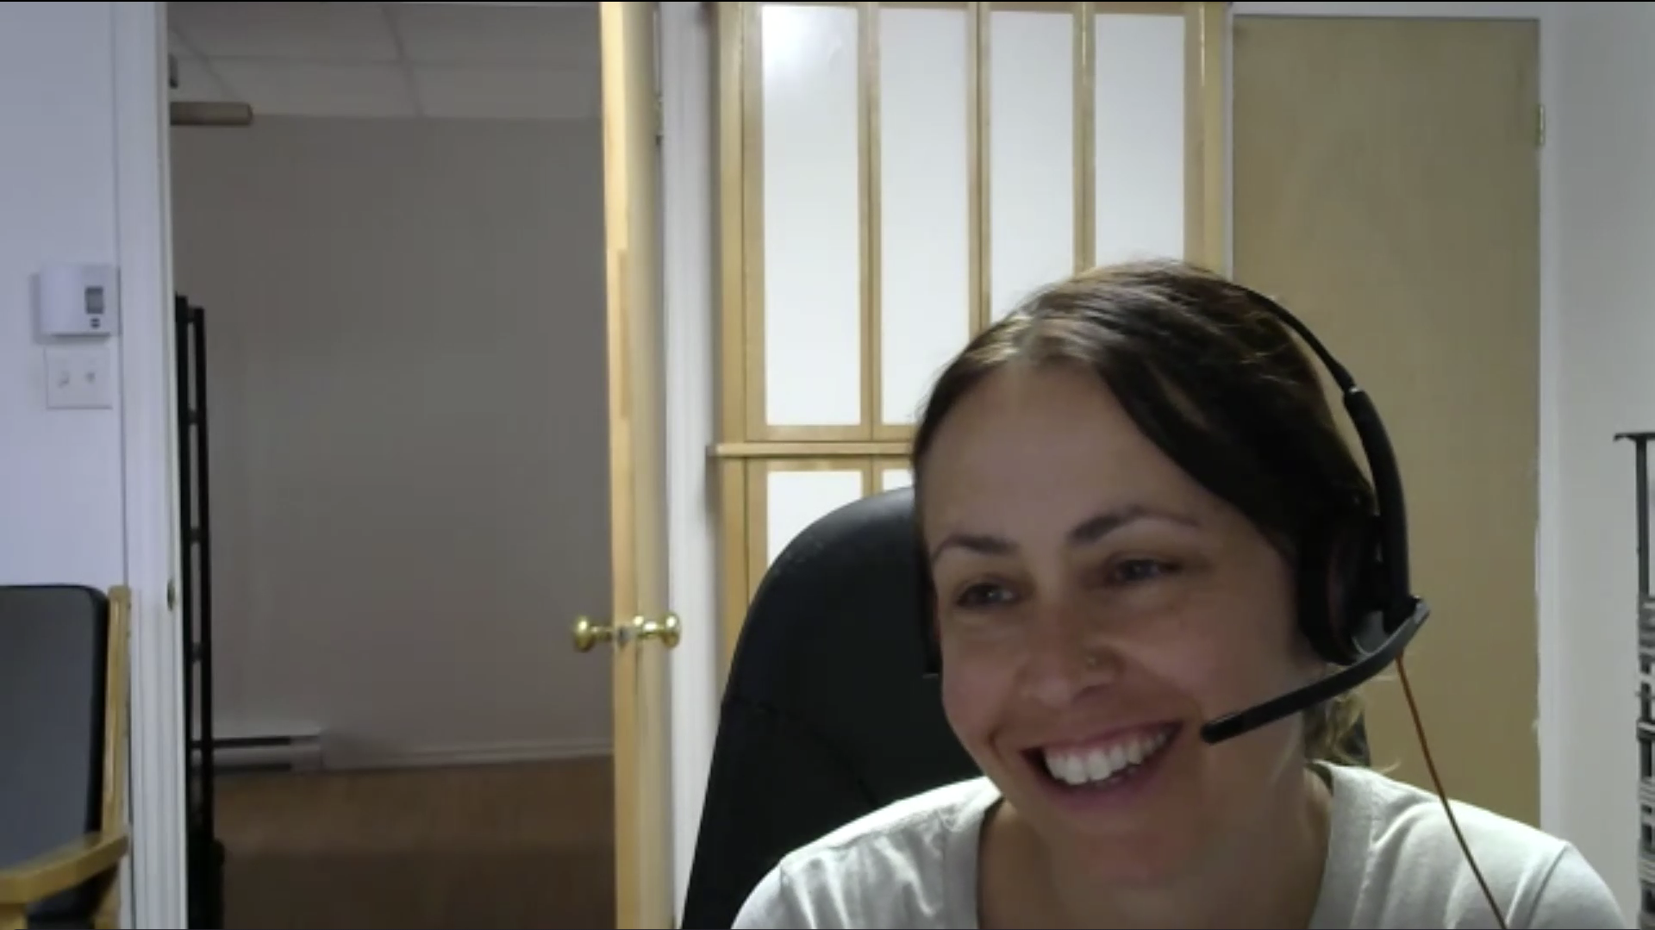
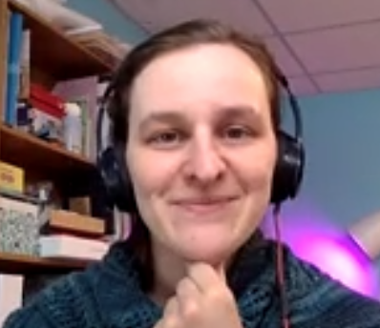
LESSONS LEARNED WHAT WORKED WELL?
Collaboration with a few key people with excellent knowledge of the school system
www.exoplanetesalecole.ca www.exoplanetsintheclassroom.ca

Slide 36
LESSONS LEARNED WHAT WORKED WELL?
Remote presentations with primary school kids and classrooms
www.exoplanetesalecole.ca www.exoplanetsintheclassroom.ca

Slide 37
LESSONS LEARNED WHAT WORKED WELL?
Remote interaction with primary school classrooms and kids (use of various tools incl. Zoom group sessions, Padlets, Google forms)
www.exoplanetesalecole.ca www.exoplanetsintheclassroom.ca

Slide 38
LESSONS LEARNED WHAT WORKED WELL?
Collaboration with partners Discover the Universe and École en réseau to test activities on a large scale, supporting teachers as they do the activities.
www.exoplanetesalecole.ca www.exoplanetsintheclassroom.ca
Notes:
We realized training them in specific workshops was really hard, but training and supporting them as they do an activity with their classrooms was very efficient, with their busy schedules the many things they juggle at the same time. For primary school teachers, that format was really successful. For secondary school kids, it was still hard to get into classrooms at first. Teachers were not enrolling in large activities (could not attend presentations due to schedule constraints, were not in "that module" at the time we were offering the activity). We ended up going in secondary classrooms later, with material that was much better developed
https://eer.qc.ca/activites-en-reseau/164460760528-a-laventure-dans-ton-systeme-planetaire

Slide 39
LESSONS LEARNED WHAT WORKED WELL?
Workshops + booths at teachers' conferences
www.exoplanetesalecole.ca www.exoplanetsintheclassroom.ca

Slide 40
LESSONS LEARNED WHAT WERE THE CHALLENGES?
Getting feedback through our Facebook group
www.exoplanetesalecole.ca www.exoplanetsintheclassroom.ca
Notes:
Another challenge we faced was getting feedback at times
For example we were really proud of our Facebook group. We had more than 100 teachers joining. It seemed really promising first, and we had a lot of engagement through a similar group for another project. But for many reasons, this groups was never really active. Was it the Facebook algorithm? Was it the fact we opened the group too early (before to actually feed it daily or at least regularly), was it the "official" nature of the group? Hard to know. We tried until now but it's still very very quiet.
Another way we tried to get feedback was Google forms. Most teachers didn't fill them. A little more sent emails when we gave this option. We think it's mainly a lack of time. They will schedule a meeting with you much more than motivated themselve to leave their email box to fill a survey.
We are still looking at ways to get continuous feedback for this project.

Slide 41
LESSONS LEARNED WHAT WERE THE CHALLENGES?
Getting feedback through Google forms (or email)
www.exoplanetesalecole.ca www.exoplanetsintheclassroom.ca
Notes:
Another challenge we faced was getting feedback at times
For example we were really proud of our Facebook group. We had more than 100 teachers joining. It seemed really promising first, and we had a lot of engagement through a similar group for another project. But for many reasons, this groups was never really active. Was it the Facebook algorithm? Was it the fact we opened the group too early (before to actually feed it daily or at least regularly), was it the "official" nature of the group? Hard to know. We tried until now but it's still very very quiet.
Another way we tried to get feedback was Google forms. Most teachers didn't fill them. A little more sent emails when we gave this option. We think it's mainly a lack of time. They will schedule a meeting with you much more than motivated themselve to leave their email box to fill a survey.
We are still looking at ways to get continuous feedback for this project.

Slide 42
CLOSEUP ON THE RESOURCES
www.exoplanetesalecole.ca www.exoplanetsintheclassroom.ca
Notes:
So here is the finished product. Our website, in French.

