Slide 1
Into the Darkness
CO detection on the Night-side of the Highly Irradiated WASP-33b
Georgia Mraz
Supervisor: Prof. Nicolas Cowan
Co authors: Dr. Antoine Darveau-Bernier, Dr. Anne Boucher
Notes:
Make sure to pick one way so either night-side or nightside

Slide 2
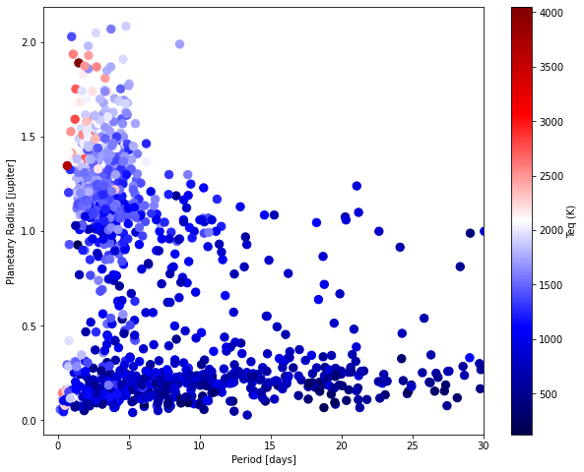
Exoplanet Demographics

Slide 3
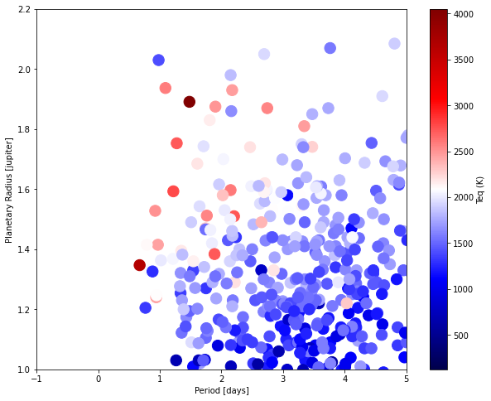
Ultra Hot Jupiters

Slide 4
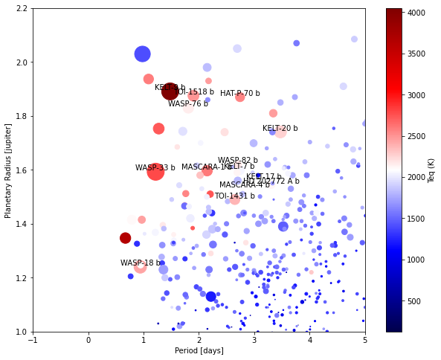
Ultra Hot Jupiters
Scaled by SNR of SPIRou
Strong irradiation from host star
100x that of Hot Jupiters (Baxter et al. 2020)

Slide 5
Ultra Hot Jupiters
Scaled by SNR of SPIRou
Strong irradiation from host star
100x that of Hot Jupiters (Baxter et al. 2020)
Tidally locked
Day to Night-side difference ~1000 K (Bell and Cowan 2018)

Slide 6
Ultra Hot Jupiters
Scaled by SNR of SPIRou
Strong irradiation from host star
100x that of Hot Jupiters (Baxter et al. 2020)
Tidally locked
Day to Nightside difference ~1000 K (Bell and Cowan 2018)
Thermal inversions

Slide 7
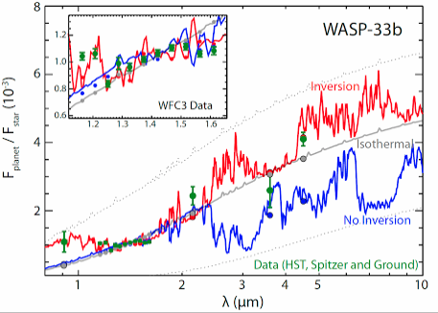
Thermal Inversions
Thermal Inversion
Pressure
Portions of the atmosphere go against the norm and increase in temperature with decreasing pressure (Beltz et al. 2022)
Temperature
Haynes et al. 2015
Notes:
Cute out hre the disociate and recombination line
This is confusing since it only relates because of the temperature
Instead could maybe lisst the elements we would expect on the day side and night side likeH20 and this on dayside and what on night side sos like map out each

Slide 8
Thermal Inversions
Thermal Inversion
Pressure
Portions of the atmosphere go against the norm and increase in temperature with decreasing pressure (Beltz et al. 2022)
Distinct emission signal on the day-side of the planet with an absorption on the night-side
Temperature
Haynes et al. 2015
Notes:
Cute out hre the disociate and recombination line
This is confusing since it only relates because of the temperature
Instead could maybe lisst the elements we would expect on the day side and night side likeH20 and this on dayside and what on night side sos like map out each

Slide 9
Thermal Inversion
Pressure
Temperature
Haynes et al. 2015

Slide 10
WASP- 33b
Stellar Parameters
A type Star
Teff: 7308 K
R*: 1.6 R⊙
vsini : 90km/s
Scaled by SNR of SPIRou
Planetary Parameters
Teq: 2781.70 K
Period: 1.2 days
Radius: 1.6 RJup
Semi major axis: 0.02 AU
Chakrabarty and Sengupta 2019

Slide 11
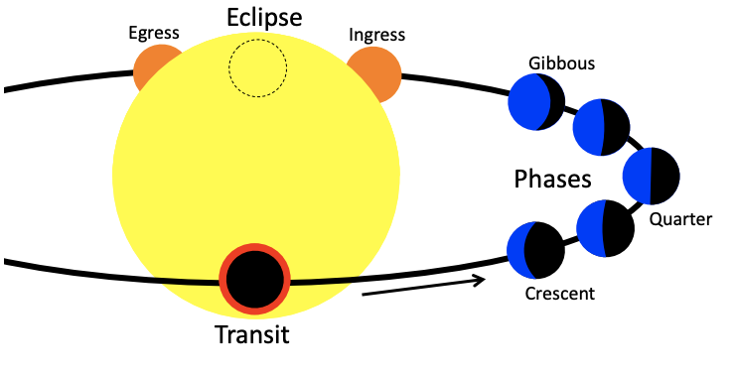
Ground Based Observation
Adapted from Cowan et al. 2015

Slide 12
Ground Based Observation
Day-side
Day-side
Night-side
Night-side
Adapted from Cowan et al. 2015

Slide 13
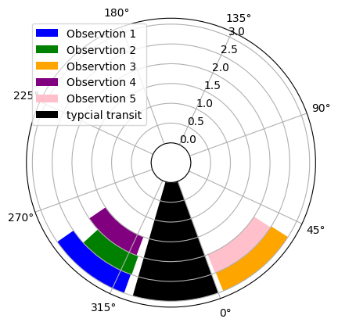
Observations
Observation 1
Observation 2
Observation 3
Observation 4
Observation 5
Typical Transit
SPIRou on Canada France Hawaii Telescope
9/22/2023 10/03/2023 10/29/2023 11/22/2023 11/26/2023
Pre-Transit Pre-Transit Post-Transit Pre-Transit Post-Transit
Pre-Transit
Post-Transit
Notes:
Check the length of each one in terms of time of observation
Reduction here is done by APERO
APERO does darks correction, bad pixel correction, background subtraction, detector nonlinearity corrections, localization of orders, geometric changes, flat field corrections, blaze, hot pixel, cosmic wave and wavelength calibration.

Slide 14
StarShips(Boucher et al. 2021, Boucher et al. 2023)
Created by:Anne Boucher and Antoine Darveau-Bernier (UDM/McGill)
Cross Correlation
Reduction
Significance
Notes:
STARSHIs created in house by Anne Bouche and Antione DB
This is the one that could mayube be cut just make sure people know your in the “starsship” camp

Slide 15
StarShips(Boucher et al. 2021, Boucher et al. 2023)
Created by: Anne Boucher and Antoine Darveau-Bernier (UDM/McGill)
Reduction
Cross Correlation
Significance
A) Telluric- corrected spectra
Orbital Phase
Notes:
STARSHIs created in house by Anne Bouche and Antione
Tease this slide so that theta re animated to explain it could also cut tho a little

Slide 16
StarShips(Boucher et al. 2021, Boucher et al. 2023)
Created by: Anne Boucher and Antoine Darveau-Bernier (UDM/McGill)
Reduction
Cross Correlation
Significance
A) Telluric- corrected spectra
B) Normalized spectra to continuum
Orbital Phase
Normalized Flux
Notes:
STARSHIs created in house by Anne Bouche and Antione
Tease this slide so that theta re animated to explain it could also cut tho a little

Slide 17
StarShips(Boucher et al. 2021, Boucher et al. 2023)
Created by: Anne Boucher and Antoine Darveau-Bernier (UDM/McGill)
Reduction
Cross Correlation
Significance
A) Telluric- corrected spectra
B) Normalized spectra to continuum
C) Emission spectra divided by reference spectrum
Orbital Phase
Normalized Flux
Notes:
STARSHIs created in house by Anne Bouche and Antione
Tease this slide so that theta re animated to explain it could also cut tho a little

Slide 18
StarShips(Boucher et al. 2021, Boucher et al. 2023)
Created by: Anne Boucher and Antoine Darveau-Bernier (UDM/McGill)
Reduction
Cross Correlation
Significance
A) Telluric- corrected spectra
B) Normalized spectra to continuum
C) Emission spectra divided by reference spectrum
D) Final spectra corrected for vertical residuals
Orbital Phase
Normalized Flux
Notes:
STARSHIs created in house by Anne Bouche and Antione
Tease this slide so that theta re animated to explain it could also cut tho a little

Slide 19
StarShips(Boucher et al. 2021, Boucher et al. 2023)
Created by: Anne Boucher and Antoine Darveau-Bernier (UDM/McGill)
Reduction
Cross Correlation
Significance
Reduction
Notes:
STARSHIs created in house by Anne Bouche and Antione DB
This could also be cut if need time

Slide 20
CC Results- CO
Post Transit
Pre Transit
N3
N2
CCF
CCF
Velocity(km/s)
Velocity(km/s)

Slide 21
StarShips(Boucher et al. 2021, Boucher et al. 2023) al.2023)(Boucher et al. 2021, Boucher et al. 2023)
Created by: Anne Boucher and Antoine Darveau-Bernier (UDM/McGill)
Reduction
Cross Correlation
Cross Correlation
Significance
Reduction
Significance
Welch T-Test evaluates the null hypothesis that two samples were drawn from the same distribution
Samples of CCF close to planet RV (~7 km/s)
Samples of CCF far from planet RV (>10 km/s)
Notes:
STARSHIs created in house by Anne Bouche and Antione DB

Slide 22
Results- CO
N3
N2
Pre Transit
Post Transit

Slide 23
Results- CO
Pre Transit
Post Transit

Slide 24
Conclusions
Non-detection of CO abs pre transit and clear detection of CO abs post transit
In the detection both blue shifted emission and CO in absorption
Due to hot day-side coming towards us
Provides evidence of the expected temperature profile
Non-detection of thermal emission from the western terminator but presence on the eastern is consistent with heat advection by an eastward jet
Could offer an economical way to constrain the vertical temperature profile of exoplanet night-sides, compared to space-based, phase-resolved spectroscopy

Slide 25
extra

Slide 26
Ultra Hot Jupiters
Scaled by SNR of SPIRou

Slide 27
Exoplanet Demographics
Large observed population of
Ultra Hot and Hot Jupiters
Warm Neptunes
Super Earths

Slide 28
Exoplanet Demographics
Large observed population of
Ultra Hot and Hot Jupiters
Warm Neptunes
Super Earths
These planets not in our solar system are important to study
Notes:
Could also cut the other types of plants here if need to cut time

