Slide 1
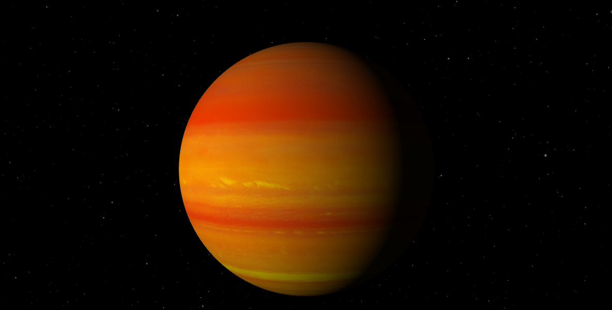
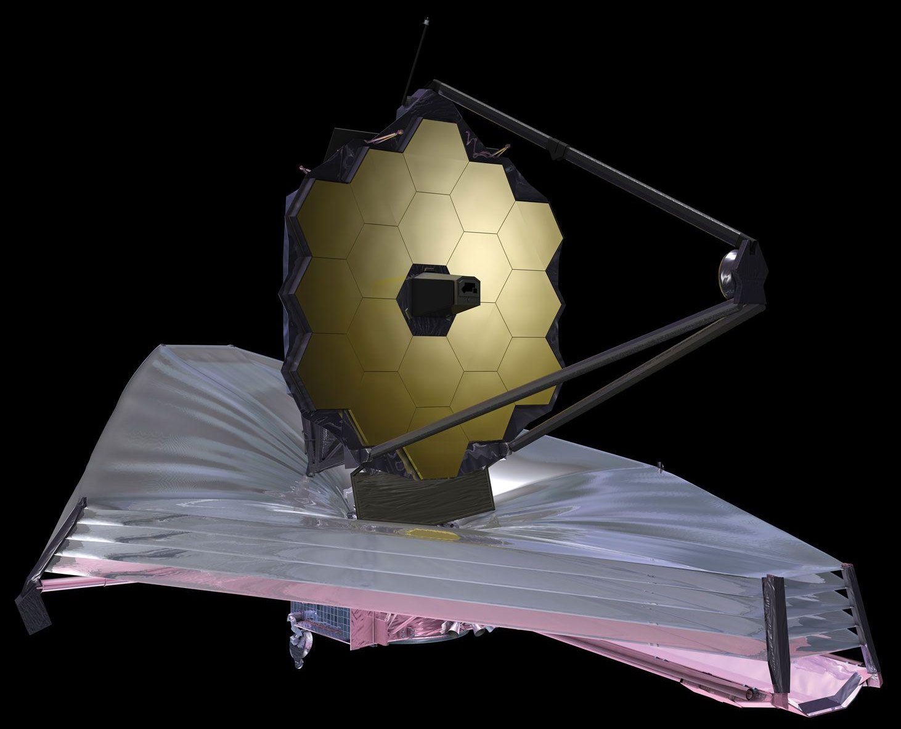
Eclipse Spectroscopy of WASP-80 b with JWST/NIRISS: Revealing Properties of Reflecting Aerosols Kim Morel, Master student with Prof. Lafrenière
CRAQ meeting
May 7th, 2024
https://science.nasa.gov/exoplanet-catalog/wasp-80-b/
https://www.britannica.com/topic/James-Webb-Space-Telescope
CRAQ annual meeting Kim Morel May 7^{th,} 2024

Slide 2
WASP-80 b
WASP-80 ★
Discovered with the transit method in 2012 (Triaud et al. 2013)
Warm Jupiter (T_{eq} ≈ 825 K)
Circular orbit with a period of 3.07 days
M_{p} ≈ 0.538 M_{jup}, R_{p} ≈ 0.999 R_{jup}
R_{p}/R★ ≈ 0.1737
Bright late-K/early-M dwarf
T_{eff} ≈ 4100 K
M★ ≈ 0.577 M◉
R★ ≈ 0.586 R◉
log g ≈ 4.663
Subsolar metallicity
Chromospherically active
from Triaud et al. 2015
CRAQ annual meeting Kim Morel May 7^{th,} 2024

Slide 3
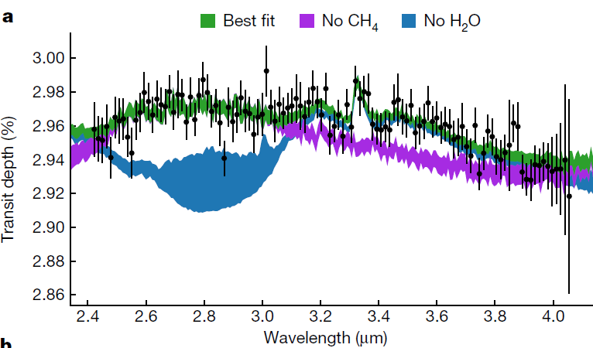
Previous Atmospheric Characterization from Transits
Rayleigh scattering slope → hazes (Fukui et al. 2014, Wong et al. 2022)
Between two regimes where either CO or CH₄ dominates carbon chemistry.
Bell et al. 2023: Observations with JWST/NIRCam (F322W2)
Detections of CH₄ and H₂O
Hazes not constrained
Presence of optically thick clouds at pressures ≤ 0.2 mbar
Bell et al. 2023
CRAQ annual meeting Kim Morel May 7^{th,} 2024

Slide 4
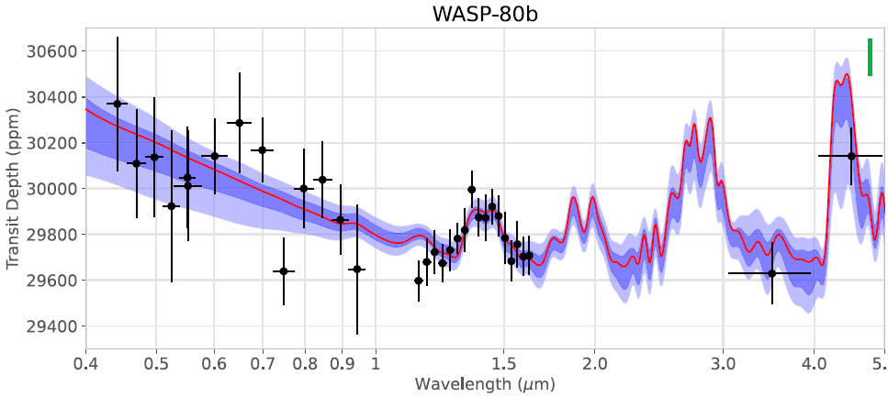
Previous Atmospheric Characterization from Transits
Several molecular species detected with high-resolution transit spectroscopy by Carleo et al. 2022: H₂O, CH₄, NH₃, HCN, CO₂(tentative)
Low-resolution optical transmission spectrum mostly featureless (Mancini et al. 2014, Fukui et al. 2014)
Wong et al. 2022, HST/STIS & WFC3 + Spitzer/IRAC
CRAQ annual meeting Kim Morel May 7^{th,} 2024

Slide 5
Previous Secondary Eclipse Observations
Spitzer/IRAC (Triaud et al. 2015, Wong et al. 2022, 3.6 & 4.5 μm)
Low bond albedo
HST/WFC3 (Jacobs et al. 2023): Broadband eclipse depth of 34 ± 10 ppm (1.1 – 1.7 μm)
A_{g} < 0.33
Longitudinal dissimilarity in the atmosphere’s aerosol composition
JWST/NIRCam (Bell et al. 2023):
Detection of CH₄
Bell et al. 2023
CRAQ annual meeting Kim Morel May 7^{th,} 2024

Slide 6
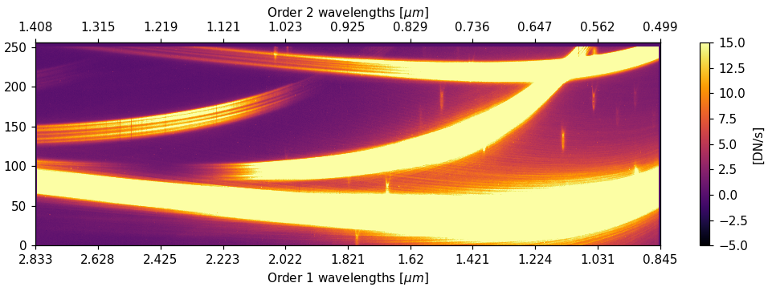
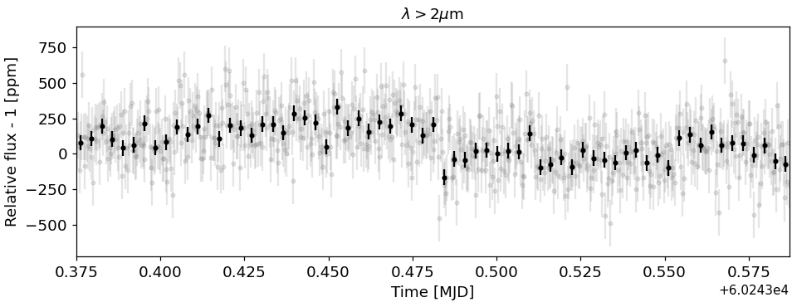
JWST NIRISS/SOSS Observations
Secondary eclipse observed in October 2023
NEAT GTO program cycle 1 (PI:D. Lafrenière)
0.7 - 2.8 μm
Data reduction pipeline: supreme-SPOON (M. Radica)
Tilt event removed
Morel+ in prep.
CRAQ annual meeting Kim Morel May 7^{th,} 2024

Slide 7
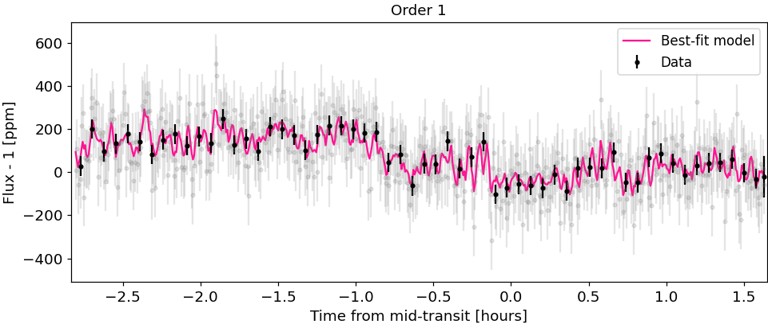
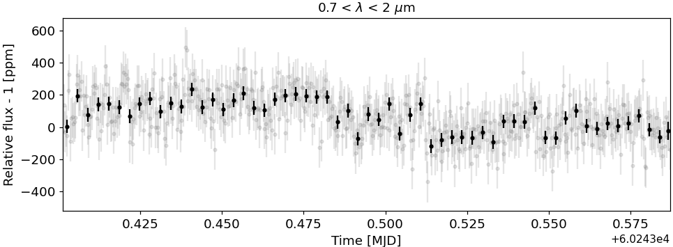
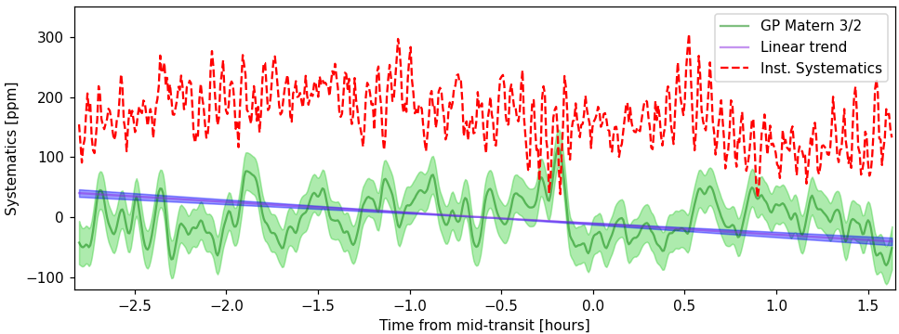
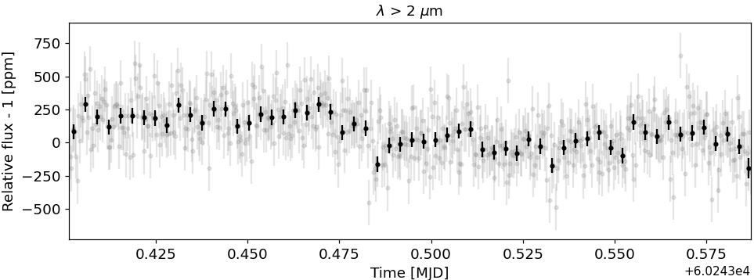
Eclipse Fitting
0.85
Systematics more prominent at shorter wavelengths
Instrumental:
Temperature
Fine Guidance Sensor
Detrending with instrument components and a gaussian process
Morel+ in prep.
CRAQ annual meeting Kim Morel May 7^{th,} 2024

Slide 8
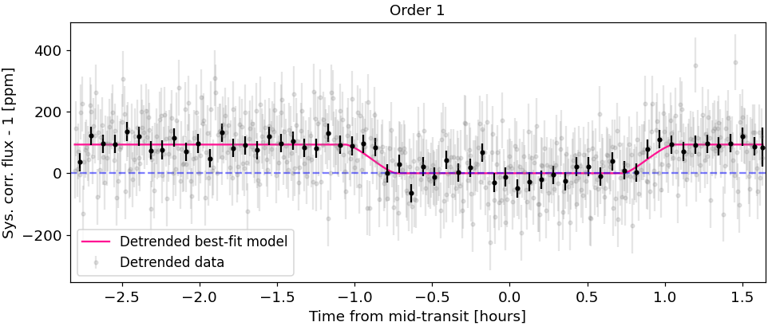
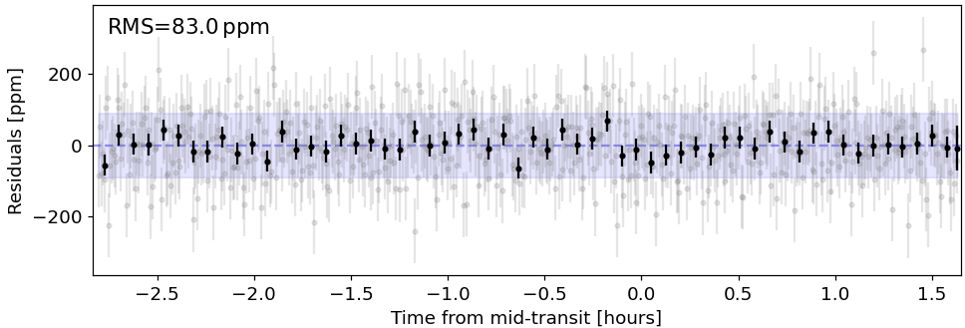
Eclipse Fitting
Systematics more prominent at shorter wavelengths
Instrumental:
Temperature
Fine Guidance Sensor
Detrending with instrument components and a gaussian process
Broadband eclipse depth:
87 ± 21 ppm
In agreement with two other data reductions
Morel+ in prep.
CRAQ annual meeting Kim Morel May 7^{th,} 2024

Slide 9
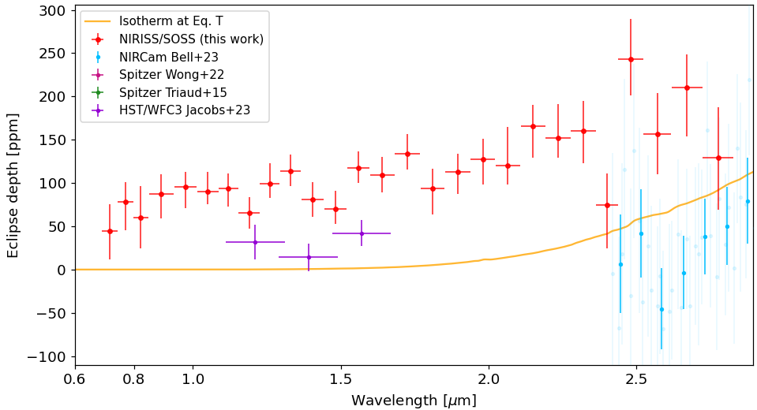
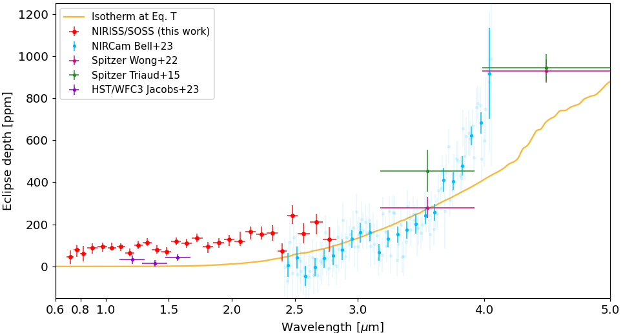
Eclipse Spectrum
Eclipse depths greater than previous studies (incl. NIRCam)
Reflected light
Morel+ in prep.
CRAQ annual meeting Kim Morel May 7^{th,} 2024

Slide 10
Conclusion
NIRISS/SOSS secondary eclipse data for WASP-80 b show various systematics, but clear evidence for an eclipse.
Next: Retrievals to characterize the atmosphere will certainly reveal the aerosols properties
Hints for variability…?
CRAQ annual meeting Kim Morel May 7^{th,} 2024
Notes:
Expected to receive strong UV flux from the star which enhance haze production.

