Slide 1
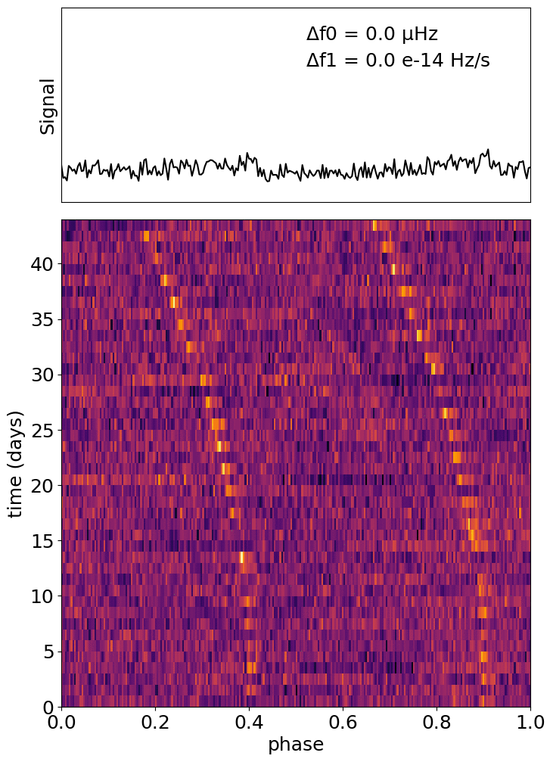
CHAMPSS:
CHIME All-Sky
Multi-day
Pulsar Stack Search
Magnus L’Argent (MSc 1)
Supervised by Victoria Kaspi
McGill University

