Slide 1
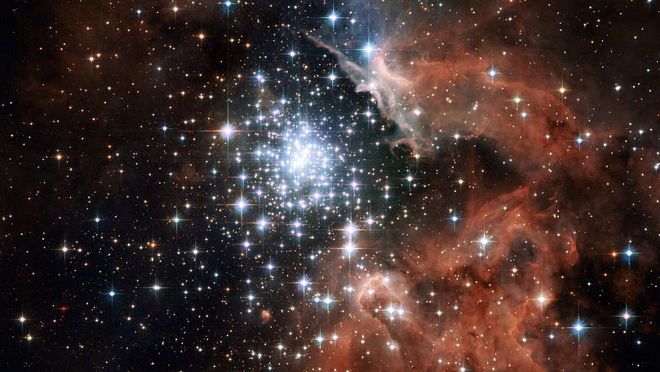
CRAQ
Detection of Rotational Signatures in Stars Candidates to Host Planets:
Insights from NIRPS and TESS Observations
Roseane Lima
Post doctorate
Notes:
Today I’m going to show you some results about…

Slide 2
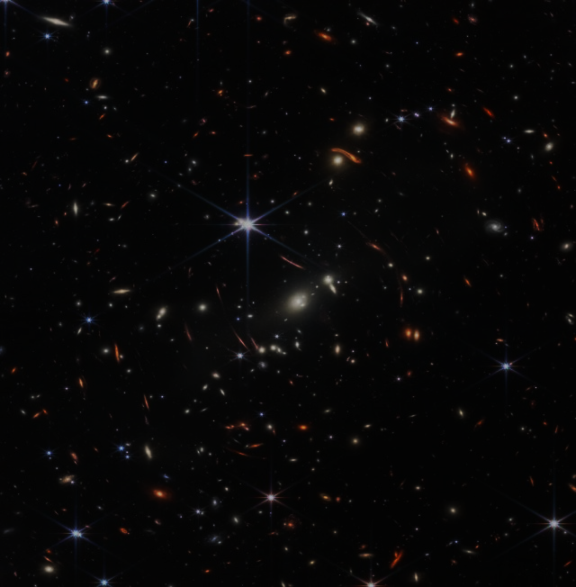
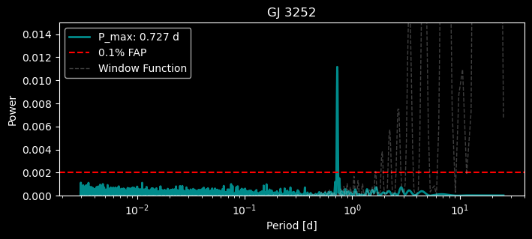
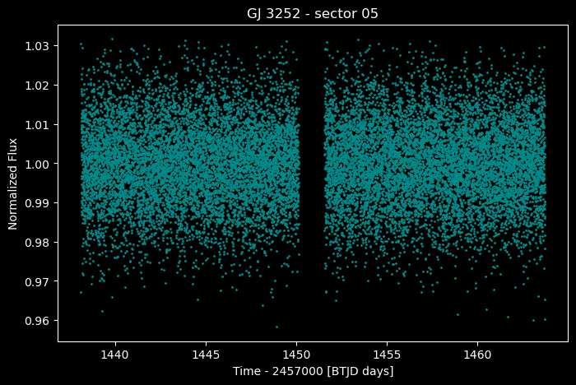
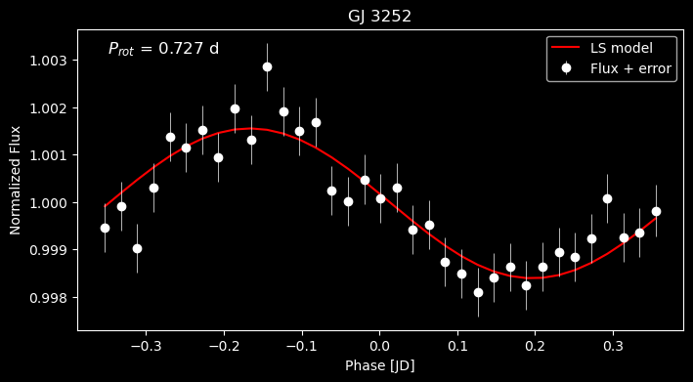
TESS
GJ 3252
Low-mass Star
M8.0V
Notes:
The first target is a low-mass star. Spectral type M8 with a rotational period of 0.7 days in the TESS light curve.

Slide 3
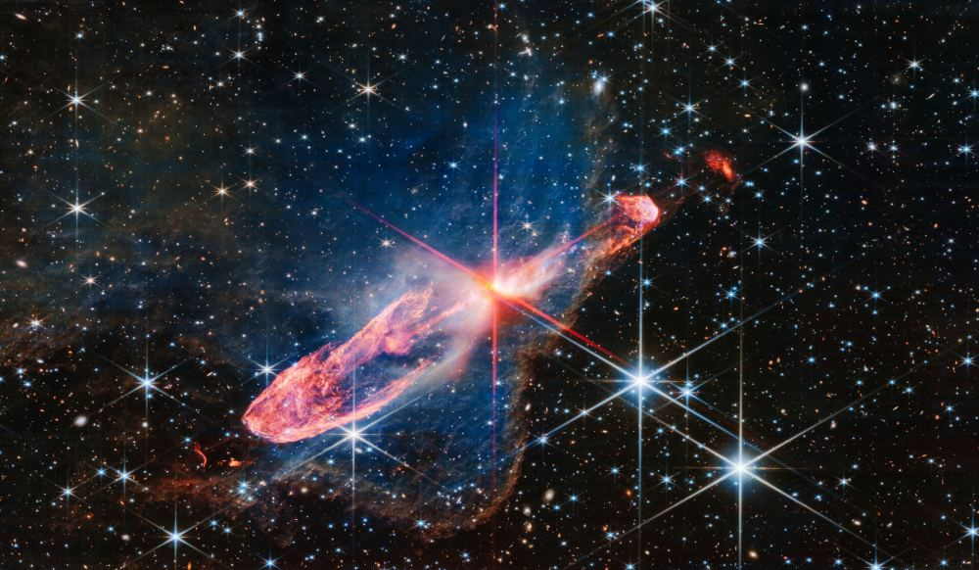
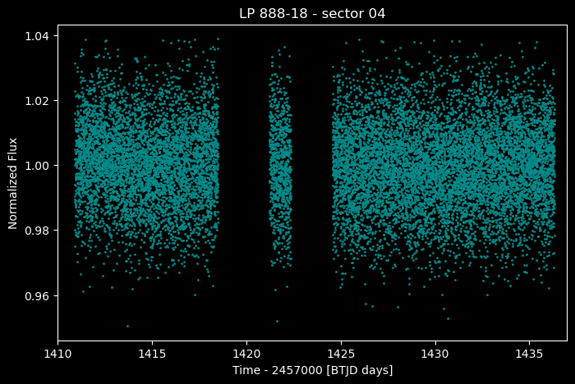
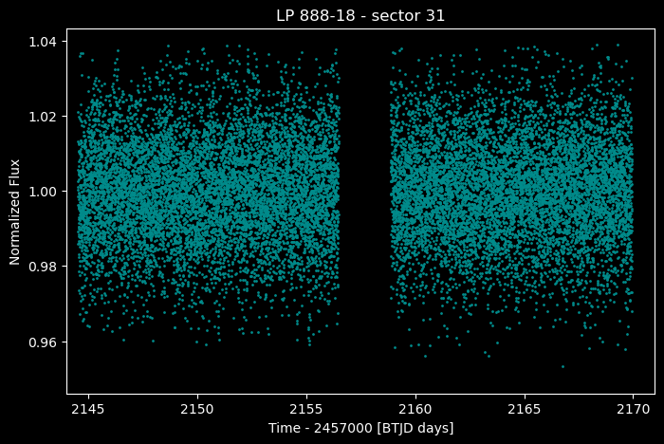
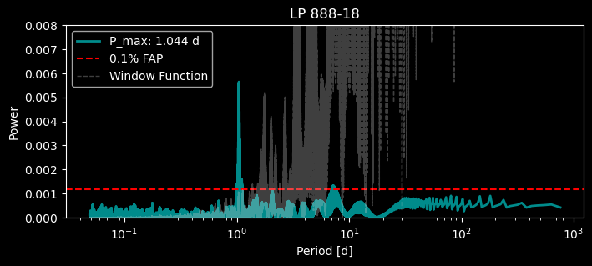
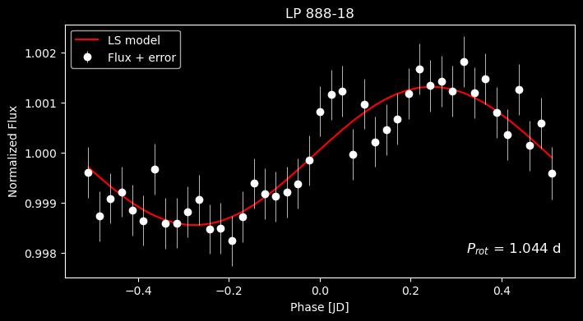
TESS
LP 888-18
Eruptive Variable
M7.5V
Notes:
The second star is an eruptive variable. Spectral type M7 with a rotational period of 1.04 days in the TESS light curve.

Slide 4
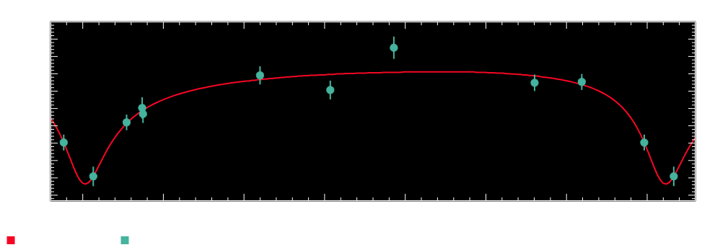
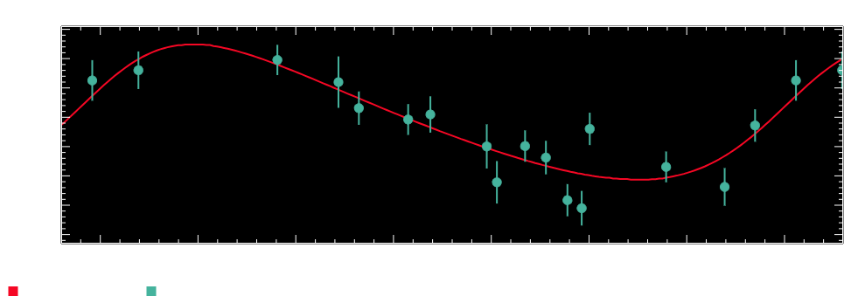
NIRPS
$$P_{rot}=0.738 d$$
Rossiter-McLaughlin effect
$$P_{rot}=1.049 d$$
Notes:
In NIRPS data, I found the same rotational periods for both stars and these RV profiles resemble the Rossiter-Maclaglin effect.

Slide 5
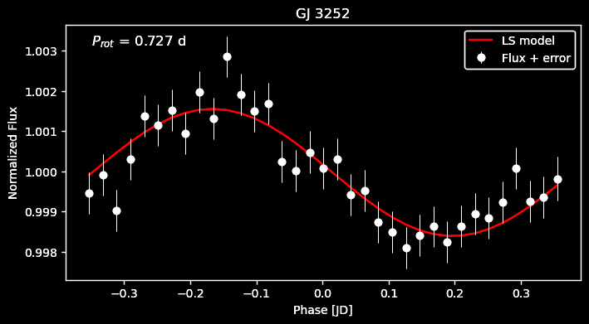
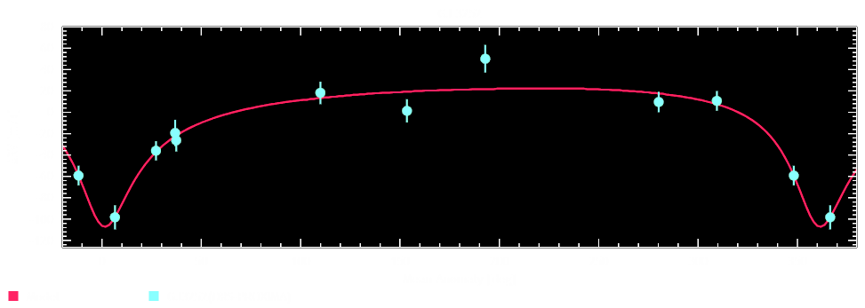
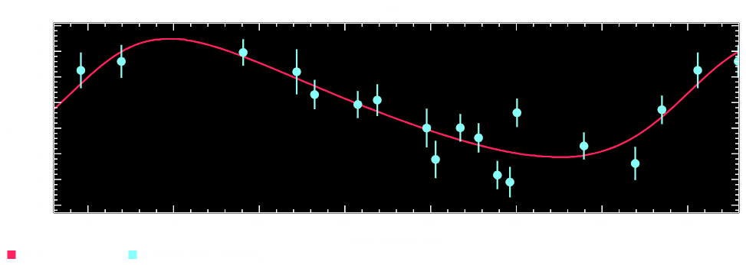
Conclusions
Low signal to noise in the TESS data
Clear rotation signature with a small amplitude
TESS
NIRPS
The Prot are very consistent
$$P_{rot}=0.727 d$$
$$P_{rot}=0.738 d$$
$$P_{rot}=1.044 d$$
$$P_{rot}=1.049 d$$
The ∆RV resemble the RM effect:
Spots are hidden during the rotation
Notes:
Even tough… We can detect…

