Slide 1
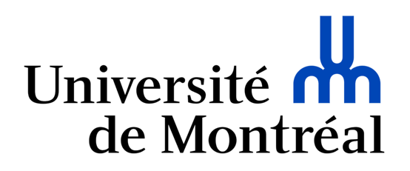
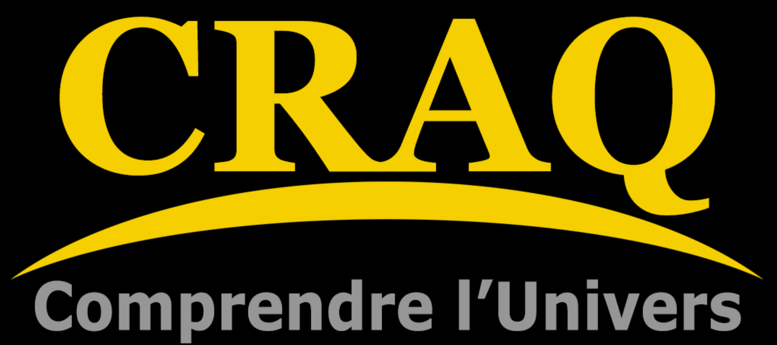
Modeling Corotating Interaction Regions (CIRs) in the winds of Wolf-Rayet stars - Part 1
Guillaume Lenoir-Craig
Superviseurs :
Nicole St-Louis
Anthony F. J. Moffat
Collaborateurs:
N. Dylan Kee (National Solar Observatory)
John Sundqvist & Nicolas Moens (K.U. Leuven)

Slide 2
Talk Outline
What are CIRs? (In the context of massive stars winds)
CIRs vs. Binarity Models
Pushing Wolf-Rayet Wind Models further
(Very near) Future work
3D RHD Models - a quick overview

Slide 3
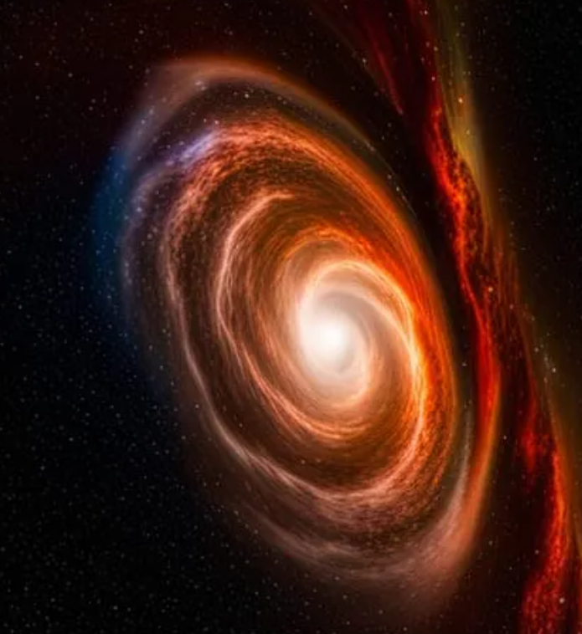
What are CIRs?
Massive star winds are radiative, and thus any brightness enhancement at the surface will create a locally enhanced outflow.
With duration and stellar rotation, a large-scale spiral structure develops. This whole phenomena creates photometric, spectroscopic and polarimetric variability.
They naturally explain the ubiquitous Discrete Absorption Components (DACs) appearing in the absoption component in the UV P-Cygni profiles of WR progenitors, O-type stars.
Credit : DALL-E

Slide 4
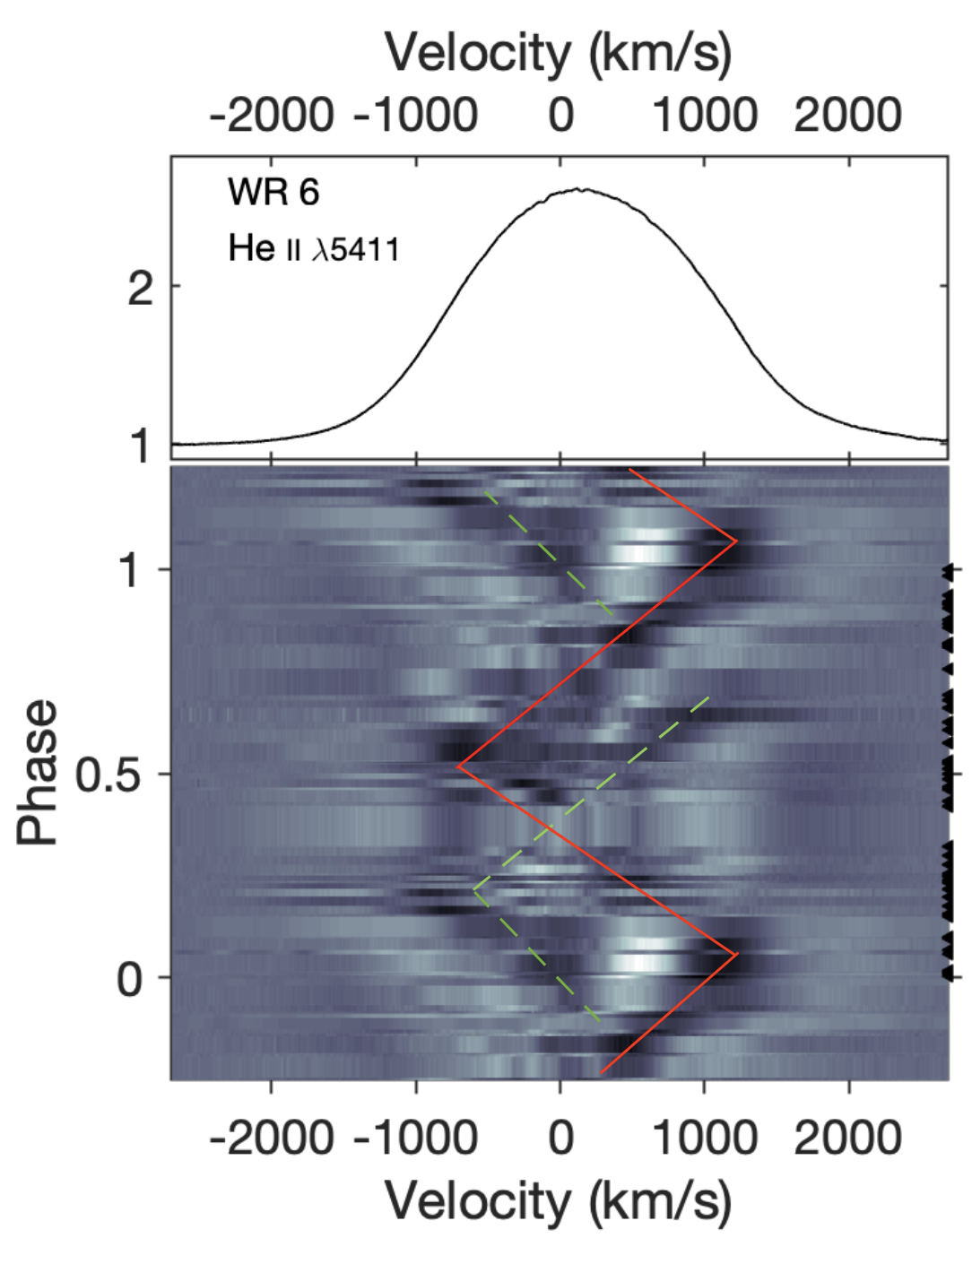
CIRs vs. Binarity Models
Crédit : St-Louis et al. (2020)

Slide 5
CIRs vs. Binarity Models
Crédit : Koenigsberger & Schmutz (2019)

Slide 6
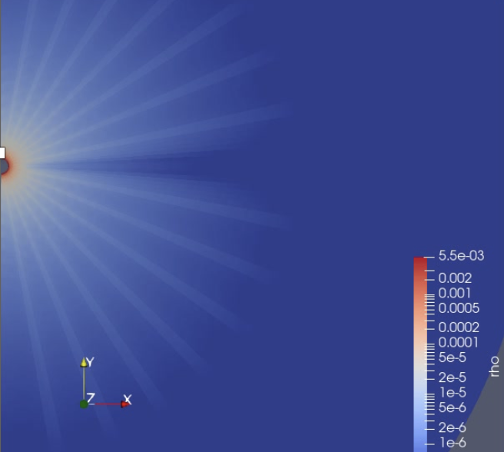
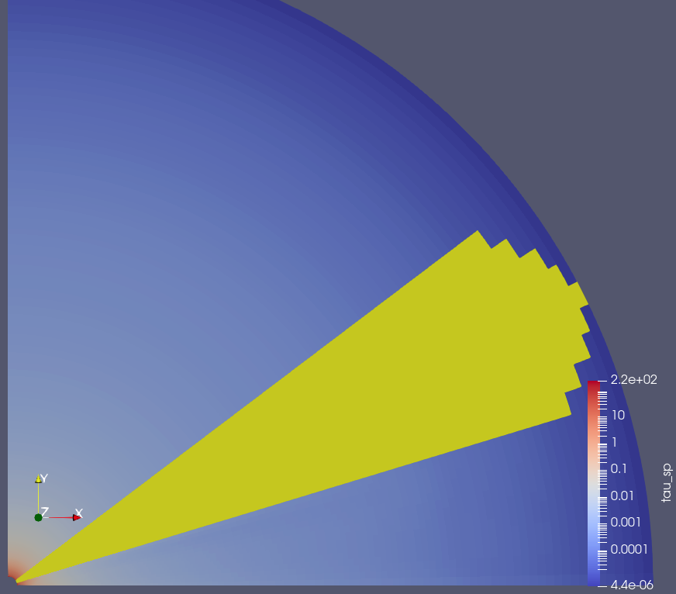
Pushing Wolf-Rayet Wind Models further: From 1D to 3D with Spot and Rotation
Start with 1-D Wolf-Rayet Wind Model, presented in Poniatowski et al. (2020)
Expand to 2-D
Incorporate Luminous Gaussian Spot mechanic on Stellar Surface
Upgrade Model to 3-D
Integrate Stellar Rotation

Slide 7
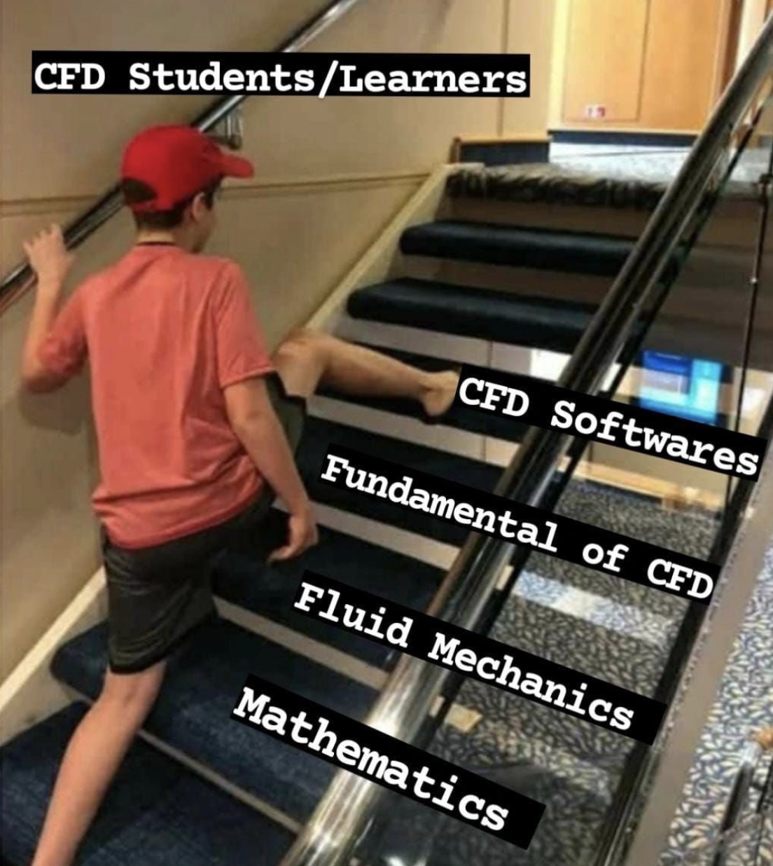
Pushing Wolf-Rayet Wind Models further: From 1D to 3D with Spot and Rotation
Start with 1-D Wolf-Rayet Wind Model, presented in Poniatowski et al. (2020)
Expand to 2-D
Incorporate Luminous Gaussian Spot mechanic on Stellar Surface
Upgrade Model to 3-D
Integrate Stellar Rotation
Crédit : Joused Murad

Slide 8
3D RHD Models – a quick overview

Slide 9
(Very near) Future Work
Implement a self-consistent determination method for the wind launching parameters (now fixed values).
Add 3D vector radiative force contributions (now strictly radial).
Create a grid of models covering as much of the parameter space as possible (using our recently granted 250 CPU-years of computation time at Alliance Canada).
Implement a customized version of the LINE3D radiative transfer code developped at K.U. Leuven to extract synthetic observables in photometry, spectroscopy (and polarimetry?).
Longer term : use these to fit real data, inform the MCMC model showcased in Rémi Sincenne’s talk and much more!
Stay tuned for these results at next year’s CRAQ!

Slide 10
Thanks for listening!

