Slide 1
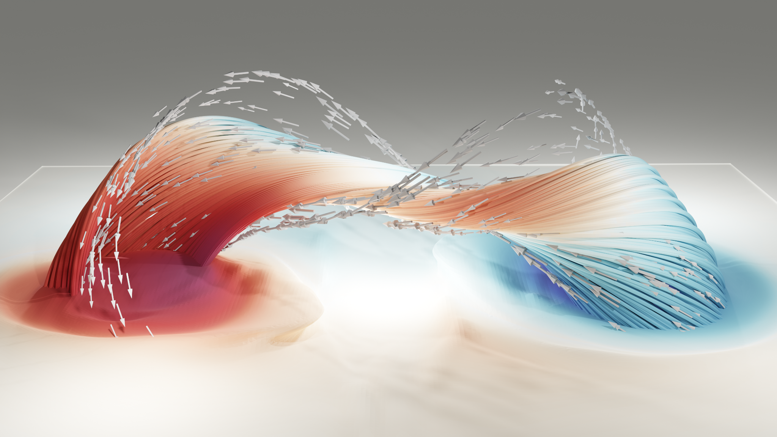
Overcoming the Challenges of Predicting Solar Flares
Henri Lamarre
Paul Charbonneau
Antoine Strugarek

Slide 2
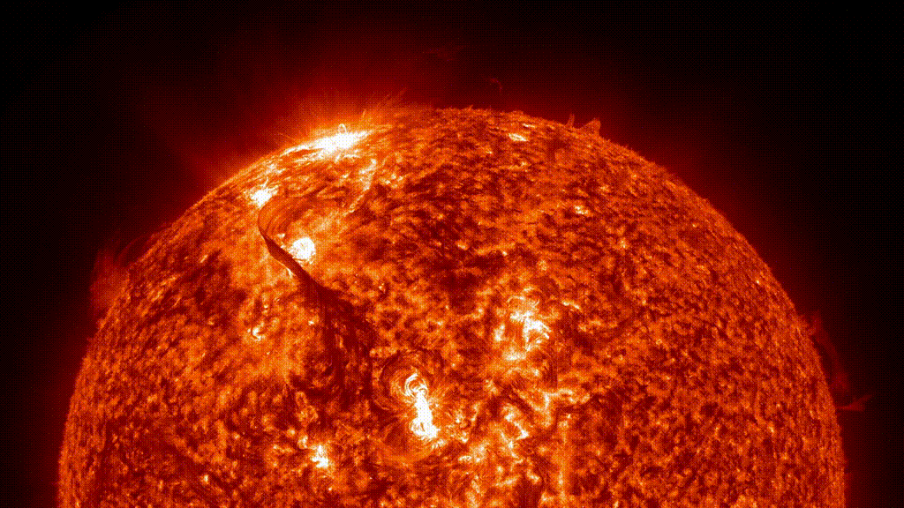
What is a Solar Flare?
https://www.youtube.com/watch?v=g9owdmL2UWQ
Notes:
Plus gros 10^33 Erg/s, Luminosité du Soleil = 10^33 erg/s

Slide 3
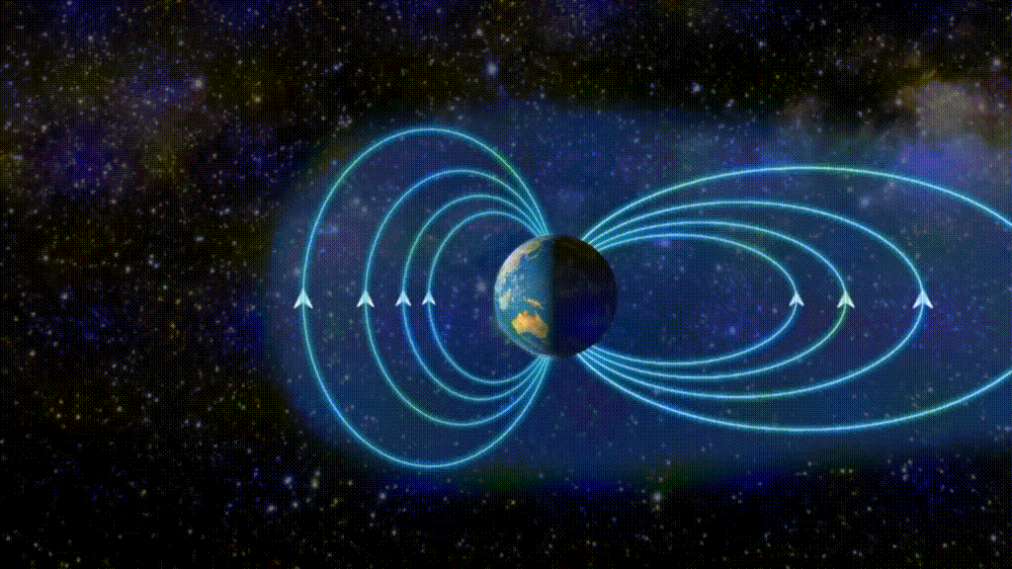
Why are we Interested?
https://www.youtube.com/watch?v=HJfy8acFaOg&t=190s
Notes:
Artist View.

Slide 4
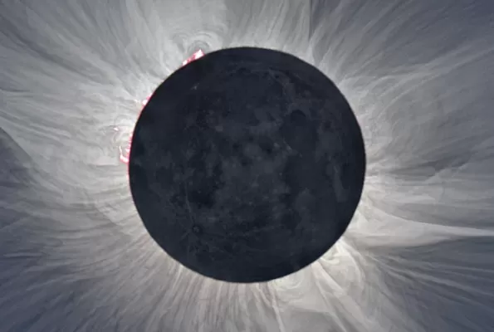
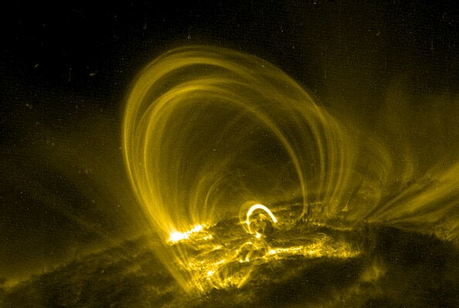
The Physics behind Solar Flares
Magnetic Fields in the Solar Corona
Coronal Loops
https://new.nsf.gov/science-matters/exploring-science-sun-during-eclipse
https://en.wikipedia.org/wiki/Coronal_loop
Notes:
Hyperliens plus clairs

Slide 5
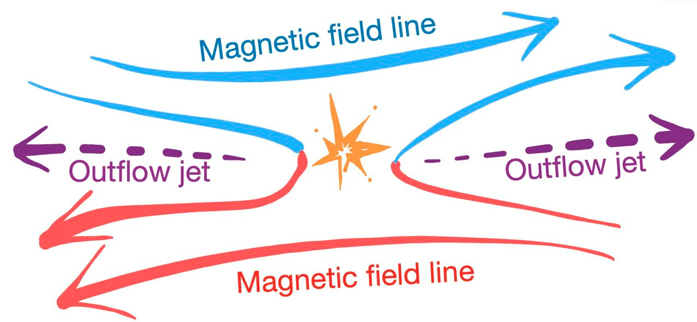
The Physics behind Solar Flares
Twisting of the Loops
Magnetic Reconnection
https://phys.org/news/2022-04-theory-mystery-fast-magnetic-reconnection.html
Strugarek 2014
Notes:
Cartoon of magnetic reconnection

Slide 6
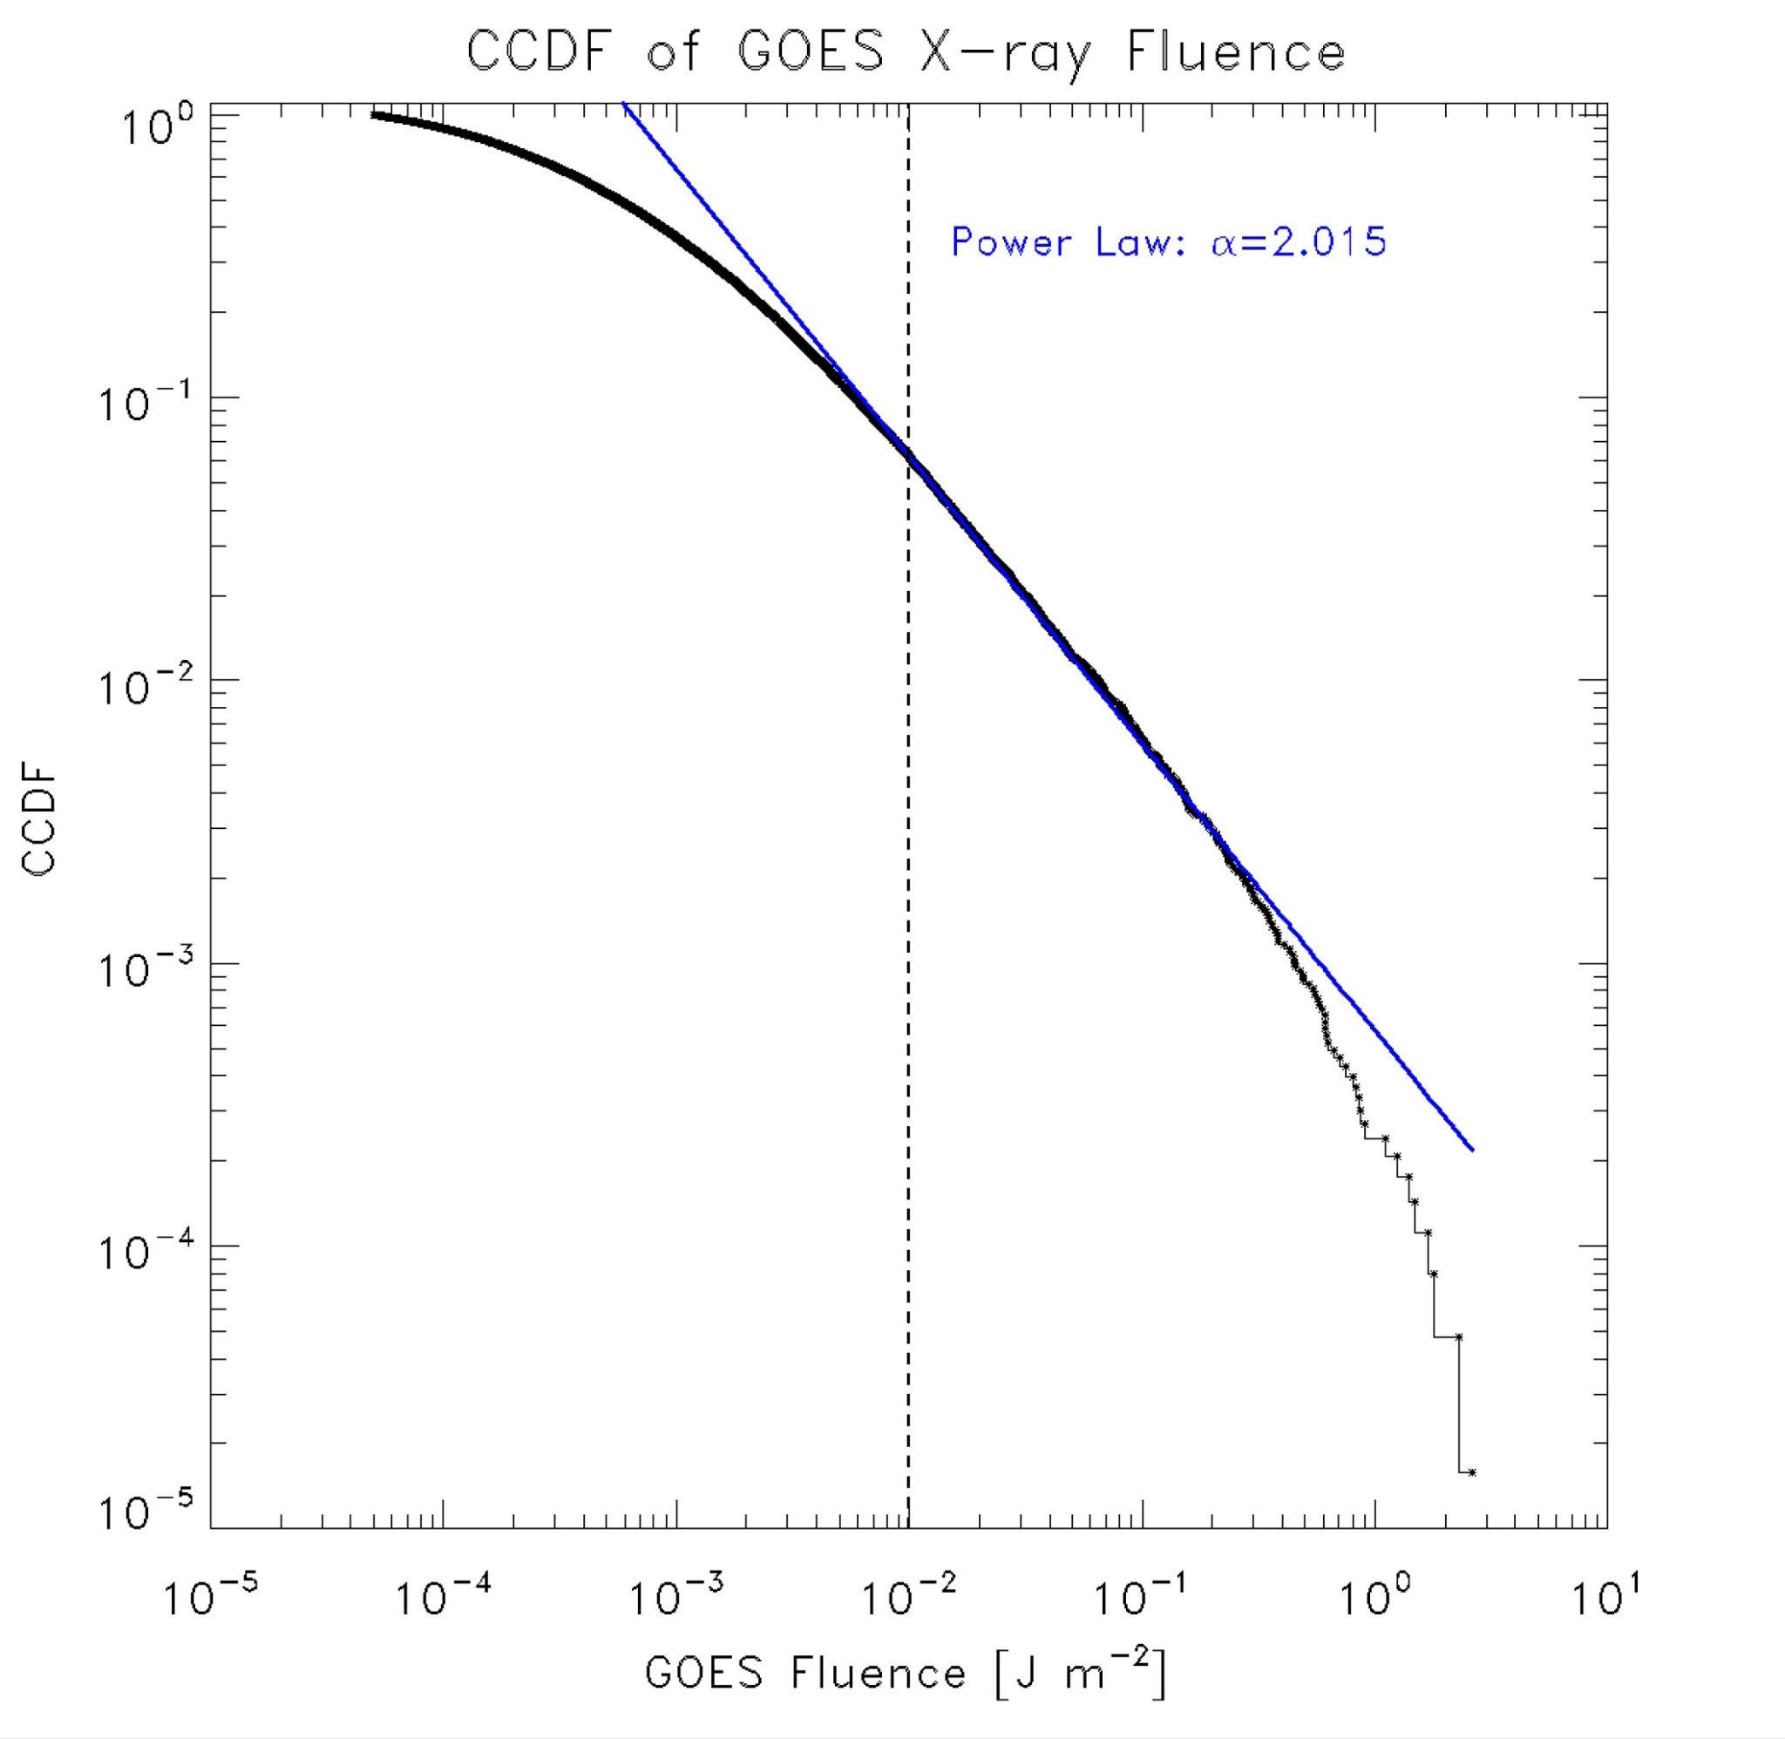
The Challenge of predicting Solar Flares
Event statistics.
Observational challenges.
Understanding the physics behind the phenomena.
https://sci.esa.int/web/soho/-/59363-solar-interior
Sakurai2022
Notes:
Observer champ magnétique dans la couronne?

Slide 7
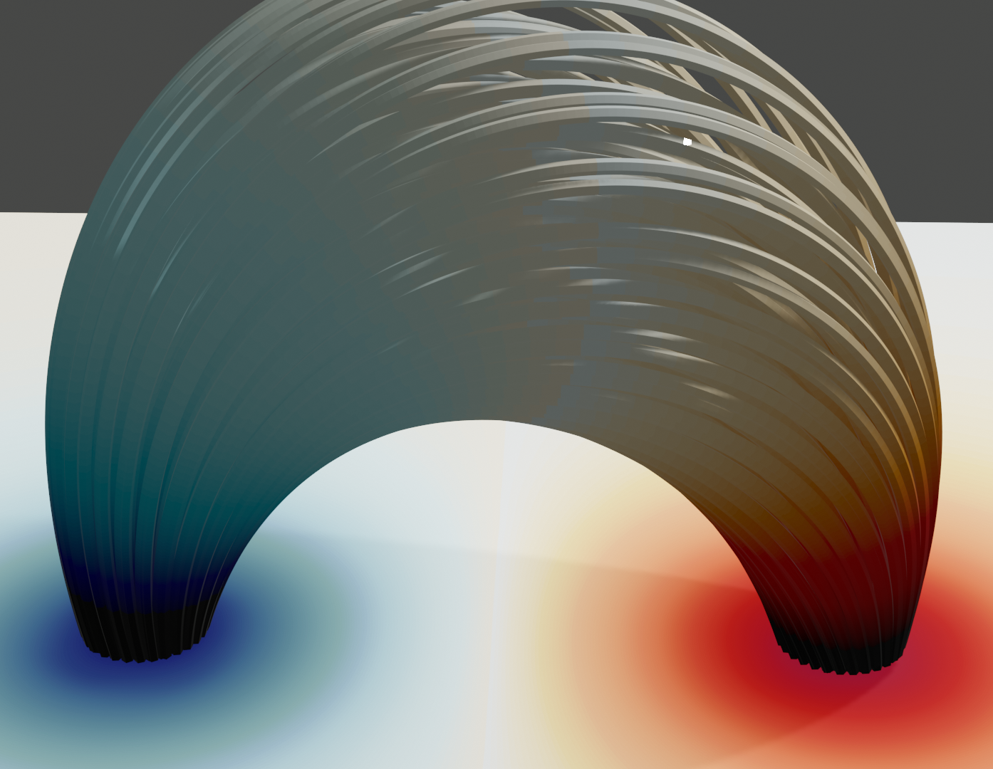
Two types of Models
Magneto hydrodynamical simulations (MHD)
Avalanche Models
Toy model with rules similar to magnetic reconnection.
Pros
Reproduces solar statistics well.
Simulations are fast, inexpensive.
Cons
Ambiguous physical interpretation.
3D Hydro Simulations where we solve Electromagnetic Equations.
Pros
Non-ambiguous physical interpretation.
Great for deepening understanding of the phenomena.
Cons
Simulations are Overdiffusive
Does not reproduce solar statistics (yet!).
Notes:
MHD - Overdiffusive (Resolution)
Meteo Spatiale!

Slide 8
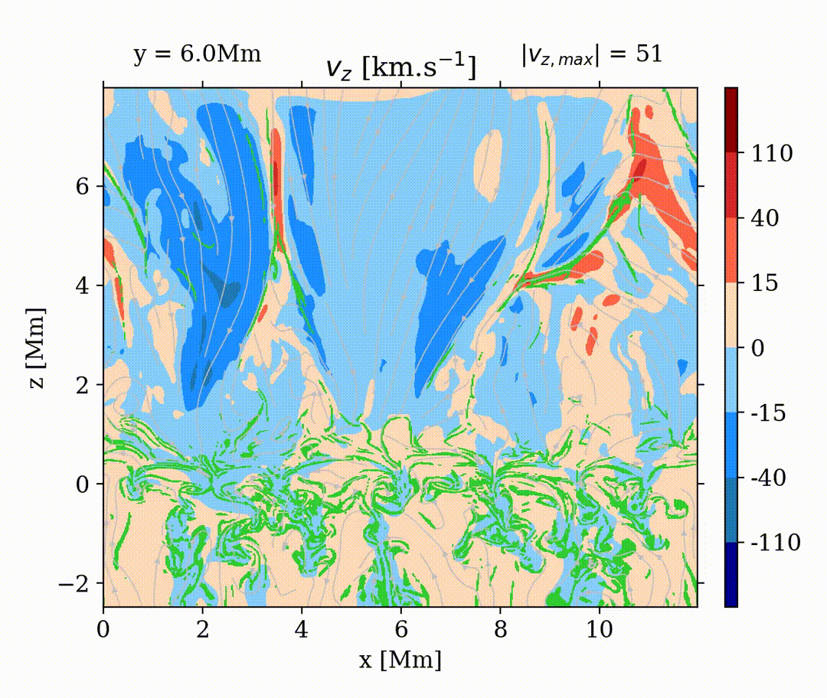
What can we learn from MHD Simulations?
How, where and when does the reconnection happen?
Study the energy transfer during the reconnection.
Are the event statistics similar in MHD models and in the Sun?
Are our assumptions in avalanche models solid?
Noraz (Preliminary)

Slide 9
How can we enhance Avalanche Models?
What set of rules reproduce solar statistics best?
How energy is defined in the models.
How to compare the models with observations?
How can we enhance predictions?
Observations (Sakurai 2022)
Avalanche Models (Lamarre 2024)
Bifrost MHD Simulations (Unpublished)
Notes:
Loi de puissance Bifrost

Slide 10
Conclusion
We want to predict solar flares.
We don’t fully grasp the physical process yet.
Avalanche models are fast and can be used for space Meteo forecasts.
MHD simulations teach us a lot about the physics behind solar flares.
In my research, I enhance MHD simulations using avalanche models, and vice versa, in order to get closer to a real-time pipeline for solar flares forecast.

Slide 11
Questions?
Henri Lamarre
Paul Charbonneau
Antoine Strugarek

Slide 12
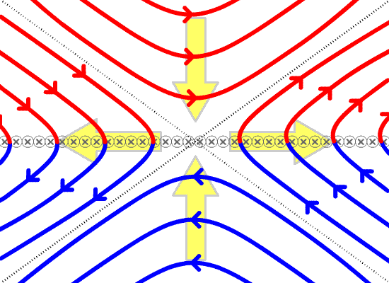
Magnetic Reconnection
https://en.wikipedia.org/wiki/Magnetic_reconnection

Slide 13
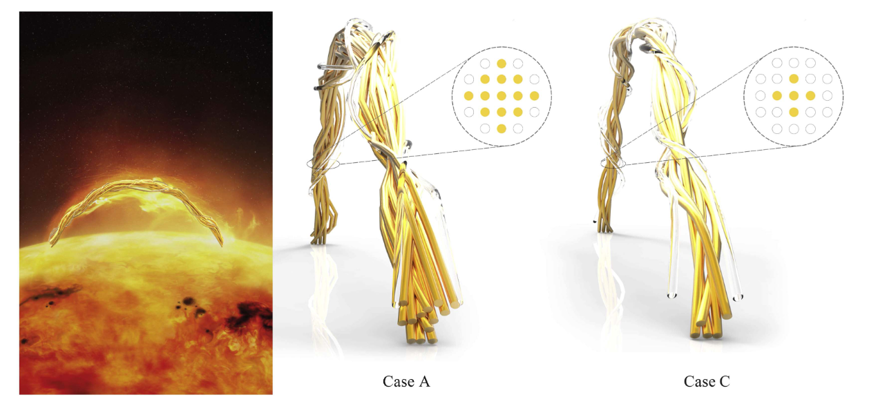
Avalanche Models
Farhang 2018

Slide 14
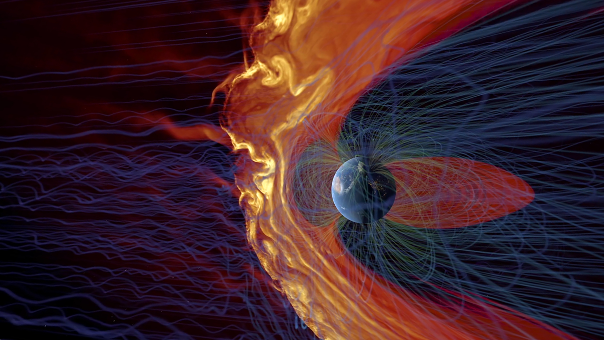
Magnetic Storm
https://eos.org/features/space-raindrops-splashing-on-earths-magnetic-umbrella

