Slide 1
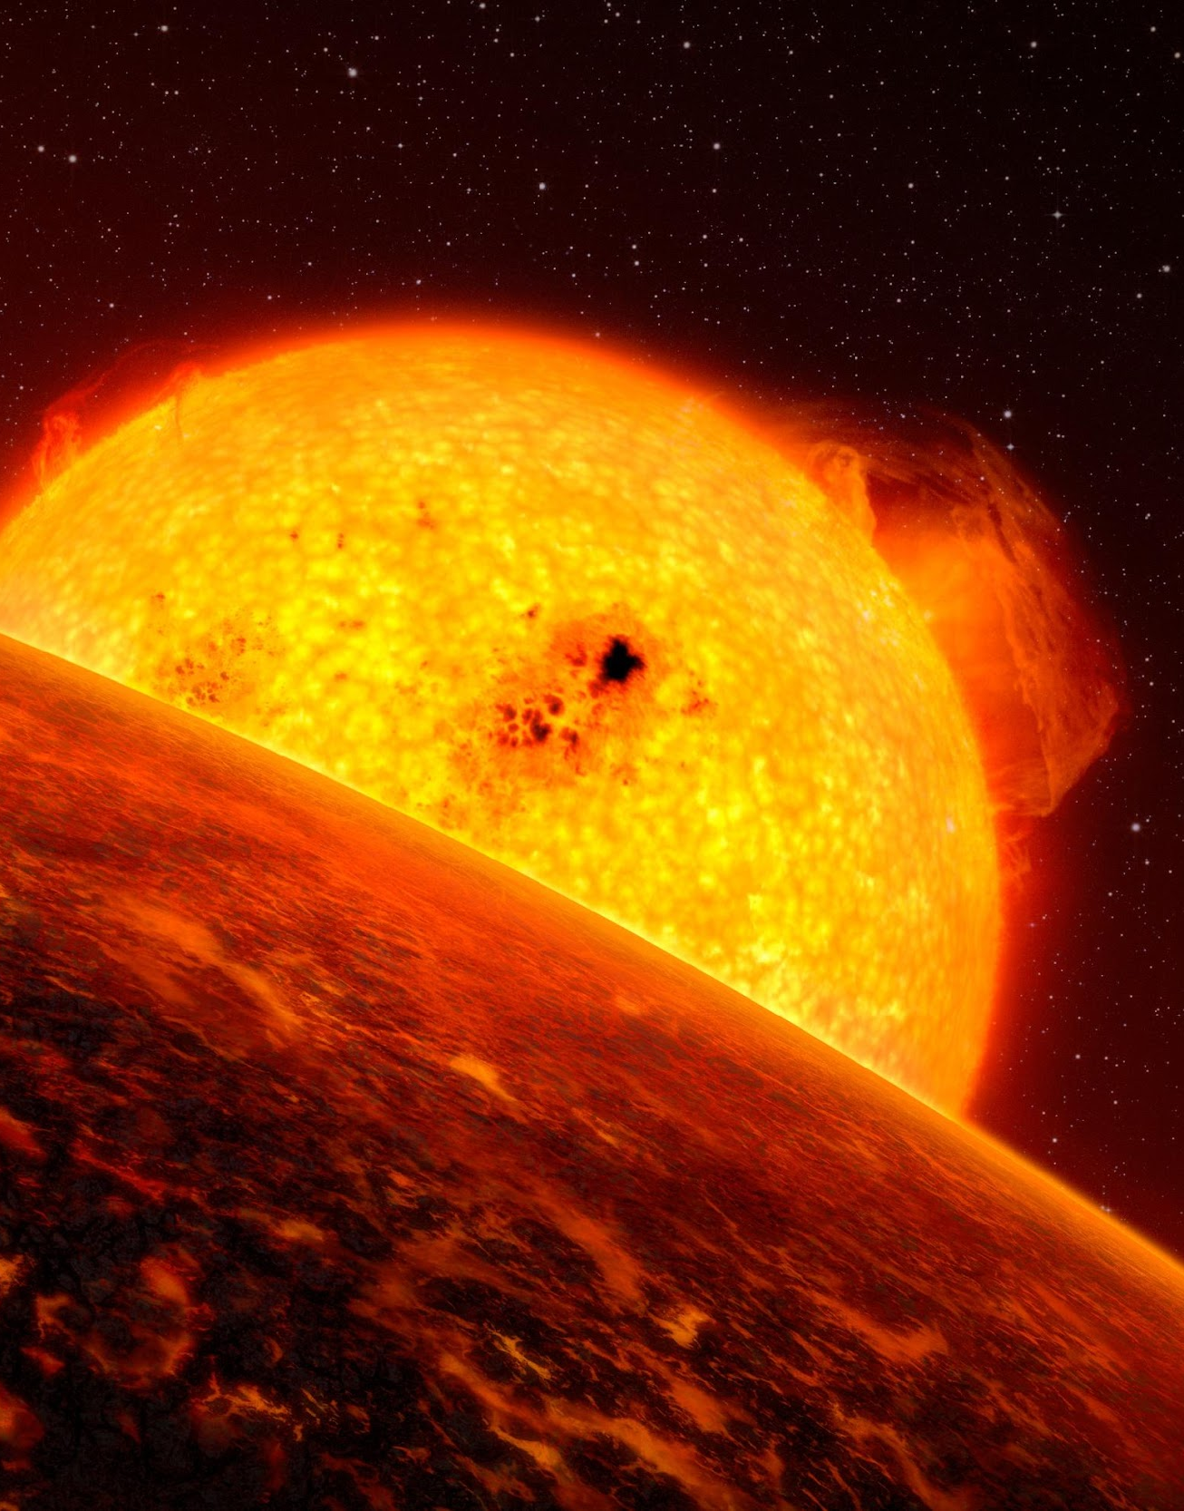
HELLRAISERS - THE THERMAL EVOLUTION OF LAVA PLANETS
Mahesh Herath, Charles-Édouard Boukaré, Nicolas Cowan

Slide 2
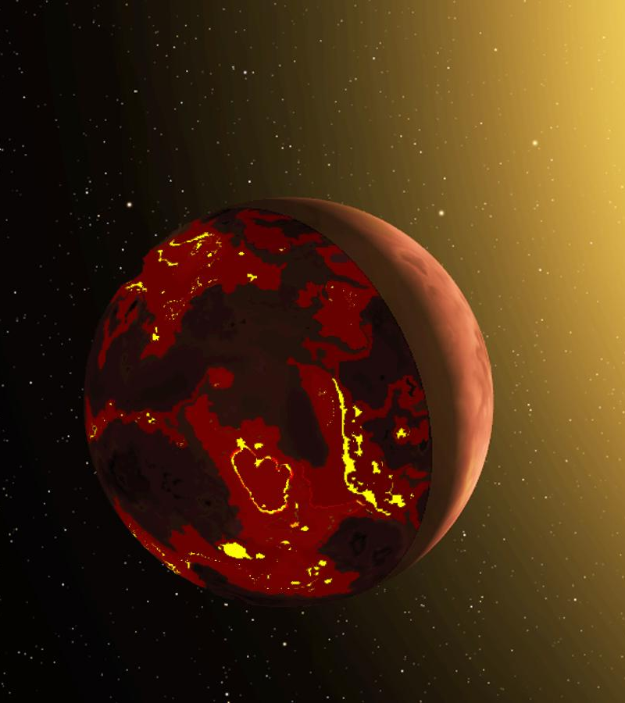
Introduction – What are Lava Planets?
Orbiting at very short distances from the host star.
Hot day-side, cool night-side.
Good test-beds for thermodynamic and interior structure models for terrestrial planets

Slide 3
Stellar Flux
T_{eq} = 0K
T_{eq} = 3000K
Night-side
S
L
Day-side
Night-side solid due to a low equilibrium temperature
Day-side kept molten due to irradiation

Slide 4
Research objectives

Slide 5
1
How deep are these magma oceans?
d =?
S
L
Are the magma oceans thin or do they occupy a significant portion of the mantle?

Slide 6
2
What is the timescale for the night-side to solidify?
S
L
t_{solid} =?
Would one side of a Lava Planet solidify completely in under 1 billion years in the absence of external heating?

Slide 7
3
How much horizontal heat transport is needed to keep the night-side molten?
S
L
Q_{H}
Would the flow of heat from the day-side to the night-side act as a heat source to keep a night-side magma ocean?

Slide 8
3
How much horizontal heat transport is needed to keep the night-side molten?
L
Q_{H}
Would the flow of heat from the day-side to the night-side act as a heat source to keep a night-side magma ocean?

Slide 9
4
Does tidal heating contribute towards having a molten night-side?
S
L
Q_{T}
The tidal flexing of a Lava Planet will generate large amounts of tidal dissipation in the interior

Slide 10
5
Does planet radius affect the results significantly?
1 R_{E}
1.5 R_{E}

Slide 11
The thermal model

Slide 12
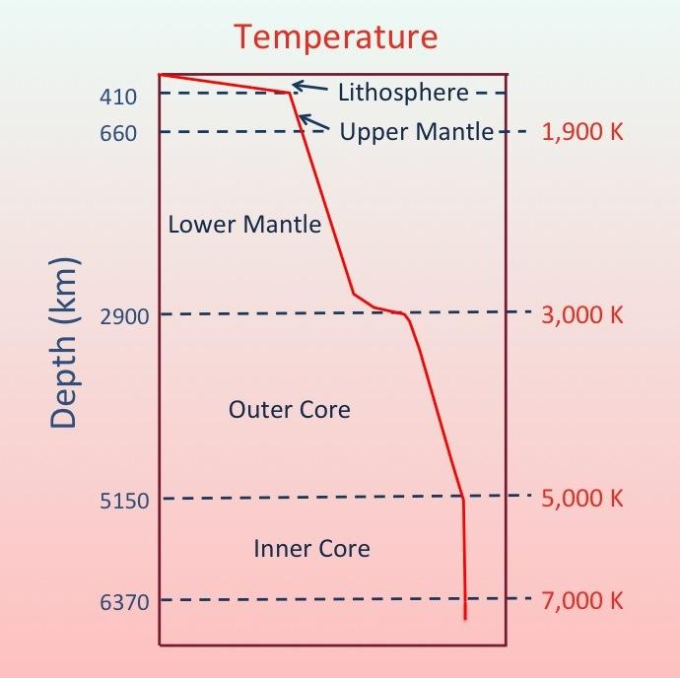
Upper Mantle
Lower Mantle
Core (molten/solid)

Slide 13
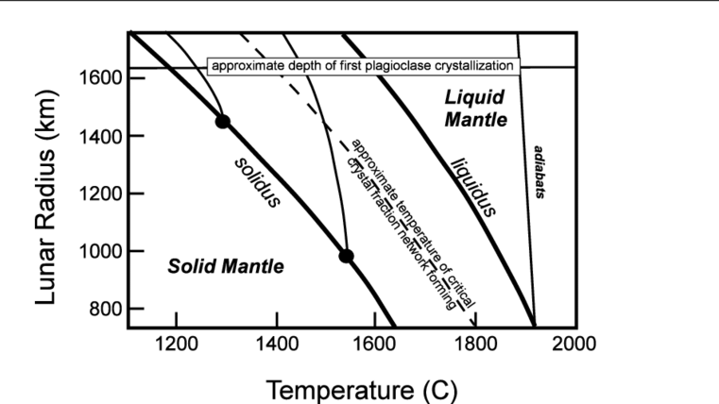

Slide 14
Upper Mantle
Lower Mantle
Core (molten/solid)
Adiabat meets liquidus and solidus

Slide 15
Temperature
Liquid Mantle
Liquidus
Geotherm
Core
Solidus
Pressure

Slide 16
Liquid Mantle
Temperature
Mush
Liquidus
Core
Geotherm
Solidus
Pressure

Slide 17
Liquid Mantle
Mush
Temperature
Liquidus
Solid
Core
Solidus
Geotherm
Pressure

Slide 18
Liquid Mantle
Mush
Temperature
Liquidus
Solid
Geotherm
Cross-Section
Core
Solidus
Pressure

Slide 19
R_{p}
Q_{R}
T_{s}
Q_{MO}
T₁
Q_{H}
Geotherm
Liquid
Q_{MS}
T₂
r₂
r₃
T₃
Pressure (increasing downwards)
S
L
Q_{T}
Mush
Q_{S}
T₄
r₄
r₅
T₅
Solid
Q_{C}
r₆
T₆
R_{c}
T_{c}
Core
Temperature (increasing right)

Slide 20
The energy budget of the planet

Slide 21
Those who balance the budget
Radiated heat
Latent heat
Horizontal heating
Tidal heating

Slide 22
HORIZONTAL HEAT TRANSFER
Day-side
Night-side
Liquid
Liquid
Q_{H}
Mush
Mush
Solid
Solid
Core
Core

Slide 23
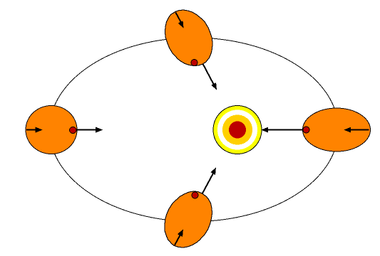
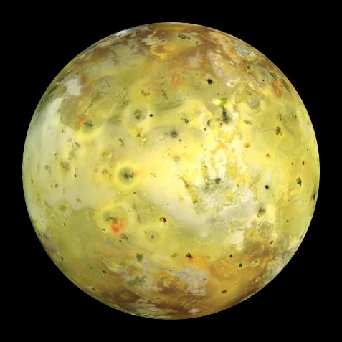
TIDAL HEATING
We use the quantity of tidal energy that has been quantified to be dissipated inside Io based on observations of thermal flux from this moon, and numerical simulations.

Slide 24
Results
Q_{H} = day-night heat transport (Watts)
Q_{T} = total tidal dissipation (Watts)
q_{T} = tidal dissipation per unit mass (W/kg)

Slide 25
Results – How does the two sides of a lava plant evolve?

Slide 26
1R_{E} t = 0 yrs
1.5R_{E} t = 0 yrs

Slide 27
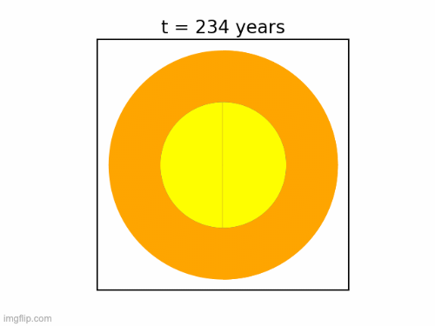
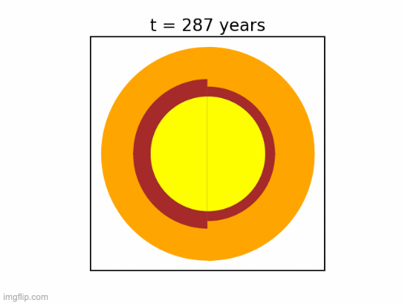
1R_{E}
1.5R_{E}

Slide 28
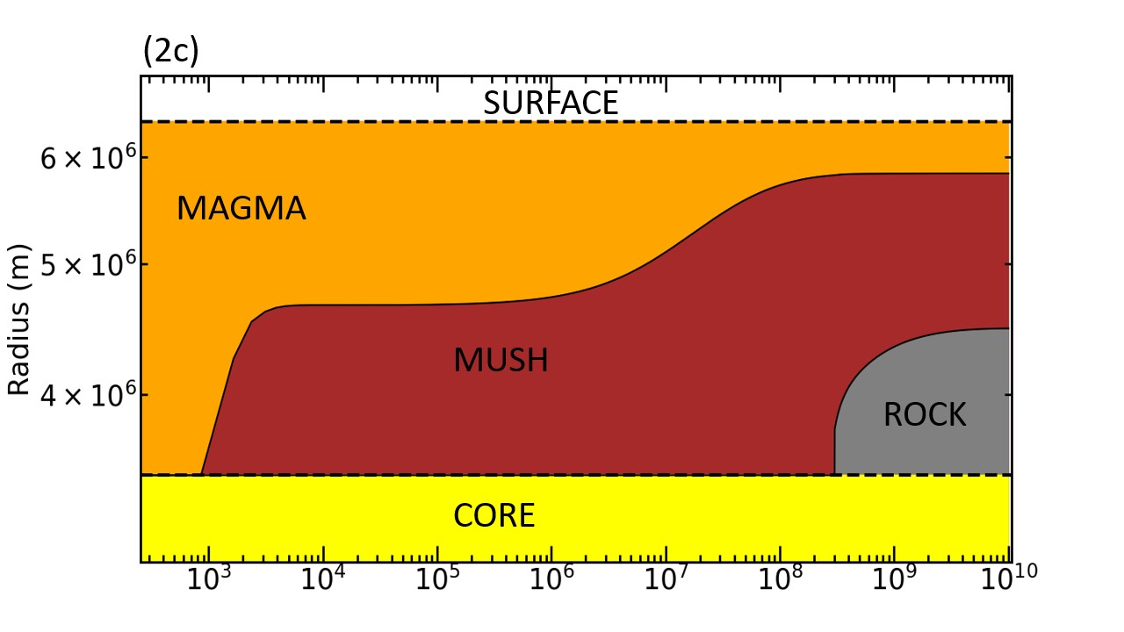
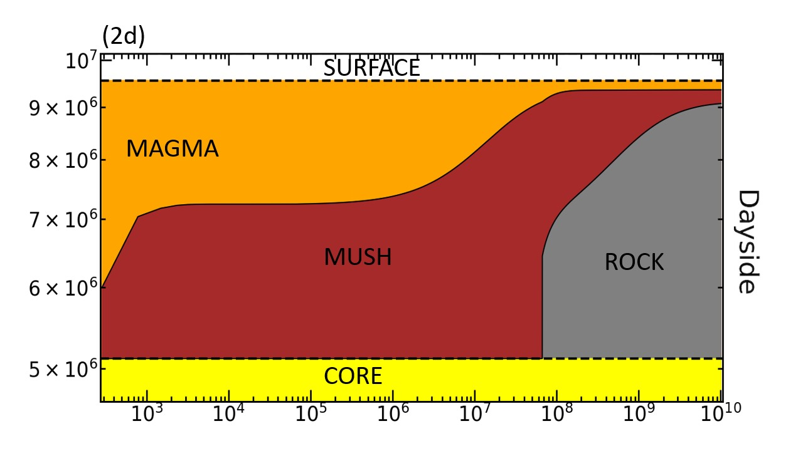
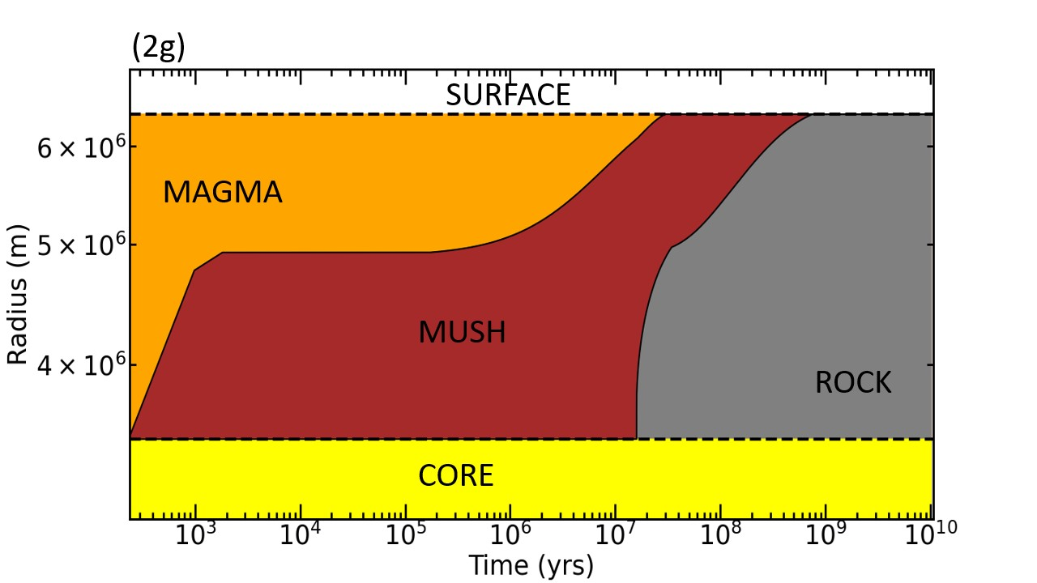
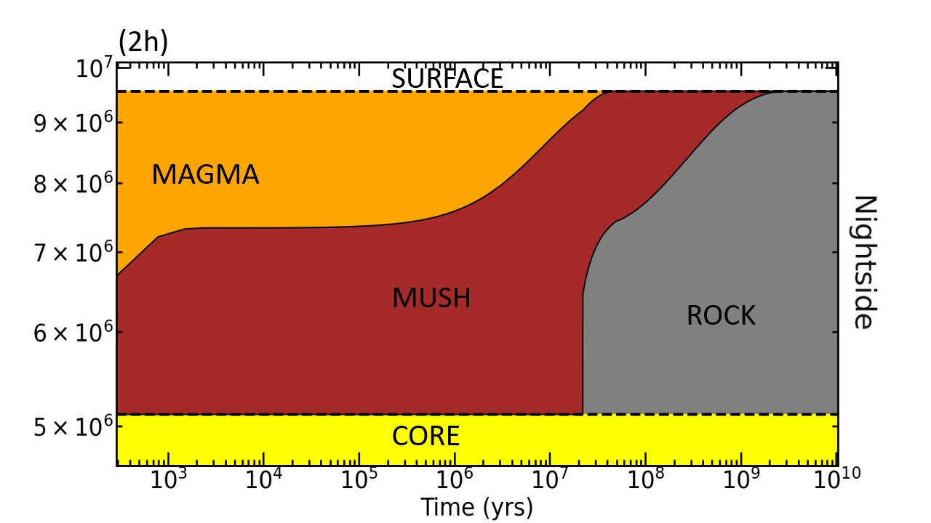
Temporal variation of internal structure
1 R_{E}
1.5 R_{E}

Slide 29
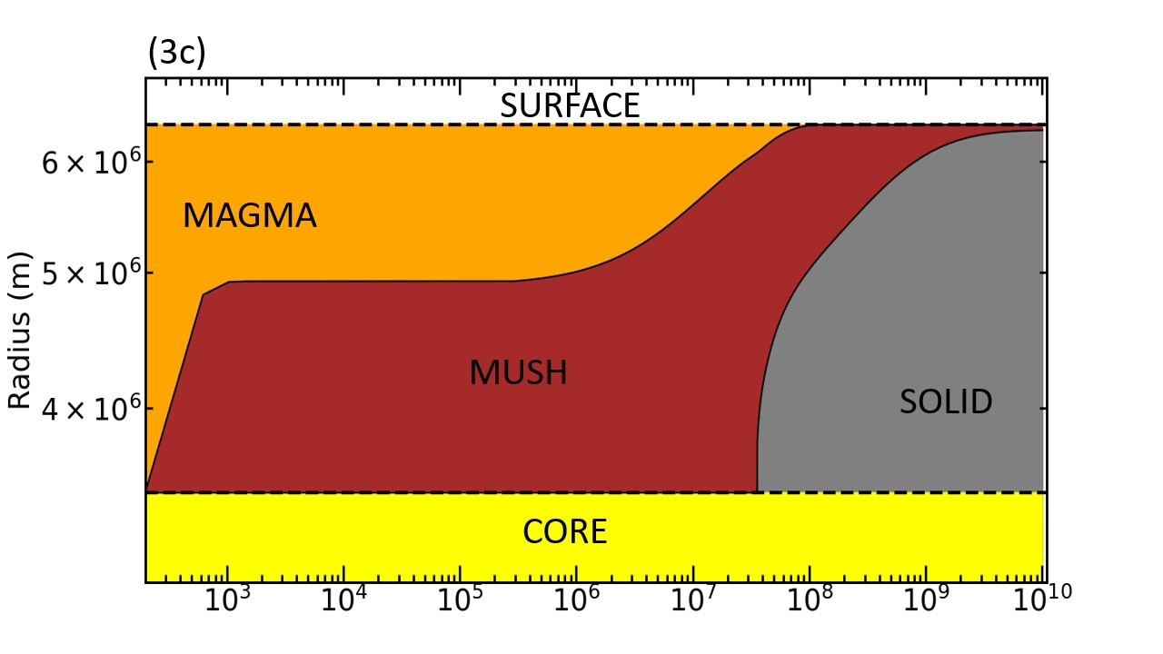
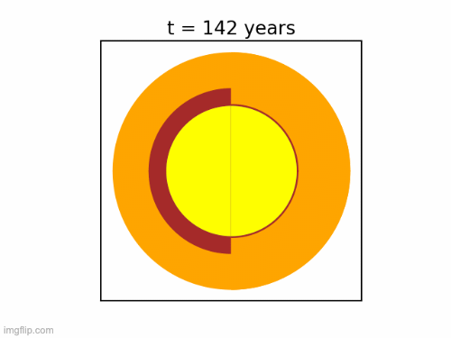
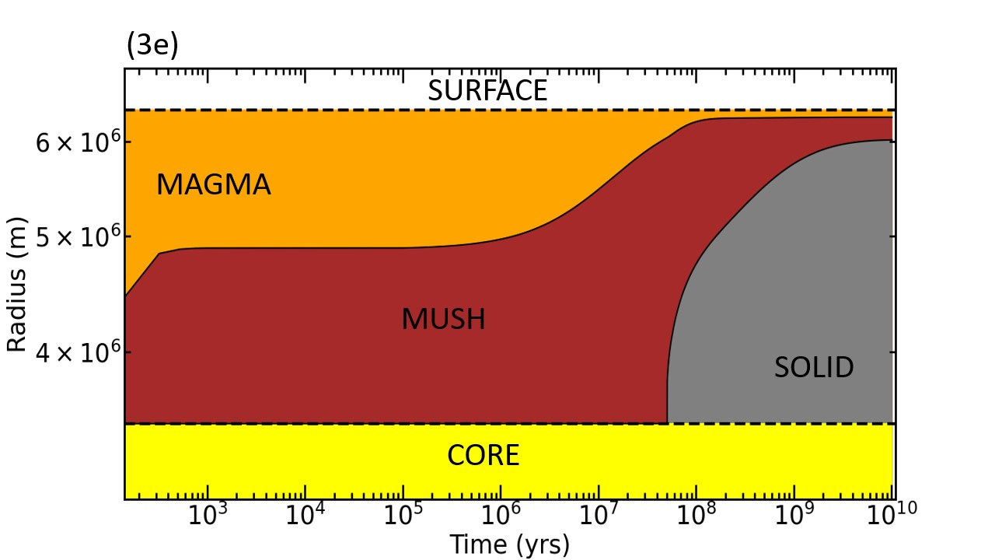
1R_{E}
The higher the quantity of horizontal heat transfer, the more likely there would be a night-side magma ocean
1 R_{E}
^{HEAT}
^{HEAT}

Slide 30
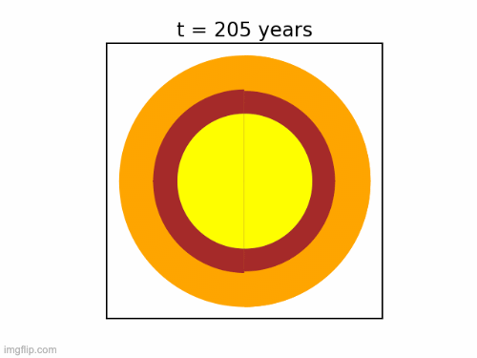
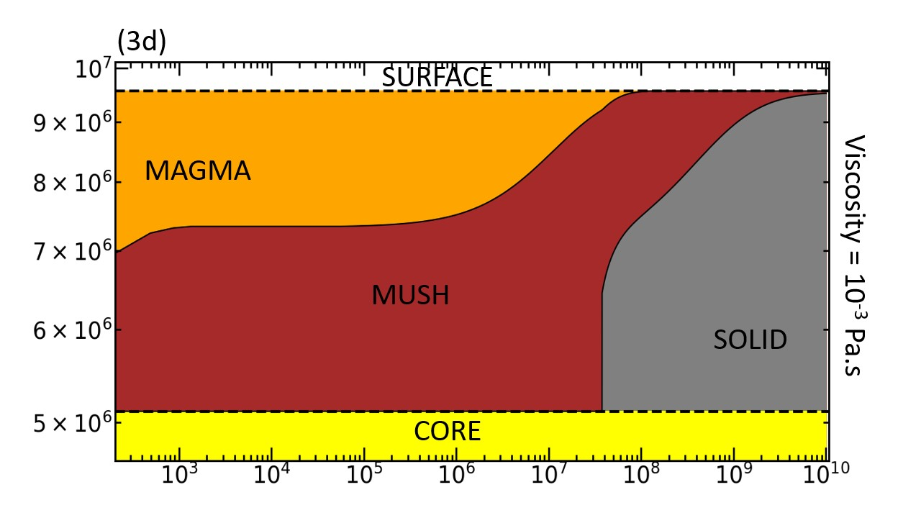
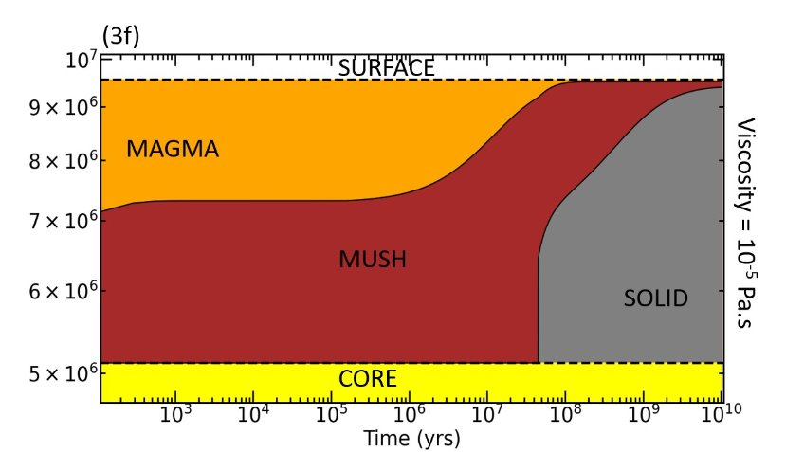
1.5R_{E}
The higher the quantity of horizontal heat transfer, the more likely there would be a night-side magma ocean
1.5 R_{E}
^{HEAT}
^{HEAT}

Slide 31
State of night-side is...
Stellar Flux
1 R_{E}
1.5 R_{E}
Solid
Magma viscosity
Mush
Day-side kept molten due to irradiation
Liquid

Slide 32
State of night-side is...
1 R_{E}
1.5 R_{E}
Solid
TIDAL HEATING extends the time period of magma oceans, but experience runaway cooling at billion year timescales because the tidal heating amount is tied to the mush mass
Magma viscosity
Mush
Liquid

Slide 33
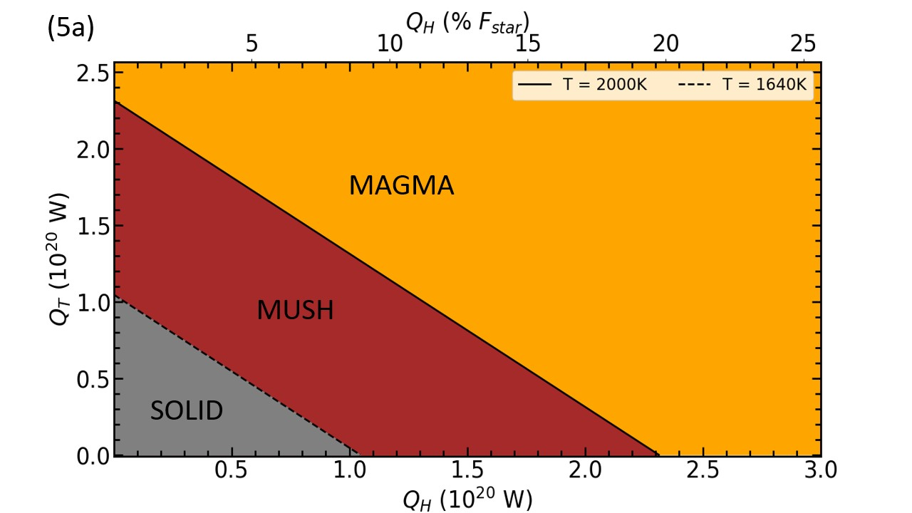
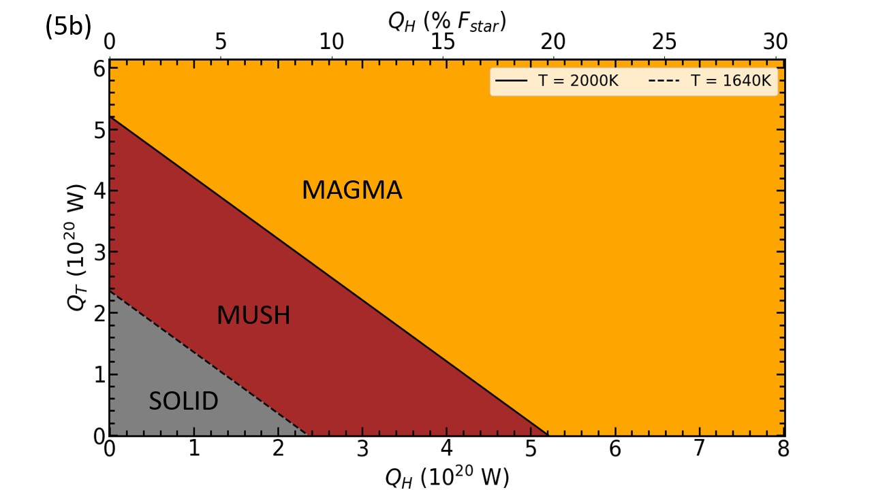
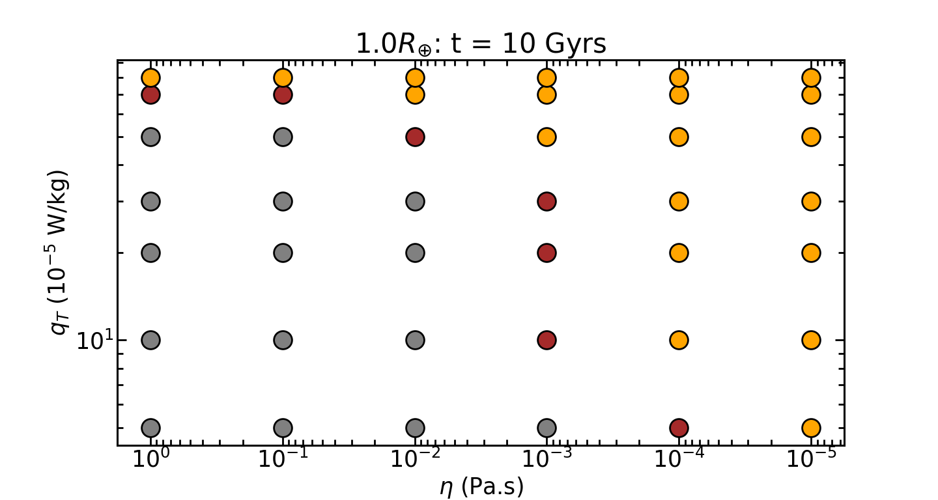
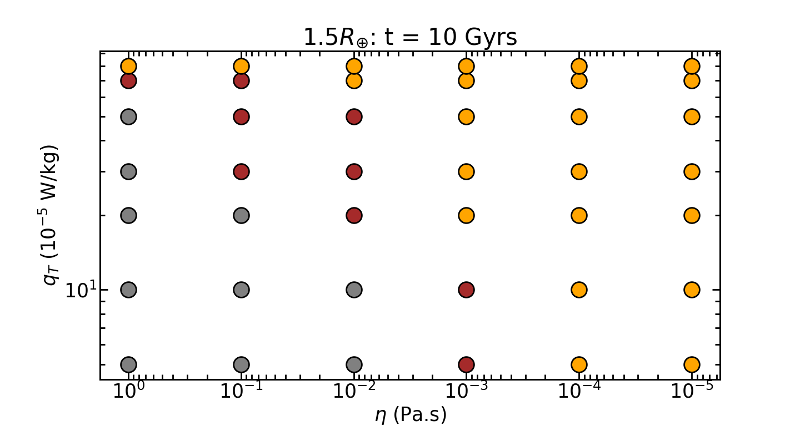

Slide 34
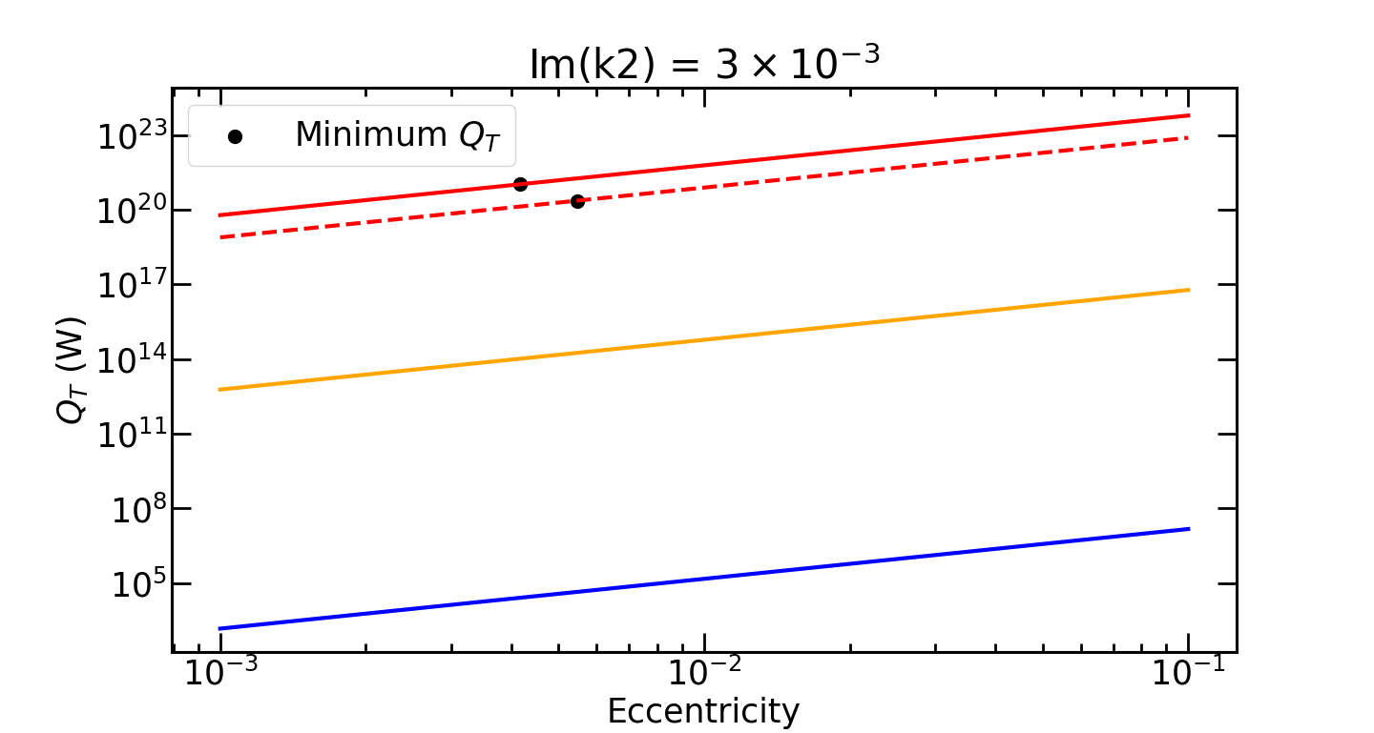
What kind of orbital eccentricity is required for the quantities of tidal heating needed for night-side melting?
K2-141 b
K2-141 b (Earth-sized)
Io
Earth

Slide 35
SUMMARY
1R_{E} and 1.5R_{E} planets require an amount of Q_{H} that is 20% and 23% of the instellation flux respectively to maintain a night-side magma ocean if day-night heating is the only heat source.
Both Earth-sized planets and Super-Earth's can experience tidal heating for billions of years before undergoing runaway cooling once the mush starts solidifying. This is unless the tidal dissipation per kg is beyond a threshold value of 8 x 10⁻⁴ W/kg.
Large amounts of tidal heating is possible at low eccentricities which is to be expected for tidally locked lava planets
A night-side thermal phase curve can tell us about the temperature distribution and thermal history of lava planets (K2-141b hopefully??).
Results will appear in Herath et al. (2024)

Slide 36
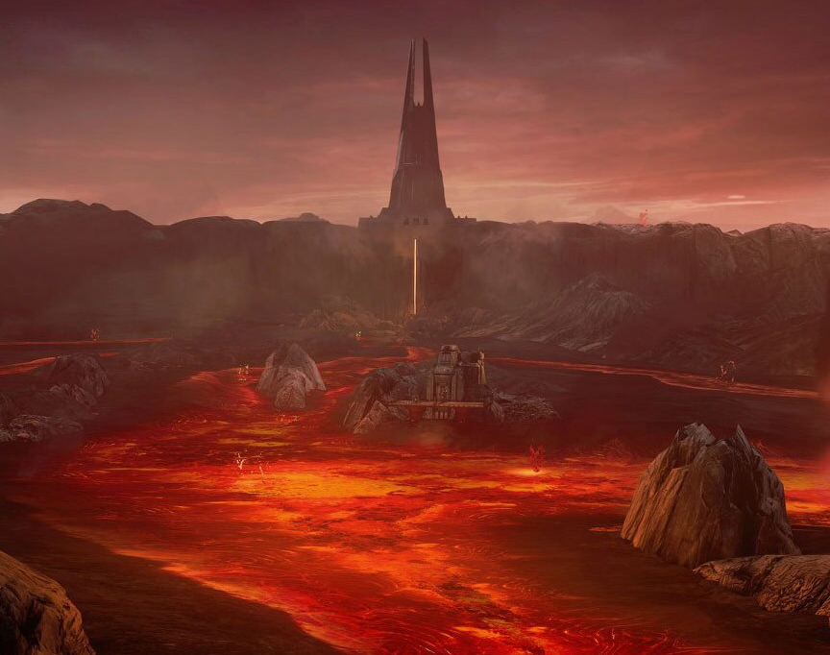
Thank you for your attention. Question time. Merci pour votre attention. Heure des questions

