Slide 1
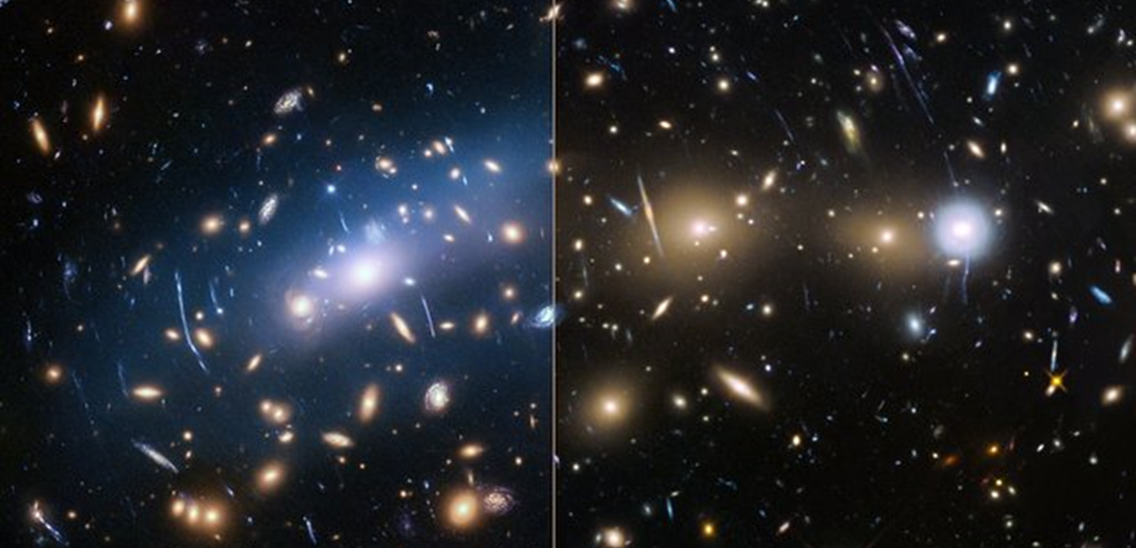
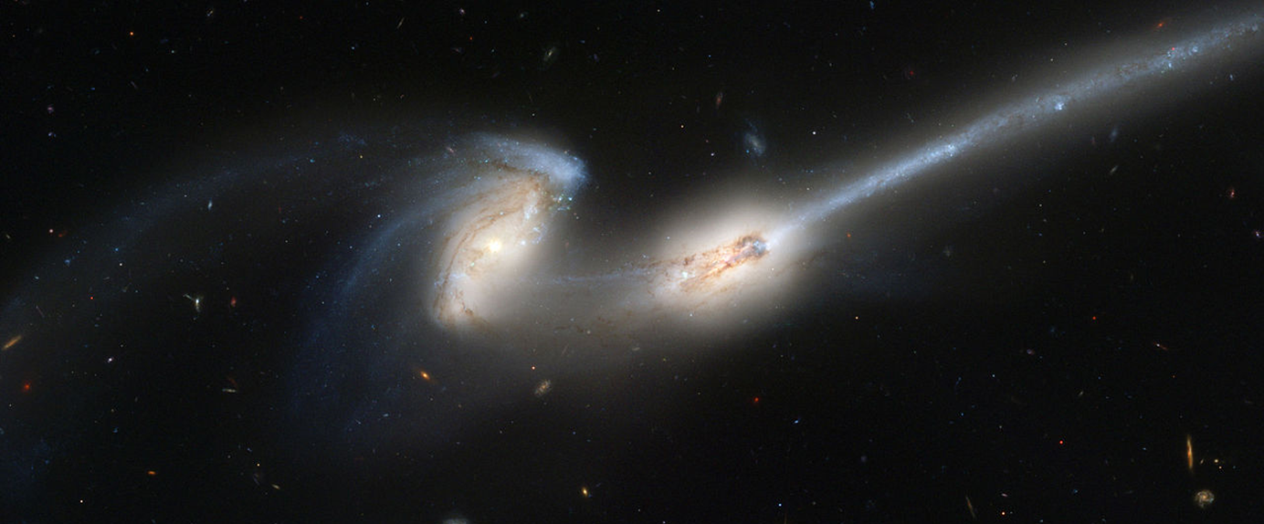
Impact of tides on intracluster light
Valérie Gendron
Source: ESA/Hubble
Supervisor: Hugo Martel
The Mice Galaxies NGC 4676. Source: NASA

Slide 2
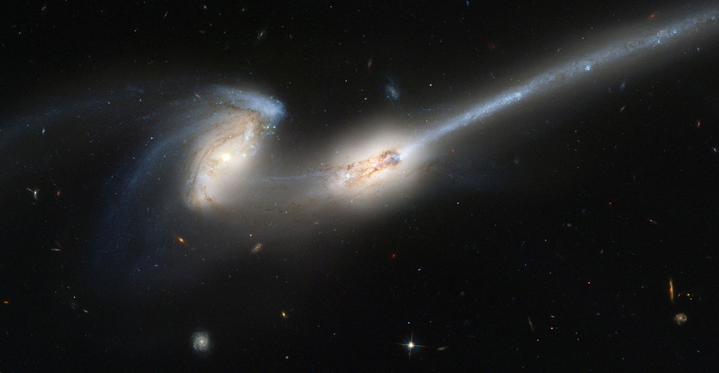
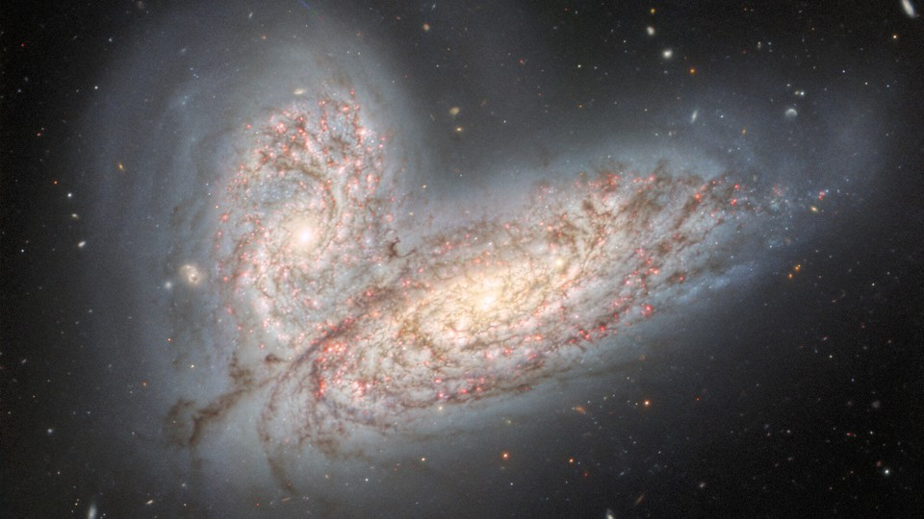
Origin of intracluster light (ICL)
Souce: NASA
Source: International Gemini Observatory
1
Tidal forces
2
Galaxy mergers
Notes:
Mécanismes de formation directs.

Slide 3
Contributions to ICL
1
Tidal forces
2
Galaxy mergers
Contini et al. (2023)

Slide 4
Contributions to ICL
1
$$\sim 90\%$$
2
$$\sim 10\%$$
Contini et al. (2023)

Slide 5
Objectives
Understanding the details of intracluster light production through tidal interaction
Is it mostly made up of stars that were already formed before the interaction?
Could the interaction trigger a starburst and add younger stars to the ICL?
Do these intracluster stars have a discernible chemical signature?
Detectable with observations?

Slide 6
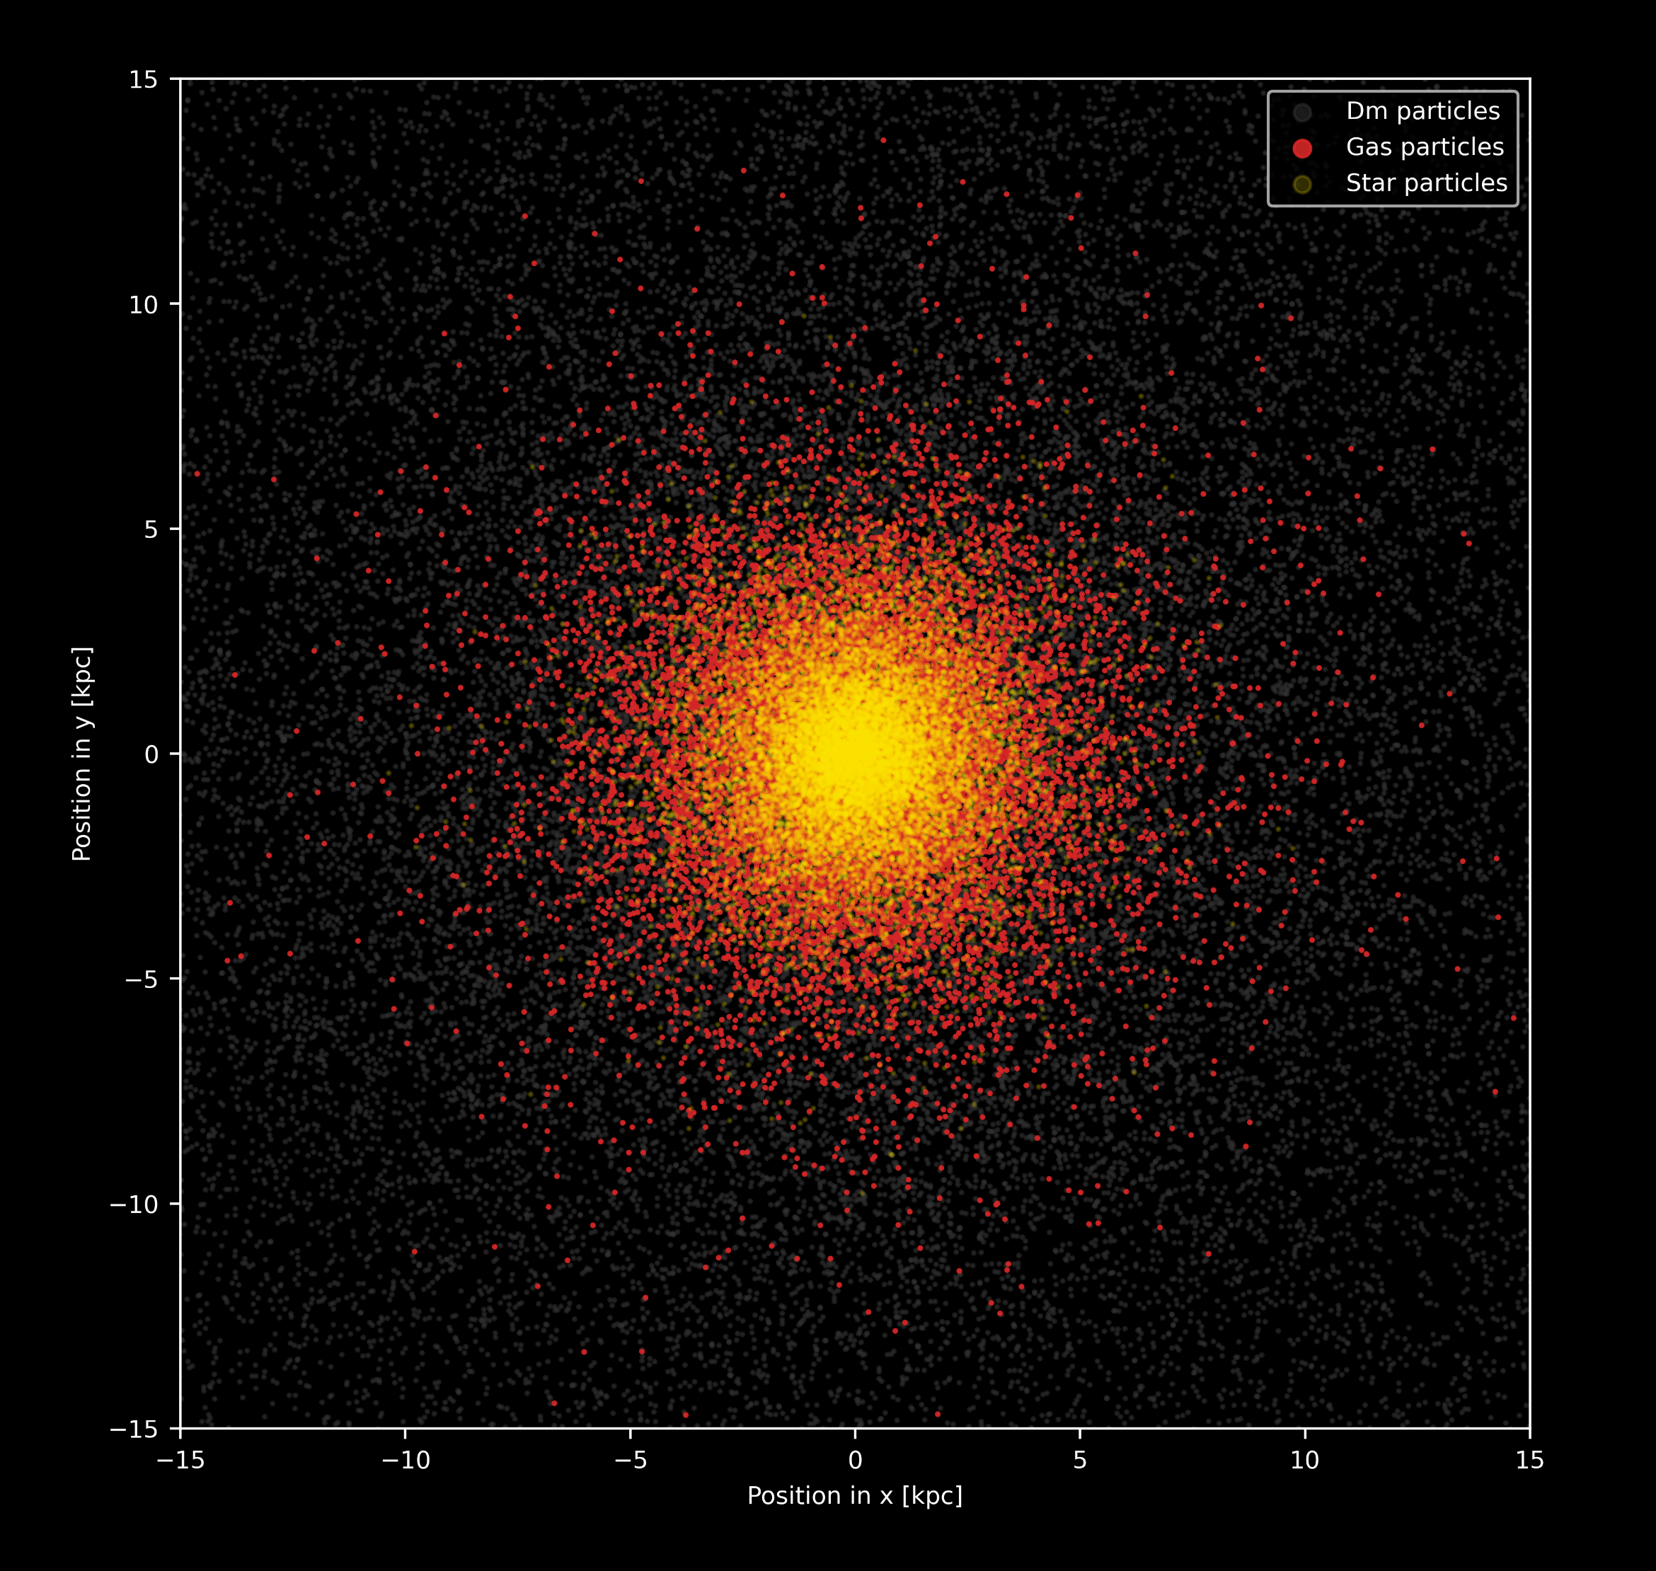
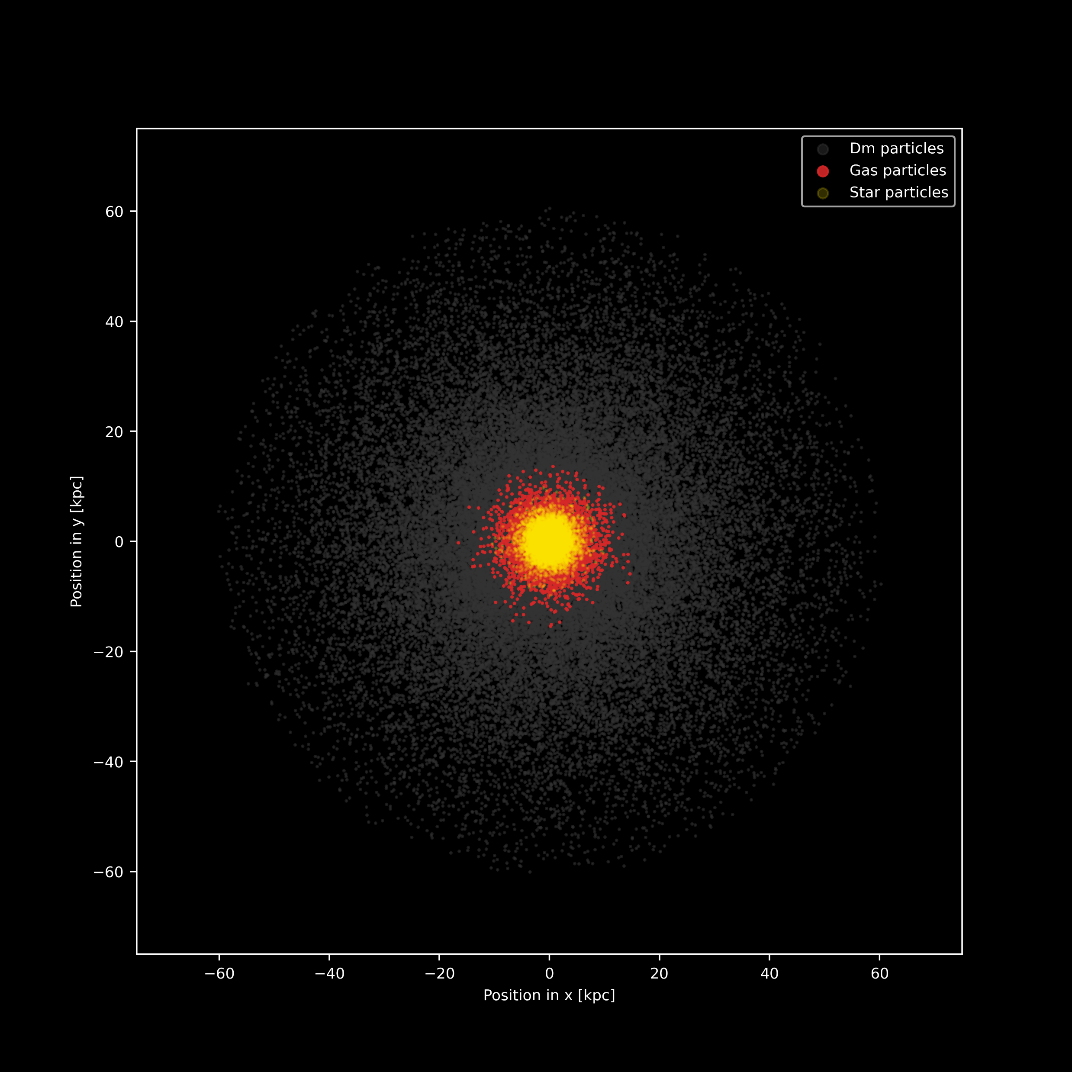
Simulations
Stellar formation
Run ISOL8_h
Stellar feedback
GCD+
Simulates dynamical and chemical evolution of isolated or interacting galaxies
Chemical enrichment
Dark matter Gas
Stars
Tidal field caused by massive galaxy
NEW!
Notes:
Run: ISOL8_h/TIDES8_h

Slide 7
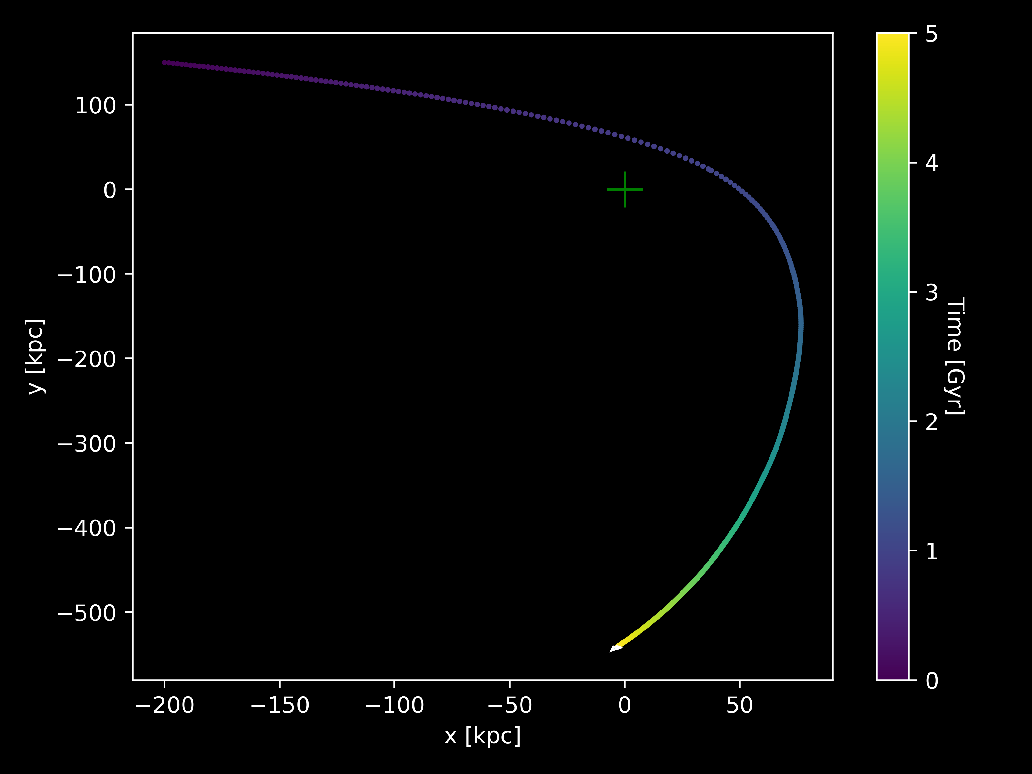
Simulations
Evolution for 5 Gyr
Stellar formation
Stellar feedback
GCD+
Simulates dynamical and chemical evolution of isolated or interacting galaxies
Chemical enrichment
Tidal field caused by massive galaxy
Run TIDES8_h_r2
NEW!
Notes:
Run: TIDES8_h_r2

Slide 8
Top view
Side view
Run TIDES6_h
Dark matter Gas
Stars
Notes:
Run: TIDES6_h

Slide 9
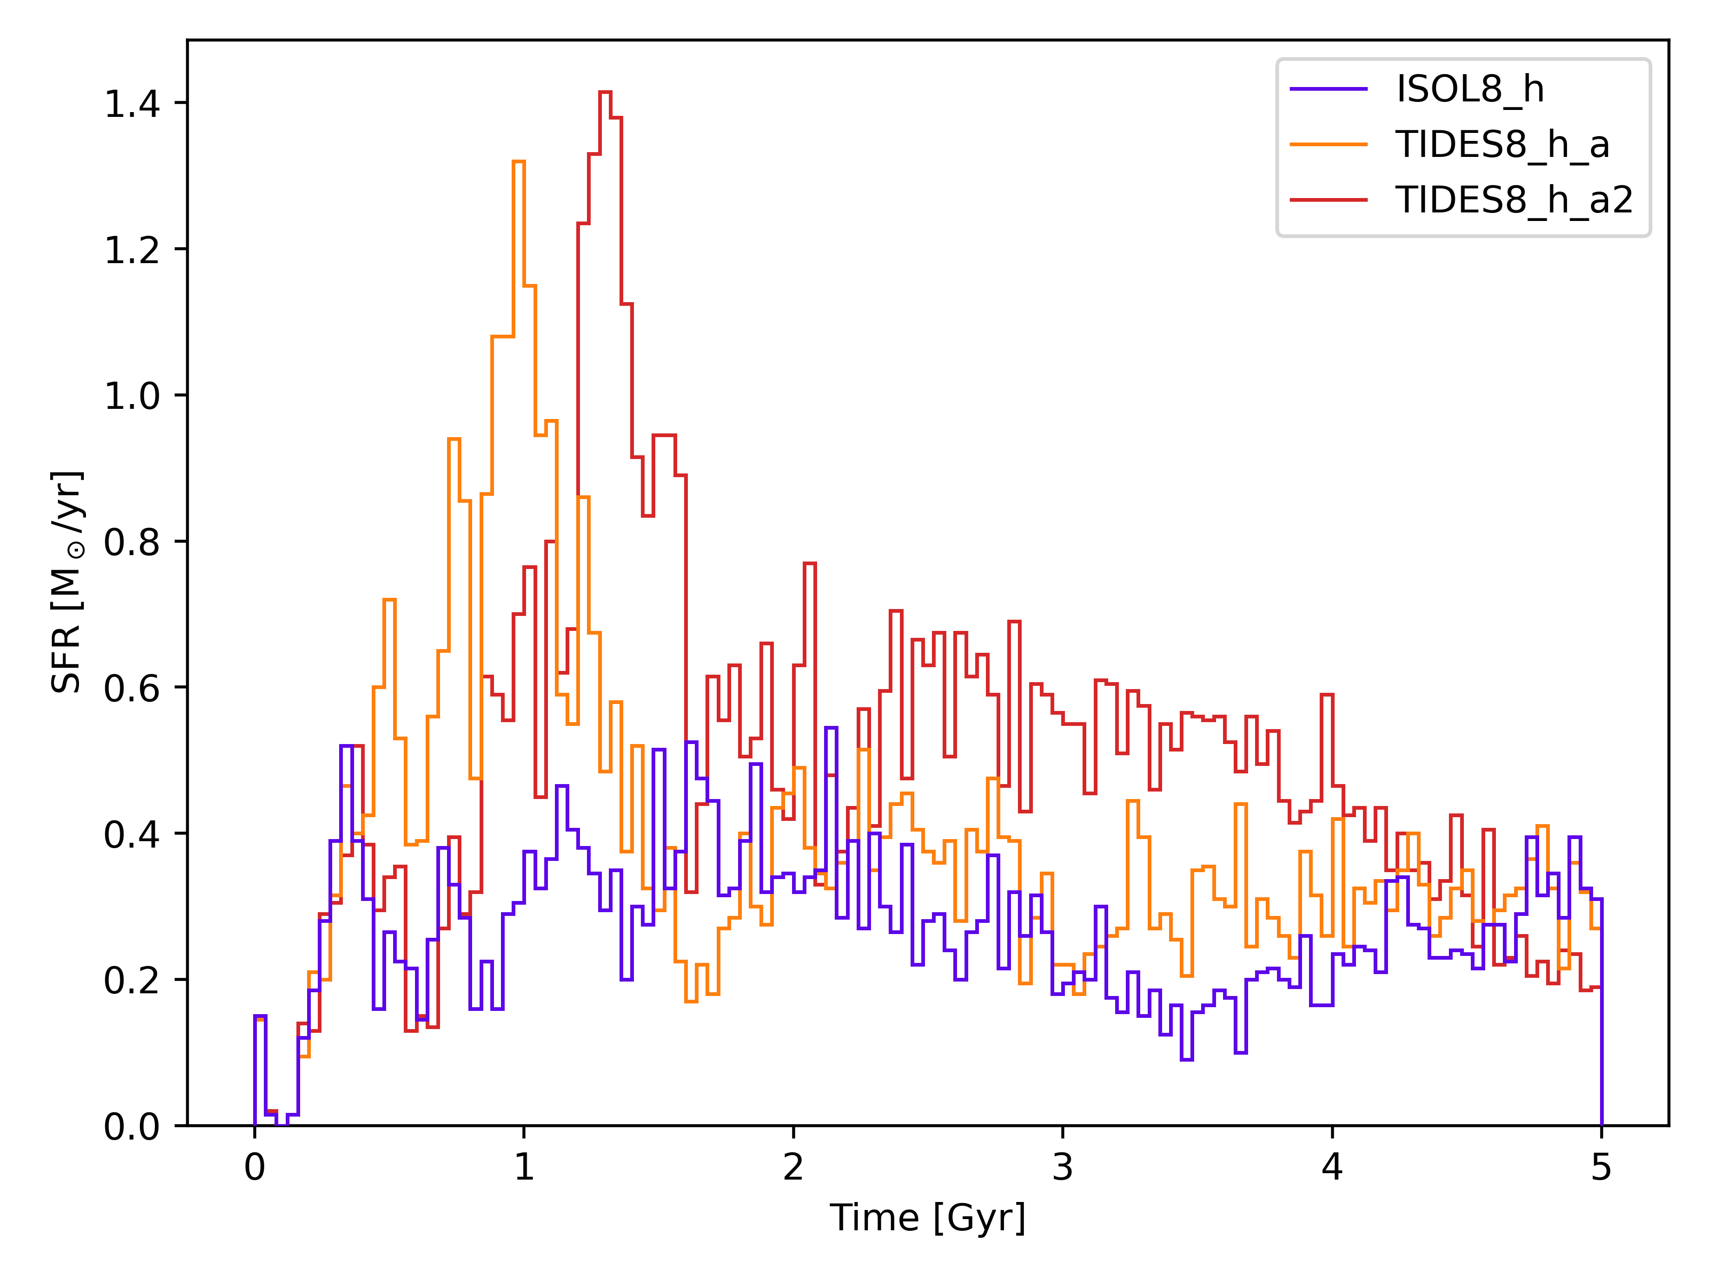
Isolated simulation
Simulations with tides
Star formation rate

Slide 10
Isolated simulation
Simulations with tides
Smallest distance
24.7 kpc at 0.4 Gyr
24.0 kpc at 0.79 Gyr
Notes:
Position du péricentre

Slide 11
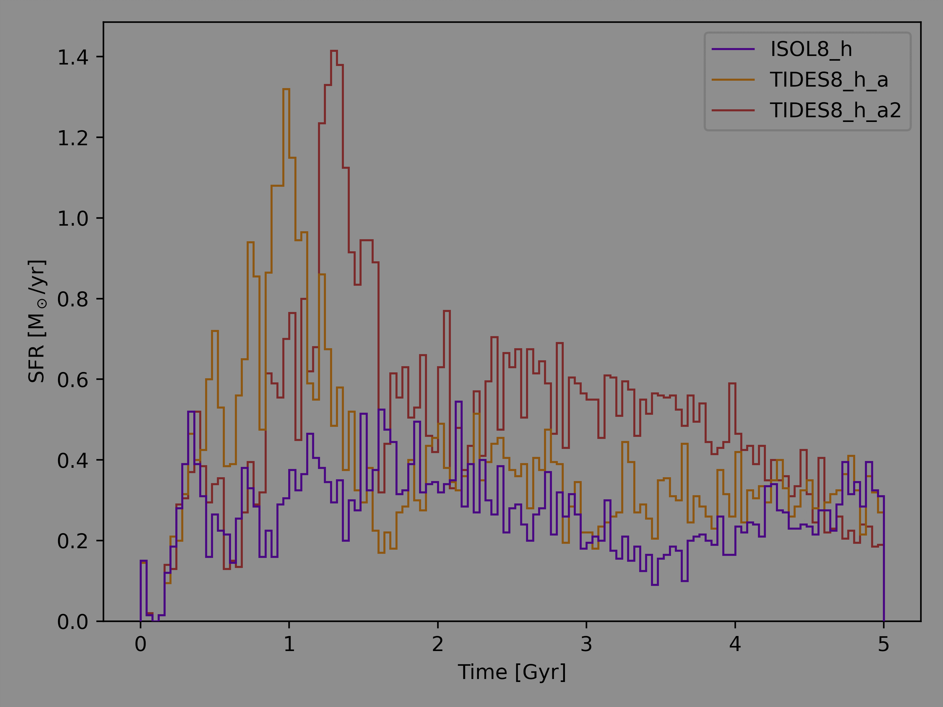
Isolated simulation
Simulations with tides
Smallest distance
24.7 kpc at 0.4 Gyr
24.0 kpc at 0.79 Gyr

Slide 12
Isolated simulation
Simulations with tides
Smallest distance
24.7 kpc at 0.4 Gyr
24.0 kpc at 0.79 Gyr

Slide 13
Isolated simulation
Simulations with tides
Smallest distance
24.7 kpc at 0.4 Gyr
24.0 kpc at 0.79 Gyr

Slide 14
Bound stars
Intracluster stars
Gravitational potential energy of galaxy
Kinetic energy of particle
$$>$$
Run TIDES8_h_p_mm
Notes:
Run: TIDES8_h_p_mm

Slide 15
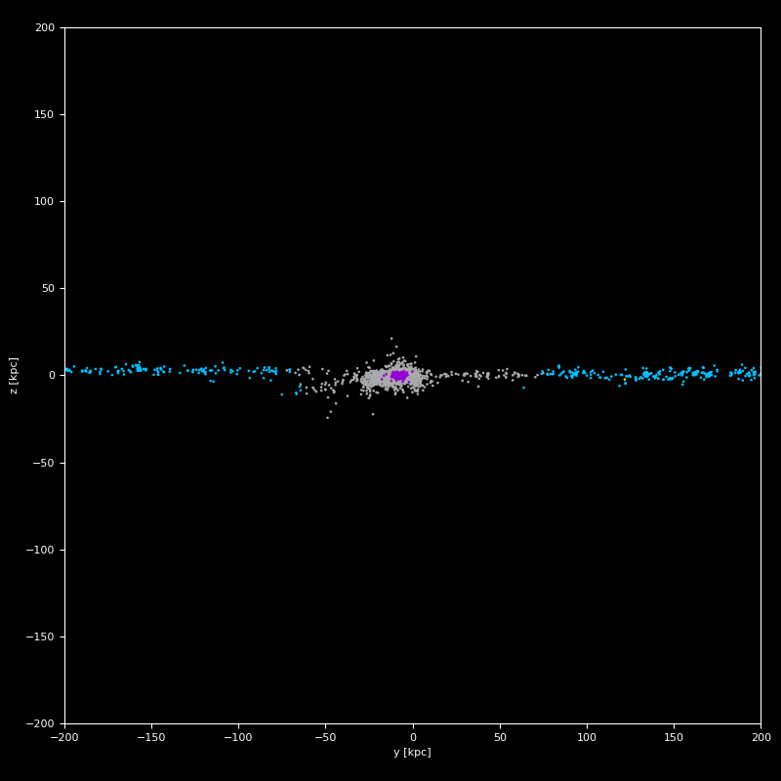
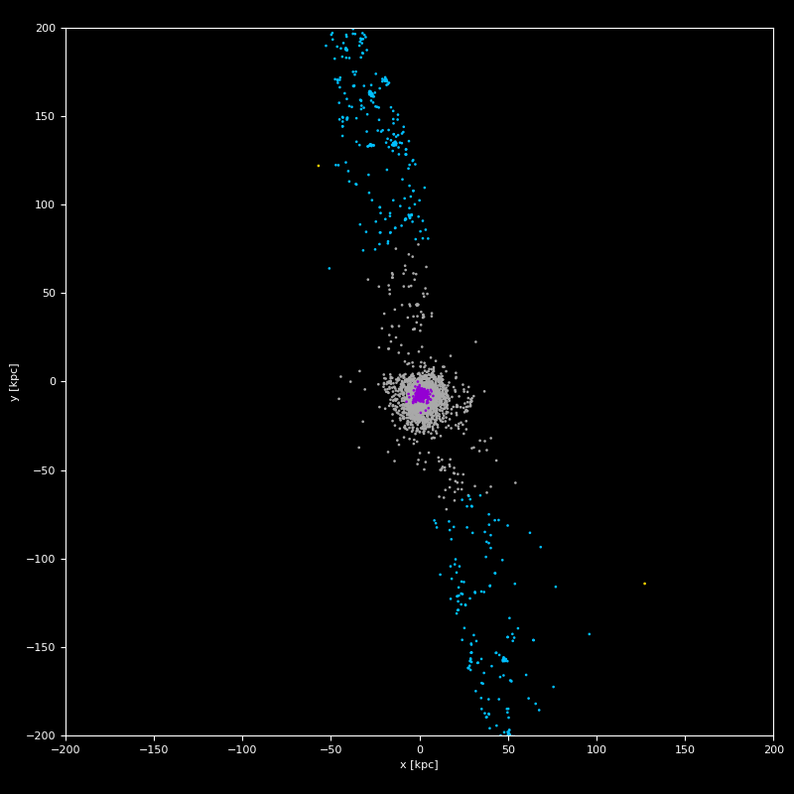
Side view
Metallicity
Old and bound
New and bound
Old and ICL
New and ICL
Top view
Run TIDES8_h_p3_mm
Notes:
Run: TIDES8_h_p3_mm

Slide 16
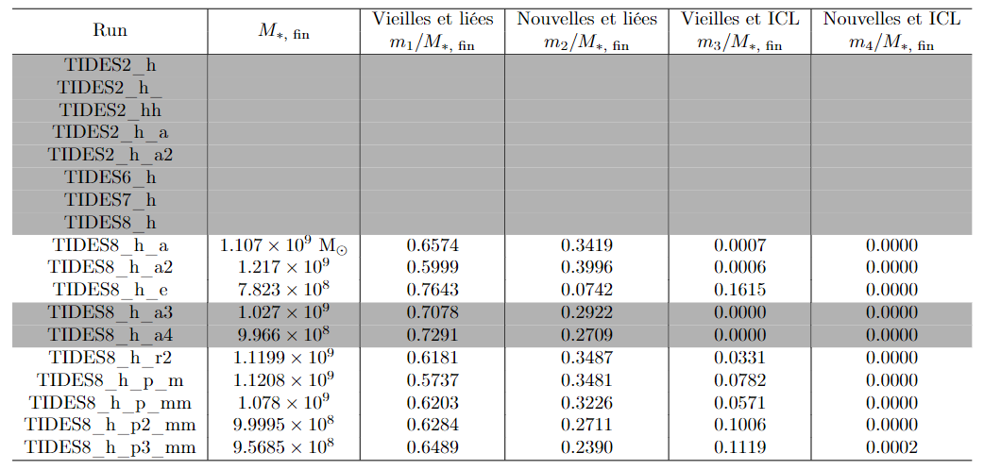
Metallicity
Notes:
Run: TIDES8_h_p3_mm

Slide 17
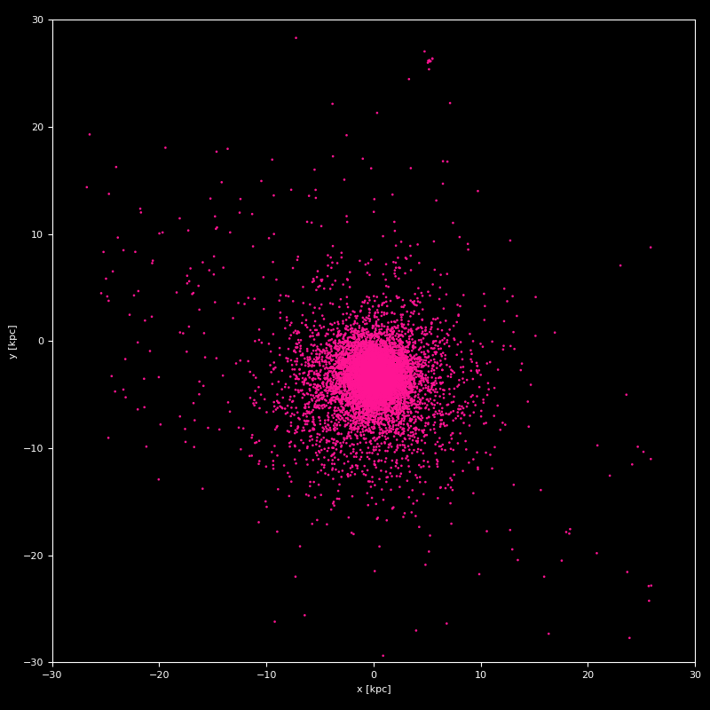
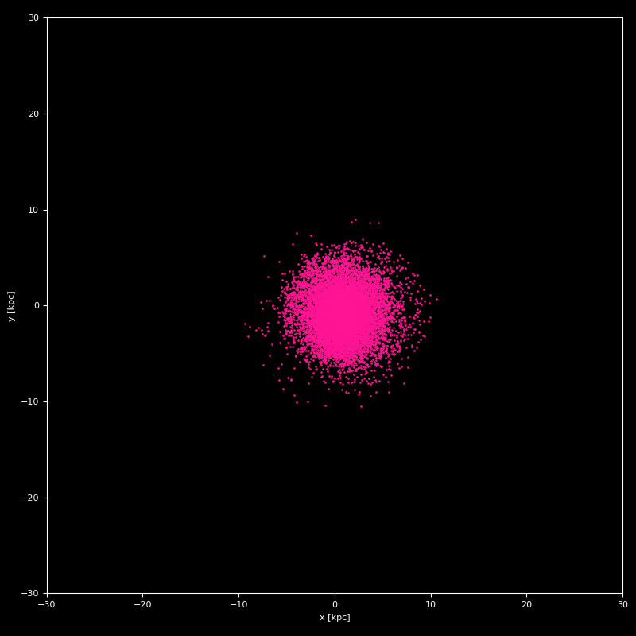
Remanent of run with tides, at 5 Gyr
Other isolated run, at 5 Gyr
Run TIDES8_h_p2_mm
Run ISOL_A
$$M_{∗}=8.99×{10}^{8}{ M}_{\text{☉}}$$
$$M_{∗}=8.91×{10}^{8}{ M}_{\text{☉}}$$
Notes:
Runs: TIDES8_h_p2_mm (gauche) et ISOL_A (droite)

Slide 18
Thank you!

Slide 20
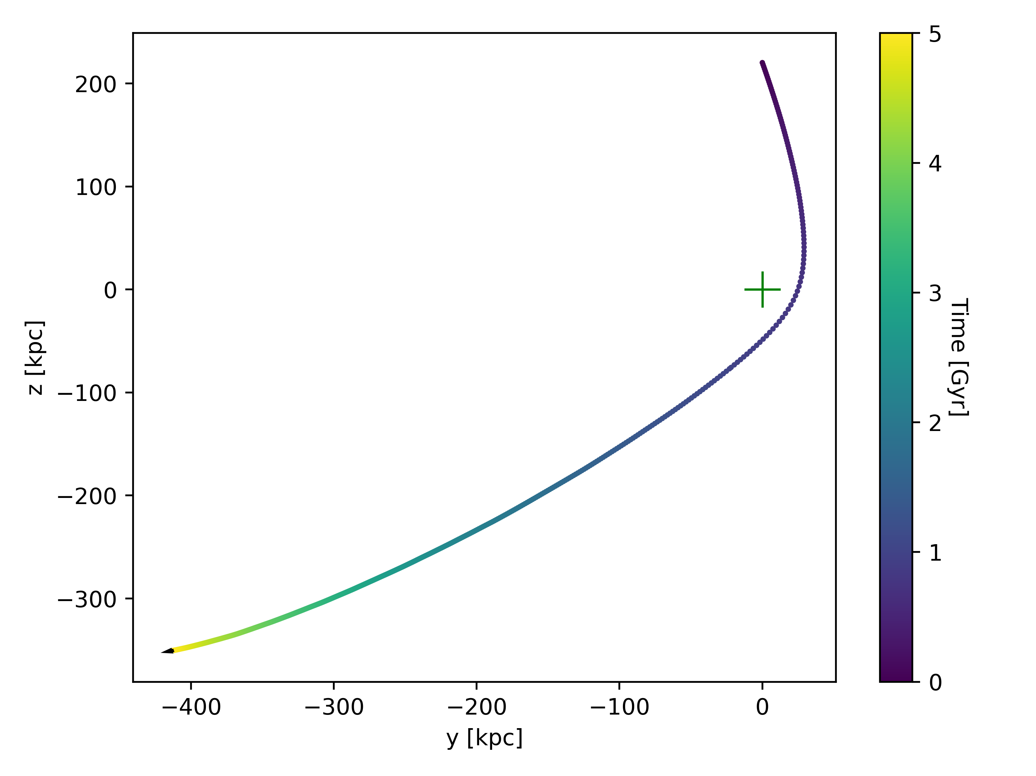
TIDES8_h_a
TIDES8_h_a2

Slide 21
