Slide 1
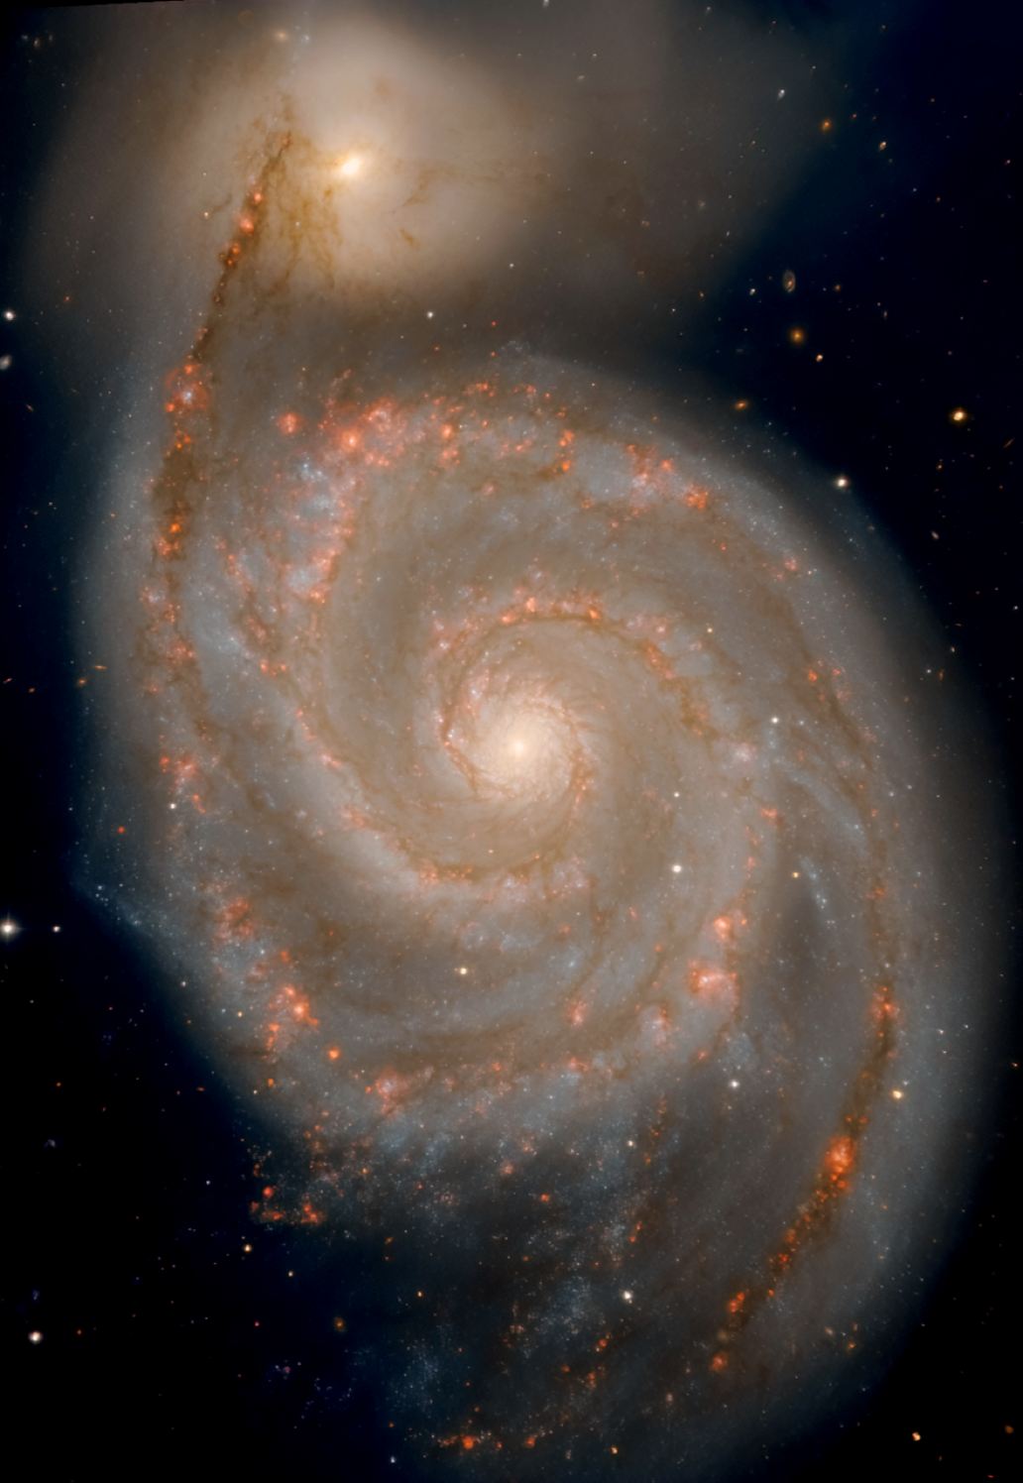
Billy Gamache – May 2024
Supervised by Laurent Drissen and Carmelle Robert
Characterization of M51's supernova remnants with the imaging spectrometer SITELLE

Slide 2
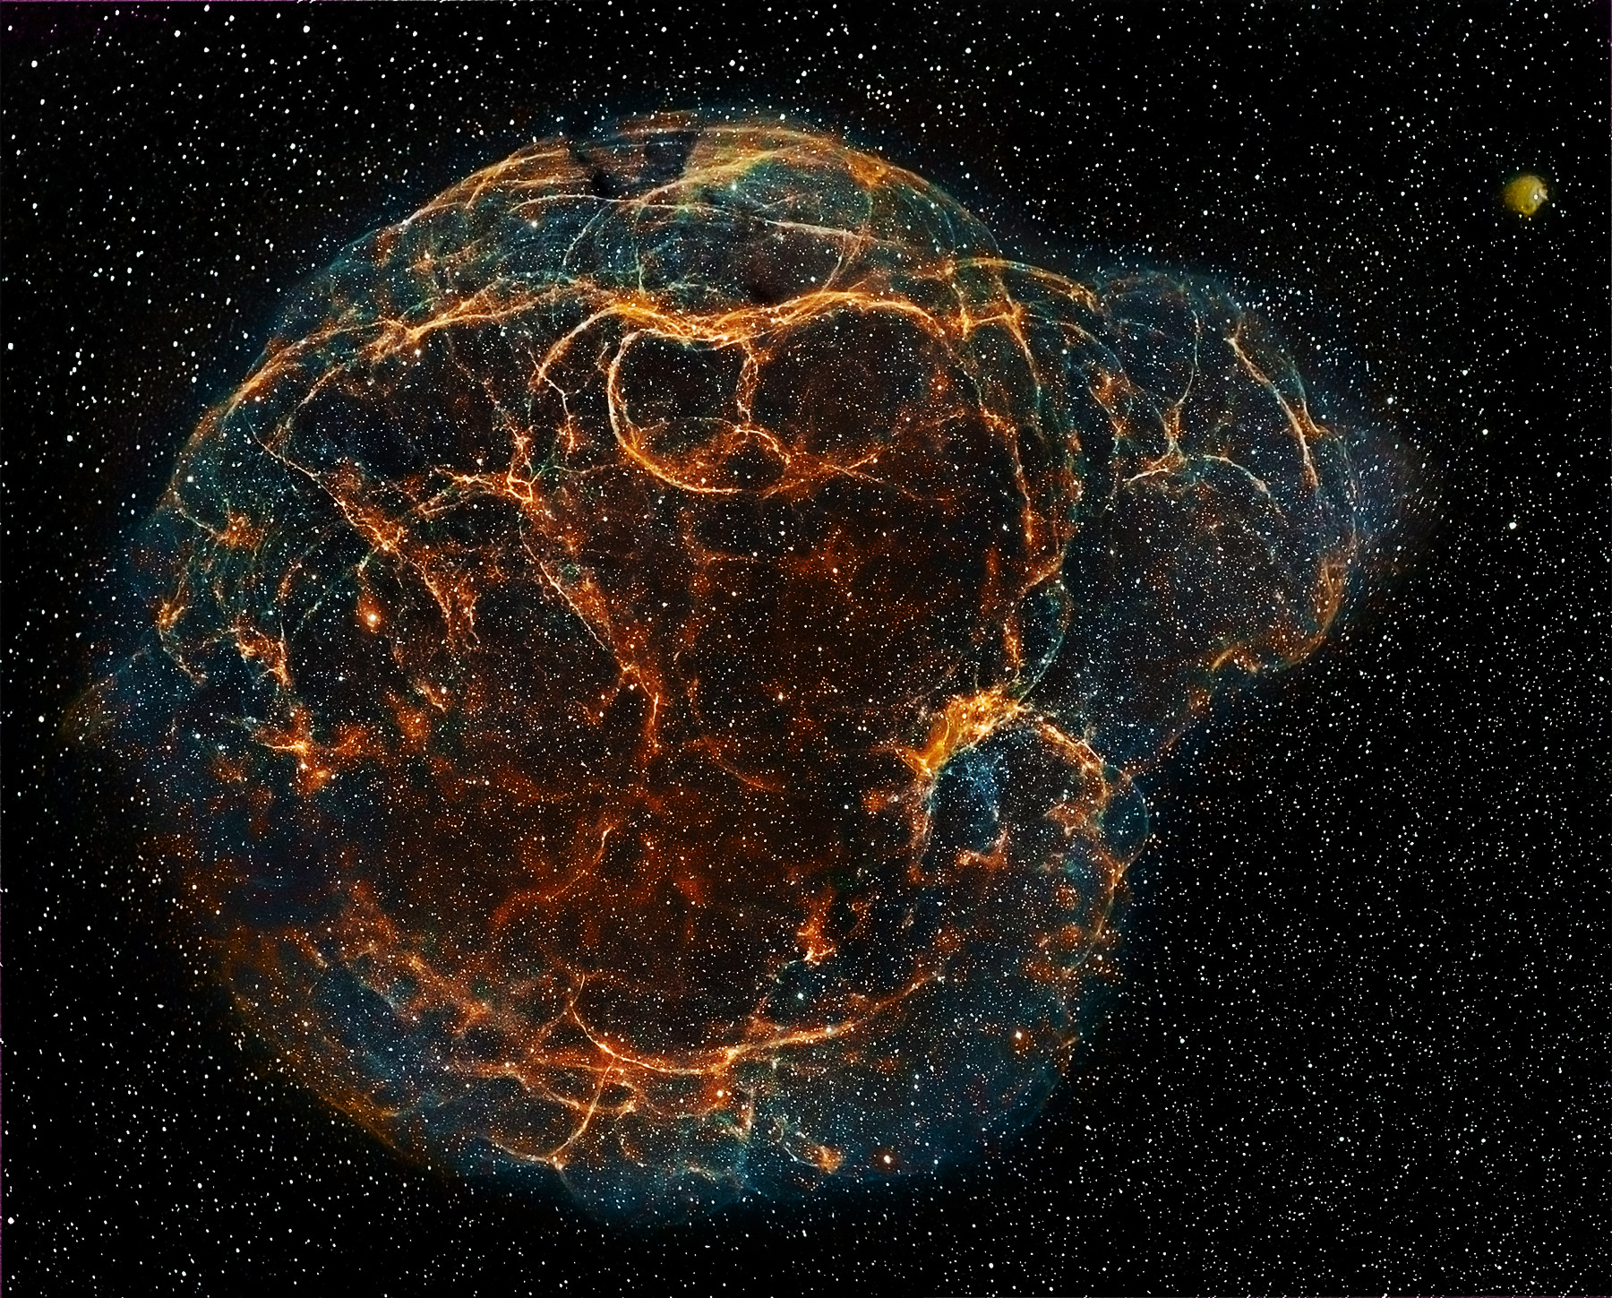
Why study SNRs ?
Simeis 147
Following star death, massive quantities of new materials and kinetic energy are ejected in the interstellar medium (ISM).
The shock-driven interaction between the ejecta and the ISM is making the SNR shine for thousands of years.
As supernovae are key elements to understand chemical evolution of galaxies and the ISM, studying SNRs properties on galaxy scale provides significant information on ISM enrichment.

Slide 3
M51 : an ideal candidate !
M51 : an ideal candidate !
Faced-on orientation (almost!)
Close (relatively!) -> ~9 Mpc
M51 as seen by SITELLE (Deepfield + Hα)
Interaction with NGC-5195

Slide 4
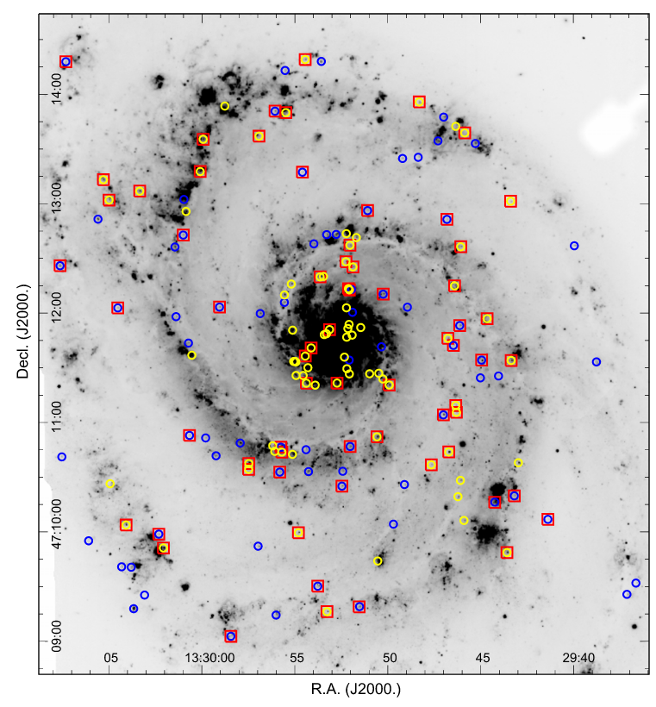
M51 : an ideal candidate !
Previous survey : Winkler et al. 2019
Candidates detection via Hubble's data
Confirmation criteria :
Winkler et al. (2019)
[SII]:Hα > 0.4
179 Candidates
61 spectroscopically confirmed

Slide 5
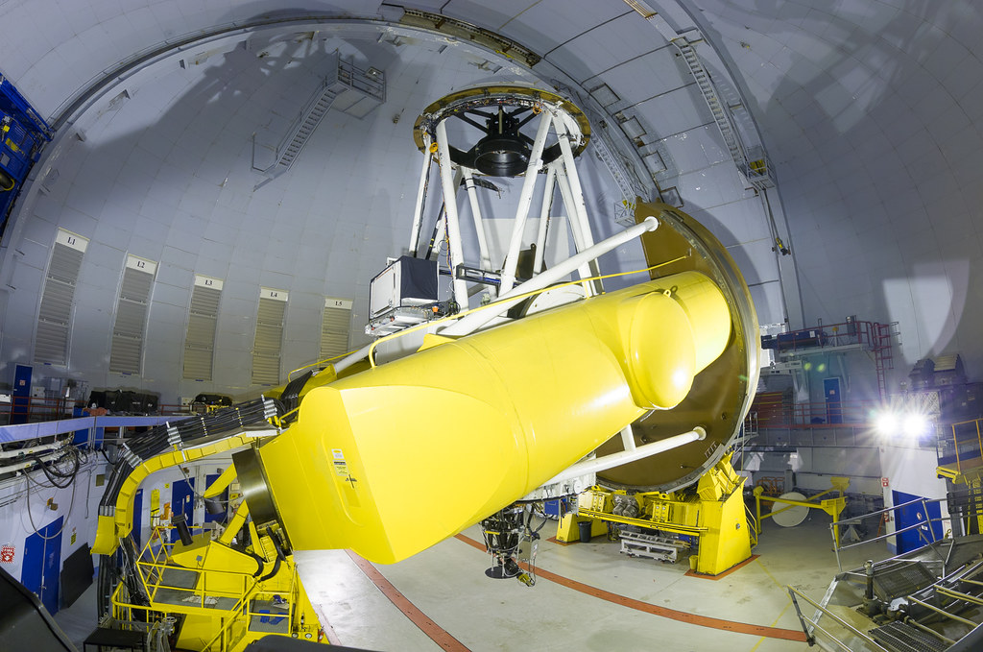
The goal of this project : Review Winkler et al. M51's SNRs spectral properties with SITELLE data cube while looking for undiscovered candidates.
SN3 filter :
Wavelengths : 648-685 nm
Field of view : 11'x11'
Spectral resolution : 5000
Total exposure time : 4h

Slide 6
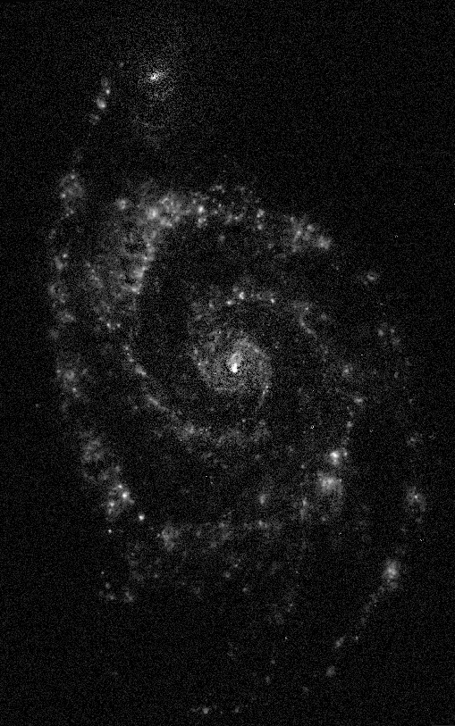
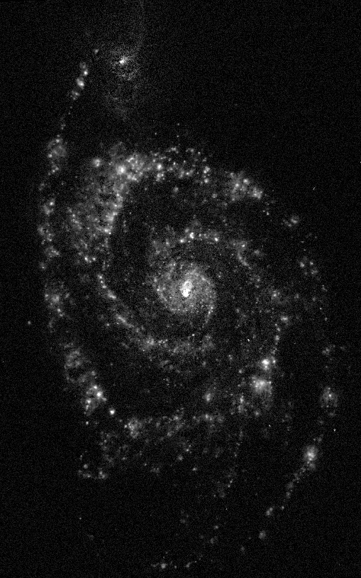
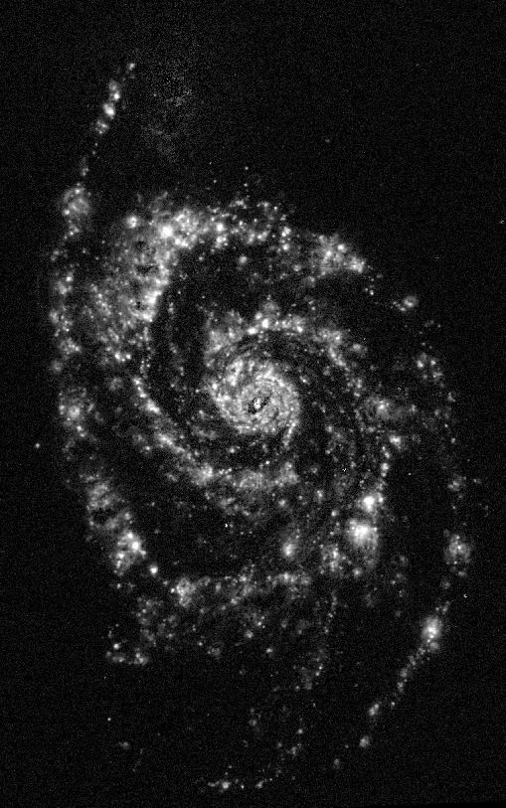
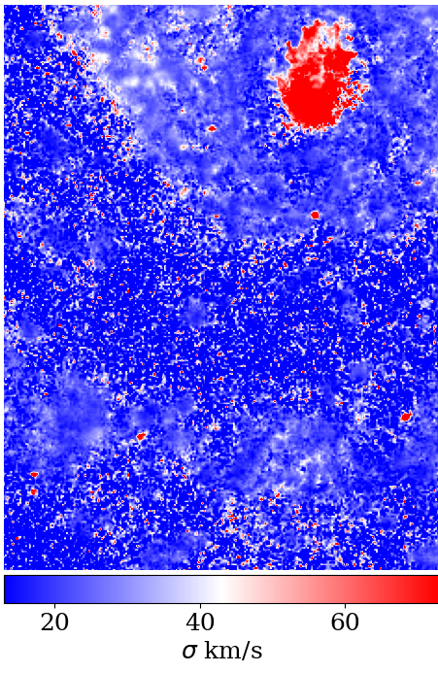
SITELLE SN3 data cube
Maps
[SII]λ6731+6716
[NII]6583
Hα
Velocity dispersion

Slide 7
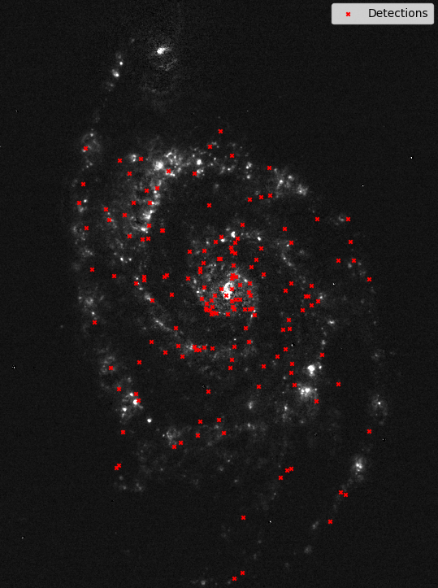
Candidates detection and spectrum fit
1. Emission peaks detection
-> Visual and detection code

Slide 8
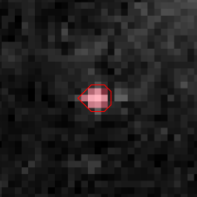
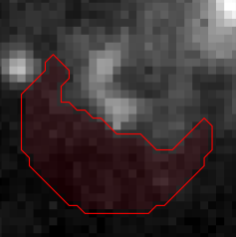
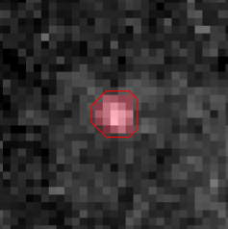
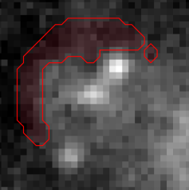
Candidates detection and spectrum fit
Domains
Backgrounds
1. Emission peaks detection
-> Visual and detection code
2. Domain and background definition
-> Using a flux threshold
140 pc

Slide 9
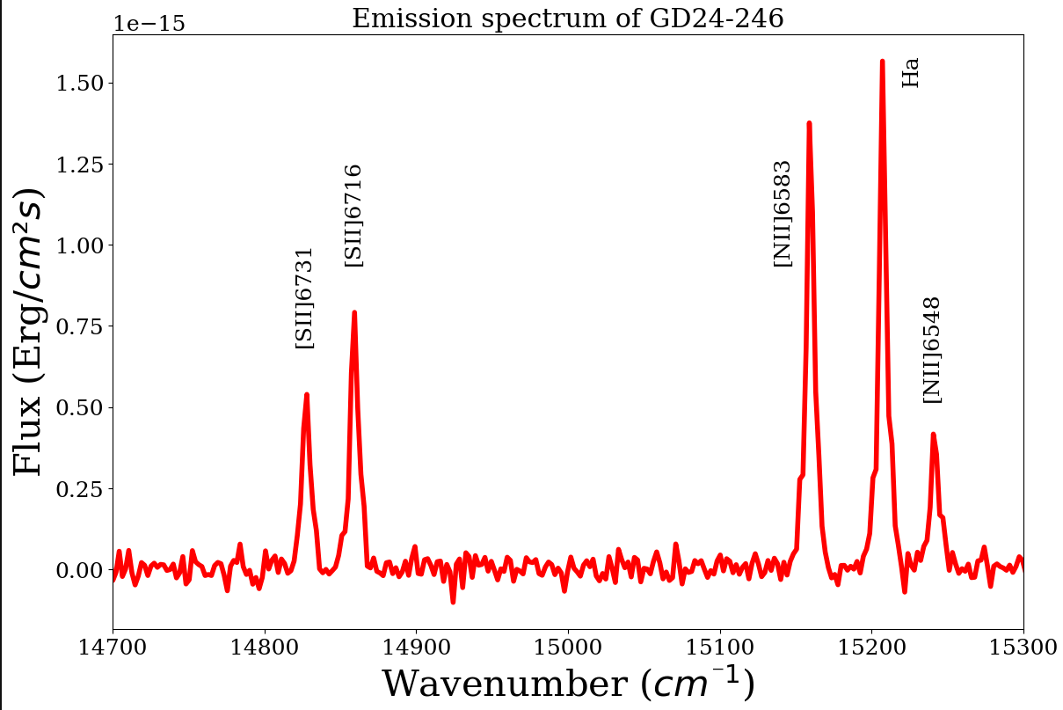
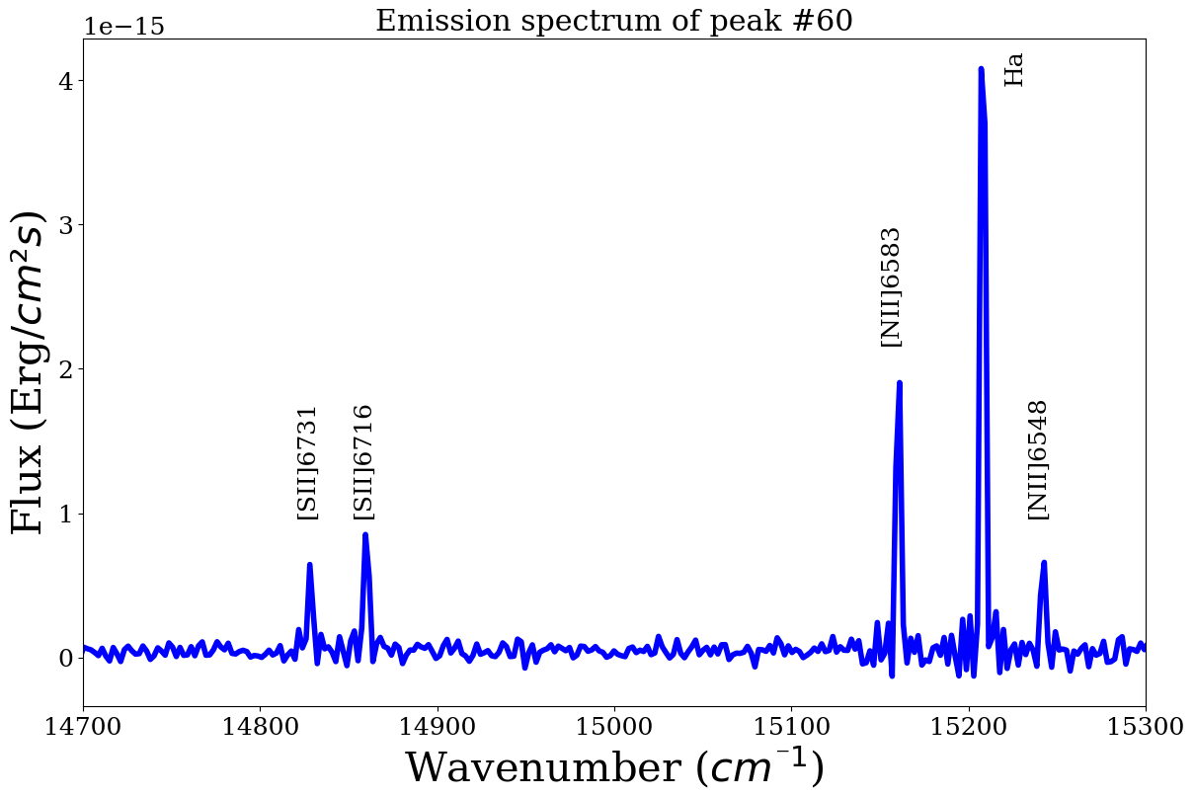
Candidates detection and spectrum fit
Supernova remnants
1. Emission peaks detection
-> Visual and detection code
2. Domain and background definition
-> Using a flux threshold
HII region
3. Spectrum fit and SNRs confirmation
-> Probing SNRs properties
[SII]:Hα > 0.4
𝜎 > 30 km/s

Slide 10
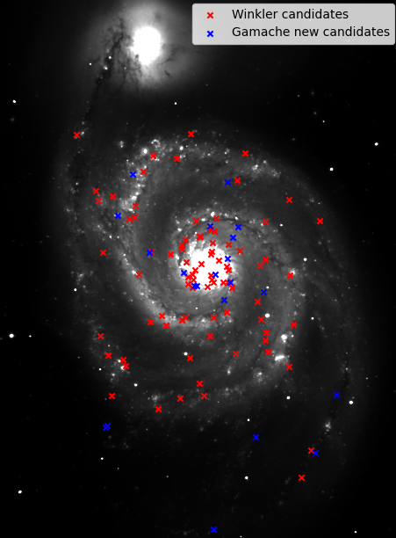
Results : Comparison with Winkler survey
101 of the 283 candidates analyzed are confirmed SNRs.
81 are Winkler's Candidates
20 are newly discovered SNRs
Criteria classification
94 of the SNRs have [SII]:Hα > 0.4 and at least Hα or [NII] velocity dispersion above 30 km/s.

Slide 11
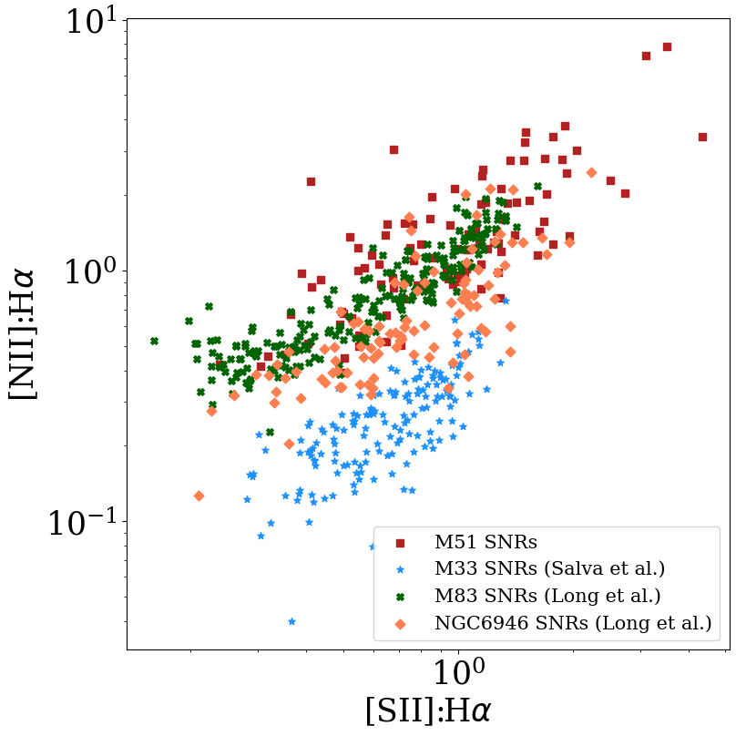
Results : Comparison with other spirals
M51 clearly tends to higher [SII]:Hα and [NII]:Hα values, compared with other spirals.
That trend indicates high metallicity in M51 galaxy.

Slide 12
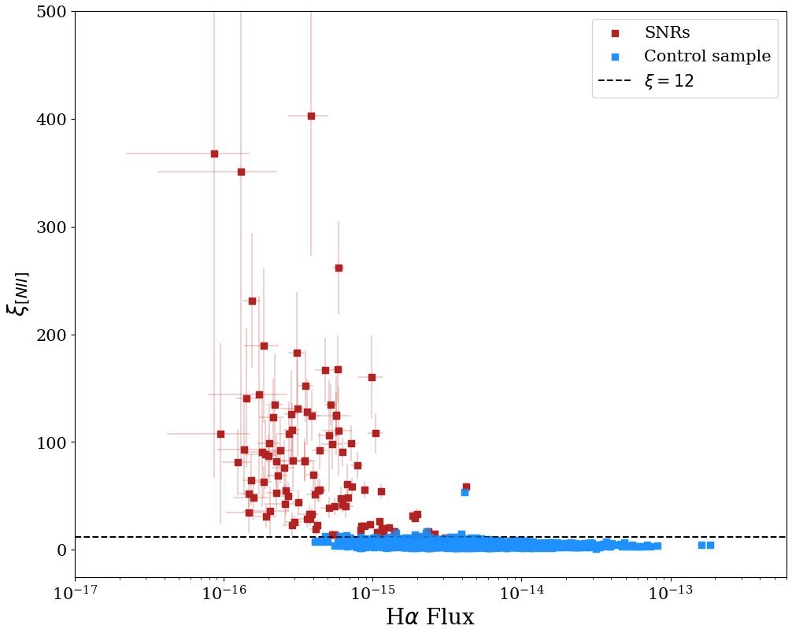
Results : Comparison with control sample
Control sample :
HII regions and DIG
Median 𝜉 ~ 5
Only 2% of the control sample has 𝜉 > 10
𝜉 = [SII]:H𝛼 × 𝜎([NII])
SNRs :
Median 𝜉[NII] ~ 59
95% of the SNRs has 𝜉 > 15
2051 emission regions

Slide 13
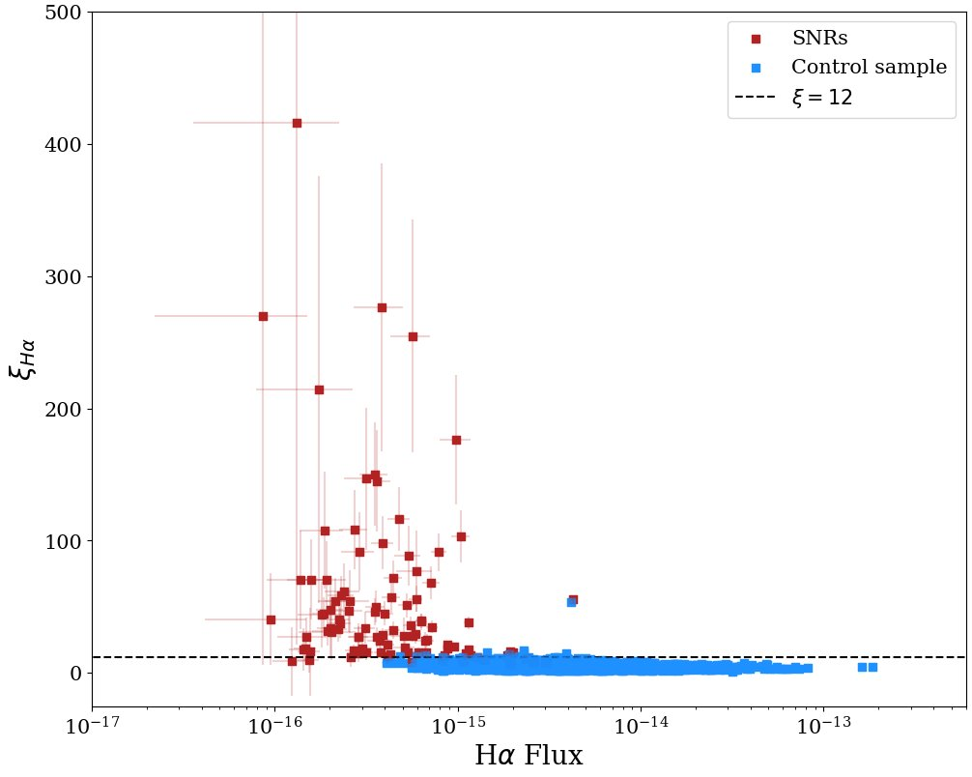
Results : Comparison with control sample
SNRs :
Median 𝜉 ~ 30
80% of the SNRs has 𝜉 > 15
𝜉 = [SII]:H𝛼 × 𝜎(H𝛼)
There is a clear indication that velocity dispersion from the model for the Hα line tends to be lower than for the [NII] lines.
In some cases, model inspection has motivated two components fitting for Hα line.

Slide 14
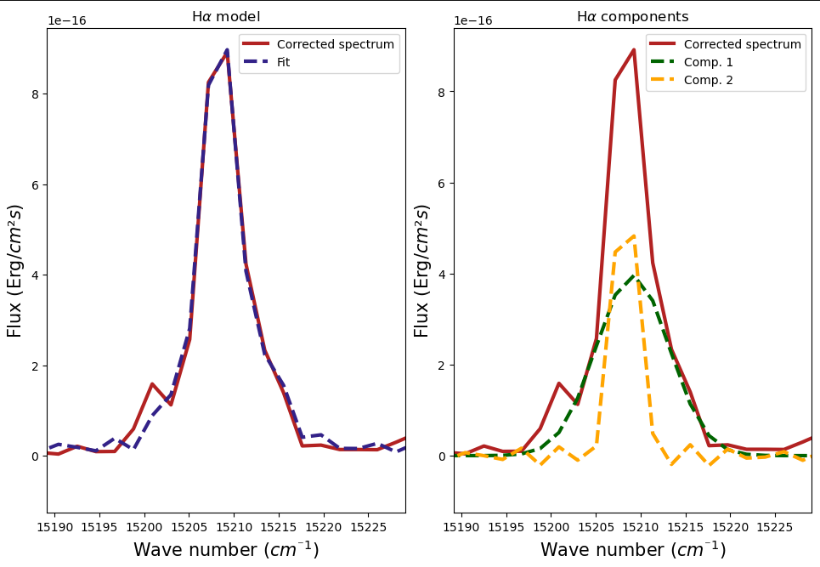
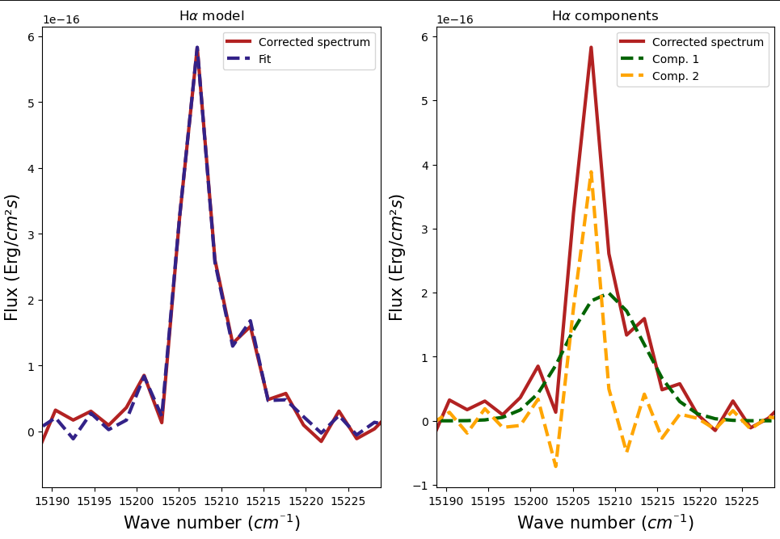
Results : Multi components fitting
Of the 31 SNRs that have been selected for two Hα component analysis, 10 are showing a broad line with S/N > 3 and 4 with S/N > 5.
Possible origins of broad and narrow components :
Background contamination.
Non-radiative shocks (broad) and shocks in SNR knots (narrow) -> Balmer-dominated SNR ?

Slide 15
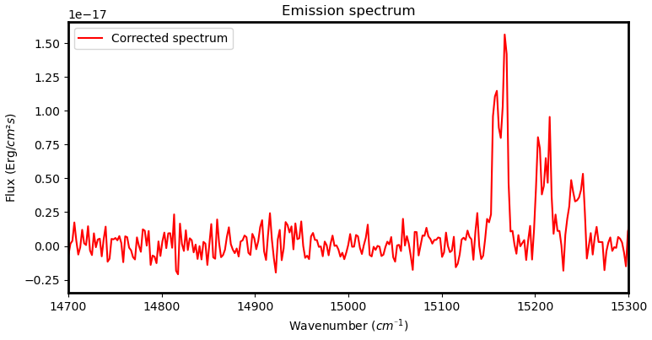
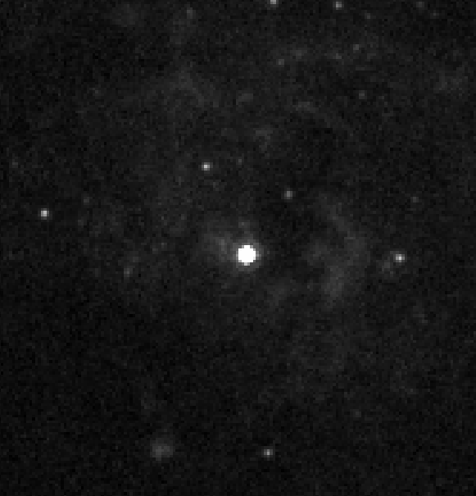
Results : A mysterious detection
Unresolved in Hubble F658N
V = -7.27 mag
B = -6.9 mag
ΔV~210 km/s
Hypothesis :
LBV nebula

Slide 16
Conclusion
SITELLE's SN3 data cube has allowed to make a complete spectral analysis of SNRs candidates in M51 from Winkler's surveys and to confirm 20 new.
The 𝜉 parameter analysis has shown clear differences between velocity dispersion of the Hα and [NII] lines.
A two-component analysis of the Hα lines showed that in some cases, a broad line is superimposed on the narrow line.

Slide 17
Questions session and...

