Slide 1
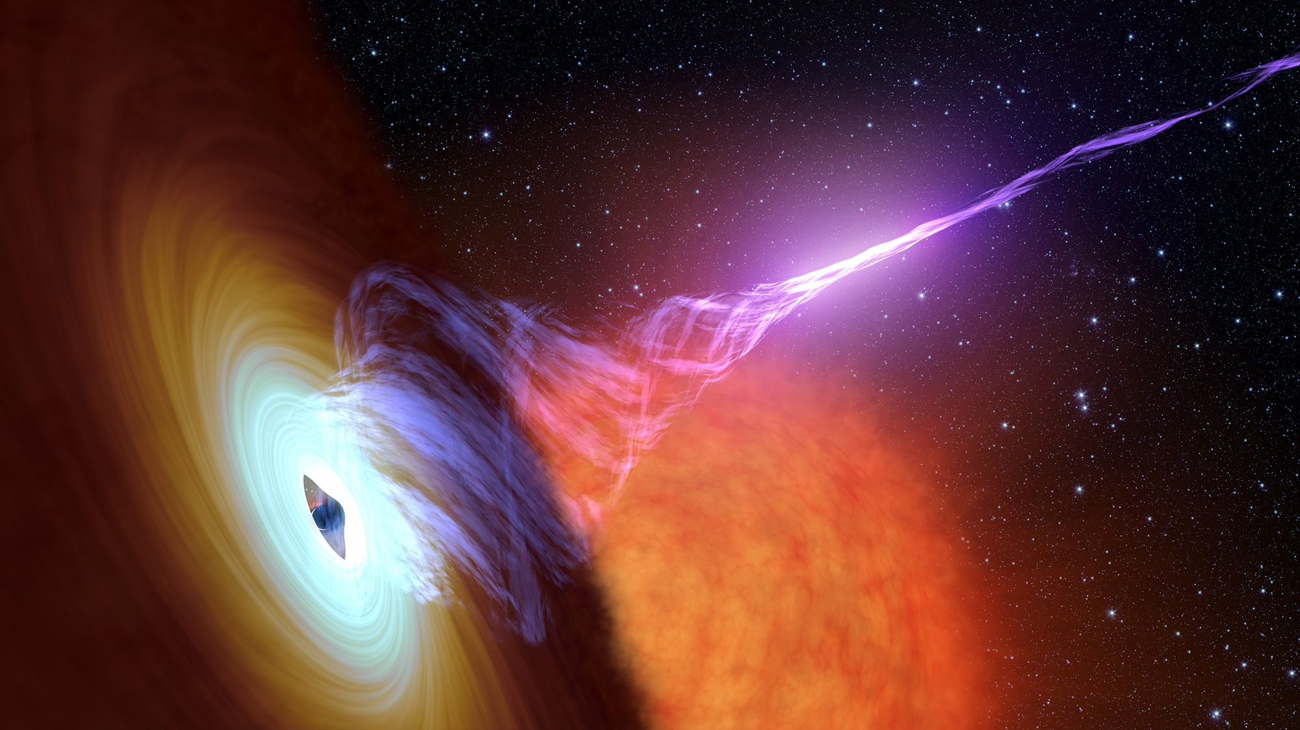
Monitoring X-ray Variability in Nearby Low Luminosity AGNs with NICER and NuSTAR
By: Nicole Ford, PHD Y1 McGill University
Advisor: Daryl Haggard
Image Credit: NASA/JPL-CALTECH

Slide 2
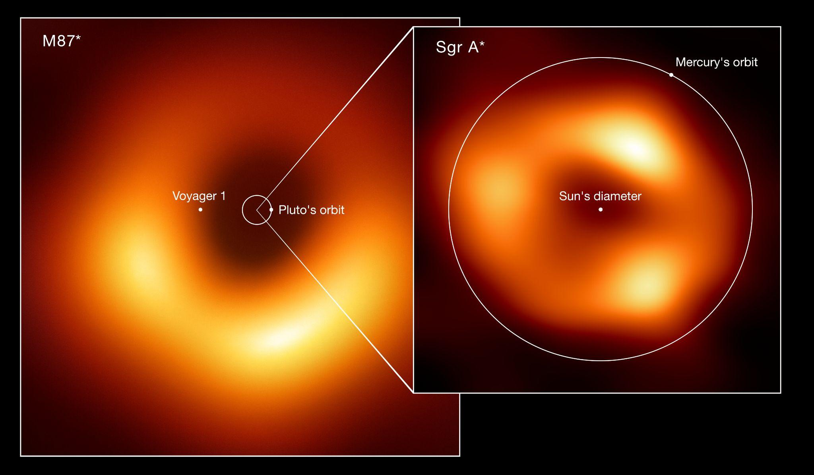
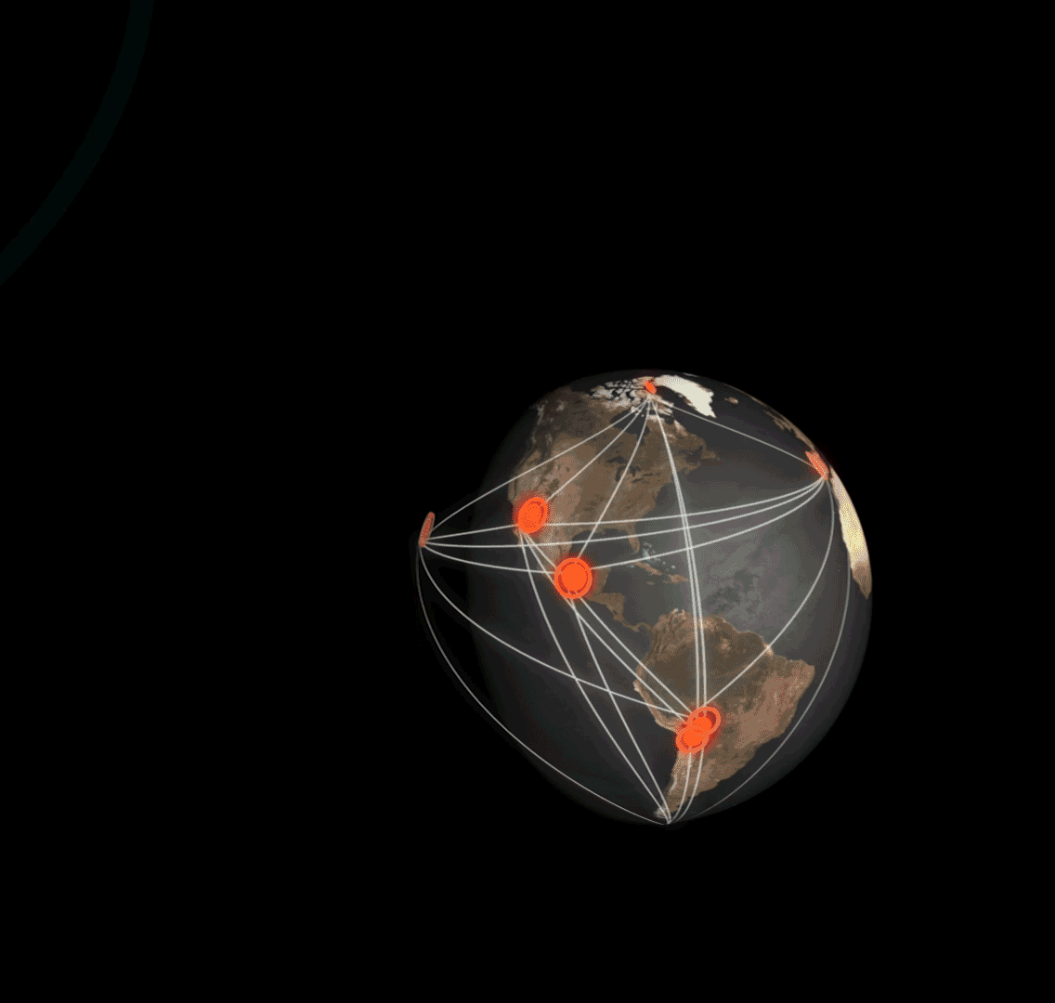
Near-Horizon Emission with EHT
M87*
Sgr A*
11 Observatories
(Very Long Baseline Interferometry)
EHTC et al., 2022
EHTC et al., 2019
Image Credit: EHT Collaboration
Notes:
https://eventhorizontelescope.org/array
Note: the angular sizes of these two event horizons are comparable, but their actual sizes are quite different: M87 spans a bit more than the distance traveled by Voyager 1, while SgrA* is close to the size of Mercury’s orbit.
“I’d like to highlight some other EHT results”

Slide 3
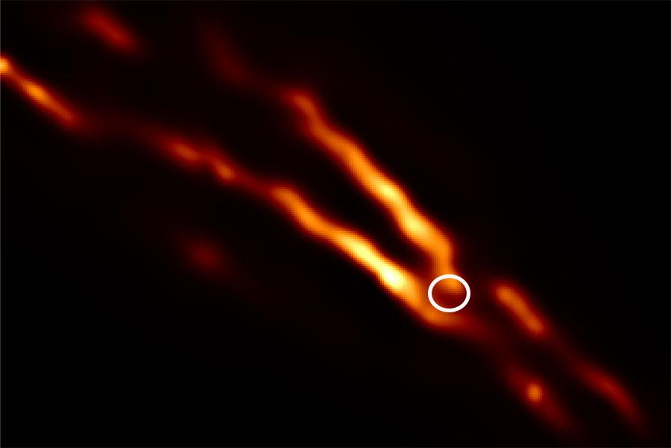
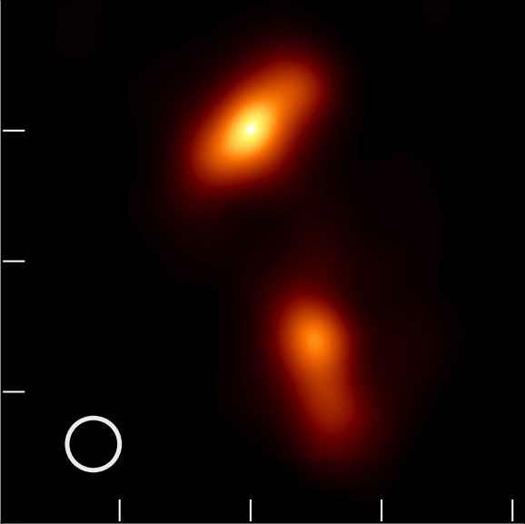
Near-Horizon Emission with EHT
CenA
3C279
J1924–2914
Janssen et al., 2021
= EHT+ALMA beam size
(~20μas, like seeing a donut on the Moon)
Kim et al., 2020
Issaoun et al., 2022
NRAO530
M87*
Sgr A*
Jorstad et al., 2023
Notes:
Start w/20 mas thing, here are some other images EHT has released for AGN that are slightly smaller and/or further away
https://eventhorizontelescope.org/array
20 microas resolution is like seeing a donut that’s on the moon :)
3C279 elongated core region, could be jet base or bent jet (rotating over time?) https://www.aanda.org/component/article?access=doi&doi=10.1051/0004-6361/202037493&#figs
J1924 precessing jet and compact core region
https://iopscience.iop.org/article/10.3847/1538-4357/ac7a40
NRAO530 bright core, polarization indicates magnetic field-powered w/helical shape
https://iopscience.iop.org/article/10.3847/1538-4357/acaea8
CenA Double sided jet “sheaths” viewed from the side – high E emission beamed along the “spine” away from our line of sight appears dark, but slower moving particles along the perimeter emit light in a variety of directions

Slide 4
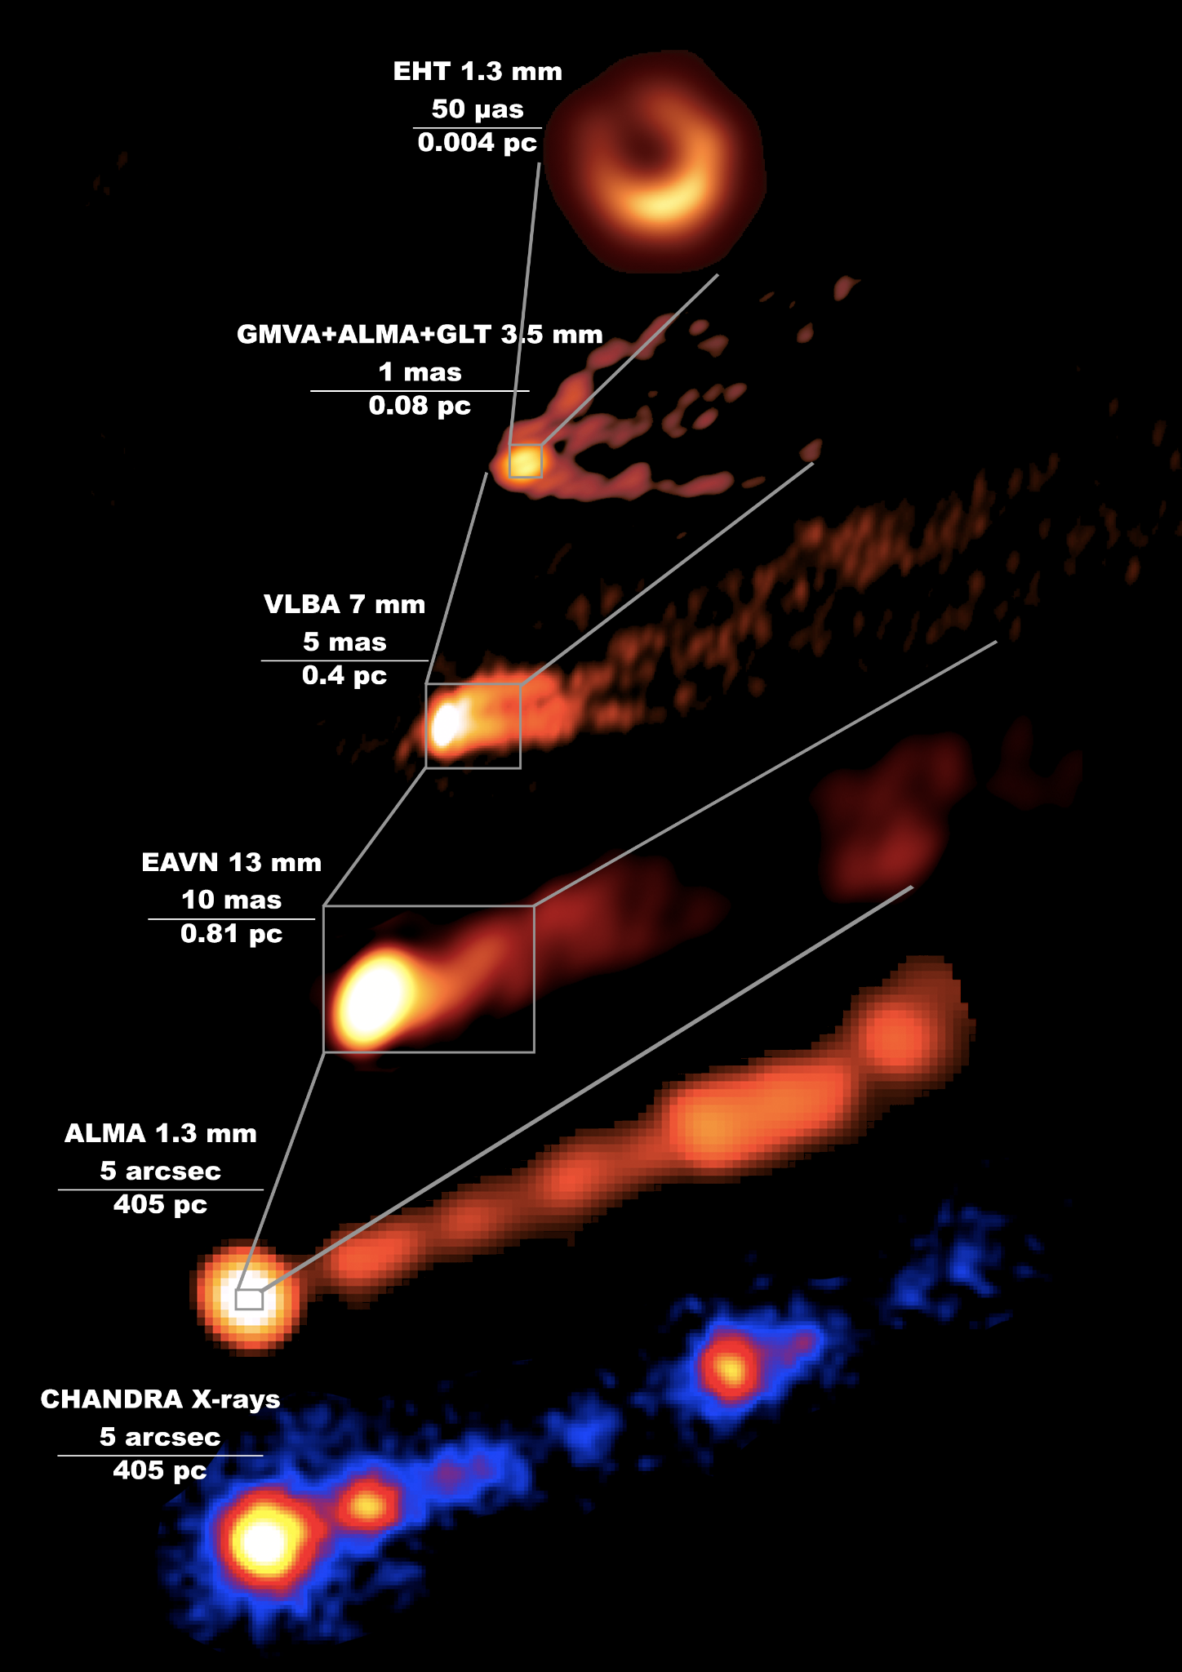
EHT + High-Energy Synergy
NEW RESULTS!
EHT MWL Science Working Group (incl. N. M. Ford) et al., 2024
Near-horizon emission is optically thin at radio/sub-mm and X-ray!
Together, they tell us about
the inner accretion flow and the jet base
Notes:
EHT is also complemented by multi-wavelength observations, in particular at high energies, since…
Example here, from very recently released work that I’m involved with…
Emphasize OOM scales (spans 6 OOM in size)
Benefits – across radio and X-ray, seeing emission from jet base and/or inner accretion flow, allows us to disentangle where emission is coming from

Slide 5
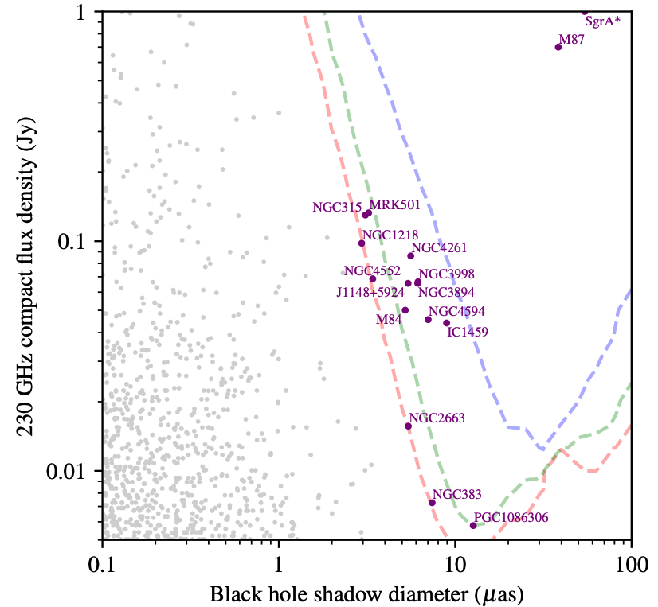
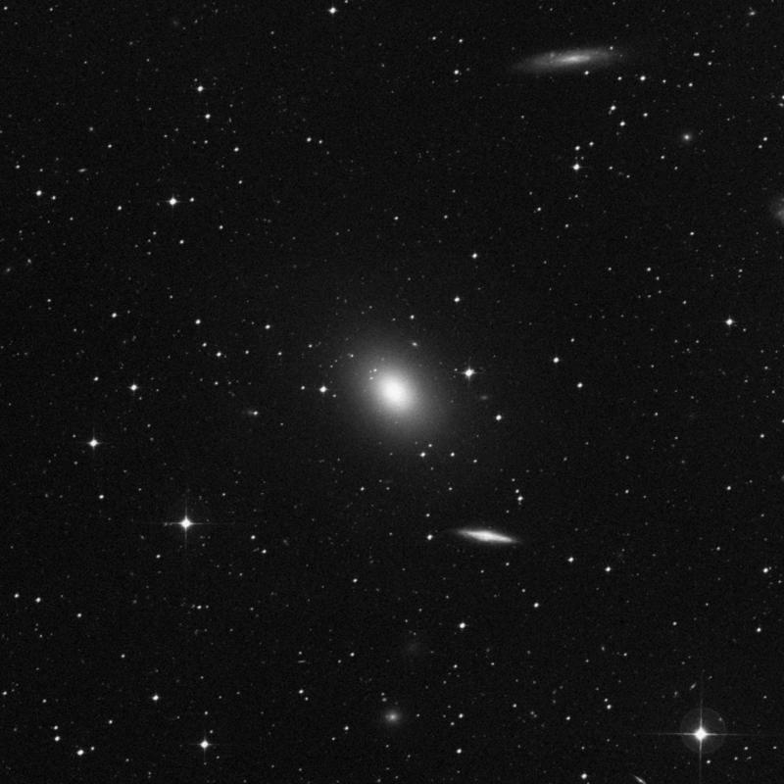
EHT Targets of Interest
SMBH Shadow resolved
SMBH Spin resolved
SMBH Mass resolved
Above mass threshold
IC 1459
NGC4594
IC1459
Johnson et al. 2023
Notes:
Now, EHT is asking the question, what’s next?
Plot axes (apparent ring size vs EHT flux) -> ignore dashed lines -> M87 & SgrA* are most obvious choices (brightest and biggest) -> purple points

Slide 6
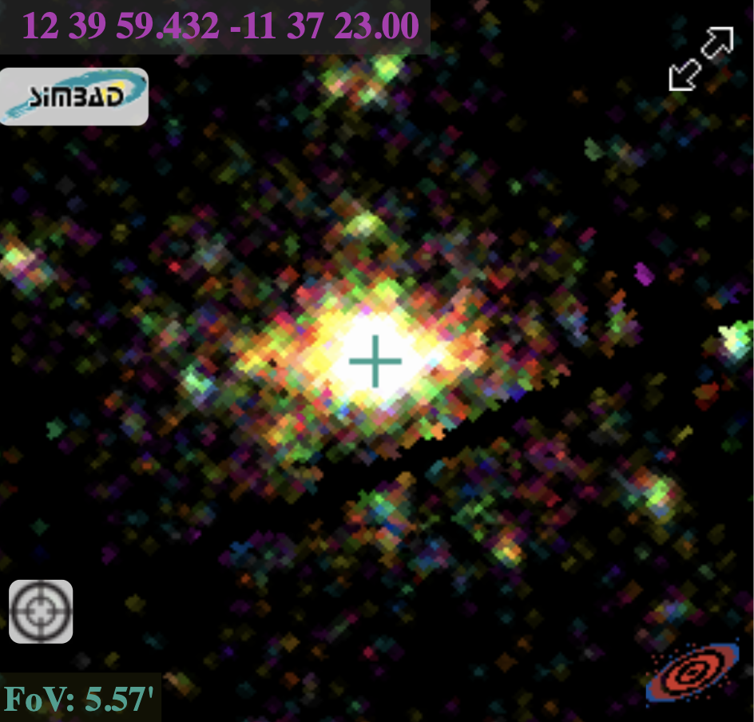
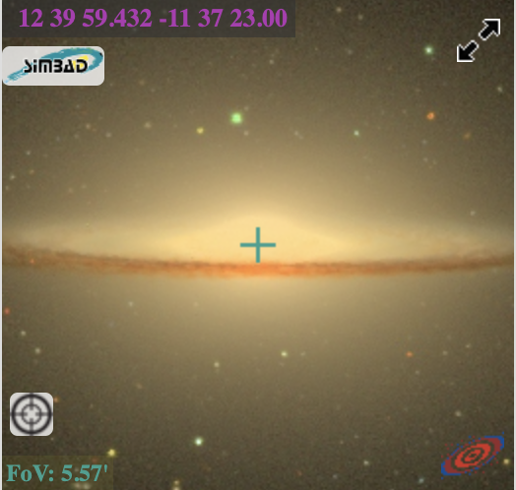
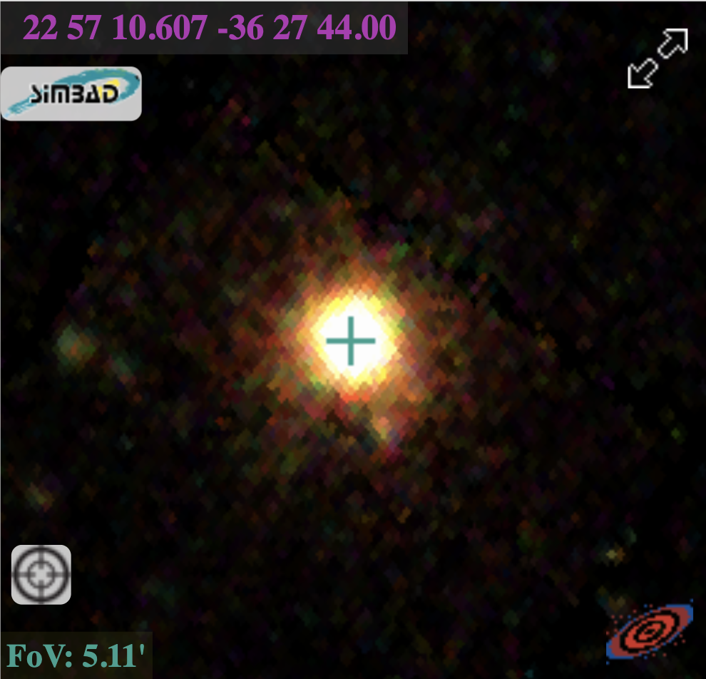
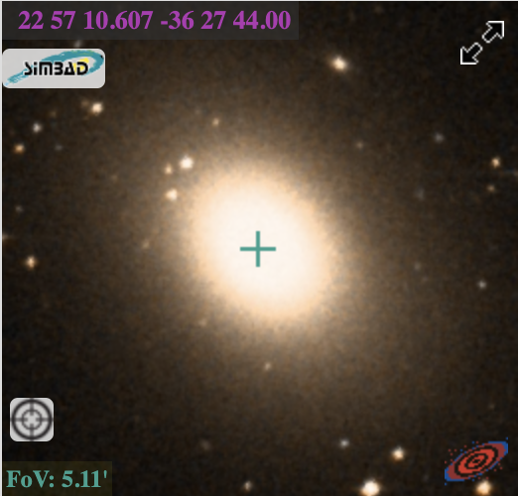
EHT Targets of Interest
Sombrero
SMBH Shadow resolved
SMBH Spin resolved
SMBH Mass resolved
Above mass threshold
SMBH Shadow resolved
SMBH Spin resolved
SMBH Mass resolved
Above mass threshold
M_{BH} = 6.3 x 10⁸ M_{sun}
Ring size = 7.0 μas
IC 1459
FoV: 5.57’
FoV: 5.57’
IC1459
NGC4594
IC1459
M_{BH}: 2.5 x 10⁹ M_{sun}
Ring size : 8.9 μas
FoV: 5.11’
FoV: 5.11’
Johnson et al. 2023
Optical (SDSS)
X-ray (XMM)
Notes:
X-ray and optical -> MBH -> ring size (just below current EHT resolution) w/future additional detectors they could be resolved -> low luminosity agn
https://science.nrao.edu/science/highlights/fy2014-1/detailed-imaging-of-the-sombrero-galaxy-jet
Sombrero SMBH mass estimated dynamically (from stellar motions)

Slide 7
Low Luminosity AGN
Bipolar Jets/outflows
Very common! ~⅓ of nearby galaxies
L/L_{Edd} ≲ 0.001
No Broad Line Region, radio loud
R_{g} = GM/c²
SMBH
5 R_{g}
> 10³⁻⁴ R_{g}
~100 R_{g}
“Thin” Outer Disk
Radiatively Inefficient Accretion Flow (RIAF)
+ warm (~10⁷ K) corona*
+ hot (~10⁹ K) corona
Notes:
LLAGN are a very common type of AGN
Add length scales for thin disk thickness, jet size
Note: instead of a warm corona, some people think hot corona emission reflecting off the accretion flow could suffice

Slide 8
Low Luminosity AGN
Bipolar Jets/outflows
How to model X-ray:
Warm corona = thermal gas (blackbody)
Hot corona = Inverse Compton (power law)
Jets = synchrotron (power law)
SMBH
5 R_{g}
> 10³⁻⁴ R_{g}
~100 R_{g}
“Thin” Outer Disk
Radiatively Inefficient Accretion Flow (RIAF)
+ warm (~10⁷ K) corona*
+ hot (~10⁹ K) corona
Notes:
In the X-ray, we think that …
Add length scales for thin disk thickness (, jet size,
Note: instead of a warm corona, some people think hot corona emission reflecting off the accretion flow could suffice

Slide 9
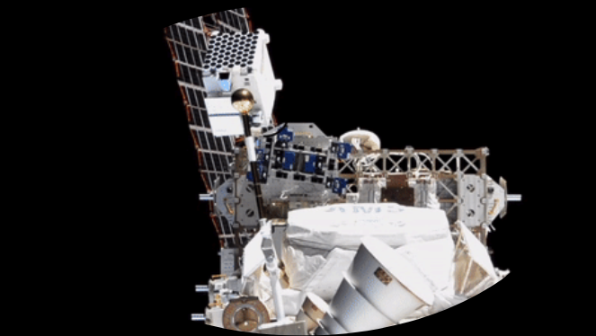
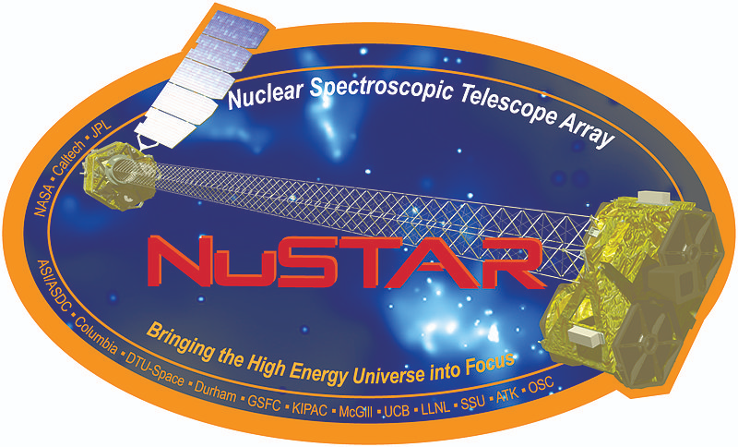
Soft and Hard X-ray Observations
NuSTAR: Hard (3 - 79 keV), 18’’ resolution, ~10’ FOV
Observations:
1x ~ 20 ks / target
Fitting:
Model: broken power law
Background: Separate extraction regions
50’’ (source), 110’’ (bkg)
NICER: Soft (0.3 - 15 keV) Non-Imaging, 5’ FOV
Observations:
~ 5 months monitoring
Fitting:
Model: absorbed power law + blackbody
Background: Joint source-background modeling w/SCORPEON
Sombrero
Notes:
For this project, we conducted the first soft x-ray monitoring campaign of these targets to characterize their X-ray emission and variability
tbabs * (ztbabs * powerlaw + mekal)
Mention that absorption has a contribution from our galactic line of sight as well as intrinsic absorption in the target galaxy

Slide 10
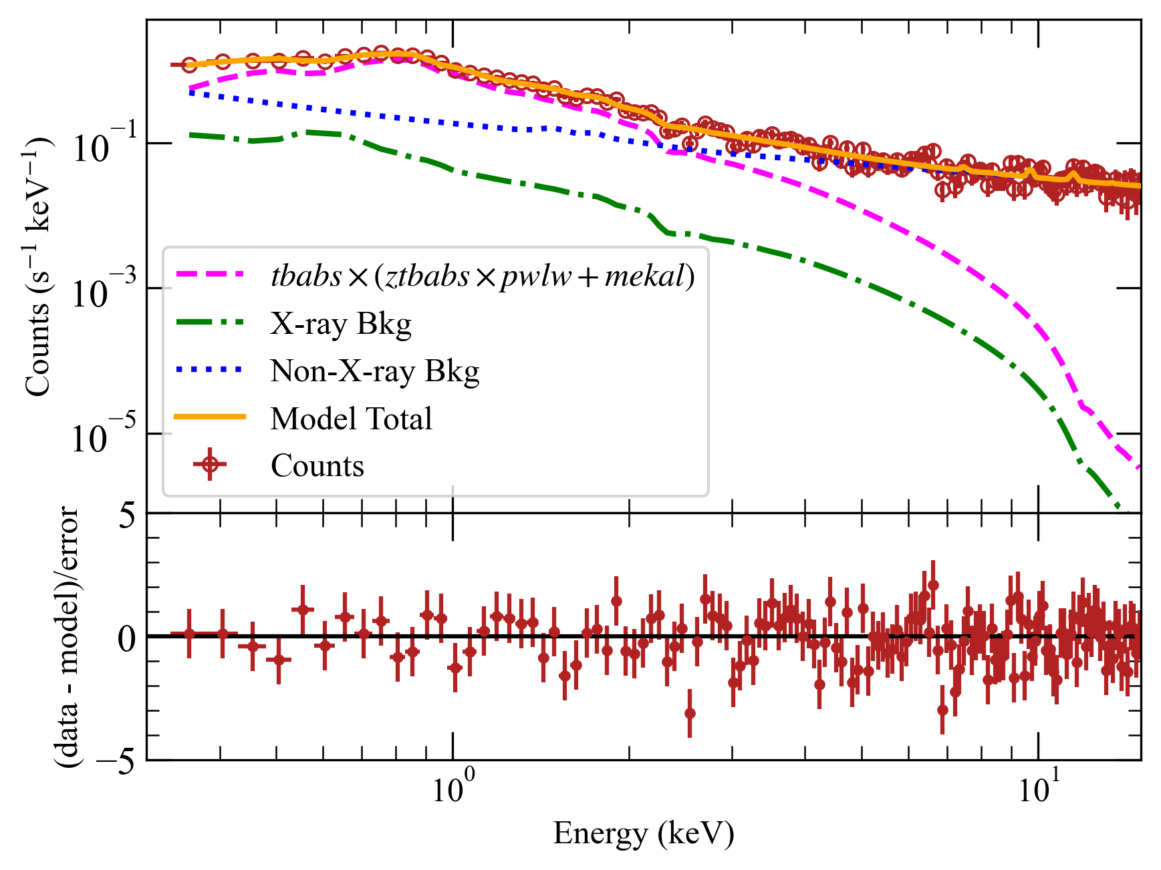
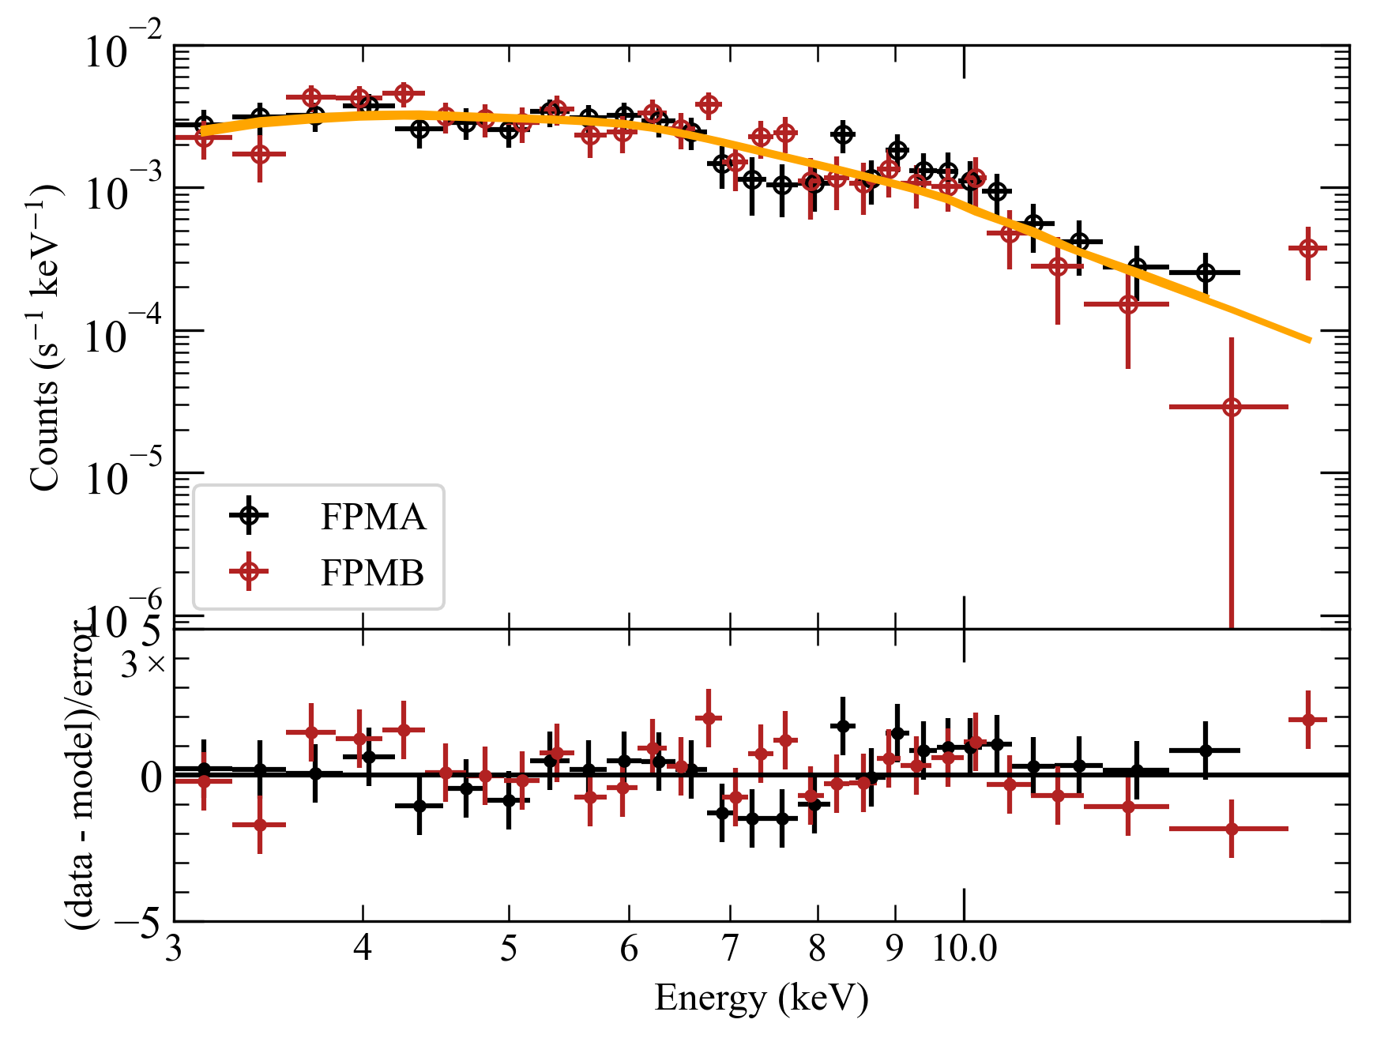
Soft and Hard X-ray Spectra (Sombrero)
NICER
NuSTAR
absorbed power law + blackbody
Power Law: Slope ~ 1.5 - 2, typical of RIAF
Blackbody: Soft excess “bump” dominates at < 2 keV Background: Non-X-ray background dominates > 2 keV.
Broken Power Law: Pre-break slope ~1.5, post-break ~2.5, break @ ~6 keV
Only reaches ~20 keV, need longer exposures, monitoring!

Slide 11
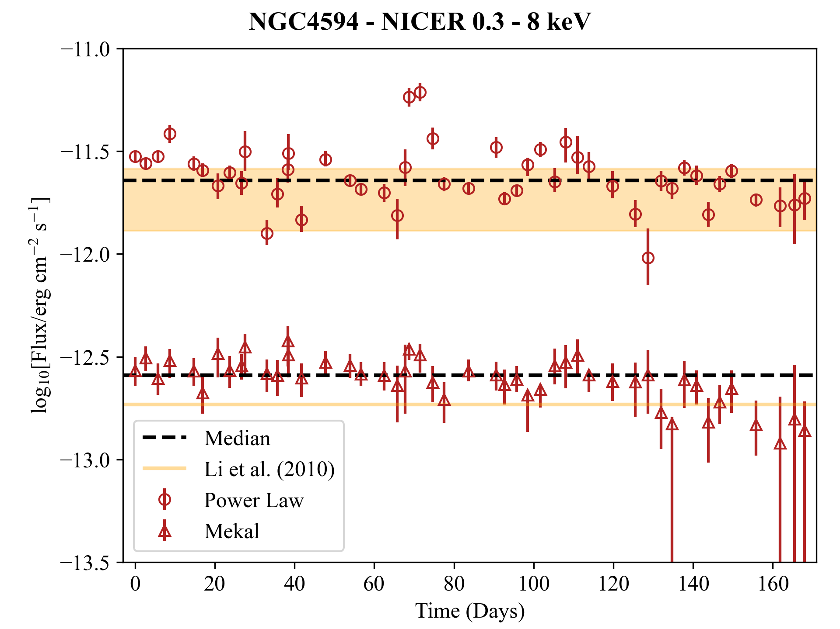
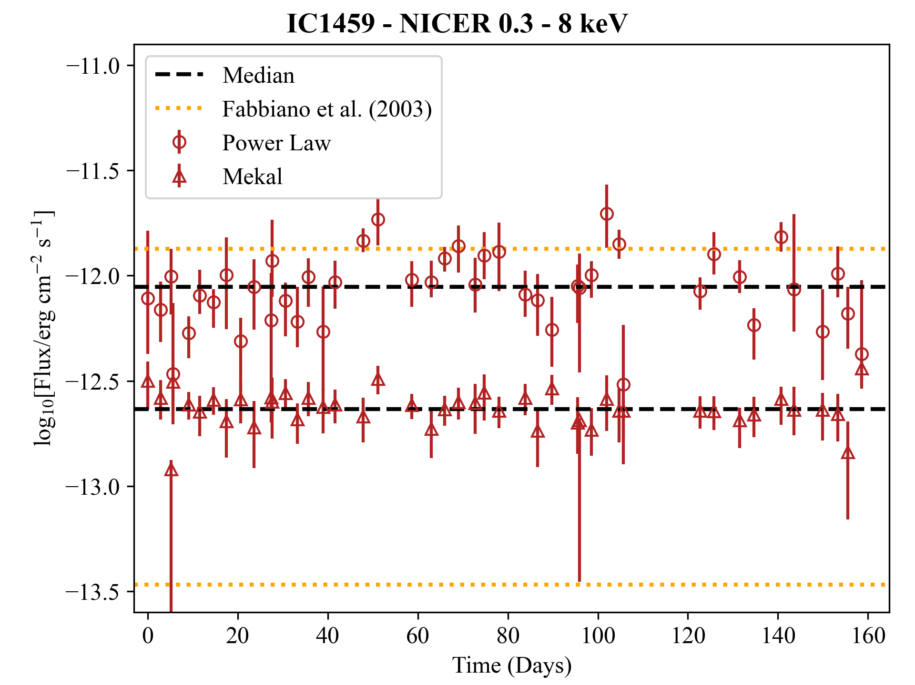
NICER Soft X-ray Light Curves
03-01 – 08-18 (2022)
Sombrero
IC1459
05-20 – 10-29 (2022)
Power Law: Aperiodic, sometimes brighter than historical Chandra obs. Factor of 2 variability amplitude is significant for AGN!
Blackbody: Roughly constant, T ~ 5 x 10⁶ K (warm)
Slightly fainter than Sombrero, uncertainties too large for detailed variability study

Slide 12
Interpretation
Power law slope indicates RIAF dominates X-ray, w/soft excess attributable to warm corona.
NuSTAR power law spectral break → synchrotron / inverse compton transition?
Sombrero aperiodic variability is w/in normal AGN range, but > previous obs (need monitoring!)
Would recommend Sombrero (brighter) over IC1459 (fainter) for further X-ray/EHT obs.
Notes:
For broad spectral modeling, there are degeneracies between models that only consider radio/sub-mm emission, and X-ray can break those degeneracies to tell us what physical scenario produced the emission we’re seeing. This is especially important when interpreting EHT observations, since the EHT frequency happens to fall very very close to where emission transitions from being jet to accretion dominated. So, we want to have as much information as possible to inform our model and tell us whether EHT is really seeing the jet base or the accretion flow (or both).
In this SED for Sombrero, I’ve added the luminosity range found from the NICER lightcurve, as well as the hard X-ray luminosity measured by NICER – I’d like to emphasize that the NICER range covers quite a bit more than what Chandra has seen. Often, we use data spanning several decades and combine it all together in one SED model, but the variability seen throughout the NICER campaign indicates that we should try to do time-resolved SED modeling to account for changes in the flux and improve model accuracy.

Slide 13
Interpretation
Power law slope indicates RIAF dominates X-ray, w/soft excess attributable to warm corona.
NuSTAR power law spectral break → synchrotron / inverse compton transition?
Sombrero aperiodic variability is w/in normal AGN range, but > previous obs (need monitoring!)
Would recommend Sombrero (brighter) over IC1459 (fainter) for further X-ray/EHT obs.
What’s Next?
More modeling!
Accretion + jet models for broad (radio to x-ray) spectrum
Time-resolved SED models
More observations!
Quasi-simultaneous soft/hard X-ray monitoring, longer hard X-ray exposures
NuSTAR+NICER 2025 Accepted (PI: N. M. Ford)
ALMA submitted
Existing multi-wavelength data from other instruments: Swift, XMM, eROSITA, TESS, …
Notes:
For broad spectral modeling, there are degeneracies between models that only consider radio/sub-mm emission, and X-ray can break those degeneracies to tell us what physical scenario produced the emission we’re seeing. This is especially important when interpreting EHT observations, since the EHT frequency happens to fall very very close to where emission transitions from being jet to accretion dominated. So, we want to have as much information as possible to inform our model and tell us whether EHT is really seeing the jet base or the accretion flow (or both).
In this SED for Sombrero, I’ve added the luminosity range found from the NICER lightcurve, as well as the hard X-ray luminosity measured by NICER – I’d like to emphasize that the NICER range covers quite a bit more than what Chandra has seen. Often, we use data spanning several decades and combine it all together in one SED model, but the variability seen throughout the NICER campaign indicates that we should try to do time-resolved SED modeling to account for changes in the flux and improve model accuracy.

Slide 14
Backup Slides

Slide 15
What types of emission do we see?
What physical mechanisms govern AGN accretion and feedback?
How does emission vary over time?
How does emission
vary with wavelength?
What accretion/jet model best describes emission?
Notes:
Observations of the accreting SMBH environment at both small and large length scales are sparse, and the connections across spatial and temporal scales are complicated to untangle.

Slide 16
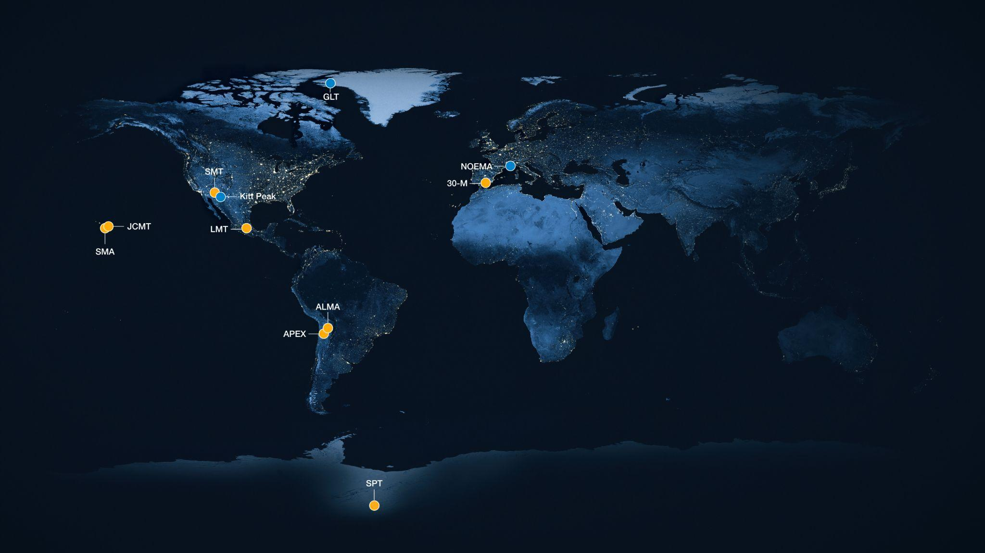
Image Credit: ESO/M. Kornmesser
Notes:
https://eventhorizontelescope.org/array

Slide 17
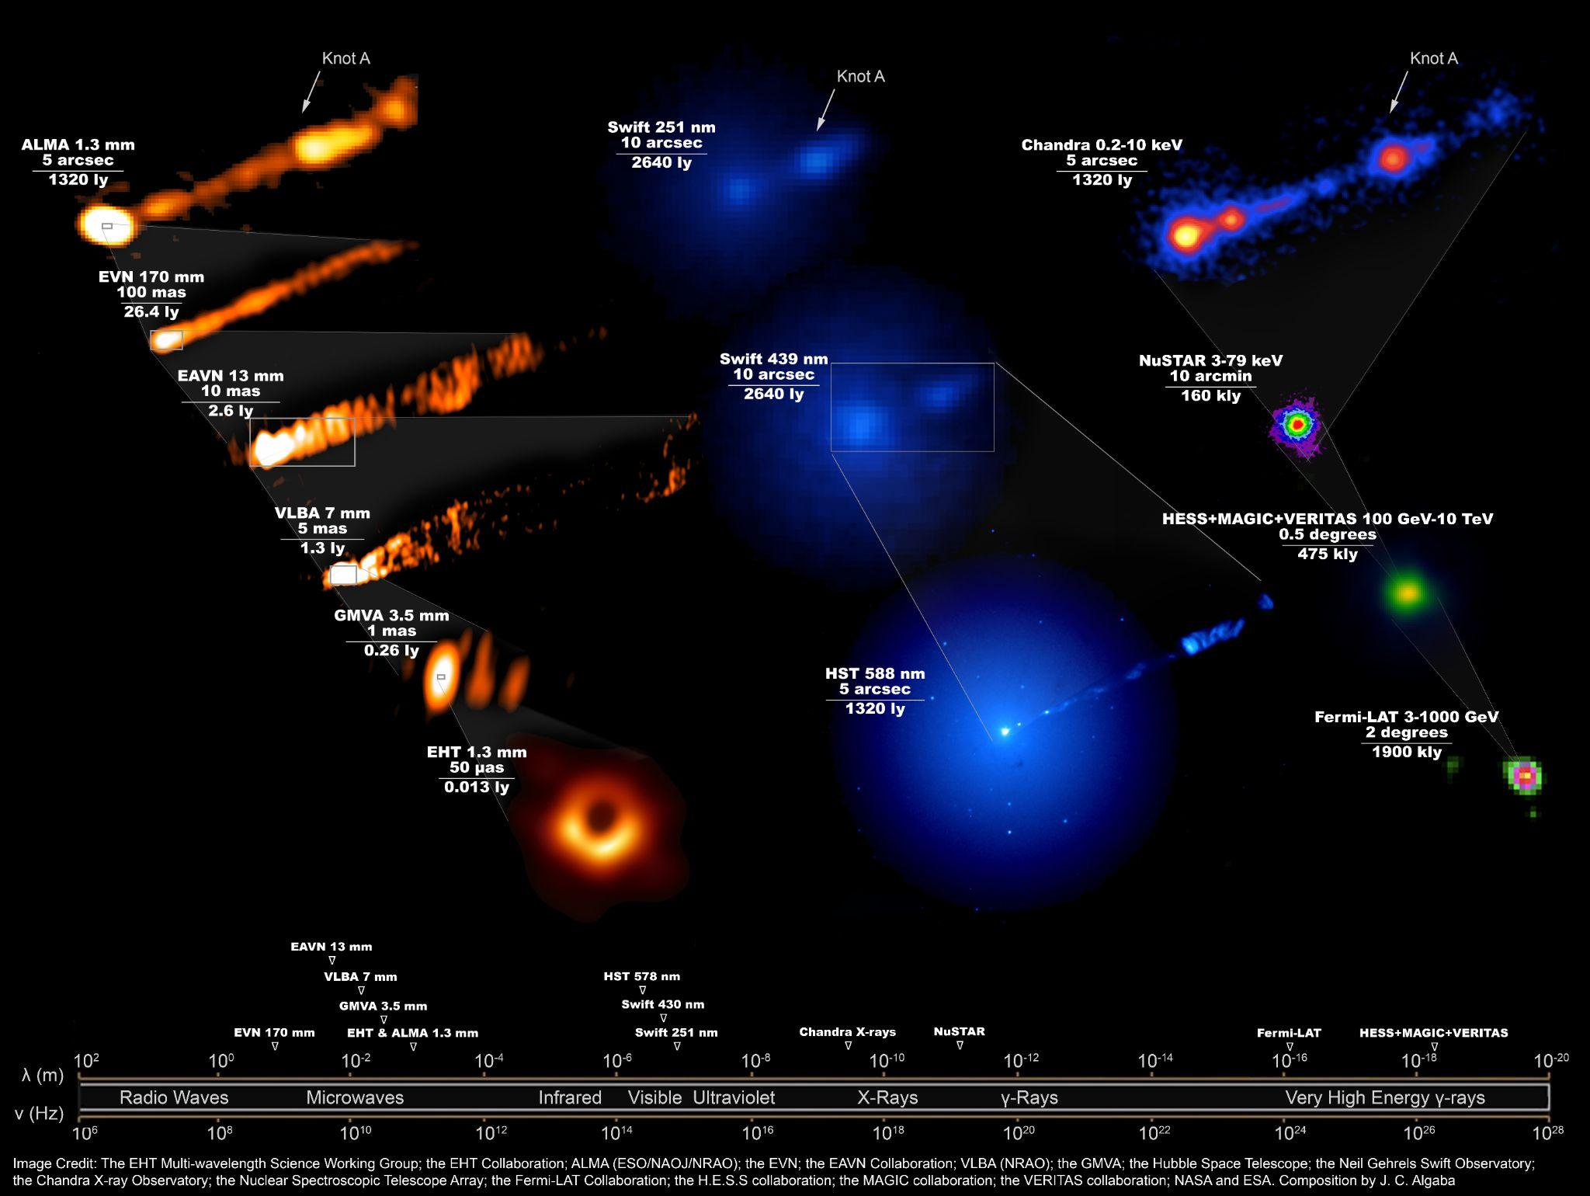
Multi-wavelength Benefits

Slide 18
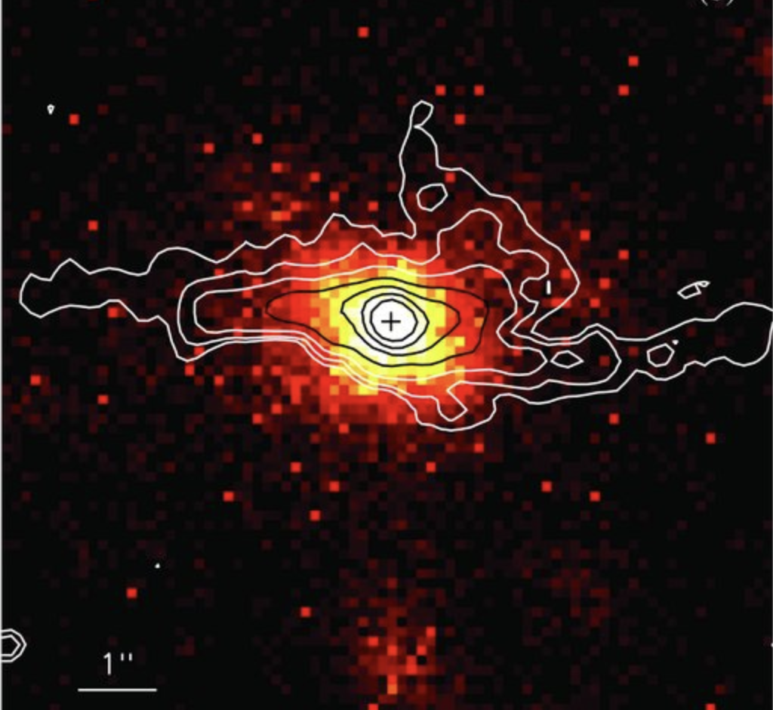
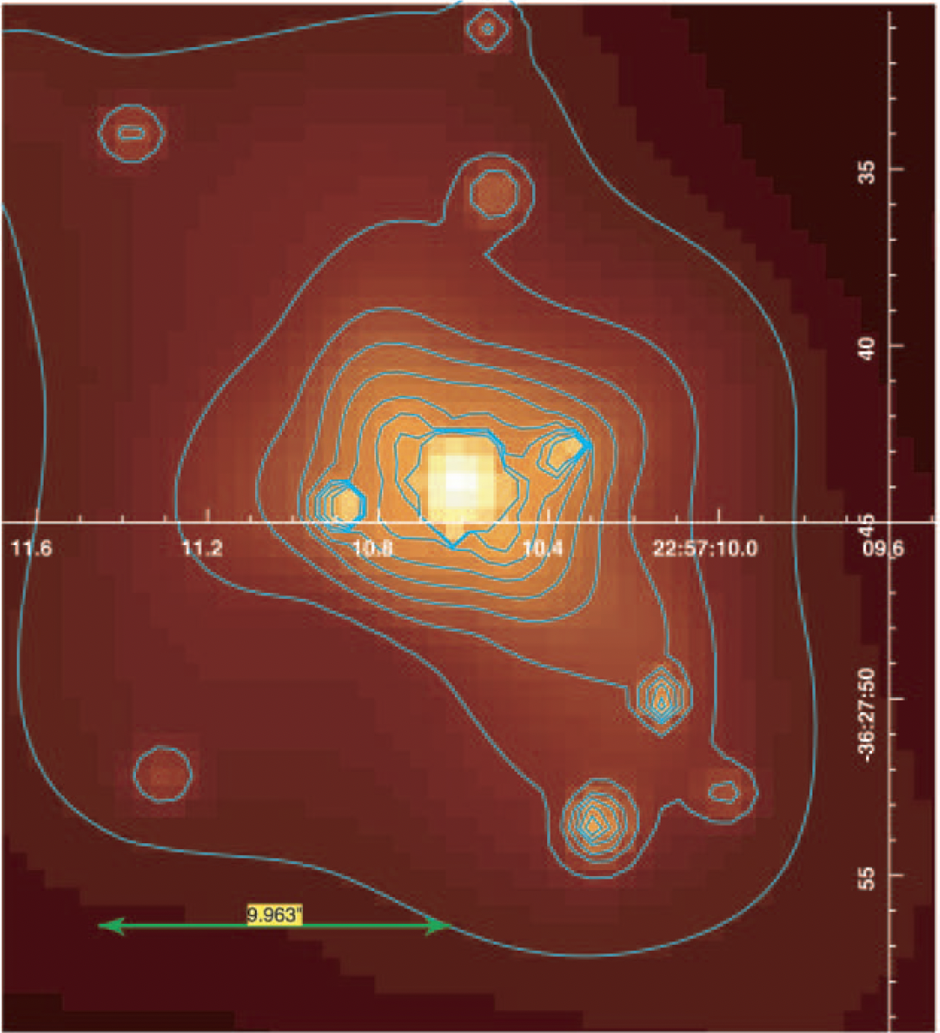
Low Luminosity AGN
Sombrero
D = 9.9 Mpc
M_{BH} = 8.8 x 10⁹ M_{sun}
Ring size = 7.0 μas
F_{0.3-8 keV} ~ 1.5 x 10⁻¹² erg/cm²/s
IC1459
D = 28.9 Mpc
M_{BH} = 9.4 x 10⁹ M_{sun}
Ring size = 8.9 μas
F_{0.3-8 keV} ~ 1 x 10⁻¹² erg/cm²/s
Notes:
We have a previous NICER campaign that collected ~60 nights of soft X-ray observations for 3 LLAGN ETHER sources in 2022. The goal with this data is to start characterizing the soft X-ray spectrum, brightness, and variability of these sources. I’ve started developing a set of scripts for processing the data using NASA’s Heasoft package, and I’m learning how to use Xspec for fitting a model to the observations in order to extract flux information. This analysis is very challenging because these sources are quite faint, on the borderline of being background-dominated. I have to use special, fine-tuned background models that were newly released by NICER in late 2022.

Slide 19
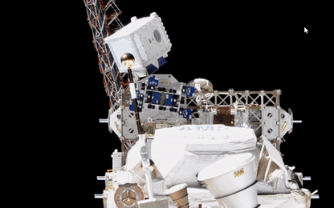
Comparing NICER & NuSTAR
NGC4594 | NICER (0.3 - 8 keV) | NuSTAR (3 - 20 keV)
<F_{𝚪1} > (10⁻¹² erg/cm²/s) | 2.4 ± 0.7 | 1.09 ± 0.09
<𝚪₁> | 1.7 ± 0.4 | 1.6 ± 0.06
<kT> (keV) | 0.5 ± 0.1 | ——
<E_{break}> (keV) | —— | 6.1^{+1.3}_{-0.6}
<𝚪₂> | —— | 3.0 ± 0.04
Norm. Excess Variance (NEV) | 0.12 ±0.05 | ——
Sombrero
IC1459 | NICER (0.3 - 8 keV) | NuSTAR (3 - 20 keV)
<F_{𝚪1} > (10⁻¹² erg/cm²/s) | 0.9 ± 0.3 | 0.7 ± 0.4
<𝚪₁> | 2.1 ± 0.7 | 2.0 ± 0.4
<kT> (keV) | 0.5 ± 0.1 | ——
<E_{break}> (keV) | —— | > 3
<𝚪₂> | —— | > 0.5
Norm. Excess Variance (NEV) | -0.02 ± 0.05 | ——
Notes:
Idea is, once we finish model fitting and extracting the fluxes/luminosity for each observation, we can compare the results with other wavelength observations to start understanding the overall SED of these systems. In particular, the SED shape can be fit by different disk accretion and jet models to see which model accurately describes the data.

Slide 20
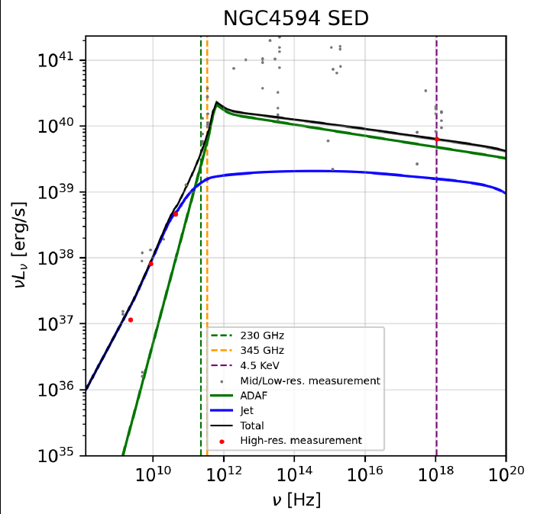
Broadband SED Modeling
EHT+
ALMA
NICER+
NuSTAR
X
X
Accretion
Jet
𝜈L_{𝜈} (erg/s)
𝜈 (Hz)
Arratia et al., in prep.

