Slide 1
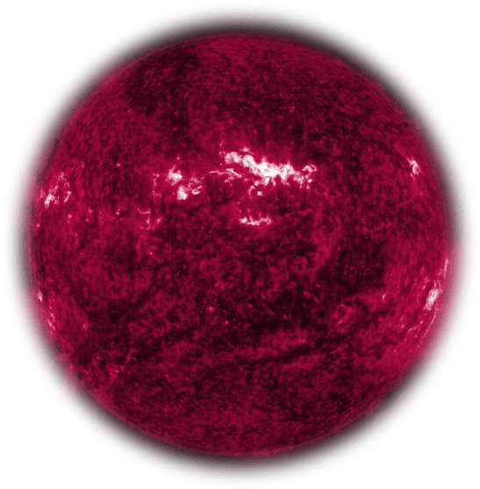
What is responsible for saturating the solar magnetic cycle?
Christian Thibeault
Avec: Paul Charbonneau & Alexandre Lemerle
CRAQ annual meeting 2024 - Mai 7th 2024
Slides template by SlidesCarnival.

Slide 2
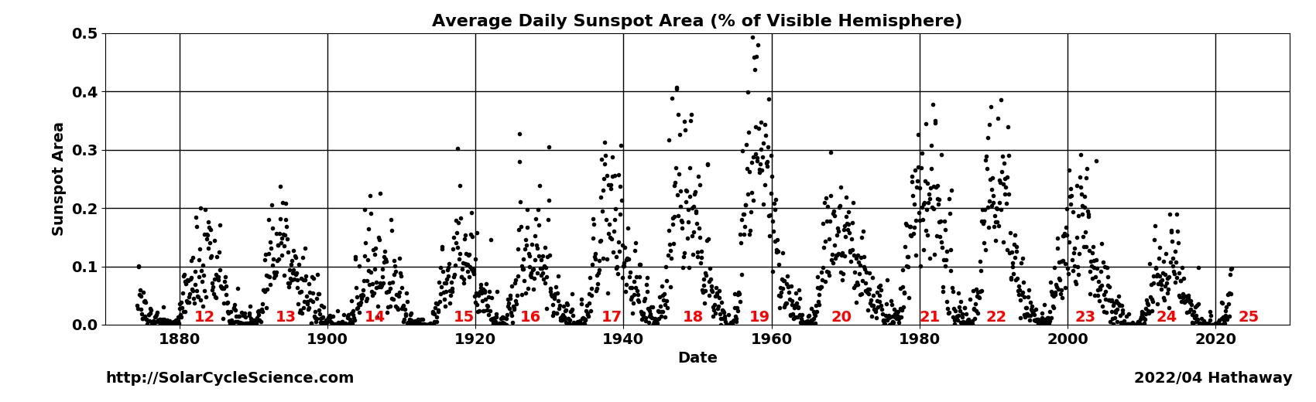
Question: Solar cycle saturation

Slide 3
Question: Solar cycle saturation
What mechanism saturates the magnetic cycle?

Slide 4
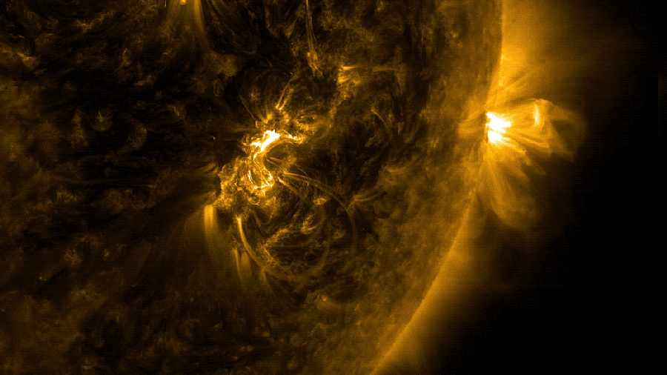
Question: Solar cycle saturation
What mechanism saturates the magnetic cycle?

Slide 5
Magnetohydrodynamics in a nutshell
The induction equation:
Source (induction)
Sink (diffusion)
B
B
B
B
S
S
S
S
S
S

Slide 6
Magnetohydrodynamics in a nutshell
The induction equation:
Source (induction)
Sink (diffusion)
B
B
B
B
S
S
Resistance:Magnetic pressure
Resistance:Magnetic Tension
S
S
S
S

Slide 7
The Babcock-Leighton Dynamo Model
BPoloidal
BToroidal

Slide 8
The Babcock-Leighton Dynamo Model
BPoloidal
BToroidal
Sunspot tilt

Slide 9
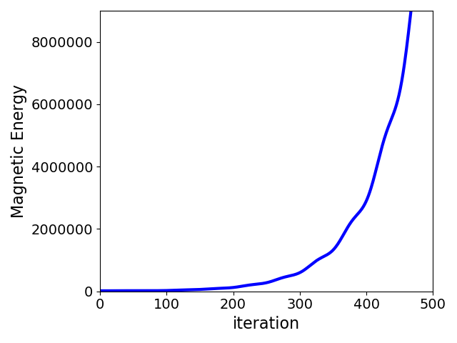
The Babcock-Leighton Dynamo Model
BPoloidal
BToroidal
No saturation mechanism
Sunspot tilt

Slide 10
The Babcock-Leighton Dynamo Model
BPoloidal
BToroidal
Sunspot tilt

Slide 11
The Babcock-Leighton Dynamo Model
BPoloidal
Magnetic backreaction
BToroidal
Sunspot tilt

Slide 12
The Babcock-Leighton Dynamo Model
BPoloidal
Magnetic backreaction
BToroidal
Sunspot tilt
Tilt quenching

Slide 13
The Babcock-Leighton Dynamo Model
BPoloidal
Magnetic backreaction
BToroidal
Sunspot tilt
Tilt quenching
Flux loss

Slide 14
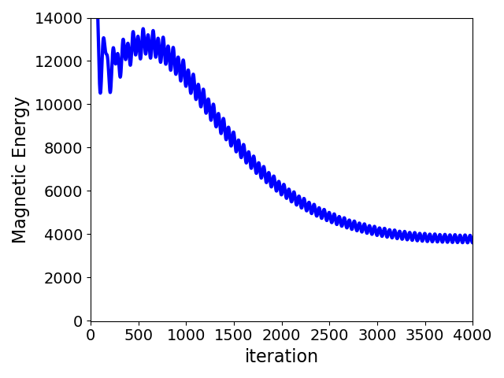
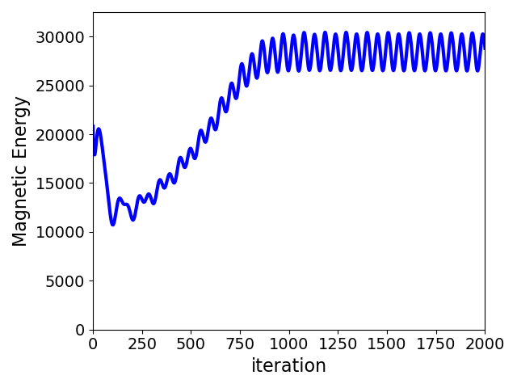
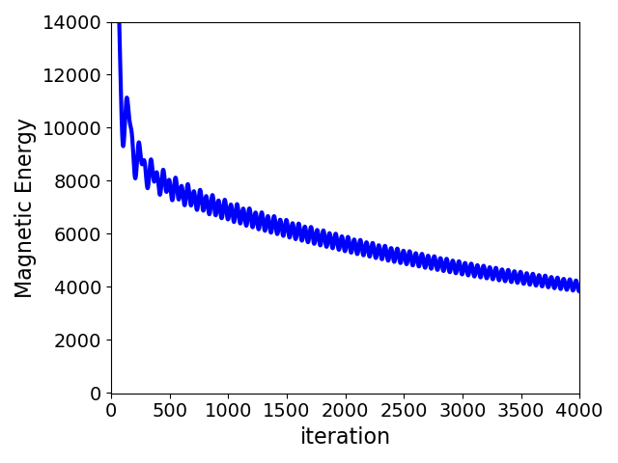
All three saturation mechanisms can saturate the cycle
Magnetic backreaction
Tilt quenching
Flux Loss
Same initial conditions, same model, different saturation mechanism

Slide 15
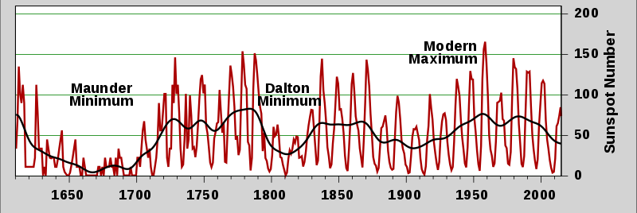
Magnetic backreaction: distinguishing factors
Observations
Model with
Magnetic backreaction
Model with
Tilt quenching

Slide 16
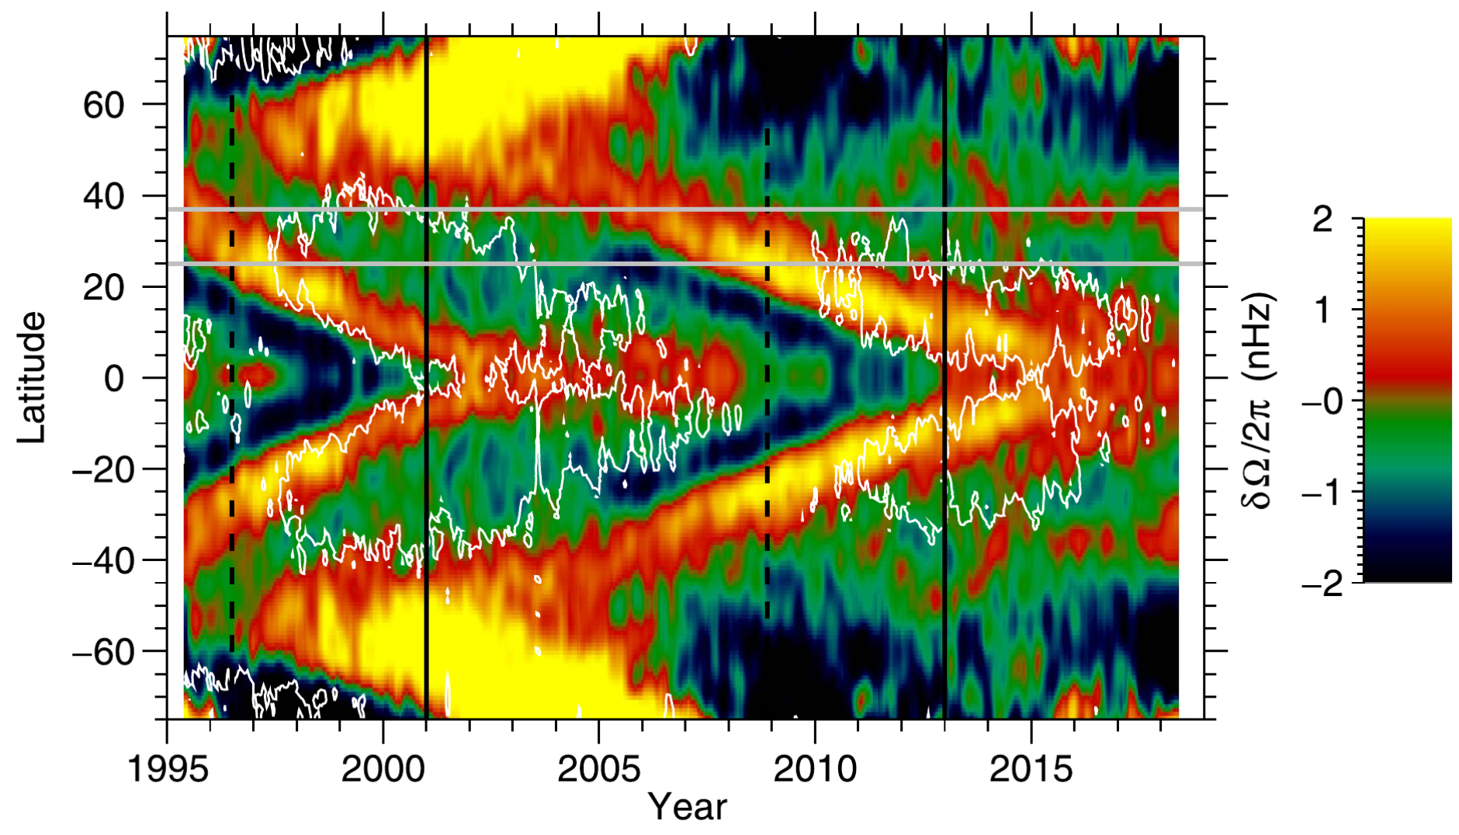
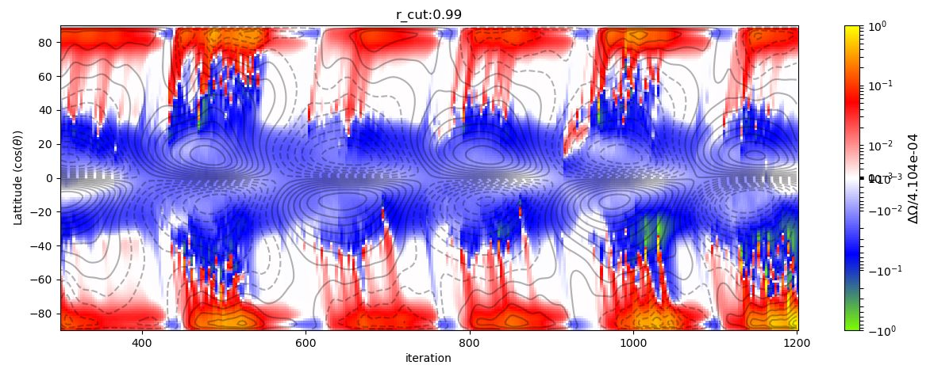
Magnetic backreaction: distinguishing factors
Observations
(surface)
Howe et al. 2018
Model with
Magnetic backreaction

Slide 17
What saturates the solar cycle?
Magnetic backreaction?
Tilt quenching?
Flux Loss?
Combination of all?
Other mechanism?

Slide 18
What saturates the solar cycle?
Magnetic backreaction?
Tilt quenching?
Flux Loss?
Combination of all?
Other mechanism?
Next steps:
Identify more observable distinguishing factors for each mechanism
Study how these mechanism work in combination with each other

