Slide 1
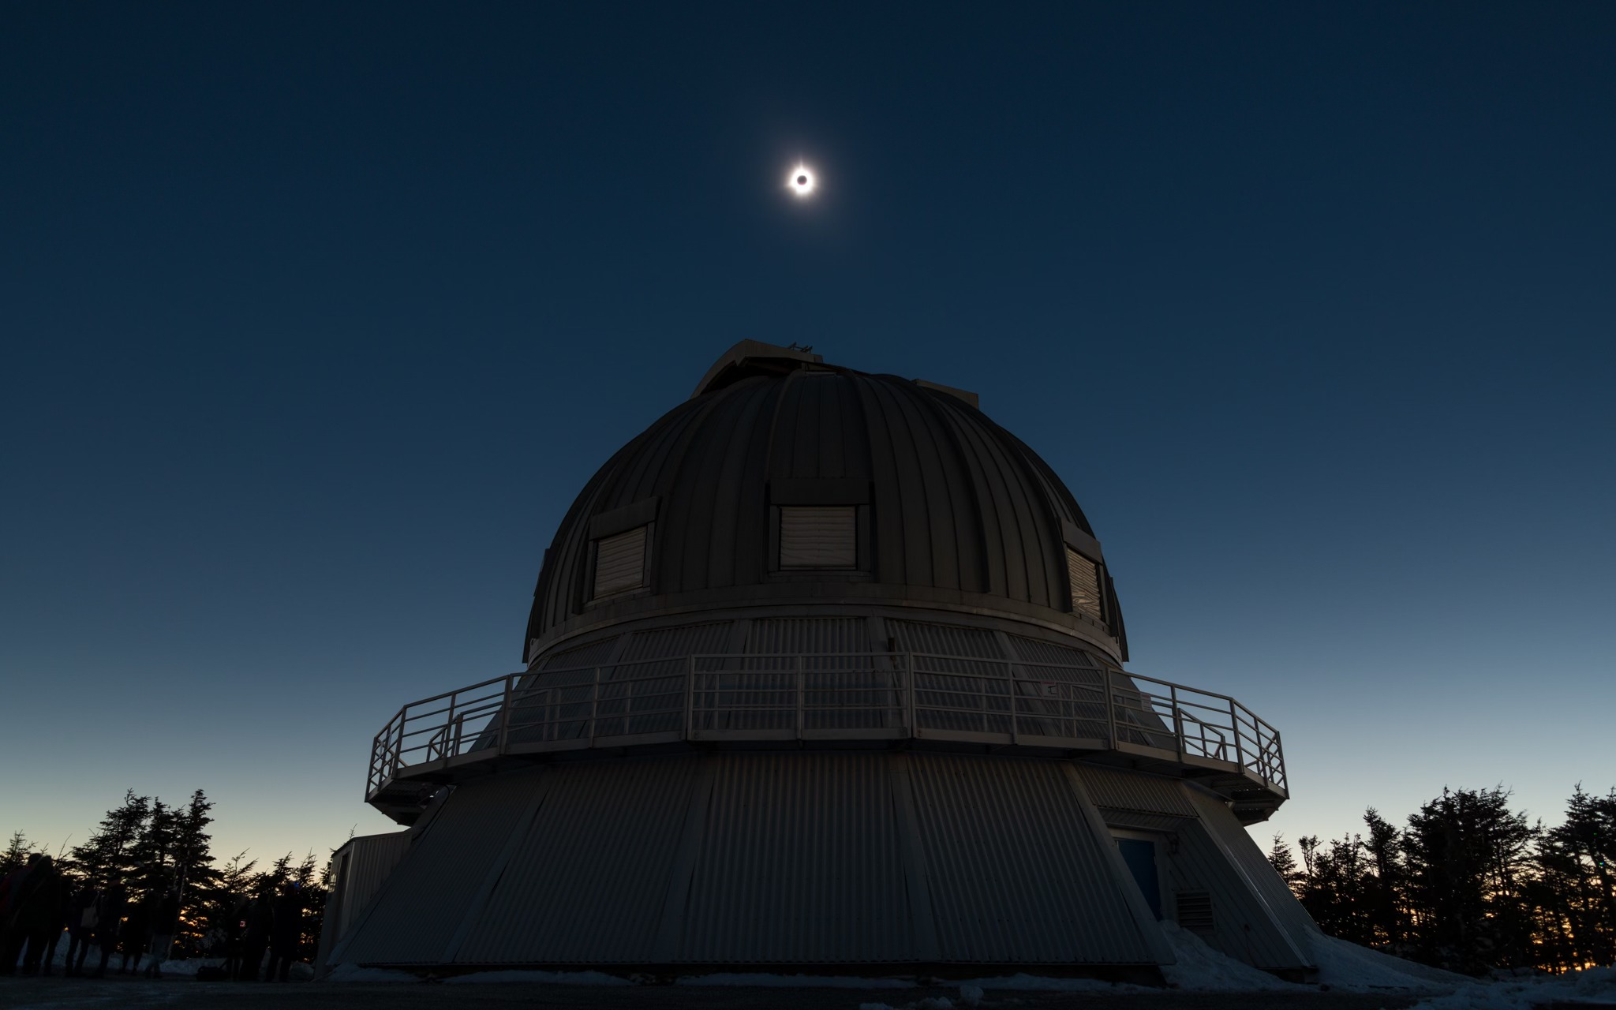
Éclipse 2024
Préparer le Québec à l’événement astronomique du siècle!
Julie Bolduc-Duval
Marie-Eve Naud
Crédit: Rémi Boucher
remiboucherphoto.com
Notes:
Julie

Slide 2
8 April 2021 (eclipse - 3 years!)
First meeting of the astro community in the province → Éclipse Québec
Notes:
Julie

Slide 3
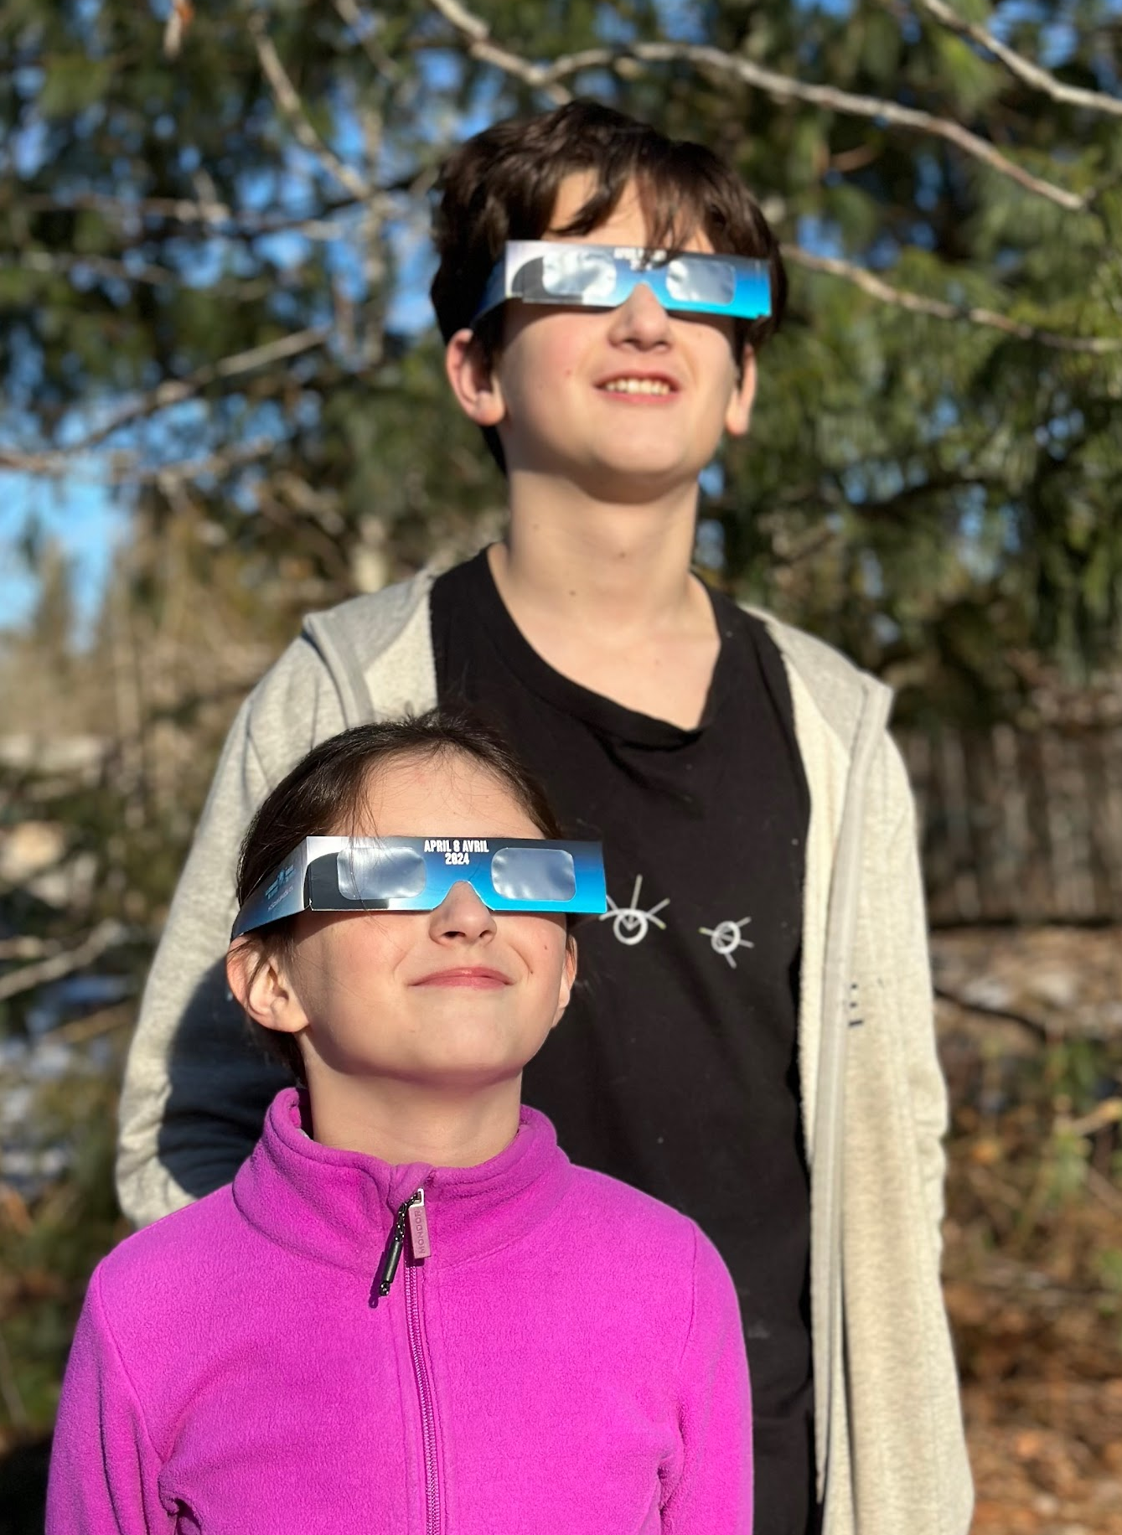
Education
Created an education committee with many partners.
Objectives:
Inform authorities
Convince the Ministry of Education to buy glasses for all K-12 students (first letter sent in January 2022)
Make sure schools are ready (timing of totality…)
Notes:
Julie

Slide 4
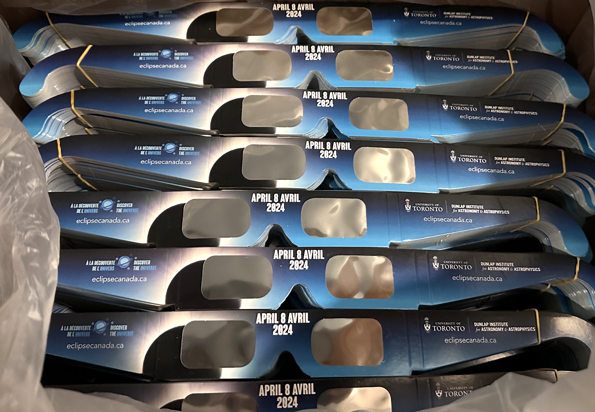
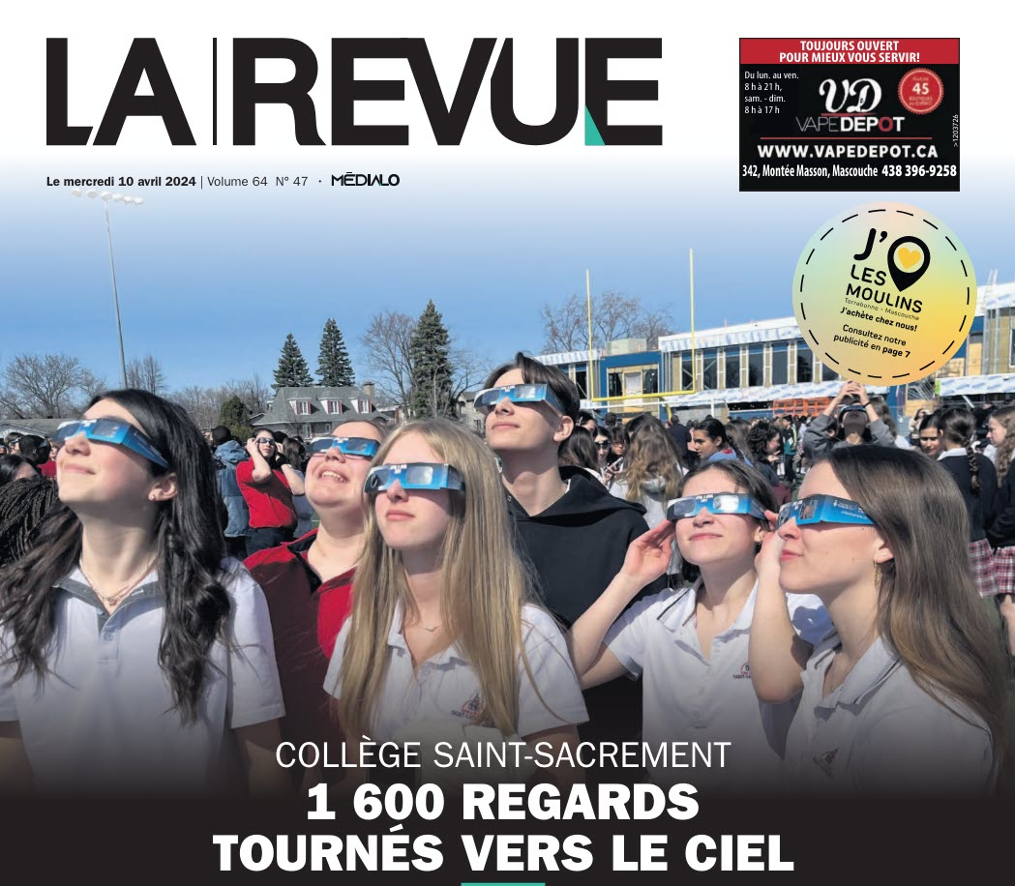
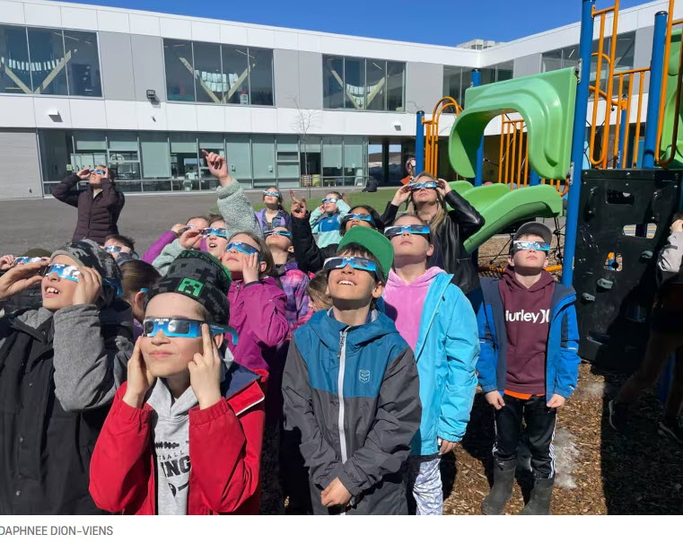
Discover the Universe
Distributed 173,600 glasses in schools in the province
(300,000 from Ontario to Newfoundland)
Notes:
Julie

Slide 5
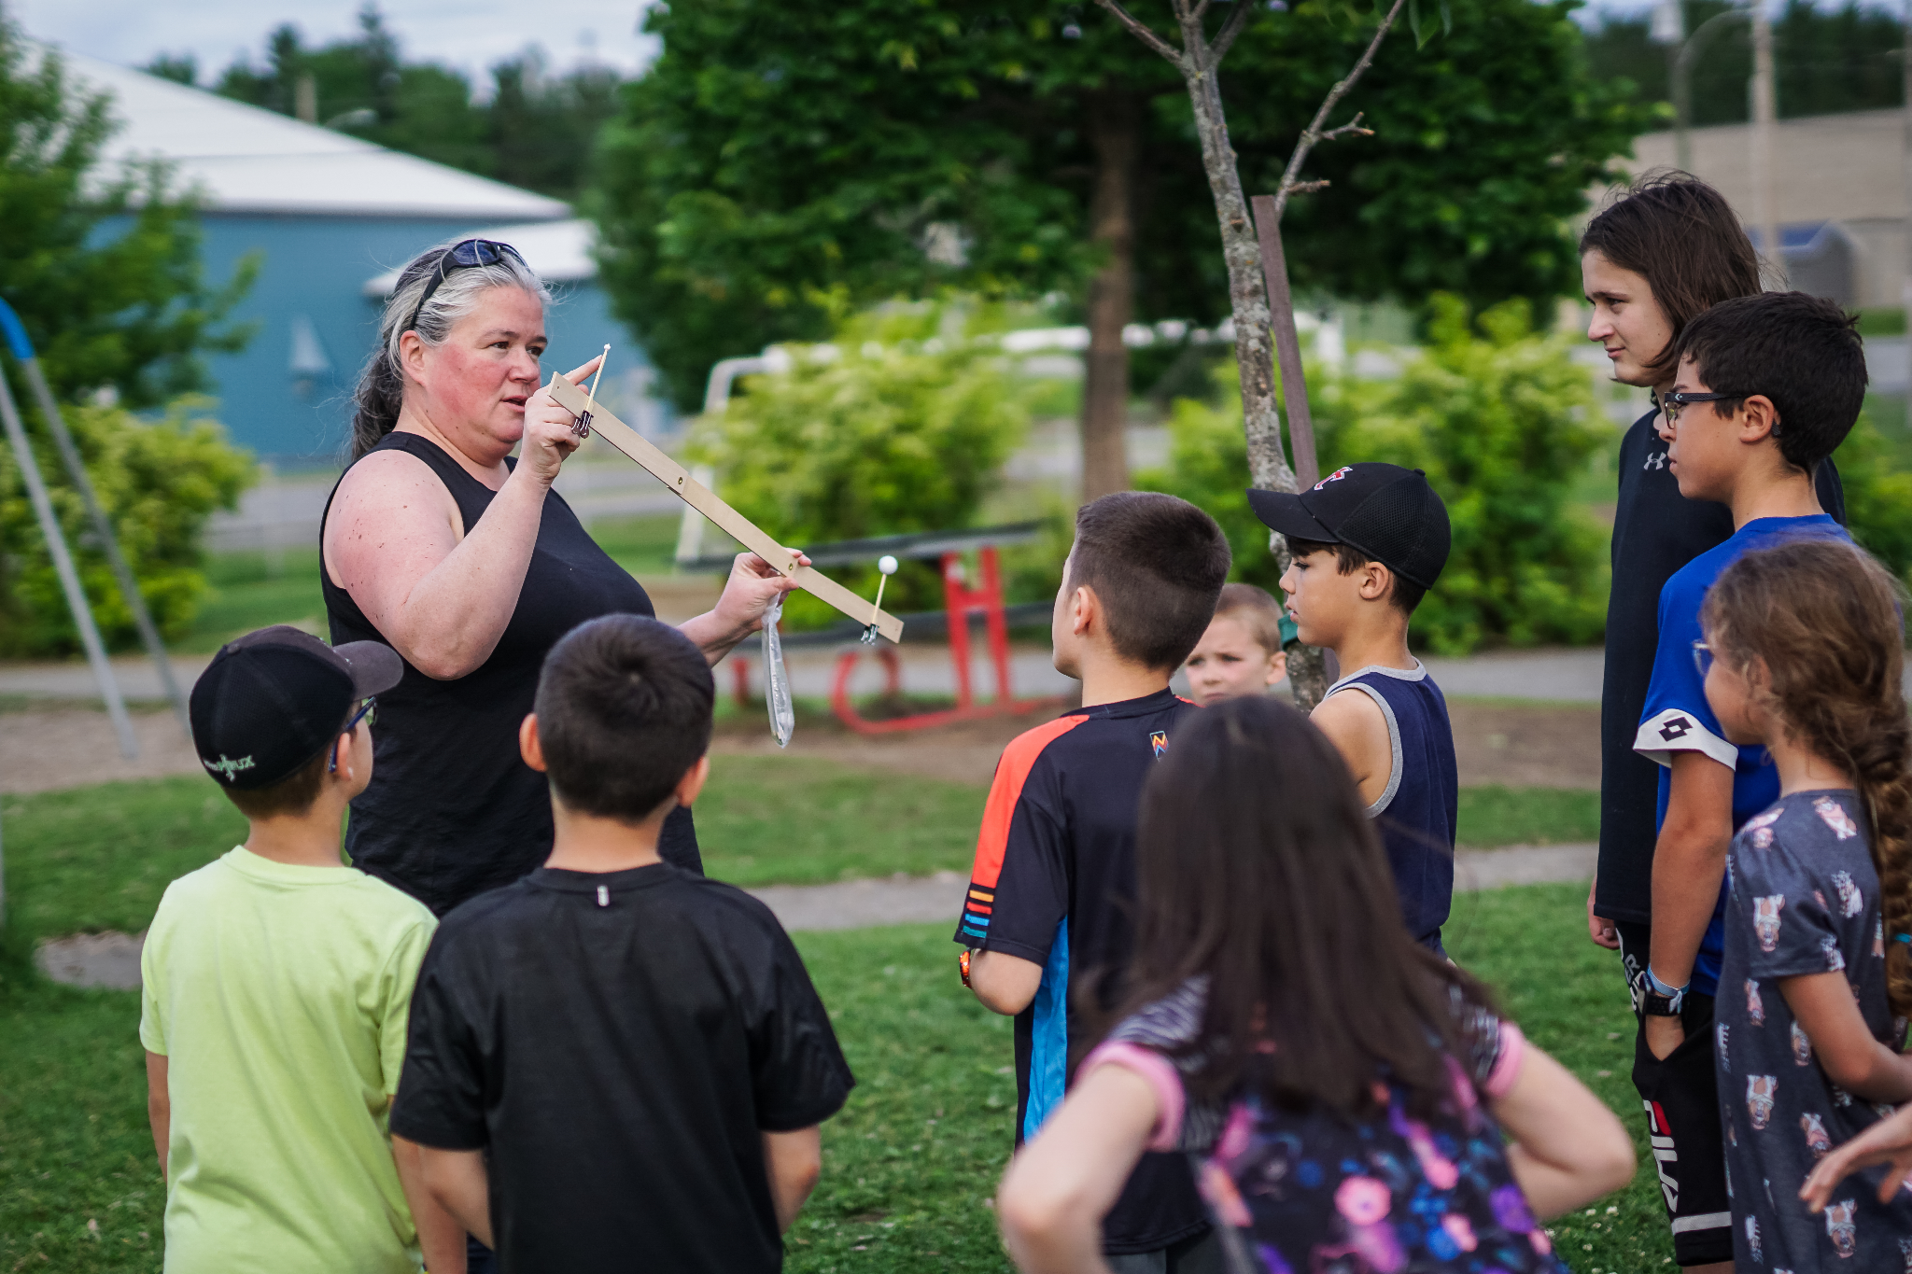
Discover the Universe
Created lots of educational content and resources!
Notes:
Julie

Slide 6
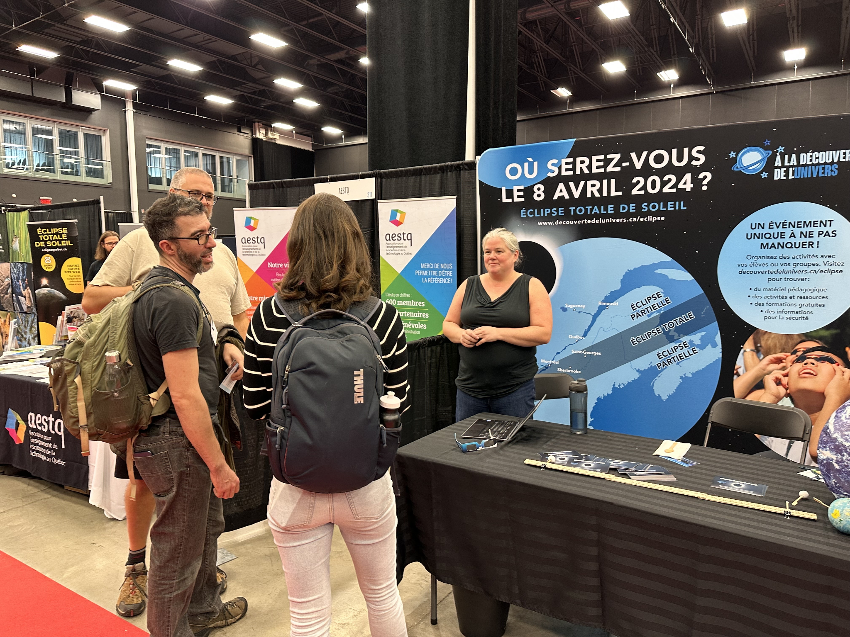
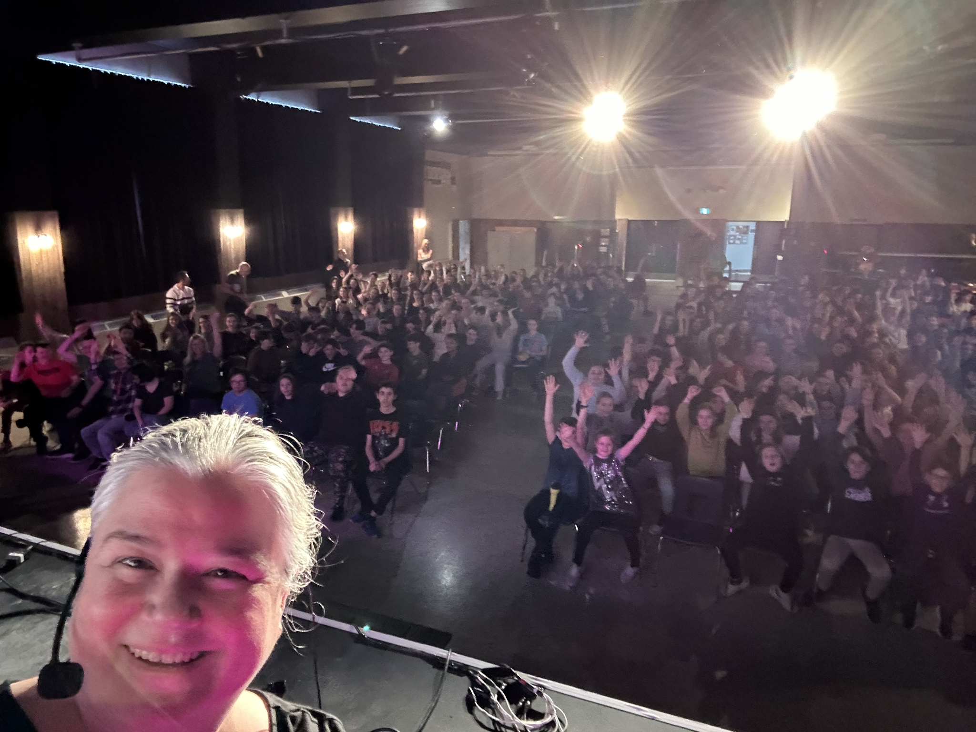
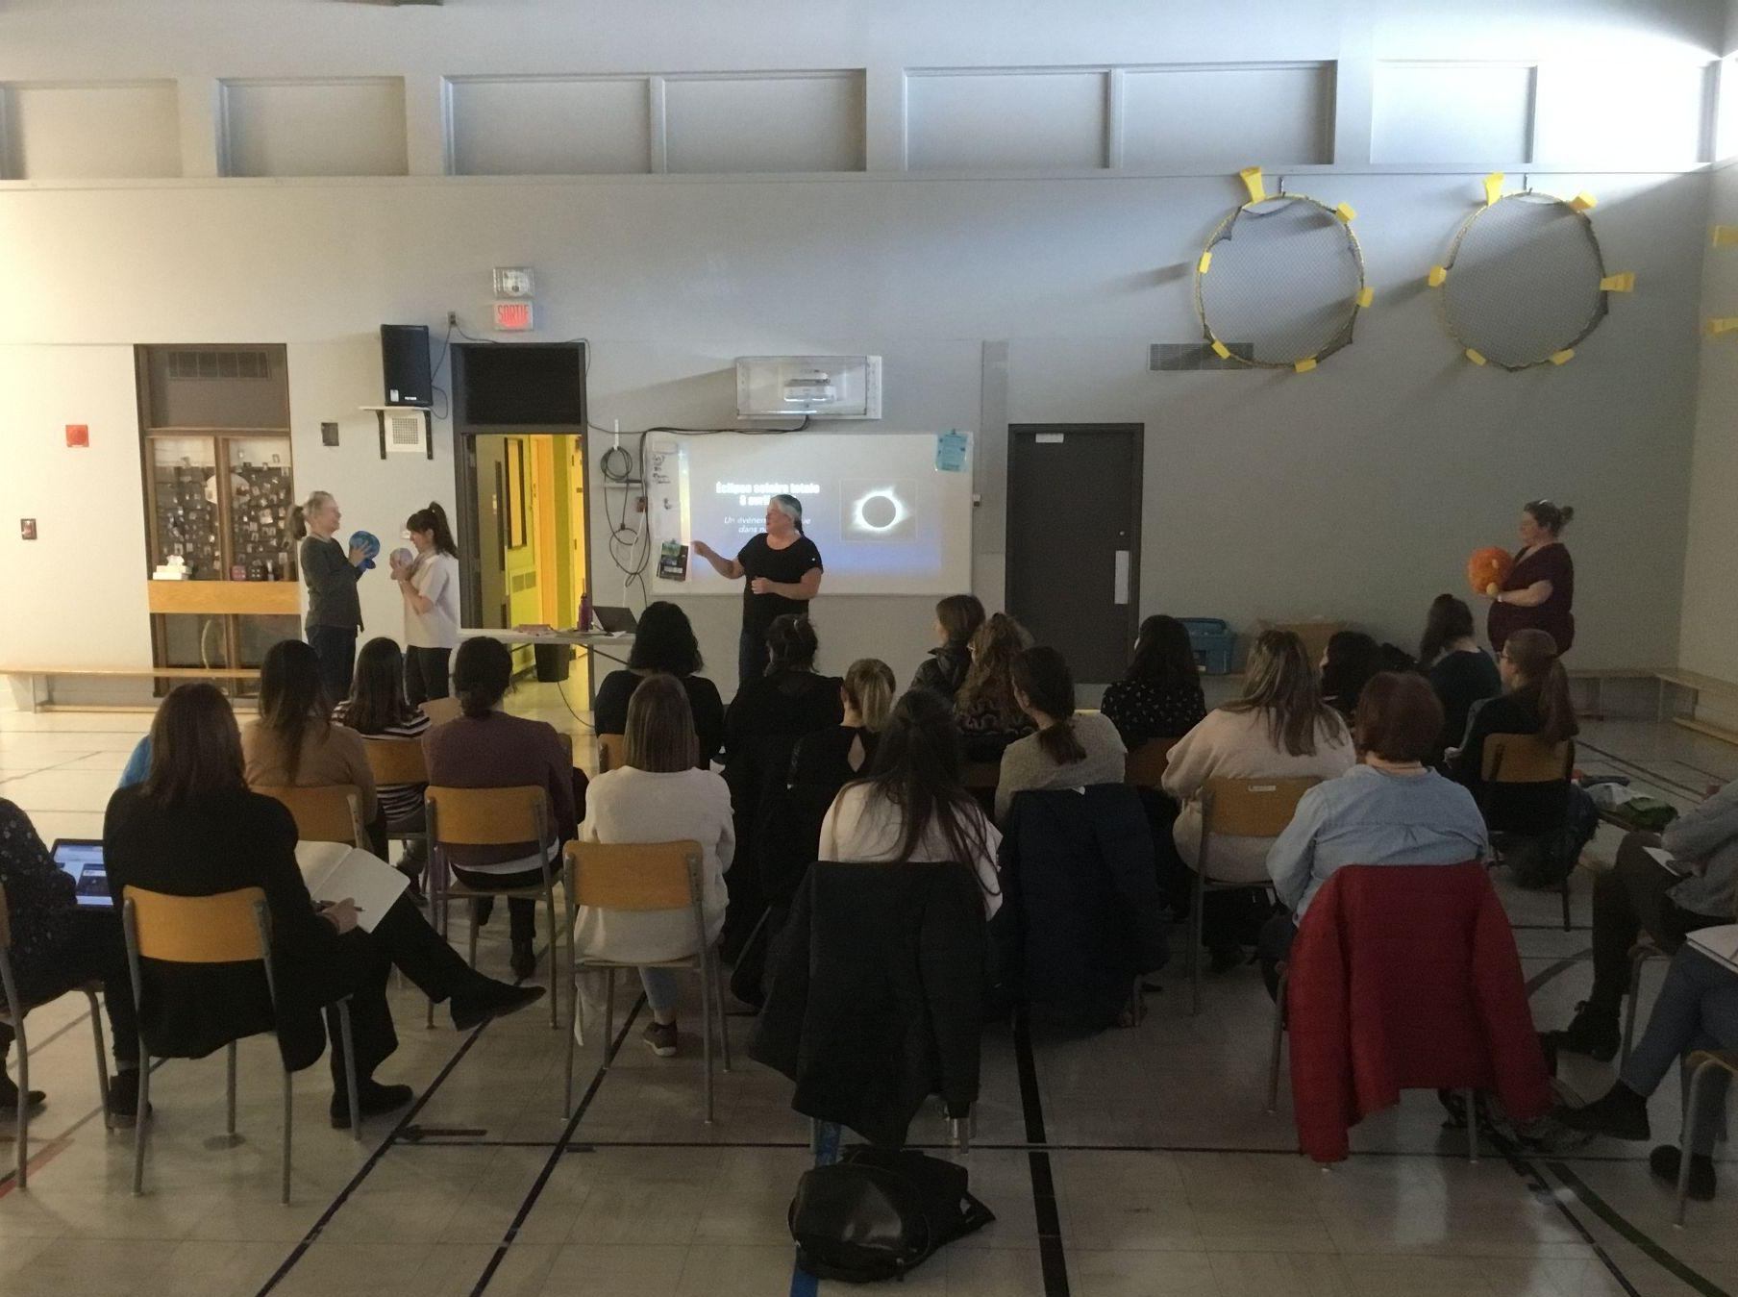
Discover the Universe
Trained 10,000s of teachers and students (online, in person…)
Notes:
Julie

Slide 7
Discover the Universe
“Un immense MERCI pour tout le travaille accompli pour que l'événement soit une réussite à notre école. Certains profs nous ont dit "bravo" mais tout le mérite vous revient. On remet ça à la prochaine éclipse!!”
“I will carry it with me as one of the most moving experiences of my life and it happened only because of the curiosity and enthusiasm inspired in our child by Discover the Universe, your work, and that of your team. Thank you. I can’t say thank you enough.”
Notes:
Julie

Slide 8
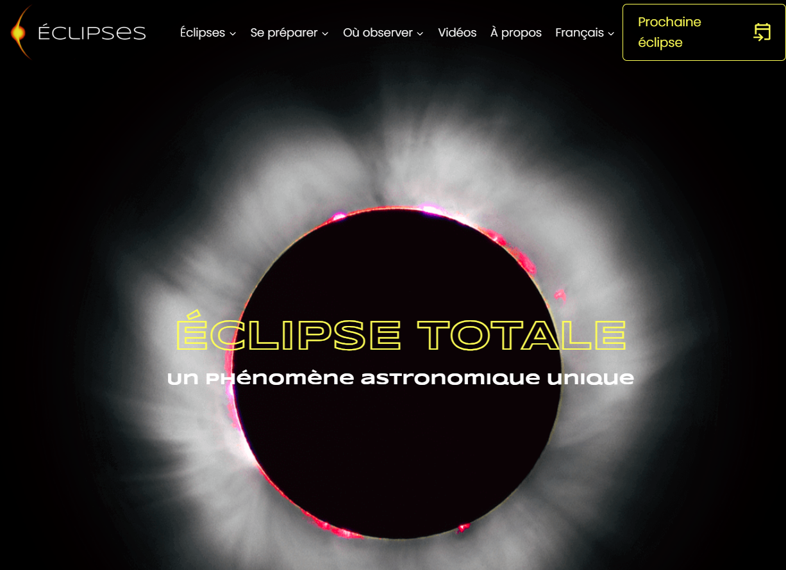
Éclipse Québec website
The reference in Québec (and beyond…)
Managed by the ASTROLab
Completely bilingual
900 000 page views on April 8!!
Notes:
Marie-Eve

Slide 9
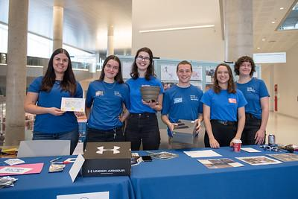
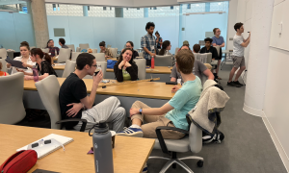
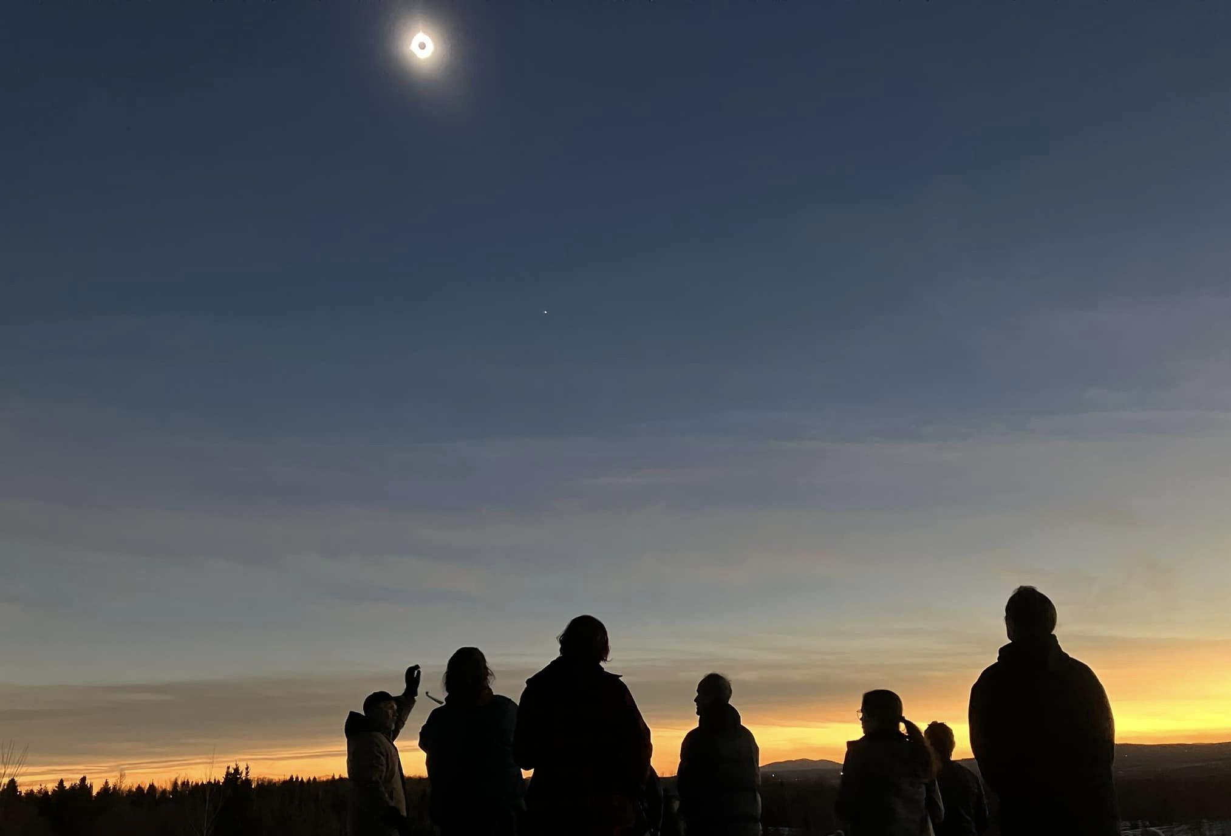
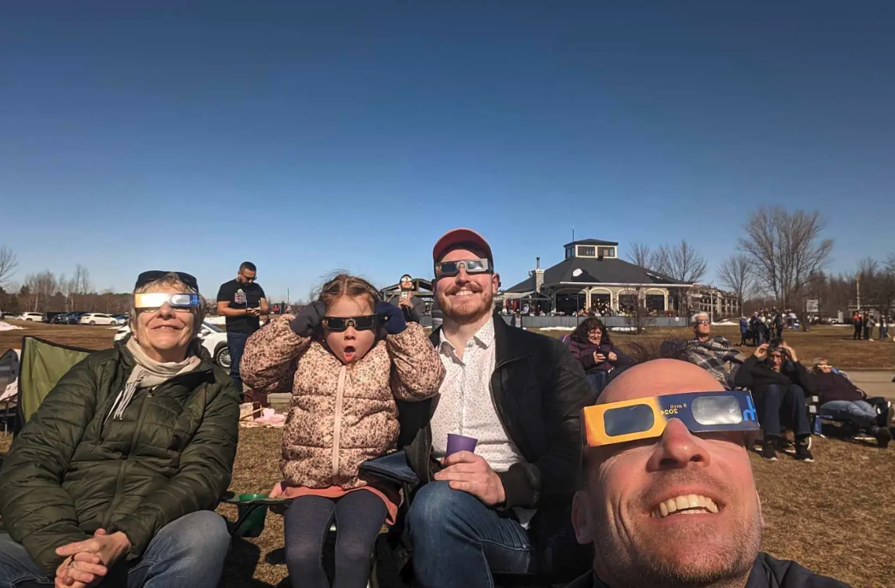
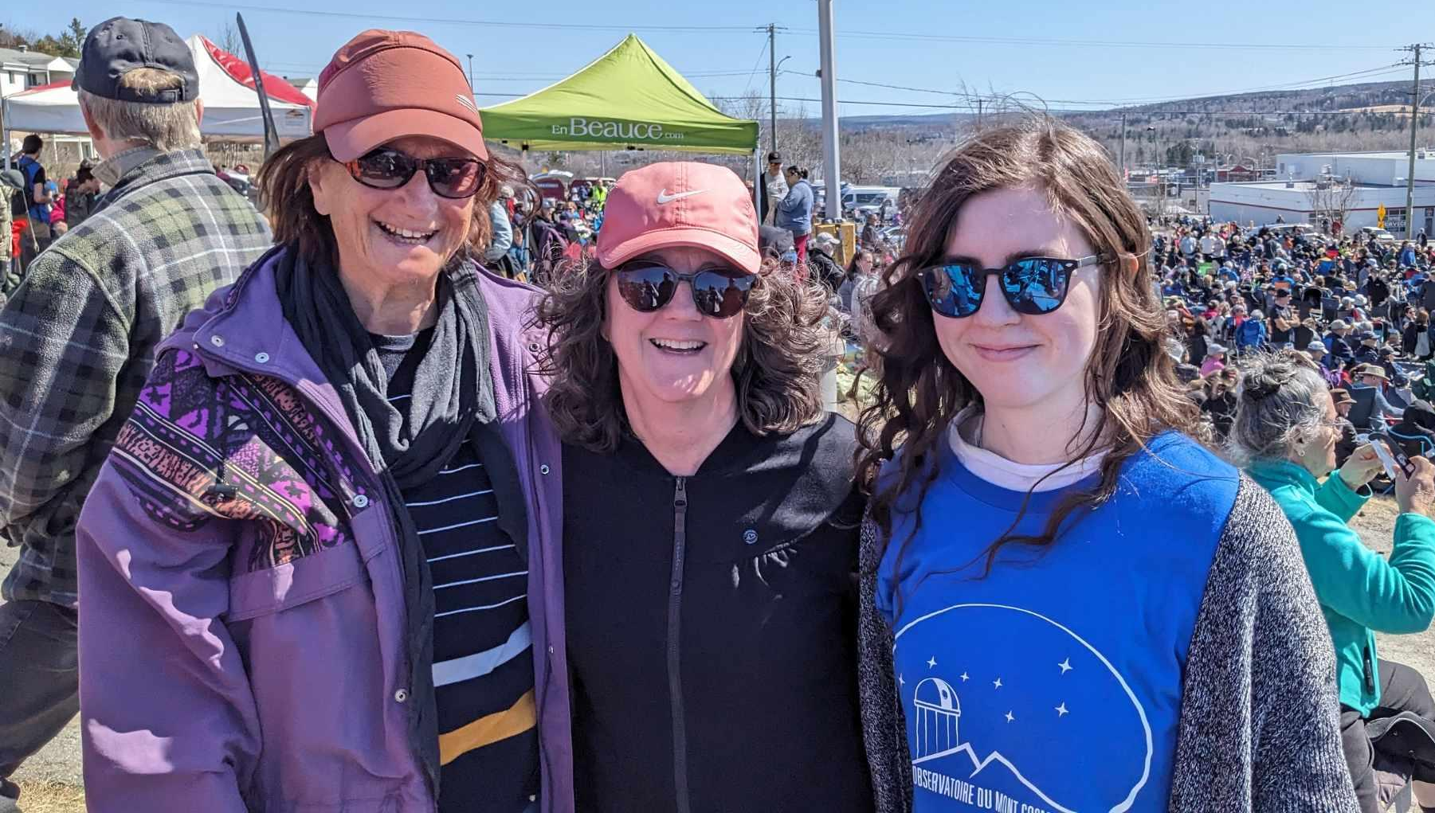
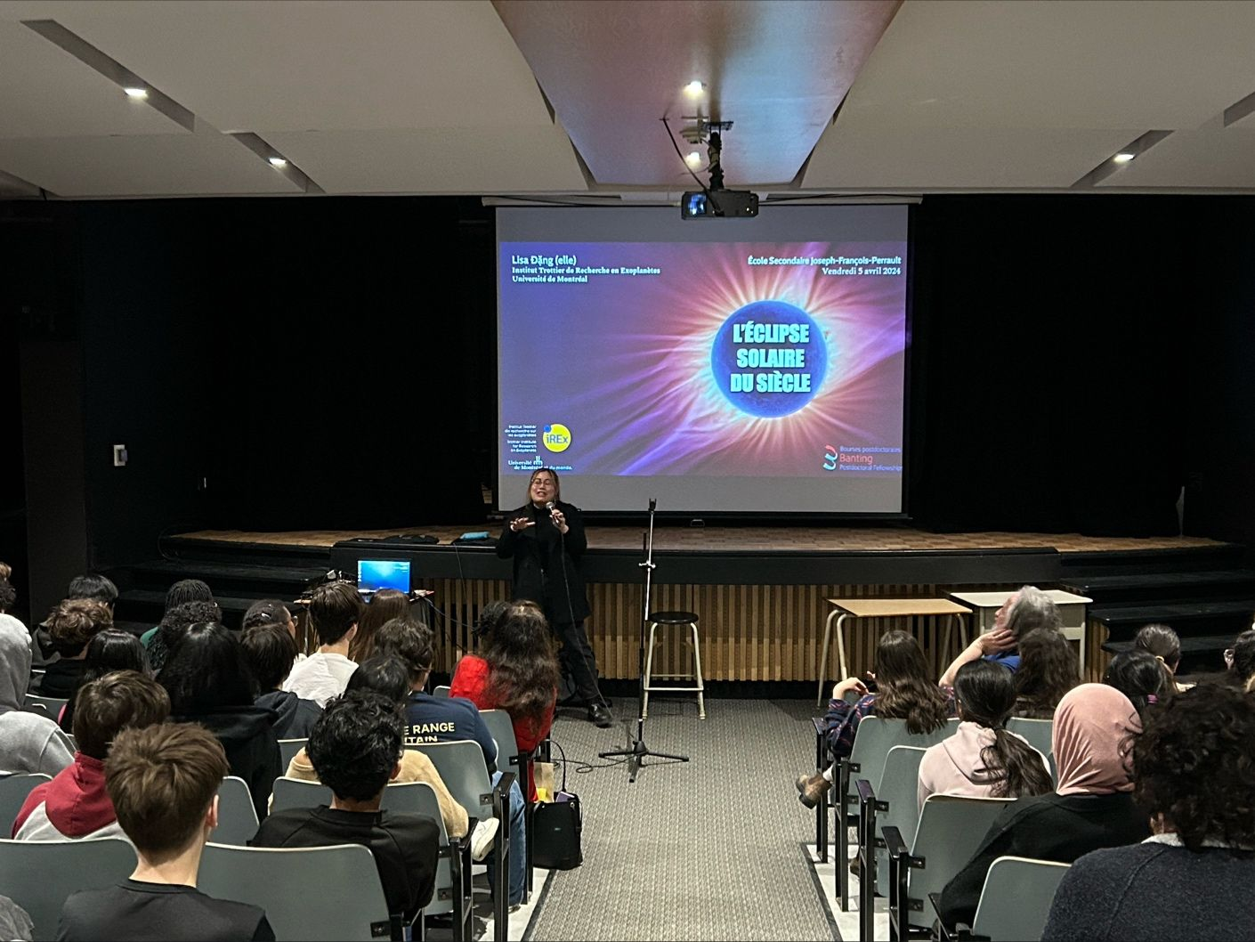
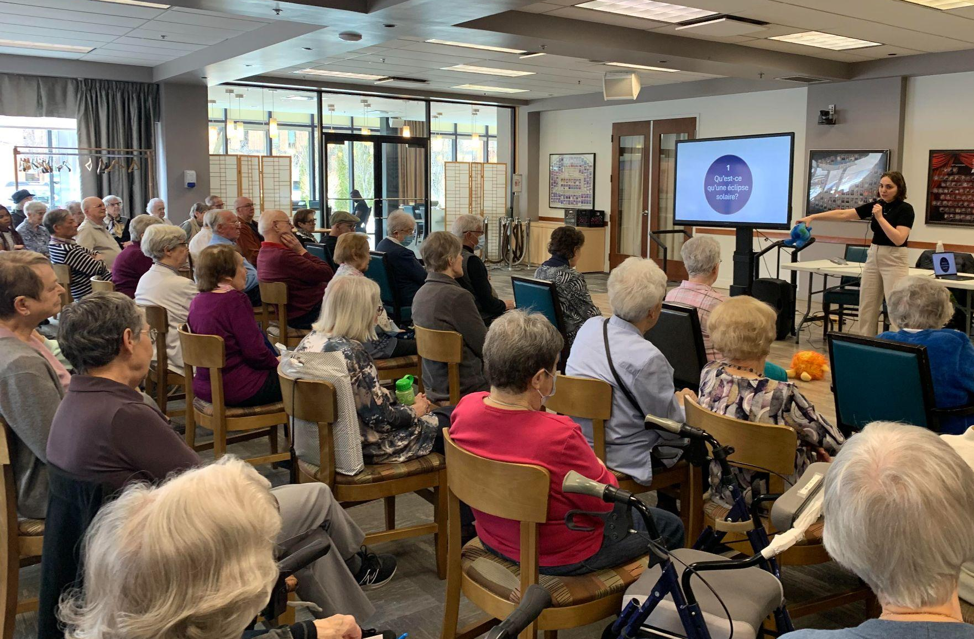
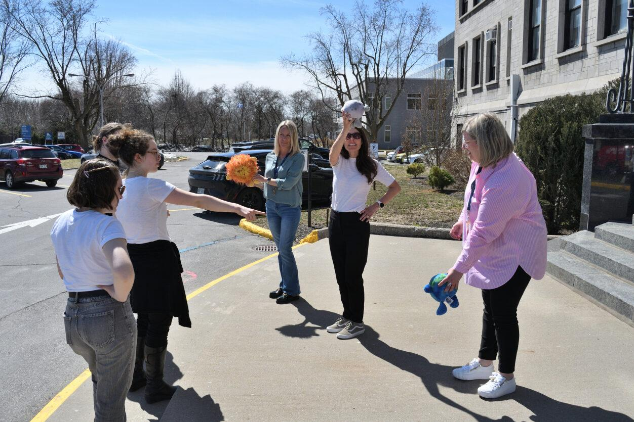
iREx/OMM/Université de Montréal
Eclipse Ambassadors
119 ambassadors trained, incl. 34 from CRAQ
Volunteered on April 8th & before
Dozens of personal initiatives that touched more than 19 000 people
Aussi avec
Notes:
Marie-Eve Credit: A. Philibert, M-E Naud, C. Dumontier, G. Lenoir-Craig, V. Gendron, L. Dang, L. Dauplaise, M. Sadikov, I. Lachance Roberts

Slide 10
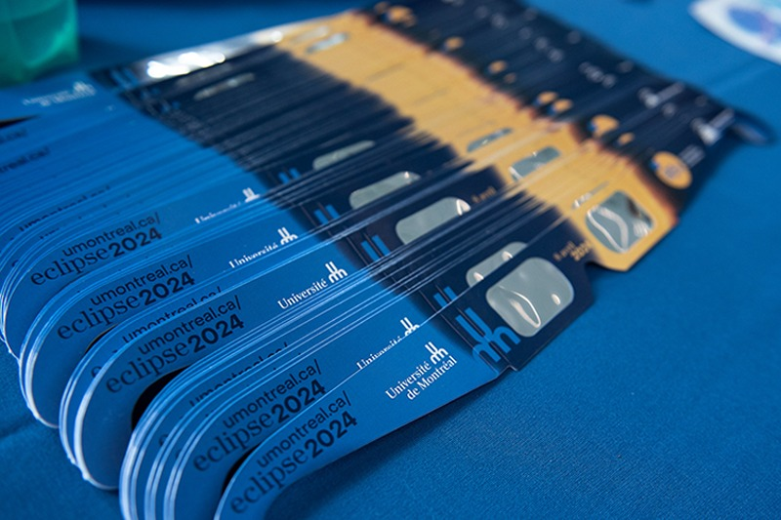
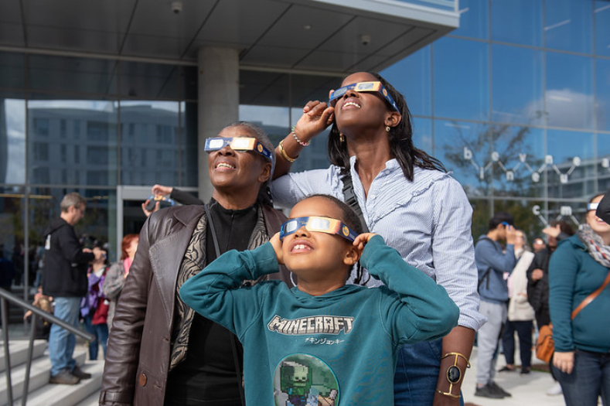
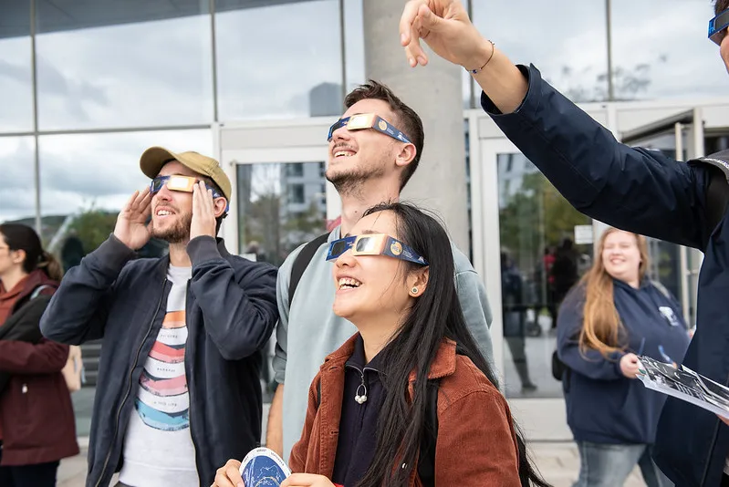
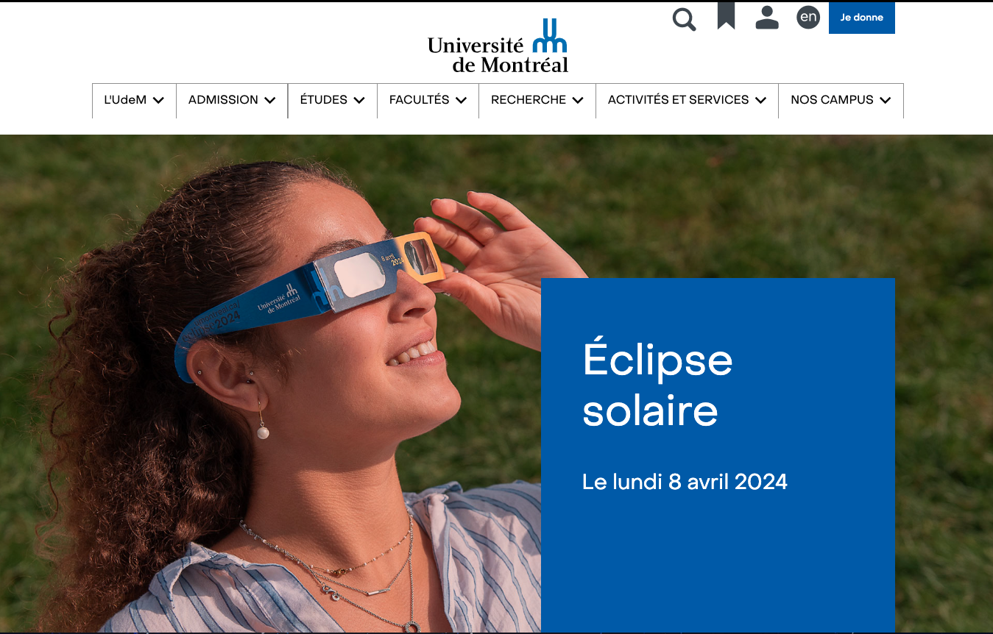
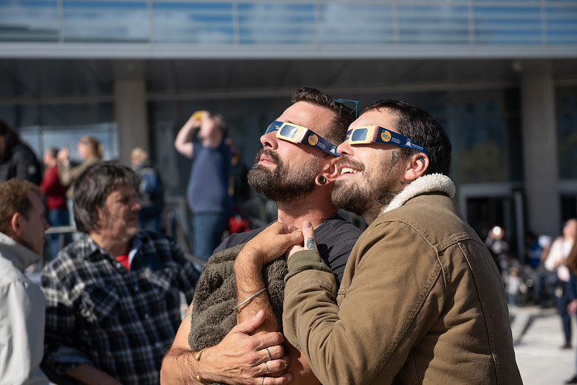
iREx/OMM/Université de Montréal
Eclipse glasses
72 000 eclipse glasses distributed
More than 20K for the general public :
Mtl librairies,
EPO activities,
via eclipse ambassadors,
Ste-Justine hospital
etc.

Slide 11
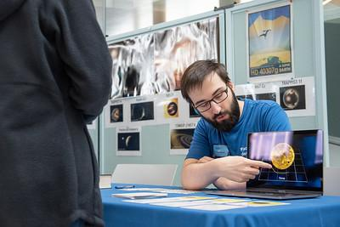
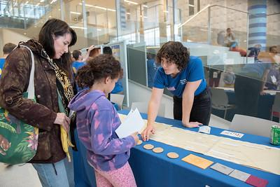
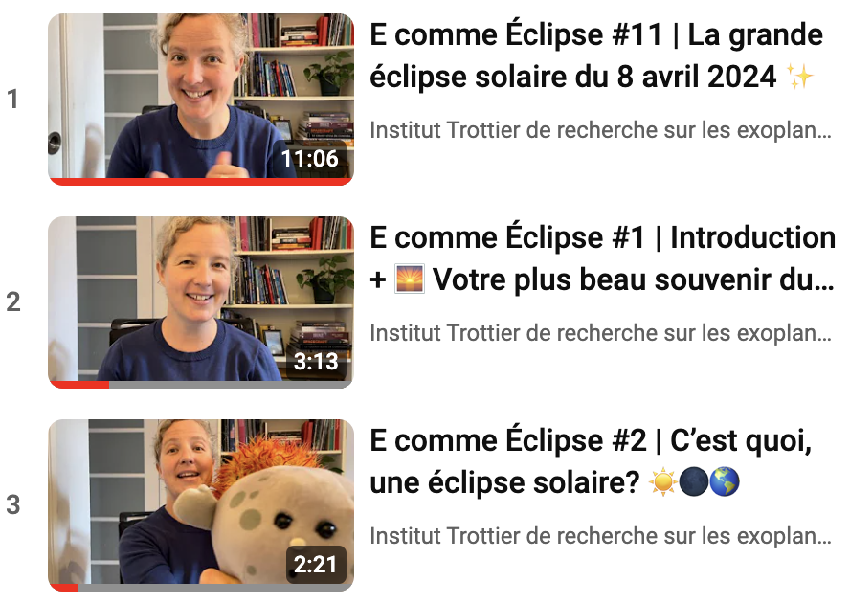
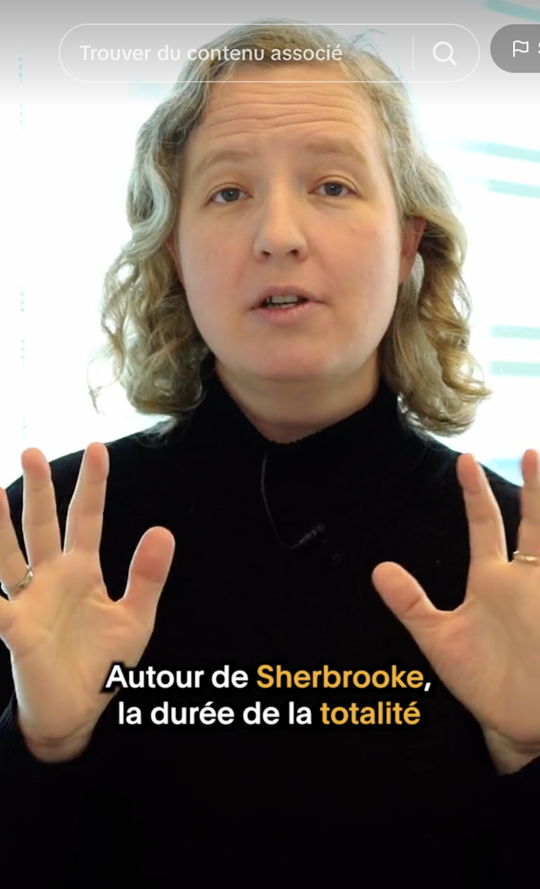
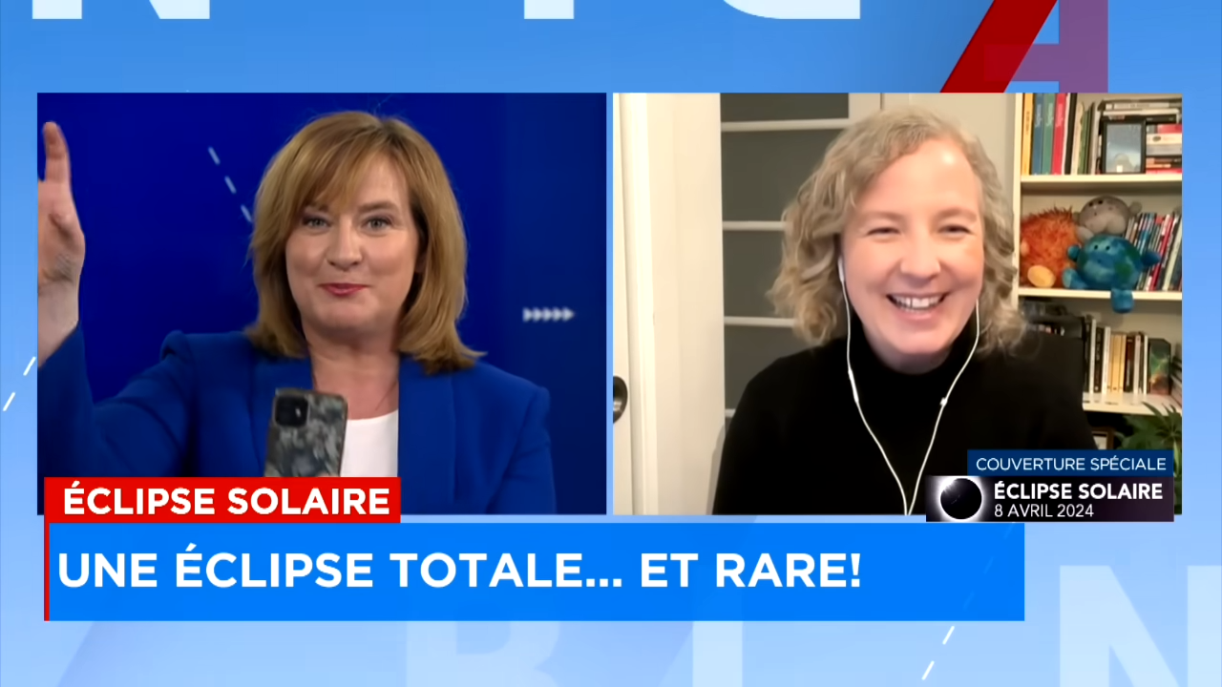
iREx/OMM/Université de Montréal
Other
Events : AstroMIL event in Oct., AoT participation in Feb., Grande conf. Feat. Paul Charbonneau in March, Event with Parité Science in April, CEPSUM, MIL events on April 8th
Multisensorial astronomy resources (AstroMIL kiosk, article)
Video series : E comme eclipse for kids on YouTube (18K views), Savoir Media for young adults on social media (1M views)
Many media interviews
Aussi avec
Notes:
Marie-Eve

Slide 12
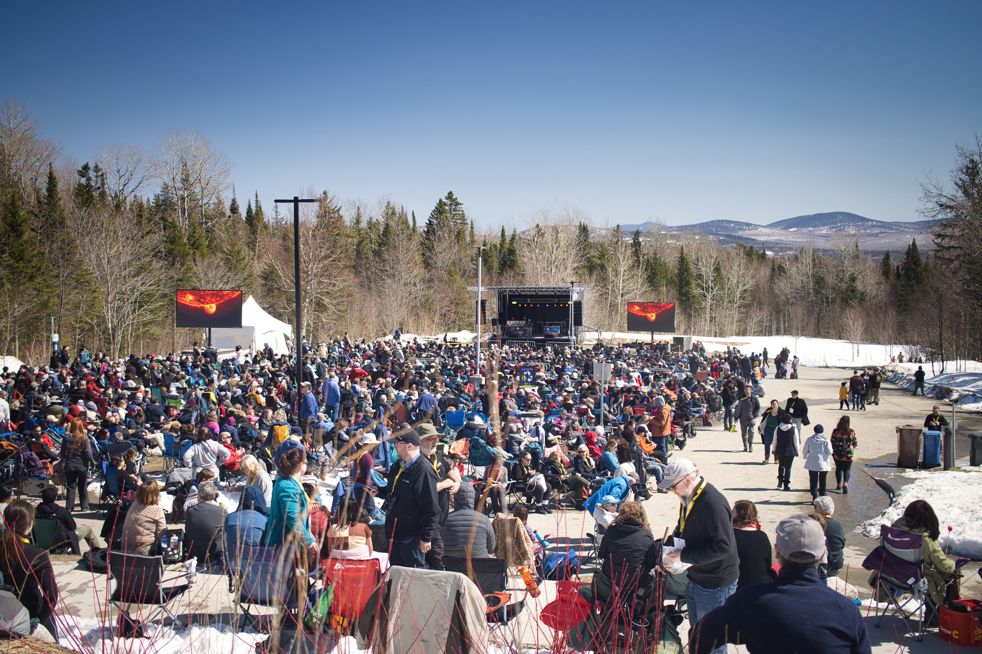
ASTROLab
For schools:
165 000 glasses sold at cost
Many online presentations, 10K children reached
Event on April 8:
2700 people (a record!)
Online streaming (close to 1 million views globally)
A lot of media
Notes:
M-Eve

Slide 13
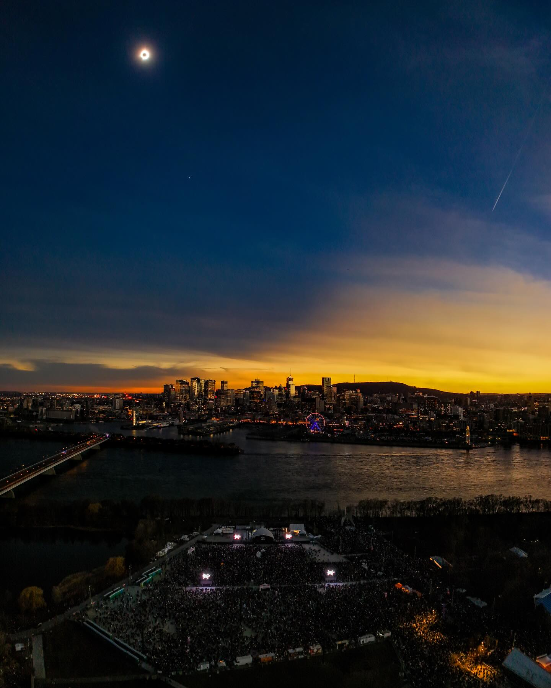
Planétarium
100,000 people at Parc Jean-Drapeau
300,000 glasses distributed in Montreal public schools (primary, secondary, cégeps)
A lot of media
Credit: J-F Savaria
Notes:
M-Eve Photo: https://www.facebook.com/photo/?fbid=1128928271678738&set=a.372070144031225

Slide 14
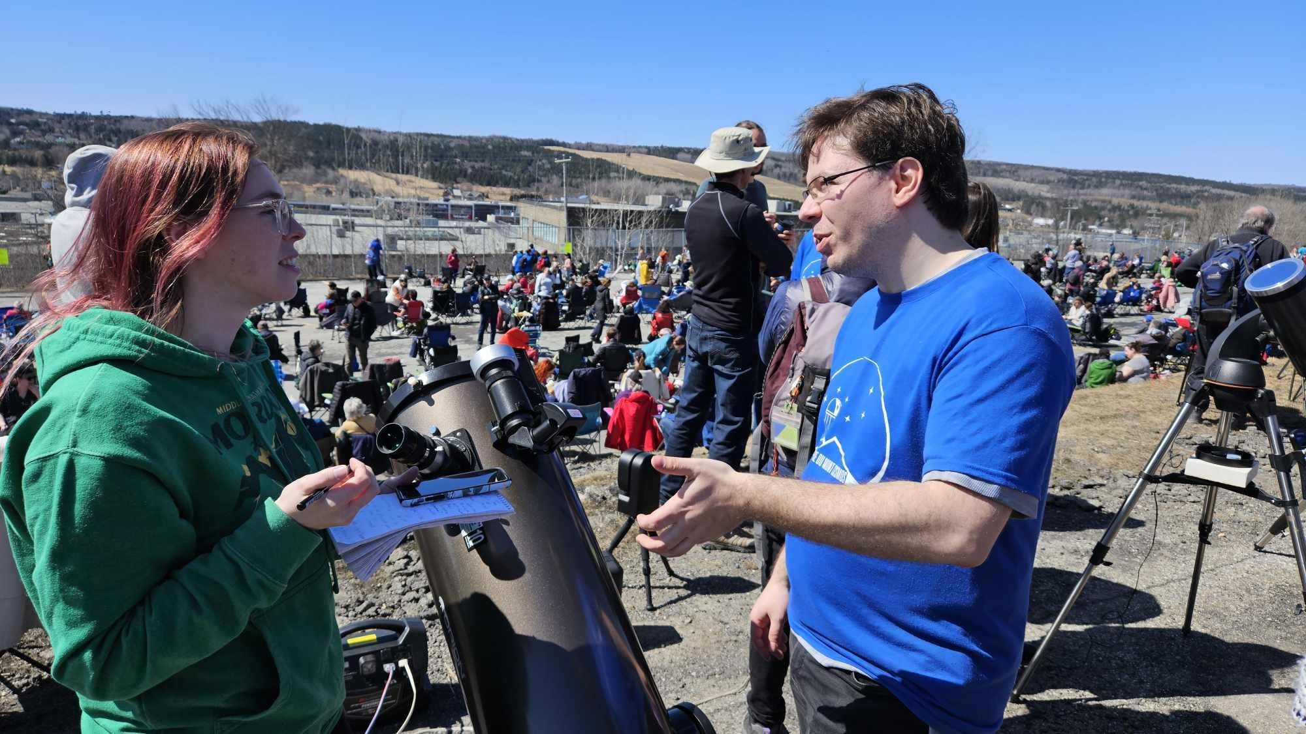
Fédération des astronomes amateurs - FAAQ
My Eclipse App
downloaded almost 350,000 times
Public events in Bromont and St-Georges (with ULaval team!) and event in Sherbrooke
Notes:
M-Eve

Slide 15
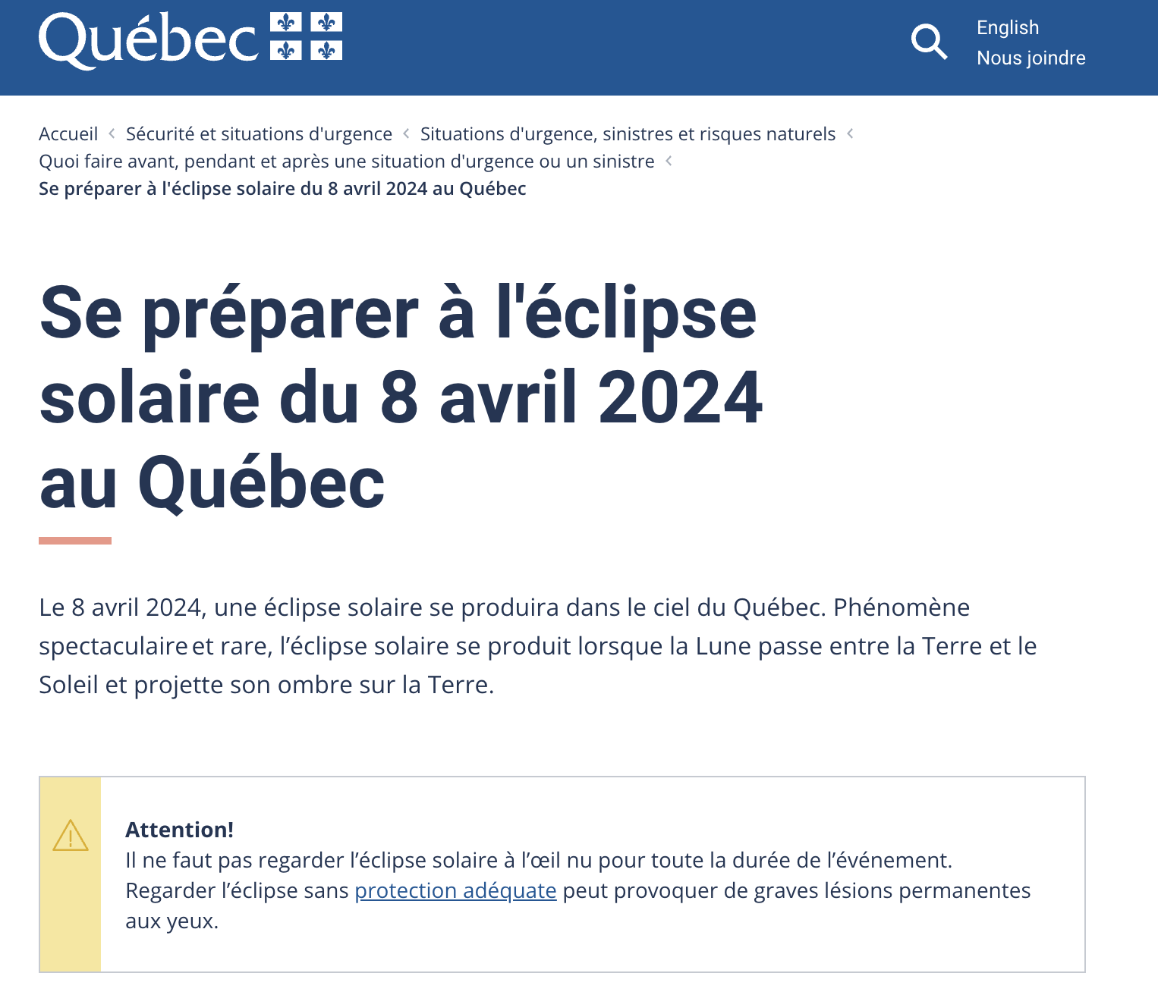
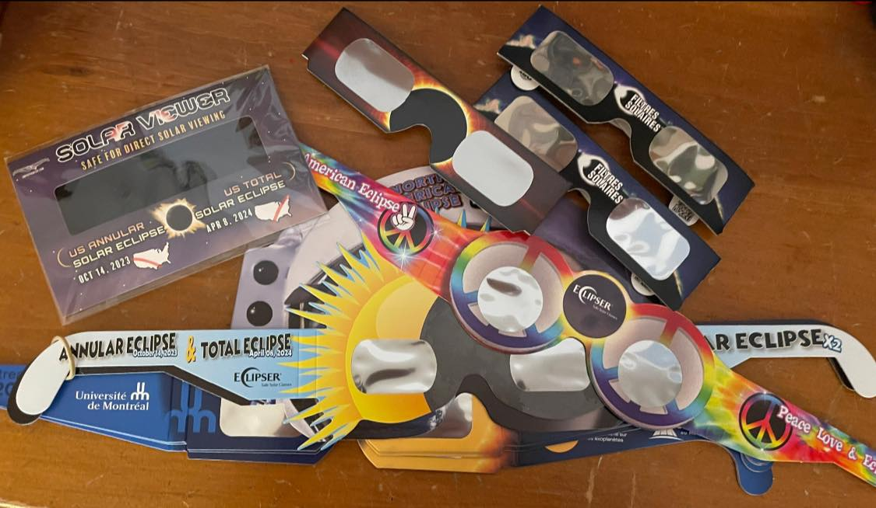
Challenges in the last few months
Guidelines from Public Health scared people - direct impact in the schools
Fear took over in many places
Glasses issues
Notes:
Julie

Slide 16
Guidelines from Public Health
Guidelines from Ministry of Education
PANIC and
CHAOS
School authorities
Astro community preparing teachers and students
(DU, ASTROLab, iREx, Planétarium…)
Notes:
Julie

Slide 17
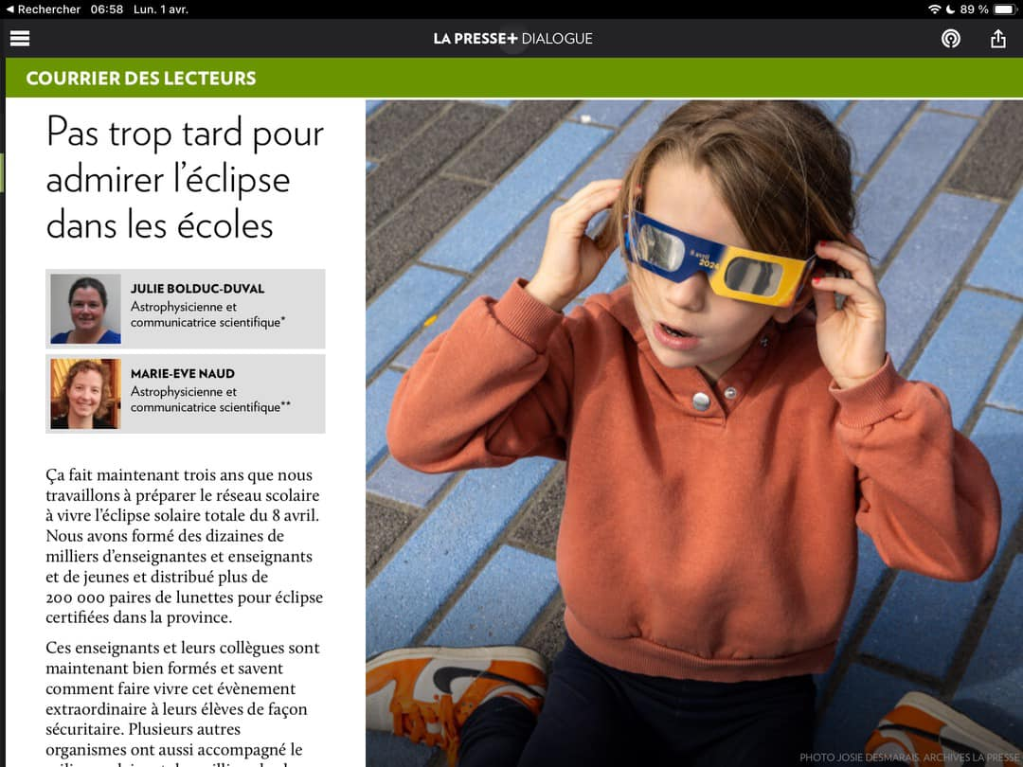
The final sprint…
Some schools are closed…
Some schools are open but…
Not allowed to go outside - even if they have glasses!
Telling students to keep glasses at all times (even during totality…)
Not allowed to distribute our glasses…
….
Notes:
Julie

Slide 18
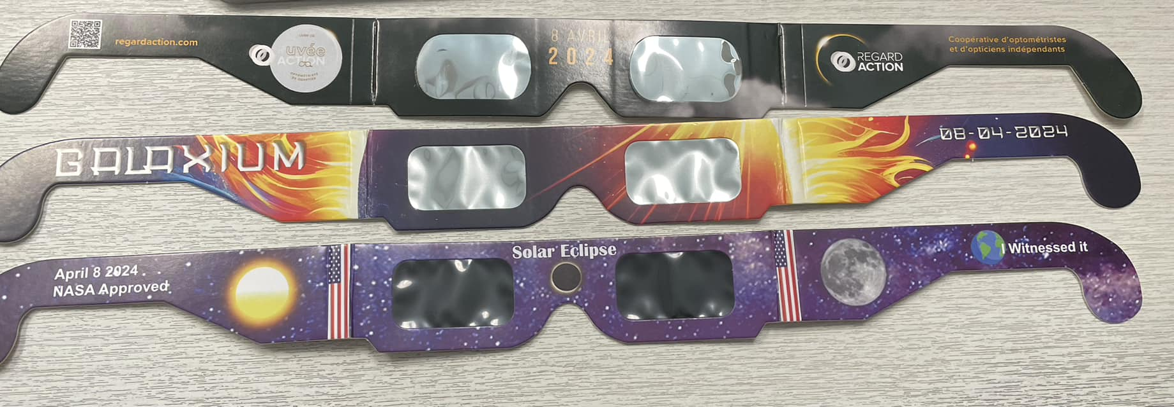
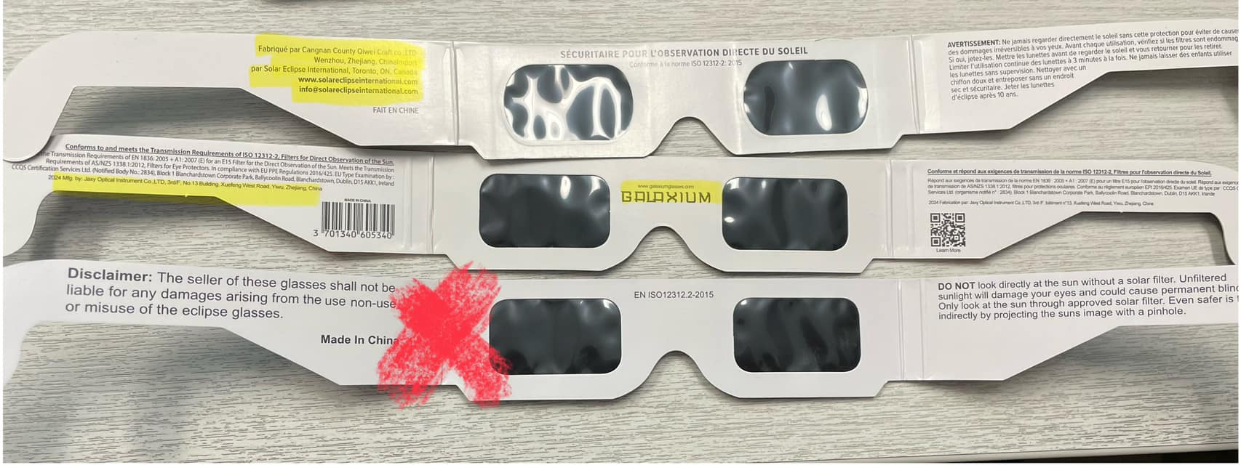
Glasses, everywhere (incl. fakes…)
Notes:
M-Eve

Slide 19
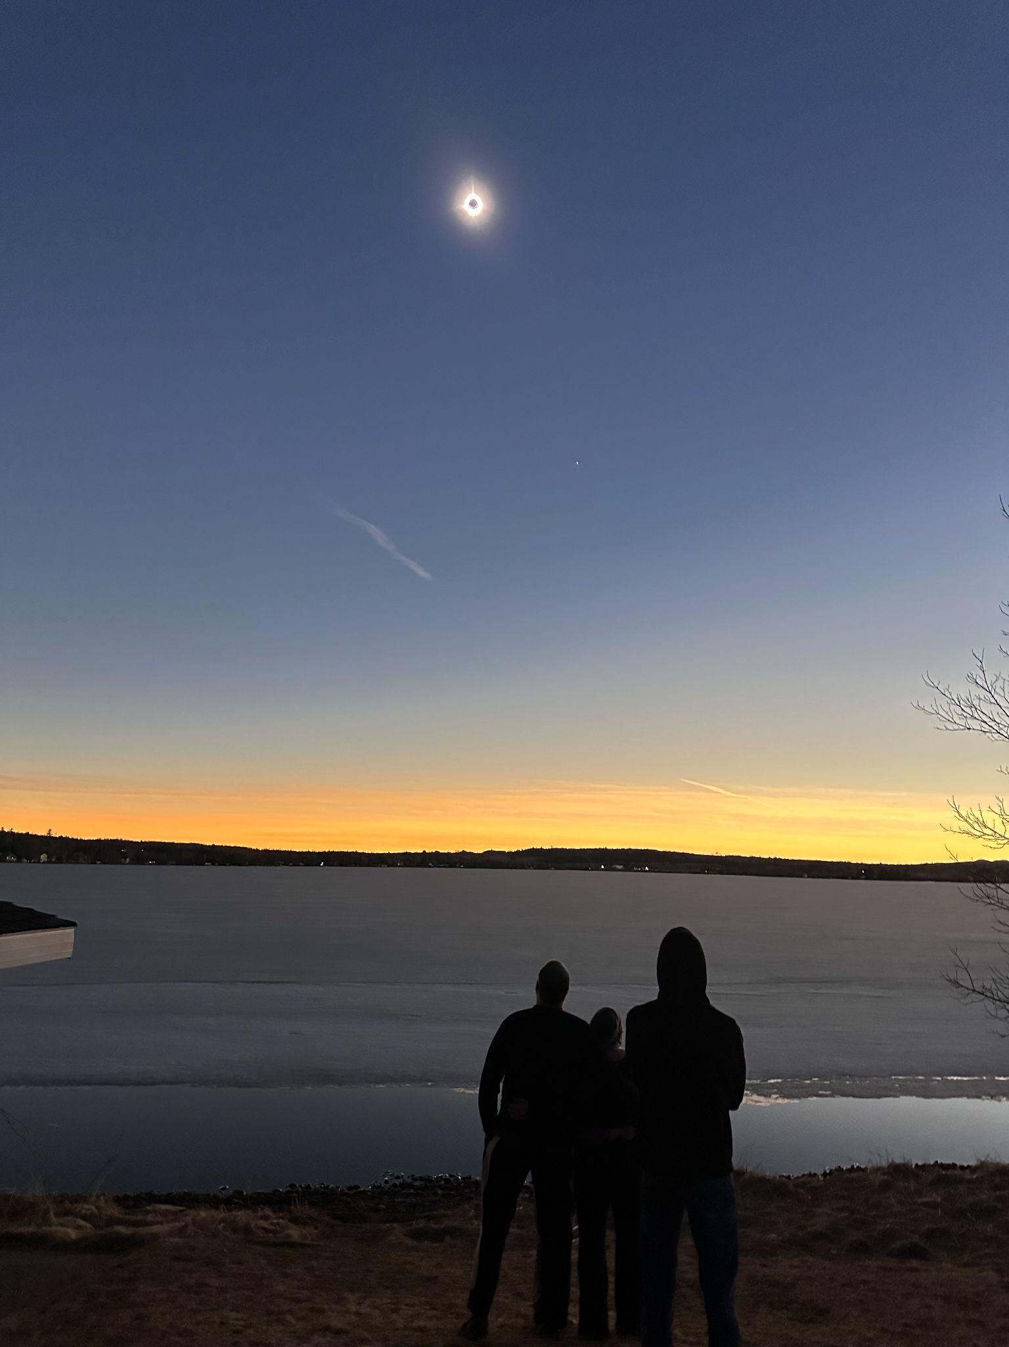
Conclusion…
We have an amazing astro community in EPO in the province: we built on each other’s strength and collaborated well.
We did really well what we had control over. The negative aspects came mainly from the decisions of others (authorities).
We were incredibly lucky with the weather!
Notes:
Julie

Slide 20
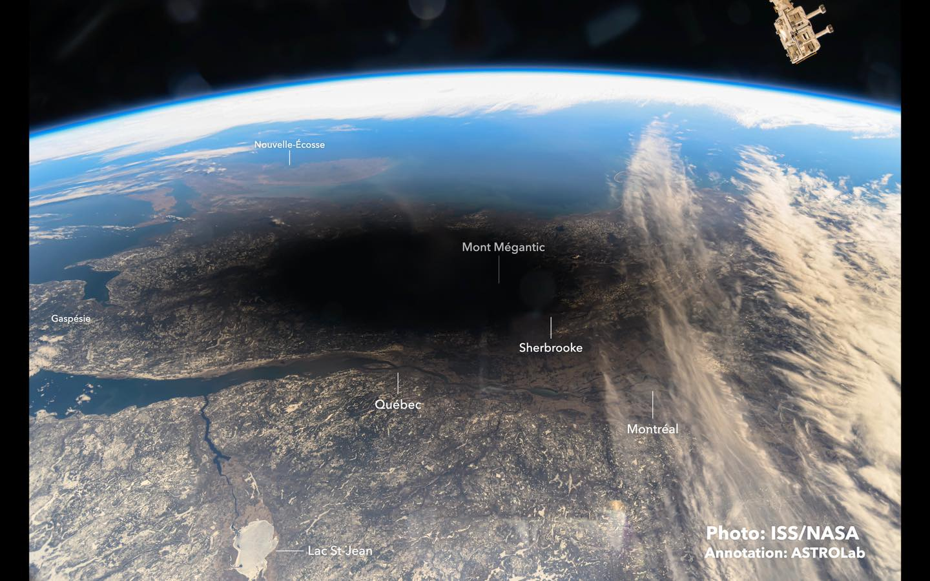
Notes:
Julie
Photo: https://www.facebook.com/photo?fbid=848837330620649&set=a.239454034892318

Slide 21
A few links
www.eclipsequebec.ca
www.decouvertedelunivers.ca/eclipse / www.discovertheuniverse.ca/eclipse
www.exoplanetes.umontreal.ca/eclipse
www.umontreal.ca/eclipse
Our article in LaPresse
Cris du coeur de Julie - 3 days before / 1 day after
Livre Éclipse co-écrit par Julie
Notes:
Julie

