Slide 1
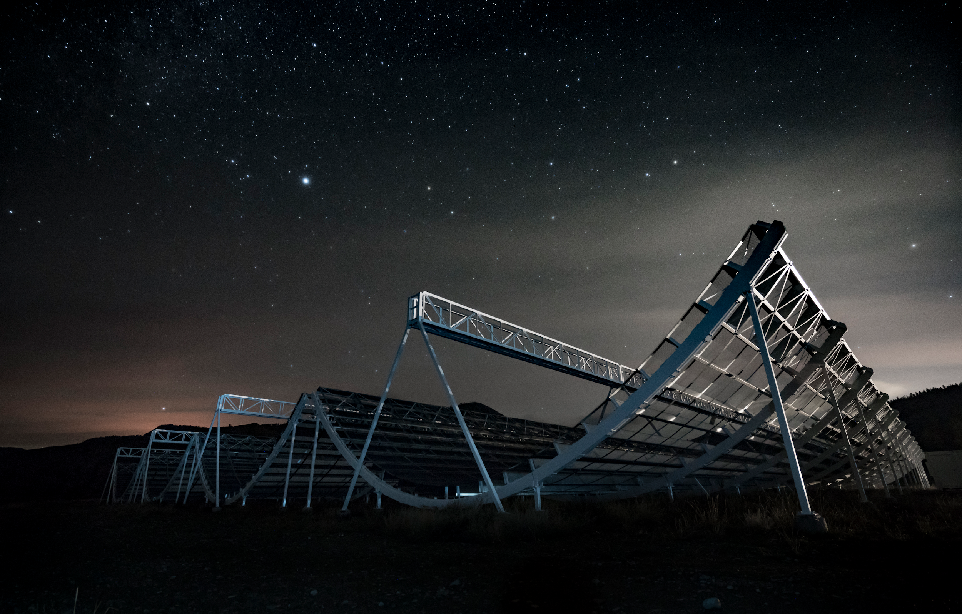
Radio Monitoring Observations of the Nearby Repeating Fast Radio Burst 20181030A
Thomas C. Abbott, McGill University
CRAQ
May 8, 2024

Slide 2
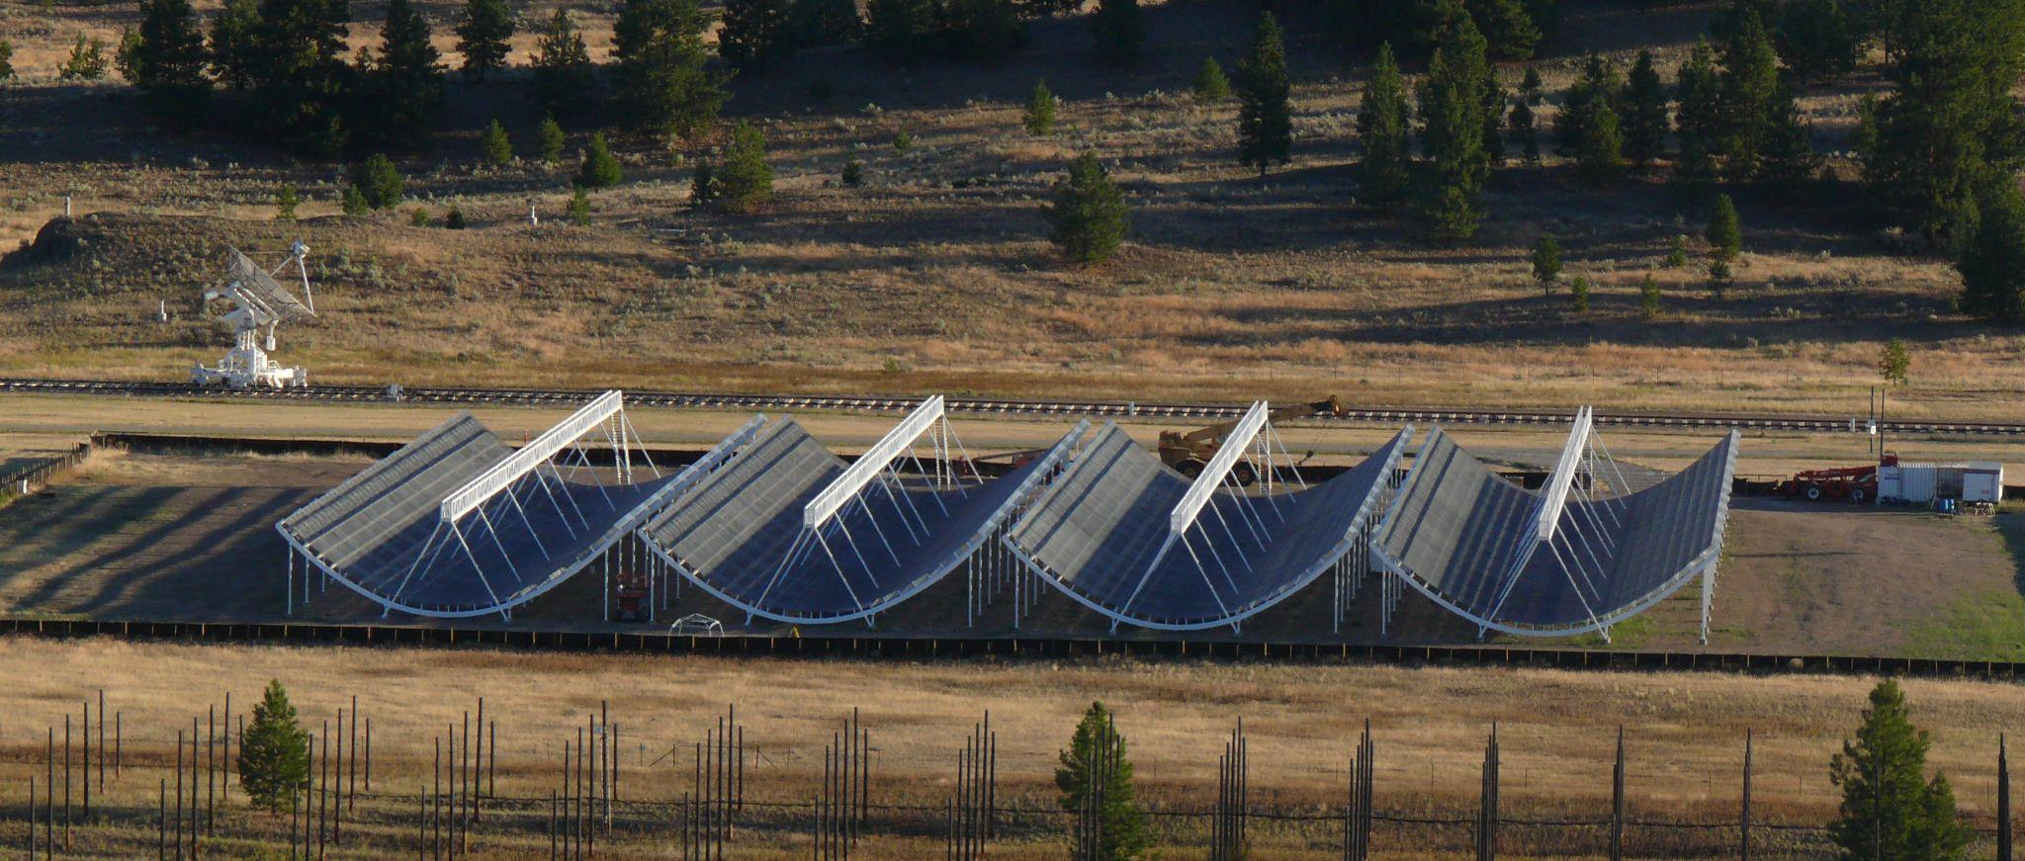
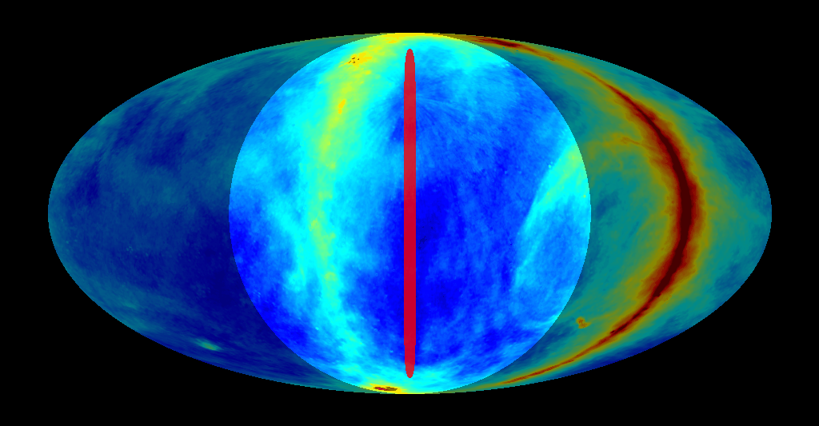
The CHIME Telescope
Canadian Hydrogen Intensity Mapping Experiment
400MHz - 800MHz
1024 simultaneous beams
Specialized backends (FRB, Pulsar, Cosmology)
Credit: CHIME Collaboration

Slide 3
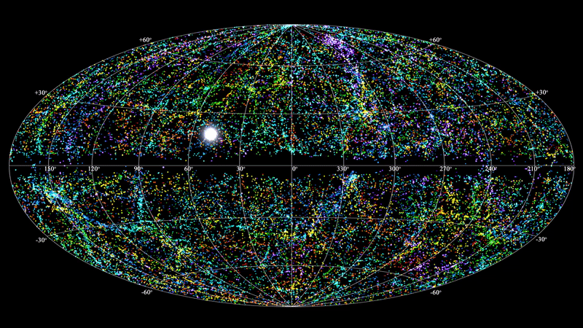
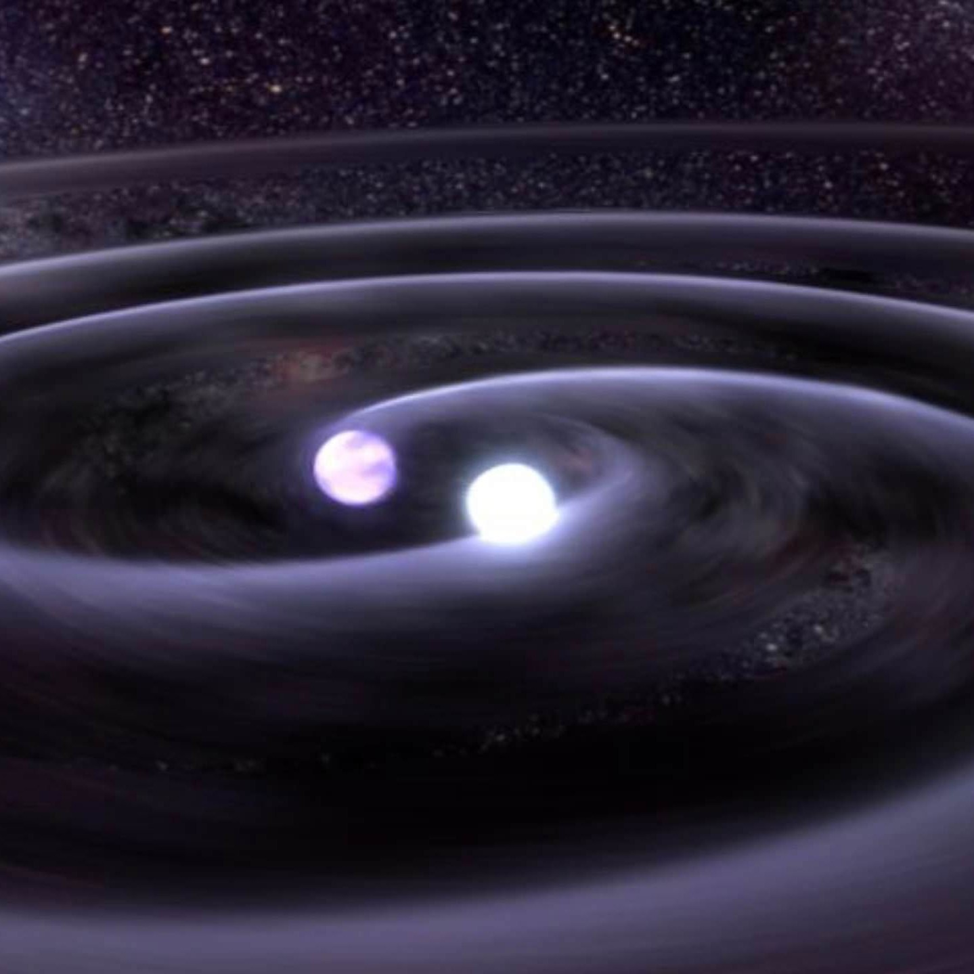
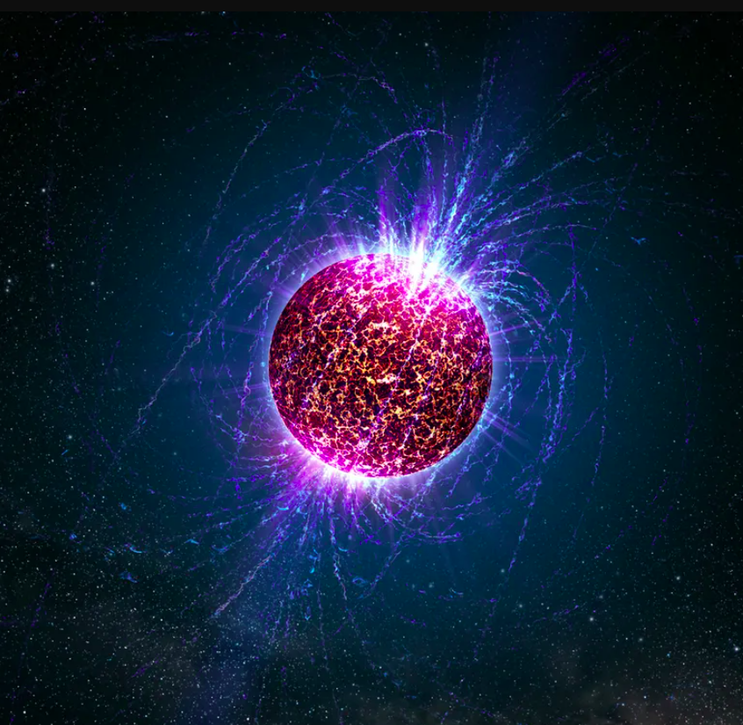
Fast Radio Bursts
Fast Radio Bursts are bright millisecond-duration radio transients
Some FRBs repeat!
Credit: T. Jarrett (IPAC/Caltech); B. Saxton, NRAO/AUI/NSF
Credit: LIGO Collaboration (left) and NASA (right)

Slide 4
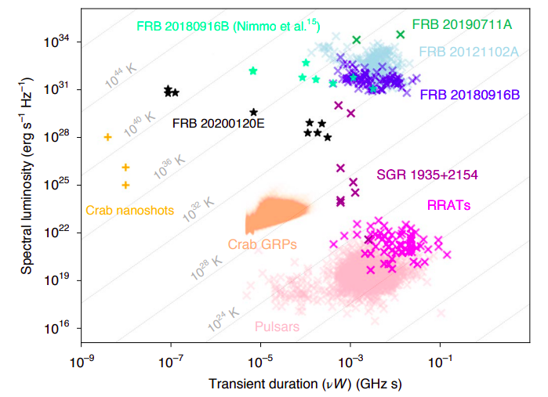
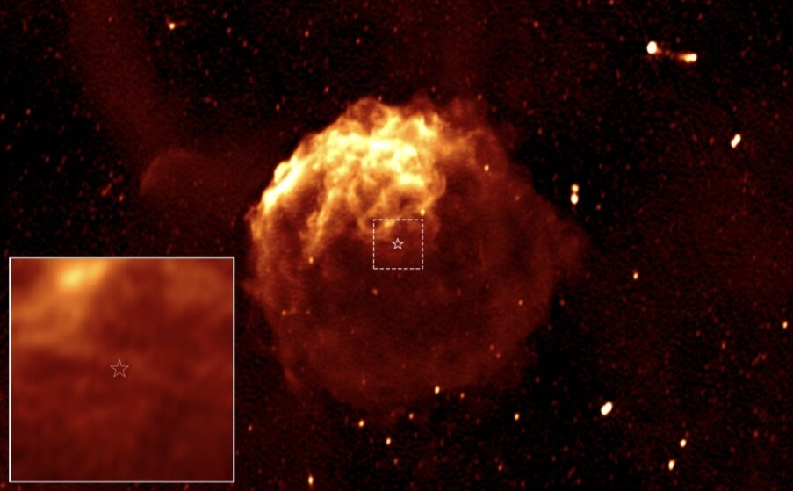
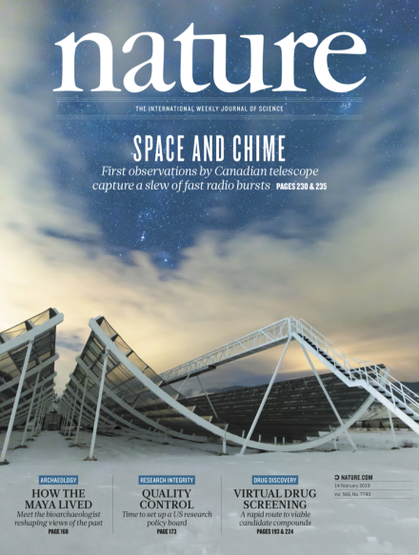
Multi-Wavelength Follow-up
FRB sources are elusive to multi-wavelength follow-up
FRB-like bursts from a galactic magnetar, SGR 1935+2154
Credit: Nimmo et al. 2022
Credit: Vreeswijk et al., 2021.
Credit: Andrew Fyfe

Slide 5
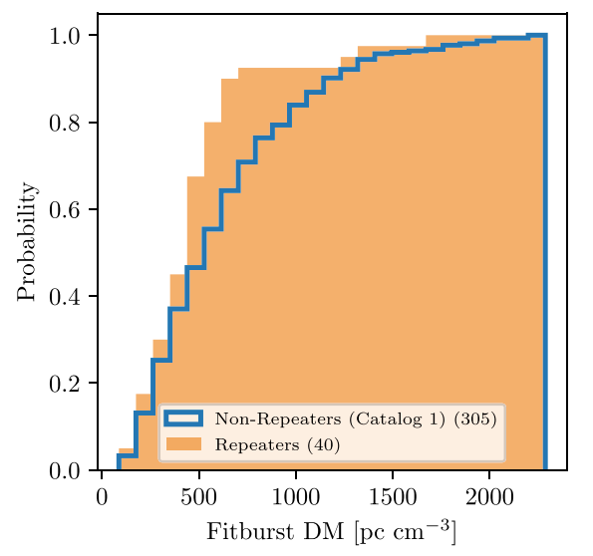
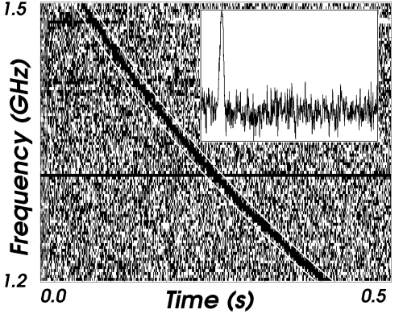
Dispersion Measure (DM)
FRBs are dispersed by ionized matter
Dispersion is frequency dependent
FRB 20181030A
Credit: Lorimer et al., 2007.

Slide 6
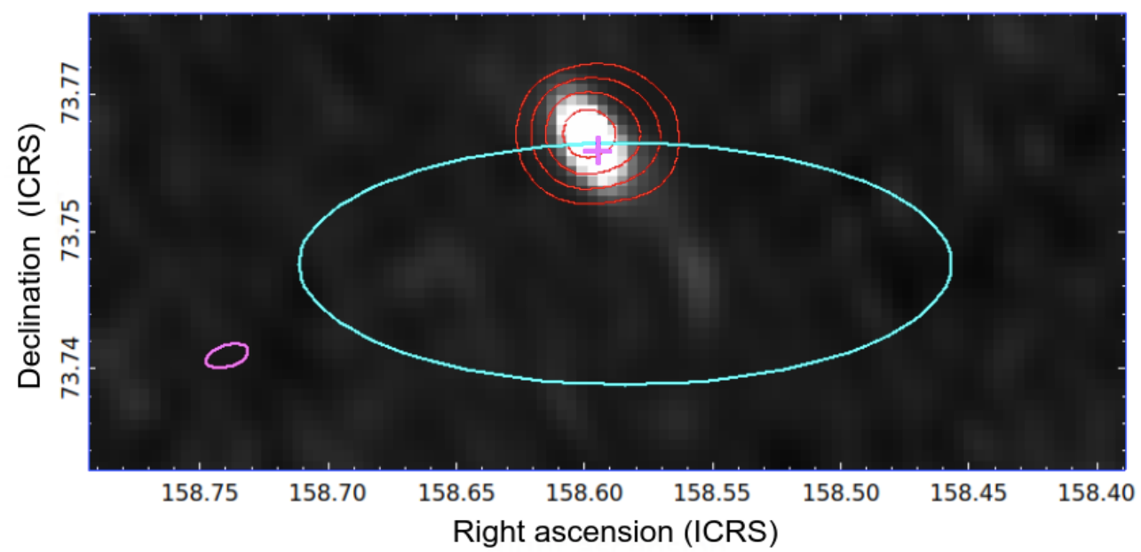
Host Galaxy of 20181030A
Localized to NGC 3252, a star-forming spiral galaxy
At a distance of ~20 Mpc, this is the second closest repeating FRB yet!
Credit: Bhardwaj et al., 2021.

Slide 7
CHIME/Pulsar Search Pipeline
Using the Pulsar backend to perform FRB searches
Higher time resolution (0.983ms → 0.041ms)
Digitally formed tracking beams provide longer exposures
Applied to several nearby repeaters
CHIME/Pulsar Filterbank Data
RFI Masking
and Cleaning
Disperse and Downsample
Presto Single Pulse Search

Slide 8
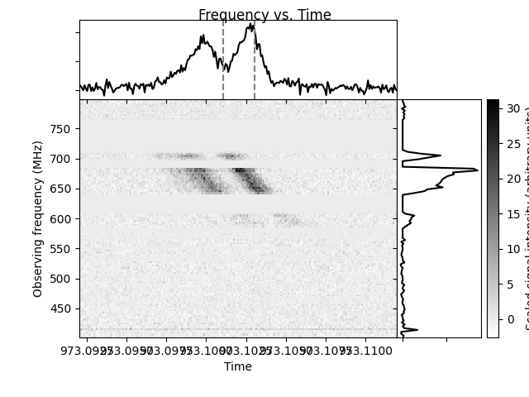
CHIME/Pulsar Search Pipeline
Currently observing 3 nearby repeating FRBs
~200 hours of exposure on
FRB 20181030A
Hints of activity but no high S/N detections to date
Over 1000 detections from other hyperactive repeating FRB

Slide 9
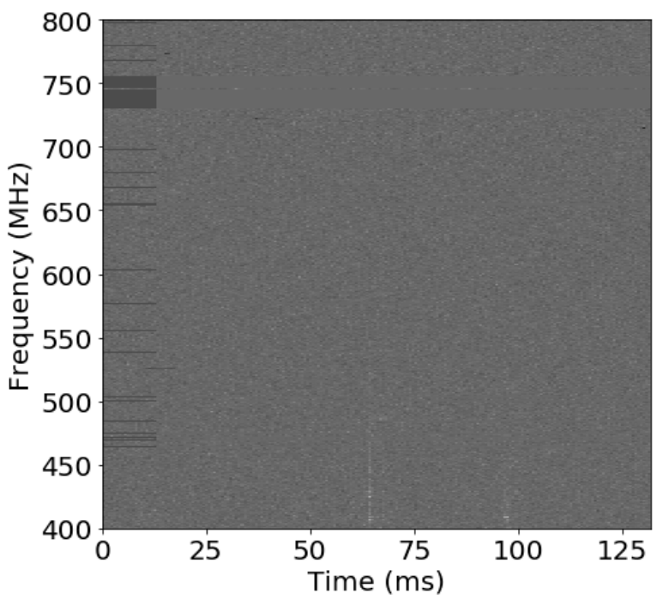
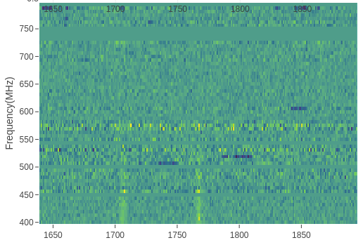
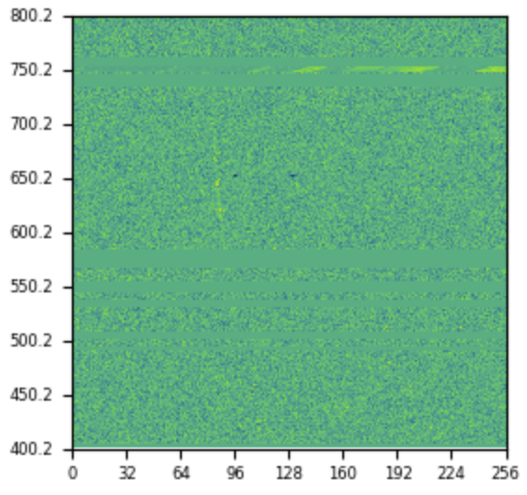
Radio Detections of 20181030A
Intensity data shows “double bursts” and some of the faintest FRBs yet.
Baseband data shows possible sub-millisecond components.

Slide 10
Preliminary Results
Baseband detection provides burst width and fluence
FRB 20181030A is among the faintest FRBs observed
FRB 20181030A
Credit: Nimmo et al. 2022

Slide 11
Conclusion
FRB 20181030A is a nearby repeating FRB that is a promising candidate for multi-wavelength follow-up
Continued observations with the highly sensitive and high-time resolution CHIME/Pulsar FRB Search may provide hints towards the link between FRBs and magnetars

Slide 12
Backup Slides

Slide 13
Outline
What are FRBs, what is CHIME, and why is CHIME good at detecting FRBs
Strengths of CHIME/Pulsar for FRB searches from repeaters
FRB progenitors, multi wavelength follow-up
Overview of R4
Why is R4 interesting
Low DM repeater
High dec (double transit)
Localized
Notable CHIME/FRB detections
Double burst detections
Show pipeline works
Spectral luminosity [erg/s/Hz] vs width → Nimmo 2022 or Majid 2021
Evidence with R117 faint bursts
Update on CHIME/PSR observations of R4

Slide 14
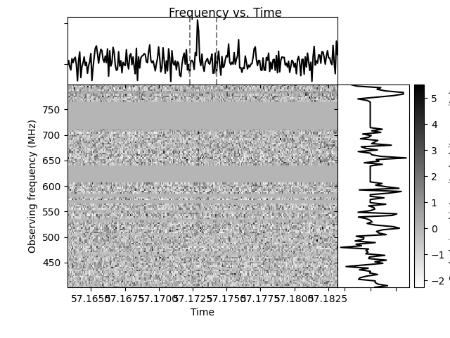
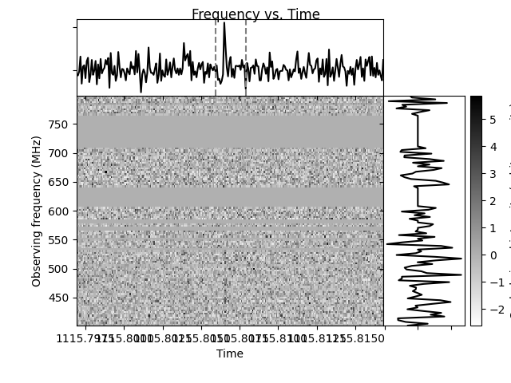
Preliminary Detections of 20181030A

Slide 15
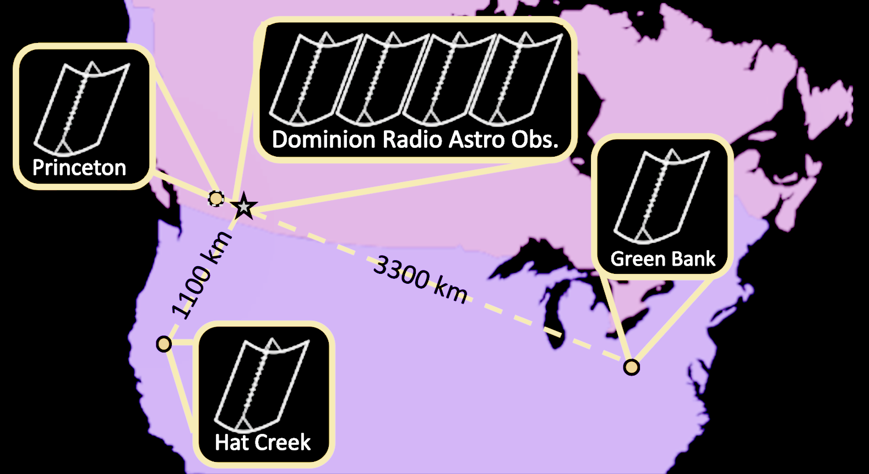
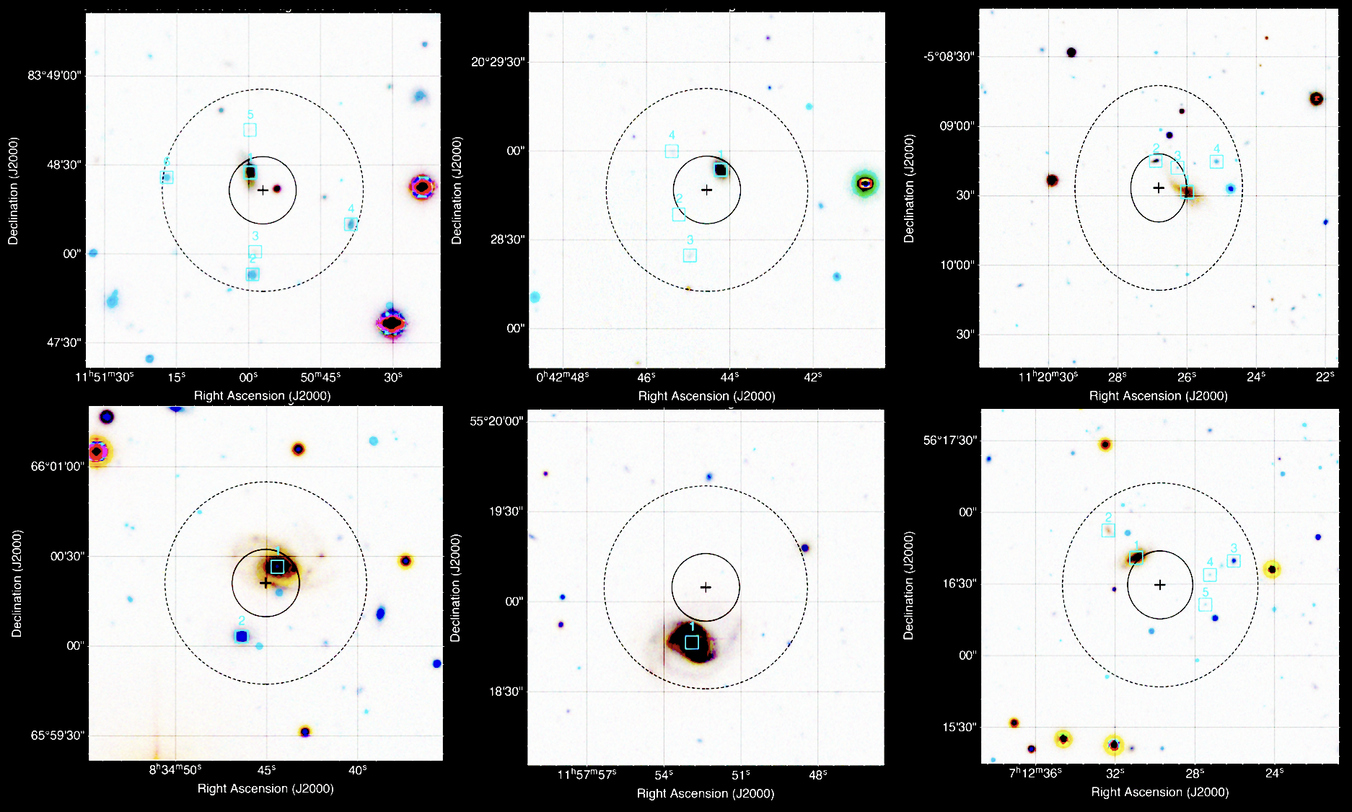
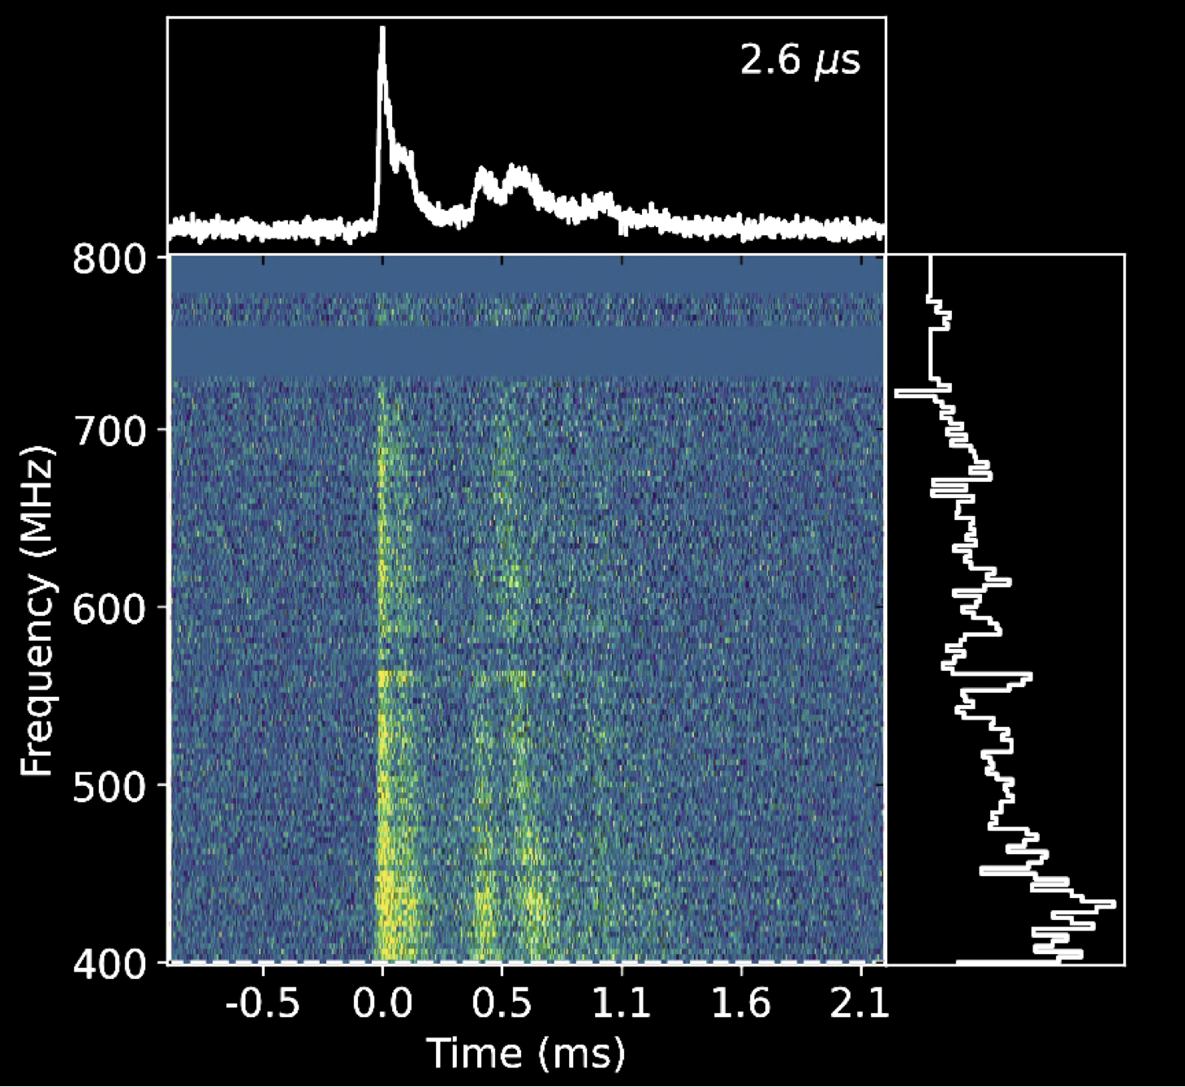
CHIME Outriggers + Baseband
3 “outrigger” telescopes enable milli-arcsecond localizations of FRBs
High resolution “baseband” data for detailed FRB analyses
CHIME/FRBs second FRB catalog

Slide 16
Abstract
20181030A is a nearby repeating fast radio burst (FRB), discovered by the Canadian Hydrogen Intensity Mapping Experiment’s (CHIME) FRB Instrument in 2018 October. In the two years after the initial detection, 8 more bursts were detected using CHIME/FRB. The most likely host galaxy of FRB 20181030A is a star-forming spiral galaxy (NGC 3252), which resides at a distance of ~20 Mpc, likely making it the second closest repeating FRB source. FRB 20181030A is thus an excellent candidate for multiwavelength follow-up since it is likely located nearby. In this talk, I will present results from 10 months of daily radio monitoring observations of FRB 20181030A using the CHIME/Pulsar instrument, outfitted on the CHIME radio telescope. The CHIME/Pulsar instrument is able to record coherently dedispersed data at high time resolution using its tracking beam capabilities. Radio bursts, with narrow microsecond-wide components, have been detected in baseband data containing bursts from FRB 20181030A, suggesting that the source may produce coherent radio emission on timescales well below the ~1 ms time resolution of the CHIME/FRB instrument. I will present results characterizing the source’s recent emission behavior, activity level, and repetition rate. I will also describe the pipeline that is being used to perform a deep search for radio bursts and measure their properties.

