Slide 1
AlphaGen: a new neural network for fast multi-plane gravitational lensing
Charles Wilson, M.Sc. candidate
CRAQ Annual Meeting 2023
Notes:
Draw attention to background image: this is what our universe looks like at the largest scales, a cosmic web of dark matter filaments and voids. The dark matter forms the skeleton on which stars, galaxies and clusters grow. This image of structure is the result of a simulation assuming our current standard model of cosmology, which has time and time again shown great success at validating observations of the universe at its largest scales

Slide 3
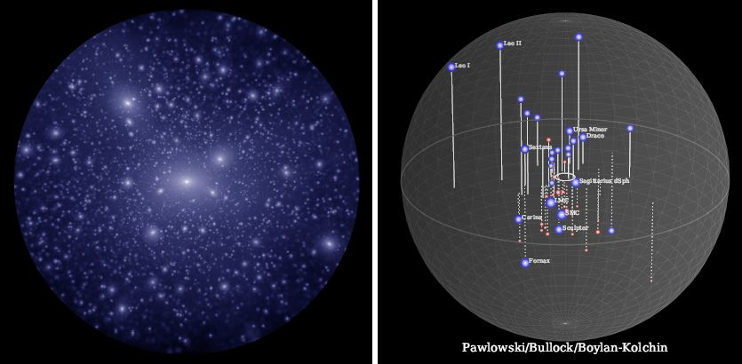
Where are the lightest halos?
𝚲CDM: >1000
Observed: ~50
Missing Satellites Problem
Notes:
We also have very strong evidence that nearly all galaxies are embedded in much larger dark matter halos. But problem at small scales! Dark matter-only simulations assuming a standard ΛCDM cosmology predict an abundance of dark matter subhalos within the host dark matter halo of the Milky Way, whereas the most recent census only tallies 50 or so satellite galaxies. This significant disagreement is known as the Missing Satellites Problem

Slide 4
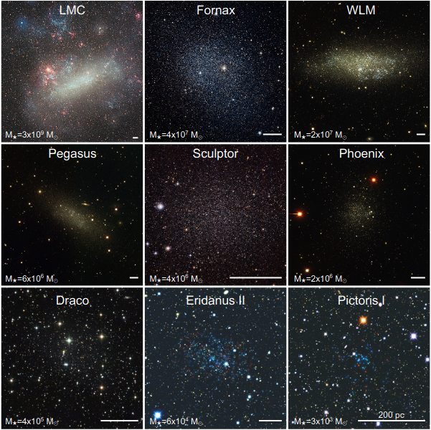
Too light for light
Galaxy formation is increasingly inefficient at low dark matter halo masses
Measurements of stellar kinematics provide information about halo properties
This method is not applicable in dark galaxies
Slawik (LMC), ESO/Digitized Sky Survey 2 (Fornax), Massey et al. (WLM, Pegasus, Phoenix), ESO (Sculptor), Schirmer (Draco), Belokurov & Koposov (Eridanus II, Pictoris I)
Notes:
Galaxy formation is increasingly inefficient at low halo masses (lower than 10**10 M_sol, making the dwarf galaxies they contain extremely faint or completely dark
In massive nearby galaxies, measurements of stellar kinematics provide a wealth of information about their underlying dark matter halos’ properties
Without luminous tracers, not possible to infer properties of low-mass halos by such observational methods

Slide 5
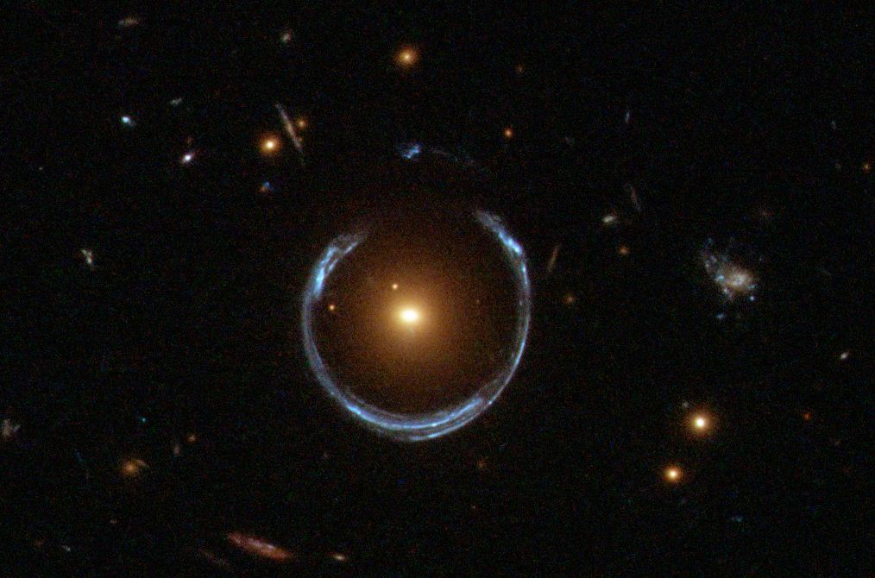
How can we find them?
Strong gravitational lensing is a very useful probe for halo mass
Also probes dark matter on small scales:
Substructure in the lens plane (subhalos)
Extragalactic halos distributed along the line-of-sight
ESA/Hubble
Takeaway: mass deflects light, substructure has mass, we should look for its contribution to the overall deflection. Modern inference methods can detect this signal, but require huge amounts of realistic simulations.
Notes:
Strong gravitational lensing allows for measurement of the mass of a lensing galaxy’s host dark matter halo
Horseshoe: central lens galaxy at z=0.44, background source at z=2.38
Also provides a powerful probe for the distribution of dark matter on the smallest scales:
Detection of massive substructure in lens plane near lensed arcs (which will be referred to as subhalos going forward)
Detection of cumulative effect of smaller substructure further from the lens, and from halos distributed along the line of sight
Takeaway: mass deflects light, substructure has mass, we should then looks for their contribution to the overall deflection
So how is substructure actually detected in lenses? Modern methods can tackle this task, but they require large amounts of realistic simulated data

Slide 6
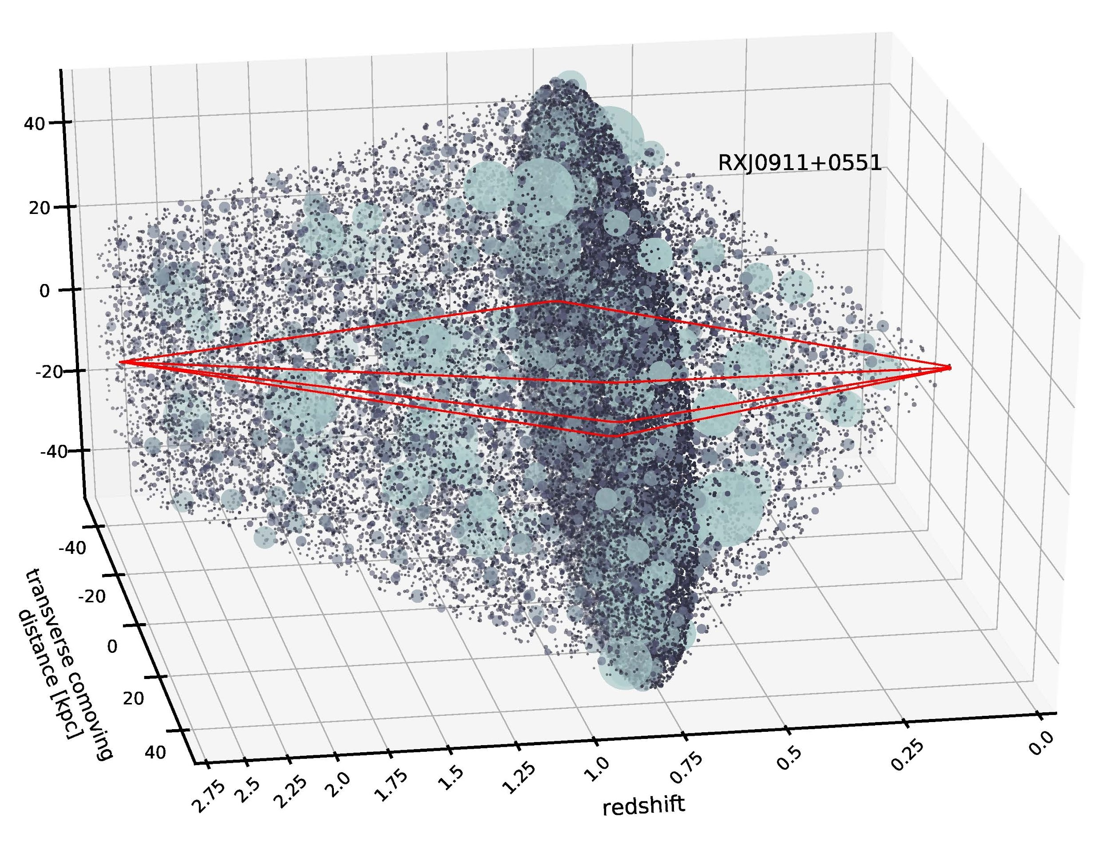
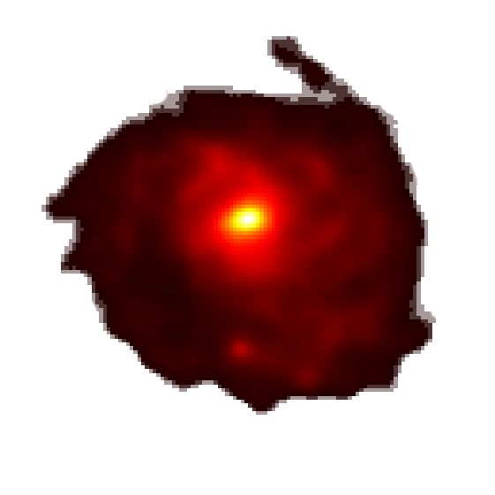
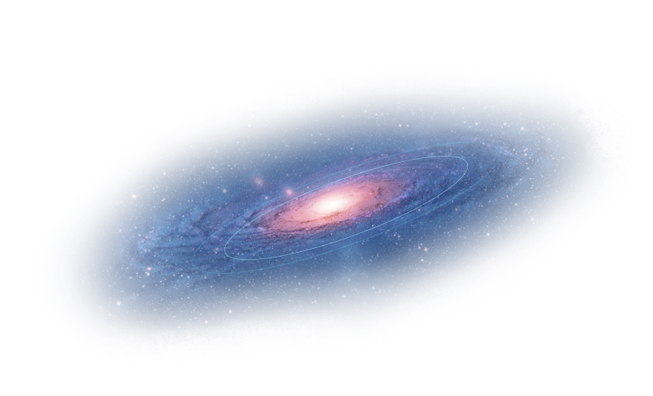
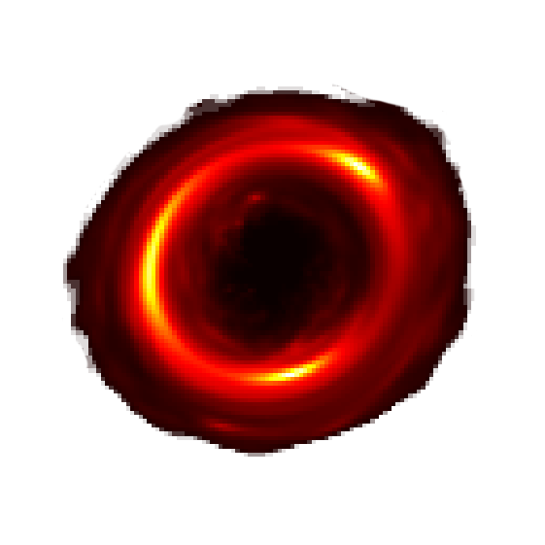
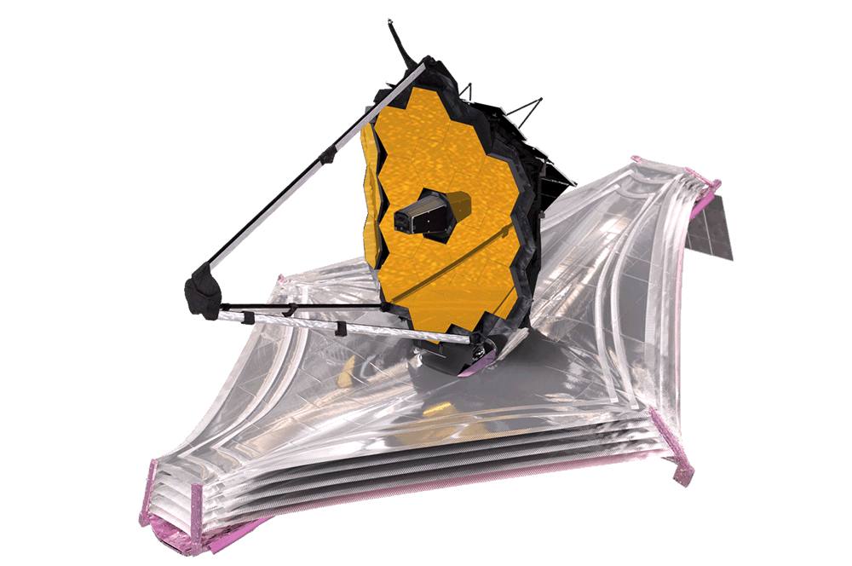
Main lens galaxy + subhalos
Background line-of-sight halos
Foreground line-of-sight halos
Distant bright galaxy
Observed lensed image
Gilman et al, 2021
Notes:
The traditional strong lensing setup is composed of a massive lens galaxy that is aligned in the line of sight to a distant bright galaxy and an observer (Earth). The light from this bright galaxy will be distorted when passing through the warped spacetime caused by the lens galaxy’s mass, and the observer will observe multiple distorted images of the bright background galaxy.
However, modern cosmological models predict that an abundance of lower-mass dark matter halos are distributed along the line of sight and on the main lens plane. The mass of a single of these halos will only incur an infinitesimal deflection, but the cumulative effect of the tens of thousands of halos that will influence the light rays will have a non-negligible effect on the lensed image.

Slide 7
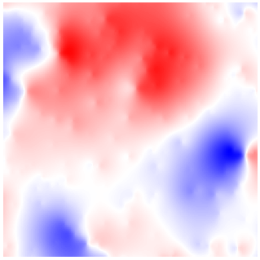
Relating halo populations to deflection angles
Set of halo models represented by set of parameters
r_{s} | 𝛼_{a} | x₀ | y₀ | z
0.35 | 6.11e-4 | -3.46 | 3.34 | 0.05
0.31 | 8.72e-4 | 0.44 | -2.24 | 0.09
0.12 | 2.61e-4 | 1.74 | -4.77 | 0.09
0.21 | 5.11e-4 | 0.58 | 0.99 | 0.09
0.14 | 7.26e-4 | -2.67 | -4.54 | 0.11
… | … | … | … | …
Horizontal
Halo 1
Halo 2
Halo 3
Ray-tracer
Halo 4
Halo 5
Vertical
etc

Slide 8
Multi-plane ray-tracing formalism
Expensive recursion over hundreds of lens planes (slow)
((Also boring))

Slide 9
How to simulate multi-plane lensing while minimizing recursion?

Slide 10
The AlphaGen pipeline
Insert choice of main deflector
Intermediate FG angles
Total FG + BG angles
Sample a halo population
h₁
h₂
h₃
h₄
h₅
h…
Foreground model
Background model
FG halos
BG halos
Foreground and Background models trained separately. Batteries not included.

Slide 11
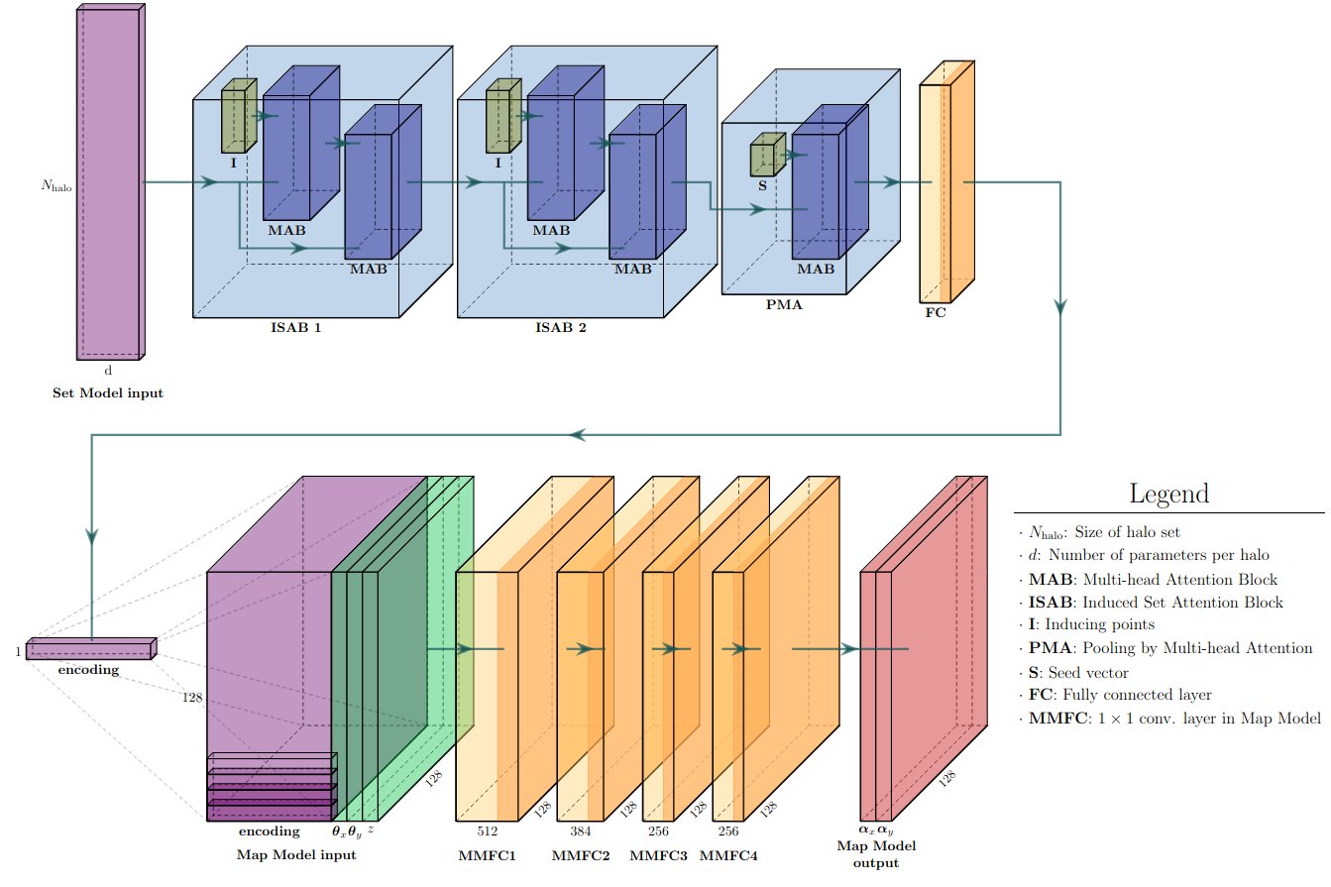
Network architecture

Slide 12
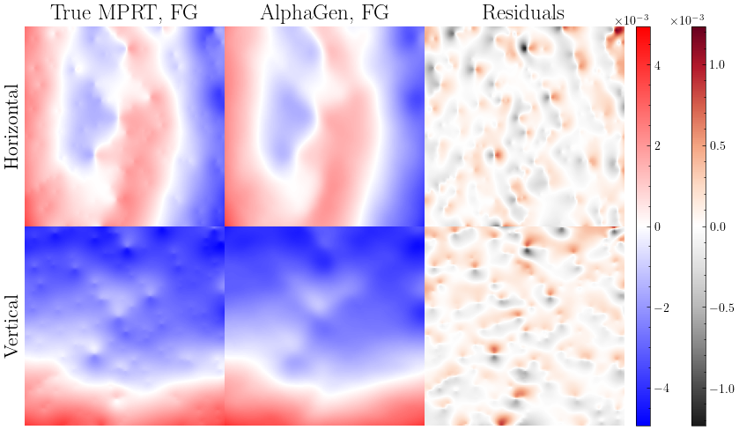
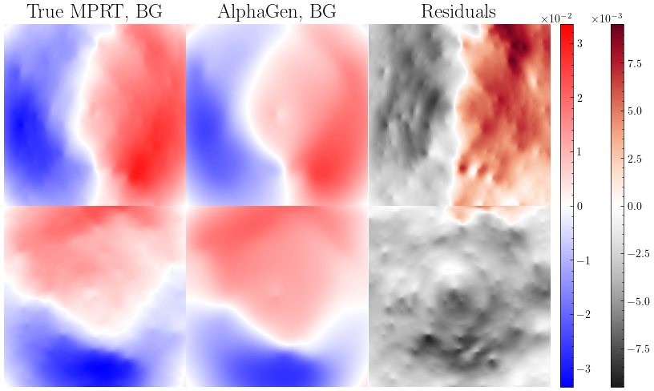
Results: reproducing multi-plane deflection angles

Slide 13
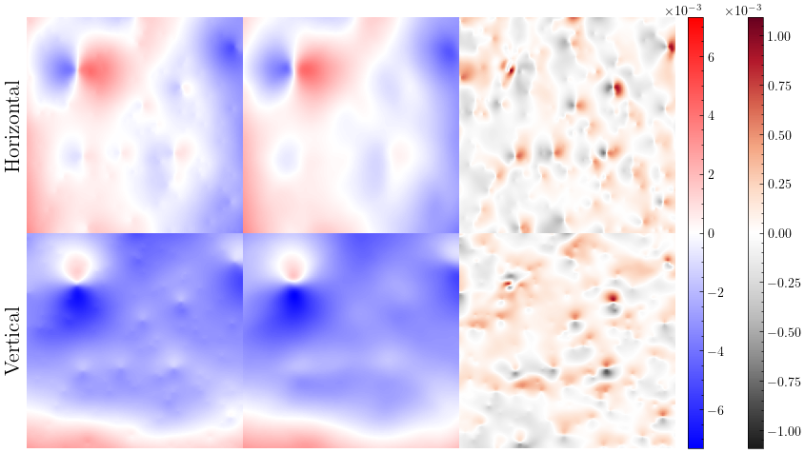
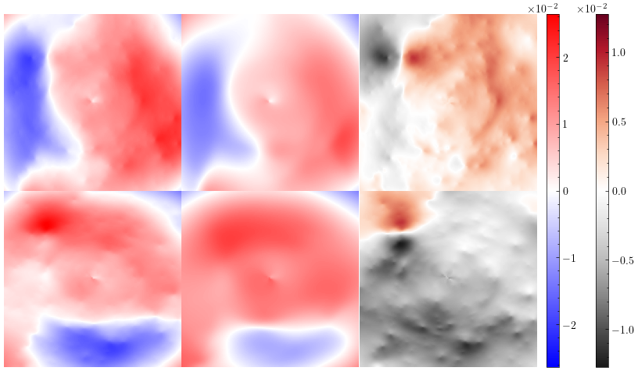
Results: reproducing multi-plane deflection angles

Slide 14
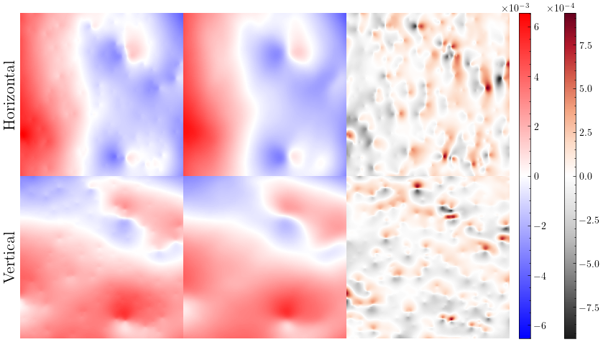
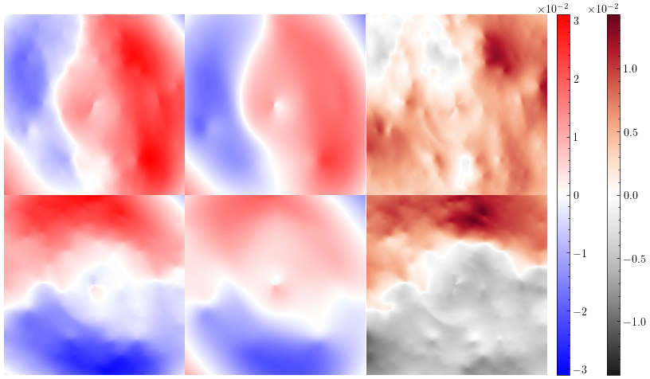
Results: reproducing multi-plane deflection angles

Slide 15
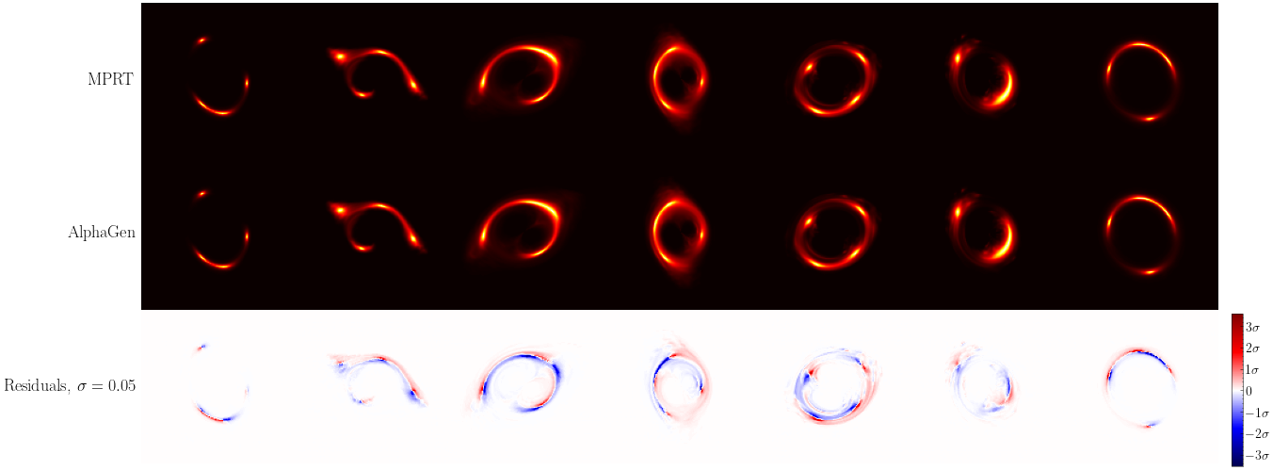
Results: lensing of HST galaxy images

Slide 16
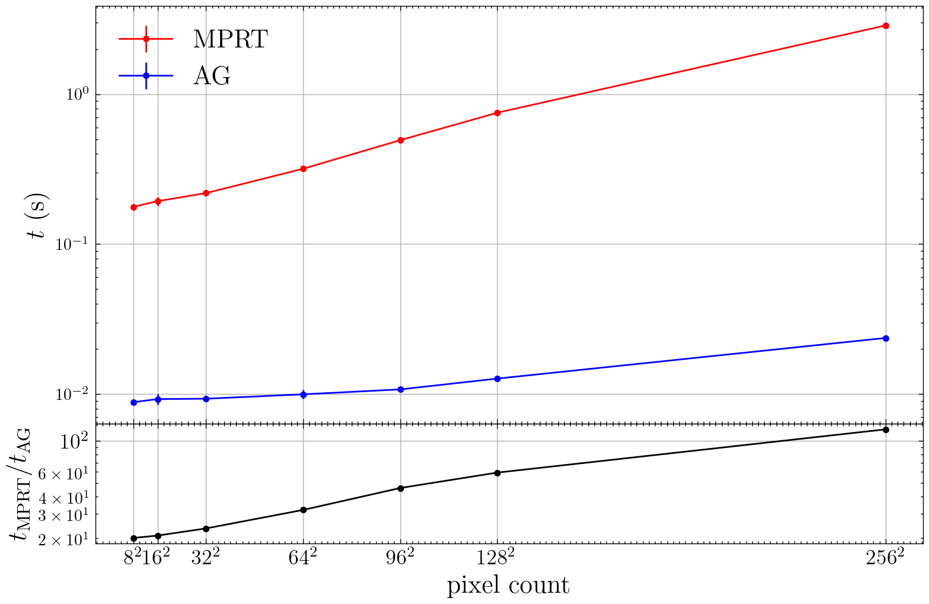
Results: ray-tracing speedup
The current AlphaGen pipeline was trained on 128² pixel fields, but is compatible with pixel grids of any size
We then compare speed benchmarks at multiple different pixel resolutions
Relative speedup of 1-2 orders of magnitude, increases with pixel size

Slide 17
Summary
Efficient simulators of multi-plane lensing are crucial to the effort of analyzing >10⁵ upcoming new strong lensing systems to infer the distribution of low-mass dark matter halos
Traditional multi-plane ray-tracing is much too slow
Our AlphaGen pipeline provides significant acceleration, making it a viable simulator
However, its accuracy must be improved as its target signal is extremely subtle
Thanks!
charles.wilson@umontreal.ca

Slide 18
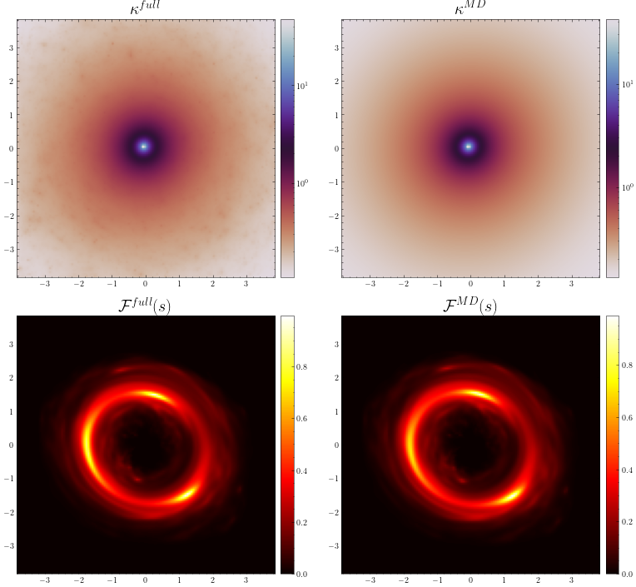
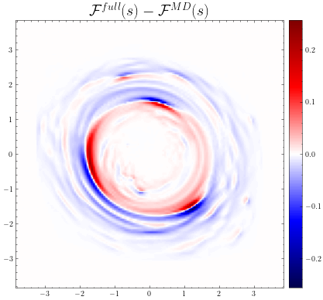
Effect of substructure

