Slide 1
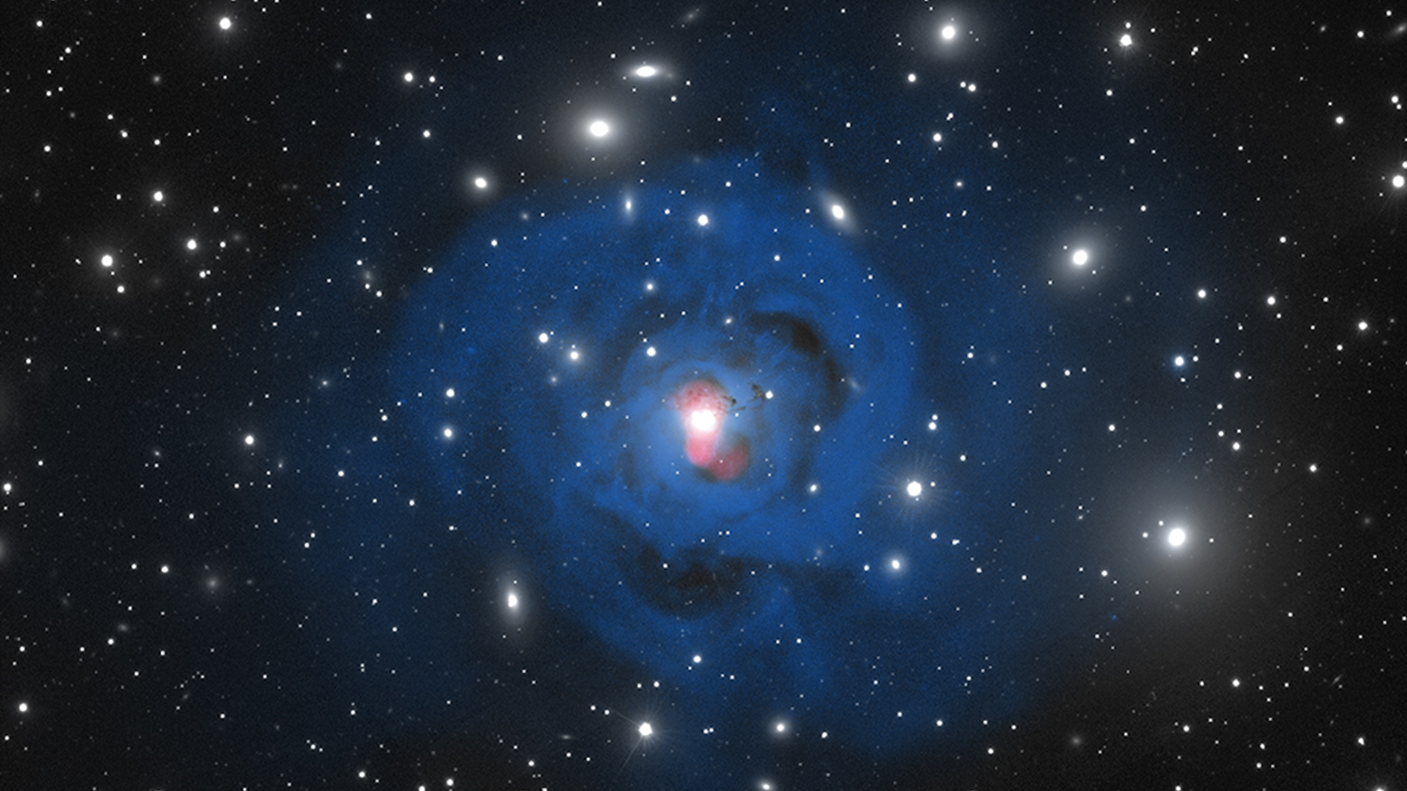



High Spectral Resolution Observations of the Filamentary Nebula Surrounding NGC 1275
Benjamin Vigneron,
PhD. Candidate,
Université de Montréal
Supervisor : Julie Hlavacek-Larrondo
Perseus cluster of galaxies. Credit: MLGM/JHL/NASA.

Slide 2
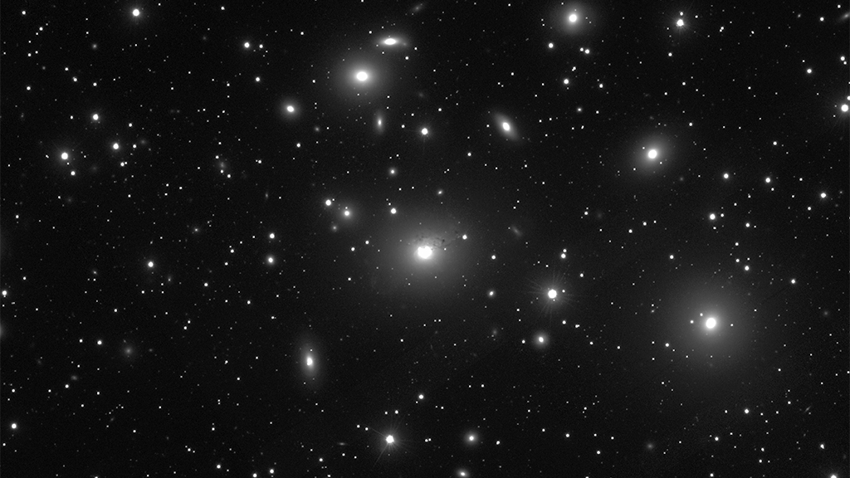
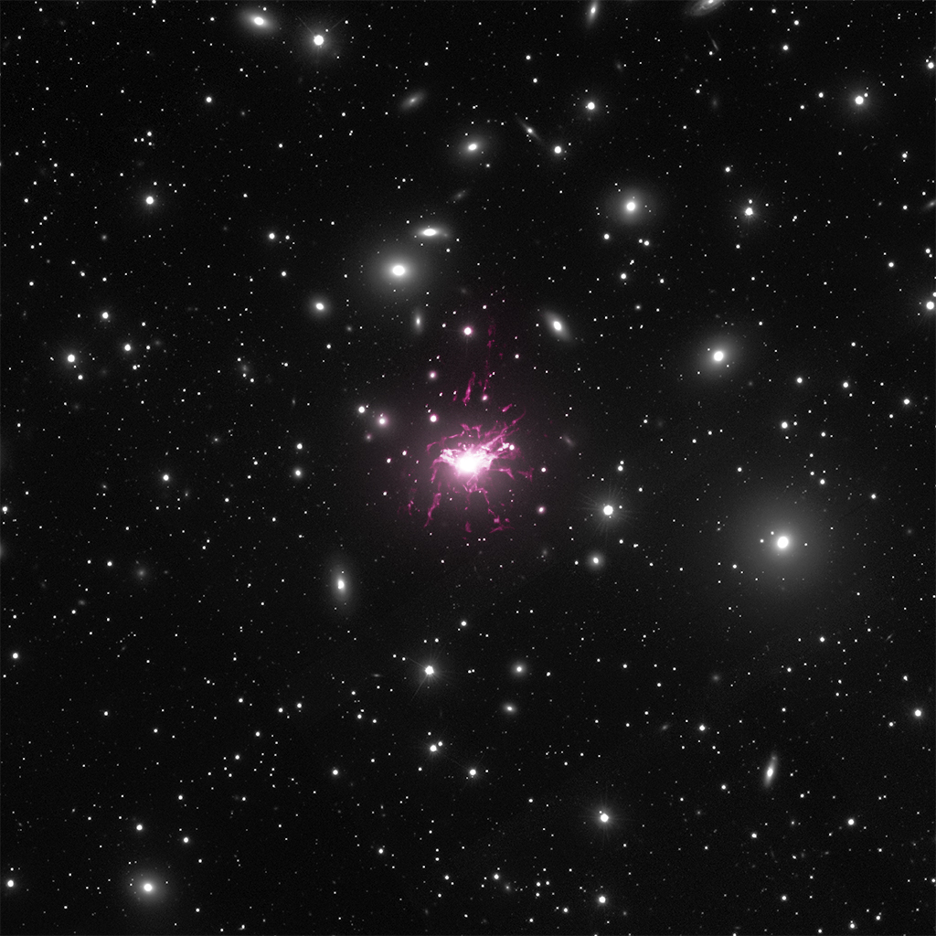
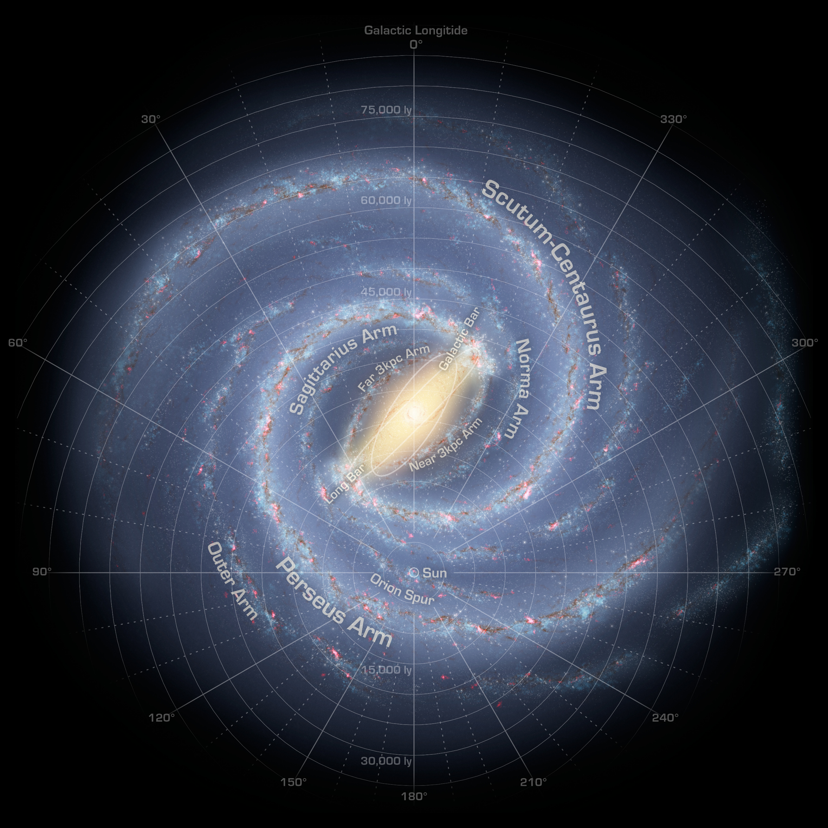
X-rays (Chandra)
Hα emission
at the redshift of
the central galaxy NGC 1275
Size of Milky Way
Radio
328 MHz
(VLA)
Brightest Cluster Galaxy
100 kpc
Perseus cluster of galaxies;
Credit: SDSS, CXC/IoA/ACFabian.
Perseus cluster of galaxies;
Credit: SDSS, CXC/IoA/ACFabian, NRAO/VLA/GBTaylor and MLGendron-M./JHlavacek-L.
Perseus cluster of galaxies;
Credit: SDSS, CXC/IoA/ACFabian, CFHT/Gendron-M.

Slide 3
What do we know ?

Slide 4
Structure of the Filaments
Thread-like structure : thin (60-70 pc wide; Fabian et al. 2008, 2016) and extended (diameters from 5 kpc to 100 kpc).
Most do NOT display stellar formation.
Extremely luminous in Hα with L_{Hα} = 10⁴⁰-10⁴² erg/s associated with temperatures of 10 000 K.
Multiphase structure : spatial correlations with cold molecular gas (T < 100 K) and soft X-ray gas (T > 100 000 K).
CO (2-1) Molecular gas emission (HERA)
Hα emission (WIYN)
Soft X-ray emission (Chandra) with superimposed Hα emission (WIYN)
Salomé et. al. 2006.
Fabian et. al. 2011.

Slide 5
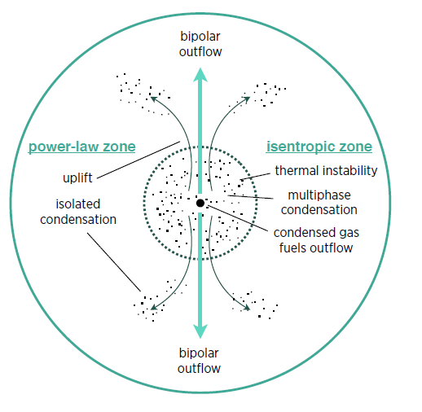
Origin of the Filaments
The morphology and depletion of metals in BCGs argues that they are being dragged out by the jets of the central black hole (e.g. work by Fabian and collaborators).
Another possibility for their origin is by precipitation-based cooling flows where clouds rain down because of thermal instabilities and produces outflows through uplift. (e.g. work by Voit and collaborators).
CO(2–1) emission (black) superimposed on the X-ray image (false colours, indicating intensity) with the radio contours (white).
CO(3-2) intensity map with X-ray cavities in dashed white contours
Voit et. al. 2015.
Russel et. al. 2016.

Slide 6
Why SITELLE ?

Slide 7
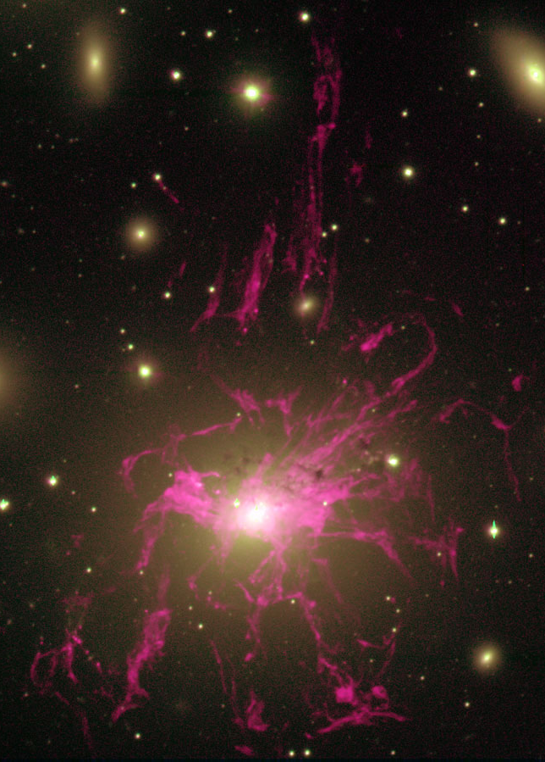
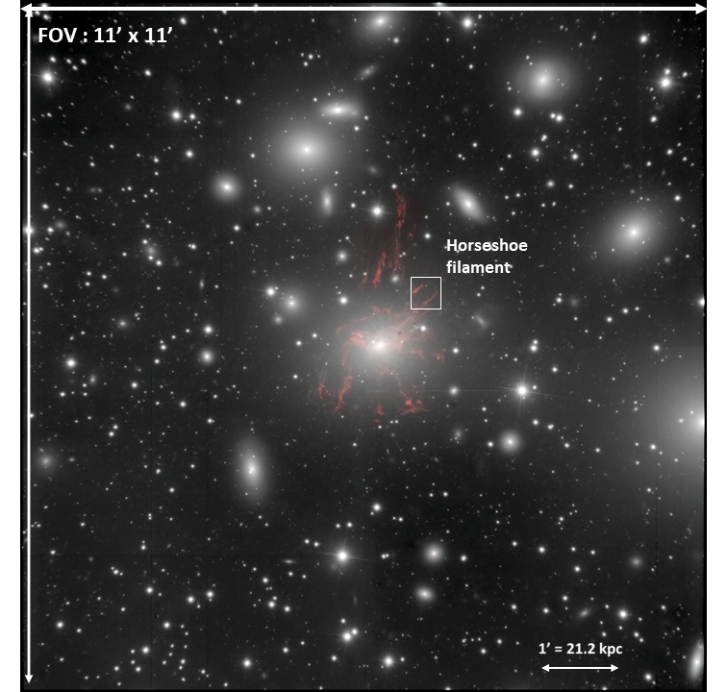
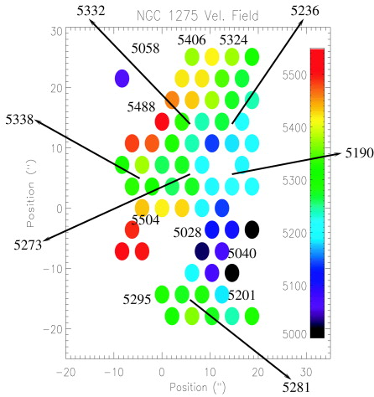
90 kpc
4.2 arcmin
SITELLE Field of View
NGC 1275 (Hα continuum)
11 arcmin x 11 arcmin
MUSE (VLT)
SINFONI
Hatch et al. 2006.
Conselice et al. 2001, see also Salomé’s work on CO observations of NGC 1275.

Slide 8
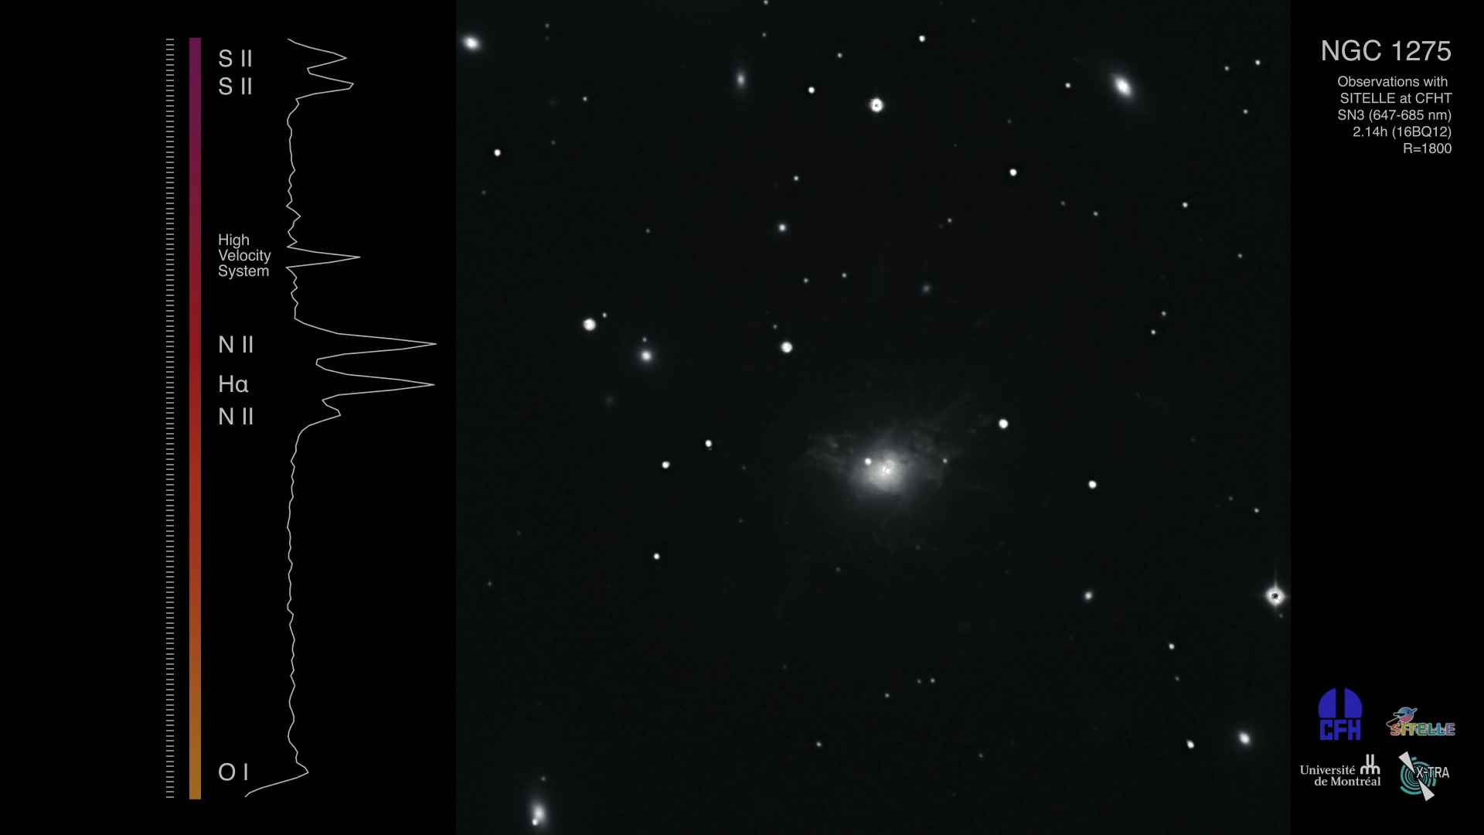
Credit: JHL/MLGM/ML.
Credit: JHL/MLGM/ML.
Credit: JHL/MLGM/ML.

Slide 9

Results
With LUCI
Special thanks to Carter Rhea and everyone involved in the LUCI Development Team.

Slide 10
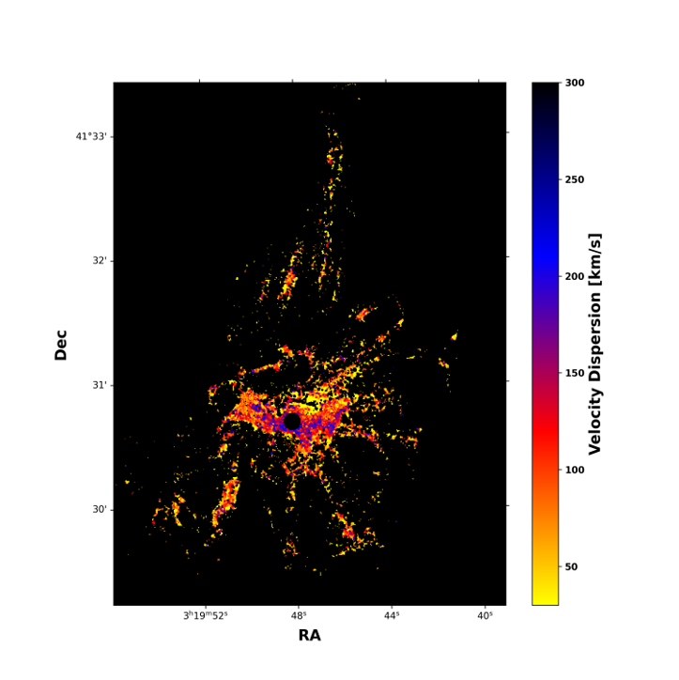
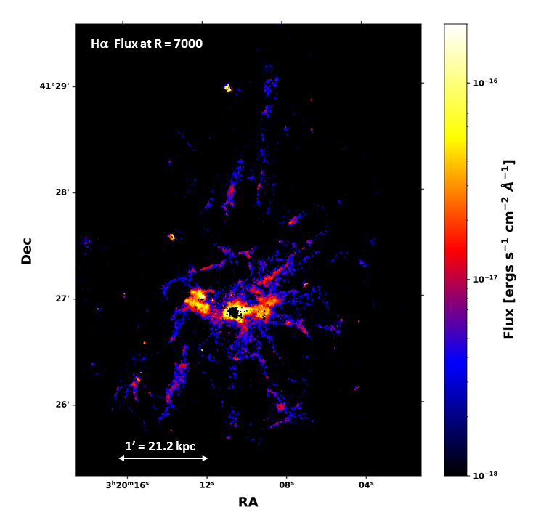
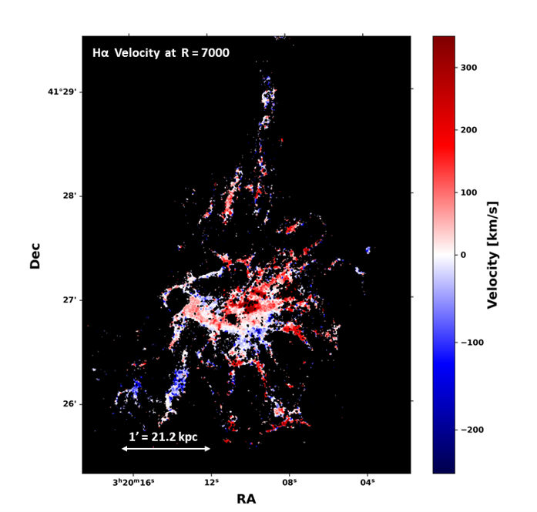
Flux, Velocity and Velocity Dispersion
Hα Velocity Dispersion at R = 7000
1' = 21.2 kpc

Slide 11
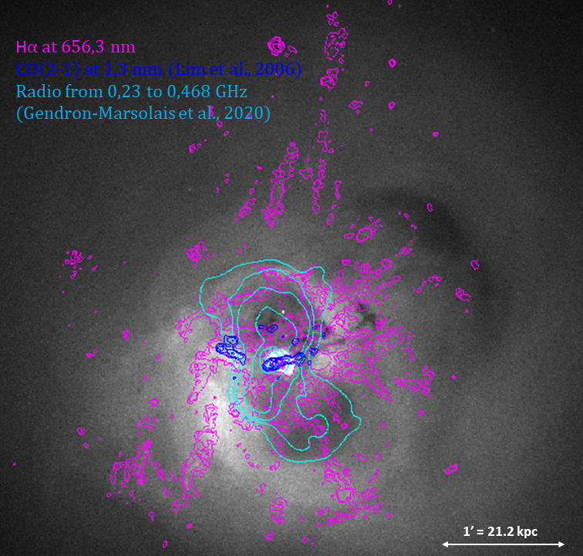
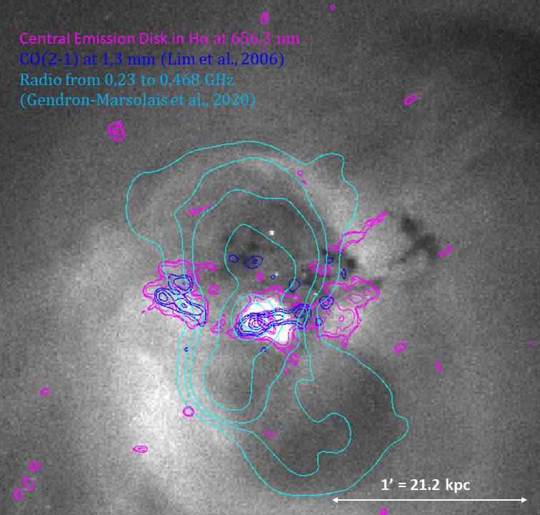
Spatial Correlation

Slide 12
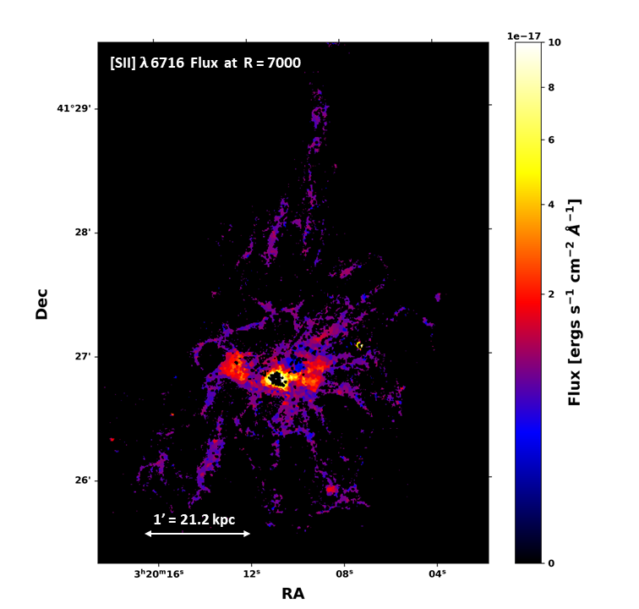

SII Emission

Slide 13
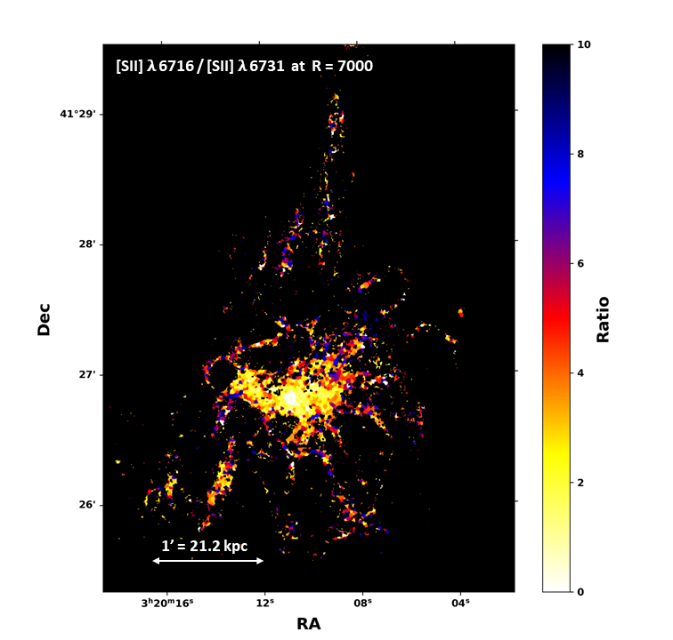
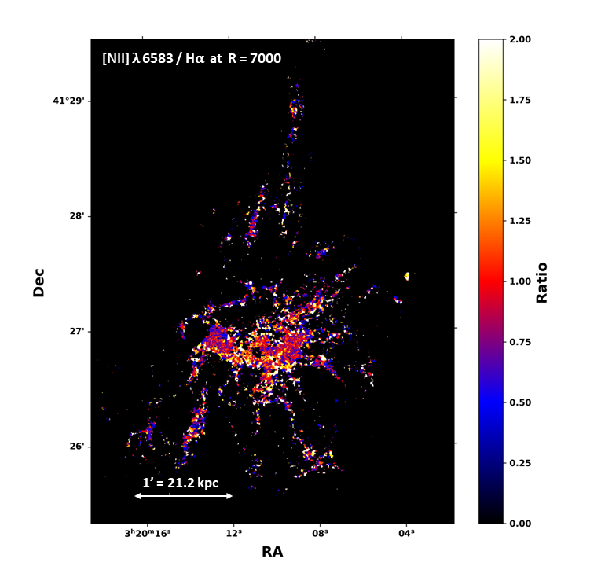
Line Ratios
The ratio SII λ 6716 / SII λ 6731 gives information on the density of the gas.
The lower the ratio, the denser the gas is in the region of interest.
As expected, the central region near the AGN has a higher density compared to the filaments.
The south-western filaments also seem to display a higher density compared to the other filaments.

Slide 14
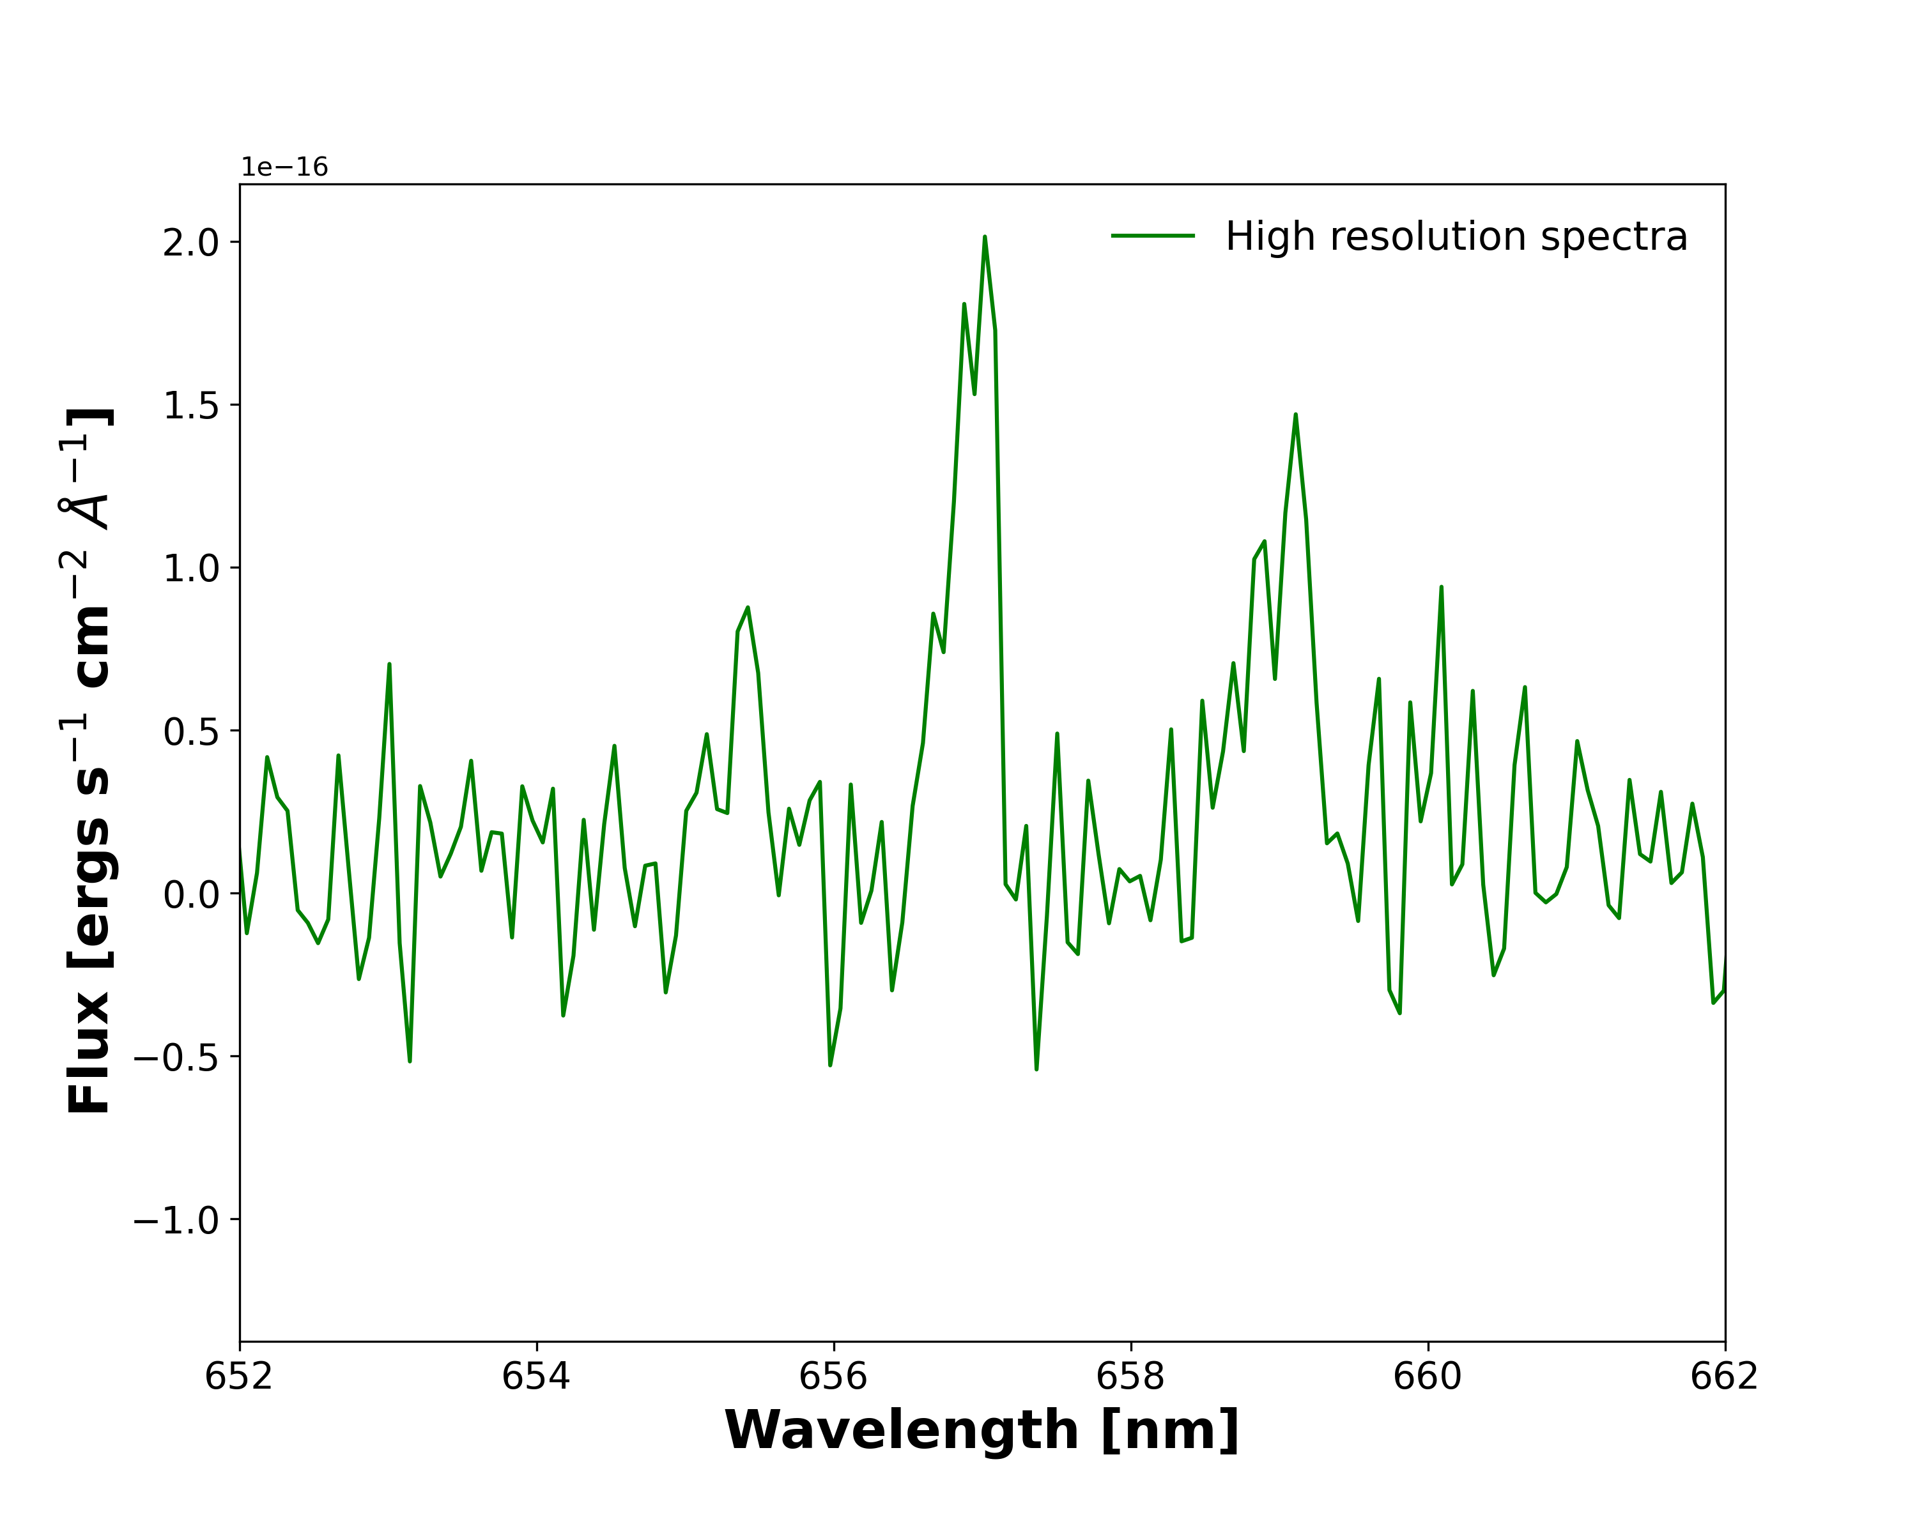
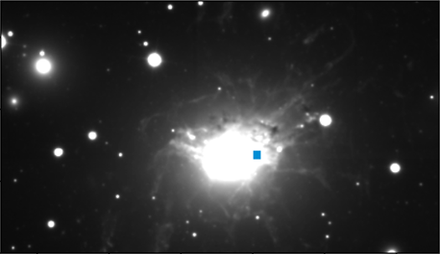
TAKE-HOME POINTS
By studying the optical emission of such filamentary nebula surrounding brightest cluster galaxies, we can deepen our knowledge on the cooling that takes place in such environment from X-ray temperatures down to molecular gas temperatures.
This cooling phenomenon is similar to what would happen during galaxy formation, therefore, detailed studies involving filamentary nebula could help us to better understand those processes, and especially the fundamental role of the supermassive black hole at the galaxy’s center.
These SITELLE data are the first of extremely high spectral resolution observations of such structure with the instrument and we expect to get more results, especially regarding localized double-component emission lines that can now be resolved, as well as extended studies of the SII emission across the nebula.
Hα
[NII] 658.3
[NII] 654.8

Slide 15
Thank you !
Benjamin Vigneron,
benjamin.vigneron@umontreal.ca
PhD. Candidate,
Université de Montréal
Link to Luci’s webpage : https://crhea93.github.io/LUCI/index.html
Supervisor : Julie Hlavacek-Larrondo
Perseus cluster of galaxies. Credit: MLGM/JHL/NASA.

