Slide 1
Inferring the abundances of the heavy elements from neutron star mergers with SPARK
Nick Vieira
Daryl Haggard & John Ruan
PhD candidate
Trottier Space Institute @ McGill

Slide 2
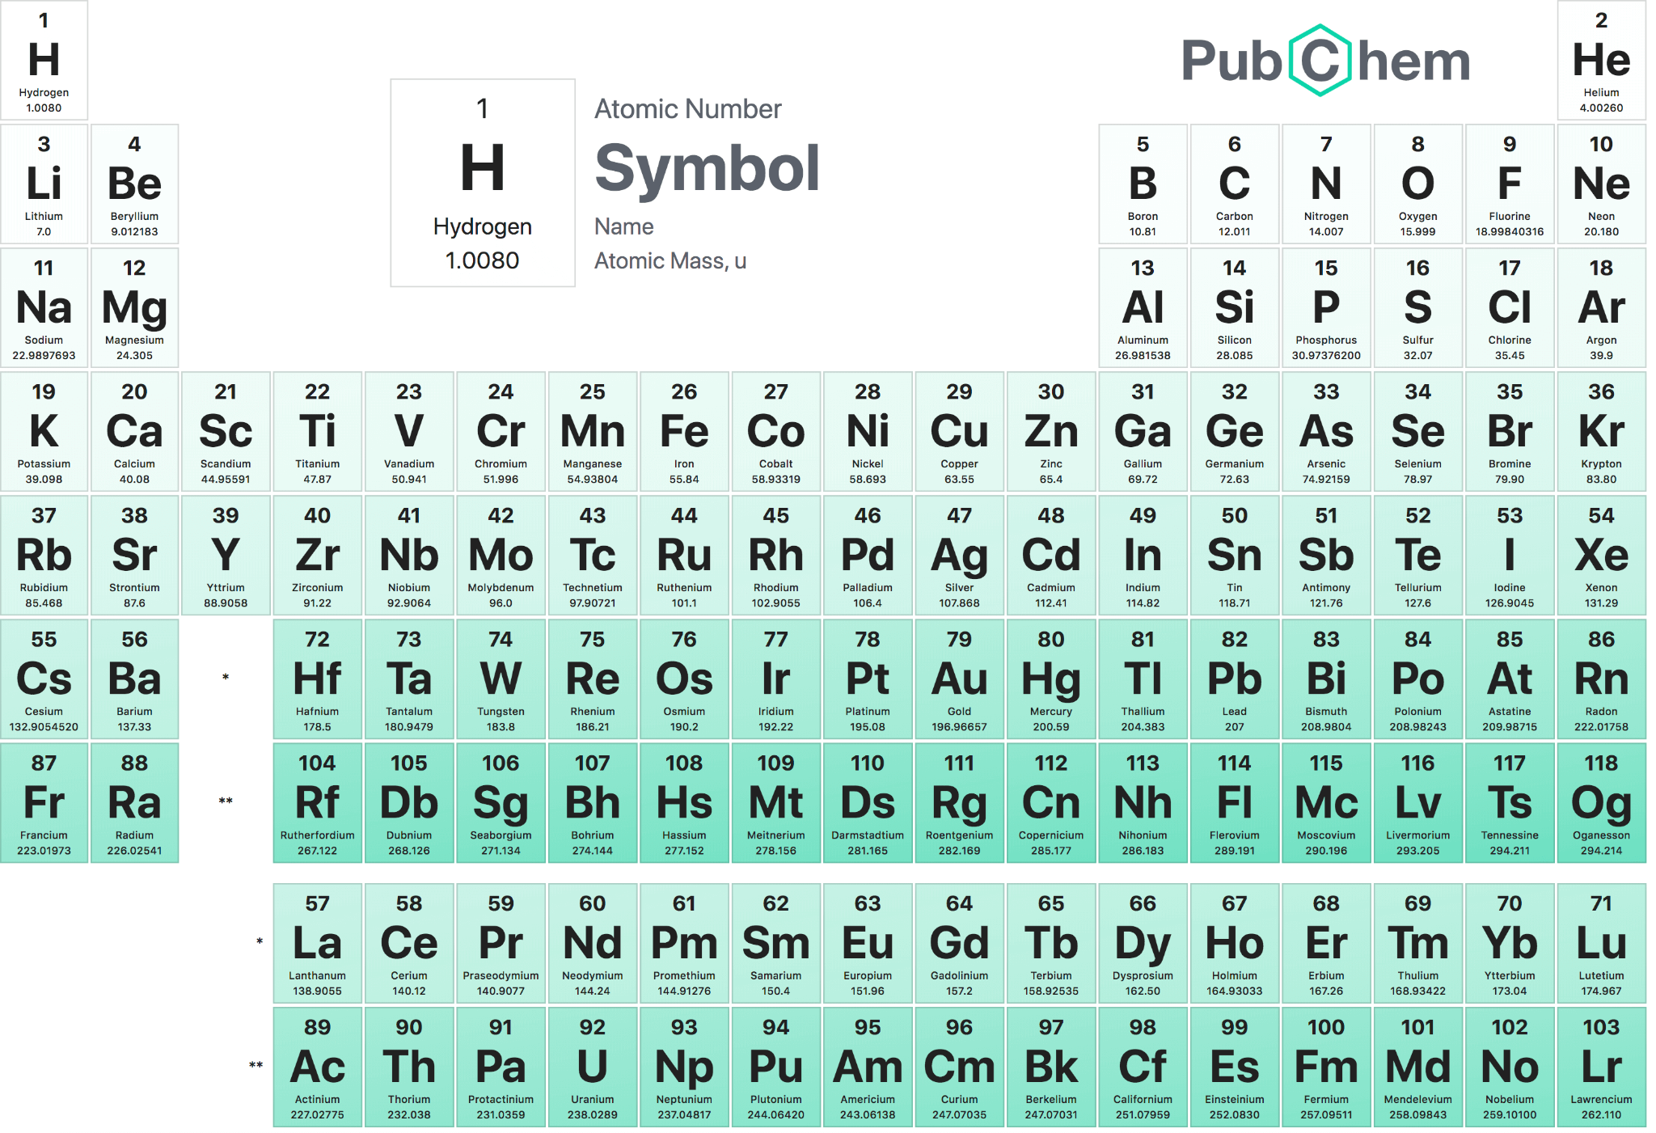
What is the origin of everything in the Universe?
file:///media/nvieira/Windows/Users/nviei/Documents/Grad_2023/Conferences_Workshops/CRAQ_9-11-May-2023/talk/Periodic_Table_of_Elements_w_Atomic_Mass_PubChem.png
Notes:
I want to start off with a very simple question: where does everything in the Universe come from?
We know that hydrogen, helium, and some lithium were produced in the Big Bang. Big Bang Nucleosynthesis is a very successful model aside from some tension between predictions and the observed abundance of lithium.
Aside from this, nuclear burning in the interiors of massive stars can generate some heavier elements. Beyond this, the explosions of massive stars can generate all of the elements in the iron group, up to, e.g., atomic number 30.
But what about everything else?

Slide 3
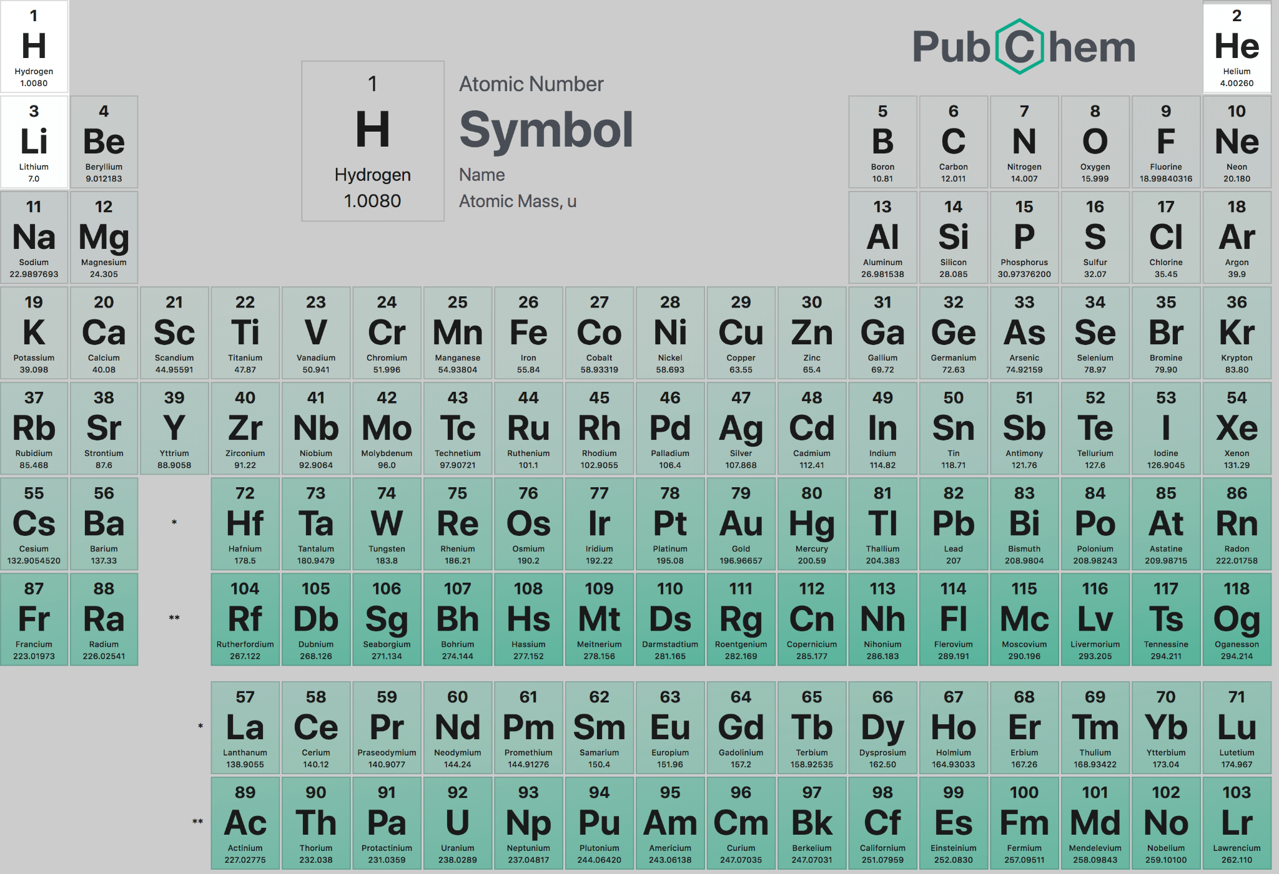
What is the origin of everything in the Universe?
Big Bang: H, He, Li
Notes:
I want to start off with a very simple question: where does everything in the Universe come from?
We know that hydrogen, helium, and some lithium were produced in the Big Bang. Big Bang Nucleosynthesis is a very successful model aside from some tension between predictions and the observed abundance of lithium.
Aside from this, nuclear burning in the interiors of massive stars can generate some heavier elements. Beyond this, the explosions of massive stars can generate all of the elements in the iron group, up to, e.g., atomic number 30.
But what about everything else?

Slide 4
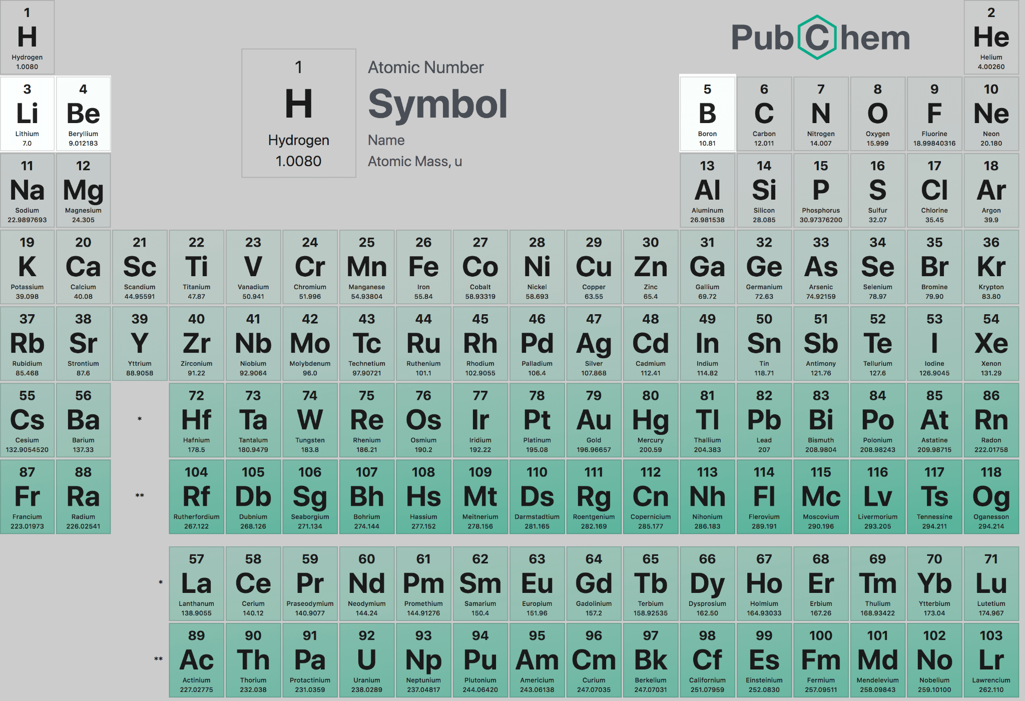
What is the origin of everything in the Universe?
Big Bang: H, He, Li
Cosmic ray fission: Li, Be, B
Notes:
I want to start off with a very simple question: where does everything in the Universe come from?
We know that hydrogen, helium, and some lithium were produced in the Big Bang. Big Bang Nucleosynthesis is a very successful model aside from some tension between predictions and the observed abundance of lithium.
Aside from this, nuclear burning in the interiors of massive stars can generate some heavier elements. Beyond this, the explosions of massive stars can generate all of the elements in the iron group, up to, e.g., atomic number 30.
But what about everything else?

Slide 5
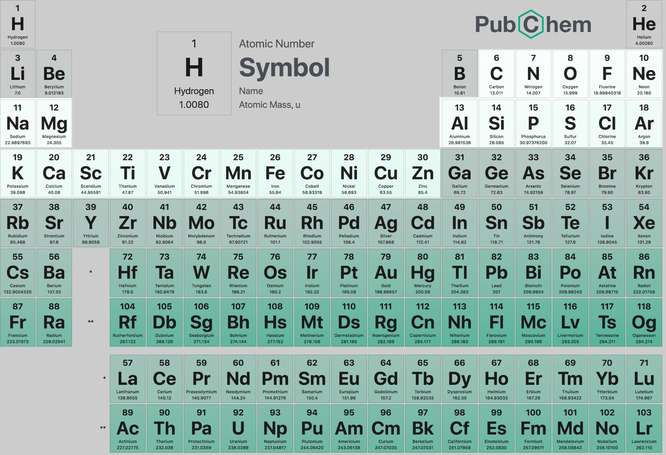
What is the origin of everything in the Universe?
Big Bang: H, He, Li
Cosmic ray fission: Li, Be, B
Nuclear burning in stars, supernovae: up to iron (Fe) group, Z~30
What about everything else?
Notes:
I want to start off with a very simple question: where does everything in the Universe come from?
We know that hydrogen, helium, and some lithium were produced in the Big Bang. Big Bang Nucleosynthesis is a very successful model aside from some tension between predictions and the observed abundance of lithium.
Aside from this, nuclear burning in the interiors of massive stars can generate some heavier elements. Beyond this, the explosions of massive stars can generate all of the elements in the iron group, up to, e.g., atomic number 30.
But what about everything else?

Slide 6
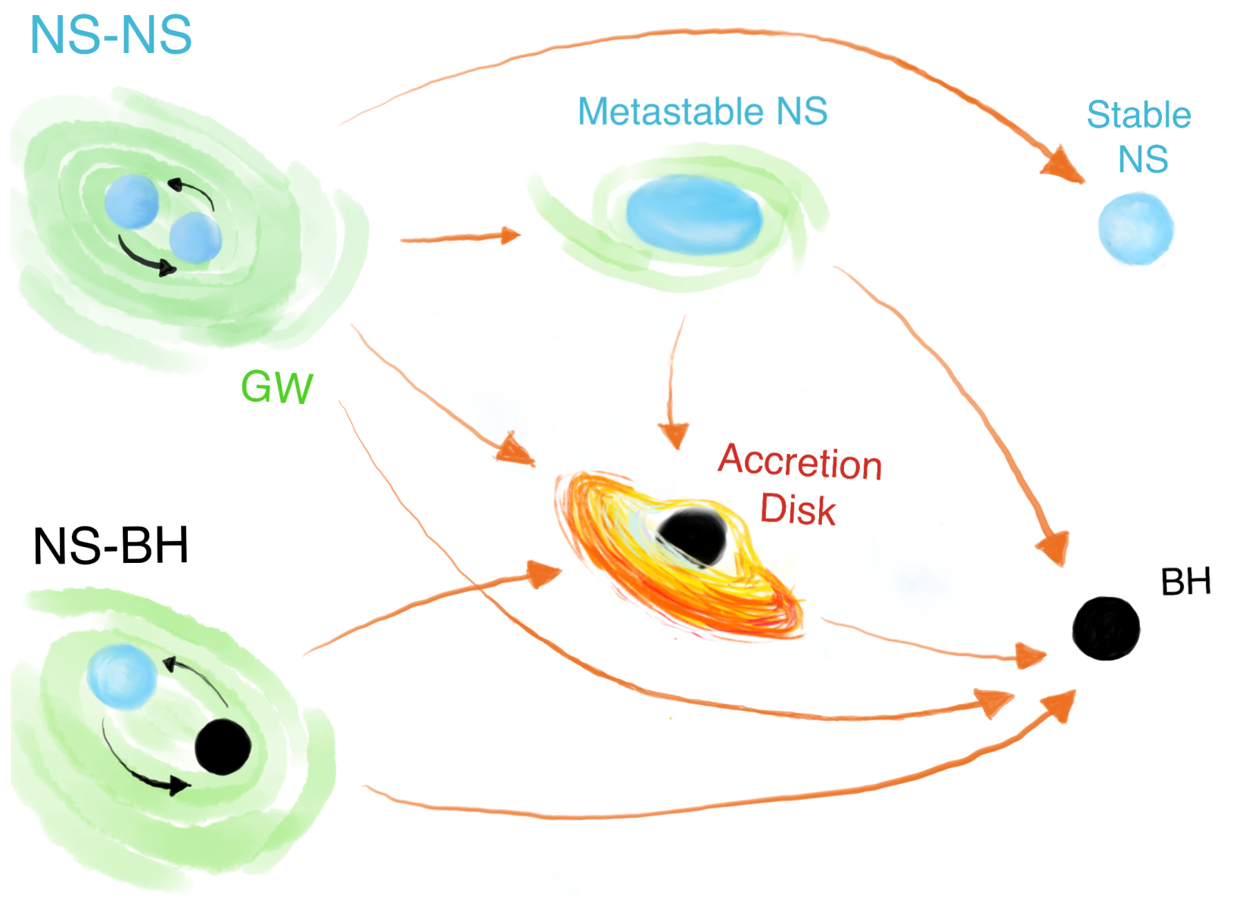
Neutron star + neutron star / black hole mergers
Unbind massive amounts of neutrons
Neutrons (r)apidly capture onto each other → r-process nucleosynthesis
Source of gravitational waves and light
Ascenzi+21

Slide 7
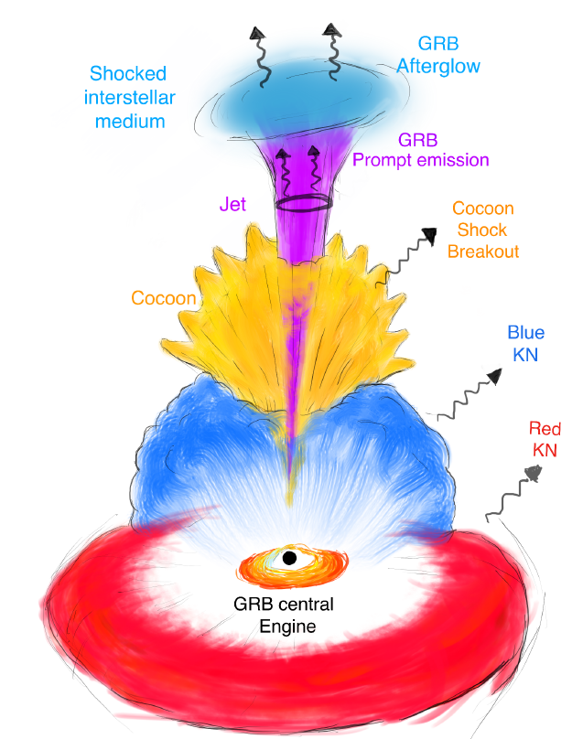
Electromagnetic counterparts
Short gamma ray burst: seconds
X-ray/radio from structured relativistic jet: months - years
Kilonova: hours - days - week in ultraviolet/optical/infrared
Ascenzi+21
Notes:
We have long expected that these sources can then produce electromagnetic emission across the spectrum, on wildly different timescales.
For example, we expect a short burst of gamma rays to be launched within a few seconds of the merger. This emission is highly beamed.
We also expect radio and X-ray emission from this relativistic jet hitting and shocking the interstellar medium, creating what we call an afterglow. This emission occurs on timescales of months to years, and is slightly more isotropic.
However, what I’m most interested in is the kilonova. This component shines in the ultraviolet, optical, and infrared on timescales of hours to weeks, and is the expected site of the r-process.

Slide 8
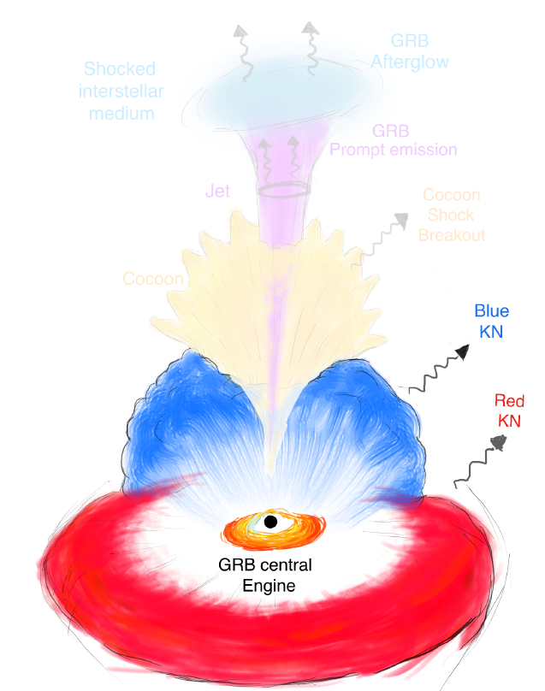
Kilonovae
Radioactive r-process isotopes decay
These decay products thermalize
Different dynamical processes → different ejecta
Different colours can indicate different compositions
Ascenzi+21
Notes:
Broadly speaking, we can divide the kilonova into two dynamical components:
Tidal ejecta, which comes from tidal disruption and is mostly confined to the plane of the merger
Post-merger ejecta, which is a catch-all term for anything which comes after the merger. This could be winds from an accretion disk, for example.
We also expect kilonovae to be divided into at least two colour components:
We expect a red component, with a lower electron fraction (i.e., exceptionally neutron-rich). This component will contain lots of lanthanides and heavier elements, which have significant absorption in the UV and optical, so that most of the emission will escape in the IR. Thus the term red.
We also expect a blue component, with a higher electron fraction, but still neutron-rich compared to most material in the Universe. This component is dominated by lighter elements and has a smaller overall opacity, and so it has significant emission in the UV and optical. Hence the term blue.
Note that red and blue don’t necessarily neatly map onto tidal and post-merger. There is still lots of debate about how red or blue the outflows can be, for example.

Slide 9
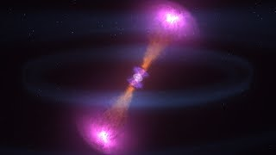
GW170817: first NS-NS merger, only gravitational wave + light detection to date
NASA
Goddard
Notes:
And in fact, when you have two neutron stars in a pair, they can produce both gravitational waves AND light! We’re finally at a multi-messenger source
So in this video, you see two neutron stars in a binary. Once again, they lose energy through gravitational waves. But when they merge, a ton of neutrons are unbound
These neutrons, through various nuclear reactions, can generate light in something we call a kilonova
https://www.youtube.com/watch?v=x_Akn8fUBeQ

Slide 10
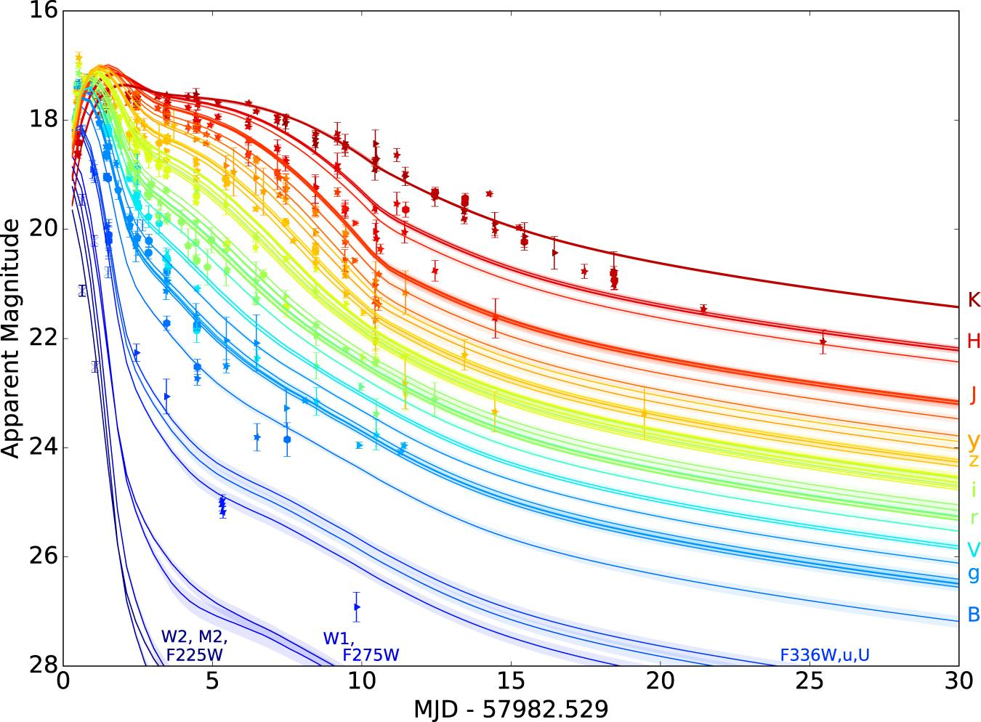
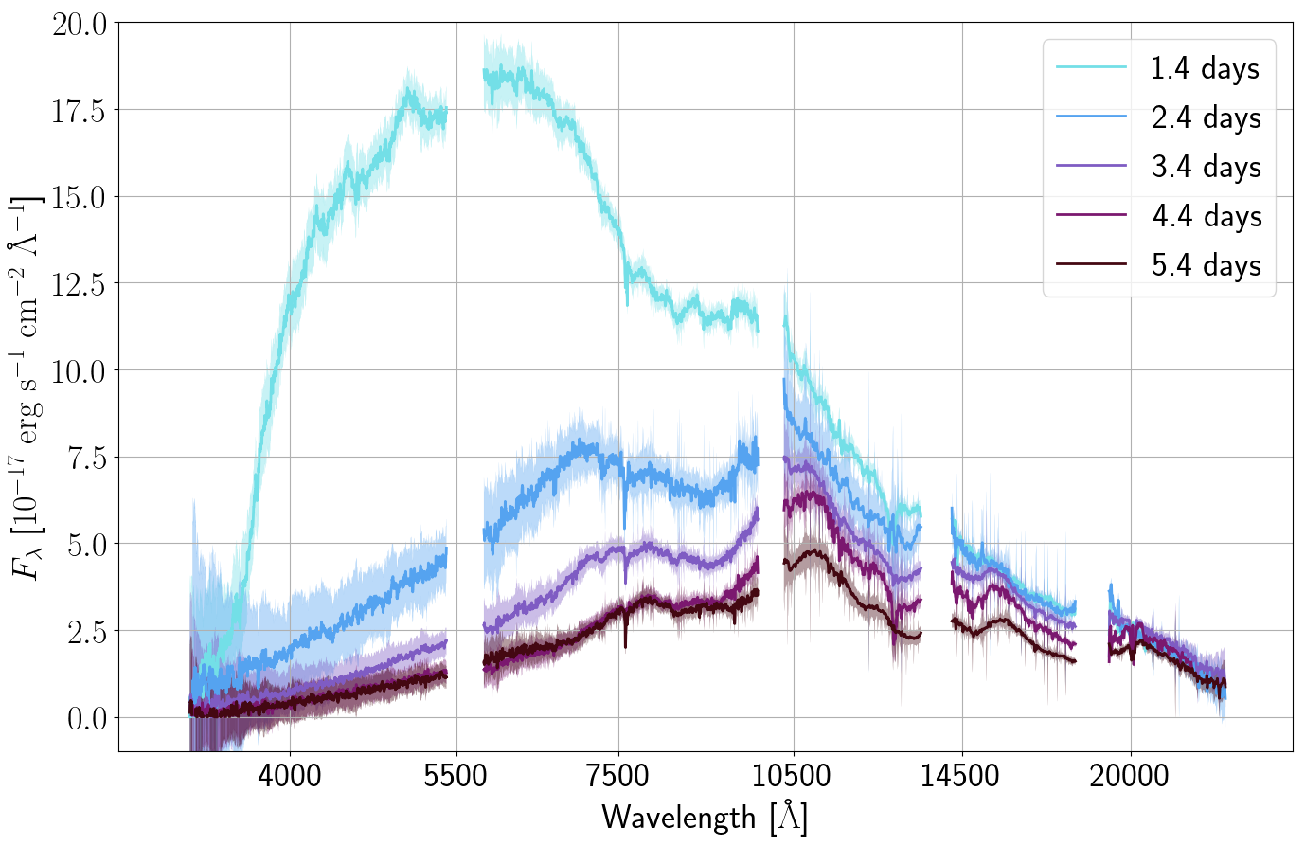
GW170817’s kilonova
Villar+17
Data: Pian+17, Smartt+17

Slide 11
GW170817’s kilonova
GW170817’s kilonova is clearly powered by decay of r-process elements. But we don’t know precisely how much of each element was produced…
Villar+17
Data: Pian+17, Smartt+17
Notes:
VERSION 2 OF THIS TRANSITION

Slide 12
GW170817’s kilonova
… can we infer the abundance of every single element from the spectra of the GW170817 kilonova?
Villar+17
Data: Pian+17, Smartt+17
Notes:
VERSION 2 OF THIS TRANSITION

Slide 13
Idea: Generate many synthetic spectra and compare them to observations → Fit for the r-process elemental abundance pattern of GW170817 (“spectral retrieval”)
SPARK: Spectroscopic r-Process Abundance Retrieval for Kilonovae
Notes:
Now we’ll start discussing my project, which is SPARK: Spectral r-Process Abundance Retrieval for Kilonovae
The fundamental idea is to generate synthetic spectra with some radiative transfer, and compare them to observations. With this comparison, we can hopefully fit for the abundances of the elements in the kilonova. In the exoplanet community, they would call this “spectral retrieval”
However, we immediately run into two issues:
First of all, radiative transfer for kilonovae is computationally expensive. This is because of the sheer number of elements involved and the number of atomic lines each element can have. These elements have huge opacities.
Second, there are again so many elements, that if we fit for each abundance individually, we would have several dozen dimensions to fit. This high dimensionality would pose a serious problem for getting any sort of fit to converge.

Slide 14
Idea: Generate many synthetic spectra and compare them to observations → Fit for the r-process elemental abundance pattern of GW170817 (“spectral retrieval”)
Problems:
many elements → high dimensionality if we naively fit for each abundance individually
SPARK: Spectroscopic r-Process Abundance Retrieval for Kilonovae
Notes:
Now we’ll start discussing my project, which is SPARK: Spectral r-Process Abundance Retrieval for Kilonovae
The fundamental idea is to generate synthetic spectra with some radiative transfer, and compare them to observations. With this comparison, we can hopefully fit for the abundances of the elements in the kilonova. In the exoplanet community, they would call this “spectral retrieval”
However, we immediately run into two issues:
First of all, radiative transfer for kilonovae is computationally expensive. This is because of the sheer number of elements involved and the number of atomic lines each element can have. These elements have huge opacities.
Second, there are again so many elements, that if we fit for each abundance individually, we would have several dozen dimensions to fit. This high dimensionality would pose a serious problem for getting any sort of fit to converge.

Slide 15
Idea: Generate many synthetic spectra and compare them to observations → Fit for the r-process elemental abundance pattern of GW170817 (“spectral retrieval”)
Problems:
many elements → high dimensionality if we naively fit for each abundance individually
SPARK: Spectroscopic r-Process Abundance Retrieval for Kilonovae
parametrize the abundances!
Notes:
Now we’ll start discussing my project, which is SPARK: Spectral r-Process Abundance Retrieval for Kilonovae
The fundamental idea is to generate synthetic spectra with some radiative transfer, and compare them to observations. With this comparison, we can hopefully fit for the abundances of the elements in the kilonova. In the exoplanet community, they would call this “spectral retrieval”
However, we immediately run into two issues:
First of all, radiative transfer for kilonovae is computationally expensive. This is because of the sheer number of elements involved and the number of atomic lines each element can have. These elements have huge opacities.
Second, there are again so many elements, that if we fit for each abundance individually, we would have several dozen dimensions to fit. This high dimensionality would pose a serious problem for getting any sort of fit to converge.

Slide 16
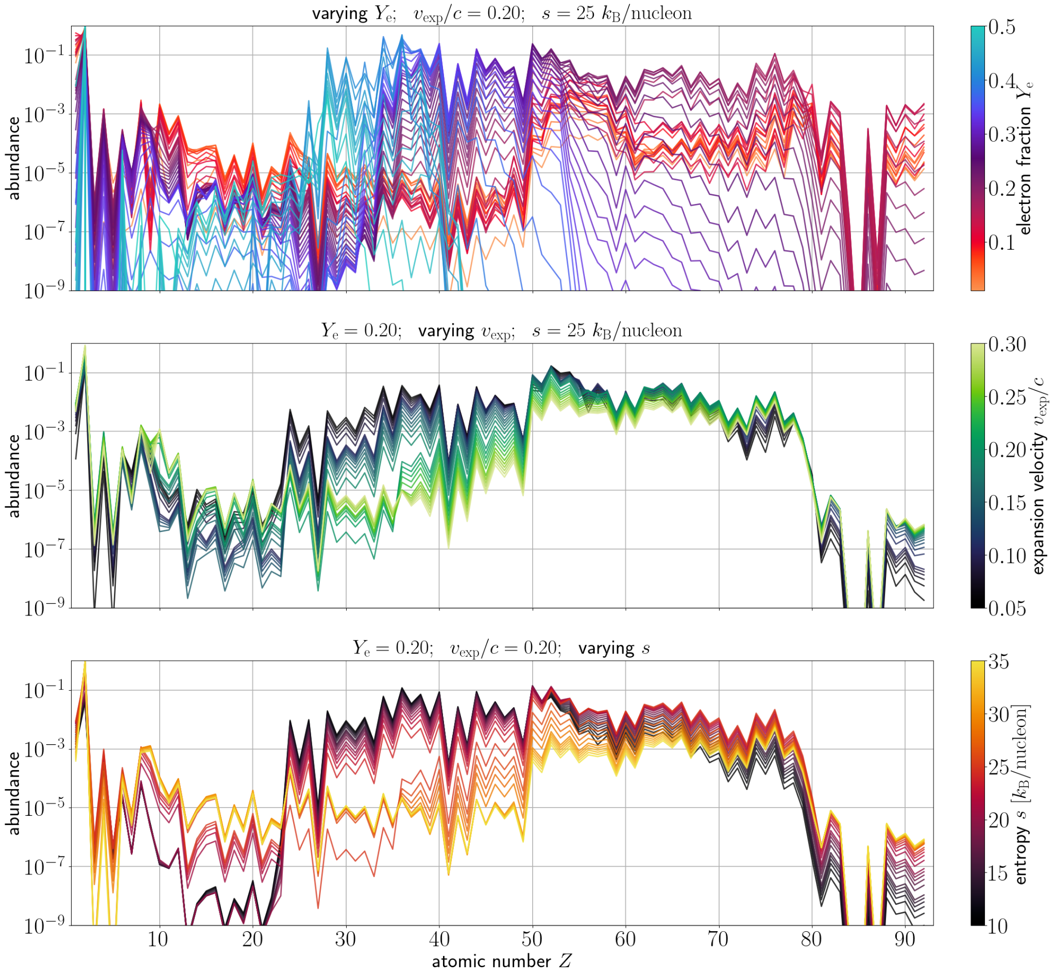
Parametrizing the abundances
Parametrize using electron fraction, expansion velocity, and entropy
Constrain fundamental conditions of the r-process
Vieira+22
Mapping from Wanajo 18

Slide 17
Idea: Generate many synthetic spectra and compare them to observations → Fit for the r-process elemental abundance pattern of GW170817 (“spectral retrieval”)
Problems:
many elements → high dimensionality if we naively fit for each abundance individually
computationally expensive
SPARK: Spectroscopic r-Process Abundance Retrieval for Kilonovae
parametrize the abundances!
Notes:
Now we’ll start discussing my project, which is SPARK: Spectral r-Process Abundance Retrieval for Kilonovae
The fundamental idea is to generate synthetic spectra with some radiative transfer, and compare them to observations. With this comparison, we can hopefully fit for the abundances of the elements in the kilonova. In the exoplanet community, they would call this “spectral retrieval”
However, we immediately run into two issues:
First of all, radiative transfer for kilonovae is computationally expensive. This is because of the sheer number of elements involved and the number of atomic lines each element can have. These elements have huge opacities.
Second, there are again so many elements, that if we fit for each abundance individually, we would have several dozen dimensions to fit. This high dimensionality would pose a serious problem for getting any sort of fit to converge.

Slide 18
Idea: Generate many synthetic spectra and compare them to observations → Fit for the r-process elemental abundance pattern of GW170817 (“spectral retrieval”)
Problems:
many elements → high dimensionality if we naively fit for each abundance individually
computationally expensive
SPARK: Spectroscopic r-Process Abundance Retrieval for Kilonovae
parametrize the abundances!
active learning!
Notes:
Now we’ll start discussing my project, which is SPARK: Spectral r-Process Abundance Retrieval for Kilonovae
The fundamental idea is to generate synthetic spectra with some radiative transfer, and compare them to observations. With this comparison, we can hopefully fit for the abundances of the elements in the kilonova. In the exoplanet community, they would call this “spectral retrieval”
However, we immediately run into two issues:
First of all, radiative transfer for kilonovae is computationally expensive. This is because of the sheer number of elements involved and the number of atomic lines each element can have. These elements have huge opacities.
Second, there are again so many elements, that if we fit for each abundance individually, we would have several dozen dimensions to fit. This high dimensionality would pose a serious problem for getting any sort of fit to converge.

Slide 19
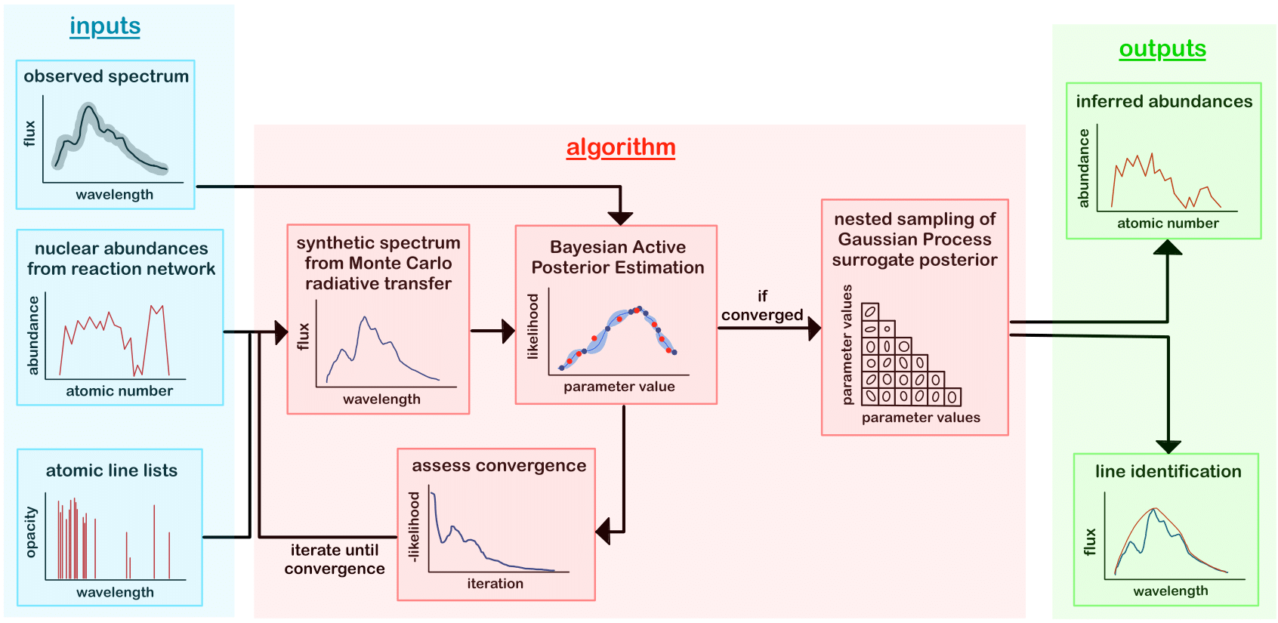
SPARK: Spectroscopic r-Process Abundance Retrieval for Kilonovae

Slide 20
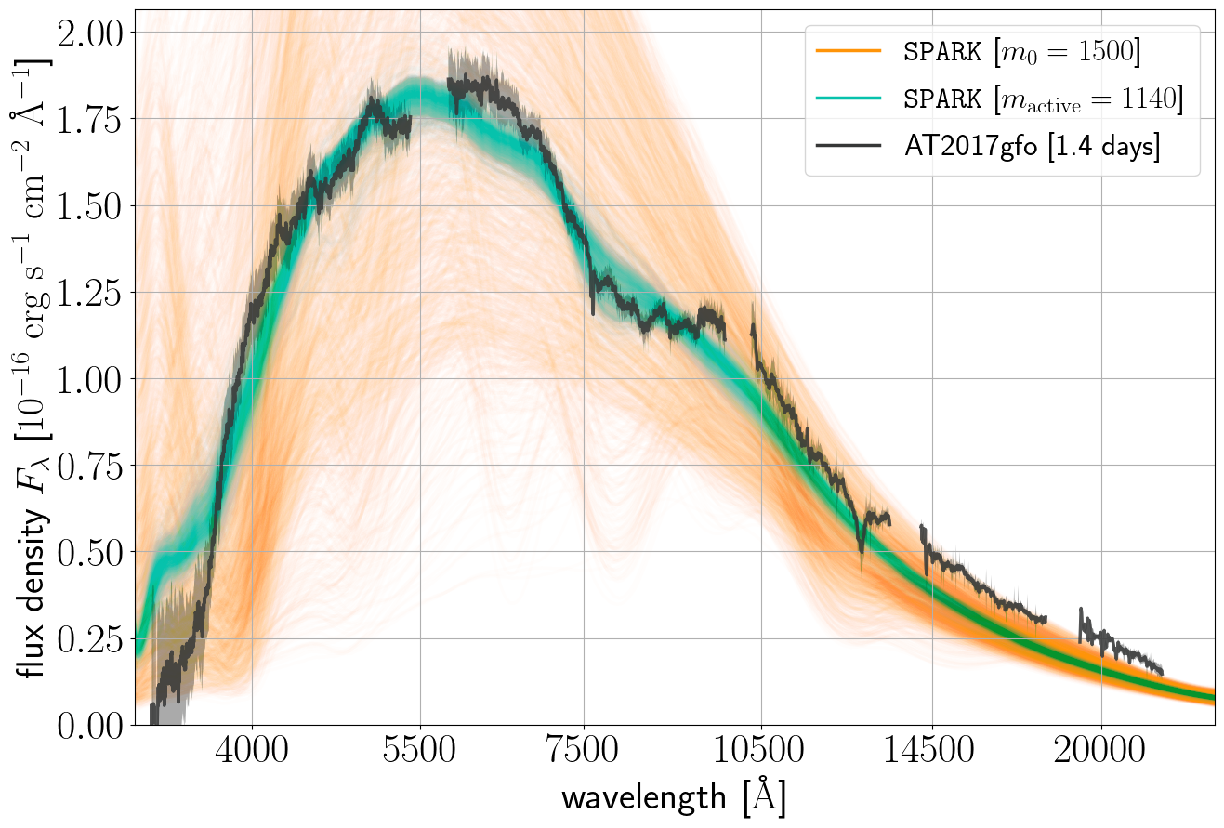
All forward model evaluations
Vieira+23

Slide 21
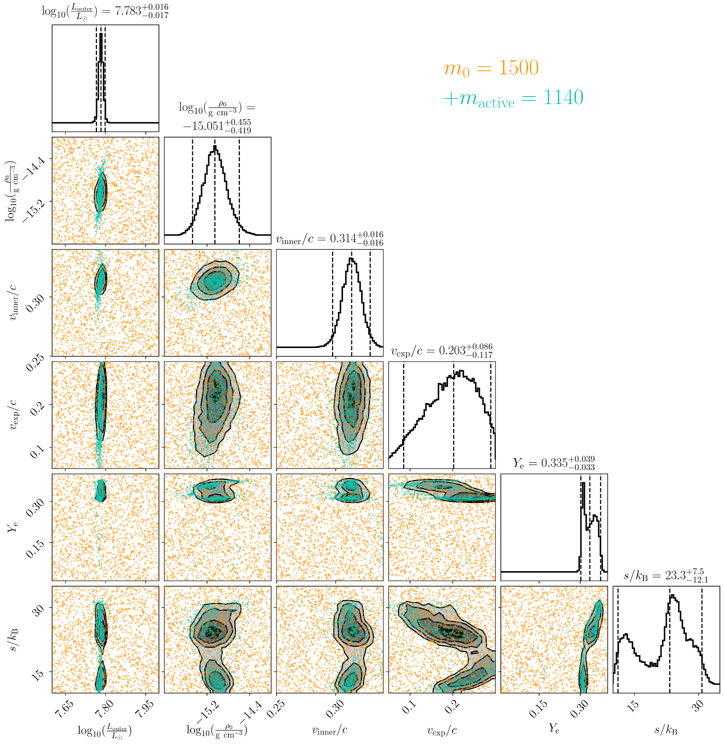
We get a posterior!
Active learning sampled where expected
Only 1140 samples to adequately constrain the posterior
Posterior is bimodal
We call our best fit “purple” (moderate electron fraction) and “warm” (moderate entropy)
Vieira+23

Slide 22
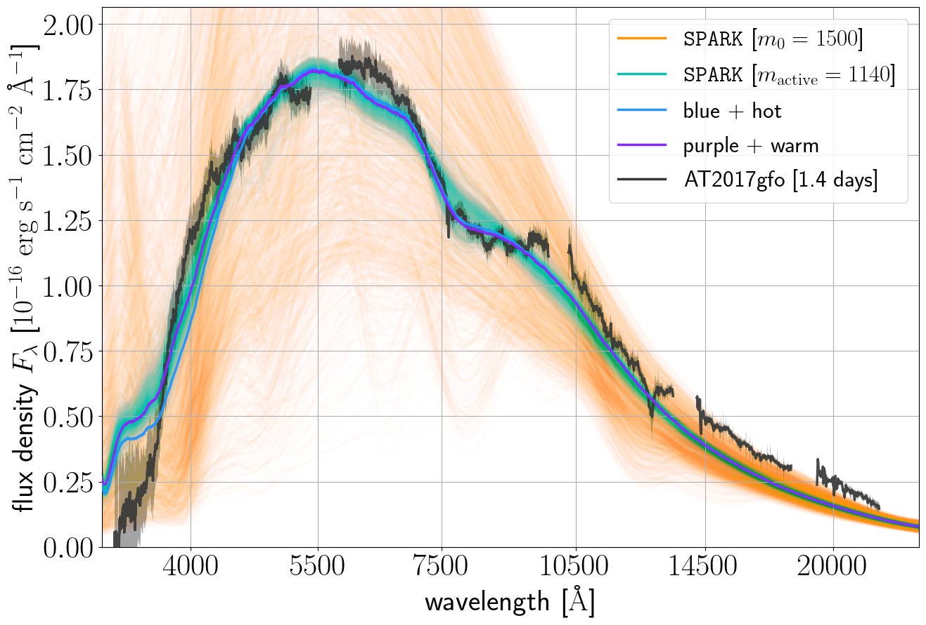
All forward model evaluations & best fits
Vieira+23

Slide 23
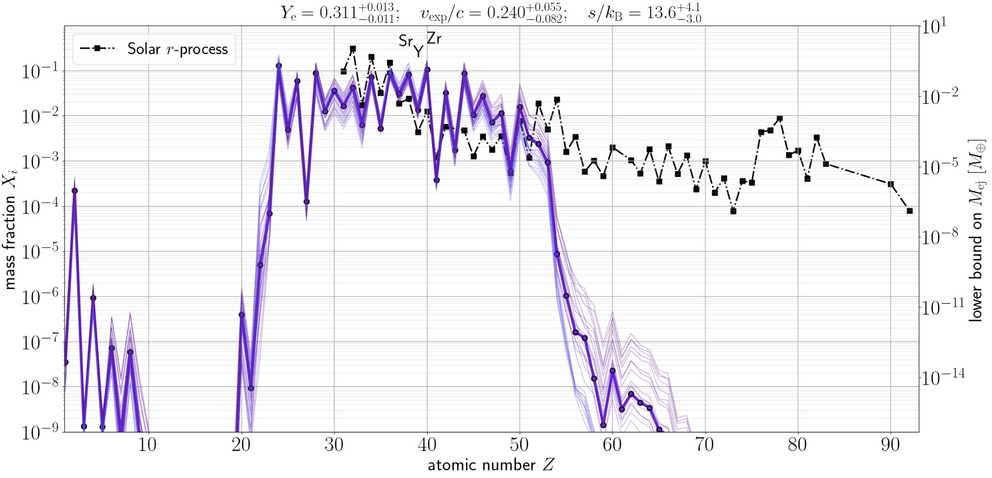
Purple+warm: abundances
Vieira+23
Solar r-process: Lodders 09 & Bisterzo+14

Slide 24
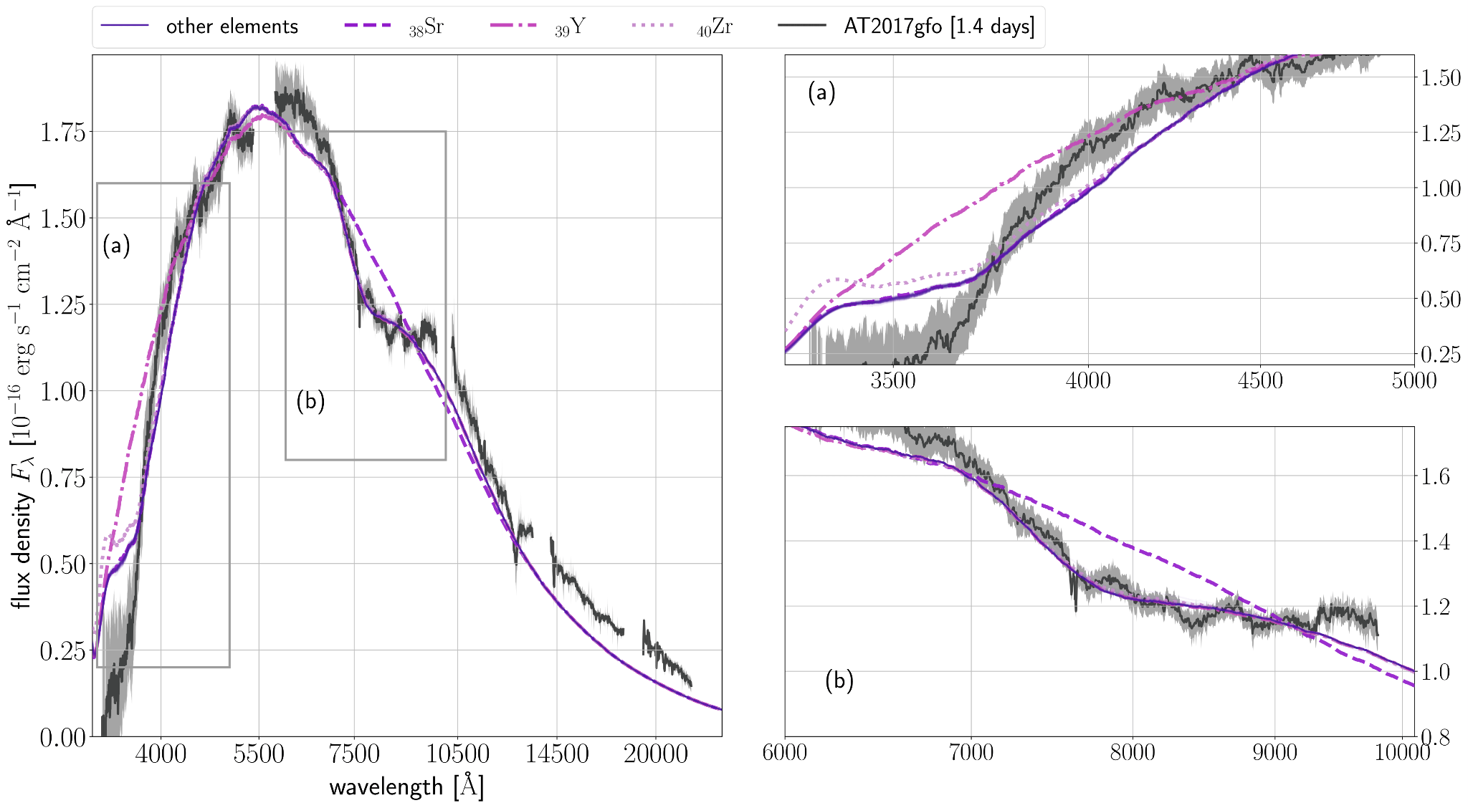
Purple+warm: leave-one-out spectra
Vieira+23

Slide 25
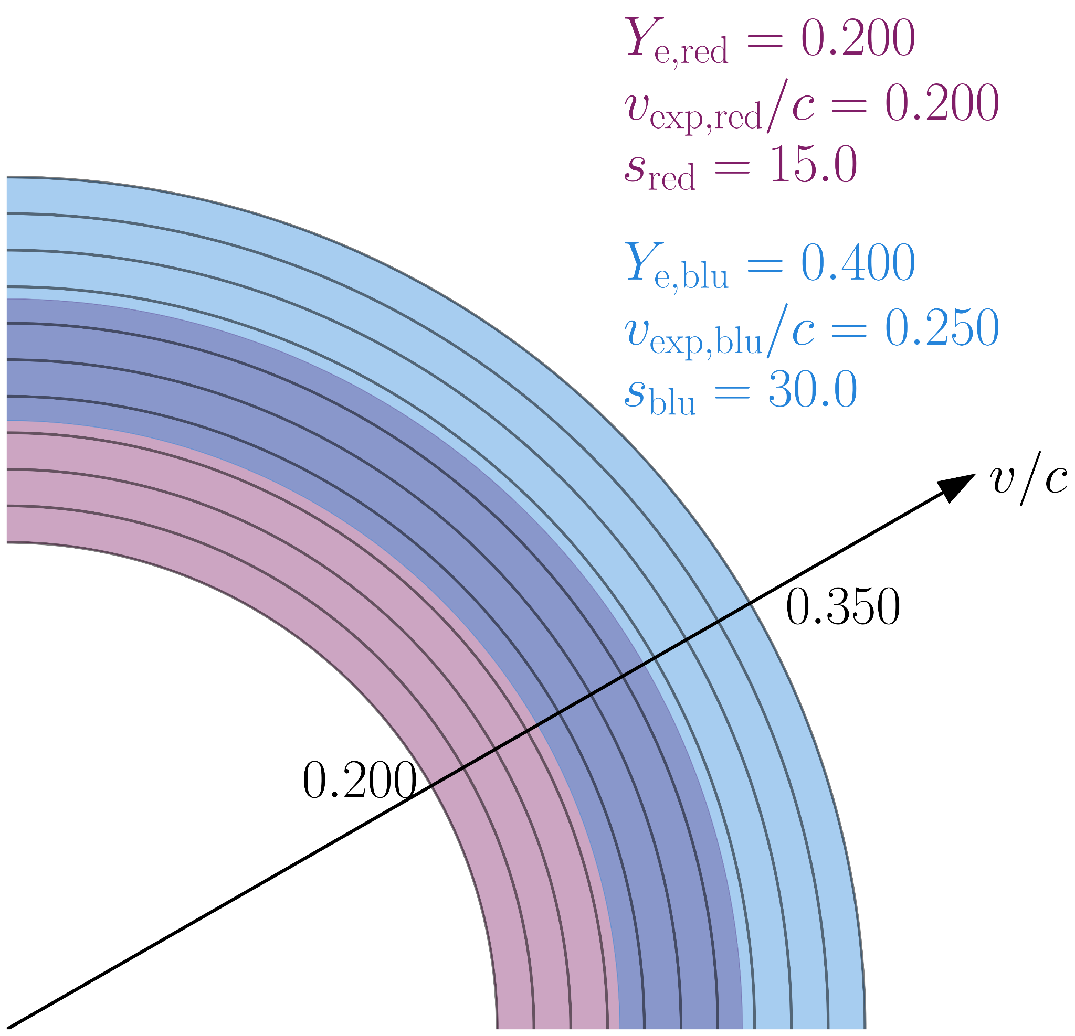
Conclusions & looking forward
Obtained the element-by-element abundance pattern of GW170817 at 1.4 days
Established SPARK as an effective tool
In the future:
Do the abundances change at later epochs?
Multi-component models
Fit new kilonovae in O4 (starting on 24 May 2023; but engineering run already underway)!
Vieira et al

Slide 26
EXTRA SLIDES FOLLOW

Slide 27
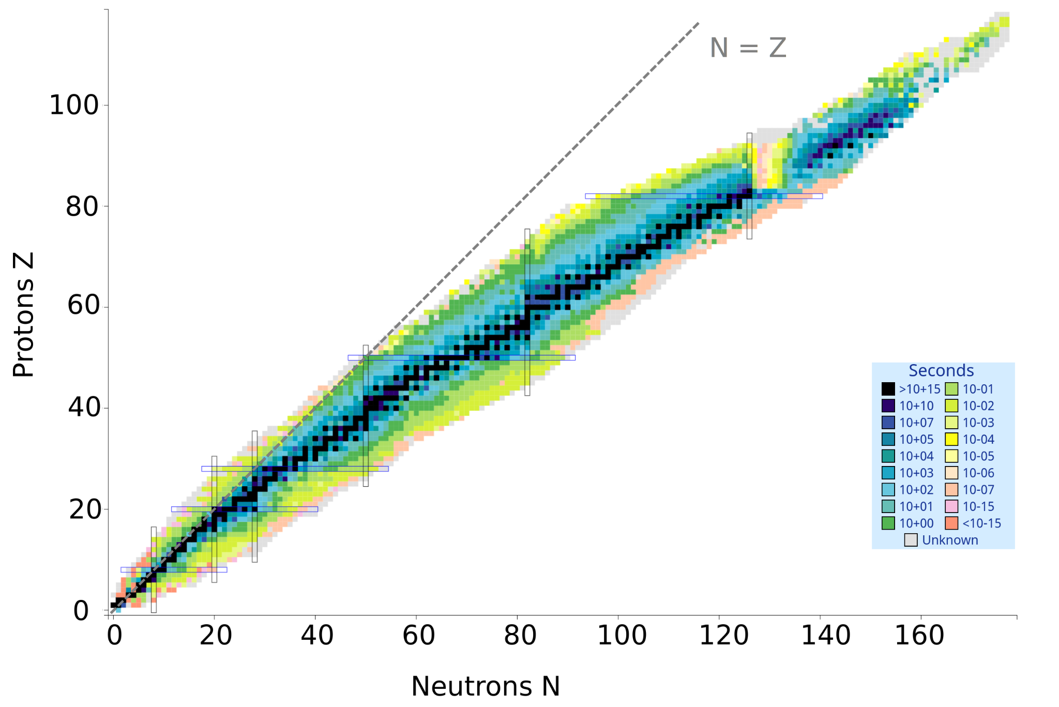
Heavy metal
Stable isotopes of heavier elements have more neutrons than protons
NNDC, Brookhaven (NuDat 3: https://www.nndc.bnl.gov/nudat3/)
Notes:
Maybe we can get a clue by looking at which isotopes are stable for these heavier elements. What we see right away is that heavier elements have far more neutrons than protons. So, to synthesize these elements, we need an environment with a lot of free neutrons…

Slide 28
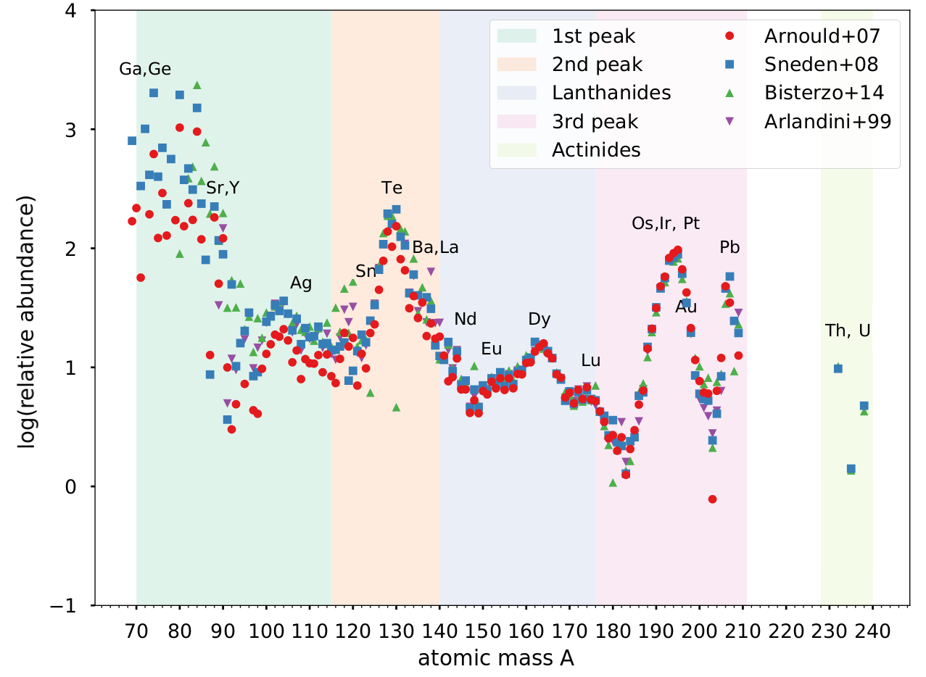
[r]apid neutron capture: the r-process
temperature ~ 10⁹ - 10¹⁰ K
density ~ 10¹² g cm⁻³
neutron capture timescale < beta-decay timescale
over t ~ 1 s (!), neutrons capture onto seed nuclei, synthesizing heavy elements
also require a neutron : seed ratio > 1
adapted from Ji+19
Notes:
This r-process requires pretty exceptional conditions: namely, temperatures in excess of 1 billion degrees Kelvin, and densities in excess of 10¹² g cm⁻³ . If we have a large number of free neutrons under these conditions, we enter the regime where the timescale for neutron capture is shorter than the timescale for radioactive beta decay.
In this regime, neutrons are repeatedly captured onto seed nuclei before the nuclei can undergo radioactive decay, and thus we can generate radioactive isotopes of very heavy elements
Importantly, this also requires a neutron to seed ratio much greater than 1---this is achieved by [...]
Here, we see an example of the r-process abundances in the Solar system, from a few different sources. The thinking is that some sort of catastrophic event which generates r-process elements happened nearby, introducing these elements to our Solar system. This abundance pattern is quite complex, and reflects a few things:
First of all, we see 3 peaks. These peaks happen to be near the magic numbers for nuclei, that is, where nuclides are most stable. So it’s not surprising that, after billions of years, these stable isotopes are what remained of some catastrophic event.
However, we also see sub-peaks. There are a few ideas for how these get formed, but one is that they are the result of repeated fission cycling. Basically, in the r-process, you generate very heavy nuclei and these almost immediately fission to create lighter elements. This cycling repeats over and over again, and so you get a pile-up of these lighter elements. We can see one such pile-up around here, for the lanthanides.

Slide 29
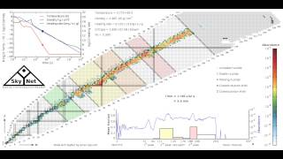
[r]apid neutron capture: the r-process
Lippuner+15
Notes:
This r-process requires pretty exceptional conditions: namely, temperatures in excess of 1 billion degrees Kelvin, and densities in excess of 10¹² g cm⁻³ . If we have a large number of free neutrons under these conditions, we enter the regime where the timescale for neutron capture is shorter than the timescale for radioactive beta decay.
In this regime, neutrons are repeatedly captured onto seed nuclei before the nuclei can undergo radioactive decay, and thus we can generate radioactive isotopes of very heavy elements
Importantly, this also requires a neutron to seed ratio much greater than 1---this is achieved by [...]
Here, we see an example of the r-process abundances in the Solar system, from a few different sources. The thinking is that some sort of catastrophic event which generates r-process elements happened nearby, introducing these elements to our Solar system. This abundance pattern is quite complex, and reflects a few things:
First of all, we see 3 peaks. These peaks happen to be near the magic numbers for nuclei, that is, where nuclides are most stable. So it’s not surprising that, after billions of years, these stable isotopes are what remained of some catastrophic event.
However, we also see sub-peaks. There are a few ideas for how these get formed, but one is that they are the result of repeated fission cycling. Basically, in the r-process, you generate very heavy nuclei and these almost immediately fission to create lighter elements. This cycling repeats over and over again, and so you get a pile-up of these lighter elements. We can see one such pile-up around here, for the lanthanides.

Slide 30
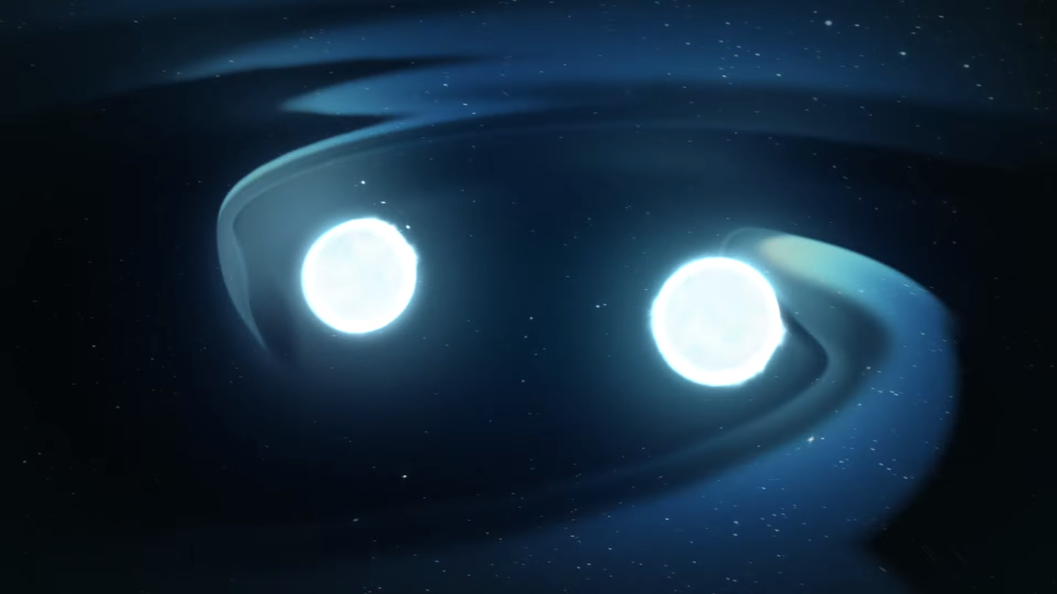
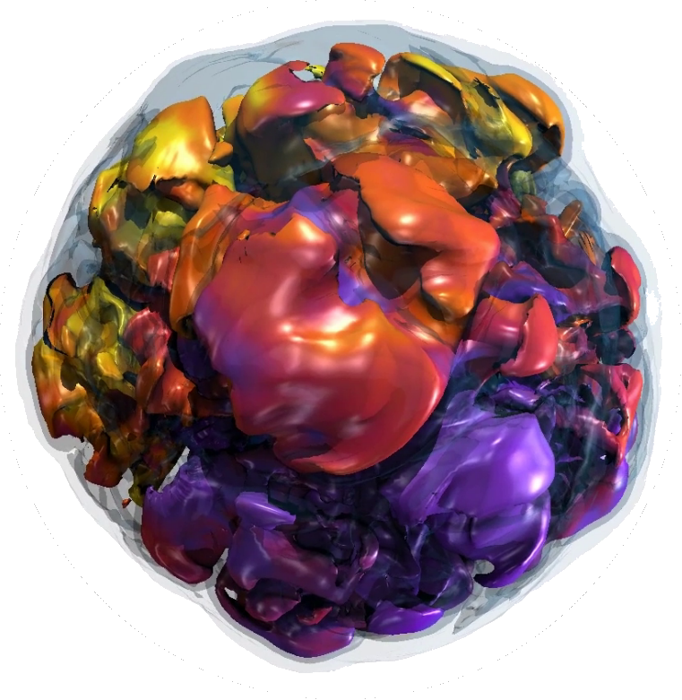
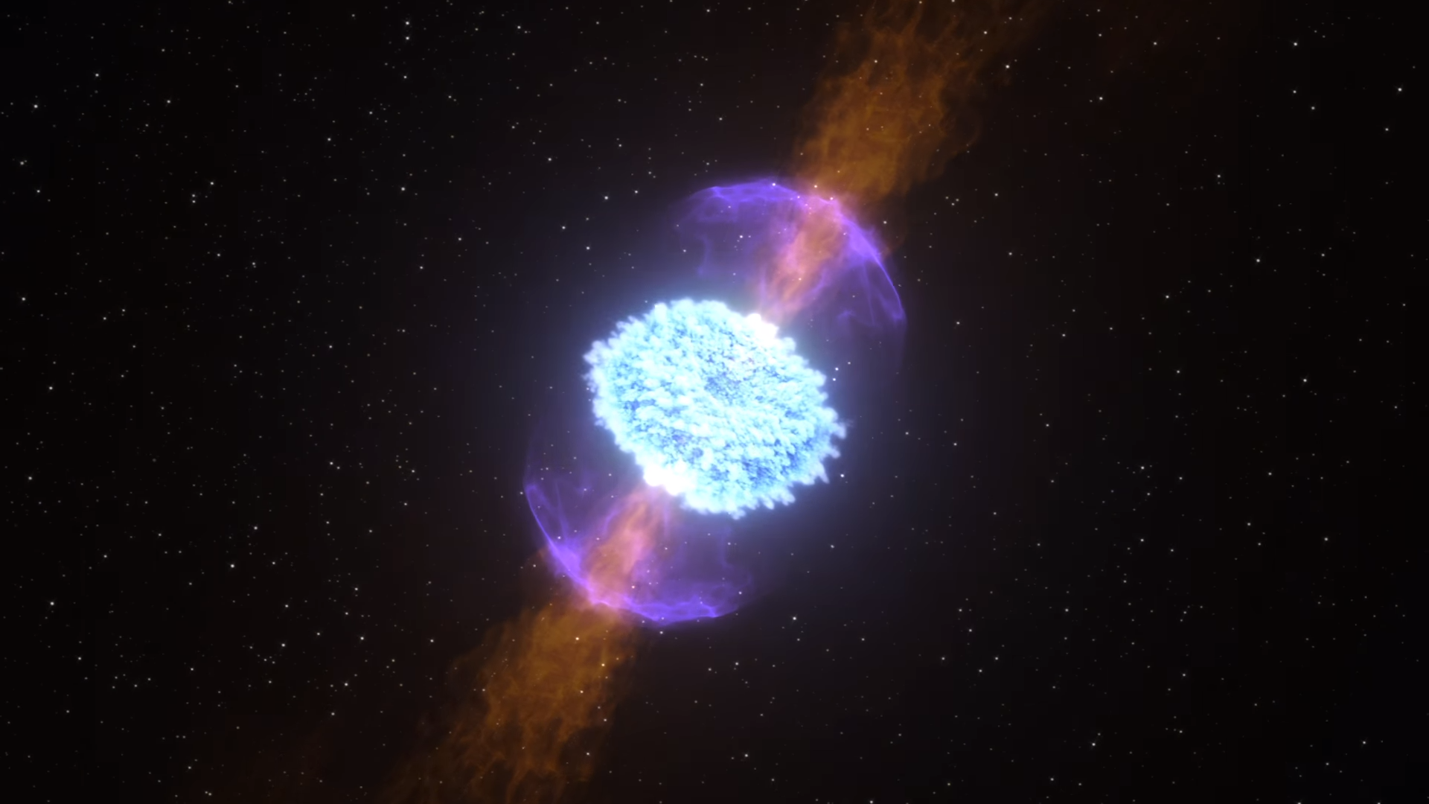
Where can we find large numbers of free neutrons?
neutron star + neutron star / black hole mergers
collapse of rapidly-rotating, highly-magnetized, massive stars
NASA Goddard
Burrows+19
Notes:
Indeed, it was recognized almost 70 years ago that you might find these large numbers of free neutrons in astrophysical settings. Many candidate sites have been proposed, but the two which are currently most favoured are the mergers of neutron stars with each other or with black holes, or, the collapse of rapidly-rotating, highly-magnetized, massive stars.
The reason these sites are favoured is that, in the ejecta produced by the catastrophic events, we find the conditions for something called rapid neutron capture, or the r-process.

Slide 31
Neutron star + neutron star / black hole mergers
NS + NS → tidal disruption, collision between surfaces of stars, formation of a remnant NS or BH, accretion disk
r-process in the tidal ejecta, squeezed collisional ejecta, and accretion disk
NS + BH → tidal disruption, formation of a remnant BH, accretion disk
r-process in the tidal ejecta and accretion disk
Notes:
Of the two main candidates for the site of the r-process, the one I’ll focus on is neutron star + neutron star / black hole mergers, which I’ll just refer to as mergers from now on
How do these produce the r-process? Well, when two NSs merge, there are several way for material to be ejected. First, you can tidally disrupt the stars before or during merger or you can squeeze out material when the surfaces of the two stars collide. Following the merger, a remnant NS or BH will be left behind. You can then form an accretion disk around this remnant, and this accretion disk can potentially launch viscously-driven winds or neutrino-driven winds.
In NS + BH mergers, the situation is similar. The main differences are that BHs do not have a surface, so you cannot get that squeezed collisional ejecta, and, the merger remnant is always a BH, which has an impact on the emission.
In any case, in both cases, the ejecta will be extremely neutron rich and have the right conditions to synthesize r-process elements.

Slide 32
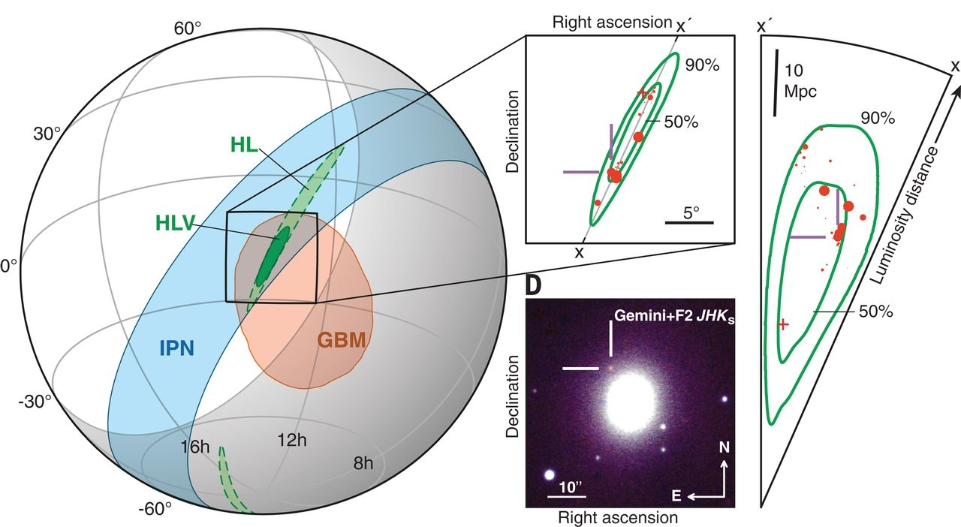
GW170817: first NS-NS merger, only gravitational wave + light detection to date
gravitational waves detected by both LIGO detectors, not Virgo
short gamma-ray burst: T + 3 seconds
kilonova: found at T + 11 hours
Kasliwal+2018

Slide 33
Fundamental tracer for neutron-richness: electron fraction
conservation of charge
equivalently, proton fraction
higher electron fraction → more protons, fewer neutrons
electron fraction ~ 0.01 - 0.45 required for r-process, less than 0.3 required to produce all peaks
Notes:
Now, the fundamental tracer for neutron richness when we discuss these nucleosynthesis events and abundance patterns is the electron fraction
This is a bit of a misnomer, or not a useful name, because it’s actually better understood as the ratio of protons to the ratio of all baryons. This means that, for a higher electron fraction, the ejecta is more proton-rich, and lacking in neutrons.
This parameter is very important in determining the abundance pattern of a given r-process event, and we usually need between 0.01 and 0.45 to get an r-process. To get a robust r-process which produces all of the peaks we saw in the previous slide, we need electron fractions closer to ~0.3.

Slide 34
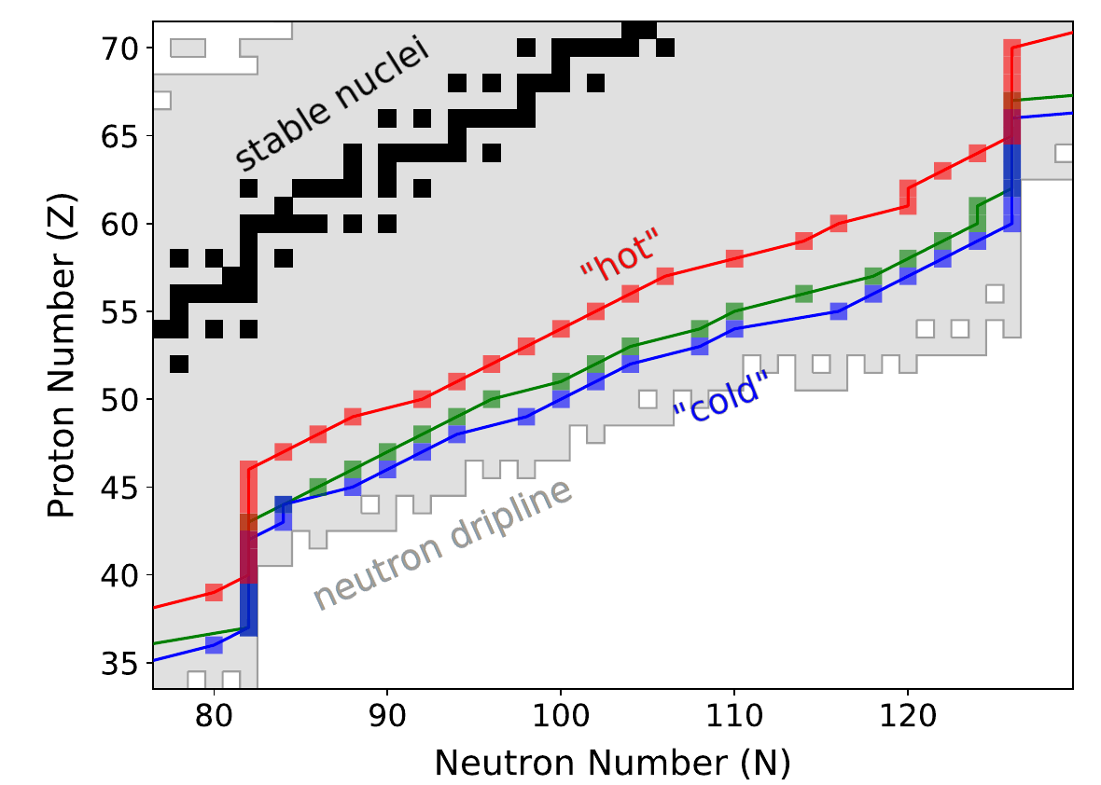
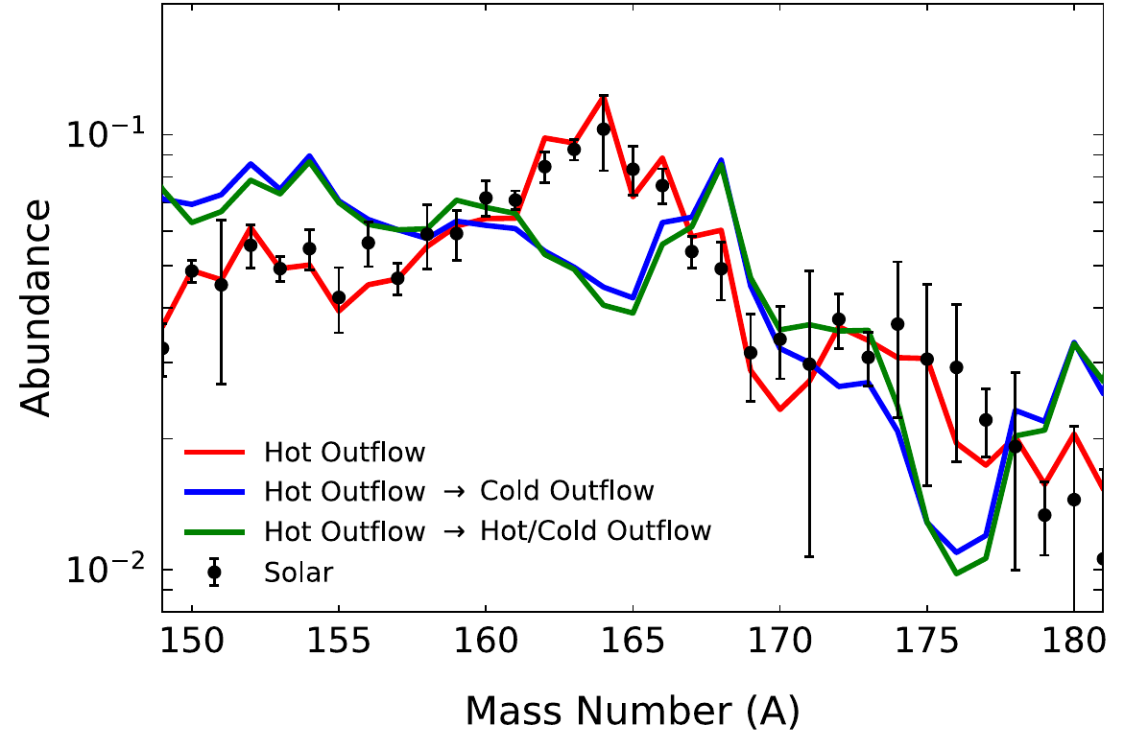
Hot or cold? Slow or fast?
hot: large entropy, equilibrium between neutron capture and photodissociation
cold: small entropy, may drop out of equilibrium before synthesizing lanthanides and heavier
can transition from one regime to another via expansion cooling / radioactive heating
expansion timescale/velocity is also important!
adapted from Vassh+21
Notes:
However, there are other parameters which determine the abundances from some r-process event. One of these is the entropy of the ejecta.
For high entropy, the plasma is radiation-dominated, and we have an equilibrium between neutron captures and photodissociations of heavy nuclei. This photodissociation gives a continuous supply of seed nuclei for neutrons to capture onto, and so we can have a robust r-proces where we generate all of the peaks in the r-process abundance pattern. The entropy is strongly dependent on temperature in this regime, hence, we call this a “hot” entropy.
For a lower or “colder” entropy, in contrast, photodissociations are almost irrelevant and equilibrium is only maintained for a short time. This can then impede the synthesis of the heaviest elements, like the lanthanides.
In these two plots, we can see how these hot and cold entropies differ. The cold scenario generates more radioactive isotopes close to the neutron dripline, while the hot scenario generates more stable nuclei through repeated photodissociations and neutron captures. This then impacts the final abundances, which we see in the bottom plot.
Importantly, we can actually transition from one regime to another via, for example, expansion cooling or radioactive heating. This is one intuitive way to realize that the expansion timescale / velocity is also an important quantity.

Slide 35
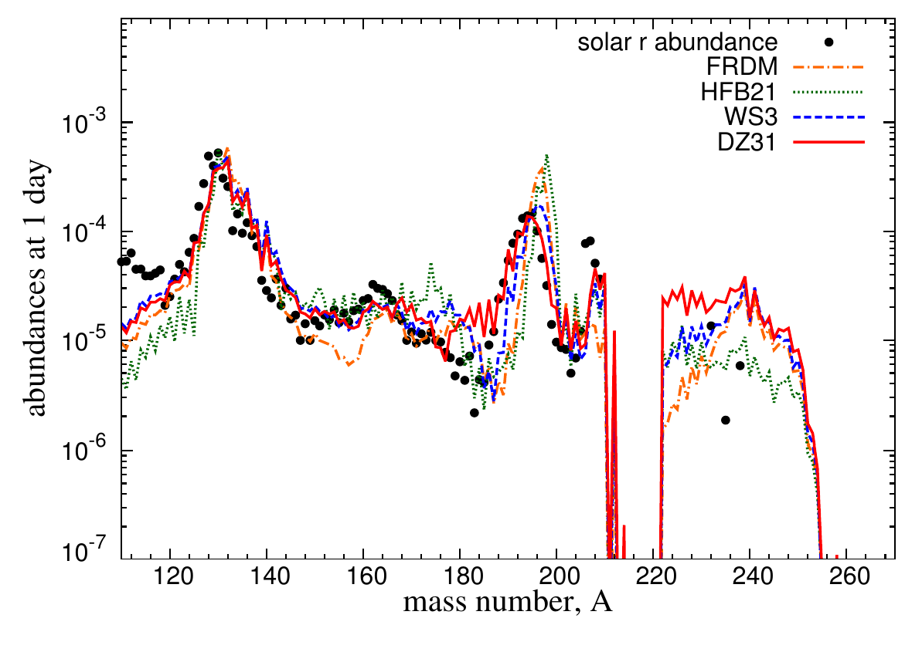
Impact of nuclear physics uncertainties
the final abundances (as predicted by reaction networks) depend sensitively on nuclear physics:
nuclear mass model
beta-decay rates
neutron capture cross-sections
treatment of fission
Mendoza-Temis+15
Notes:
One final note is that these abundances are highly impacted by uncertainties in the nuclear physics
The abundances I showed just before are from reaction network calculations, where you write down the coupled differential equations for several thousand reactions, you set up some plasma with some temperature, density, entropy, and so on, and you say “go”.
The outcomes of these calculations are very sensitive to the nuclear physics employed. The four most important pieces of physics are:
which nuclear mass model you use
the accuracy of the beta-decay rates of different radioactive isotopes
the neutron capture cross-sections for different isotopes
and the treatment of fission
For example, here we’re seeing the outcomes of the same reaction network calculations, where the nuclear mass model has been varied. You can see that this impacts the location, width, and amplitude of some of the r-process peaks, for example.

Slide 36
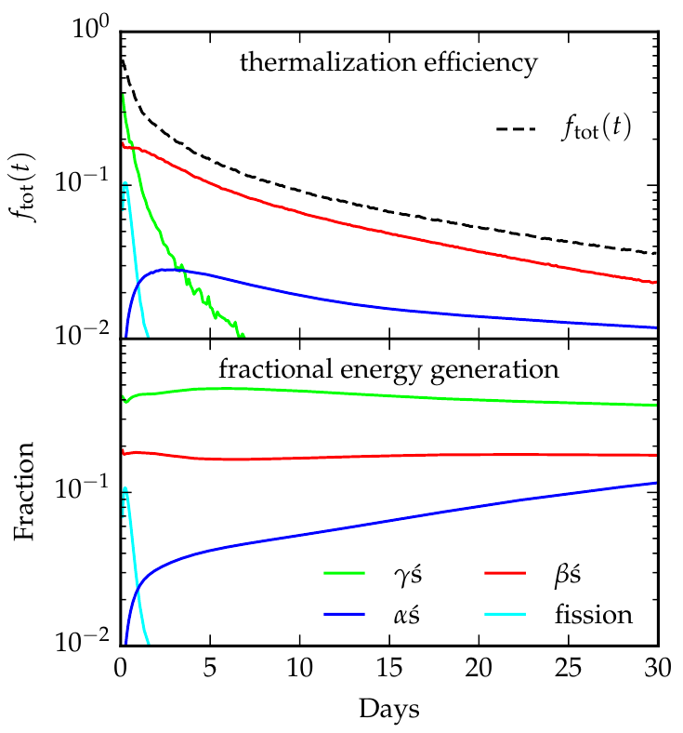
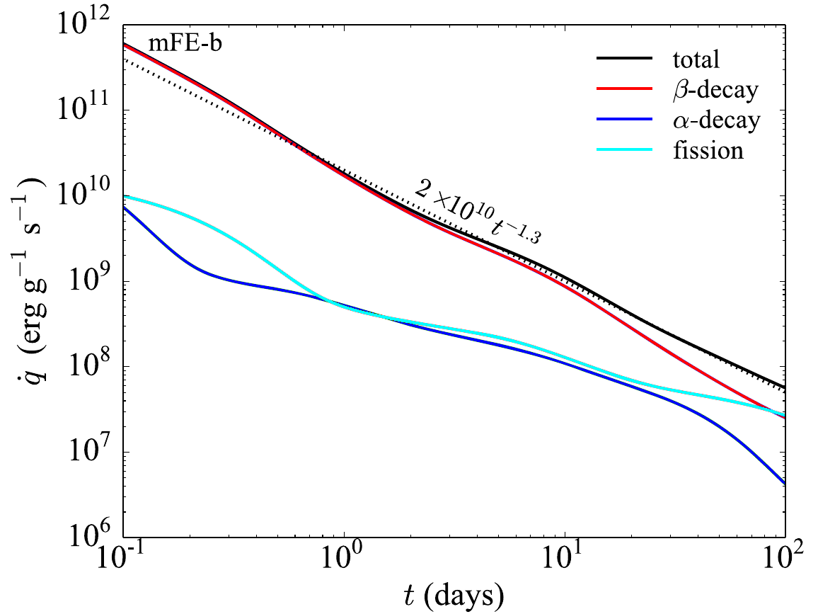
Radioactive decay, thermalization, and r-process heating
radioactive decays:
𝜶, 𝛽, 𝛾-particles + fission fragments
power law heating → kilonova
thermalization
Barnes+16
Wanajo 18
Notes:
I want to clarify why this emission is in the UV, optical, and IR in the first place. The mechanism is the following:
In the r-process, you synthesize lots of radioactive isotopes. These freshly-synthesized isotopes undergo alpha, beta, and gamma decays, as well as fission.
These processes deposit energy into the surrounding ejecta. In a process called thermalization,

Slide 37
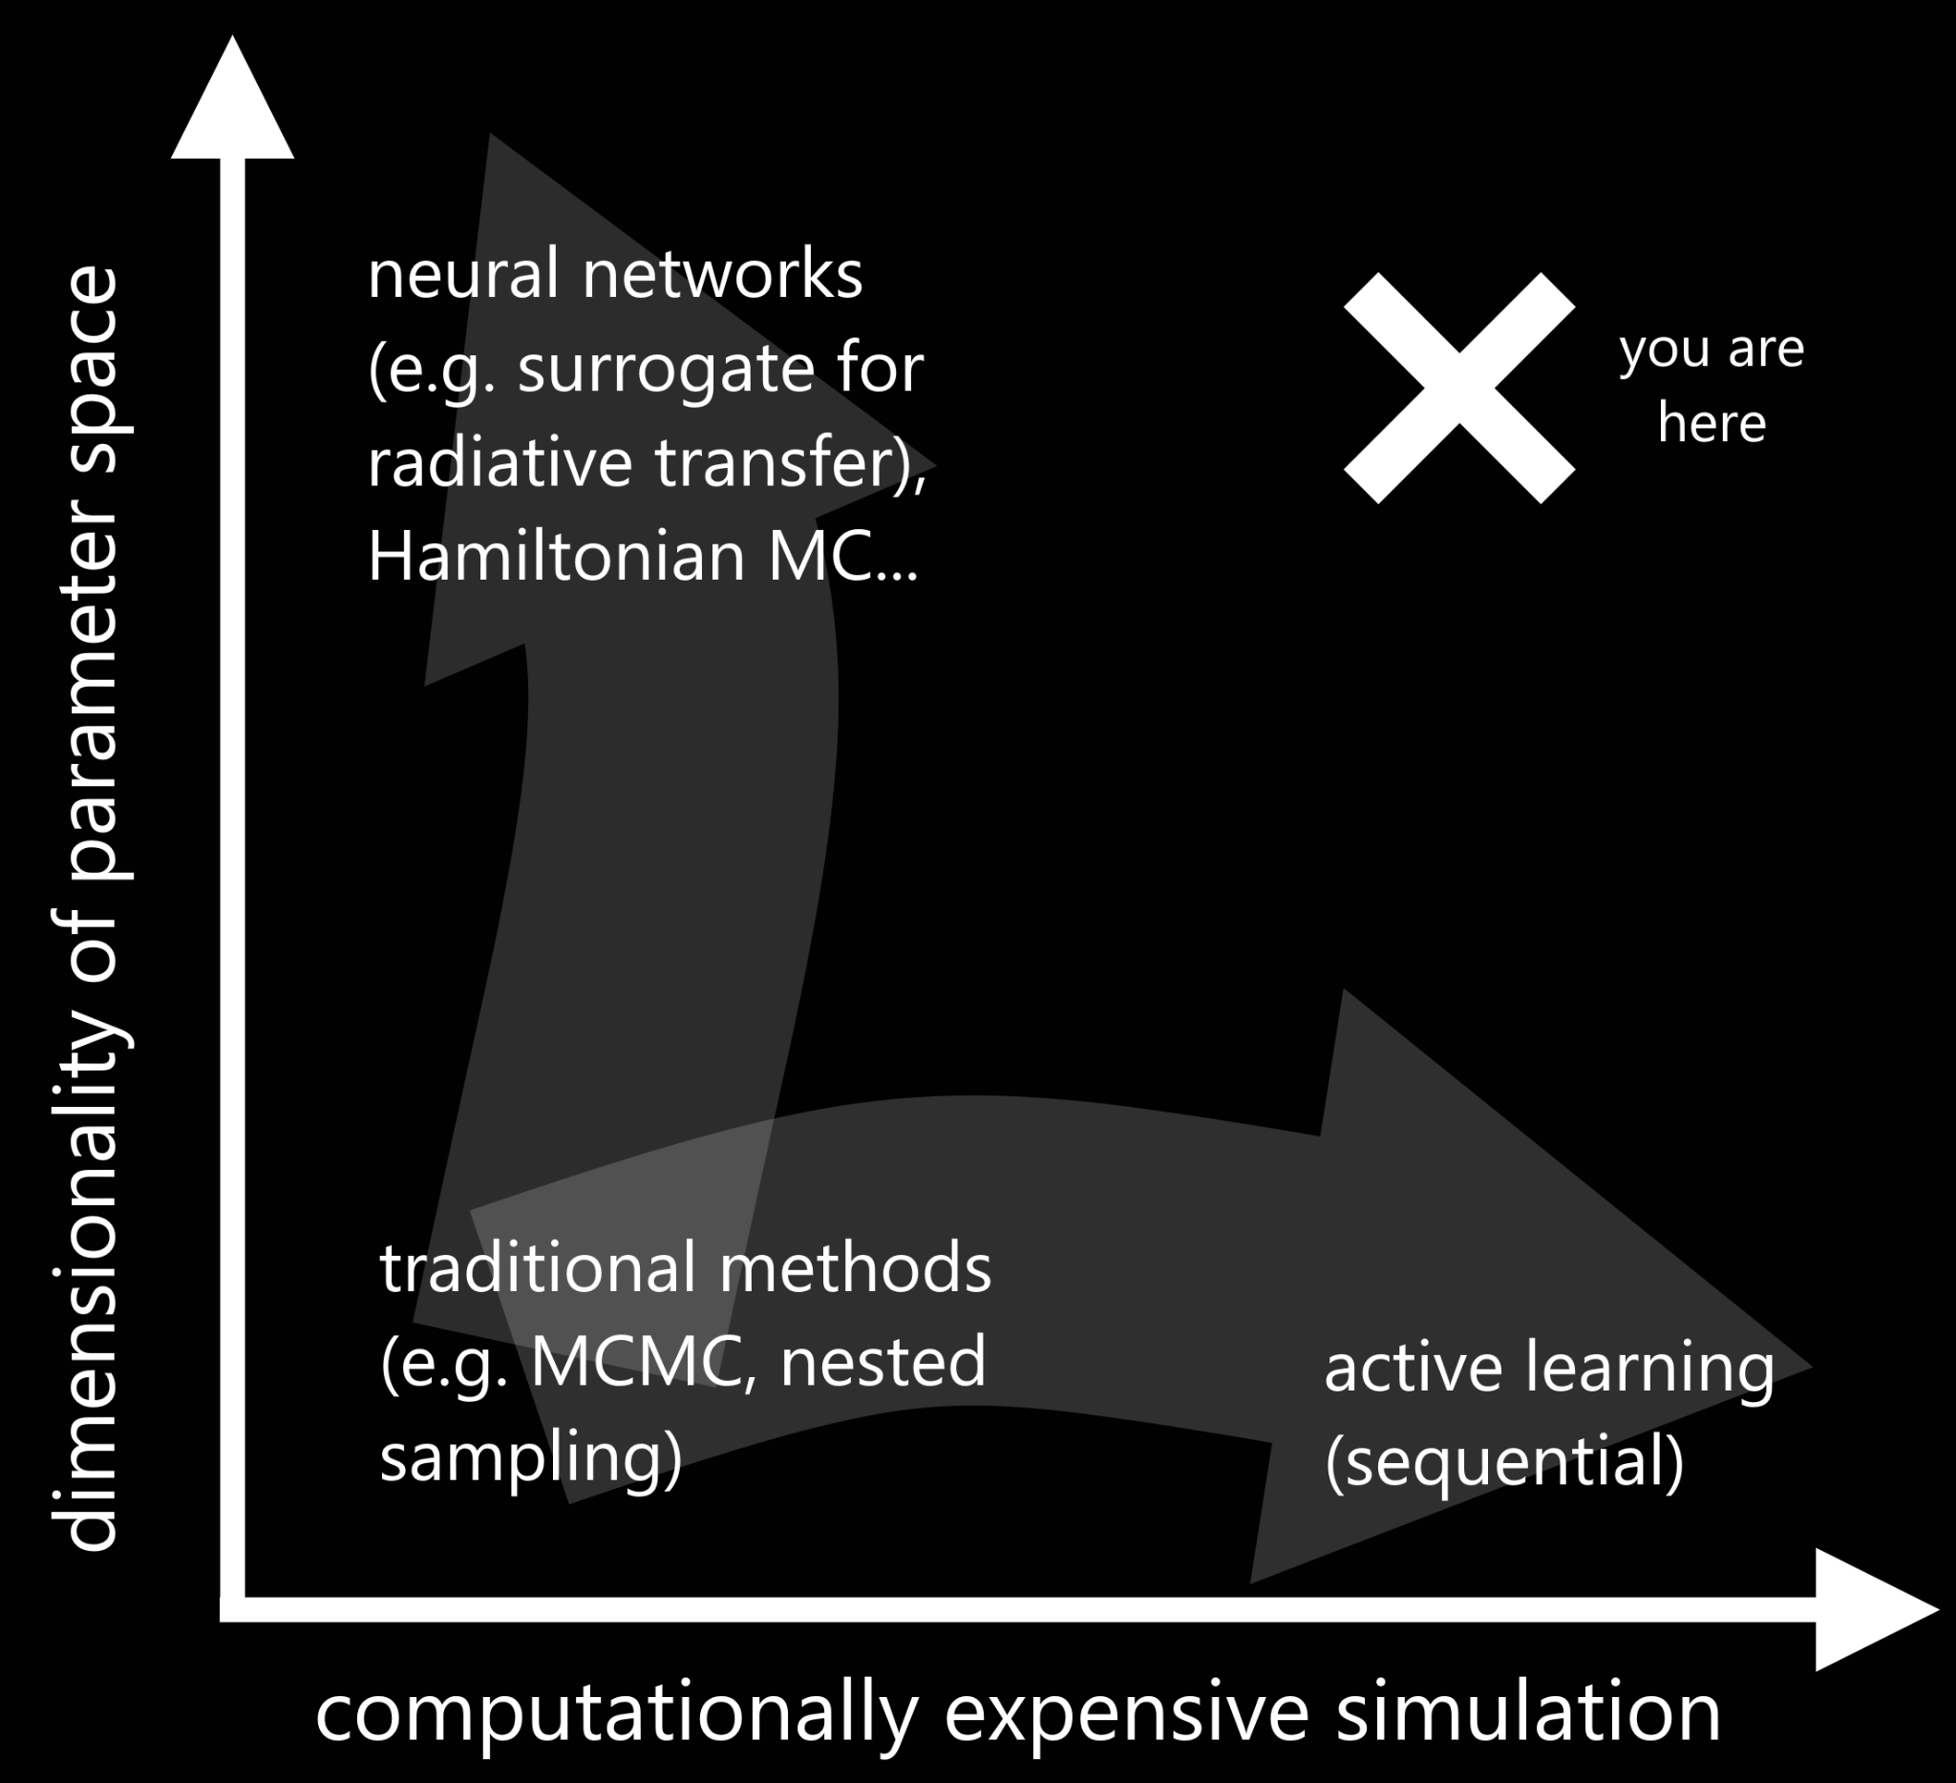
Inference regimes
Notes:
Either of these problems on its own is manageable, and there are techniques which work in those regimes
Here, we have on the horizontal axis how computationally expensive your simulation is, and on the vertical, the dimensionality of the problem
For low dimensionality, not computationally expensive, we can use traditional methods like an MCMC, nested sampling, or even a simple least-squares fit
For high dimensionality, we can use things like neural networks or a Hamiltonian MC
For high computational expense, we can use active learning approaches to limit the number of simulations we need to run overall
Unfortunately, when you combine these two issues, there aren’t really any methods which account for both issues in a computationally feasible way. So, we need to do our best to solve at least one of these problems

Slide 38
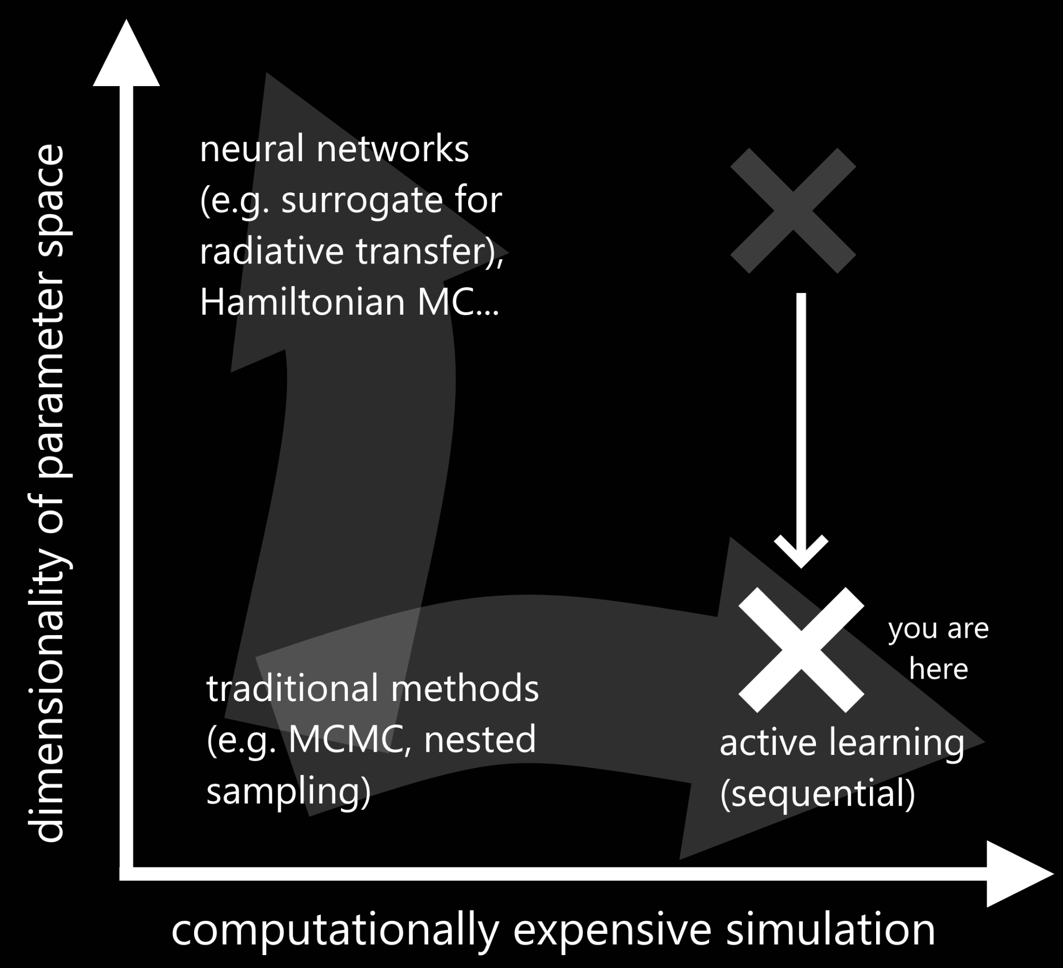
Inference regimes

Slide 39
Radiative transfer with TARDIS
1D Monte Carlo radiative transfer code for spectral synthesis
Radiation-matter interactions in a stratified medium under homologous expansion (e.g., supernovae, kilonovae)
Produce a synthetic spectrum at a single point in time
Computationally expensive
https://tardis-sn.github.io/tardis/

Slide 40
SPARK: Spectroscopic r-Process Abundance Retrieval for Kilonovae

Slide 41
SPARK: Spectroscopic r-Process Abundance Retrieval for Kilonovae

Slide 42
SPARK: Spectroscopic r-Process Abundance Retrieval for Kilonovae
Notes:
Once we have obtained a good fit to the spectrum, we can then look at the corresponding abundances and associate features in our spectrum with specific elements

Slide 43
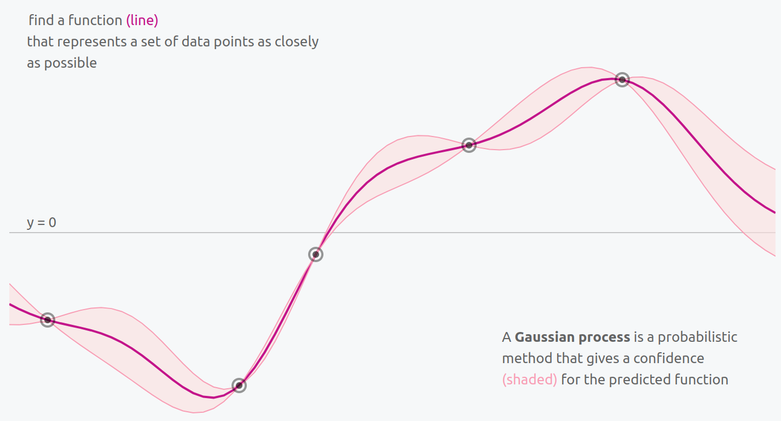
Gaussian Processes
GPs can approximate a function by conditioning on data and can provide uncertainties
In our case, we have some point and the function we care about is the posterior
Train our GP on pairs
Görtler+19
https://distill.pub/2019/visual-exploration-gaussian-processes/
Notes:
Why a Gaussian process? Well, GPs are a very powerful tool which can be used to approximate any function by conditioning them on data, or in the language of machine learning, training them on data
Importantly, a Gaussian process can also be used to provide an estimate of the uncertainty, which can be really powerful
This image here shows a 1D Gaussian process being conditioned on a few data points, and it’s from this really nice interactive visual exploration of GPs which I highly recommend you check out
In our case, we have some point which we’ll call theta, and the function we want to approximate is the posterior p of theta given some data X
So, we’re training our GP on pairs of theta and p

Slide 44
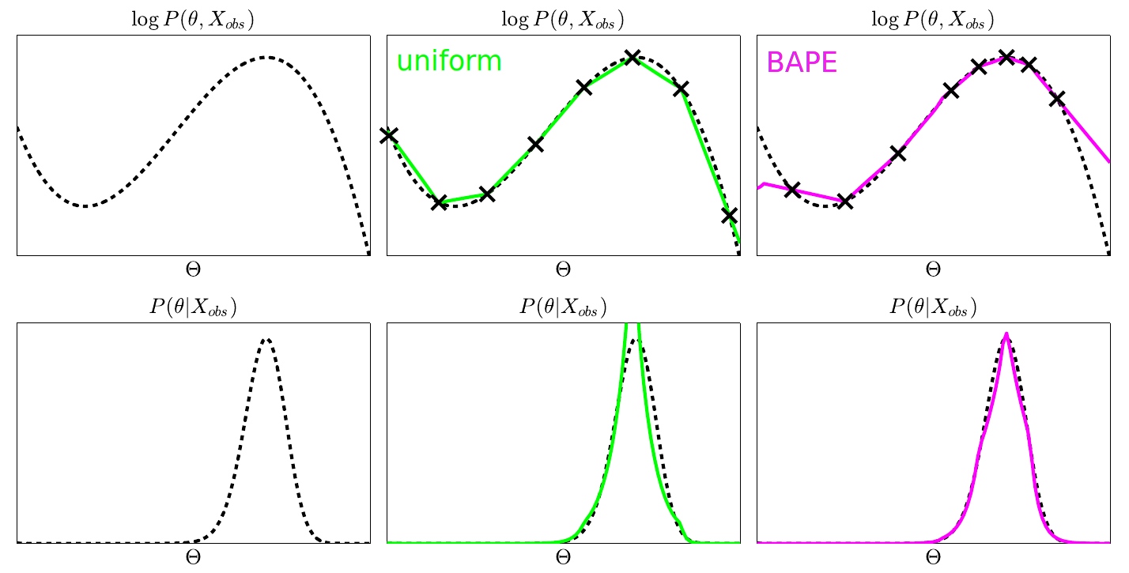
Bayesian Active Posterior Estimation (BAPE)
Kandasamy+17

Slide 45
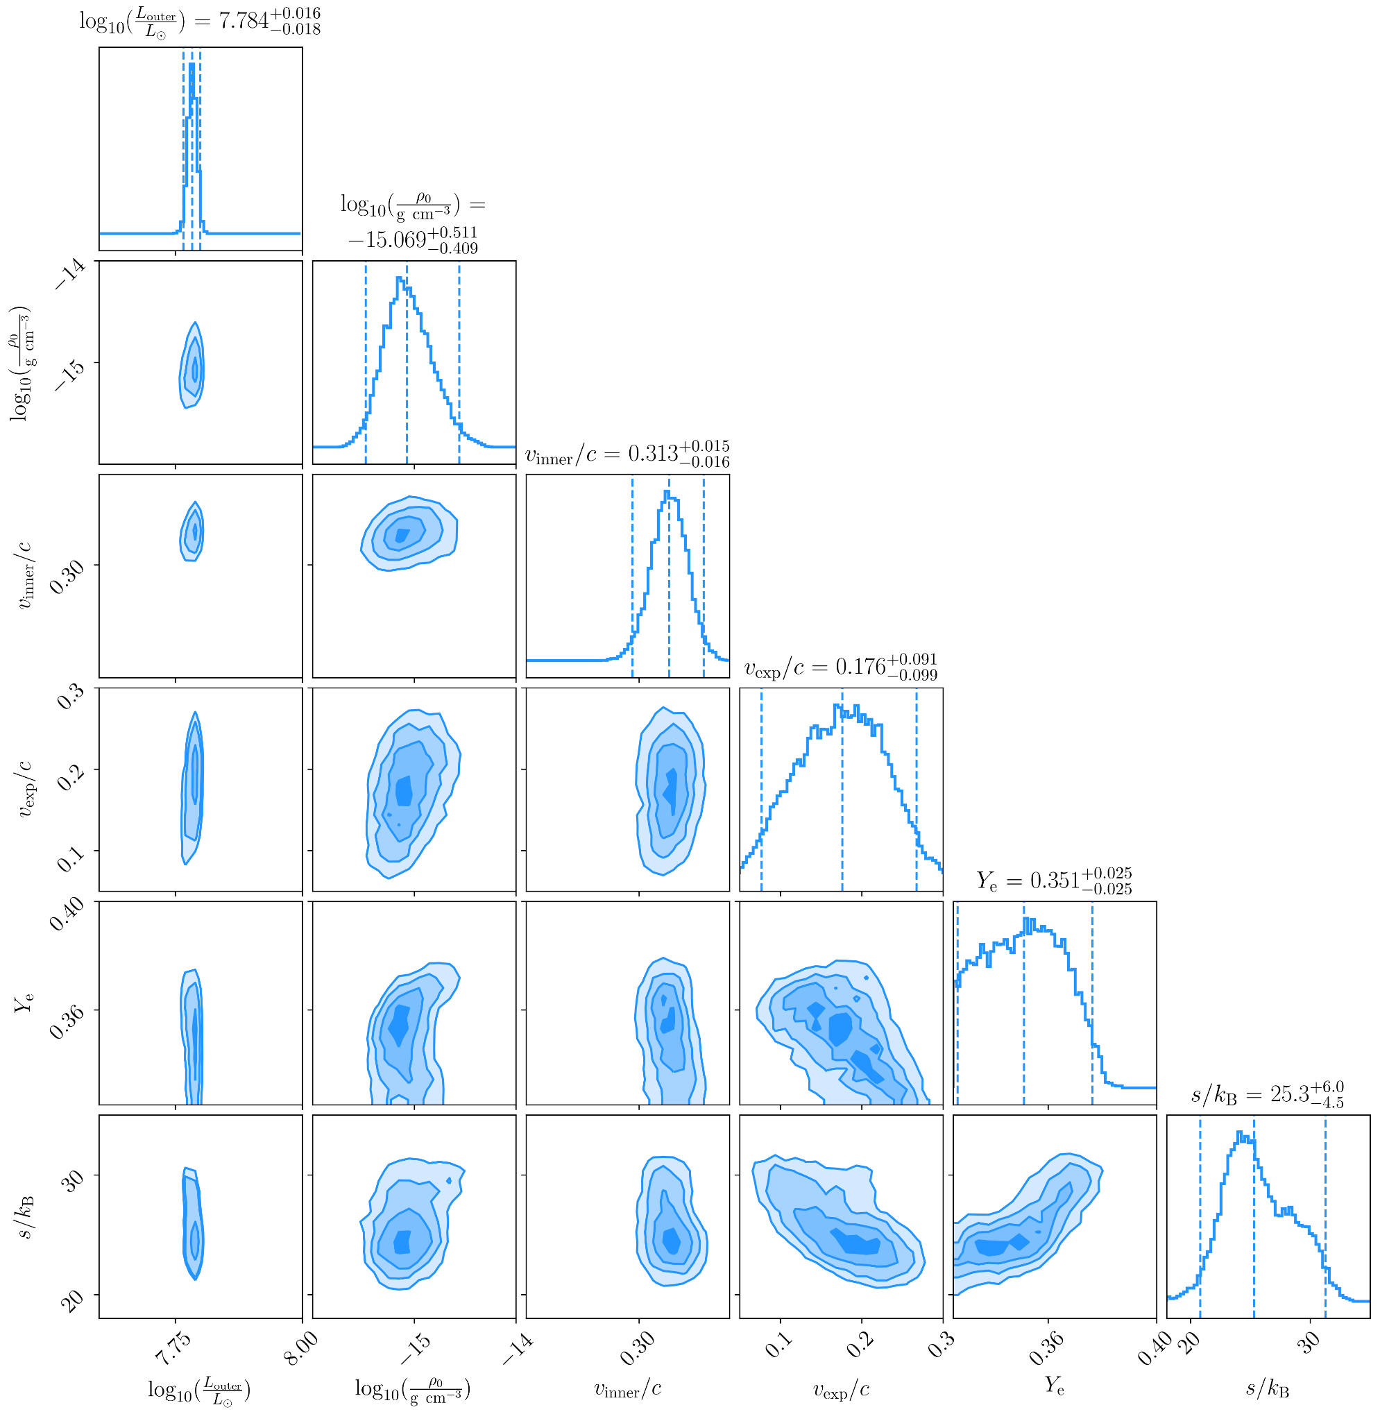
Blue+hot: posteriors
Higher (bluer) electron fraction
Larger (hotter) entropy
Peak is not as sharply defined as purple, warm mode
Nonetheless, what do the best fit and its abundances look like?
Vieira+23

Slide 46
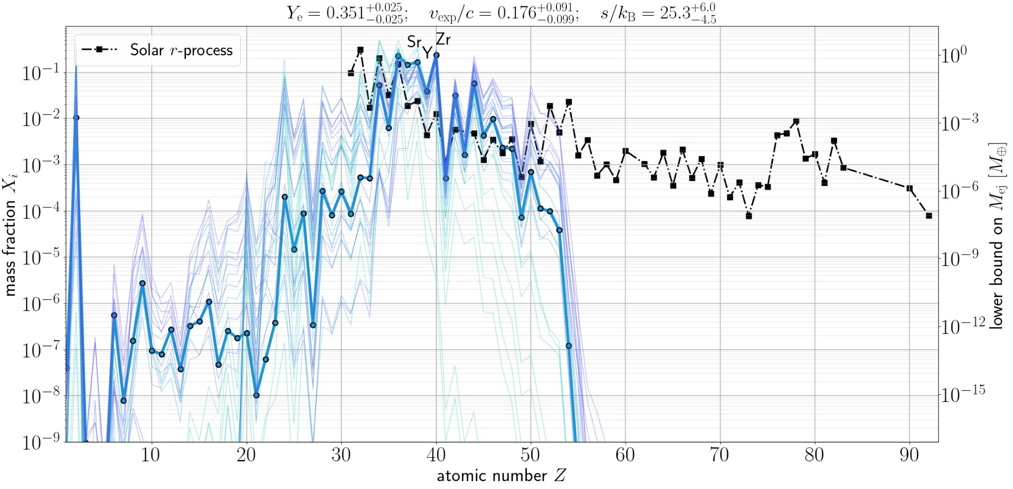
Blue+hot: abundances
Vieira+22
Solar r-process: Lodders 09 & Bisterzo+14

Slide 47
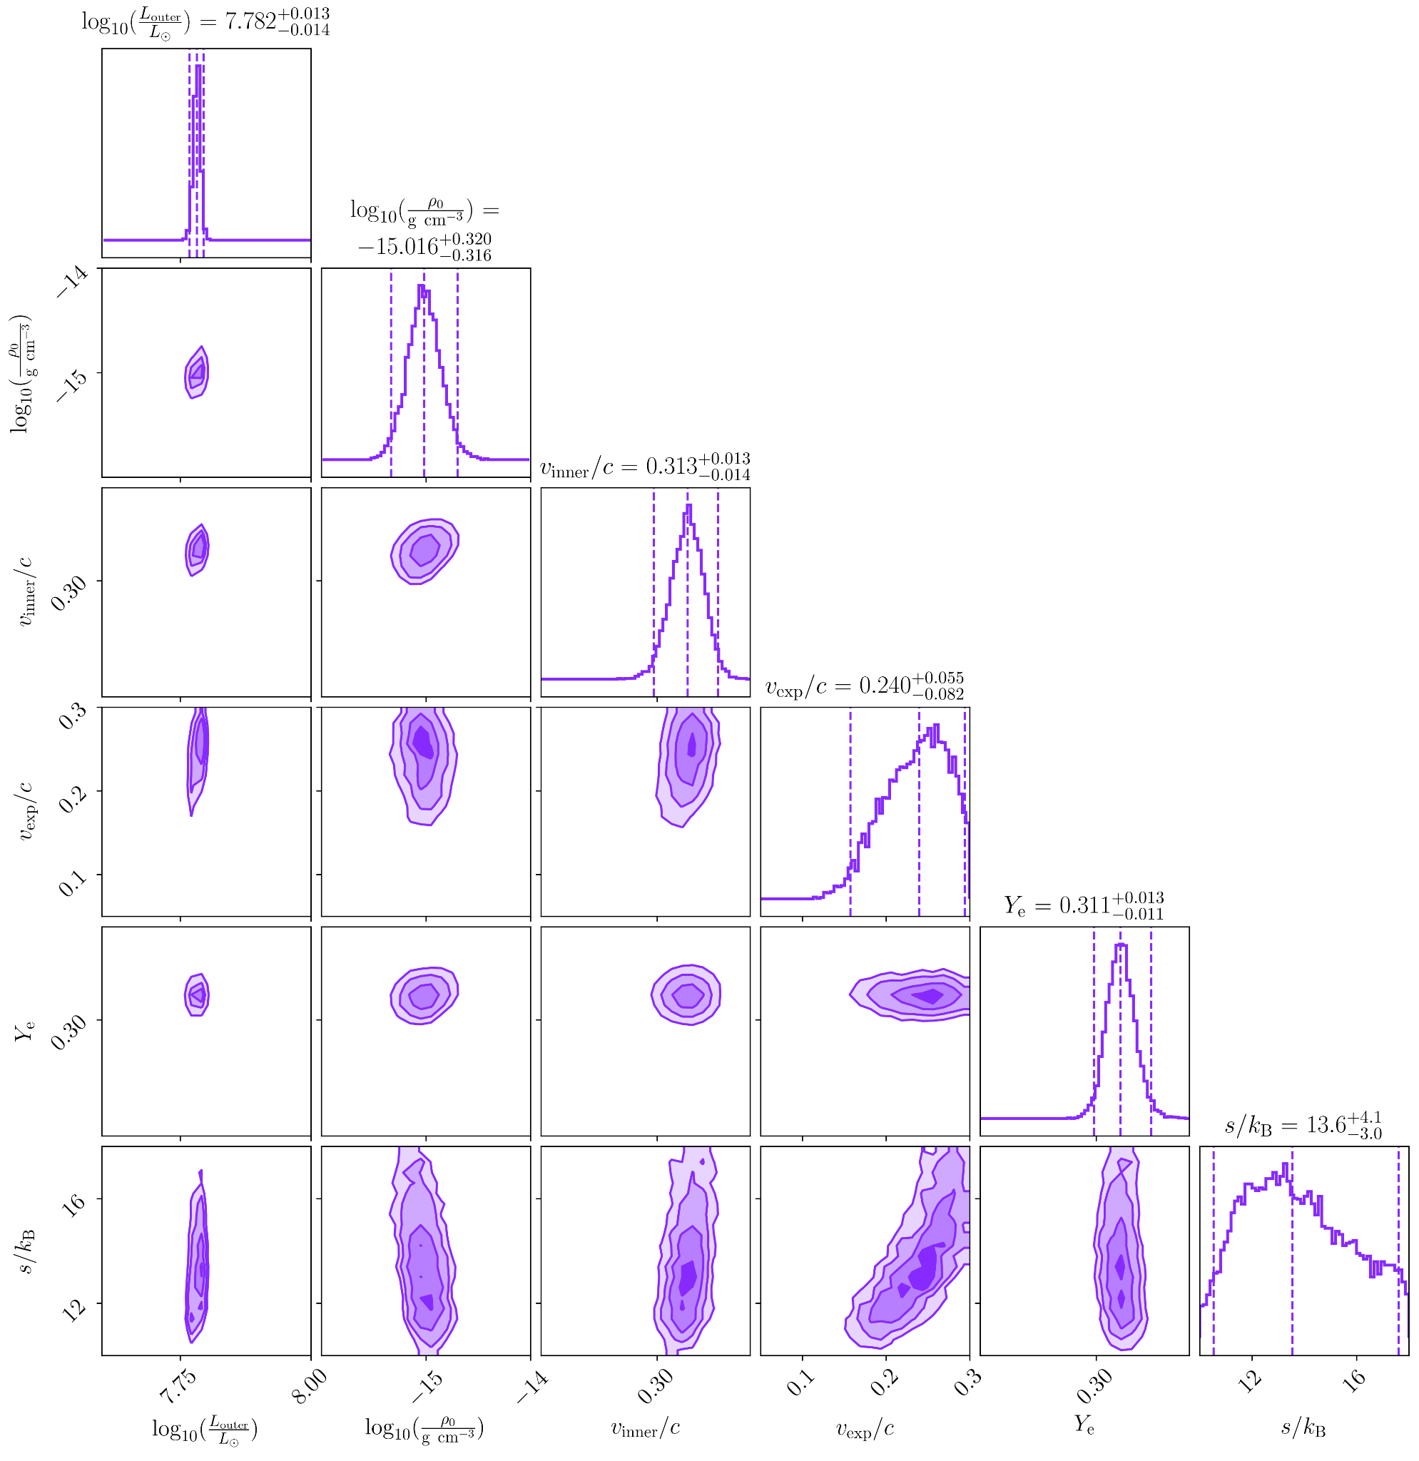
Purple+warm: posteriors
Lower (~ purple) electron fraction
Smaller (colder) entropy
Slightly faster expansion velocity
Peak is more sharply defined
What do the best fit and its abundances look like?
Vieira+23

Slide 48
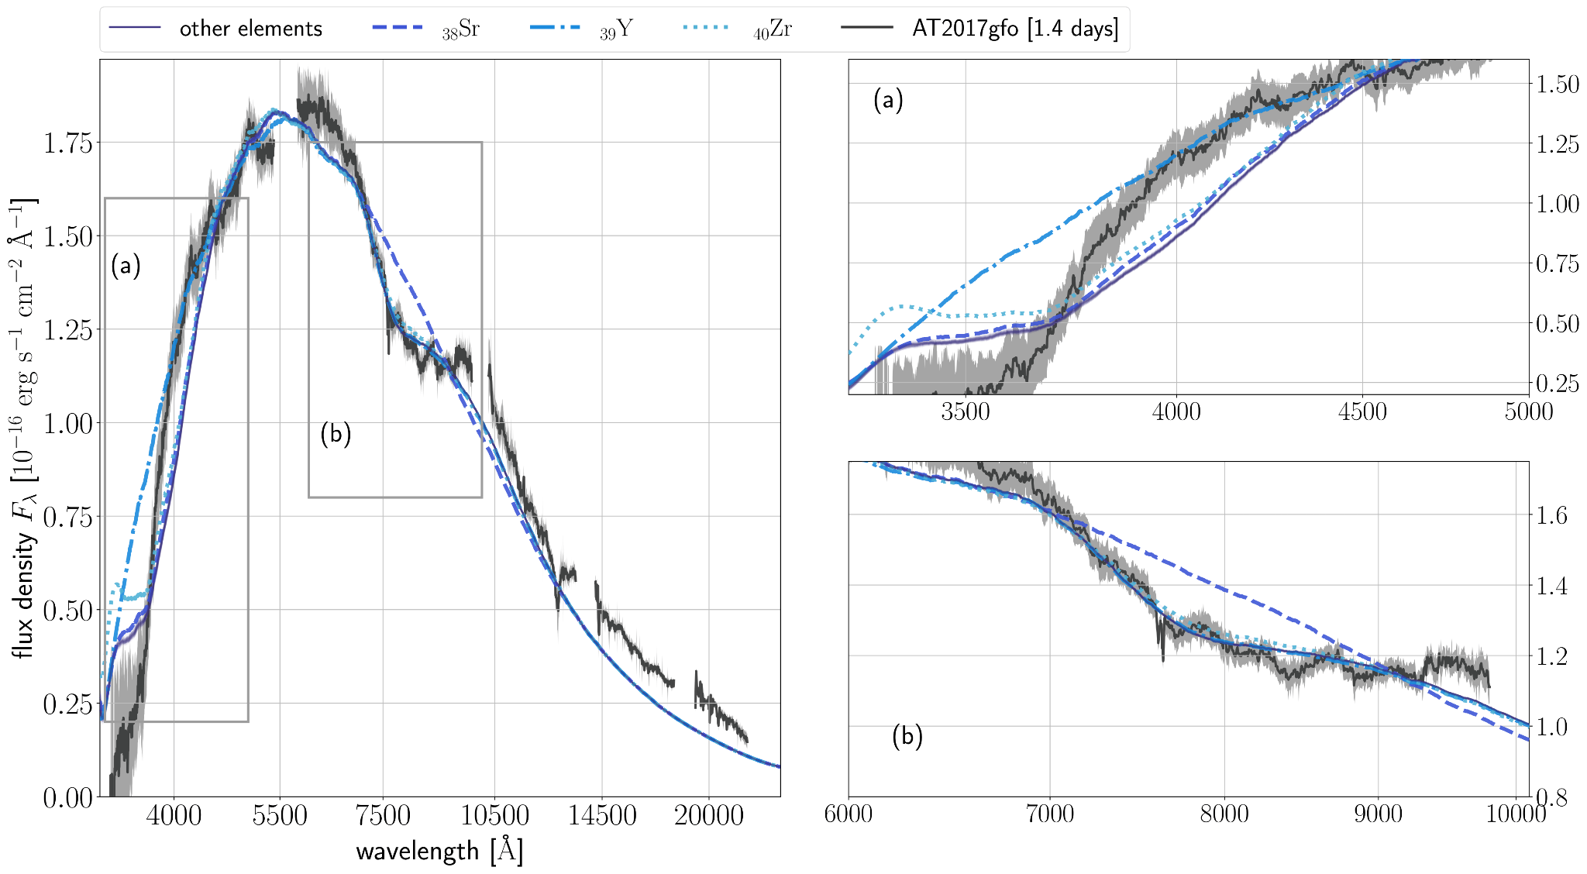
Blue+hot: leave-one-out spectra
Vieira+23

Slide 49
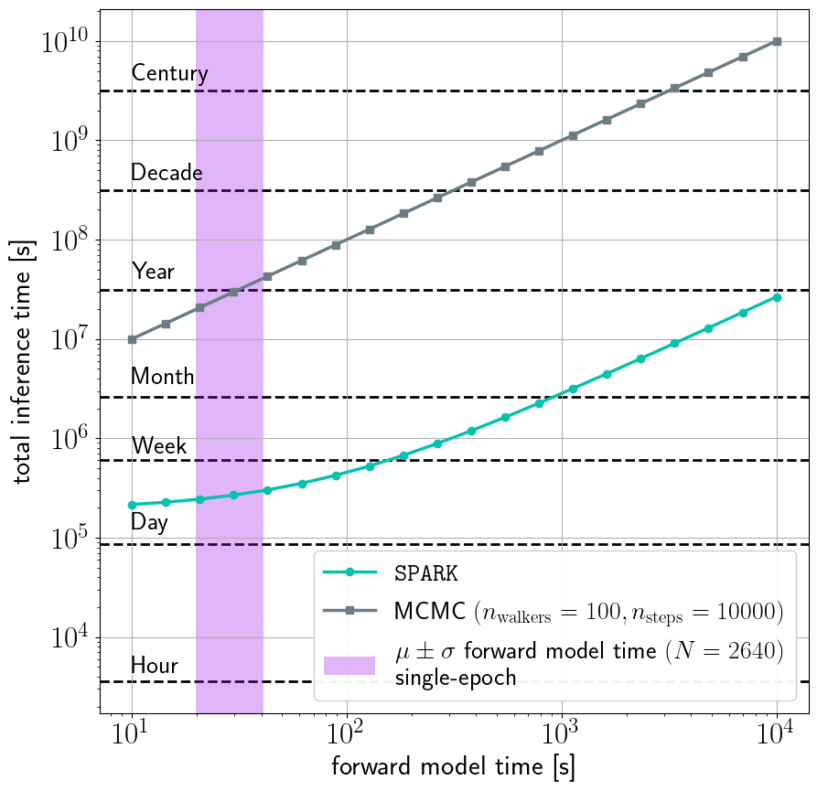
Inference is now computationally tractable
Purple band: forward model evaluation time
Typical MCMC would take a year
SPARK: less than a week!
As our model develops in complexity, the purple band will move to the right.
Vieira+23

Slide 50
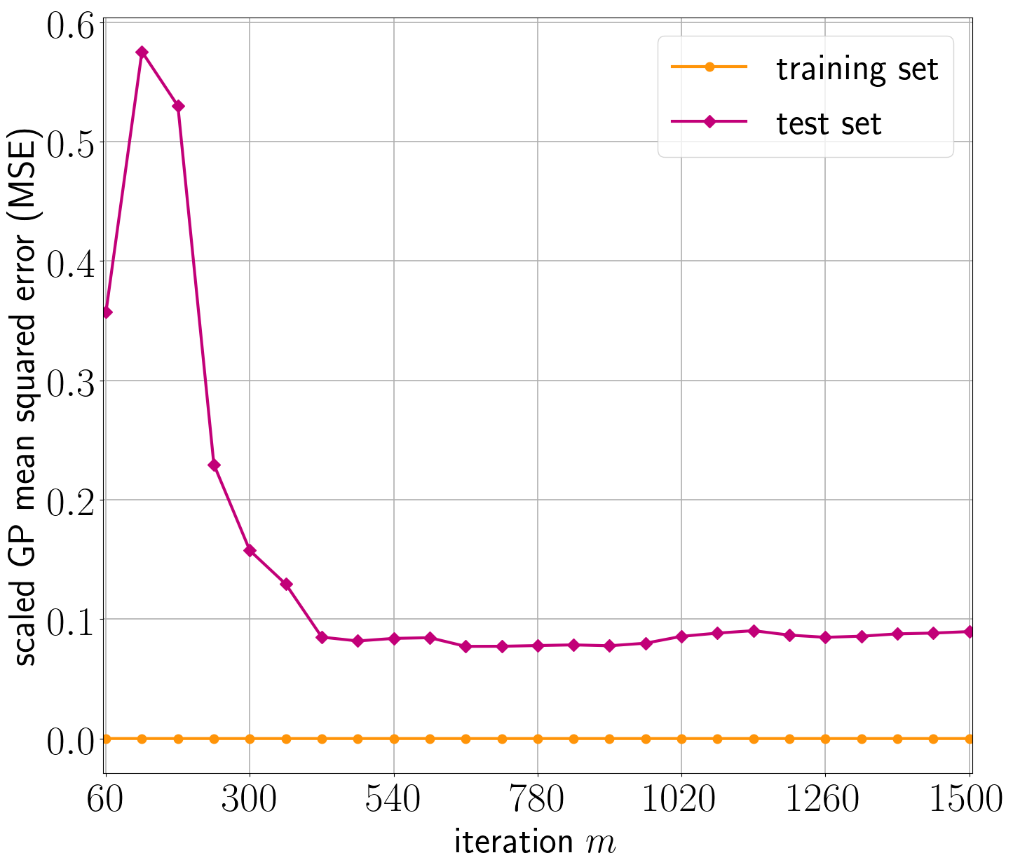
Test set error convergence
Vieira+23

Slide 51
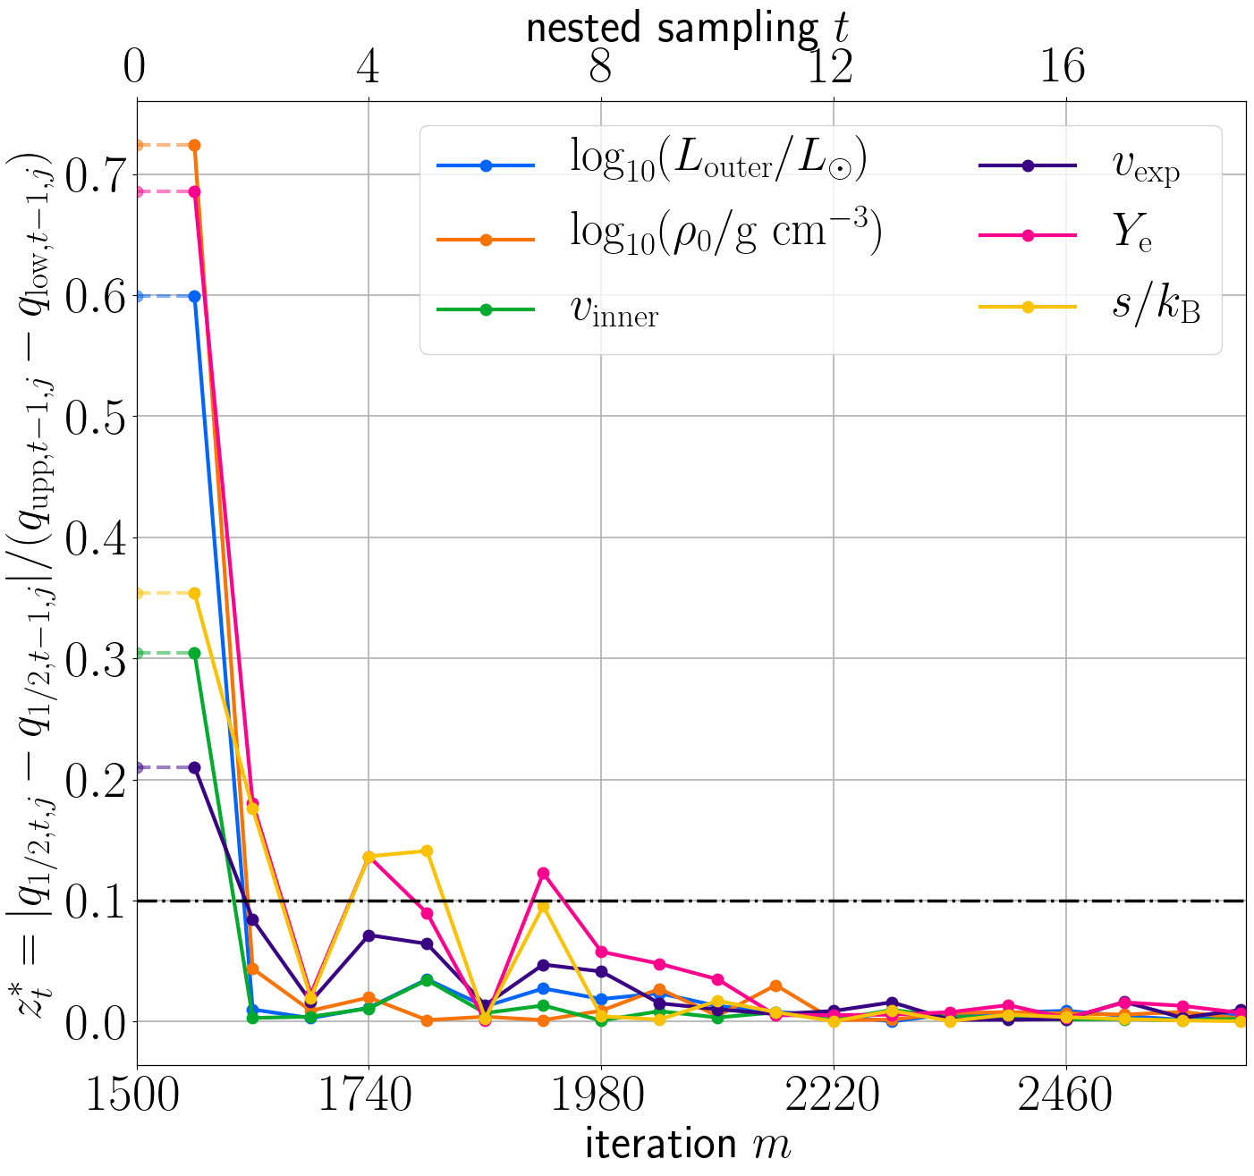
z convergence diagnostic
Vieira+23

Slide 52
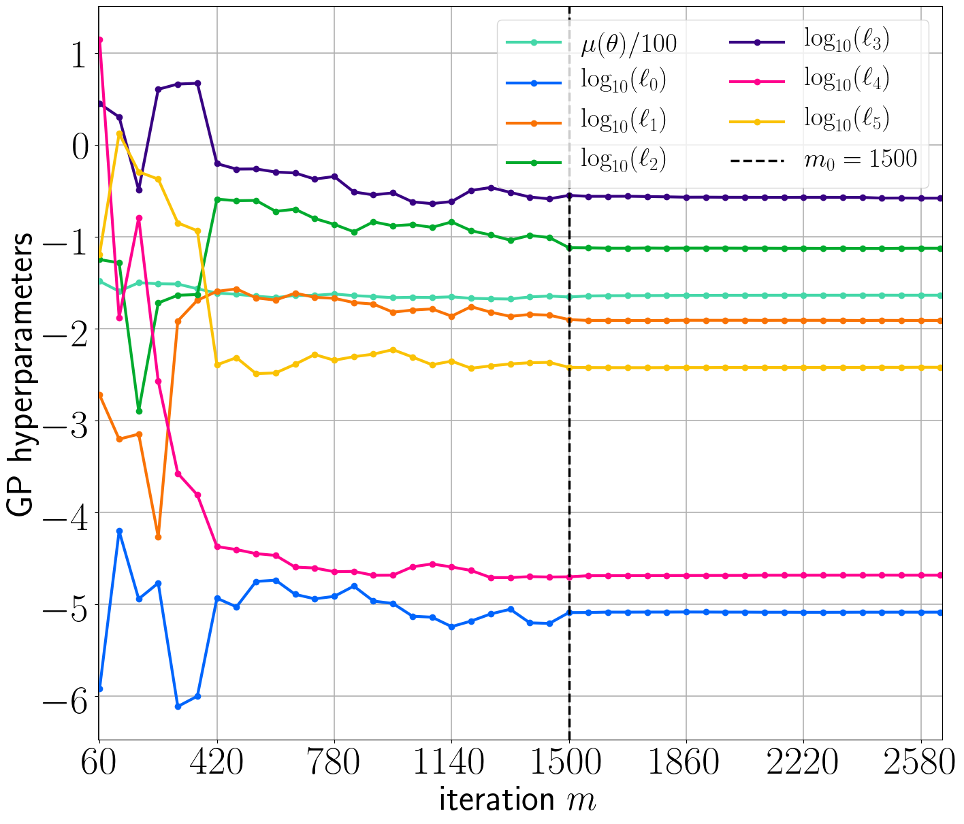
Gaussian process hyperparameter convergence
Vieira+23

Slide 53
Nested sampling of the GP
Why nested sampling and not just an MCMC?
Nested sampling is better at capturing multi-modal distributions; we do not know a priori that our posterior will be simple or unimodal
Nested sampling is better at capturing the tails of distributions

Slide 54
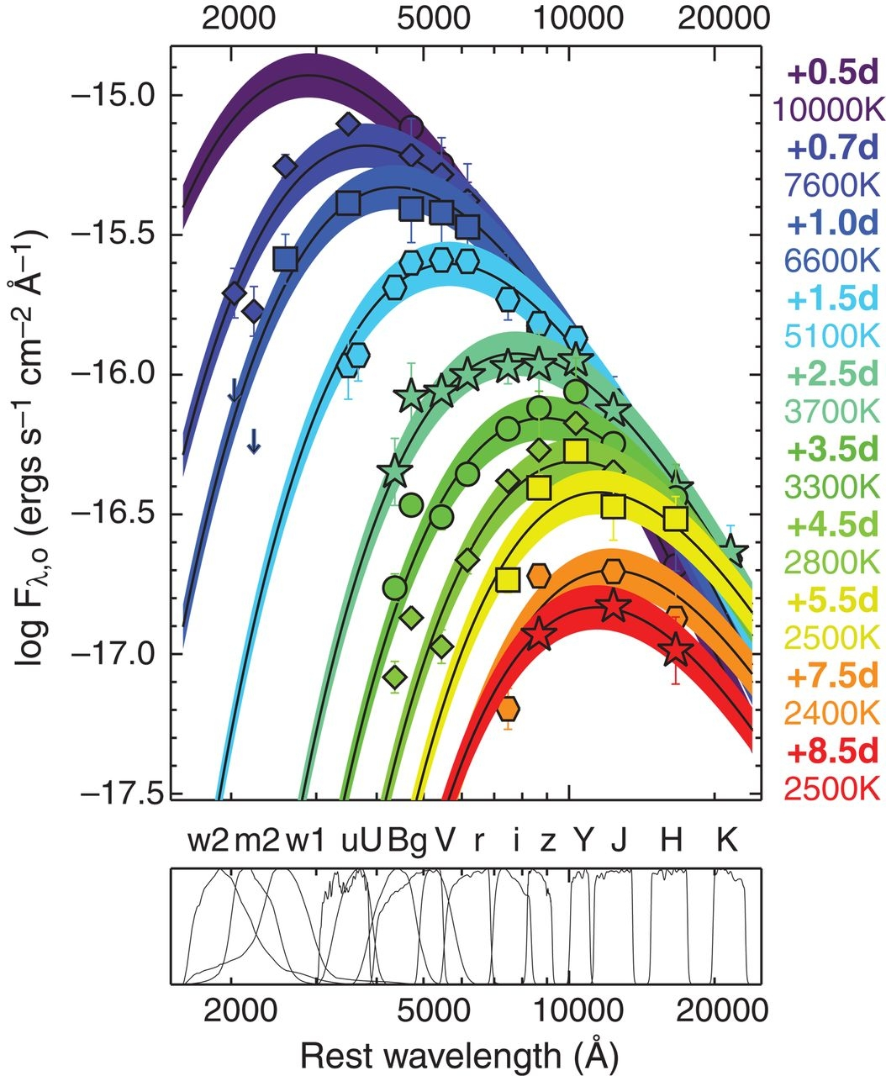
GW170817 evolution
Villar+17
Drout+17

Slide 55
Collapsars
Siegel+19

Slide 56
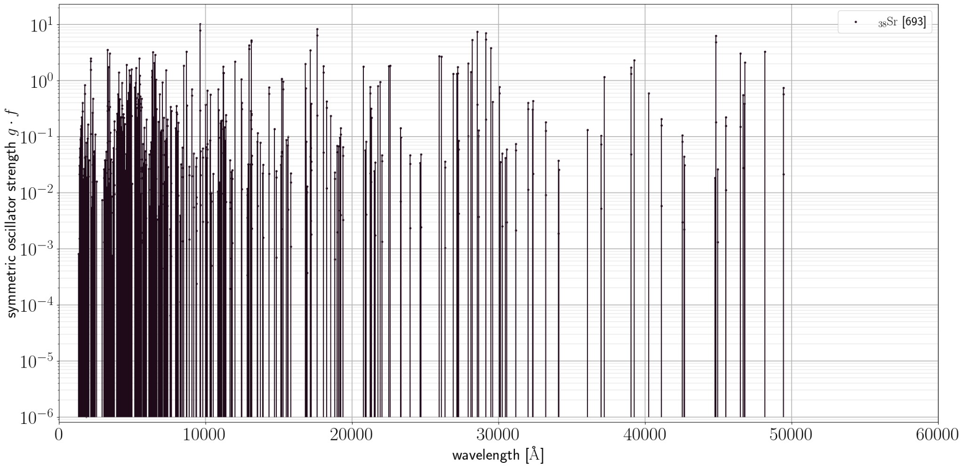
₃₈Strontium
Vieira et al
Lines from Vienna Atomic Line Database

Slide 57
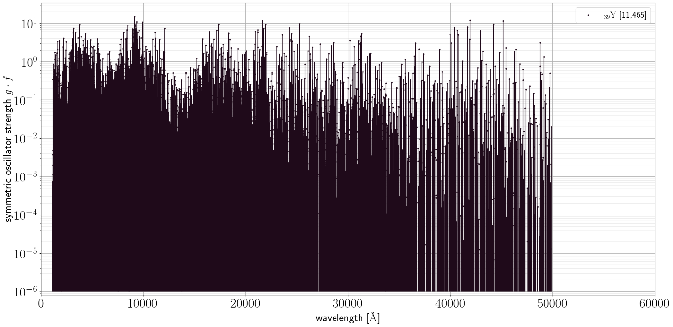
₃₉Yttrium
Vieira et al
Lines from Vienna Atomic Line Database

Slide 58
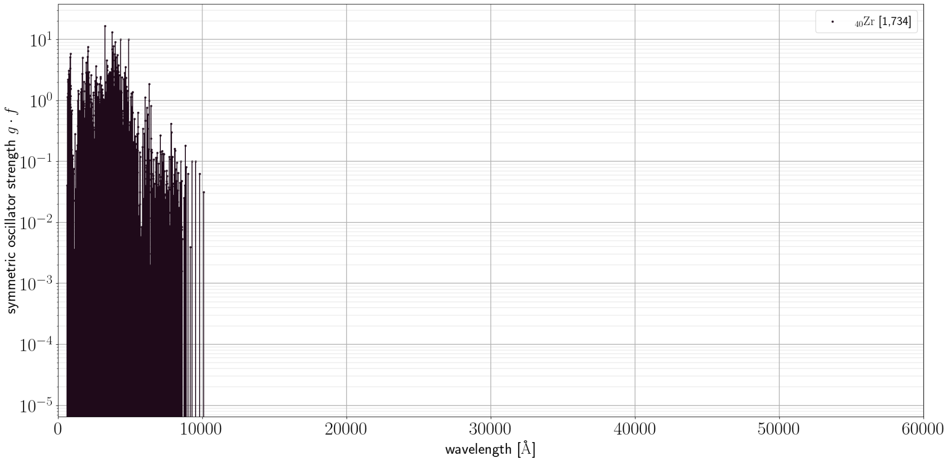
₄₀Zirconium
Vieira et al
Lines from Vienna Atomic Line Database

Slide 59
Bayesian inference
likelihood of data given model and parameters
prior probability of model and parameters
posterior probability of parameters and model given data
normalization term, model evidence

Slide 60
Neutron (or proton) captures & photodissociation

Slide 61
Radioactive decays
alpha
beta-minus
beta-plus
gamma

Slide 62
Neutronization / protonization via neutrinos

Slide 63
Sobolev approximation & expansion opacity

Slide 64
Multi-component effects
Kawaguchi+20

Slide 65
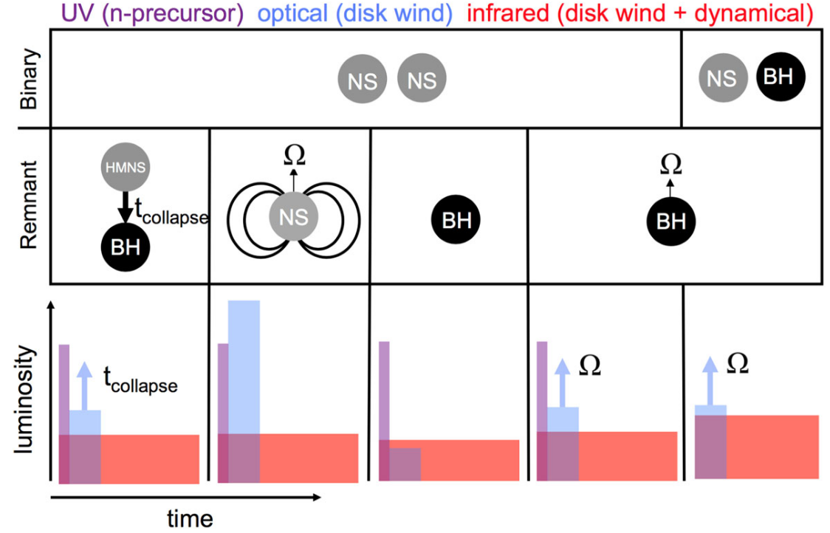
Merger outcomes
Metzger 19

Slide 66
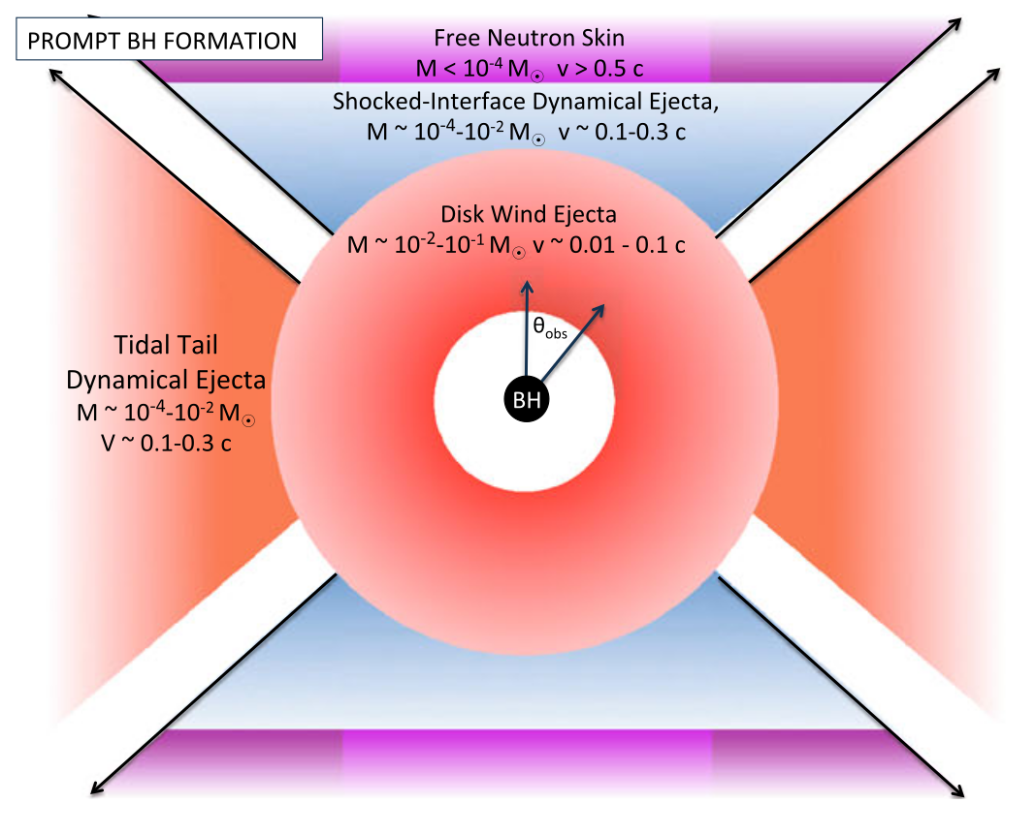
Ejecta
components
Metzger 19

Slide 67
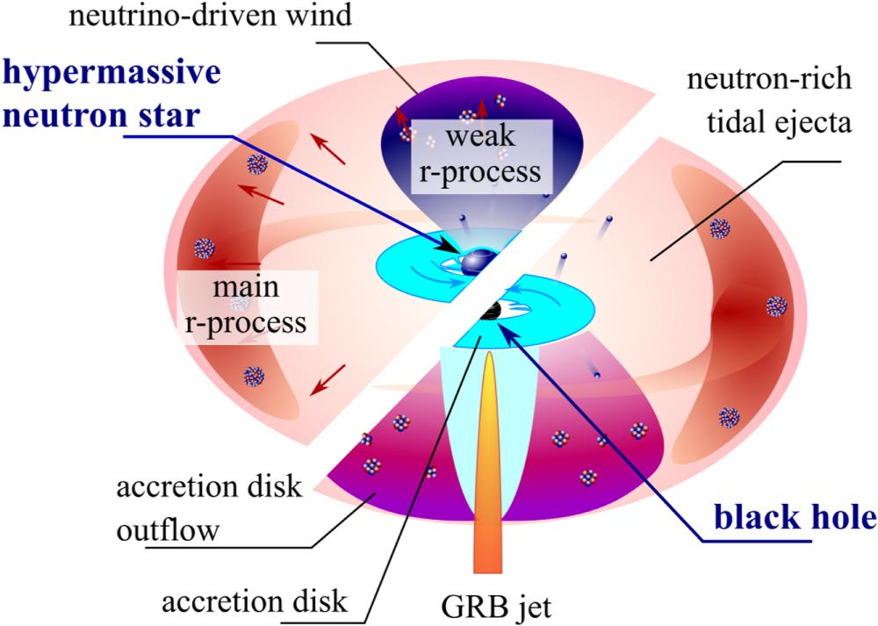
Axisymmetric kilonovae
Korobkin+21

Slide 68
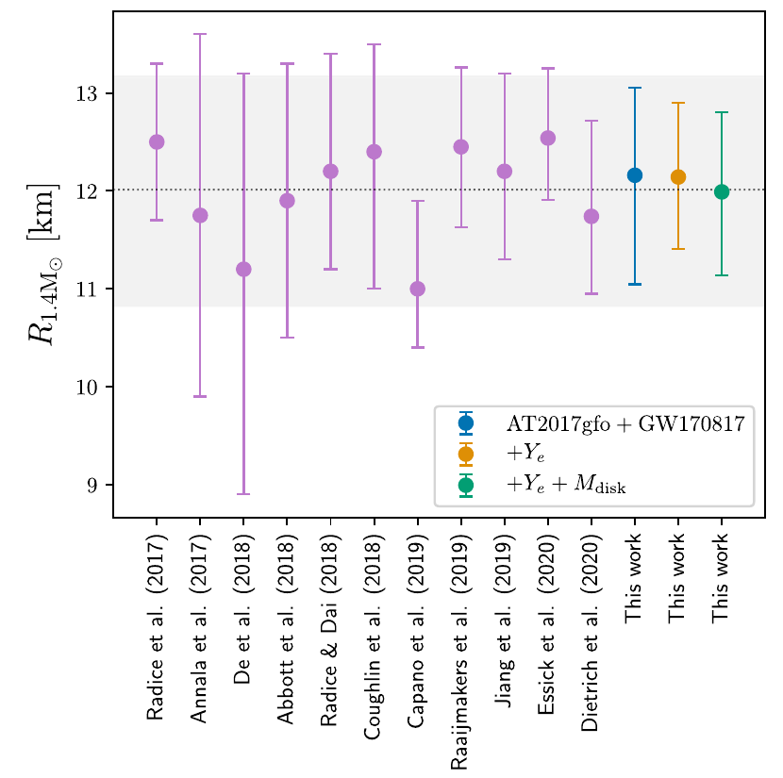
Inferring the neutron star radius
Breschi+21 & references therein

Slide 69
More events to come
BNS VT = binary NS detection volume ⨉ network live time
Black: observed
Blue line+regions: median, 50%, 90% confidence intervals for Poisson fit
Abbott+21 (LVC O3 catalog)

Slide 71
LIGO + Virgo + KAGRA observing plans

Slide 72
Expansion opacities: first half of lanthanides (f-shell)
Vieira et al

Slide 73
Expansion opacities: second half of lanthanides (f-shell)
Vieira et al

Slide 74
Expansion opacities: 4d-shell
Vieira et al

Slide 75
Expansion opacities: 5d-shell
Vieira et al

