Slide 1
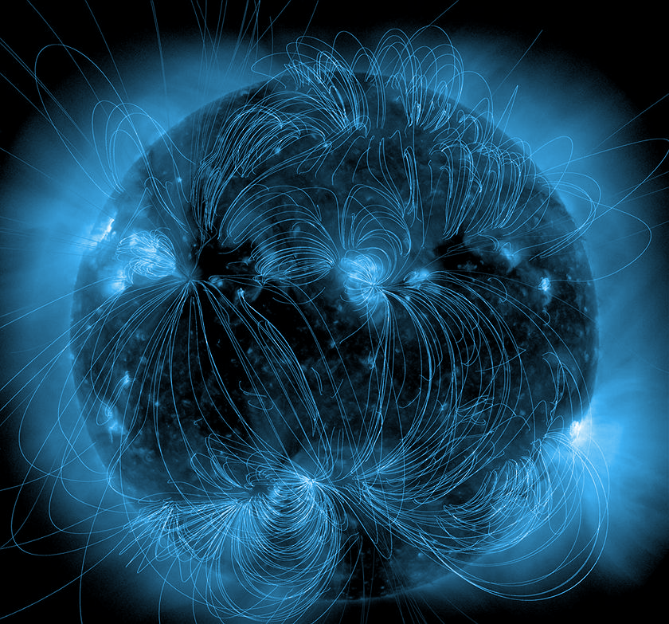
Flare forecasting through data assimilation in "sandpile" avalanche models
Christian Thibeault
Université de Montréal
CRAQ annual meeting - May 6th 2023
(NASA/SDO)

Slide 2
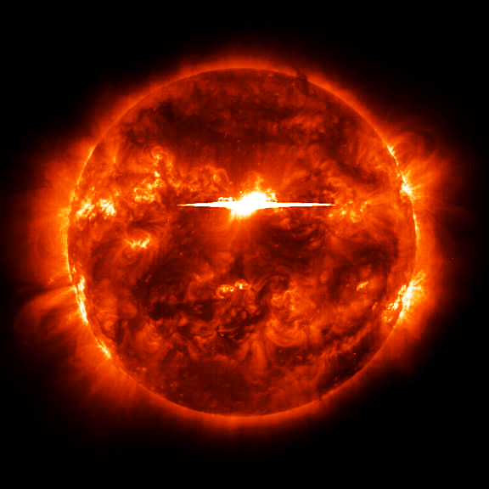
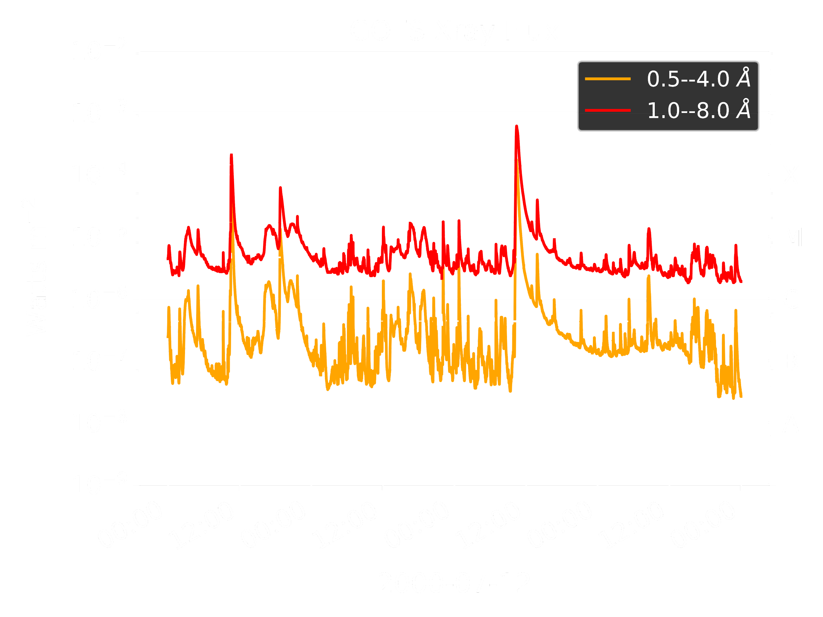
What are Solar Flares?
Solar Flare (class: X5)
NASA/SDO/Goddard

Slide 3
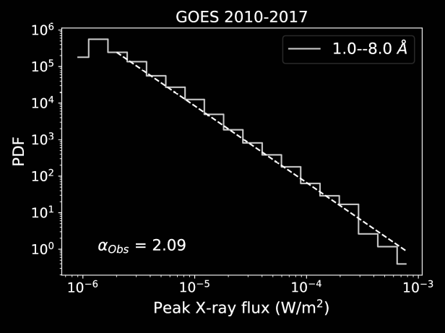
What are Solar Flares?
Solar Flare (class: X5)
NASA/SDO/Goddard

Slide 4
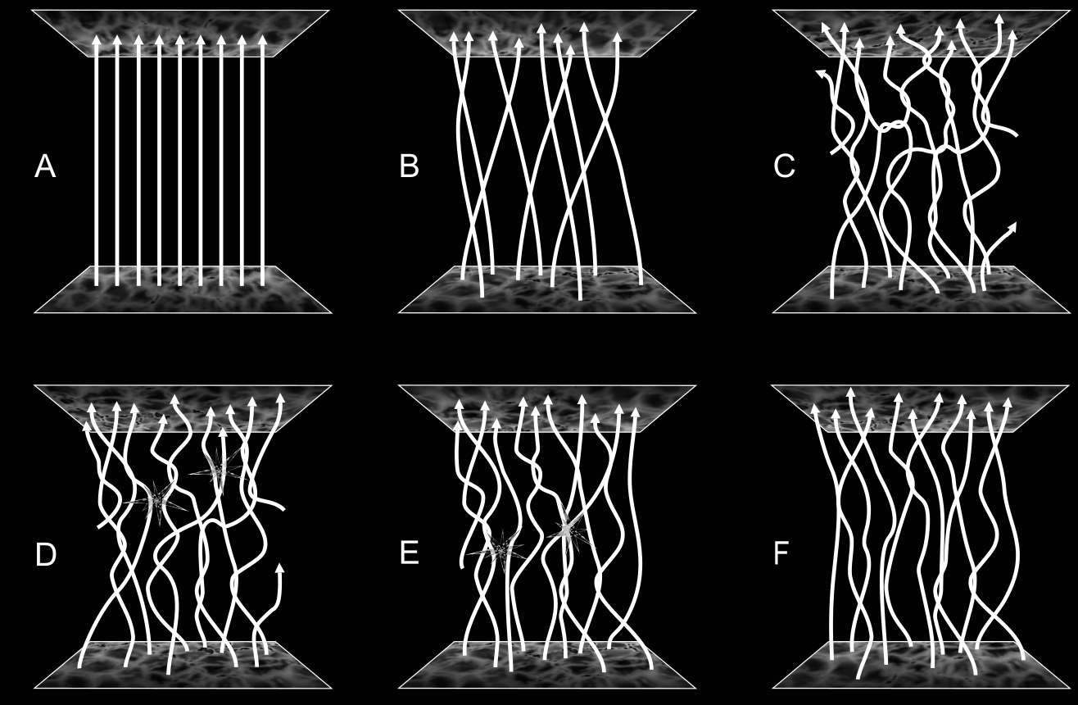
Parker nanoflare model

Slide 5
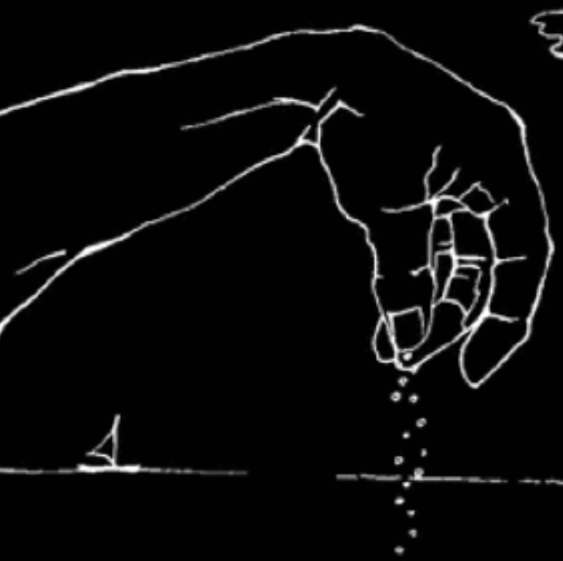
Sandpile Model of Solar Flares
Physical interpretation:
Nodes: Measure of the local magnetic “twist” on a coronal loop
Coronal Loop
‘’Sandpile model’’
Coronal Loop
Footpoint
Footpoint
Photosphere
Y
X
X
Y
Photosphere
Y
Footpoint

Slide 6
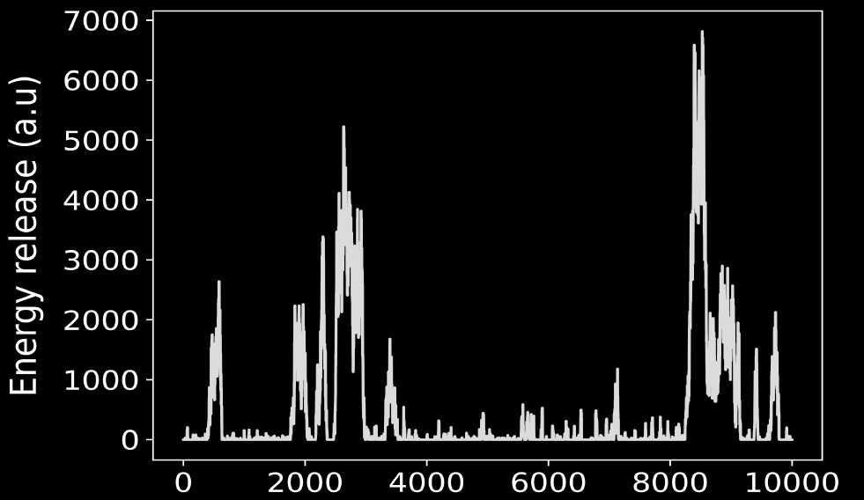
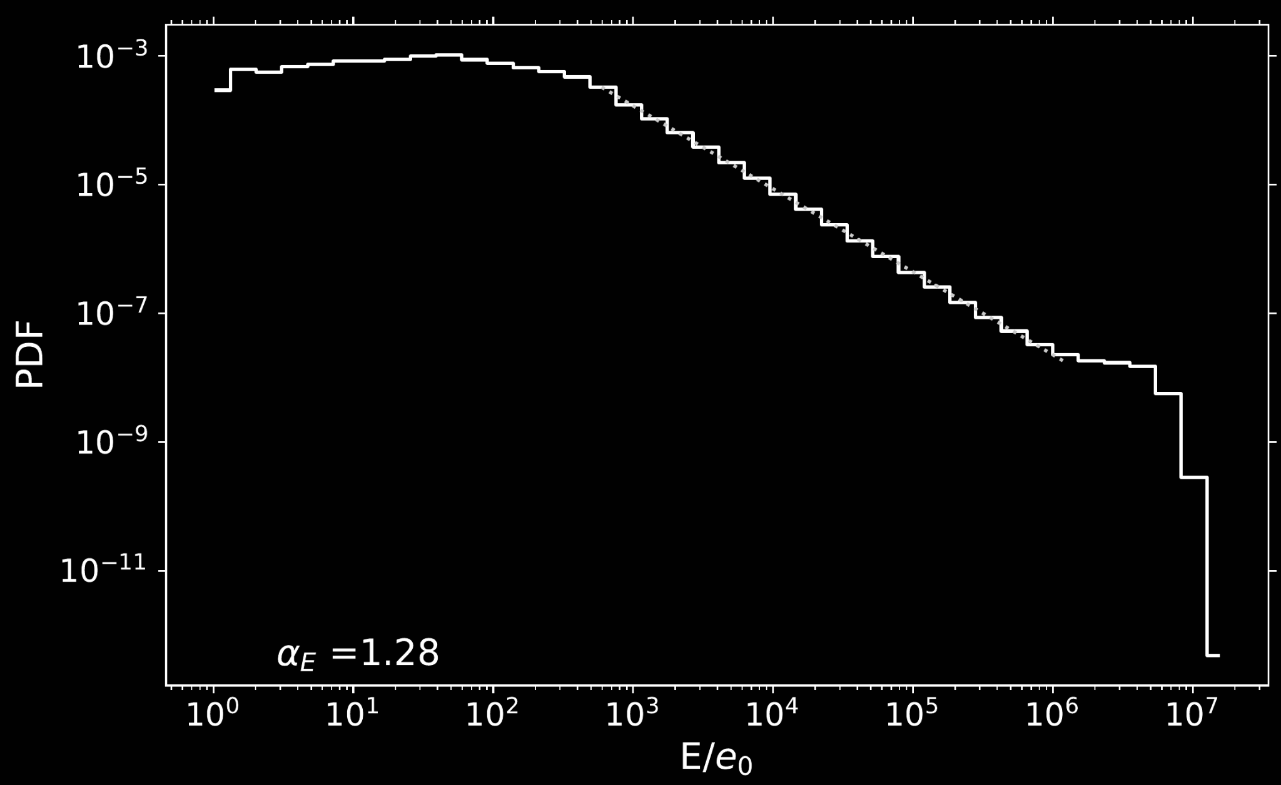
Sandpile Model of Solar Flares
Physical interpretation:
Nodes: Measure of the local magnetic “twist” on a coronal loop
Coronal Loop
‘’Sandpile model’’
Coronal Loop
Footpoint
Footpoint
Photosphere
Y
X
X
Y
Photosphere
Y
Footpoint

Slide 7
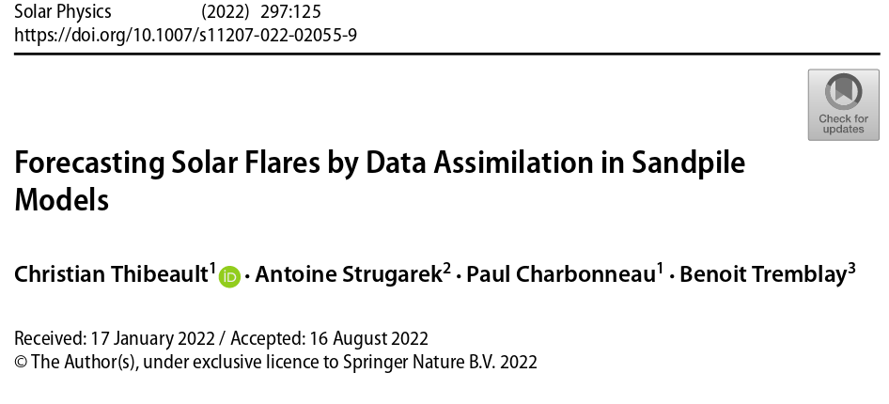

Slide 8
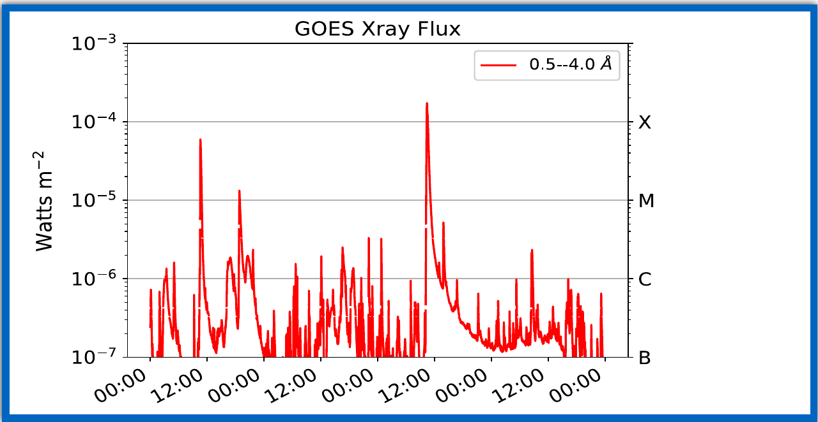
Data assimilation
Observations
Observations

Slide 9
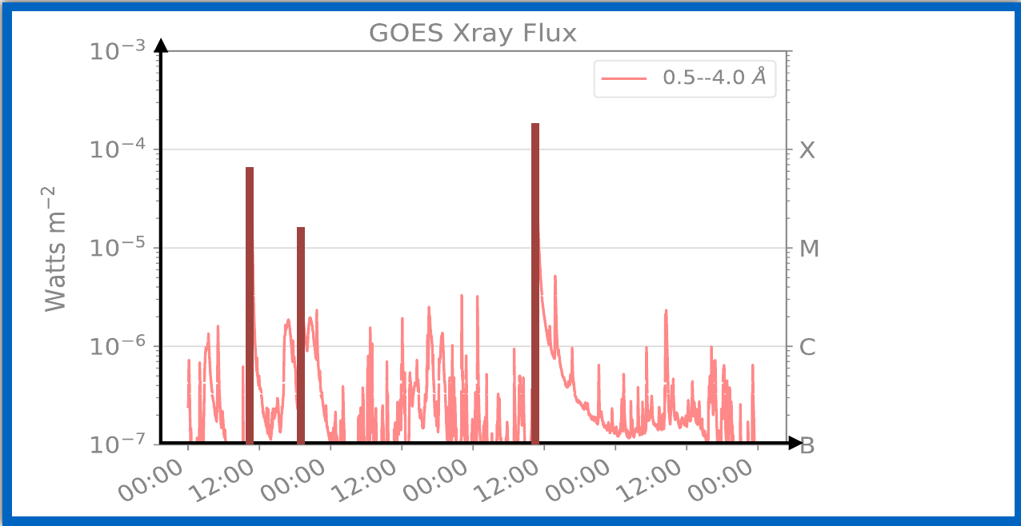
Data assimilation
Observations
Observations

Slide 10
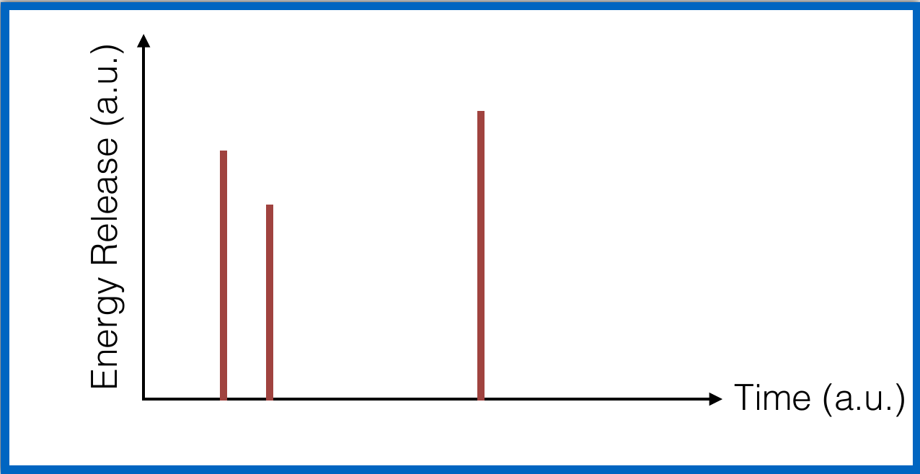
Data assimilation
Observations
Observations

Slide 11
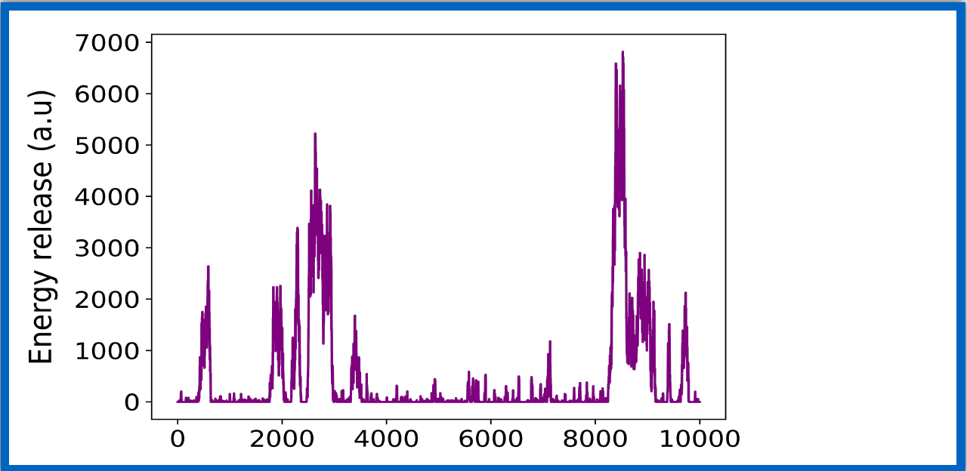
Data assimilation
Observations
Observations
Sandpile
model
Sandpile
model

Slide 12
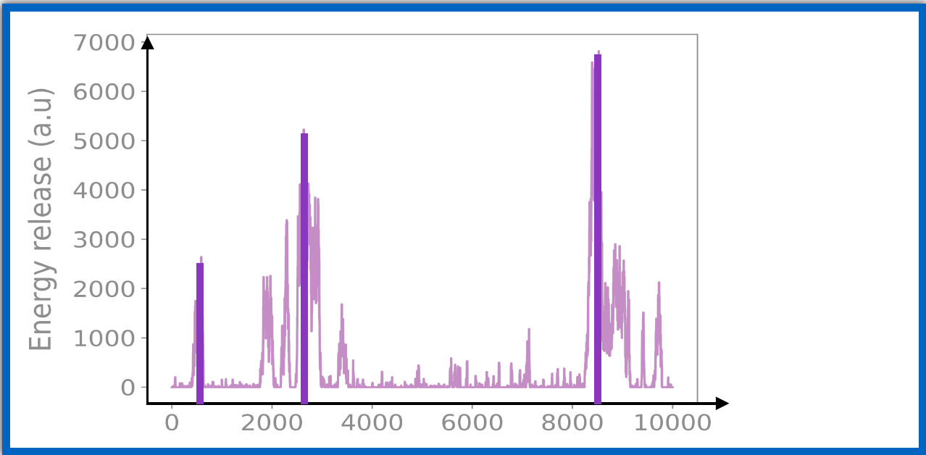
Data assimilation
Observations
Observations
Sandpile
model
Sandpile
model

Slide 13
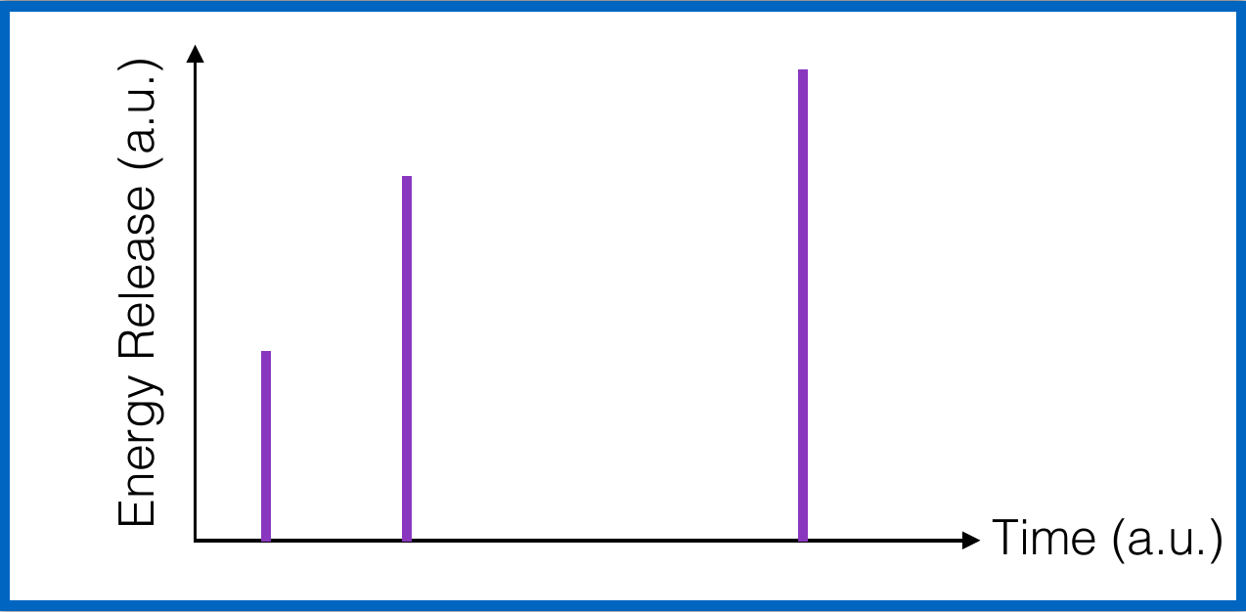
Data assimilation
Observations
Observations
Sandpile
model
Sandpile
model

Slide 14
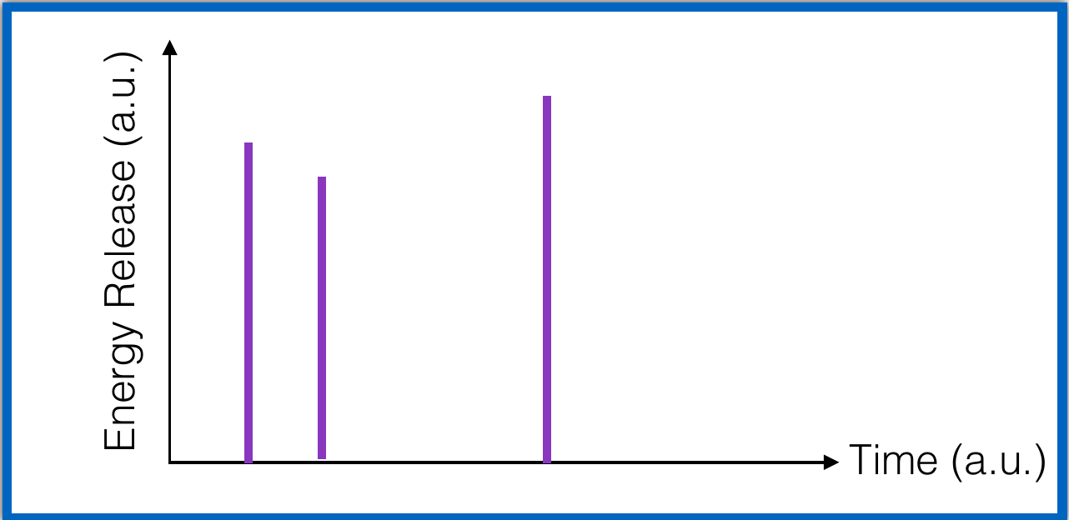
Data assimilation
Observations
Observations
Fit model to observations
Sandpile
model
Sandpile
model

Slide 15
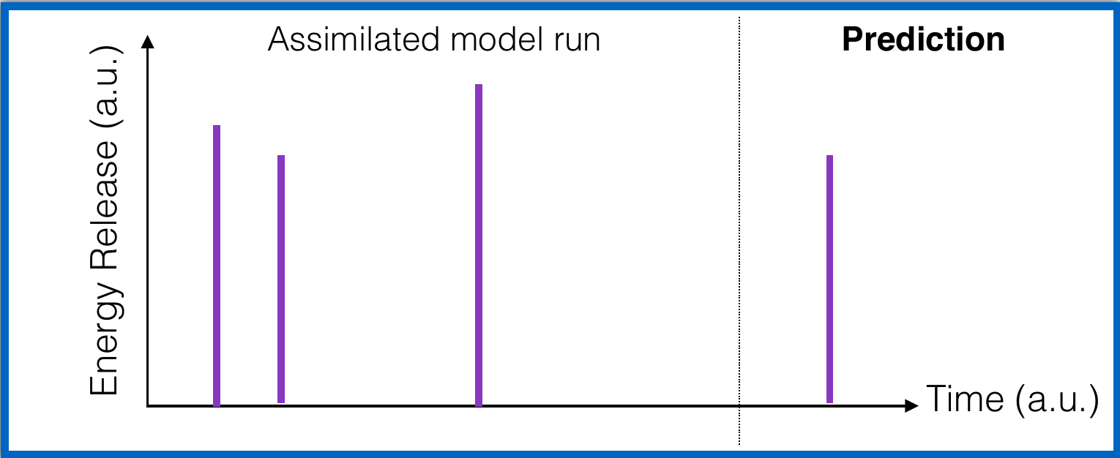
Data assimilation
Observations
Observations
Sandpile
model
Sandpile
model

Slide 16
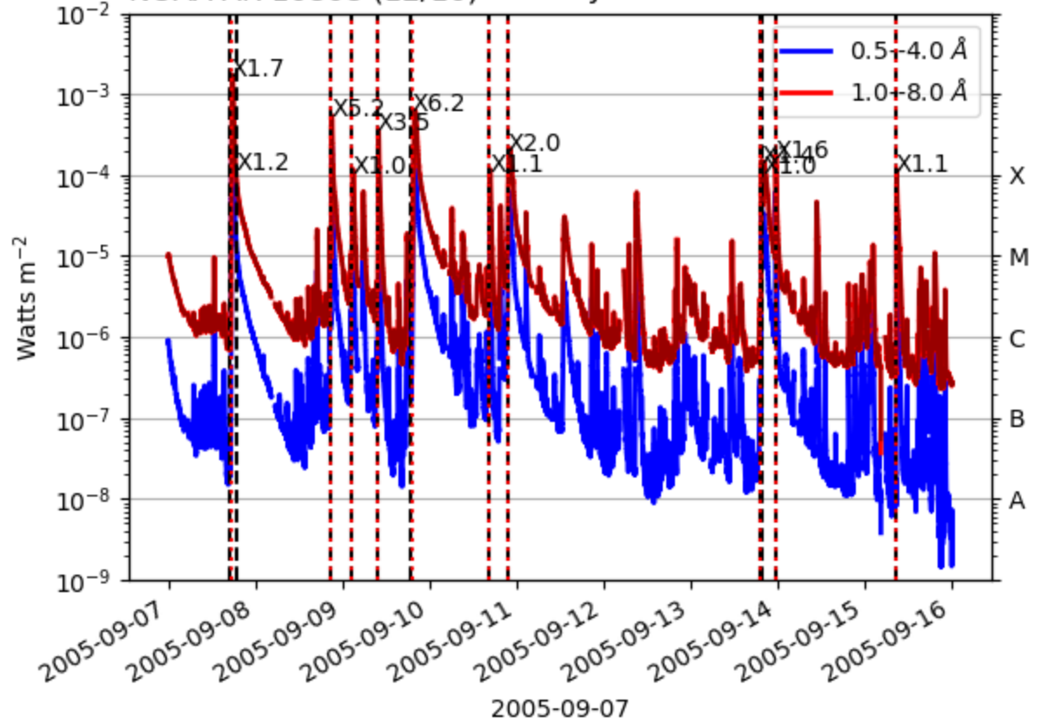
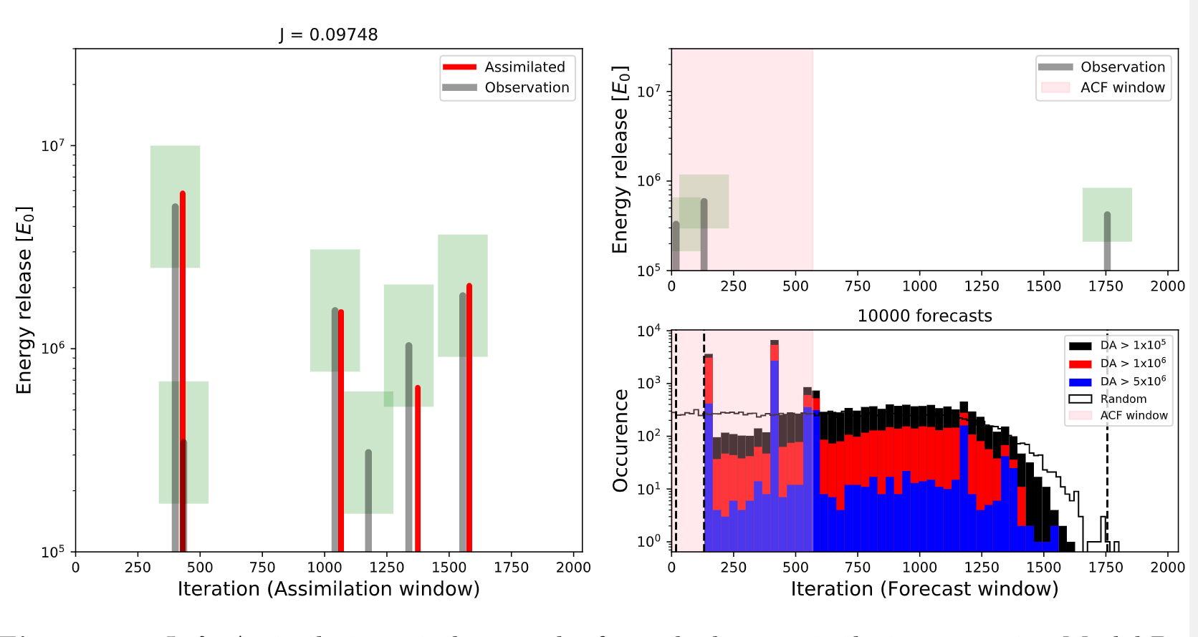
X11.7
X2.0
X1.0
X5.7
X6.2
X1.0
X3.5
X1.2
X1.0
Thibeault et. al 2022

Slide 17
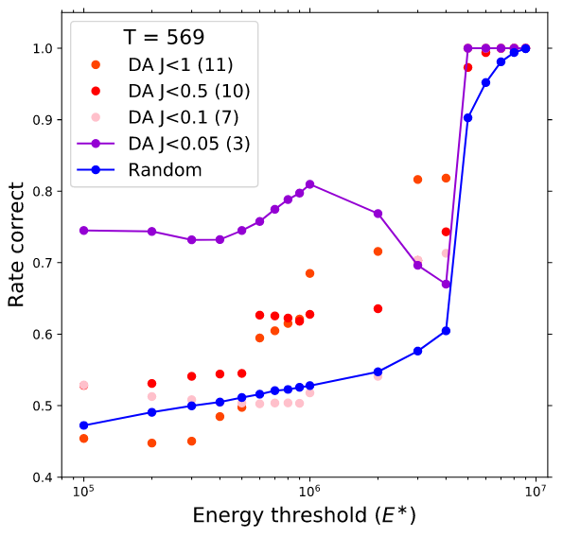
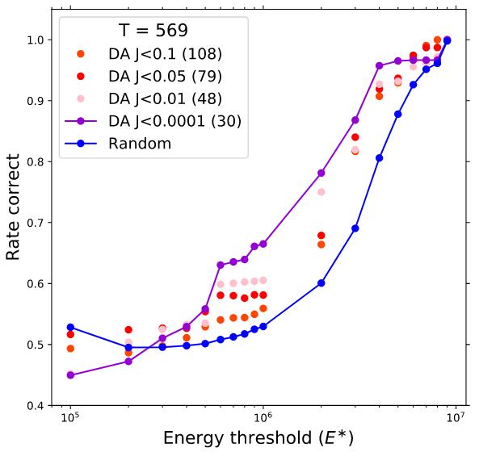
The quality of our forecast is increased with respect to a random ‘climatological’ forecast.
The quality of our forecast is increased with respect to a random ‘climatological’ forecast.
X1.2
X1.0
Thibeault et. al 2022

Slide 18
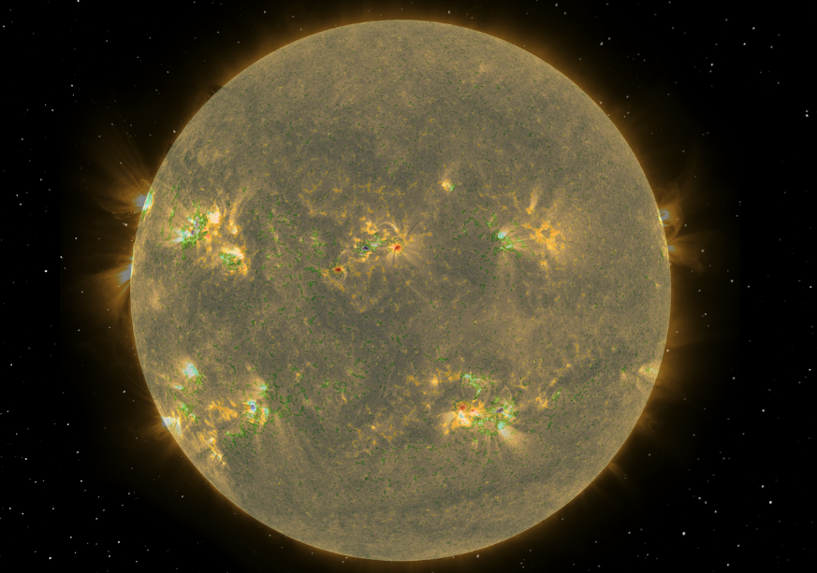
What next
Test on much larger datasets (more GOES times series)
Use machine learning to accelerate and/or replace the data assimilation step
Explore predictivity of other avalanche models for flares (and their parameters)
Expand assimilation to fit more than the initial condition (e.g. the rate of forcing)

Slide 19
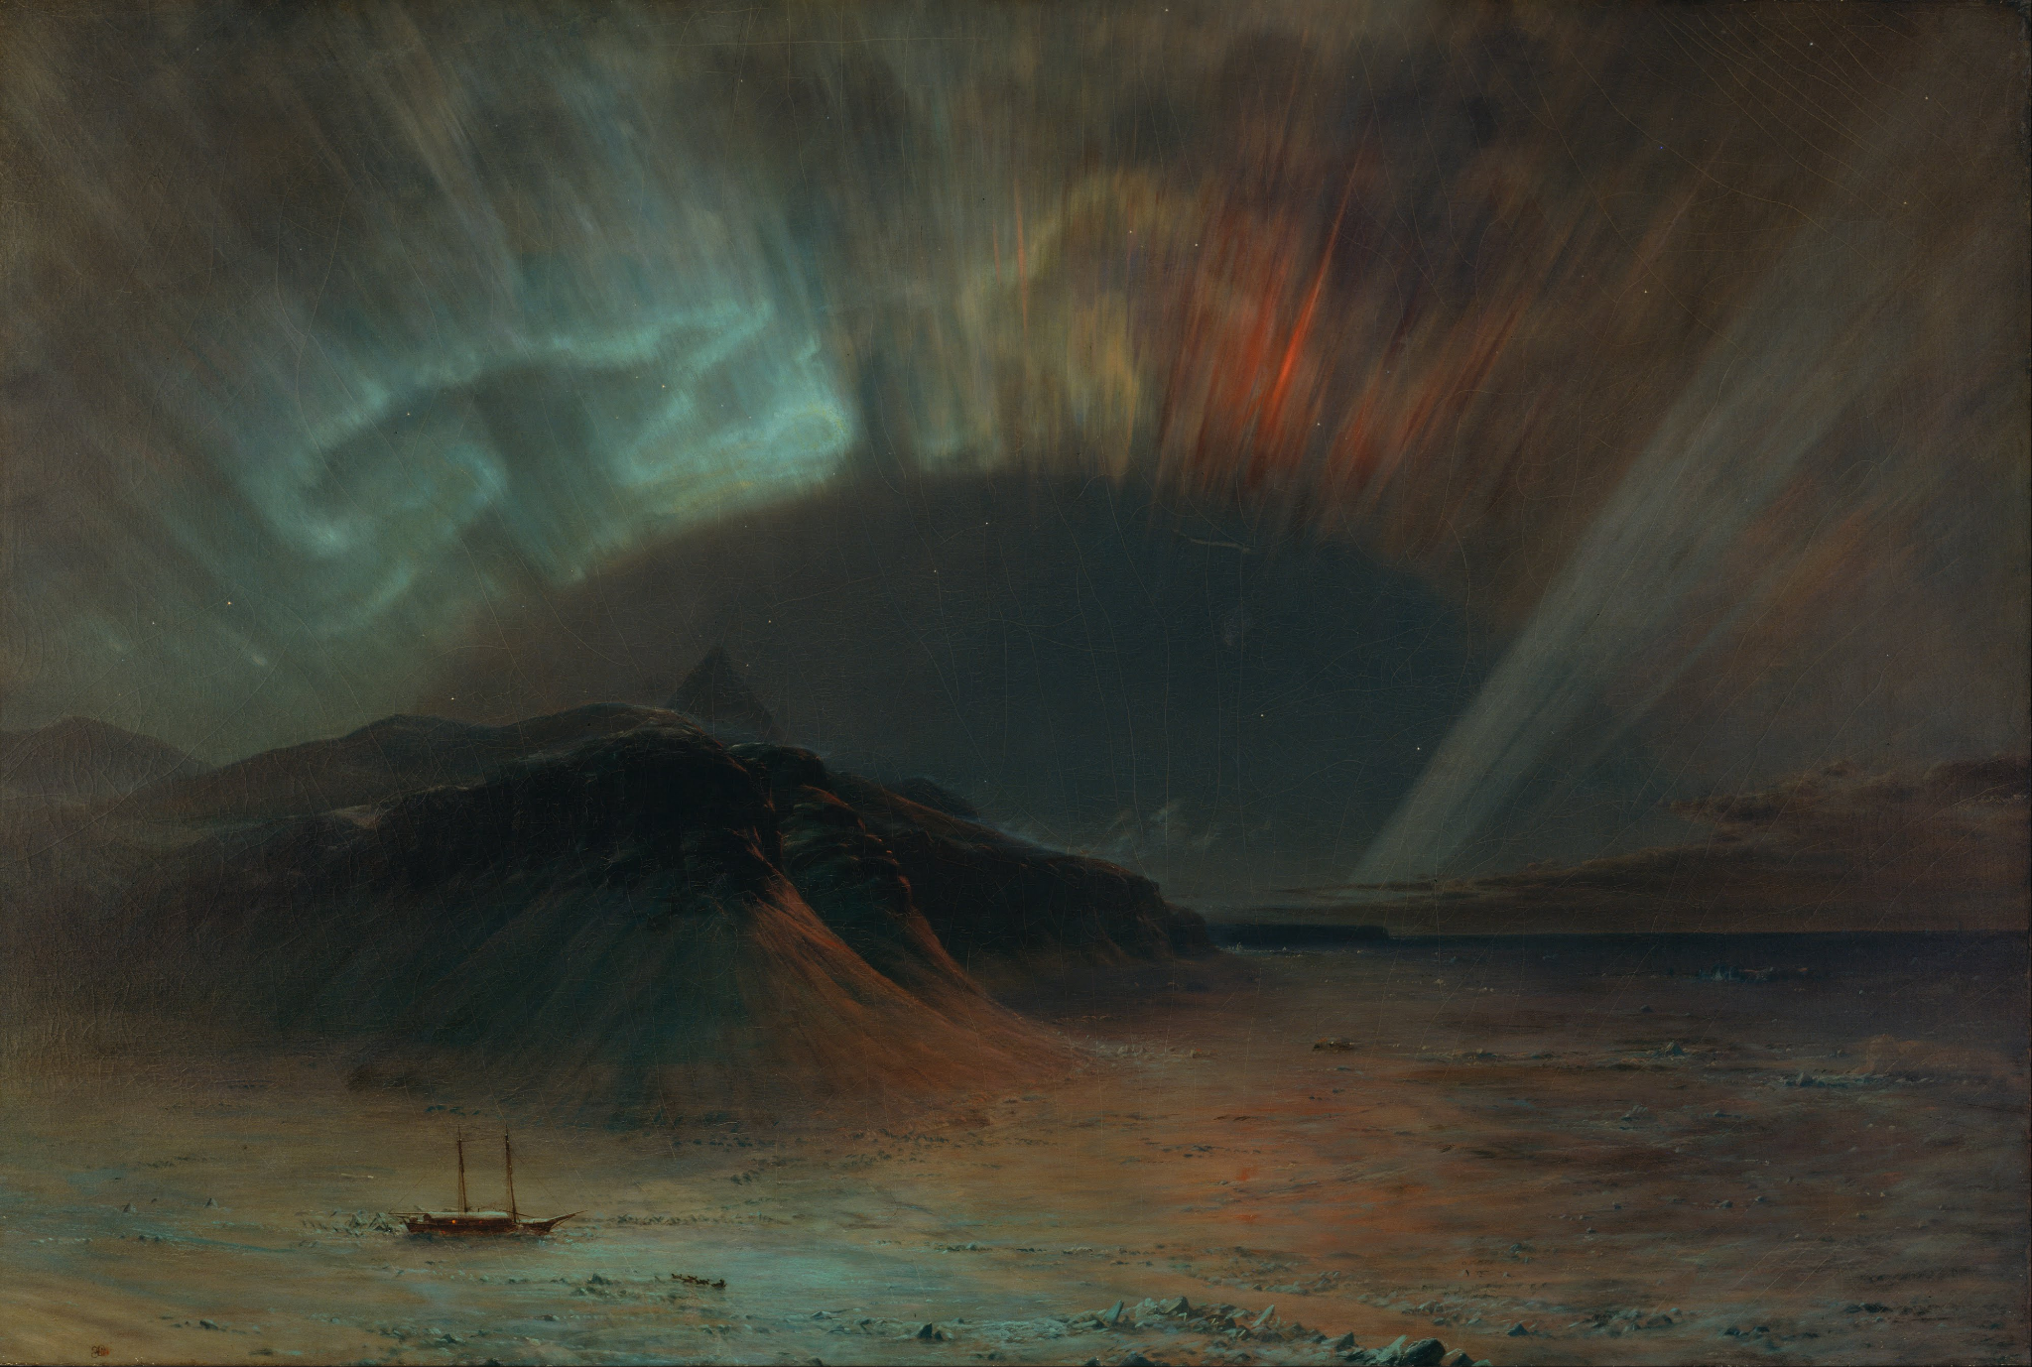
Thank you!
Frederic Edwin Church (1865) "Aurora Borealis"

Slide 21
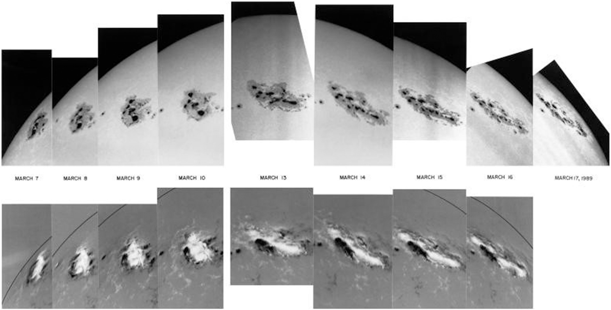
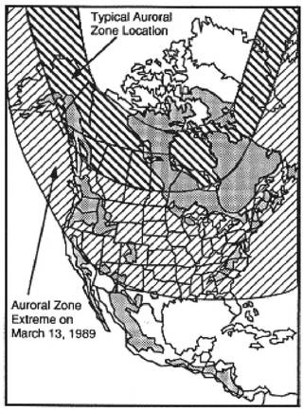
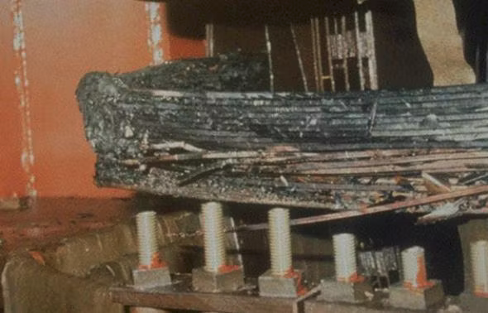
L’éruption solaire de 1989: Panne électrique au Québec pendant 9 heures
(D. H. Boteler 2019)
(NASA)
(American Geophysical Union)

