Slide 1
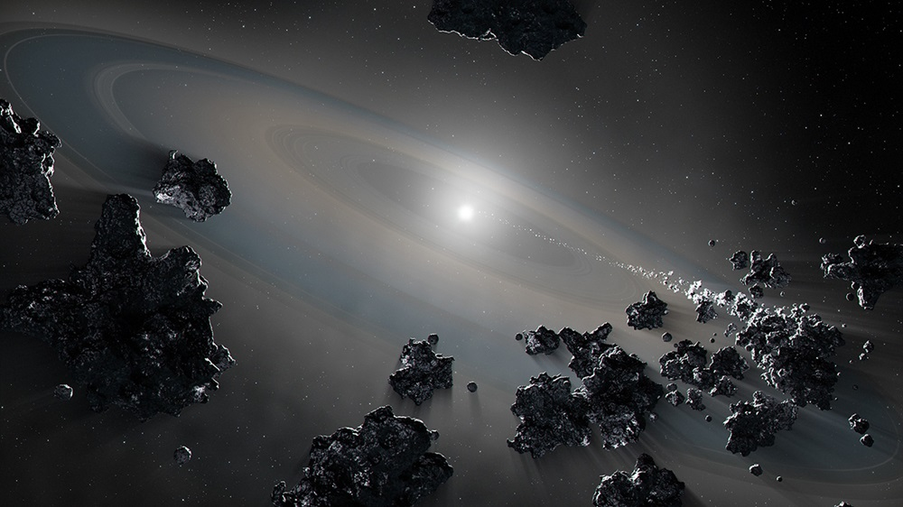


NASA, ESA, Joseph Olmsted (STScI)
Exploring remnant
exo-planetary material with
white dwarf
stars
Dr. Amy Steele
Postdoctoral Fellow
Trottier Institute at McGill
Supervisor: Prof Eve Lee
CRAQ Annual Meeting, 2023

Slide 2
Where we begin
After evolution of a sun-like star, we are left with a white dwarf (WD) that may or may not have leftover planets and disturbed asteroid belts
“Compositions are difficult to ascertain for exoplanets.”
– Caroline Piaulet, CRAQ 2023
What do we observe?
Notes:
Just to make sure we're all on the same page, white dwarfs are the endpoints of stellar evolution for most stars. When we study exoplanetary material around such an object, the planetary system has survived the these exciting stages.
What

Slide 3
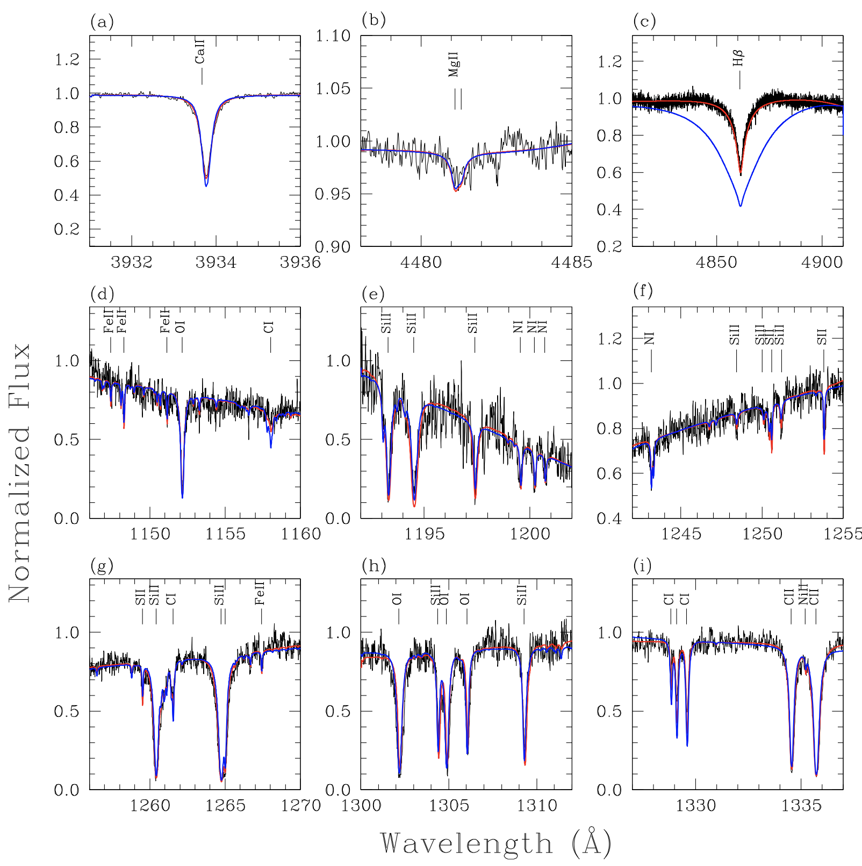
~45%
Comet-like pollution of JUST the photosphere
WD 1425+540
~2% nitrogen mass fraction comparable to that in comet Halley
Xu et al. 2017

Slide 4
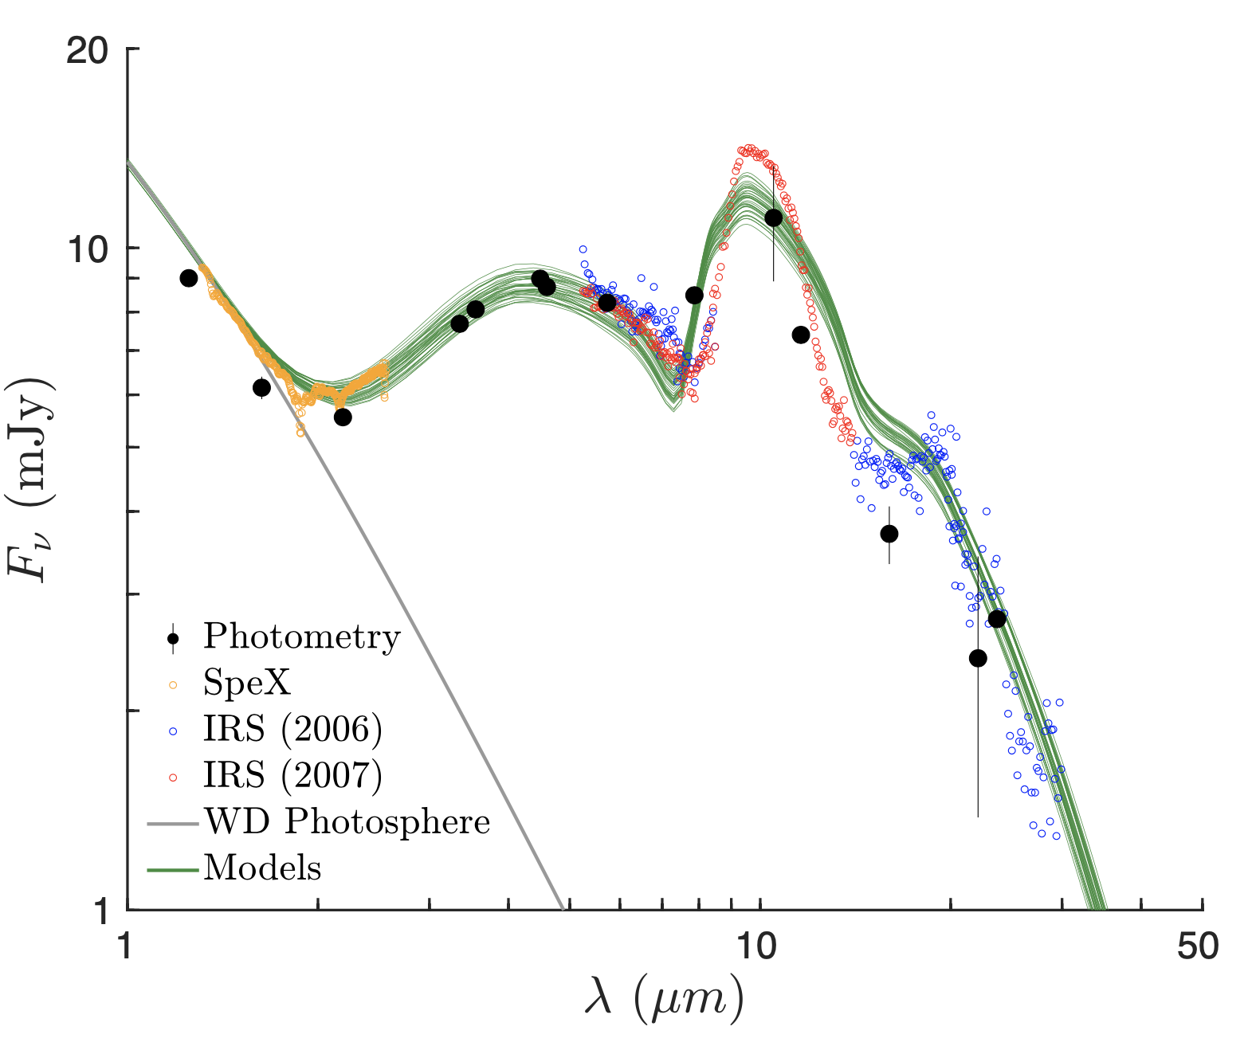
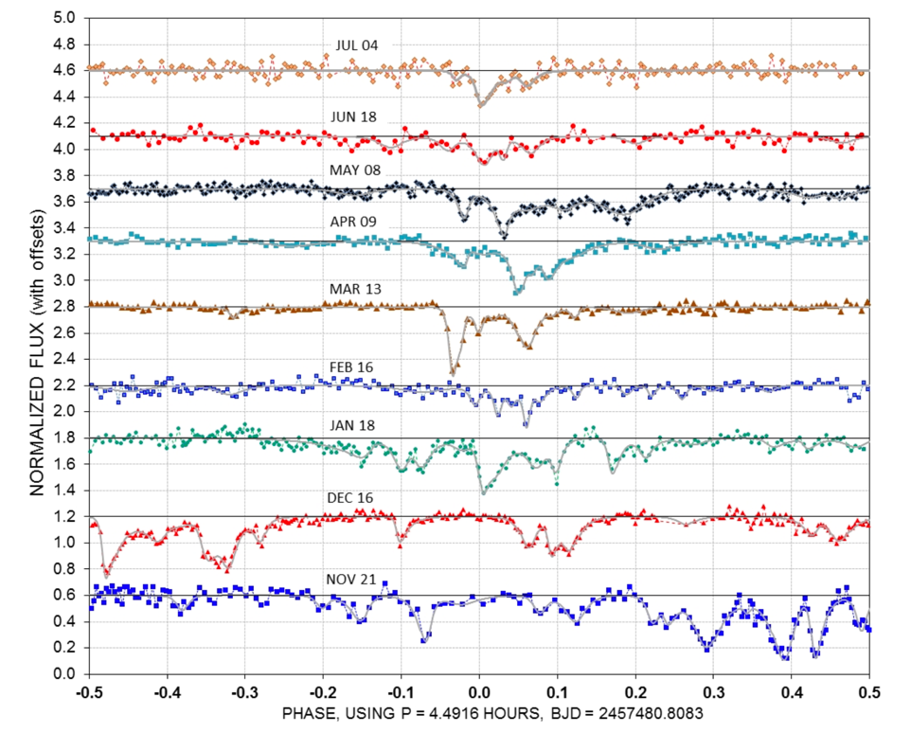
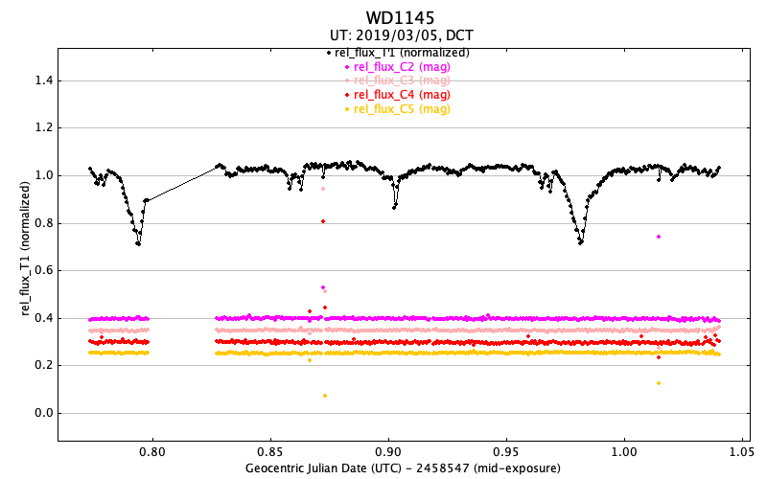
~1.5%
Thermal emission from dust or grains
Sizes of emitting material
~ 1 – 1000 micron
Ballering et al. 2022, G29-38
Notes:
[2] https://commons.wikimedia.org/wiki/File:Atomic_emission_spectrum_of_helium.svg

Slide 5
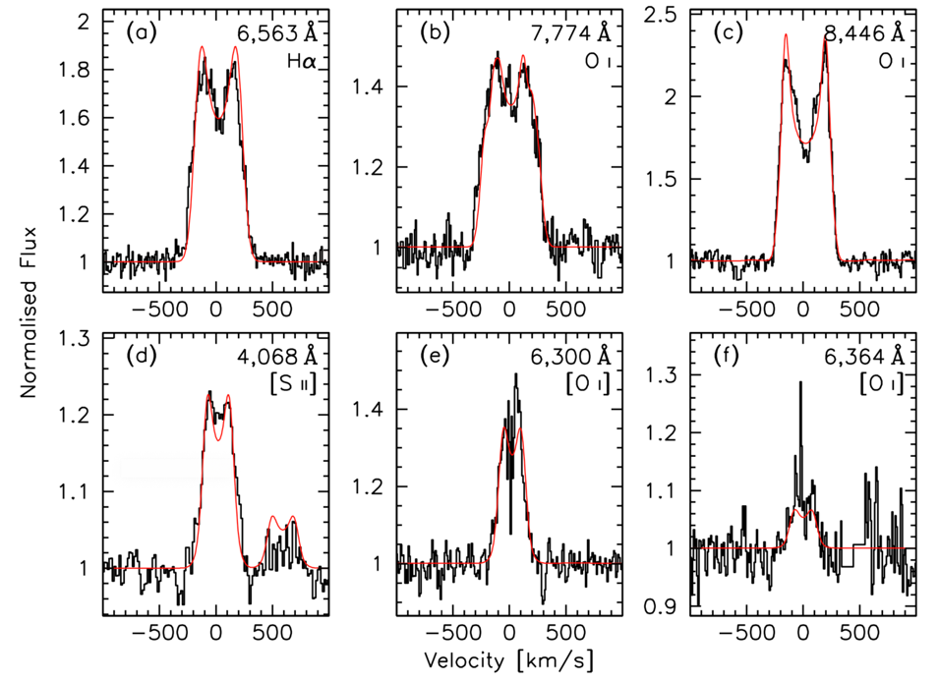
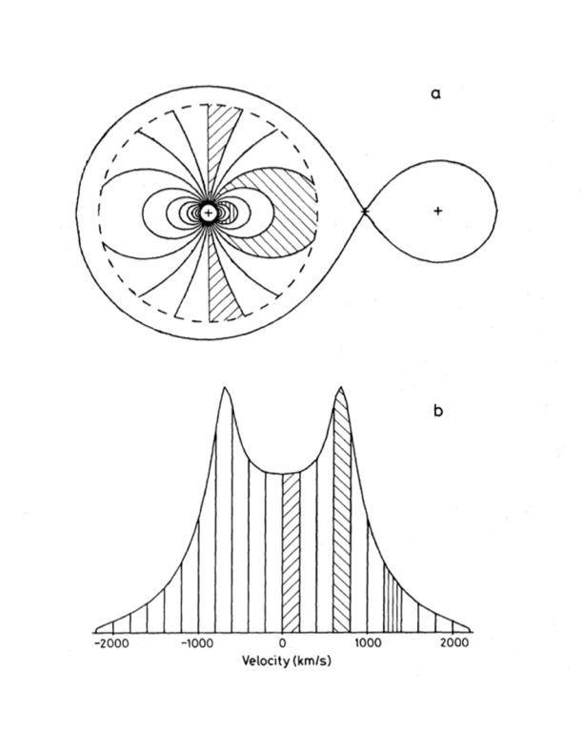
~0.1%
Gas disk viewed in emission
WD J0914+1914
WD consuming
a gas giant
Horne & Marsh, 1986
Gänsicke et al., 2019

Slide 6
<0.1%
Gas disk viewed in absorption
WD 1145+017
Asteroid-like pollution of BOTH the photosphere and a circumstellar disk
Observations from S. Xu and A. Steele

Slide 7
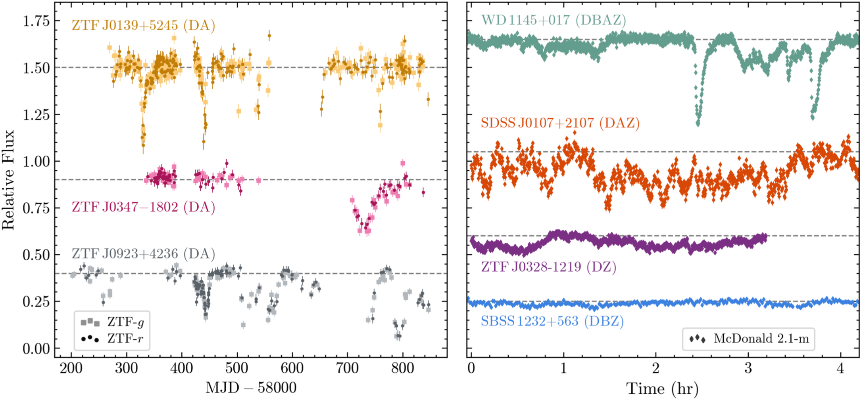
8
total with transits
Guidry et al. 2022

Slide 8
Side View
Dust
Planetesimal
Gas
Top View
Absorption, transits
Dust
Gas
WD
WD
Emission
Planetesimal
Observer
Front View
WHITE DWARF
Sample Geometry
Not to Scale!
Gas
Planetesimal
orbit
Picture borrowed from Siyi Xu+ 2019
and updated to include dust
Notes:
The object that has this small polluted white dwarf community excited, is WD1145+017.
WD1145 has a transiting, disintegrating planetesimal or asteroid.
Size of white dwarf shown in blue, the transiting body is outlined in white, with sublimating material shown in colors in blue and pink. The gas is accreting onto the surface in eccentric, precessing streams

Slide 9
WDs with unexpected metals in their photospheres = polluted WD
~45%
WD
Dust disks detected through infrared excess
Dust
~1.5%
WD
WDs with gas disks detected
through Keplerian emission
features (30)
~0.06%
Planetesimal
Absorption, transits
Dust
Gas
WD
Emission
WDs undergoing transits by captured, disintegrating exo-planet(esimal)s
8

Slide 10
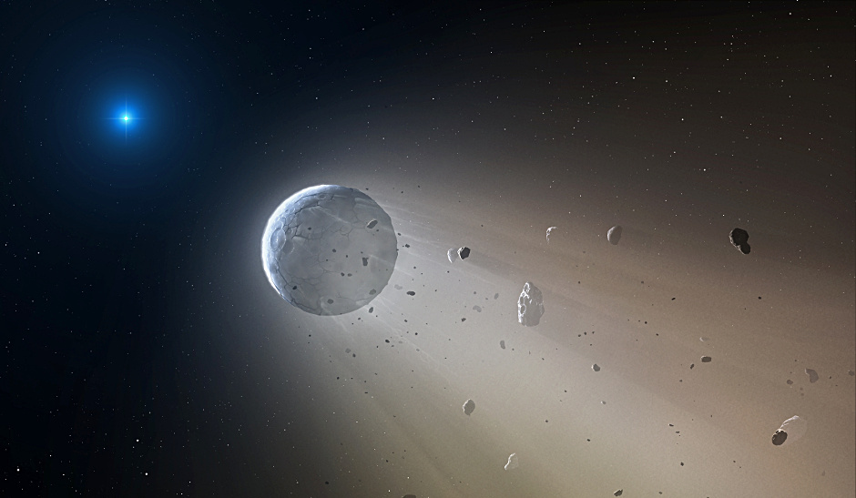
White dwarf (WD)
Remnant
small object
Artist’s Credit: Mark A. Garlick, CfA
Notes:
ASTROSiLICATE
The astronomical Silicate (or astroSilicate) is a construction of parts meant to match observations of the interstellar medium, though it has been the unspoken gold standard used in some fraction to model dust in debris disks. The construction begins with the imaginary component, which is then used along with a Kramers-Kronig analySis to construct the real component.

Slide 11
What does the chemical abundance pattern tell us?
White dwarf (WD)
Can we use observed species to improve models of gas and dust around other stars?
Mg
Remnant
small object
O
Ca
Fe
Si
Artist’s Credit: Mark A. Garlick, CfA
Notes:
ASTROSiLICATE
The astronomical Silicate (or astroSilicate) is a construction of parts meant to match observations of the interstellar medium, though it has been the unspoken gold standard used in some fraction to model dust in debris disks. The construction begins with the imaginary component, which is then used along with a Kramers-Kronig analySis to construct the real component.

Slide 12
What does the chemical abundance pattern tell us?
White dwarf (WD)
Can we use observed species to improve models of gas and dust around other stars?
Remnant
small object
Mg
O
Si
Ca
Fe
Artist’s Credit: Mark A. Garlick, CfA
Notes:
ASTROSiLICATE
The astronomical Silicate (or astroSilicate) is a construction of parts meant to match observations of the interstellar medium, though it has been the unspoken gold standard used in some fraction to model dust in debris disks. The construction begins with the imaginary component, which is then used along with a Kramers-Kronig analySis to construct the real component.

Slide 13
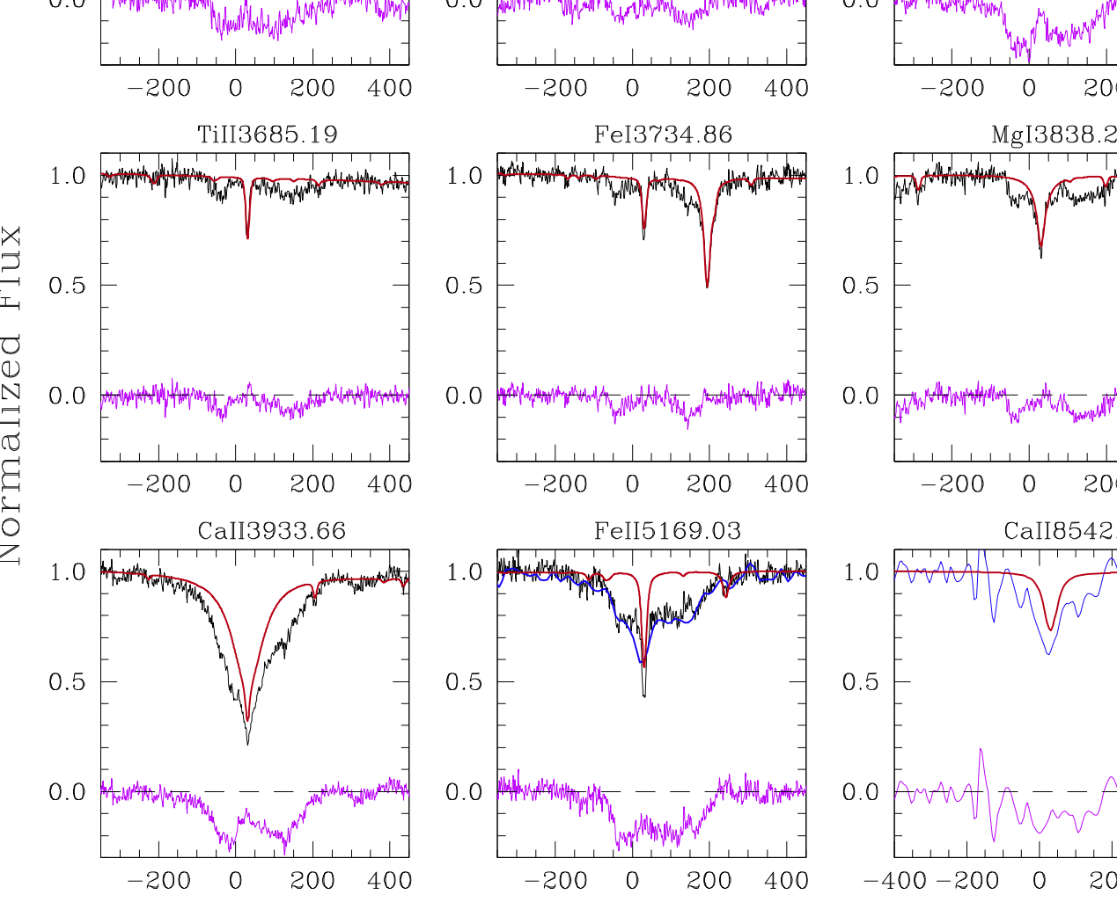
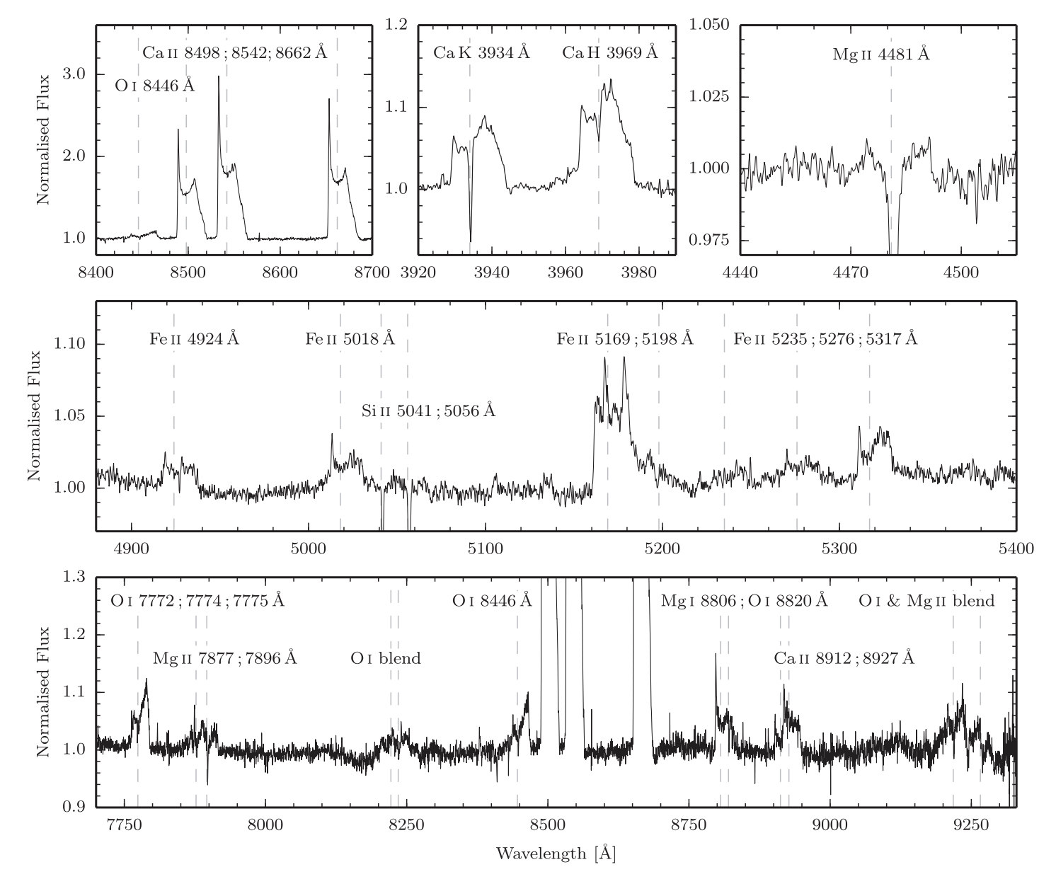
What does the chemical abundance pattern tell us?
“Core-rich materials (siderophiles) in the atmospheres of white dwarfs provide independent evidence for rapid planetesimal formation, concurrent with star formation.”
Bonsor et al. 2023
H |  |  |  |  |  |  |  |  |  |  |  |  |  |  |  |  | He
Li | Be |  |  |  |  |  |  |  |  |  |  | B | C | N | O | F | Ne
Na | Mg |  |  |  |  |  |  |  |  |  |  | Al | Si | P | S | Cl | Ar
K | Ca | Sc | Ti | V | Cr | Mn | Fe | Co | Ni | Cu | Zn | Ga | Ge | As | Se | Br | Kr
WD 1145+017, Xu et al. 2016
SDSS J1228, Manser et al. 2016
WD J0611-6931, Dennihy et al. 2021
Notes:
almost alL wds show evidence of calcium.
Investigate differences in optical constants of minerals containing Ca

Slide 14
Can we use observed species to improve models of gas and dust around other stars?
Oui!
Convert elements observed in gas to potential source minerals in solids
H |  |  |  |  |  |  |  |  |  |  |  |  |  |  |  |  | He
Li | Be |  |  |  |  |  |  |  |  |  |  | B | C | N | O | F | Ne
Na | Mg |  |  |  |  |  |  |  |  |  |  | Al | Si | P | S | Cl | Ar
K | Ca | Sc | Ti | V | Cr | Mn | Fe | Co | Ni | Cu | Zn | Ga | Ge | As | Se | Br | Kr
Example: Clinopyroxene
Ca(Mg,Fe)Si₂O₆
Notes:
Stages? Before answering this question, a quick review of stellar evolution would be useful. Sun like stars spend about 10 billion years on the main sequence fusing hydrogen into helium. When the hydrogen is depleted the star begins fusing helium into heavier elements in shells and eventually the core. The time spent at each of these successive stages decreases by at least an order of magnitude. While mass loss is always occurring through the stellar wind, the amount of mass lost increases noticeably on the asymptotic giant branch through the production and subsequence expulsion of molecules and grains. The increasing luminosity and decreasing temperature mean that the radius of the star increases. Planets close in to the star will be engulfed. Planets beyond a few AU that are not engulfed will move further away from the star when it loses most of its mass on the AGB. Following this stage, the outer layers of the star expand away, visible as a planetary nebula, and the leftover core of the star is a called a white dwarf. Additionally, convection in the outer layers brings certain light elements like lithium to the interior, where these species are destroyed. So the chemical signatures of these stars change over time as well.

Slide 15
Why worry about the dust?
It absorbs and reradiates starlight, potentially affecting spectral line strengths
Almost all WDs show evidence of calcium, but main method of modeling systems with dust do not include it
My solution:
Derive optical constants of minerals containing Ca, Mg, Si, Fe, O to use in circumstellar modelling
Notes:
ASTROSiLICATE
The astronomical Silicate (or astroSilicate) is a construction of parts meant to match observations of the interstellar medium, though it has been the unspoken gold standard used in some fraction to model dust in debris disks. The construction begins with the imaginary component, which is then used along with a Kramers-Kronig analySis to construct the real component.

Slide 16
Optical Constants for pyroxenes
Steele et al. submitted
Ca(Mg,Fe)Si₂O₆
N = n + ik
X-ray: scattering functions
IR: laboratory data
Fixed disk and grain properties, varying optical constants
Near IR: options depending on potential situation
n and k obey the Kramers-Kronig relations
Notes:
Why care about the x-ray?
Potential high-energy photons
Could likely sub-in the astroSilicate, but the innermost edge/optical is different for different minerals.

Slide 17
Steele et al. submitted
Using our optical constants to model a dusty debris disk
Cloudy model
star
dust
Fixed disk and grain geometries, varying optical constants
Can probe crystallinity
Using pyroxene in Cloudy for the first time
Allows for better radiative transfer modeling by including Ca
Astrosilicate vs calcium pyroxene
Notes:
Why care about the x-ray?
Potential high-energy photons
Could likely sub-in the astroSilicate, but the innermost edge/optical is different for different minerals.

Slide 18
Main Takeaways
Polluted WDs with C-S disks provide the most direct method of determining the composition(s) of remnant Kuiper belt analogues
High-resolution spectroscopy provides the elements, spectral energy distributions tells us how they are assembled.
We have extended the optical constants for pyroxene of different crystallinities to study this exoplanetary material beyond just composition.

Slide 19
Merci!
Polluted WDs with C-S disks provide the most direct method of determining the composition(s) of remnant Kuiper belt analogues
High-resolution spectroscopy provides the elements, spectral energy distributions tells us how they are assembled.
We have extended the optical constants for pyroxene of different crystallinities to study this exoplanetary material beyond just composition.
Image credit: NASA/JPL-Caltech

Slide 20
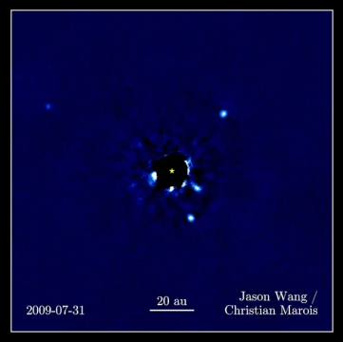
Exoplanetary systems
exo: outside [1]
Top-down view of HR 8799
What can we know?
How do we know?
How many?: every star has at least 1 planet
Morphology (form and structure), total number of planets and where they are (hot jupiter or familiar Jupiter), asteroid belts and how many
Atmospheric composition
Optical: light scattering, light curves
IR: features in a spectrum through atmosphere, solid state transitions for silicon, images
mm wavelength: thermal emission from cold dust

Slide 21
Evolution of most (95%) stars
Sun-like stars
Red dwarfs
~95% of stars turn into
white dwarfs
Notes:
Just to make sure we're all on the same page, white dwarfs are the endpoints of stellar evolution for most stars. When we study exoplanetary material around such an object, the planetary system has survived the these exciting stages.

Slide 22
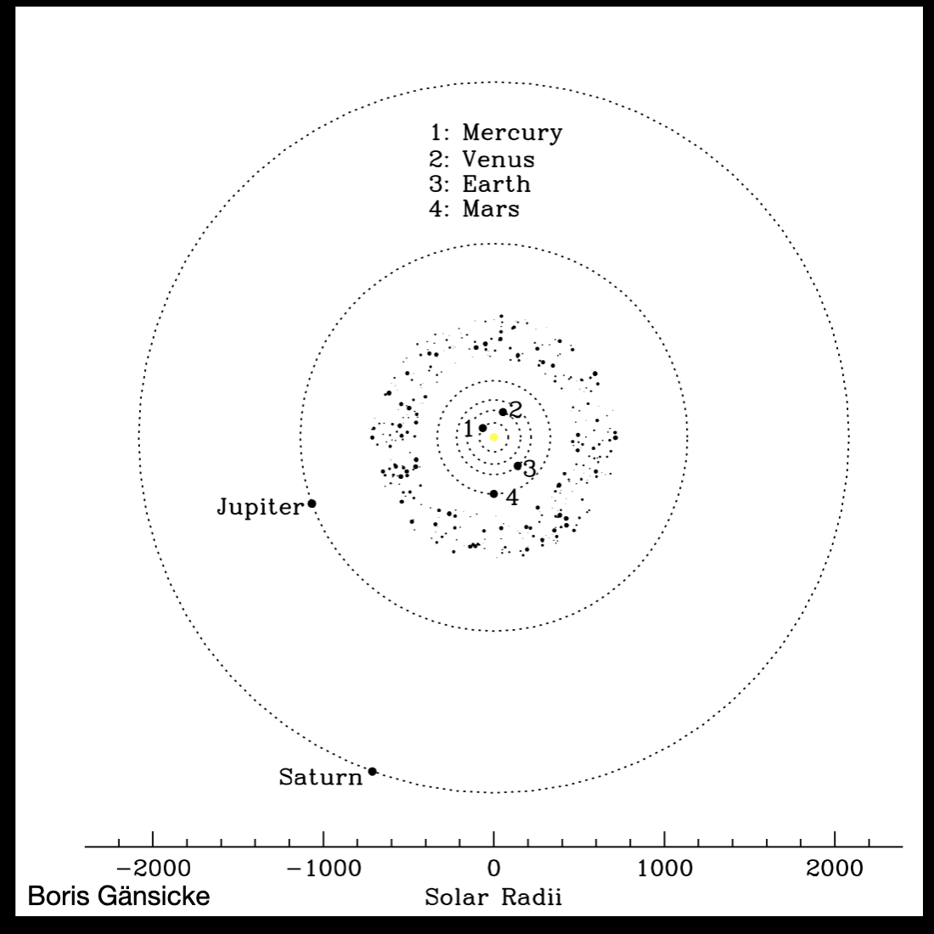
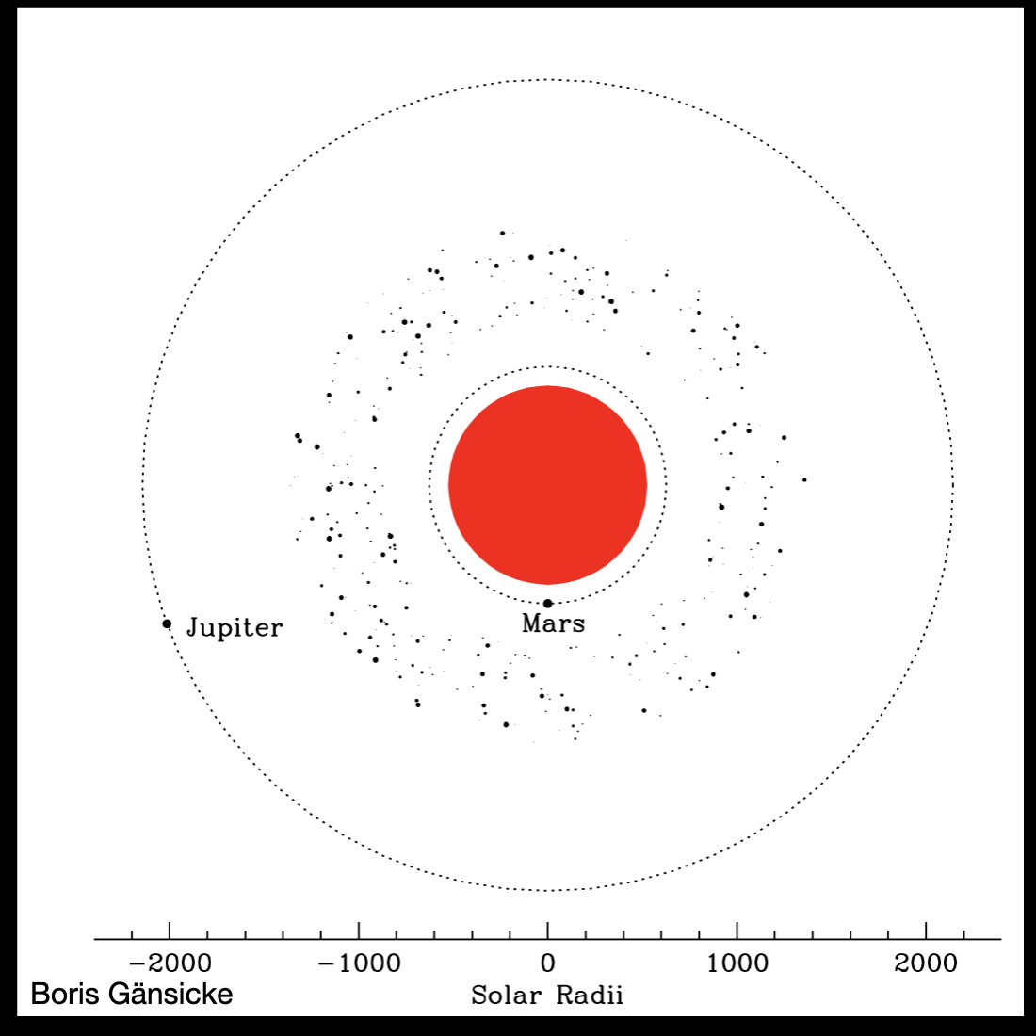
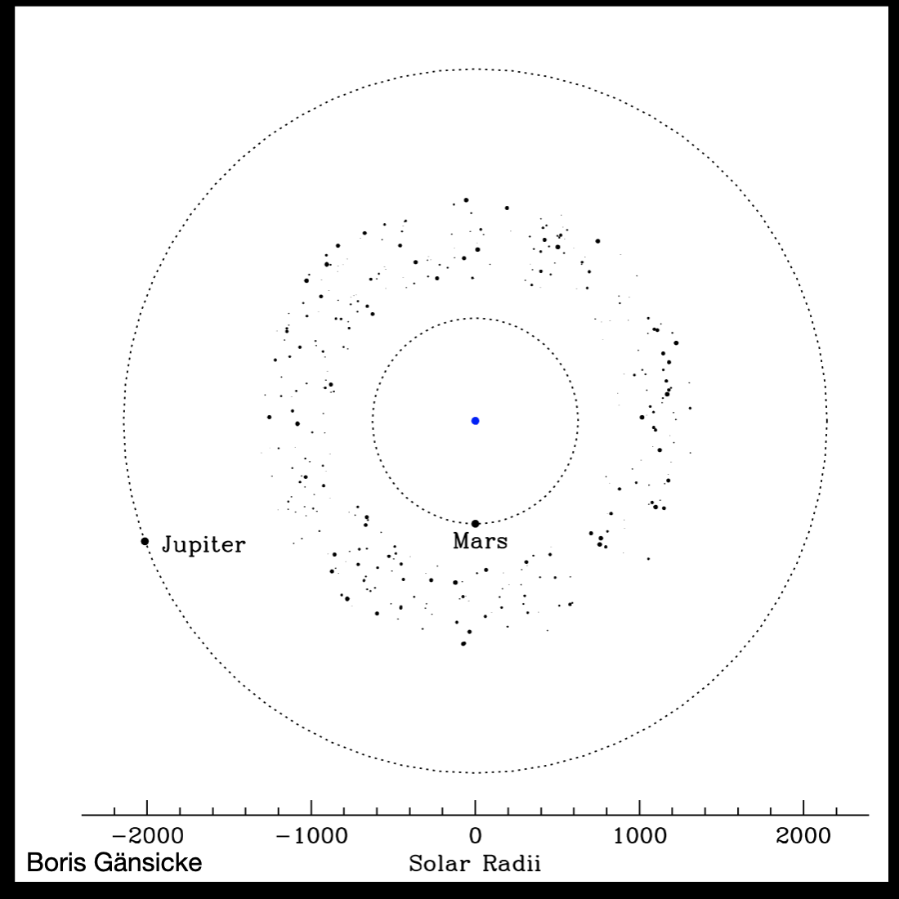
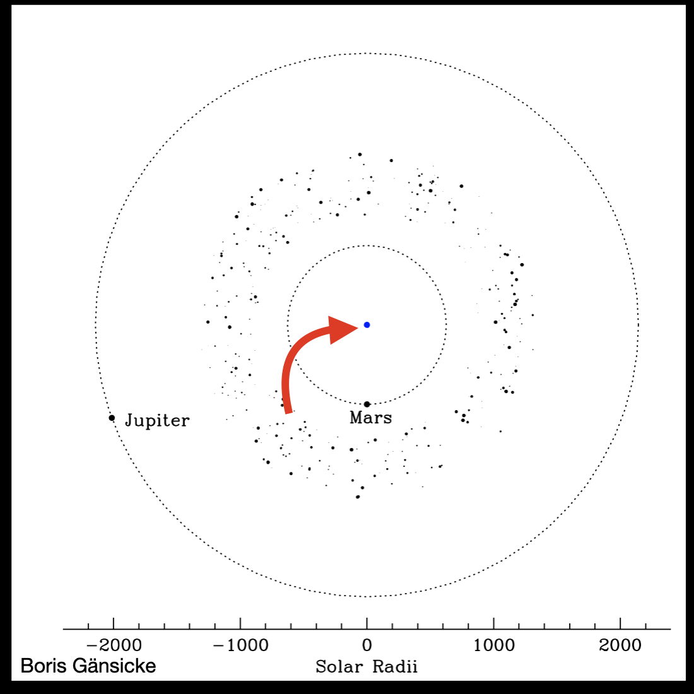

Slide 24
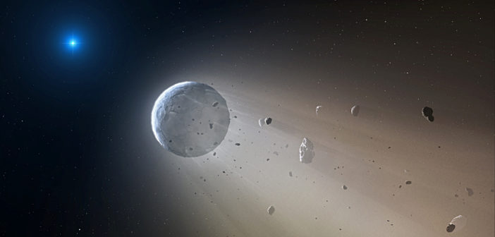
Summary
asteele@physics.mcgill.ca (until June 2023)
We hope to encourage the dusty debris disk community to further investigate results of WD pollution seeming to come from minerals to build “debris disk silicates” based on laboratory data and observations.
We use x-ray data of elements to calculate optical constants (OC) shortward of 10eV and build full OC datasets of minerals
We show that a temperature difference in optical constants for one mineral can affect resulting dust models
Artist’s Credit: Mark A. Garlick, CfA
Steele et al. in prep
Steele et al. in prep

Slide 25
Solid Rocks
Notes:
[2] https://commons.wikimedia.org/wiki/File:Atomic_emission_spectrum_of_helium.svg

Slide 26
Solid Rocks
~ 10² km
~ 1 micron
Gary et al. 2017, WD1145+017
Ballering et al. 2022, G29-38
Notes:
[2] https://commons.wikimedia.org/wiki/File:Atomic_emission_spectrum_of_helium.svg

Slide 27
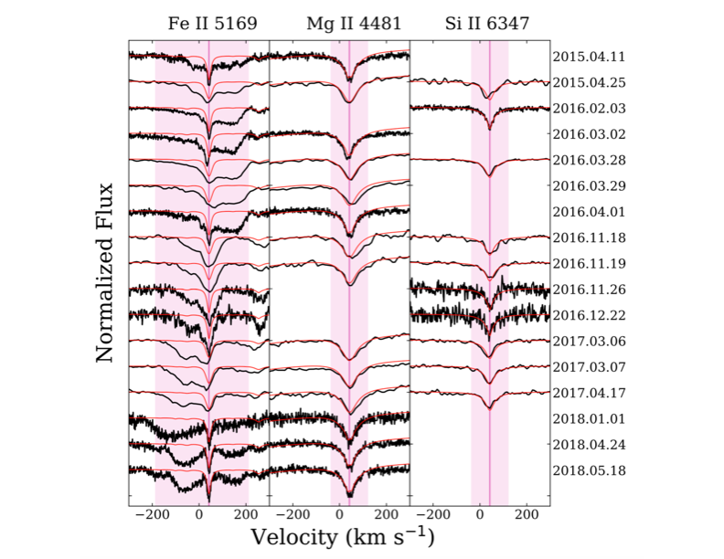
White dwarfs as cosmic mass spectrometers
Or, why we should use WDs with exo-planeteSimal disks to define a “debris disk Silicate”
AstroSilicate: mg_{x}Fe_{2—x}Si0₄
Orthopyroxene: (mg,Fe)₂Si₂O₆
Pyrope garnet: mg₃al₂Si₃O₁₂
Olivine: (mg,Fe)₂SiO₄
Quartz: SiO₂
albite: NaalSi₃O₈
Clinopyroxene: Ca(mg,Fe)Si₂O₆
Notes:
ASTROSiLICATE
The astronomical Silicate (or astroSilicate) is a construction of parts meant to match observations of the interstellar medium, though it has been the unspoken gold standard used in some fraction to model dust in debris disks. The construction begins with the imaginary component, which is then used along with a Kramers-Kronig analySis to construct the real component.

Slide 28
Top View
Gas
Gas
Observer
WD
WD
Planetesimal
Side View
Planetesimal
Observer
Front View
WHITE DWARF
Planetesimal
Gas
WD1145+017
T~15,000 K
Picture borrowed from Siyi Xu+ 2019
Not to Scale!
Notes:
The object that has this small polluted white dwarf community excited, is WD1145+017.
WD1145 has a transiting, disintegrating planetesimal or asteroid.
Size of white dwarf shown in blue, the transiting body is outlined in white, with sublimating material shown in colors in blue and pink. The gas is accreting onto the surface in eccentric, precessing streams

Slide 29
Possible source populations for close-in discs and delivery mechanisms
Asteroid belts vs Kuiper belts
  How does composition change on RGB/AGB?
Delivery mechanisms:
  Increase in unstable MMRs/chaotic zone in single-planet systems
  Destabilization and scattering in multi-planet systems
  Secular resonance changes in multi-planet systems
  Kozai from binary companions ⇐ only one where we can realistically detect most of the perturbers?
Are planets needed at all? (Veras et al 2022: radiation forces enough? Depends on particle size)
Can we really learn much about outer planetary systems? Or is the dynamical problem too unconstrained?

Slide 30
White dwarf planetary systems: discs and close-in planetesimals

Slide 31
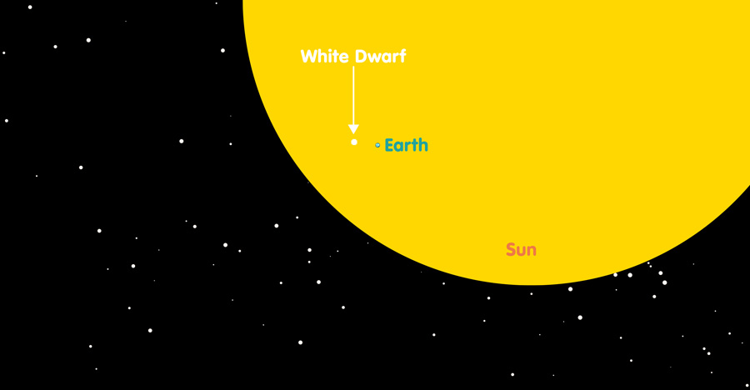
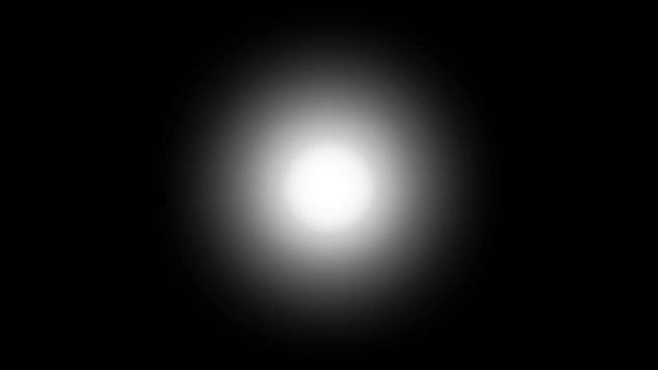
Transiting remnant asteroids around dead stars
White Dwarf
Jupiter
Earth
Asteroid too small to see
Sun-like star
White dwarf star
Transits are MUCH easier to detect around a WD, but also hard to find, both because they are so small

Slide 32
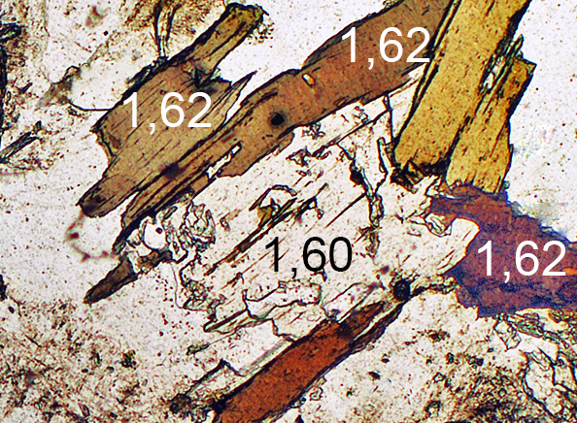
Optical constants, n and k
Components of the complex index of refraction: N = n + ik
Measured through reflection or transmission spectra of minerals
n encodes: group velocity
k encodes: absorption properties
As a complex function, n and k are related through the Kramers-Kronïg relations
Notes:
Good afternoon! I’m Dr. Amy Steele and am a postdoctoral fellow at the Trottier Space Institute at McGill UniverSity in Montreal. Today I’ll present research that is on its way to submisSion and will hopefully aid in the modelling of dust in circumstellar disks. We’ve extended the optical constants of several minerals to the x-ray, describe why, and suggest future steps.
Optical constants refer to the wavelength dependent, real and imaginary components of the complex index of refraction. The imaginary component k is of particular interest because it encodes the absorptive properties of a material.

Slide 33
Astronomical Silicate
Or the “Astrosilicate”, Draine & Lee (1984), Draine 2003
Real, n
Astrosilicate: Mg_{x}Fe_{2—x}Si0₄
Crystalline olivine, Huffman & Stapp (1973)
33 Lorentzian oscillators
Imaginary, k
What should the composition truly be for dust around a main sequence star?
Adopted from Al₂O₃
Assumed smooth and connected
Notes:
ASTROSiLICATE
The astronomical Silicate (or astroSilicate) is a construction of parts meant to match observations of the interstellar medium, though it has been the unspoken gold standard used in some fraction to model dust in debris disks. The construction begins with the imaginary component, which is then used along with a Kramers-Kronig analySis to construct the real component.

Slide 34
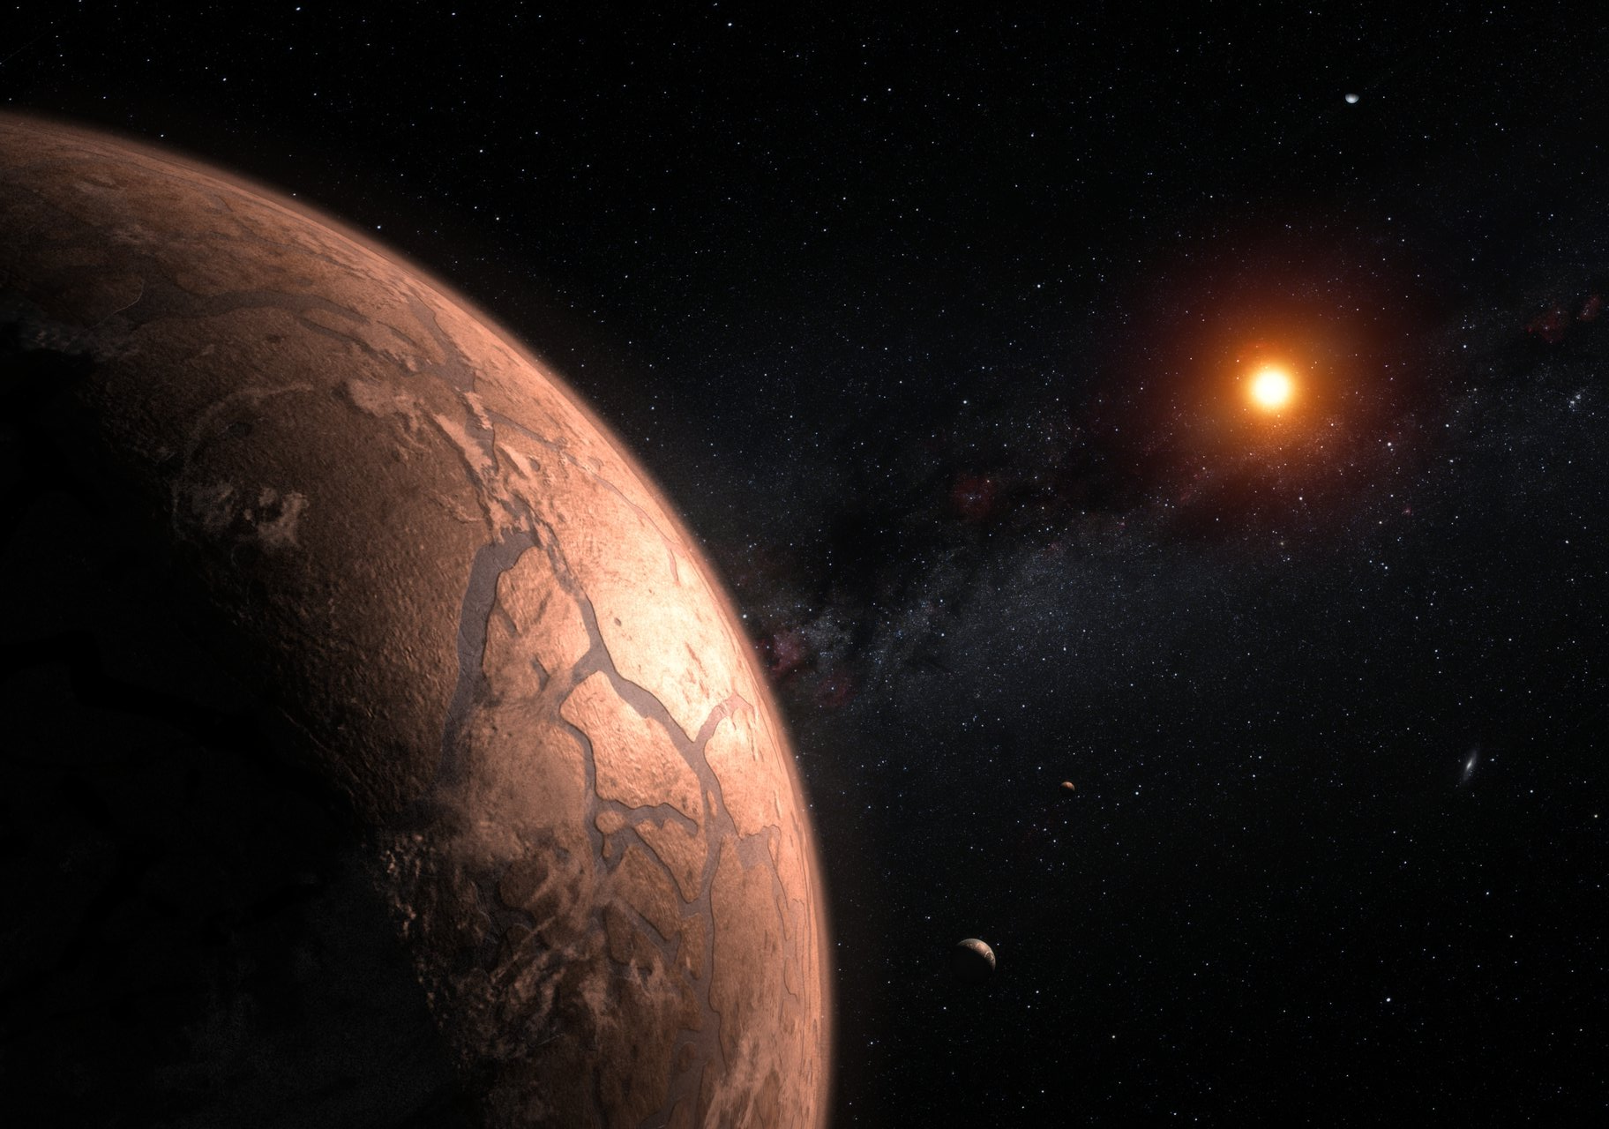
Exoplanets and their ”dead” host stars?
Notes:
“in addition to determining just the planetary statistics, a critical element of the committee’s exoplanet strategy is to continue to build the inventory of planetary systems around specific nearby stars. Therefore, this survey strongly supports a vigorous program of exoplanet science that takes advantage of the observational capabilities that can be achieved from the ground and in space.”
National Academies of Sciences, Engineering, and Medicine. 2010. New Worlds, New Horizons in Astronomy and Astrophysics. Washington, DC: The National Academies Press. https://doi.org/10.17226/12951.
Why are radial velocity need: only get how big thing is compared to star with transits, get the mass from radial velocity
TESS responsible for bringing total to 5000
Give context to current JWST observations by observing and characterizing the host star
Plan: Improve radial velocity measurements on existing ground-based telescopes to discover planets within a few times the mass of Earth as potential targets for future space-based direct-detection missions.
National Academies of Sciences, Engineering, and Medicine. 2010. New Worlds, New Horizons in Astronomy and Astrophysics. Washington, DC: The National Academies Press. https://doi.org/10.17226/12951.
This artist’s impression shows several of the planets orbiting the ultra-cool red dwarf star TRAPPIST-1. New observations, when combined with very sophisticated analysis, have now yielded good estimates of the densities of all seven of the Earth-sized planets and suggest that they are rich in volatile materials, probably water.
An active star makes studying the planet harder. Trappist observations published in Nature: one of the planets might not have an atmosphere
Credit:ESO/M. Kornmesser

Slide 35
Exoplanets and their ”dead” host stars?
Transiting remnant asteroids around dead stars
Track the breaking apart of asteroids around dead stars to:
see how long it takes for the rocks to completely disintegrate (this is unknown)
see what they are
made of!
Notes:
“in addition to determining just the planetary statistics, a critical element of the committee’s exoplanet strategy is to continue to build the inventory of planetary systems around specific nearby stars. Therefore, this survey strongly supports a vigorous program of exoplanet science that takes advantage of the observational capabilities that can be achieved from the ground and in space.”
National Academies of Sciences, Engineering, and Medicine. 2010. New Worlds, New Horizons in Astronomy and Astrophysics. Washington, DC: The National Academies Press. https://doi.org/10.17226/12951.
Plan: Improve radial velocity measurements on existing ground-based telescopes to discover planets within a few times the mass of Earth as potential targets for future space-based direct-detection missions.
National Academies of Sciences, Engineering, and Medicine. 2010. New Worlds, New Horizons in Astronomy and Astrophysics. Washington, DC: The National Academies Press. https://doi.org/10.17226/12951.

Slide 36
Pyroxene w/ Ca at 10K
NaAlSi₂O₆
Pyroxene w/ Ca at 100K
NaAlSi₃O₈
Pyroxene w/ Ca at 200K
NaAlSi₄O₁₀
Pyroxene w/ Ca at 300K
Mg₂AlSi₂O_{7.5}
Mg₃AlSi₃O_{10.5}
Mg₄AlSi₄O_{13.5}
Mg₉AlSi₉O_{28.5}
MgFeAlSi₂O_{7.5}
Mg_{1.5}Fe_{1.5}AlSi₃O_{10.5}
Mg₂Fe₂AlSi₄O_{13.5}
Mg_{4.5}Fe_{4.5}AlSi₉O_{28.5}
Ca₂Al₂SiO₇
Ca₂Mg_{0.5}AlSi_{1.5}O₇

Slide 37
Draine Astrosilicate n, k
Mineral Data Source:
Astrophysical Laboratory Group of the AIU Jena
NaAlSi₂O₆
NaAlSi₃O₈
MgFeAlSi₂O_{7.5}
NaAlSi₄O₁₀
Mg_{1.5}Fe_{1.5}AlSi₃O_{10.5}
Mg₂AlSi₂O_{7.5}
Mg₂Fe₂AlSi₄O_{13.5}
Pyroxene w/ Ca at 10K
Mg₃AlSi₃O_{10.5}
Mg_{4.5}Fe_{4.5}AlSi₉O_{28.5}
Pyroxene w/ Ca at 100K
Mg₄AlSi₄O_{13.5}
Ca₂Al₂SiO₇
Pyroxene w/ Ca at 200K
Mg₉AlSi₉O_{28.5}
Ca₂Mg_{0.5}AlSi_{1.5}O₇
Pyroxene w/ Ca at 300K

Slide 38
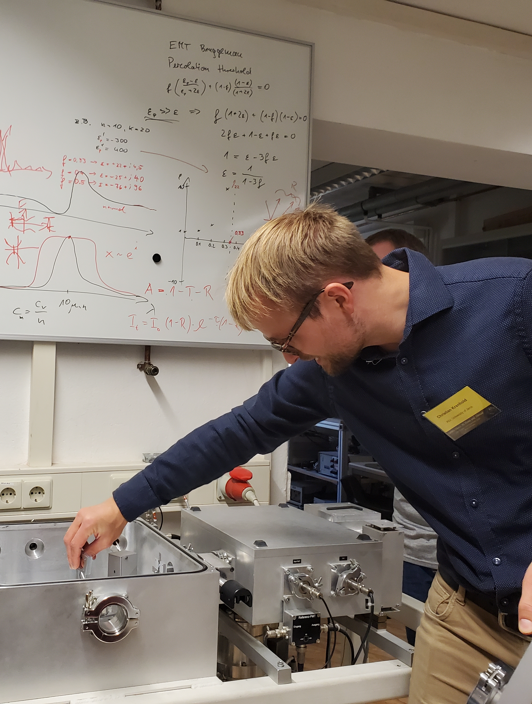
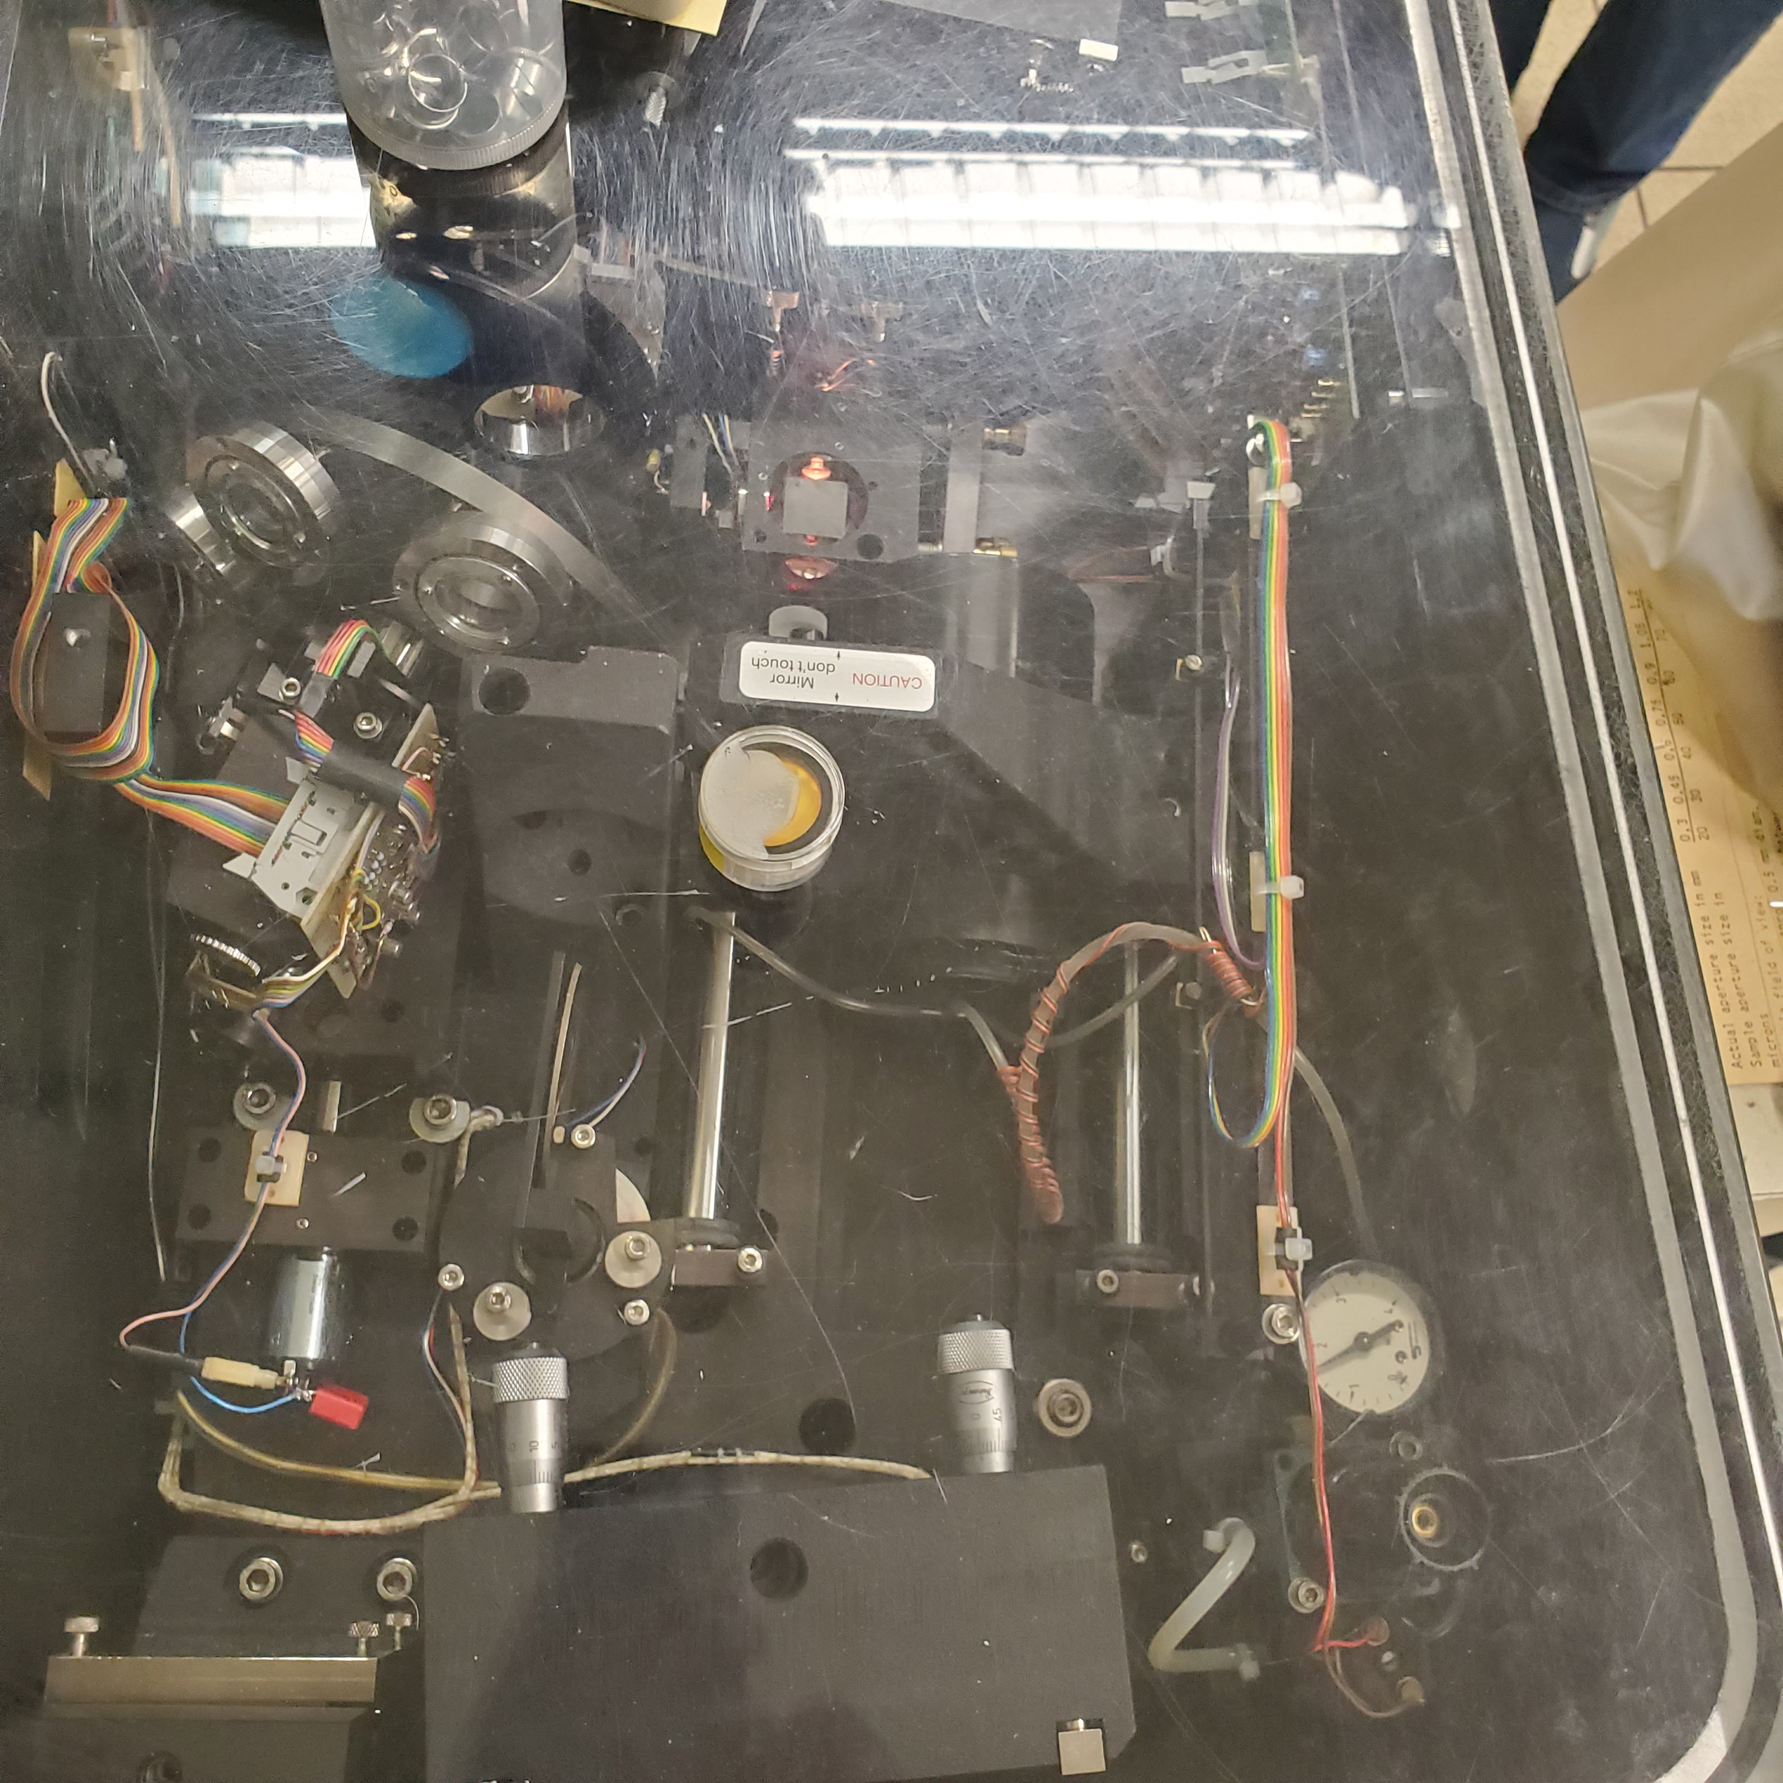
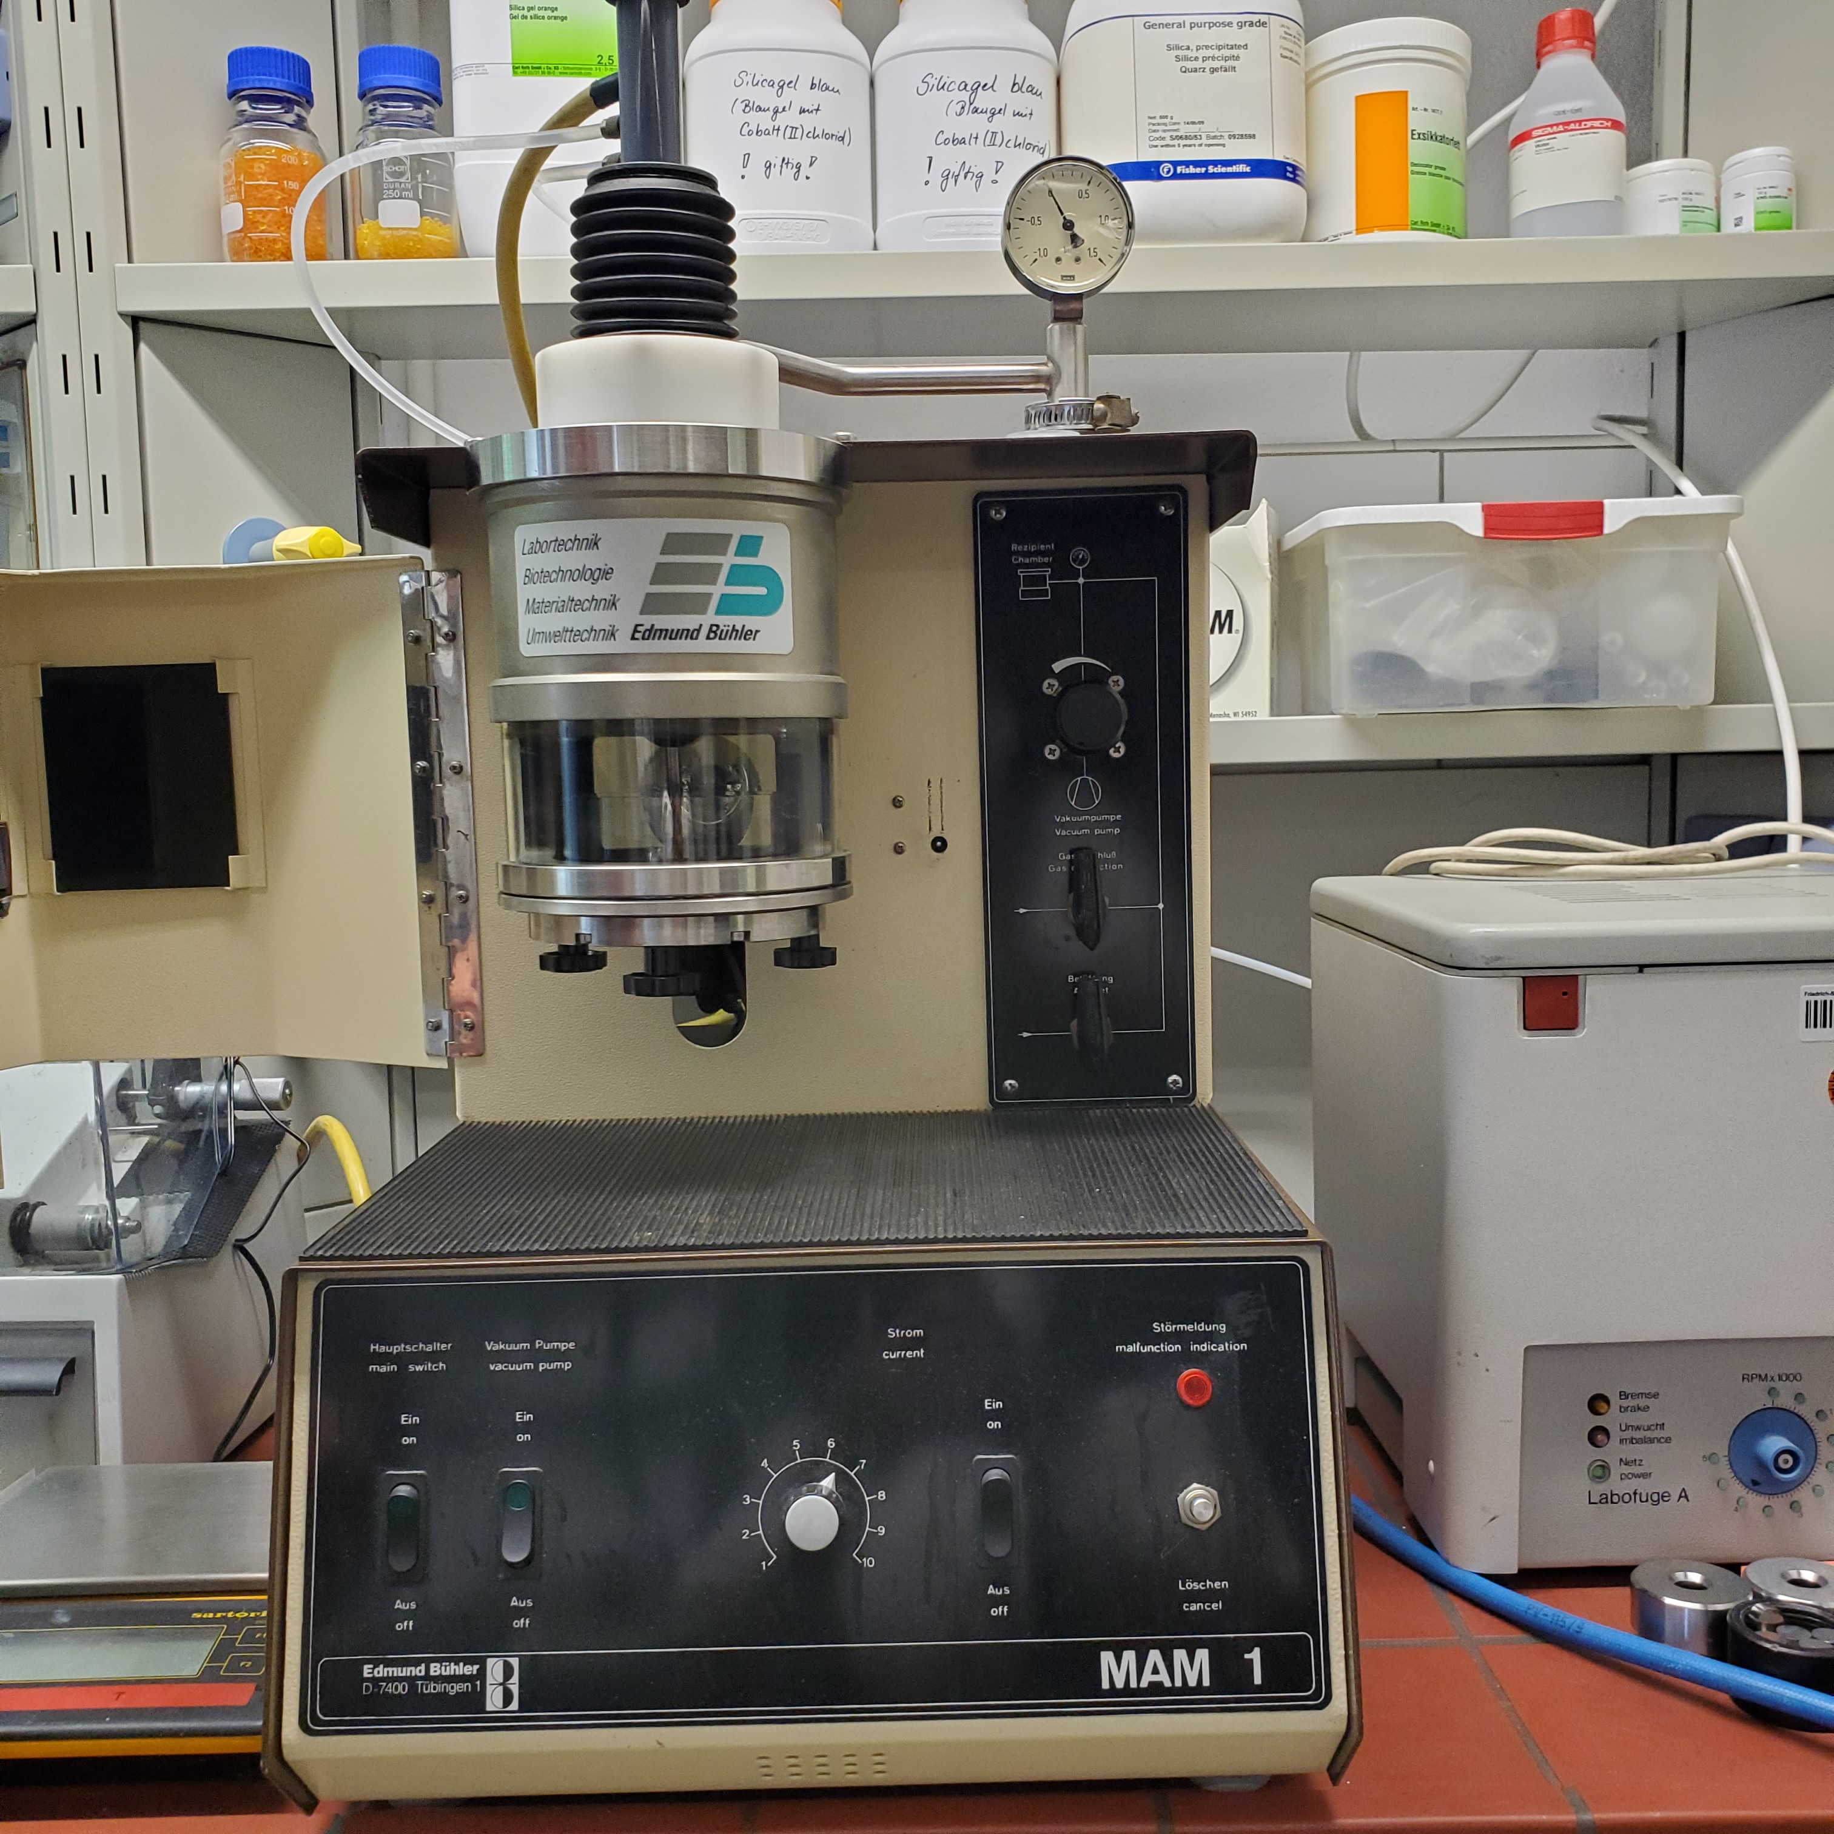
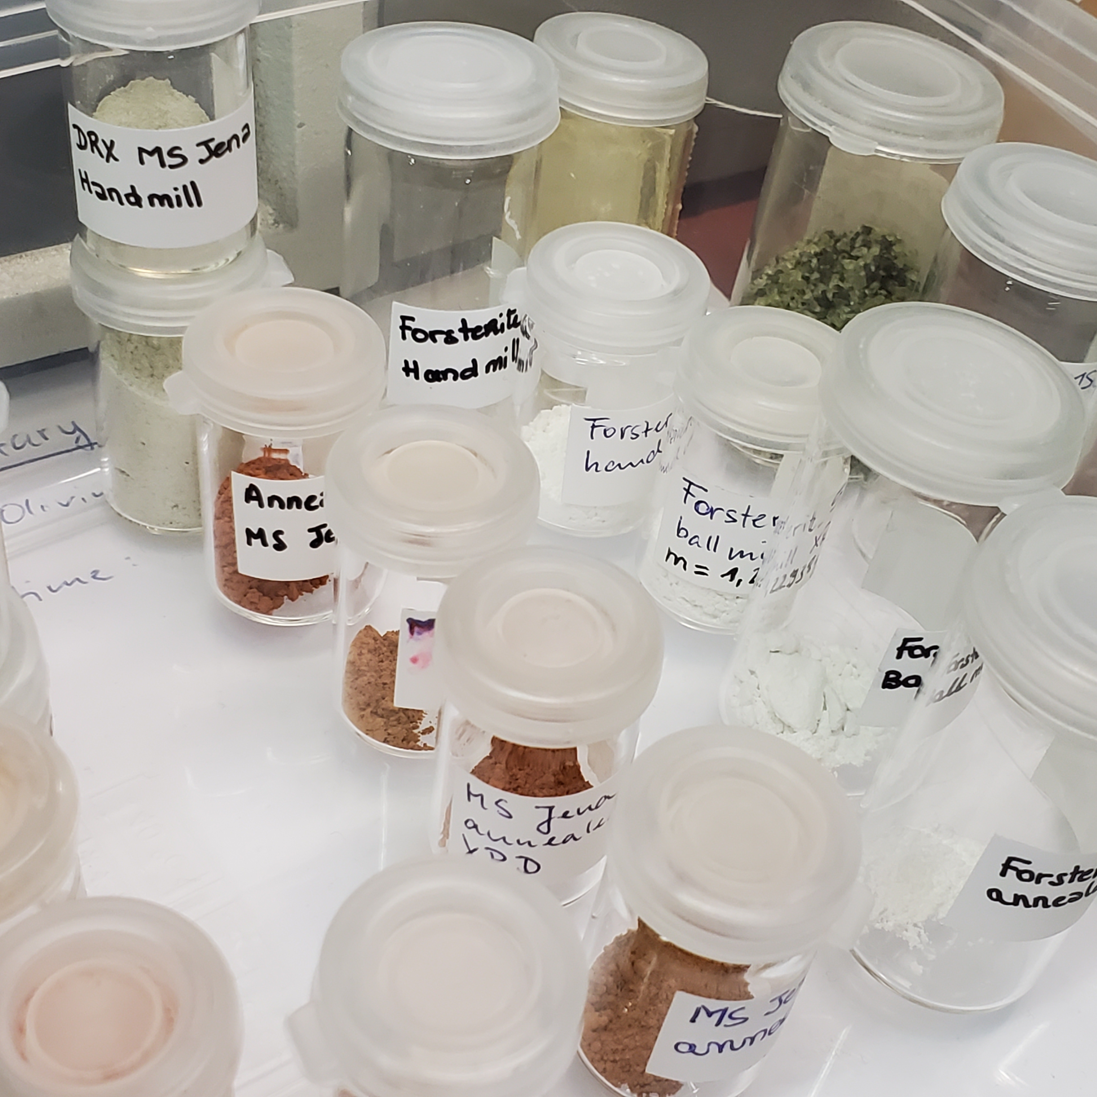
University of Jena laboratory tour
Optical constants of different materials measured here
So, no problem right?

