Slide 1
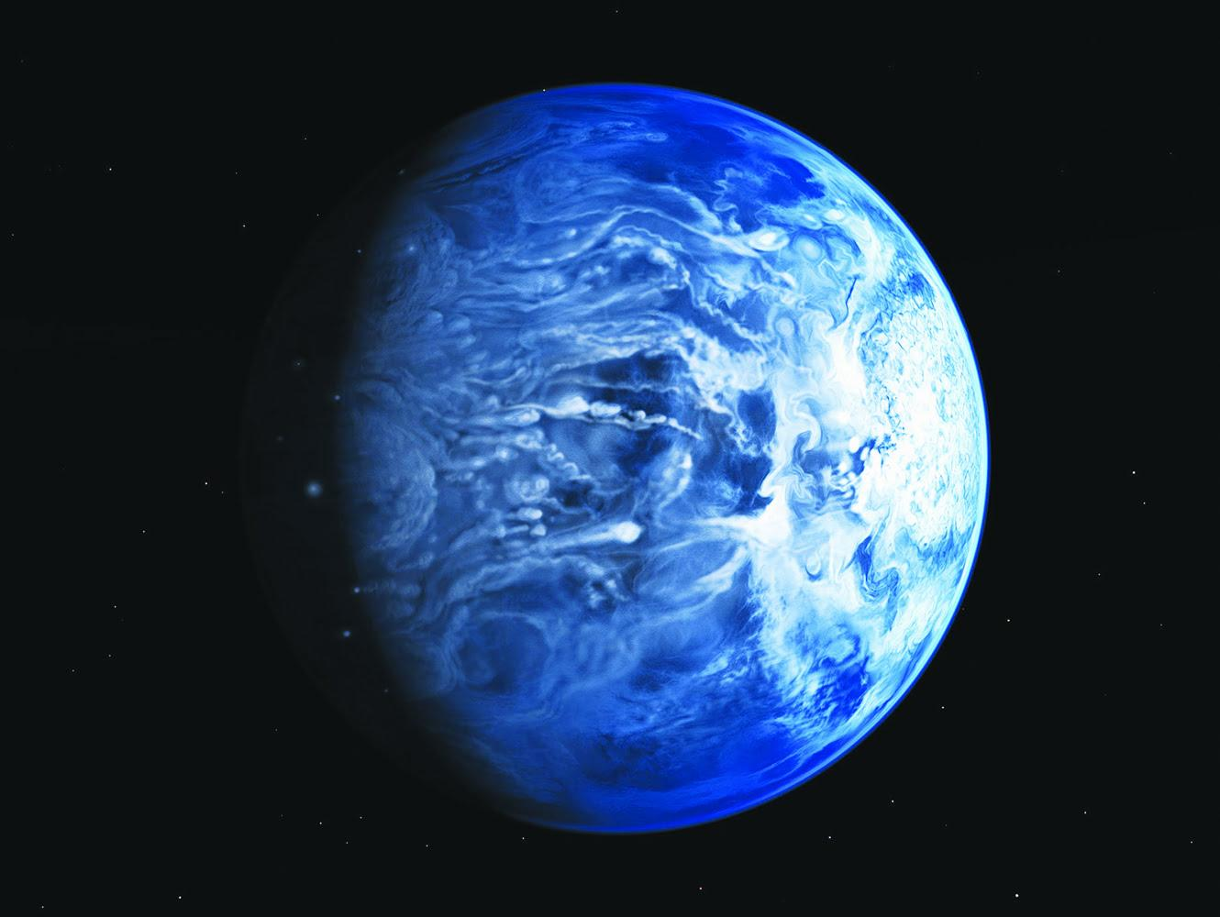
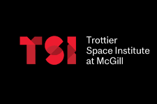
Using Longitudinally Resolved Spectra on Exoplanet Phase Curves
Jared Splinter
Department of Earth and Planetary Sciences
McGill University, Montreal
CRAQ Annual Scientific Meeting
Supervisor: Nicolas Cowan
Artist concept of HD 189733b

Slide 2
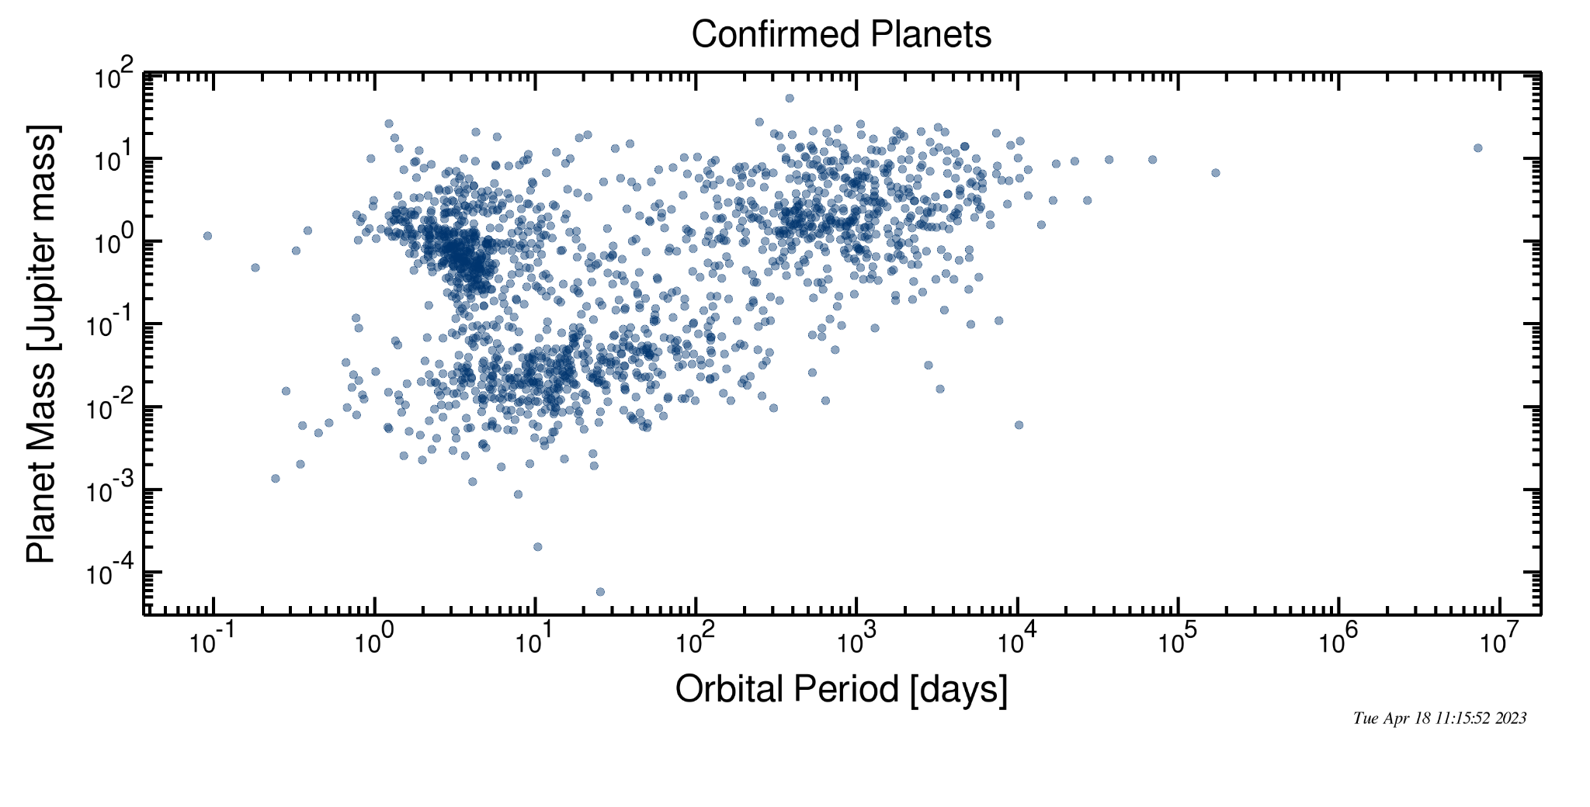
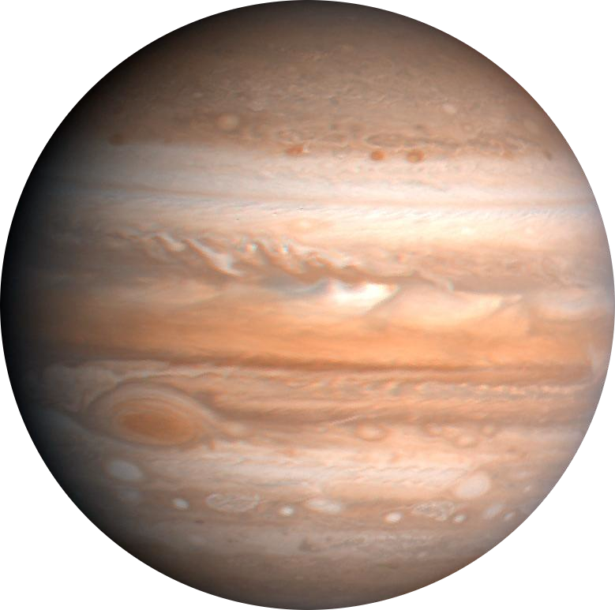
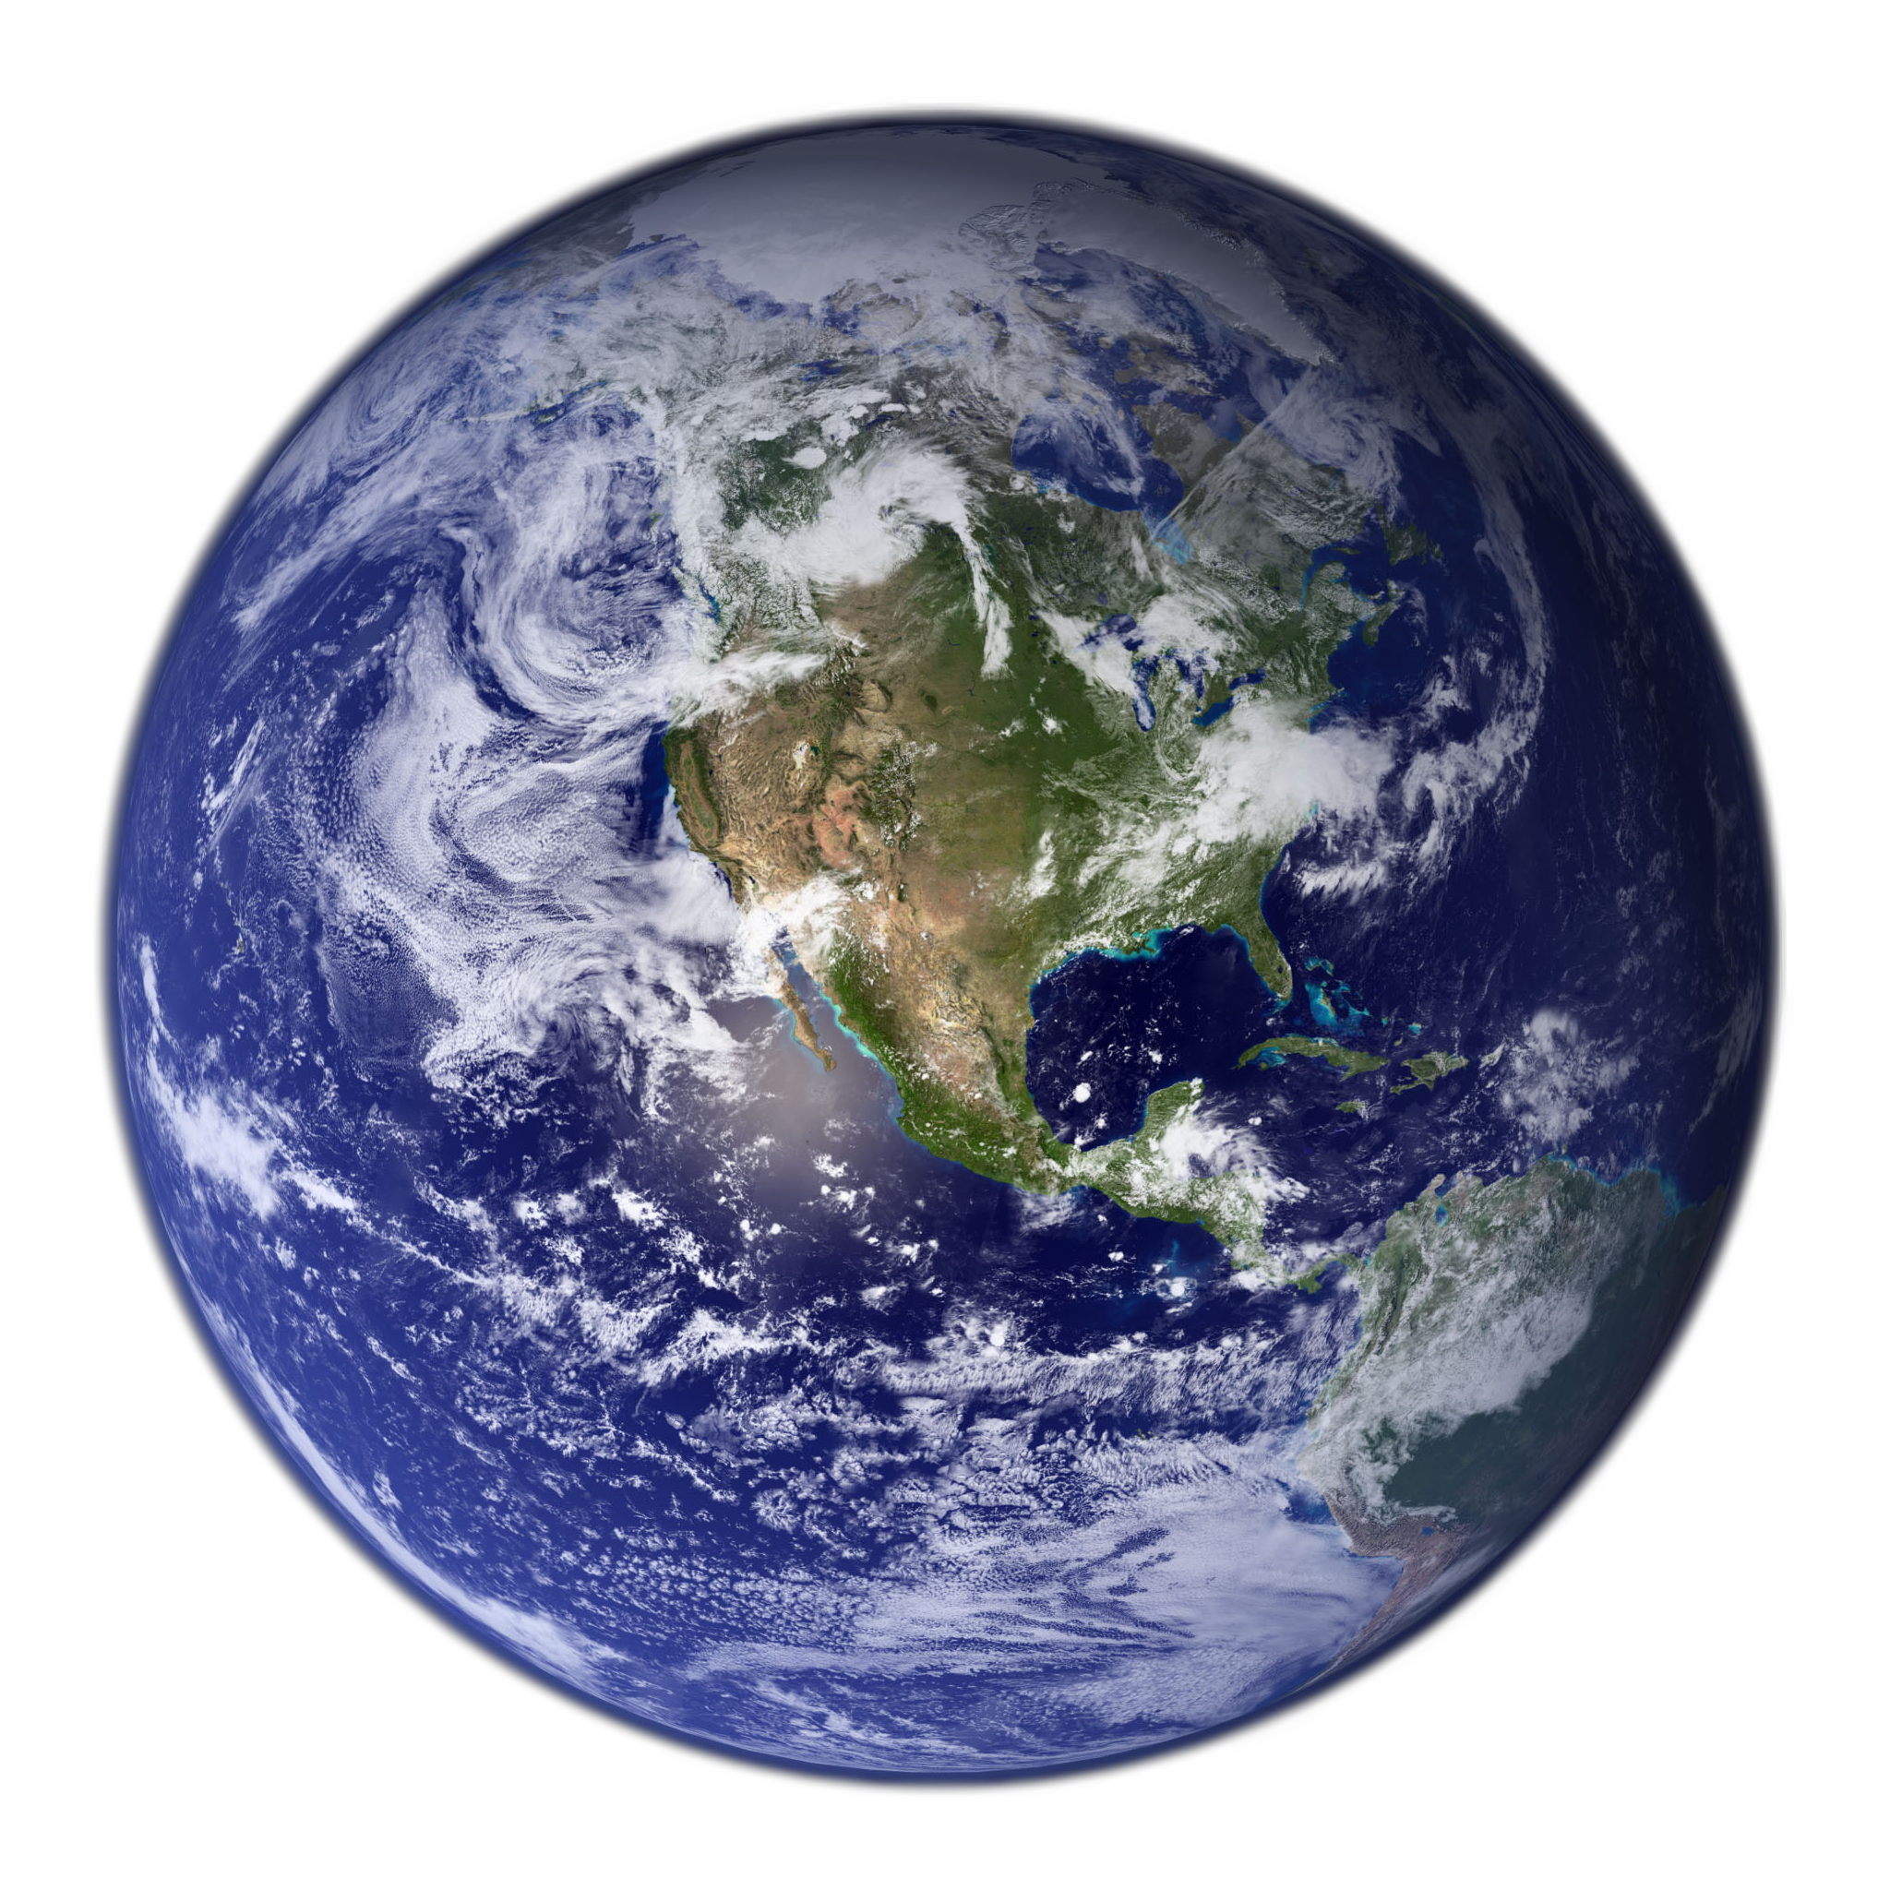
Over 5000 confirmed Exoplanets
Image Credit: NASA,ESA, G.Bacon (STScI)

Slide 3
Exoplanets I look at: Hot Jupiters
Why?
Big and Massive Planets
+
Closer to their Star
=
Better Signal
(and thus easier to characterize)
Orbital Period [Days]
Image Credit: NASA,ESA, G.Bacon (STScI)

Slide 4
Phase Curves
Image Credit: NASA, ESA, CSA, Dani Player (STScI)

Slide 5
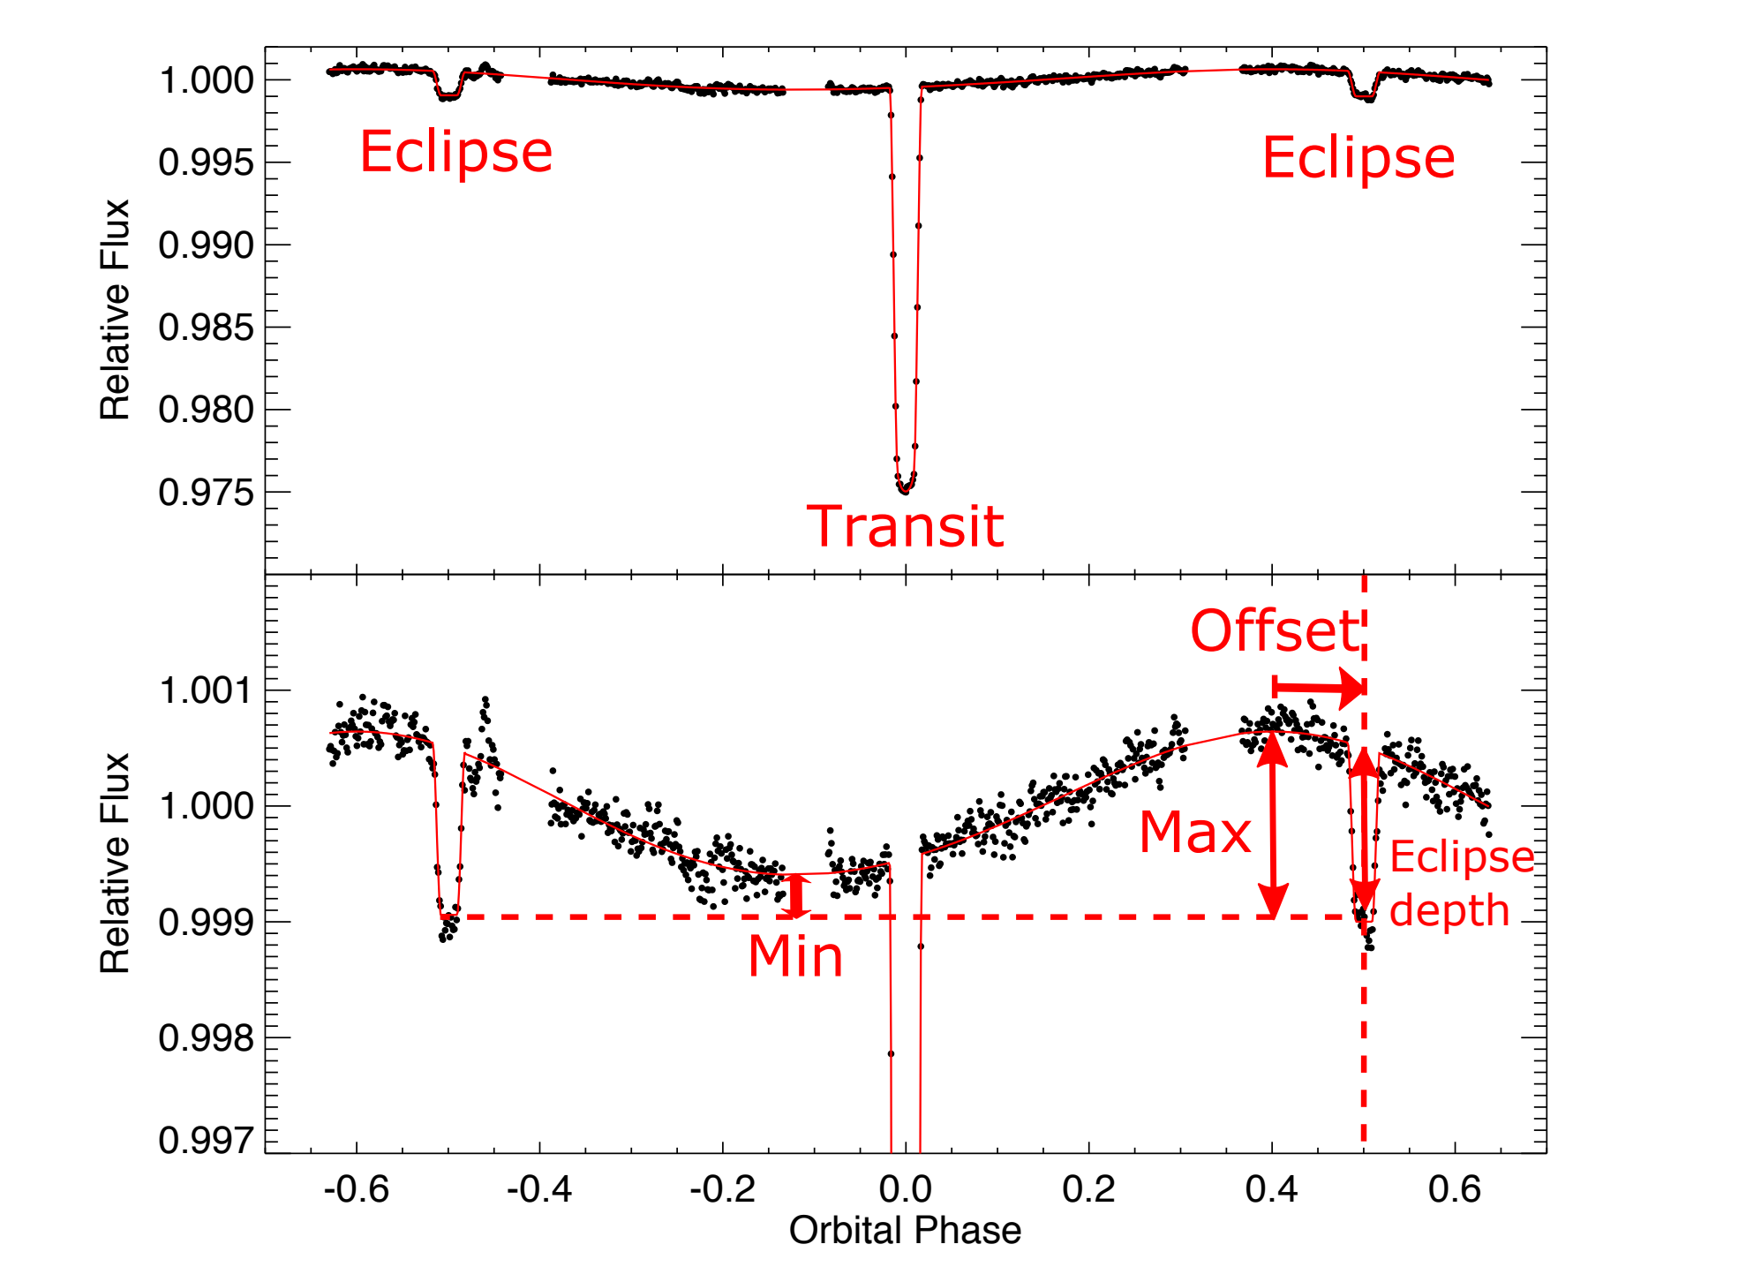
Phase Curves
What can we get?:
Eclipse Depth
How bright the dayside is
Phase Curve Offset
Location of brightest spot
Phase Curve Relative Amplitude
Contrast between brightest and dimmest longitudinal locations
Image from: Parmentier, V., & Crossfield, I.J. (2018). Which makes use of phase curve from Knutson, H.A.(2012).

Slide 6
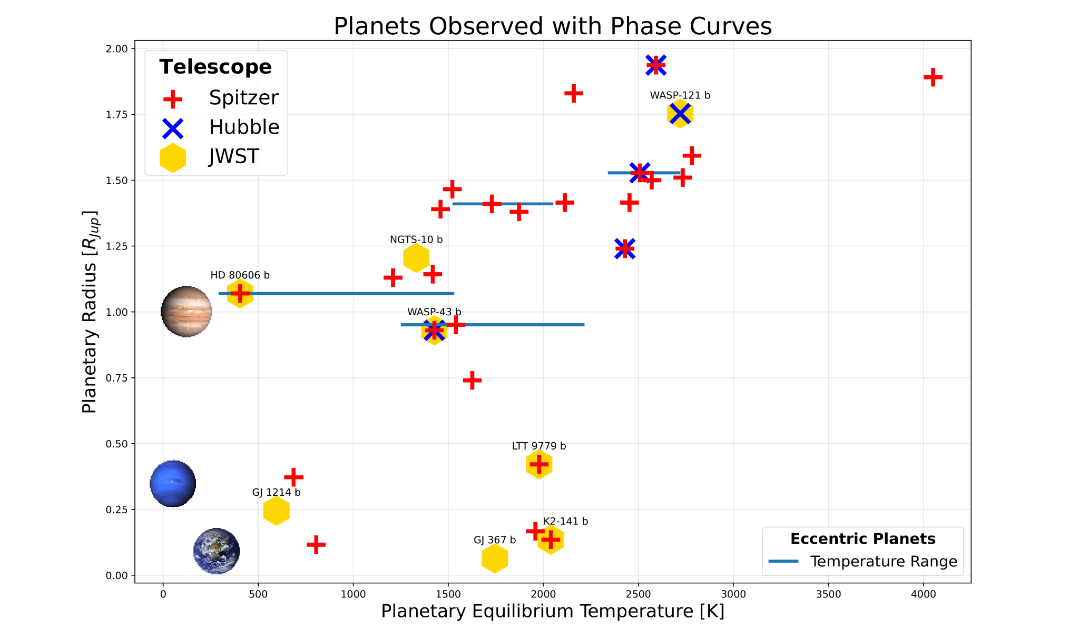
Previous Observations
Most observations done with photometry (ex. Spitzer)
Handful of planets observed with spectroscopic phase curves

Slide 7
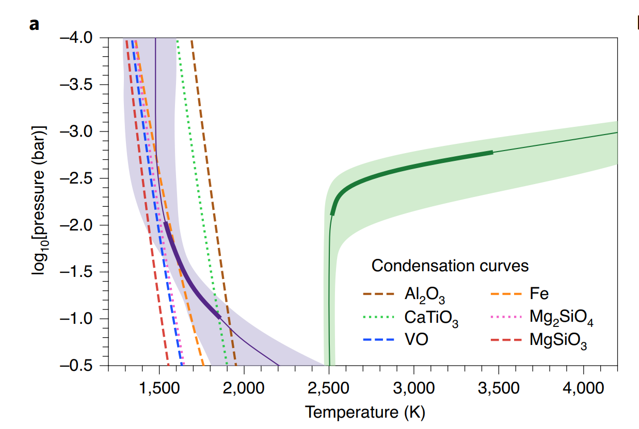
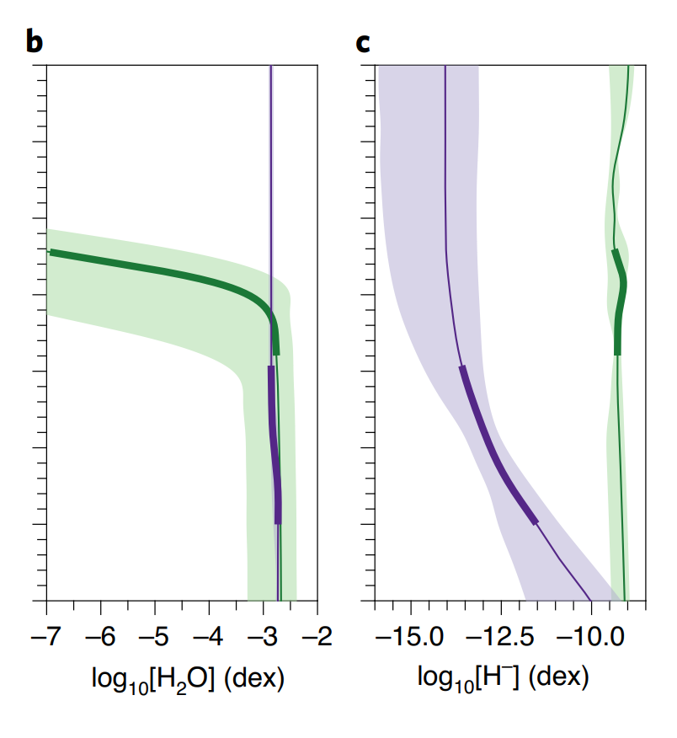
Spectroscopic Phase Curve
in Infrared
Higher Signal-to-noise
Better coverage of blackbody of the planet
Probe layers of atmosphere
Temperature-Pressure Profile
Better constrained
Molecular Composition/detection
Detect new molecules
Longitudinal abundance
Energy Balance/ Heat Transfer Models
Cloud map
Wind patterns
Mikal-Evans, T. et al. (2022)
Mikal-Evans, T. et al. (2022)
Notes:
Further insights are anticipated with the James Webb Space Telescope, which will enable higher signal-to-noise ratio spectroscopy across the broader 0.8–11μm wavelength range. This will provide fuller coverage of the H− opacity continuum and access to stronger H2O bands at longer wavelengths, breaking the degeneracy between the two species. Additional spectral features, such as the CO spectral band at 4.5μm, will provide further leverage for constraining the chemical composition, thermal structure and wind patterns of the atmosphere.

Slide 8
Traditional Spectral Retrieval - Disk Integrated Spectra
Past observations fit using 1D codes assuming planet’s atmosphere is uniformly symmetric or a ‘spherical cow’ model
Pro:
Easy simplified model
Con:
…not exactly right

Slide 9
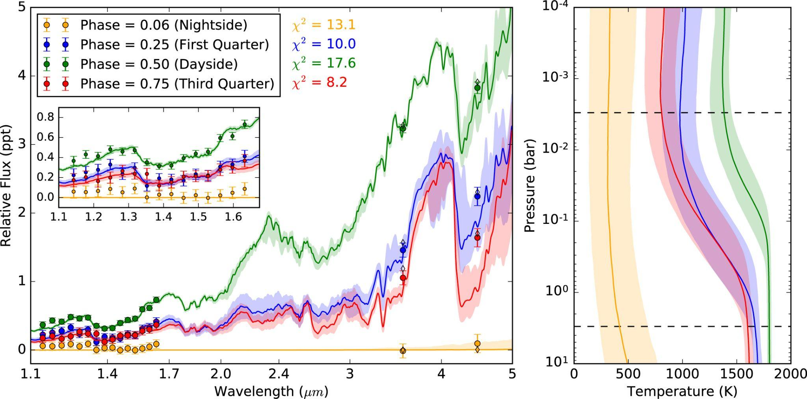
1D Spectral Retrieval Example
Spectrum is longitudinally varying!
Stevenson et al. (2017)

Slide 10
Recently.. Higher Dimensional Models!
1D models:
>1D models:
Multi-dimensional spectral retrieval codes have been introduced showing improved results!
… but they are more complex and computationally expensive
(and not as well tested)

Slide 11
Tidal Locking
Short-period planets tend to be Tidally Locked
Permanent Dayside and Nightside
Image Credit: NASA,ESA, G.Bacon (STScI)

Slide 12
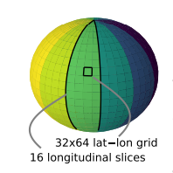
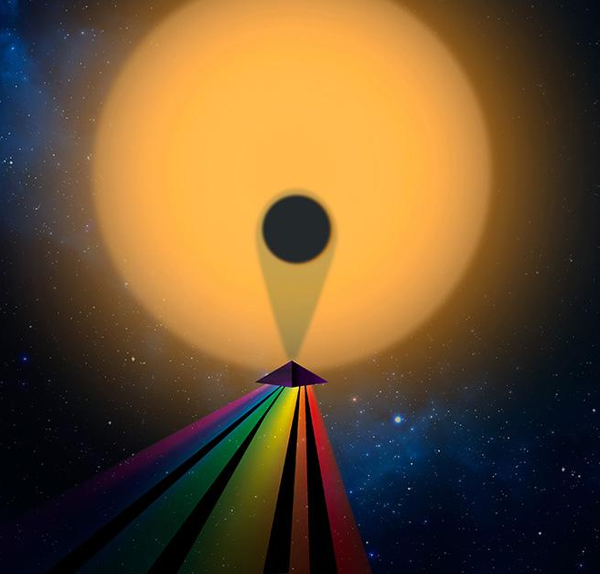
An Alternative - Longitudinally Resolved Spectra
For tidally locked planets observations can be spatially mapped (Cowan & Agol 2008)
Fourier
Magic
Map by Wavelength
Cubillos et al. (2021)
Credit: NASA

Slide 13
Benefits of Spatial Mapping
Spatially Mapped Spectra can be fit using existing tested 1D codes
Takes less time and less complexity than multi-dimensional models
Cubillos et al. (2021)

Slide 14
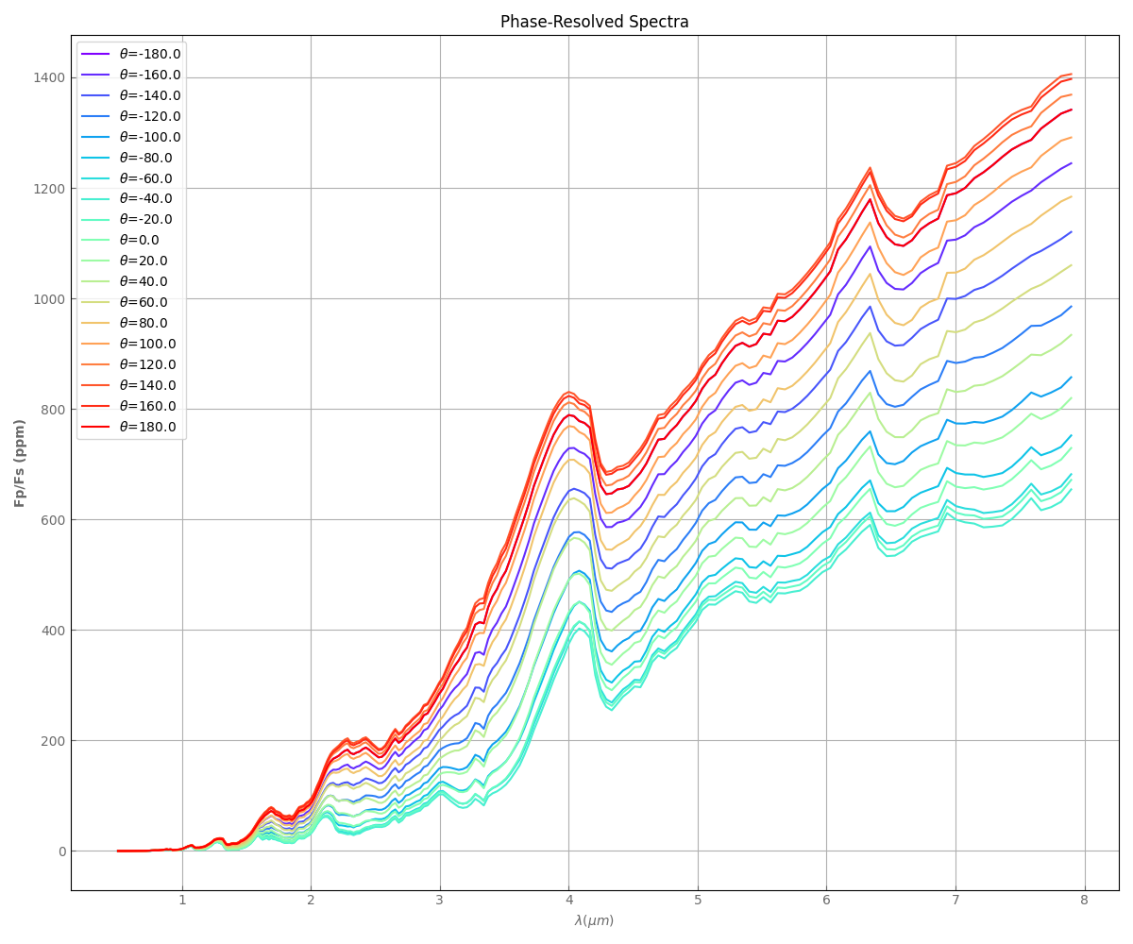
Current Work - Testing Retrieval Methods
Disk Integrated
Longitudinally-Resolved
Multi-Dimensional
Synthetic Spectra of HD 189733b built from Global Circulation post-processed with Radiative Transfer models
Retrieval Results can be compared to “ground truth”

Slide 15
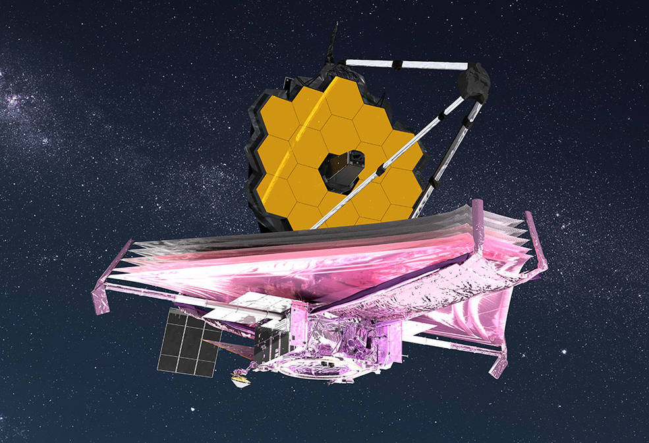
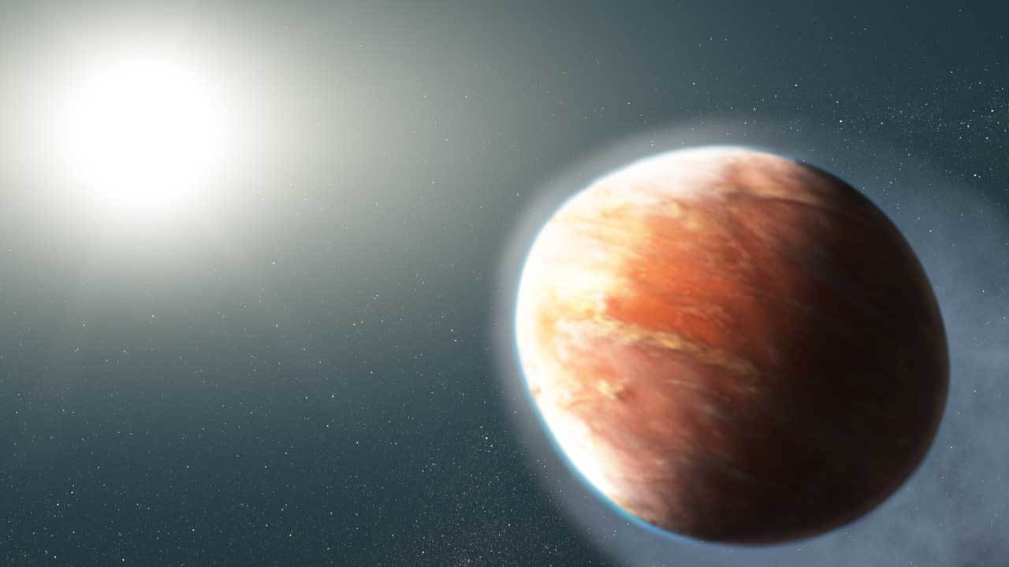
Next Steps - Real JWST Data
JWST observation of exoplanet WASP-121b arrives in October!

Slide 16
Next Steps - Real JWST Data
Part of the NEAT GTO JWST Program!
(NIRISS Exploration of the Atmospheric diversity of Transiting exoplanets)

Slide 17
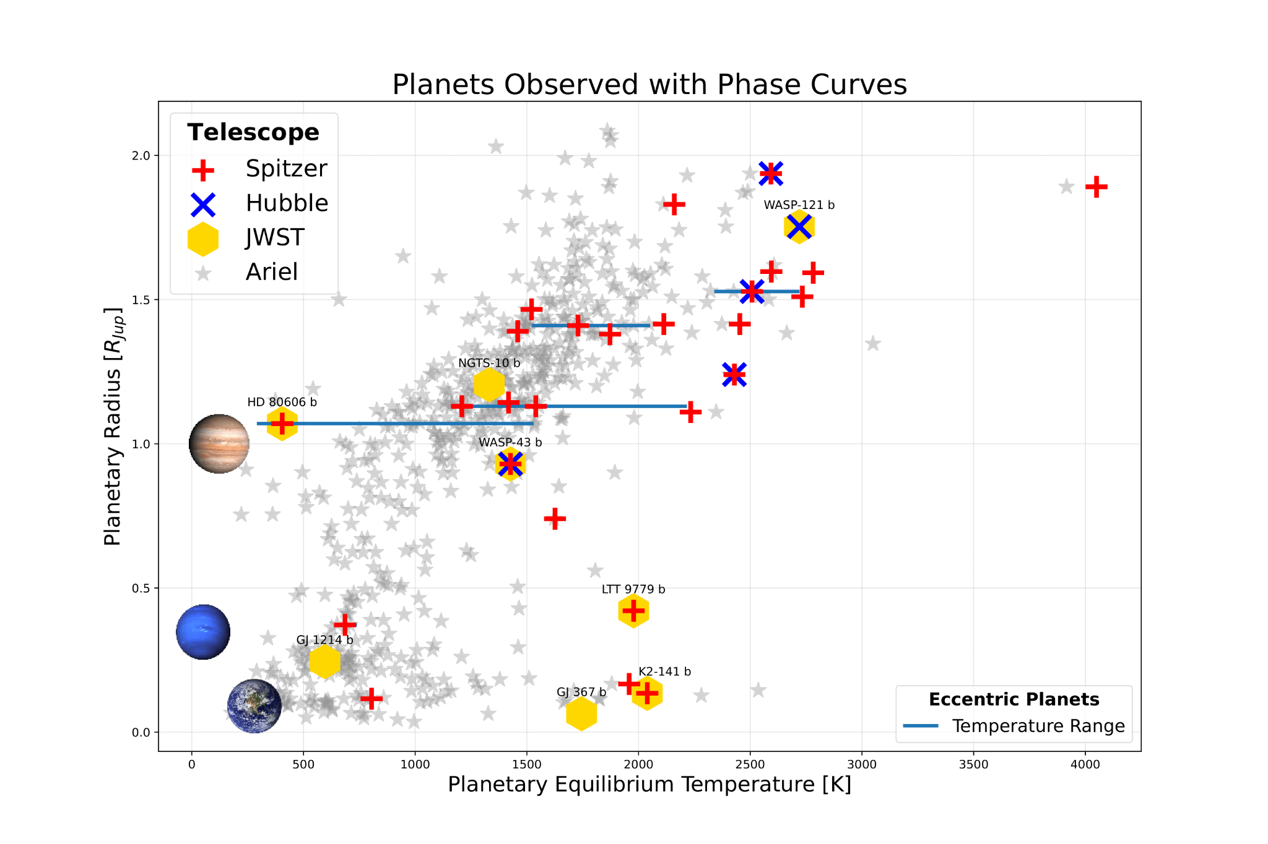
Future Exoplanet Atmospheric Characterization
Image Credit :ESA
Results can be used to help guide science of ESA’s ARIEL Mission
ARIEL telescope (2029)
Will exclusively characterize exoplanet atmospheres
Greatly increase the number of Exoplanet Phase Curves
Ariel added by Cheryl Wang

Slide 18
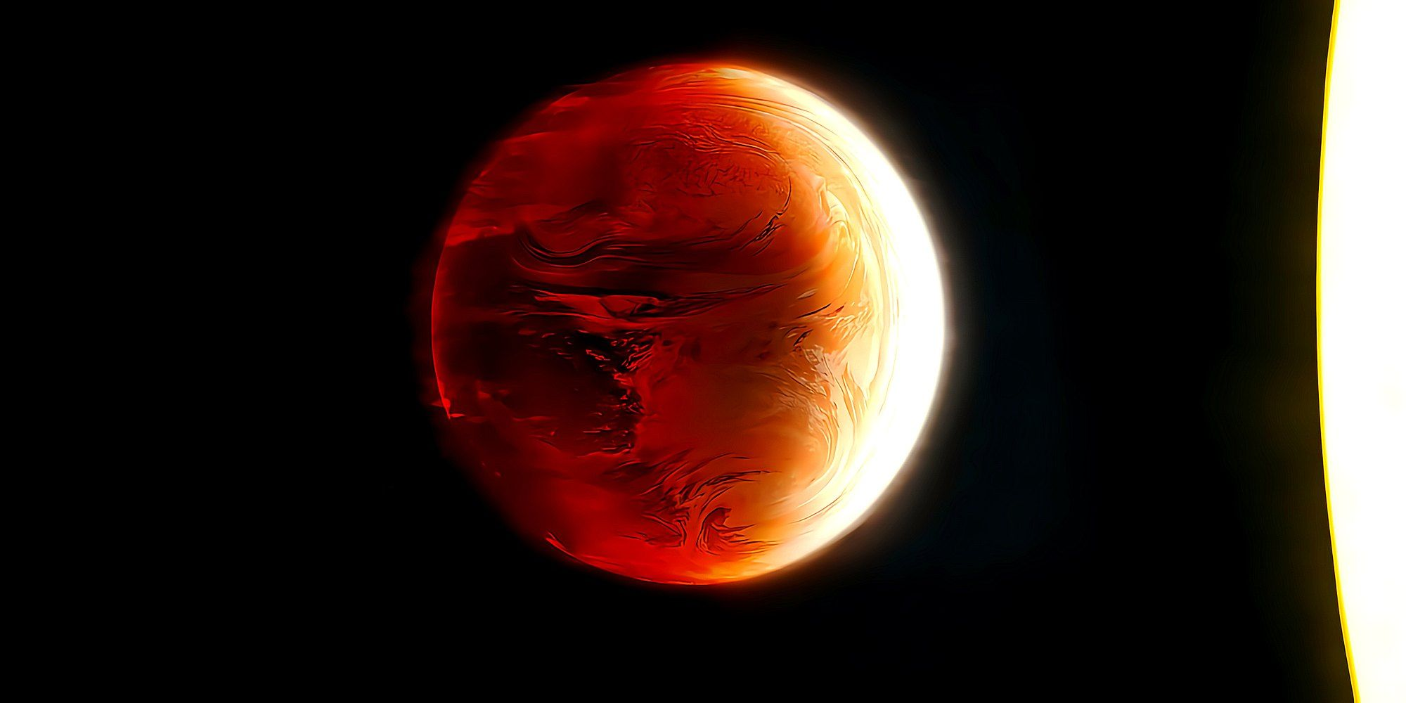
Future Work:
-Characterize more Exoplanets
-Build data pipeline for ARIEL
Thanks for Listening!

