Slide 1
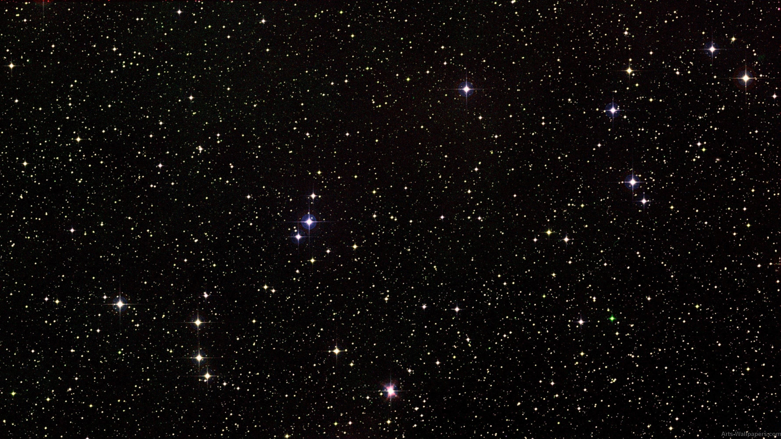
Classifier les amas de galaxies avec des méthodes d’apprentissage automatique
Maria Sadikov Étudiante à la maîtrise à l’Université de Montréal
Supervisée par Julie Hlavacek-Larrondo et Laurence Perreault-Levasseur
10 mai 2023

Slide 2
Galaxy clusters
+
Dark matter
(84% of mass)
+
+
Galaxies
(3% of mass)
Intra-cluster medium (Gas)
(13% of mass)
Supermassive black hole
(negligeable mass)
Image: NASA, ESA, Adam G Riess
Image: EHT Collaboration

Slide 3
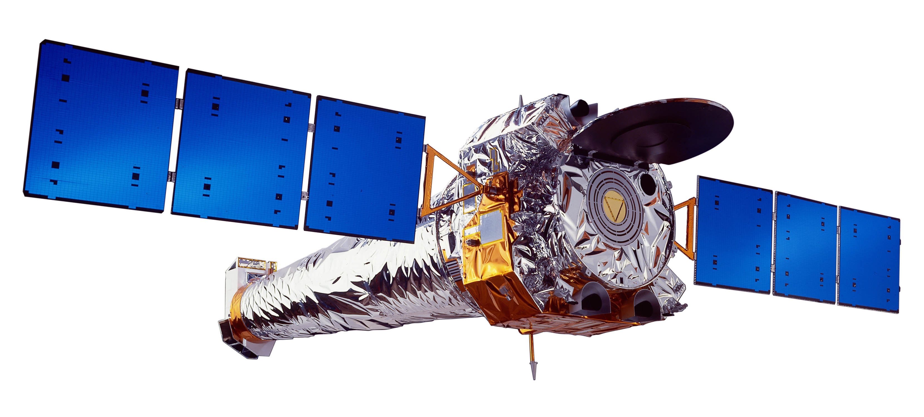
Galaxy clusters
+
Dark matter
(84% of mass)
+
+
Galaxies
(3% of mass)
Intra-cluster medium (Gas)
(13% of mass)
Supermassive black hole
(negligeable mass)

Slide 4
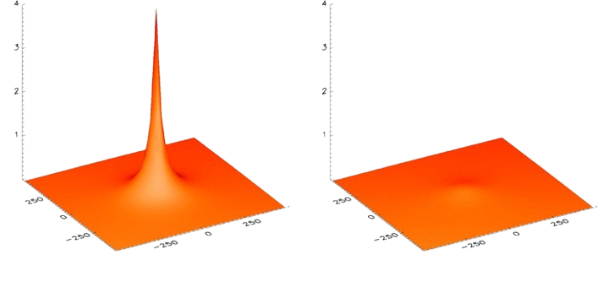
Galaxy cluster classification
Cool core cluster
Non cool core cluster
Brillance de surface (γ s⁻¹ arcmin⁻²)
Brillance de surface (γ s⁻¹ arcmin⁻²)
Distance (kpc)
Distance (kpc)
Distance (kpc)
Distance (kpc)
Peaked X-ray emission
Uniform X-ray emission
Images: Million & Allen

Slide 5
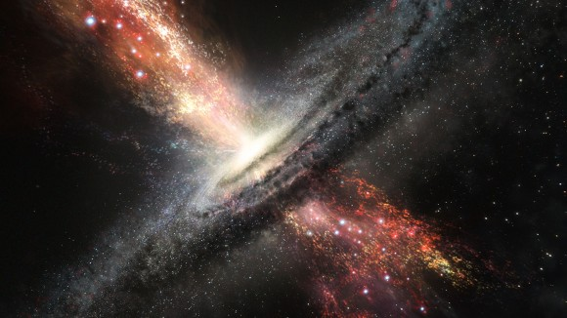
Galaxy cluster classification
Cool core cluster: the gas gets heated by the SMBH through AGN feedback
relativistic jets (transfer energy to the ICM)
accretion disk around black hole
Image: Nature

Slide 6
Galaxy cluster classification
Traditionnal methods are time-consuming & biased
Future X-ray surveys (such as eROSITA) will provide very large amounts of data!
We need a fast & efficient method of analyzing it machine learning
Image: eROSITA, Max Planck Institute

Slide 7
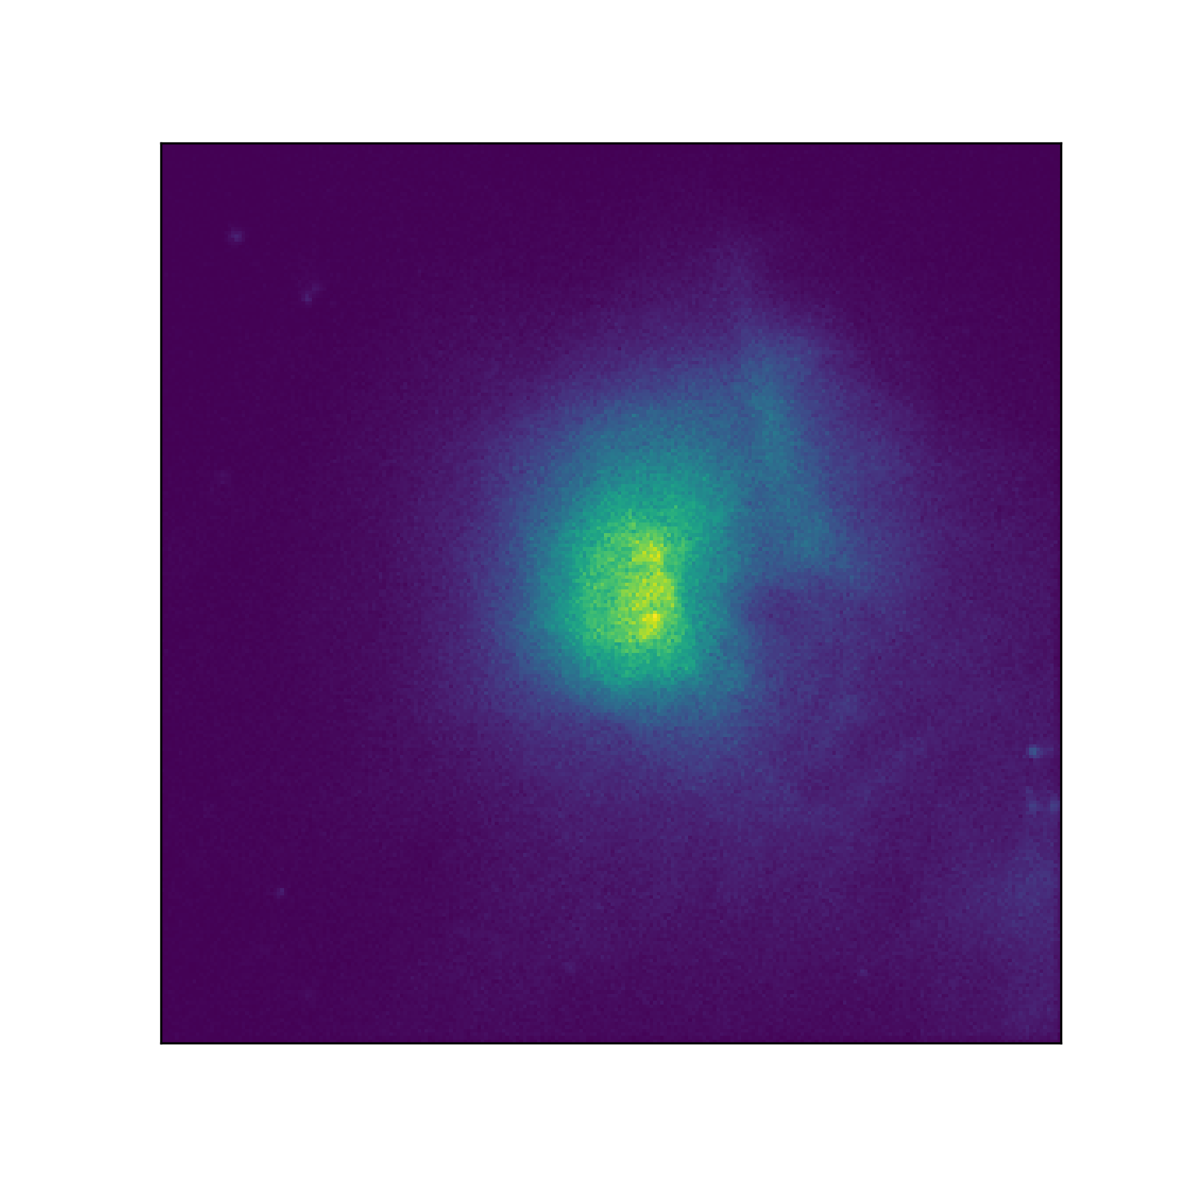
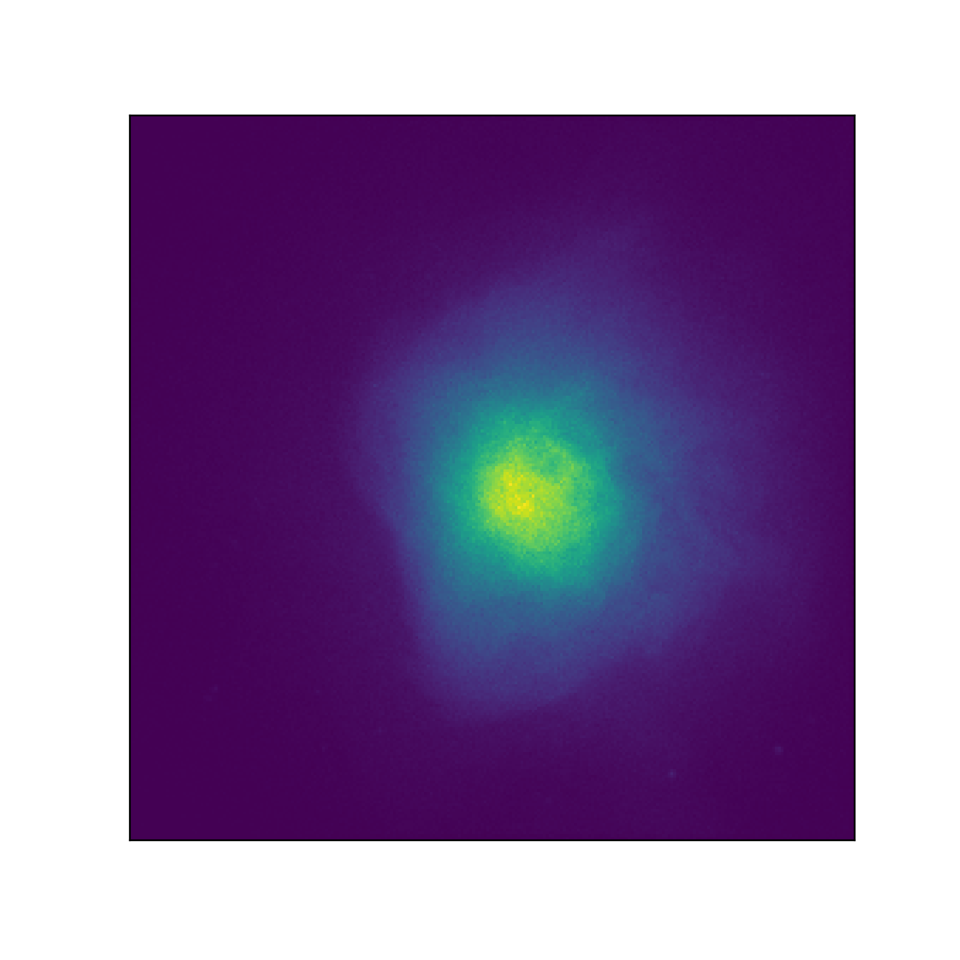
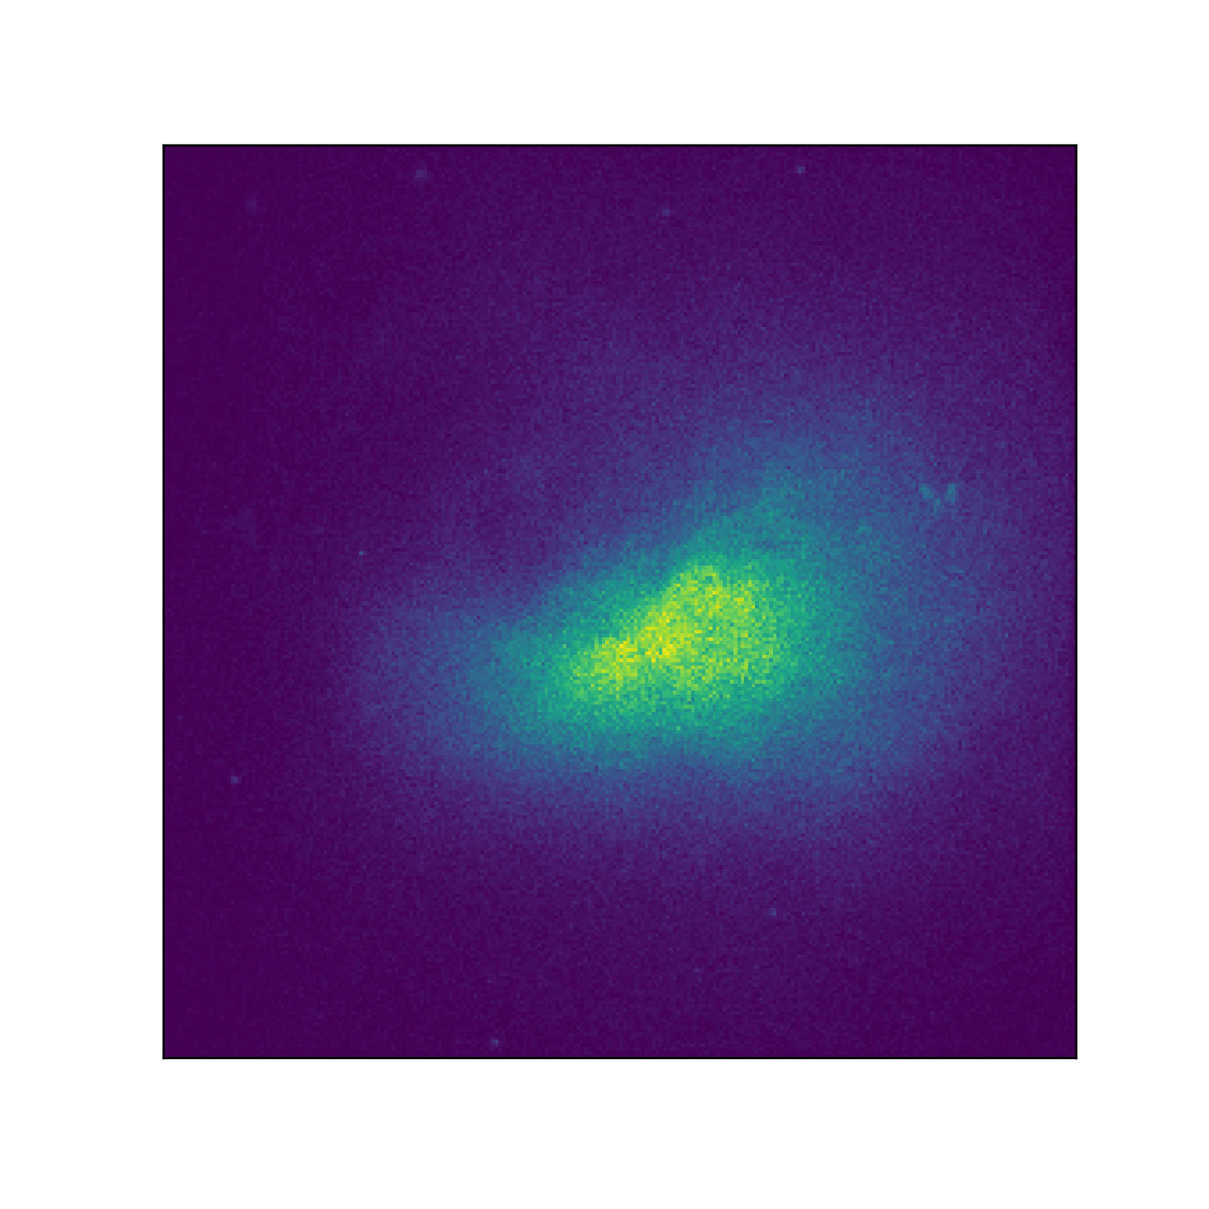
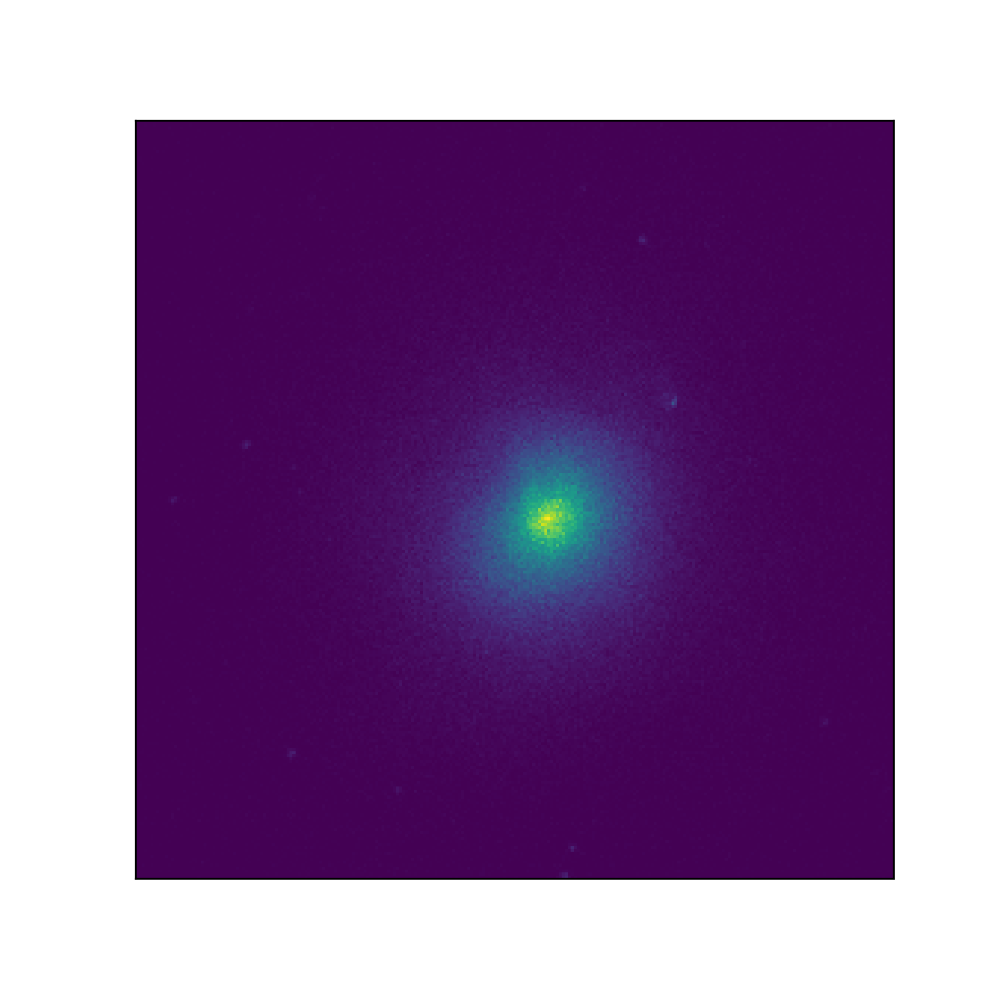
Data
Cosmological hydrodynamical simulations (Illustris TNG)
ICM physical properties
Simulated Xray images
Metrics (Labels)

Slide 8
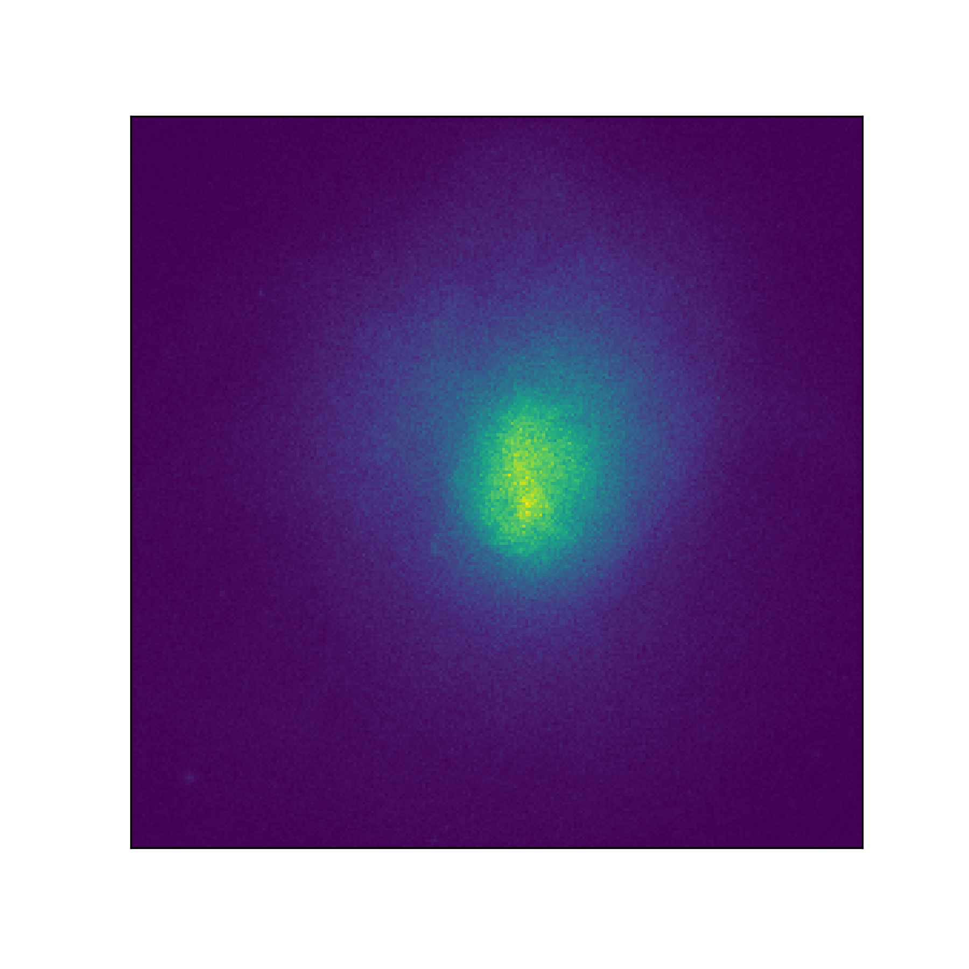
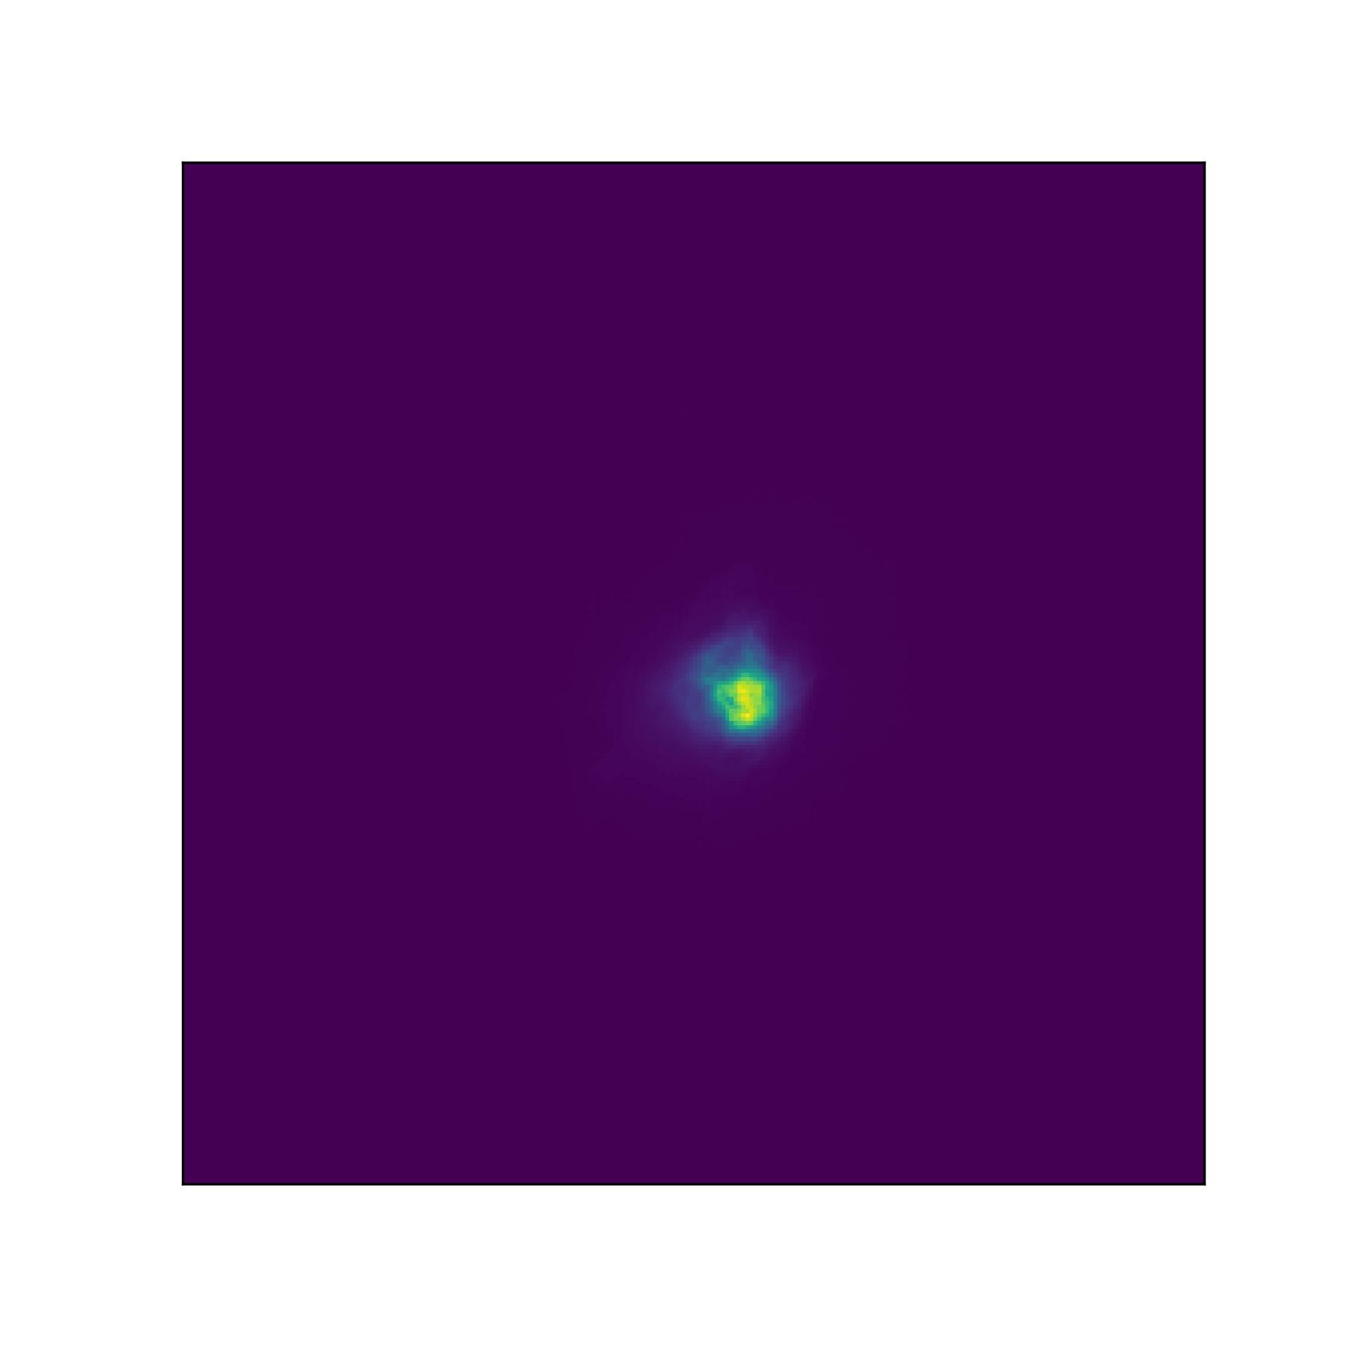
Classification metrics
Central cooling time
Central electron density
Central entropy
Concentration parameter
Non cool-core
Cool-core

Slide 9
Classification metrics
t_{cool =}
3(n_{e}+n_{p})kT 2 n_{e}n_{H}ᴧ(T,Z)
Central cooling time
Central electron density
Central entropy
Concentration parameter

Slide 10
Classification metrics
Central cooling time
Central electron density
Central entropy
Concentration parameter

Slide 11
Classification metrics
k_{B}T
n_{e}^{2/3}
K=
Central cooling time
Central electron density
Central entropy
Concentration parameter

Slide 12
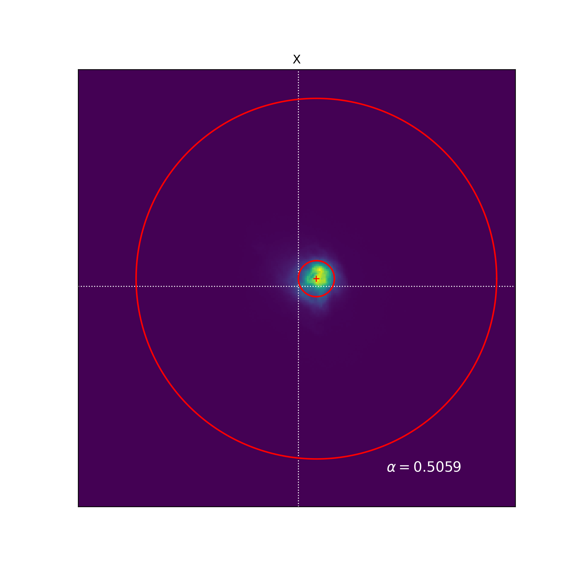
Classification metrics
CSB (<40 kpc)
CSB (<400 kpc)
⍺ =
Central cooling time
Central electron density
Central entropy
Concentration parameter

Slide 13
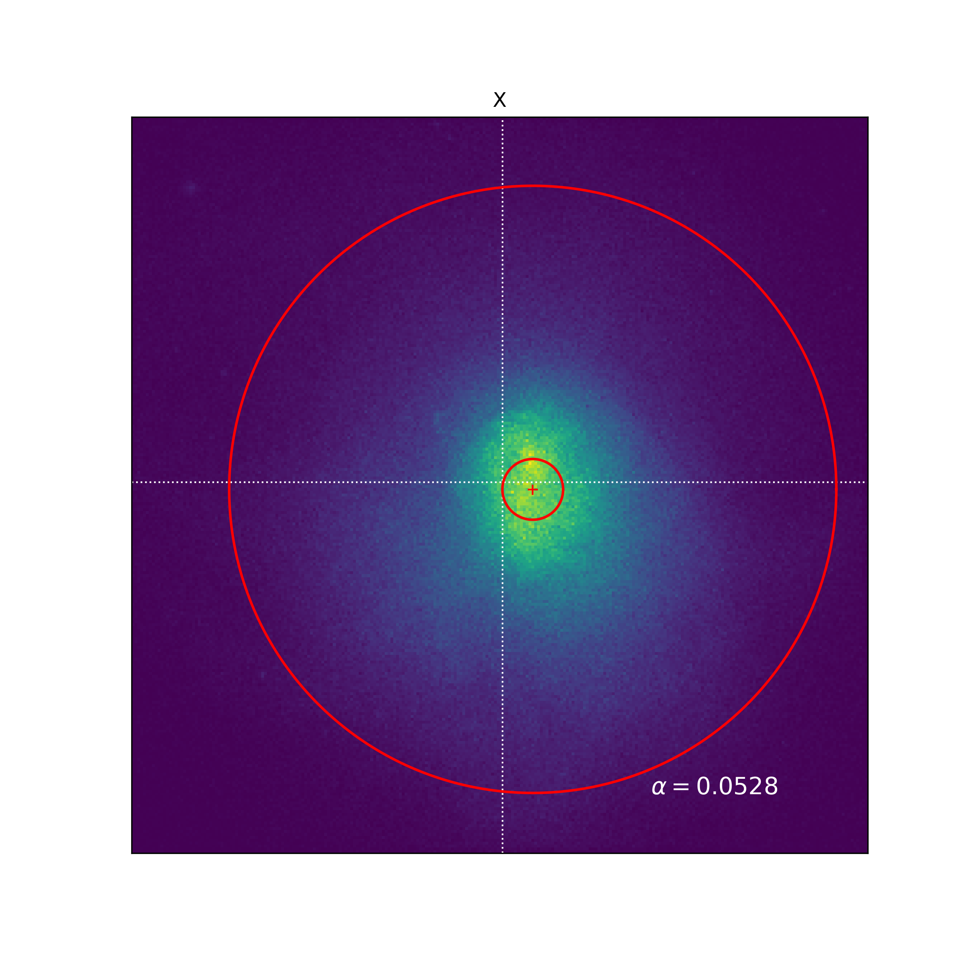
Classification metrics
CSB (<40 kpc)
CSB (<400 kpc)
⍺ =
Non cool-core
Cool-core
Notes:
Encore une fois, voici la comparaison pour nos deux amas charactéristiques + commenter.
- Les métriques ne sont pas toujours en accord!!

Slide 14
Neural network: ResNet (for now)
CCT
Conv
POOL
Batch Norm
FC layers
Conv
Batch Norm
Batch Norm
Conv
Batch Norm
Conv
…
n_{e}
K₀
⍺
Input: image

Slide 15
Merci!
contact: maria.sadikov@umontral.ca

