Slide 1
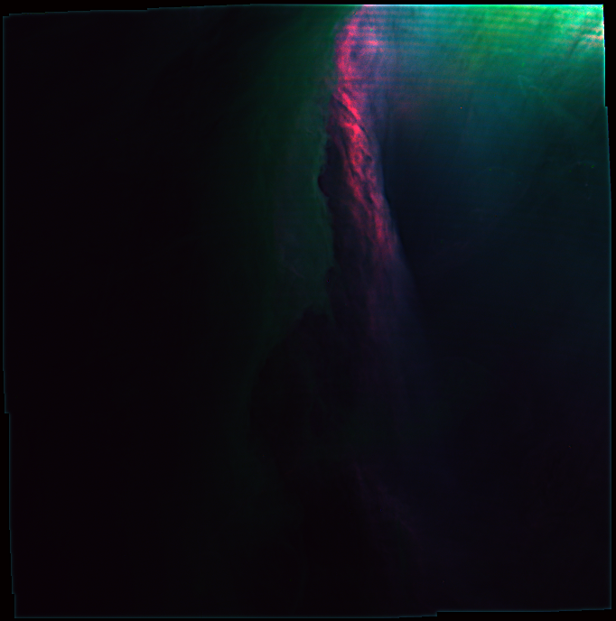



Tackling the Orion Nebula with SITELLE :
a thermodynamic approach
CRAQ Annual Meeting 2023
Maxime Royer Ph. D.
May 10 2023

Slide 3
X ≠ Y

Slide 4
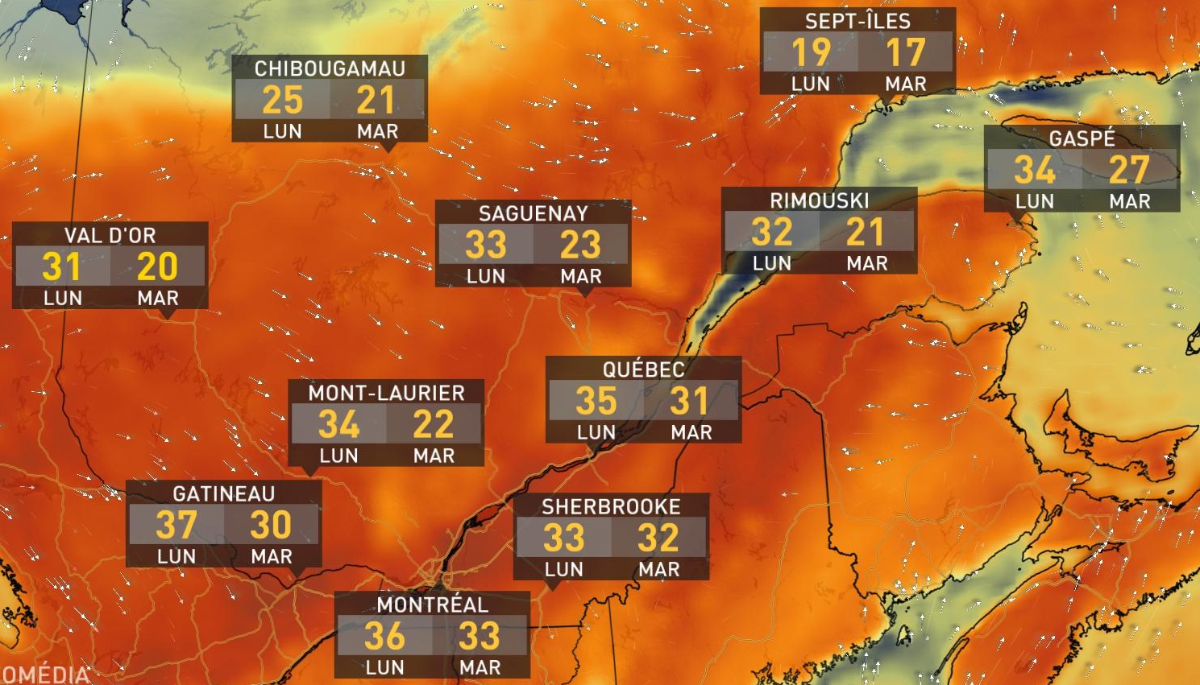

Slide 5
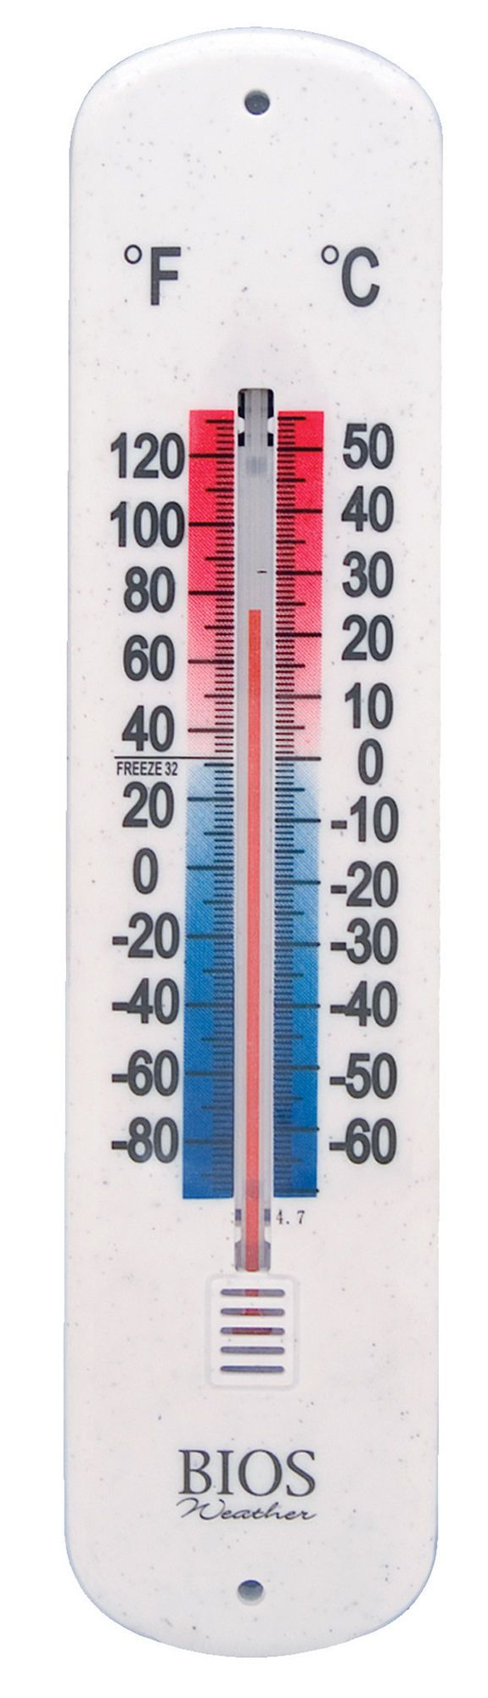
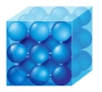

Slide 6
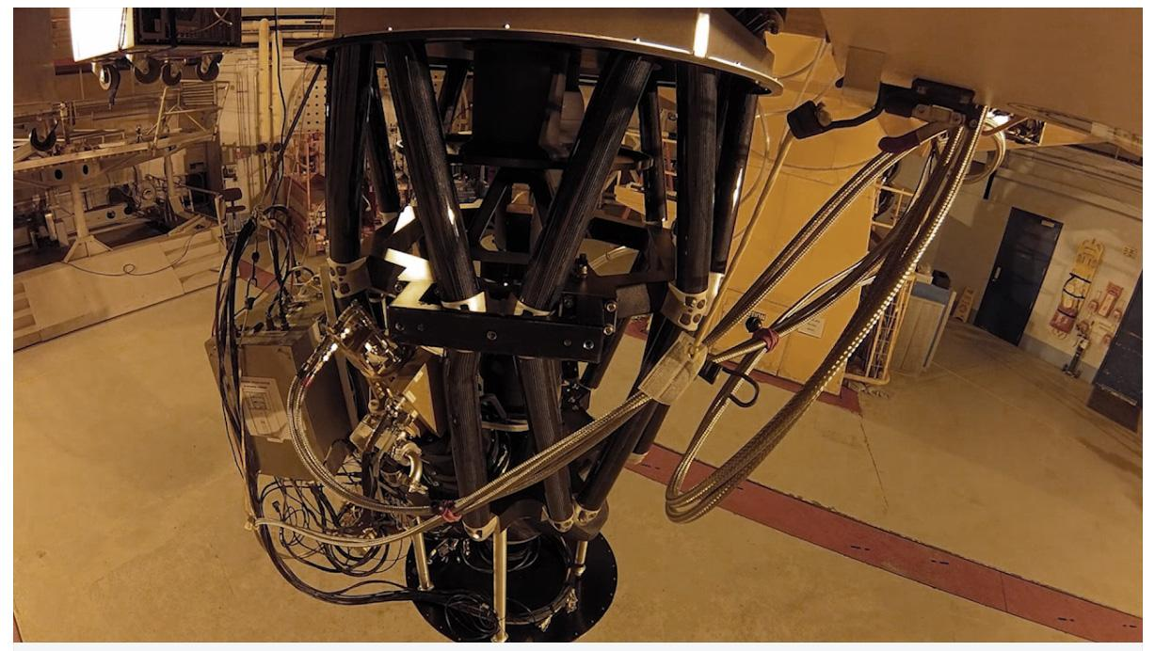
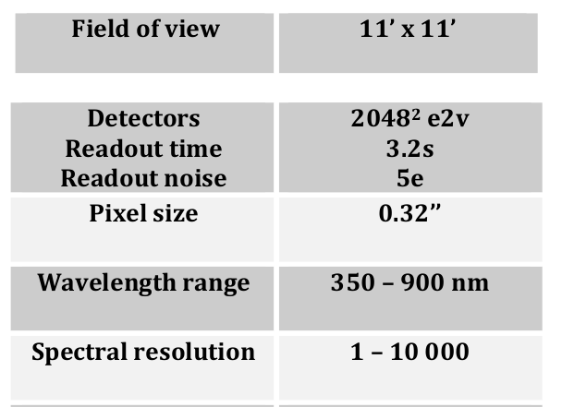

Slide 7
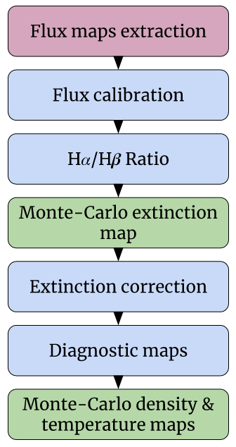

Slide 8
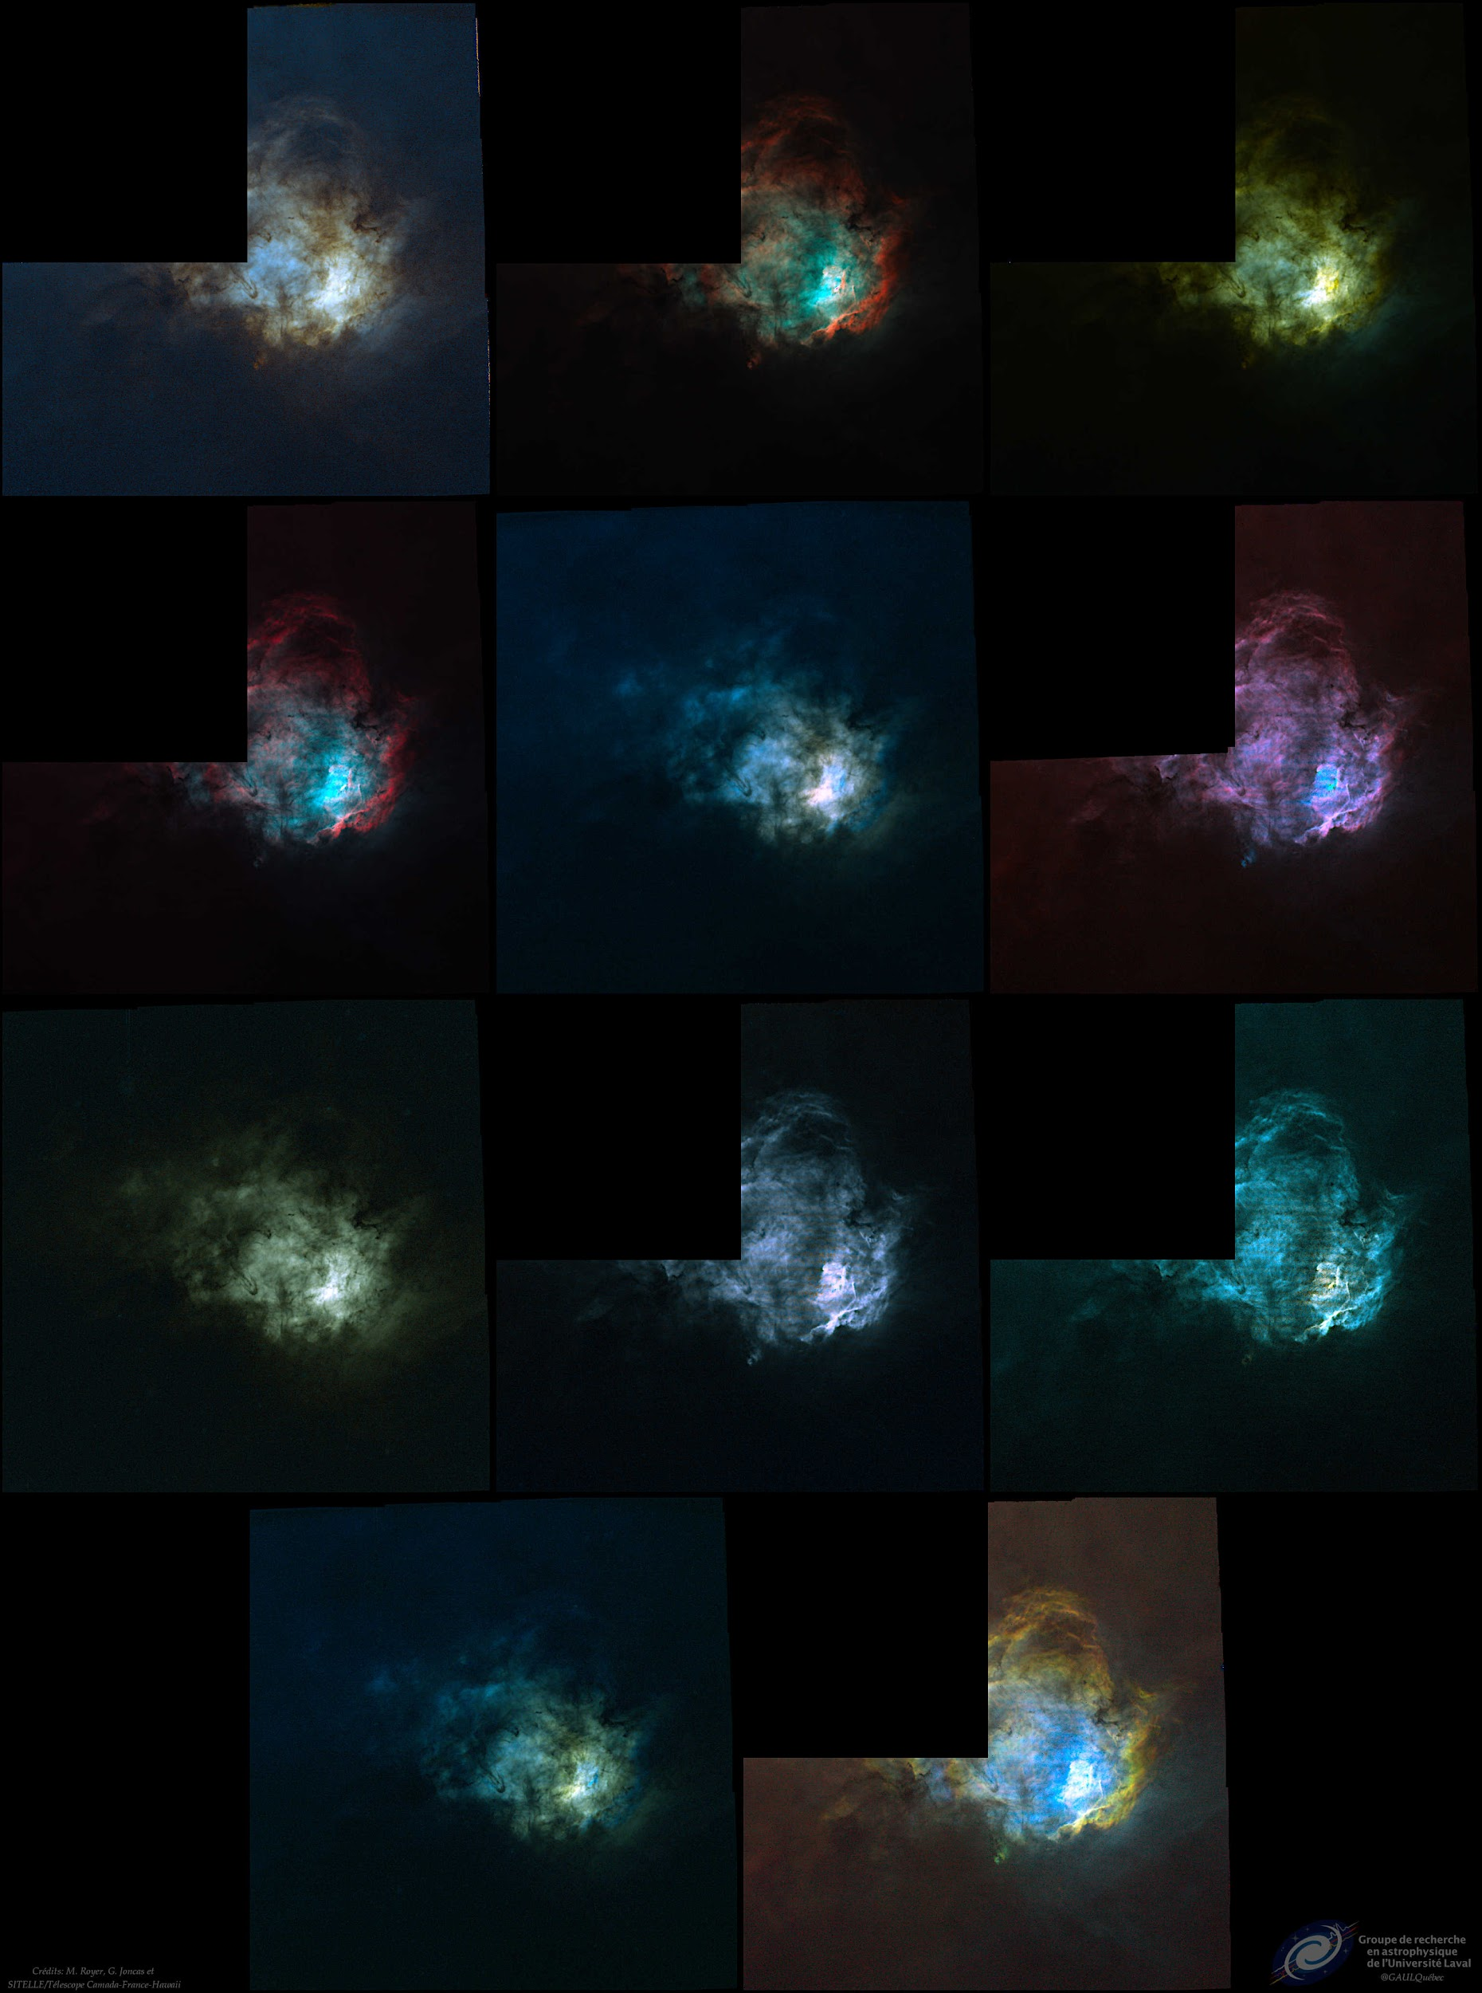

Slide 9
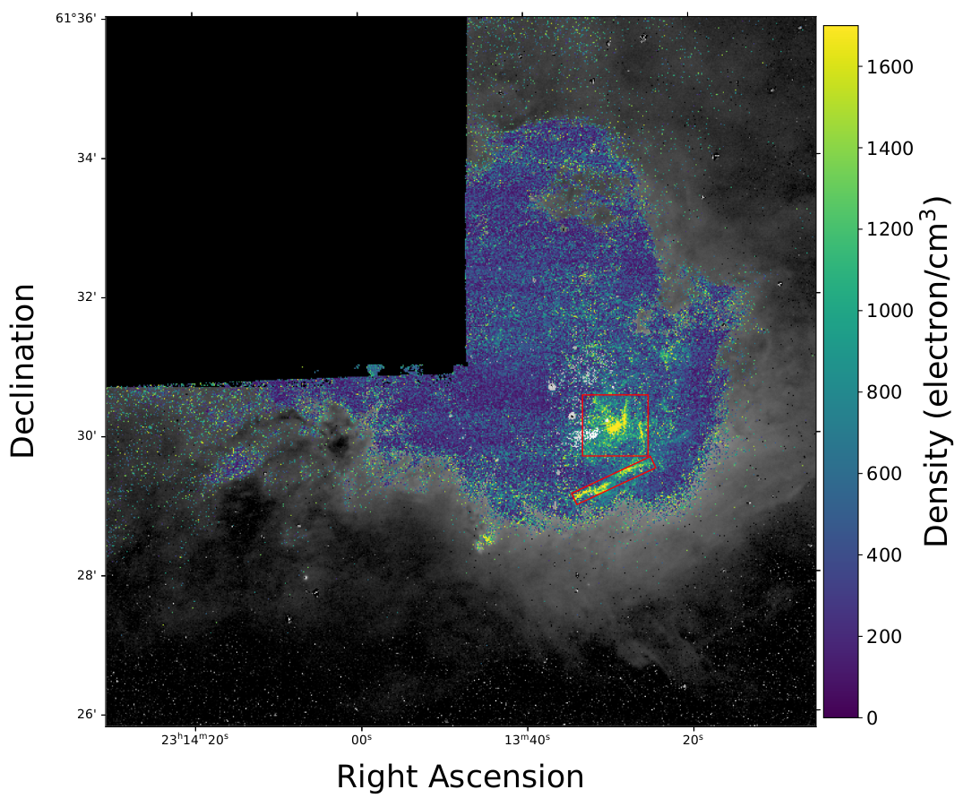
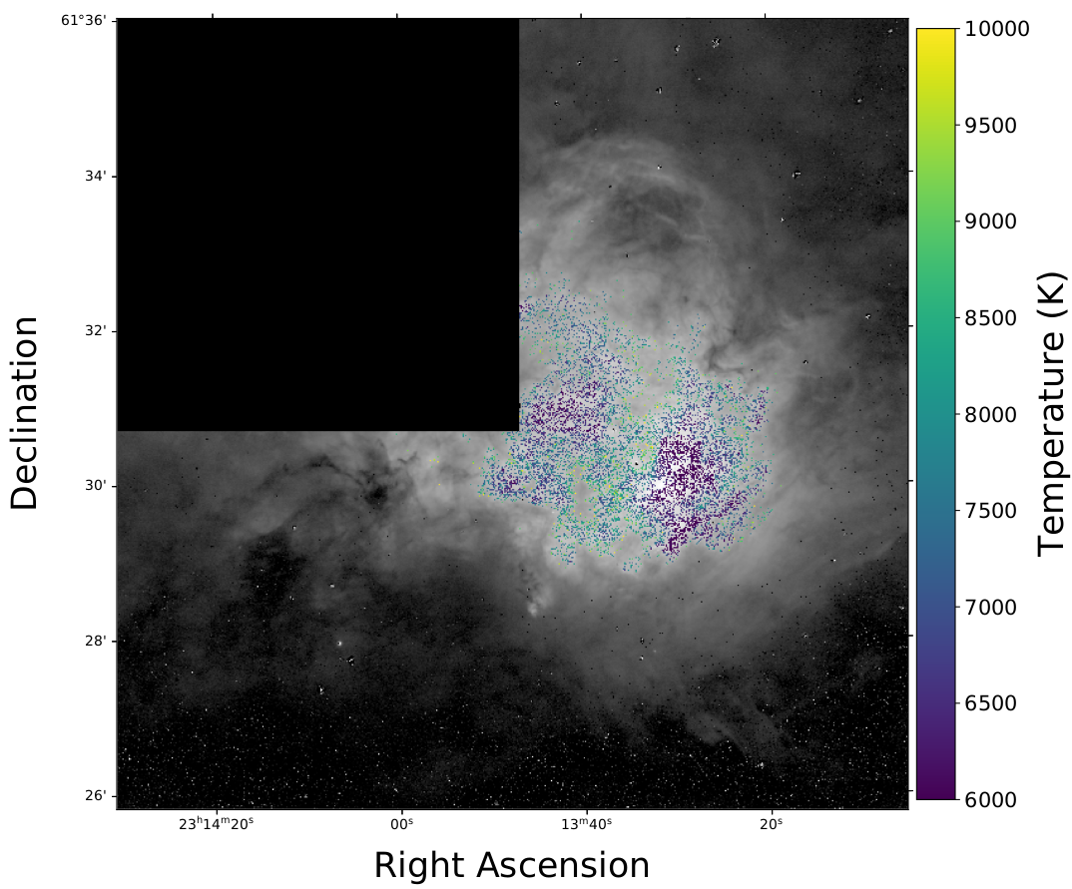
[SII] Median = 390 ± 210 electrons/cm³
[NII] Median = 7160 ± 570 K

Slide 10
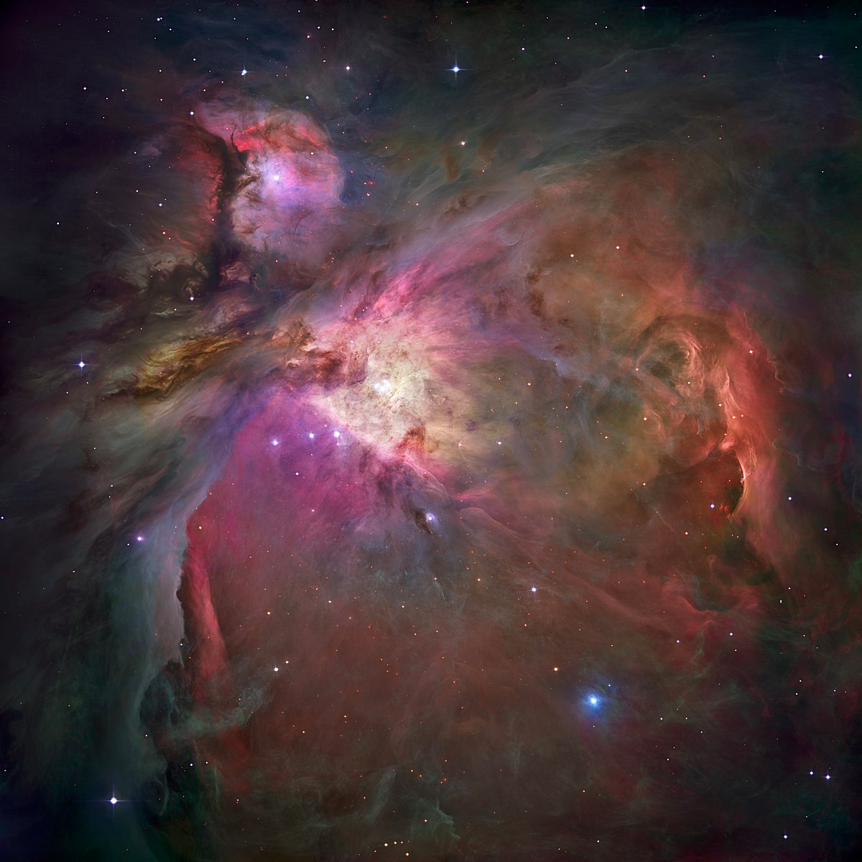

Slide 11
The target

Slide 13
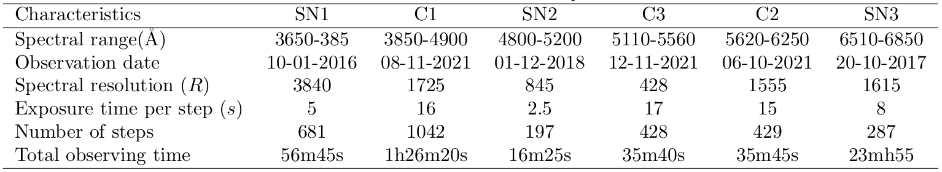

Slide 14
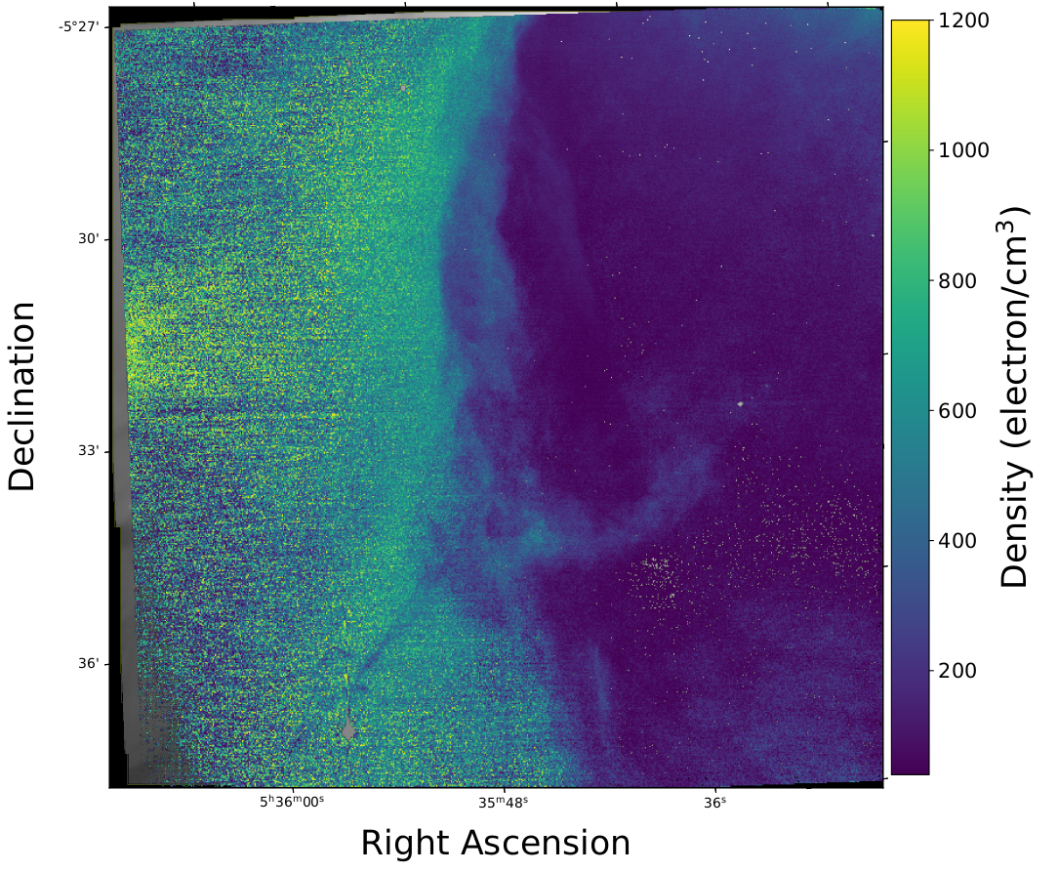
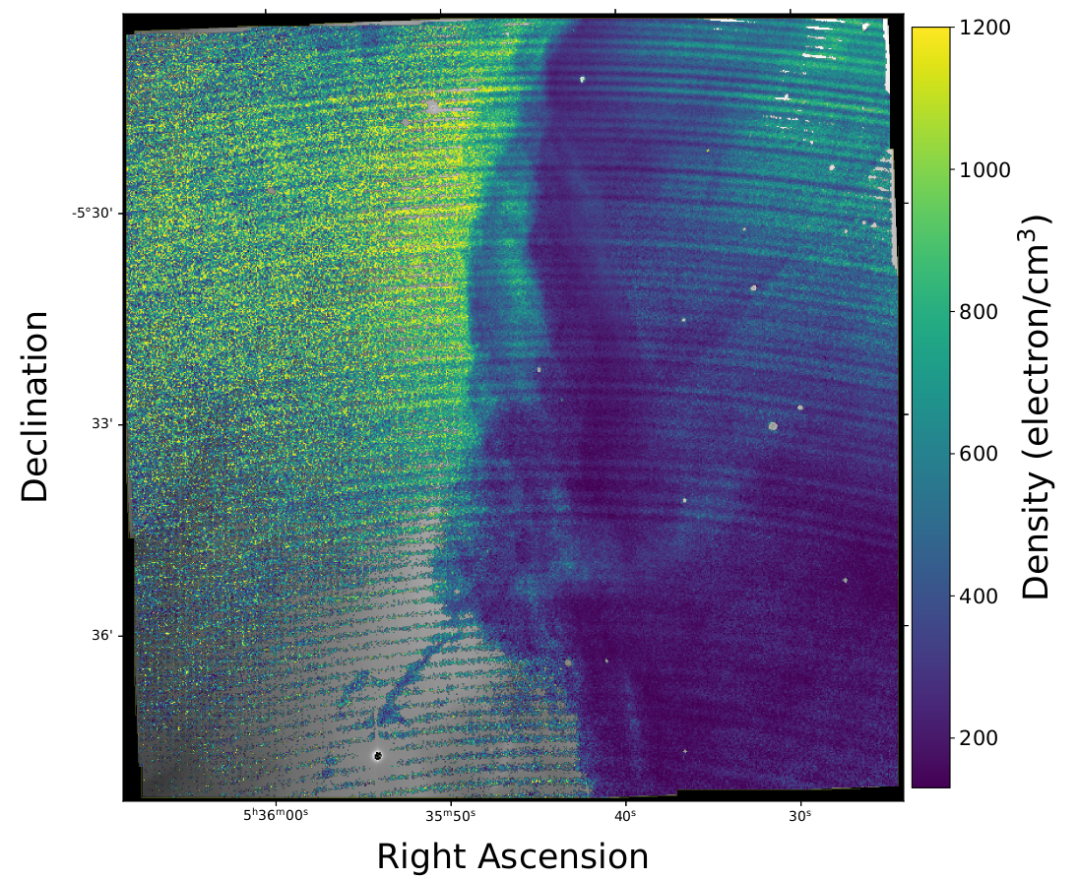
[OII] median = 230 ± 40 electrons/cm³
[SII] median = 415± 310 electrons/cm³

Slide 15
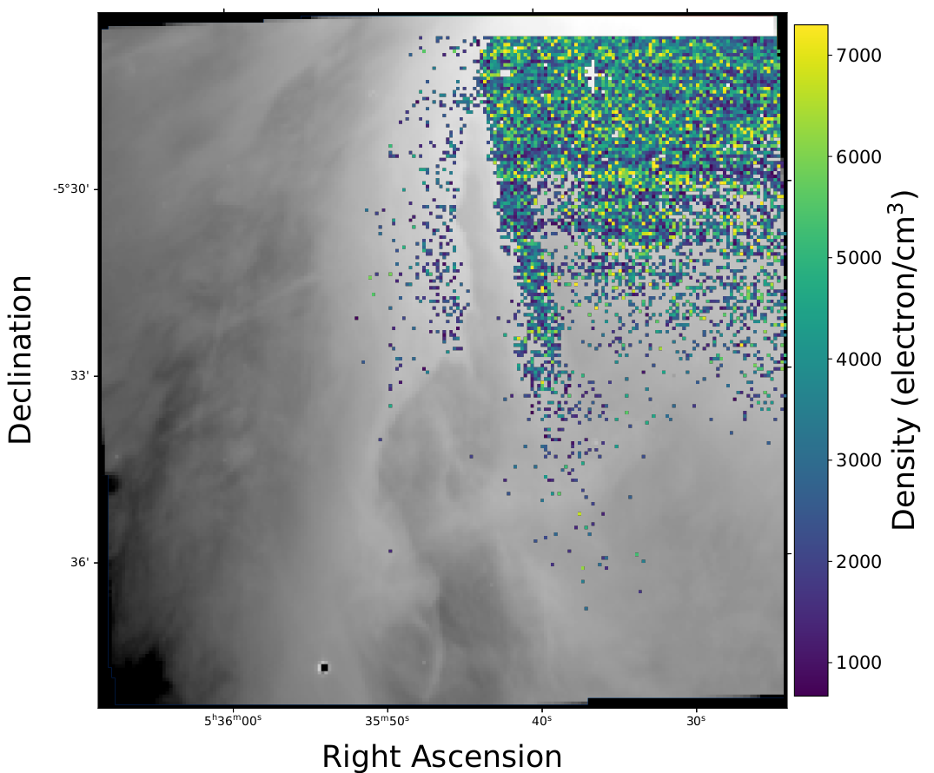
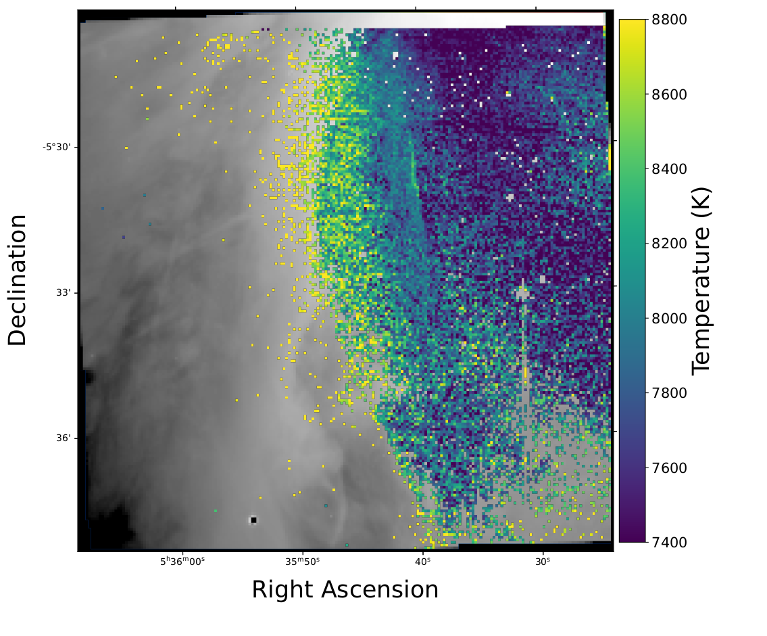
[ClIII] median = 3295 ± 1800 electrons/cm³
[NII] median = 7810 ± 420 K

Slide 16
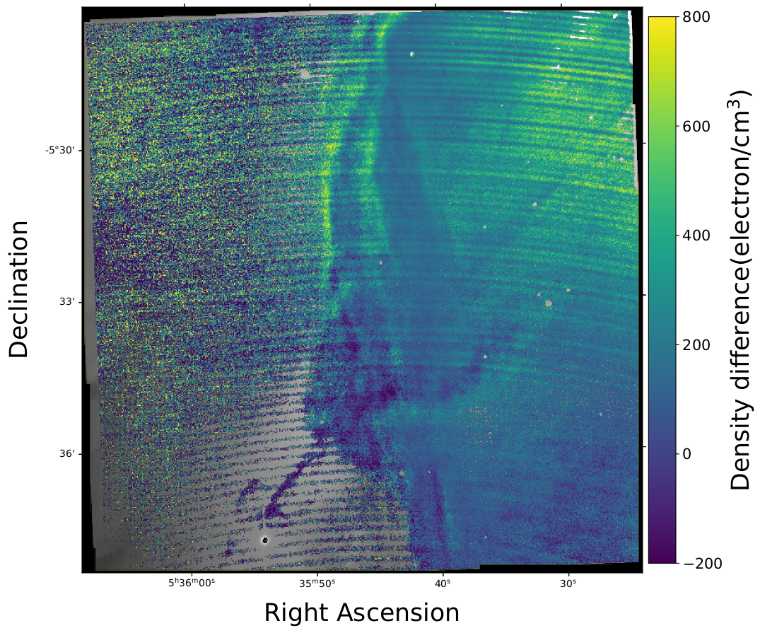
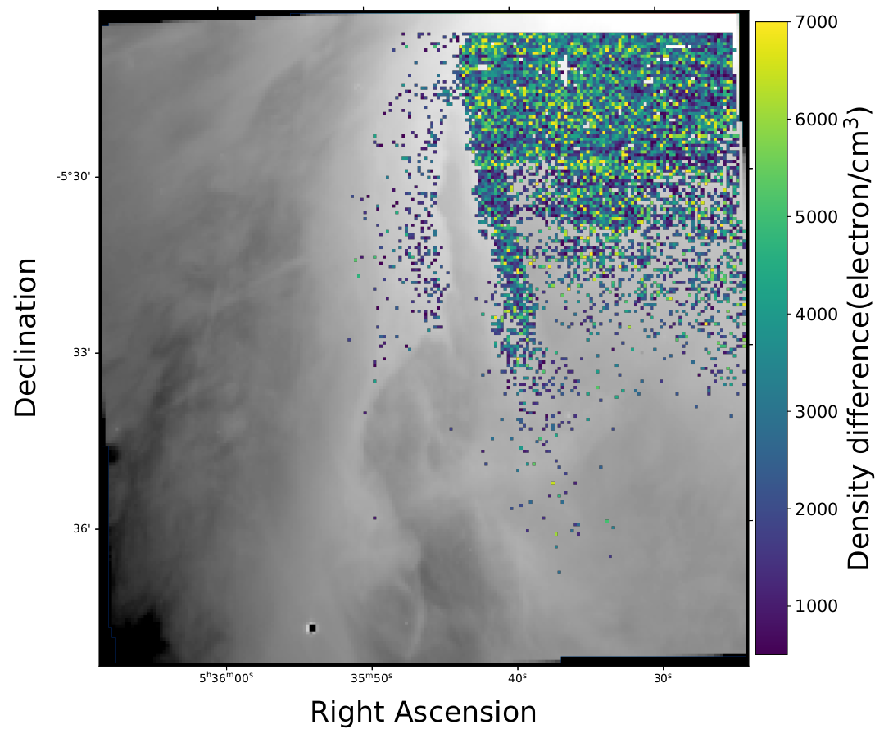
Median difference [SII] vs [OII] = +170 electron/cm³
Median difference [CLIII] vs [SII] = +2860 electron/cm³

Slide 17
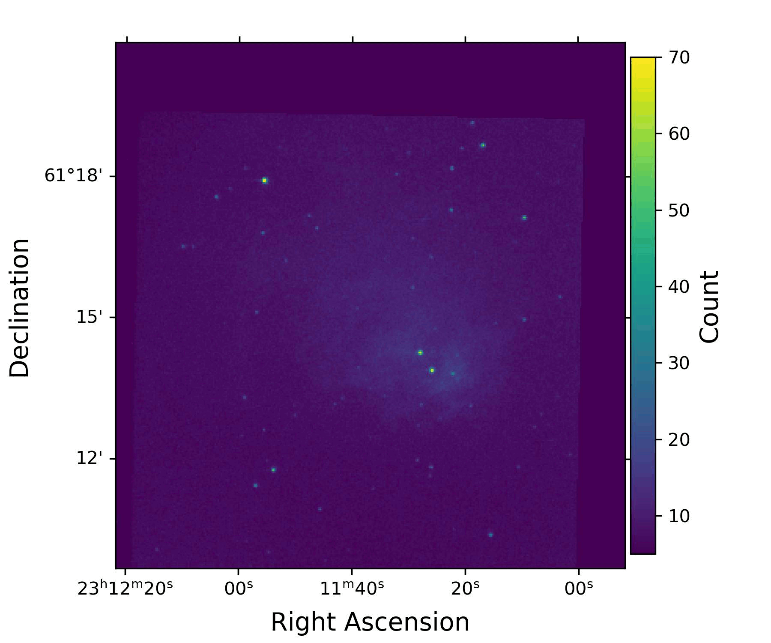

Slide 18
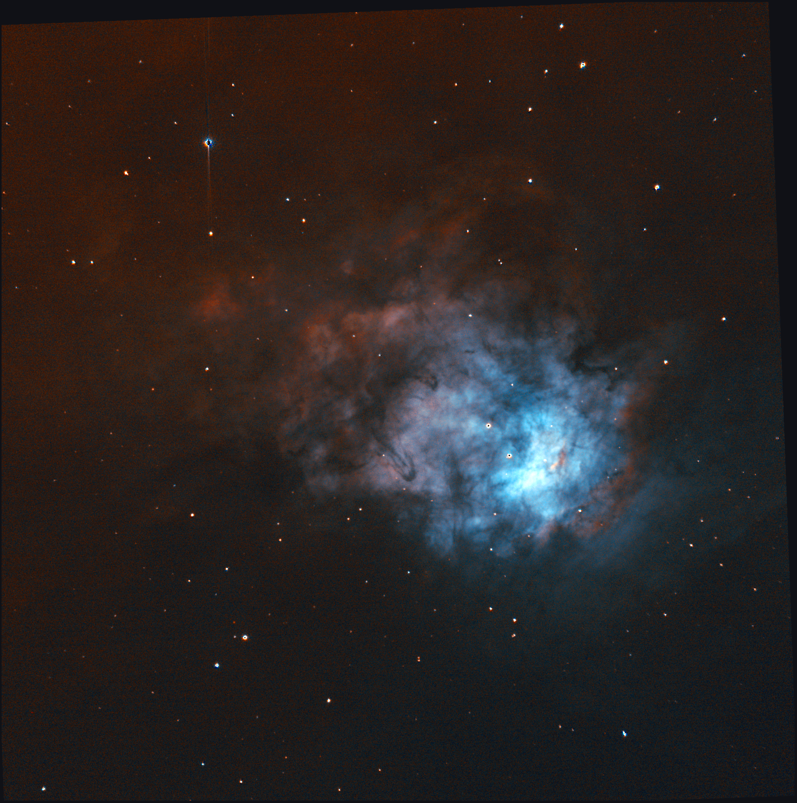
Tackling the Orion Nebula with SITELLE : a thermodynamic approach
Questions?
CRAQ Annual Meeting 2023
Maxime Royer Ph. D.
May 10 2023

