Slide 1
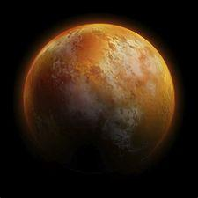
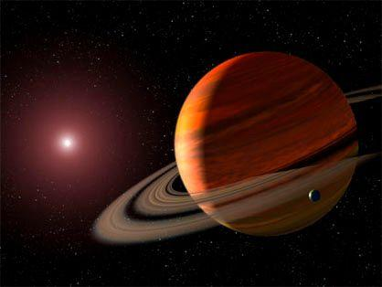
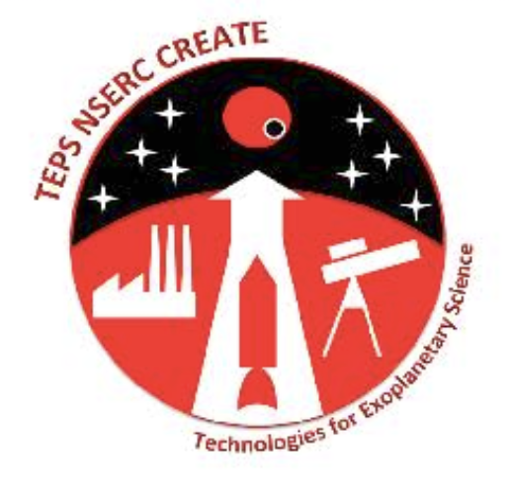
Image credits: NASA
A population of small low-density water world candidates
Caroline Piaulet (PhD student)
University of Montreal
Advisor: Björn Benneke
Project undertaken in collaboration with D.P. Thorngren
CRAQ Meeting, May 2023
Notes:
Hi everyone I am C Piaulet, PhD in BB group
One of the main goals of exoplanet science and One of my main research interests lies in
Remembering that revealing the diversity of outcomes of planet formation is one major goals of exoplanetary science,
Today I want to share with you the story of how the Kepler-138 system opened for us an unprecedented window into the nature of small temperate exoplanets

Slide 2
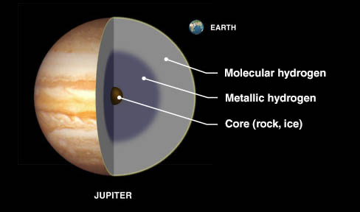
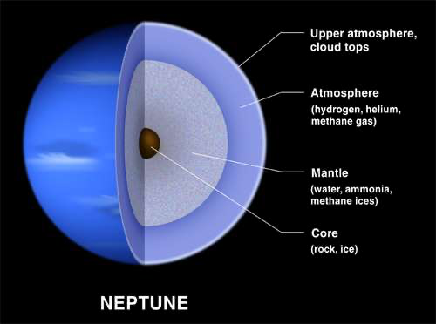
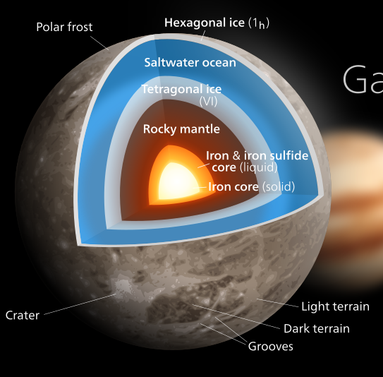
Compositions are diverse in the Solar System
Ganymede
Moon of Jupiter
Jupiter
Earth
Neptune
Image credits : Benoit Gougeon (UdeM), NASA, Kenvinsong

Slide 3
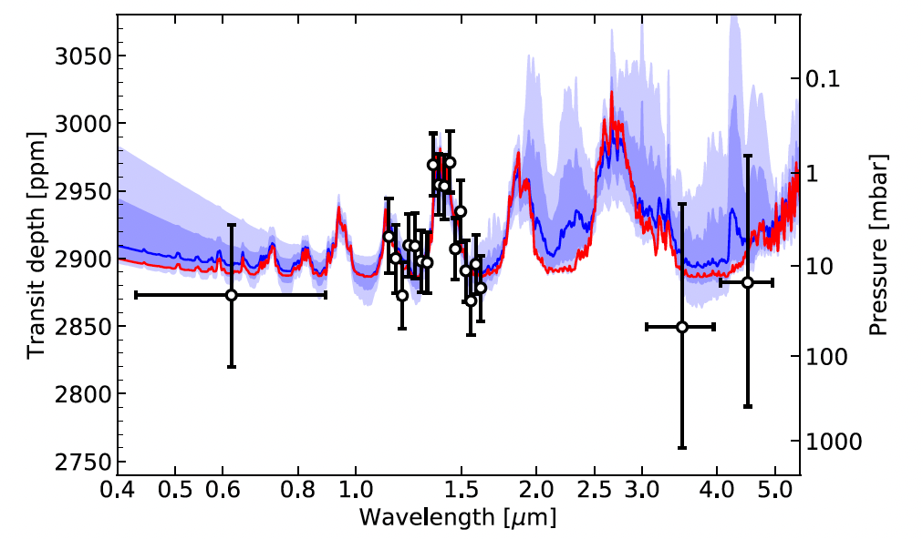
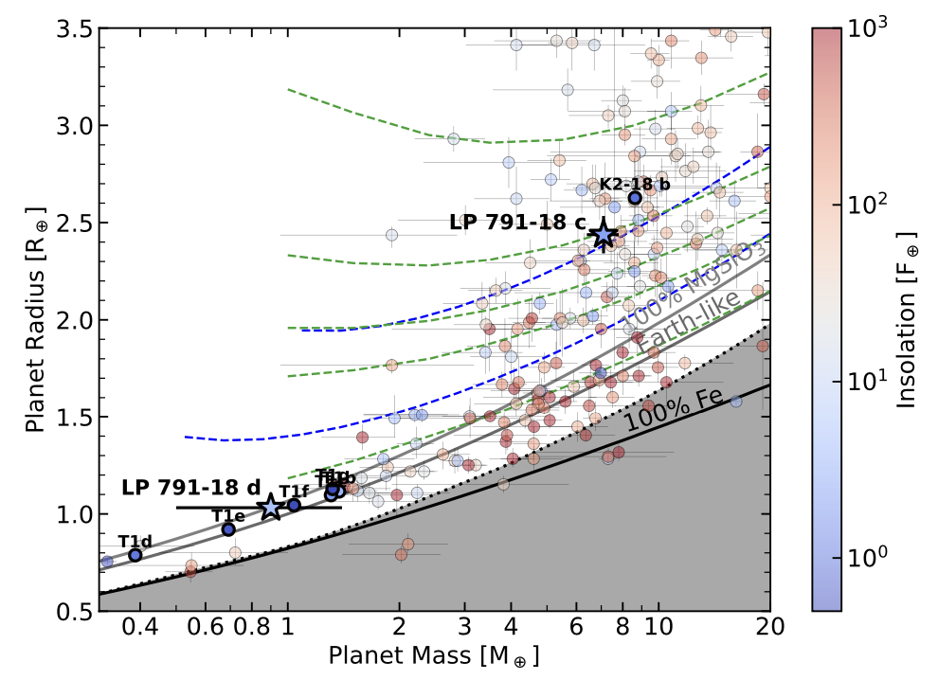
Compositions are hard to ascertain for exoplanets
5% H/He
2% H/He
50% H2O
1% H/He
10% H2O
Benneke, Wong, Piaulet, et al. (2019)
K2-18 b has a hydrogen-dominated cloudy upper atmosphere...
... but is there water below the H/He layer ? (Madhusudhan+, 2020, 2021)
Adapted from Peterson, Benneke, Collins, Piaulet et al.
2023, Nature, accepted

Slide 4
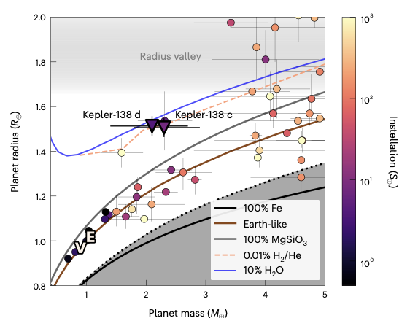
Using extremes to resolve degeneracies
Looking out for the keystone planets that “should not exist” if compositions could only be rock + H/He:
Radius valley
Low-density small planets
Figure dapted from Piaulet et al. (2022)

Slide 5
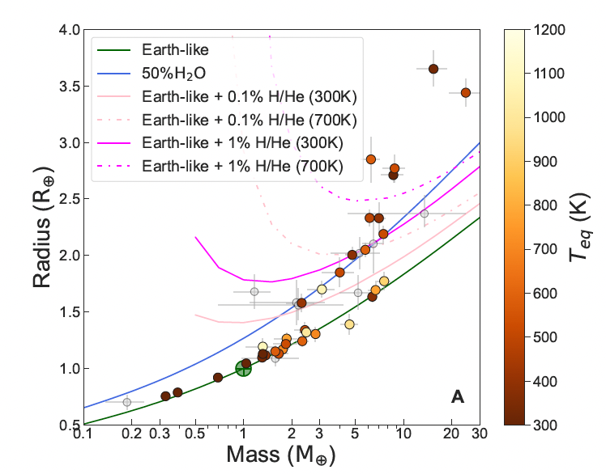
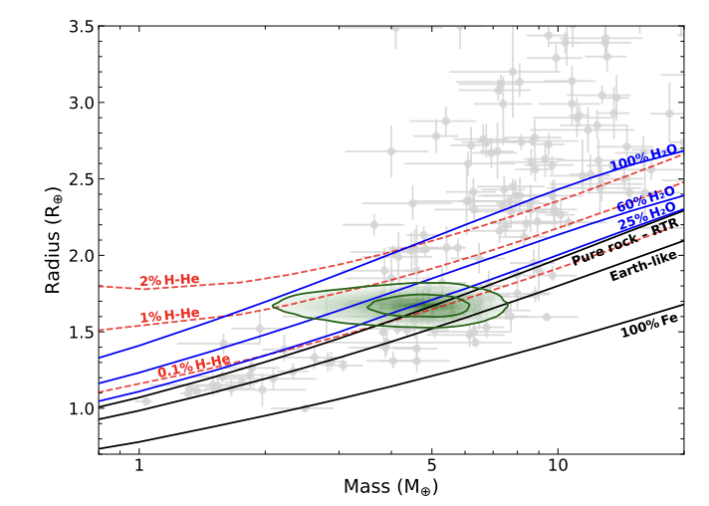
An emerging population...
TOI-1452 b
Adapted from Cadieux et al. (2022)
Luque and Pallé (2022)

Slide 6
A populated “wedge” for ice-rich candidates
HEAVIER
Consistent with
rocky composition
1
MASS REL. TO
EARTH-LIKE
COMPOSITION
LIGHTER
Ice-rich ‘water
world’ candidates
Consistent with
H/He-rich

Slide 7
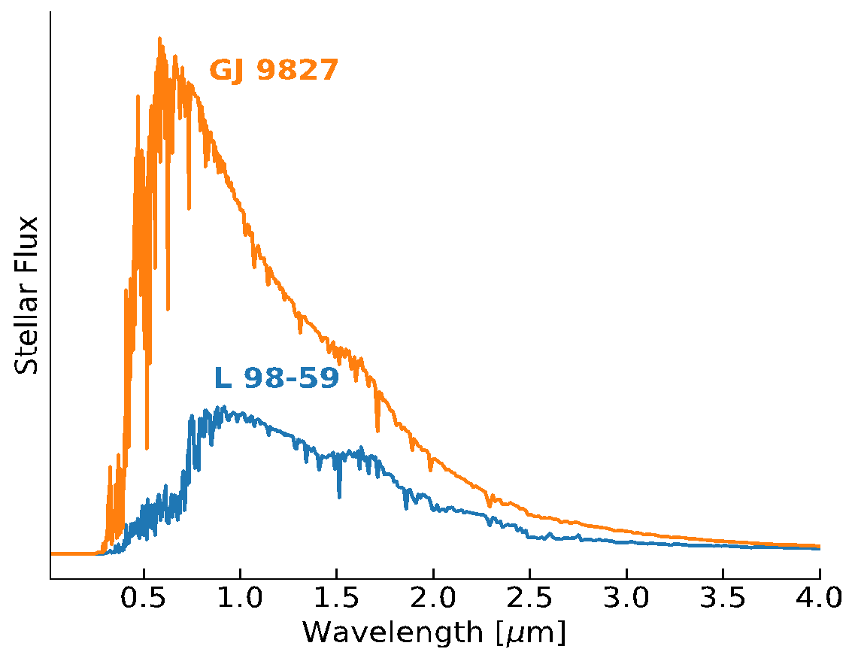
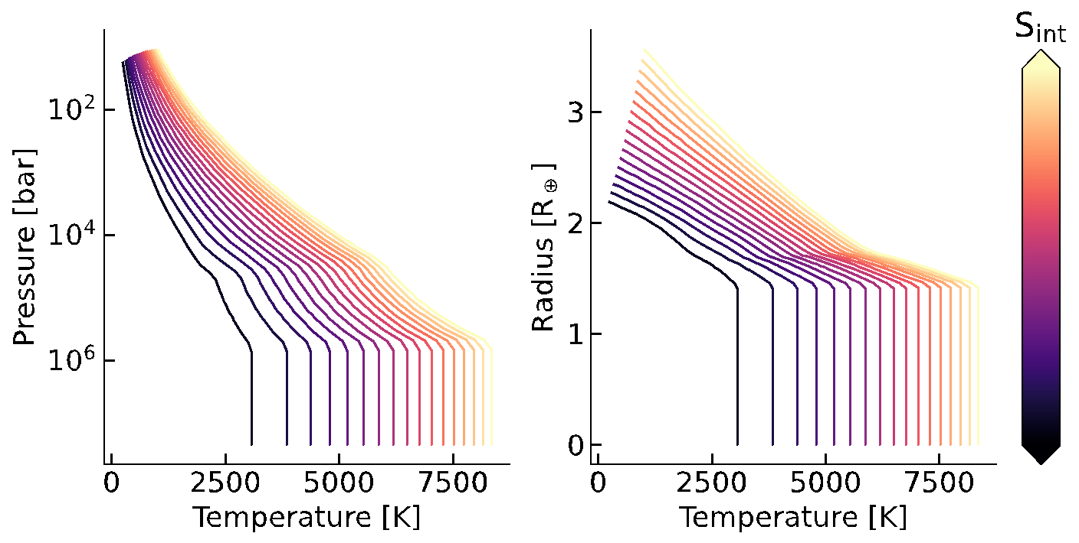
Testing the water world hypothesis
&
Range of plausible compositions ?
Robustness to atmospheric escape
Coupled interior-atmosphere models
Star
Planet (atmosphere)
M_{p}
X/H, C/O
A_{B}
+
T_{eff}, log g, [Fe/H]
T_{int}
S_{inc}
Planet (interior)
H2/He
H2O
+

Slide 8
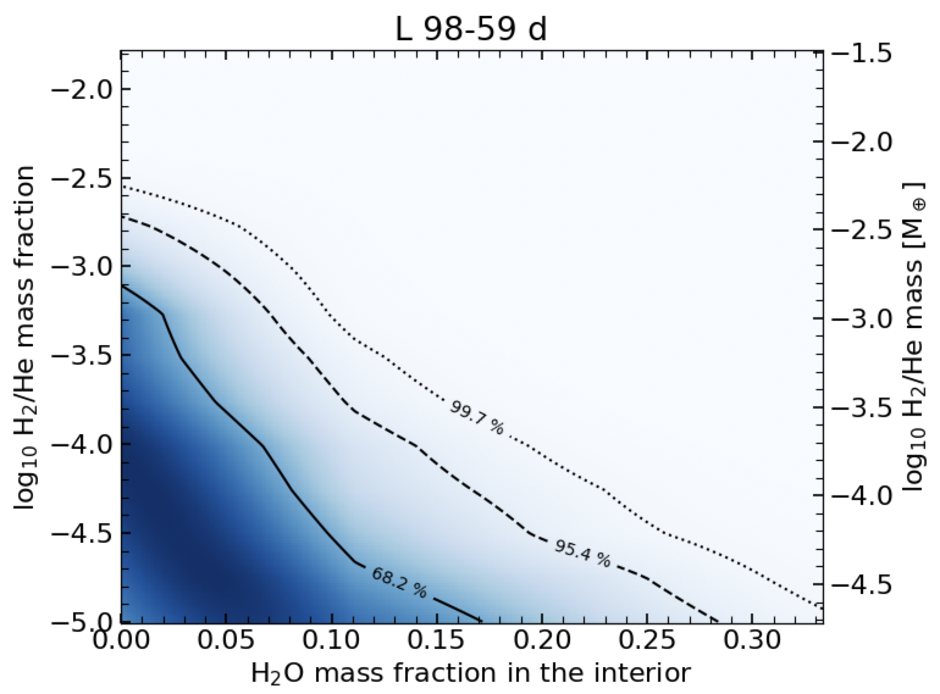
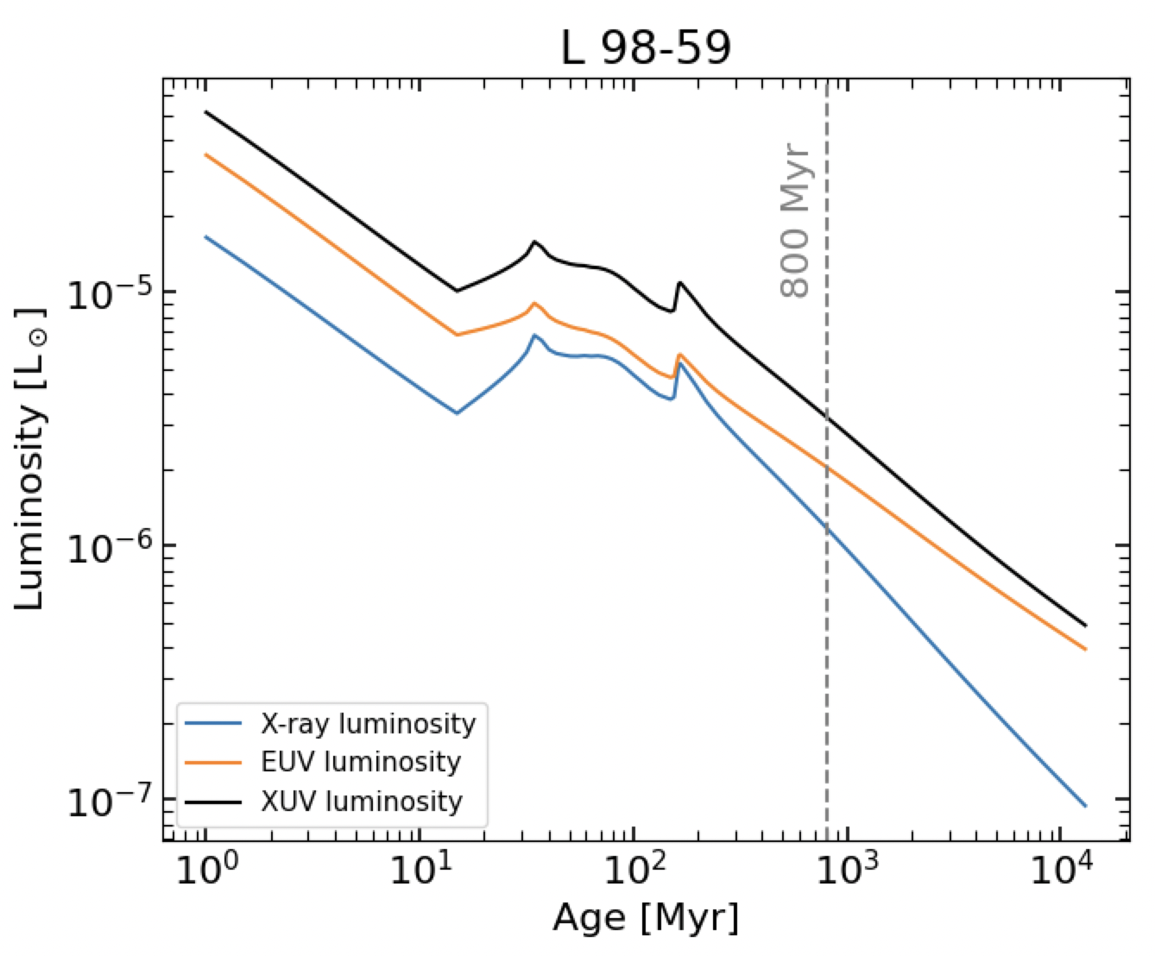
Showcasing the method: L 98-59 d
** Preliminary
~0.01 % H/He by mass
Escape timescale: 70-200 Myr
H2/He
H2O
HYDROGEN
Stellar evolution tracks
+ Hydrodynamic escape
WATER

Slide 9
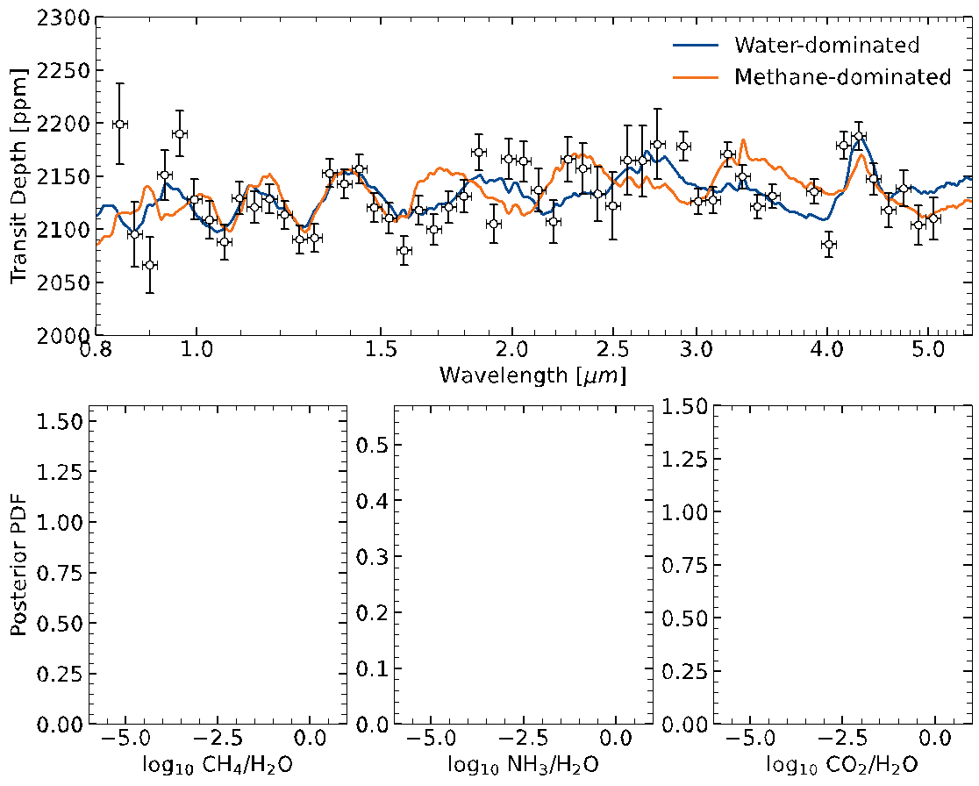
Identifying volatile species with JWST
5 transits w/ NIRISS SOSS
+ 5 transits w/ NIRSpec/G395

Slide 10
Take-home messages
Small, low-density exoplanets are keystone test cases for the ”water world” hypothesis
We identified a sub-population of discovered planets that are unlikely to retain hydrogen, and could be made ~10% water by mass
Follow-up with JWST can allow us to identify the volatile species by probing their atmospheres
Notes:
we still have much more to learn about this type of planet than we thought we did
-> still lots to learn about this part of the parameter space!
Vision of the future where we can turn our focus to these planets to expand our understanding of the breadth of outcomes of planet formation
low density makes them even more accessible targets for transmission spectroscopy to go beyond these important but broad first brushes and dig into the details of their atmospheres and interiors
volatile-rich rather than H/He-rich planets
still more planet types to be discovered

Slide 11
Additional material

Slide 12
JWST: H2/He vs. H2O atmospheres

Slide 13
Using extremes to resolve degeneracies
Looking out for the keystone planets that “should not exist” if compositions could only be rock + H/He:
At the high-mass end
At the low-mass end
Hot Neptune desert planets
Low-density small planets
Radius valley
Hot Neptune
desert
Adapted from Burt et al. (2020)
Adapted from Piaulet et al. (2022)

Slide 14
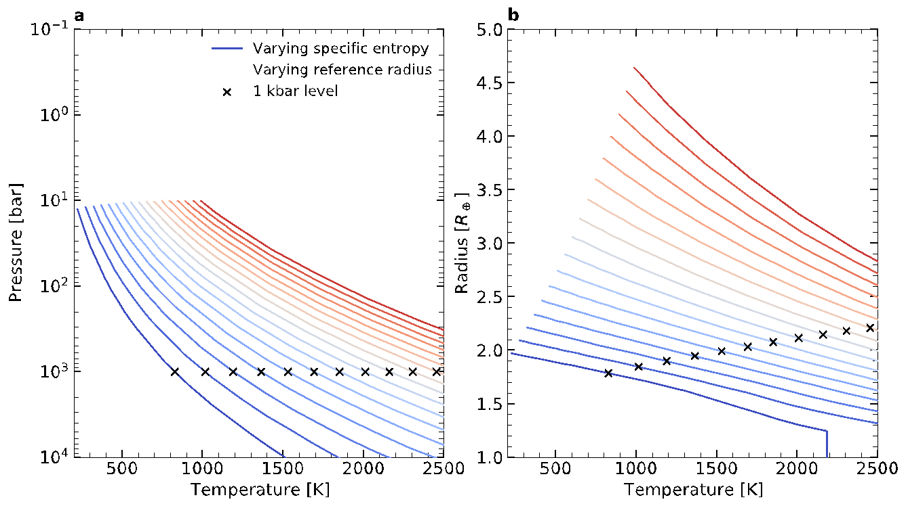

Slide 15
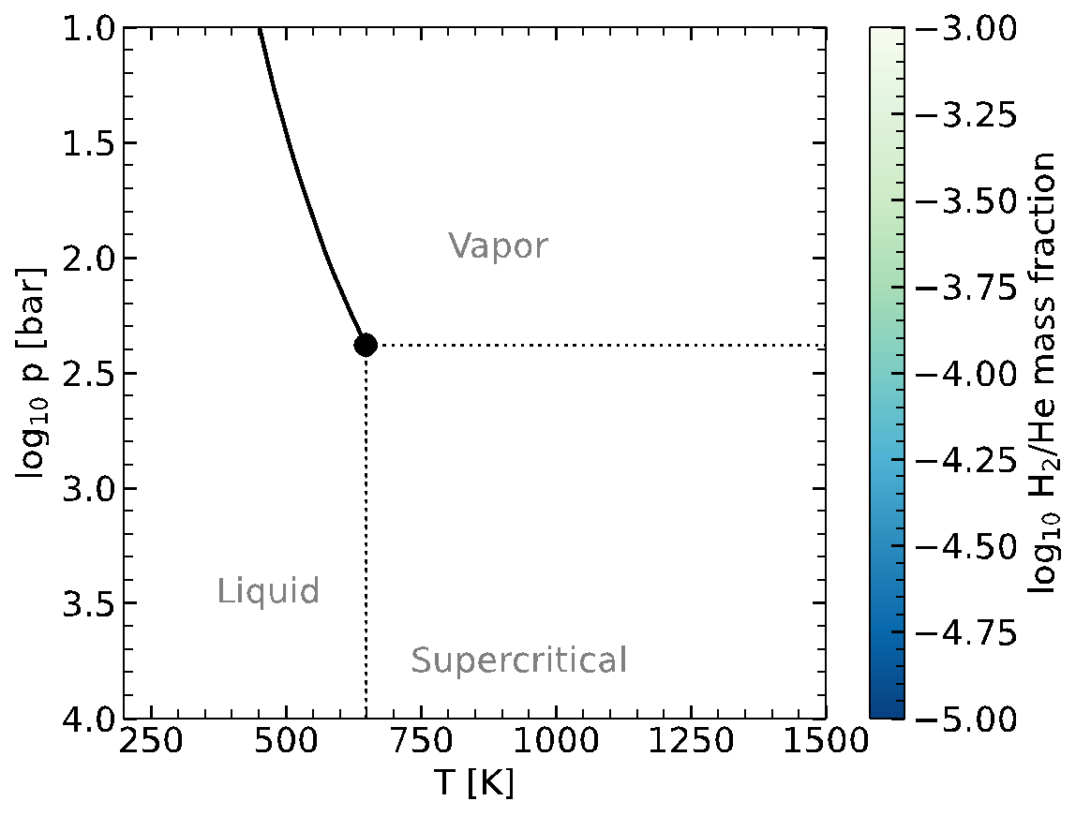

Slide 16
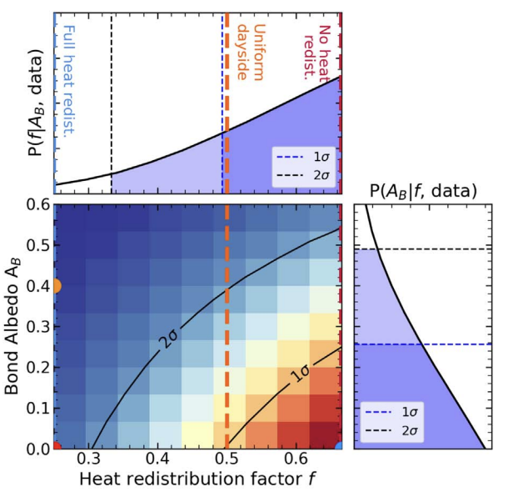
Stripped Neptune mantle: TOI-824 b
Atmosphere observations favor
high metallicity / low heat redistribution
+
For hot Neptune desert planets, H/He should have
been lost, but TOI-824 b is very massive
Figures from Roy, Benneke, Piaulet et al. (2022)

