Slide 1



WASP-121b’s dayside atmosphere as viewed with ESPRESSO and CRIRES+
Stefan Pelletier
University of Montreal
Advisor: Björn Benneke
Image credit: John Hook
CRAQ, May 2023

Slide 2
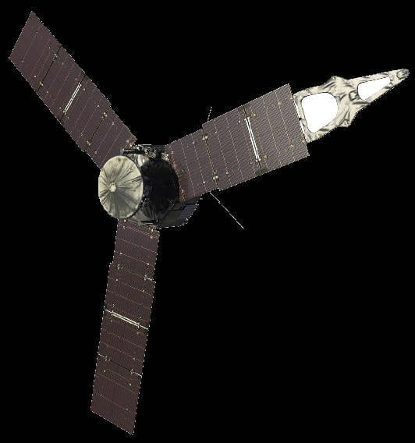
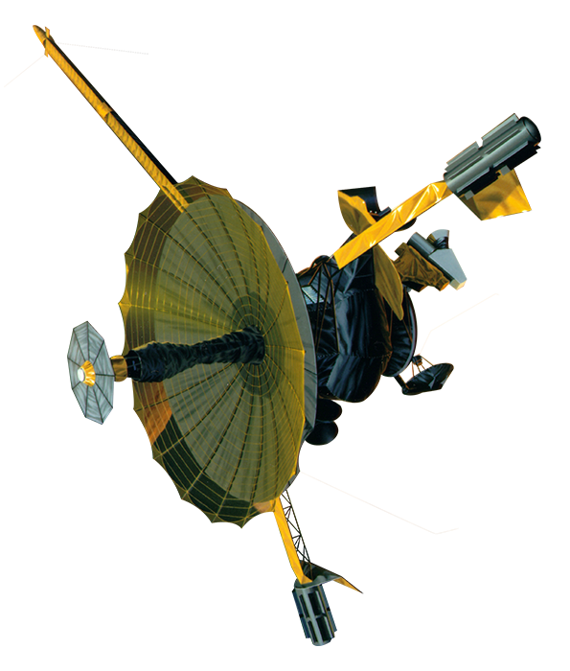
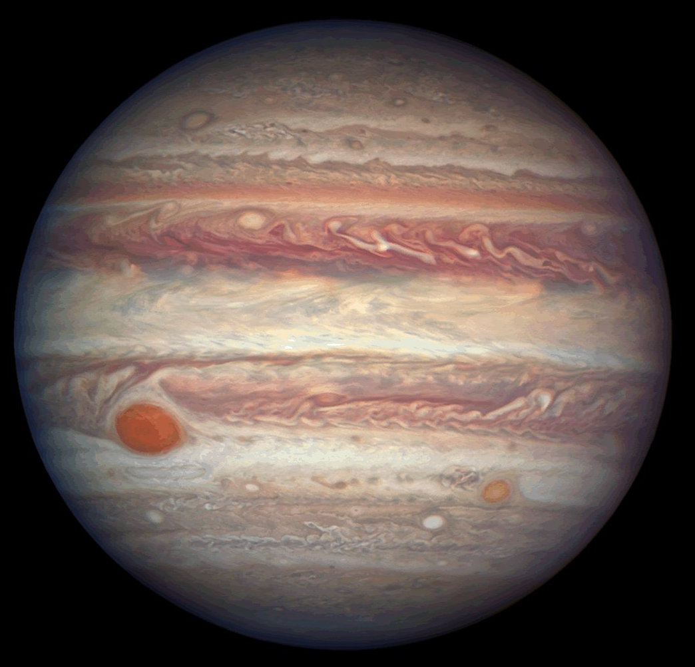
Notes:
Did you know that Jupiter’s composition is actually not very well known?

Slide 3
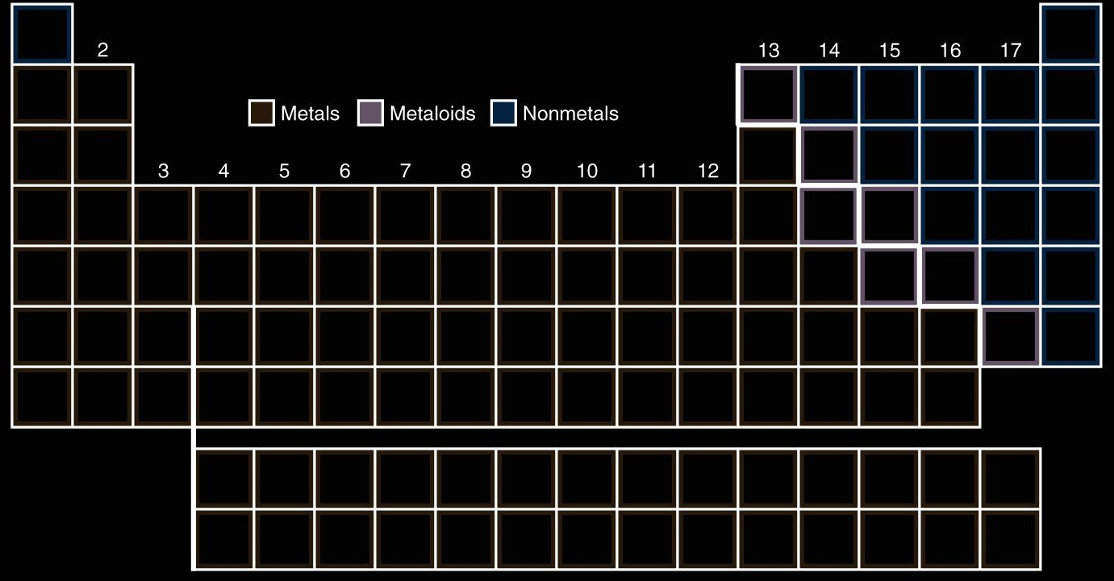
Elements measured on Jupiter
H
He
C
O
Volatiles

Slide 4


Slide 5
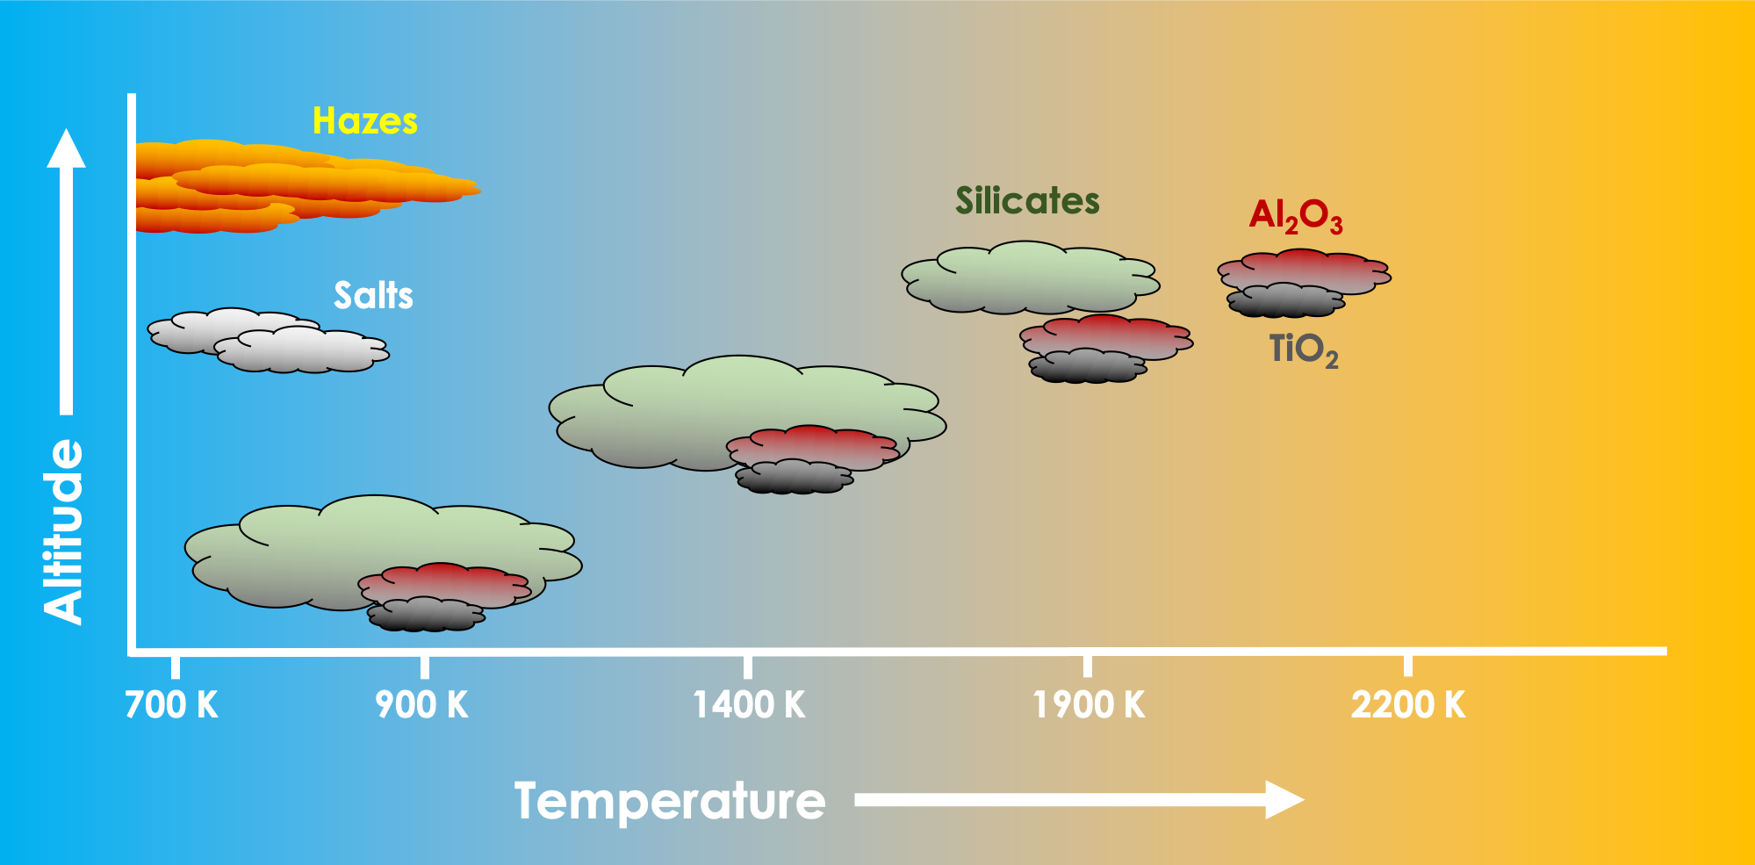

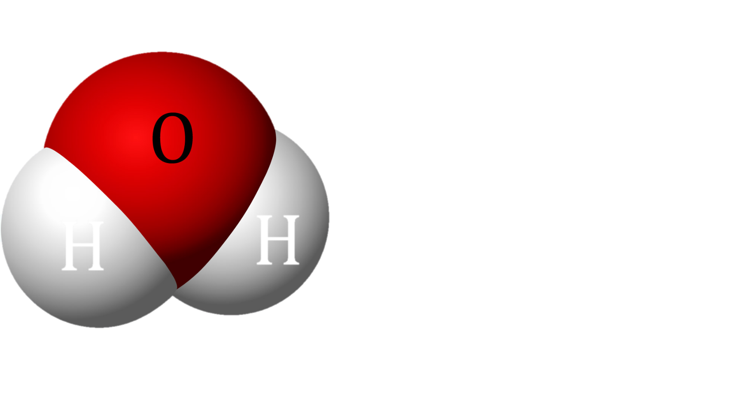
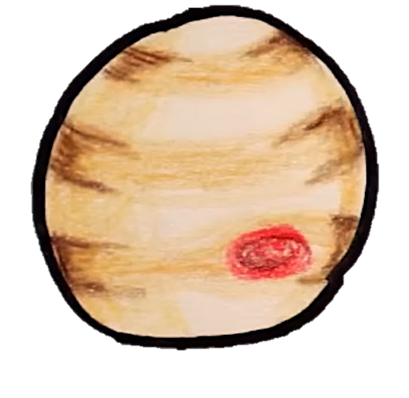
The Ultra-hot Jupiter Opportunity
Jupiter
(Ultra-hot)

Slide 6
CRAQ 2022

Slide 7
16 Species Detected on WASP-76b

Slide 8
Measured Refractory Abundances on WASP-76b

Slide 9
Elements measured on WASP-76b
H
He
Fe

Slide 10
Elements measured on WASP-76b
H
He
Fe
Refractories

Slide 11
Bridging the refractory-to-volatile gap
H
He
C
O
Fe
Ices
Rocks

Slide 12

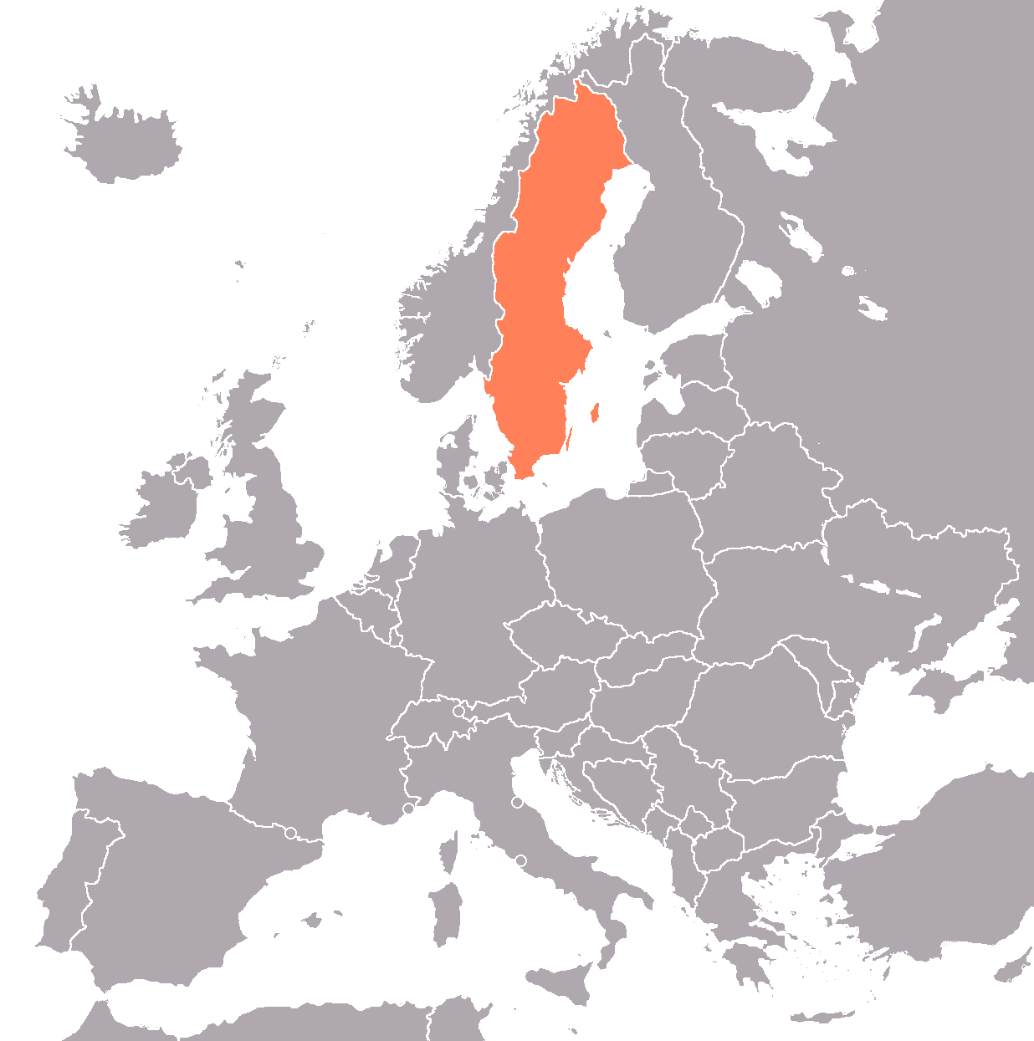

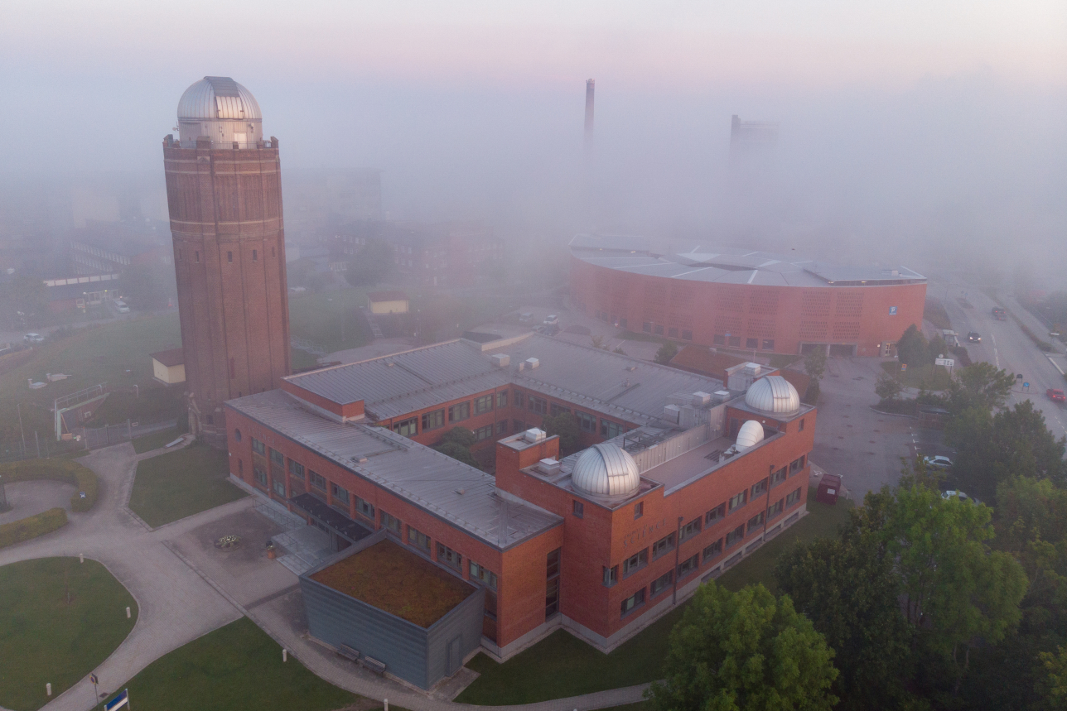
Lund
Observatory

Slide 13
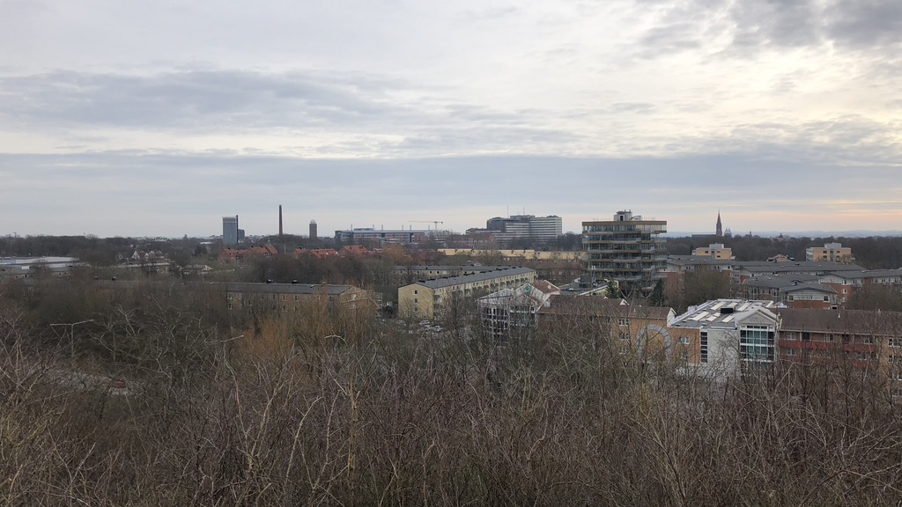
Lund Observatory

Slide 14

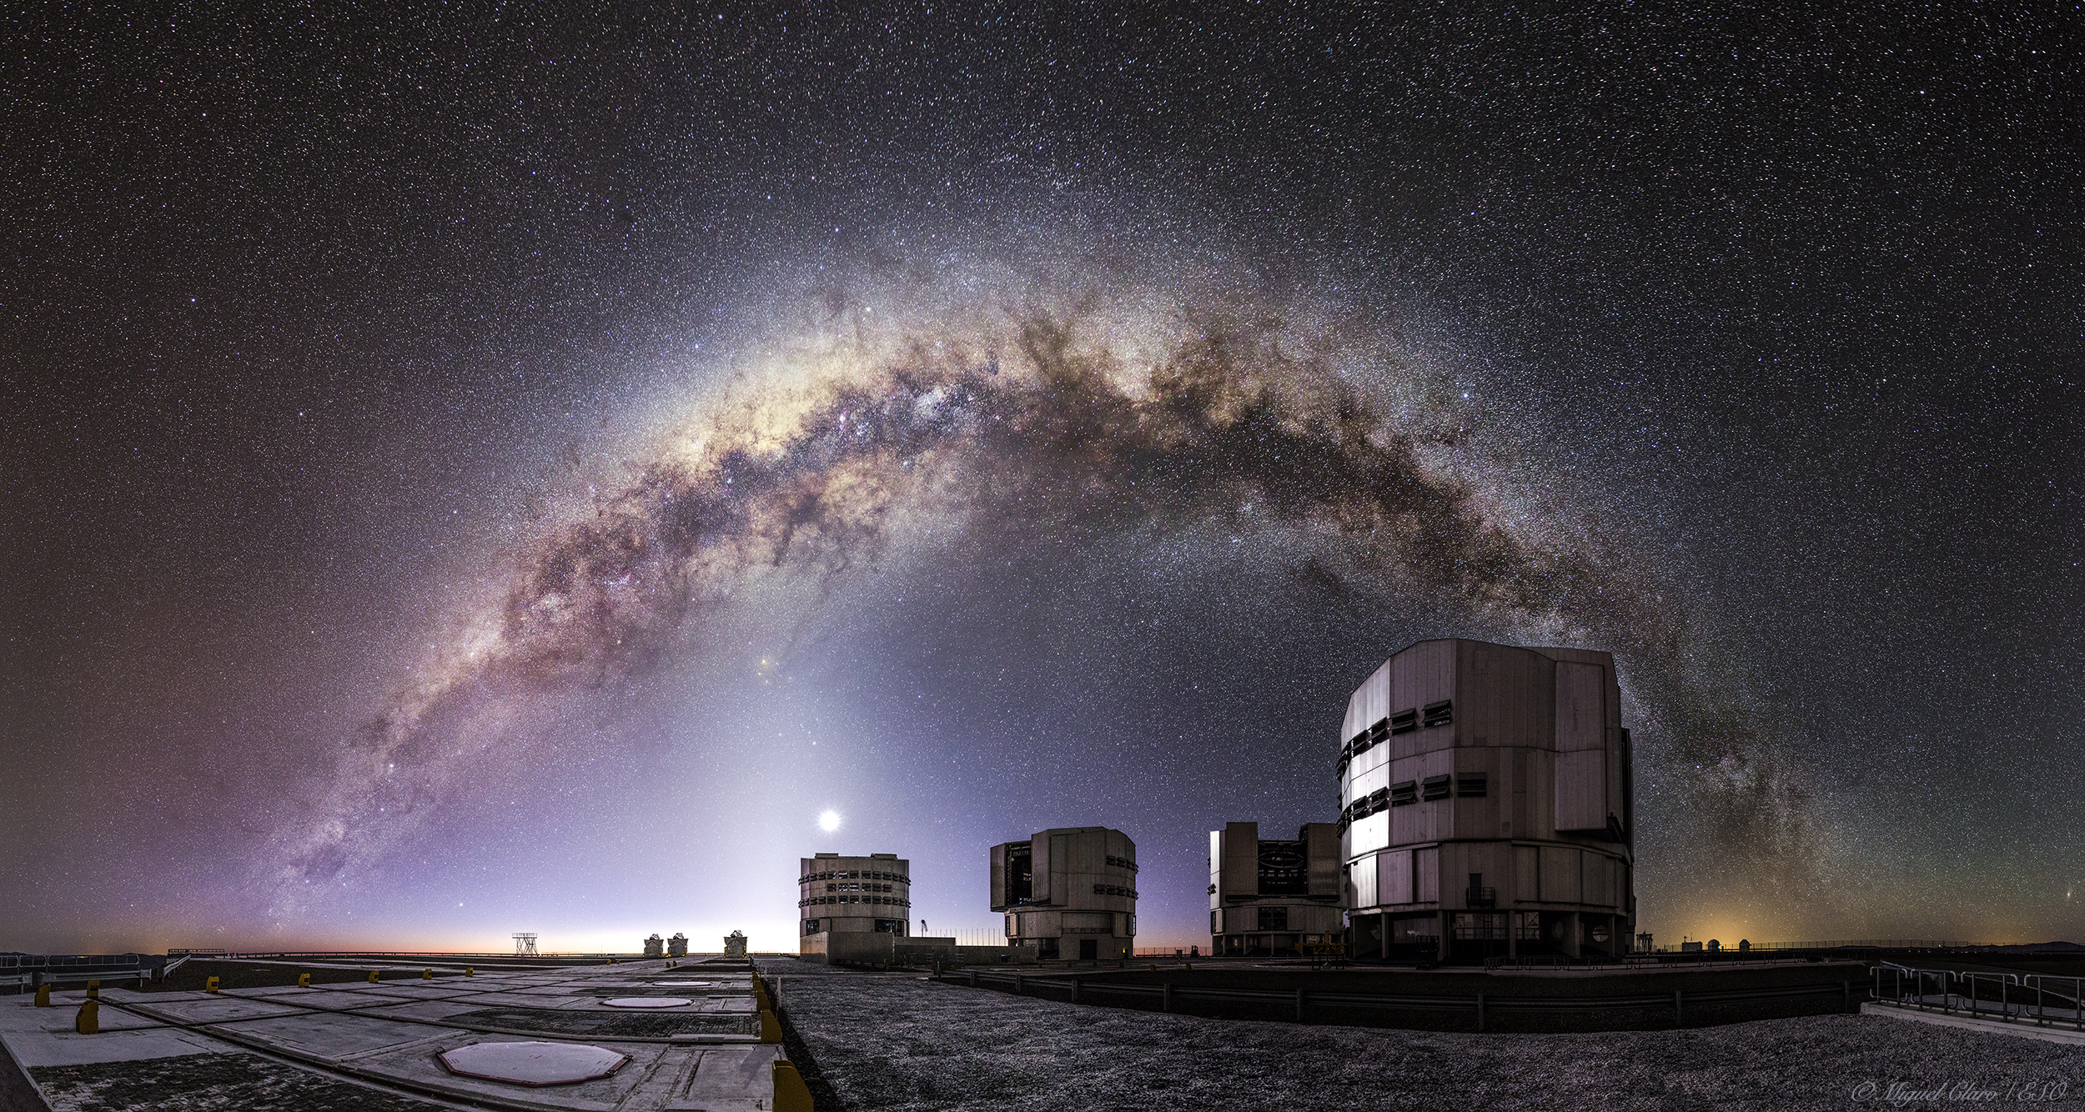


Slide 15




Dayside Observations of WASP-121b
T $\sim$ 2300K
CRIRES+ (IR)
6h (2 $×$ 3h)
ESPRESSO (VIS)
28h (8 $×$ 3.5h) – Hoeijmakers et al. 2023

Slide 16

Emission of WASP-121b’s Atmosphere

Slide 17
CO, H₂O, and Fe on WASP-121b
CRIRES+
CRIRES+
ESPRESSO

Slide 18
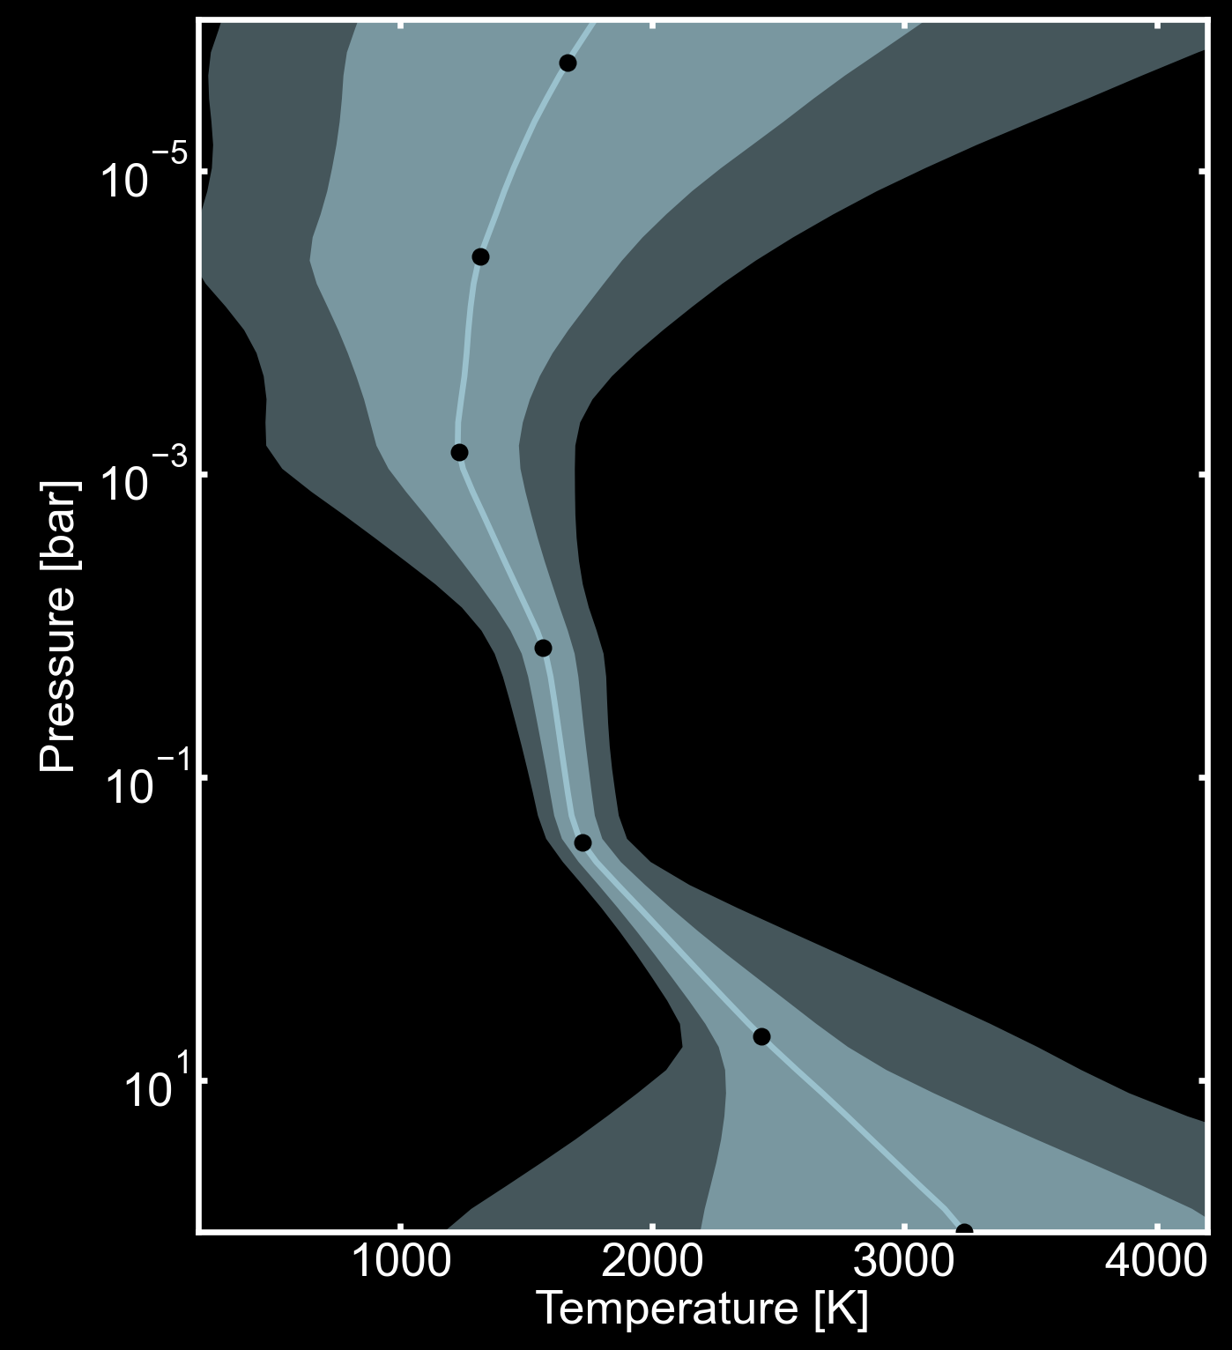
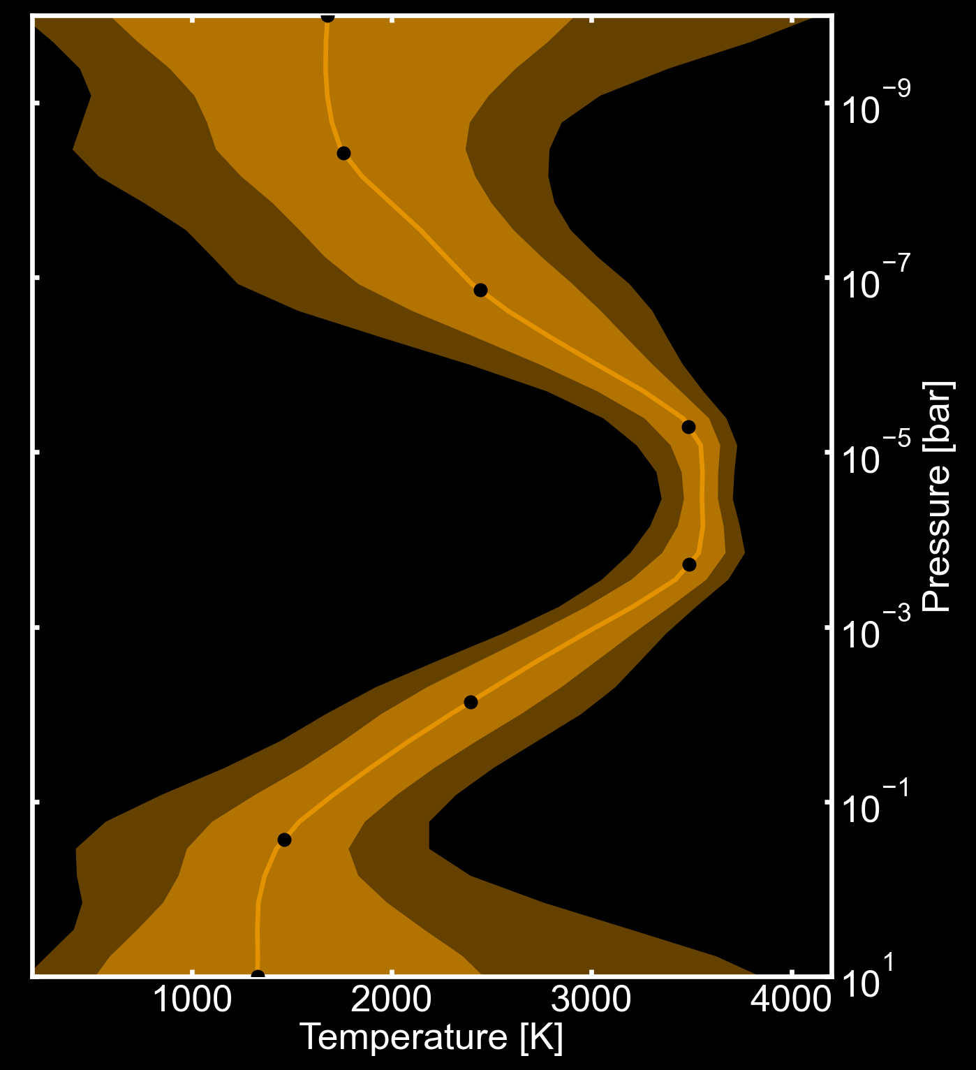
Retrieved Dayside Temperature Structure
Boring hot Jupiter
Ultra-hot WASP-121b

Slide 19
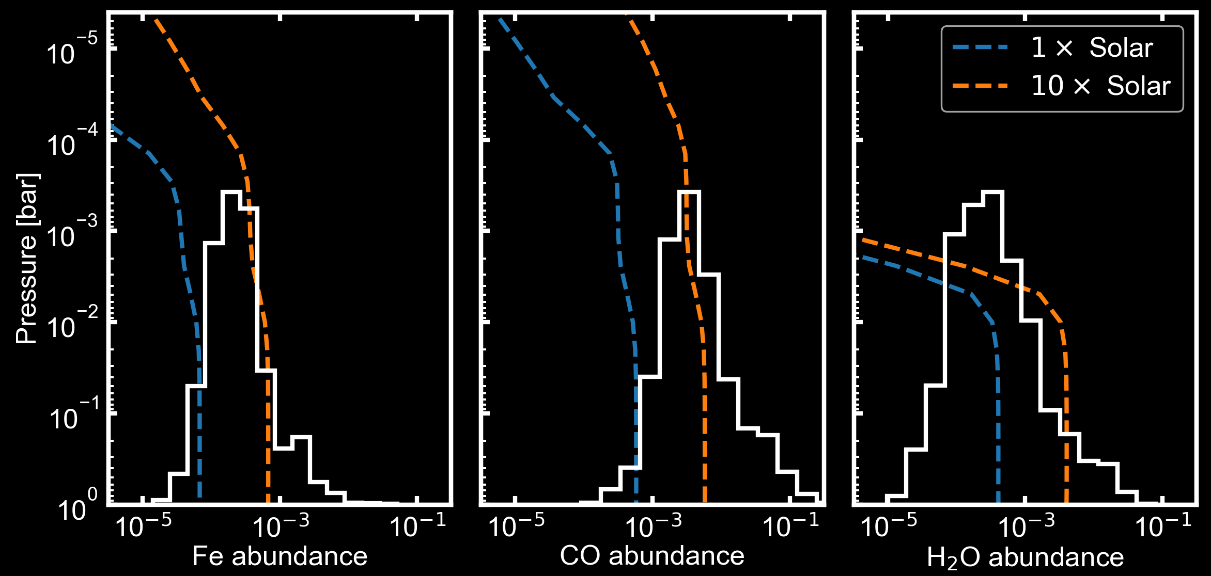
Measured Fe, CO, H₂O Abundances
WASP-121b’s atmosphere is enriched in iron and carbon relative to solar

Slide 20
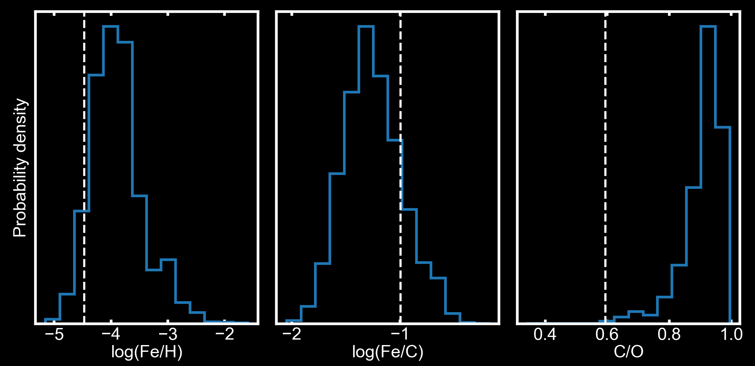
WASP-121b Elemental Abundance Ratios
Super-solar Fe/H = WASP-121b must have accreted rocky planetesimals

Slide 21
WASP-121b Elemental Abundance Ratios
Sub-solar Fe/C = WASP-121b accreted more volatiles than rocks

Slide 22
WASP-121b Elemental Abundance Ratios
High C/O ratio = gas accretion occurred beyond the ice lines

Slide 23

WASP-121b likely formed in the outer disk, enriched by more volatiles than rock

Slide 24
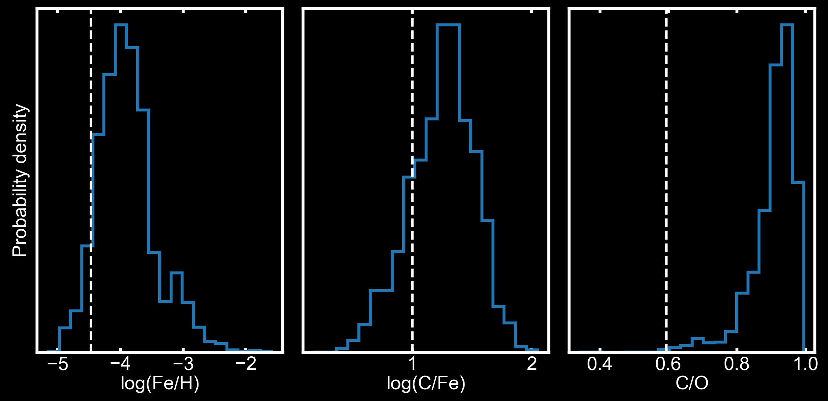
Conclusions
We observed WASP-121b using ESPRESSO and CRIRES+ and detected CO, H₂O (volatiles) and Fe (refractory)
1
Measured refractory-to-volatile abundances ratios (Fe/C, Fe/O, Fe/H) on a giant planet for the first time
2
Inferred WASP-121b’s formation to the outer disk with accretion from high ice-to-rock fraction planetesimals
3

