Slide 1
Reconstructing Background Galaxies
via Sparse Horseshoe Prior and Starlet Basis
Hasti Nafisi CRAQ ,May 10th 2023
Supervisors: Prof. Guy Wolf, Prof. Yashar Hezaveh

Slide 2
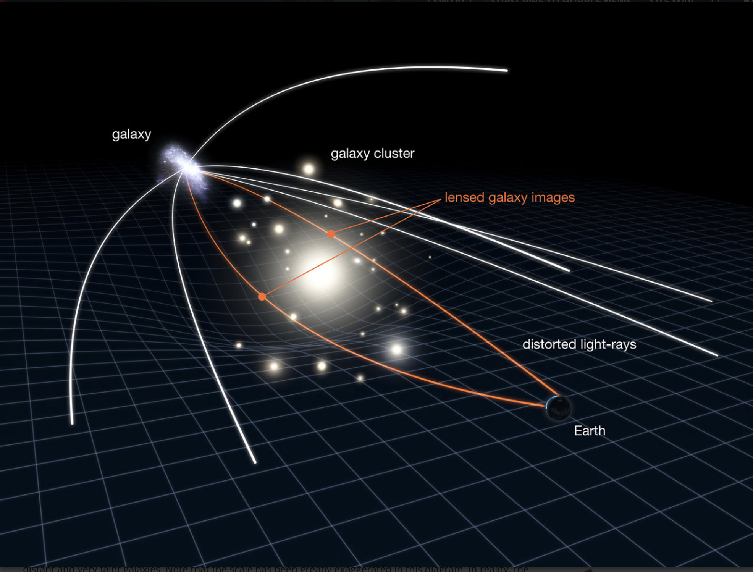
Gravitational Lensing
The effect
Making it appear brighter
Forming multiple images
Rings or arcs of light
The amount of bending
The mass and distribution
The distance
Photo Credit: NASA, ESA & L. Calçada

Slide 3
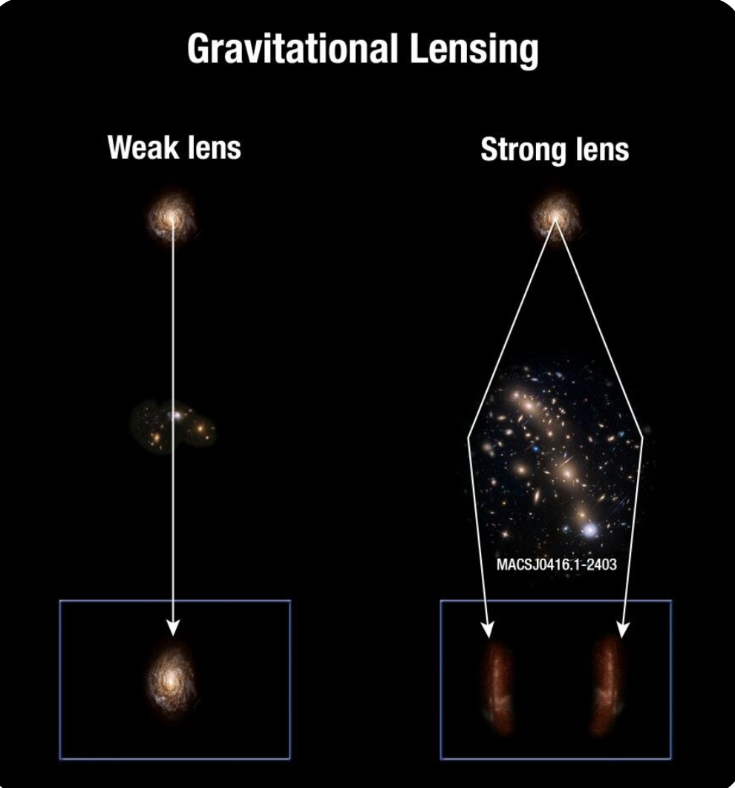
Strong lensing and weak lensing
Strong lensing
The alignment of the objects
Strong massive object to create multiple distorted images
Resulting in arcs or rings
Weak lensing
Relatively weak massive object
Slight distortion of the background object
Photo Credit: A. Feild (STScI)

Slide 4
The starlet wavelet transform
Mathematical functions for signal and image processing
Break down complex signals/images into simpler components (the frequency and time-domain information)
Starlets specialized wavelets for analyzing galaxy images
Capture the unique features of galaxy images, such as their irregular shapes and varying brightness levels.

Slide 5
The starlet wavelet transform
The starlet wavelet transform decomposes an n$×$n image, $c_{0}$, into a coefficient set, W, defined by:

Slide 6
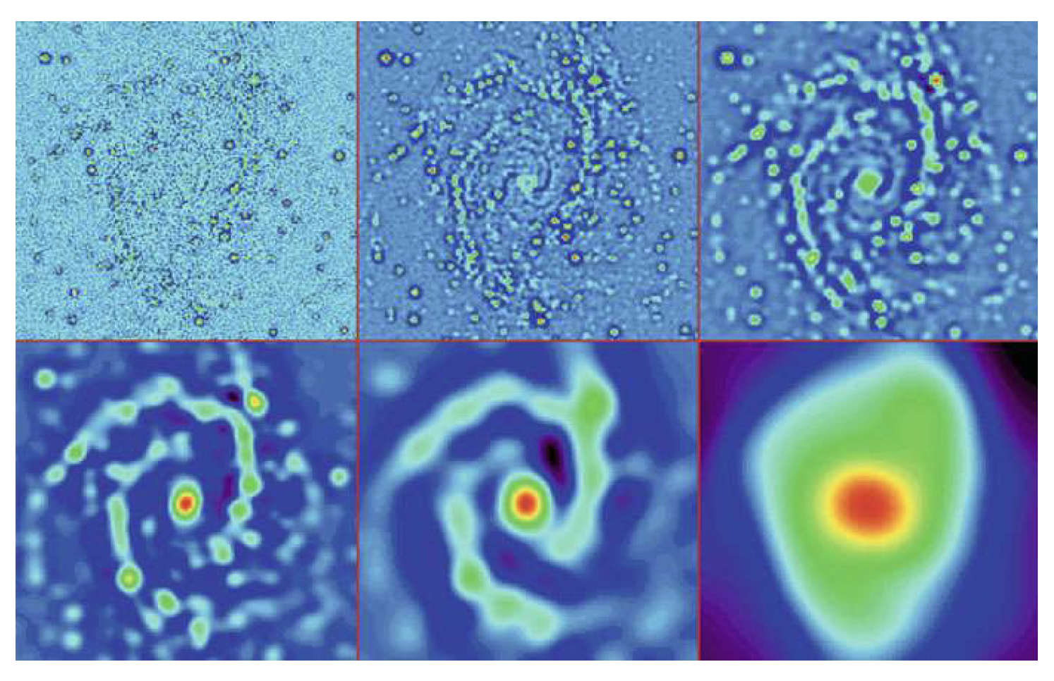
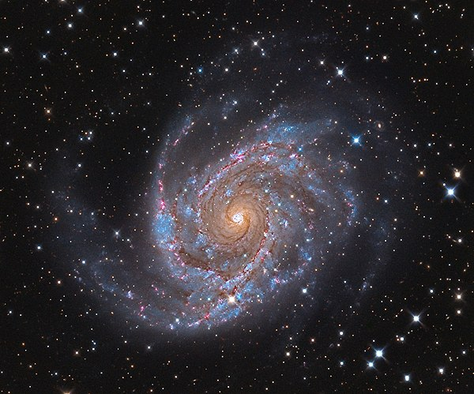
The starlet wavelet transform
Starlet transform of NGC 2997 by the IUWT

Slide 7
Horseshoe prior
Horseshoe prior is a type of sparse prior, useful for Starlet-based analysis
Encourages inferred values to be near zero but allows non-zero values with fat tails
Horseshoe prior has advantages over other sparse priors: better accuracy and noise robustness
Notes:
Need for a sparse prior

Slide 8
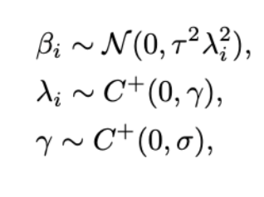
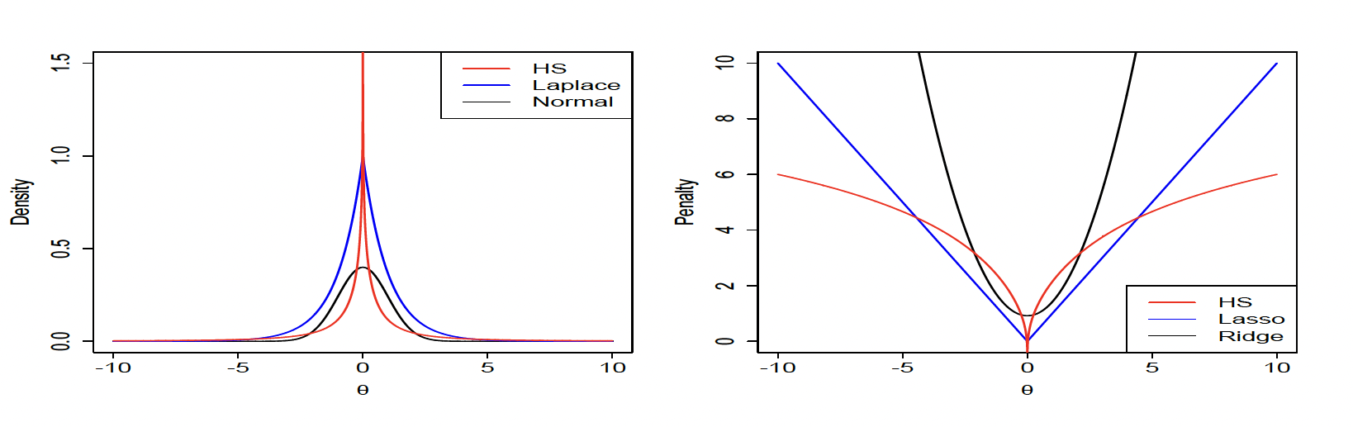
Horseshoe prior
Notes:
Need for a sparse prior
The horseshoe estimator assumes that the coefficients are drawn from a normal distribution with mean zero and a scale parameter that is allowed to vary across different coefficients. The scale parameter is itself drawn from a half-Cauchy distribution. where τ is a global shrinkage parameter that controls the overall amount of shrinkage applied to the coefficient, and λi is a local shrinkage parameter that controls the amount of shrinkage applied to each individual coefficient.
The local shrinkage parameter λi is drawn from a half-Cauchy distribution with scale parameter γ,

Slide 9
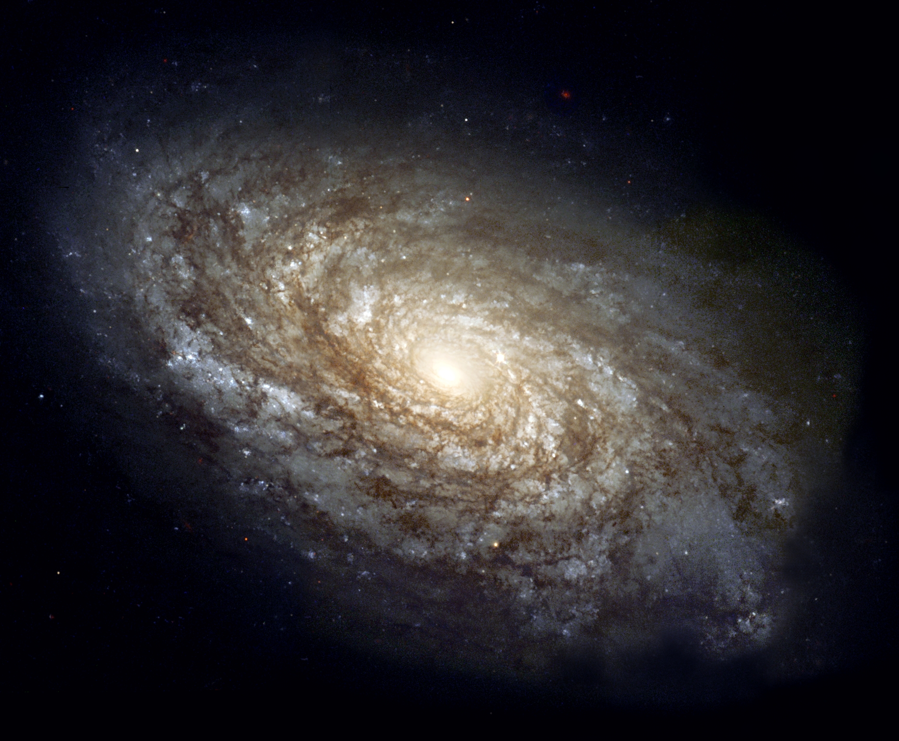
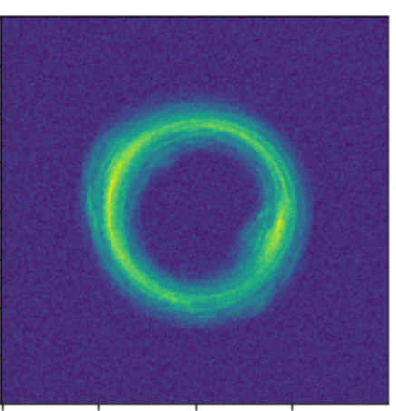
The data generation
$$D=LS+noise$$
S = Galaxy image
D = Lensed image

Slide 10
The data generation
The goal is to have a maximum a posteriori (MAP) estimate of the background source, S , given some noisy observations $D_{noisy}$

Slide 11
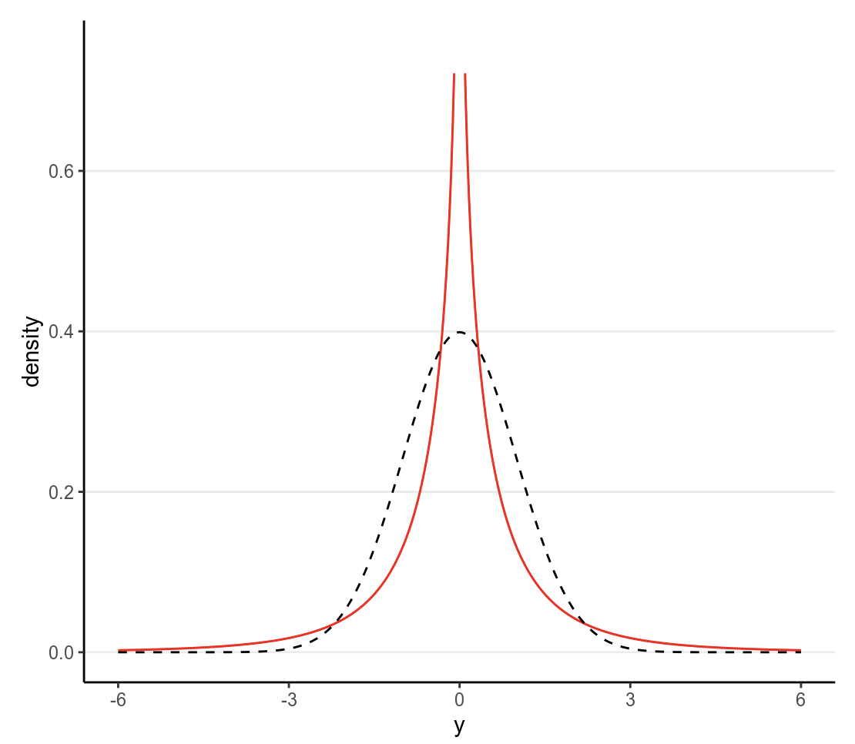
Methodology
Inverse Starlet Wavelet
Sample from HS
lensing
Horseshoe (HS)
prior
6 sparse images
Solving iteratively using Markov Chain Monte Carlo (MCMC)

Slide 12
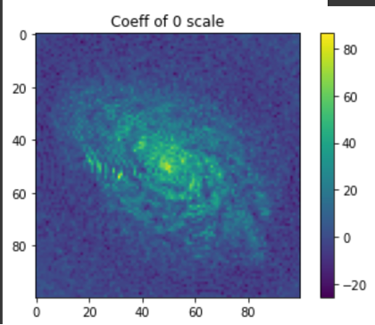
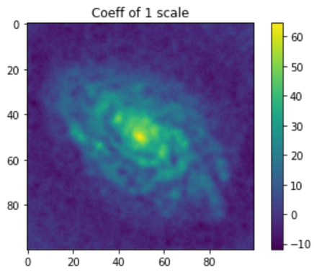
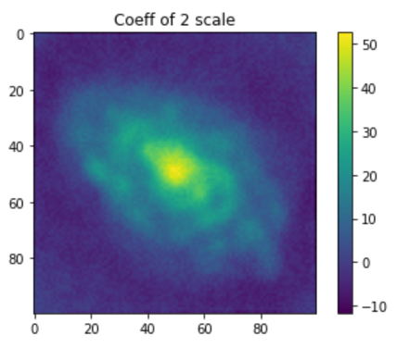
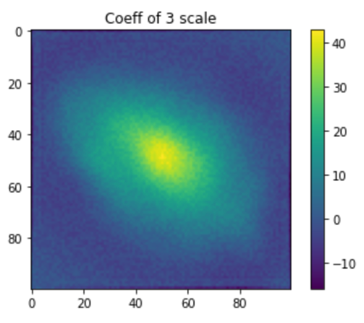
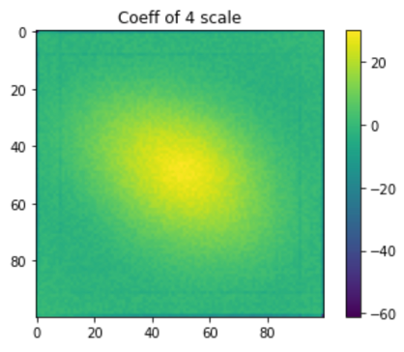
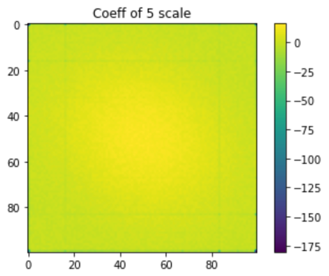
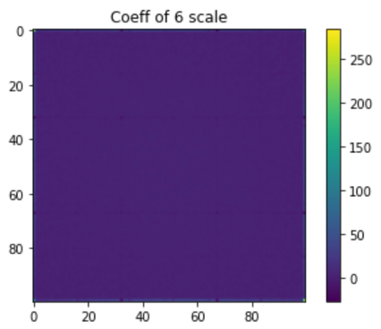
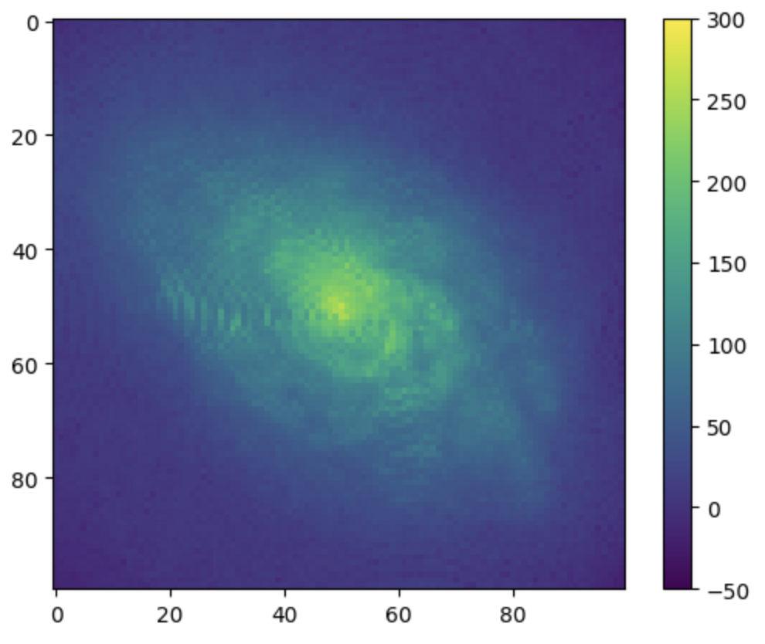
Results
Reconstructed
Image

Slide 13
Results
HS
MSE: 46.157
SSIM: 0.990
L2
MSE: 86.461
SSIM: 0.981
MSE: Mean Squared Error
SSIM: The Structural Similarity Index
Notes:
Galaxy image analysis is an important task in astronomy to understand the properties and evolution of galaxies

Slide 14
Conclusion
Using a sparse prior like the Horseshoe prior is important for Starlet-based galaxy image analysis to encourage sparsity
It improves efficiency, accuracy, and robustness to noise
Future work: Caparison with other prior
Notes:
Galaxy image analysis is an important task in astronomy to understand the properties and evolution of galaxies

Slide 15
Thank you
I hope this presentation has provided a useful overview of Starlets and the Horseshoe prior for galaxy image analysis

