Slide 1
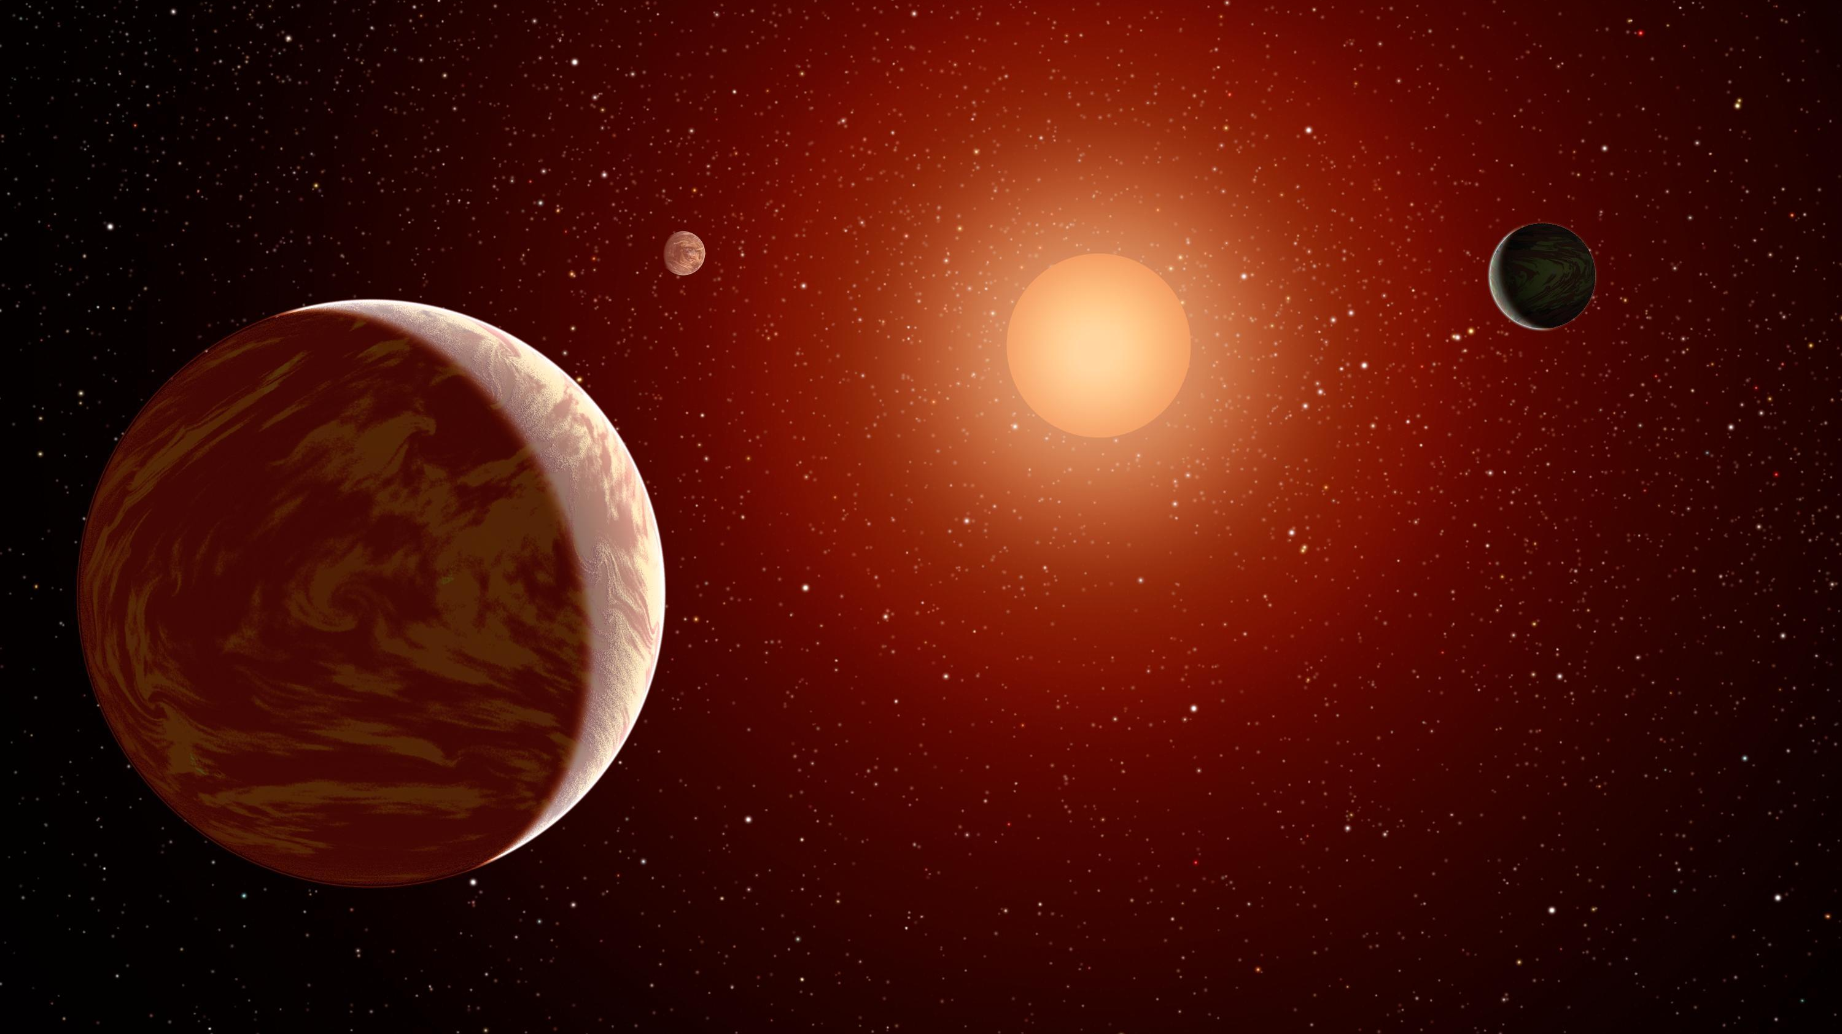



The Role of Magma Oceans in Maintaining Surface Water on Rocky Planets Orbiting M-Dwarfs
Keavin Moore
Supervisor: Nicolas Cowan
CRAQ Annual Meeting
May 11th, 2023
Image: NASA

Slide 2

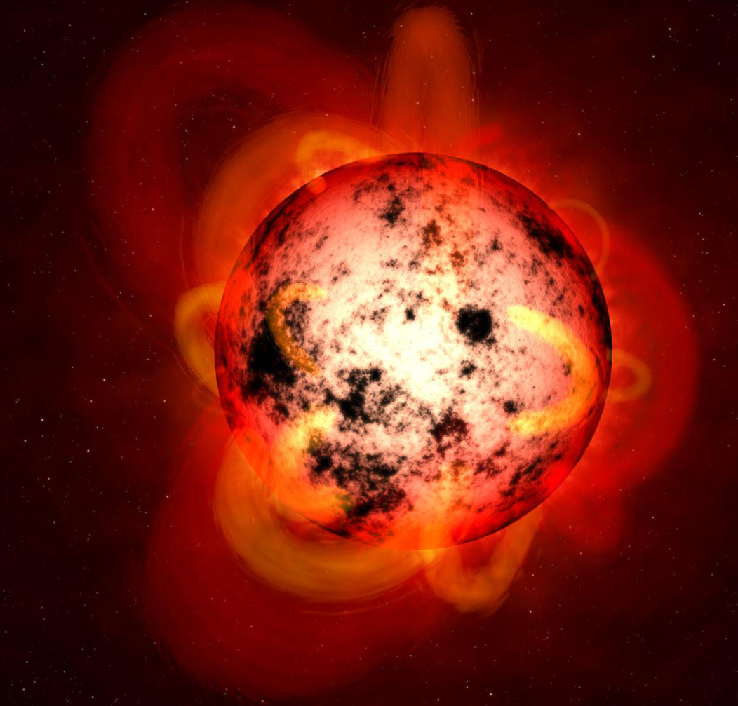
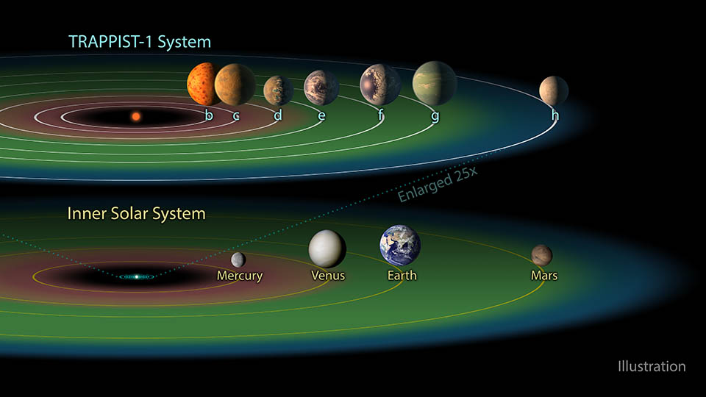
The surface water of M-Earths is susceptible to loss due to their close orbits and high irradiation, which can lead to complete desiccation
Water lost
X-ray+EUV
(XUV) Radiation
N₂
Sun
M-dwarf
Jupiter
H₂O
CO₂
Earth
(NASA)
Atmosphere
“M-Earth”
(NASA JPL)
Notes:
Planets currently in HZ were receiving much more flux in the past when their host star was young, so they may have completely lost their atmospheres and surface water

Slide 3
Planets begin with a molten surface magma ocean.
Box model of surface magma ocean, steam atmosphere, and loss to space; surface magma ocean solidifies from bottom-up
Silicate magma ocean properties:
Partition coefficient = 0.001
→ water is incompatible and will preferentially stay in the melt
Saturation limit = 0.1 - 10 wt.%
→ controls timing of atmospheric degassing
(100% steam)
Surface desiccated
Moore, Cowan, & Boukaré (submitted)
Notes:
Mention planets starting hot here; introduce magma ocean – surface temperature hot enough to melt rock

Slide 4
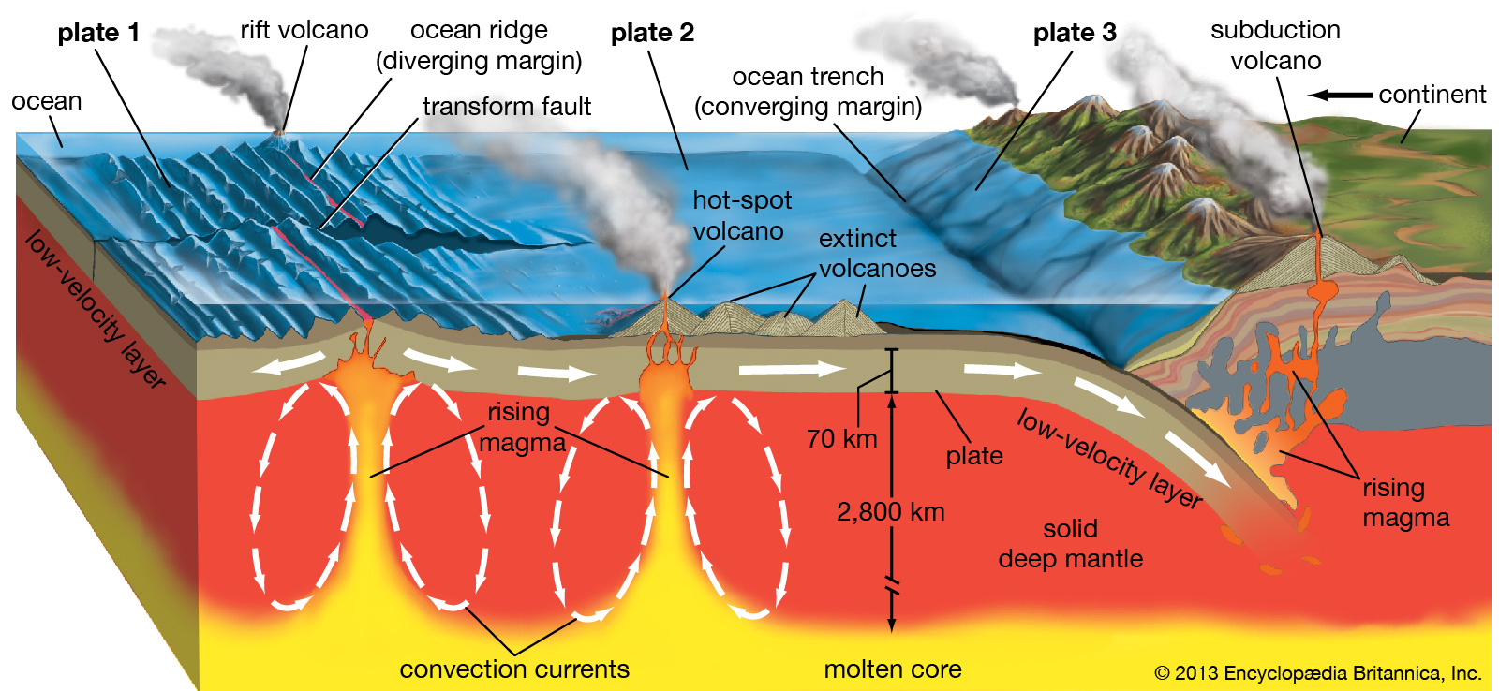
The deep-water cycle: Water on Earth is exchanged between surface & mantle reservoirs, driven by plate tectonics (e.g., Hirschmann 2006; Langmuir & Broecker 2012)
degassing
regassing
Water dissolved in the mantle reduces its viscosity and allows it to flow more readily, a requirement for plate tectonics
Notes:
Water dissolved in the mantle reduces its viscosity and allows it to flow more readily, a requirement for plate tectonics

Slide 5
Box model of deep-water cycling and loss to space for an M-Earth with active plate tectonics
Moore & Cowan (2020)
Surface reservoir
Interior reservoir
Moore & Cowan (2020);
Moore, Cowan, & Boukaré (submitted)

Slide 6
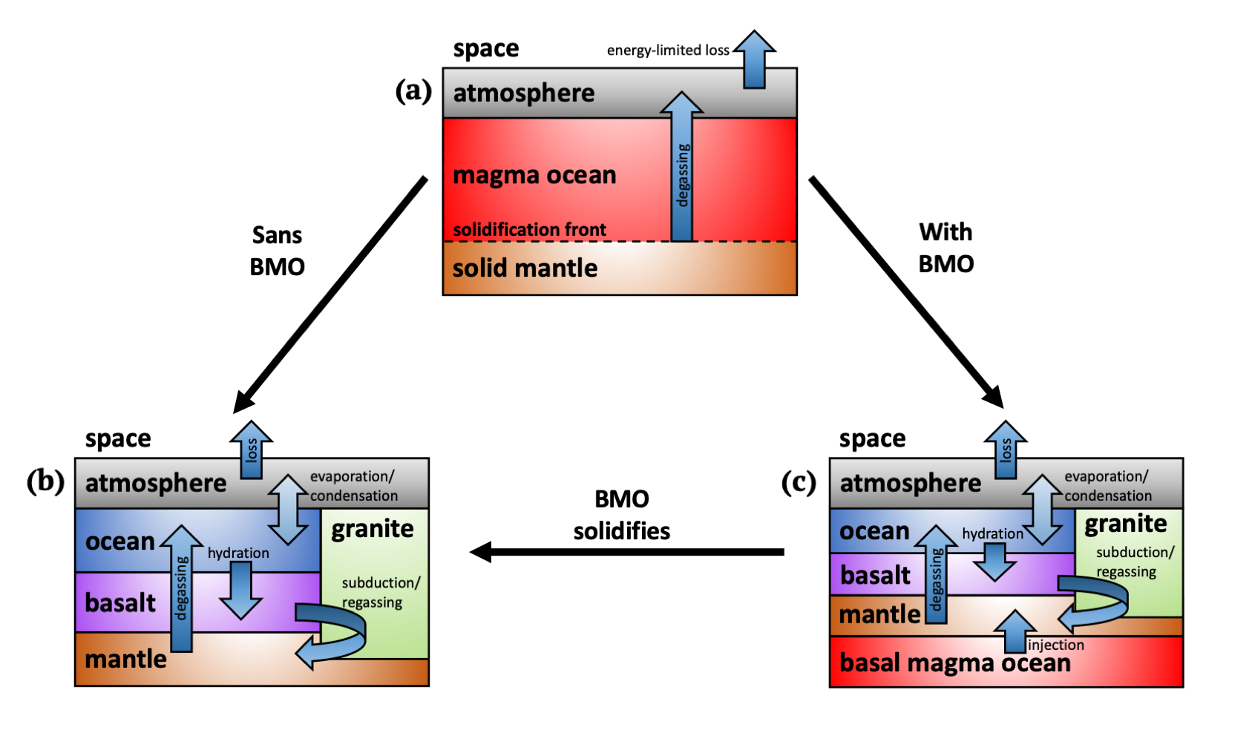
Flowchart of simulations: M-Earth begins with a steam atmosphere in a surface magma ocean phase; once solidified, planet shifts into plate-tectonics-driven deep-water cycling
Surface magma ocean phase
Plate-tectonics-driven deep-water cycling
Moore, Cowan, Boukaré (submitted)

Slide 7
Flowchart of simulations: M-Earth begins with a steam atmosphere in a
surface magma ocean phase; once solidified, planet shifts into plate-tectonics-driven deep-water cycling
Surface magma ocean phase
Plate-tectonics-driven deep-water cycling
Moore, Cowan, Boukaré (submitted)
“Habitable” = liquid surface water present
Notes:
Geophysical theories suggest basal magma oceans in Solar System, so we create another box model (Earth may have had a basal magma ocean, and there may still be one on Venus or Mars) --- will this help retain water? We test this as well

Slide 8

magma ocean
magma ocean
deep-water cycling
deep-water cycling
surface magma ocean solidifies
basal magma ocean solidifies
basal magma ocean
1 Earth Ocean $≡1.4×{10}^{21}$ kg
Moore, Cowan, Boukaré (submitted)
Notes:
Long-lived basal magma ocean keeps mantle hydrated at late times; good for ongoing plate tectonics, but unlikely to enhance habitability

Slide 9




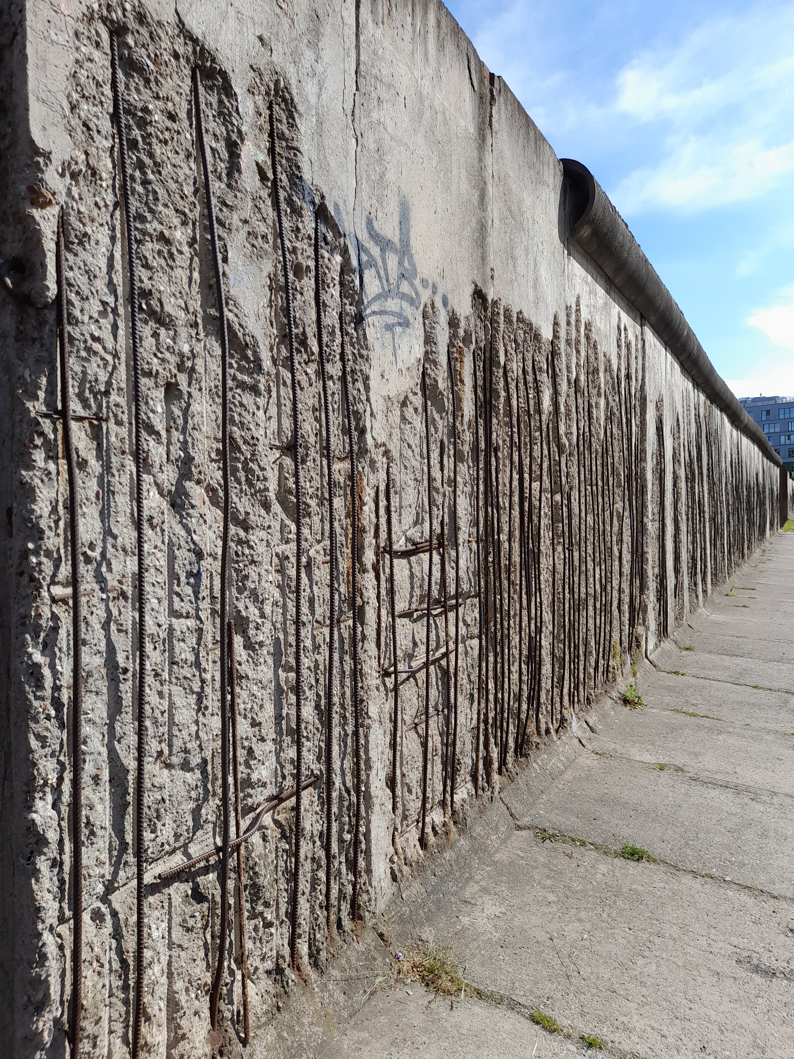

CRAQ International Internship 2022: w/ Lena Noack at the Freie Universität Berlin 🇩🇪
Stagnant-lid M-Earth + degassing + (slow) resurfacing

Slide 10
Undergraduate thesis results (Ben David & Albert Zhang): how does planetary mass affect water evolution of terrestrial planets?
As planetary mass is increased:
More water sequestered (and potentially trapped) in solid mantle
Less water lost during magma ocean, more water loss during deep-water cycling
Fewer ”survivors” of coupled simulations
Moore, David, Zhang, Cowan (in prep)
Notes:
This is a work-in-progress

Slide 11
Conclusions
Total water loss expected to be up to 20 Earth Oceans; results indicate much lower amounts due to coupled simulations
Short-lived basal magma ocean can be beneficial to habitability
Water can remain hidden from loss to space during surface magma ocean, and can be sequestered in solid mantle during deep-water cycling
Overall, desiccation problem may have been overstated by previous literature
Still significant work to be done to improve and expand model --- the importance of coupling geophysics, atmospheric science, and astronomy cannot be overstated!
Thanks for listening!

Slide 12
(C. Dressing)

Slide 13
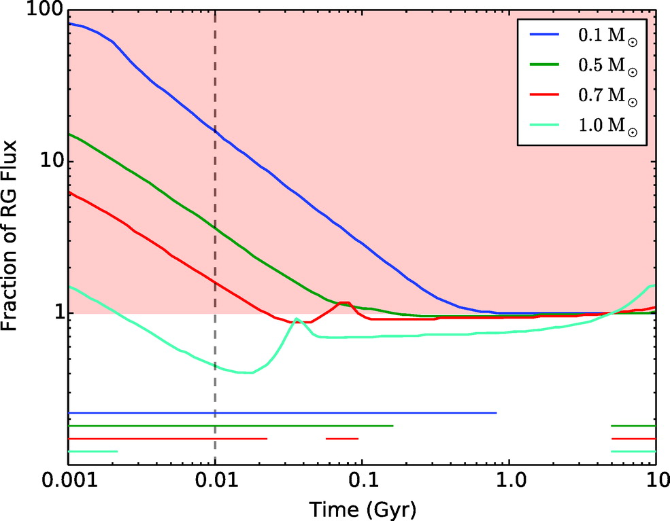

Following formation, M-Earth begins in Runaway Greenhouse state; surface will be a molten Surface Magma Ocean below a thick steam atmosphere!
M-dwarfs
$≅282$ W/m^2
surface temperature “runs away”
planet formation
hot, uninhabitable “runaway greenhouse”
Time in RG
Goldblatt et al. (2013);
Moore, Cowan, & Boukaré (submitted)
Luger & Barnes (2015)

Slide 14
Loss of water to space: limiting escape rates throughout the M-Earth’s lifetime
Runaway greenhouse
Notes:
We’ve implemented two kinds of loss into our model
(Maybe move this slide to end, if timing is too long)

