Slide 1
Bayesian Assessment of Kepler’s Small Long-Period Exoplanet Candidates with Gaussian
Processes and Nested Sampling
Michael R. B. Matesic
2023-05-10

Slide 2
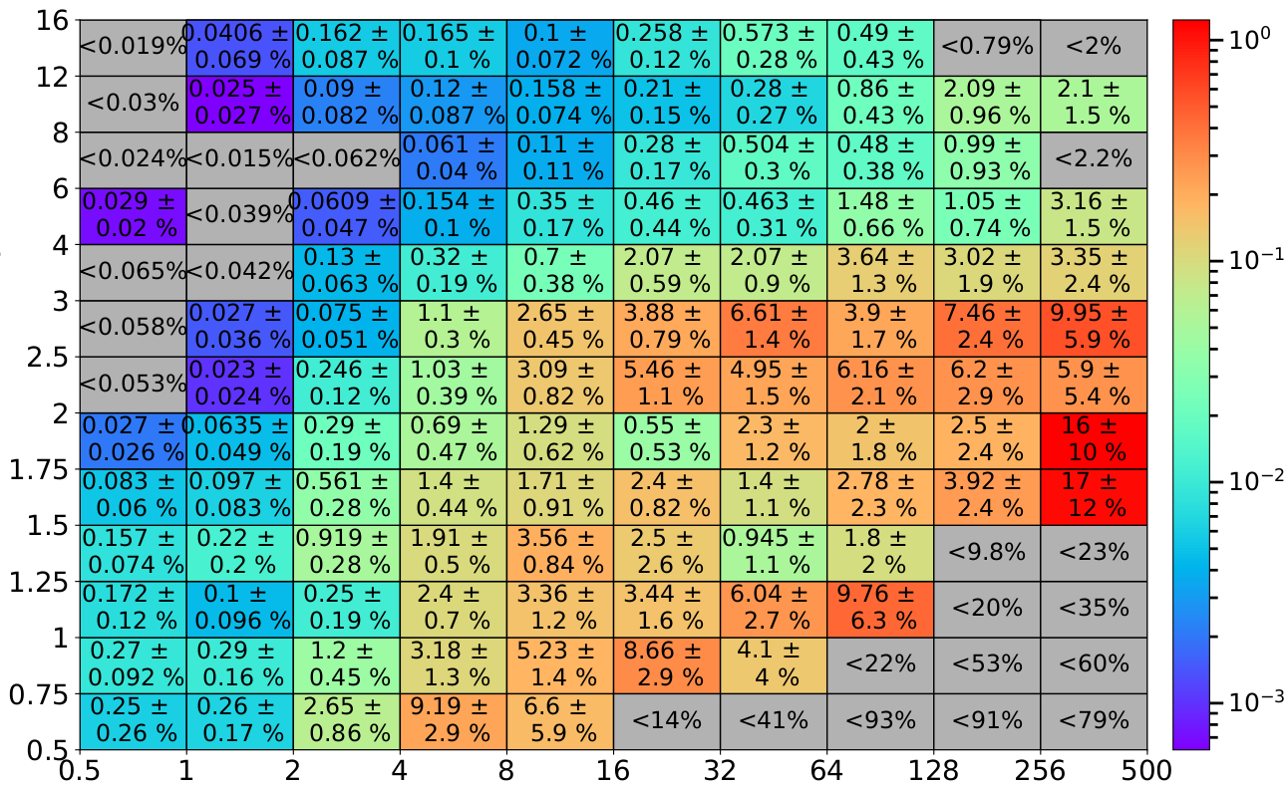
Expected Exoplanet Population FGK Occurrence Rates (Hsu et al. 2019)
Planetary Radius $\left[R_{⊕}\right]$
Orbital Period [days]

Slide 3
DR25 Reliability Estimates (Thompson et al. 2018)
All Stars
FGK Stars
Planetary Radius $\left[R_{⊕}\right]$
Reliability [%]
Orbital Period [days]
Orbital Period [days]

Slide 4
Planet-Candidate (PC) Hypothesis (Kepler-62f)
Transit Model
Noise Model
Joint Model
Relative Flux
+
=
Phase
Phase
Phase

Slide 5
General Methodology
Gaussian process white & correlated noise.
Two hypotheses fit via nested sampling:
Planet-Candidate (transit + noise).
False-Alarm (noise).
Bayes’ Theorem:
$$Posterior=\frac{Likelihood×Prior}{Evidence}⟺𝒫_{𝒟}(θ)=\frac{ℒ_{𝒟}\left(θ\right)π\left(θ\right)}{𝓩_{𝓓}}$$

Slide 6
Comparison of Hypotheses (Kepler-62f)
PC (transit + noise)
FA (noise)
Relative Flux
Relative Flux
vs.
Phase
Phase

Slide 7
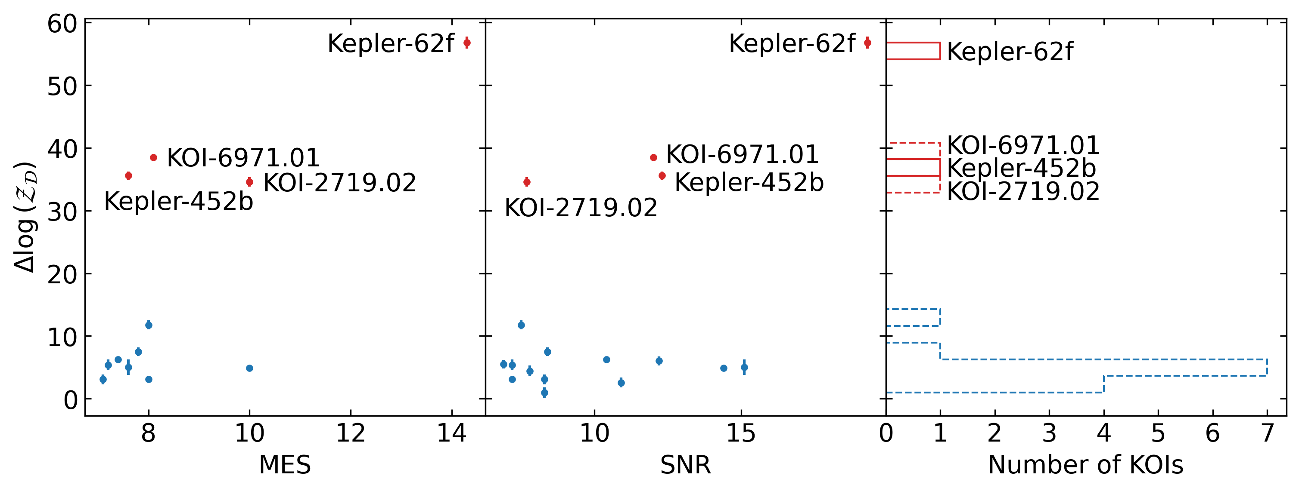
Bayesian Evidence ($𝓩_{𝓓}$), Multiple-Event-Statistic (MES), and Signal-to-Noise Ratio (SNR)
Logged PC-FA differences in Bayesian evidence against DR25 scores for MES (left) and SNR (middle); also binned (right).
$Δlog(𝒵_{𝒟}$)
MES
SNR
Number of KOIs

Slide 8
Conclusions and Next Steps
Publish current analysis.
Transition to simulation-based inference framework.
$NRE≃\log\left(\frac{ℒ_{𝒟}}{𝓩_{𝓓}}\right)=\log\left(ℒ_{𝒟}\right)−\log\left(𝓩_{𝓓}\right)$.
Perform evidence-reliability mapping via injections.
Hubble follow-ups.
Deploy on broader datasets (Kepler, K2, TESS, Plato, etc.).

Slide 9
References
Hsu, D. C., Ford, E. B., Ragozzine, D., & Ashby, K. 2019, AJ, 158, 109, doi: 10.3847/1538-3881/ab31ab
Thompson, S. E., Coughlin, J. L., Hoffman, K., et al. 2018, ApJS, 235, 38, doi: 10.3847/1538-4365/aab4f9

Slide 10
Standardization by Quantiles
Original posterior distribution (left), uniform quantile-based priors (middle), and recovered posteriors (right).

