Slide 1


TOI-2010 b
Confirming a warm-Jupiter
Chris Mann – UdeM

Slide 2

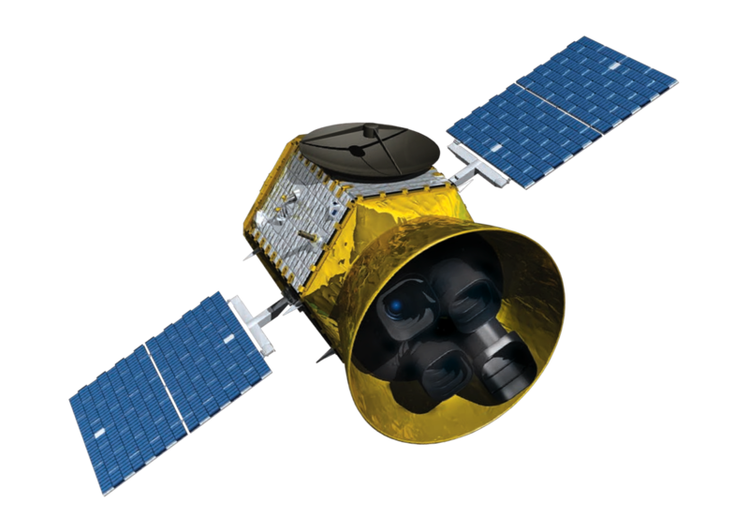
TESS > TFOP > TSTPC
TESS Mission
TFOP
TESS mission:
Discover exoplanets (esp. small ones) around bright and nearby stars
Mission planning
Satellite controls
Data processing
Target catalogue
TESS Follow-up Observing Program (TFOP)
Provides external follow-up
Observing
Strategy
Verifying
TSTPC
Search algorithms
Confirming
TESS Single Transit Planet Candidate (TSTPC)
Specifically targets that don’t re-transit (or have widely separated transits)
Hunting
General wizardry...
Notes:
TESS: Kind of a Successor to Kepler, but focus on planets that can be studied in detail
TFOP: ground- and space-based that cover TESS’s limitations. Check for FPs.
TSTPC: single-transit, alias hunts
These are two working groups I am a part of

Slide 3
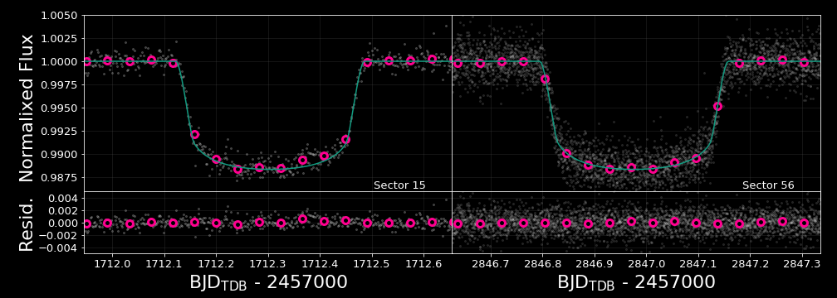
TESS data
TOI-2010
Notes:
Detection was clear, and many parameters except P can be estimated.
Promising as it was, there was essentially no constraints on period.

Slide 4
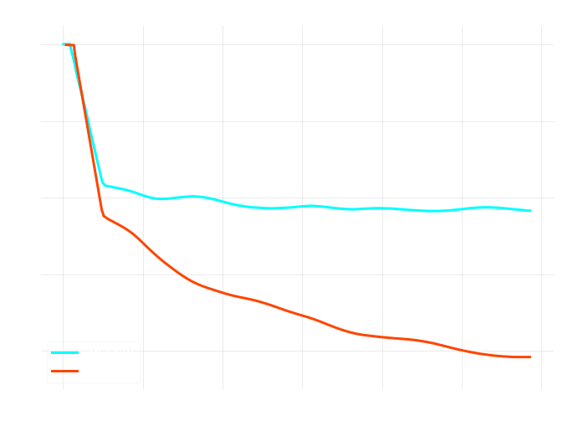
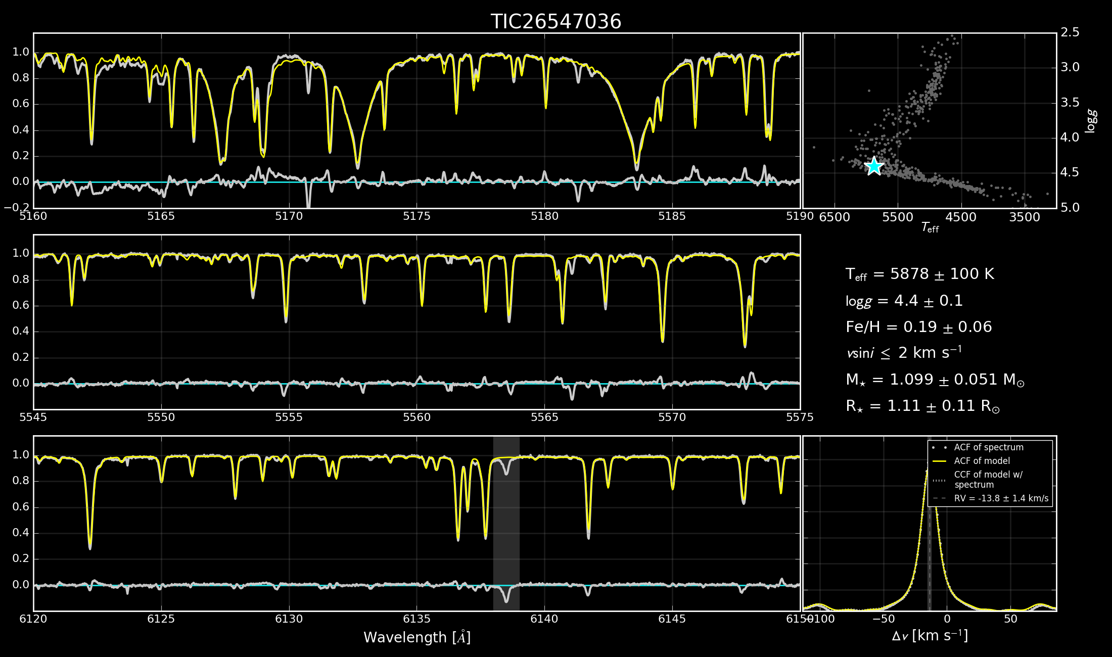
Vetting + Reconnaissance
TOI-2010
TSTPC vetting:
Checking for red-flags: transit shape, eclipses, potential for nearby eclipsing binaries, systematics, etc.
High-resolution spectroscopy with Keck/HIRES
High contrast speckle imaging with Gemini-N/`Alopeke
Notes:
Vetting happens internally.
See how FEASIBLE other obs are
Also had recon spectra from LCOGT/NRES, and FLWO/TRES to determine stellar params.
Got some high-contrast imaging to look for close neighbours.
Found a faint neighbour outside the correlation radius (very unlikely to be an issue with detected planet).
Grey circle: Speckle Correlation Radius (~1.2 arcsec) where air column difference start to become important.

Slide 5
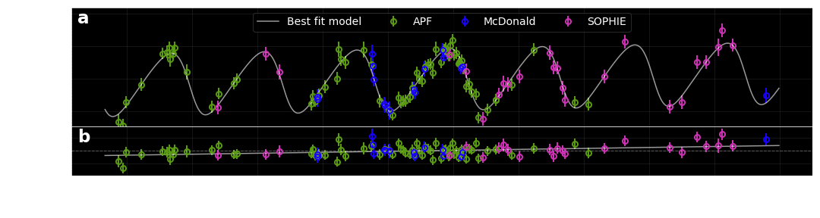
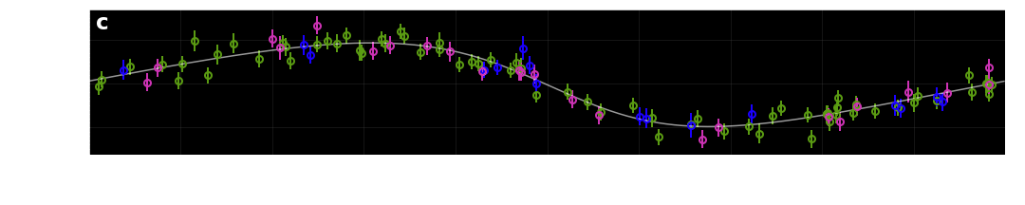
RVs
RV coverage
Spans 992 days (~2.7 years)
Excellent baseline and phase coverage
TOI-2010
Invert then Hue offset 50
Notes:
This provides a decent period constraint. Being several periods since TESS detection, next predicted transit window was +/- 1.5 days (2-sigma window was 6 days). Still far too uncertain for most transit-related observation proposals.
Automated Planet Finder telescope @ Lick observatory – 70 spectra
Tull spectrometer @ McDonald observatory – 16 spectra
SOPHIE spectrograph @ Observatoire de Haute-Provence – 24 spectra

Slide 6
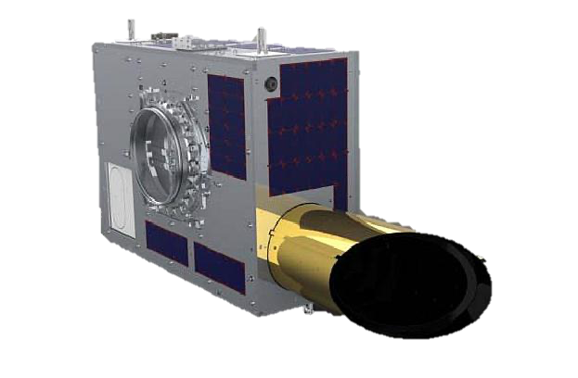
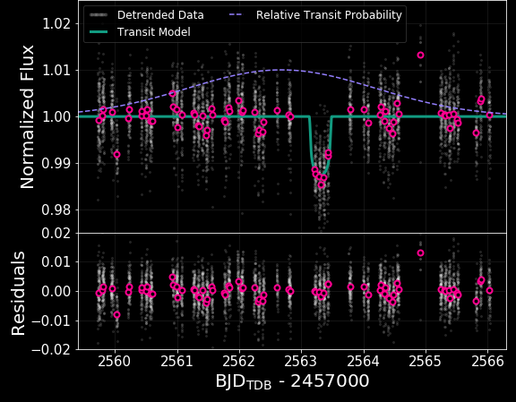

NEOSSat
TOI-2010
Observed 6.5-day window
Covered $2σ$ timing uncertainty
Caught transit (!!!)
$σ_{P}$ from ~6 hours down to seconds!
We preserve future “observability” of target by substantially improving ephemeris uncertainty.
Notes:
TESS data constrains transit shape very well
RVs constrain mass and set loose prior on period
NEOSSat constrains period very tightly
(second-accurate period is, of course, assumes no TTVs)

Slide 7
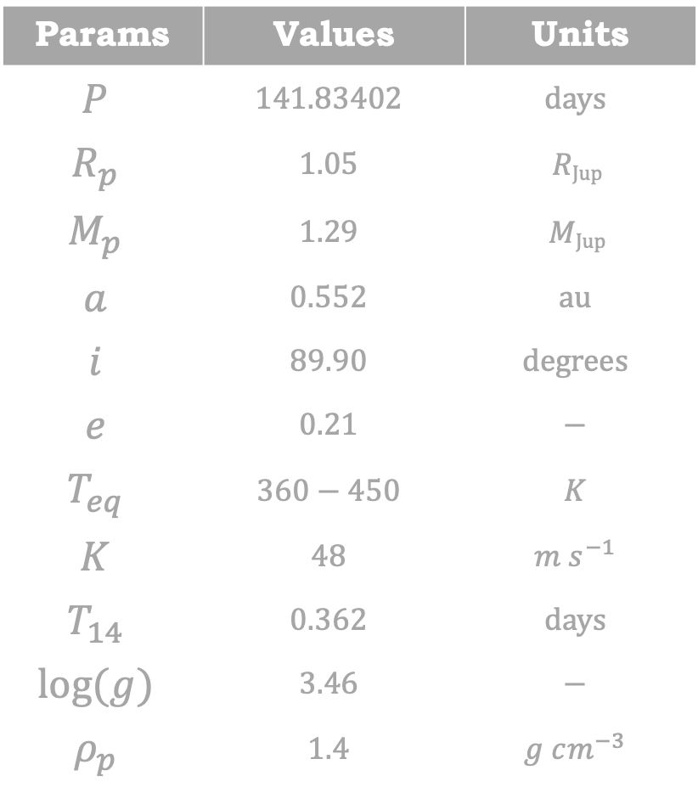
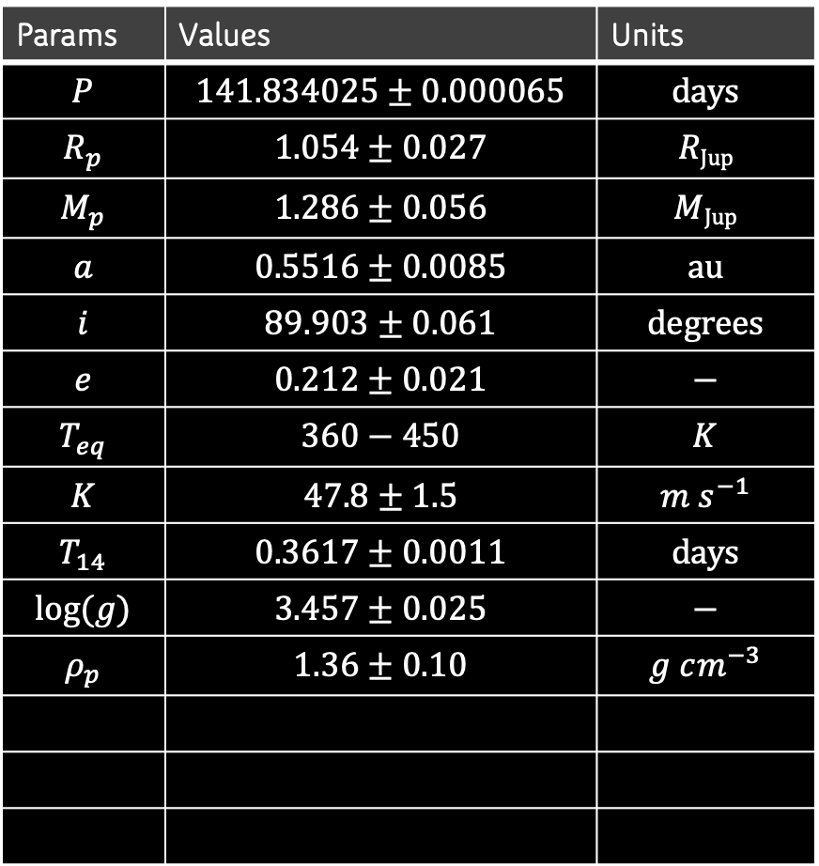
Global fit
TOI-2010
Params | Values | Units
$$P$$ | $$141.834025±0.000065$$ | $$\text{days}$$
$$R_{p}$$ | $$1.054±0.027$$ | $$R\text{Jup}$$
$$M_{p}$$ | $$1.286±0.056$$ | $$M\text{Jup}$$
$$a$$ | $$0.5516±0.0085$$ | $$\text{au}$$
$$i$$ | $$89.903±0.061$$ | $$\text{degrees}$$
$$e$$ | $$0.212±0.021$$ | $$\text{−}$$
$$T_{eq}$$ | $$360−450$$ | $$K$$
$$K$$ | $$47.8±1.5$$ | $$m s^{−1}$$
$$T_{14}$$ | $$0.3617±0.0011$$ | $$\text{days}$$
$$log⁡(g)$$ | $$3.457±0.025$$ | $$\text{−}$$
$$ρ_{p}$$ | $$1.36±0.10$$ | $$g cm^{−3}$$
Params | Values | Units
$$P$$ | $$141.83402$$ | $$\text{days}$$
$$R_{p}$$ | $$1.05$$ | $$R\text{Jup}$$
$$M_{p}$$ | $$1.29$$ | $$M\text{Jup}$$
$$a$$ | $$0.552$$ | $$\text{au}$$
$$i$$ | $$89.90$$ | $$\text{degrees}$$
$$e$$ | $$0.21$$ | $$\text{−}$$
$$T_{eq}$$ | $$360−450$$ | $$K$$
$$K$$ | $$48$$ | $$m s^{−1}$$
$$T_{14}$$ | $$0.362$$ | $$\text{days}$$
$$log⁡(g)$$ | $$3.46$$ | $$\text{−}$$
$$ρ_{p}$$ | $$1.4$$ | $$g cm^{−3}$$
Used EXOFASTv2 (Eastman et al. 2019)
Simultaneous fit of Transit, RV, and SED/isochrone models
A “warm-Jupiter”
Very low stellar insolation – atmosphere inflation likely decoupled from irradiation
Reasonable follow-up potential for transmission/eclipse spectroscopy and Rossiter-McLaughlin measurements
Notes:
SED from archival photometric measurements (Tycho, 2MASS, WISE, and Gaia) (V-mag = 9.8)
Jupiter-like planet, with ~400 K temperature.
Moderate eccentricity (~100 K swing in “annual” temperature cycle)
Only a couple giant planets with well-known mass and radius are lower insolation. Only 1 or 2 of those have comparable magnitudes.

Slide 8
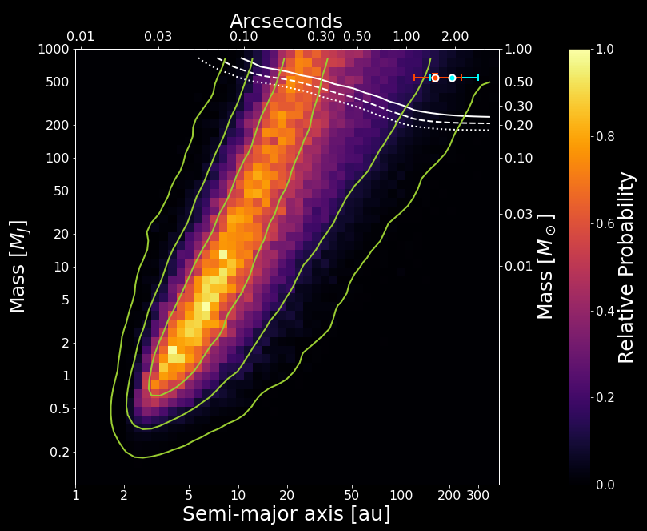

Companion Search
TOI-2010
Small ($2σ$) slope in RV residuals
(process from Bryan et al. 2016)
Make $(M,a)$ grid
Generate many random orbits in cells; gauge their ability to match the data
Find region of “likely” parameter space
Unclear if either of two known close neighbours are responsible
Notes:
i drawn from uniform cos(i); e drawn from empirically motivated Beta distribution; T0, T_peri, omega fitted.
Concentration of probability at smaller end is an eccentricity effect.
Nearby stars:
- Gaia 1.9”: similar parallax, but distances 2-sigma discrepant (few parsecs)
- Alopeke 1.5”: higher prob region, but no distance info.
Nearby stars don’t exclude something hiding in this highlighted parameter space.

Slide 9
TESS data (continued…)
TOI-2010
Whoops! TESS caught another transit while I was preparing the paper.
Transit occurred exactly when our new ephemeris predicted
Final analysis included both TESS transits
Notes:
In hindsight, made the NEOSSat transit catch mostly superfluous
However, NEOSSat detection is what made us push forward with the publication.
Also, if period was 0.6% larger, we would have missed the second TESS transit.

Slide 10
Thank you
Paper is being submitted within the next few days. Keep an eye out!
– christopher.mann@umontreal.ca –

