Slide 1
Searching for Dark Matter Subhaloes in Fermi-LAT UFOs
Matthew Lundy
CRAQ 2023
matthew.lundy@mail.mcgill.ca

Slide 2
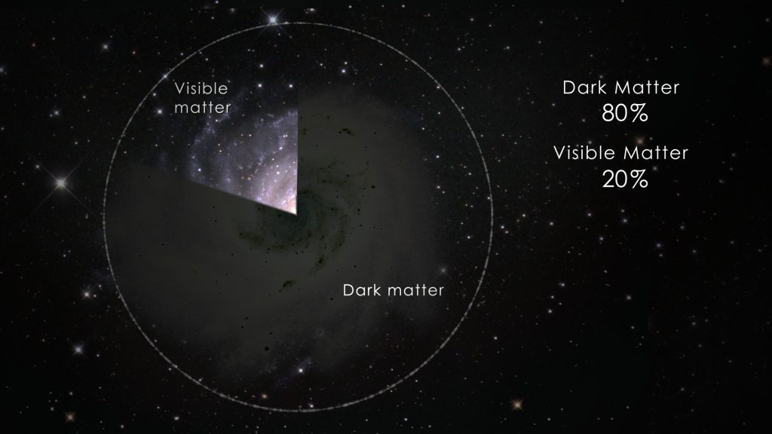
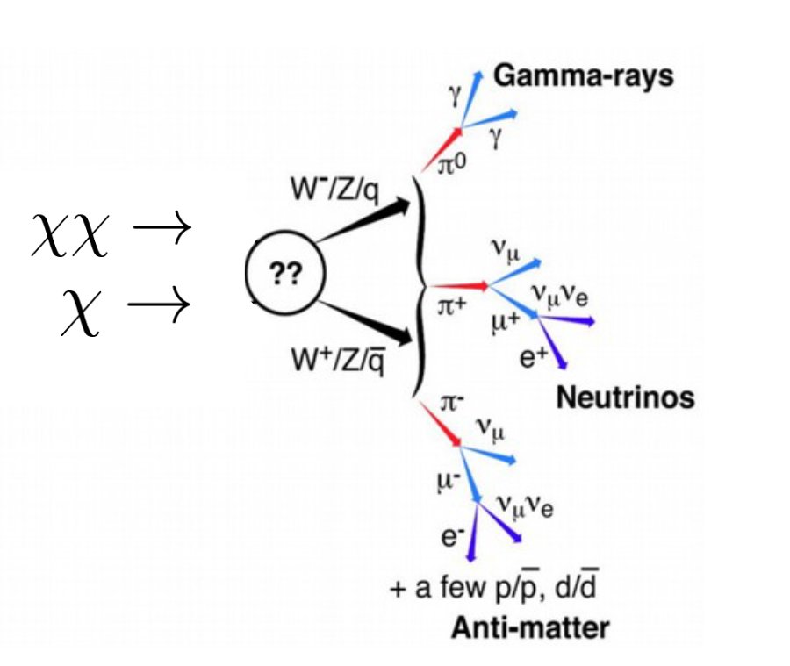
Searching for Dark Matter Subhalos in Fermi-LAT UFOs
Credit: Fermi-LAT
Matthew Lundy
CRAQ 2023
matthew.lundy@mail.mcgill.ca
Credit: NASA

Slide 3
Indirect Detection of Dark Matter
Indirect Detection of dark matter is the study of the unique products of possible decay/annihilation channels for theoretical DM particles.
(Billard, 2021)
Credit: Fermi-LAT
The most common theoretically well motivated particle is the WIMP lying in the GeV-TeV range
DM Subhaloes | May 2023 | Matthew Lundy
3

Slide 4
What makes a good DM source?
Particle physics model
parameter, this is model dependent and fixed for a given limit.
How bright is the source, how many photons are we getting?
$$Flux\left(χχ→ ?\right)=\frac{<σv>}{2m_{χ}^{2}}J_{factor}N_{γ}$$
The thermally averaged cross-section: how strong is the interaction? Smaller cross sections mean that the interaction is less likely to occur so we have less events… this is what we measure
The astrophysical parameter representing the integral of the dark matter along the line of sight. Sources with a high J-factor are more visible for the same DM models. This is what we use to select sources
DM Subhaloes | May 2023 | Matthew Lundy
4

Slide 5
Galactic Center
Pre-existing studies show an excess but it’s difficult to disentangle from millisecond pulsars or other sources
Dwarf Galaxies
Very deep pre-existing limits with 100s of hours of data. No evidence of signal perhaps due to distance.
Subhaloes
Lots of unexplored sources. Potentially very bright sources, and could resolve known unassociated sources
(Griffen,2016)

Slide 6
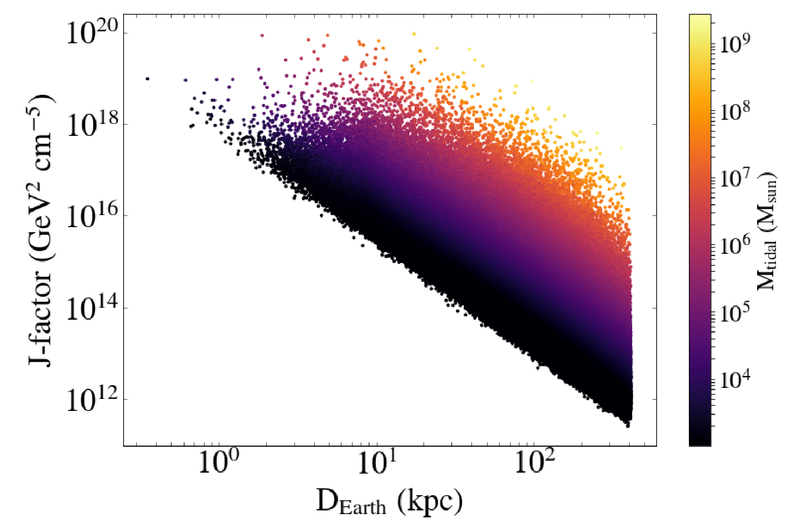
J Factors for DM Subhaloes
(Coronado-Blázquez,2019)
The brightest substructures in recent simulations are subhaloes that don’t have sufficient mass to attract baryonic matter. These have unique signatures:
Extended (>0.1 degree)
Show DM spectral shape
No multiwavelength counterparts
Brighter
Closer
DM Subhaloes | May 2023 | Matthew Lundy
6

Slide 7
IACTs vs. Pair Production Telescopes
FERMI-LAT
VERITAS
Wide FoV, survey instrument (2.4 sr)
Worse angular resolution (3.5-0.15˚)
20 MeV - 300 GeV Energy range
Good for identifying candidates
Pointed Instrument (3 ˚ diameter)
Good angular resolution (0.08 ˚ at 1 TeV)
85 GeV- >30 TeV Energy range
Good for confirming DM origin
DM Subhaloes | May 2023 | Matthew Lundy
7

Slide 8
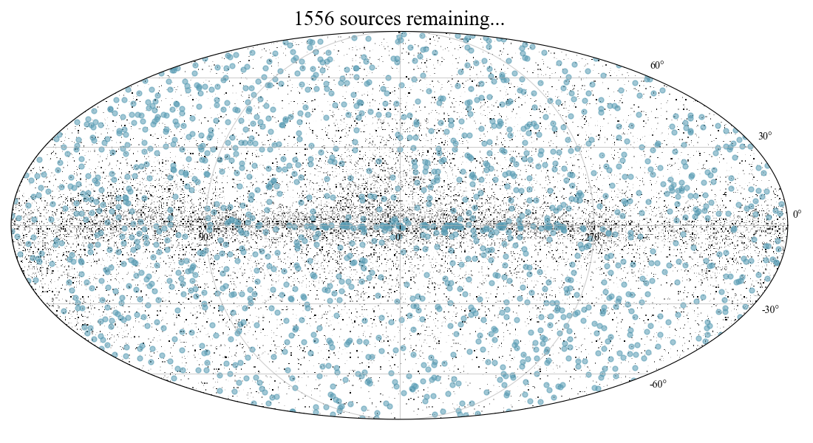
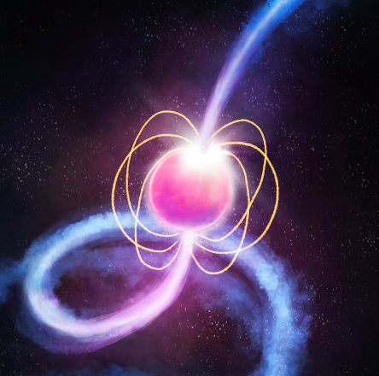
Source Selection
Fermi–LAT Map
Most gamma-ray sources in the existing catalogues are blazars and pulsars. A series of cuts targeting these can help to trim the possible subhaloes in Fermi-Lat
Pulsar
Blazar
DM Subhaloes | May 2023 | Matthew Lundy
8

Slide 9
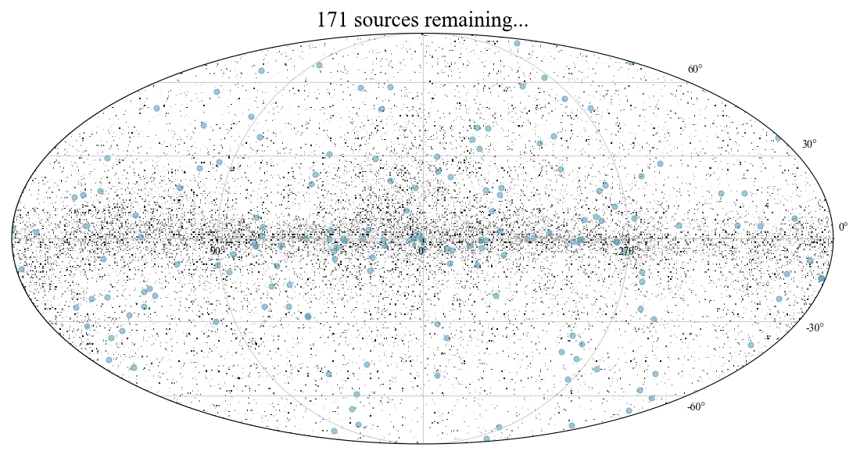
Association Cut
Fermi–LAT Map
First the source must be unassociated with no known counterparts at other wavelengths.
Pulsar
Blazar
DM Subhaloes | May 2023 | Matthew Lundy
9

Slide 10
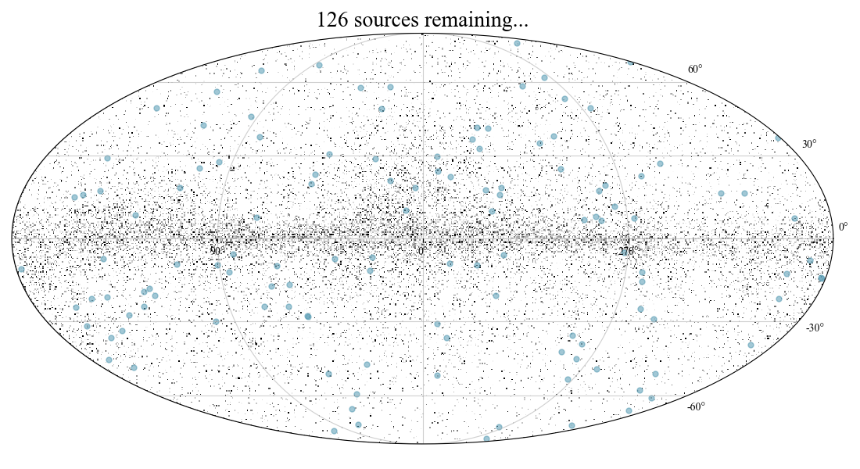
Galactic Plane Cut
Fermi–LAT Map
Most sources in the galactic plane are assumed to be unidentified pulsars. Pulsars are often difficult to disentangle in these bright and crowded regions.
Pulsar
Blazar
DM Subhaloes | May 2023 | Matthew Lundy
10

Slide 11
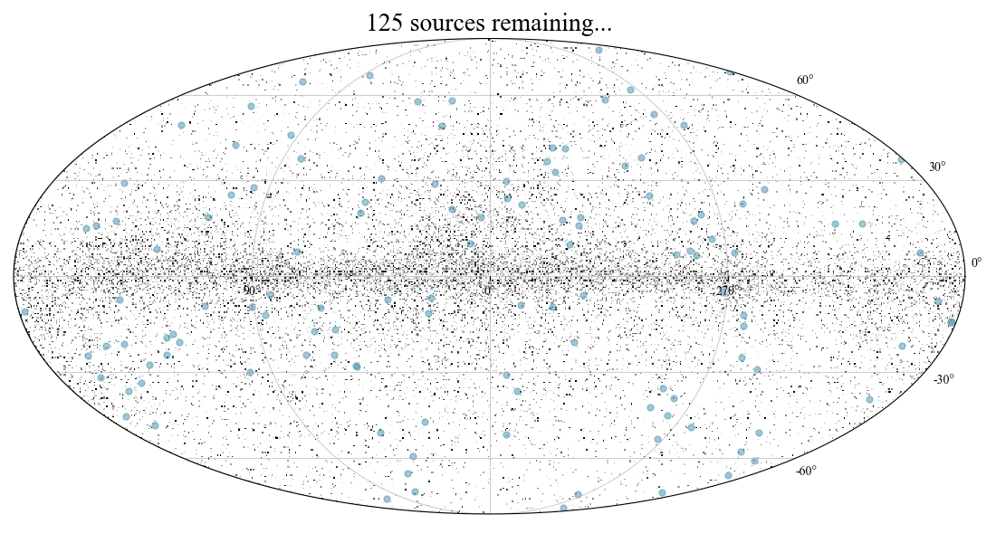
Variability Cut
Fermi–LAT Map
Dark matter decay is just a statistical process assumed to have a non-variable signal. Blazars often go through extreme flaring events uncharacteristic of dark matter.
Pulsar
Blazar
DM Subhaloes | May 2023 | Matthew Lundy
11

Slide 12
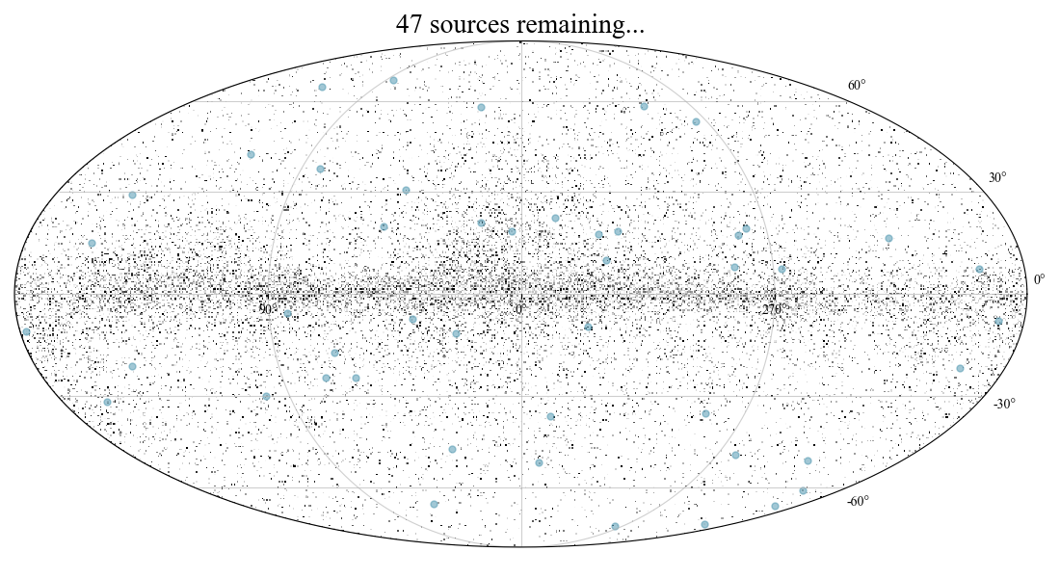
Spectral Cut
Fermi–LAT Map
We require a power law cut of 2 to make the source in the sensitivity range of VERITAS and to remove sources with uncharacteristic cutoffs
Pulsar
Blazar
DM Subhaloes | May 2023 | Matthew Lundy
12

Slide 13
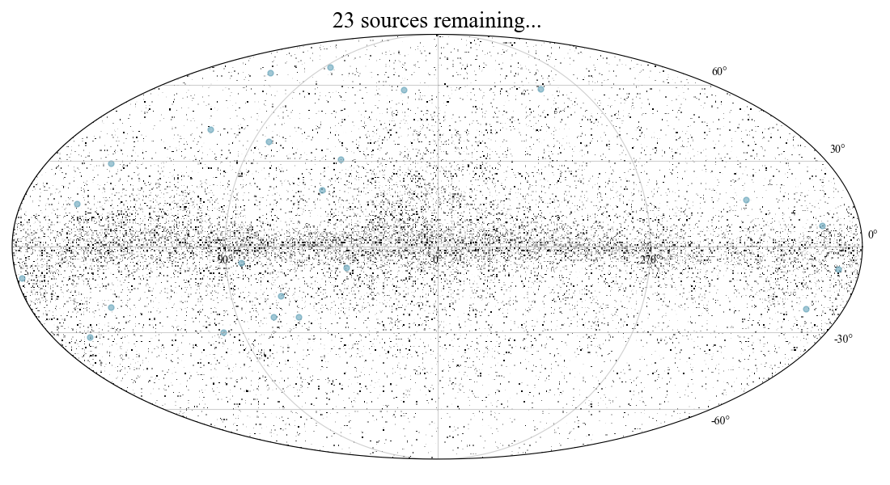
Visibility Cut
Fermi–LAT Map
VERITAS must be able to observe the source, so we cut on RA/Dec for a Northern Hemisphere Source
Pulsar
Blazar
DM Subhaloes | May 2023 | Matthew Lundy
13

Slide 14
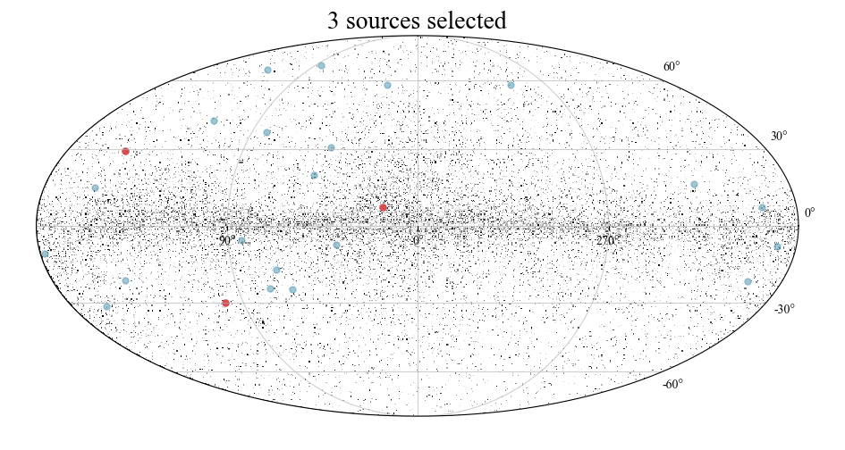
Multiwavelength Cut
Fermi–LAT Map
We perform a search through the literature to ensure there is no solid detection or strong counterparts that were previously unidentified in the 3FHL catalogue. Sources are then ranked by extrapolated TeV flux.
Pulsar
Blazar
DM Subhaloes | May 2023 | Matthew Lundy
14

Slide 15
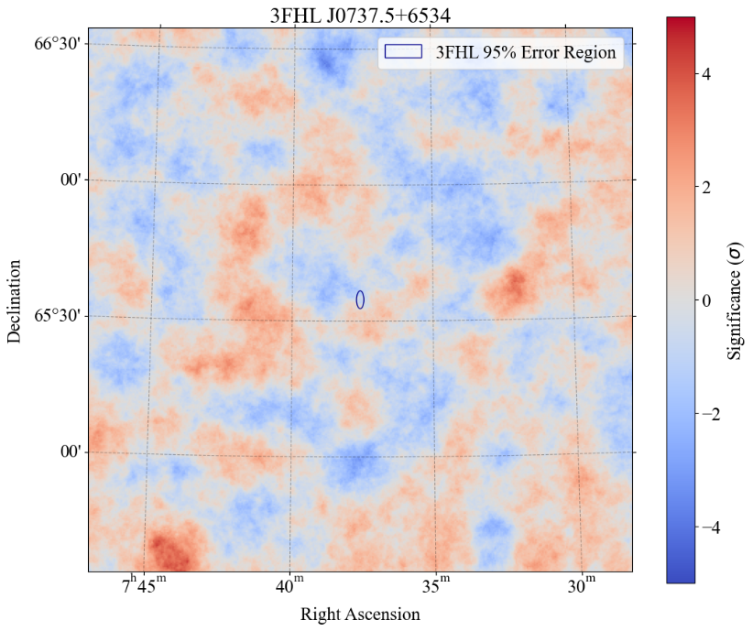
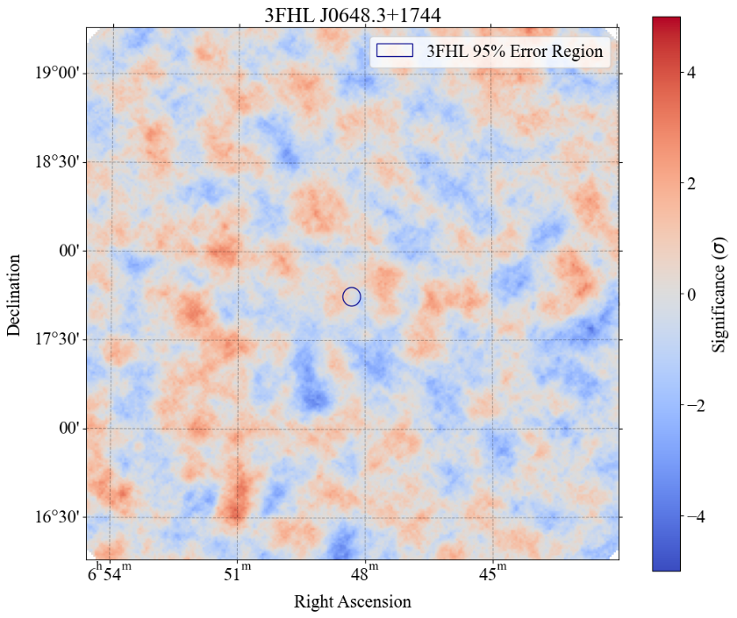
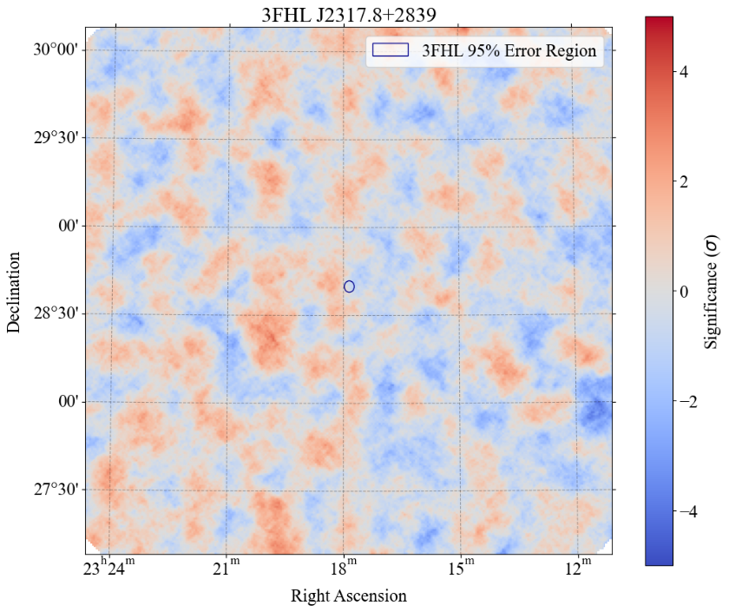
Sky Maps
No significant TeV emission is seen by VERITAS spatially coincident with any canidate source. As such we place constraints on the emission at TeV energies.
-1.0σ : 11h
-0.15σ : 9h
-0.8σ : 12h
DM Subhaloes | May 2023 | Matthew Lundy
15

Slide 16
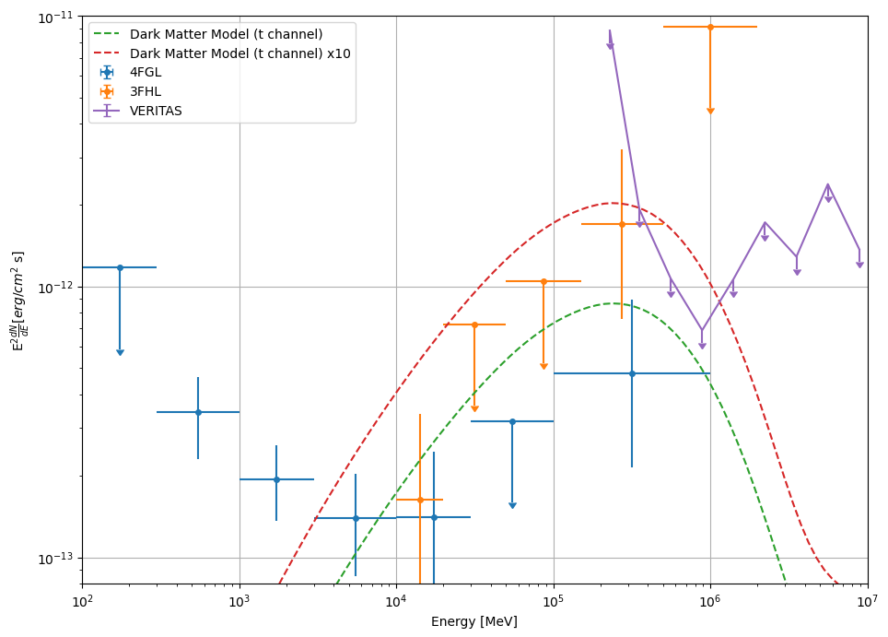
Spectral Model
Comparing our non-detection to extrapolated DM models we see that our results are in tension with a DM interpretation of these unassociated objects.
What they are is still unknown but by placing significant constraints on the VHE emission we are moving towards a fuller understanding of the gamma-ray zoo of objects.
DM Subhaloes | May 2023 | Matthew Lundy
16

Slide 17
Future Work
Deeper observations may be required to understand exactly the spectral behaviour of these sources at the IACT break.
There still exists other subhalo candidates to explore at TeV energies and new observations may still provide a promising candidate.
Next generation of IACT (Cherenkov Telescope Array) are ~10x as sensitive
Credit: CTA
DM Subhaloes | May 2023 | Matthew Lundy
17

Slide 18
Questions?
Contact: matthew.lundy@mail.mcgill.ca
DM Subhaloes | May 2023 | Matthew Lundy
18

