Slide 1
Technical analysis of the transit wavelength solution of JWST observations (SOSS)
Dereck Lizotte, Jason Rowe

Slide 2
Goals
Build a reliable pipeline from the ground up
From raw JWST data to a wavelength solution
Helps compare with already existing public pipelines
Prepare for incoming HAT-P-1b JWST data
Stellar spectra in existing JWST data does not fully agree with models
This work was done with HAT-P-18b SOSS data
This disagreement would therefore be present in planetary spectra
We need a general solution that could work for current and upcoming data

Slide 3
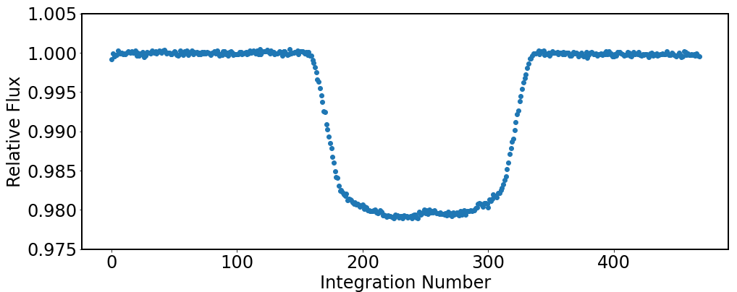
JWST Raw Data (briefly…)
2048 (spectral) x 256 (spatial) – overlaid/stacked image (469)
Trace our primary transit flux data
Find median flux for each image (along the “time” axis (469))

Slide 4
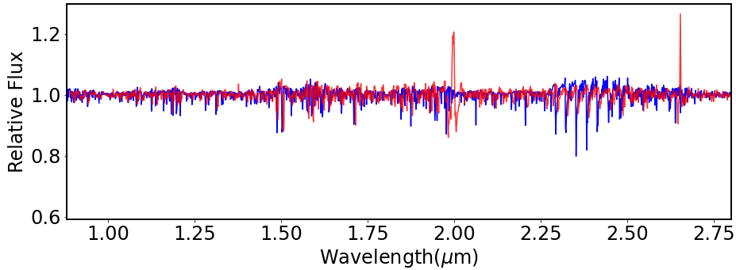
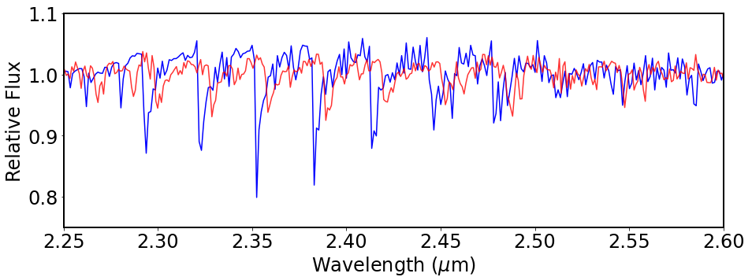
Wavelength solution
We need to translate our 2048 spectral axis into wavelength
Is the reference table accurate?
Compare high SNR stellar spectrum with a model (ATLAS 9)

Slide 5
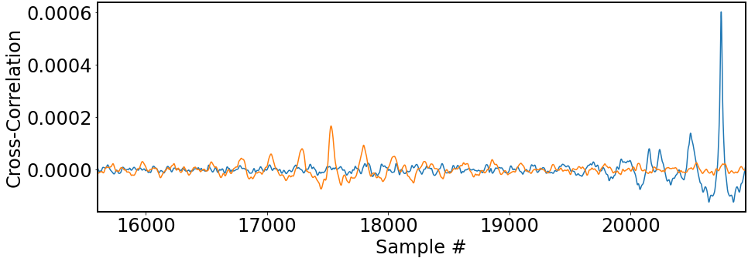
Cross-correlation
Where do the data and model best match?
Auto-correlation (blue) has a peak at a “lag” of 0
Cross-correlation (orange) has a peak where data-model best correlate
Difference between them is the “lag” by which the data must be corrected

Slide 6
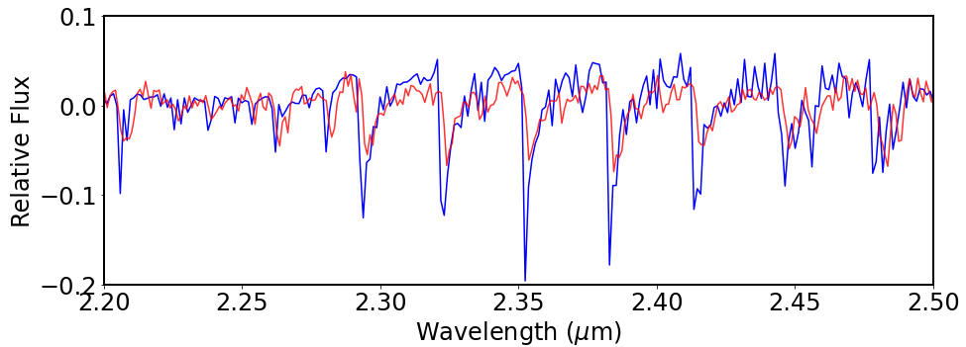
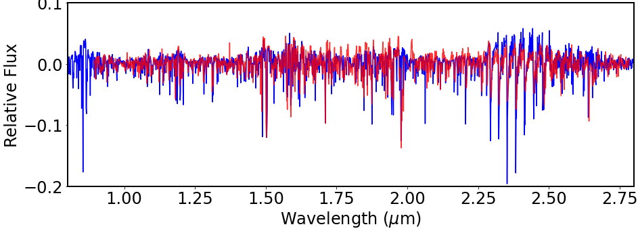
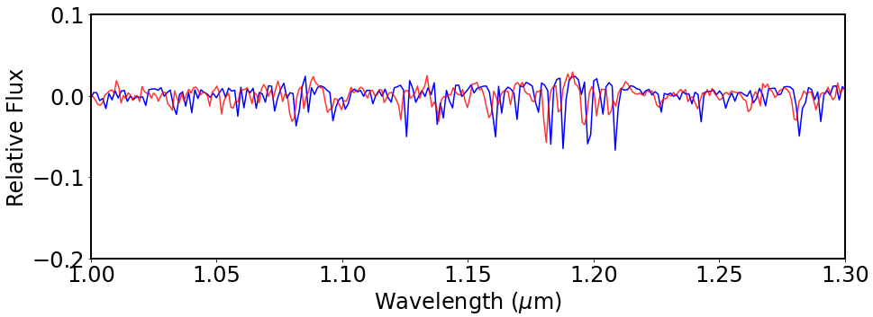
Preliminary Results
Found correction of -0.0046 ± 0.0019 μm
Different corrections needed at different wavelengths

Slide 7
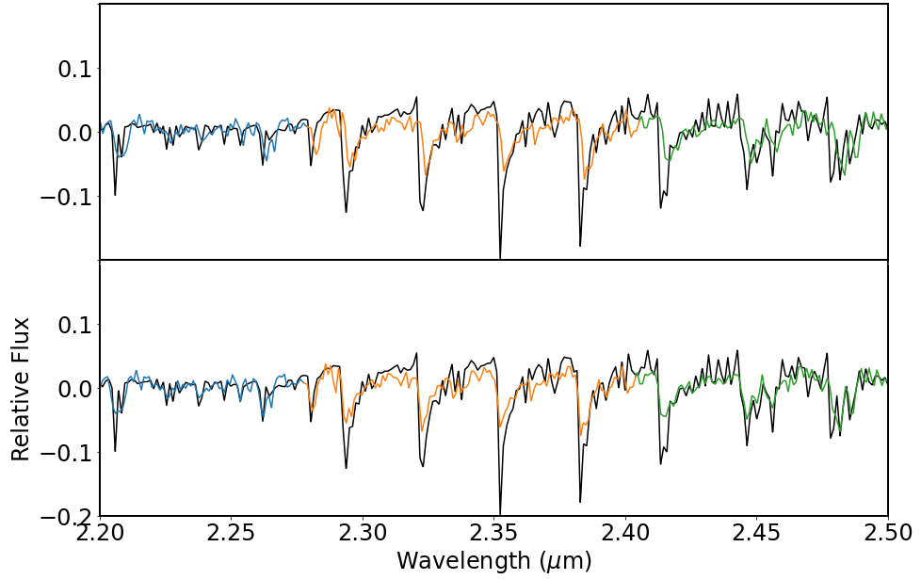
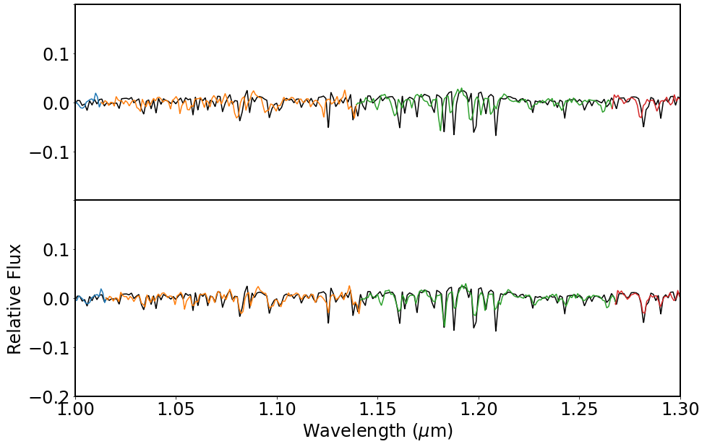
Rolling Cross-correlation
Divide the (previously corrected) data into pieces and cross-correlate each one with the model
Find finer lag corrections for each section of the data

Slide 8
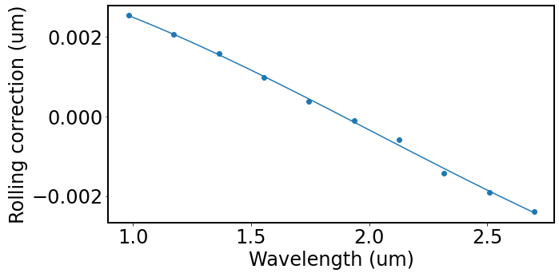
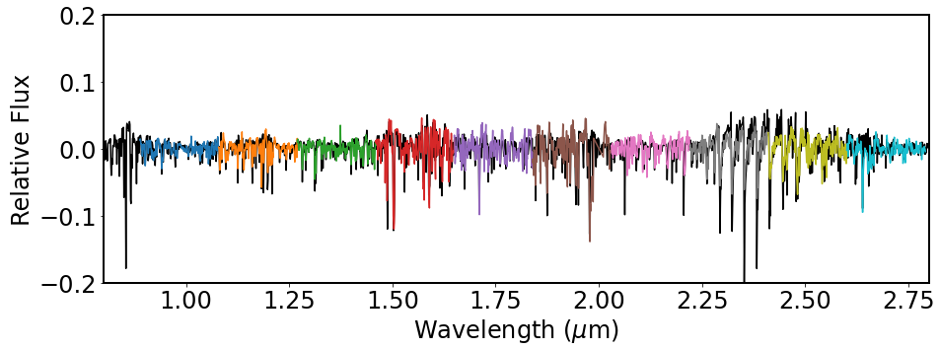
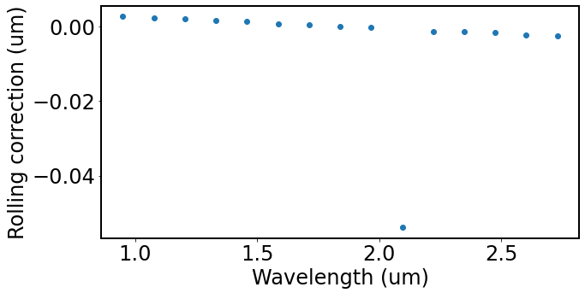
Rolling Cross-Correlation
Relation between correction and wavelength
Sensitivity to over-fitting by cross-correlation increased by presence of gaps due to removal of outliers…

