Slide 1
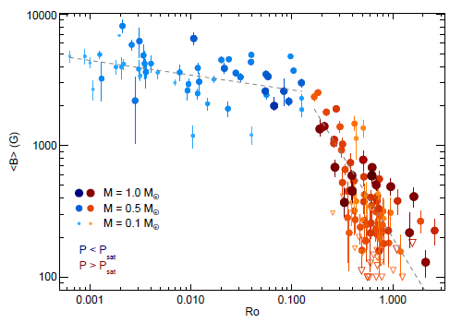





Michaël Lévesque:
Université de Montréal
Évolution Magnéto-rotationnelle des étoiles de type solaire.
Dynamo:
(Babcock-Leighton)
$$α, M$$
$$B_{0} →T$$
$$Ω, ΔΩ$$
$$Ω$$
Évolution Rotationelle:
(MacGregor-Brenner)
Vents Stellaire:
(Weber-Davis)
$$∂_{t}J$$
Reiners and al, 2022
Notes:
Belcher, J. W., and K. B. MacGregor. “Magnetic Acceleration of Winds from Solar-Type Stars.” The Astrophysical Journal 210 (December 1, 1976): 498–507. https://doi.org/10.1086/154853.
Charbonneau, Paul, Cedric St‐Jean, and Pia Zacharias. “Fluctuations in Babcock‐Leighton Dynamos. I. Period Doubling and Transition to Chaos.” The Astrophysical Journal 619, no. 1 (January 20, 2005): 613–22. https://doi.org/10.1086/426385.
Charbonneau, Paul. “Dynamo Models of the Solar Cycle.” Living Reviews in Solar Physics 17, no. 1 (December 2020): 4. https://doi.org/10.1007/s41116-020-00025-6.
MacGregor, K. B., and M. Brenner. “Rotational Evolution of Solar-Type Stars. I. Main-Sequence Evolution.” The Astrophysical Journal 376 (July 1, 1991): 204. https://doi.org/10.1086/170269.
Reiners, A., D. Shulyak, P. J. Käpylä, I. Ribas, E. Nagel, M. Zechmeister, J. A. Caballero, et al. “Magnetism, Rotation, and Nonthermal Emission in Cool Stars: Average Magnetic Field Measurements in 292 M Dwarfs.” Astronomy & Astrophysics 662 (June 2022): A41. https://doi.org/10.1051/0004-6361/202243251.

