Slide 1
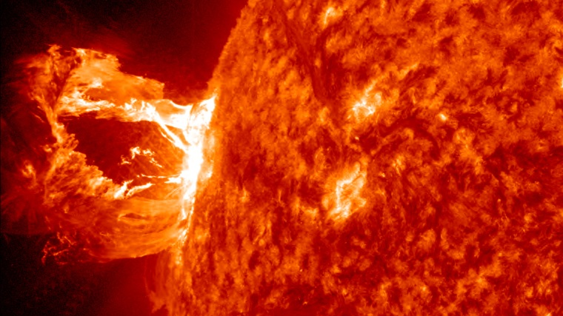
Predicting Solar Flares with Sandpile Avalanche Models
Rencontre annuelle du CRAQ 2023
Henri Lamarre
NASA/SDO/AIA

Slide 2
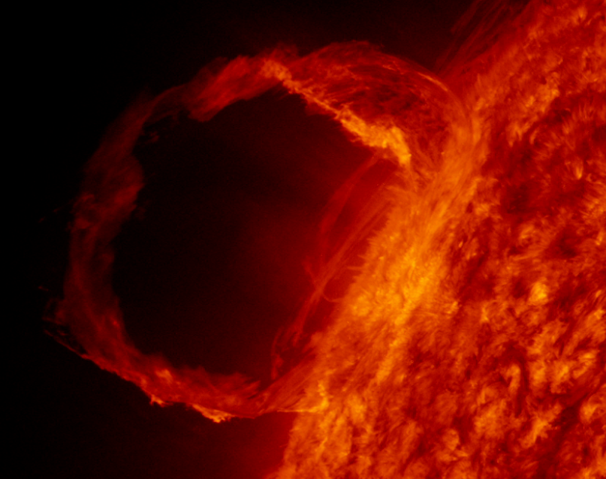
Solar Flares
What are Solar Flares?
How do they happen?
How do they affect us?
What are the main challenges with Solar Flare prediction?
NASA/SDO/AIA
Notes:
What are solar flares:
Mass éjection violent at the surface of the sun
Link to Sunspots
How do they happen:
We dont know but magnetic reconnection.
How do they affect us:
Magnetosphere but infrastructure in space. Plus very large events
Why is Solar Flare prediction important:
Large events, Hydroquebec, communication, also something more interesting: magnetic reconnection and magnetic fields of a star.
Main challenges:
Chaos, Scale of events/power law

Slide 3
Avalanche Models
Where can avalanche models be used?
What is self-organized criticality?
Why is this relevant for solar flares?
Sergei Klishin (Youtube)
Notes:
Where can avalanche models be used:
Avalanches, Séismes, accumulation d’énergie et relâchement sur courte période de temps
What is self-organized Criticality:
Un état dans le modèle pour lequel la transition de phase est l’état d’équilibre. L’équilibre
du tas de sable est d’avoir une courbure maximale et de constamment osciller entre charge et décharge.
Why is this relevant for solar flares:
We think that solar flares qualify, les power laws sont un bon indicateur de SOC. Et nous avons
une analogie très intuitive sur comment les modèles sandpile sont relies aux boucles magnétiques.

Slide 4
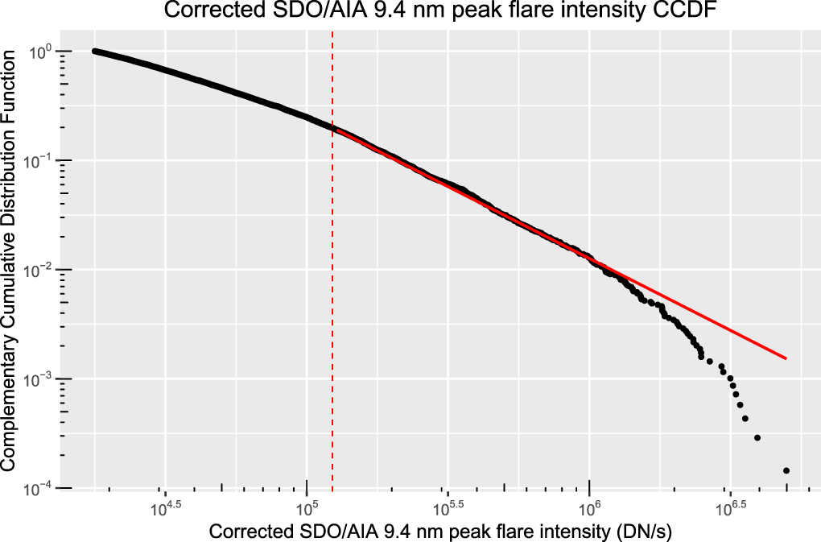
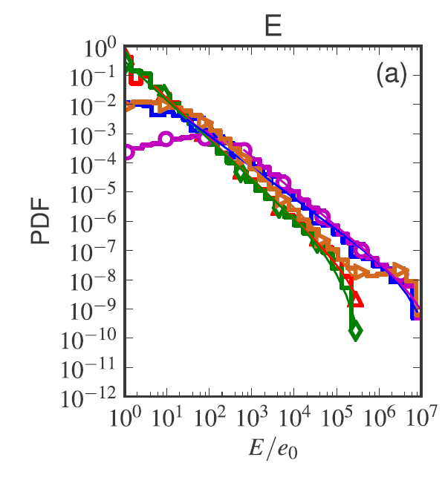
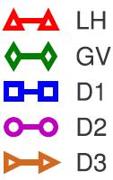
Why use this model?
Solar flare statistics
Predictability
What is the connection between sand piles and solar flares?
Verbeeck+19
Strugarek+14
Notes:
Apart from the appealing analogy and simplicity of the model, why are we interested in using it?
Predictability:
Parler de l’article de Christian brièvement.
Where do we go from here:
Parler des pentes, des waiting times, etc. Parler de ma recherche comment les definitions d’énergies changent les statistiques.

Slide 5
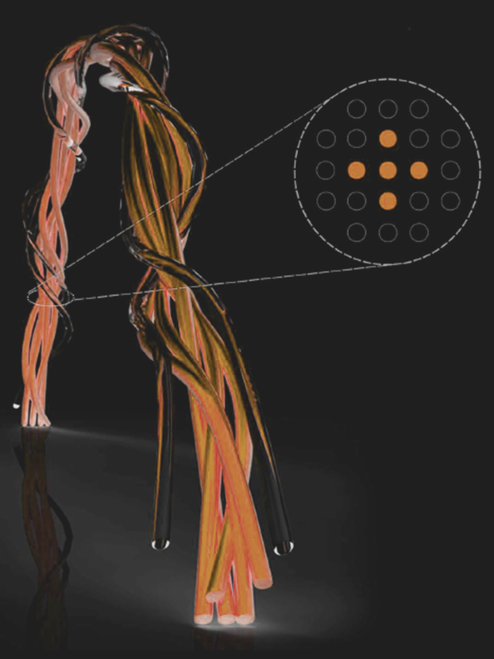
Connection to Flares
How do Avalanche models work?
What is the connection between sand and flares
How do we relate this to observations?
Farhang+18
Notes:
How do avalanche models work:
Driving, courbure, redistribution, avalanches, SOC
What is the connection:
Hauteur de la pile de sable → magnetic vector potential : twist
Avalanche -> reconnection magnétique? Relaxation de la courbure du champ magnétique.
How do we relate this to observation:
Défénir l’énergie du système et en suite Données GOES.

Slide 6
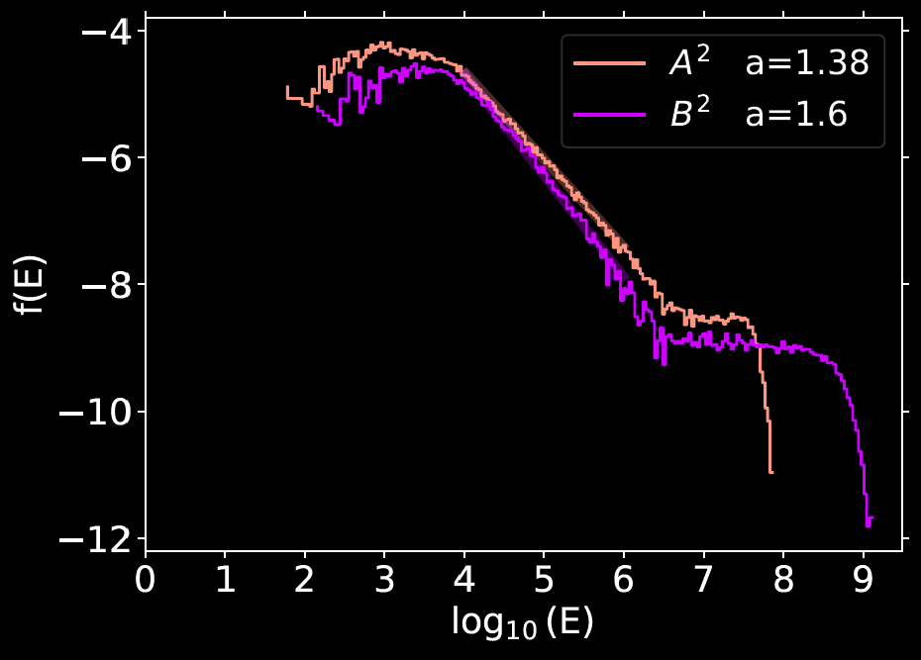
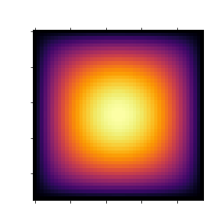
Choosing an Energy Definition
E = $\sum{B^{2}}$
E = $\sum{A^{2}}$
Notes:
Décrire le problème des lois de puissances et pourquoi on cherche une pente plus élevée.
Expliquer les lattice, expliquer les énergies
Expliquer la bosse

Slide 7
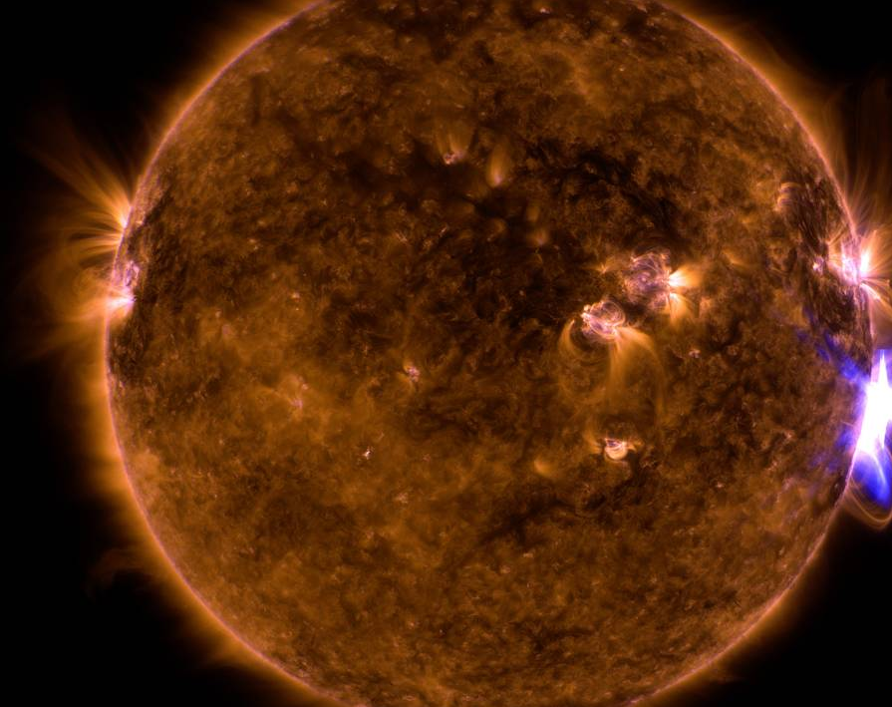
Thank you! Questions?
References:
Charbonneau, Paul, et al. "Avalanche models for solar flares (Invited Review)." Solar Physics 203 (2001): 321-353.
Farhang, Nastaran, Hossein Safari, and Michael S. Wheatland. "Principle of minimum energy in magnetic reconnection in a self-organized critical model for solar flares." The Astrophysical Journal 859.1 (2018): 41.
Strugarek, Antoine, et al. "Deterministically driven avalanche models of solar flares." Coronal Magnetometry (2014): 371-393.
Thibeault, Christian, et al. "Forecasting Solar Flares by Data Assimilation in Sandpile Models." Solar Physics 297.9 (2022): 125.
Verbeeck, Cis, et al. "Solar flare distributions: Lognormal instead of power law?." The Astrophysical Journal 884.1 (2019): 50.
NASA/SDO

