Slide 1
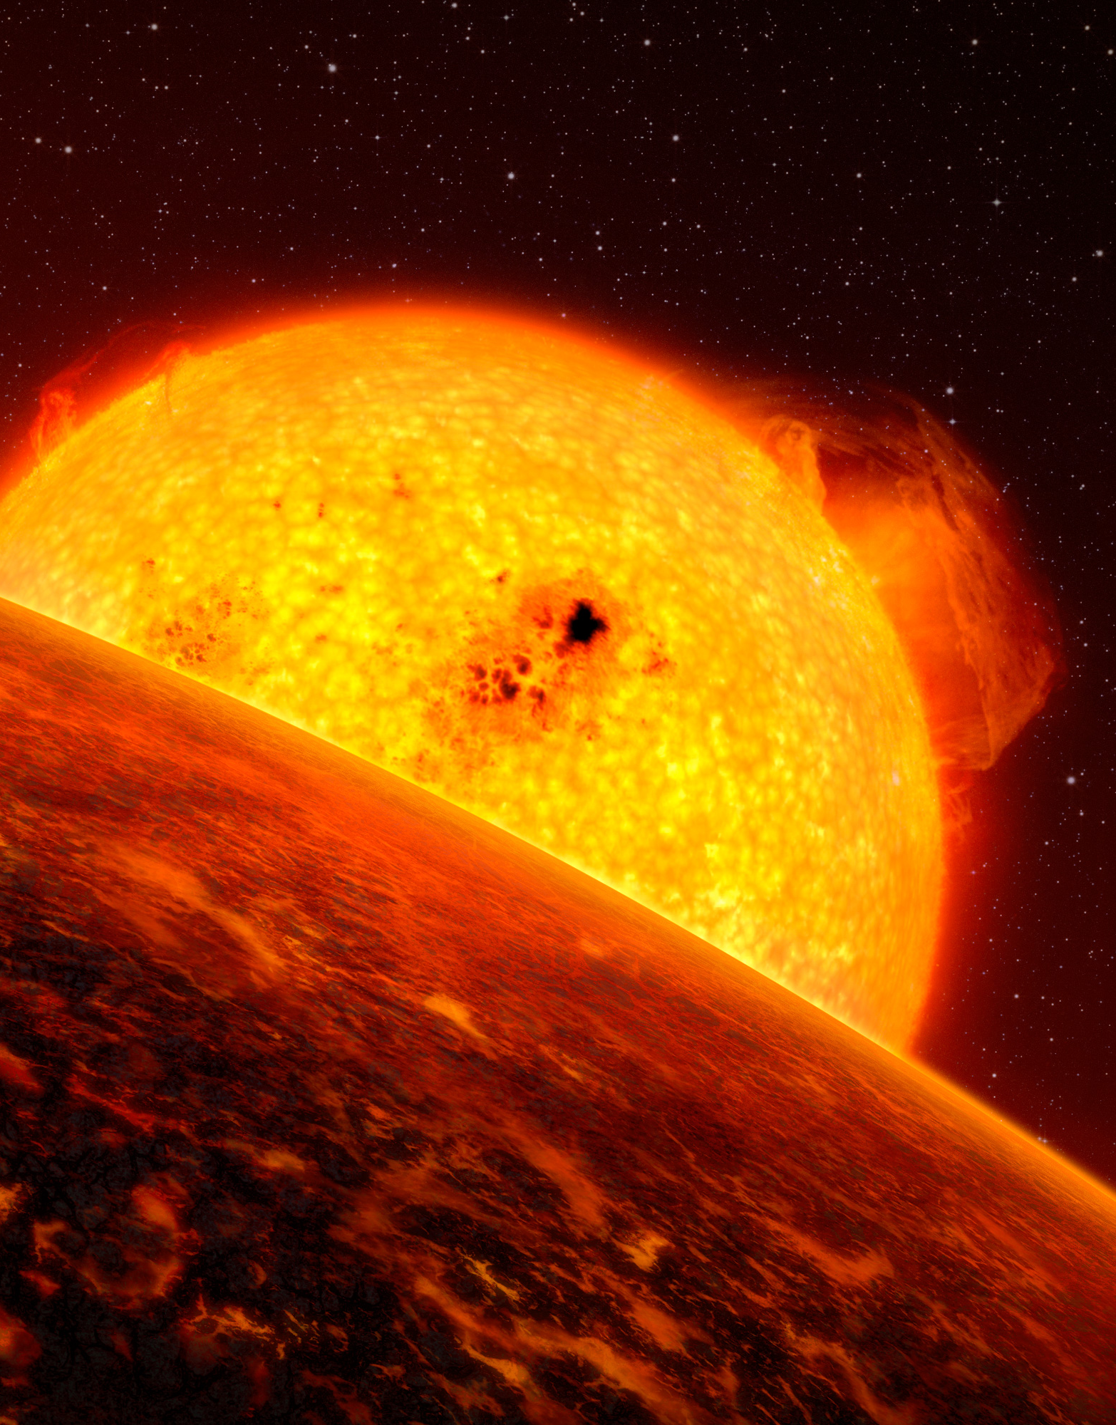
thermal evolution of Lava planets
CRAQ 2023
Mahesh Herath (2nd year PhD student), Charles-Eduoard Boukare, Nicolas Cowan

Slide 2
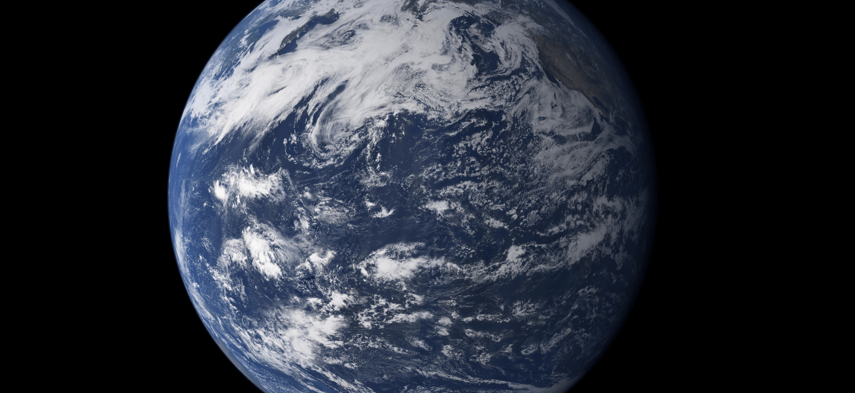
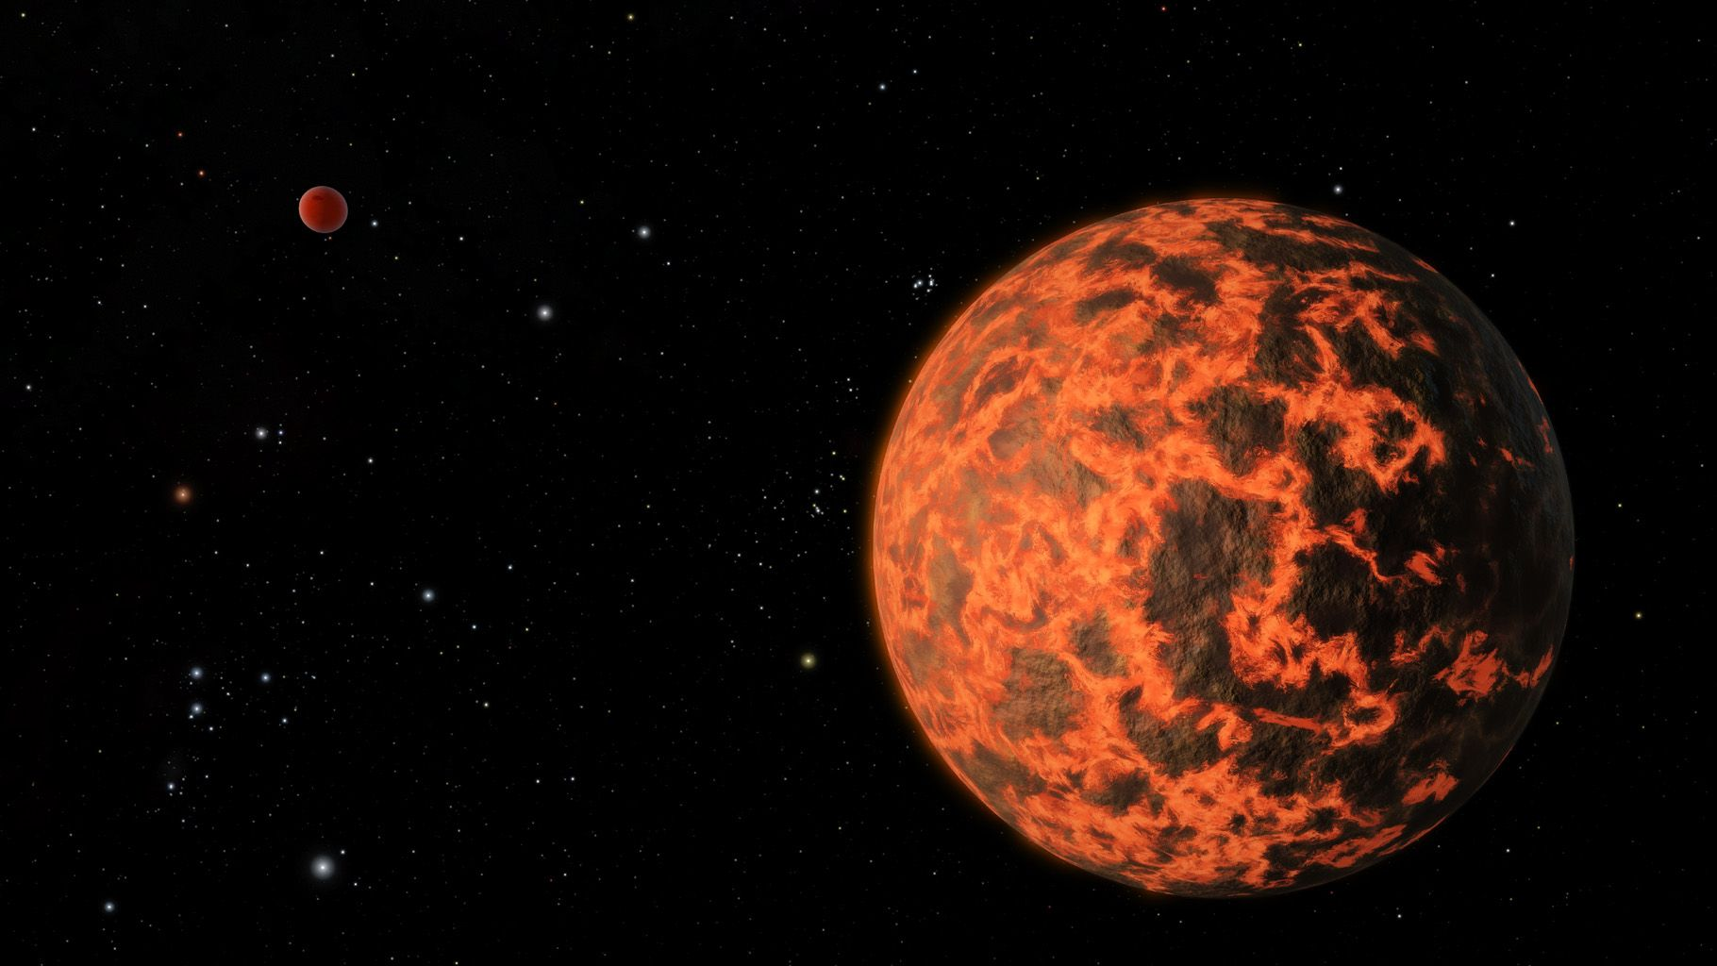
LAVA PLANETS IN CONTEXT
Earth began life as a magma rich world before it cooled down into the lively world we see before us.
But what about planets that have sustained magma oceans on their surfaces for billions of years? Do they evolve differently?

Slide 3
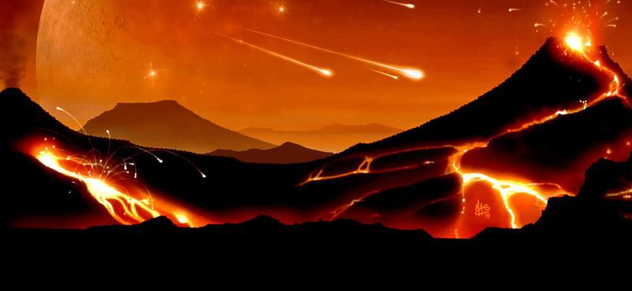
LAVA PLANETS IN CONTEXT
Orbiting at very short distances for the host star, Lava planets are expected to have super-heated surfaces that could be observed with the best space telescopes.
Are their surfaces hot enough for us to study with thermal phase curves?
How deep are their magma oceans as a result of how they thermally evolved?
Can the internal temperature profile tell us if the interior can release gases into the planet's exterior, and how the interior is differentiated into layers?
How would different variations of the internal structure affect the thermal evolution?

Slide 4
THE THERMAL MODEL
START: Interior structure and initial thermal profile
Allow temperature of each layer to evolve according to thermal equations per layer
1
2
Check the temperature profile against the solidus/liquidus of Silicate mantle
Back to step 2 and repeat
3
Allow crystallization of the mantle and repeat the process
4

Slide 5
THE THERMAL MODEL
START: Interior structure and initial thermal profile
Allow temperature of each layer to evolve according to thermal equations per layer
1
2
Check the temperature profile against the solidus/liquidus of Silicate mantle
Back to step 2 and repeat
3
Allow crystallization of the mantle and repeat the process
4

Slide 6
INTERIOR STRUCTURE
Upper Mantle
Lower Mantle
MAGMA OCEAN
Fe CORE
Core (molten/solid)
STAGE 1
Use thermoelastic data of mantle minerals and compressed Iron to model the interior
MAGMA OCEAN
SOLID SILICATES
Fe CORE
STAGE 2

Slide 7
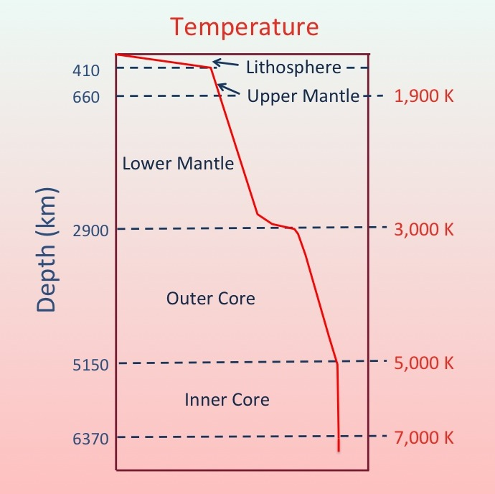
Upper Mantle
Lower Mantle
Core (molten/solid)

Slide 8
THE THERMAL MODEL
START: Interior structure and initial thermal profile
Allow temperature of each layer to evolve according to thermal equations per layer
1
2
Check the temperature profile against the solidus/liquidus of Silicate mantle
Back to step 2 and repeat
3
Allow crystallization of the mantle and repeat the process
4

Slide 9
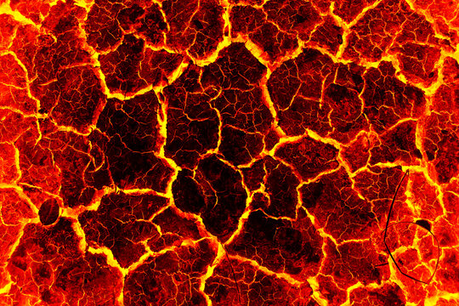
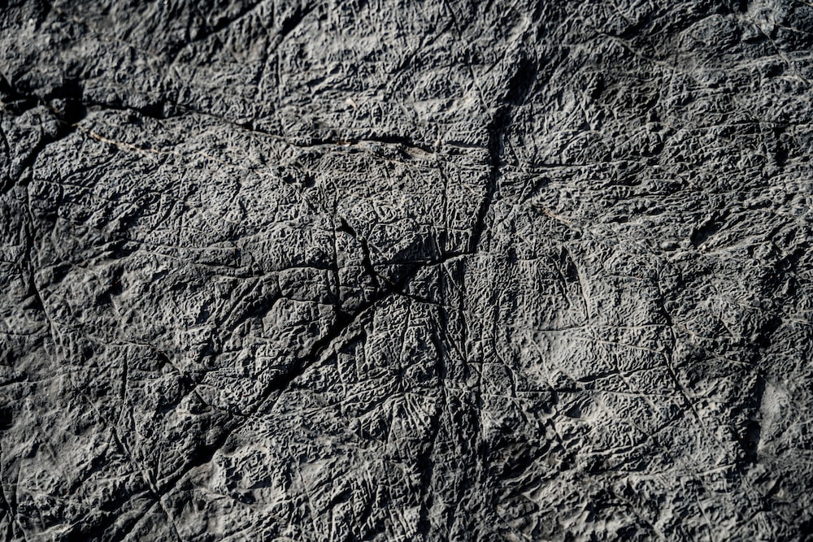
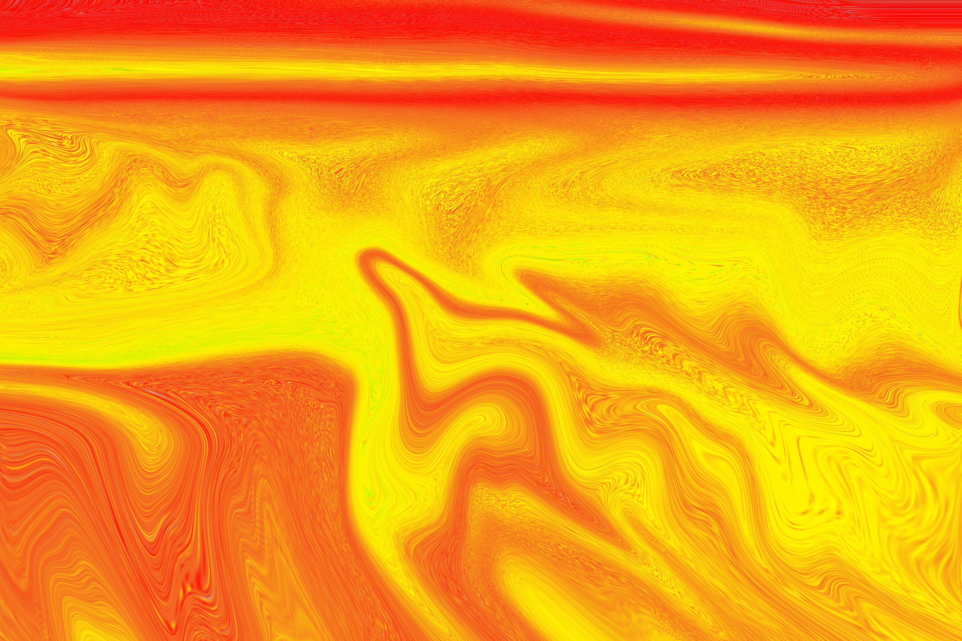
Ts = 1000, 2000, (constant)
Going out
Going out
Going out

Slide 10
THE THERMAL MODEL
START: Interior structure and initial thermal profile
Allow temperature of each layer to evolve according to thermal equations per layer
1
2
Check the temperature profile against the solidus/liquidus of Silicate mantle
Back to step 2 and repeat
3
Allow crystallization of the mantle and repeat the process
4

Slide 11
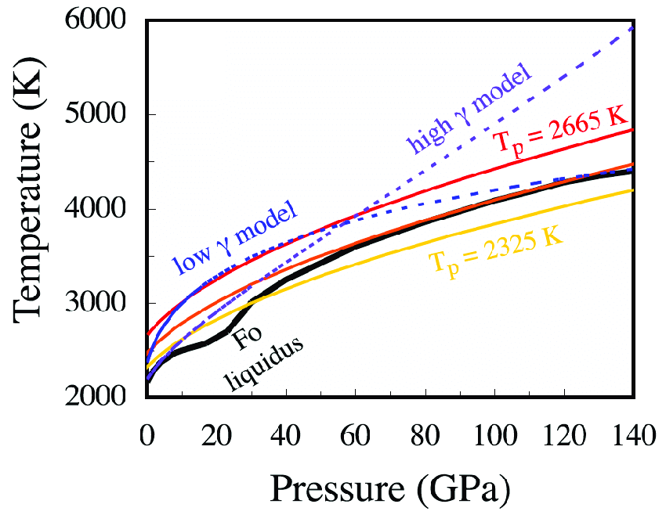
Upper Mantle
Lower Mantle
Core (molten/solid)
Adiabat meets liquidus and solidus

Slide 12
z
T_{eq}
R_{p}
MO keeps cooling quickly
Rapid cooling of magma ocean
Initial very hot magma ocean
silicate liquidus
MO stops convecting
Mantle stops convecting
Convecting MO over convecting solid mantle
Mush solidifies from bottom up
Mush thickens at expense of MO
Mush forms at base of MO
Temp

Slide 13
THE THERMAL MODEL
START: Interior structure and initial thermal profile
Allow temperature of each layer to evolve according to thermal equations per layer
1
2
Check the temperature profile against the solidus/liquidus of Silicate mantle
Back to step 2 and repeat
3
Allow crystallization of the mantle and repeat the process
4

Slide 14
PRELIMINARY RESULTS – TESTS FOR EARTH MASS PLANETS

Slide 15
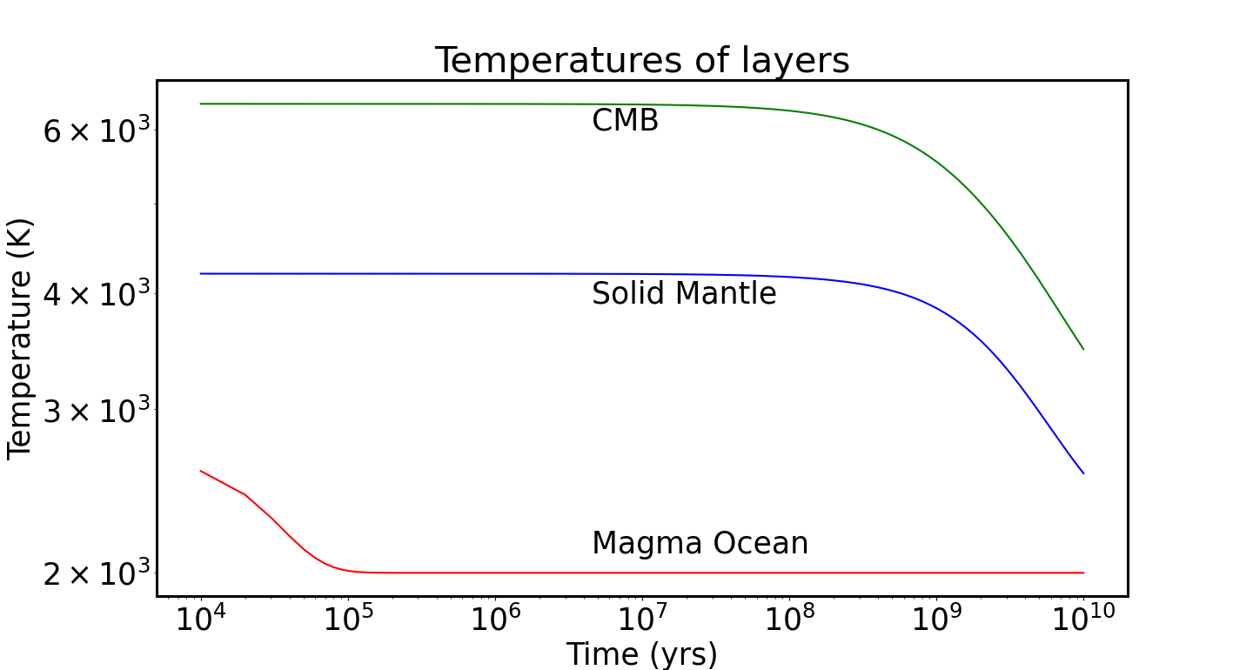
Upper Mantle
Lower Mantle
Core (molten/solid)

Slide 16
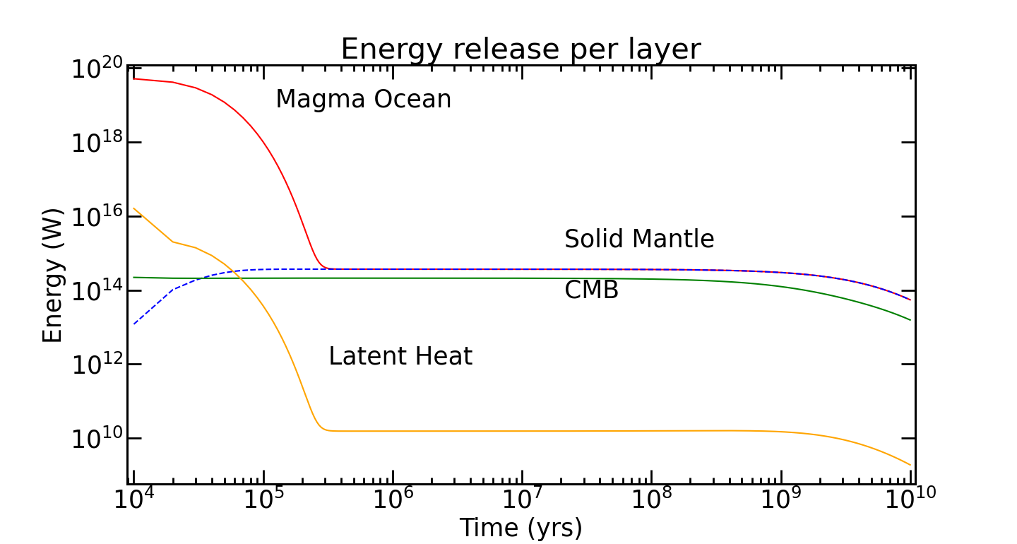
Upper Mantle
Lower Mantle
Core (molten/solid)

Slide 17
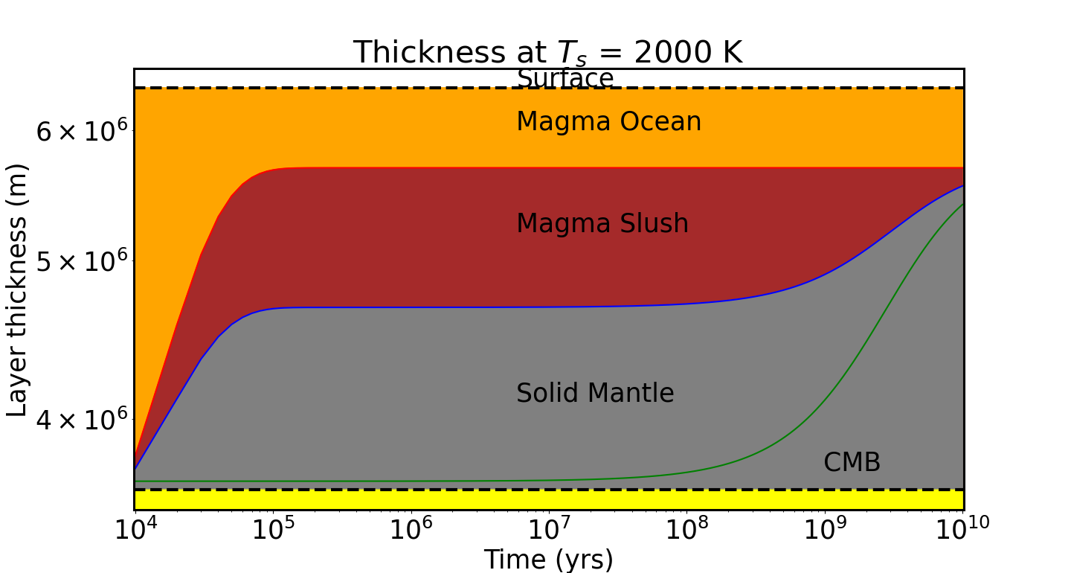
Upper Mantle
Lower Mantle
Core (molten/solid)

Slide 18
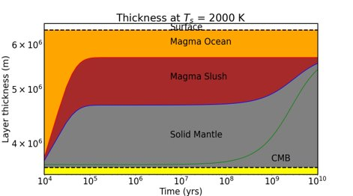
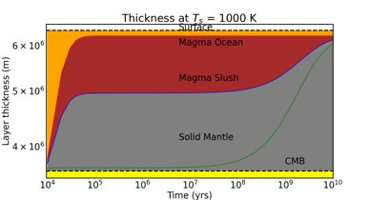
WHAT IF THE SURFACE TEMPERATURE IS DECREASED

Slide 19
Upper Mantle
Lower Mantle
Core (molten/solid)

Slide 20
THE EXTENT OF MAGMA CRYSTALLIZATION CAN ALSO DEPEND ON THE COMPRESSIBILITY OF THE MATERIAL.

Slide 21
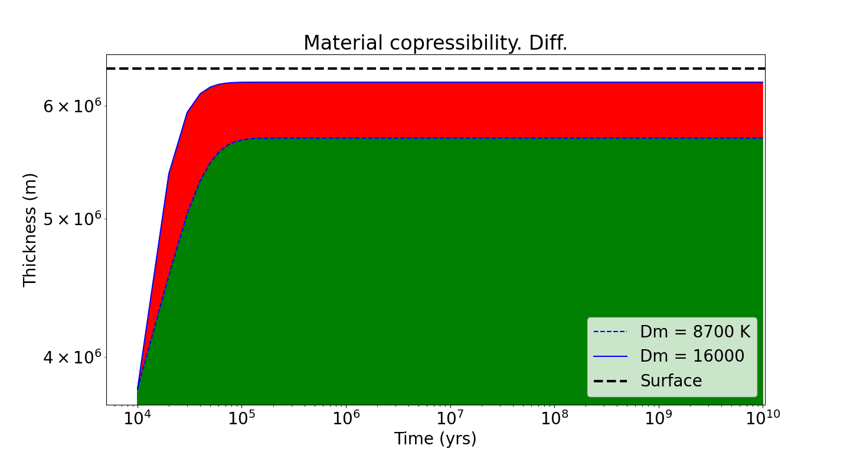
Upper Mantle
Lower Mantle
Core (molten/solid)

Slide 22
WHAT IF WE ADD AN EXTRA SOURCE OF ENERGY INTO THE MAGMA OCEAN??

Slide 23
Upper Mantle
Lower Mantle
Core (molten/solid)

Slide 24
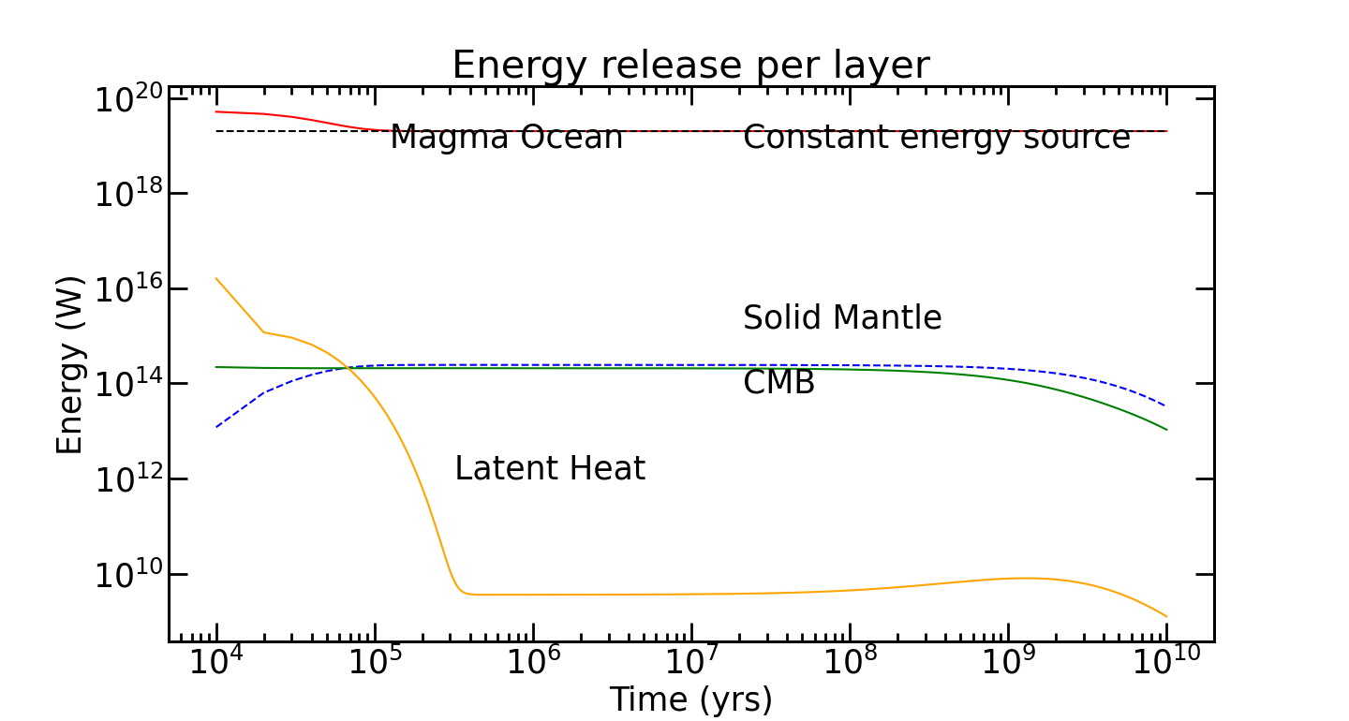
Upper Mantle
Lower Mantle
Core (molten/solid)

Slide 25
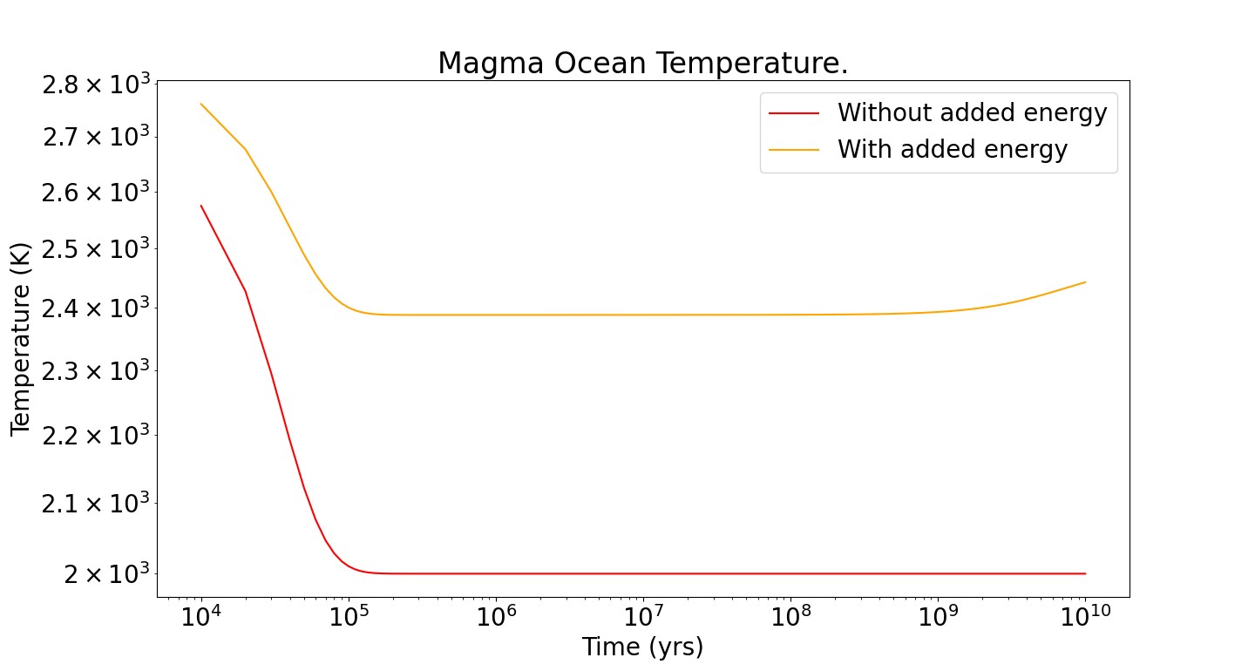
Upper Mantle
Lower Mantle
Core (molten/solid)

Slide 26
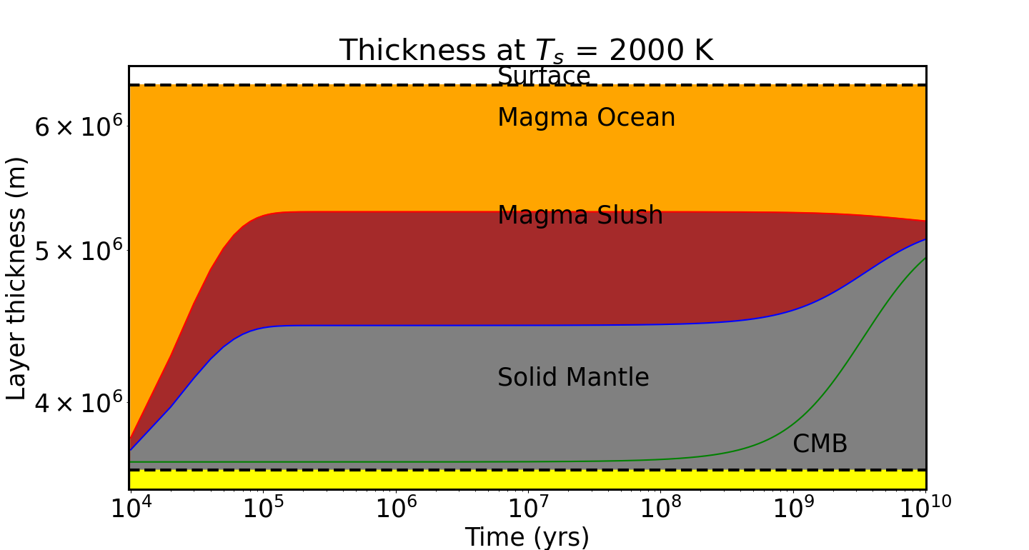
THE MAGMA OCEAN BECOMES DEEPER!! TIDAL HEATING IS A POSSIBLE SOURCE OF ADDITIONAL ENERGY

Slide 27
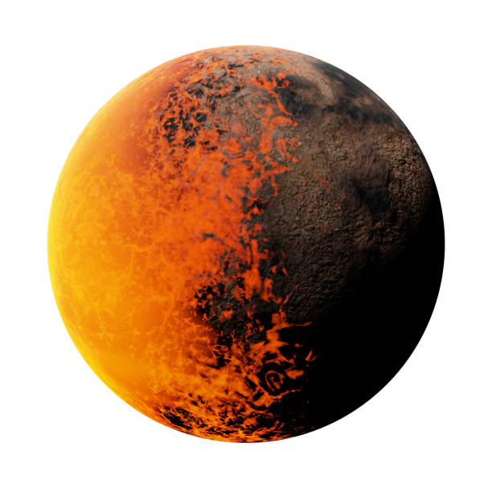
APPLICATION TO TIDALLY LOCKED PLANETS??
One model for the dayside
A different model for the nightside

Slide 28
FURTHER WORK TO DO
Investigate how planet mass affects the thermal evolution of the magma ocean.
Vary the composition. For instance, add or reduce the amount of Fe in the mantle.
Radially vary the viscosity with a pressure dependency. Will likely change the cooling rate.
Investigate the effects of tidal heating
Use the models to check if magnetic fields can be generated by these planets.
Make a detailed fluid dynamical model of Lava planet thermal evolution.
Can JWST observe the thermal phase curves of Lava planets?

Slide 29
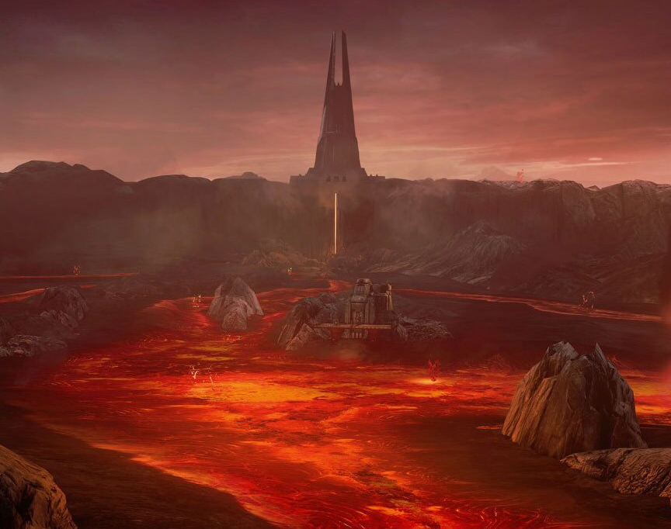
Thank you for your attention. Question time. Merci pour votre attention. Heure des questions

