Slide 1
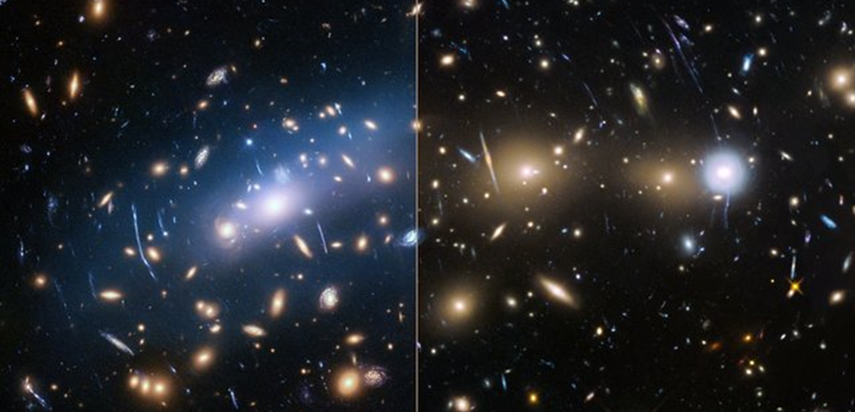
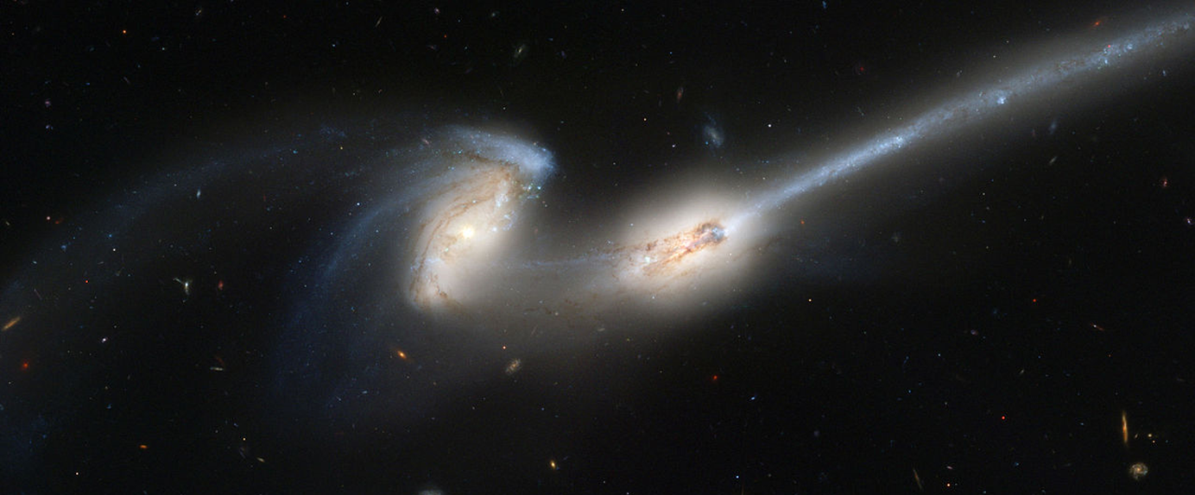
Origin of intracluster light
Valérie Gendron
Source: ESA/Hubble
Supervisor: Pr. Hugo Martel
The Mice Galaxies NGC 4676. Source: NASA

Slide 2
Top view
Side view
Stars
Gas
Dark matter

