Slide 1
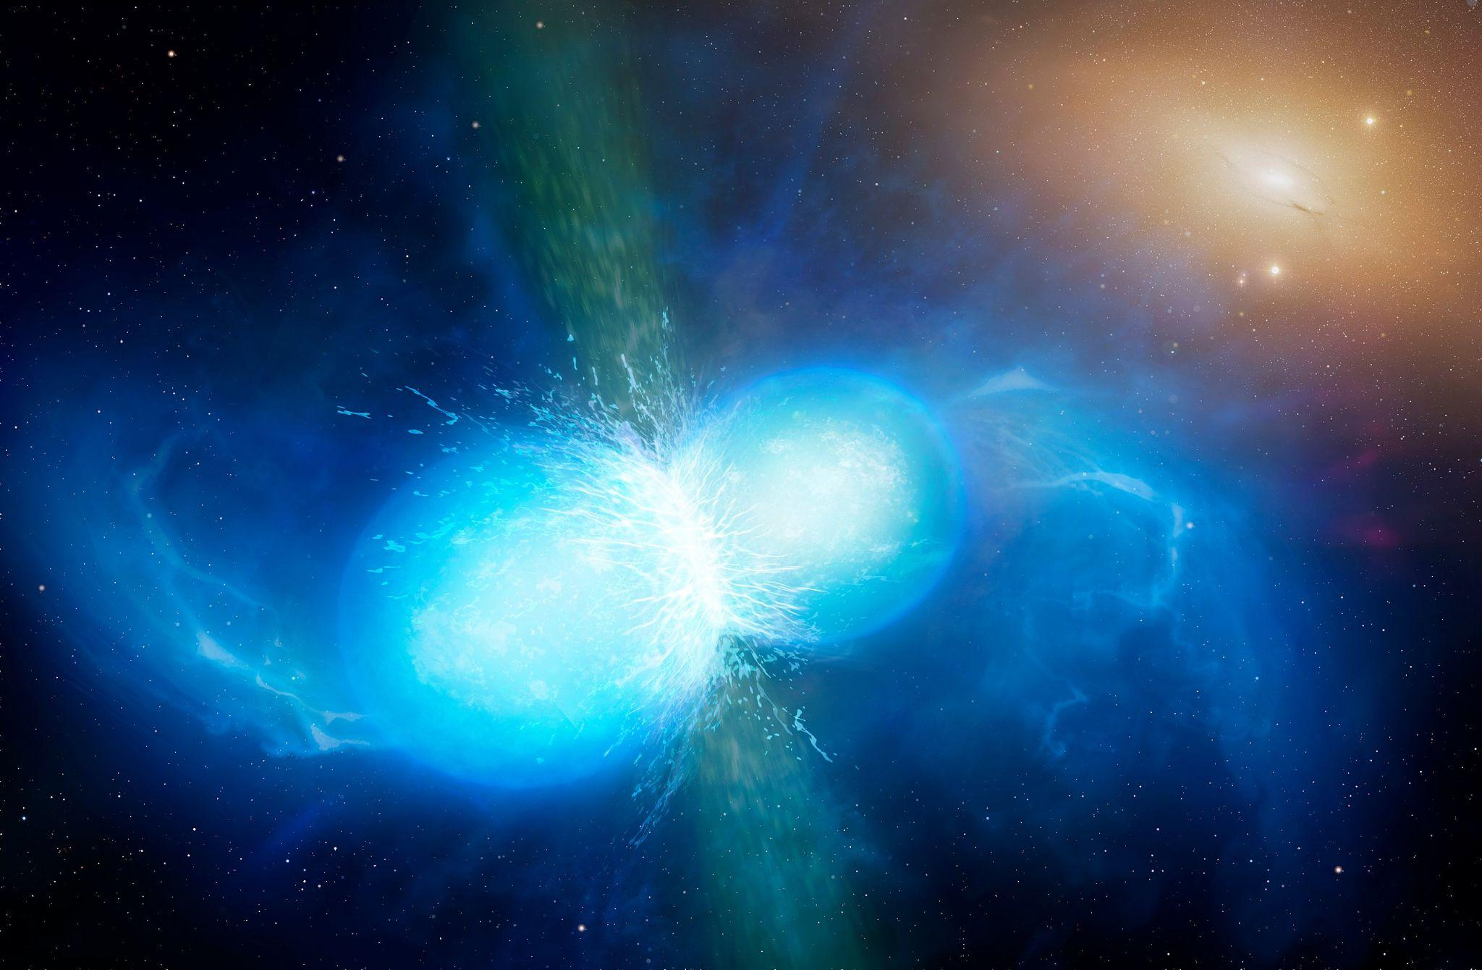
Exploring Neutron Star Merger Spectral Features with Dimensionality Reduction
By: Nicole Ford
(McGill M.Sc.)
Supervisors:
Profs. Daryl Haggard
& John Ruan
Image credit:
University of Warwick/Mark Garlick
Notes:
Hello everyone, my name is Nicole. Nick just did a great job telling us about kilonovae, and how to estimate the properties and nucleosynthesis of the famous GW170817 signal. My work follows a very similar theme and is complementary to Nick’s work. I am trying to build up a suite of simulated kilonova spectra to explore the range of physical and spectral features a kilonova can have, and connect the varied physical properties to what elements are created. Nick’s code is very thorough and precise in its parameter estimation, my code is more like a quick and dirty way to get an estimate of a kilonova’s properties and where it falls within the wider zoo of kilonova. Hopefully, when new kilonova candidates are observed, this code will be able to quickly diagnose whether you’re actually seeing a kilonova, and give an idea of what its properties are.

Slide 2
Reminder: EM Counterpart (kilonova)
Kilonova: EM transient (days - weeks) from merger involving a neutron star - visible in UV/optical/IR
*Kilonova = key site of heavy r-process element formation*
Notes:
A kilonova is a radioactively-powered transient event
What I mean by this is: in the exceptionally neutron rich ejecta following these mergers, radioactive isotopes of heavy elements are rapidly synthesized via rapid neutron capture, or, the r-process
These isotopes decay, and their decay products thermalize, producing the transient
Crudely, these mergers can have two or more dynamical components, with different colours due to to their composition
A bluer component is thought to originate from lighter elements with smaller opacities (shock heating/neutrinos blowing stuff out before lots of fusion has occurred?)
A redder component is thought to be caused by the large opacity of some of the heaviest elements, especially the lanthanides or actinides (tidal dynamical ejecta, takes more time to get out/happens later, rich in heavy elements)

Slide 3
What Can Kilonova Spectra Tell Us?
Element 2
We have only seen one!
Element 1
Element 3
Flux
Bluer
Wavelength (λ)
Redder
Notes:
The kilonova spectrum we observe is essentially a blackbody continuum with little chunks taken out and added in due to the presence of heavy elements synthesized in the ejecta. In particular, Nick highlighted how these mergers are a key site of r-process nucleosynthesis. Different r-process elements will absorb and re-emit light at different wavelengths, and so their presence manifests as absorption and emission features in the spectrum. By identifying these features in the spectra, we can tie them back to the formation of particular elements in the NS merger, as well as the physical conditions of the material that formed the elements we see.
We have only one observed event, GW170817, but we do not know how representative this event is of NS mergers and kilonovae as a population. We would like to explore the parameter space of possibilities for kilonovae, so that we have some idea of what to expect for the appearance of future observed spectra, and what elements dominate the spectral absorption/emission features. So, we use simulations to generate spectra for kilonova with varied physical properties of luminosity, density, velocity, electron fraction, etc., and see what element absorption features appear.

Slide 4
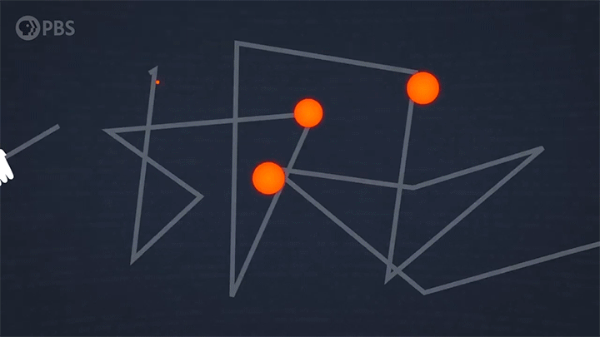
Simulations: The Setup
1D Monte Carlo Radiative Transfer
𝝆(v, t)
Line-forming region
Photosphere
v_{inner}
v_{outer}
Credit: PBS
Notes:
To generate simulations we use the TARDIS code, which is a Monte Carlo radiative transfer spectral synthesis code. TARDIS is configured as a spherically symmetric expanding ejecta shell. The inner boundary of the shell represents the photosphere, which is where thermalized photons emerge. They propagate through the ejecta (which we call the “line forming region”) and interact with nuclei as they go, being absorbed and re-emitted at different wavelengths and in different directions until some of them eventually escape through the outer boundary, forming the spectrum we observe.
20-30% speed of light
SN much slower

Slide 5
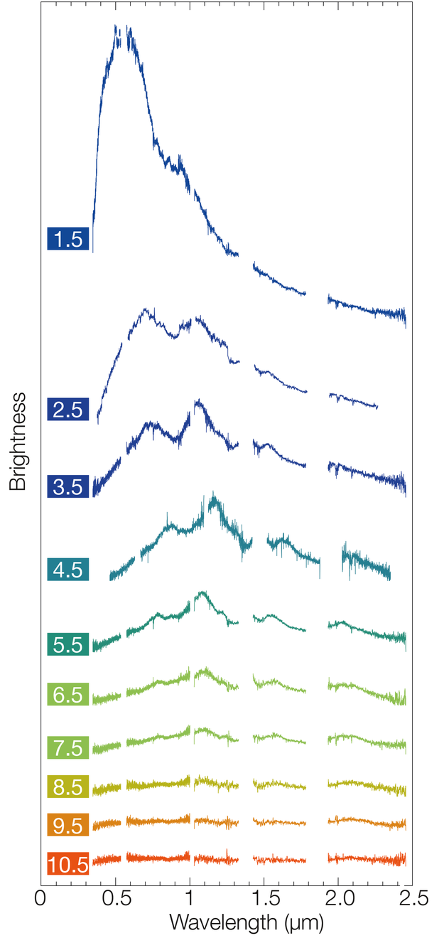
Simulations: Implementation
Y_{e} = Electron Fraction, L = Luminosity, 𝝆 = Density, v_{inner} = Inner velocity, v_{exp} = Expansion velocity, S = Entropy
Randomly Sampled Dataset:
Y_{e} = Electron Fraction, L = Luminosity, 𝝆 = Density, v_{inner} = Inner velocity, v_{exp} = Expansion velocity, S = Entropy
1,500 simulations
x 3 epochs
= 4,500 spectra
x 5,000 wavelength bins/spectrum
= A LOT of information!
ESO/E. Pian et al./S. Smartt & ePESSTO
Notes:
Lots of information contained in a kilonova spectrum, and we want to explore kilonova parameter space, so we want lots of spectra. We describe the kilonova ejecta using several physical parameters, including the composition, velocity, density, brightness. We sample from a broad range for these parameters in order to fully explore kilonova parameter space, and we generate datasets at several different times after the merger. This adds up to quite a lot of information.
it can be challenging to extract meaningful trends given the volume and complexity of the raw data.
We tackle this task by applying some machine learning techniques to simplify our dataset and identify trends in the spectral features.
Transition note, justify why machine learning

Slide 6
Can machine learning help us extract the most meaningful kilonova spectral features, and link these back to certain r-process elements formed in the ejecta?
Image credit: Zhu et al. 2020

Slide 7
Dimensionality Reduction: Autoencoder
Latent Space
Out: Ndims << 5000
Encoder Layers
Out: Ndims < 5000
Decoder Layers
Out: Encoder Ndims
Input Spectrum
Ndims = 5000
(binned fluxes)
Reconstructed Spectrum
Ndims = Input Ndims
most *unique* information
Decoder Layer(s)
Out: Encoder Ndims
Notes:
We take advantage of the fact that information in kilonova spectra is correlated between different wavelengths. The flux at one wavelength is related to the flux at the wavelengths around it.
We can train a neural network to learn how fluxes are correlated across wavelengths for all our simulated spectra, and ask the network to pick out the most “unique” information contained in each spectrum. If the network learns the correlations in the data well, it should be able to reconstruct each spectrum starting from just the most “unique” subset of information. This technique is a type of unsupervised machine learning known as dimensionality reduction. If you’re familiar with Principal Component Analysis, then you’ve seen dimensionality reduction in action!
For our work, we apply a dimensionality reduction technique called an autoencoder. The AE begins by taking a set of binned spectral fluxes as input, and then collapses this list of inputs down by passing it through some neural network layers known collectively as the “encoder” layers. The reduced dimension encoded space is then collapsed down further into a latent space (like the output of PCA). Then, if desired, we can reconstruct the input spectrum by passing the latent space information through decoder layers, and finally an output reconstruction.
While PCA treats each spectrum as a simple sum of the most “unique” components of information, AE is more powerful because it can combine information in nonlinear ways to effectively capture more complex spectral features.
We take an unsupervised approach where we train our AE only on the spectral features, not the underlying physical parameters for the simulations. This way, we are really just learning the shape of the spectra, and then we will see later how these shapes correlate with the underlying physical parameters.

Slide 8
Dimensionality Reduction: Autoencoder
Original
Reconstruction
Optimize AE architecture =
Minimize (original - reconstruction)
Flux
Wavelength (λ)
For our data, we go from 5000 → 5 latent dimensions
Notes:
We train a bunch of AE models with different neural network architectures to see how far we can reduce the dimensionality while maintaining an accurate reconstruction of the original data. We find that we can minimize the reconstruction error with an AE that reduces down from 5000 to 5 dimensions. This is a three orders of magnitude decrease in information, much easier to work with! Now, we need to see what we can learn about kilonovae from these reduced dimensional spectra data.

Slide 9
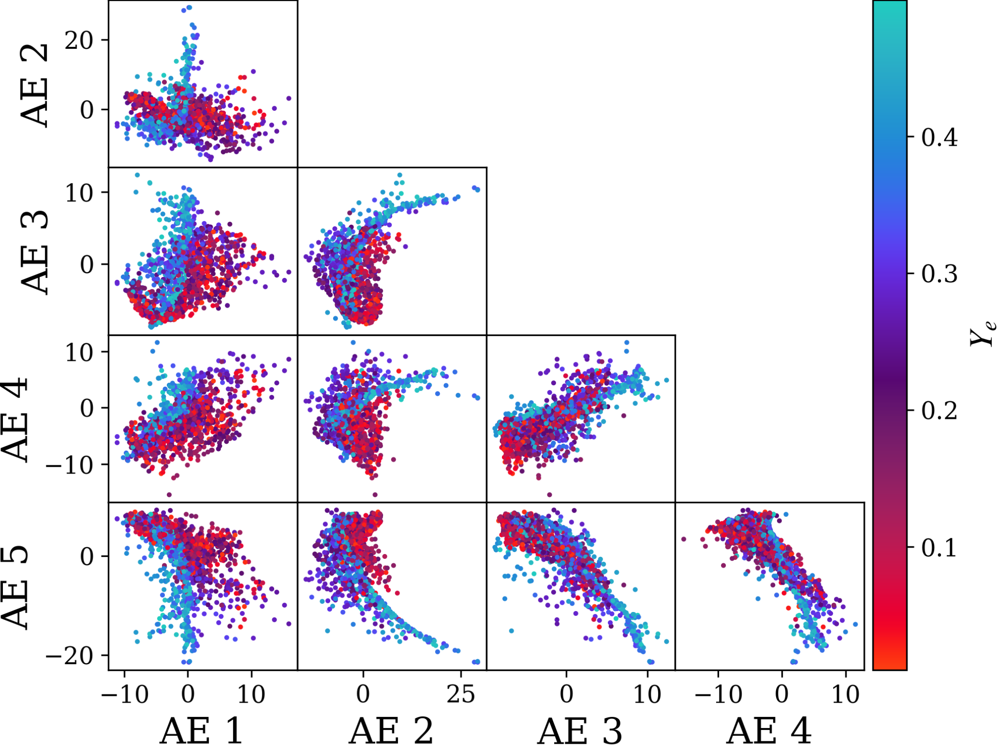
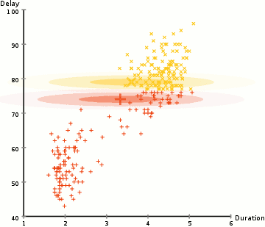
Autoencoder: Latent Space Clusters
Credit: PBS
For our data, ~ 6 clusters
Notes:
First, I’ll note that even though we’ve collapsed our spectra down to 5 dimensions, this is still tough for humans to visualize. Can anyone here visualize a 5D cube? I can’t.
The easiest way to show that on a 2D screen is by showing a bunch of 2D projections along different axes of the 5D space. That’s what each plot is, with each point corresponding to a spectrum. We color the points by Ye, their electron fraction, which essentially describes the composition of the kilonova ejecta and what r-process elements are synthesized. Hopefully you can see here that the distribution of color is not random; there are clusters of points that seem to share similar electron fractions. This is great, because it means there’s some correlations between the position of spectra in latent space and the r-process elements synthesized. How do we quantify these clusters?
We apply another machine learning technique for identifying clusters of data in the latent space. Our clustering algorithm hones in on where points are densely concentrated, and identifies approximately 6 clusters in the 5D latent space. To make this easier to interpret, lets just zoom in on one 2D projection…

Slide 10
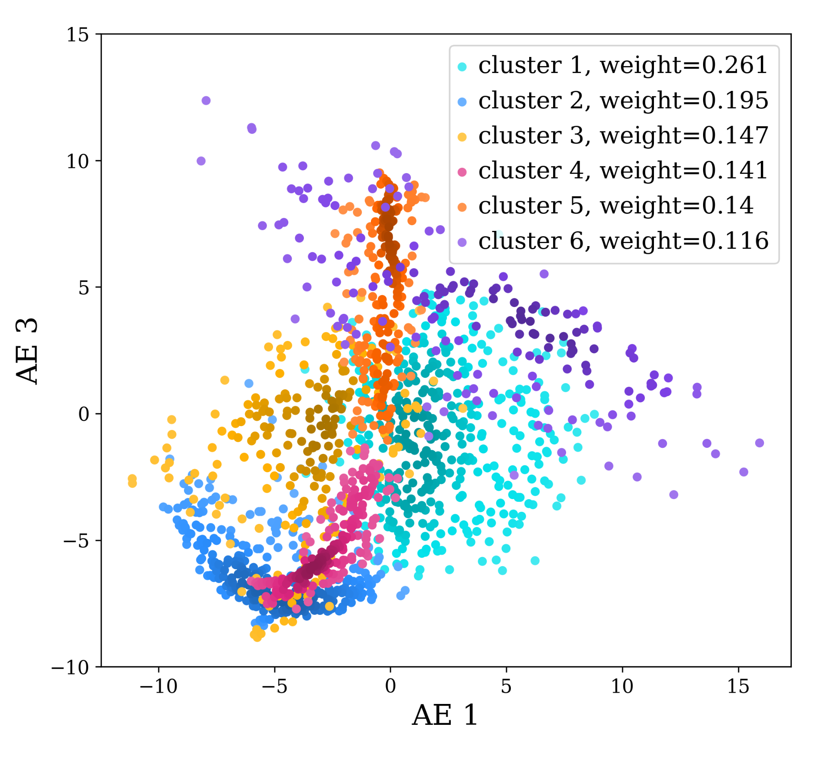
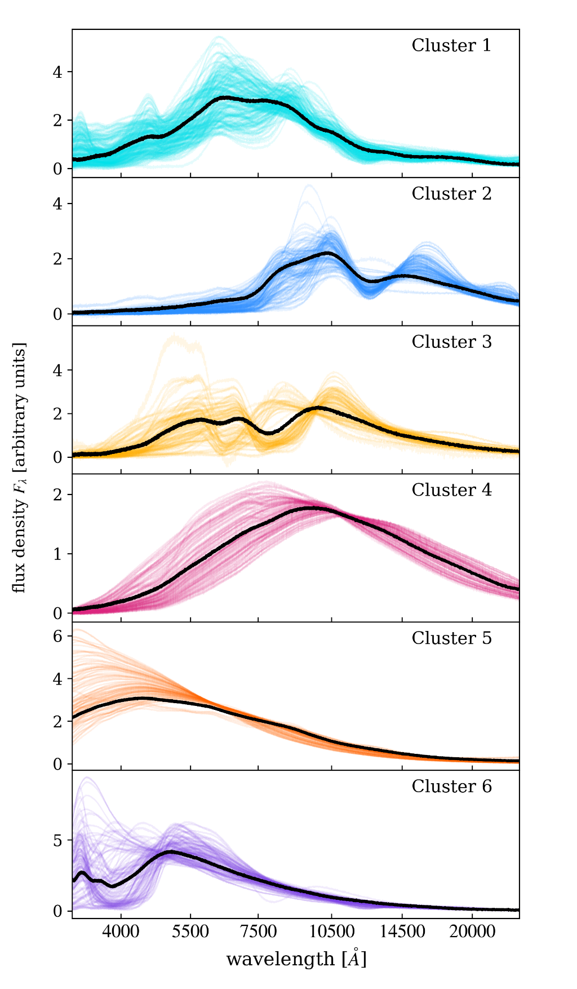
Cluster 1
Cluster 2
Cluster 3
AE latent dimension 3
Cluster 4
Cluster 5
Cluster 6
AE latent dimension 1
Notes:
Here’s one 2D projection of the latent space, with each cluster represented by a color. Denser regions of the cluster are shown in a slightly darker gradient. On the side I’m showing the full, 5000 bin spectra that confidently belong to each cluster. Interestingly, each cluster of spectra display a characteristic shape, either a blackbody or with some distinct absorption features. The black line in each cluster marks the shape of the mean spectrum.
Now we can zoom in on a representative spectrum for two of these clusters, and utilize another feature of TARDIS which allows us to see what elements are causing the absorption features.

Slide 11
Spectral Features
Cluster 3
II
II
II
II
Strontium!
Notes:
Label cluster numbers
Take more time to talk about this

Slide 12
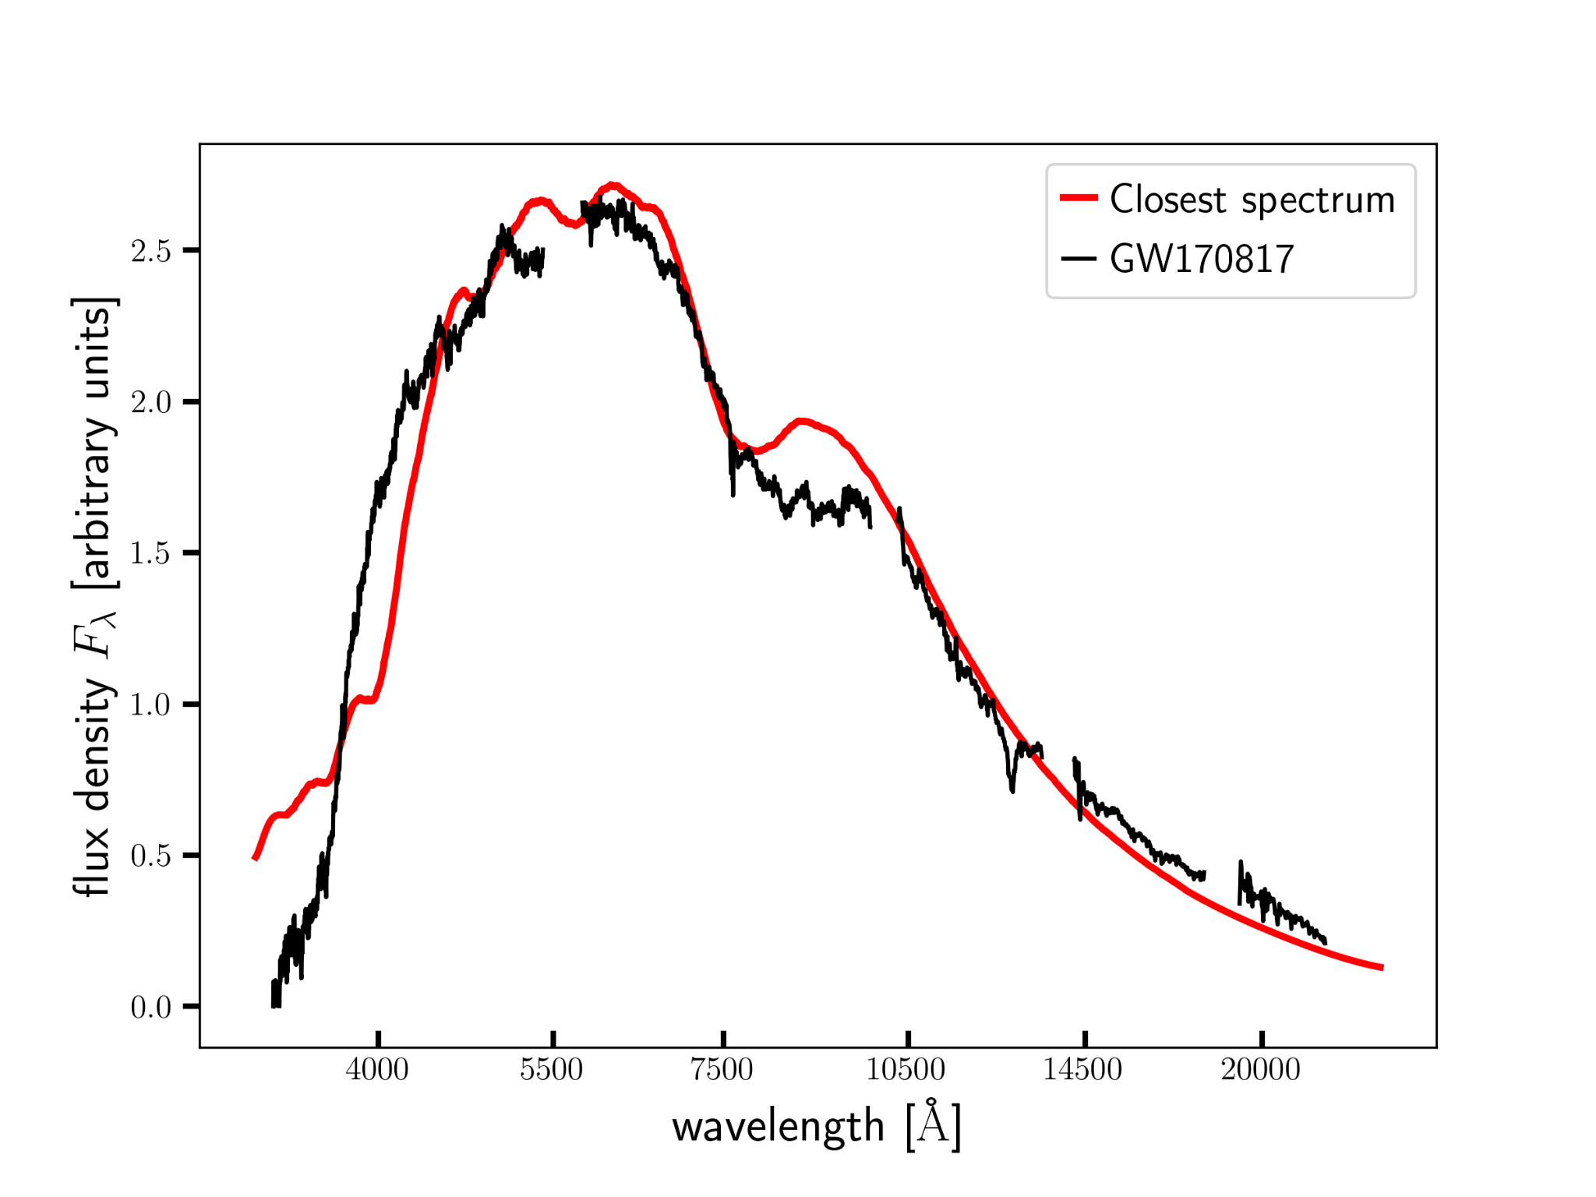
Conclusions & Future Work
Simulated spectra to explore kilonova w/different physical conditions
Used dimensionality reduction + clustering to extract unique spectral information
Identified absorption feature/heavy element combinations for different clusters
Future Work:
Build a more complex spectra training set
input any new observed kilonovae!
(keep an eye out for Ford et al., in prep!)
Notes:
Add a bullet summarizing slides 18 and 19 in the conclusion section

Slide 13
Backup Slides

Slide 14
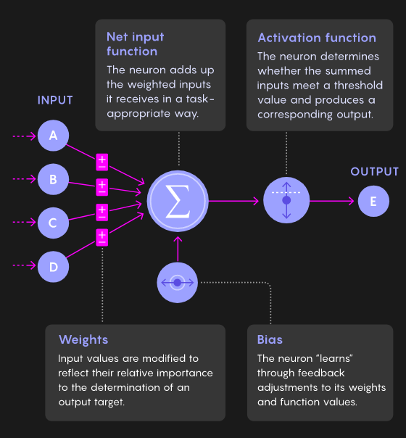
Machine Learning: Deep Neural Network
Input: dendrites
Node +
Activation: Cell body
Output: Axon + terminals
Credit: Quanta
Notes:
I want to briefly highlight some machine learning basics, which hopefully look somewhat familiar from the Machine Learning session yesterday. As a reminder, a neural network in machine learning is kind of designed to emulate how the brain’s neurons are designed. A set of information is fed in and processed by a node (or collectively, a network of many layers of nodes), which is “activated” in some way in order to process the information and output some result. A “deep” neural network is a collection of multiple layers of interconnected nodes.

Slide 15
TARDIS Spectral Features
1
2
3
4
5
6

Slide 16
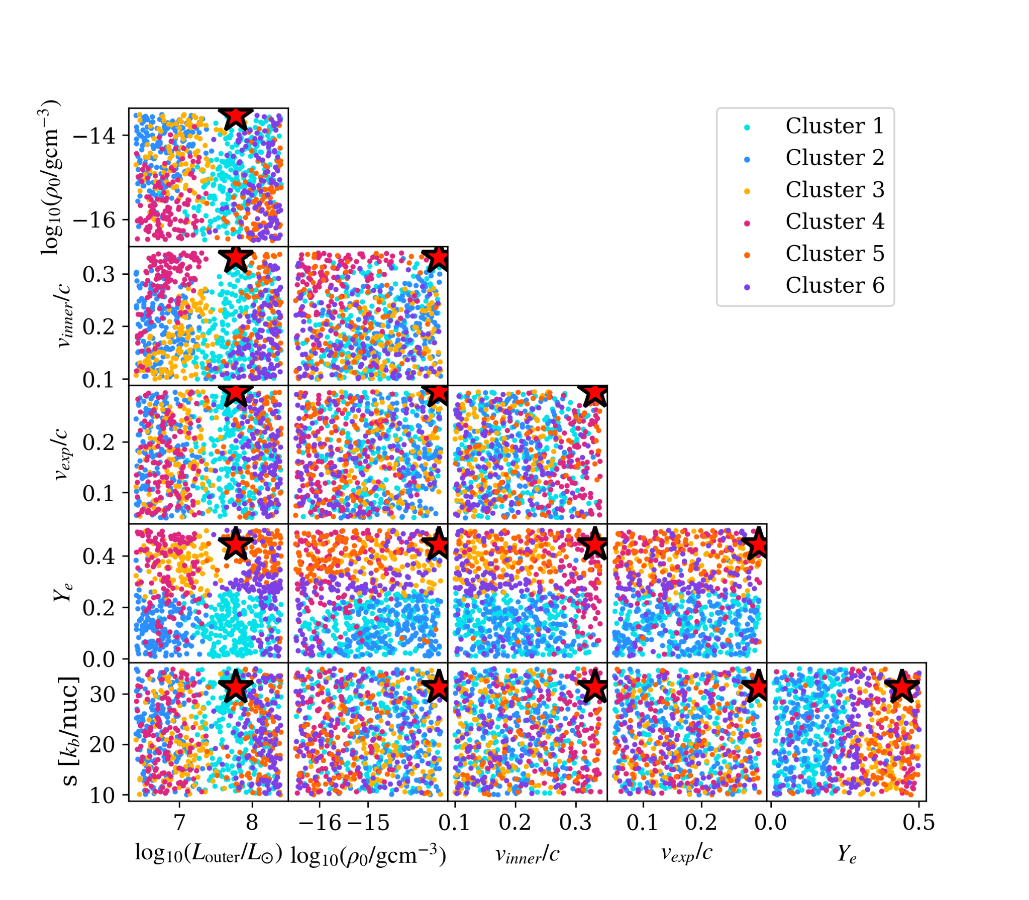
Cluster Physical Properties

Slide 17
Cluster Physical Properties
Density vs Luminosity
Inner Velocity vs Luminosity
Electron Fraction vs Luminosity

Slide 18
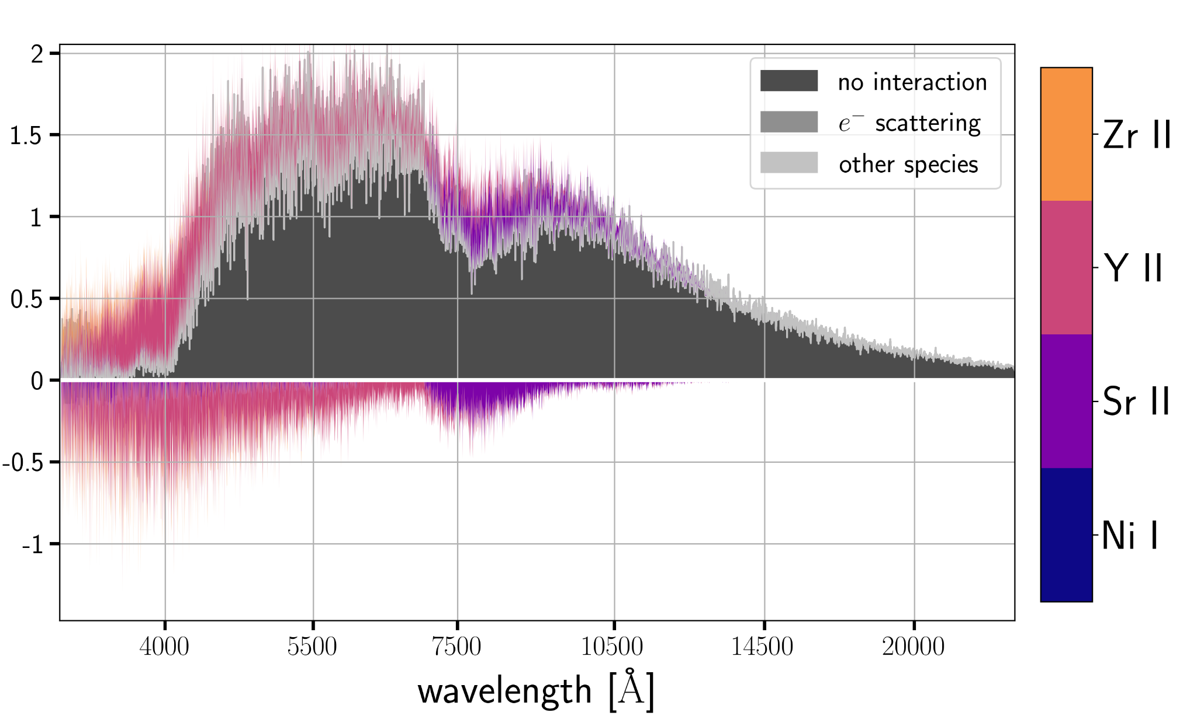
Bonus: GW170817
Notes:
Maybe move this into main

Slide 19
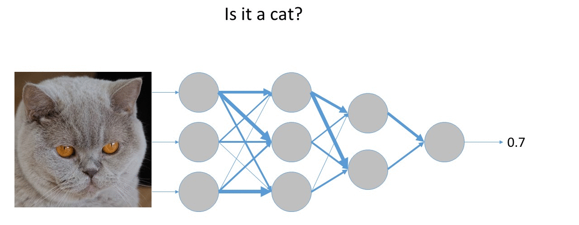
Machine Learning: Deep Neural Network
Modified from Xeridia

Slide 20
Clustering
W₁ + W₂ + . . . W_{n}
(𝝻₁,𝝨₁)
(𝝻₂,𝝨₂)
(𝝻_{n},𝝨_{n})
Unsupervised Machine Learning!
Cluster 1
Cluster 2
Cluster n
Dimension 2
Dimension 1
Credit: PBS
Notes:
Want to identify clusters from the dataset. Start by assuming they are gaussian distributed, so each cluster has some associated mean and standard deviation, and also a relative weight compared to the other clusters. Our clustering algorithm identifies how many clusters it thinks it needs to accurately capture the data, and it also assigns cluster membership probabilities to each cluster. This is useful in situations where certain spectra might be in the transition between two clusters, sharing some features of each cluster.

Slide 21
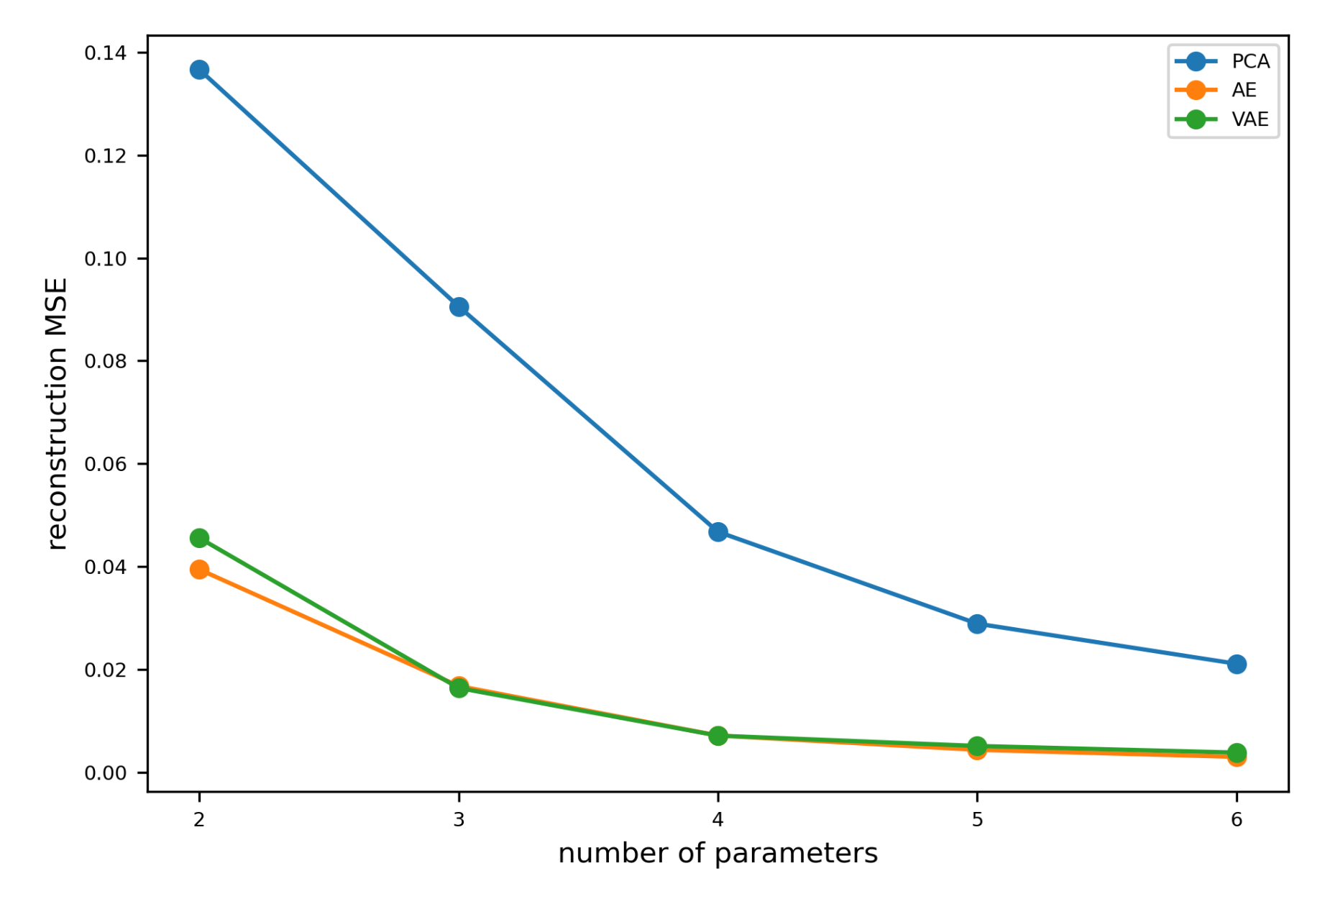
Dimensionality Reduction Comparison
Reconstruction error
number of parameters

Slide 22
Cluster Physical Properties
Cluster # | Electron Fraction | Luminosity | Density | Velocity | Key Elements
1 | Low | High | Moderate | Wide Range | Lanthanides
2 | Low | Low | High | Moderate | Lanthanides/ 1st peak
3 | High | Moderate | High | Moderate | 1st peak
4 | Very High | Moderate | Very Low | High | 1st peak
5 | Very High | High | Very Low | Wide Range | 1st peak
6 | High | High | Wide Range | Low | 2nd peak
Notes:
Update this table to match paper

Slide 23
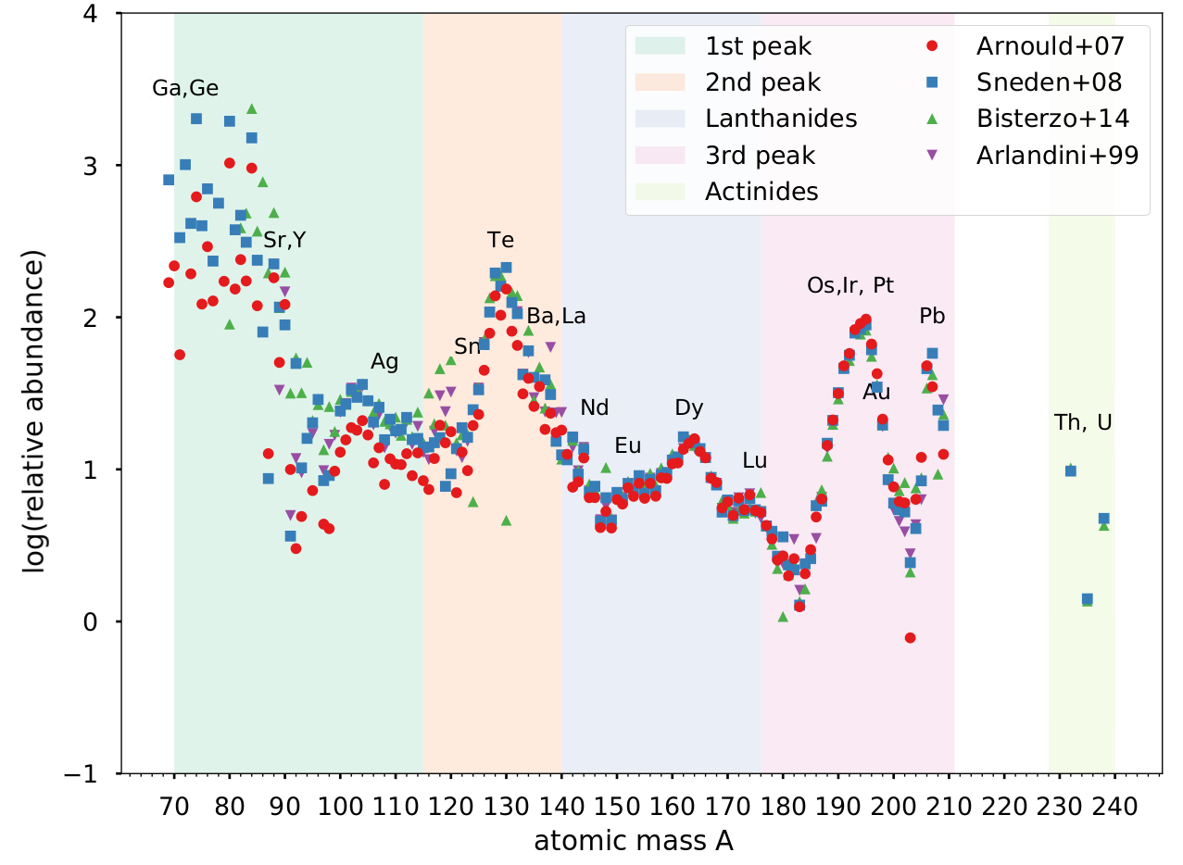
r-process elements
adapted from Ji+19
Notes:
Sr = 38
Te = 52
Xe = 54

