Slide 1
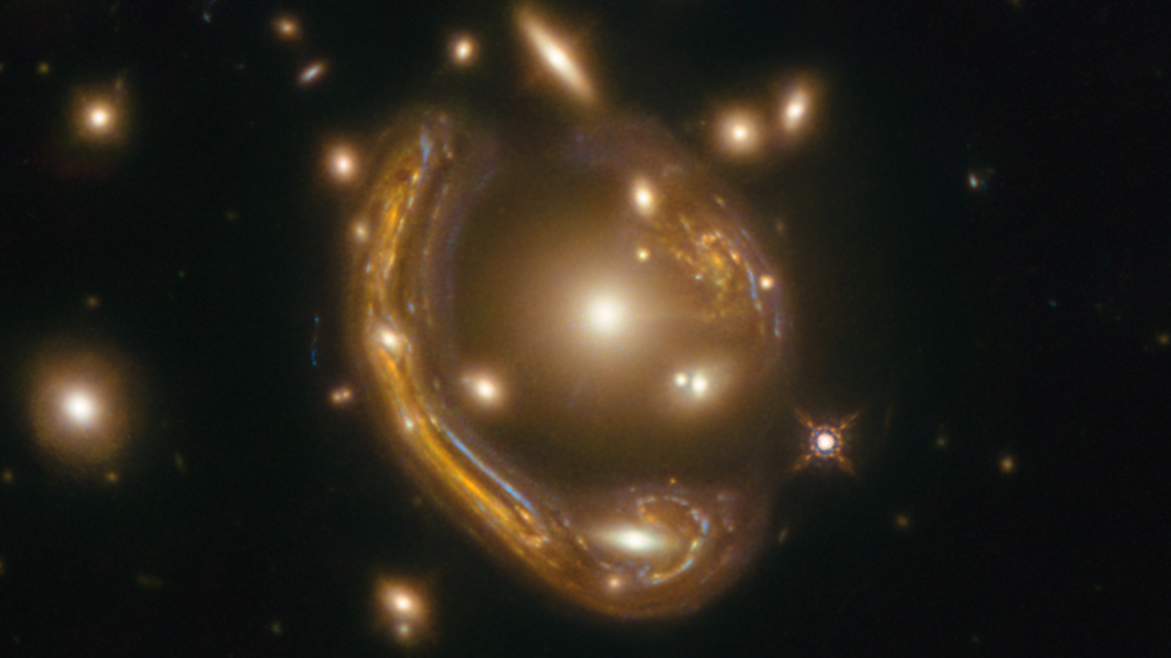
Heavy Lifting: Leveraging Machine Learning to Measure Masses of Supermassive Black Holes
David Chemaly
Second year Master student in Astrophysics at University of Montreal
Co-supervised by Prof. Julie Hlavacek-Larrondo and Prof. Yashar Hezaveh
NSERC, FRQNT, CRAQ and IVADO scholar
david.chemaly@umontreal.ca
Notes:
At the beginning of the talk: present goal of meeting. Proposing a collaboration with MassiveFIRE and why we need the simulations

Slide 2
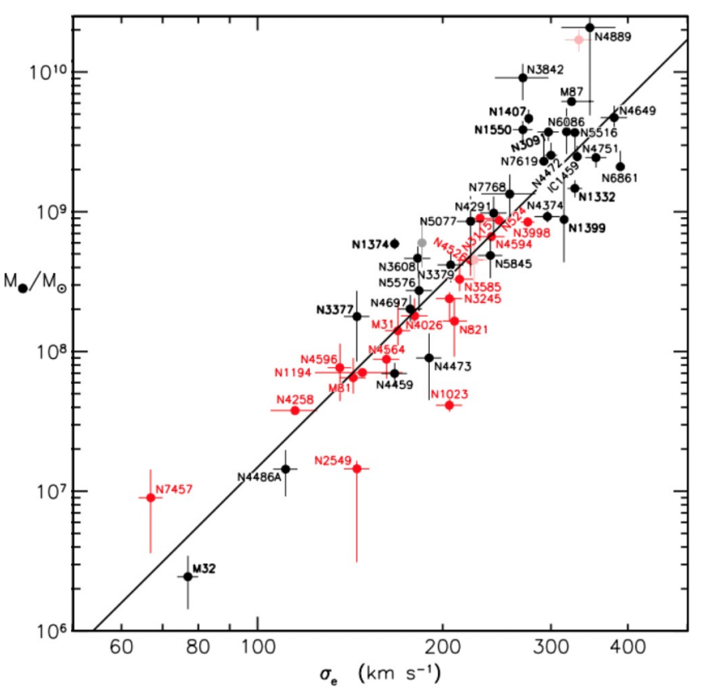
Why Measure the Mass of a SMBH ?
Astronomer now convincingly affirm that a vast majority of galaxies host a BH
Primordial objects that corelate with the galactical scale physic
Kormendy & Ho 2013
Notes:
Nowadays, we know that most galaxies harbor a BH and that these BH are to galactacal scale physics. A great exemple to illustrate this intriguing phenomenon is the M-sigma relation shown in this figure.
Graph: COROLATED NOT LEAD!!!!
VELOPCITY DISPERSION OF THE BULDGE OF THE GALAXY
- Axe X et Y
- Log scale
- Direct proportionality
- even though this might feel intuitive it is not since the mass and size of a SMBH is négligeable compared to it’s host galaxy
- being able to measure BH at higher distances (when universe was yougner) might enable us to shine some light on this yet to be explained phenomenon

Slide 3
How to measure the mass of a SMBH?

Slide 4
Best Method to Measure Mass
Davis et al. 2013
Problem: High spatial resolution is needed to resolve the sphere of influence which prevents us from obtaining masses at higher distances (z ≳ 0.2)
Notes:
Add reference for the first bullet (of the stars, ionized, et molecular)

Slide 5
How can we solve this problem ?
Straight forward solution is to wait for the new generation of telescopes
Fortunately, the Universe has given us a way to magnify our imaging via lensing

Slide 6
Gravitational lensing

Slide 7
Gravitational lensing

Slide 8
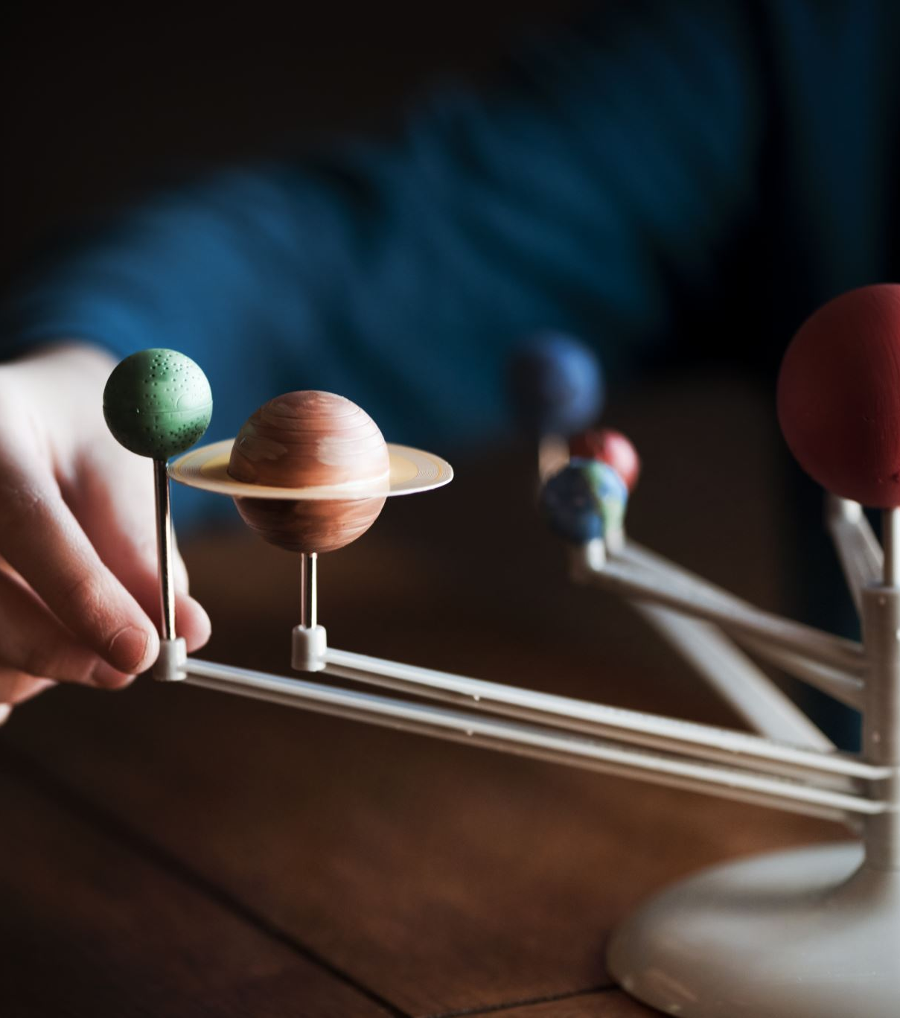
My project
We know that this methodology worked for a toy model (Hezaveh 2014), but does it still hold when exposed to much more realistic scenarios
Next step: apply the same method to realistic simulations of galaxies harboring a SMBH and see how precisely we can measure its mass

Slide 9
FIRE Simulation

Slide 10
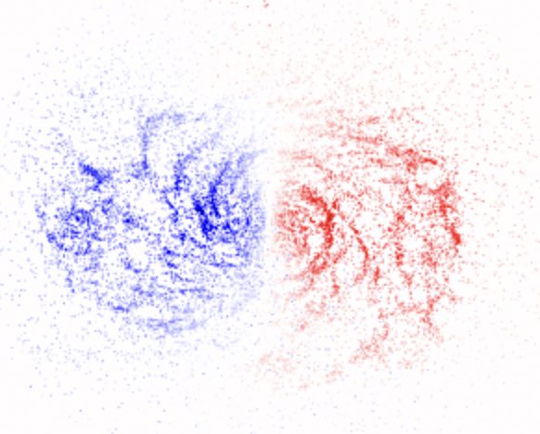
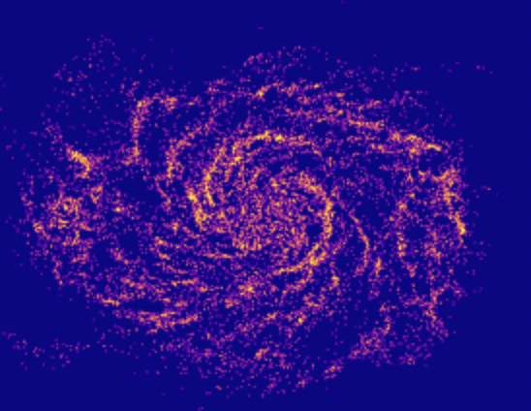
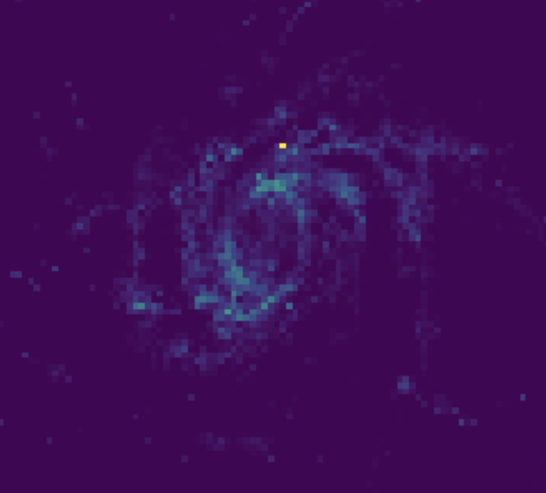
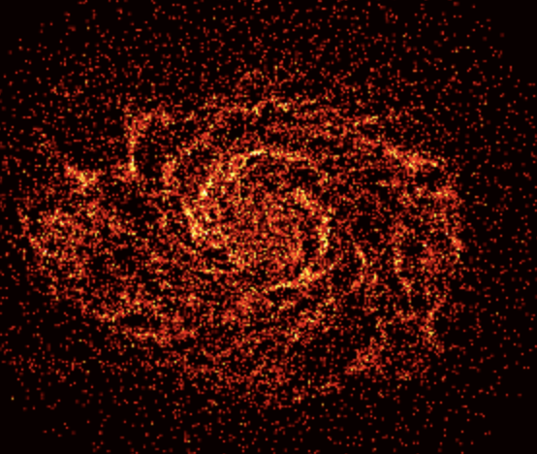
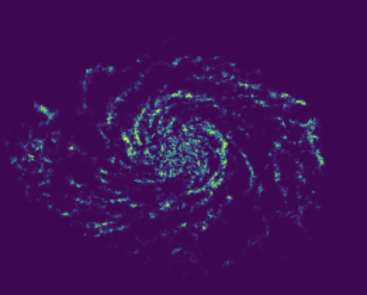
ALMA observations

Slide 11
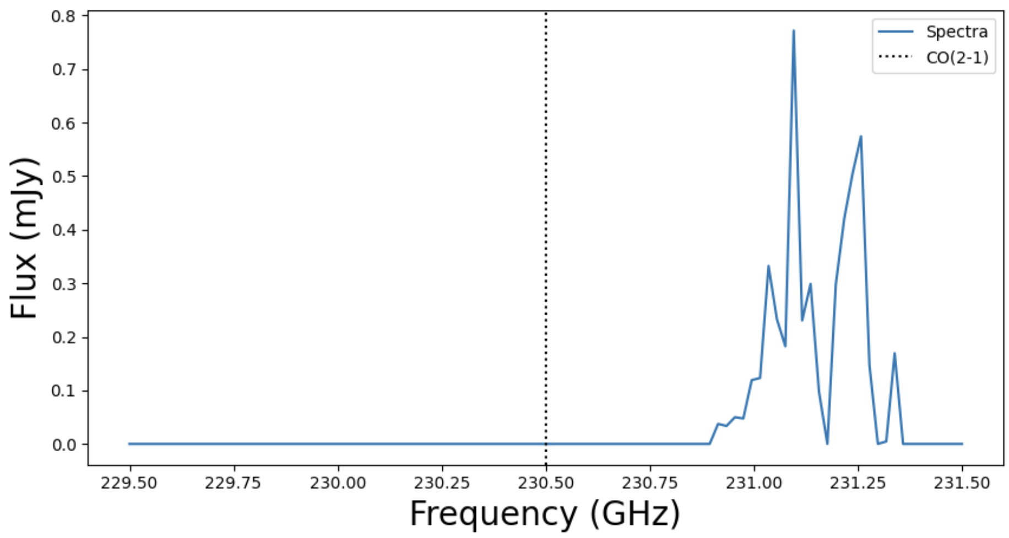
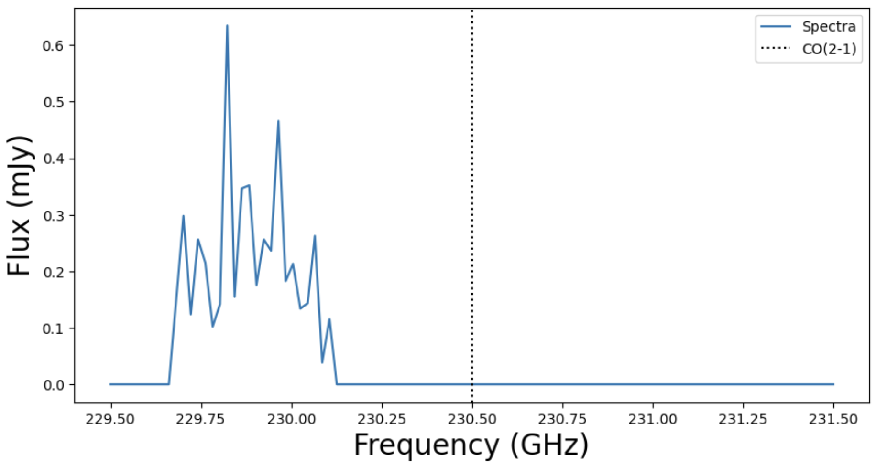
Data cube

Slide 12
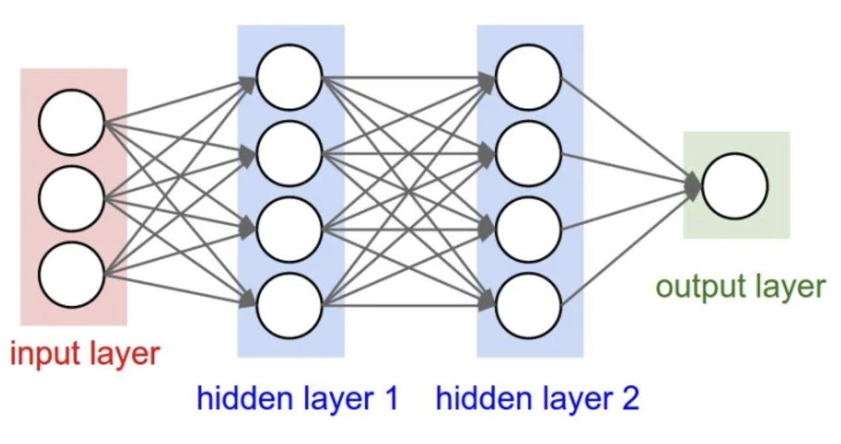
Neural Network

Slide 13
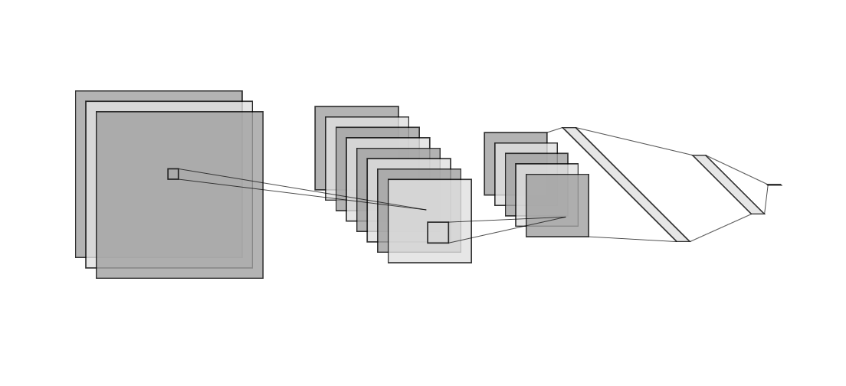
Convolutional Neural Network

Slide 14
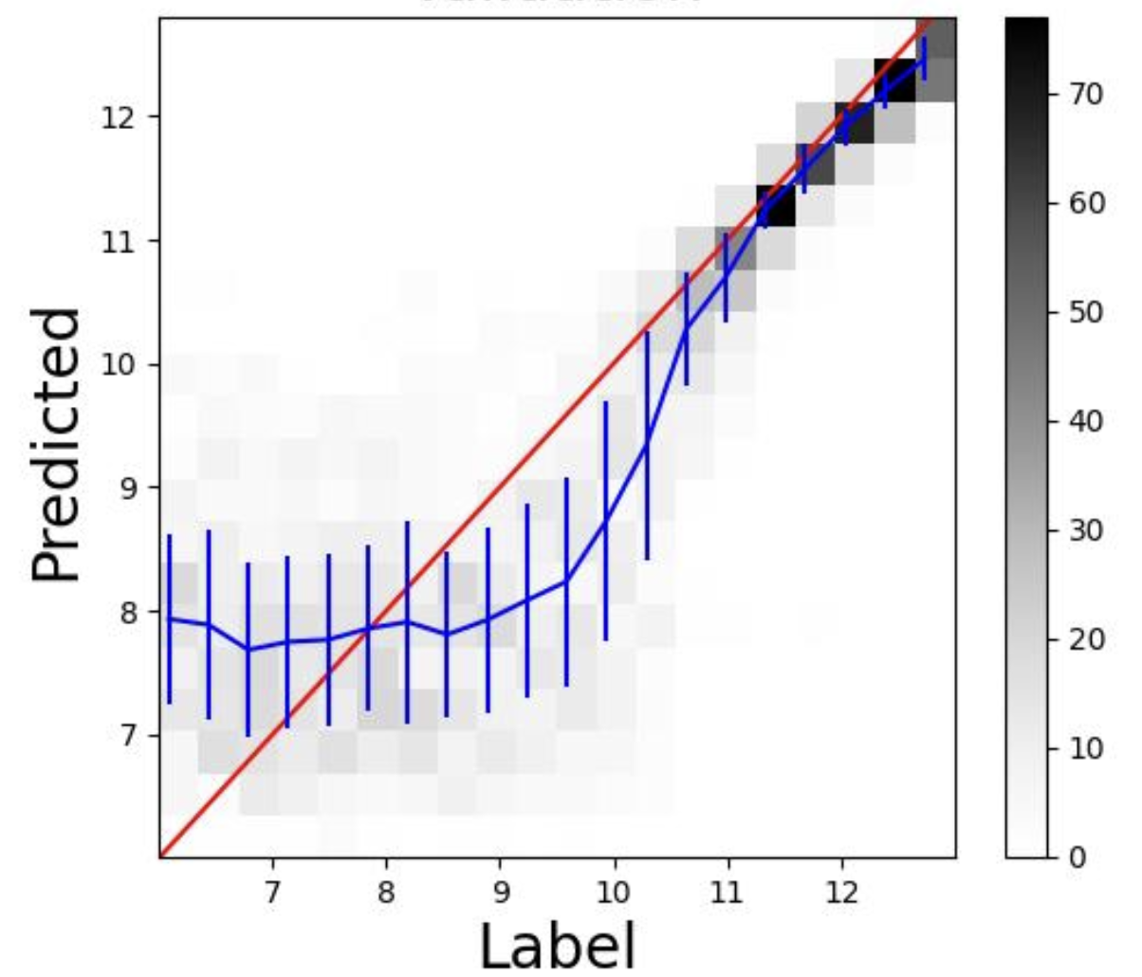
Results

Slide 15
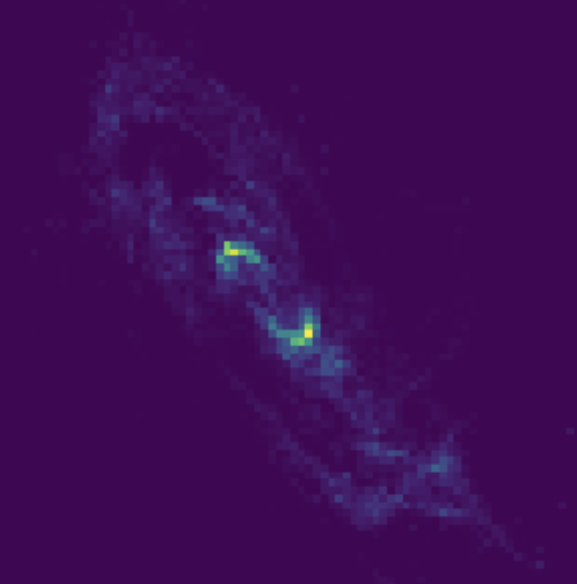
Bayesian inference
P( )

Slide 16
Bayesian inference
P( ) = p( )p( )
p( )

Slide 17
Conclusion
Using molecular gas as kinematic tracers is the best way to measure the mass of SMBHs.
We use simulations because we need to know the mass of enough SMBHs to train a neural network.
CNNs are the best networks to use when the data is spatially correlated.
We developed a completely automated pipeline capable of measuring the mass of a SMBH from a lensed ALMA data cube.

