Slide 1
The LHS 1140 System Revisited with the Line-by-line Framework
Rencontre annuelle du CRAQ 2023
Charles Cadieux
2023-05-10

Slide 2
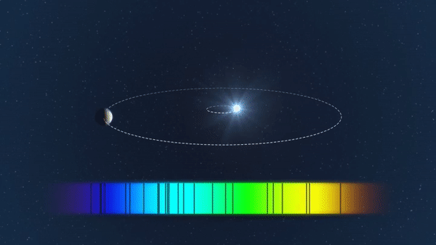
Radial Velocity Measurement
Radial velocity (RV): velocity of a star in the line-of-sight direction
A planetary companion induces a reflex motion on its host star
Measured from the Doppler shift of spectral lines (amplitude ∝ M_{p})
Exo-Earth around:
Sun, 10 cm/s
M5, 1–2 m/s (~1/1000th pixel of SPIRou)
Credit: ESO/L. Calçada

Slide 3
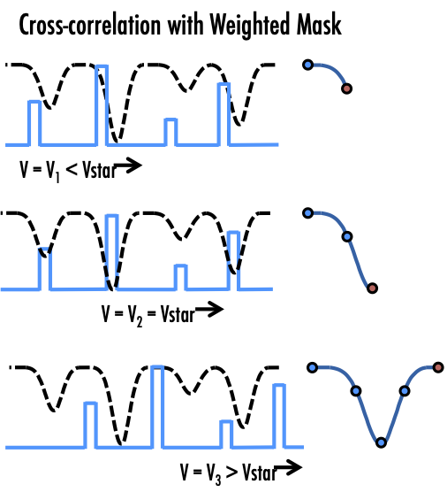
Radial Velocity Measurement
Radial velocity (RV): velocity of a star in the line-of-sight direction
A planetary companion induces a reflex motion on its host star
Measured from the Doppler shift of spectral lines (amplitude ∝ M_{p})
Exo-Earth around:
Sun, 10 cm/s
M5, 1–2 m/s (~1/1000th pixel of SPIRou)
Cross-correlation function (CCF)
e.g., Baranne+1996, Roy+2016

Slide 4
Radial Velocity Measurement
Radial velocity (RV): velocity of a star in the line-of-sight direction
A planetary companion induces a reflex motion on its host star
Measured from the Doppler shift of spectral lines (amplitude ∝ M_{p})
Exo-Earth around:
Sun, 10 cm/s
M5, 1–2 m/s (~1/1000th pixel of SPIRou)
Cross-correlation function (CCF)
Line-by-line approach
Weighted average of RVs measured on individual spectral lines
e.g., Baranne+1996, Roy+2016
e.g., Dumusque 2018, Artigau+2022

Slide 5
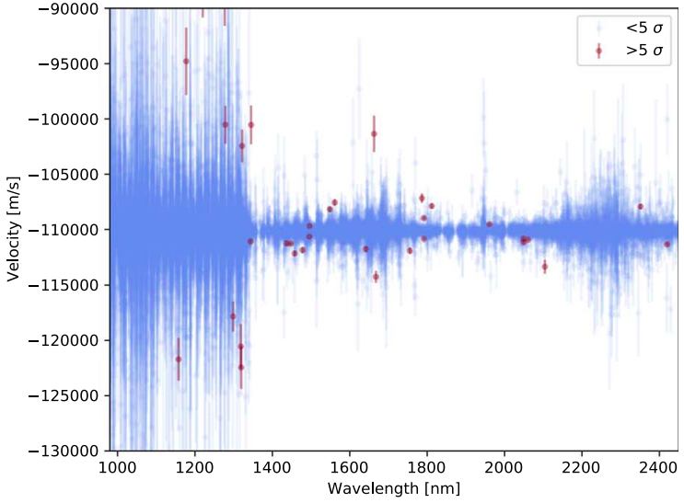
Line-by-line (LBL) Velocimetry
Method developed at UdeM (Artigau, Cadieux, Cook, Doyon, Vandal et al. 2022)
RV measured from Taylor expansion of a stellar template (Bouchy et al. 2001)
Automatic rejection of outliers from various sources (e.g., telluric contamination, detector defects)
LBL has led to multiple mass characterizations:
TOI-1452 b (Cadieux+2022), TOI-1759 b (Martioli+2022), TOI-2136 b (Gan+2022), TOI-1695 b (Kiefer+2023)
lbl.exoplanets.ca

Slide 6
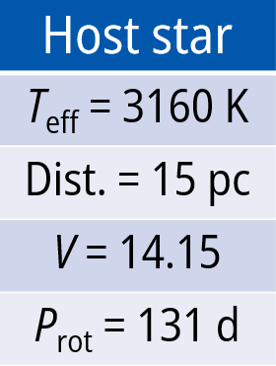
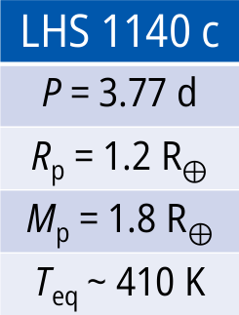
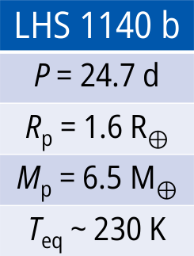
Context: The LHS 1140 System
Two transiting super-Earths around an M4.5 dwarf:
LHS 1140 b, inside the Habitable Zone (Dittmann+2017)
LHS 1140 c, an inner, smaller planet (Ment+2019)
Lillo-box et al. revisited this system with ESPRESSO and TESS in 2020
*Not to scale!
P (days)

Slide 7
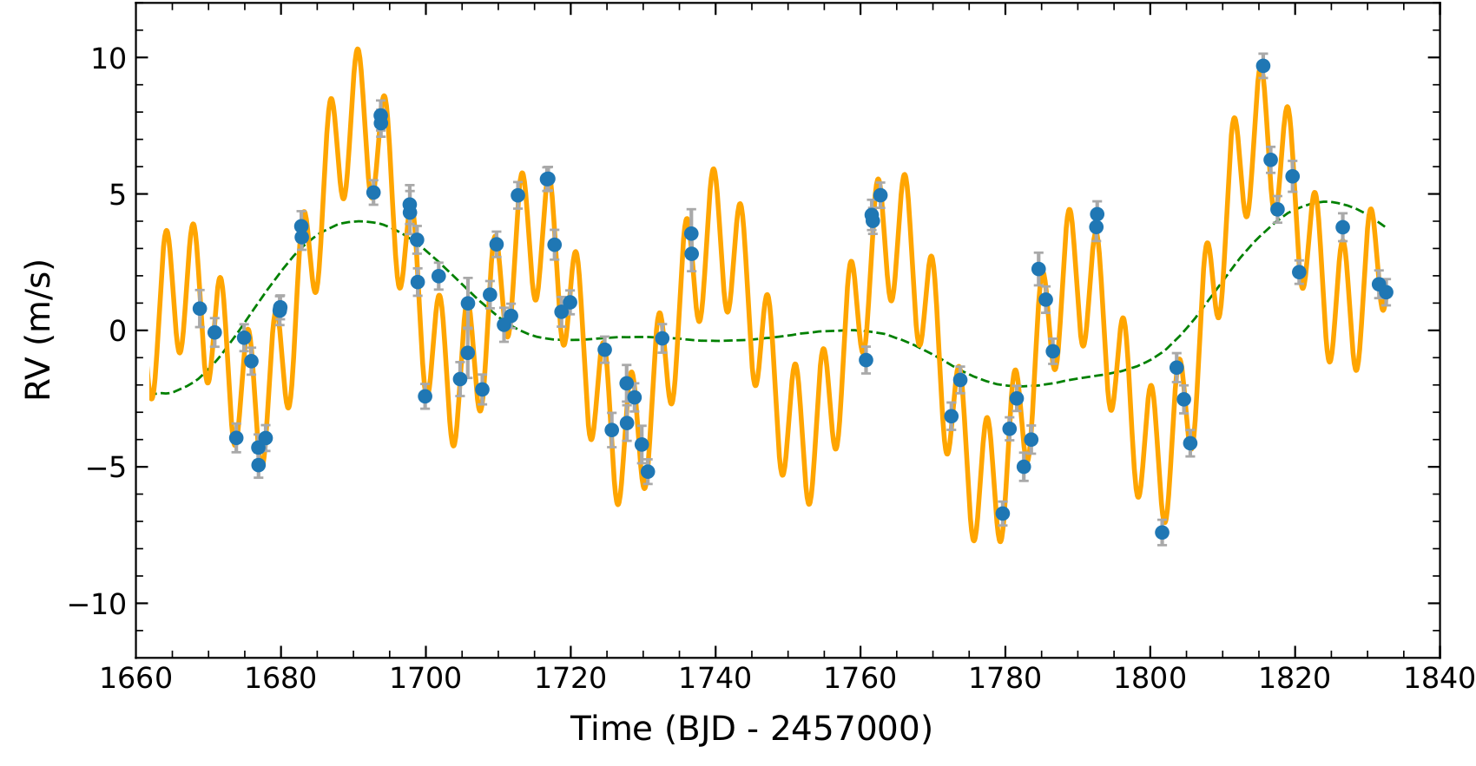
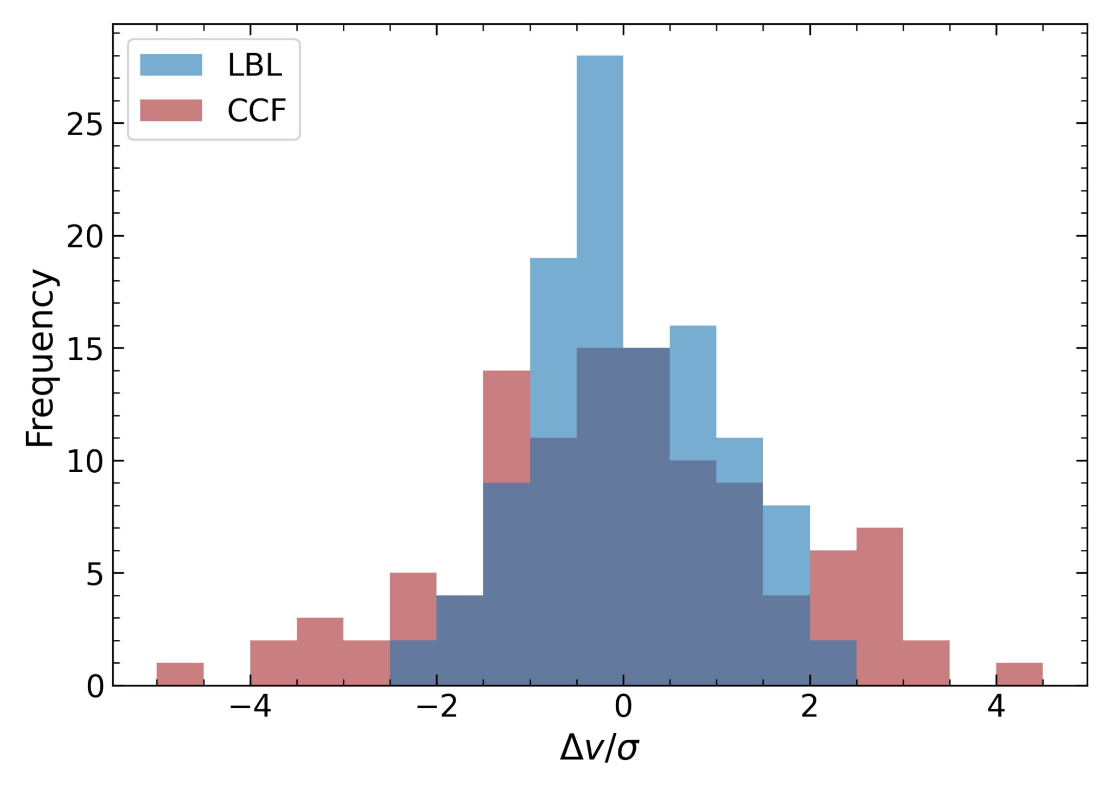
ESPRESSO data of LHS 1140 with LBL
We reanalyzed the publicly available ESPRESSO data of LHS 1140 with the LBL framework
LHS 1140 RVs derived from a CCF show three times more dispersion than LBL ones
*CCF refers to RV data published in Lillo-box+2020
Cadieux et al. in prep.

Slide 8
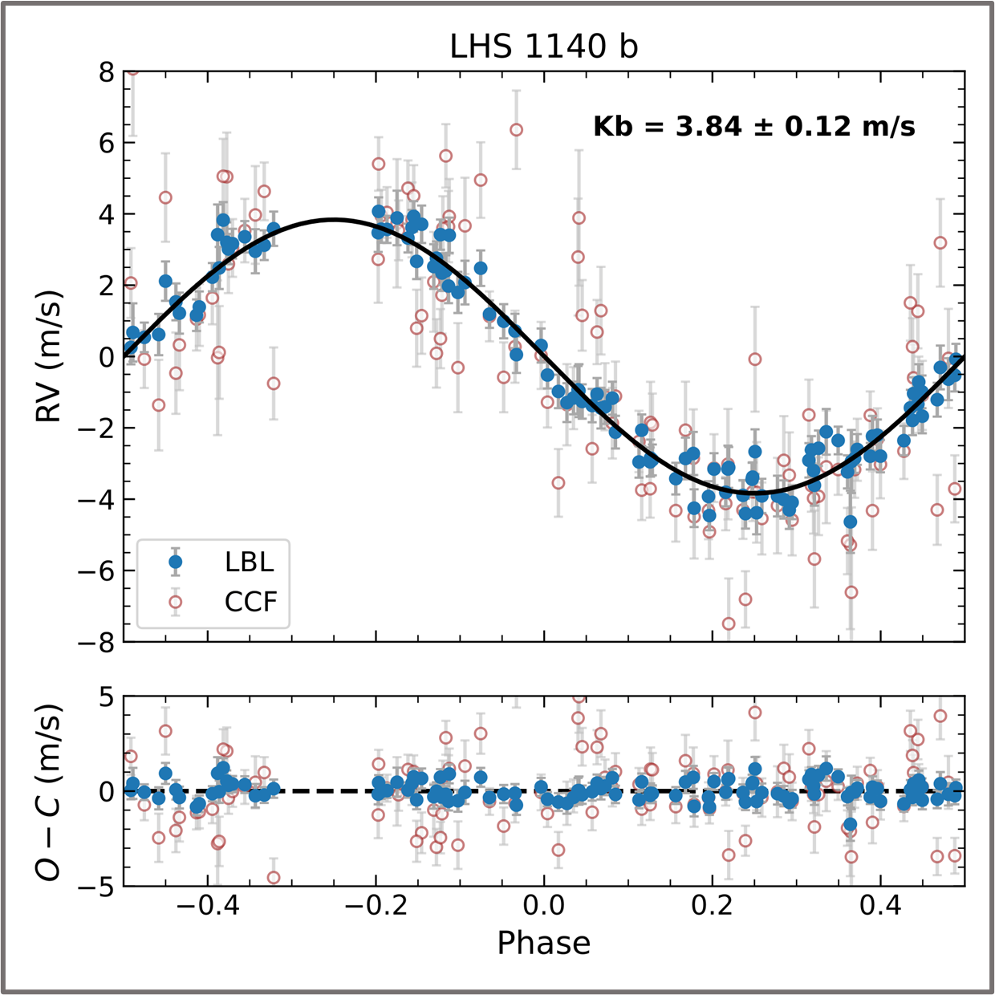
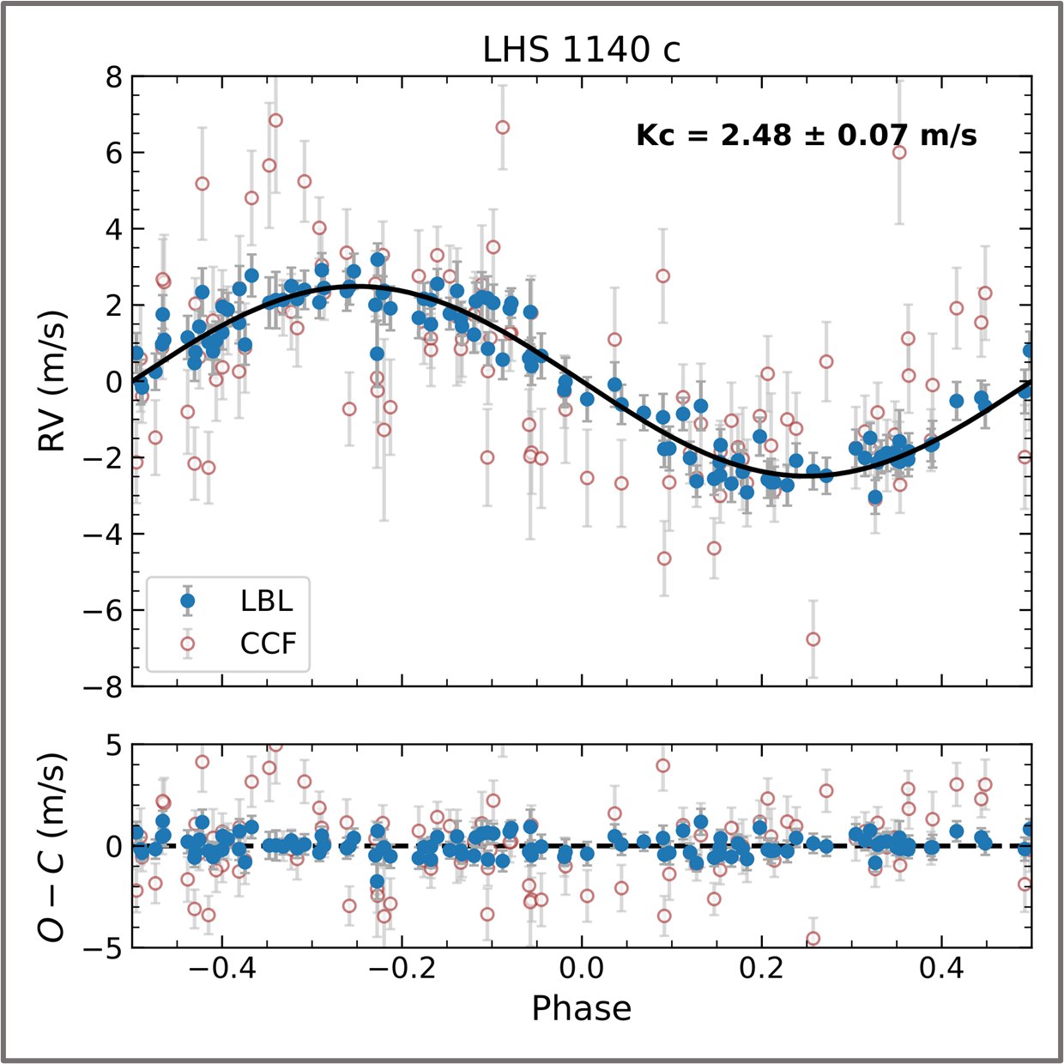
ESPRESSO data of LHS 1140 with LBL
Cadieux et al. in prep.

Slide 9
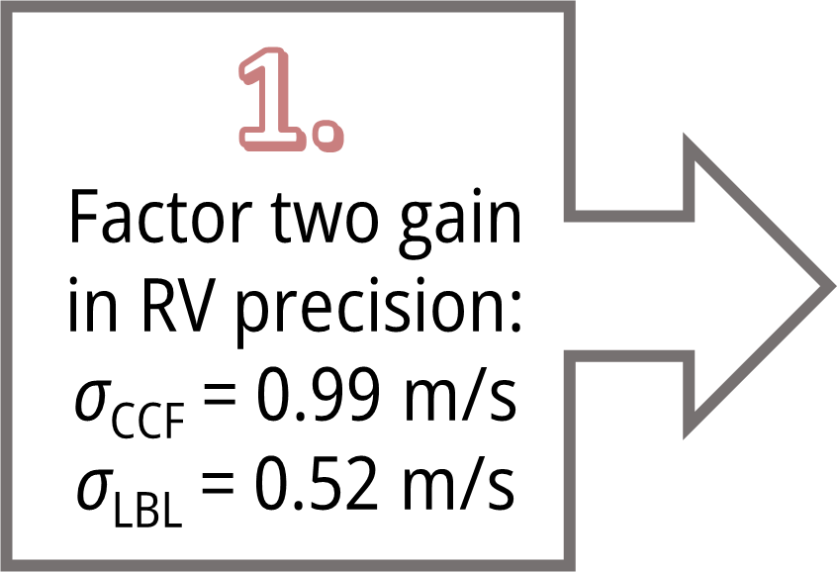
ESPRESSO data of LHS 1140 with LBL
Cadieux et al. in prep.

Slide 10
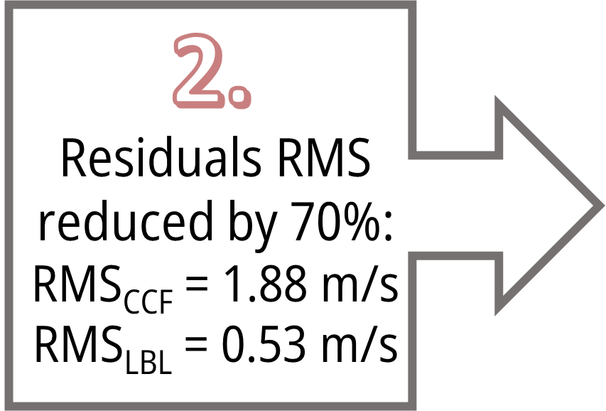
ESPRESSO data of LHS 1140 with LBL
Cadieux et al. in prep.

Slide 11
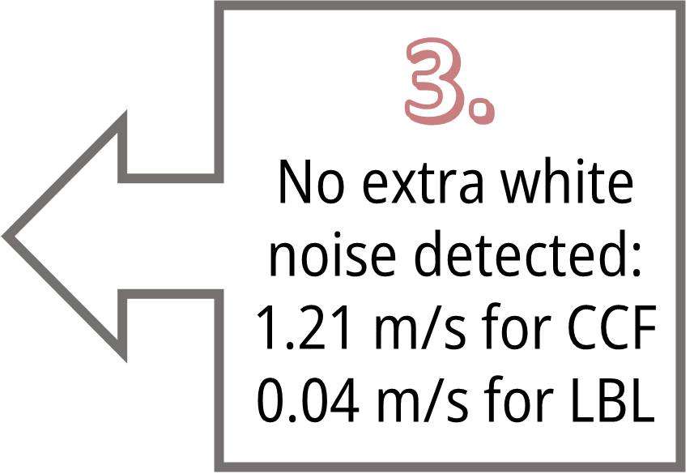
ESPRESSO data of LHS 1140 with LBL
Cadieux et al. in prep.

Slide 12
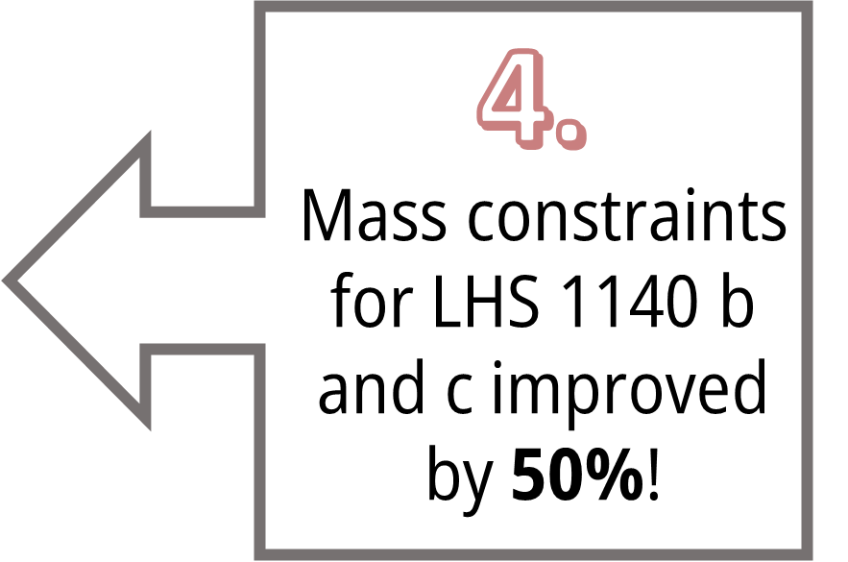
ESPRESSO data of LHS 1140 with LBL
Cadieux et al. in prep.

Slide 13
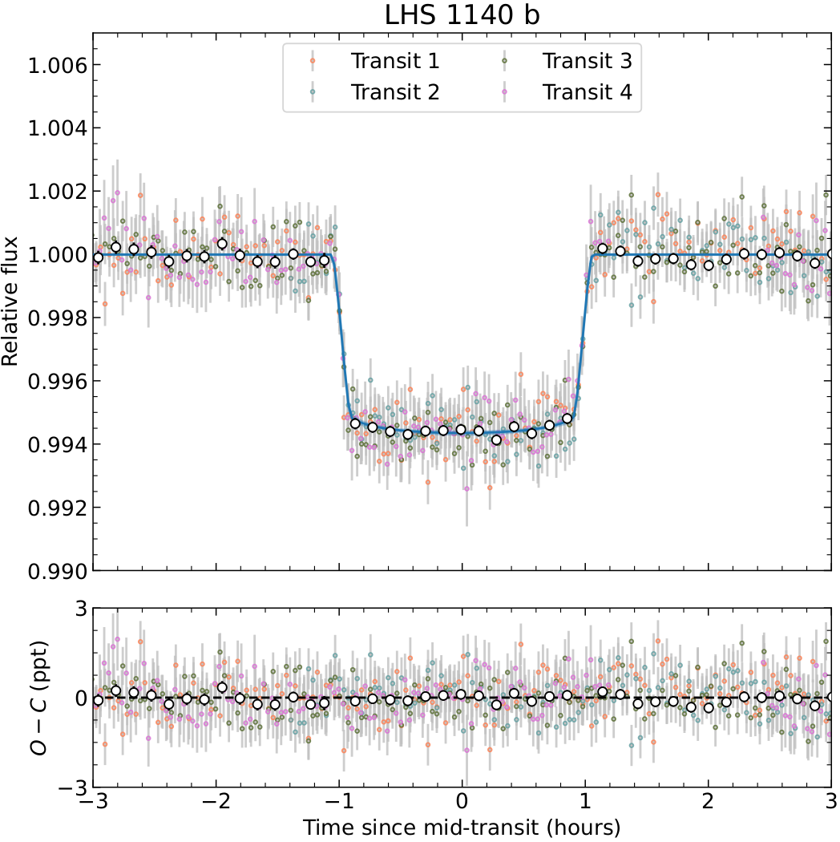
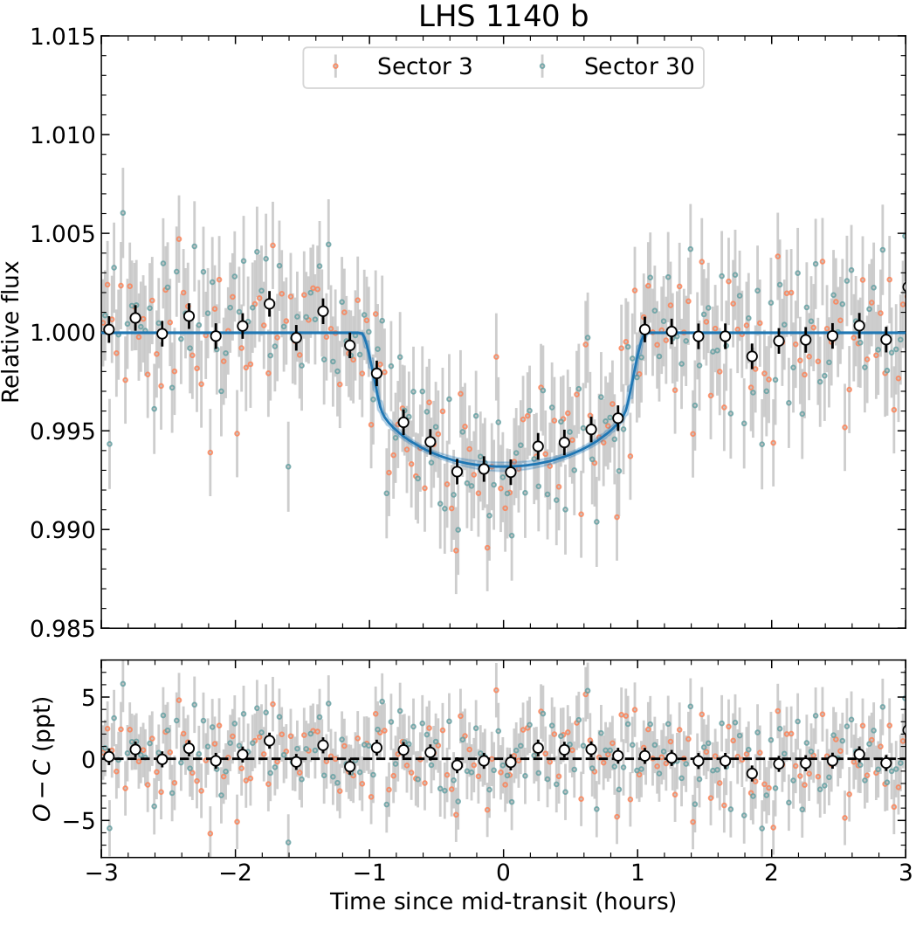
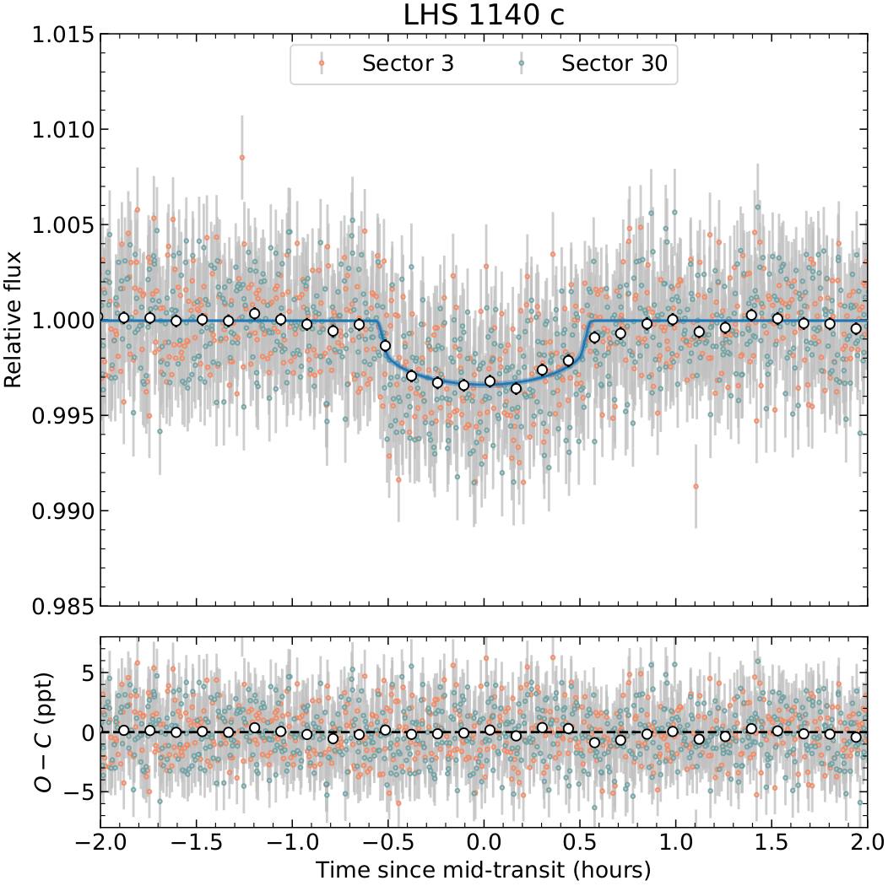
Archival Transits
Including 3 unpublished Spitzer transits
New TESS sector 30 data
Cadieux et al. in prep.

Slide 14
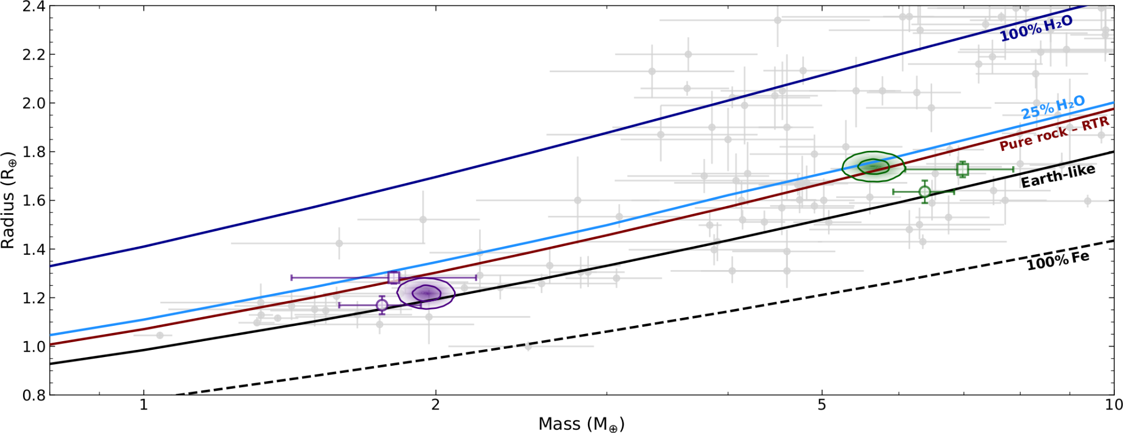
New mass-radius constraints!
Ment+2019 (HARPS + Spitzer)
Lillo-box+2020 (ESPRESSO + TESS)
LHS 1140 b
LHS 1140 c
Cadieux et al. in prep.

Slide 15
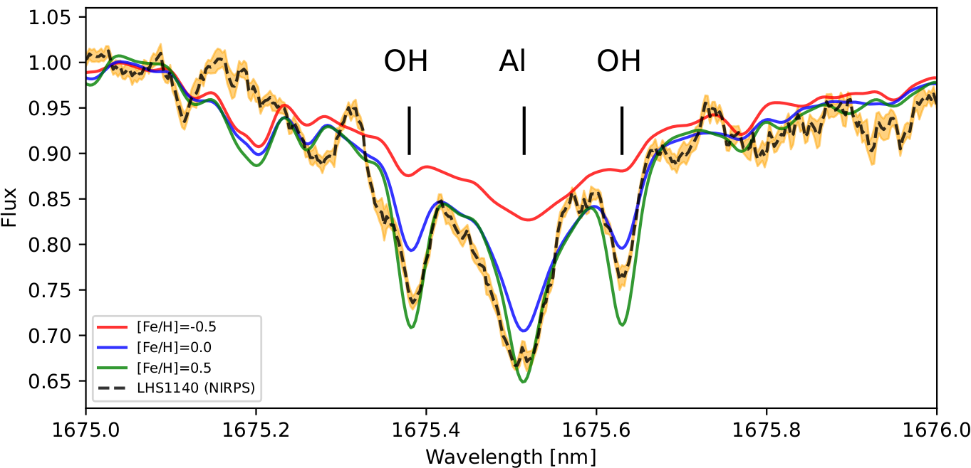
Bonus: Stellar abundances with NIRPS
Refractory elements (Fe, Mg, Si) constitute the bulk material of an exoplanet core and mantle
Use the stellar abundance ratios of Fe/Mg and Mg/Si as proxy for the planets (Dorn+2017, Cadieux+2022)
Ongoing work: Infer the core- and water-mass fractions of the planets
Work by Farbod Jahandar
Cadieux et al. in prep.

Slide 16
Summary & Next steps
The line-by-line (LBL) is an outlier resistant method for precision radial velocity. LBL outperforms the CCF method in the nIR and for M dwarfs.
LBL analysis of existing ESPRESSO data of LHS 1140 resulted in a ~50% improvement of the mass detection of the planets
The Habitable zone planet LHS 1140 b is now compatible with a water-rich object (detailed internal structure analysis ongoing). Ultimately, confirming the water-world hypothesis will require transmission spectroscopy with JWST
Merci!

