Slide 1
The HII Regions of NGC925 as Observed With SITELLE
CRAQ23
Damien Beaulieu – May 10 2023
MSc. Student w/ prof. Carmelle Robert and prof. Hugo Martel

Slide 2
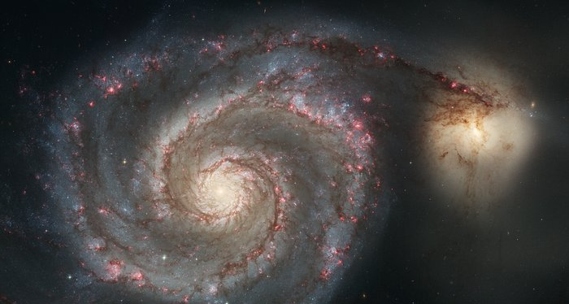
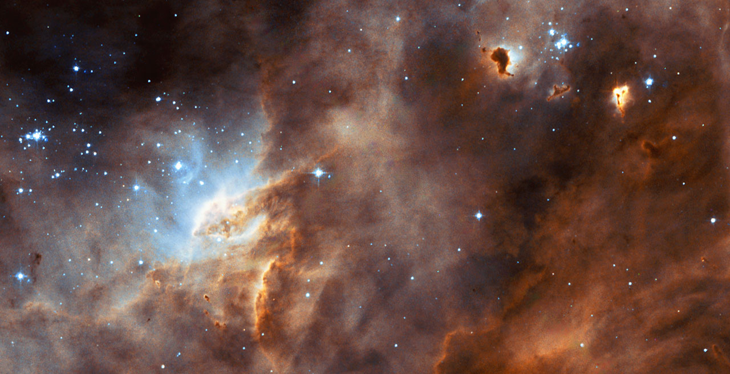
Sánchez (2020)
Why study star formation
Kennicutt (1998)
VS
M51: NASA, ESA, S. Beckwith (STScI), and The Hubble Heritage Team (STScI /AURA)
LMC: NASA/ESA and the Hubble Heritage Team (AURA/STScI/HEIC)
At large scales star formation can be measured as a global phenomenon
i.e. gas density and the star formation rate (SFR)
are averaged over galactic scales
But the local environment has the final word in the star-forming process
i.e. if the conditions for star formation are met or not
What are the interplay between global phenomenons and local environments on the star-forming process?

Slide 3
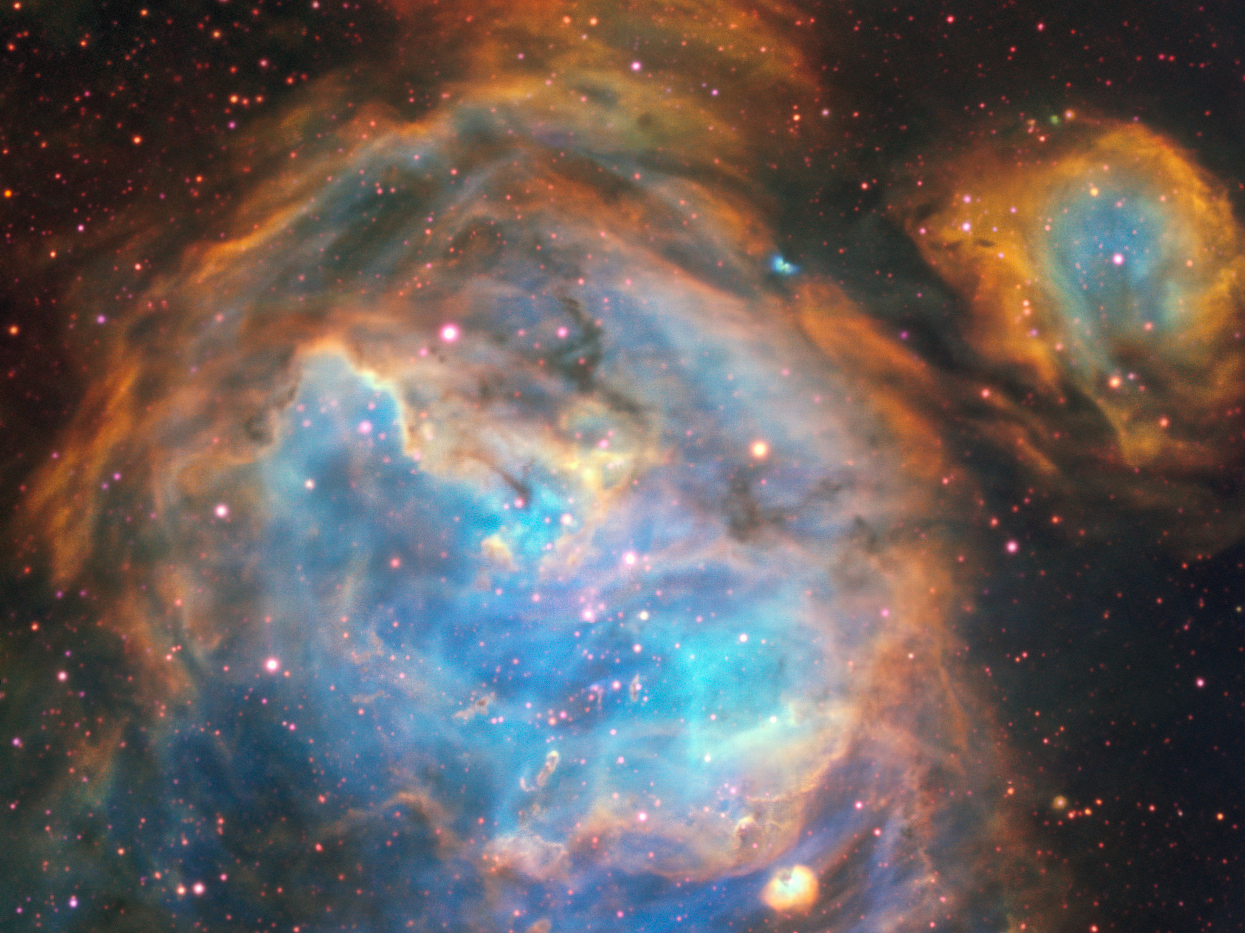
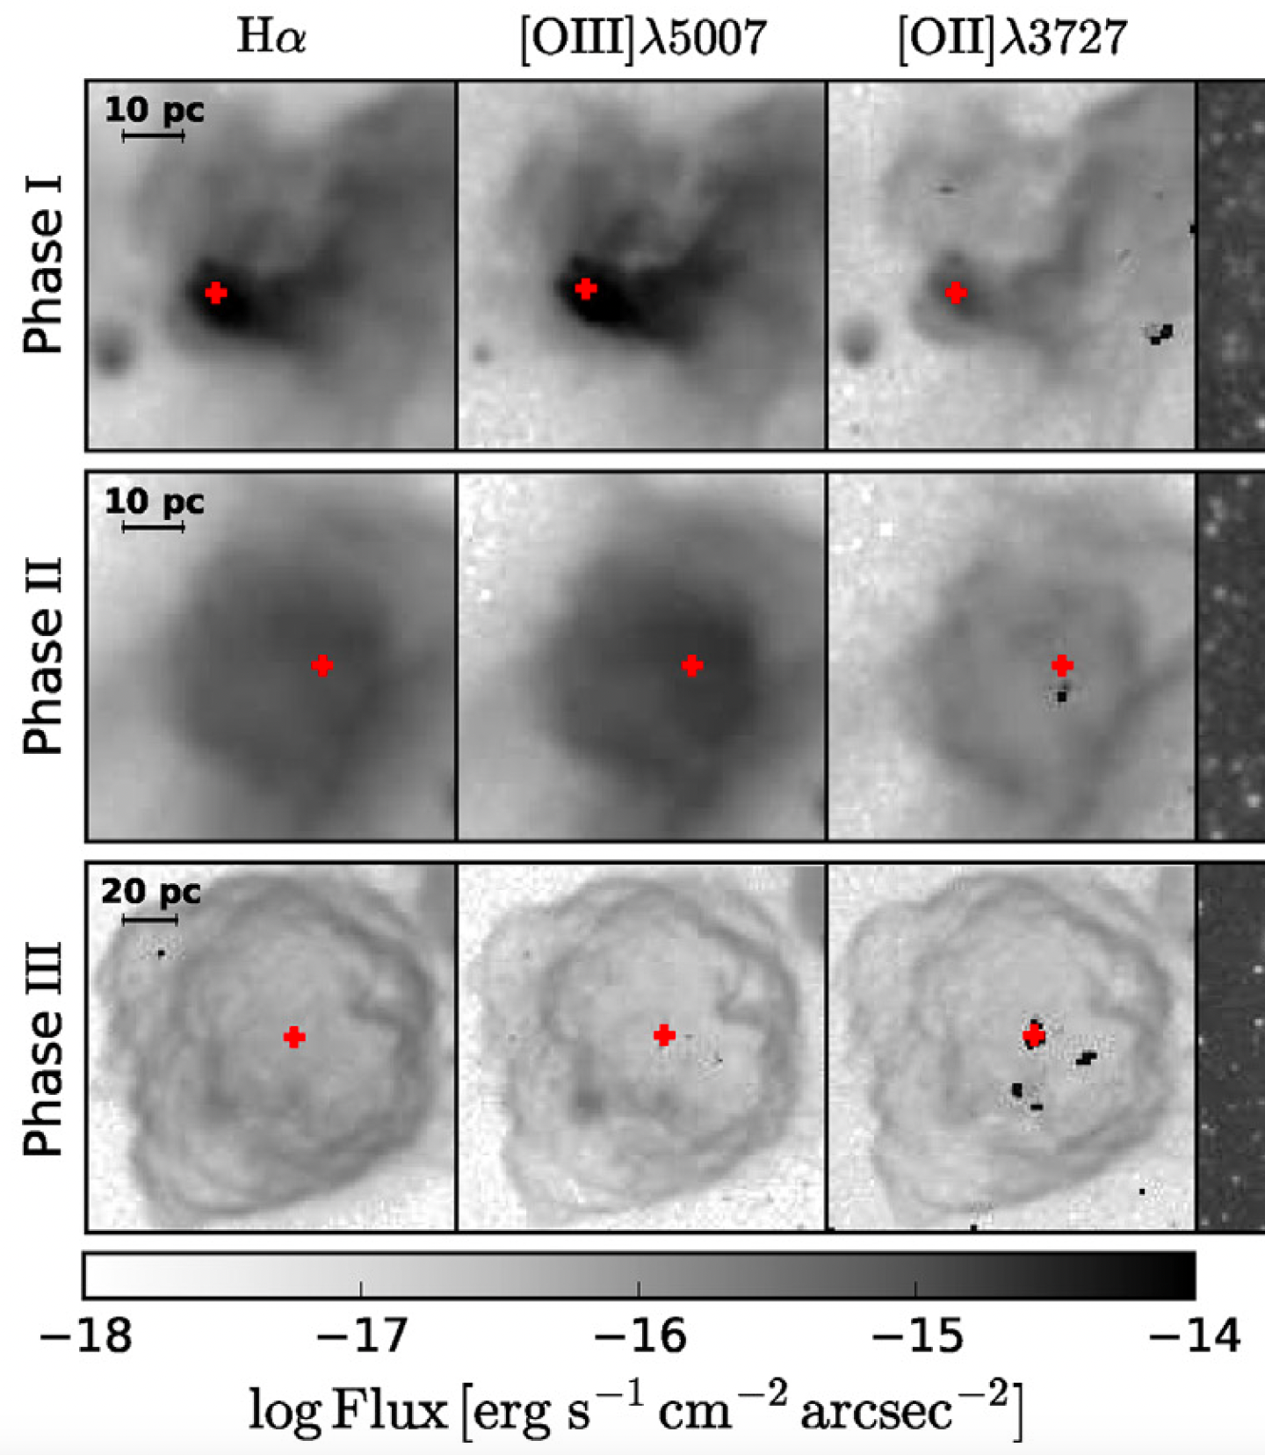
Ionized gas and HII regions;
Tracing star formation
figure: NASA, ESA, CSA, Jason Champion (CNRS), Pam Jeffries (STScI), PDRs4ALL ERS Team
HII regions are:
Gas cloud ionized by massive stars
i.e. massive stars are “illuminating” the
remaining gas in which they were just born
Image: ESO, A. McLeod et al.
Understanding the composition
of HII regions is understanding
the environment in which stars can form
figure: Pellegrini et al. (2020) - modified
can form ou have formed?
Notes:
So with this is mind -> ionized gas is a tool to study SF
HII region are:
Remains of a gas clouds (where star formation just took place) that are
now ionized by young massive stars (which have just been borned)

Slide 4
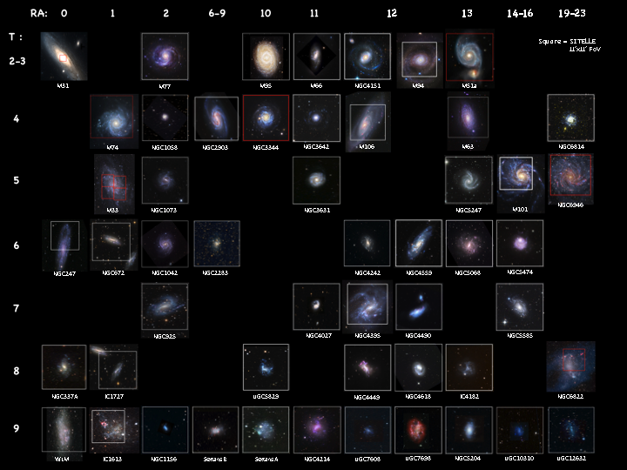
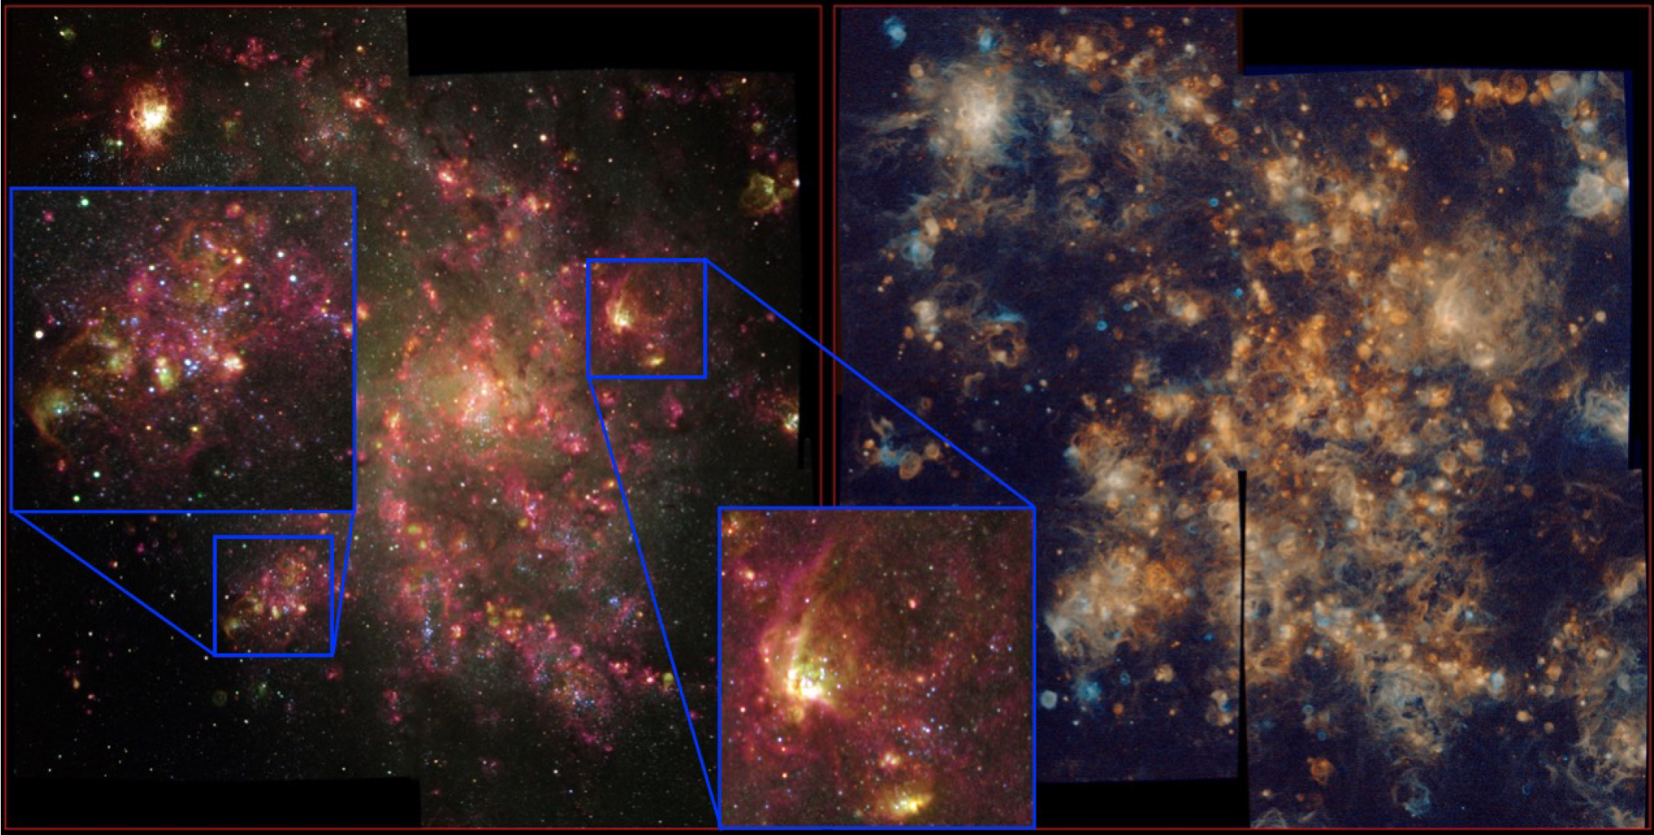
The SIGNALS galaxy survey
PI: L. Rousseau-Nepton, P. Martin, C. Robert, L. Drissen, P. Amram
Star-formation, Ionized Gas And Nebular Abundances Legacy Survey
Observe ~35 nearby galaxies to:
Compile a catalog of spatially and spectroscopically resolved HII regions
Enable the study of the small-scale physics of star-forming regions in various local environment
Image: Rousseau-Nepton et al. (2019)
Image: SIGNALS website

Slide 5
The SIGNALS galaxy survey
PI: L. Rousseau-Nepton, P. Martin, C. Robert, L. Drissen, P. Amram
Star-formation, Ionized Gas And Nebular Abundances Legacy Survey
Observe ~35 nearby galaxies to:
Quantify the effects of both galactic and local environments on the star-forming process
Image: Rousseau-Nepton et al. (2019)
Image: SIGNALS website

Slide 6
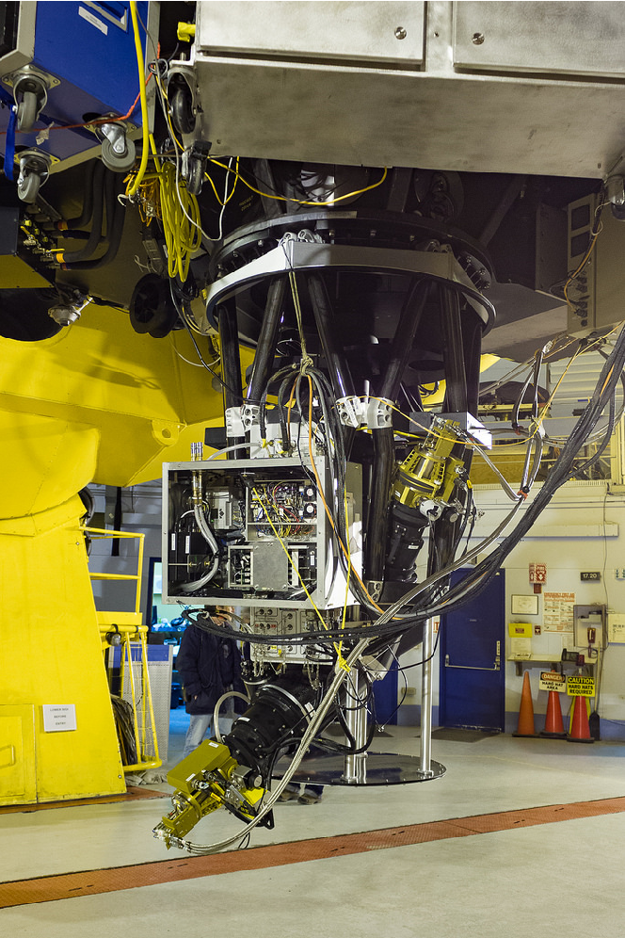
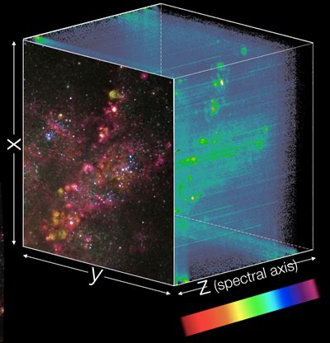
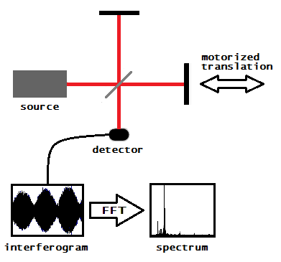
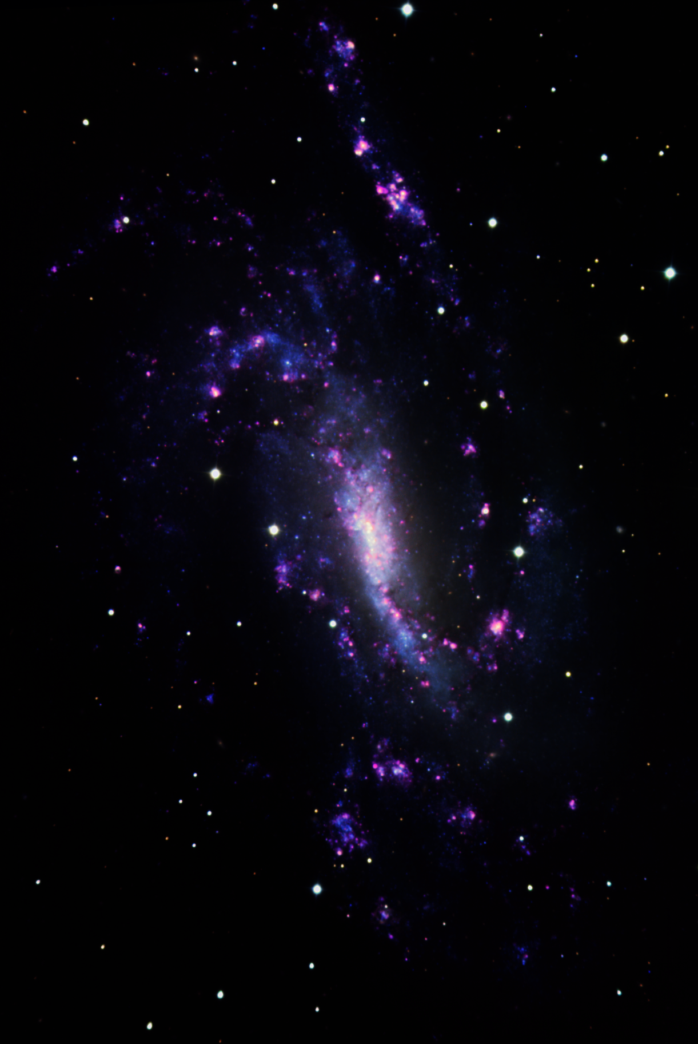
IFTS: images and spectra
Image: Tom Benedict (CFHT)
Imaging Fourier Transform Spectrometer
SITELLE is an IFTS tailored for observation of optical emission lines
Light goes through a Michelson interferometer, interference patterns are measured and a Fourier transform decomposes the signal into wavenumbers [cm⁻¹]
Drissen et al. (2019)
Image: SIGNALS website (modified)
Field of view (FOV) = 11’x11’
Spatial resolution = 0.32”/pixel
Spectral range: ~350 to ~900 nm
Image: wikipedia, Fourier-transform spectroscopy
IFTS observations produce hyperspectral datacubes
$⟹$ a spectrum (Z) is available for each spatial pixel (X,Y)
(aka spaxels)
Each pixel of the CCD is measuring a different point in space!
Notes:
Pour la présentaion du colloque plus netrer dans les details de SITELLE (montrer exemple monochromatique puis polychromatique et après espace)

Slide 7
Travelling through the spectrum of NGC925
10.5’
SITELLE can
easily detect from
[OII] all the way to [SII]
7’
continuum emission in the SN2 filter indicates the old stellar population
Emission lines like H$α$
are the signatures of recent star formation
HII region complex
Integrated spectrum

Slide 8
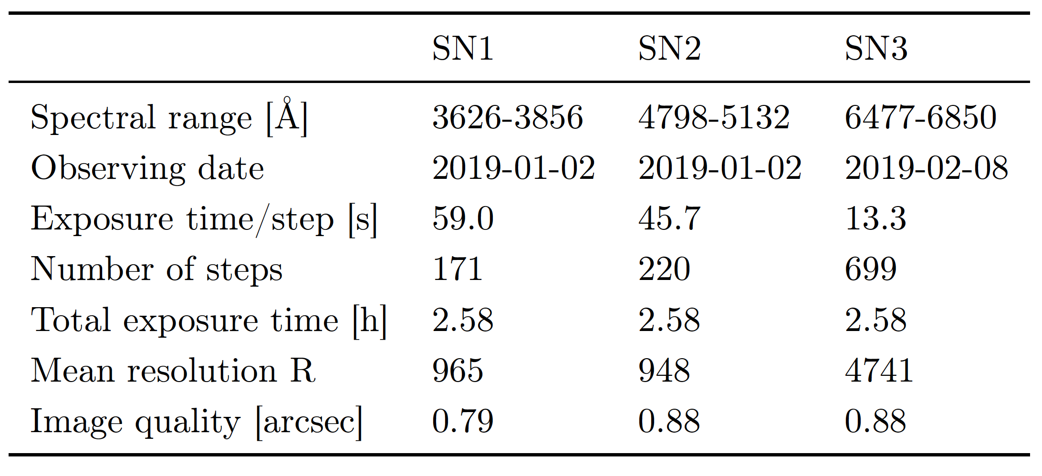
Composite image of NGC925 with SITELLE
A deep dive in NGC925
Observed through SIGNALS in 2019:
Distance: 9.2 Mpc
Inclination: 58.9˚
Angular size: 10.5’ x 6’
Type: SAB(s)d (spiral, barred, late-type)
Member of NGC1023 group
Assymetries:
Bar is not well defined
Patchy star formation scattered throughout the galaxy
Dynamic, isophotal and bar centers are not coincident

Slide 9
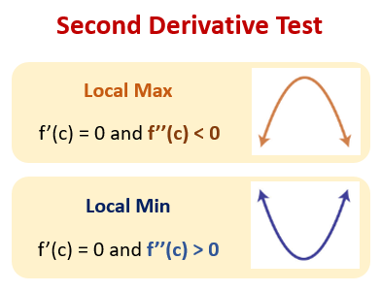
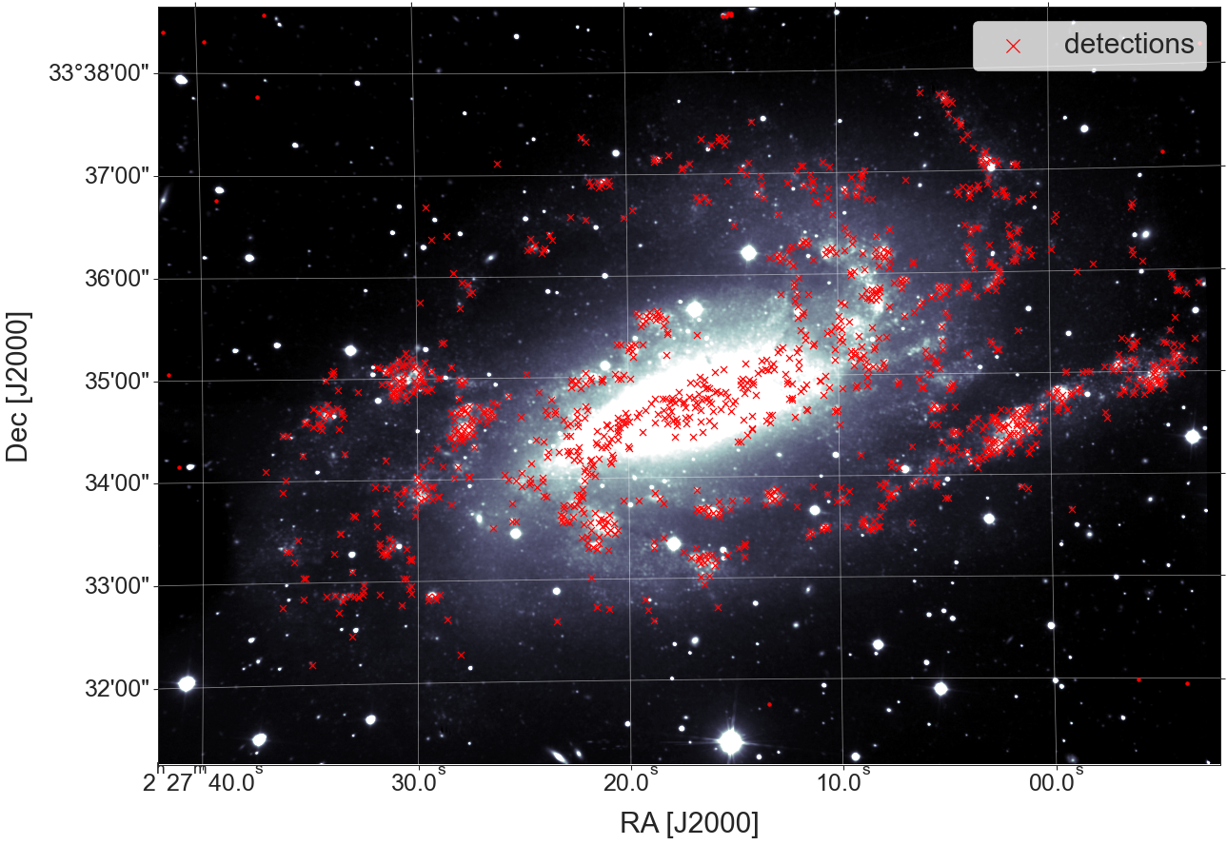
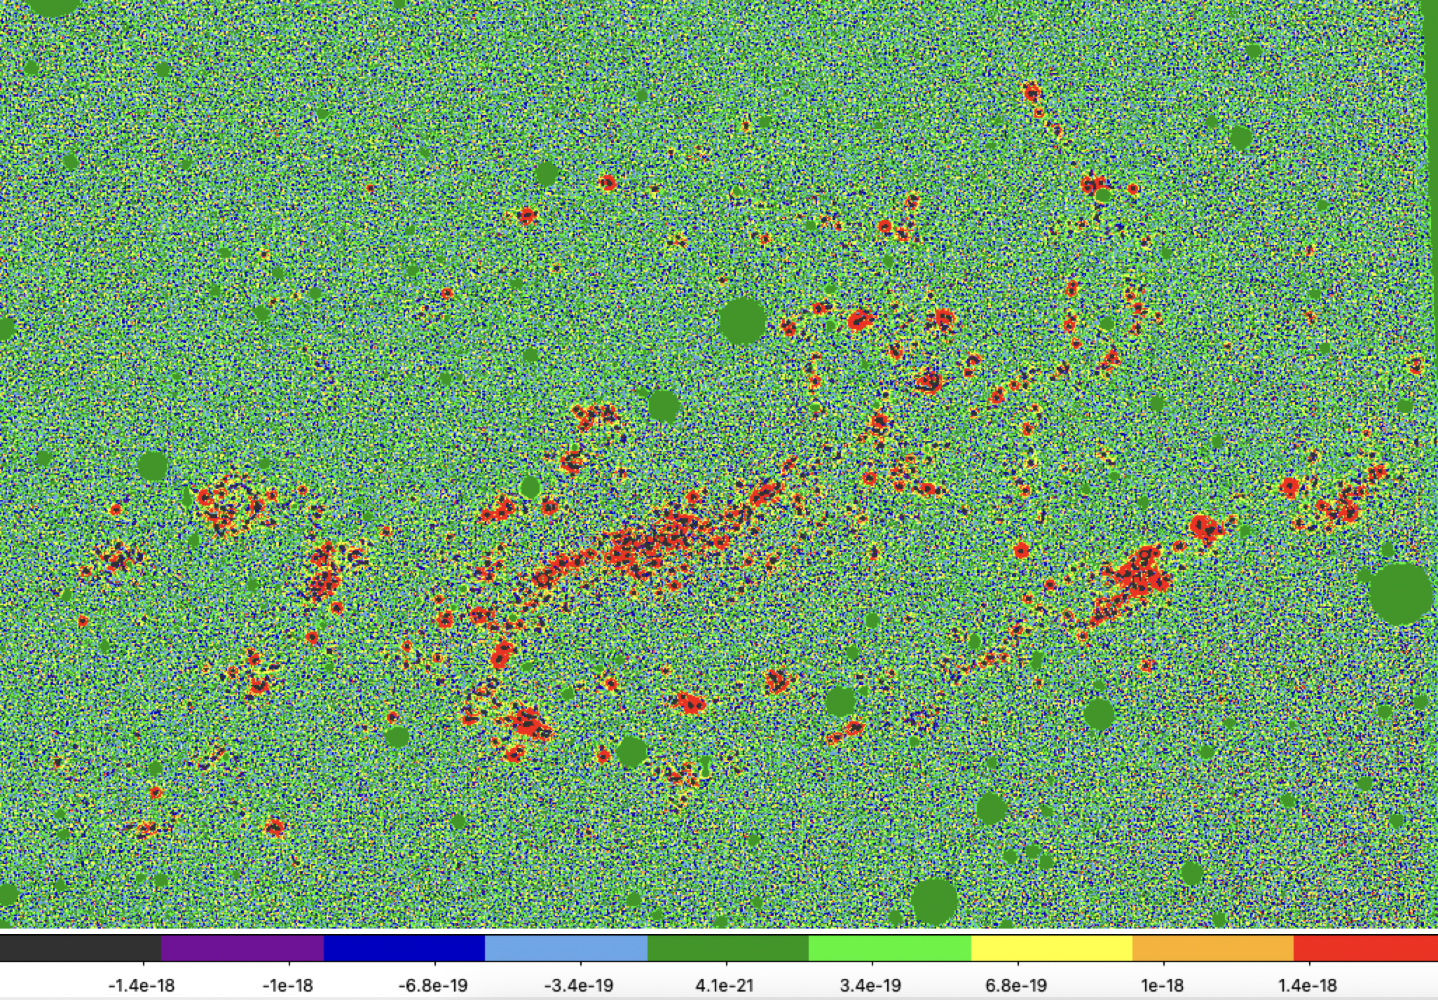
methodology
Detecting star forming regions
Savard et al. (in prep)
Laplacian operator on the galaxy to detect emission peaks
1292 HII region
candidates in NGC925
Laplacian map

Slide 10
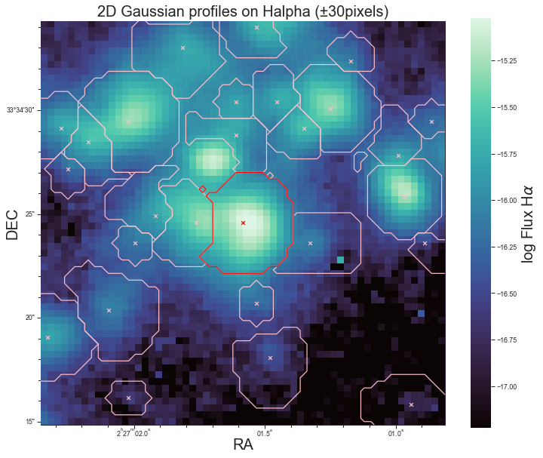
methodology
Region #414
Extracting the spectra
2D Gaussian profiles to define morphology
Everything else is considered as background emission
region of interest
background
(i.e. emission that is not part
of any surrounding regions)
Notes:
By fitting a 2d gaussian

Slide 11
methodology
Region #414
Extracting the spectra
SN3
SN2
SN1
integrated
region
spectrum
integrated
background spectrum
Notes:
By fitting a 2d gaussian

Slide 12
methodology
Region #414
Extracting the spectra
Corrected HII region
HII region
Removing the background singles out the HII region emission from the diffuse emission and the stellar population
background
Corrected region spectrum: region spectrum – background spectrum
SN3
SN2
SN1
Notes:
By fitting a 2d gaussian

Slide 13
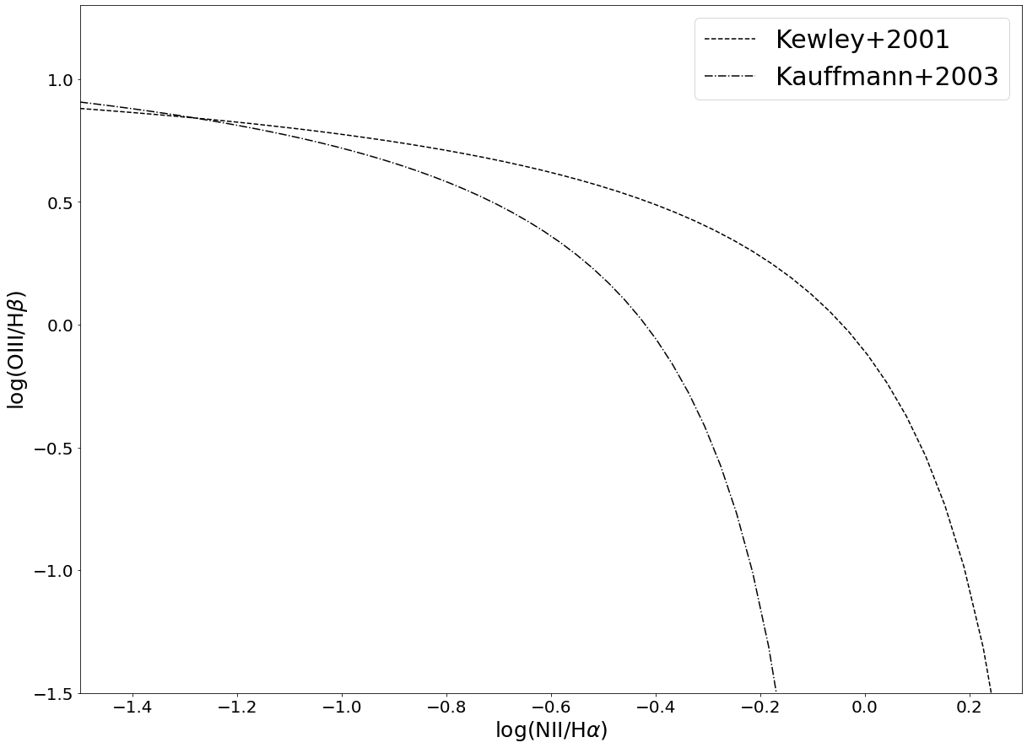
results
BPT diagrams
BPT = Baldwin, Phillips & Terlevich (1981)
Distinguising the ionizing origin
AGN and/or shocks
The ratio
[NII]$λ$6583/H$α$ vs [OIII]$λ$5007/H$β$
distinguish photoionization from stars, AGN and shocks
comp.
Star formation

Slide 14
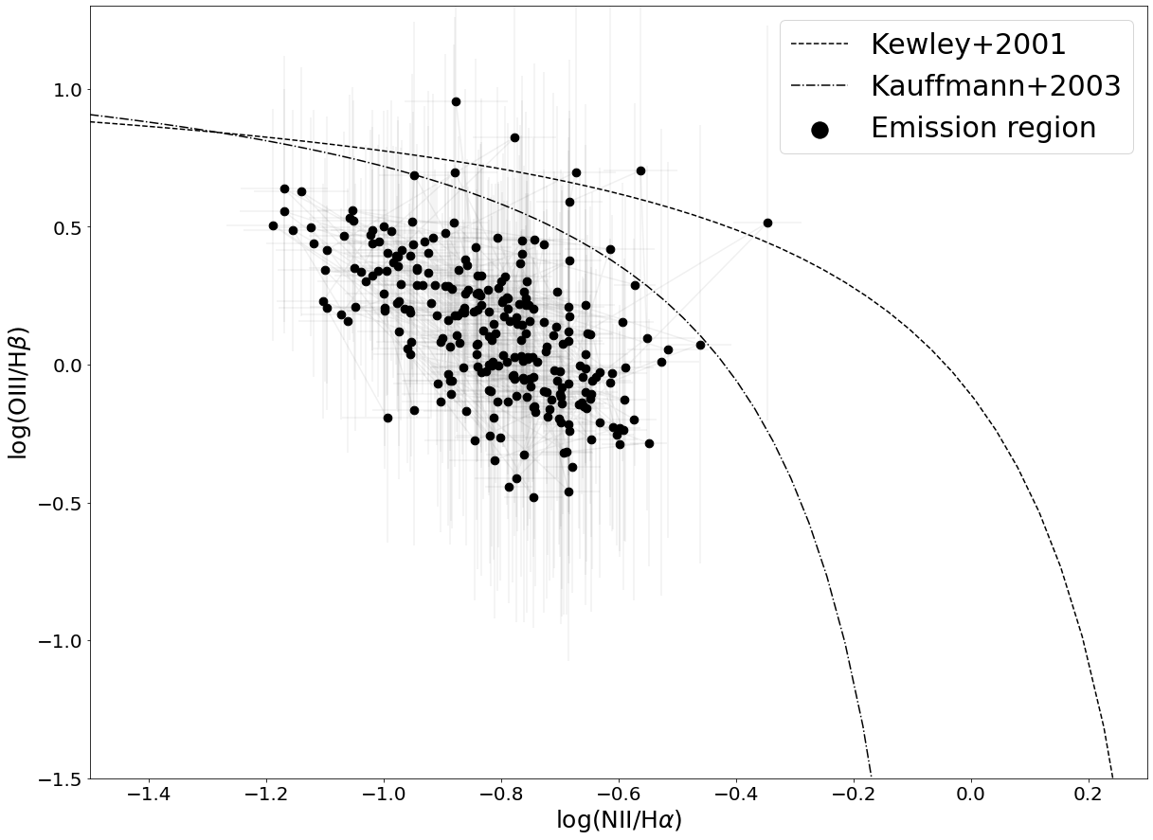
results
BPT diagrams
Distinguising the ionizing origin
AGN and/or shocks
Each point in the diagram is an emission region detected in NGC925
comp.
Star formation
Most of the emission region are indeed
HII regions
S/N > 5
on [NII]$λ$6583, H$α$, [OIII]$λ$5007 and H$β$

Slide 15
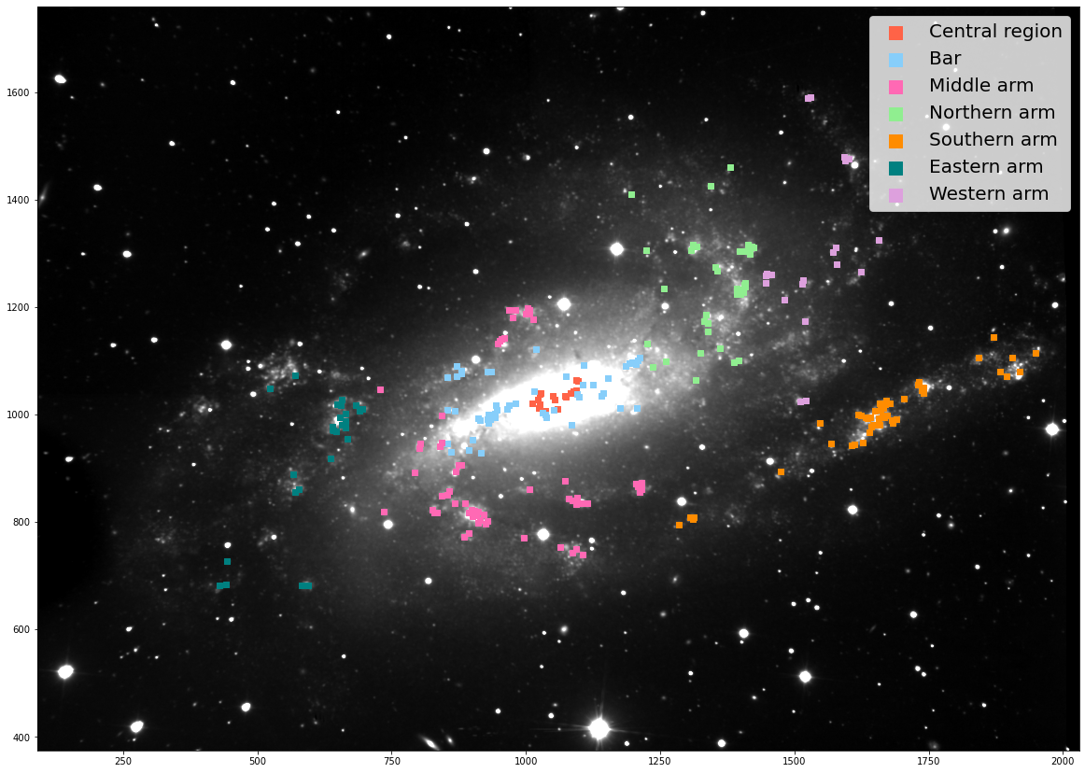
results
BPT diagrams
Color coded by galactic location

Slide 16
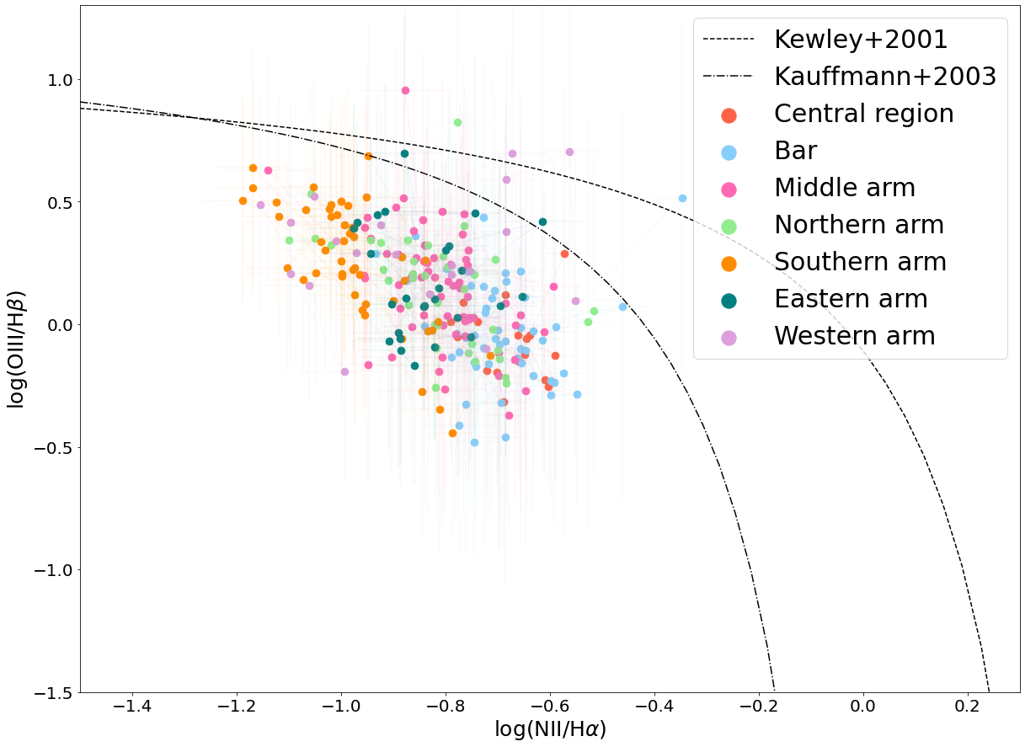
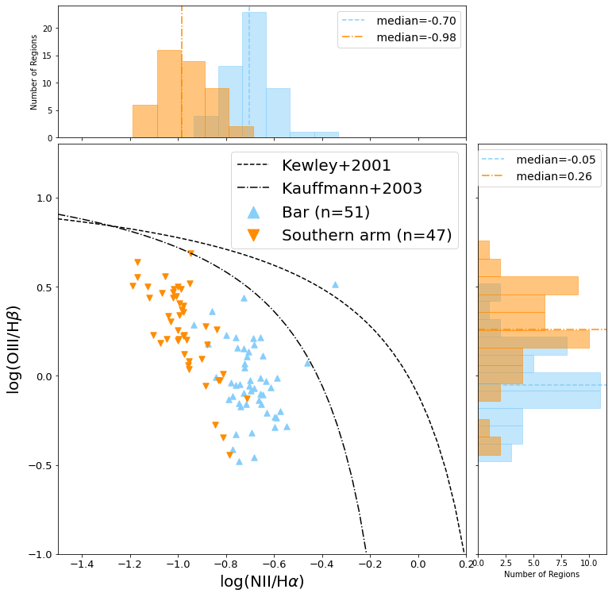
results
BPT diagrams
Color coded by galactic location
Star formation
S/R > 5
on [NII]$λ$6583, H$α$, [OIII]$λ$5007 and H$β$
Notes:
Grossir taille des points dans la légende

Slide 17
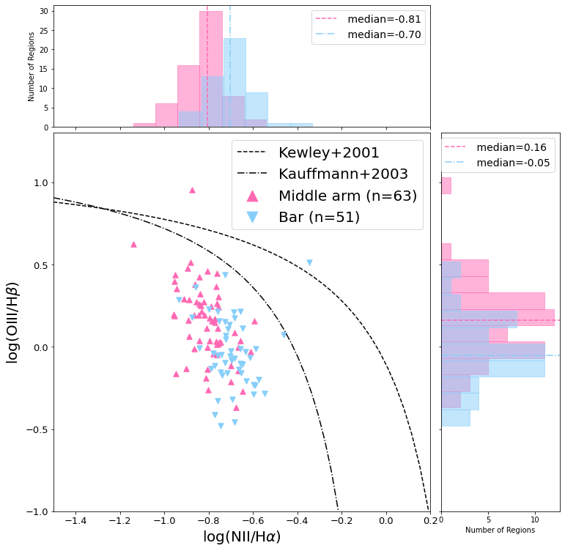
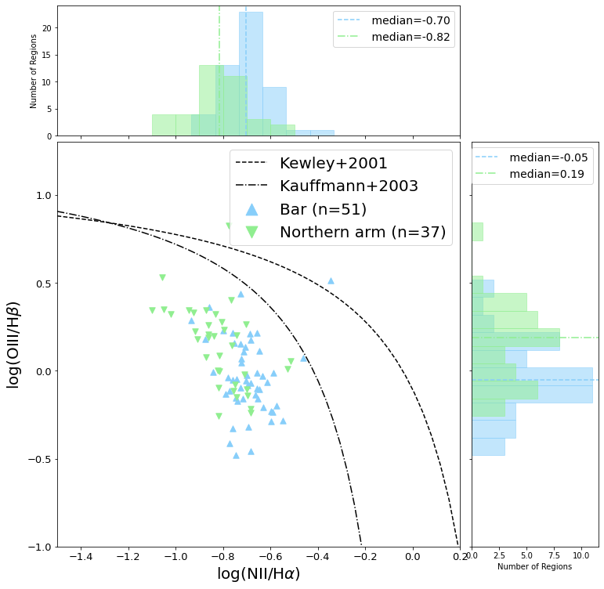
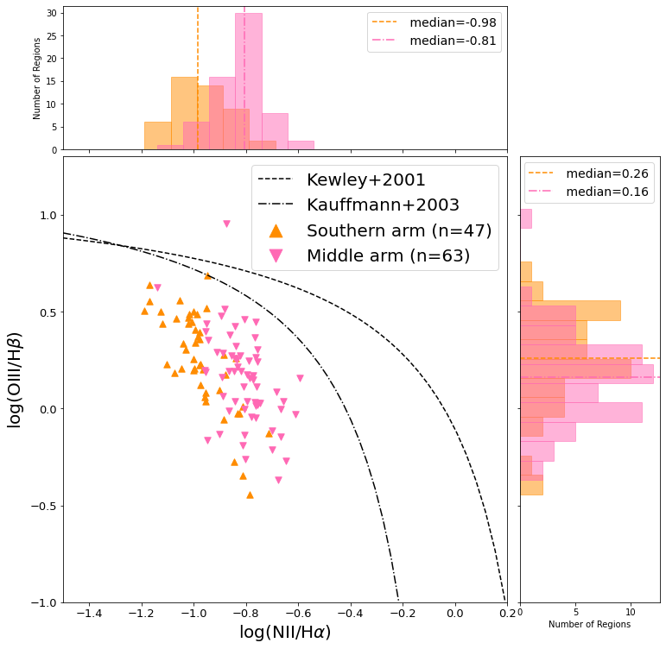
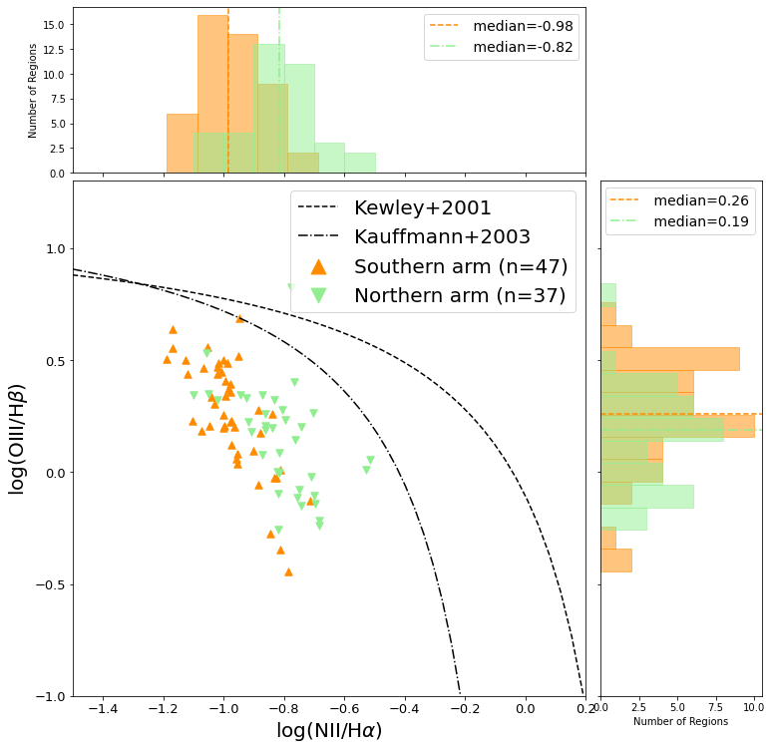
results
BPT diagrams
Impact of the galactic location on star formation?
The galactic location appears to influence the position of HII regions in the BPT diagram
Chemical properties of star-forming regions appears to be different based on their location within the galaxy
Notes:
Encore grossir!

Slide 18
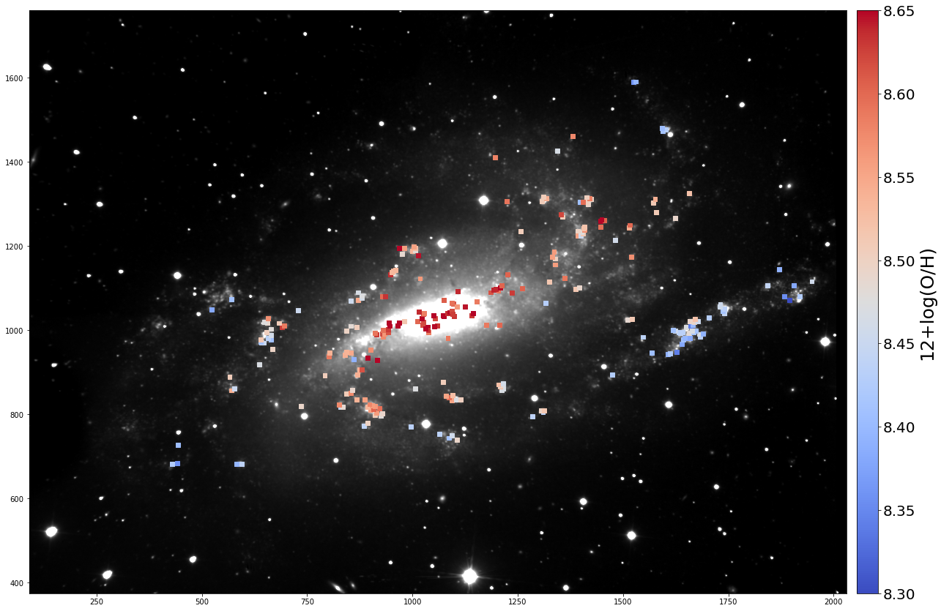
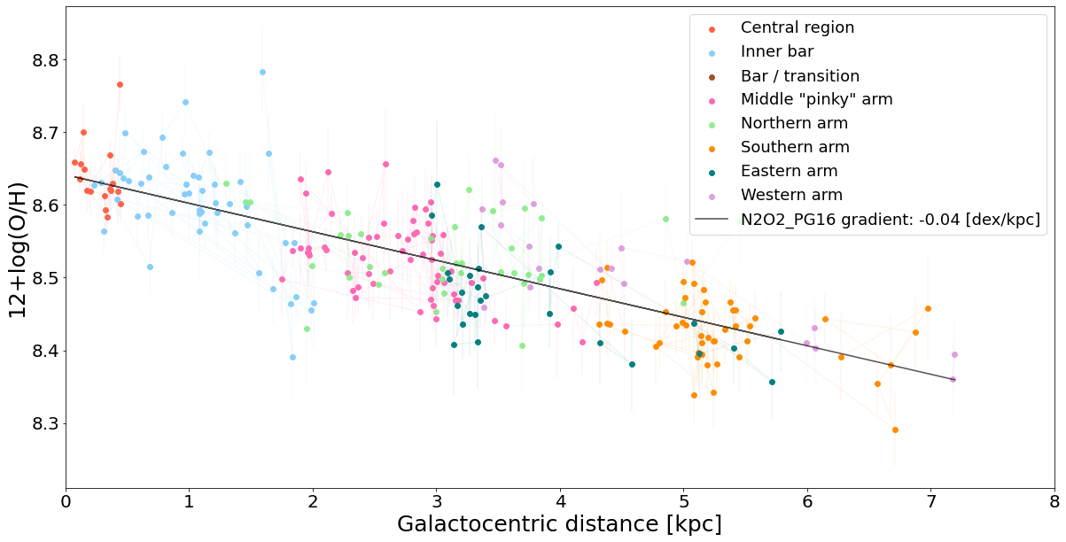
results
Metallicity gradient
It is unusual to find a metallicity gradient in a barred galaxy.
Table: Zurita et al. (2021)
The bar structure is probably recent and it did have the time to influence the galaxy
Notes:
Écreire l’indicateur en haut

Slide 19
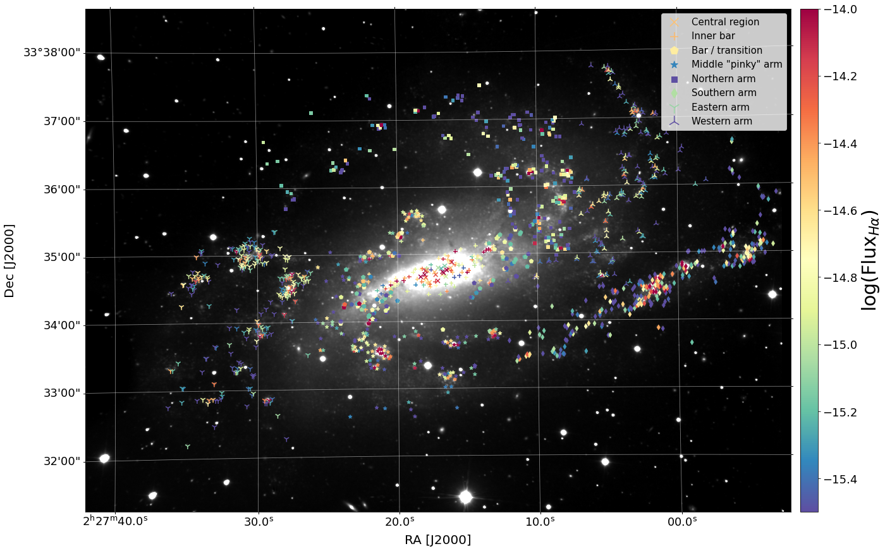
results
Star Formation Rate
Kennicutt (1998)
$$SFR_{Hα}=7.9×{10}^{−42}L_{Hα}$$
Grayscale: Integrated CO intensity (Leroy et al. 2009)
$${SFR}_{L_{Hα,total}}=0.675 M_{⊙}/yr$$
Molecular gas $⟹$ active star formation!
(and available for future SF)
Sustained star formation scattered throughout the galaxy
Notes:
Rajouter texte pour expliquer les chiffres genre sum ha =

Slide 20
Conclusions
The chemical properties of star-forming regions appears to be different based on their location within the galaxy
The bar structure is probably recent and it did have the time to influence the galaxy
3) Sustained star formation scattered throughout the galaxy
Many possibilities to explain the conclusions:
Collision (or interaction) with another galaxy?
Accretion from a nearby cloud?
“Natural asymmetries” that are evolving?
questions?

Slide 21
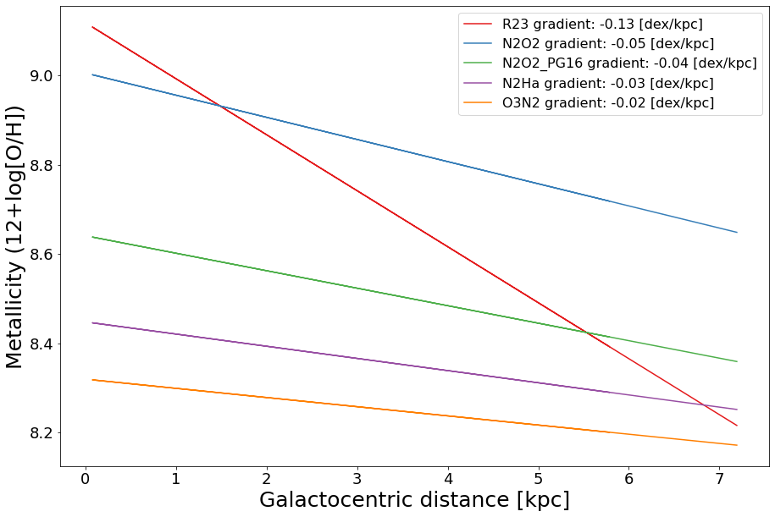
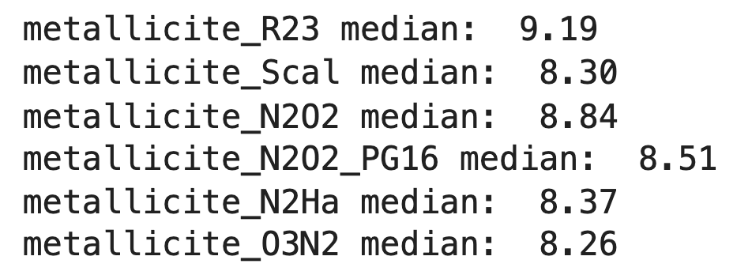
Backup slide: metallicity calibrator
⚠️ is very dependent on the calibrator used to compute the metallicity ⚠️

Slide 22
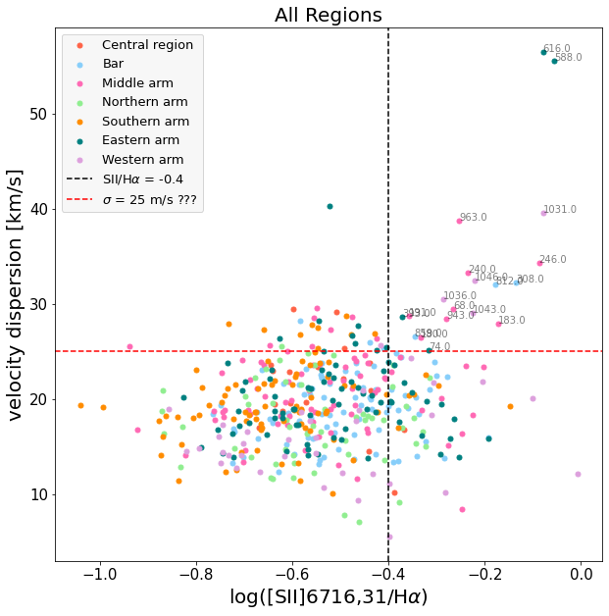
Backup slide: Supernovae remnants
in the catalogue
region #588 is not an HII region, but a supernovae remanent
SN3
SN2
SN1
Regions with strong $[SII]λλ6716,31$/$Hα$ ratios and high velocity dispersion are thought to be SNR
$\left[SII\right]λλ6716,31/Hα$ is weaker in HII regions:

