Slide 1

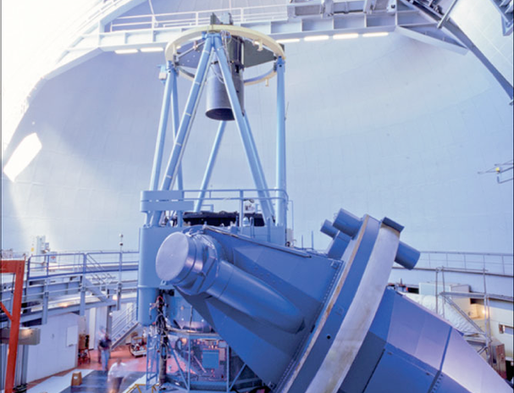







First Light and Science with the Near-Infrared Planet Searcher (NIRPS) Romain Allart on behalf of the NIRPS consortium
Trottier postdoctoral fellow
Université de Montréal, Institut Trottier de Recherche sur les Exoplanètes
https://www.eso.org/sci/facilities/develop/instruments/NIRPS.html
http://www.astro.umontreal.ca/nirps

Slide 2
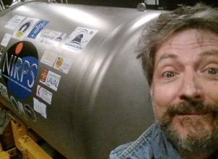
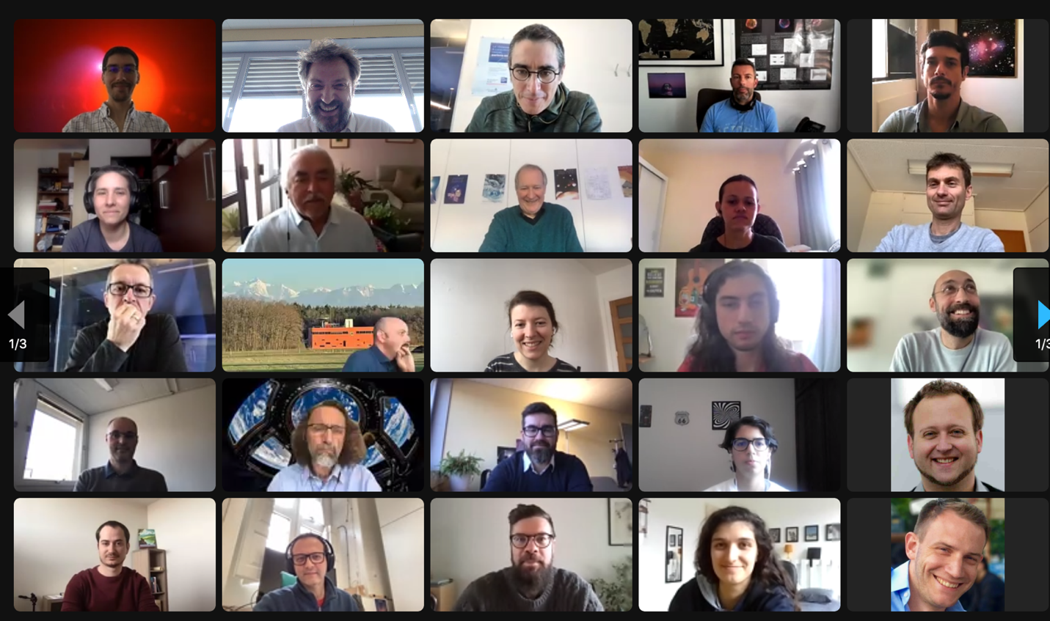






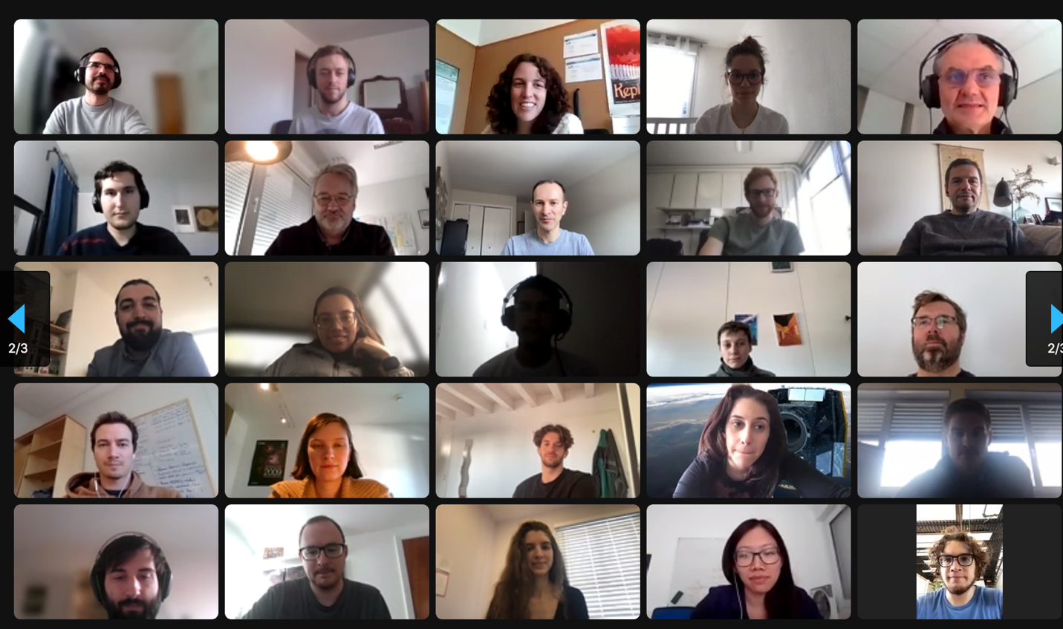

Co-PIs : R. Doyon (UdeM) + F. Bouchy (Geneva)
Co-Is : F. Pepe, N. Santos, R. Rebolo, X. Delfosse,
J. De Medeiros, G. Wade
Proj. Scientist : E. Artigau (UdeM)
Proj. Manager : L. Malo/F. Baron (UdeM)
System Engineer : F. Wildi (Geneva)

Slide 3
Milestones
Proposals ( ) 2014/2015
Kickoff Jan 2016
FDR May 2017
PAE Front End Sept 2019
Front-End Comm Nov 2019
PAE Spectrograph Oct 2021
Front-End + Fiber Comm Dec 2021
AIV in La Silla March-April 2022
First Light June 2022
Science Operations April 2023
Top Level Requirements
Y, J, H bands simultaneously
Fiber feed from AO
Two observing modes:
  HA: R~84’000
  HE: R~72’000
High RV precision (1 m/s)
and high spectral fidelity
Simultaneous operation with HARPS
DRS: Espresso-like + APERO (SPIRou)

Slide 4
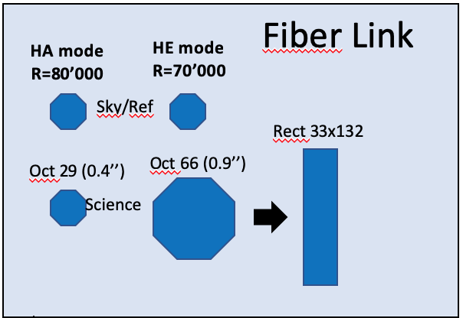
Fiber Link
HA mode
R=84’000
HEmode
R=72’000
Sky/Ref
Science fibers
Oct 29 (0.4’’)
Oct 66 (0.9’’)
Rect 33x132 m
Cryogenic white pupil spectrograph
R4 echelle grating (73x73 mm pupil, 13.3 l/mm)
5 ZnSe prisms train for cross-dispersion
H4RG-15 detector 4k x 4k
Notes:
NIRPS in a nutschell
4 main sub-systems

Slide 5
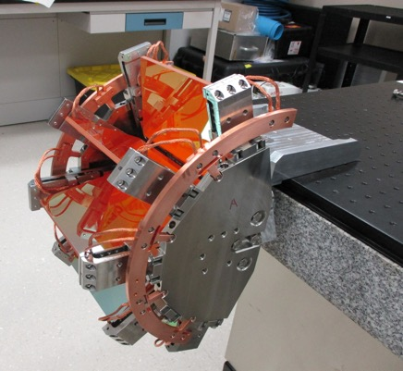
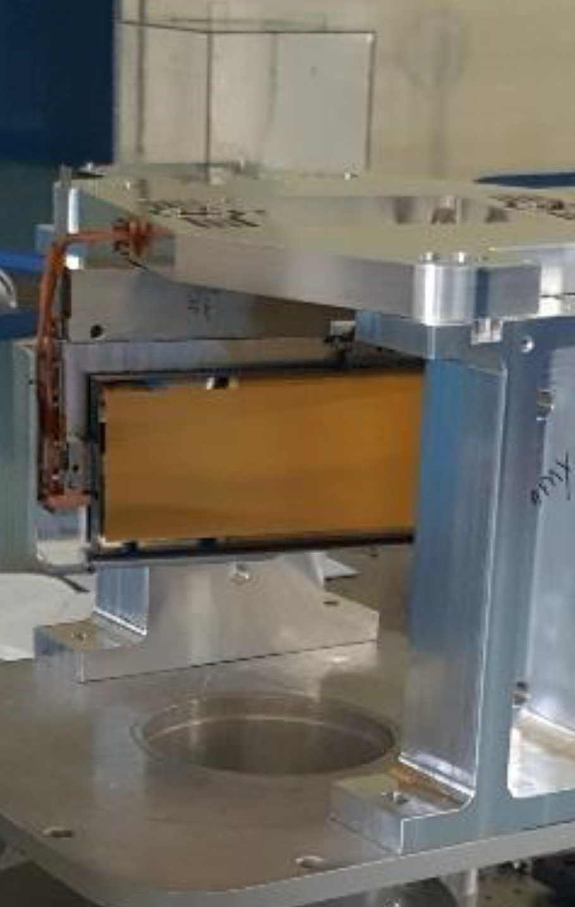
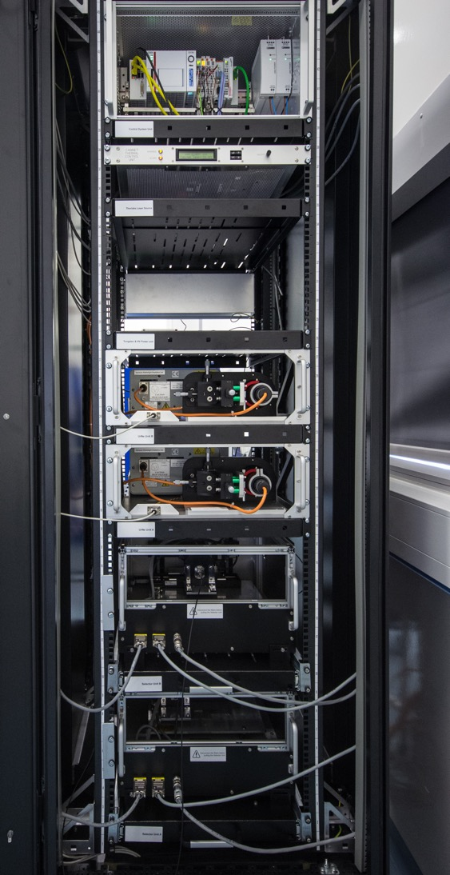
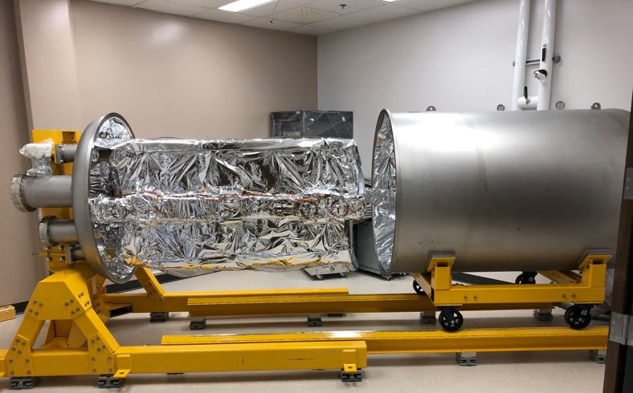
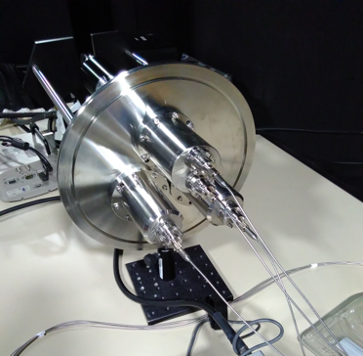
Front-end with AO system
Prisms train
Echelle R4 grating
Fiber Stretcher
Fiber Double Scrambler
Cold Shield and Cryostat
Calibration Unit

Slide 6
ESO 3.6m telescope
NIRPS Room - Coudé Floor of 3.6m
Cryo-coolers
Cryostat
Fiber Link
Fiber Stretcher
Double Scrambler
Front-End

Slide 7
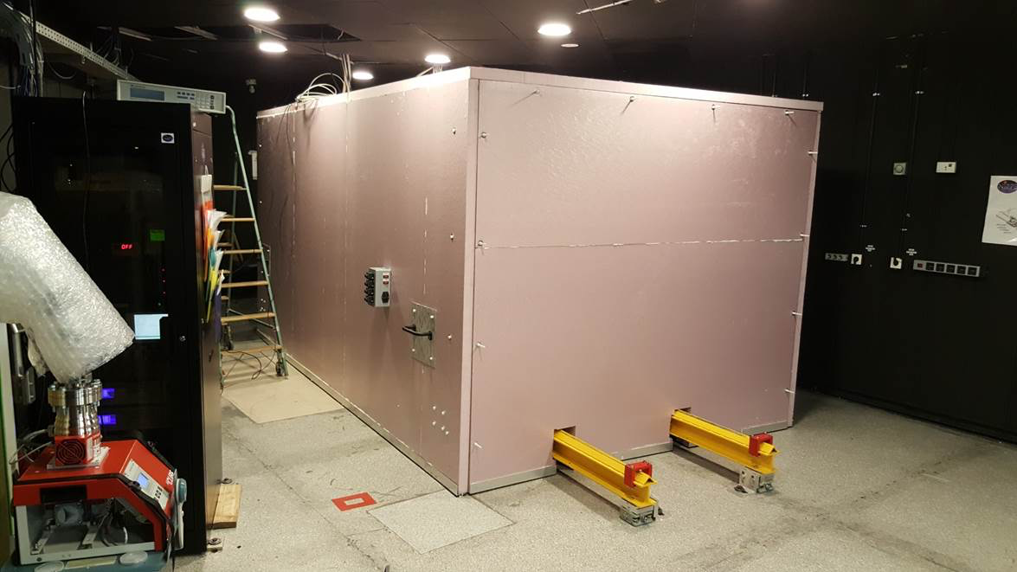

Slide 8
NIRPS first light 17 May 2022
And 4 commissioning later…

Slide 9
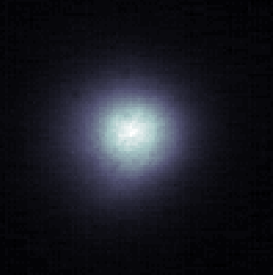
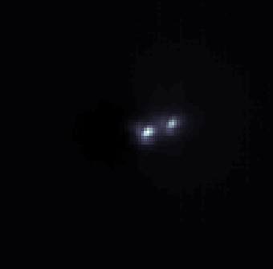
NIRPS AO imaging capability
tet01 Mic I=4.73
tet02 Mic J=5.84
Separation 0.3 arcsec
AO loop open
AO loop closed

Slide 10
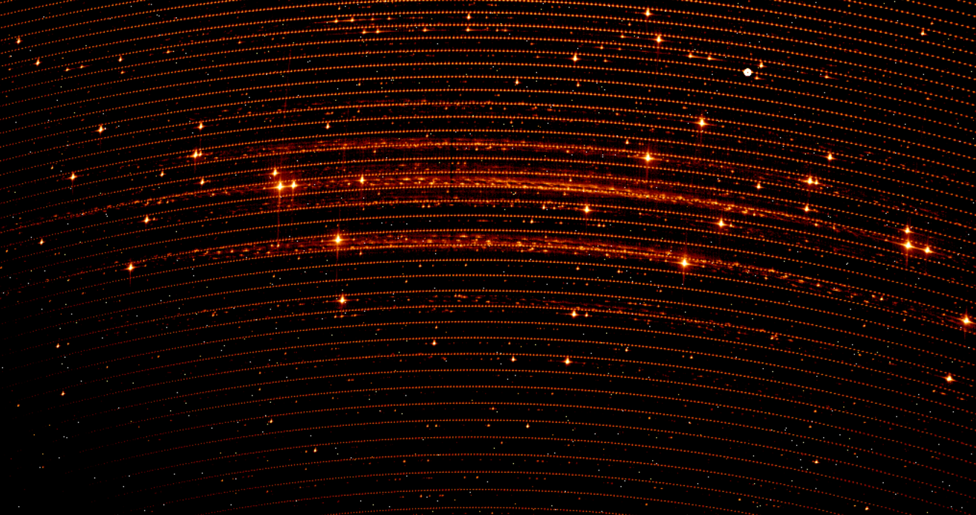
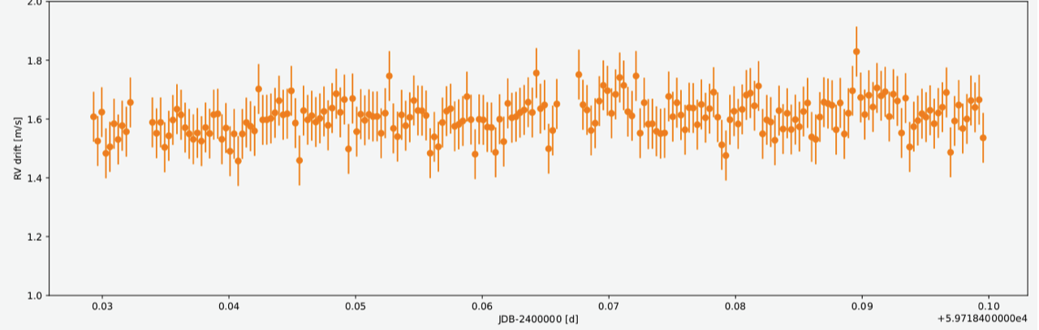
Wavelength solution
UrNe + Fabry-Pérot
accuracy = 0.75 m/s
40 cm/s
FP sequence over 1h45 : 6 cm/s RMS

Slide 11
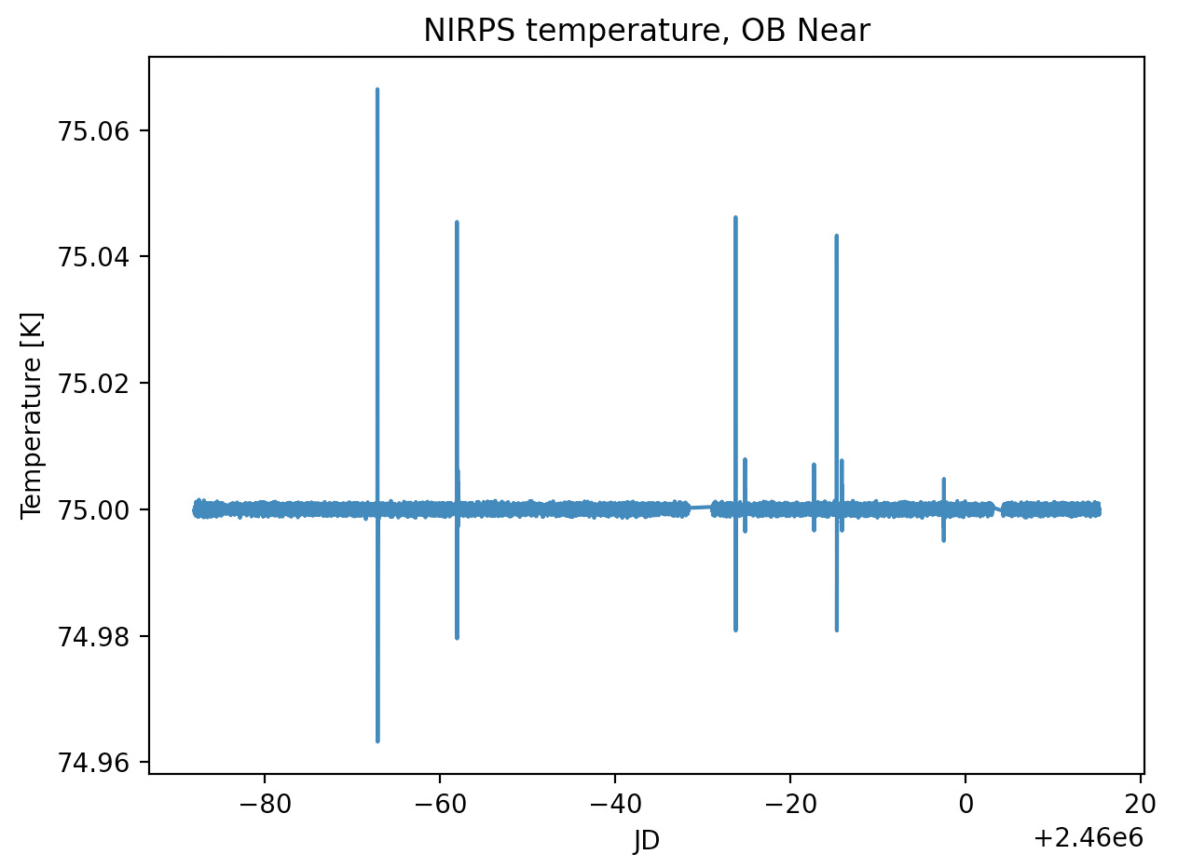
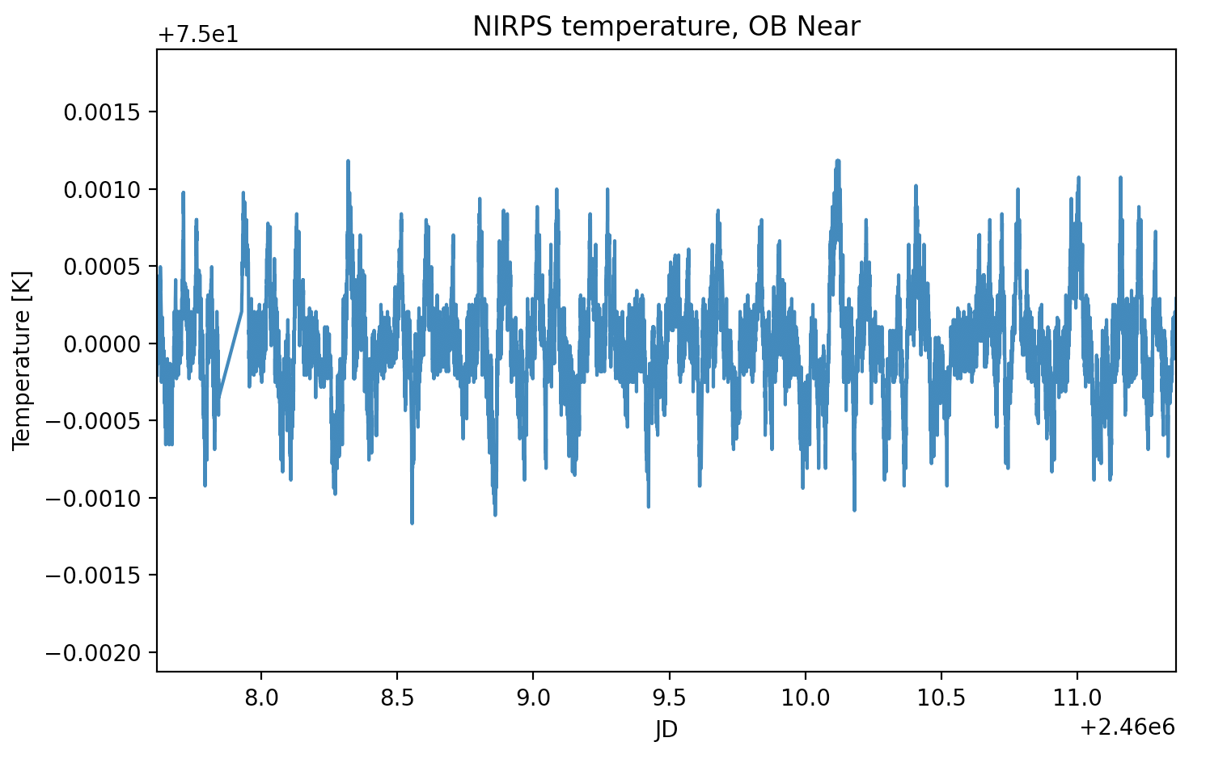
Thermal stability
1 mK
sub-mK thermal stability achieved over several months

Slide 12
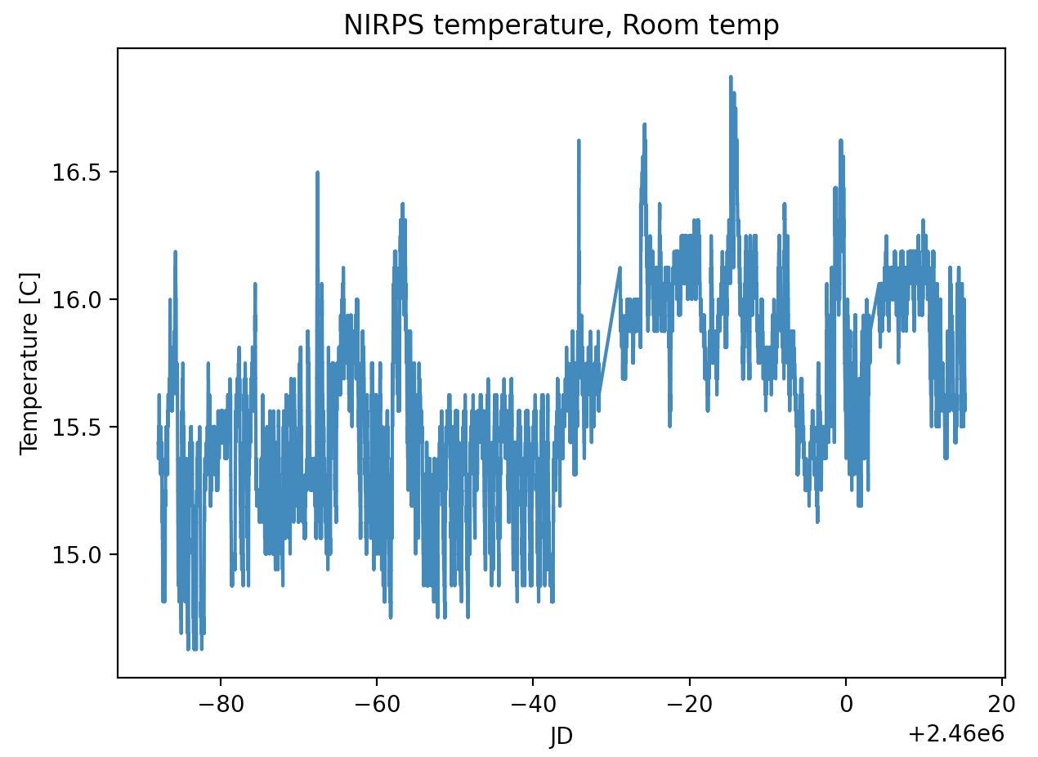
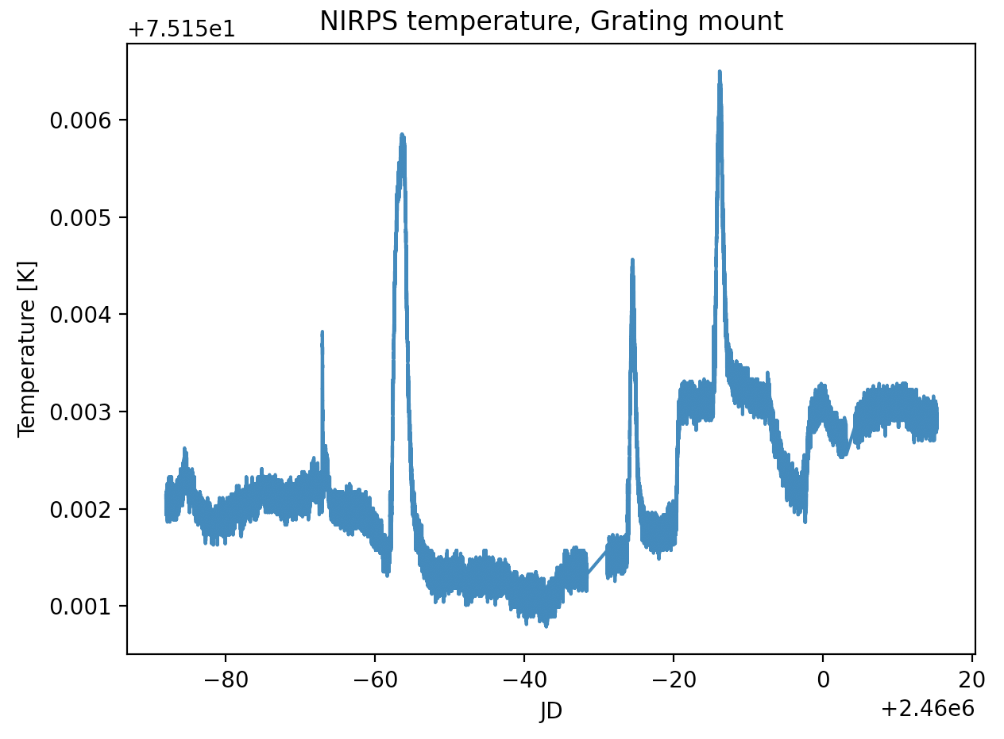
Thermal stability
Power outage
Small coupling of the cryo-optics and room temperature.
  HARPS-like thermal enclosure under construction

Slide 14
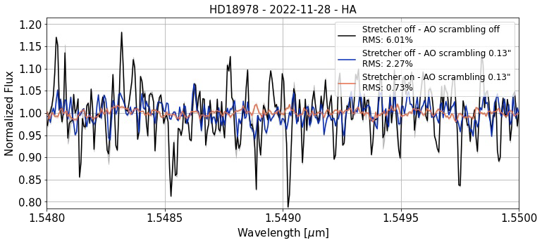
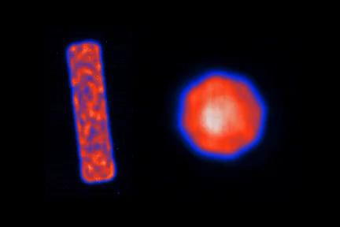
Modal noise
A0 scrambling and stretcher reduce modal noise by a factor 5 (HE) and 10 (HA)
Relatively stable over several days.
Can be calibrated out using fast-rotating hot stars (also used for telluric correction)

Slide 15
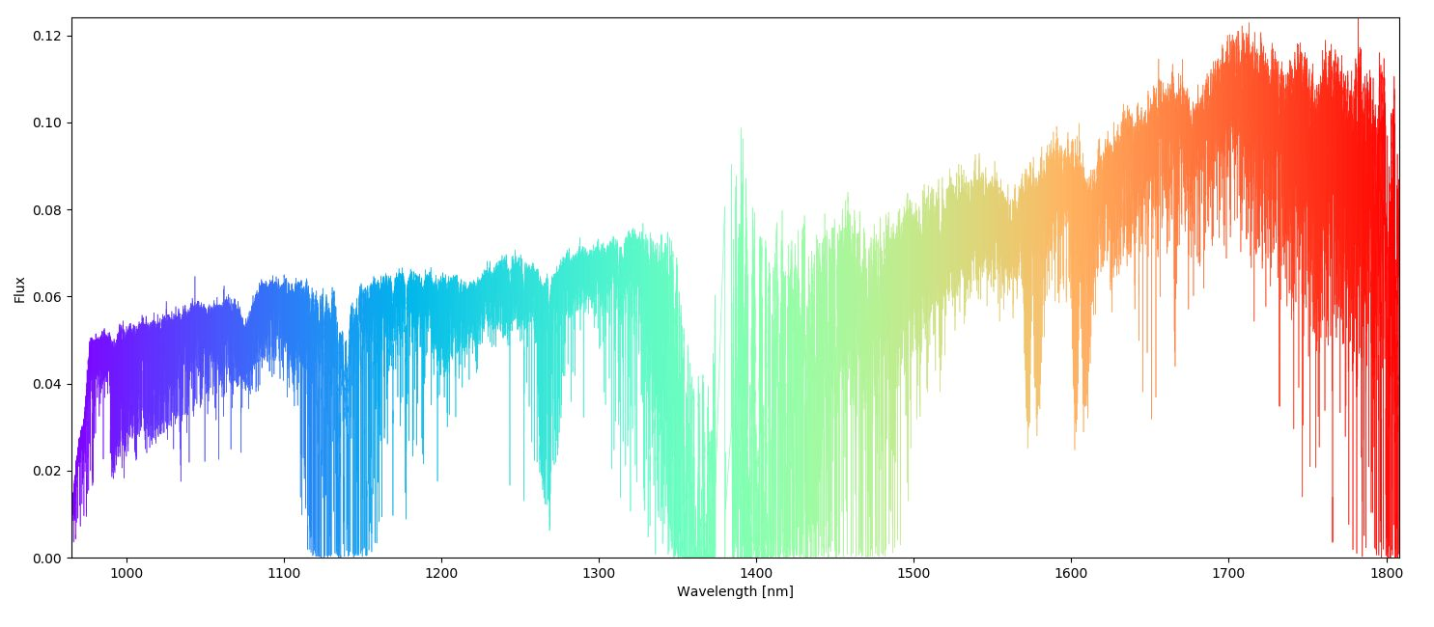
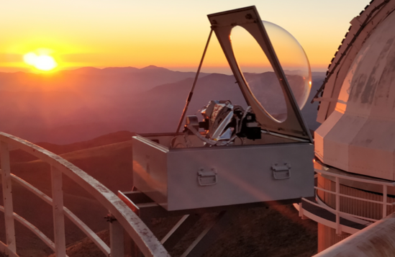
Proxima NIRPS spectra
‘lost order’ from fiber train absorption
CO₂
O₂
H₂O
Spectral coverage 971 – 1854 𝝁m (70 spectral orders)
Spectral resolution HA = 84’000 HE = 72’000
Operated simultaneously with HARPS

Slide 16
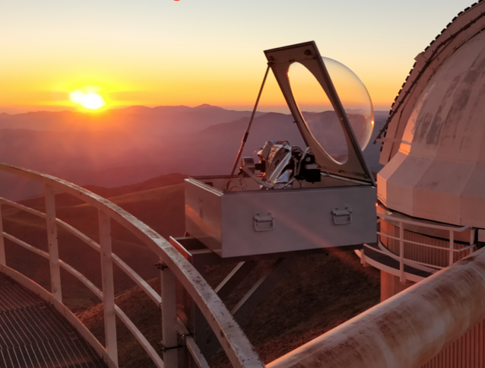
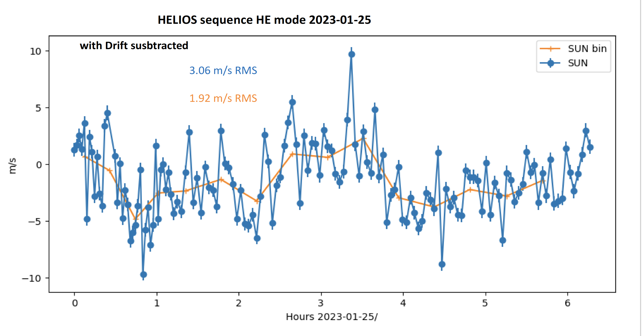
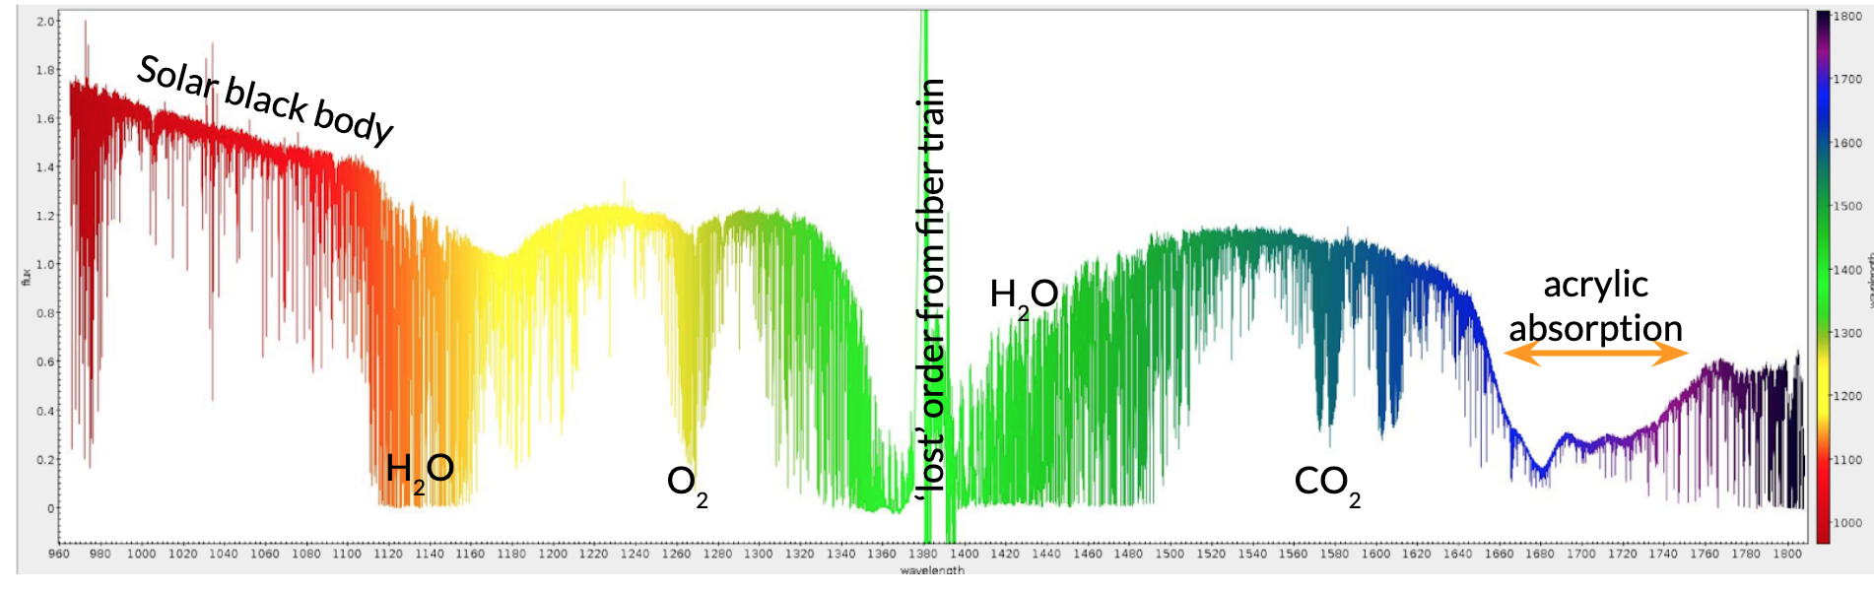
NIRPS connected to solar telescope HELIOS
to observe the Sun as a star with HARPS and NIRPS every possible day
Courtesy : X. Dumusque

Slide 17
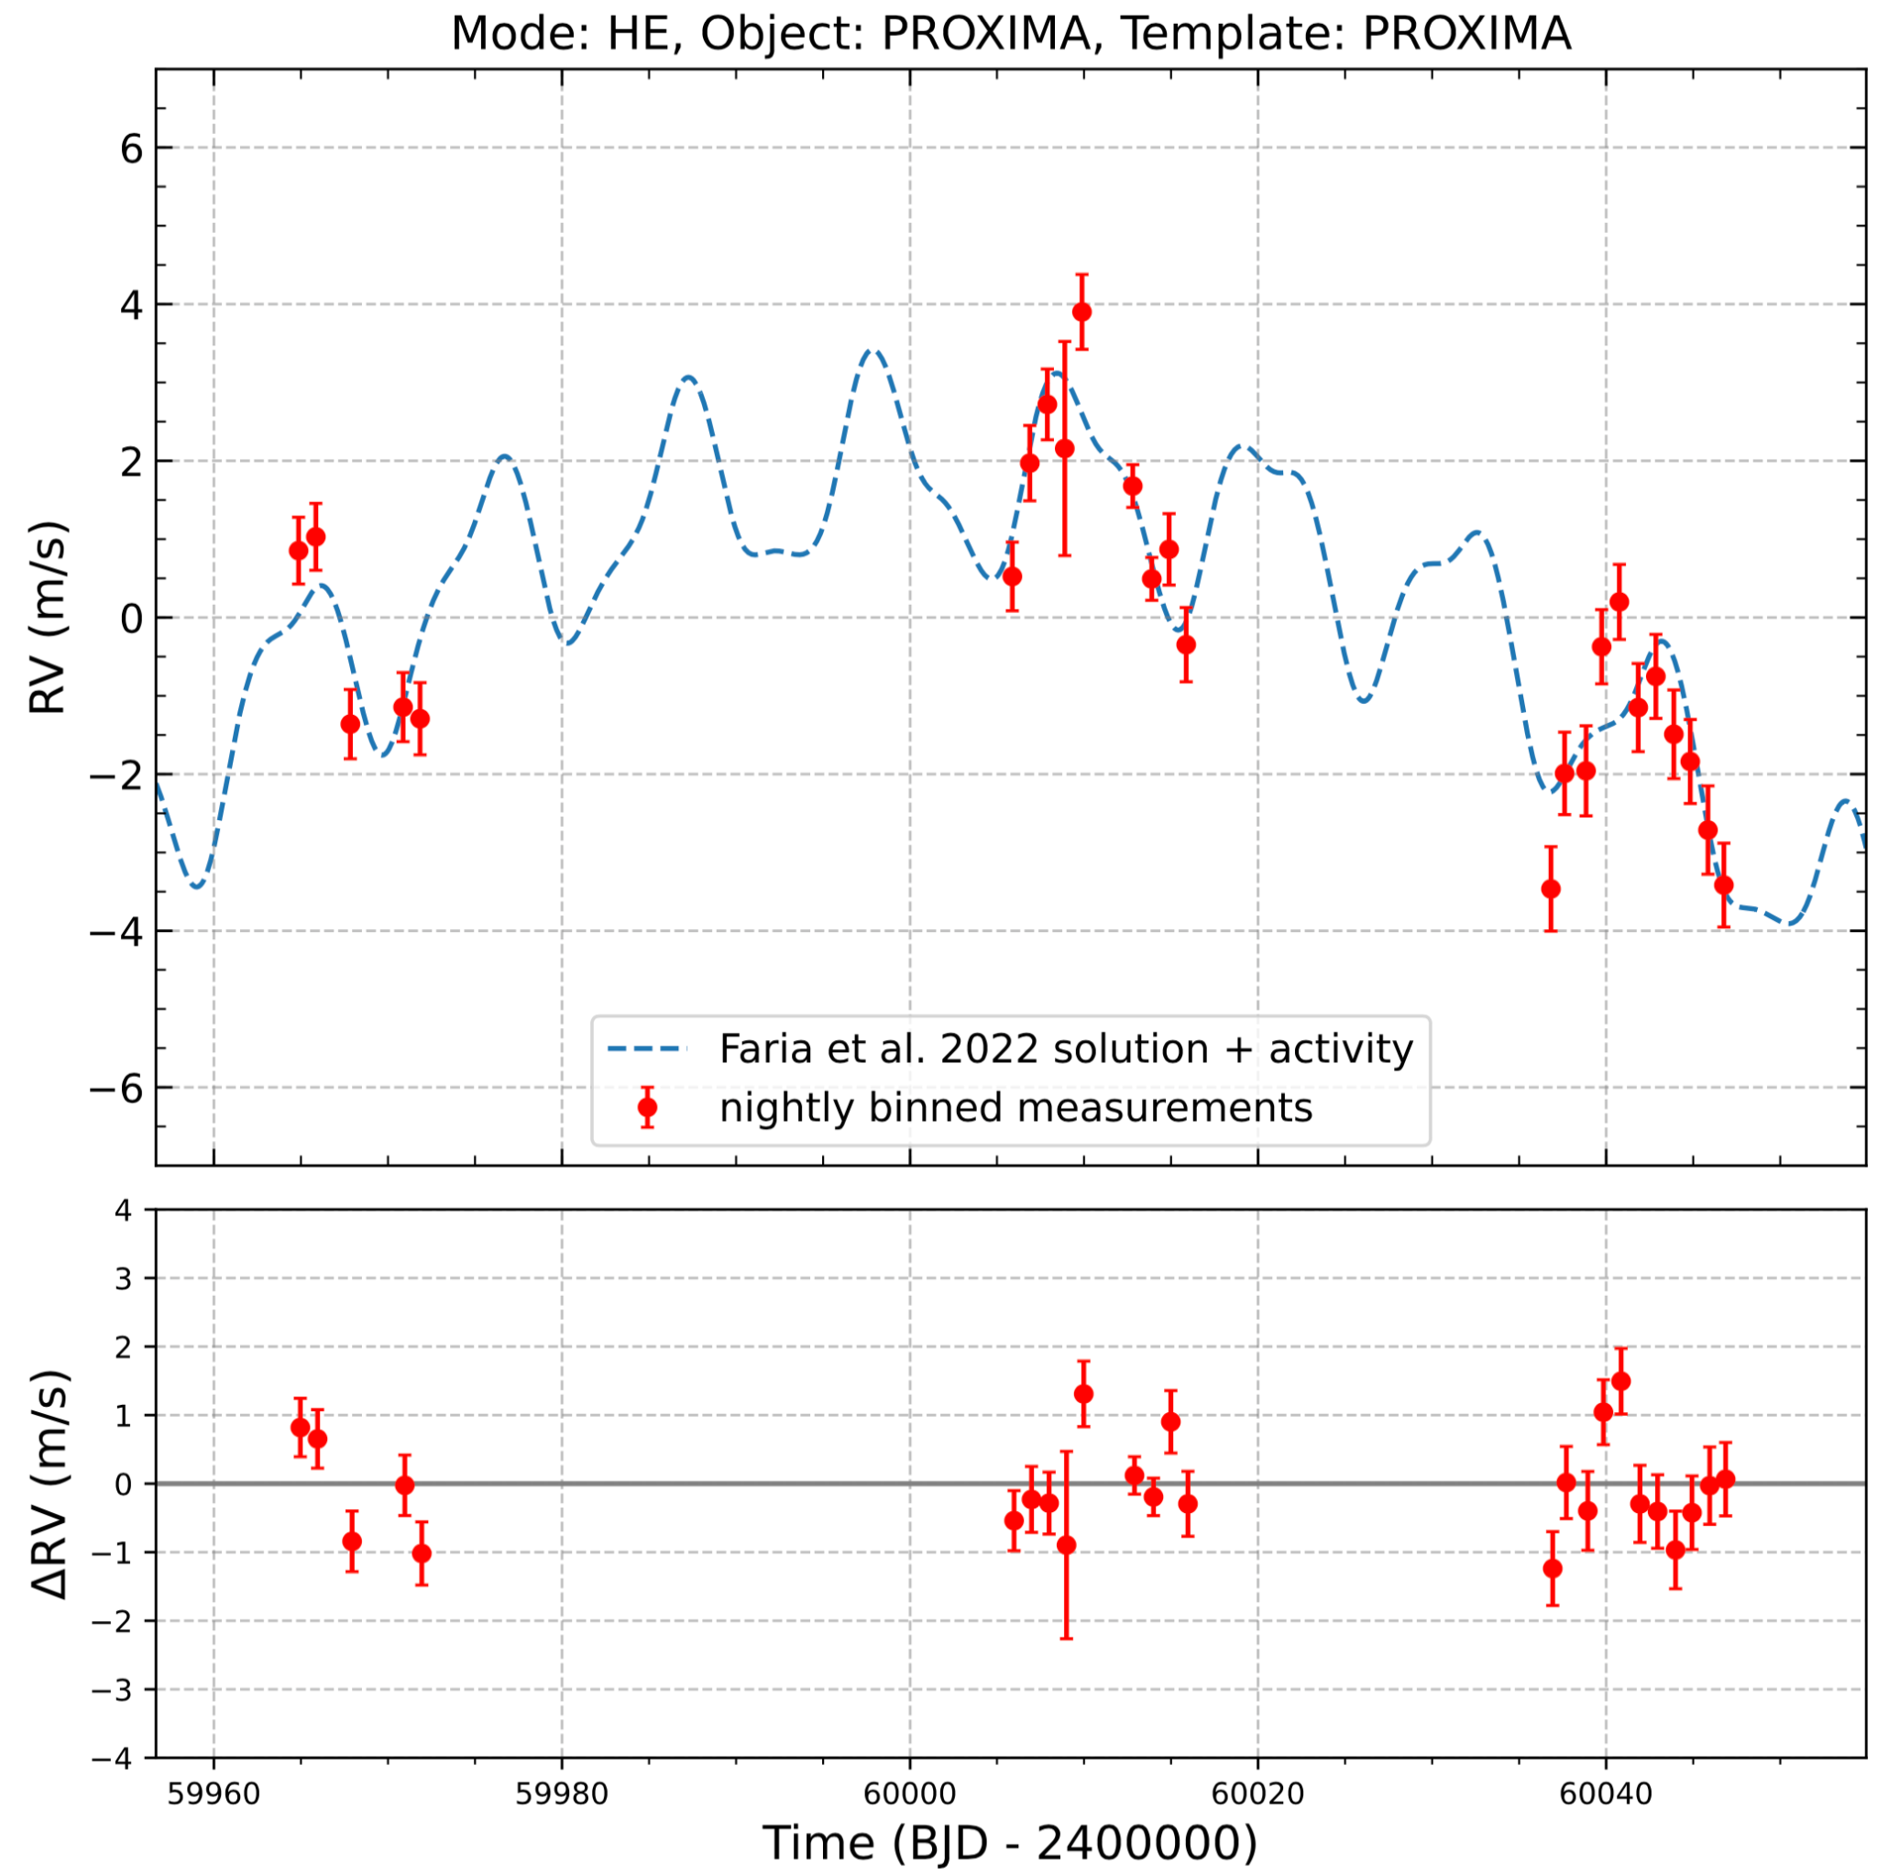
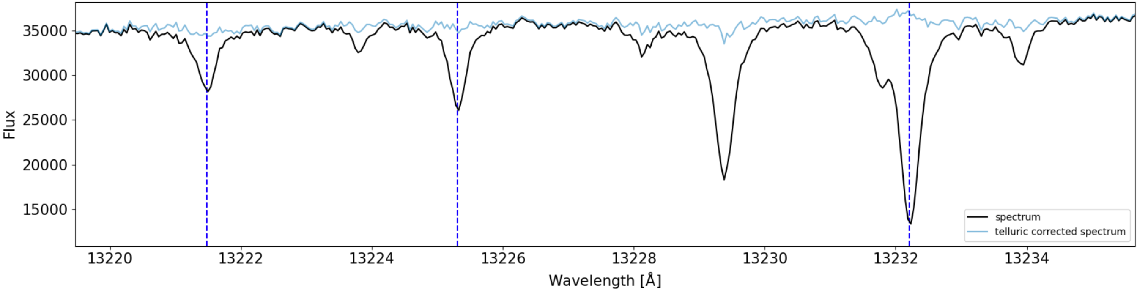
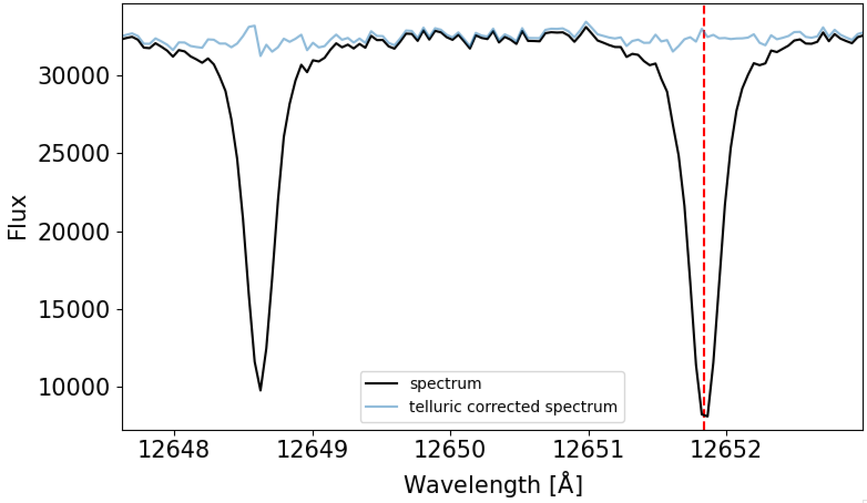
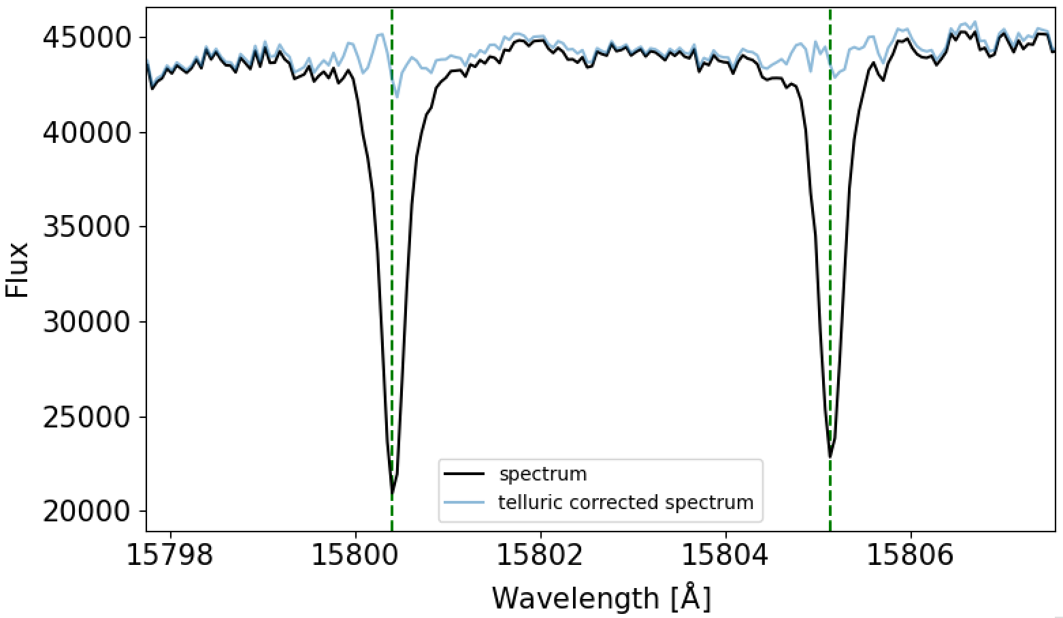
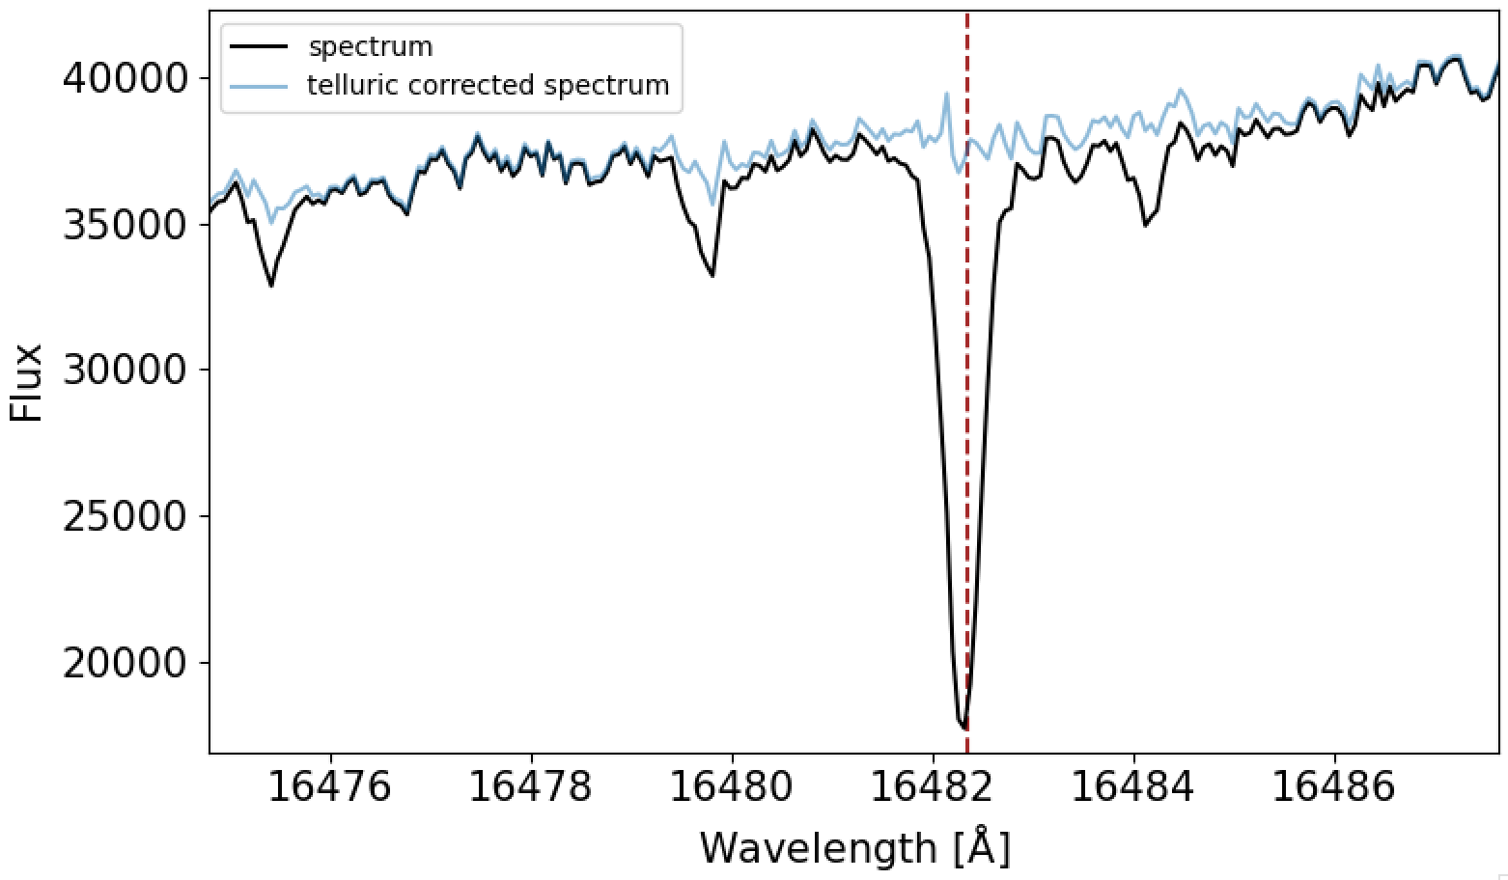
Preliminary results - Proxima
No GP
Telluric-corrected RVs extracted
with the line-by-line (LBL) extraction method
Uncertainty of our closest competitor
H₂O lines
O₂ lines
CO₂ lines
uncertainty ~60 cm/s
CH₄ lines
Telluric correction
Credit: Etienne Artigau; Allart et al. 2022

Slide 18
Preliminary results – GJ581
Credit: Etienne Artigau

Slide 19
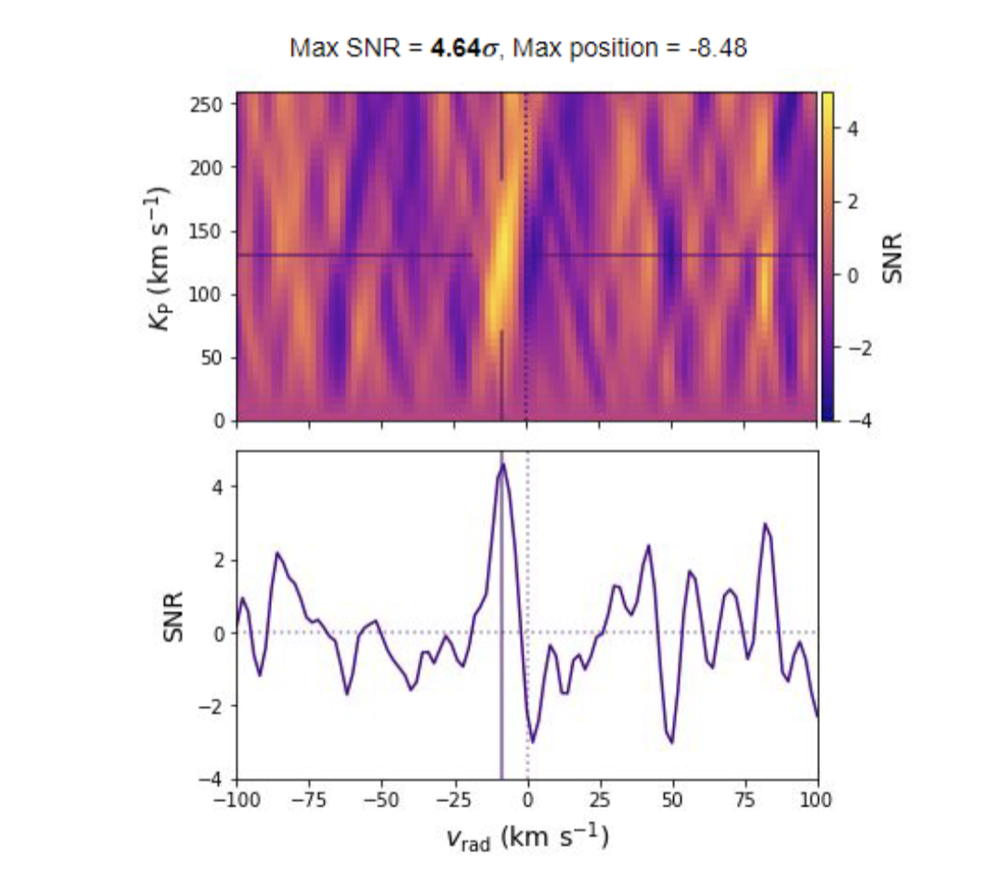
Water detection in WASP-127b
Credit: Frédéric Genest

Slide 20
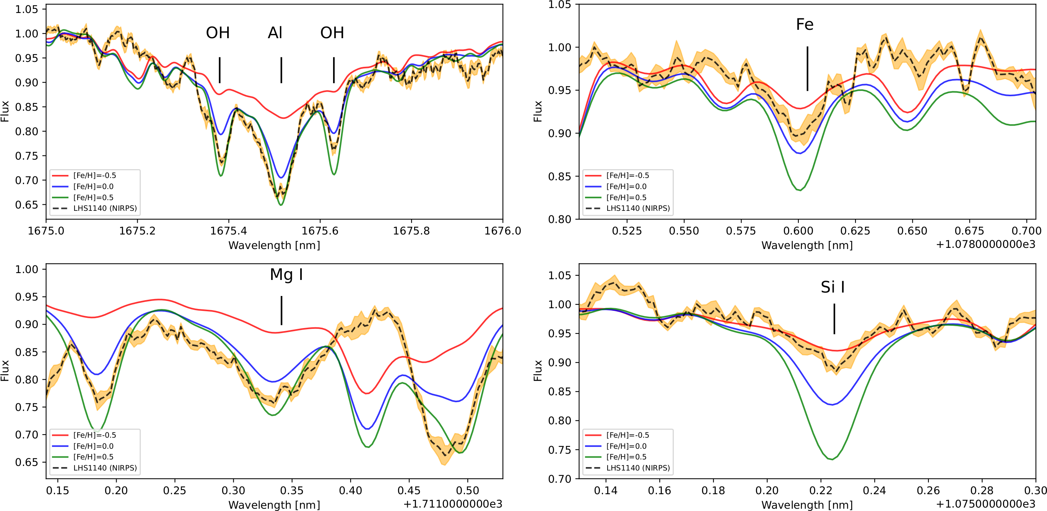
Abundance determination – LHS1140
Credit: Farbod Jahandar

Slide 21
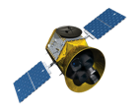
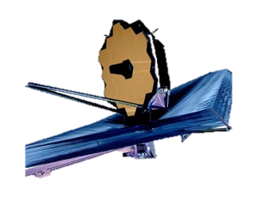

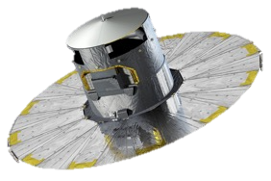
NIRPS main science cases
Detection of exoplanets around M dwarfs, active stars and young stars
RV search for planets around M dwarf to image with ELT
Mass and density characterization of transiting exoplanets (mainly from TESS)
Exoplanet atmosphere characterization through transmission spectroscopy at high resolution
Mitigation of stellar activity using chromatic effect + sensitive spectral lines + Zeeman broadening
NIRPS AO guiding camera to identify nearby stellar component and/or rule out blended EBs
Long term monitoring of Sun observed as a star in both visible + nIR
NIRPS GTO: 725 nights over 5 years since April 1st 2023!

Slide 22
NIRPS GTO Science Highlights
PRV focused on M dwarfs
Time is distributed equally over three work packages
  WP1: blind searches
  WP2: transit follow-up
  WP3: atmospheric characterization
NIRPS GTO: 725 nights over 5 years since April 1st 2023!

Slide 23
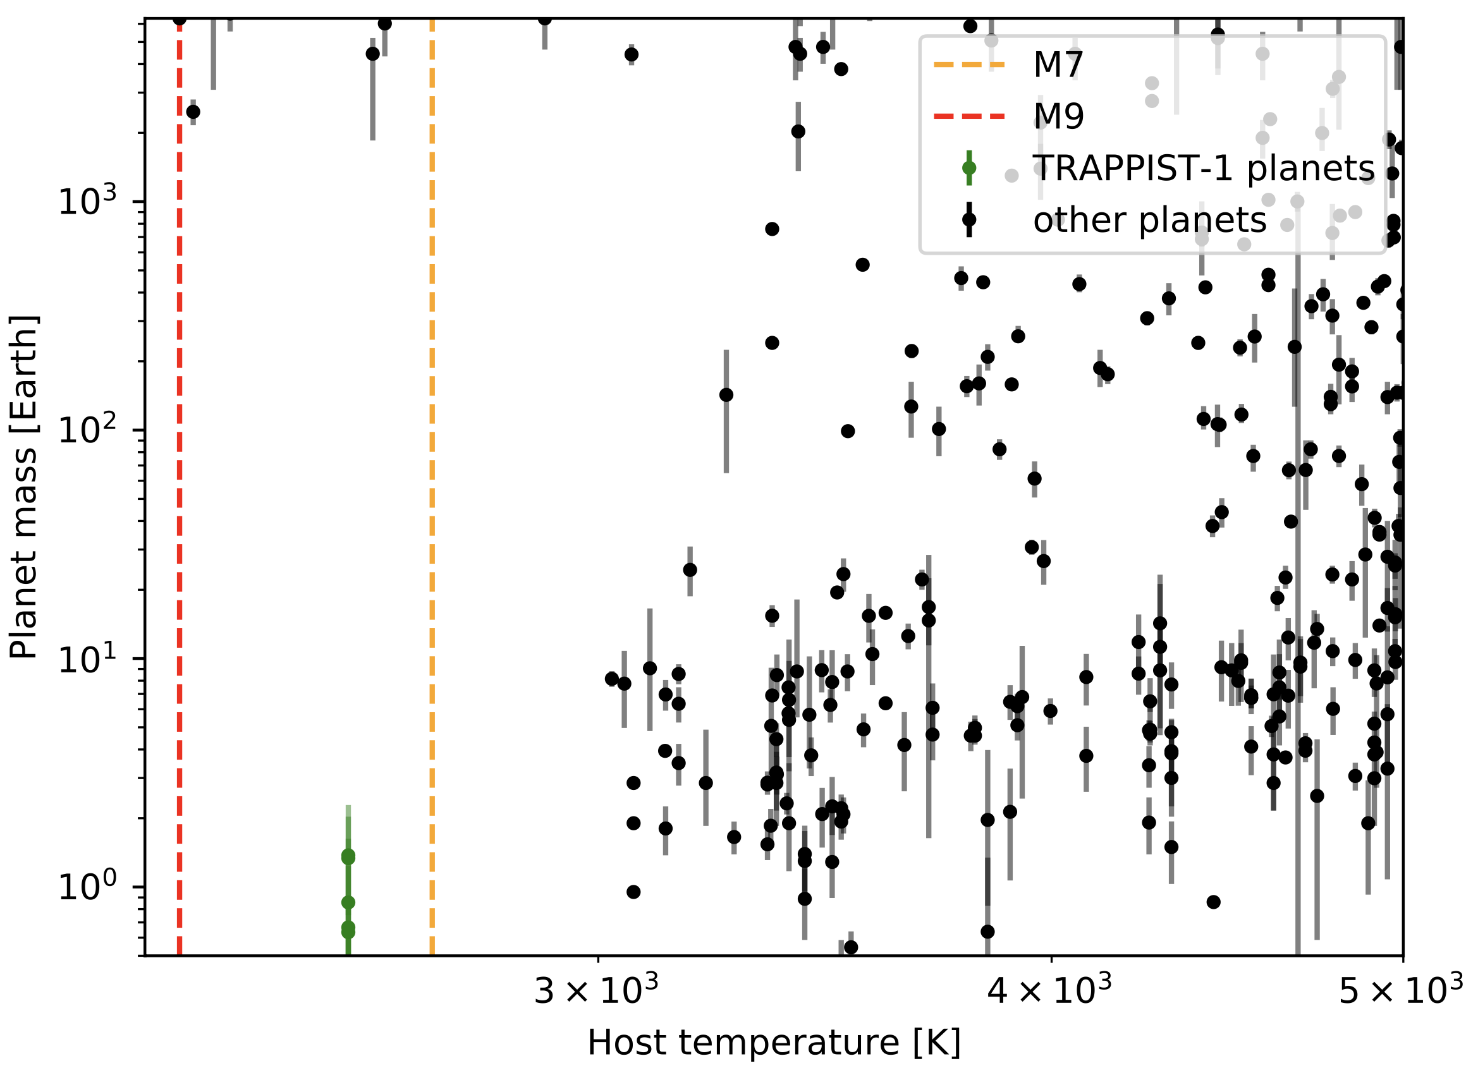
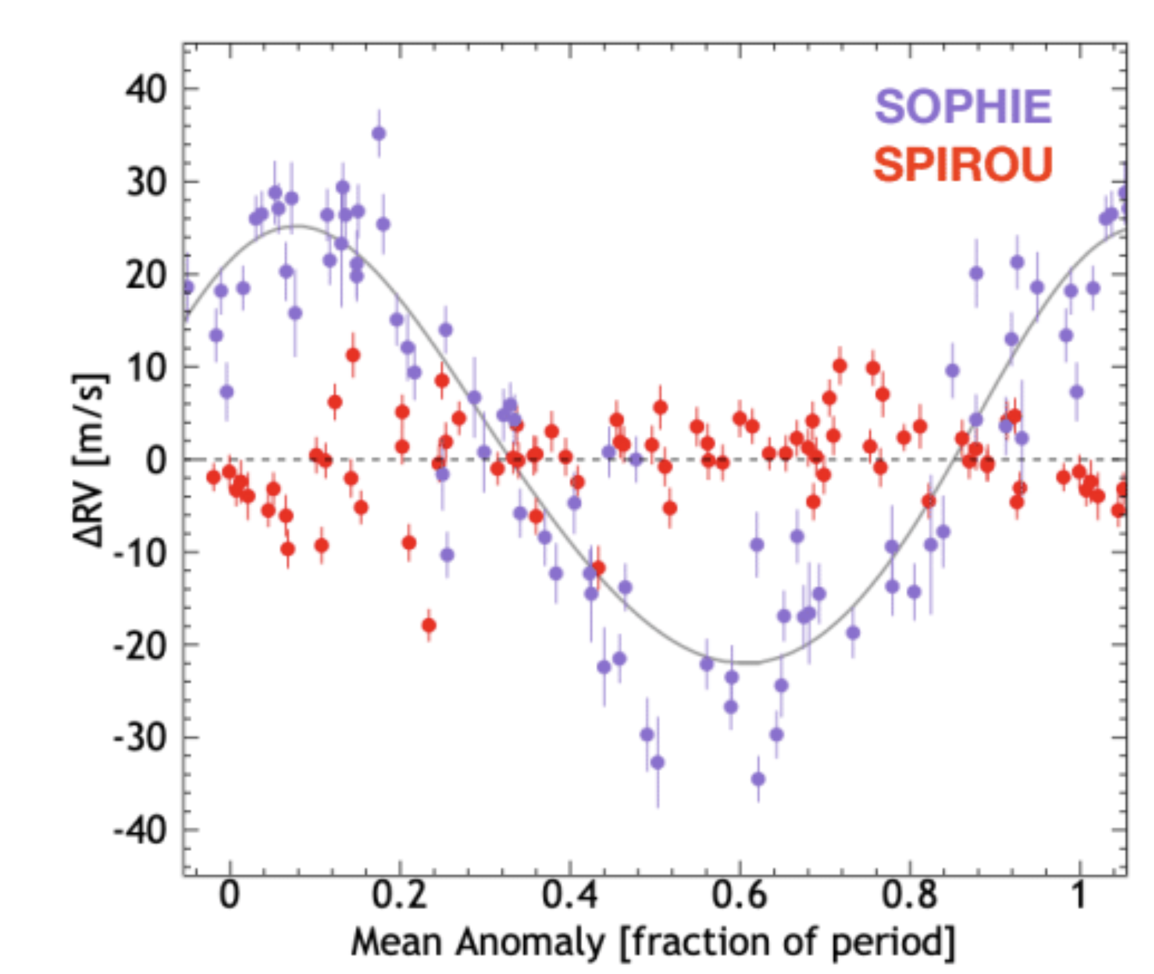

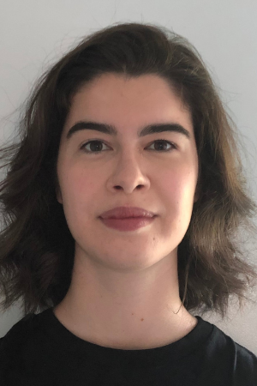
WP1 – RV searches
Coordinator: Lucille Mignon & Xavier Delfosse
A census of the planetary system in the Solar Neighbourhood
  Imaging target for the ELT (ANDES currently in PDR)
GAUCHO : Grasping exoplanet Architectures in UltraCool Hosts
PACAMARA: Probing Age-CAlibrated M dwARfs for exoplAnets
…
AD Leo
CRAQ students involved:
Credit: Etienne Artigau
Carmona et al (2023)

Slide 24
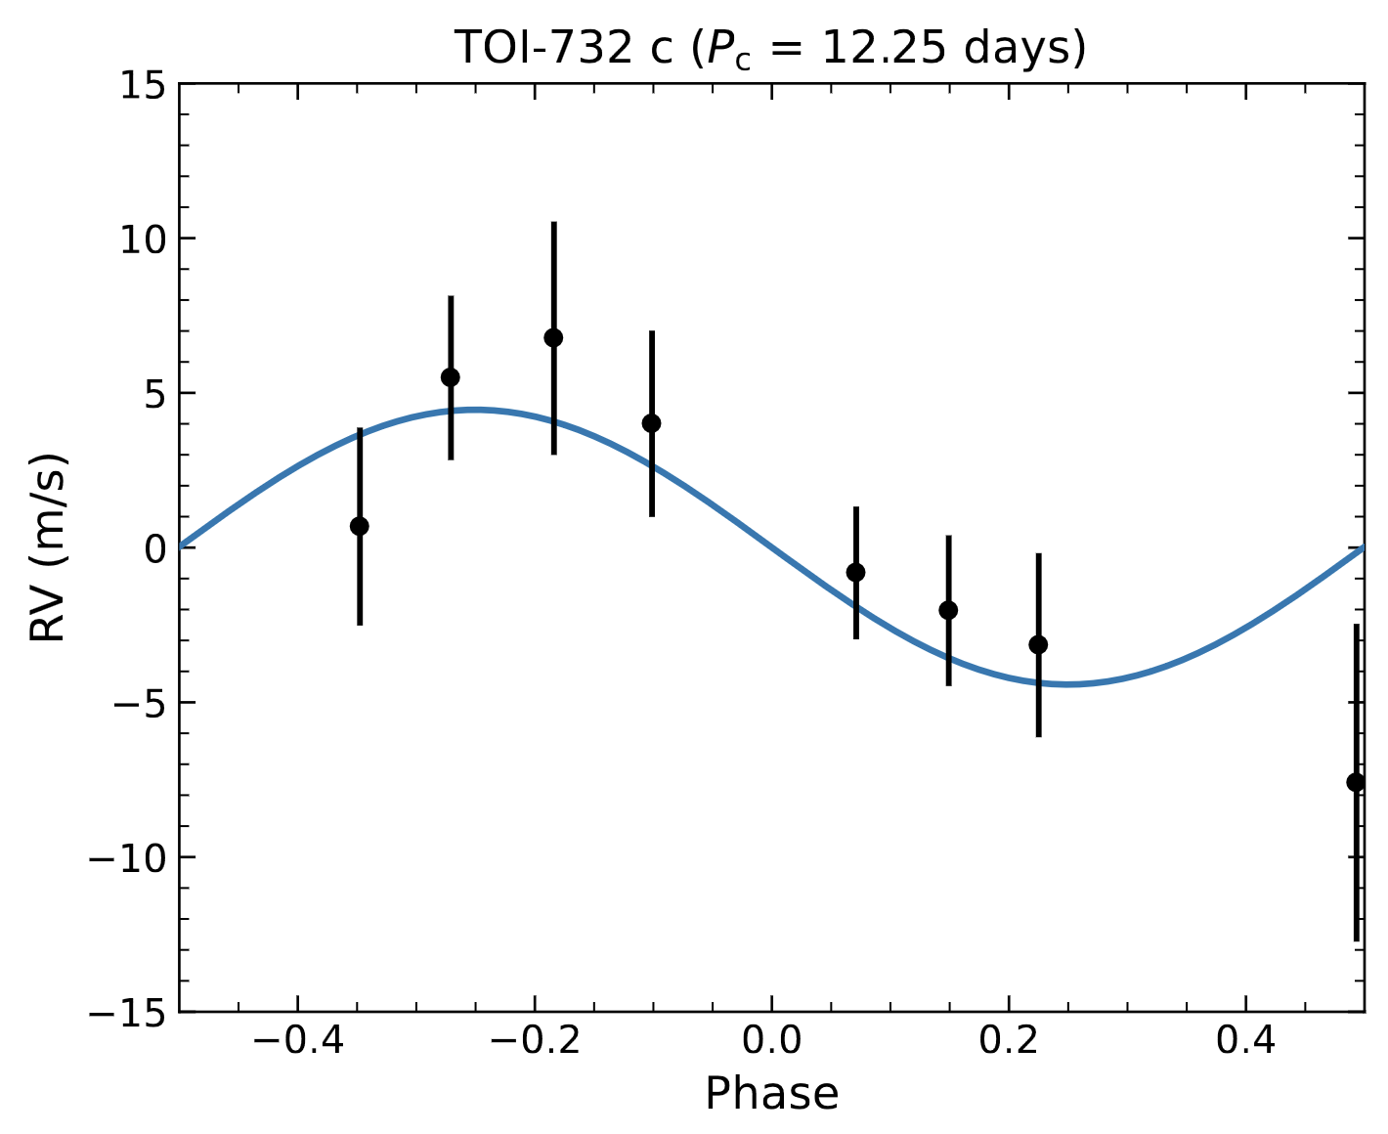
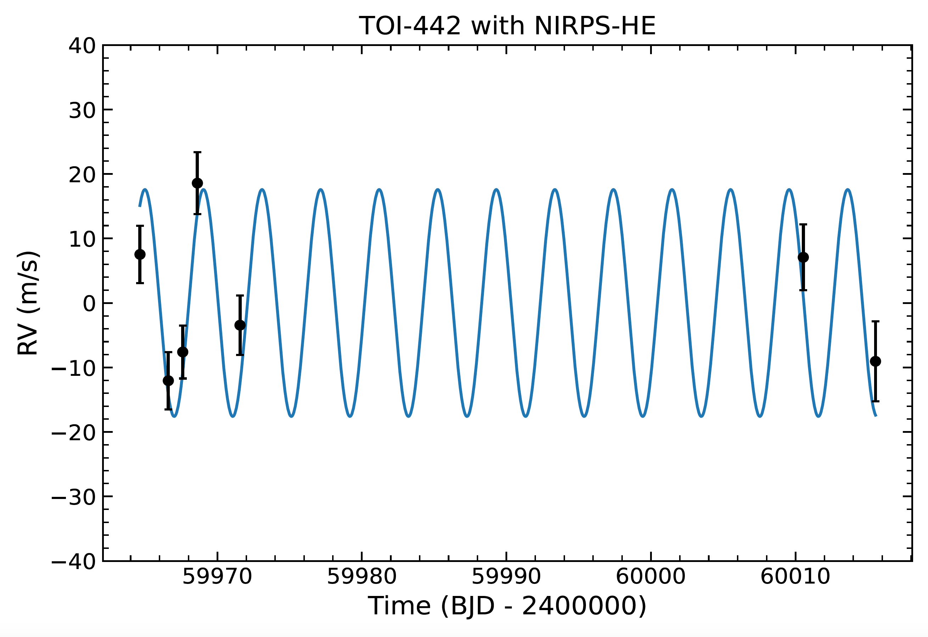
WP2 – Mass characterization of exoplanets transiting M dwarfs
Coordinators: F. Bouchy & R. Doyon
Occurence of giant exoplanets around M dwarfs
Density and composition of super-Earth and sub-Neptunes around M dwarfs
The radius valley as a key tracer of planet formation and evolution
Iron core mass fraction of rocky planets
Exploring the diversity of transiting exoplanets within the Habitable Zone
Architechture of multi-planetary systems as a test of planet formation theories
Young planets transiting M dwarf
…
Credit: Charles Cadieux
CRAQ students involved:

Slide 25
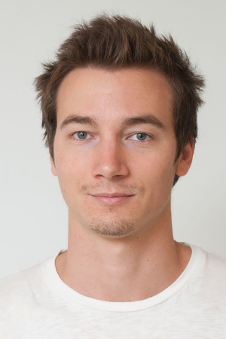




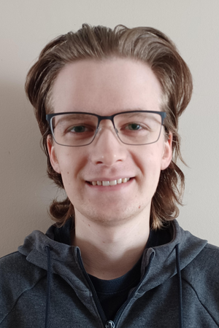
WP3 – Atmospheric characterization
Coordinator: Romain Allart
Transmission spectroscopic survey to unveil the origin of the evaporation desert
An emission survey probing the transition between hot and ultra-hot Jupiters.
Elemental and isotopic abundances and detailed chemistry and dynamics with “ELT-quality” NIRPS/HARPS Legacy Transmission Spectra
Characterizing young planets discovered by TESS
Transmission spectroscopy of the TRAPPIST-1 planets
…
CRAQ students involved:

Slide 26
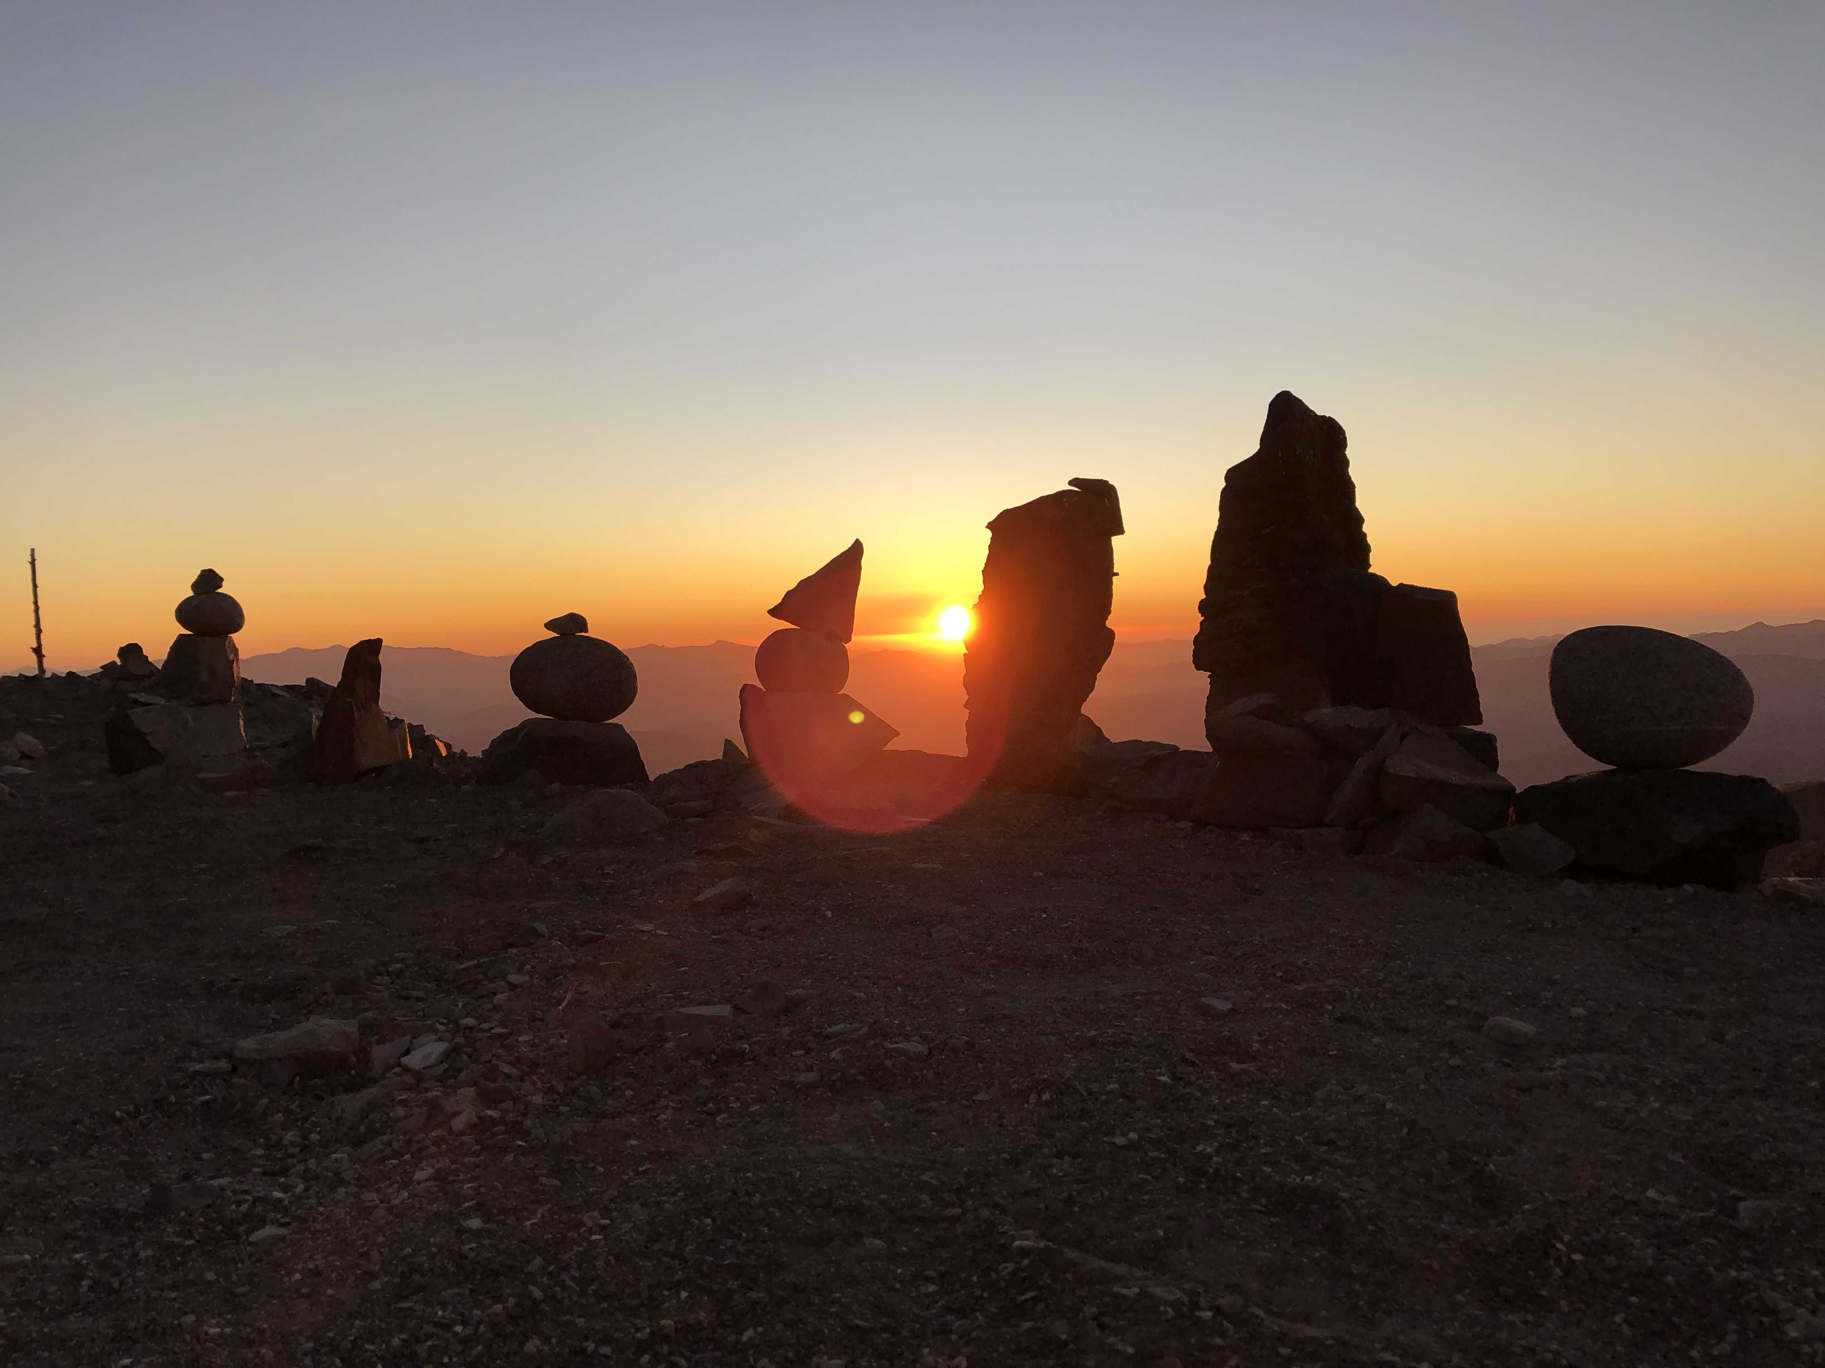
Summary
HARPS is not alone!
Exciting and very encouraging results from commissioning
The best has yet to come from the NIRPS consortium and the community.

